Slide 1
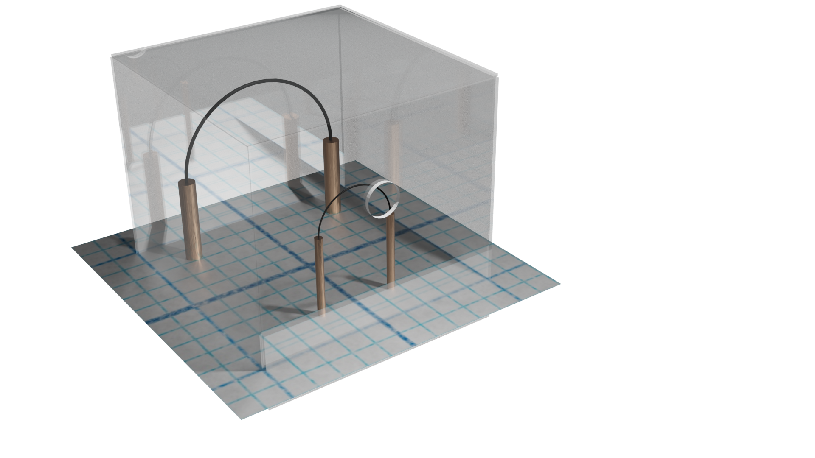
Strategies for maximizing sensitivity of
superfluid ³He-B bolometers:
How we will up our SQUID game
D. E. Zmeev 13/12/23 Lancaster

Slide 2
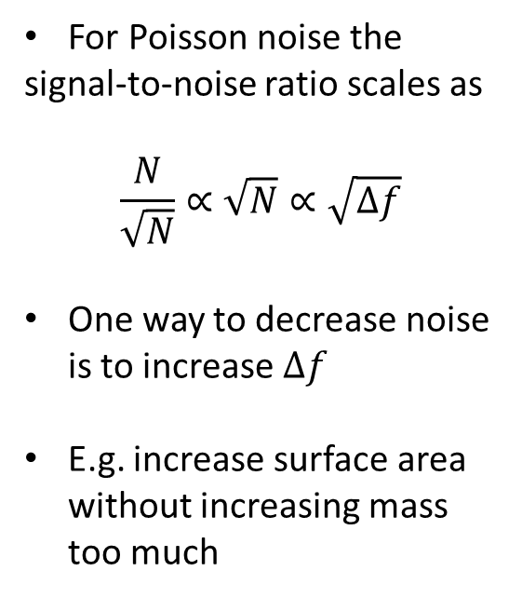
Potential ways for shot noise reduction
For Poisson noise the
signal-to-noise ratio scales as
$$\frac{N}{\sqrt{N}}∝\sqrt{N}∝\sqrt{Δf}$$
One way to decrease noise is to increase $Δf$
E.g. increase surface area without increasing mass too much

Slide 3
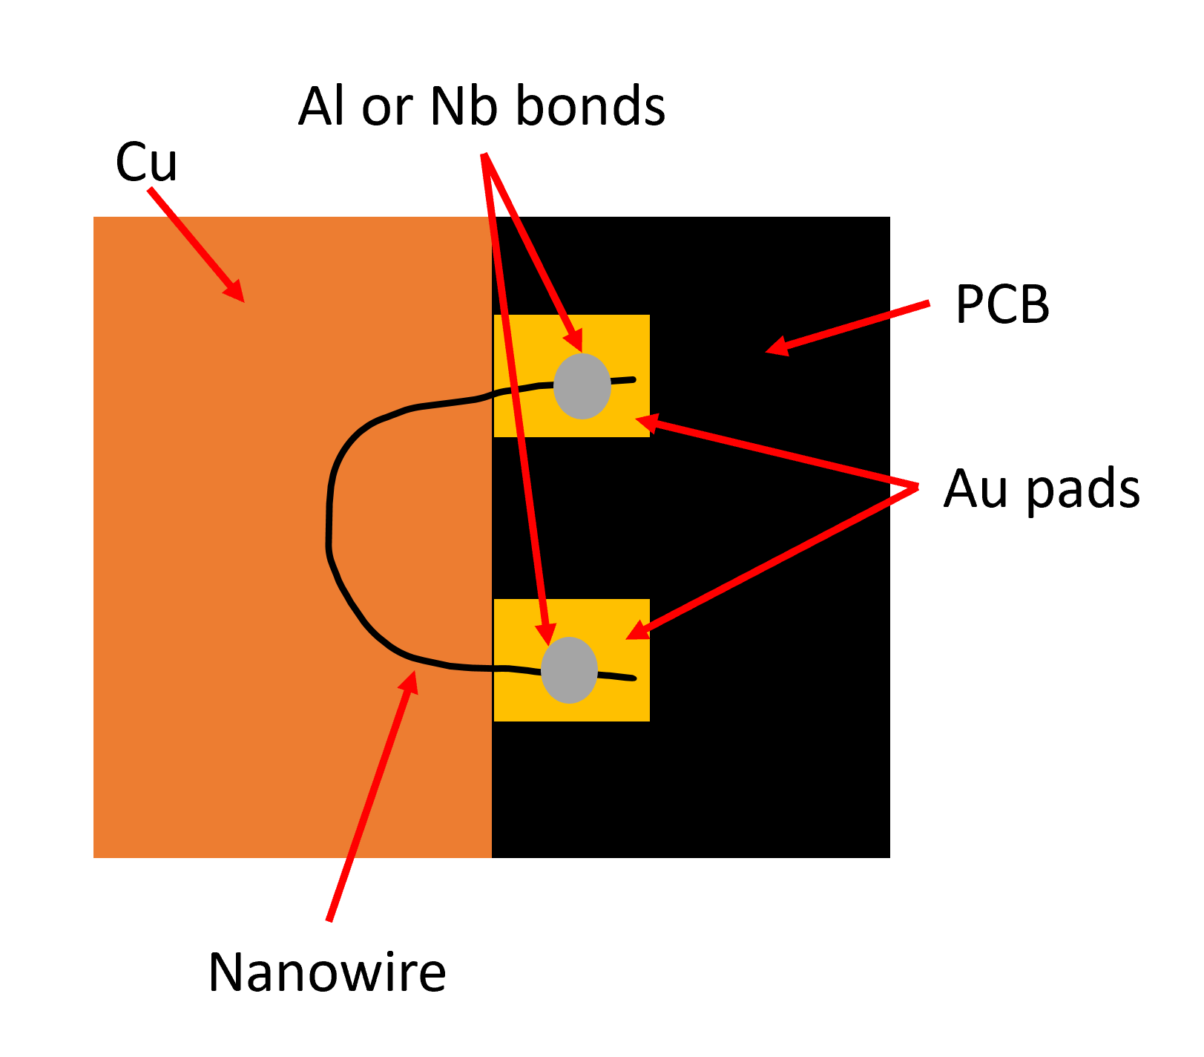
1. Sail made from PMMA or 2D material flake
3 nm thick, uniform PMMA films on Si wafers are achievable [1]. Need to test with free film stretched across a superconducting wire. ρ=1.2 g cm⁻³
Largest graphene flakes are usually ~10 µm across. Other 2D materials are available, e.g. ~mm size hBN [2].
Do sharp corners matter?
[1] C. B. Walsh, E. I. Franses, Thin solid films 429, 71 (2003)
[2] A.S. McKeown-Green et al., arXiv:2311.01387

Slide 4
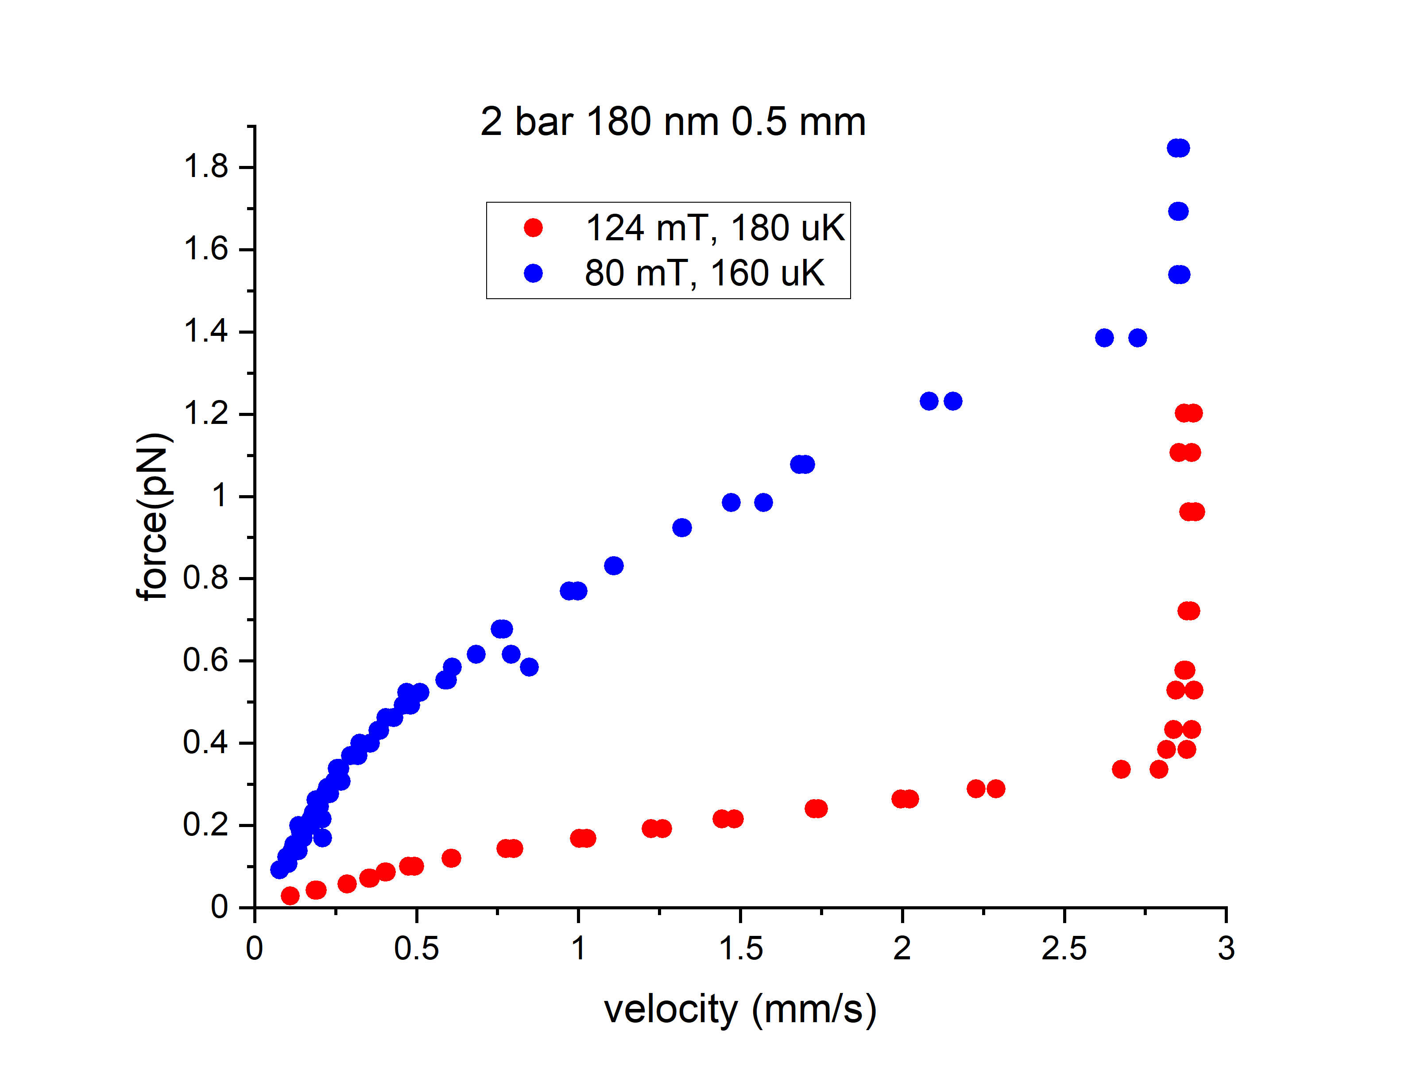
2. A topological defect

Slide 5
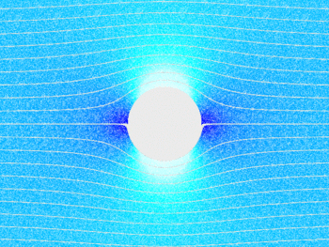
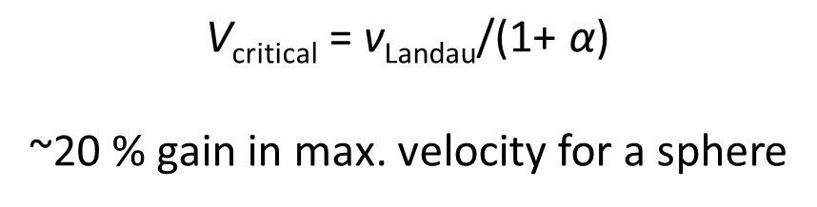
3. Reduction of the flow enhancement factor
v
V_{max} = αv
α =2 for a cylinder
α =1.5 for a sphere
$$\text{V}\text{critical}\text{ = }\text{v}\text{Landau}\text{/(1+} \text{α}\text{) }$$
~20 % gain in max. velocity for a sphere
Q~10⁷ @200 Hz achieved for a levitating superconducting spheres probed by SQUID
Hofer et al., Phys. Rev. Lett. 131, 043603 (2023)
We can make light superconducting spheres with ρ=1.5 g cm⁻³, c.f. NbTi ρ=6 g cm⁻³)

