Slide 1


CLARA 400 Hz Automated RF Conditioning
Russell McLean
ASTeC STFC UKRI
russell.mclean@stfc.ac.uk
Notes:
The abstract pattern can be removed or repositioned if required. Be careful to ‘Send to Back’ so that it does not obscure any important information.

Slide 2
Overview
CLARA Overview
RF Conditioning
NO-ARC method
NO-ARC V1 & V2
NO-ARC V3 & 400Hz conditioning
NO-ARC future work
Software project management tips
Notes:
The abstract pattern can be removed or repositioned if required. Be careful to ‘Send to Back’ so that it does not obscure any important information.

Slide 3
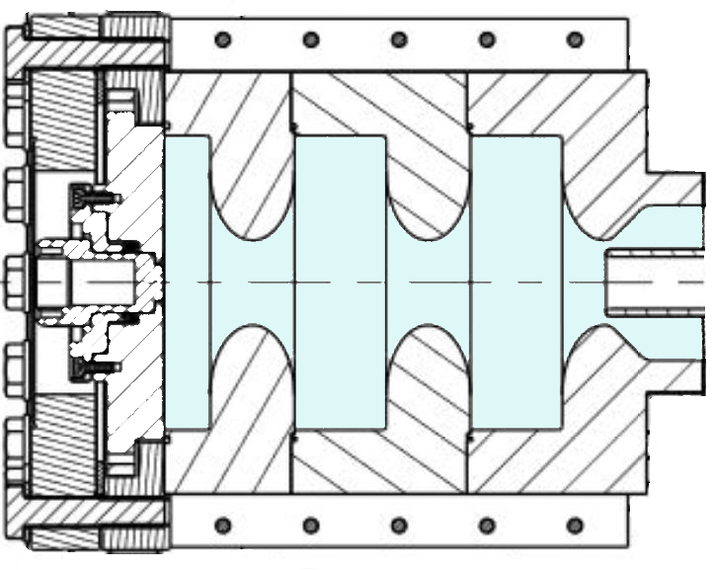
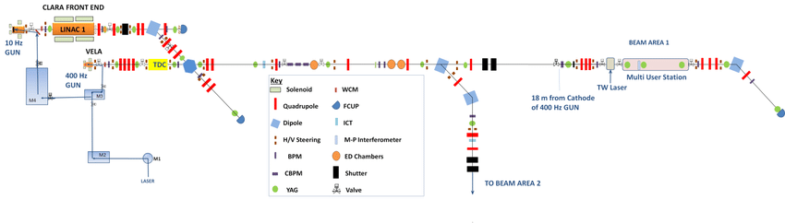
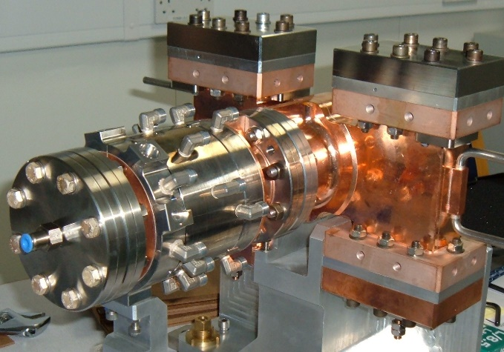
CLARA & VELA
(Daresbury Laboratory)
LRRG & HRRG
LRRG / Gun-10
Low Repetition Rate Gun
10Hz
2.5 cells
CLARA - Compact Linear Accelerator for Research and Applications is designed to be a flexible 250MeV test facility (still expanding, currently at 40MeV).
HRRG / Gun-400
High Repetition Rate Gun
400Hz
1.5 cells
VELA - Versatile Electron Linear Accelerator is designed to provide a high-quality electron beam for industrial and academic applications.

Slide 4
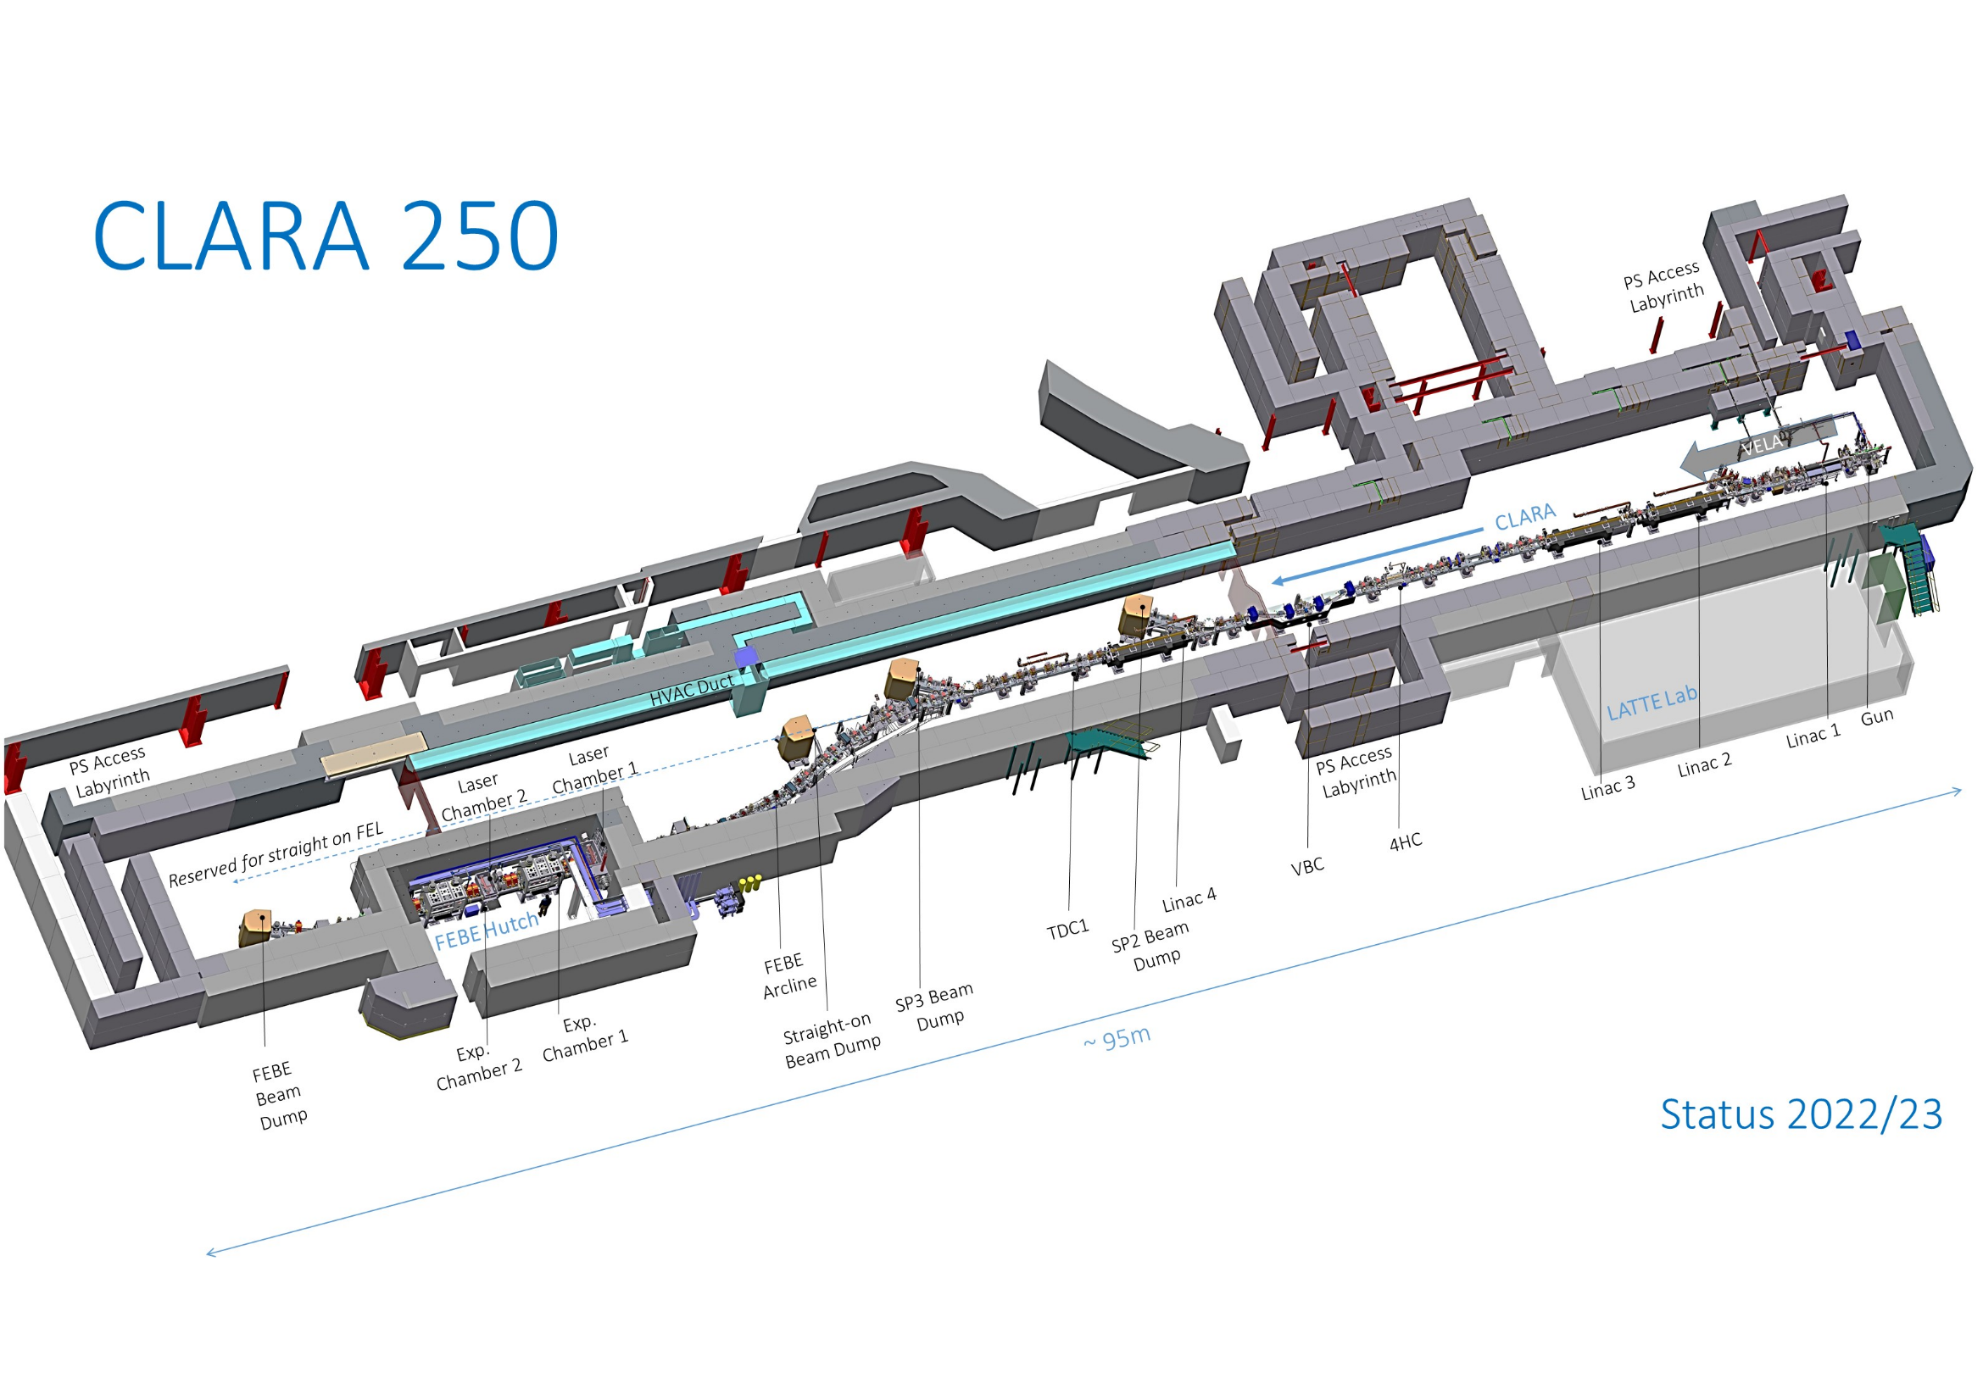

Slide 5
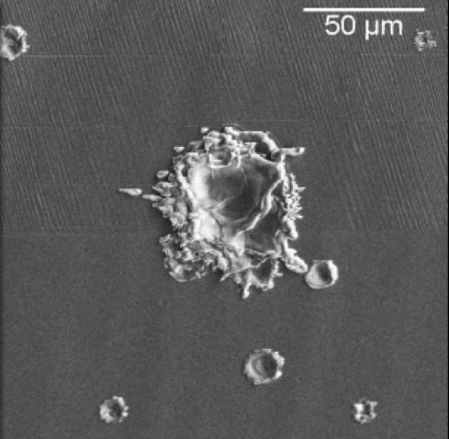
Motivation for Automating RF Conditioning
“We define rf breakdown as a phenomenon that abruptly and significantly changes transmission and reflection of the rf power directed to the structure under test. Breakdown is accompanied by a burst of x-rays and by a bright flash of visible light”
Dolgashev, V. A., & Tantawi, S. G. (n.d.). RF BREAKDOWN IN X-BAND WAVEGUIDES *. (Available at: http://www.mrcwdc.com/Magic/)
Breakdowns
Cavity material cannot instantly cope with high E-fields
Introduction of power into the cavity gradually until operating power is reached (conditioning)
Avoids excessive breakdowns which can damage the structure
Advantages of Automated Conditioning
Increased reaction timescales (< 10 ms compared to > 200 ms)
Minimises damage to high gradient structures
More time efficient 24 hr unmanned operation
More rapid conditioning
Repeatability & standardised breakdown detection
Recording of data
Different conditioning approaches are configurable
Photo courtesy of Jan W. Kovermann, 2010 (Available at https://indico.cern.ch/event/127284/contributions/1344829/attachments/82105/117647/CLICtalk.pdf)

Slide 6
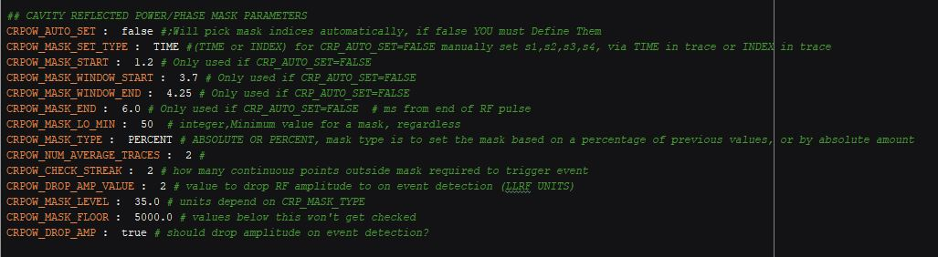
NO-ARC Architecture
No Operator Automatic RF Conditioner
High Level
Local GUI & config file
Mid Level
C++ & Python
Low Level
Control Systems
Human Interaction
Hardware Interaction
Python
The aim is to effectively replace an operator with automated code
Written in Python
Main classes:
  Controllers (sets hardware parameters)
  Monitors (reads hardware parameters)
  Data (reading and recording data)
  View (GUI interaction)
Configuration file includes any parameters that we might want to adjust
  Type of resonant structure return different signals/channels
  Conditioning parameters: repetition rate, pulse length… (etc.)
CLARA / VELA

Slide 7
NO-ARC Main Controller Loop
Loop, each iteration checks if all states OK
If all states OK, can increase power
If a breakdown occurs:
  Stop breakdown checking
  Disable RF
Breakdown State
Stop Mask Checking
GUI Mod Protection
Disable RF Output
LLRF Output State
Stop Mask Checking
Can RF Output State
Previous State Good?
Initiate Log Ramp
Min Pulses Required
Normal Ramp?
Log Ramp up
Can Ramp Status
Normal Ramp Up

Slide 8
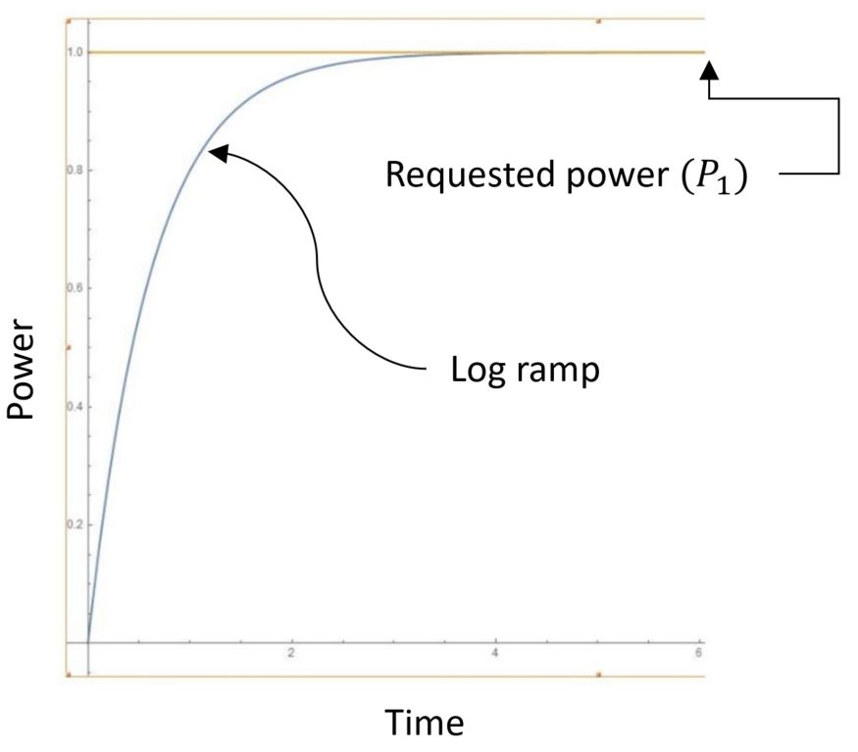
NO-ARC Main Controller Loop
Two methods of increasing power:
Ramp if low number of breakdowns in last 100,000 pulses (not necessarily linear but according to a defined map)
Log ramp if recovering to an already achieved power level e.g. after breakdown (safer than directly ramping to previous target power)
Breakdown State
Stop Mask Checking
GUI Mod Protection
Disable RF Output
LLRF Output State
Stop Mask Checking
Can RF Output State
Previous State Good?
Initiate Log Ramp
Min Pulses Required
Normal Ramp?
Log Ramp up
Can Ramp Status
Normal Ramp Up

Slide 9
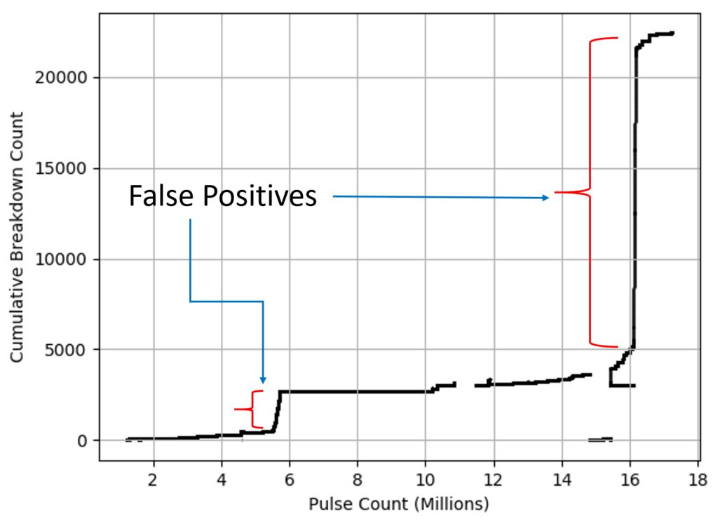
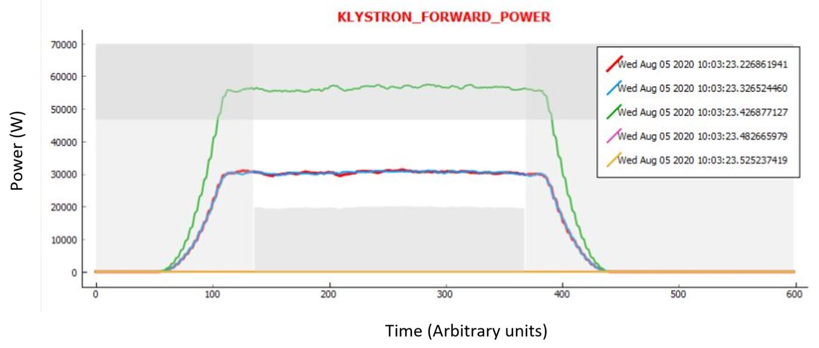
Breakdown detection
Outside Mask Event Detection (OMED)
Data from conditioning of Gun-10 (2019/20)
Mask is defined to represent ‘no breakdown’
Any trace outside this region is deemed a breakdown
Problems with masks: false positives
    Starting off with a breakdown
    Noise at low power
    Timing jitter

Slide 10
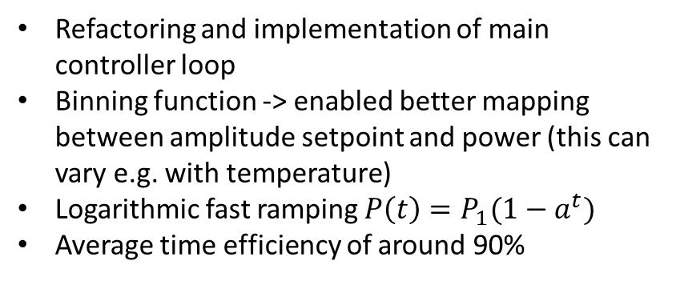
NO-ARC V1 & V2
V1
V2
V1 was used to condition Gun-400 up to 2.5 MW (2018)
Data gathered from cavity probe for Machine Learning training dataset.
Refactoring and implementation of main controller loop
Binning function -> enabled better mapping between amplitude setpoint and power (this can vary e.g. with temperature)
Logarithmic fast ramping $P\left(t\right)=P_{1}(1−a^{t})$
Average time efficiency of around 90%
V1 was used to condition Gun-10 (Dec 2019 – Feb 2020 )
Average time efficiency of 56% (machine pulsing with power delivered to cavity e.g. no breakdown)
Already more time efficient than “supervised” conditioning

Slide 11
NO-ARC V3
Deprecated Software
uTCA
Upgrade to Python3
Upgrade to PyQt5 GUI
400Hz
CLARA
Libera LLRF
EPICS
Libera decimates at > 100Hz yet we need to check for breakdowns at 400Hz
uTCA crate runs OMED detection at 400Hz
Libera operates as normal
NO-ARC
Virtual Accelerator
VEPICS
Virtual Accelerator
NO-ARC can connect to an entirely separate controls network (VEPICS)
VEPICS PVs are generated by the virtual accelerator (we define the behaviour)
Can test NO-ARC when machine not operational!
Live machine time can be spent where it matters
Testing on the real machine is potentially dangerous anyway

Slide 12
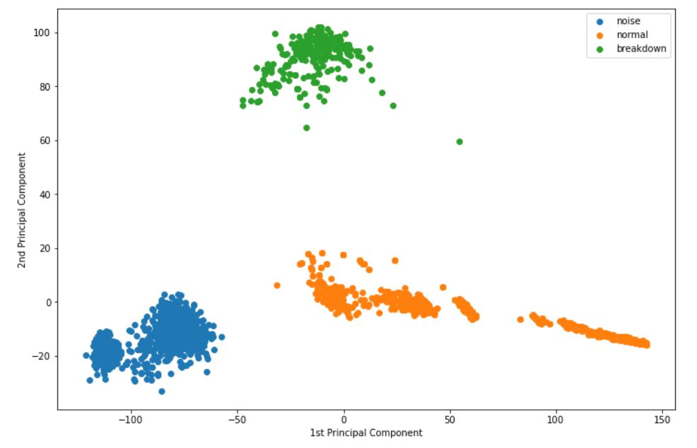
NO-ARC V4 & Beyond
Configurations for all rf structures
  Flexibility to choose any/all structures at runtime
  Generic case for any test stand?
ML breakdown detection algorithm
Store data from EVERY uTCA trace (400Hz)
  Around 40GB in 24 hours, potentially 100s of TB by end of conditioning
  Can be used for ML training
  Can be used to investigate how dark current relates to breakdown events (new breakdown prediction method?)
Web interface
  Can be viewed from anywhere simultaneously (many stakeholders)
Notes:
trace: 0-8ms of powers/phases fwd/rev for cavity, klystron, probe

Slide 13
Software Project Management
For Scientists and Engineers
Software now widely used in science and engineering applications
Use will only grow
Likely will already have to write some code/ will do in future
How can you do it ‘properly’?

Slide 14
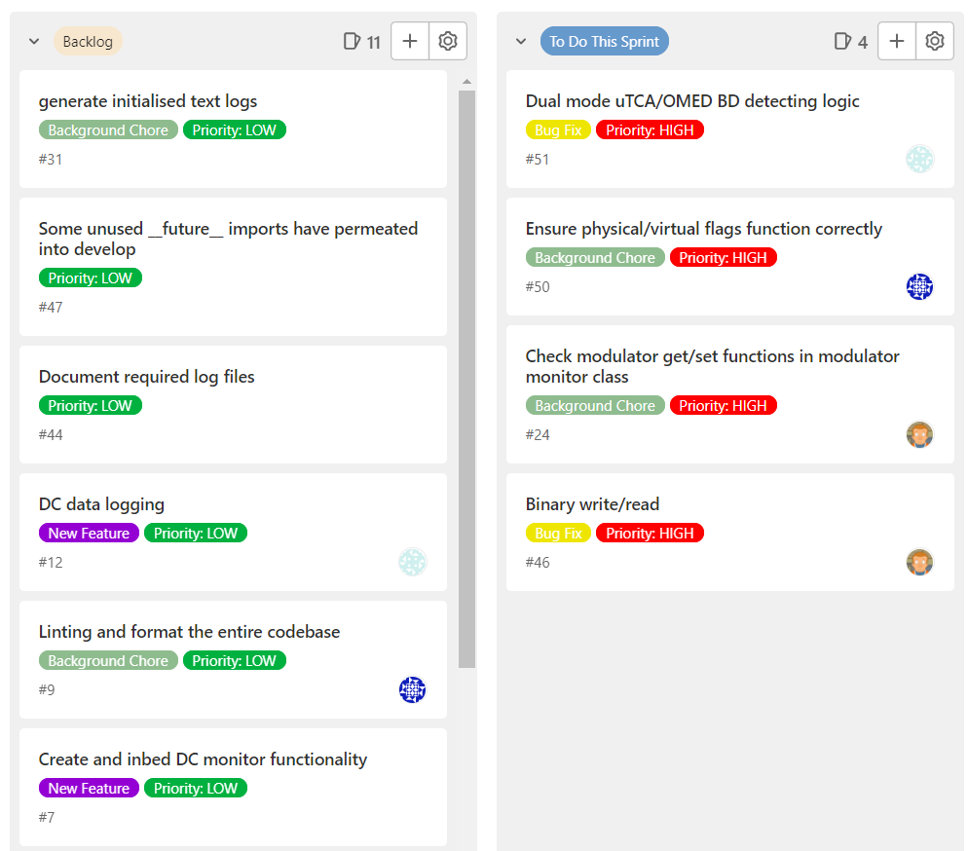


Software Project Management For Scientists and Engineers
Version Control
Git is a local VCS (free and open source)
Every change is documented
Use a command line or gui to commit any changes to your code
Can roll back changes
Repository Hosting
GitHub/GitLab (free websites) for remote hosting
Enables easier collaboration
Can use project management tools such as issue boards and pull requests
More advanced features such as CI/CD tools

Slide 15
Software Project Management For Scientists and Engineers
release
Git Branching Workflow
Two key branches: Main and Develop
  Main: code in production
  Develop: staging area for new changes
When making changes do this in a separate branch, which gets merged later
Best to push your branch and merge it in the remote repo where it can be viewed by others, e.g. via a pull request
Issue #
main
develop
branch
New changes
deploy
merge
Target Host

Slide 16
Conclusions
Automated RF conditioning is already more time efficient than supervised conditioning
Ready to test 400Hz conditioning
More features in the works e.g. use of ML breakdown detection
To do
Notes:
The abstract pattern can be removed or repositioned if required. Be careful to ‘Send to Back’ so that it does not obscure any important information.

Slide 17


Acknowledgments:
Thanks to…
Tony Gilfellon
Louise Cowie
Any Questions?
Notes:
The abstract pattern can be removed or repositioned if required. Be careful to ‘Send to Back’ so that it does not obscure any important information.

Slide 18
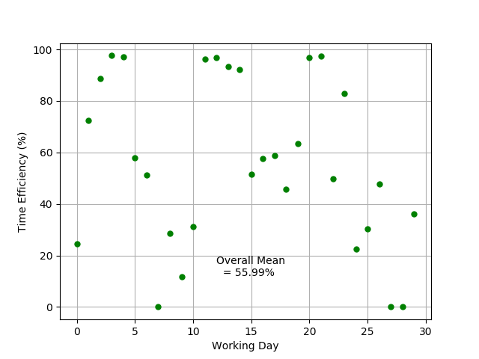
Application of v1
Version 1 of NO-ARC was also used to condition Gun-400 up to 2.5 MW (2018)
Data gathered from cavity probe for Machine Learning training dataset.
Version 1 of NO-ARC was used to condition Gun-10 (Dec 2019 – Feb 2020 )
Average daily time efficiency of 56%
Already more time efficient than “supervised” conditioning

Slide 19
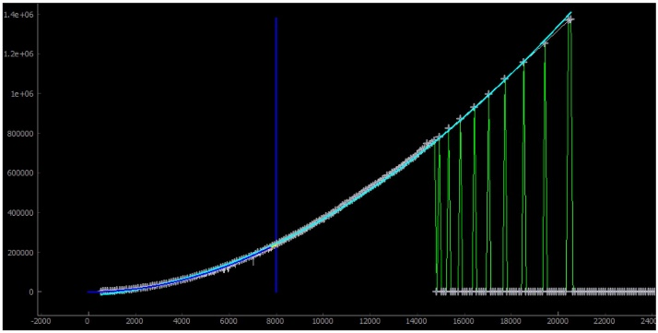
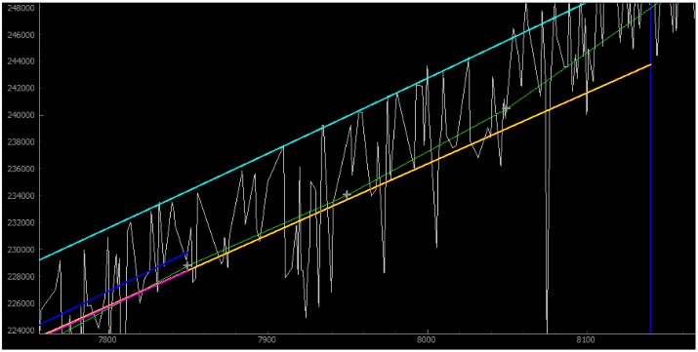
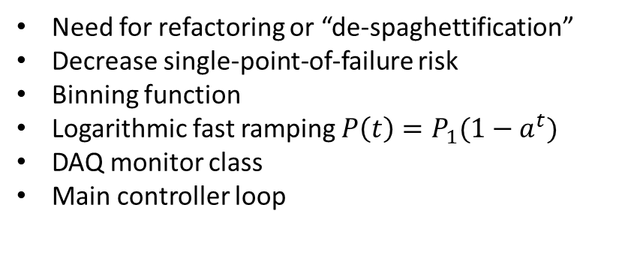
v1 vs v2
Need for refactoring or “de-spaghettification”
Decrease single-point-of-failure risk
Binning function
Logarithmic fast ramping $P\left(t\right)=P_{1}(1−a^{t})$
DAQ monitor class
Main controller loop
Klystron Forward Power (W)
Klystron Forward Power (W)
Amplitude set points (arb. Units)

Slide 20

Git & GitHub
Git is a local version control tool
You can create different copies (branches) of code and implement different features or fixes on each
All changes get recorded and you can roll back to previous versions
Sites like GitHub and GitLab are places to store Git projects (repositories)
Enable collaboration allowing other developers to access the project
Other features form the basis of agile development like project boards, issue reporting, continuous integration

Slide 21
Git Workflow
A production and a development branch
Feature branch workflow:
issue
release
develop
copy
Feat or Fix branch
merge
develop
production

Slide 22
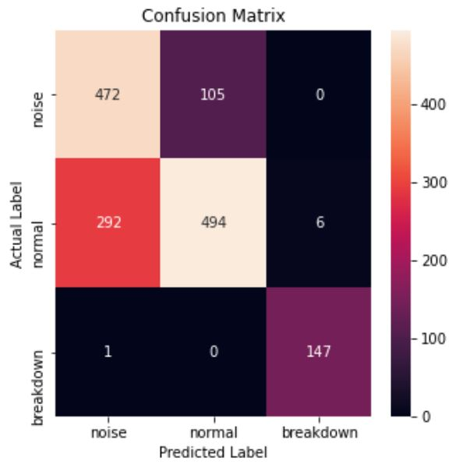
Initial ML Results for HRRG Conditioning
400 Hz High Repetition Rate Gun was conditioned up to 2.5 MW in 2018.
Principal Component Analysis, PCA, method used to classify cavity probe traces as either, noise, normal or breakdown.
Good separation achieved in 2 dimensions.
From Confusion Matrix:
Accuracy (= diagonal cells / all cells) = 73.37%
Precision (= 147 / 151) = 96.08%
Recall (=147 / 148) = 99.32%

Slide 23
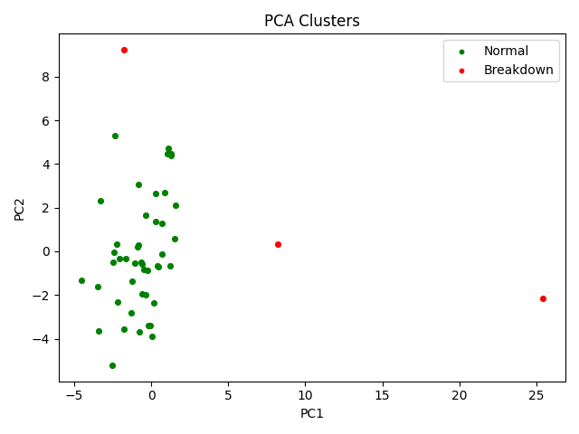
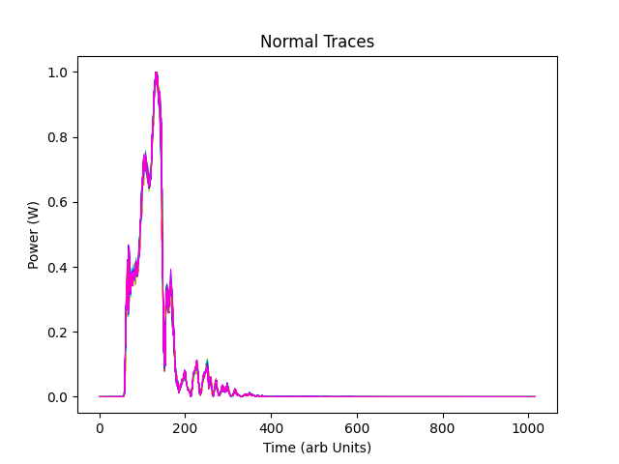
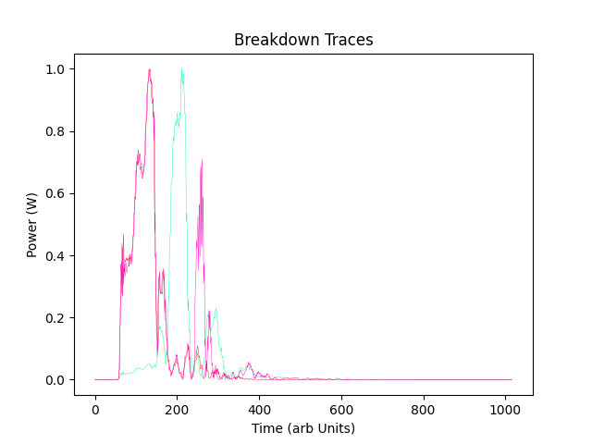
Initial ML Results for Linac 1 Conditioning
Mask breakdown detection flagged 48 breakdowns.
PCA used to classify cavity reverse power traces already flagged as breakdowns into two clusters.
Normal cluster (n=45) contains no real breakdowns.
Breakdown cluster (n=3) contains the 2 real breakdowns.
1 false positive compared to 46.

