Slide 1

Gap waveguide-based slow wave structure for W-band travelling wave tubes
Amira Zied Abozied, Rosa Letizia and Jonathan Gates
Lancaster University, School of Engineering
NVEC 13/09/2022
National Vacuum Electronics Conference (NVEC) 2022
Notes:
name is amira zied
will be discussing my project which is---

Slide 2
Introduction
Travelling wave tubes (TWTs) are a Vacuum Electron Device(VEDs) that have had an emerging interest for applications at frequencies between 80-300GHz.
Advantages of TWT:
High output power
Robust
Do not require significant maintenance
Applications:
Satellite and wireless communications
Imaging
Healthcare applications
TWT consists of:
Slow wave structure
Magnetic focusing system
Electron gun
Input and output ports for RF signal
The slow wave structure (SWS) is the core component of the TWT that influences the operation of the TWT
National Vacuum Electronics Conference (NVEC) 2022
Notes:
There’s an interest to develop TWTs between 80-300GHz due to the demand for high power and high frequency operation in satellite communications, imaging and healthcare applications
High freq (80-300GHz) TWTs have many applications: Satellite and wireless communications
Imaging
Healthcare applications
The TWT is a VED that operates by a beam-wave interaction that amplifies the input signal.
It consists of a SWS, a magnetic focusing system, an electron gun and an input/output. The SWS acts to slow down the input RF signal until the phase velocity of the signal and the electron beam are the same.. continuous interaction between the electron beam and the SWS results in an amplification of the input signal.
The SWS geometry determines the TWT’s operation due to the inverse relationship between dimensions of the SWS and frequency range. As frequency of operation increases and dimensions reach the sub-millimetre level, fabrication of the structures becomes more difficult and costly

Slide 3
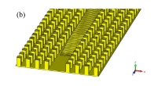
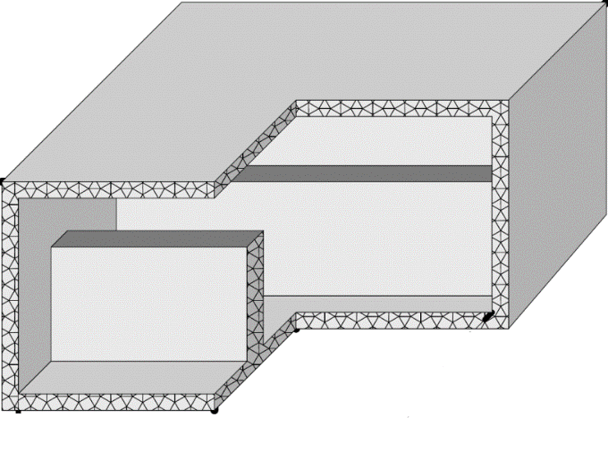
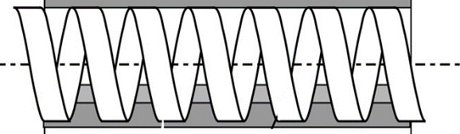
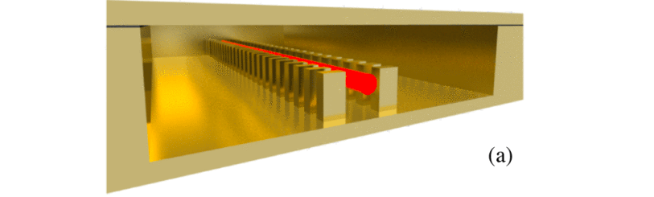
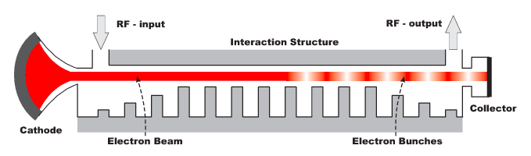
Slow wave structures(SWS) for high frequency TWTs
PhC Corrugated Waveguide
Corrugated Waveguide
Helix SWS
Double Corrugated Waveguide
Carter, R. (2018)
Mineo, M. et al, IEEE (2010)
Letizia, R. et al, IEEE (2015)
Mineo, M. et al, EuMC (2009)
And more…
Slow wave structure
M. Mineo et al, EuMC, (2009)
Schematic of a TWT
Notes:
For context, mention the helix as the traditional SWS but it is limited in dimensions due to the frequency,max of 15-20GHz. (check this)
For solid state, it’s not enough power esp at high frequency. Developing field very quickly. Turn to tubes for needing more power or more lifetime
You can see here a schematic of the TWT and where the SWS is located
There are many types of SWS, the most well studied and conventional is the helix SWS which has been used in microwave frequency TWTs since the 1940s. However helix SWS are not feasible at high freq due to the difficultly in fabrication as frequency increases. Therefore literature has brought various other designs of SWS
We look at the corrugated waveguide for inspo due to its easier fabrication and relatively simple design as an option to develop high power TWT, esp since it has been demonstrated in TWT up to 1 THz
For example, the corrugated waveguide, appreciated for its easy fabrication and the fact it is an all metal structure, has inspired other variations of this such as the double corrugated waveguide, photonic crystal waveguide, and double vane staggered waveguide
Additionally there are folded waveguides, planar waveguides and many more, all which provide different results in term of fabrication and good beam-wave interaction depending on the application and purpose

Slide 4

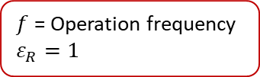
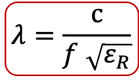

Gap waveguides (GW)
Schematic for the theoretical gap waveguide
Realisation of a groove gap waveguide
PEC
Metal conductor
$$h< λ/4$$
$$h< λ/4$$
PMC
PMC
Perfect magnetic conductor (high impedance surface)
PEC
h = the air gap between the PEC and PMC
Advantages:
Contactless walls – alleviates fabrication and assembly issues
Integrated filtering capabilities via bandstop generation
Novel coupler topologies possible
TEM wavelength in a parallel plate waveguide:
$$λ=\frac{c}{f \sqrt{ε_{R}}}$$
$f$ = Operation frequency
$$ε_{R}=1$$
National Vacuum Electronics Conference (NVEC) 2022
Notes:
Expand on filtering capabilities: dampens the higher order mode so more interaction can occur with the beam.
One possible solution to the design issues found at high freq rectangular SWS are GW, which is a relatively new technology
How a GW works: A local TEM mode can propagate in the central metal ridge within a predetermined operating frequency band, while the perfect magnetic conductor(PMC) plates can confine the propagating wave when the distance is less than a quarter wavelength from the PEC, as no waves will propagate between the PEC/PMC plate unless there is a metal ridge guiding element
The PMC represents a special boundary condition that the tangential magnetic field = 0 and therefore surface current density=0, which can be interpreted as a high surface impedance.
Can realise PEC of the gap waveguide with any metal conductor in this case we chose copper, and an AMC which is an artificial magnetic conductor, which is the realised version of the theoretical PMC, is realised by a textured surface, such as the pin structure.
The advantages of GW which is why we selected them as initial study
No contact with upper walls - bonding of the walls is done away from the areas critical for the electromagnetic properties of the SWS.
Can dampen higher order modes due to stopband
Flexible design may ease coupler design
Elena Pucci, Gap Waveguide Technology for mm-wave applications (2013)
A. Valero-Nogueira, E. Alfonso, J. I. Herranz, and P. S. Kildal, “Experimental demonstration of local quasi-TEM gap modes in single-hardwall waveguides,” IEEE Microwave and Wireless Components Letters, vol. 19, no. 9, pp. 536–538, 2009.

Slide 5
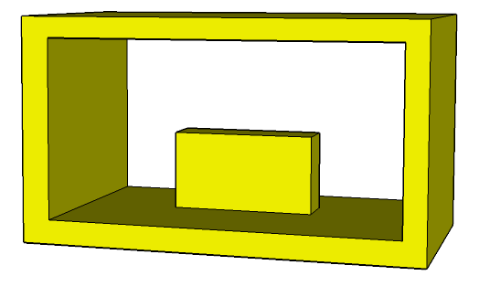
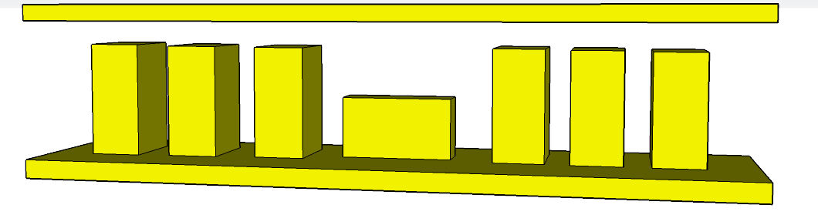
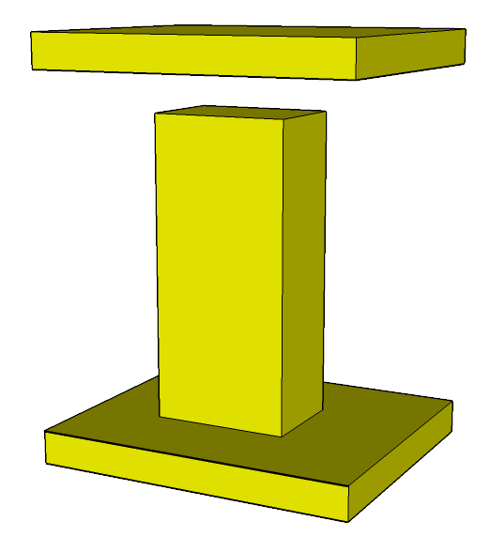
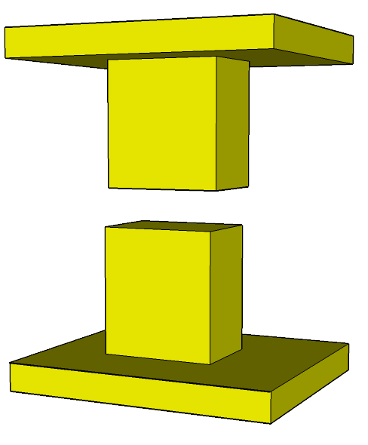
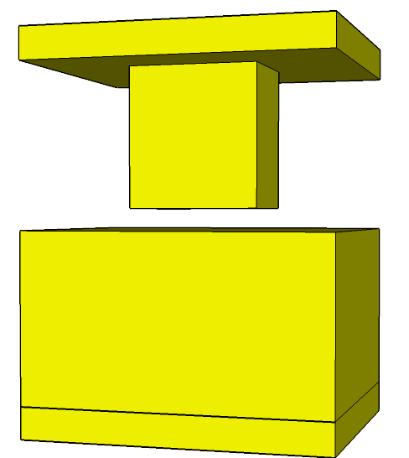
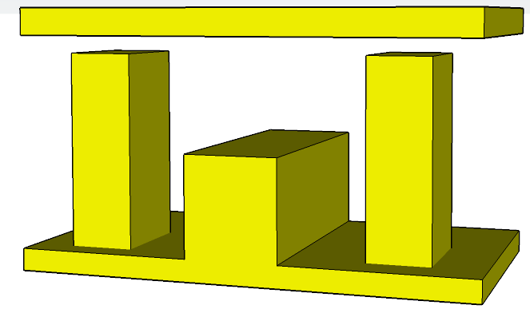
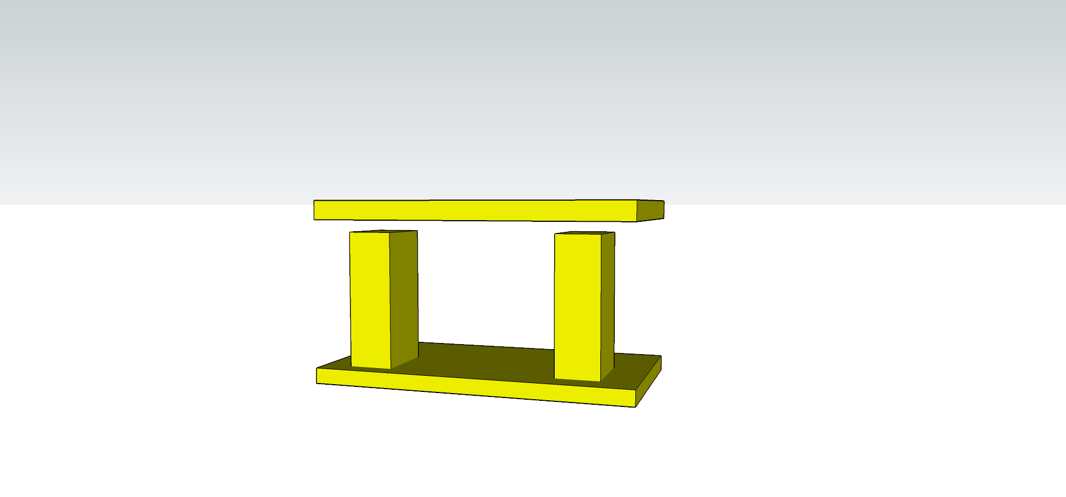
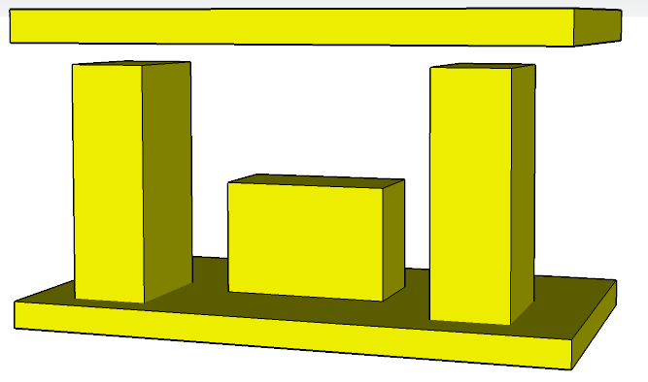
Gap waveguide-based SWS
REPLACED BY
TYPES OF PINS
TYPES OF GAP WAVEGUIDE SWSs
Groove
Ridge
Half wall/half pin GW
Full pin GW
Half height GW
Corrugation
Notes:
Typical gap waveguide is the full pin, with 3 or more pins on each side used as a replacement of the metal walls on the side of a rectangular waveguide
-literature has brought about various types of pins which act as the AMC
-The central groove can be left empty to allow a quasi TE-10 mode to propagate, or be loaded with a corrugation or ridge to specify the propagating mode
-Can explain the flexibility of the GW

Slide 6
Unit cell air gap study
Half height GW
Full pin GW
National Vacuum Electronics Conference (NVEC) 2022
Notes:
-air gap h defines the bandstop of the structure
-larger gap creates a narrower bandstop and vice versa, in both cases

Slide 7
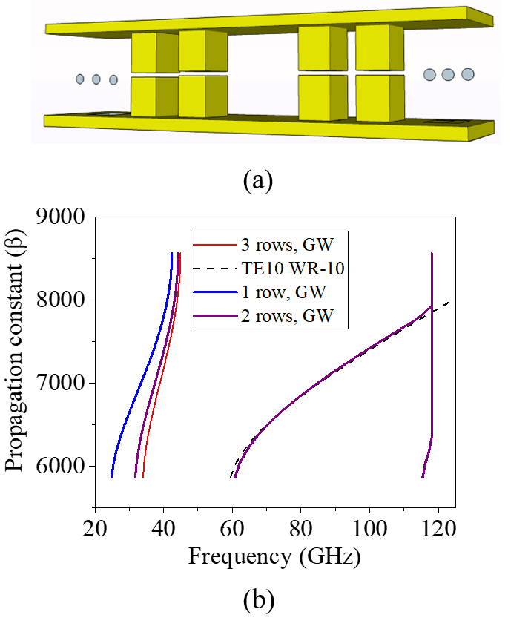
Gap waveguide pins – Varying pin rows
National Vacuum Electronics Conference (NVEC) 2022
Notes:
Typical GW uses 2-3 rows of pins, but even one row of pins was suitable for confinement in this structure
Can be seen that the number of pins in this configuration has minimal effect on the dispersion
-this is comparing the GW groove with a typical wr-10 metal rectangular groove waveguide

Slide 8
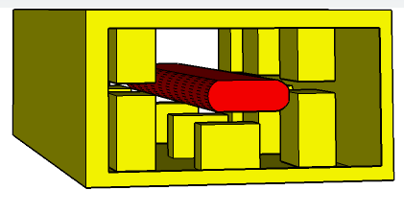
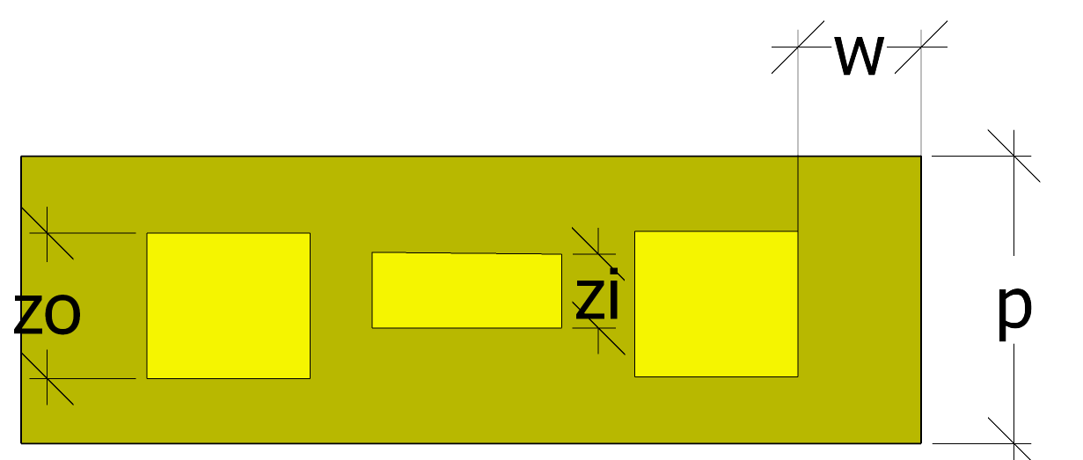
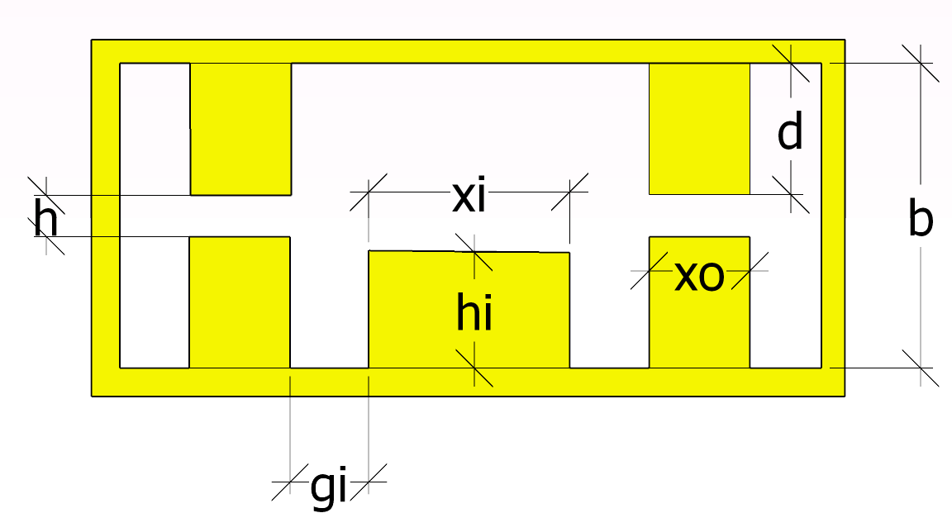
Designed SWS
W-band (87-100 GHz) gap waveguide slow wave structure (GW - SWS) for large bandwidth SWS realized by longitudinal central corrugations and gap waveguide for confinement
1 row of pins at each side of the corrugation
Interaction with sheet beam 1 x 0.2mm, 0.08mm above central corrugation
Parameter | Dimension (mm)
b | 1.27
xi | 0.6
hi | 0.46
zi | 0.31
xo | 0.47
zo | 0.58
p | 1.1
gi | 0.42
w | 0.5
d | 0.61
h | 0.05
Front view
Top view
Notes:
Considering all this the final design is shown here
-Central corrugation added to make the SWS
-went with half height pin due to shorter pins meant they were less likely to bend or snap during fabrication
-read bullet points

Slide 9
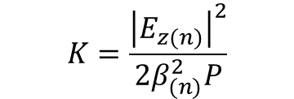
Eigenmode simulations
Interaction impedance:
$$K=\frac{{\left|E_{z(n)}\right|}^{2}}{2β_{(n)}^{2}P}$$
Full pin GW
Half height GW
Half wall/half pin GW
National Vacuum Electronics Conference (NVEC) 2022
Notes:
-eigenmode simulations
Average coupling impedance was taken with the sheet beam 1 x 0.2mm, 0.08mm above central corrugation
-comparing the gw with the same corrugation but with different pin configurations

Slide 10
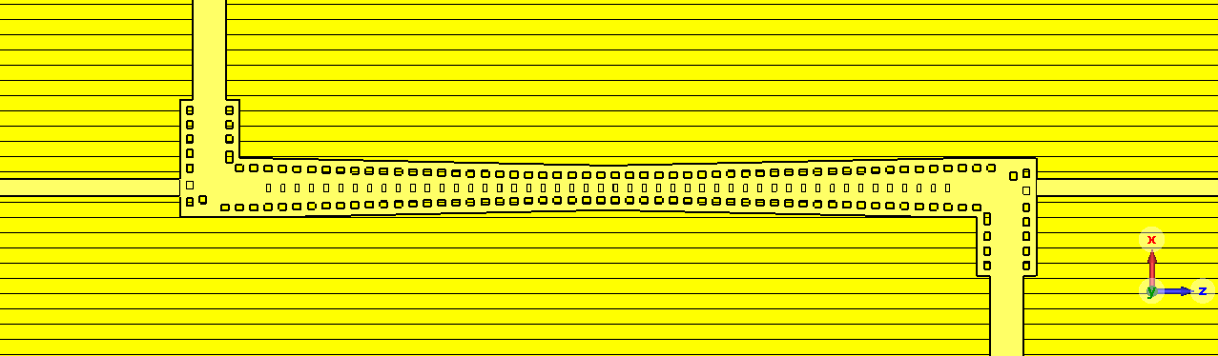
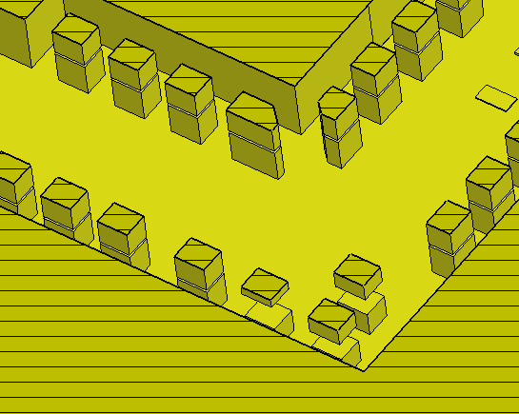
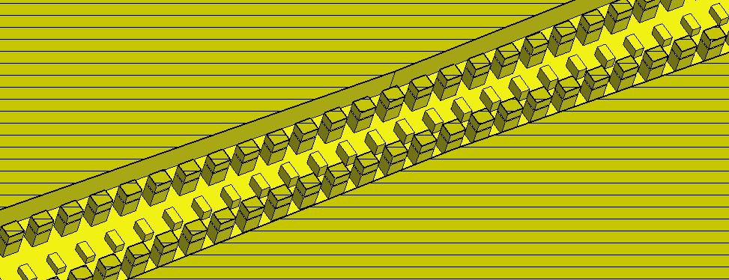
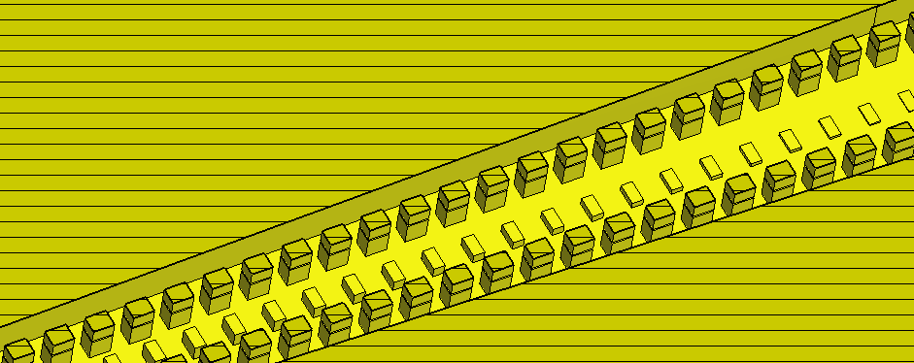
Complete GW-SWS design (half-height pin)
Input port: WR-10 (2.54 x 1.27mm)
Beam tunnel
Bend
Propagating section
Tapering section
National Vacuum Electronics Conference (NVEC) 2022
Notes:
Coupler structure design, consisting of propagating section, tapering to taper the sws to standard wr-10, and the bend to facilitate the beam tunnel
For the full structure the propagating section, 90 periods, for fabrication to do cold tests 10 periods

Slide 11
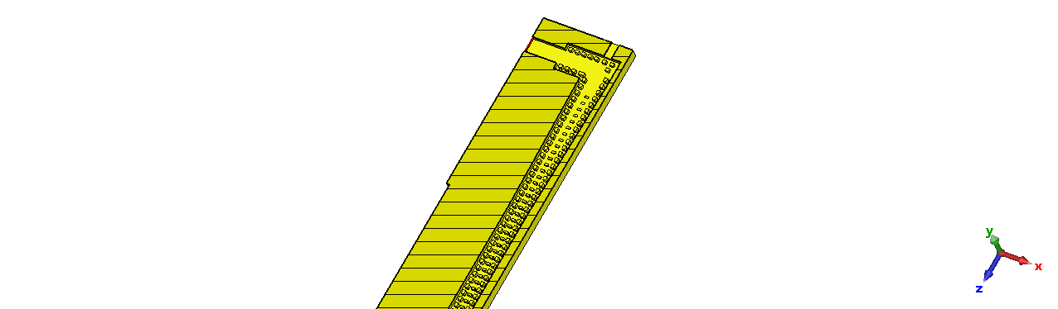
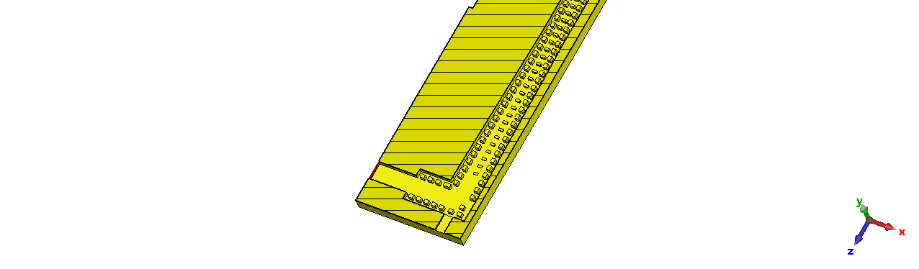
Complete GW-SWS design
Half-height GW-SWS pin was chosen for design
Reflections of approximately -15dB in the 82-100GHz operating range
Simulated with aluminium conductivity 1.78x10⁷ S/m
Prototype machined with aluminum to measure cold characteristics
Top view
Input port: WR-10 (2.54 x 1.27mm)
10 propagating periods
Beam tunnel
National Vacuum Electronics Conference (NVEC) 2022
Notes:
Half height required shorter coupler needed compared to full pin.
Reflections of approximately -15dB in the 82-100GHz operating range
-results

Slide 12
Full GW-SWS TWT
90 propagating periods
Input port: WR-10 (2.54 x 1.27mm)
Beam tunnel
National Vacuum Electronics Conference (NVEC) 2022
Notes:
90 period copper reduced conductivity s11 and s21 to show true scattering parameters in an actual TWT, parametric study done to choose optimum number of periods

Slide 13


Particle-in-Cell (PIC) Simulations on the GW-SWS TWT
Tube stability equation:
Tube is stable
$$Q=G −S_{11}− S_{22}−S_{21}<0$$
$Q$ = Stability
$$G=Gain \left(dB\right)$$
National Vacuum Electronics Conference (NVEC) 2022
Notes:
Input/output plot, output power stabilises after a certain input power
-gain shown between 25-30 dB from 87-100 GHz
-Using sparameters before and gain, can see the tube is stable and therefore no oscillations

Slide 14
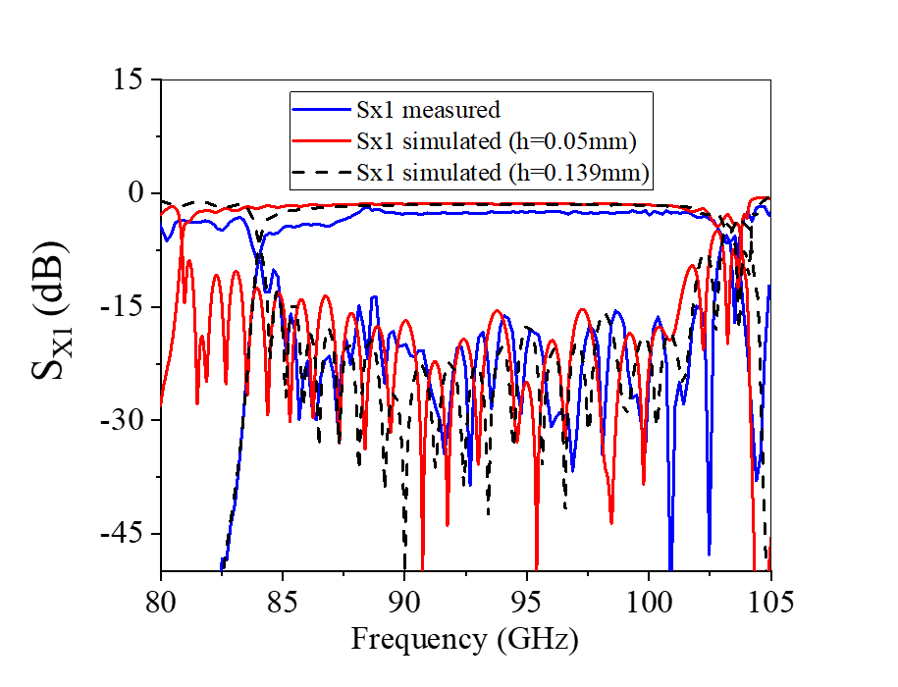
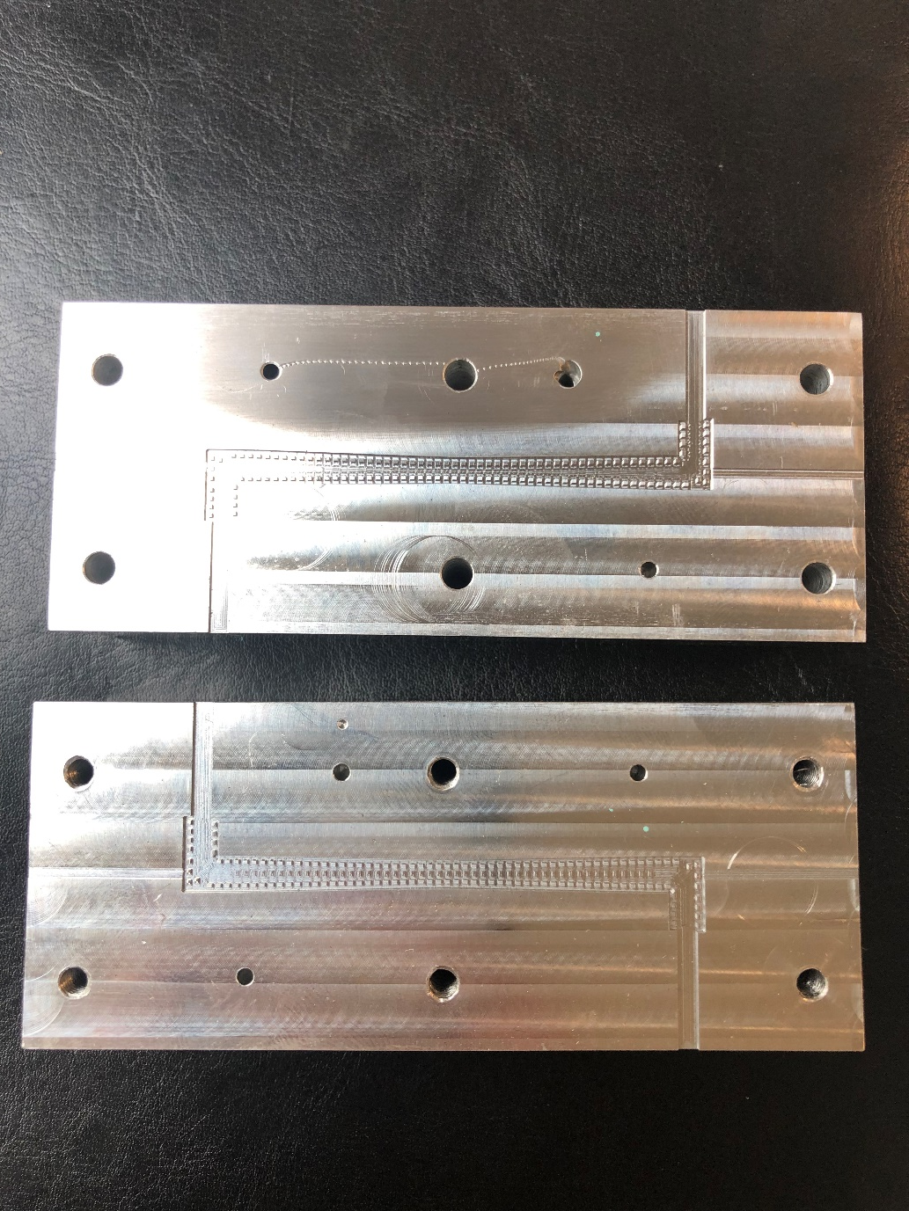
Fabrication
60K RPM air turbine spindle
2 days per half to machine
0.4mm tooling part used
National Vacuum Electronics Conference (NVEC) 2022
Notes:
Fabrication done using CNC machining, at 60K RPM air turbine spindle
2 days per half to machine
0.4mm tooling part used
Gap size has a noticeable shift on the lower cut off frequency
While still in the band of interest, this can cause beam velocity asynchronism with the phase velocity for the propagating mode
Currently working on improving the tolerances on the gap height

Slide 15
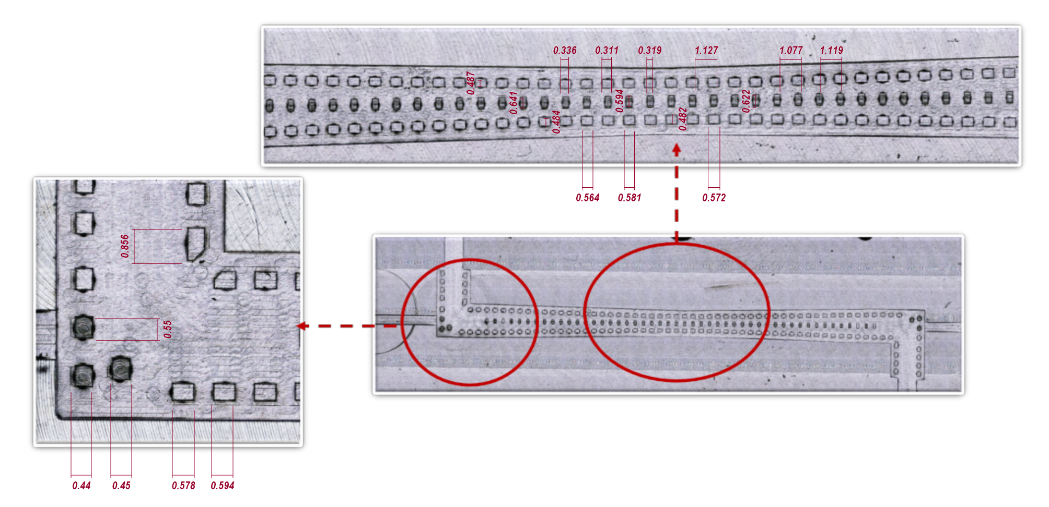
Fabrication
Measured surface roughness ~200 nanometers
Tolerances ~ +/- 10-50 microns
National Vacuum Electronics Conference (NVEC) 2022
Notes:
Measured dimensions and surface roughness under 3d microscope
Tolerances and surface roughness within expected ranges

Slide 16
Conclusions and Future work
The gap waveguide can be implemented into high frequency TWTs to improve assembly, allow more flexible design and filter out unwanted higher order modes
Improvement of air gap of fabricated piece, closer to original value to shift lower cut-off frequency
Incorporation of gap waveguide to rectangular planar waveguides
National Vacuum Electronics Conference (NVEC) 2022
Notes:
Improvement of air gap of fabricated piece, closer to original value to shift lower cut-off frequency
Incorporation of microstrip gap waveguide to rectangular planar waveguides

Slide 17
Thank you
National Vacuum Electronics Conference (NVEC) 2022

