Slide 1
Millimeter-wave undulators for compact XFELs
Liang Zhang^{1,3}, Jim Clarke^{2,3}, Craig R. Donaldson ^{1,3}, Craig W. Robertson ¹, Colin G. Whyte ¹, and Adrian W. Cross ^{1,3}
liang.zhang@strath.ac.uk
¹Department of Physics, SUPA, University of Strathclyde
²ASTeC, STFC Daresbury Laboratory, Sci-Tech Daresbury
³The Cockcroft Institute, Sci-Tech Daresbury

Slide 2
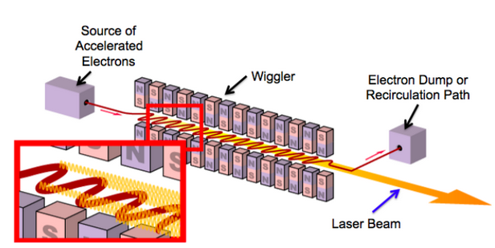
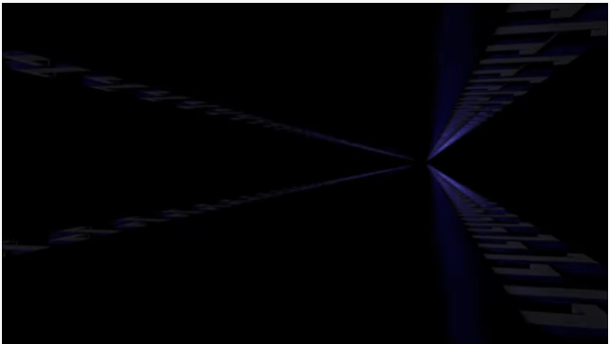
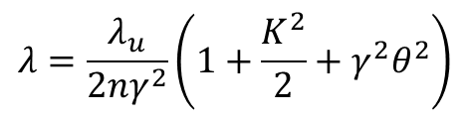
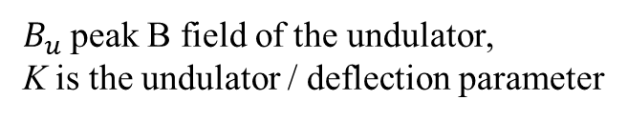

Free-electron Laser (FEL)
Undulator
The concept was proposed in 1972
First experiment in 1977-78
Wavelength of output radiation
$$λ=\frac{λ_{u}}{2{nγ}^{2}}\left(1+\frac{K^{2}}{2}+γ^{2}θ^{2}\right)$$
$B_{u}$peak B field of the undulator,
K is the undulator / deflection parameter
$K=\frac{\left|e\right|λ_{u}B_{u}}{2πmc}$= $0.934B_{u}{[T]λ}_{u}[cm]$
[1] Bolko Beutner, Introduction to Free Electron Lasers
[2] P. G. O'Shea and H. P. Freund, 292 (5523), pp. 1853-1858, 2001.
[3] A. Ghaith, et. al, Physics Reports 937(6), 2021
[4] https://www.youtube.com/watch?v=-kdqVuJxkrs

Slide 3
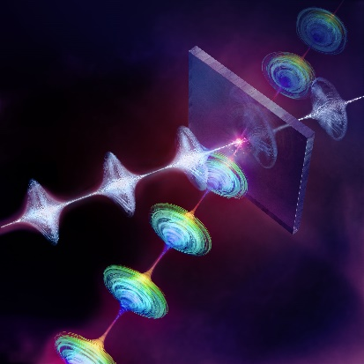
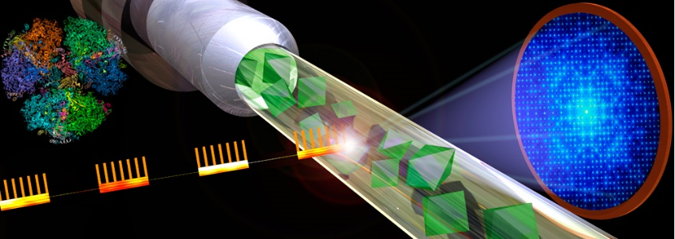
X-ray Free-electron Laser (XFEL)
First X-FEL operated in 2005. Features:
  Coherent, narrow bandwidth, high energy, short duration
Applications:
  Bioscience (molecular movies of enzyme catalysis)
  Physics (understand internal structure of star core)
  Chemistry (observe form / break of bonds between molecules)
  Challenges:
  GeV-energy electron beams
  Undulator with short period
  High cost (~£5 Bn), <10 XFELs in the world
  Timeliness: UKXFEL science case made by STFC in Oct. 2020 and CDR approved 2022
Copyright: European XFEL

Slide 4

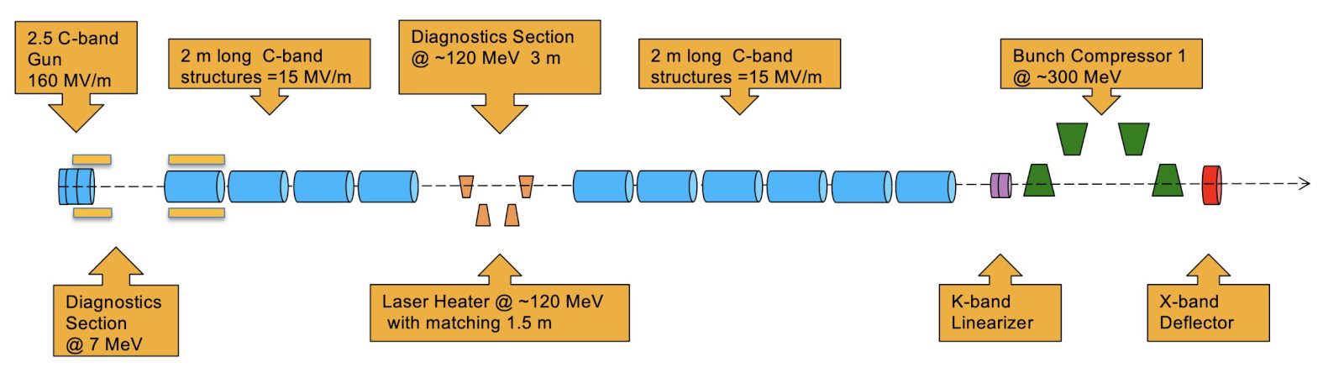
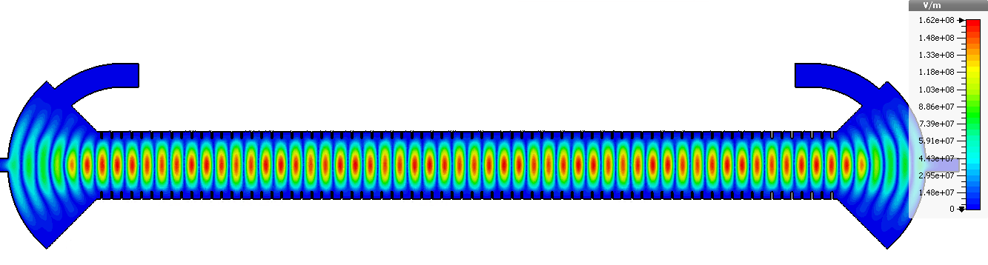
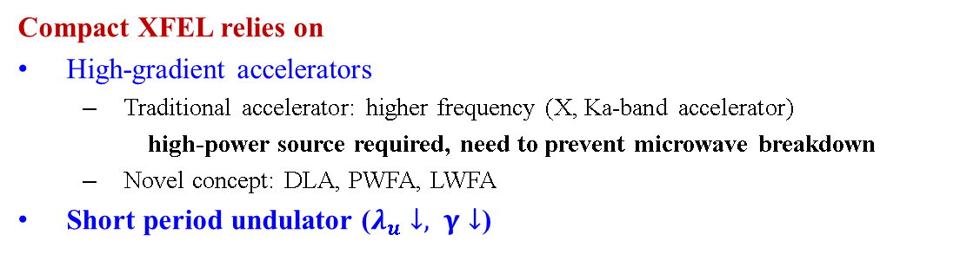
Compact XFEL
Europe XFEL: 17.5GeV, 3.4km
Swiss XFEL: 5.8GeV, 740m
CompactLight: 5.5GeV, 480m (Conceptual Design Report)
Compact XFEL relies on
High-gradient accelerators
  Traditional accelerator: higher frequency (X, Ka-band accelerator)
    high-power source required, need to prevent microwave breakdown
  Novel concept: DLA, PWFA, LWFA
Short period undulator ($λ_{u}↓, γ↓$)

Slide 5
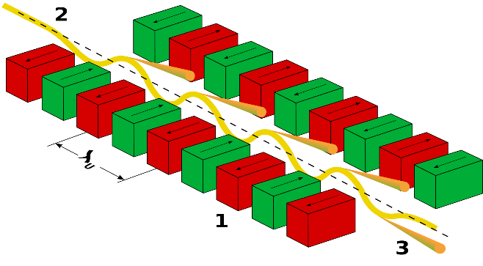
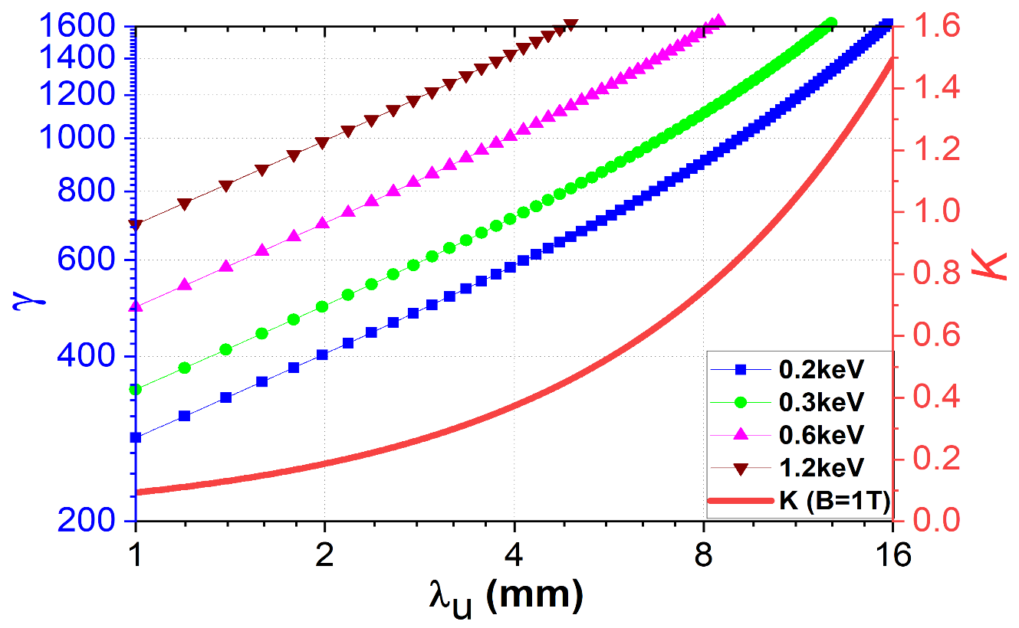
Undulators
Permanent magnet undulators
Cryogenic permanent magnet undulators
Superconducting undulators
Exotic undulators (Microwave undulator, Optical undulator)
  State-of-the-art PMU
 | SwissFEL (Aramis) | Europe XFEL
Structure | Planar hybrid | Planar hybrid
Material | NdFeB | NdFeB
K | 1.2 | 3.0
Period | 15 mm | 26 mm
Peak field | 0.85 T | 1.24 T
Gap type | Variable | Variable
Gap | 4.7 mm | 6 mm
300MeV
200MeV
1.7 mm period allows for generating soft X-ray radiation using a 250 MeV beam.
Moderate K value for 1.7 mm period MU mitigated by
588 periods per meter.

Slide 6
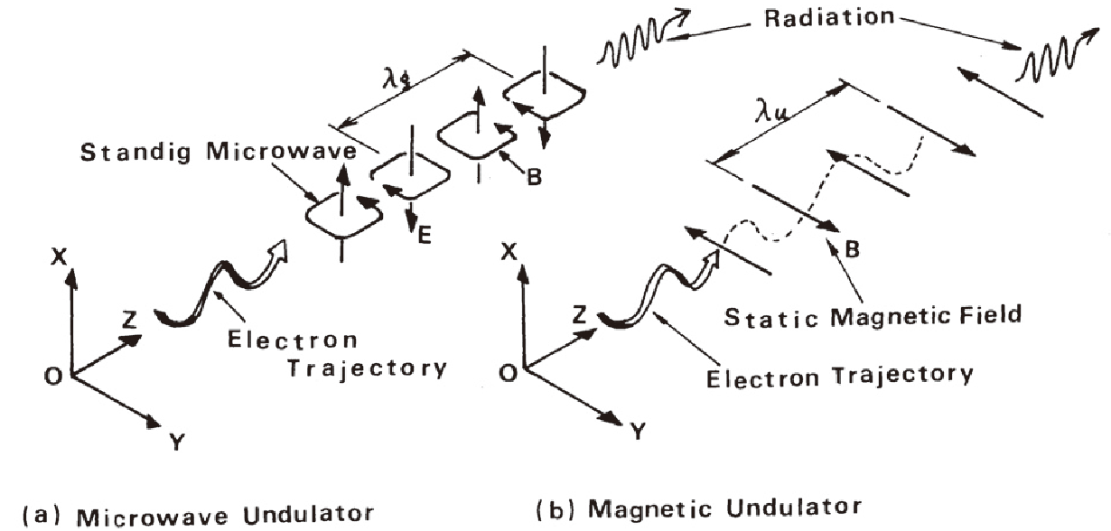
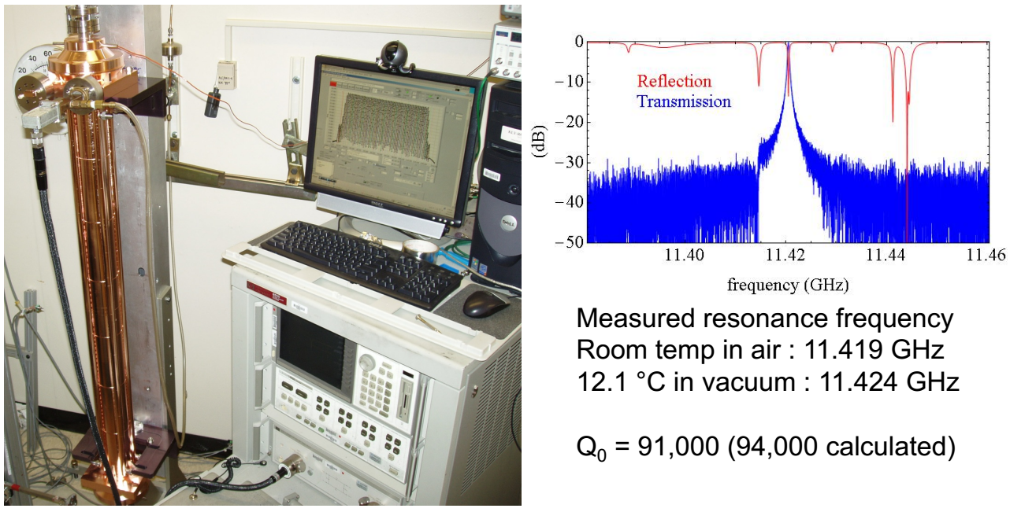
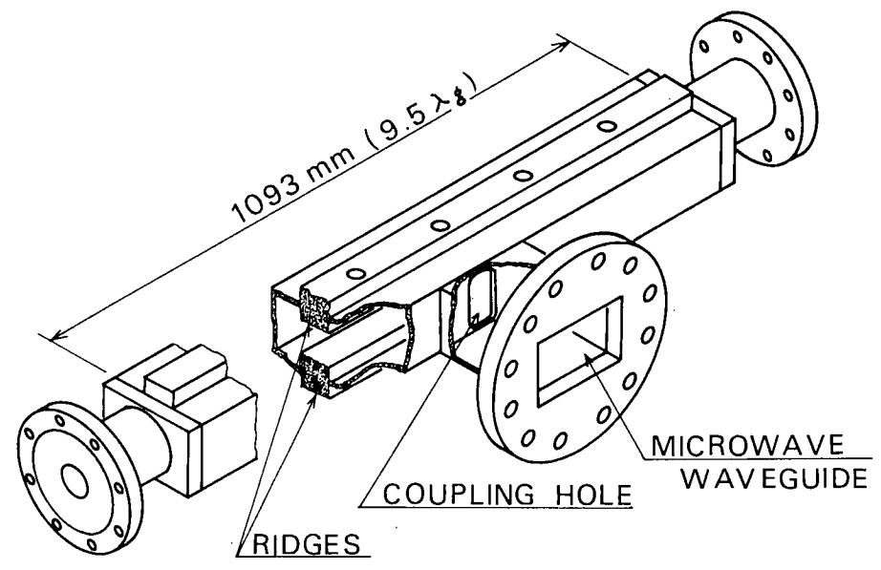
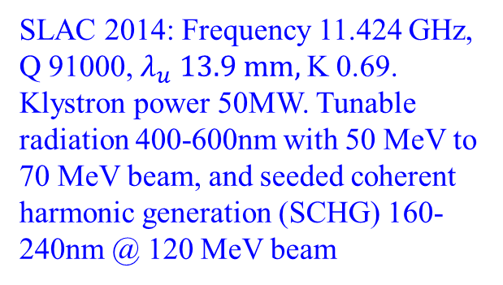
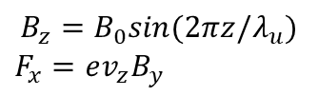
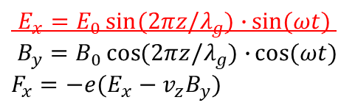
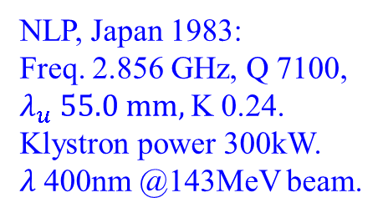
Microwave undulator (MU)
$E_{x}=E_{0}\sin{(2πz/λ_{g})∙}\sin{(ωt)}$
$B_{y}=B_{0}\cos{(2πz/λ_{g})∙}\cos{(ωt)}$
$F_{x}=−e(E_{x}−v_{z}B_{y})$
$$B_{z}=B_{0}sin⁡(2πz/λ_{u})$$
$F_{x}=ev_{z}B_{y}$
NLP, Japan 1983:
Freq. 2.856 GHz, Q 7100, $λ_{u} 55.0 mm,$K 0.24.
Klystron power 300kW. $λ$400nm @143MeV beam.
SLAC 2014: Frequency 11.424 GHz, Q 91000, $λ_{u} 13.9 mm,$K 0.69.
Klystron power 50MW. Tunable radiation 400-600nm with 50 MeV to 70 MeV beam, and seeded coherent harmonic generation (SCHG) 160-240nm @ 120 MeV beam
[1] T. Shintake, Jpn. J. Appl. Phys. 22, 844, 1983.
[2] S. Tantawi, Phys. review letters 112, 164802, 2014.

Slide 7
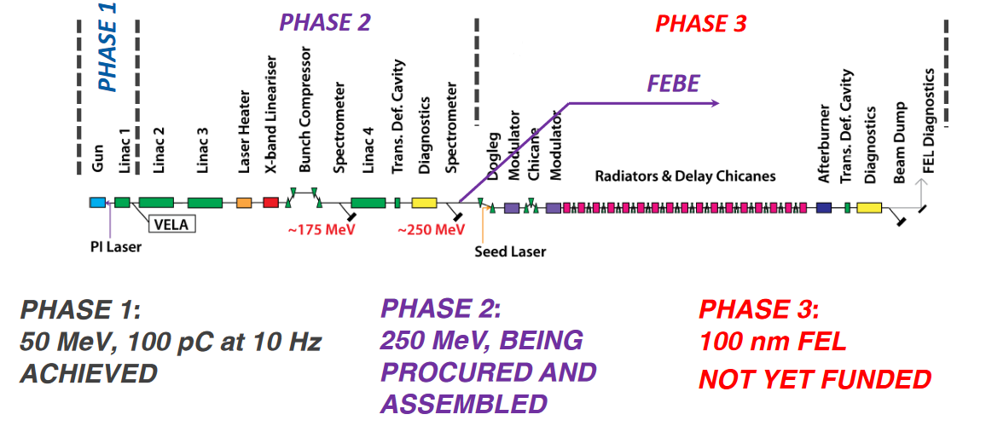
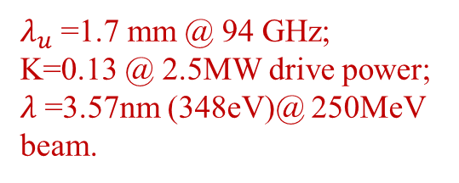
Features of mmWU
Features
Shorter undulator period, lower beam energy;
Large aperture to reduce wakefield;
Fast control of polarization and magnetic field (electrical vs mechanical);
Resilient to damage by radiation (copper vs rare-earth material).
Demonstrate soft X-ray radiation using the FEBE 250MeV beam
$λ_{u}$ =1.7 mm @ 94 GHz;
K=0.13 @ 2.5MW drive power;
$λ$=3.57nm (348eV)@ 250MeV beam.
[1] Deepa Angal-Kalinin, FEBE Users Group Meeting, 5th July 2022.

Slide 8
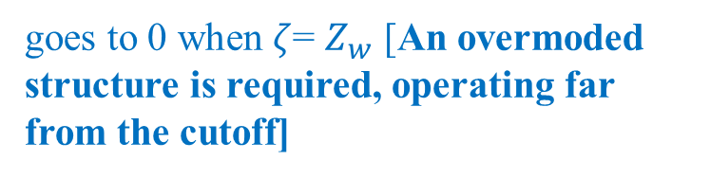
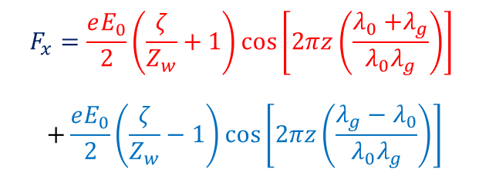
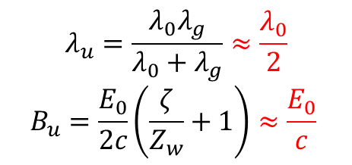
Requirements for MU
$$F_{x}=\frac{eE_{0}}{2}\left(\frac{ζ}{Z_{w}}+1\right)\cos\left[2πz\left(\frac{λ_{0}{+λ}_{g}}{λ_{0}λ_{g}}\right)\right]$$
$$+\frac{eE_{0}}{2}\left(\frac{ζ}{Z_{w}}−1\right)\cos\left[2πz\left(\frac{{λ_{g}−λ}_{0}}{λ_{0}λ_{g}}\right)\right]$$
Backward Wave
Forward Wave
goes to 0 when $ζ$= $Z_{w}$ [An overmoded structure is required, operating far from the cutoff]
$$λ_{u}=\frac{λ_{0}λ_{g}}{λ_{0}+λ_{g}}≈\frac{λ_{0}}{2}$$
$$B_{u}=\frac{E_{0}}{2c}\left(\frac{ζ}{Z_{w}}+1\right)≈\frac{E_{0}}{c}$$

Slide 9
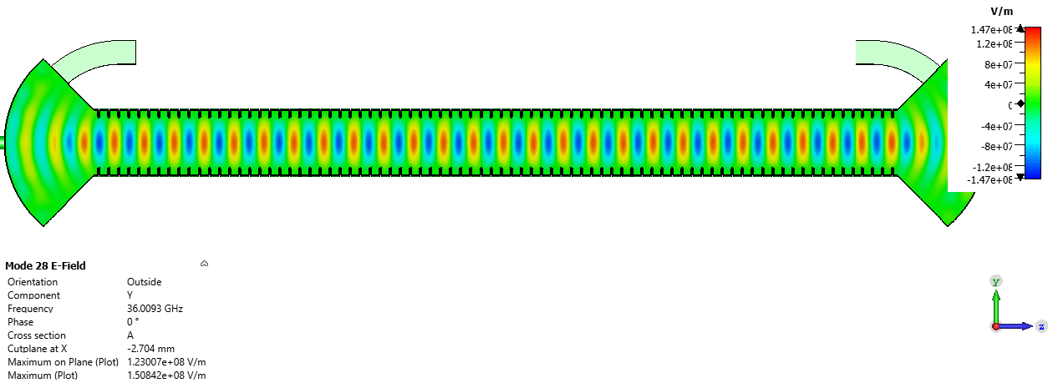
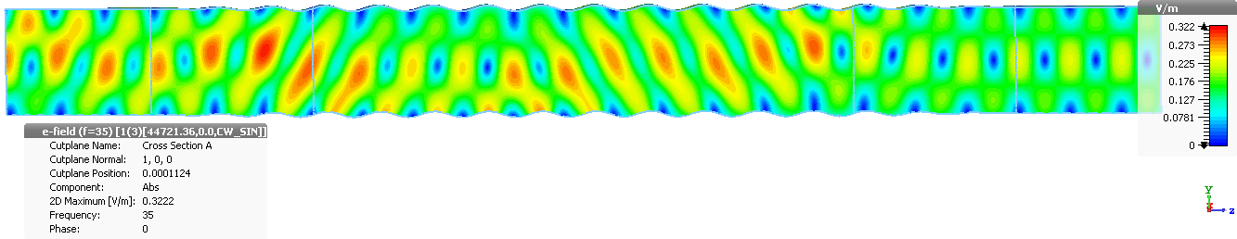
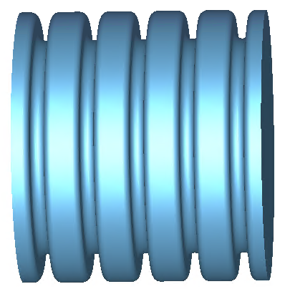
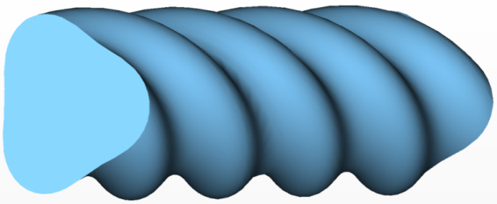
Types of MUs
Flying-type undulator based on helically corrugated waveguide.
Mode coupling to generate copropagating wave to increase the effective interaction length.
Cavity-type undulator based on the corrugated waveguide
 | Cavity-type undulator | Flying-type undulator
Microwave source | Medium power, long pulse microwave source, 30 MW, 2 μs | High power, short pulse microwave source, 800 MW, 10 ns
Field stability | Excellent | Tapered field due to loss
Phase accuracy | Excellent | Require phase locking
[1] L. Zhang, W. He, J. Clarke, et. al, IEEE Trans. Electron Devices, 65(12), pp. 5499-5504, 2018
[2] L. Zhang, W. He, J. Clarke, et. al, Journal of Synchrotron Radiation, vol. 26, 2018

Slide 10
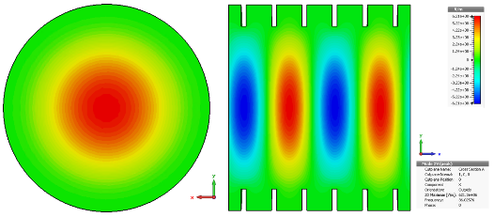
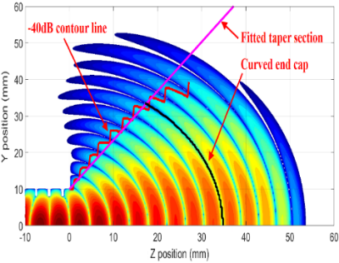
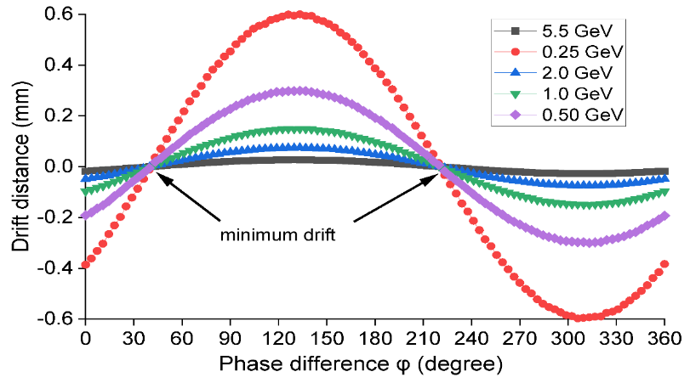
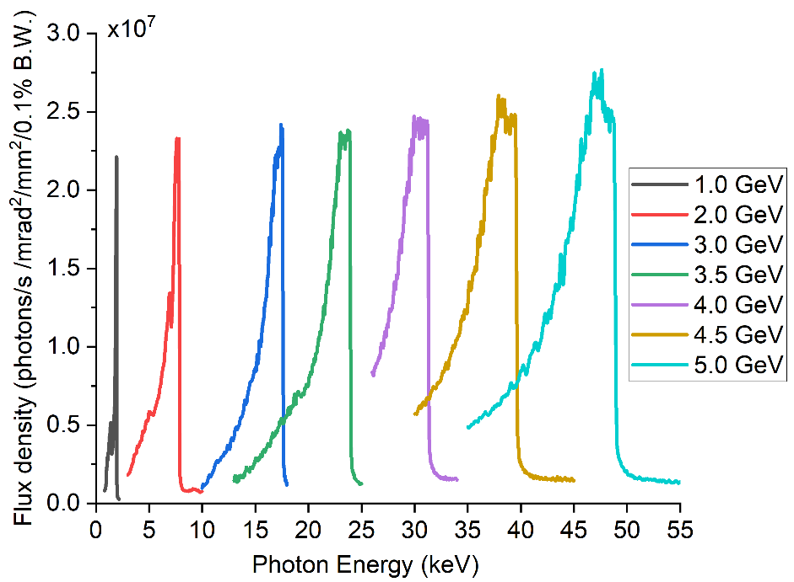
Ka-band MU
  Design and optimize the undulator structure based on low-loss quasi-optical corrugated waveguide. Inner Diameter of 16.2mm, Length of 1m, K peak of 0.5 @50MW, 36GHz, 2μs pulse duration.
Scalable (frequency and cavity length) design for the coupler structure
Particle trajectory simulation in the MU
Designed from near-field radiation pattern
Zero drift distance by controlling injection phase
Small drift distance at higher beam energy (oscillator for beam energy > 1GeV)
[1] L. Zhang, W. He, J. Clarke, et. al, IEEE Trans. Electron Dev., 66(10), p.4392-4397, 2019.
[2] L. Zhang, J. Clarke, C. Donaldson, et. al, Sci. Rep., 12, 7071, 2022.

Slide 11

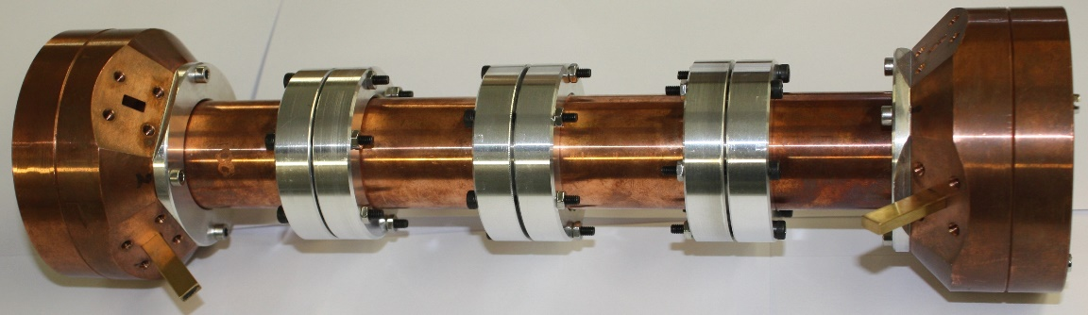
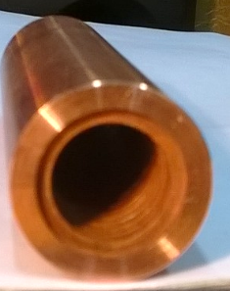
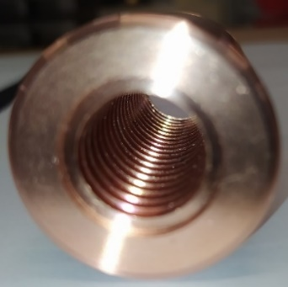
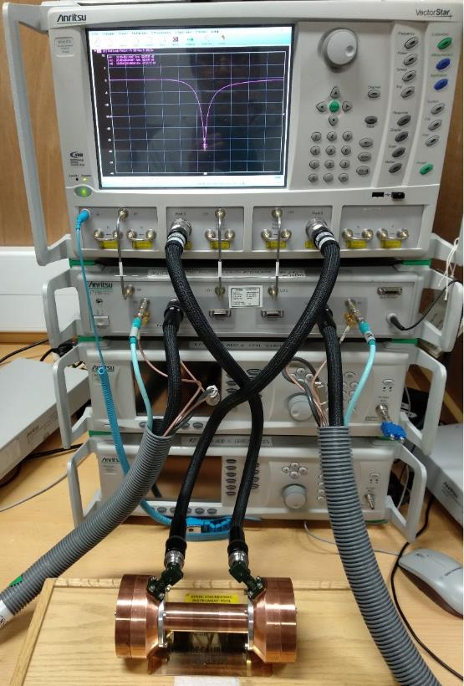
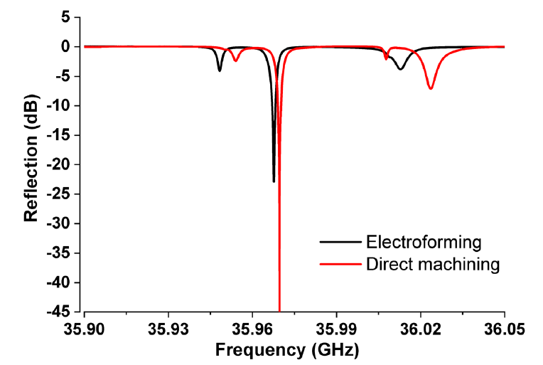
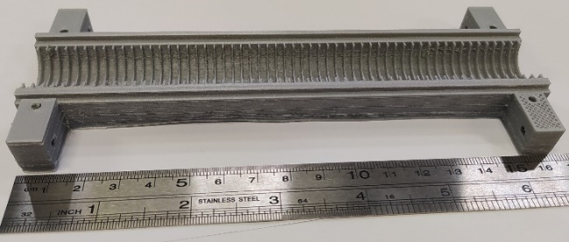
Manufacture of the MU
Evaluate the different methods of manufacture of a short section of MU and measure performance using a Vector Network Analyser (VNA).
(1) Electroforming
(2) Direct machining
Electroforming and direct machining are promising
(3) 3D printing + plating
[1] L. Zhang, C. Donaldson, J. Clarke, et al. Sci. Rep., 12, 7071, 2022.
Notes:
3D printing: good accuracy, seeking for the copper plating method.
Better result for the directly machining method compared with the electroforming method.
Prepare for the high frequency shorter wavelength undulator.
Problems:
The structure was made by electroforming method.
~40% of the Q₀ compared with simulation.
Higher drive power is required.

Slide 12
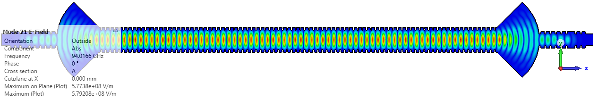
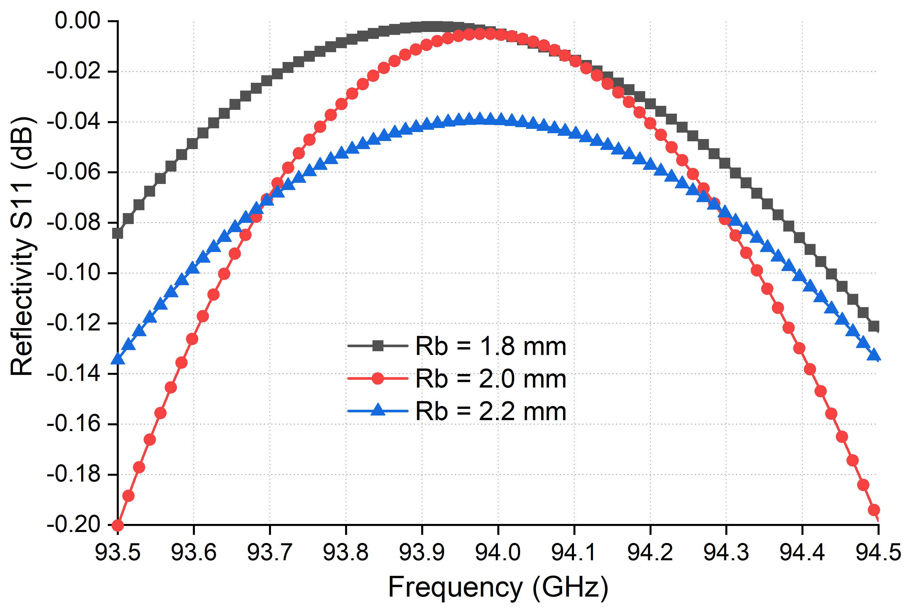
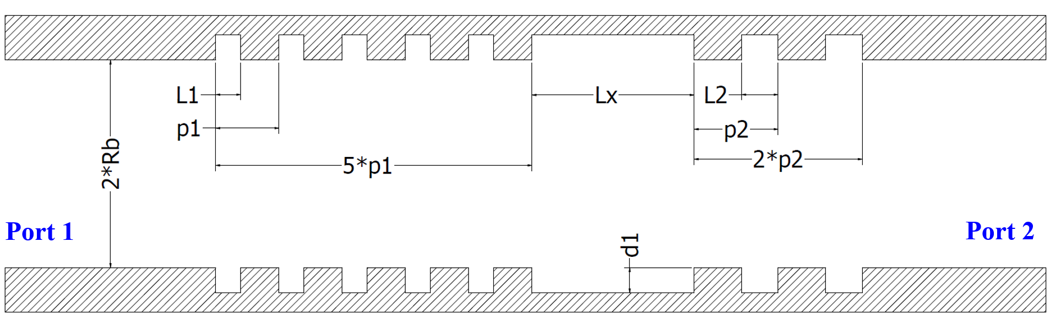
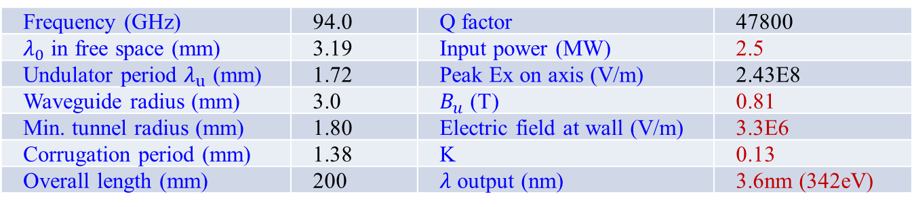
W-band mmWU
Frequency (GHz) | 94.0 | Q factor | 47800
$λ_{0}$ in free space (mm) | 3.19 | Input power (MW) | 2.5
Undulator period $λ_{u}$ (mm) | 1.72 | Peak Ex on axis (V/m) | 2.43E8
Waveguide radius (mm) | 3.0 | $B_{u}$ (T) | 0.81
Min. tunnel radius (mm) | 1.80 | Electric field at wall (V/m) | 3.3E6
Corrugation period (mm) | 1.38 | K | 0.13
Overall length (mm) | 200 | $λ$ output (nm) | 3.6nm (342eV)
Broadband feature enables step-tunning.
Bragg reflector reduces the mm-wave power leakage and maintains the large aperture.
[1] L. Zhang, et. al, J. Infrared Milli. Terahz Waves, vol. 37, no. 9, pp. 846-856, 2016.

Slide 13
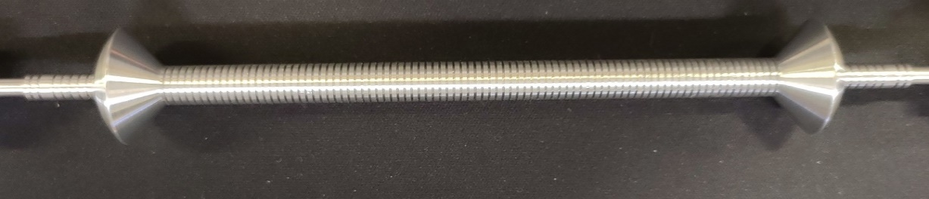
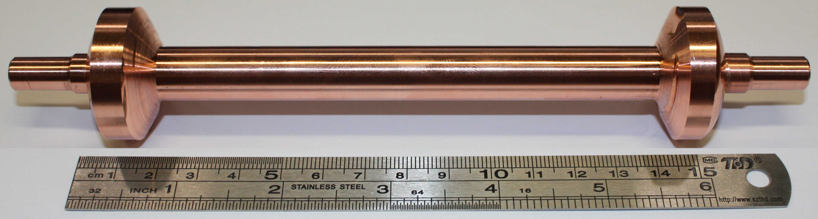
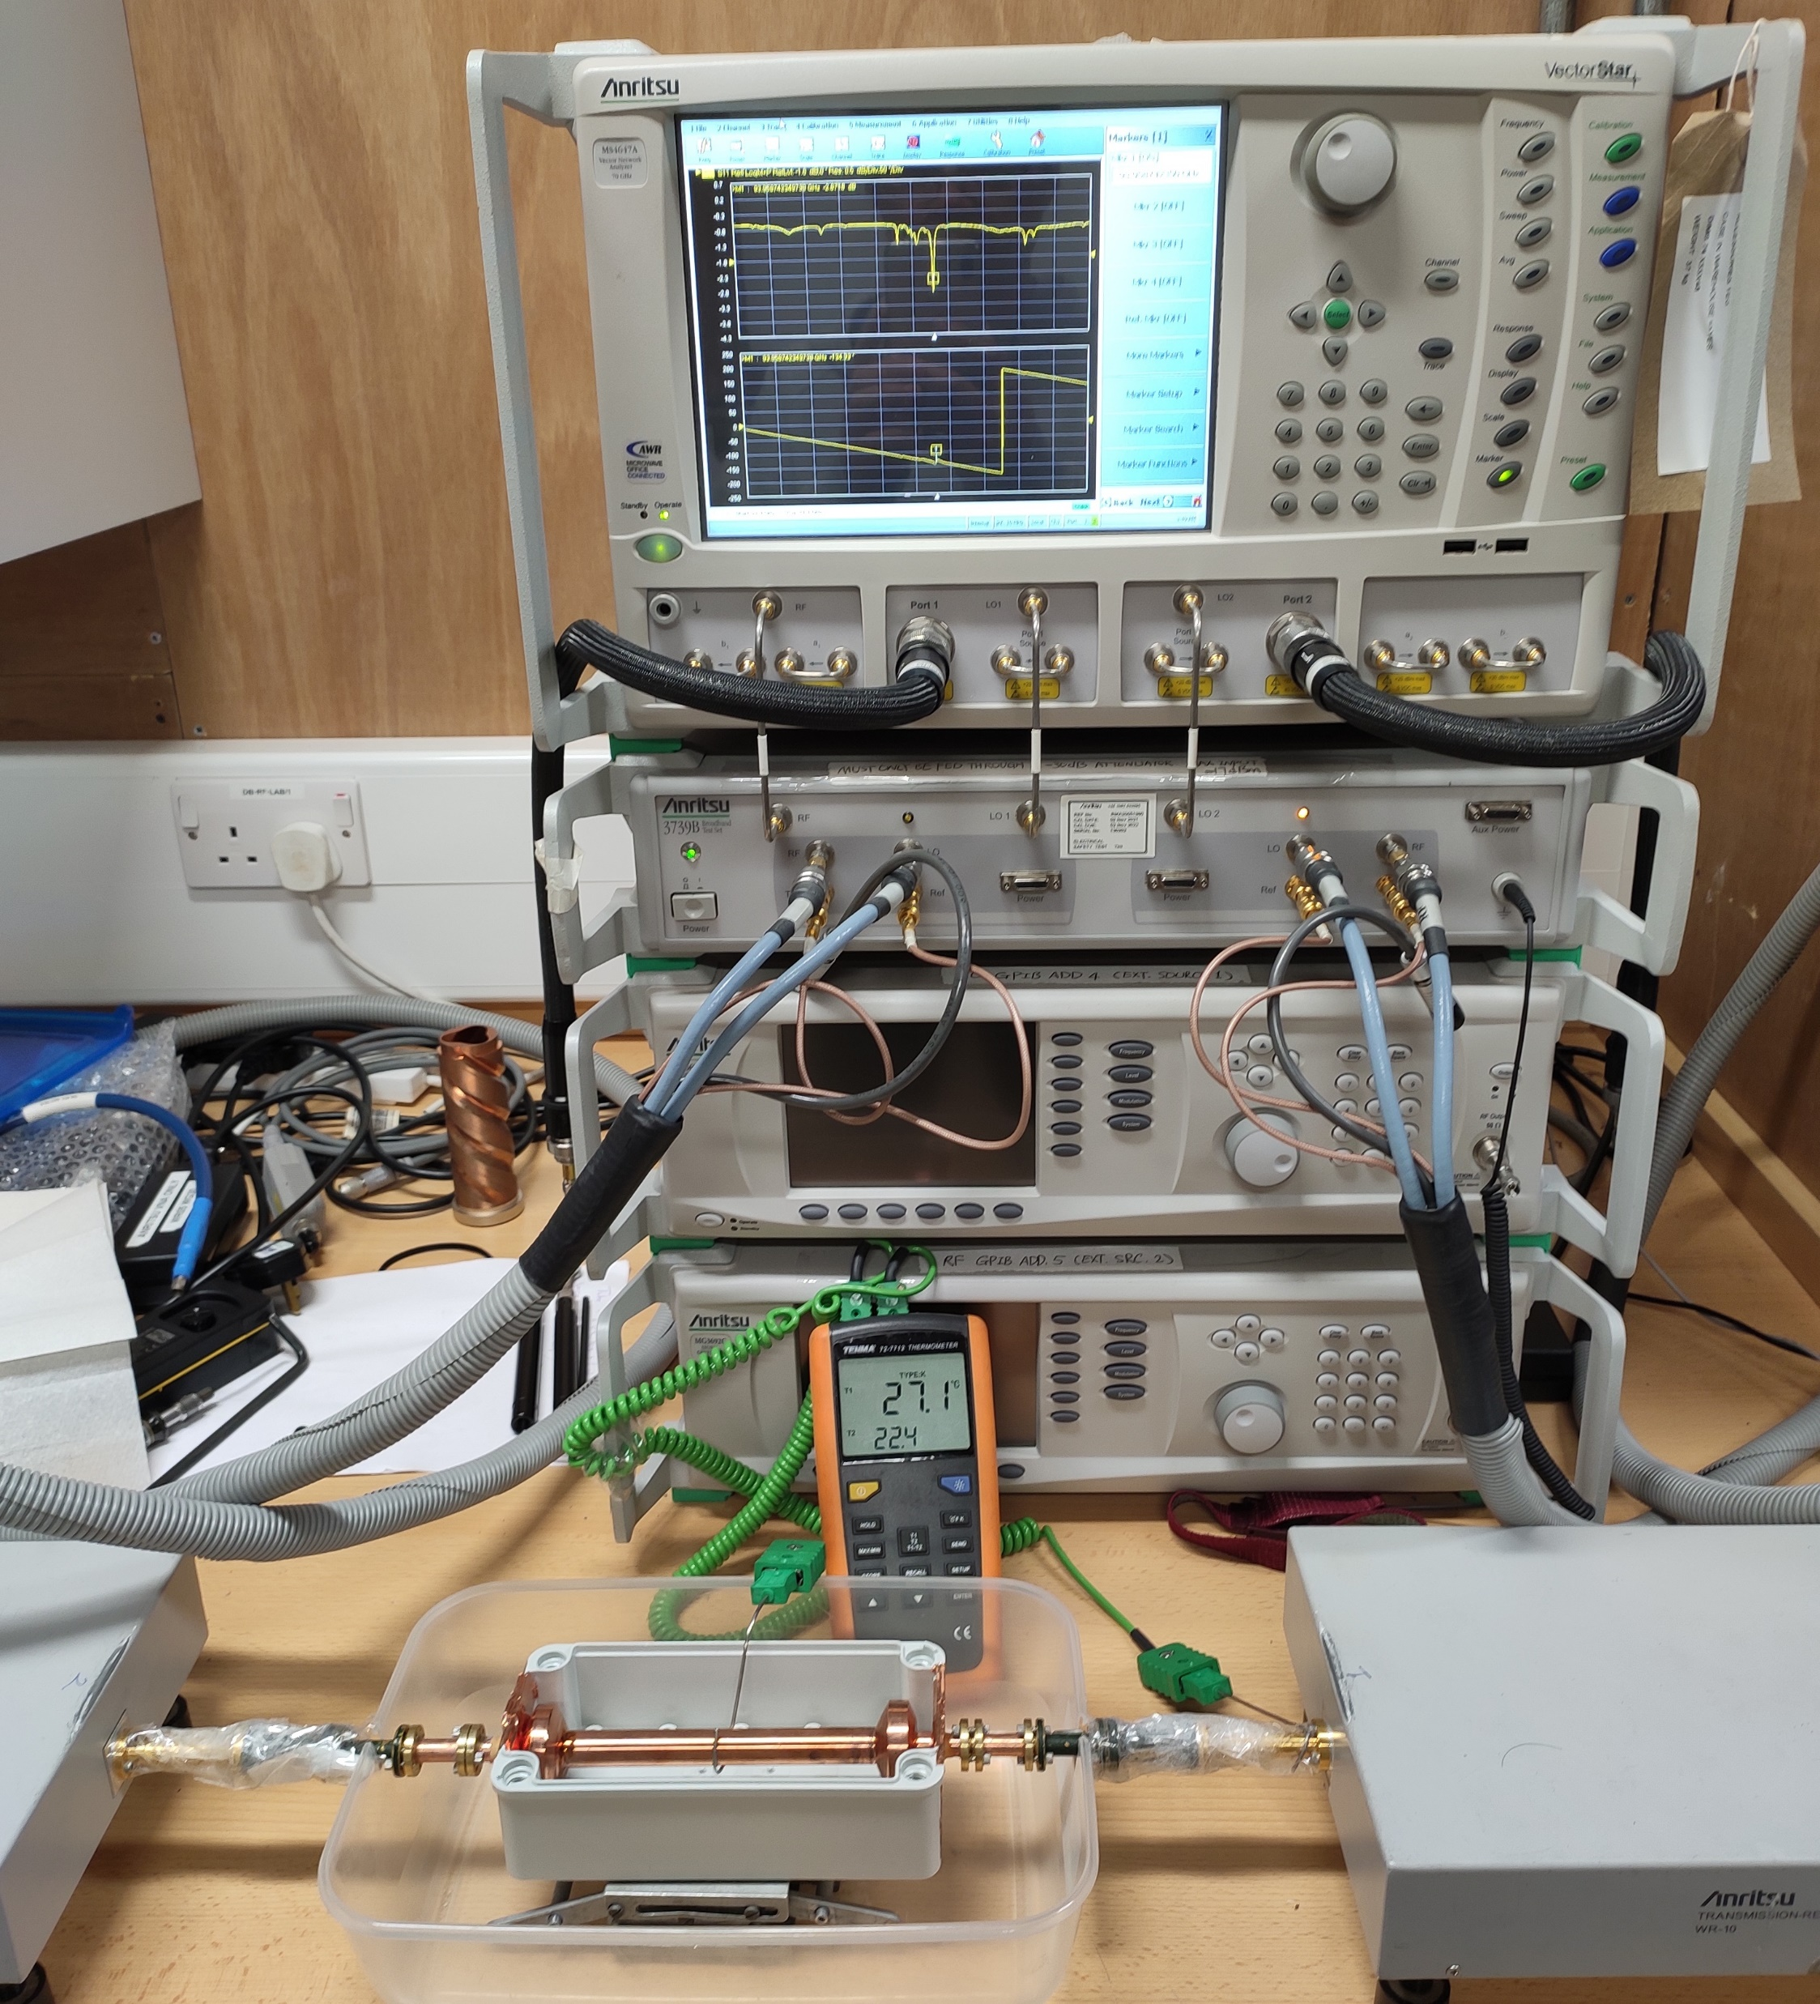
W-band mmWU

Slide 14

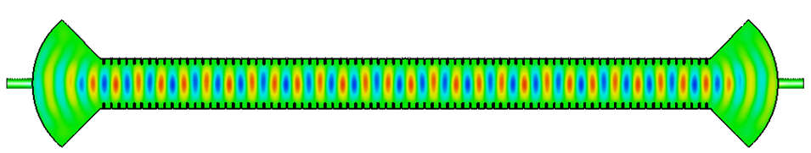
FEL Experimental setup
High-power AMP
Phase shifter
Spectrometer
Signal generator
Pre-amplifier
Chiller
Electron gun
Modulator
Linacs
MU
Seed laser
Seeded coherent harmonic generation (SCHG) setup
Self-Amplified Spontaneous Emission (SASE) can be achieved by cascading multiple MU sections
[12] Sami Tantawi, Phys. Rev. Lett., 112(16), 164802, 2014

Slide 15
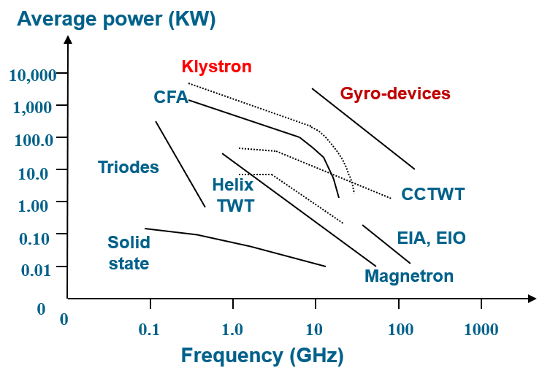
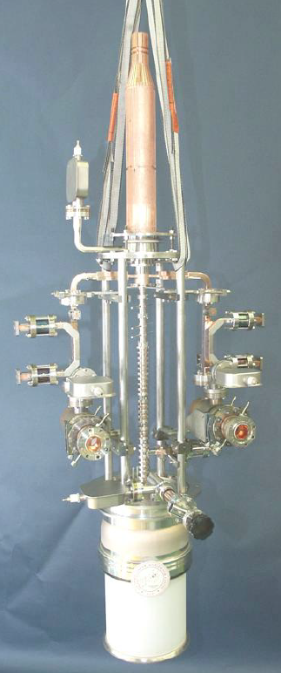
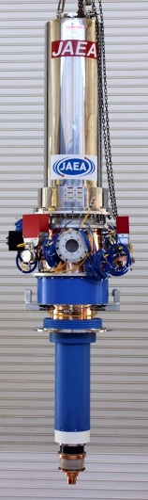
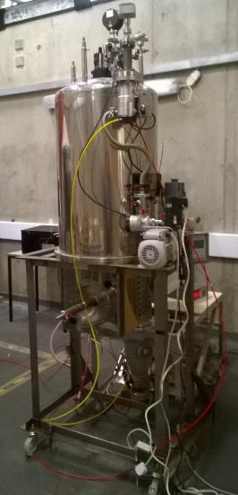
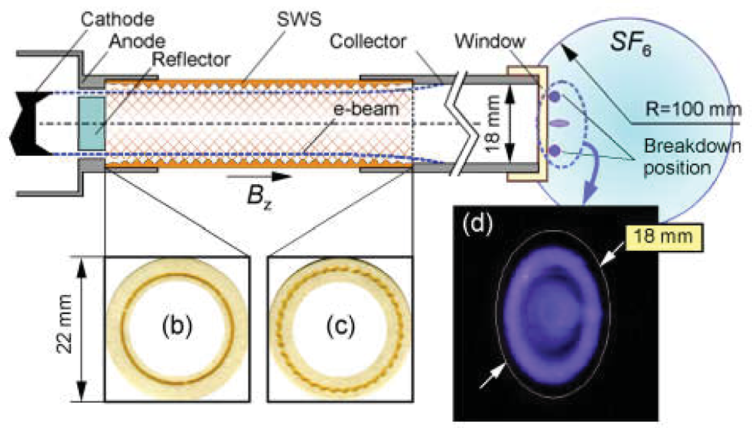
Driving sources
SLAC
12GHz,
75 MW,
1.6 µs @120 Hz, Eff. 55%.
Japan
170GHz,
1 MW, CW,
Eff. 45%.
MBK
Frequency | Sources | Specifications
X-band | Klystron | 11.424 GHz, 75 MW, 55%, SLAC
Ka-band | Gyro-klystron | 30.0 GHz, 15 MW, 40%, IAP
 | CARM | 35.7 GHz, 30 MW, 10%, IAP
 | Gyrotron | 35.0 GHz, 250 MW, 10%, NRL
W-band | Gyrotron | 94.4 GHz, 5.6 MW, 23%, pulsed mode, IAP
D-band | Gyrotron | 170 GHz, 1 MW, 45%, CW, CPI, KIT, Japan, IAP
 | CARM | 250 GHz, 20 MW, 20%, NRL
Strathclyde
90GHz, ~10 MW, ~150ns, single shot, Eff. ~4%. (2D SWS)
60MW@36GHz
IAP, Russia
90GHz, 150MW, ~1ns, eff. 13%, IAP, Russia
Notes:
The oscillator can be used when the beam energy is large. For a low beam energy, amplifiers are preferred.

Slide 16
Conclusion
Millimetre-wave undulator enables
  X-FELs using the 250MeV FEBE beam at Daresbury Lab
  The MW-level millimetre-wave source developed for the MU can be used for high-gradient accelerator research
  Enhances the search for axion-like-particles (ALPs) by increasing the event rate of the detection system
[1] E. Nanni, SLAC, HG 2021.
[2] G. Linde, IEEE Trans. Aerospace and Electronic Systems, 44(3), pp. 1102-1117, 2008.
[3] M. A. K. Othman, et. al, Appl. Phys. Lett. 117, 073502 (2020).
[4] L.M. Capparelli, Physics of the Dark Universe, 12 (37-44), 2016.

Slide 17
I would like to thank the Science and Technology Facilities Council (STFC) U.K., Cockcroft Phase 4 grant ST/V001612/1 for supporting this research.
Thank you for attention!
I’d be happy to answer any questions

