Slide 1



A high-k mm-wave binormal scattering diagnostic for MAST-U
Turbulent Dynamics of
Tokamak Plasmas
(TDoTP)
D. C. Speirs*¹, K. Ronald¹, A. D. R. Phelps¹, R. Vann², P. G. Huggard³, H. Wang³, V. H. Hall-Chen^{4,5} and A. Field⁵
¹Department of Physics, SUPA, University of Strathclyde, Glasgow, G4 0NG, Scotland, U.K.
²York Plasma Institute, Department of Physics, University of York, Heslington, York, YO10 5DD, U.K.
³Millimetre Wave Technology Group, STFC, RAL Space, OX11 0QX, UK
⁴Rudolf Peierls Centre for Theoretical Physics, University of Oxford, Oxford OX1 3NP, U.K.
⁵CCFE, Culham Science Centre, Abingdon OX14 3DB, U.K.
*email: david.c.speirs@strath.ac.uk

Slide 2
Motivating Physics: Cross-scale turbulence coupling
Spherical aspect tokamaks benefit from enhanced confinement
Believed to be associated with flows disrupting ion scale
Ion scale simulations (in isolation) have shown that finite β suppresses energy diffusivity by ion scale turbulence
Isolated electron scale simulations appear to be weakly affected by β on their own
Cross scale simulations show:
  Substantial suppression of energy diffusivity by electron scale fluctuations when ion scale turbulence is free to evolve (compared to electron scale predictions)
  When ion scale turbulence is suppressed – significant uplift in electron scale contribution to energy diffusivity AND
  Evidence that electron scale indirectly enhances the ion scale turbulence by disrupting sub –ion-scale flows
  Simulations suggest impacts can be substantial (near order of magnitude) in energy diffusivity at ion scales
    Limits the enhancement of confinement by flows
    Maeyama et al PRL, 2015, 114, 255002, 2015
    Maeyama at al Nucl. Fusion, 57, 066036, 2017

Slide 3
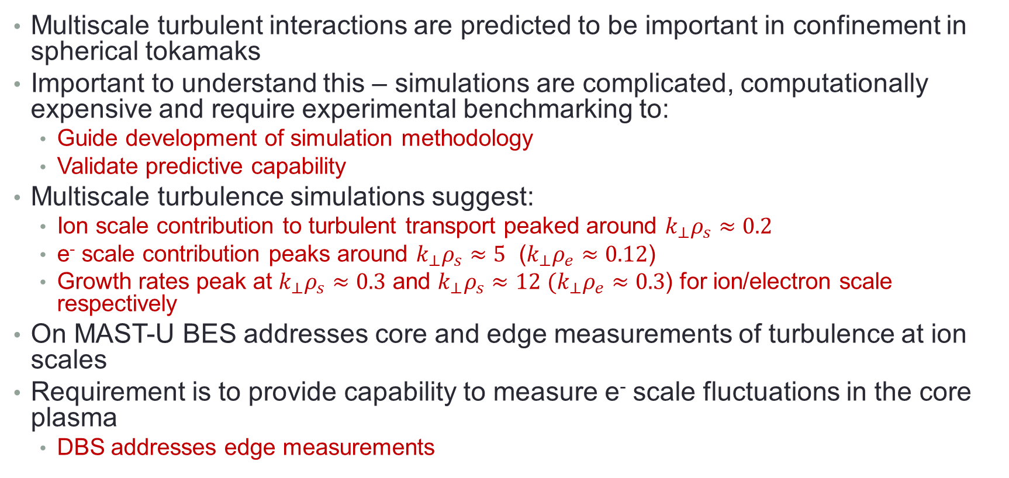
Objective: Cross Scale turbulence measurement
Multiscale turbulent interactions are predicted to be important in confinement in spherical tokamaks
Important to understand this – simulations are complicated, computationally expensive and require experimental benchmarking to:
  Guide development of simulation methodology
  Validate predictive capability
Multiscale turbulence simulations suggest:
  Ion scale contribution to turbulent transport peaked around $k_{⊥}ρ_{s}≈0.2$
  e⁻ scale contribution peaks around $k_{⊥}ρ_{s}≈5$ ($k_{⊥}ρ_{e}≈0.12$)
  Growth rates peak at $k_{⊥}ρ_{s}≈0.3$ and $k_{⊥}ρ_{s}≈12$ $(k_{⊥}ρ_{e}≈0.3$) for ion/electron scale respectively
On MAST-U BES addresses core and edge measurements of turbulence at ion scales
Requirement is to provide capability to measure e⁻ scale fluctuations in the core plasma
  DBS addresses edge measurements

Slide 4
High-k Turbulence Diagnostic - specifications
Multi-scale modelling requires the resolution of small scales in core
  Development focussed on k⊥ρ_{e} ∼ 0.1 → 0.4.
  Observation of possible anisotropy in Electron Temperature Gradient (ETG) driven turbulence partially motivates orientation / alignment of measurement.
    Radial - ion scale: Binormal - electron scale
    Require a diagnostic to measure Binormal-polarised electron-scale turbulence
Measurement Location
  Desirable to see turbulence throughout plasma
  Priority to equatorial plane
  ∼1/2 minor radius from the centre of the plasma out to the pedestal
    k⊥ρ_{e} range measurable at a given radius limited by receiving port aperture and access contraints.

Slide 5
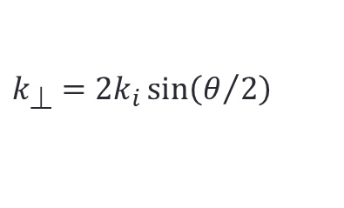





Proposed scheme – a high-k RF scattering diagnostic
  Can sense dn and dB (by x-polar detection)
  A previous high-k radial scattering diagnostic @280GHz was successfully installed on NSTX [1].
  Principle of operation - Bragg scattering:
$$ω_{s}=ω_{i}+ω_{}$$
$${\vec{k}}_{S}={\vec{k}}_{i}+{\vec{k}}_{⊥}$$
$$k_{⊥}=2k_{i}\sin\left(θ/2\right)$$
$${\vec{k}}_{S}$$
Assume ²H discharge on MAST-U with the parameters:
Plasma density = ~10²⁰ m⁻³
f_{pe} = 90GHz
T ~ 1keV
B ~ 0.5T
Implies ρ_{e} ∼ 0.02cm and ρ_{D} ∼ 1.3cm.
$${\vec{k}}_{⊥}$$
$${\vec{k}}_{i}$$
[1] D. R. Smith, E. Mazzucato, W. Lee et al. Review of Scientific Instruments 79, 123501 (2008); doi: 10.1063/1.3039415

Slide 6
Diagnostic operational parameters
Operating frequency of 376GHz
  Needs to be sufficiently high to avoid natural resonances in the plasma.
  Should be at a frequency avoiding harmonics of the MAST-U gyrotron EBW heating frequencies (28GHz and 34.8GHz).
k⊥ρ_{e} of at least ~0.35 resolvable at maximum scattering angle.
  Informed by theory of expected turbulence spectrum.
  Receiving window aperture limited at the frequency of operation.
Beam waist of 2 – 3 cm within the scattering region.
  Ensures sufficient wavenumber resolution, while providing good localisation of measurement and adequate signal-to-noise ratio.

Slide 7
CHASI - Collective High-k Adjustable-radius Scattering Instrument
Sub-system diagram with institutional contributions / responsibilities
376GHz source electronics / antenna
Focussing and adjustable launching optics carriage
Launching / receiving windows, flanges and mounts
Translatable / rotatable receiving optics carriage
376GHz heterodyne detection electronics
Multichannel digitisation and processing of data
Data archiving / integration with MAST-U data acquisition systems
Rutherford Appleton Laboratory
University of Strathclyde
University of York
Culham Centre for Fusion Energy
Overall project oversight

Slide 8
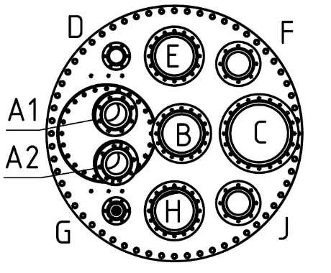
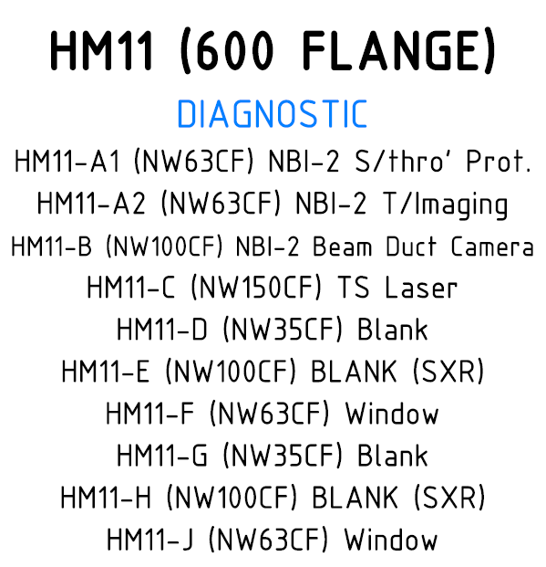
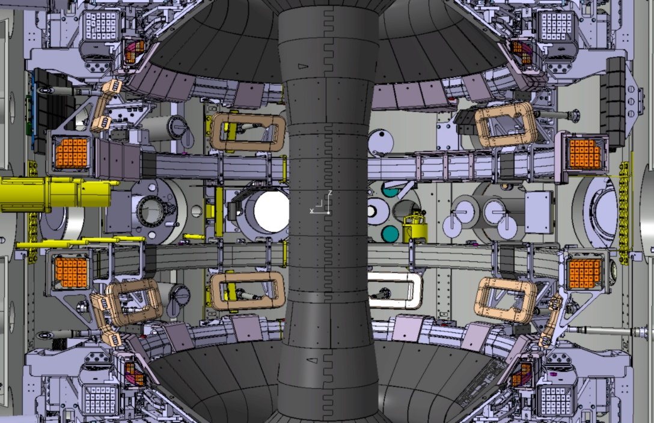
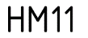
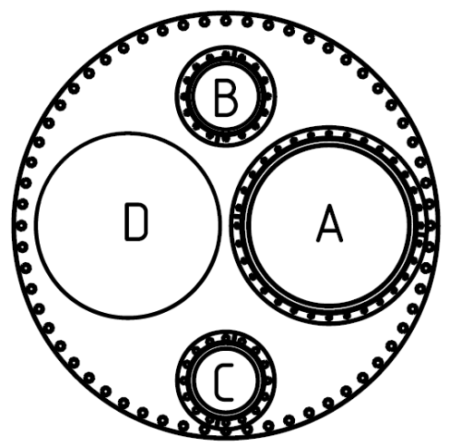
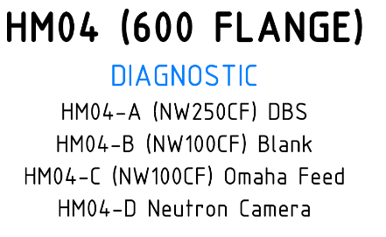
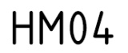
CDR Approved MAST-U installation configuration @376GHz
Launching
120mm diameter quartz window
290mm
Detection
Port sharing with high-k
Proposed receiving port aperture / window
250mm
Alternative equatorial ports have been identified – HM11 (sector 11, launching) and HM04 (sector 4, detection).
Reconfiguration required on HM04 for elliptical detection window / aperture – assuming relocation of HM04-A and replacement with a dual o-ring sealed 250mm x 290mm elliptical flange / window.
Launching / receiving antenna and optics mounted externally on port, with injection / egress of RF via low OH content fused-silica windows.
Increased frequency to 376GHz - extends k⊥ρ_{e} measurement range over reduced receiving window aperture.
8

Slide 9
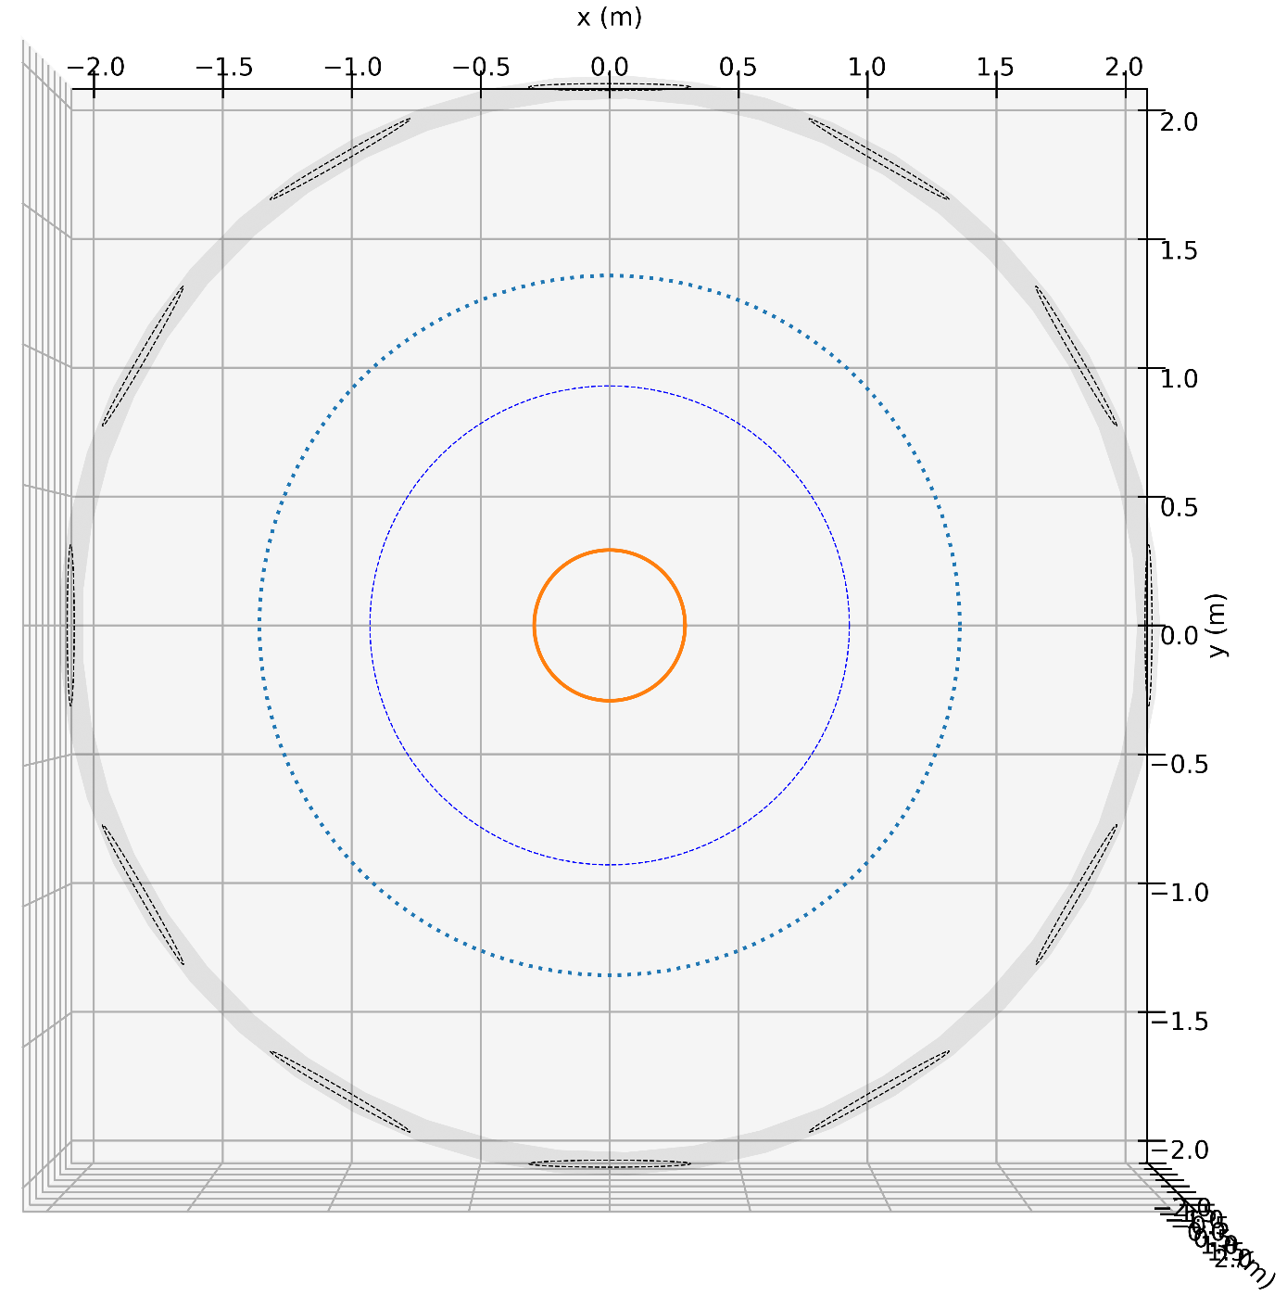
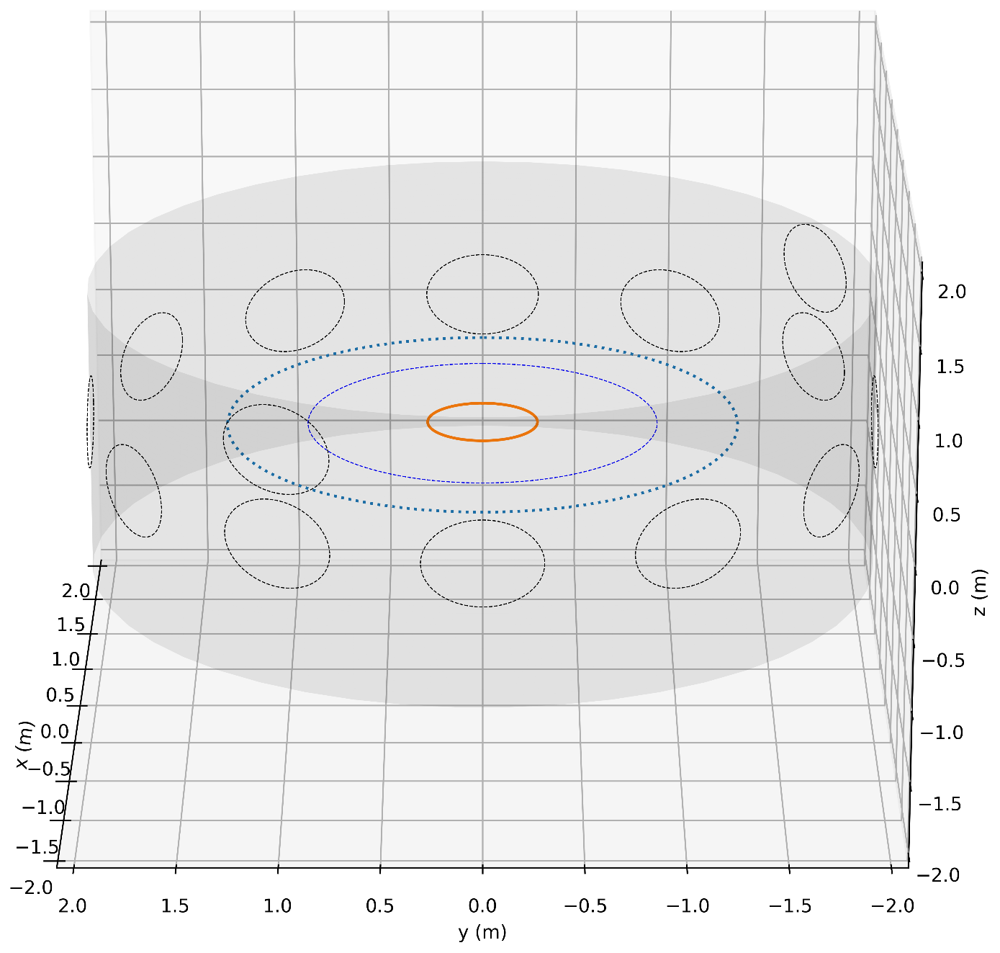
High-k scattering diagnostic relative to other diagnostics and NBI beams.
1
2
12
NBI-2 Imaging
High-k launch
3
High-k launch
1
11
12
2
High-k detect
11
3
High-k detect
SWIP-DBS
UCLA-DBS
10
4
4
UCLA-DBS
NBI-2
EBW heating beam
SWIP-DBS
9
5
10
8
7
6
SAMI
NBI-1
EBW heating beam
5
BES
9
EBW heating beam
SAMI
6
8
NBI-2
launch
7
NBI-1
launch
BES

Slide 10
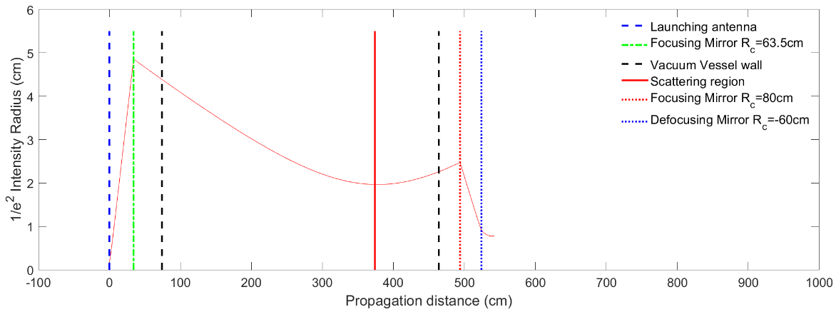
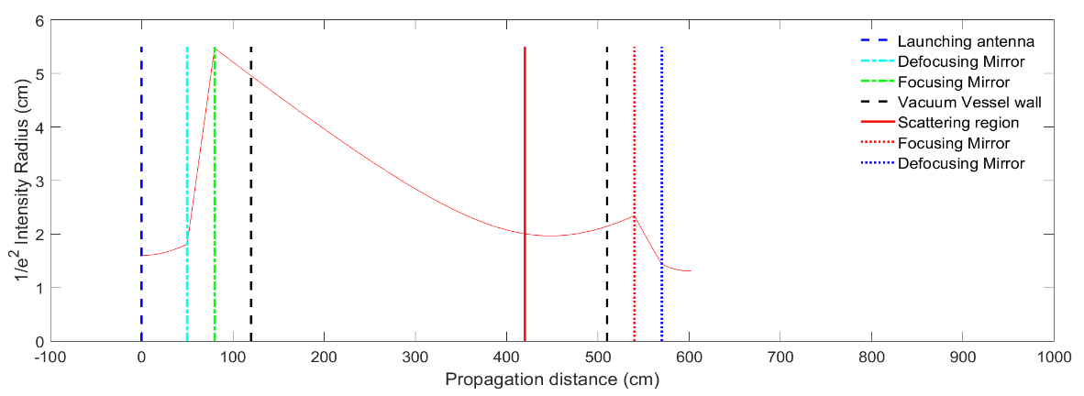
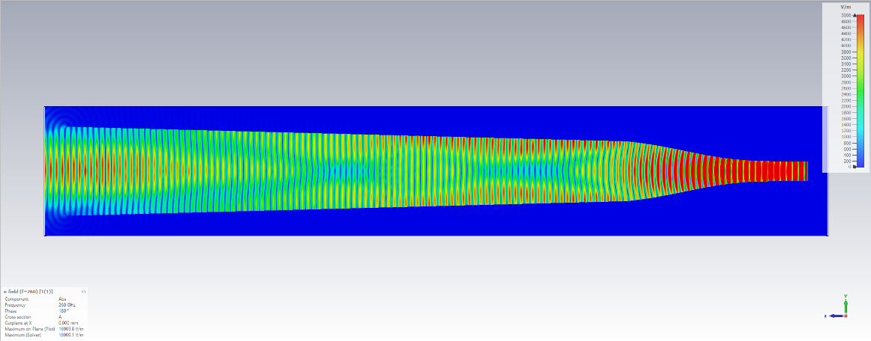
80
R_{c1} = -0.32m
Launching optics carriage
70
Polariser
60
50
z (cm)
40
R_{c2} = 0.635m
30
Proposed launching port
Location (120mm quartz window)
20
10
0.14m
Carriage can be rotated to avoid fouling of HE11-2
0
0
10
20
30
40
50
60
70
80
x (cm)
[1] L. Zhang et al., IEEE Transactions on Electron Devices, 64, 6, pp. 2665-2669 (2017)

Slide 11
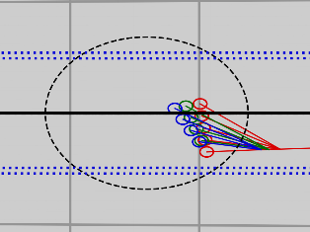
Detection optics carriage
Quote received from Culham Special Techniques for a ~15mm thick, 290mm x 250mm receiving window :-
Corning 7979 = £29,200
Delivery = 26 weeks
Corning 7980 = £4,200
Delivery = 12 weeks
⇒ Corning 7979 is the preferred material for the launching and receiving windows. Investigating “Heraeus Infrasil 302” as a cheaper alternative with similar low-loss.
~5-10% loss of incident power at resonant transmission peak
30
Vertically aligned linear detector array
~40% loss of incident power at resonant transmission peak
R_{c4} = -0.6m
20
y (cm)
10
Rotatable linear detector array carriage
R_{c3} = 0.8m
0
Linear translation of optics carriage (aligned with primary ray) to adjust focal point / intersection of scattered beams (~20cm max translation).
40
30
20
10
0
x (cm)
Linear translation track
Polariser
Scattered signal components
Rotatable linear detector array carriage
0.14m
Primary ray
Proposed receiving port aperture / window
Primary ray

Slide 12
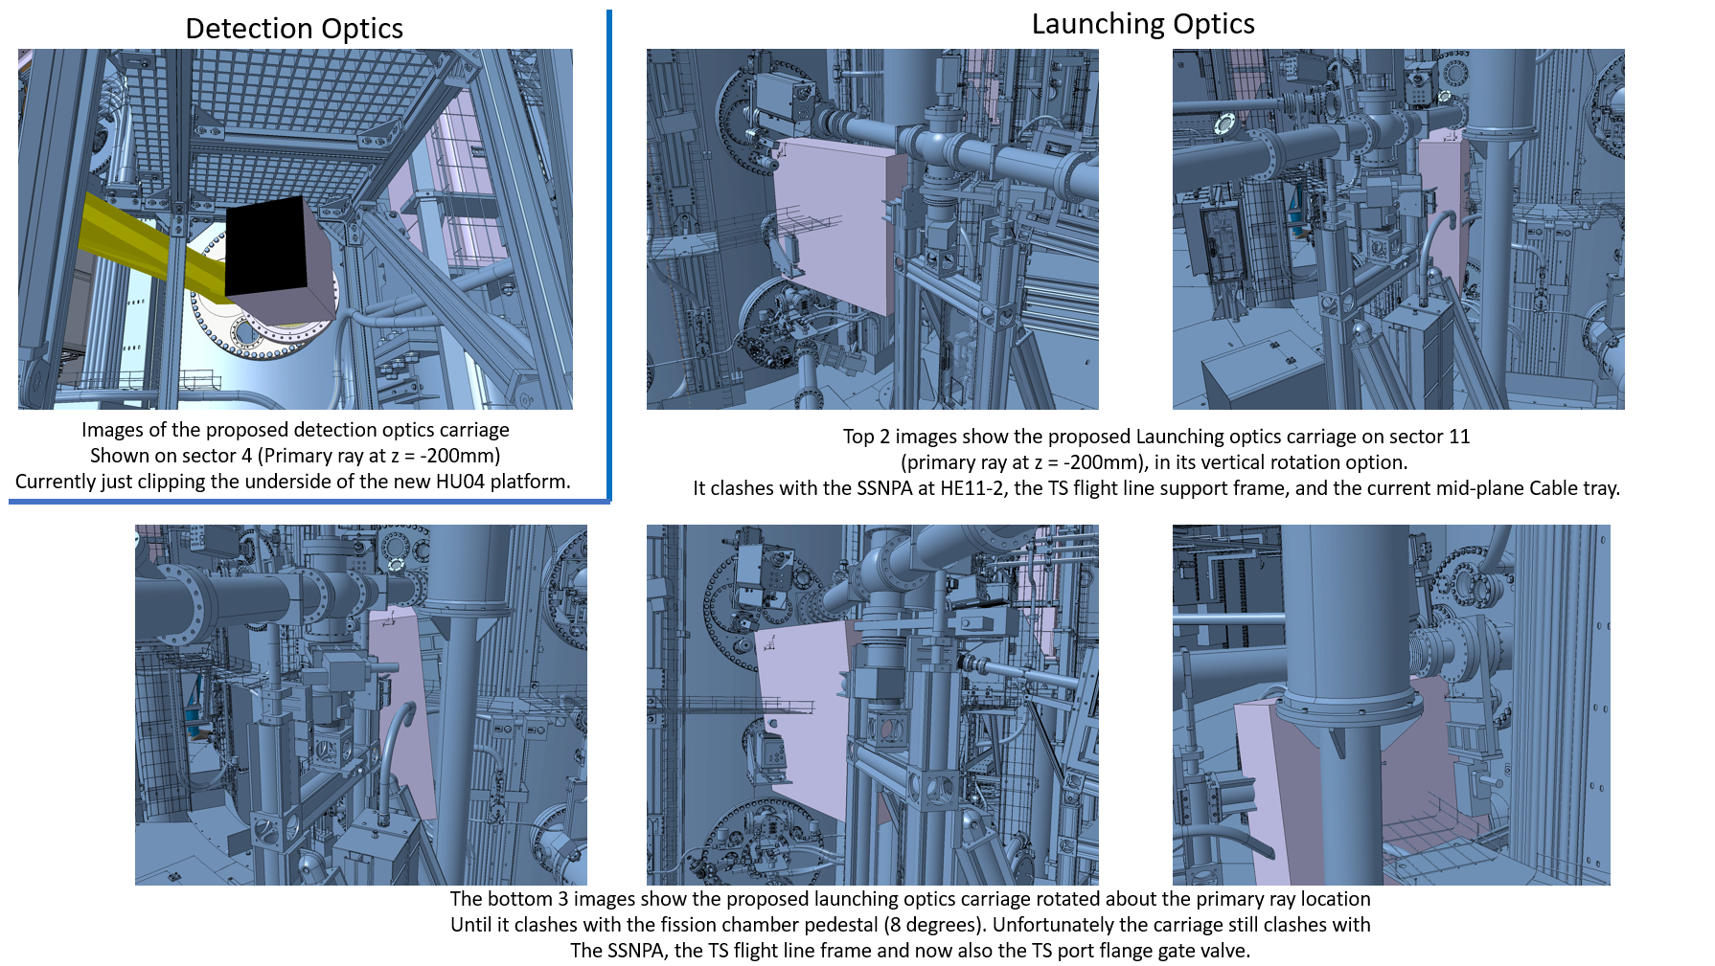
Illustrations of launching / detection boxes relative to ex-vessel components (thanks to Keith Hawkins, CCFE)

Slide 13
Solid state source and heterodyne receiving electronics
Builds on RAL-Space’s expertise in building high efficiency, high power frequency multipliers and low noise heterodyne receivers [1].
Exploits RAL-Space’s world class GaAs Schottky diode technology.
Source:
  Output of a commercial low phase noise oscillator at 31.3GHz is passed to a power amplifier and frequency tripled to 94GHz.
  Signal is amplified to a level of 2W, and then successively frequency doubled with efficiencies of 25% and 20%, to give a power of 100mW at 376GHz.
  Receiver
  On the receive side, a similar oscillator / amplifier / multiplier arrangement provides local oscillator signals at 185.8GHz for a 6 pixel subharmonic mixer array.
  Scattered signals from the plasma enter the feedhorns and are down converted in the mixers to an intermediate frequency of 4.4GHz, then amplified and bandpass filtered.
  A second stage performs down-conversion to baseband using a commercial IQ mixer.
[1] B. M. Courtier et al., Geophysical Res. Lett, https://doi.org/10.1029/2021GL096475 (2022)

Slide 14
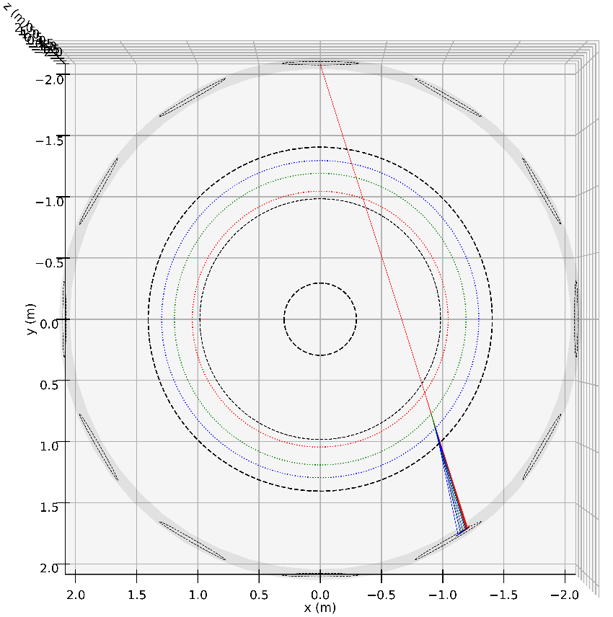
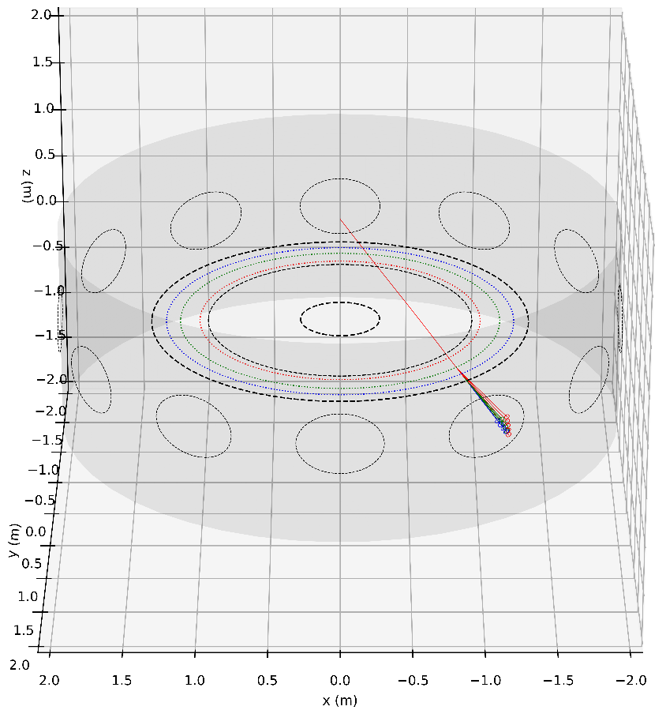
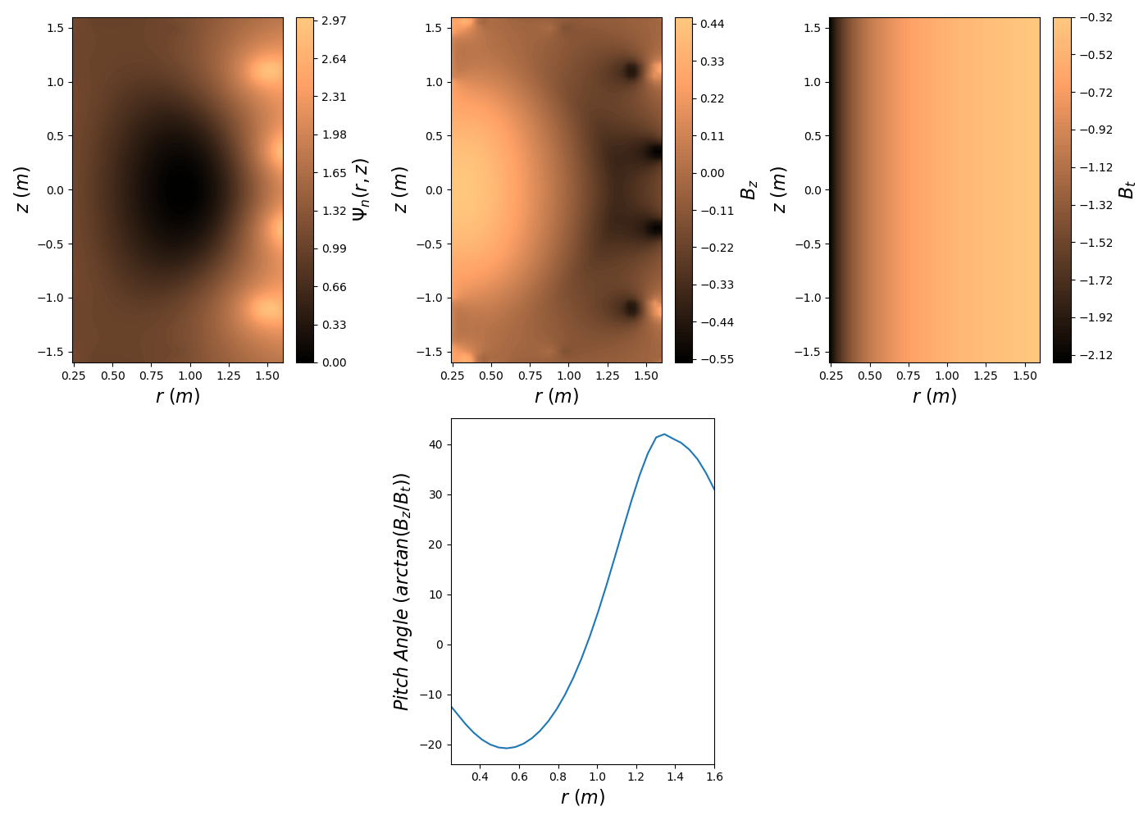
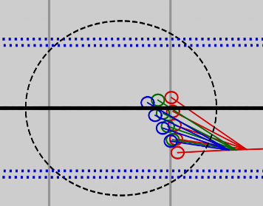
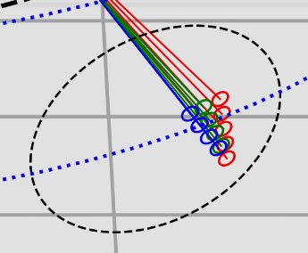
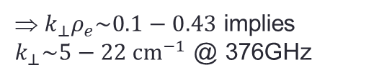
Scotty [1] beam-tracing calculations of primary and scattered ray paths @ 376GHz on MAST-U (sample equilibrium-1)
HM11
HM04
Magnetic field pitch angle as a function of radius, highlighting scattering locations as colour-coded intersection points.
HM04
Maximum k⊥ρ_{e} resolvable for each R_{scatt} :
k⊥ρ_{e} = 0.28 @ R_{scatt} = 1.0m
k⊥ρ_{e} = 0.36 @ R_{scatt} = 1.14m
k⊥ρ_{e} = 0.43 @ R_{scatt} = 1.24m
Scattering radii :
R_{scatt} = 1.0m
R_{scatt} = 1.14m
R_{scatt} = 1.24m
⇒ $k_{⊥}ρ_{e}\sim 0.1−0.43$ implies $k_{⊥}\sim 5−22 {cm}^{−1}$ @ 376GHz
[1] V H Hall-Chen, F I Parra, and J C Hillesheim, ‘Beam model of Doppler backscattering’, Plasma Phys. Control. Fusion 64 095002 (2022).

Slide 15
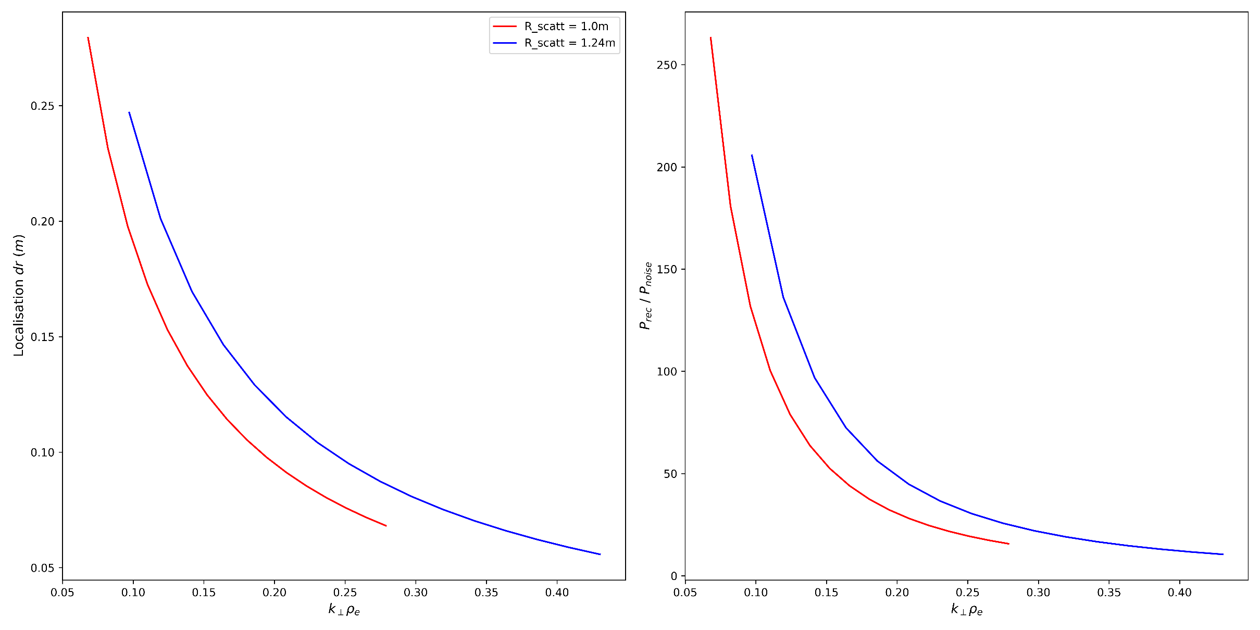
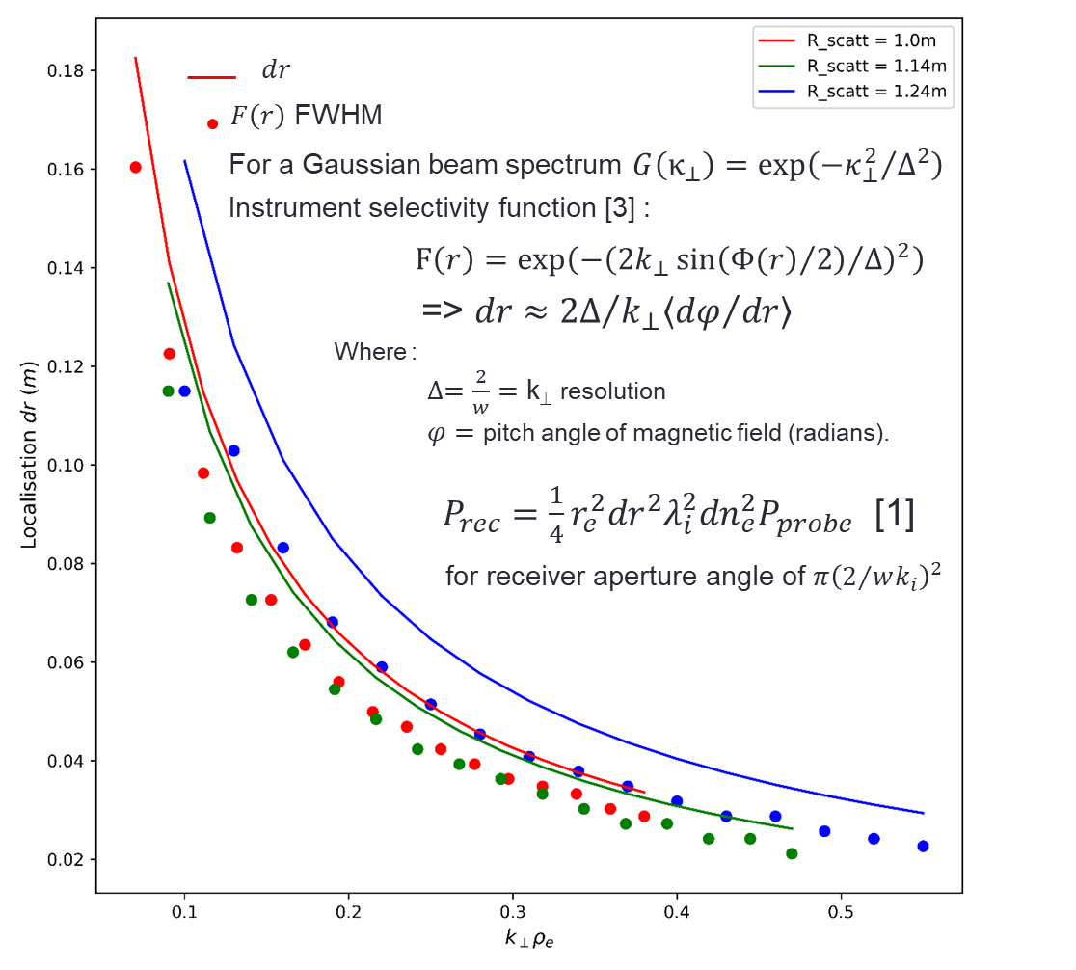
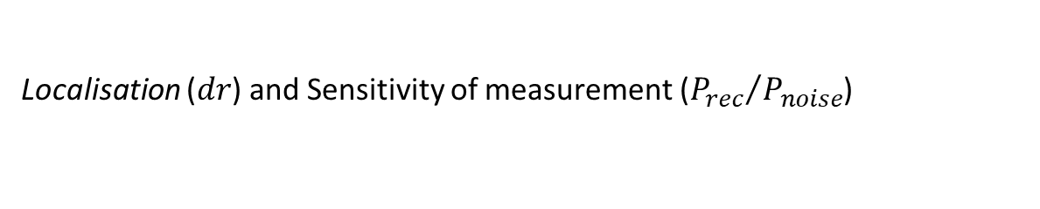
Scotty beam-tracing calculations of primary and scattered ray paths @ 376GHz on MAST-U (Sample equilibrium-1)
Localisation ($dr$) and Sensitivity of measurement (${P_{rec}}/{P_{noise}}$)
For dn_{e} / n_{e} = 4x10⁻⁶
P_{probe} = 12.5mW (-9dB of 100mW)
B_{noise} = 10MHz
P_{noise} = 1.38x10⁻¹³ W
[1]
[2]
(a)
(b)
[1] E. Mazzucato, Physics of Plasmas 10, 753 (2003); doi: 10.1063/1.1541018
[2] D. R. Smith, E. Mazzucato, W. Lee et al. Review of Scientific Instruments 79, 123501 (2008); doi: 10.1063/1.3039415

Slide 16
CHASI - Workplan
Year 1
Year 2
Year 3
Q1
Q2
Q3
Q4
Q1
Q2
Q3
Q4
Q1
Q2
Q3
Q4
CST Microwave Studio Simulation and optimisation of launching antenna
Fabrication of launching antenna
Laboratory testing of launching antenna
Laboratory assembly of launching / receiving optics carriages and optical components
Laboratory commissioning and testing of high-k scattering diagnostic
Installation and commissioning of high-k scattering diagnostic on MAST-U
First experimental measurements on MAST-U
Construct detailed CAD geometries of launching and receiving optics carriages and mounting hardware
Interpretation and analysis of results
Requisition optics mounts, translational / rotational stages, mirrors and low-loss fused silica launching / receiving windows
Integration with MAST-U data acquisition systems
Coordinate with BES and DBS diagnostic teams to ensure excellent potential for cross-scale measurements
Full Gaussian wave-optics simulations of beam launching / receiving optics
Engagement with turbulence theory and experimental communities to ensure effective future exploitation and impact
Design of mm-wave source and heterodyne detection electronics
Fabrication of mm-wave source and detection electronics
Design of multi-channel digitisation, processing and data acquisition system
Fabrication / programming of multi-channel acquisition and data processing system
CAD drawings produced of MAST-U launching / receiving port modifications and flange assemblies for window installation
Machining / fabrication of new port flange plates, window mounts and support structures
Installation of new equatorial port flanges with low-loss launching / receiving windows
Installation of ancillary mounting hardware for launching / receiving carriages
Fabrication of brackets and mounting hardware
MAST-U vessel access
Development of documentation
Publications and dissemination
Project management
Rutherford Appleton Laboratory
University of Strathclyde
University of York
Culham Centre for Fusion Energy

Slide 17
Experiment Plan
The diagnostic is anticipated to contribute to an integrated study of turbulence
  It is not expected to in-and-of itself require a focussed experiment
It is anticipated that the diagnostic can be available on all MAST-U shots
  Setup of the diagnostic to address alignment can be parasitic
  Diagnostic will be calibrated – merely requires to be tested over a range of equilibria repeated a reasonable number of times
  Beam tracing simulations used with equilibrium data to achieve predictive capability
  Should allow diagnostic to be pre-tuned for specific equilibria
For precision measurements during experiments
  Primary ray will be monitored with high attenuation to ensure optimum alignment.
  Binormal aligned detector array provides turbulence spectrum in one pulse.

Slide 18
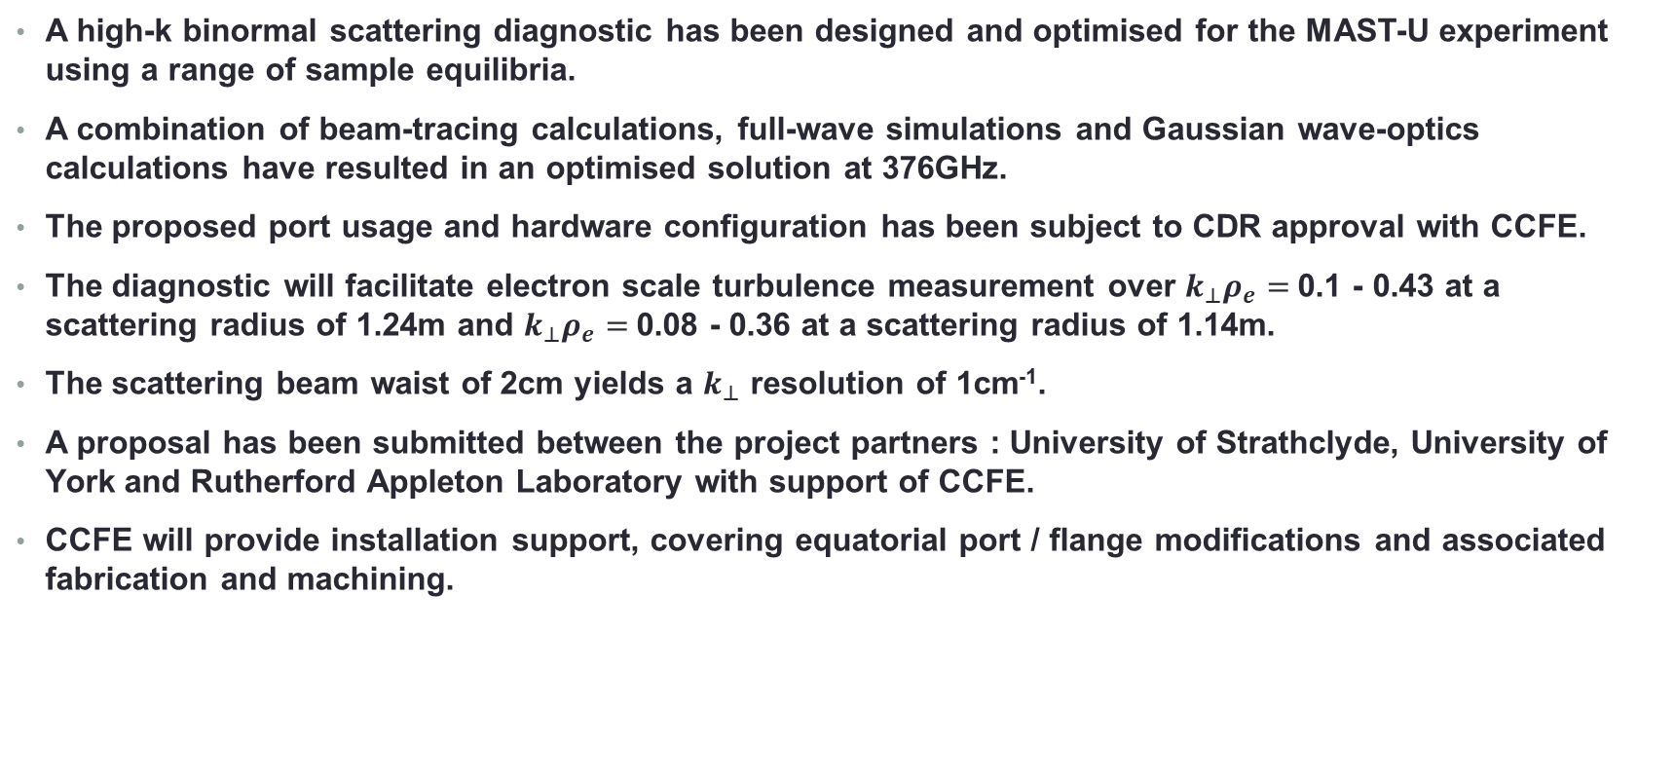
Summary
A high-k binormal scattering diagnostic has been designed and optimised for the MAST-U experiment using a range of sample equilibria.
A combination of beam-tracing calculations, full-wave simulations and Gaussian wave-optics calculations have resulted in an optimised solution at 376GHz.
The proposed port usage and hardware configuration has been subject to CDR approval with CCFE.
The diagnostic will facilitate electron scale turbulence measurement over $k_{⊥}ρ_{e}=$0.1 - 0.43 at a scattering radius of 1.24m and $k_{⊥}ρ_{e}=$0.08 - 0.36 at a scattering radius of 1.14m.
The scattering beam waist of 2cm yields a $k_{⊥}$ resolution of 1cm⁻¹.
A proposal has been submitted between the project partners : University of Strathclyde, University of York and Rutherford Appleton Laboratory with support of CCFE.
CCFE will provide installation support, covering equatorial port / flange modifications and associated fabrication and machining.

Slide 19
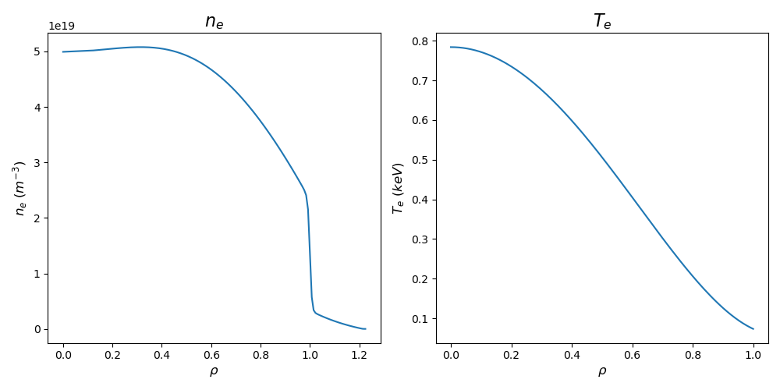
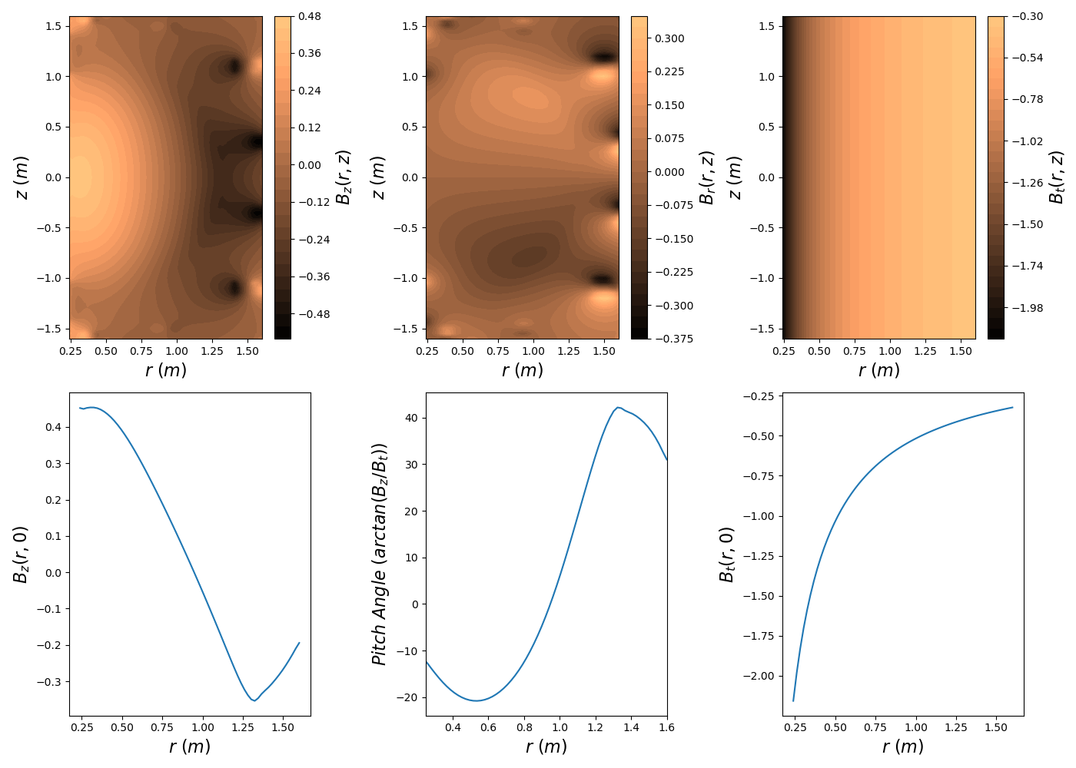
MAST-U Sample equilibrium-1

Slide 20
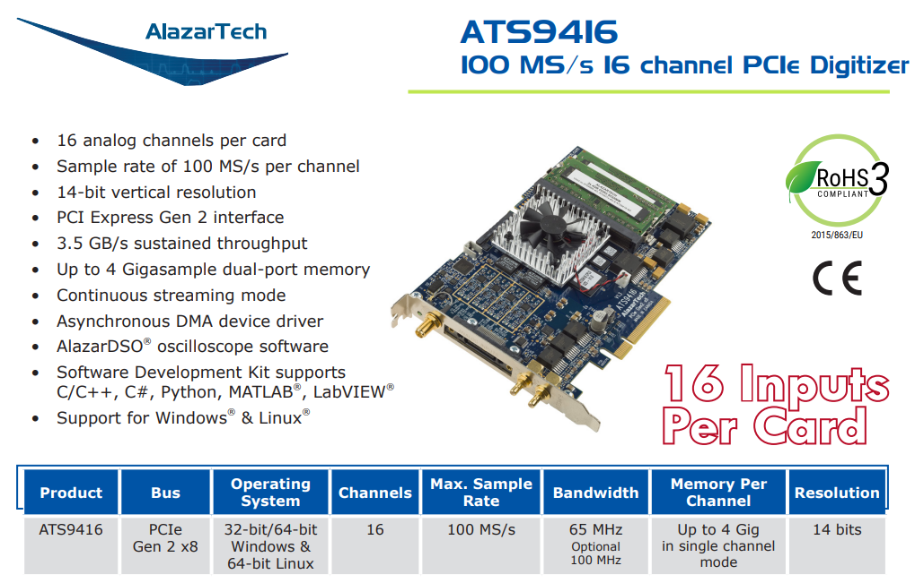
Digitisation / sampling configuration
  Specification
  5 channels
  ~15MHz bandwidth on around 5 channels at a time.
  5 second sampling time @50MSa/s, so 100MB/s per channel @ 14 bits
  ⇒ 2500MB per 5 second shot over all 5 channels.
  Hardware
  Alazartech ATS9416 digitizer solution identified.
  16 channels @ 100MS/s (14 bit) more than sufficient.
  Development kits for various programming languages.
  Potential to add additional channels later without upgrading DAQ.

