Slide 1


Multi-objective optimization techniques for RF structure design
NVEC 2022
Samuel Smith
13/09/2022
Supervisor: Prof. Graeme Burt
Start date: October 2020

Slide 2
Contents
Introduction to multi-objective optimisation
Optimisation 1: Optmisation of RF structures
Appropriate visualisation techniques and solution selection methods
Optimisation 2: Beam capture optimisation
Final selection and final design
Conclusions

Slide 3
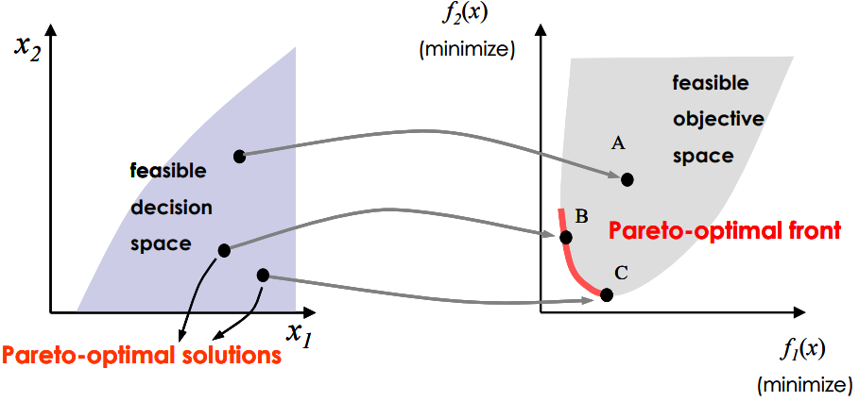
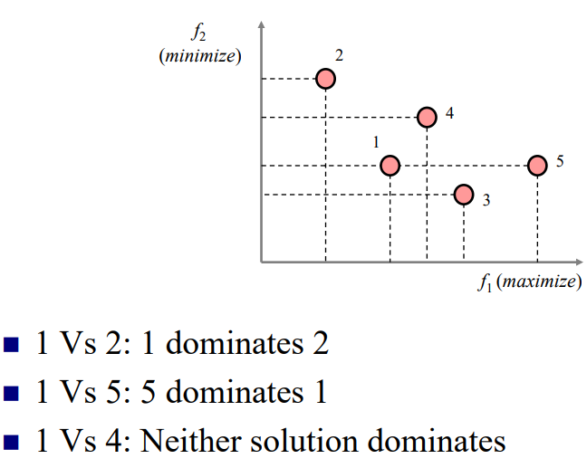
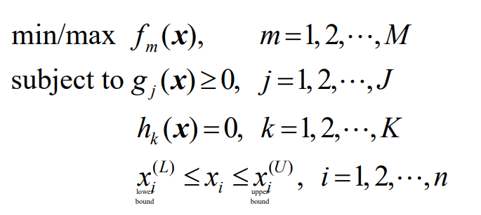
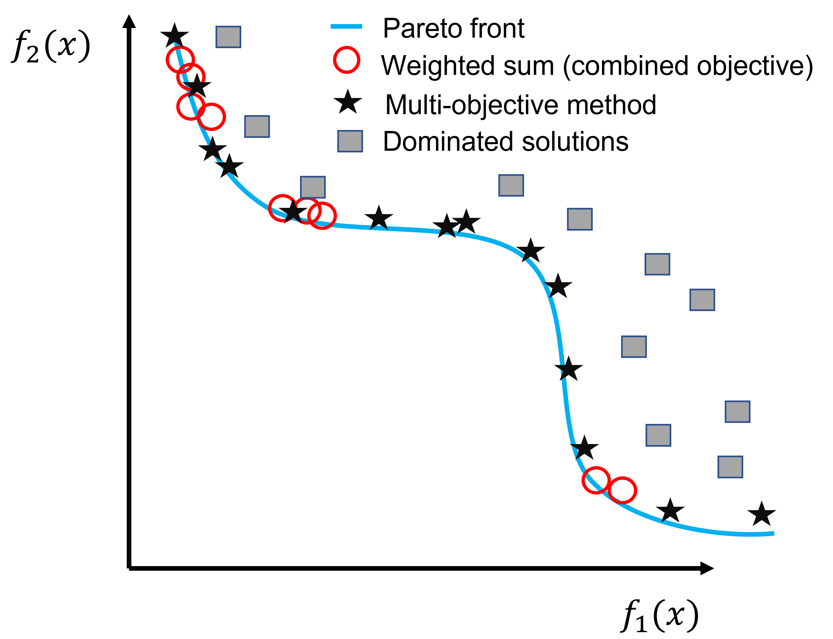
Introduction
MO methods are used when two or more conflicting objectives must be optimised simultaneously.
For a nontrivial multi-objective optimisation problem, no single solution exists that simultaneously optimizes each objective. In this case there exists a set of solutions (Pareto optimal) that define the best trade-off between competing objectives.
A solution is called nondominated or Pareto optimal if none of the objective functions can be improved in value without degrading some of the other objective values.
Typically, genetic algorithms are used for these problems. Inspired by biology – take a population of randomly generated candidate solutions and evolve them towards better solutions using the ideas of mutation, fitness and recombination.

Slide 4
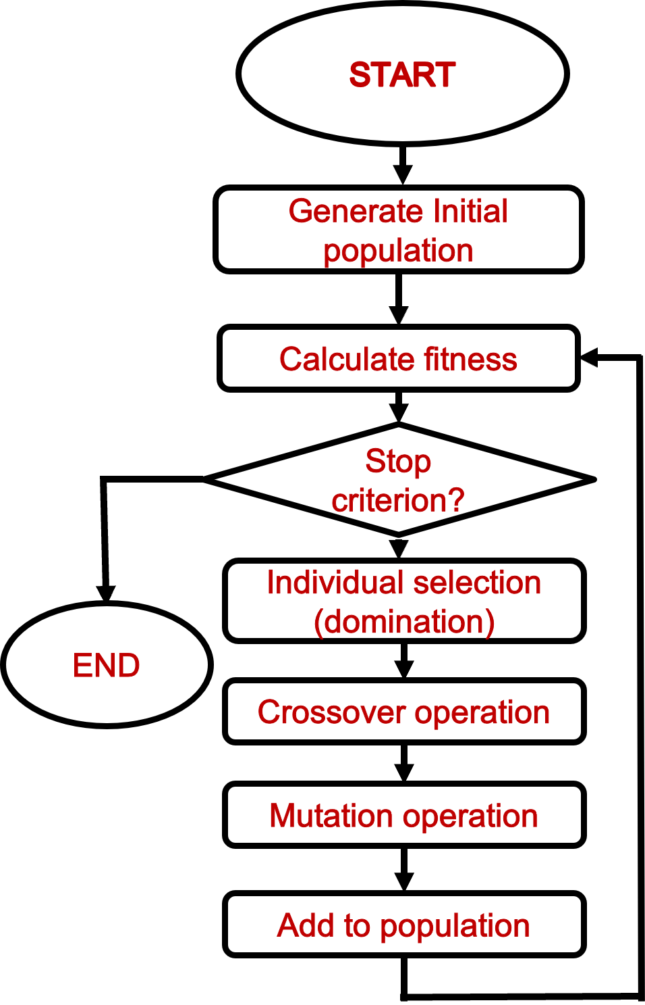
Genetic Algorithms
Example of a MO flow inspired by biology, optimisation continues until a certain number of generations has been completed, or a certain fitness is reached.

Slide 5
Multi-objective Optimisation and Accelerators
Other examples of MO optimisation applied to RF and beams:
Often in RF design we have conflicting objectives making these methods attractive. For example, when designing an RF accelerating cavity, we have conflicting objectives between maximizing the shunt impedance and minimizing the peak fields.
These methods have been applied to various problems in the accelerator field before – but typically for only two objectives.
Two optimisations are considered in this talk:
Terzić, Balša, et al. "Simultaneous optimization of the cavity heat load and trip rates in linacs using a genetic algorithm." Physical Review Special Topics-Accelerators and Beams 17.10 (2014): 101003.
Bazarov, Ivan V., and Charles K. Sinclair. "Multivariate optimization of a high brightness dc gun photoinjector." Physical Review Special Topics-Accelerators and Beams 8.3 (2005): 034202.
Feng, H., et al. "Proposed design and optimization of a higher harmonic cavity for ALS-U." Review of Scientific Instruments 91.1 (2020): 014712.
Luo, T., et al. "RF design of APEX2 two-cell continuous-wave normal conducting photoelectron gun cavity based on multi-objective genetic algorithm." Nuclear Instruments and Methods in Physics Research Section A: Accelerators, Spectrometers, Detectors and Associated Equipment 940 (2019): 12-18.
1 :
RF design of a C-band standing wave cavity
2 :
Maximizing beam capture from a thermionic cathode
Kranjčević, Marija, et al. "Multi-objective shape optimization of radio frequency cavities using an evolutionary algorithm." Nuclear Instruments and Methods in Physics Research Section A: Accelerators, Spectrometers, Detectors and Associated Equipment 920 (2019): 106-114.

Slide 6
Optimisation 1

Slide 7
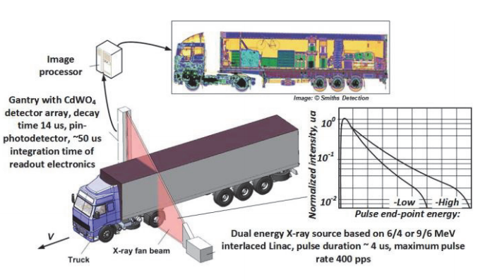
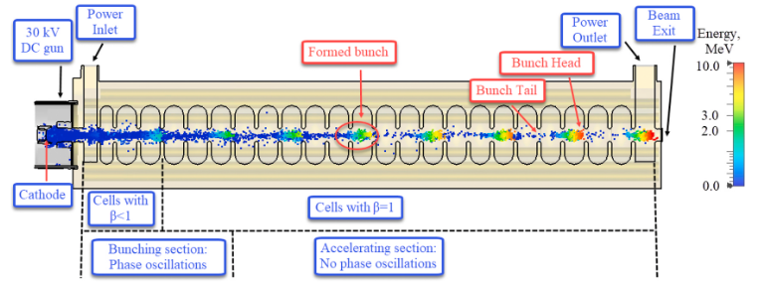
Background
Design of a low energy (2 Mev) linac for industrial applications.
Previous experience with a similar X-band (12 GHz) at Lancaster – now interested in C-band (5.7 GHz) to reduce tolerance costs.
Needs to be robust, reliable, stable and operate well below max operating conditions 50% - 70% (peak fields, heating etc.).
Shielding and weight considerations - small transverse size to minimize required shielding.
Compact design for potential mobility.
Arodzero, Anatoli, et al. "High speed, low dose, intelligent X-ray cargo inspection." 2015 IEEE Nuclear Science Symposium and Medical Imaging Conference (NSS/MIC). IEEE, 2015.
Requires optimisation to get the best RF efficiency and beam performance
Kutsaev, S. V., et al. "Linear accelerator for security, industrial and medical applications with rapid beam parameter variation." Radiation Physics and Chemistry 183 (2021): 109398.

Slide 8
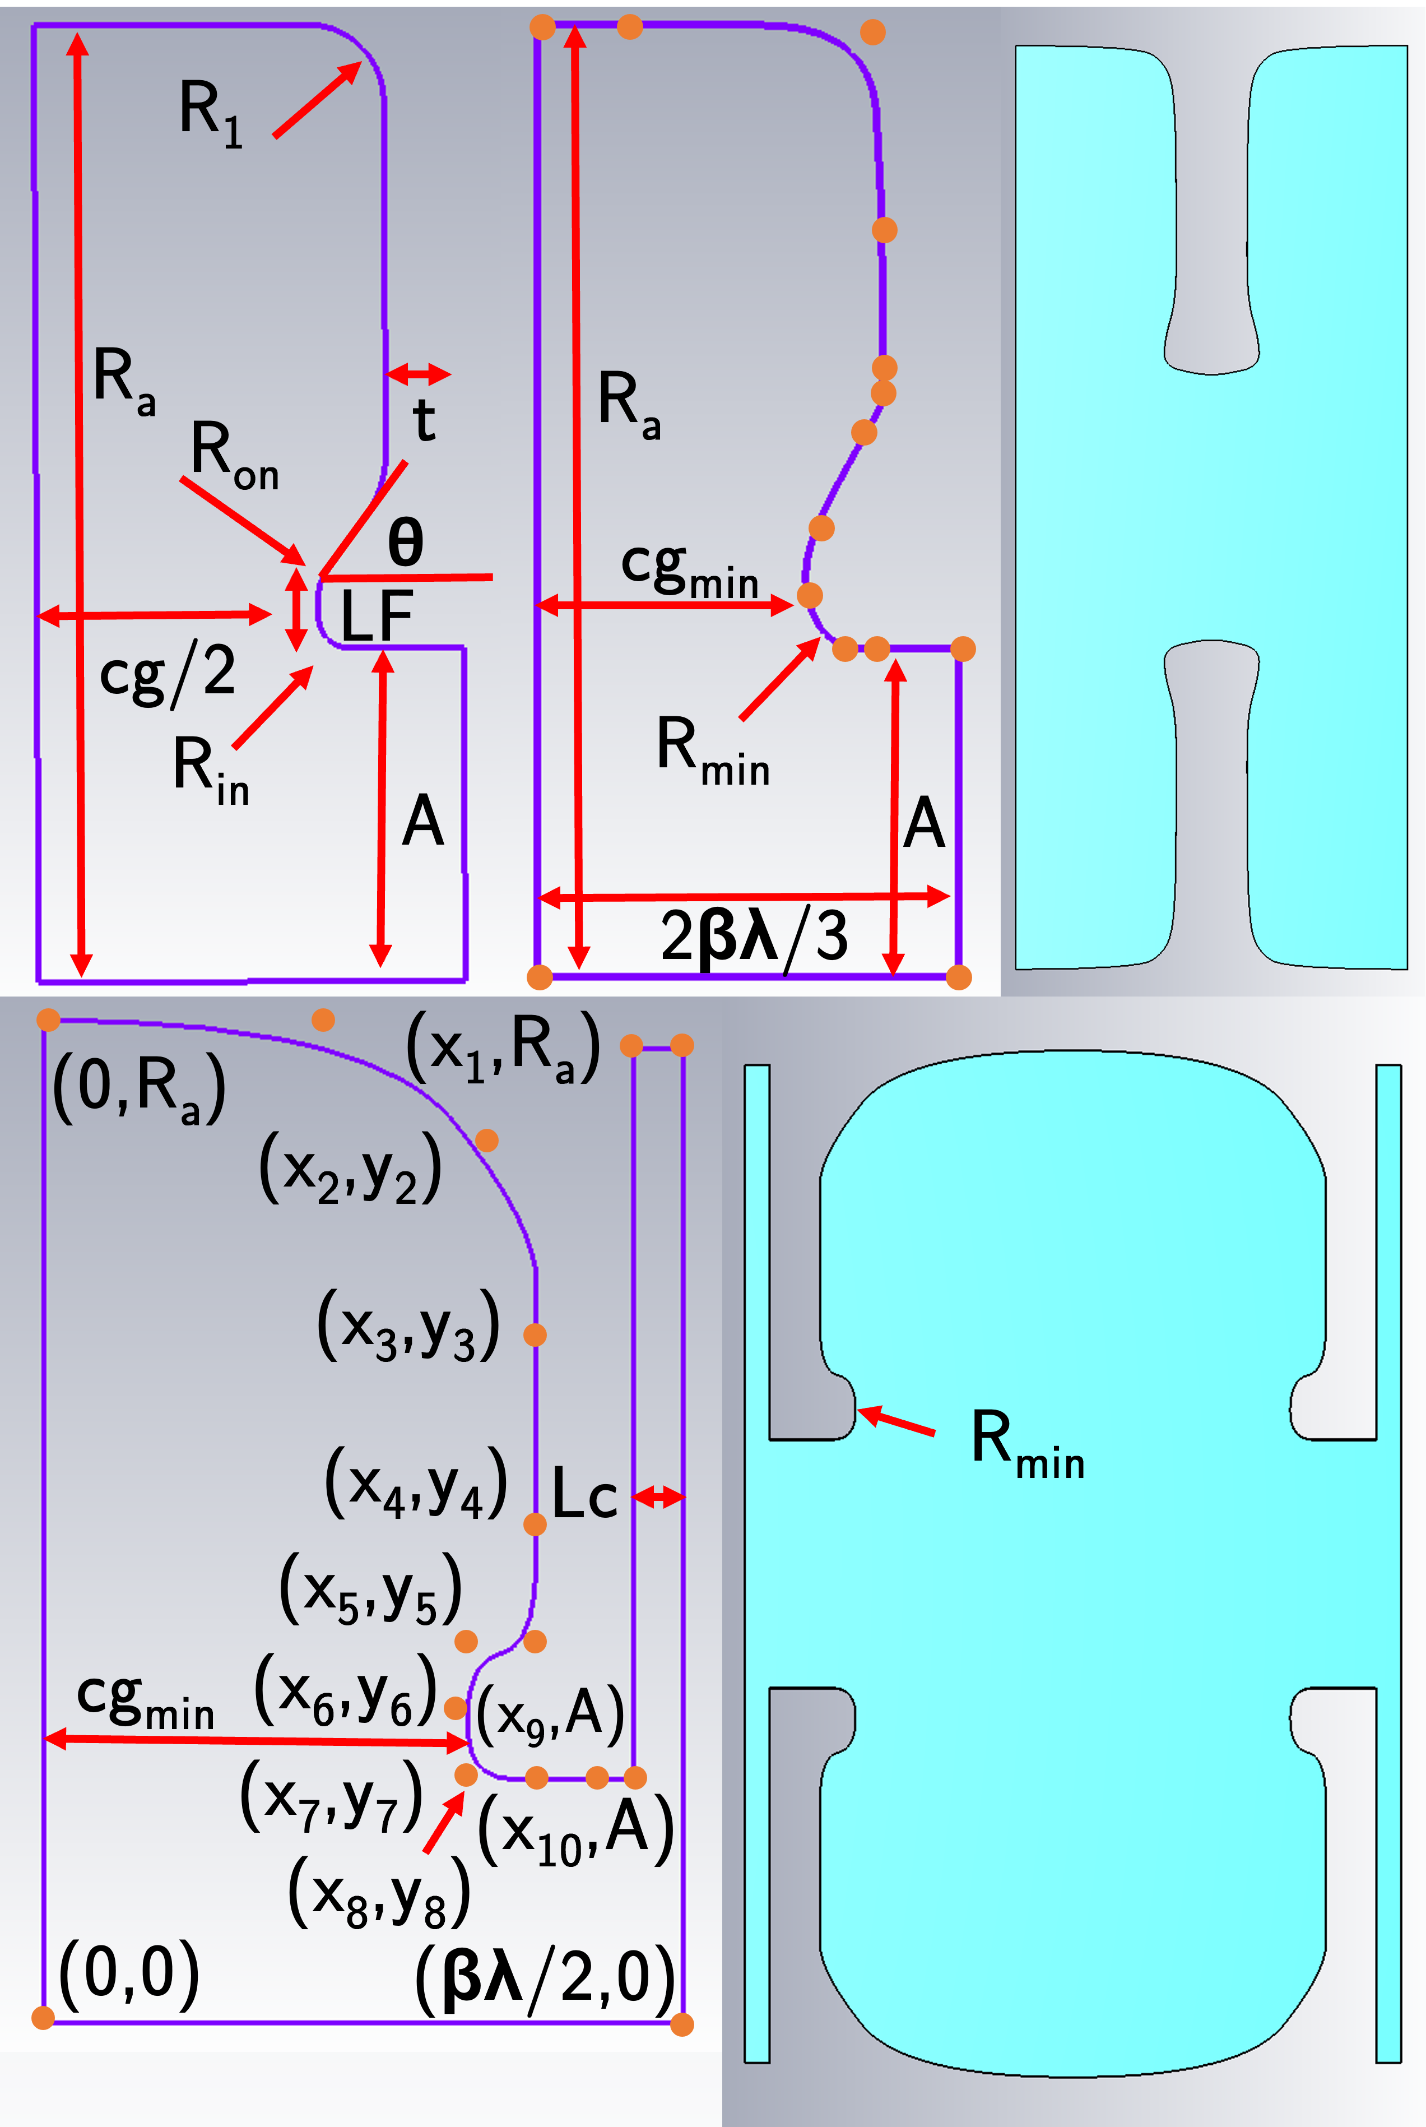
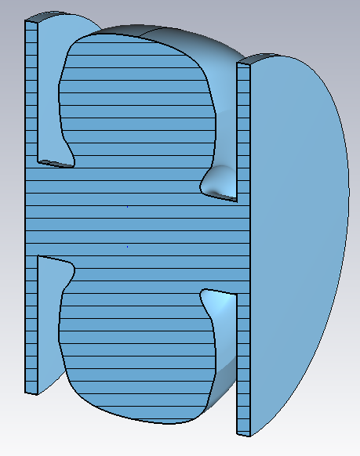
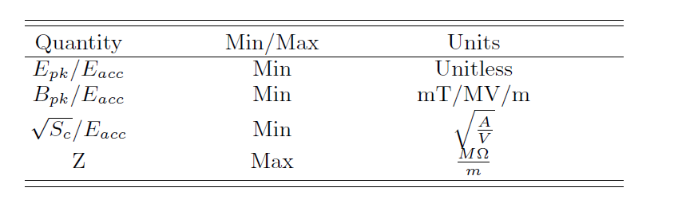
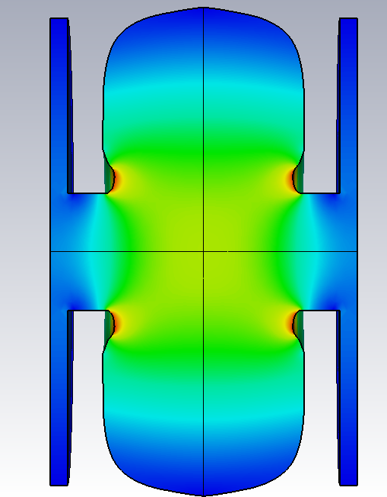
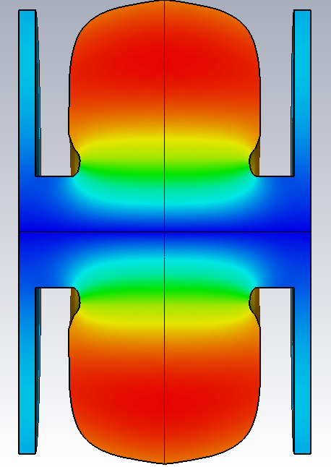
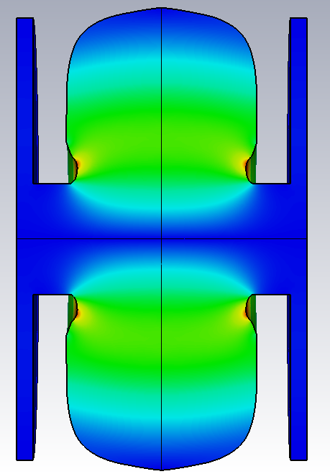

Modelling and Problem Setup
First step to design a single cell with optimal performance.
Geometry set-up using non-uniform rational basis splines (NURBS) and several control points, which has been shown to increase the shunt impedance by up to 15%.^{[1]}
Points were related back to minimum dimensions for manufacturing i.e nose cone radius and nose cone gap.
Inputs: positions of all control points and cavity radius.
Four objectives (peak fields and shunt impedance), with a constraint placed on the frequency.
$$Z= \frac{V_{a}^{2}}{P_{diss }∗L}$$
E
H
S_{c}
Nasr, M. H., and S. G. Tantawi. New Geometrical-Optimization Approach using Splines for Enhanced Accelerator Cavities' Performance. No. thpmk049. SLAC National Accelerator Lab., Menlo Park, CA (United States), 2018.

Slide 9
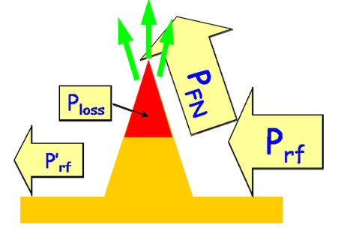


Note on S_{c}
The modified Poynting vector (S_{c}) is a local field quantity that has been shown to predict breakdown in several different cavity types.
$$S_{c}=Re\left\{\overline{S}\right\}+g_{c}∙Im\left\{\overline{S}\right\}$$
$$g_{c}=1/6$$
Combines the surface electric field and P/C (input power / circumference) into one quantity. It is the active power flow + a scaled reactive power flow, with a scaling factor of 1/6 typically used.
It should not exceed 5 W/μm² for a breakdown rate of 1 x10⁻⁶ at a pulse length of 200 ns.
S_{c}
Grudiev, Alexej, S. Calatroni, and W. Wuensch. "New local field quantity describing the high gradient limit of accelerating structures." Physical Review Special Topics-Accelerators and Beams 12.10 (2009): 102001.

Slide 10
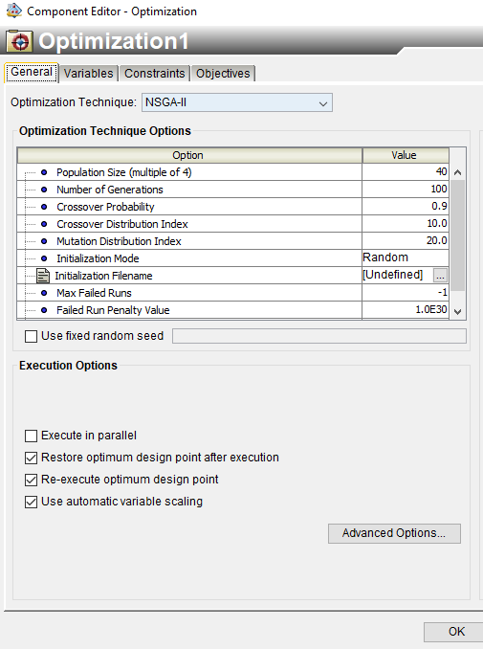
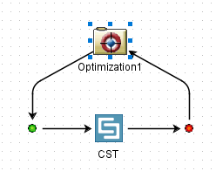
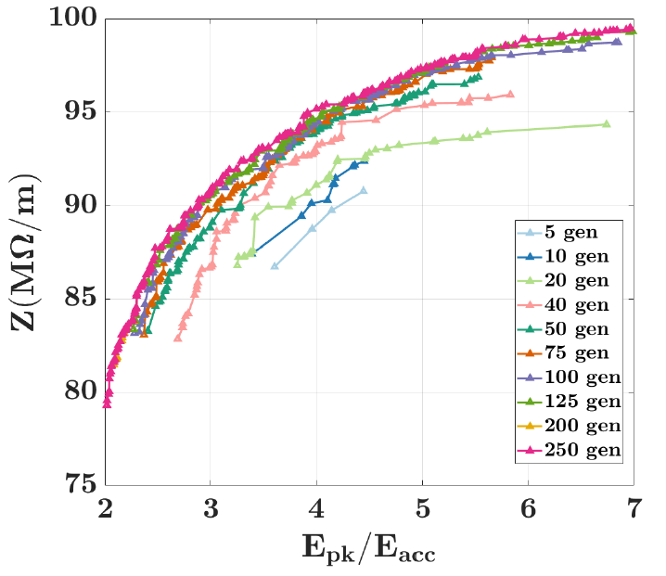

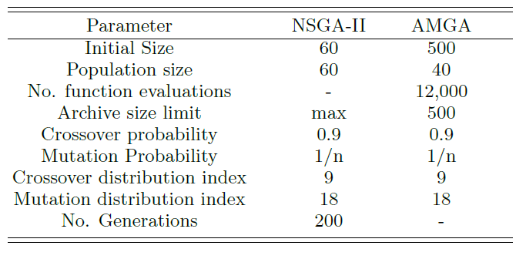
Simulation Approach
Electromagnetic simulations were performed in CST studio suite, with optimisations performed using Isight (open system for integrating design and simulation models).
Fast Non-dominated Sorting Genetic Algorithm (NSGA-II), and the Archive-Based Micro Genetic Algorthim (AMGA) used, which offers an improvement over NSGA-II by using an archive to maintain its search history.
Frequency handled by estimating the maximum and minimum cavity radius, and then setting a constraints for a small value of ε with ε = 20 MHz.
Convergence vs number of generations investigated for the Z vs. E_{pk}/E_{a} objectives.
https://www.3ds.com/products-services/simulia/products/isight-simulia-execution-engine/

Slide 11
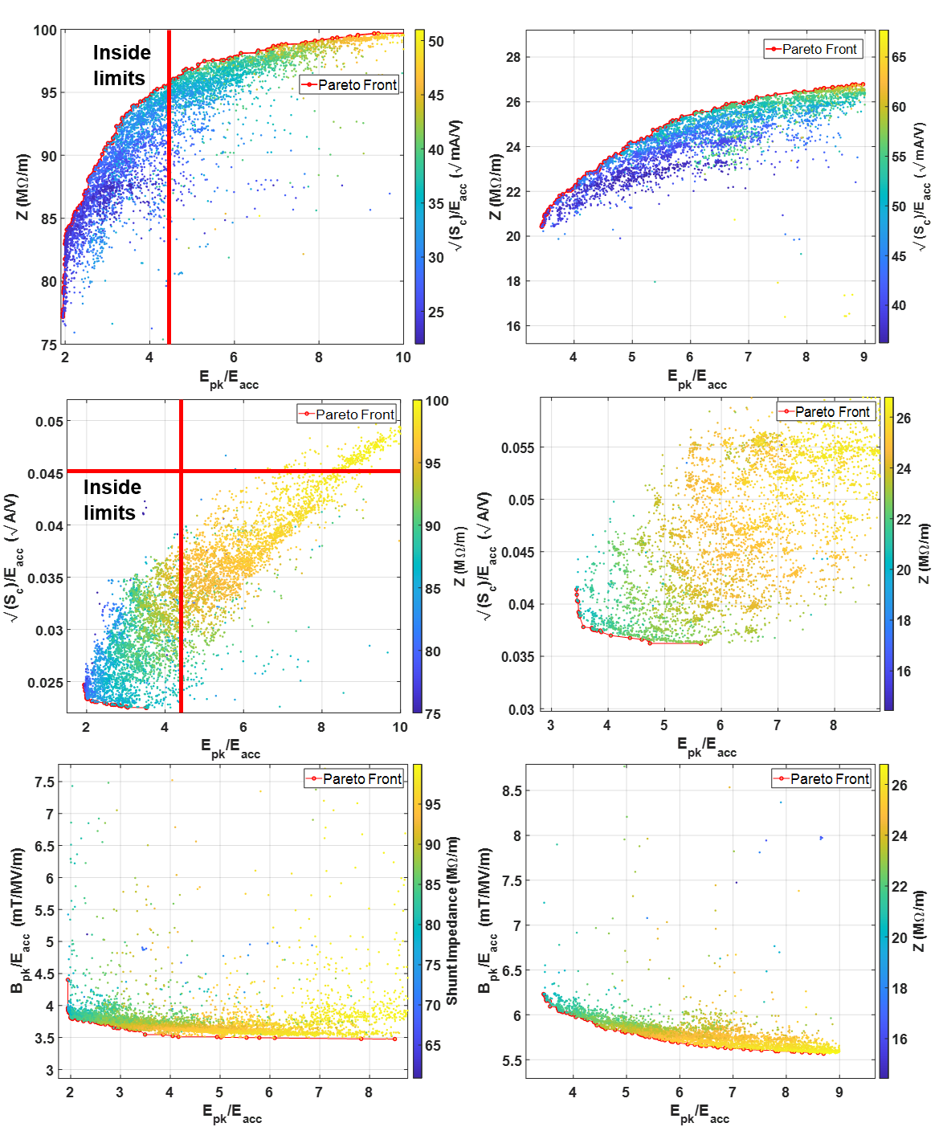
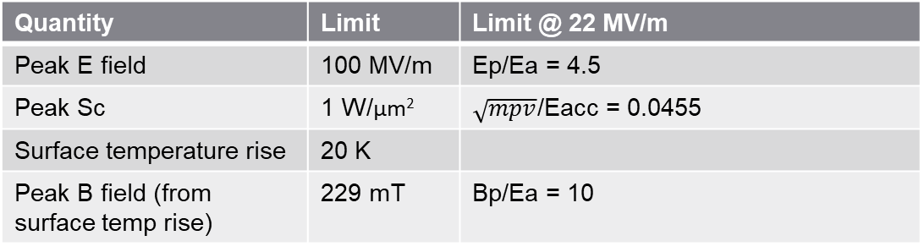
Results
Optimisations produce thousands of Pareto optimal points, Pareto fronts for the objectives are shown.
S_{C} well within limits with a small Pareto front with E_{pk}/E_{acc}.
Results were shown to not depend on B_{pk}/E_{acc} as there were no features that enhanced the magnetic field.
Inside limits
Quantity | Limit | Limit @ 22 MV/m
Peak E field | 100 MV/m | Ep/Ea = 4.5
Peak Sc | 1 W/μm² | $\sqrt{mpv}$/Eacc = 0.0455
Surface temperature rise | 20 K
Peak B field (from surface temp rise) | 229 mT | Bp/Ea = 10

Slide 12
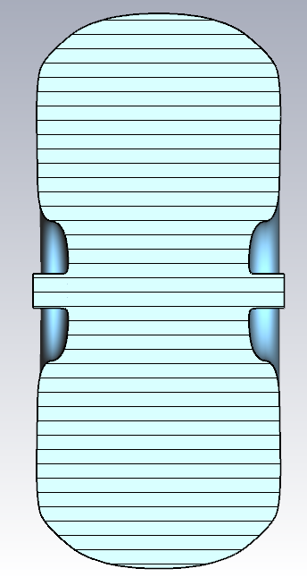
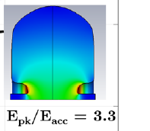
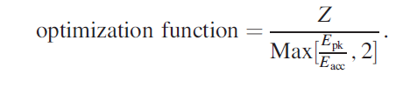
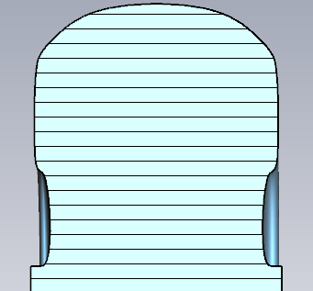
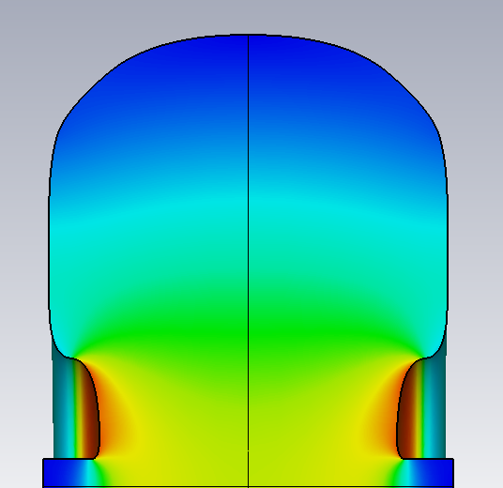
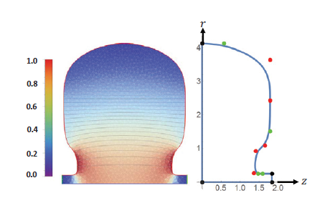
Single vs. MO optimization
12 000 runs with AMGA algorithm
Comparison with results from SLAC paper, assumed wall thickness was 0.5 mm (not stated).
Similar cavity shapes found with similar performance.
SLAC iterations: 20000, with a single optimisation function.
Although the MO Pareto front is not fully converged, the trade off between the objectives can be clearly seen allowing one to pick a different design.
Epk/Eacc = 2.18
114.7 Mohm/m
Epk/Eacc = 1.47
101 Mohm/m
Epk/Eacc = 2.02
112.98 Mohm/m
SLAC: Epk/Eacc = 2
113 Mohm/m
Nasr, M. H., and S. G. Tantawi. New Geometrical-Optimization Approach using Splines for Enhanced Accelerator Cavities' Performance. No. thpmk049. SLAC National Accelerator Lab., Menlo Park, CA (United States), 2018.

Slide 13
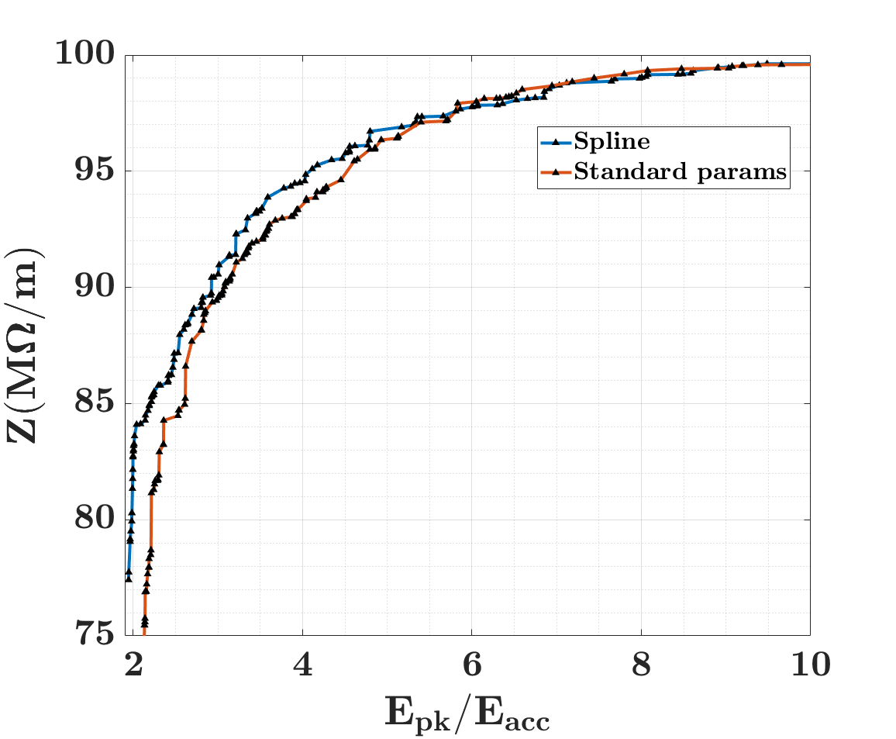
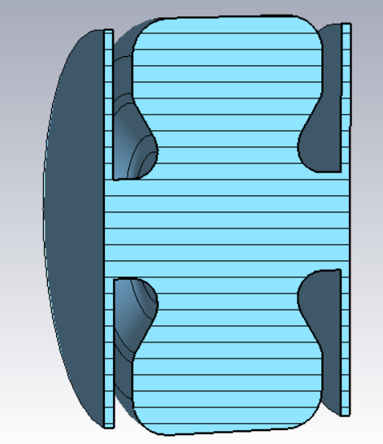
Splines vs Standard Shapes
A comparison was made between using the splines and standard modelling methods showing a 10 % improvement in the shunt impedance at low values of E_{pk}/E_{acc} with the difference reducing at larger values as the longer nose cones are easier to replicate with standard shapes.
Splines could also be used for more complicated features such as coupling slots, power couples or to shape fields for desired properties all allowing for improved performance.
VS.

Slide 14
Visualisation
Techniques

Slide 15
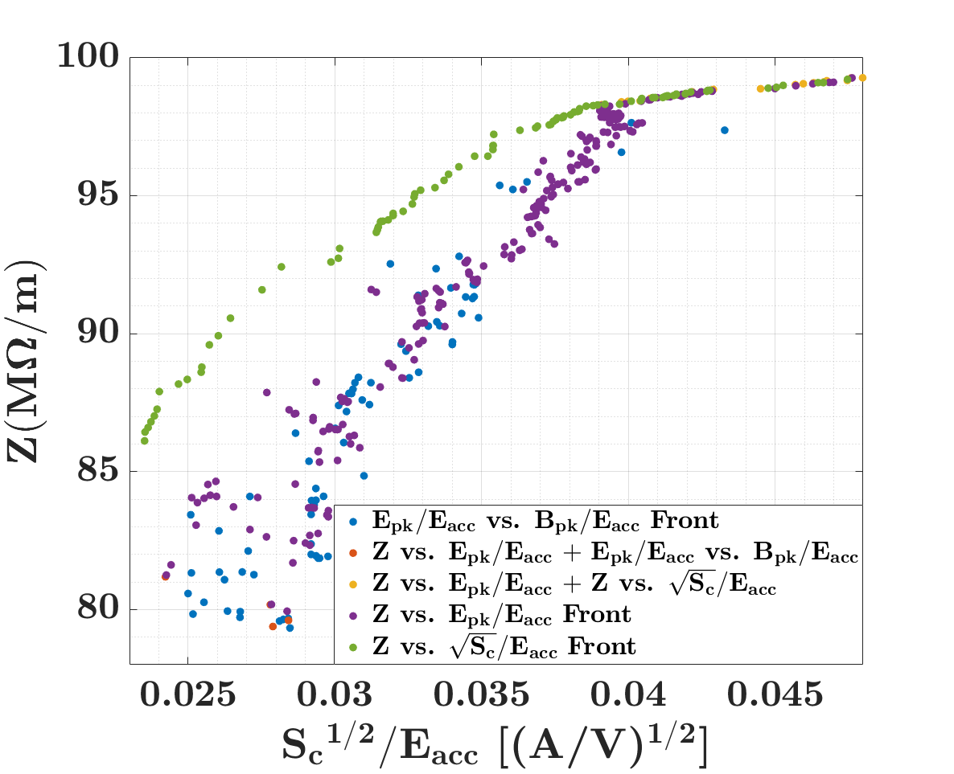
Visualising the N-dimensional Pareto Optimal Objective Space
Once the number of dimensions of the problem is > 4, and the number of Pareto Optimal solutions grows large it becomes increasingly difficult to visualise the data and select a final design from the set.
2D scatter plots can be useful for quickly investigating trade offs, although if the number of objectives increases from two to N, the Pareto front is now a (N − 1)-dimensional hypersurface. There is no guarantee that points that lie on one Pareto front are close to the others.
Considering this, more intricate methods of visualisation must be implemented when N ≥ 3 in order to assist in the selection process
S.J. Smith, R. Apsimon, G. Burt, S. Setiniyaz, and M.J.W. Southerby, “Visualisation of Pareto Optimal Spaces and Optimisation Solution Selection Using Parallel Coordinate Plots”, in Proc. IPAC'22, Bangkok, Thailand, Jun. 2022, pp. 2487-2490. doi:10.18429/JACoW-IPAC2022-THPOST020

Slide 16
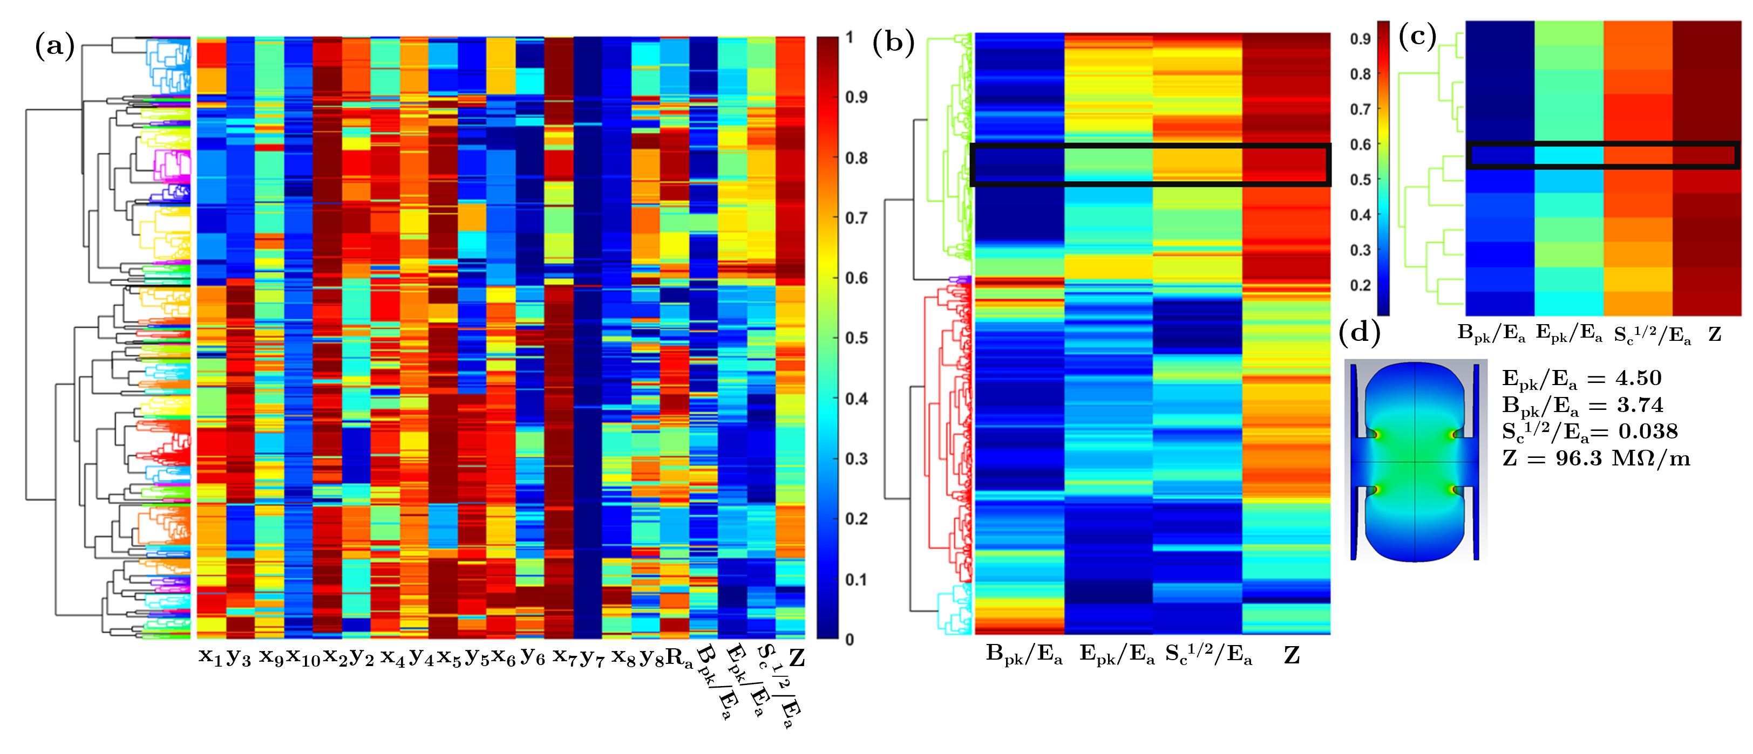
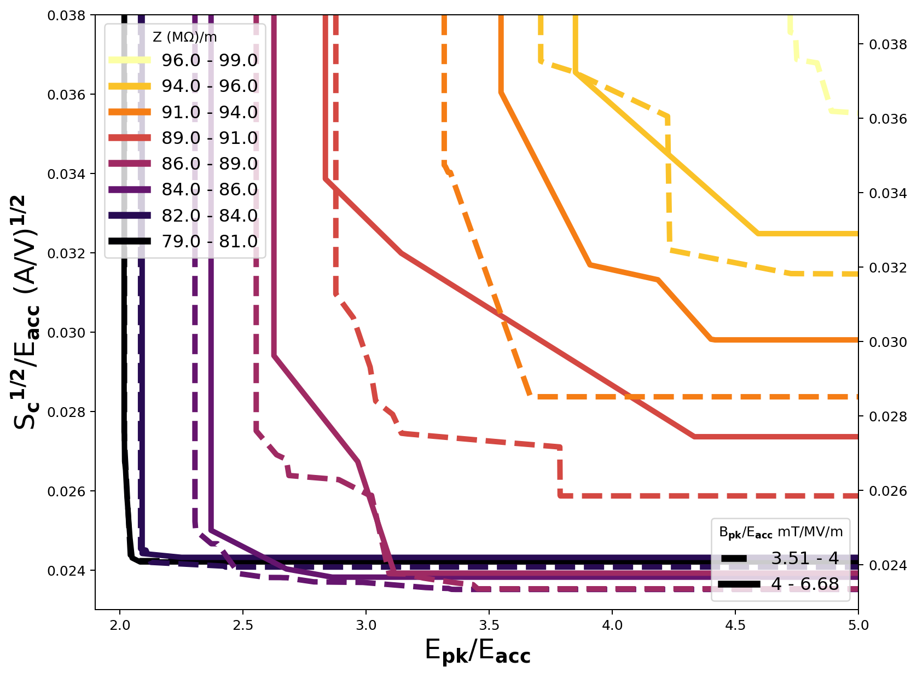
Visualisation
Heat maps display the interaction between matrix elements as a color of varying intensity. The entire input and objective space can be visualised in this way.
The data must be ordered to be useful for example using clustering or ranking by similarity.
Decision maps display bi-objective Pareto fronts as a function of a third objective and a fourth objective can be included in colour.
Can deal with large data sets as the data is binned into 2 MΩ/m bins, before finding 2D Pareto fronts.
Thanks to M. Southerby for permission to use images

Slide 17
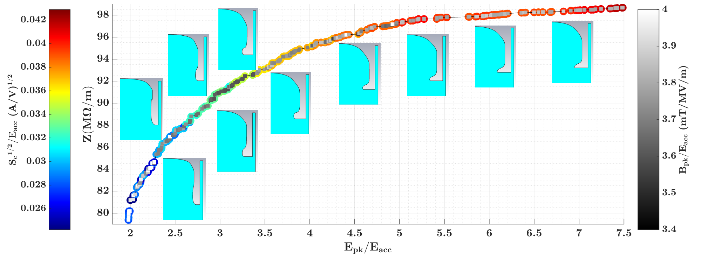
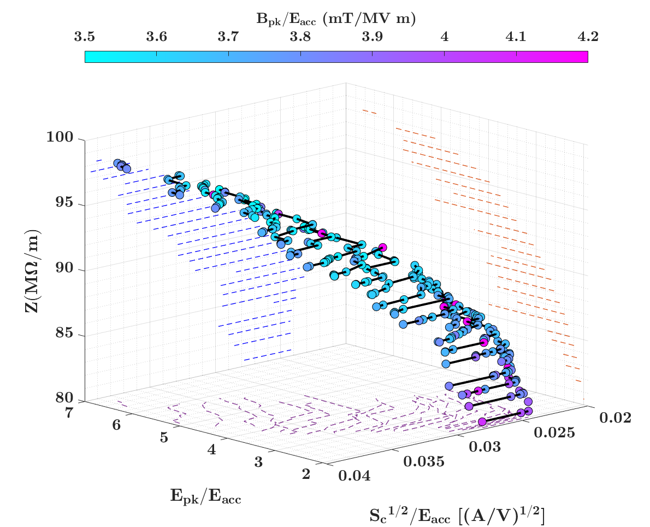
Scatter Plots
2D scatter plots provide an easy way to visualise the trade offs between 3 objectives and are the easiest to use for a low number of objectives.
Geometry is shown along the Pareto front showing interesting geometries at low values of E_{pk}/E_{acc} that may not have been considered without the optimisation.
3D scatter plots can be used when N < 4 and can show the entire objective space, allowing for a visualisation of how the objectives interact. Projection onto the 2D aces can show the Pareto fronts clearly.

Slide 18
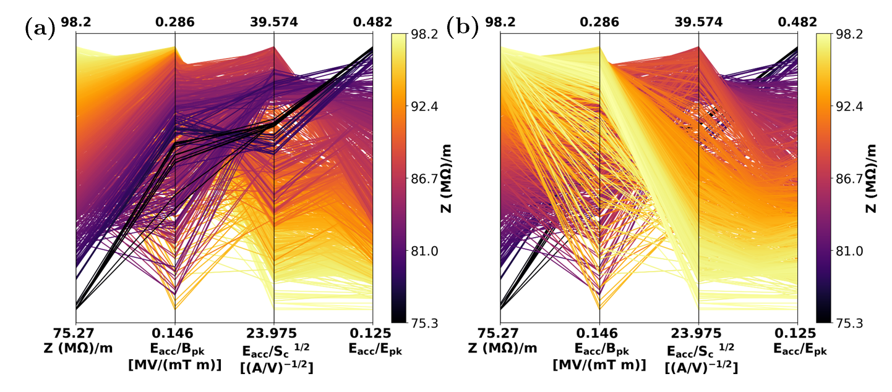
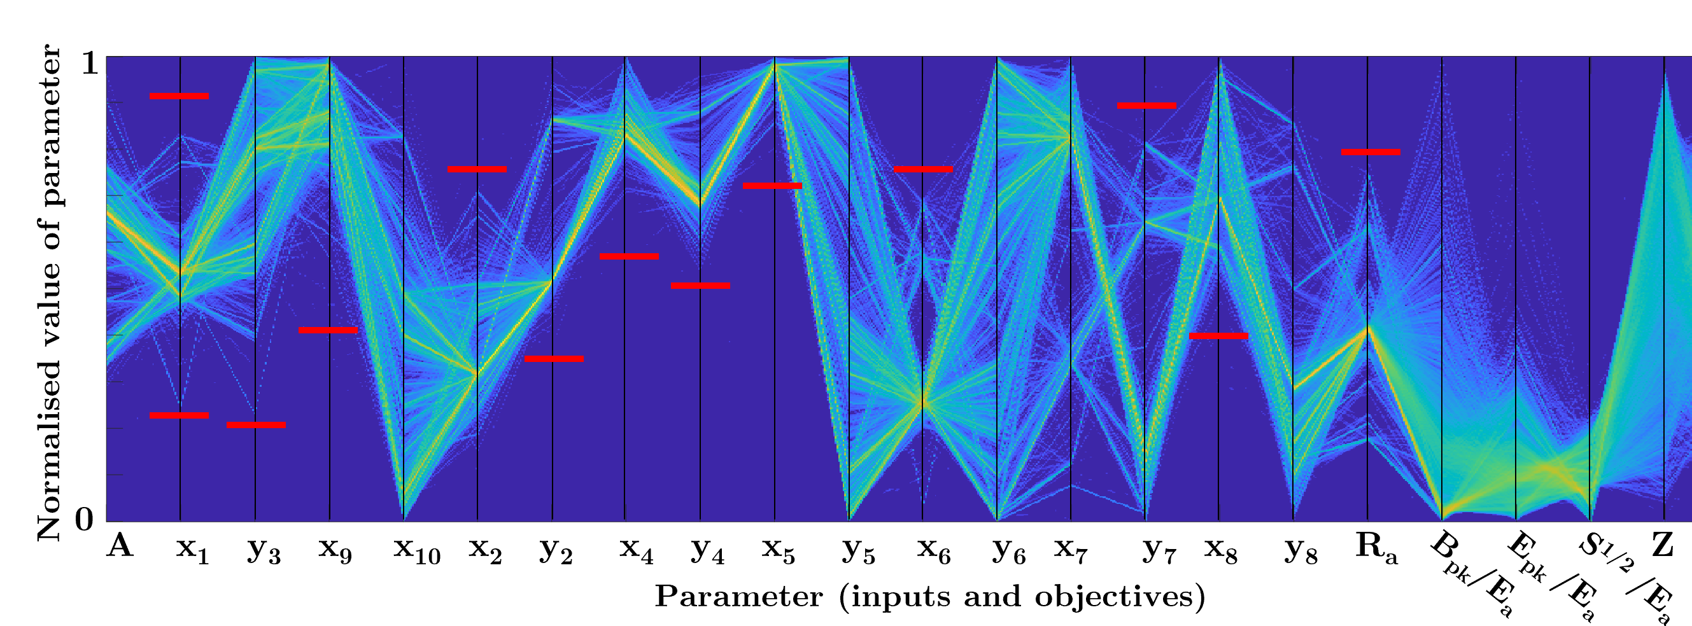
Parallel Co-ordinate Plots (PCPs)
After investigating several methods for visualisation including radar charts, polar plots, decision maps (DMs), heat maps and 3D Pareto surface Approximations we found that Parallel coordinate plots were the easiest to use when the number of dimensions is > 4.
PCPs display a solution as a line crossing equally spaced axes. Each axis represents an objective, and the objective value is given by the point at which the solution crosses the axis.
PCPs possesses four degrees of freedom: (i) objective axis order, (ii) axis scale (logarithmic, linear, etc.), (iii) axis rotation (maximizing or minimizing), and (iv) plot order of solutions (important for larger datasets).
Can display as many objectives as the screen resolution will allow.

Slide 19
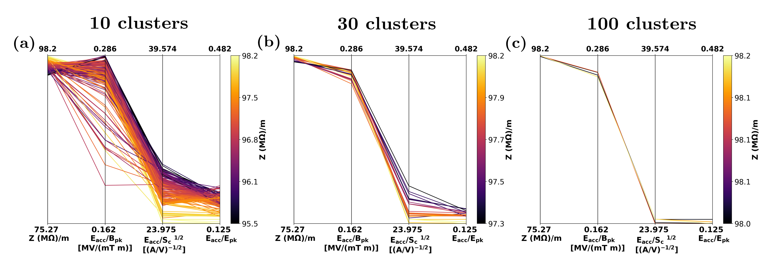
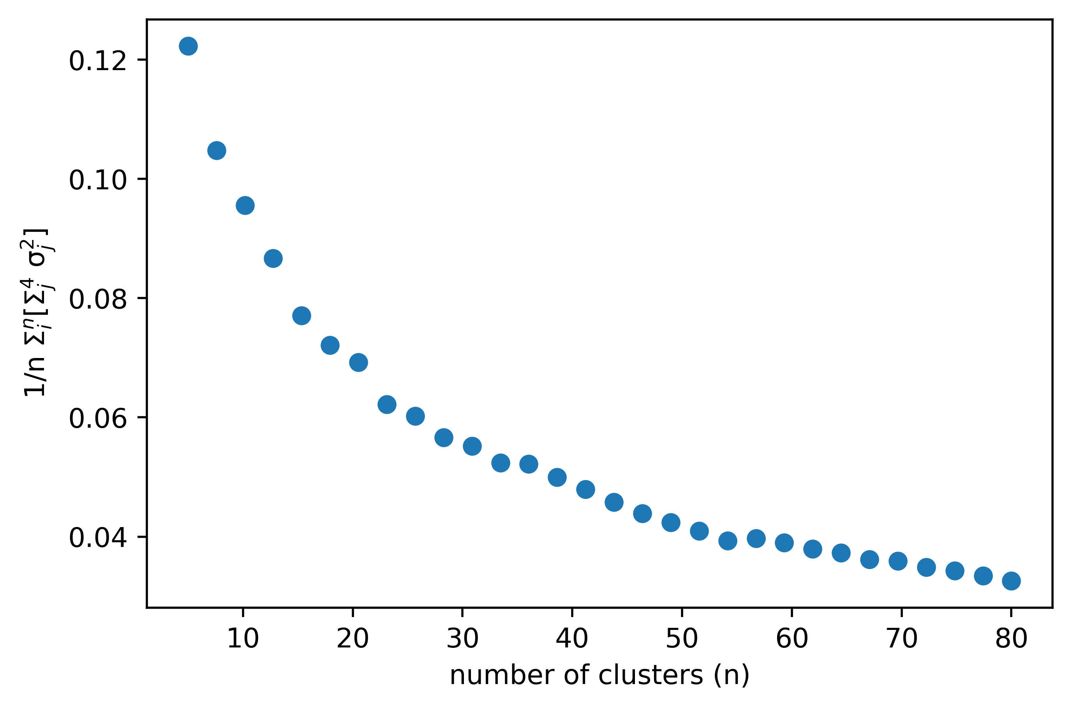

Reducing the data set
Although PCPs are powerful tools for visualising the data, it is still difficult to select an individual solution for a final design.
These data sets can contain many solutions that have similar values for objectives, either due to slight mesh differences or due to the definition of a non-dominated solution.
We require a way to reduce the data sets while still retaining the important information: Various clustering algorithms exist that group similar solutions based on objective values, that could be used to reduce the dataset, while still retaining the important information.
We used the agglomerative hierarchical clustering algorithm to group similar solutions based on the Euclidean distance between the solutions in the objective space.
Representative point then chosen using:
Thanks to M. Southerby for permission to use images

Slide 20
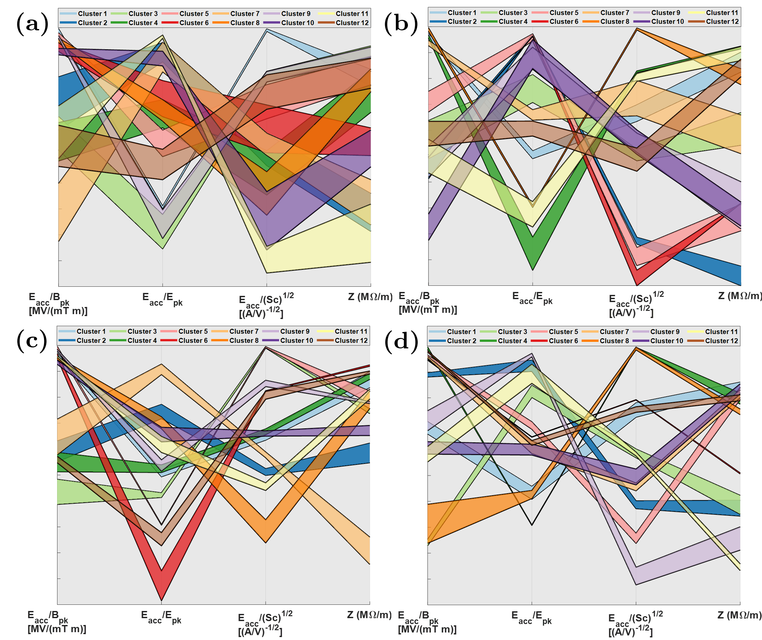
Cluster variance
Four graphs show the cases for 12, 24, 36 and 48 clusters.
Clusters are represented with their 25 % and 75 % percentiles.
With 12 clusters there is significant overlap between the clusters meaning that by picking one cluster, other solutions that fall into the others will be missed.
For 24-36 clusters they are easily distinguishable and can be read on a single PCP plot, making this range ideal.

Slide 21
Optimisation 2

Slide 22
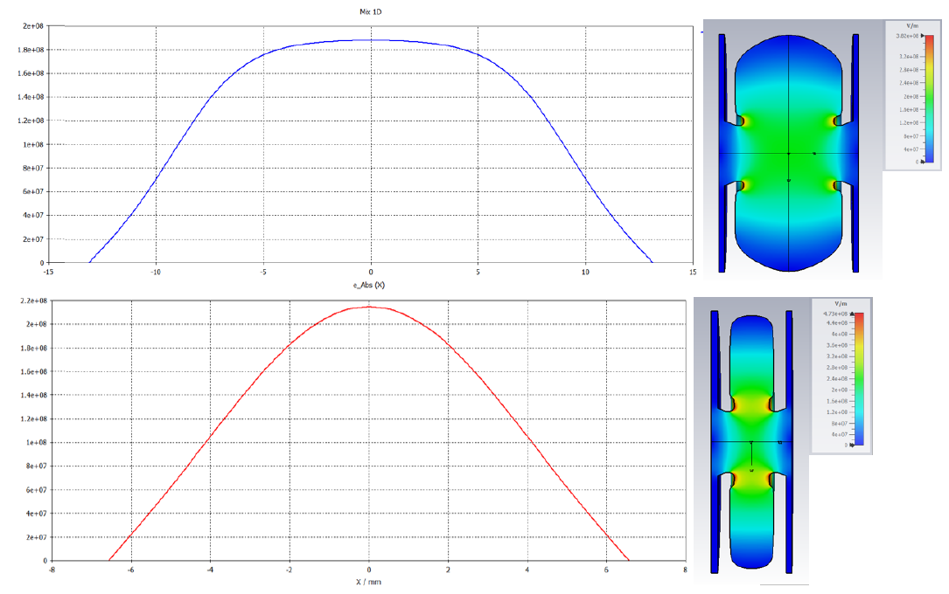
Optimisation 2 setup
Particles : N = 1000
total charge: Q = -1.0000E-03 nC
average kinetic energy: E = 2.5002E-02 MeV
energy spread: dE = 6.7085E-03 keV
Emission time: t = 1ns
Linac lifetime can be driven by number of electrons that backstream to the cathode, therefore maximizing the capture and minimizing the bombardment is desirable.
Optimisation of field lengths and amplitudes for an electron buncher cavity to capture a 1 ns long (~6 RF periods) electron beam.
ASTRA tracking code used for optimization with Matlab interface and algorithm (Gamultiobj – a NSGA-II variant).
Inputs were the first 3 cell lengths, and first 3 cell amplitudes.
Individual fields were taken from β =1 and β = 0.5 cavities, scaled and combined.
INPUT | β1 | β2 | β3 | β4 | β5 | A1 | A2 | A3 | A4 | A5
Range | 0.2-0.5 | 0.5-0.8 | 0.8-1 | 1 | 1 | 0.25-0.5 | 0.75-1 | 0.8-1 | 1 | 1
Output | Total capture % | Capture with E > 1.5 MeV | Average KE > 1.5MeV | % electrons return to cathode

Slide 23
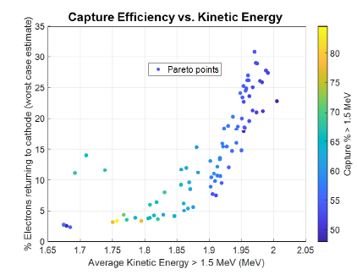
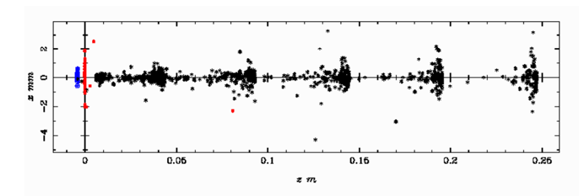
Optimisation 2 Results
Population of 50, with 150 generations.
Optimisations show that a low amplitude and short first cell is required to maximise the linac capture and minimize the number of electrons returning to the cathode.
Trade off between average energy, power required and capture efficiency.

Slide 24
Optimisation 2 Results
Effect of the length of cell 2 and 3 and increasing the maximum field on axis.

Slide 25
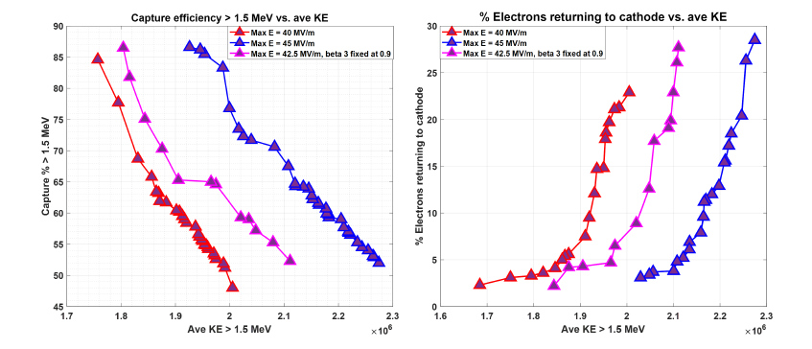
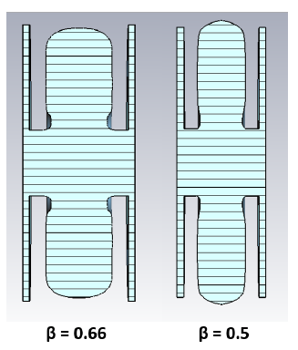
Simulation approach
Optimisation was repeated for various maximum field amplitudes on axis, until a design was selected.
Design required shorter than β = 1 cells, so optimisation was repeated for β = 0.66 and β = 0.5 showing the reduction in shunt impedance and increase in minimum values of E_{pk}/E_{acc} possible.

Slide 26
Putting it all together

Slide 27
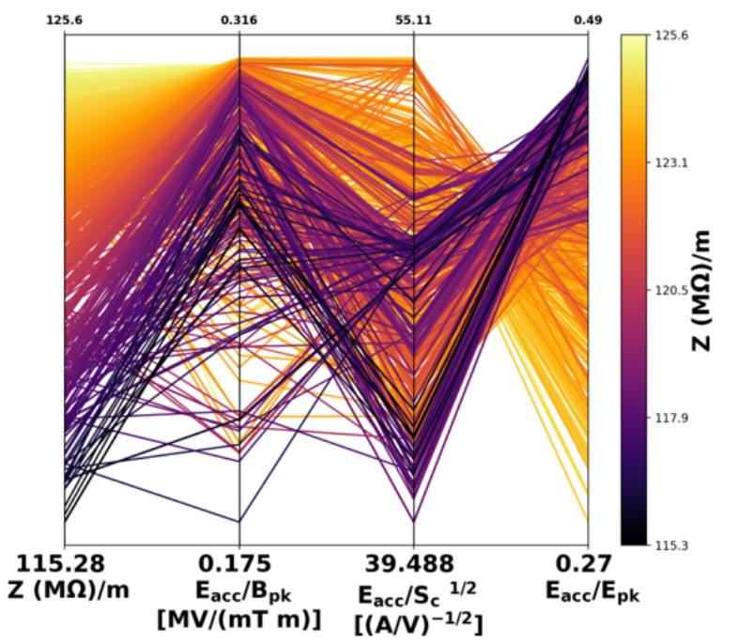
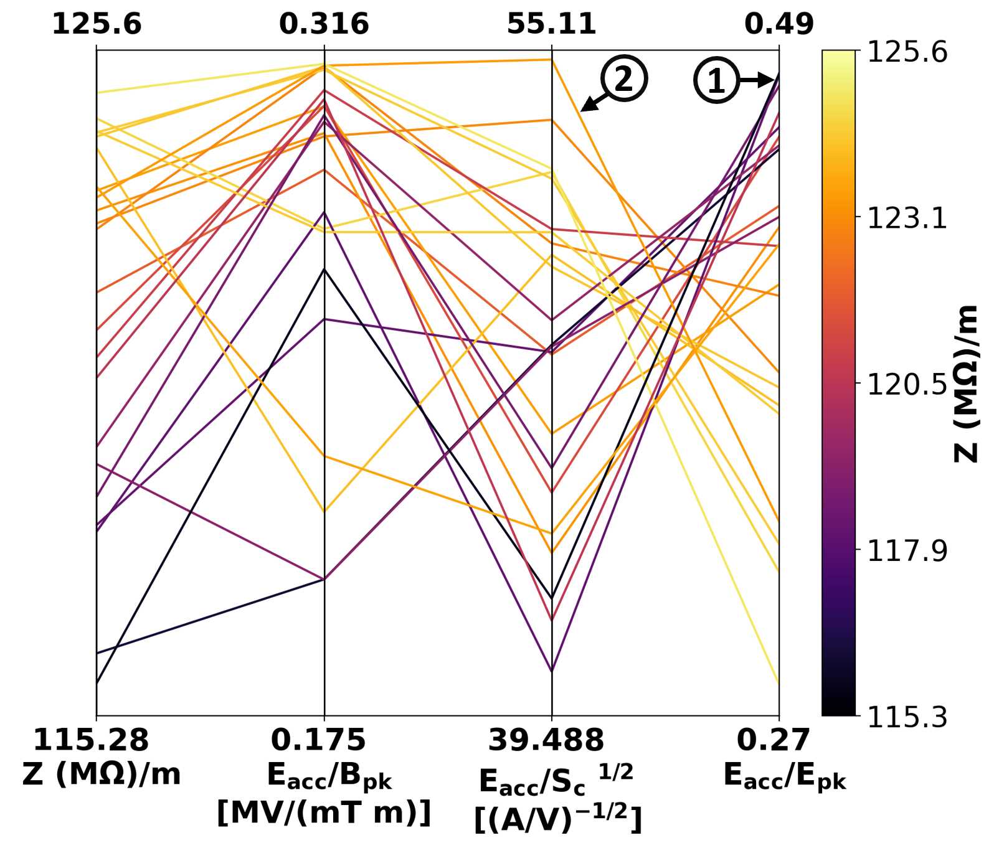
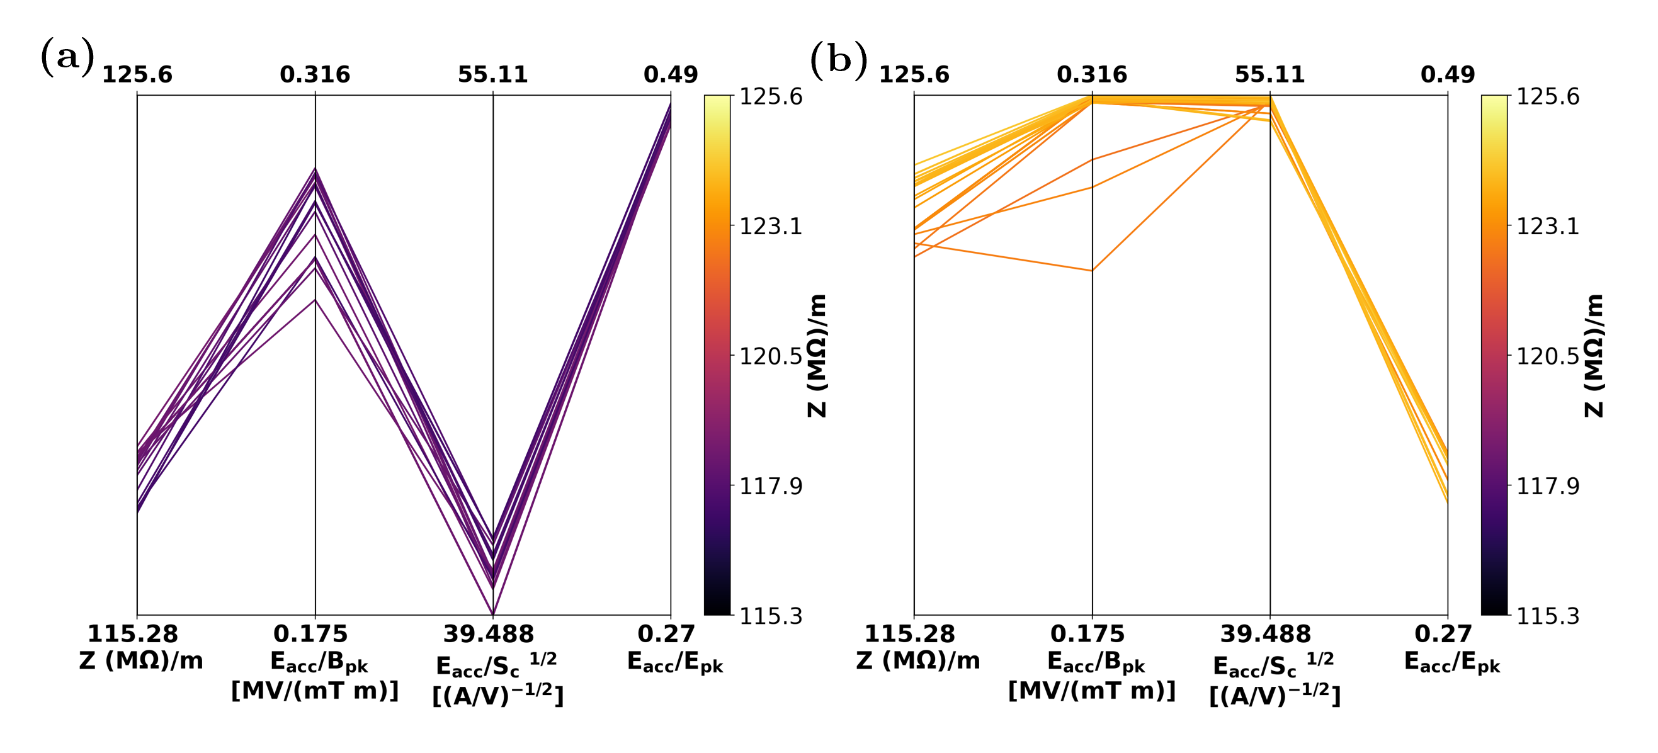
Selection approach 1
Best method for when N > 4.
Hard to read PCP is reduced to 24 clusters than can be clearly read and compared to each other.
Solution 1: E_{pk}/E_{acc} limited design, opened cluster shows similar solutions, of which 1 can be selected, although another cluster has a smaller value for E_{pk}/E_{acc} it has a smaller Z.
Solution 2: S_{c} limited, opened cluster shows some more variance, but selection from the opened cluster can depend on requirements for the other objectives.

Slide 28
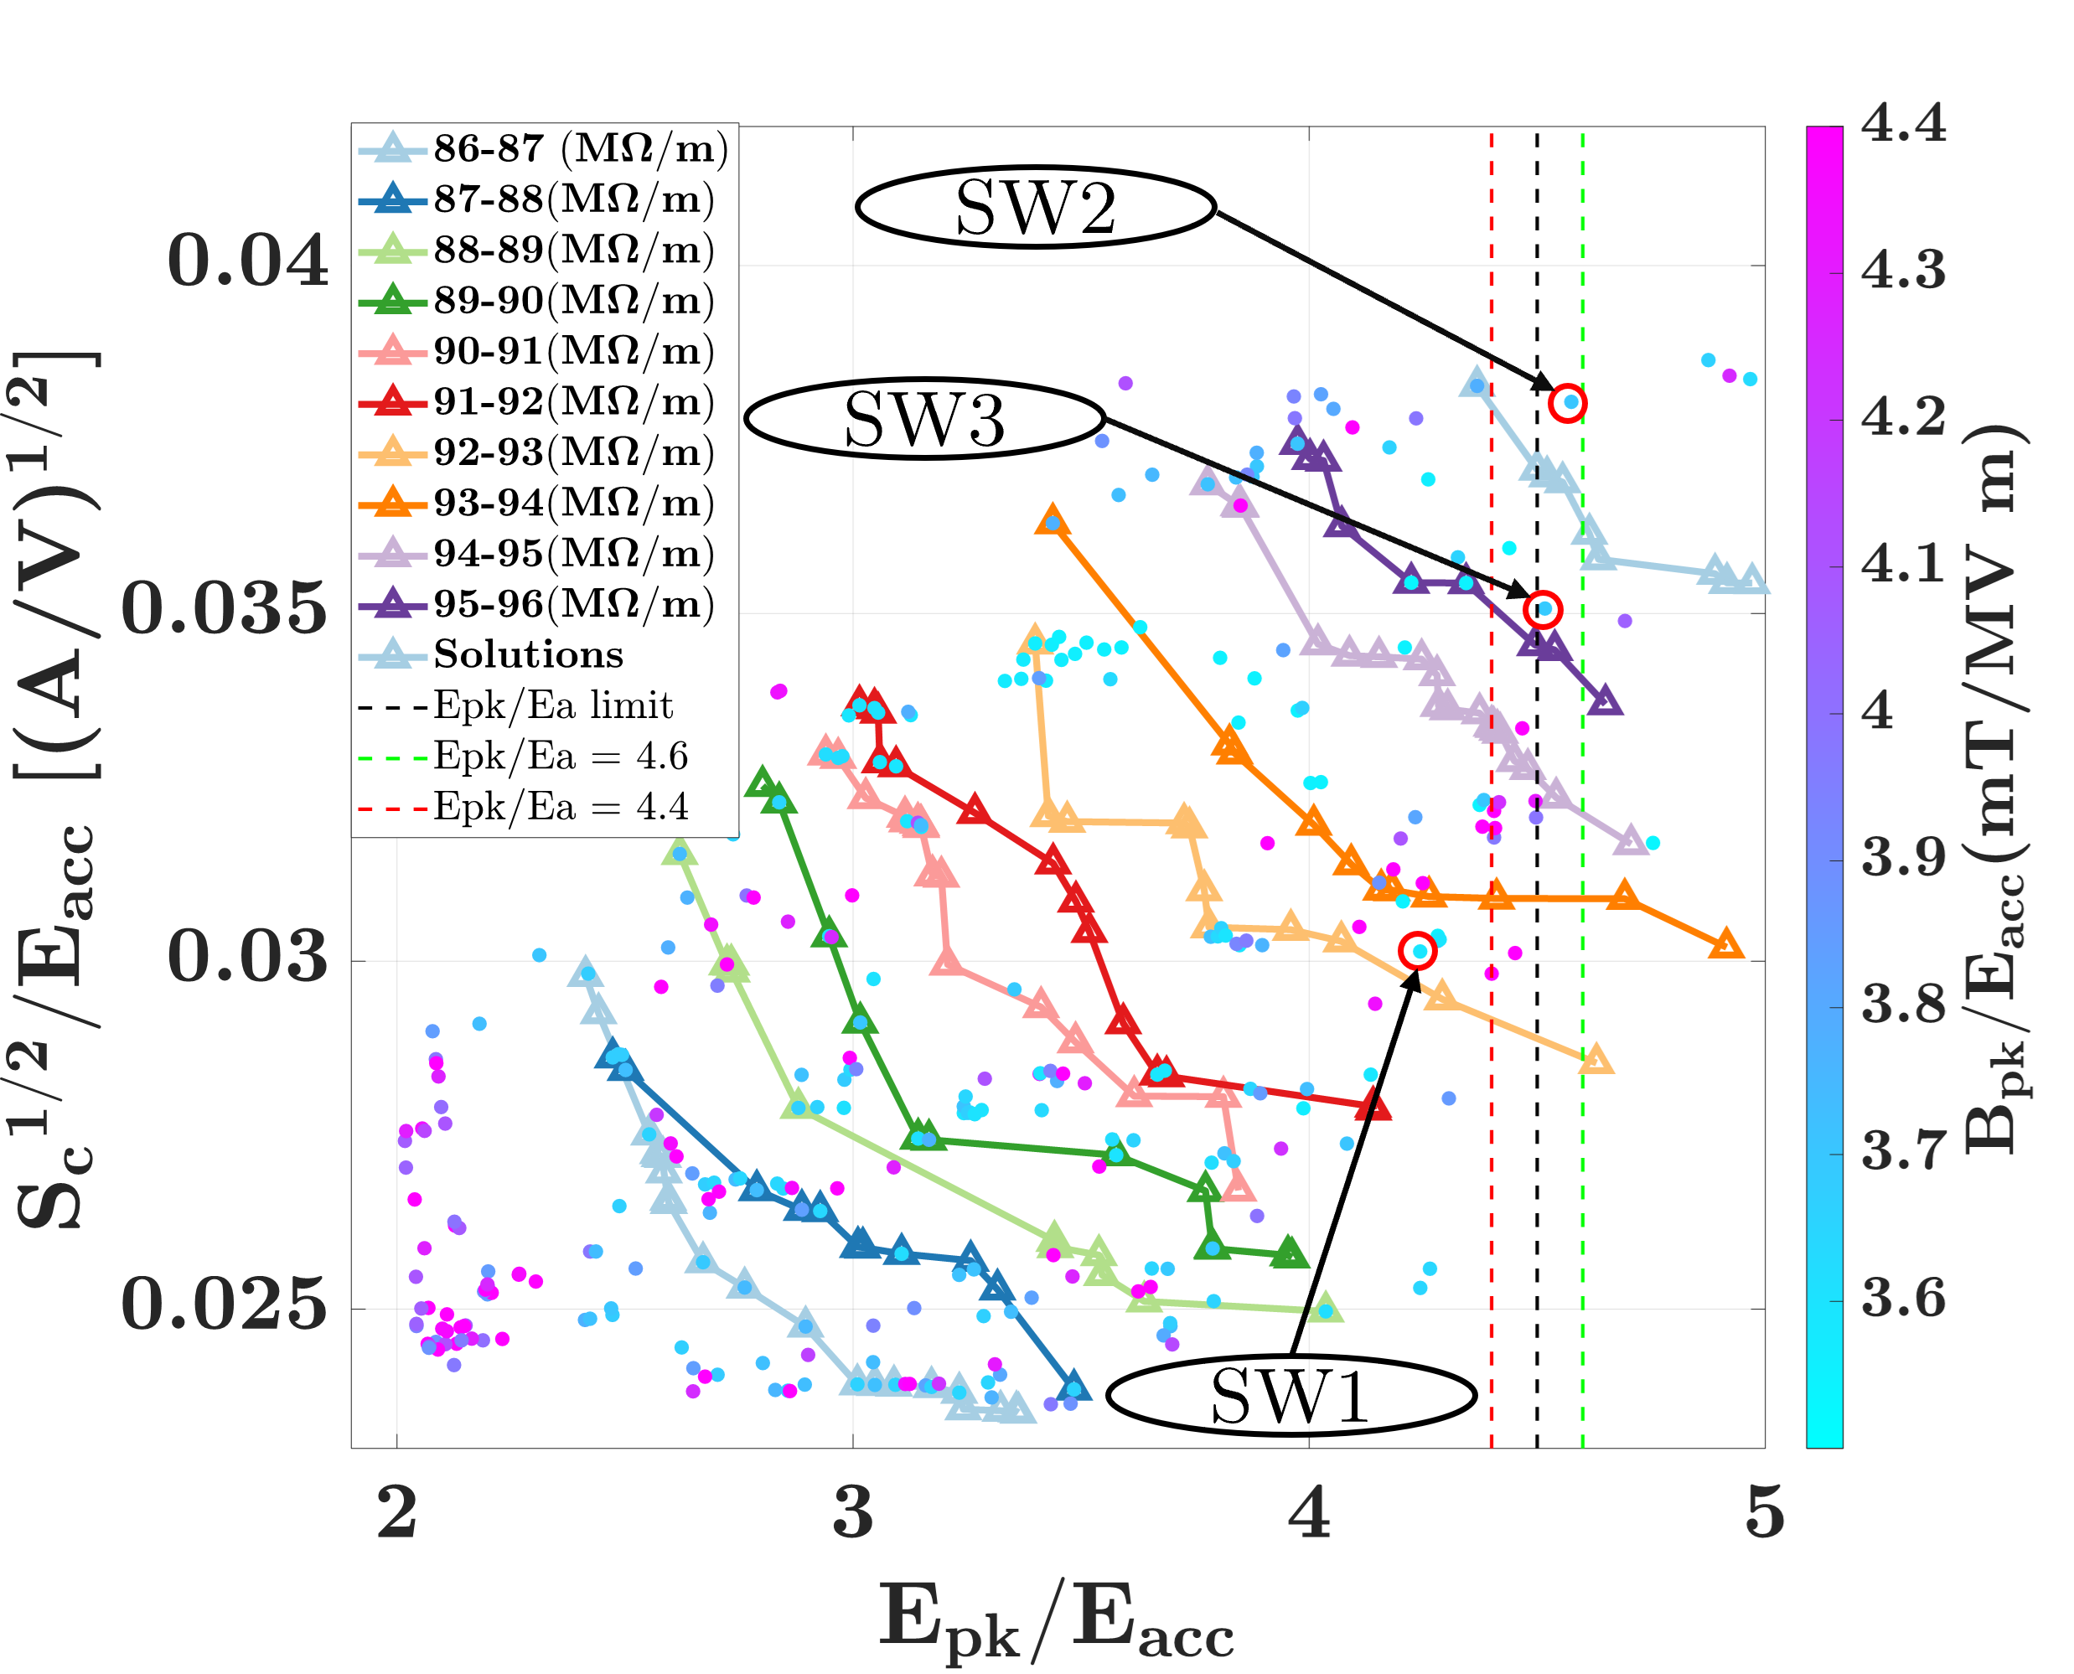
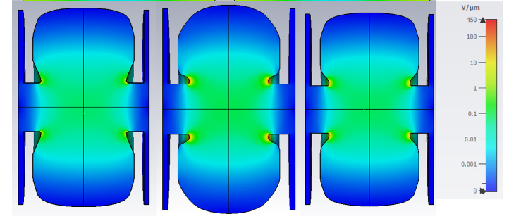
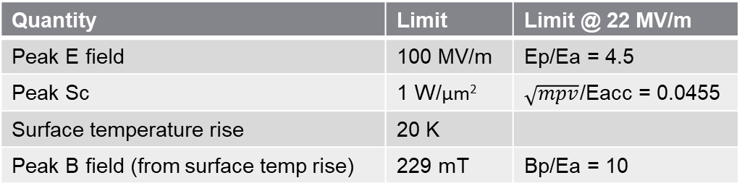
Selection approach 2
Good for N < 4.
Decision map used to select final linac design – check points with low values of B_{pk}/E_{acc} and close to the limit of E_{pk}/E_{acc}.
Only two objectives matter as S_{c} and B_{pk}/E_{acc} were always under the limit due to the modest gradient.
3 design options depending on how close to the limit of S_{c} we wanted to go.
Quantity | Limit | Limit @ 22 MV/m
Peak E field | 100 MV/m | Ep/Ea = 4.5
Peak Sc | 1 W/μm² | $\sqrt{mpv}$/Eacc = 0.0455
Surface temperature rise | 20 K
Peak B field (from surface temp rise) | 229 mT | Bp/Ea = 10

Slide 29
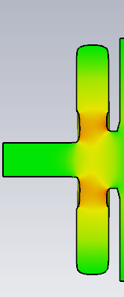






Putting it all together
Just reducing the first cell length would case the first cell to be too difficult to tune, therefore another optimisation was performed on the first cell.
Keeping the same β, a 20 % reduction in the field length was achieved.
2nd and 3rd cells were also re-optimised with the chosen β’s from the cell length optimisation.
Final design < 5 % of the beam returning to the cathode, and a total capture efficiency of ~ 90 %.
β = 0.44
β = 0.35
β = 0.44 improved

Slide 30
Thanks for listening!
Questions?

