Slide 1
A High Brightness Photoinjector based on a Travelling-Wave C-band Technology (I.FAST WP 7.4)
Dr. Thomas Geoffrey Lucas :: Research Fellow :: Paul Scherrer Institut
10-11th January 2022

Slide 2
Contents
Motivation of a TW RF photogun
TW RF photogun: RF Design and High Gradient Limitations
Plans for Realisation
Applications to FEL and ICS sources
Conclusion

Slide 3
Motivation

Slide 4
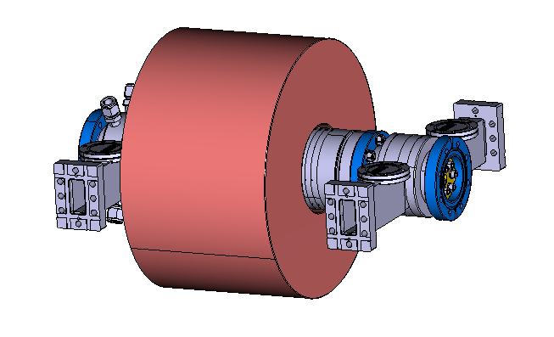
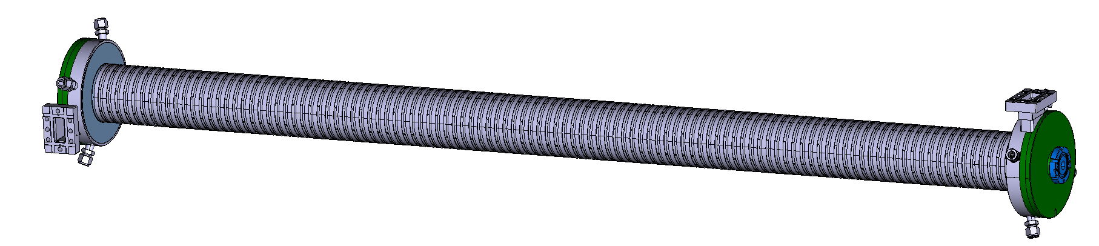
Motivation for Travelling Wave RF Photogun
A Travelling Wave RF photogun will allow:
Higher gradients on the cathode leading to a higher brightness bunch.
  Possible because of the reduced fill time and consequently RF pulse length.
Higher repetition rates possible.
  RF pulse length is shorter therefore a reduced thermal dissipation.
More cells for a higher rigidity bunch.
  Mode separation not an issue compared to SW RF photoguns
Simplify RF system.
  Gun can be powered with same high power RF network as linear accelerators.
Figure 1: Rendering of a 60 MeV injector with TW RF Photogun

Slide 5
TW RF Photogun
RF Design and Possible High Gradient Limitations

Slide 6
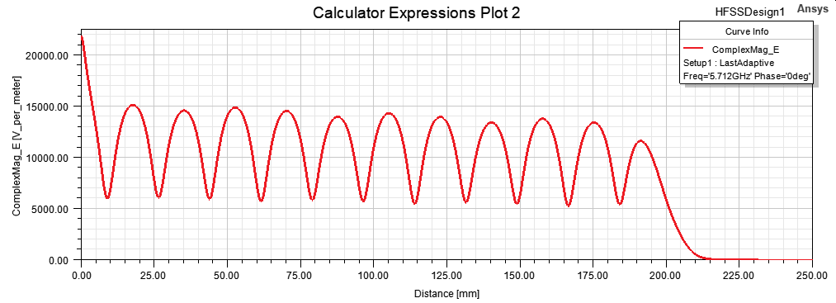
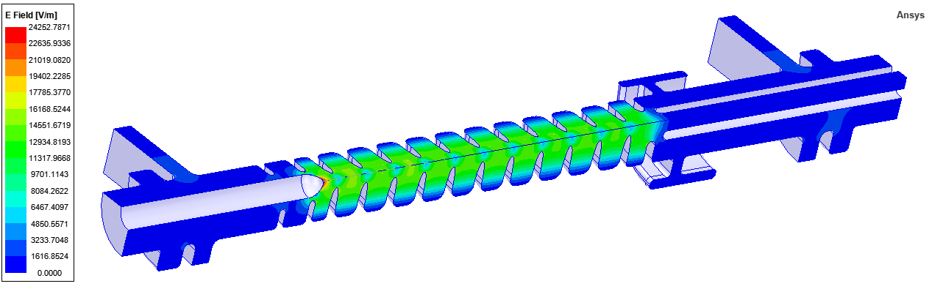
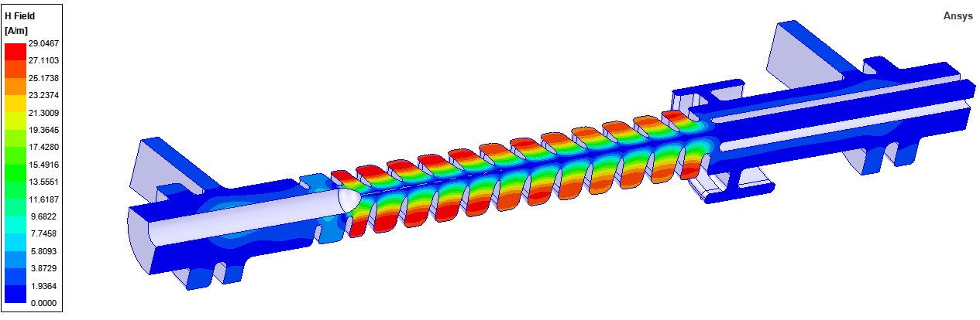
RF Design
RF Design
Design from PhD Thesis of M. Schaer.
Operational Frequency is 5.712 GHz.
High peak cathode field of 135 MV/m at nominal power.
High Gradient Considerations
Peak E field on cathode and signficantly higher than other parts of structure.
Peak H field low enough not to cause pulsed surface heating.
Figure 2: Axial Ez field
Figure 3: Peak E and H fields of TW RF photogun

Slide 7
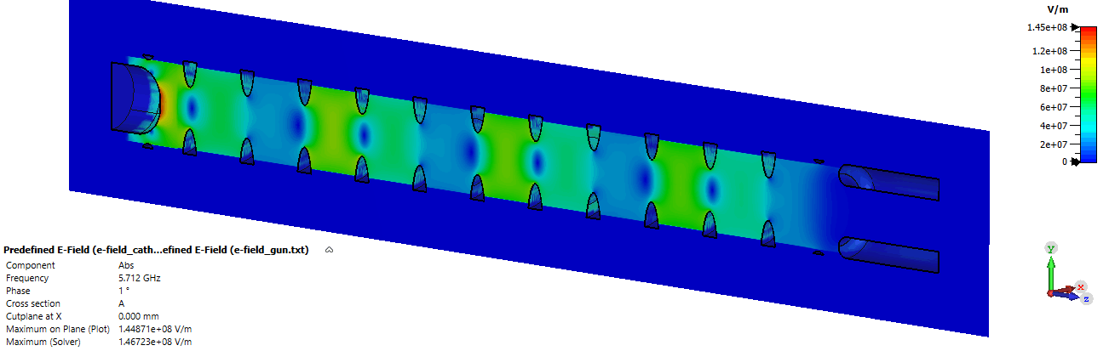
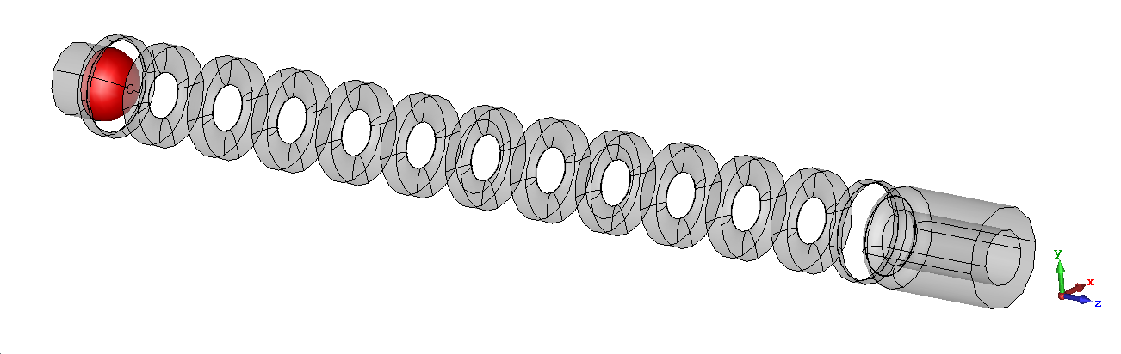
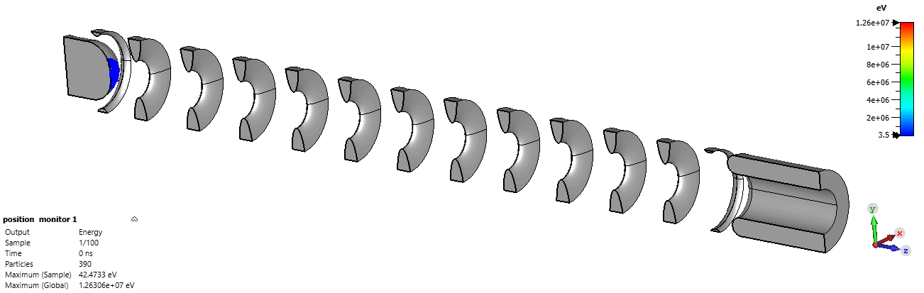
Dark Current Simulations
Figure 4: Electromagnetic fieldmap used for Dark Current Simulations
Figure 5: Emitter surface used for Dark Current Simulations
Figure 6: PIC Simulation Results

Slide 8
Dark Current Simulations
Figure 7: Dark Current properties
Field Enhance-ment Factor (β) | Effective area (A_{e}) [um^2] | Cathode Gradient [MV/m] | Charge arriving downstream (per 90ns RF pulse) [pC] | Capture Ratio | Total Field emitted charge (per 90ns RF pulse) [pC] | Peak Energy [MeV]
70 | 0.01 | 135 | 5.9 | 0.31 | 19.0 | 13.0
70 | 0.01 | 200 | 160.3 | 0.29 | 552.8 | 19.2
70 | 0.1 | 135 | 65.8 | 0.31 | 212.3 | 13.0

Slide 9
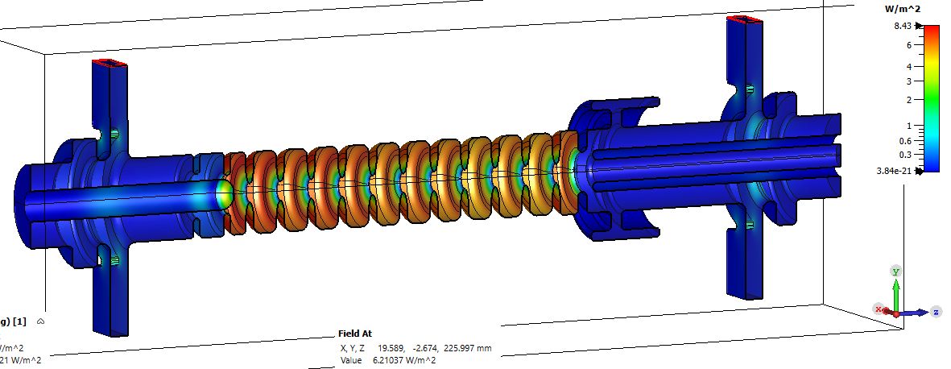
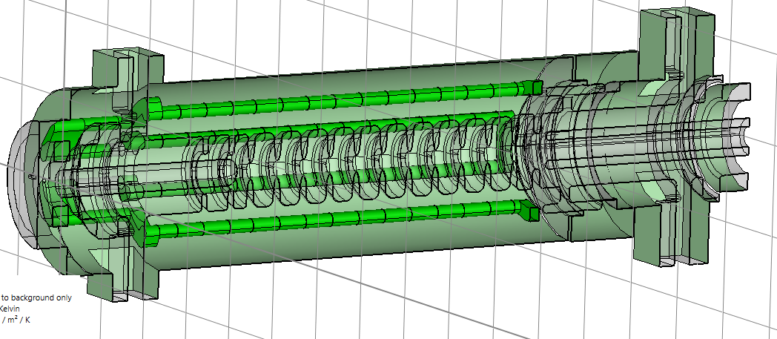
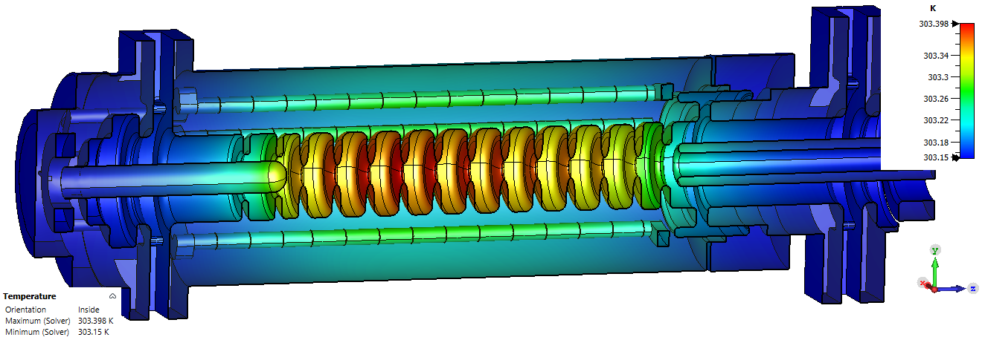
Thermal Simulations
Figure 8: Power loss model
Figure 9: Cooling Model
Figure 10: Steady State Thermal Model

Slide 10
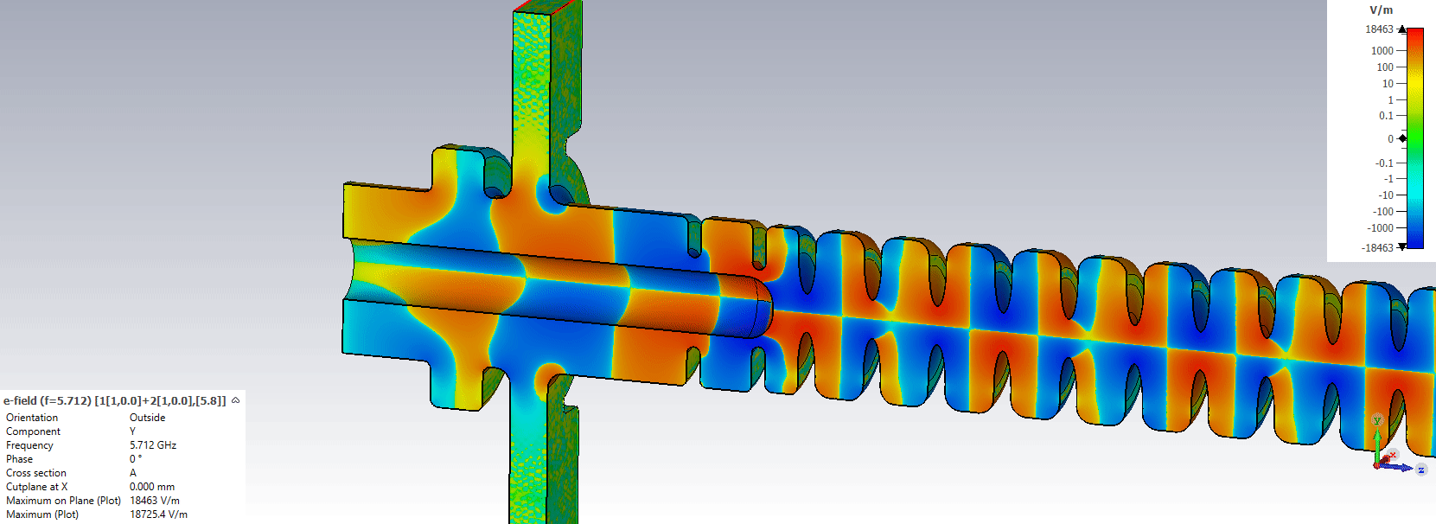
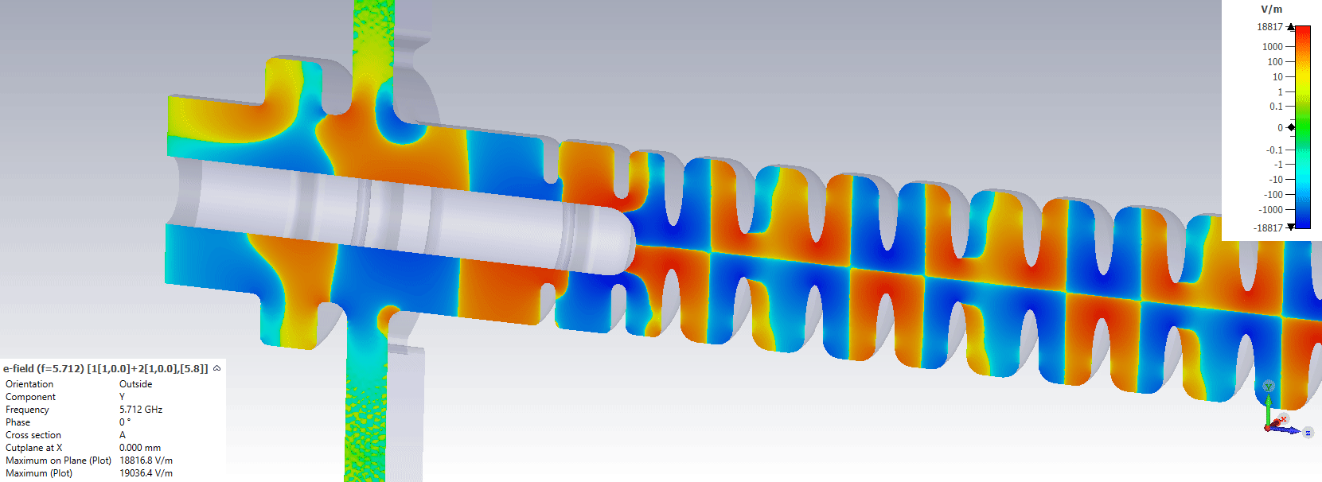
Alignment Concerns

Slide 11
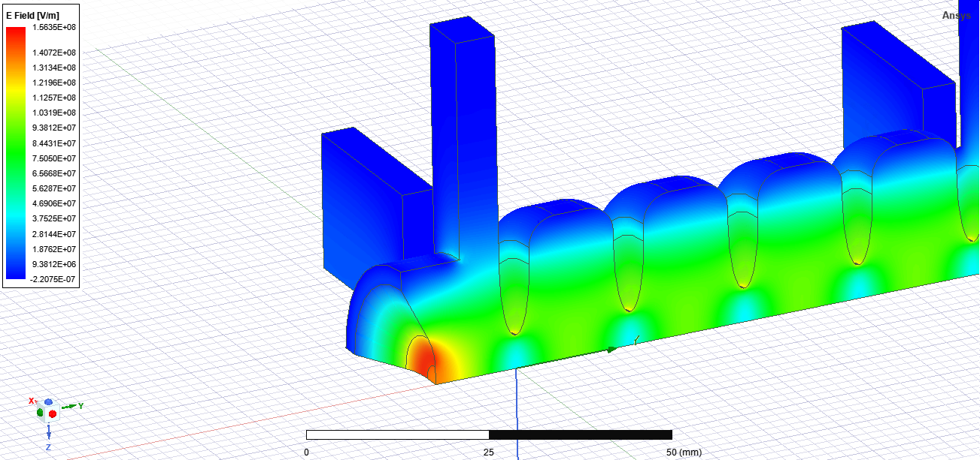
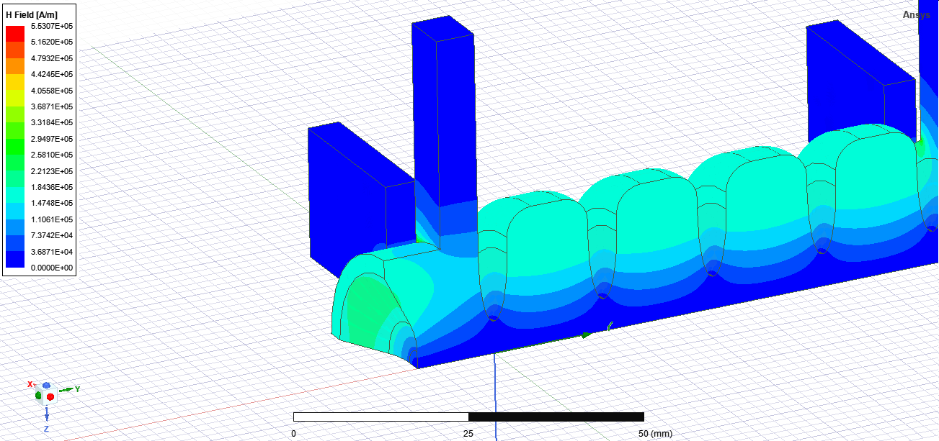
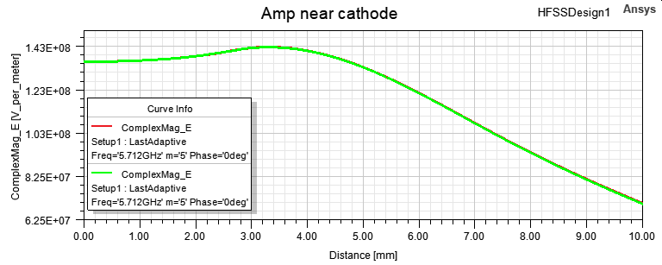
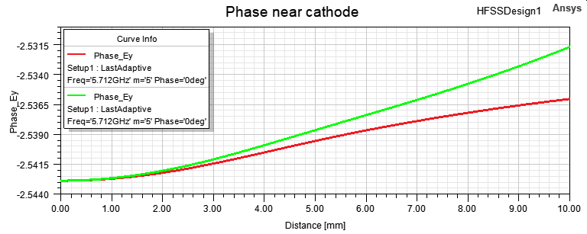
New RF Coupler: Design 1

Slide 12
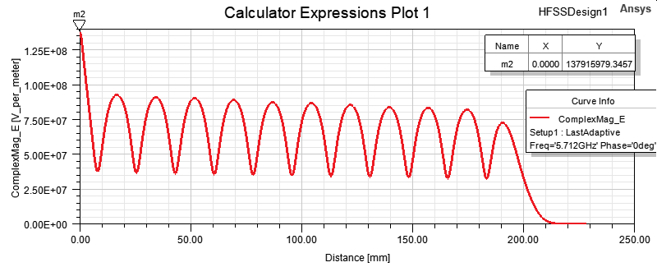
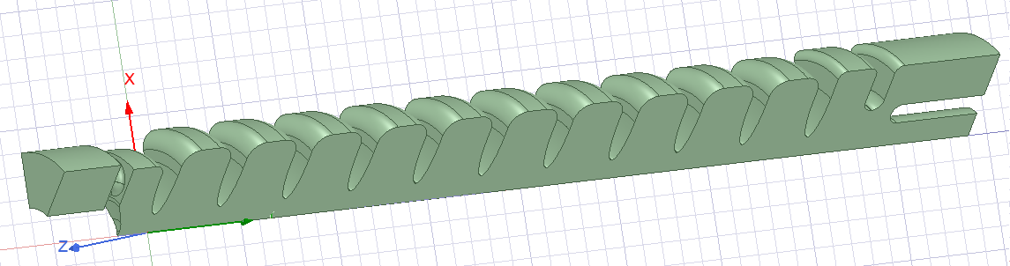
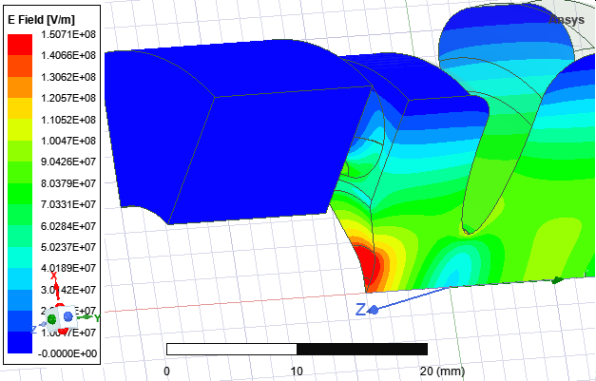
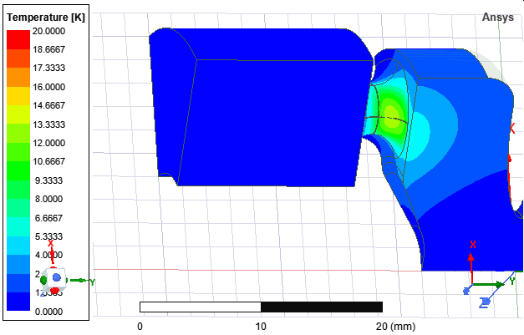
New RF Coupler: Design 2

Slide 13
Realisation
Plans for High Power Testing at PSI

Slide 14
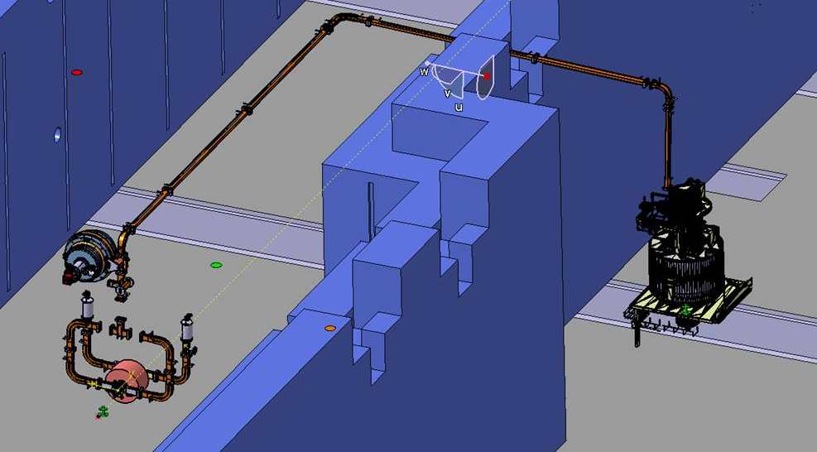
Waveguide Network

Slide 15
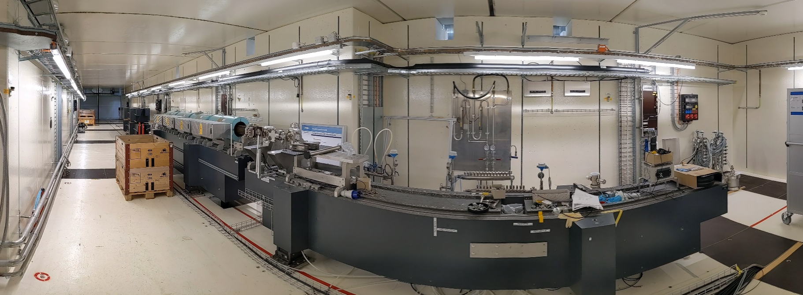
Bunker

Slide 16
Applications to Free-Electron Lasers

Slide 17
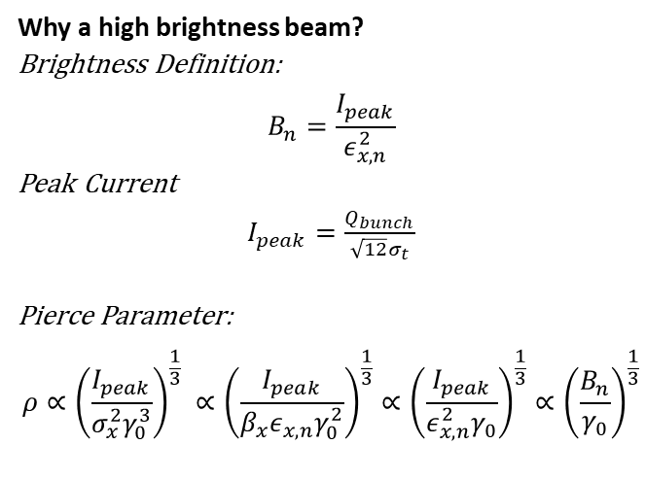
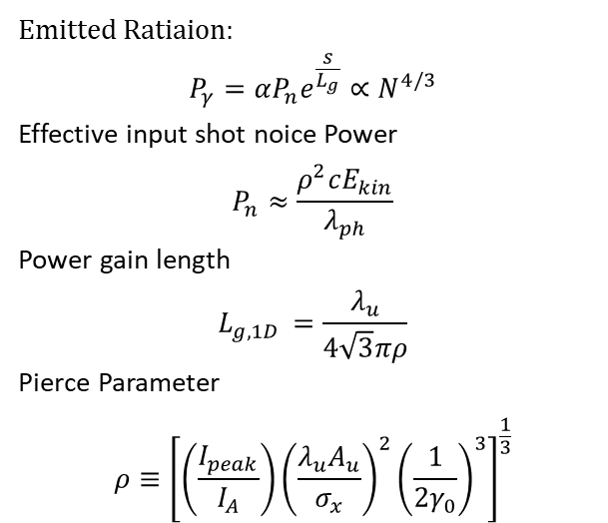
Basic FEL physics
Generation of X-rays through the SASE (Self-Amplified Spontaneous Emission) process.
Emitted Ratiaion:
$$P_{γ}=αP_{n}e^{\frac{s}{L_{g}}}∝N^{4/3}$$
Effective input shot noice Power
$$P_{n}≈\frac{ρ^{2}cE_{kin}}{λ_{ph}}$$
Power gain length
$$L_{g,1D }=\frac{λ_{u}}{4\sqrt{3}πρ}$$
Pierce Parameter
$$ρ≡{\left[\left(\frac{I_{peak}}{I_{A}}\right){\left(\frac{λ_{u}A_{u}}{σ_{x}}\right)}^{2}{\left(\frac{1}{2γ_{0}}\right)}^{3}\right]}^{\frac{1}{3}}$$
Why a high brightness beam?
Brightness Definition:
$$B_{n}=\frac{I_{peak}}{ε_{x,n}^{2}}$$
Peak Current
$I_{peak}=\frac{Q_{bunch}}{\sqrt{12}σ_{t}}$
Pierce Parameter:
$$ρ∝{\left(\frac{I_{peak}}{σ_{x}^{2}γ_{0}^{3}}\right)}^{\frac{1}{3}} ∝{\left(\frac{I_{peak}}{β_{x}ε_{x,n}γ_{0}^{2}}\right)}^{\frac{1}{3}}∝{\left(\frac{I_{peak}}{{ε_{x,n}^{2}γ}_{0}}\right)}^{\frac{1}{3}}∝{\left(\frac{B_{n}}{γ_{0}}\right)}^{\frac{1}{3}}$$

Slide 18
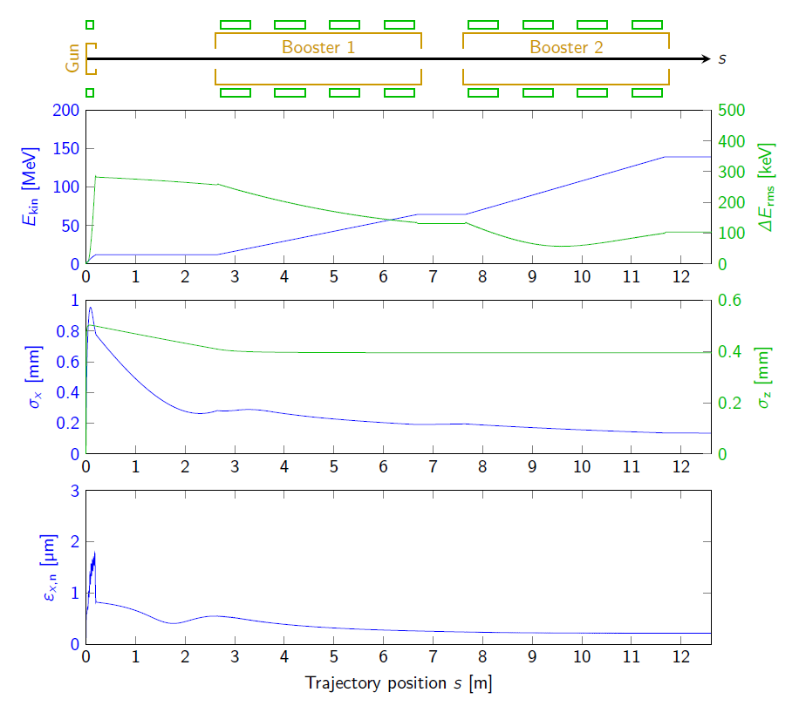
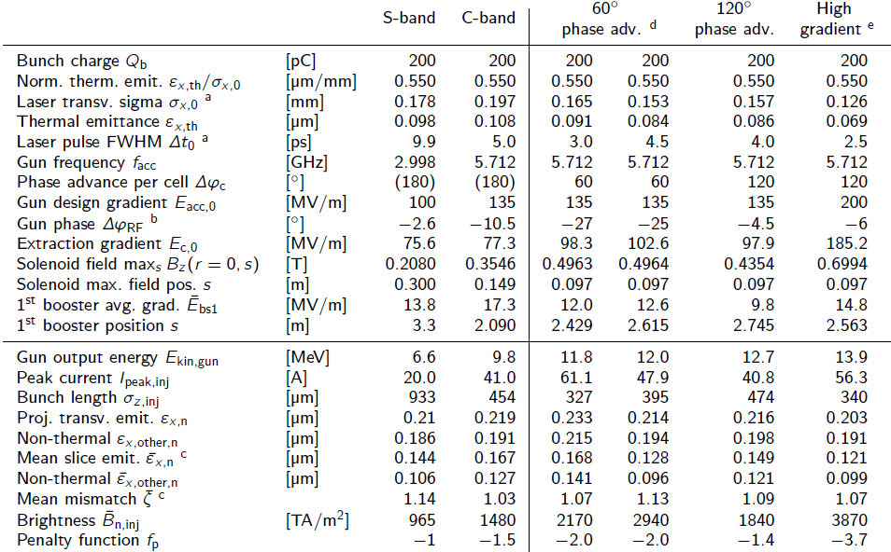
Beam Dynamics and FEL Figures of Merit
Beam dynamics calculations from M. Schaer’s thesis.

Slide 19
Applications to Inverse Compton Sources

Slide 20

Inverse Compton Scattering Basic Physics
Number of Scattered X-ray:
$$N_{x}=\frac{N_{e}N_{L}σ_{T}}{2π(σ_{L}^{2}+σ_{x}^{2})}FF$$
Resonant wavelength:
$$λ_{x}=\frac{λ_{L}}{2γ^{2}\left(1−β_{z}cosφ\right)}(1+γ^{2}θ^{2})$$
Brilliance:
$$B_{x}≈1.5×{10}^{−3}\frac{N_{e}N_{L}σ_{T}γ^{2}}{{\left(2π\right)}^{3}ε_{x,n}^{2}σ_{L}^{2}}F_{rep}$$

Slide 21
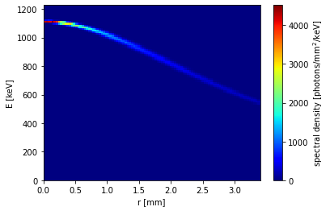
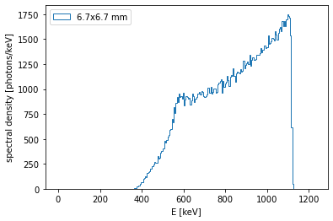
ICS Calculations
TW gun and two C-band accelerators
ICS calculator developed as part of Smart*Light ICS project: L. Stoel, J. Schoonwater, O.J. Luiten.
An advantage of ICS is the ability to access MeV level X-rays relatively simply compared to other X-ray sources.

Slide 22
Conclusion
A Travelling Wave RF photogun is under design at PSI as part of WP 7.4 of IFAST.
The design is based on work performed by M. Schaer for his PhD thesis.
Modifications have been made to ease manufacturing tolerances.
TW Gun will be sent for fabrication in mid 2022 and will be tested to high power subsequently.
When applied to an FEL it has the ability to increase the beam brightness by a factor of 4 when applied to the SwissFEL gun.
When applied to a compact compton source it reduces the complexity of the RF network by allowing the gun and accelerating structures to be powered by a single klystron modulator.

Slide 23
Acknowledgements
Mattia Schaer whose PhD thesis this work is based on.
Paolo Craievich, Riccardo Zennaro, Jean-Yves Raguin, Fabio Marcellini and Marco Pedrozzi of PSI RF group. Reto Fortunati of Mechanical Group.
Jom Luiten whose ICS code was used for distributions.

Slide 24
Thank you
Any Questions?

