Slide 1
Development Areas for Cargo Inspection Linacs
Mike Jenkins
Rapiscan Systems

Slide 2
Areas of Development
Higher Speed Systems
Dose Optimisation
Multi-View Systems

Slide 3
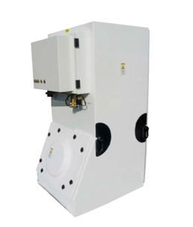
Current Linac Parameters
1 MeV | 2.5 MeV | 6/4 MeV
Single Energy | Single Energy | Dual Energy
X-band | X-band/S-band | S-band
π/2 mode (bi-periodic) | π/2 mode (bi-periodic/side coupled) | π/2 mode (side coupled)
Diode Electron Gun | Triode Electron Gun | Diode/Triode Electron Gun
Up to 400Hz | Up to 1000Hz | Up to 1000Hz
Up to 1rad/min @ 100Hz | Up to 10rads/min @ 100Hz | Up to 200rads/min @ 100Hz
Linacs used in cargo inspection systems are generally:
Normal conducting electron linacs
Standing wave RF structures
RF source is a magnetron
Self contained systems
  Monoblock style
  Separate modulator and x-ray head

Slide 4
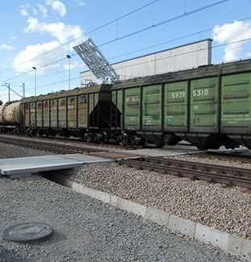
Higher Speed Systems
There is demand in the security market for systems that can image conveyances travelling through the system at higher speeds
The maximum speed that the conveyance can travel through a system at is determined by:
  the line width
  the maximum repetition rate of the linac

Slide 5
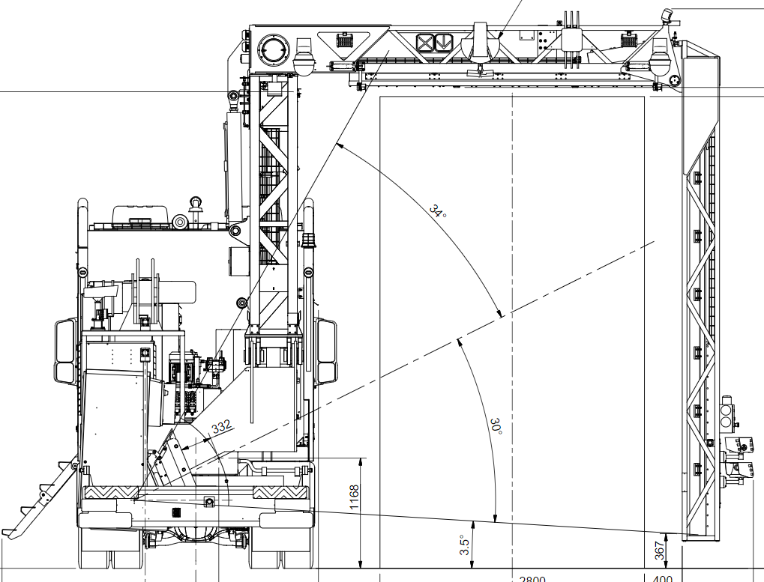
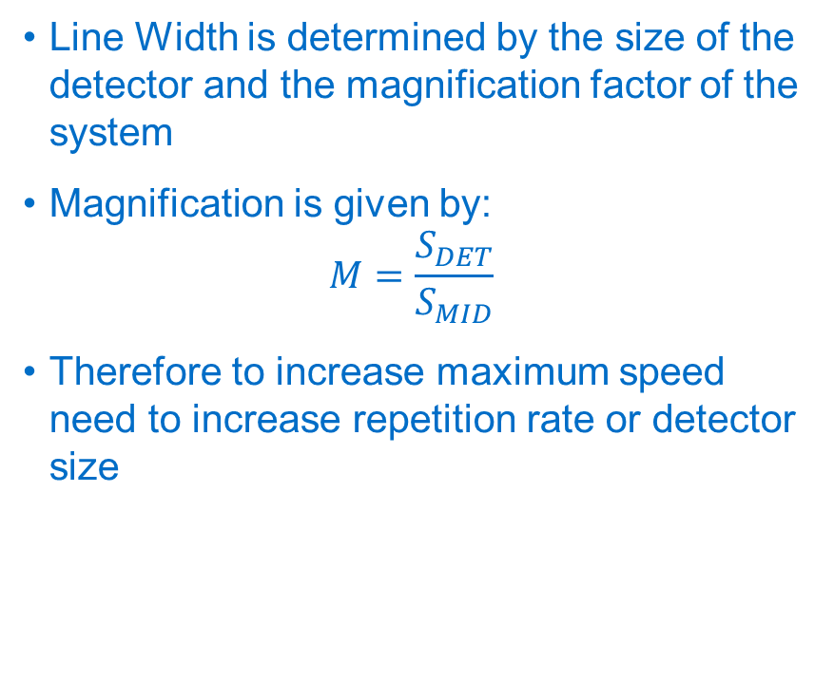
Line Width
Line Width is determined by the size of the detector and the magnification factor of the system
Magnification is given by:
$$M=\frac{S_{DET}}{S_{MID}}$$
Therefore to increase maximum speed need to increase repetition rate or detector size

Slide 6
Ways to Increase Repetition Rate
New RF sources which have higher average power limits and higher duty factors
Change how material separation is done
Any other options?

Slide 7
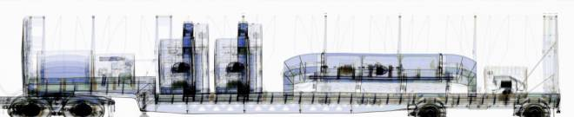
Material Separation
This is an industry standard requirement where different materials need to be identified within an image
To do this dual energy linacs are used which interleave high and low energy pulses
Typically the high and low energy pulses have different RF peak power and different gun currents
If we can have two energy pulses in one RF pulse we double the effective repetition

Slide 8
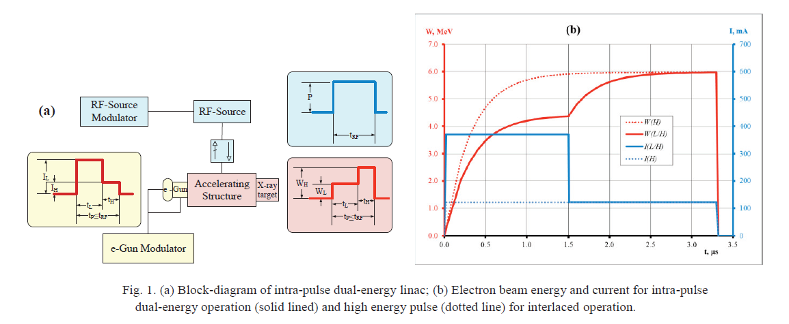
Intra-Pulse Dual Energy Systems

Slide 9
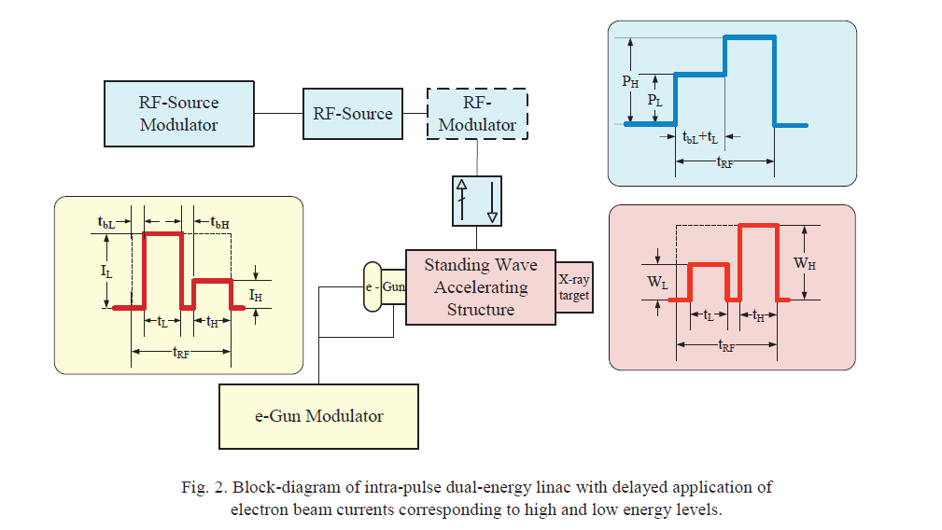
Intra-Pulse Dual Energy Systems

Slide 10
Dose Optimisation
We are seeing requirements for higher performance systems and for systems with smaller exclusion zones
  Higher performance systems typically require higher dose output linacs
  Smaller exclusion zones require lower dose and/or less leakage radiation
How to optimise usable dose from the system whilst minimising leakage?
  Brute force method is add more shielding around the linac
  Is there a better way?

Slide 11
Beam Transport
Most leakage radiation is due to electrons not being captured and transported
Improving capture and beam transport is therefore key
Linacs used for security scanning typically don’t have any beam focusing elements
Do we need to look at including these or would optimising the linac designs give sufficient improvements?

Slide 12
Multi-View Systems
Increasing numbers of tenders for systems which image cargo in multiple planes
Rapiscan already have this style of system using tube sources, looking at development options for linac based systems
Most common are requests for dual view systems which image through the side and top
Potentially advantageous to image in more than two planes

Slide 13
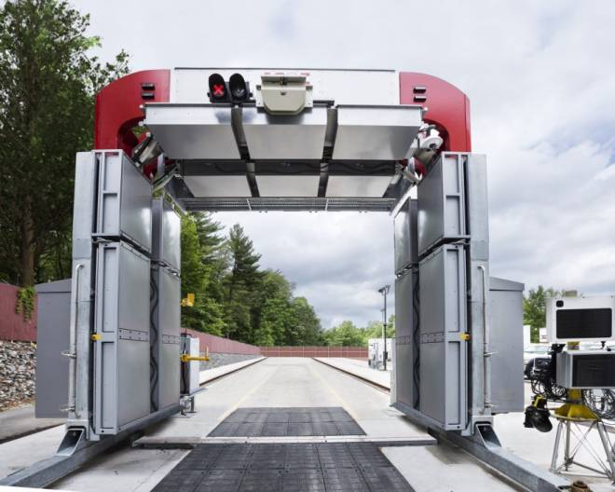
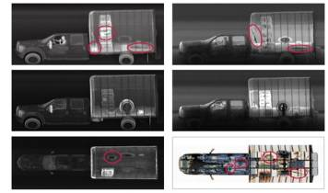
Z-Portal
Backscatter
Transmission

Slide 14
Challenges
Most linac based multi-view systems duplicate the entire linac for each view point
This makes these style of systems very costly
How do we make this cheaper?
  Use beam transport systems to have one linac but multiple targets?
  Have a common RF system between linacs – duplicate the cavity and electron gun systems?
Is there a solution that gives better performance?

Slide 15
Summary
Significant development areas remain within the security linac market
Key drivers are the customer requirements
  Seeing increasing performance requirements
  Higher throughput/faster conveyance systems
  More complex systems (dual view)
  Price

