Slide 1
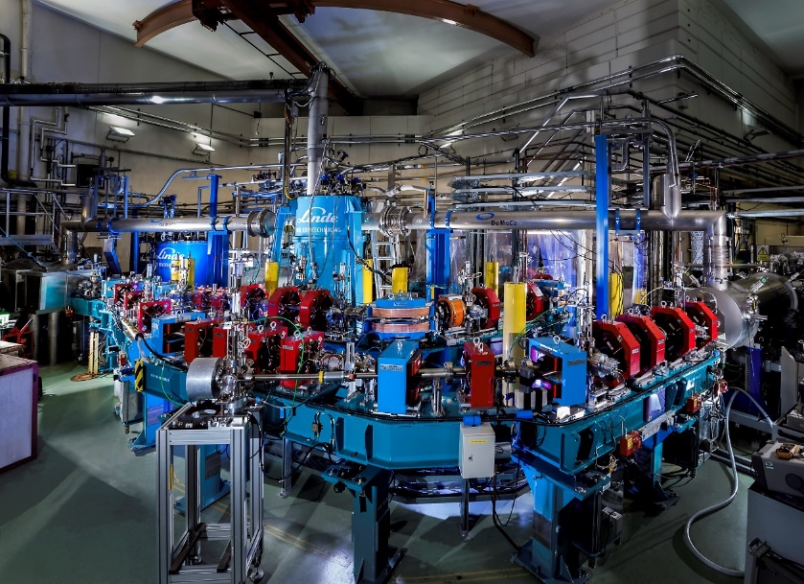

(Electron) Energy Recovery Linacs & Their Future Applications in Imaging
Peter Williams
Accelerator Physicist
STFC Daresbury Laboratory & Cockcroft Institute
iFAST Accelerator Imaging sub-task meeting
10th January 2022

Slide 2
What Is An Energy Recovery Linac?
Linear
Accelerator
Recirculating
Linac
Energy Recovery
Linac
Ring
(Cyclotron, Synchrotron
Storage Ring…)
Excellent beam quality
Beam disruption tolerant
Average beam current limited
High average beam current
Lower cost than linac
Beam quality limited
Beam disruption limited
High average beam current
Beam start
Excellent beam quality
Beam disruption not limited
Average beam current limited
Expensive
Beam end
Accelerating cavity
Notes:
Typical times for reaching equilibrium are 1-10 ms

Slide 3
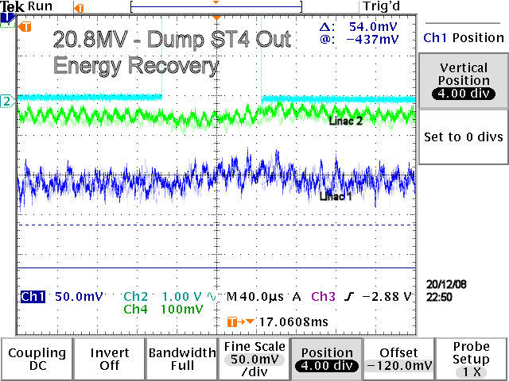
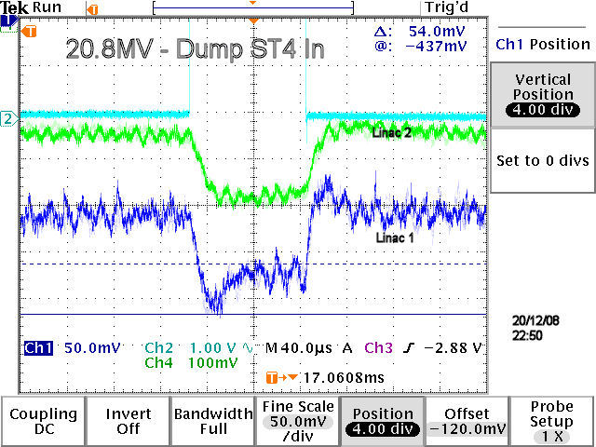
accelerating
E_{z}(z)
decelerating

Slide 4
ERLs Widen the Applications of Electron Accelerators Because…
  Provide (nearly) linac quality/brightness beam at (nearly) storage ring beam powers:
    P_{beam} >> P_{RF}
    beam quality source limited: e_{beam} < e_{ring equilibrium}
  Radiation control: allows us to dump beam at low energy
    can mitigate intractable (i.e. expensive) environmental/safety concerns
  High power beam with reduced RF drive ⇒ allows us to consider higher power applications than would otherwise be unaffordable = GW class electron beams
  ERLs Apply Wherever You Need An Electron Beam With Simultaneous High Quality AND High Average Power:

Slide 5
How ERLs Can Impact Imaging
  ERLs Apply Wherever You Need An Electron Beam With Simultaneous High Quality AND High Average Power:
      Driving Free-Electron Lasers – provide coherent EUV to X-ray photons → imaging.
        ERLs overcome the power limit of storage ring FEL (short bunch, lasing disruption)
      Driving Compton Sources – particularly for gamma (MeV) photons → imaging.
        overcome small Compton cross section, preserve small spectral bandwidth
        Use Compton generated MeV photons to produce novel medical isotopes exploiting narrowband resonances → imaging.
      NOT:
      Driving brem sources – linacs cheaper, ERL beam quality not required
      Driving spontaneous SR sources – storage rings cheaper, SR damping sufficient

Slide 6
ERLs for Free Electron Lasers

Slide 7
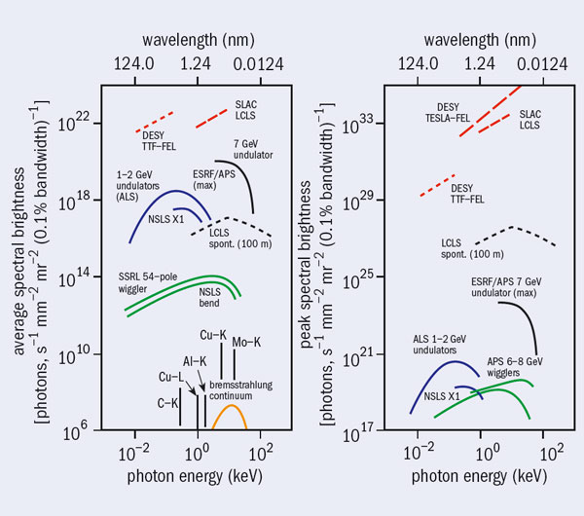
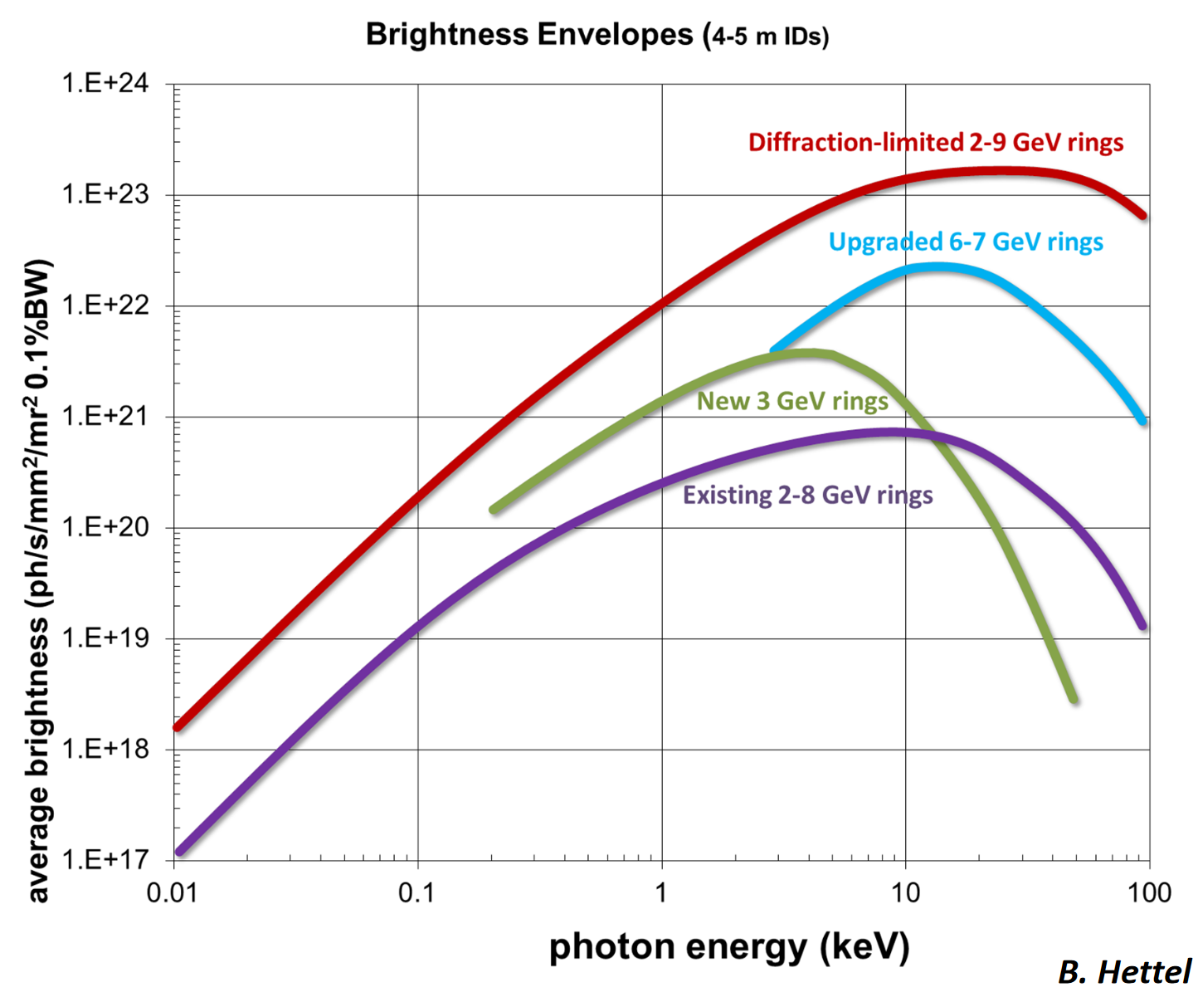
Why ERLs for Free Electron Lasers?
Free electron lasers offer simultaneous transverse and longitudinal coherence and peak brightness approaching 10 orders of magnitude improved with respect to spontaneous SR sources = VERY attractive for chemistry, biology, drug development, materials development etc etc. Hence the new generation of XFEL facilities: LCLS-1 & 2, Eu-XFEL, SHINE
To date however, FELs limited in AVERAGE brightness with respect to “4th generation” spontaneous SR sources e.g. ESRF-EBS. Why? The lasing process is too good at extracting power from the electron beam and putting it into the radiation, so the spent beam is too “screwed up” to store in a storage ring. Answer: don’t store it, throw it away = single use of bunches = repetition rate of radiation limited to repetition rate of linac and beam power can only equal RF drive power. Eg to reproduce a typical storage ring (Spring-8): 8 GeV and 500 mA current = 4 GW RF drive power required!
ERLs free us from that constraint: Don’t store the beam, instead recover it’s energy and pass it to the next bunch.
11 year old comparisons of average (left) and peak (right) brightness of XFELS (red) and 3rd generation SR sources (blue, black, green) and table top sources (bottom left only) – from CERN Courier, November 2010
The upgraded “4th generation” SR sources like ESRF-EBS recapture the crown in terms of average brightness (blue)… but now nearly physics limited (red)

Slide 8
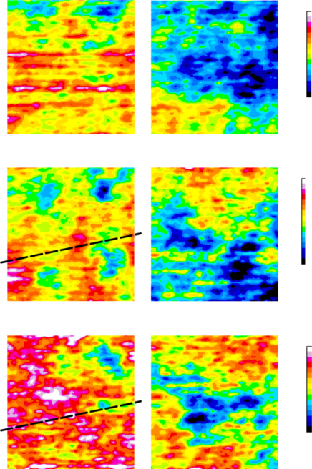
ERLs for FELs – Where we are now
The application of ERL-FELs to “the real world” (not just imaging) is in its infancy… an example using IR-FEL to image DNA distribution:
Daresbury ALICE (2005 – 2017)
Multiyear user program on Oesophageal cancer diagnosis technique
Oesophageal adenocarcinoma often progresses from Barrett's oesophagus: lining of the oesophagus is damaged by stomach acid and changed to a lining similar to that of the stomach.
The challenge is to identify patients with Barrett’s oesophagus who will develop oesophageal cancer – present diagnosis method subjective – leads to false positives
High intensity and ease of wavelength tune-ability key here – scan across tissue samples at 3 precisely chosen wavelengths – replicating DNA fluoresces differently to benign – differential image analysis identifies which samples are cancerous
Since discontinuation of ALICE, work continues with lower flux FELIX
Cancer
Barretts
7.0μm
7.3μm
(protein)
8.05μm
(DNA)
reflected IR light
Fibre tip
IR light
Sample
Scanning Platform

Slide 9
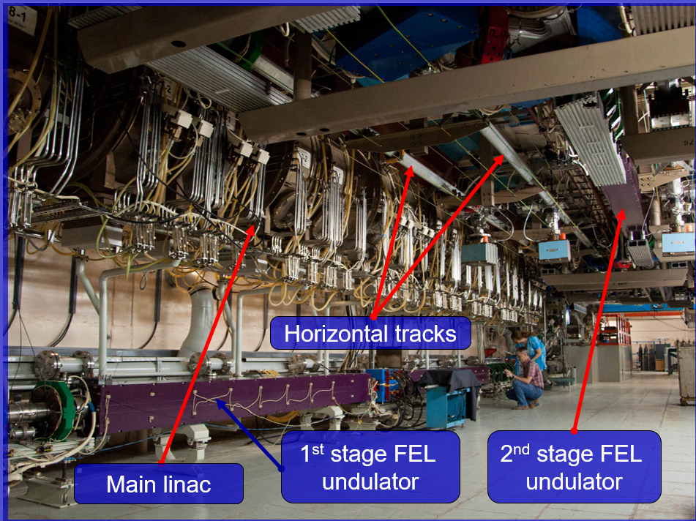
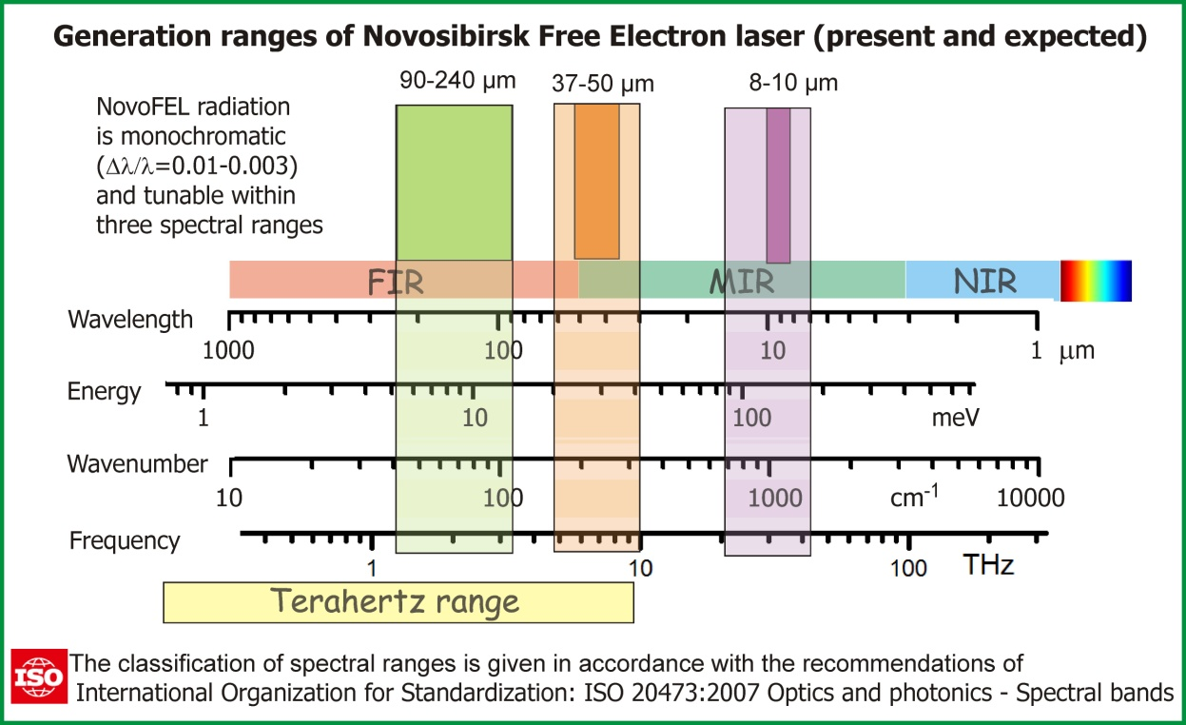
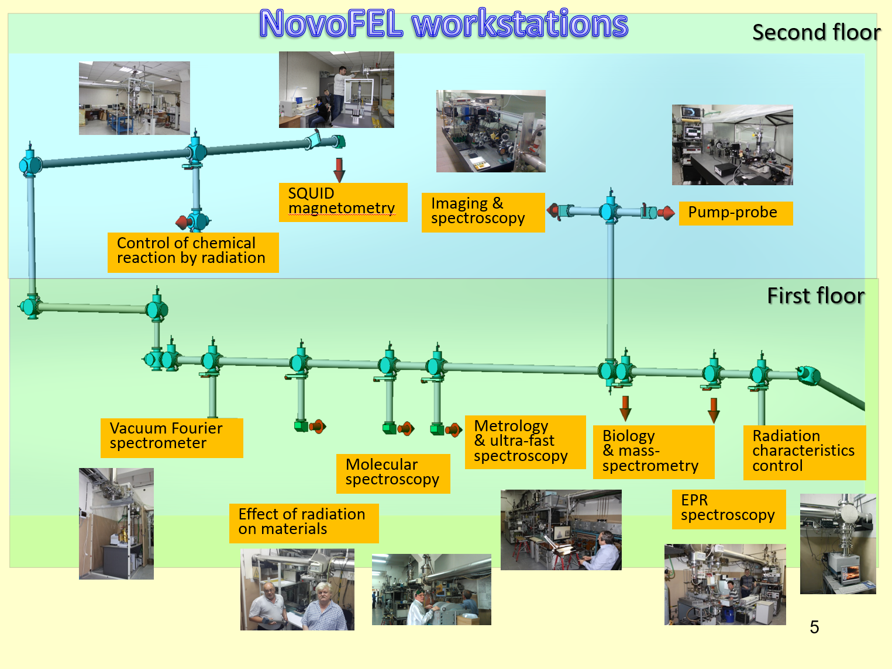
ERLs for FELs – Where we are now
The application of ERL-FELs to “the real world” (not just imaging) is in its infancy… an example of pump-probe type experiments using IR + THz
Budker Inst. NovoFEL (2003 – present)
THz & IR for biological research

Slide 10

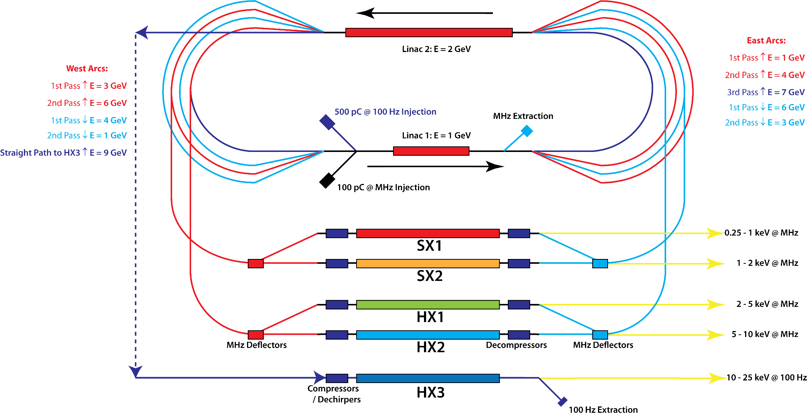
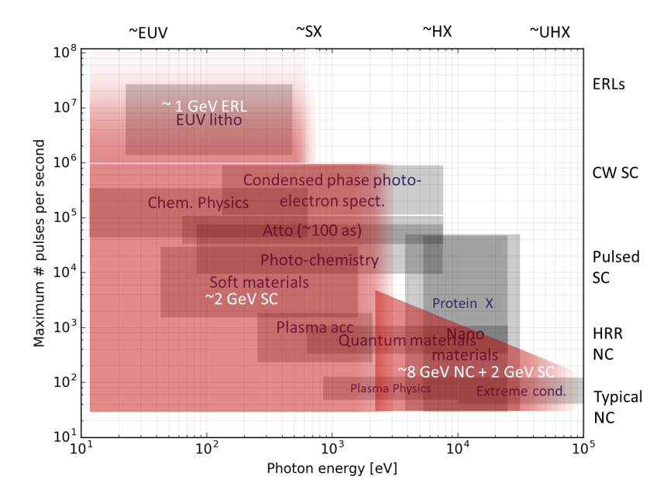
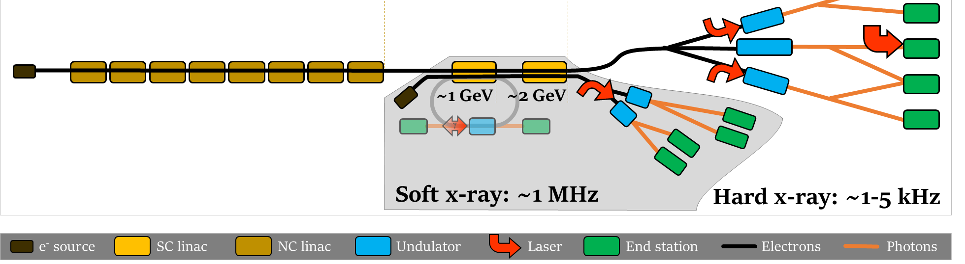
ERLs for FELs – Where we are going
Nm scale EUV radiation likely to be the most important application of ERL-FEL’s, but not the only. This has been recently explored in the context of the UK-XFEL facility proposal, (also at SHINE – Shanghai … and also for LHeC)
UK-XFEL:
Proposal to drive hard X-ray FELs with ERL directly – enables type of oscillator FEL termed XFELO – capable of producing transform limited pulses = single cycle X-rays, also large harmonic powers – potentially extending FEL pulses to MeV photon scales. Deemed too ambitious in the context of the proposal! … so …
…2020 Science Case https://www.clf.stfc.ac.uk/Pages/UK-XFEL-science-case.aspx includes science that could be addressed by incorporating a ~1 GeV ERL into a larger UK-XFEL facility. ERL drives soft X-ray FEL at high average power, enabling lithography & seeding of the hard X-FELs… providing a high power seed pulse results in superior output compared to the SASE lasing seen in Eu-XFEL and LCLS-2 by introducing longitudinal coherence = eliminating noisy pulses. A seeded XFEL can therefore be considered the second generation of XFEL.
Left: Plot of photon energy vs pulse repetition rate shows potential application areas – ERLs sit at the top
Concept UK-XFEL facility incorporates ERL for soft X-ray & ICS gammas

Slide 11
ERLs for Compton Sources

Slide 12
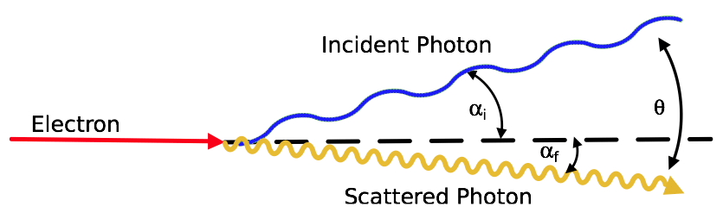
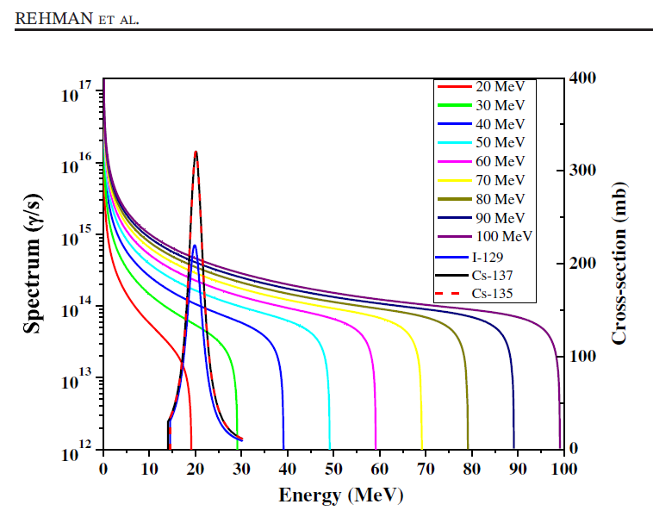
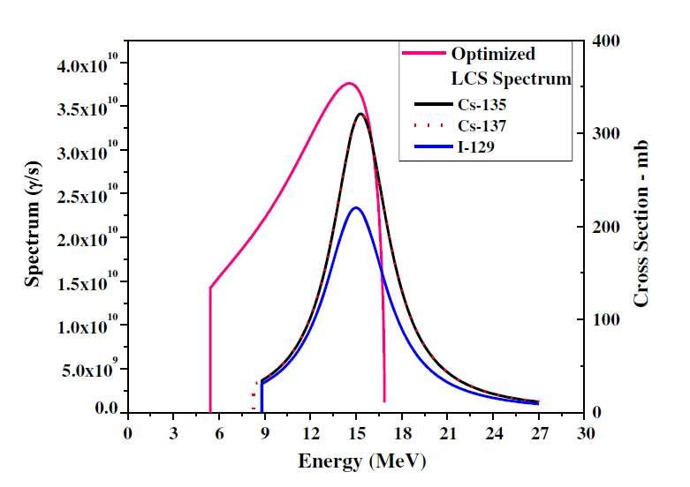
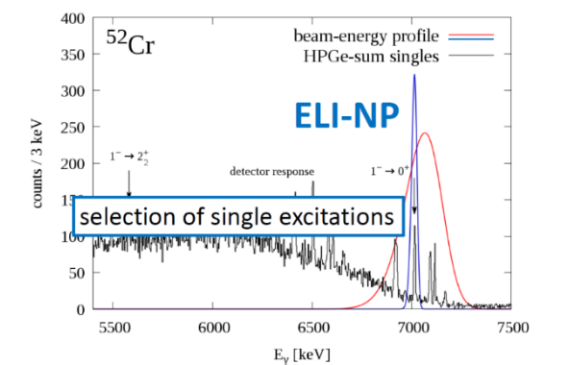
Why ERLs for Compton Gamma Sources?
Two situations for Compton sources:
X-ray (< 300 keV) – same output photon energy as large synchrotrons, but with a smaller cheaper accelerator
Gamma (MeV) – no narrowband competitor source, only brem (broadband)
Narrowband due to energy-angle correlation of cross section in combination with collimation. Existing sources are lower flux equilibrium storage rings – NewSUBARU (Spring-8 Campus, Japan) and HIγS (Duke U, USA). As with FELs, limitation is disruption to stored beam. ELI-NP VEGA partially mitigates this as ring is non-equilibrium
Example: broad photonuclear “dipole resonances” of nuclear structure are not well matched to brem energy spectrum
Raw, loosely collimated ICS gamma bandwidth well matched to dipole resonance, and flux enabled by ERL compensates for lower cross section of ICS vs brem
Brem spectra compared to dipole resonances of I-129 and Cs-135/137
ICS spectrum compared to dipole resonances of I-129 and Cs-135/137
Most exciting implications however when can narrow bandwidth below typical nuclear excitation spacings of 10 – 100 keV → selective excitations of single nuclear modes “nuclear photonics”.

Slide 13
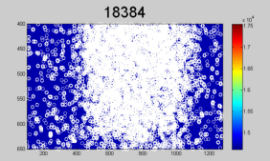
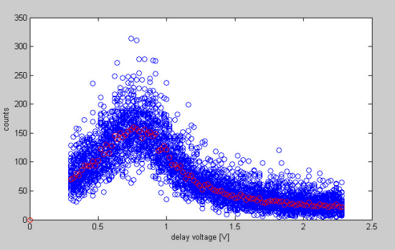
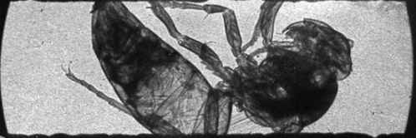
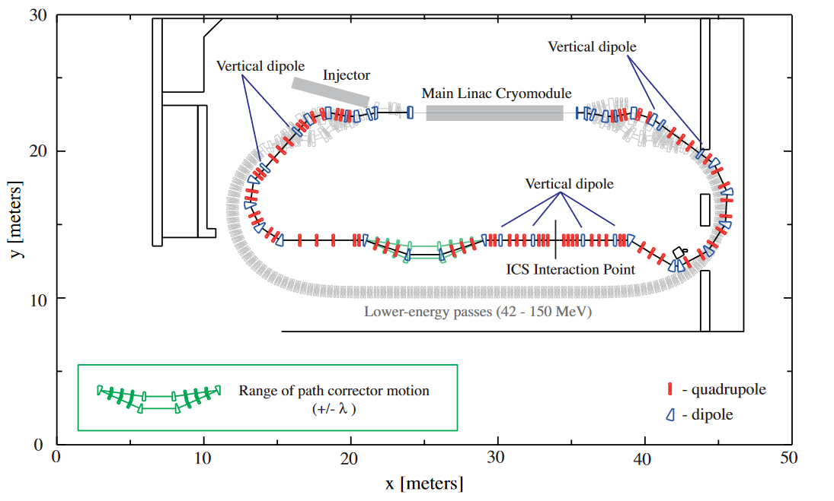
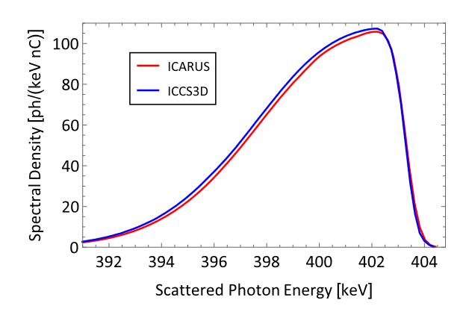
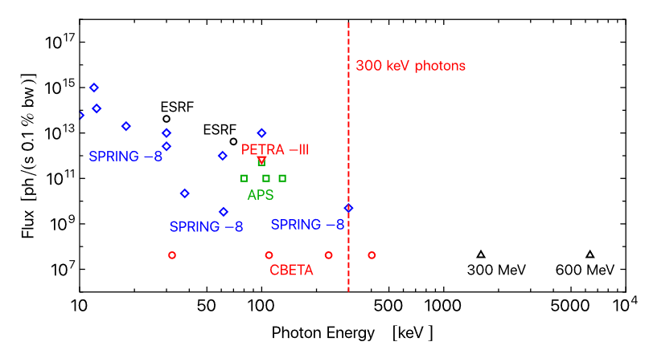
ERLs in Compton Sources – Where we are now
Test experiments carried out on Daresbury ALICE (2009) … & KEK cERL (2015)
Design for ICS source on existing CBETA ERL https://doi.org/10.1103/PhysRevAccelBeams.24.050701
Flux and brilliance at largest SR sources (Spring-8, ESRF, APS, PETRA-III) fall off rapidly above 100 keV such that CBETA (much smaller machine) outperforms them above 300 keV. The independence with energy implies a step change in capability for higher energies (black triangles show examples at 300 and 600 MeV electron beam energy)

Slide 14
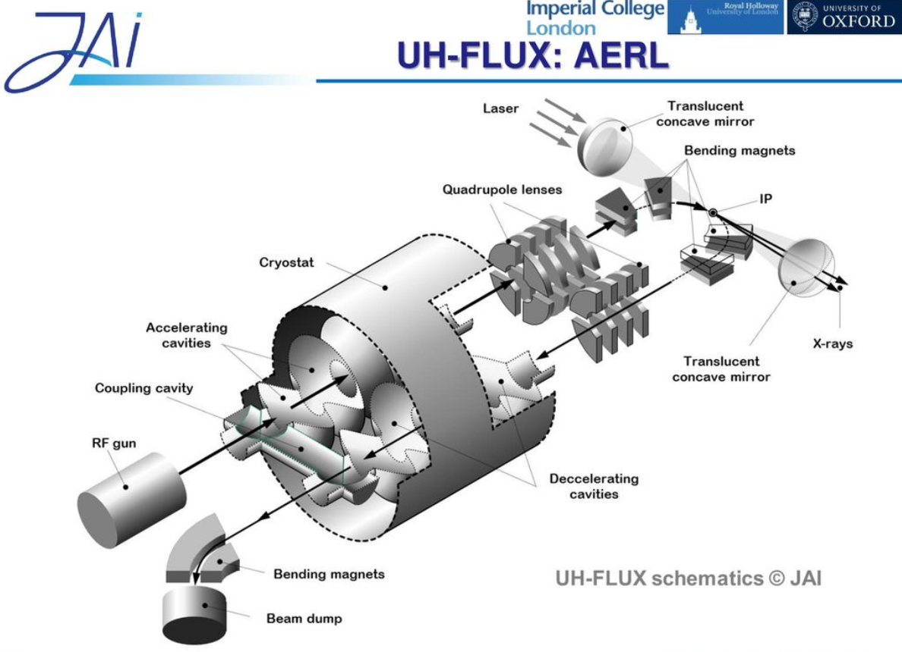
ERLs in Compton Sources – Where we are now
Compact design for ICS source using twin-axis cavities
I. V. Konoplev, K. Metodiev, A. J. Lancaster, G. Burt, R. Ainsworth, and A. Seryi https://doi.org/10.1103/PhysRevAccelBeams.20.103501
Development of twin axis technology also attractive in context of next high energy physics collider – there is a possibility to base either an ILC-like or FCC-ee-like machine on ERL – see upcoming ECFA / CERN Roadmap on ERLs and appendix on ERL collider proposals

Slide 15
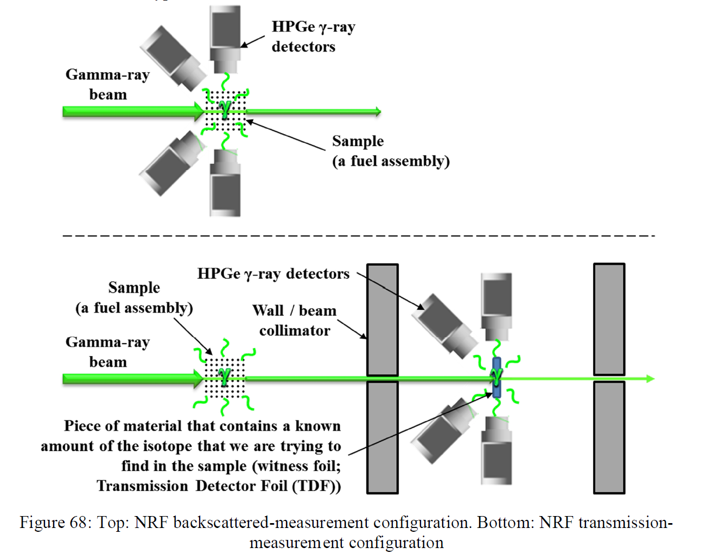
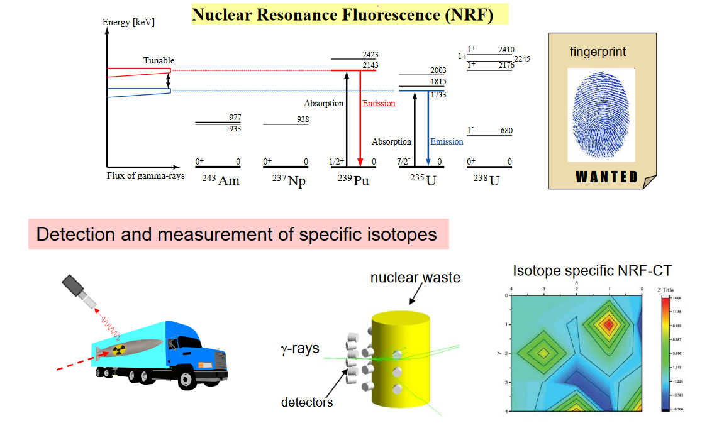

ERLs in Compton Sources – Where we are going - NRF: Security
Next generation ERLs considering ICS sources: UK-XFEL / DIANA, MESA @ Mainz, PERLE @ IJCLab
For gammas in 1-3 MeV range: Nuclear Resonance Fluorescence (γ, γ’), pencil beam of ICS source ideal for Computed Tomography in assay of unknown materials where isotopic differentiation is required
In this example, perform a scan at peak energy 2143 MeV to identify Pu-239, retune the source and scan again at 1733 MeV to identify U-235

Slide 16
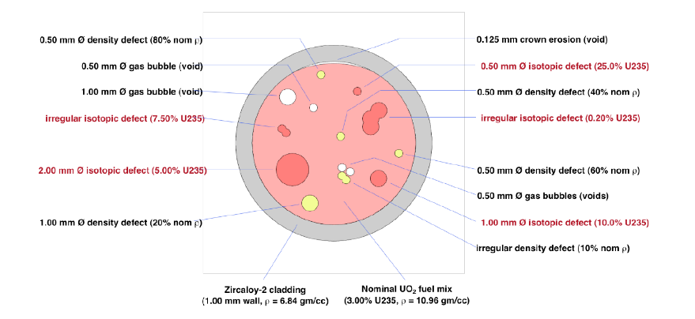

ERLs in Compton Sources – Where we are going - NRF: Security
For gammas in 1-3 MeV range: Nuclear Resonance Fluorescence (γ, γ’), Initial considerations from LLNL on impact of ICS source vs brem for imaging defects in fuel assemblies using NRF – necessary throughput only feasible industrially with high flux source based on ERL
Simulated fuel rod containing isotopic defects
Simulated resulting image from 2 MeV Brem
Simulated resulting image from 1.733 MeV ICS

Slide 17
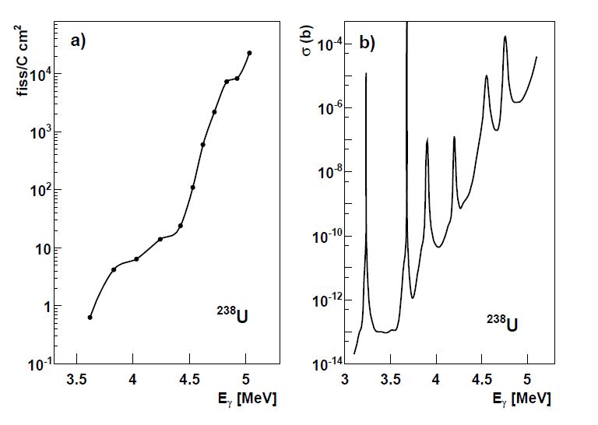
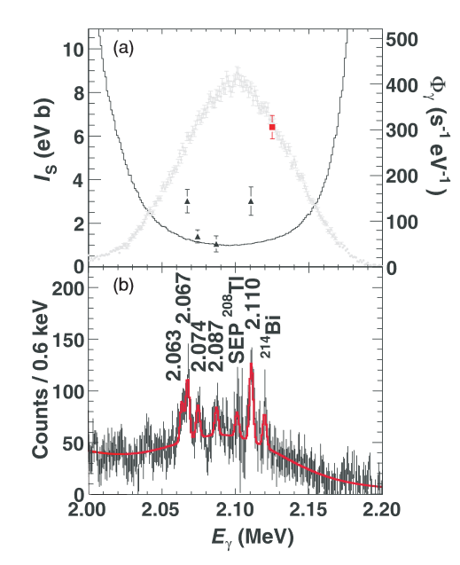
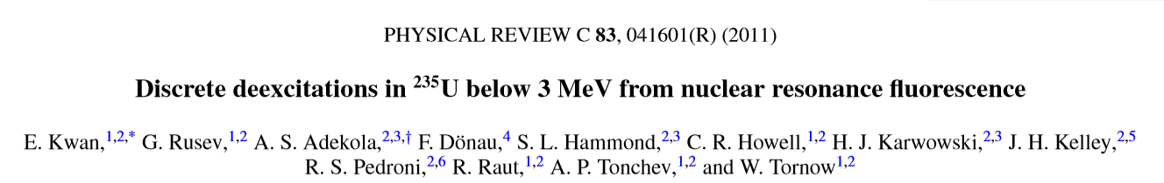
ERLs in Compton Sources – Where we are going: Transmutation
As with atomic energy levels, we expect discrete nuclear energy levels. A broadband source cannot resolve these. A source with bandwidth narrower than typical excitation spacings (~100 keV) would enable selective excitations of single nuclear modes
The observed broad “dipole resonances” of nuclear structure actually composed of multiple sharp resonances, storage ring ICS has identified some of these in establishing nuclear resonance fluorescence
Predicted “hidden fine structure” resonances in photofission cross sections
U-238 seen with Brem
U-238 seen with ICS
Study on HIγS:
“In addition to the nine previously reported transitions for U-235, 13 more were observed for the first time”
“Perspectives for photofission studies with highly brilliant, monochromatic γ-ray beams” P. G. Thirolf et. al., EPJ Web of Conferences 38, 08001 (2012)

Slide 18
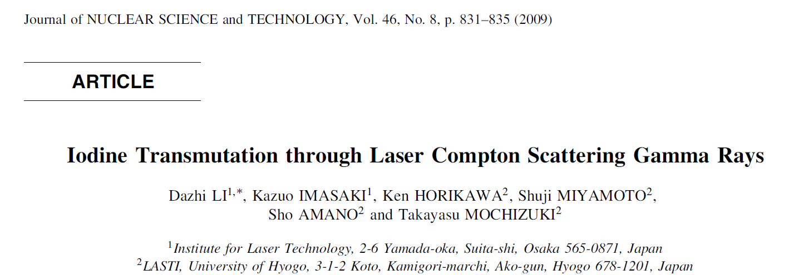
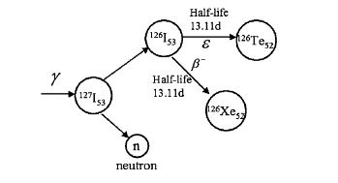
ERLs in Compton Sources – Where we are going: Transmutation
For gammas > 3 MeV: Photonuclear / Photofission (γ, n) (γ, p),(γ, f), Transmutation
“Combining NRF with irradiation at > 5 MeV and narrow bandwidth (0.1 – 0.01 %) are expected to enable development of techniques to possibly selectively transmute specific isotopes. This would allow investigation of improved nuclear waste management techniques via induced photofission of actinides and long-lived fission products. Crucially, a high value source or product oxide could be purified without the need for wet chemical partitioning. Thus allowing purification of a mixture of isotopes, or alternatively selective destruction of a contaminant that has grown into a material. For example, in growth of Am-241 in a can of PuO2 greatly increases operator dose when this is recycled as MOX fuel which could be mitigated if the Am-241 could be eliminated in situ.” Julian Spencer NNL – contributed text to UK-XFEL science case.
Other ideas: Assay of centrifuges whilst in operation??
Demonstration on NewSUBARU storage ring ICS (2009)
Selective transmutation of I-127 using ICS (a stand-in stable isotope to prove the principal for I-129)

Slide 19
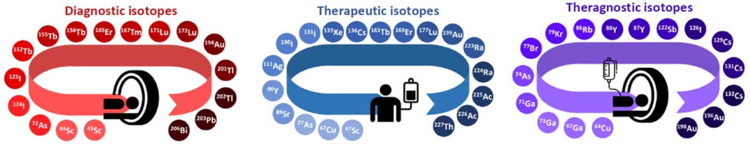
ERLs in Compton Sources – Where we are going: Transmutation for Medical Isotopes
Production of medical isotopes is possible via high-flux ICS γ-ray sources, particularly using (γ,n) reactions. Many isotopes of interest have been identified; we have looked at 28 potential candidates for this production method so far.
In comparison with other methods: cyclotron production, irradiation from research reactors, ISOL methods, the photonuclear route suffers from a deficiency in on-target flux and therefore activity.
For example, ERL expected to produce 〖~10〗^10 ph/s whereas there are ~〖10〗^12 protons/cm^2 s produced in cyclotron methods (MC40 Cyclotron) and ~〖10〗^14 neutrons/cm^2 s produced in research reactor irradiation (MURR) .
In addition, the cross sections for the photo-nuclear reactions are typically smaller than those for other production routes. Advantage may be gained in tailoring gamma ray energies to giant dipole resonance (GDR), particularly if resonance fine structure is established
Most promising candidates are those that are difficult to produce by other means due to a lack of economic production method or a one that results in problematic contaminants
Potential radioisotopes identified by the MEDICIS project for ISOL production.

Slide 20
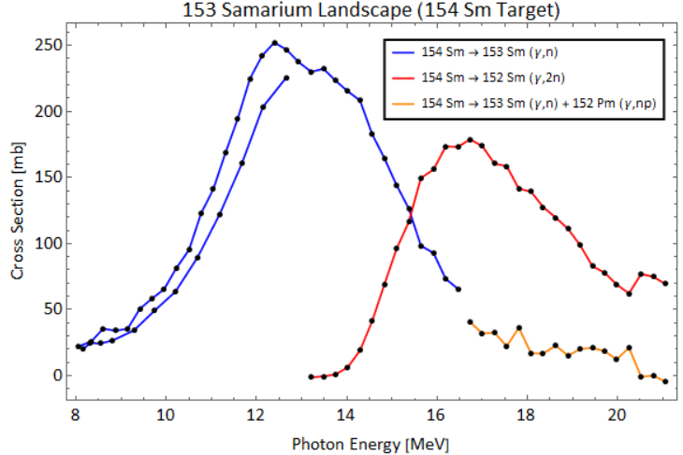
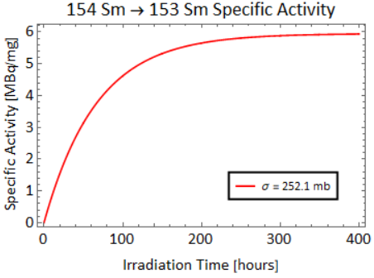
ERLs in Compton Sources – Where we are going: Transmutation for Medical Isotopes
A particular case of note is the production of 153 Samarium – a 𝛽^− emitter used in the palliation of bone metastases. Radiopharmaceutical 153 Sm products include Quadramet (Lantheus) and Lexidronam (Dow Chemical).
However, current production methods using research reactor irradiation (n,γ) lead to long-lived contamination by 154 Europium, reducing the shelf-life of the product.
→ A photo-nuclear production method may avoid this.
Specific activity of 153 Sm as a function of irradiation time for the DIANA ICS source.
Cross section as a function of incident photon energy for a 154 Sm target undergoing (γ,n) reactions.
153 Sm could be produced from a bulk samarium target or enriched 154 Sm target with a cross section peaked at 𝜎=252.1 mb @ 12.39 MeV incident photon energy.
A narrowband ICS source allows the cross section peaks to be targeted.
Bulk Samarium targets carry the additional chance of other isotopes decaying into contaminants… These are just preliminary studies.

Slide 21
Future: An ERL as Part of a UK-XFEL Facility?

Slide 22
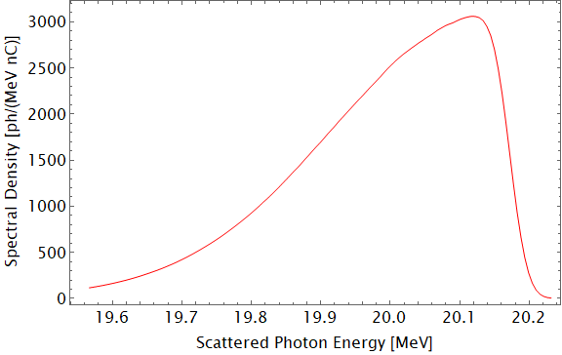
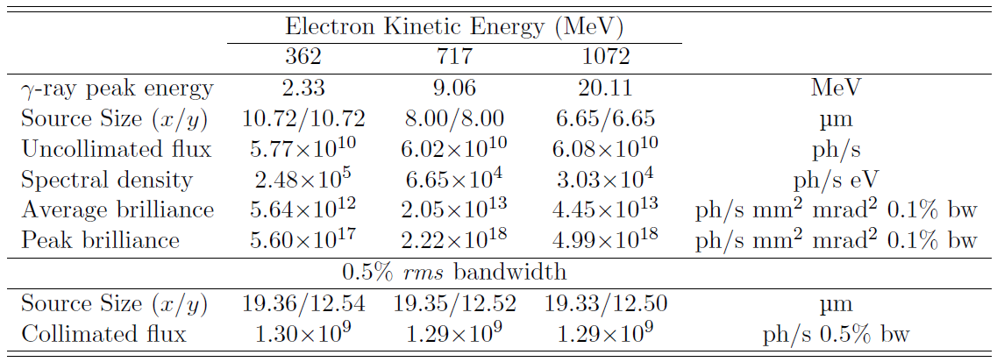
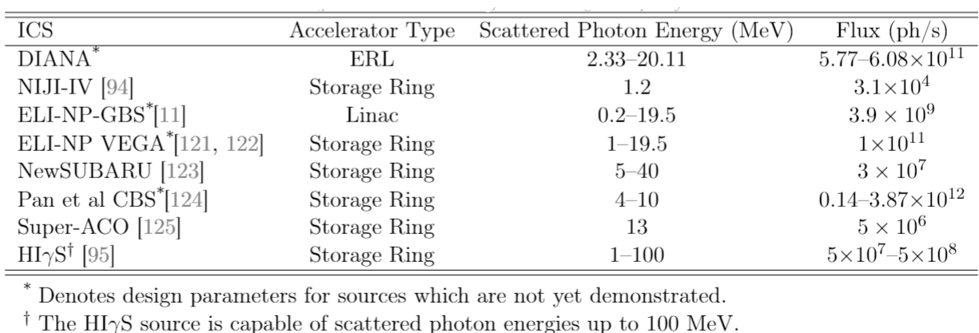

Future: An Energy Recovery Linac As Part of a UK-XFEL?
Incorporating an ERL into a larger UK-XFEL facility would enable a high average power EUV-FEL and Compton source in initial stages of project, and provide seed source for hard X-FEL
Capability would also act as essential testbed for superconducting RF & electron source technologies required for next global particle physics collider – ERL R&D identified as necessary in 2020 ECFA/CERN European Strategy for Particle Physics
The properties of such a gamma source (detailed below) would be superior to all existing and planned sources

Slide 23
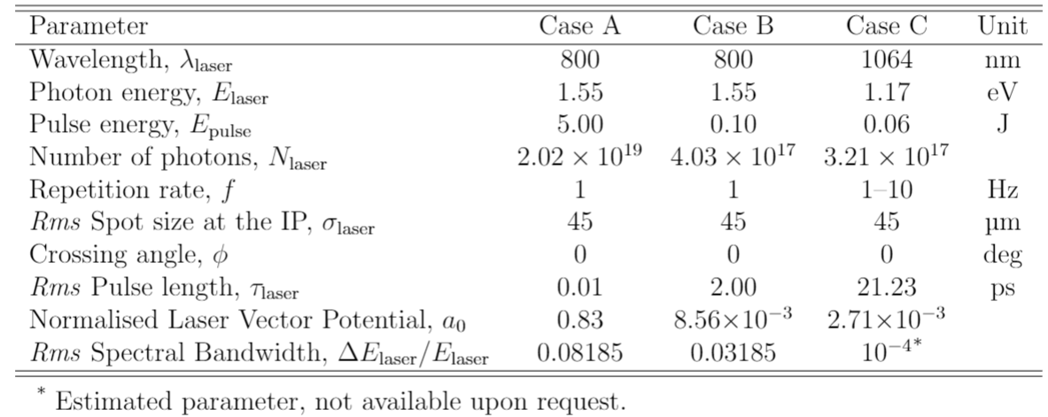
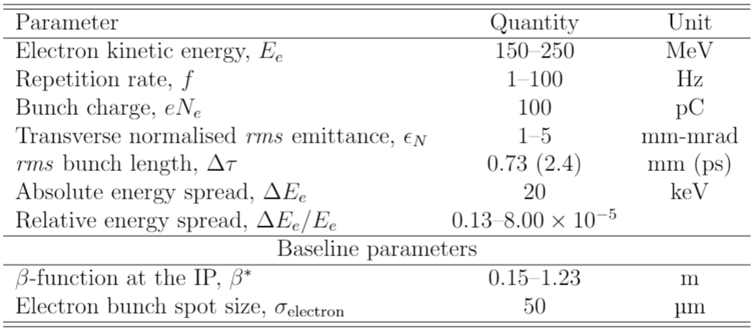
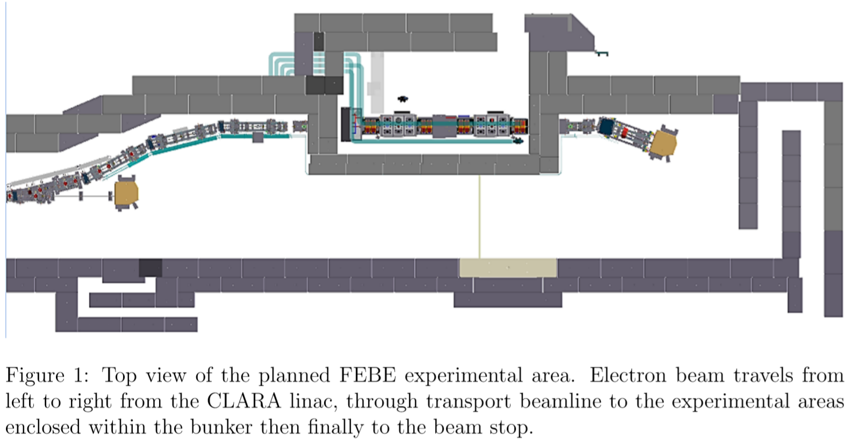
Pathway to an ERL based ICS Source – CLARA Demonstrator
To build community and gain experience a γ-ray ICS source demonstration is being designed for the CLARA linac at Daresbury – this will be low flux as CLARA is a 100 Hz linac, not ~100 MHz (typical for ERL), but can be done soon
Our aim is to demonstrate production, detection and characterisation of the spectrum of collimated γ-rays against semi-analytical spectrum simulations in the linear regime.
Three sets of laser parameters are being considered: the FEBE Ti:Sa laser (full and reduced power) and a Nd:YAG system.
Electron parameters are widely tuneable, delivering a variety of bunch configurations.
Gammas collimated by a lead collimator post interaction of mm scale aperture radius place 10m downstream and then detected by a HPGe detector placed beyond that.
Top: Selection of potential laser parameters at the IP. Bottom: Proposed FEBE design parameters for the electron bunch at the IP.

Slide 24
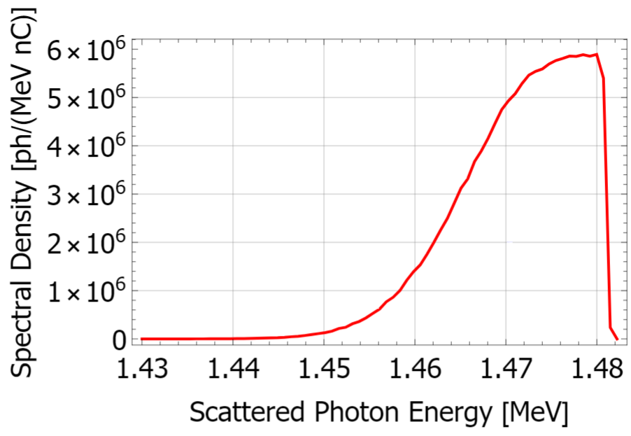
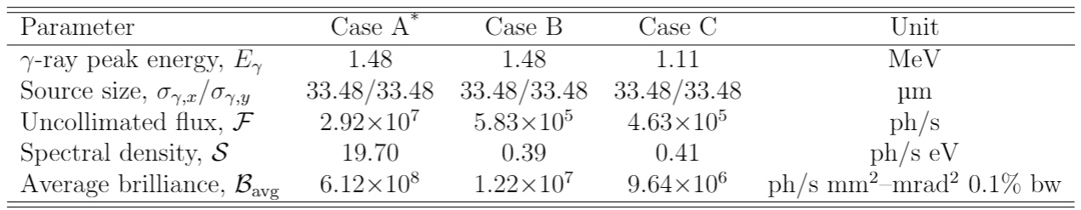
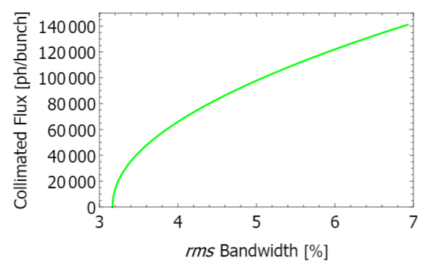
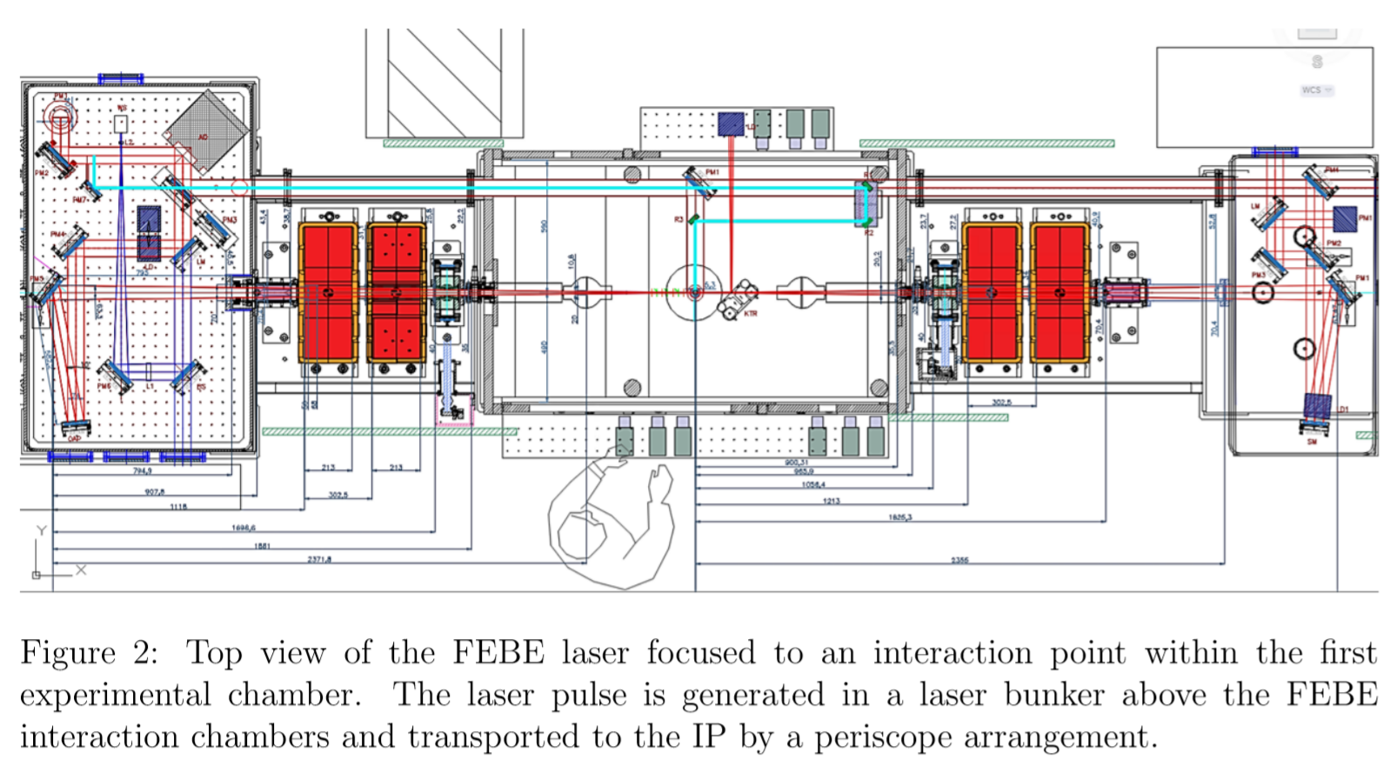
Pathway to an ERL based ICS Source – CLARA Demonstrator
First experiment is designed to scatter 1000 ph/s though a lead collimator to a HPGe detector to detect single photon event. A similar configuration, with larger collimator aperture could be used for NRF test experiments
Predicted spectrum from ICARUS code, spectral yield benchmarked against analytical methods.
Potential future experimentation includes: Nuclear Resonance Fluorescence Studies, High repetition rate experimentation with Fabry-Perot laser resonator cavity, Non-linear (intense laser) inverse Compton scattering experiments, Mitigation of non-linear ponderomotive broadening by laser chirping
Top: ICARUS simulated spectrum of the FEBE ICS experiment for the case B laser. Bottom: Trade-off between collimated flux and bandwidth of the source for the case B laser.

Slide 25
Conclusion
  ERLs can facilitate improved imaging applications through provision of high average power Free-Electron Lasers in the EUV to soft-X ray range, and by Compton sources – in particular in MeV gamma range
  Promising applications in the fields of security, decommissioning, medical isotopes
  There is an opportunity to incorporate an ERL driving an FEL and gamma facility as part of a UK-XFEL facility
  We are developing an incremental pathway towards such a capability through demonstration on existing CLARA accelerator at Daresbury
  Thanks in particular to Joe Crone, Phd Student (Manchester), who produced the Compton calculations. Thanks also to Hywel Owen, Bruno Muratori – Accelerator Physics Group, Daresbury

