Slide 1
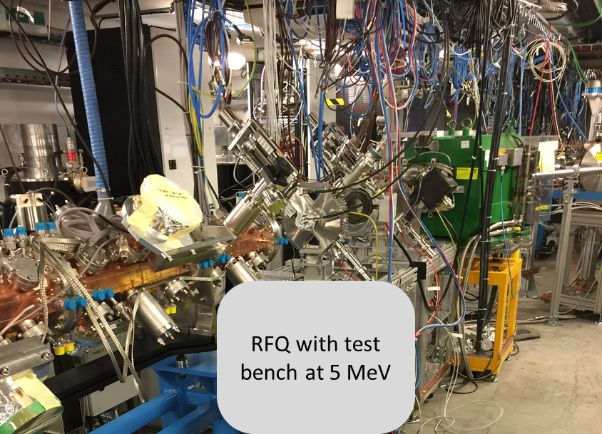
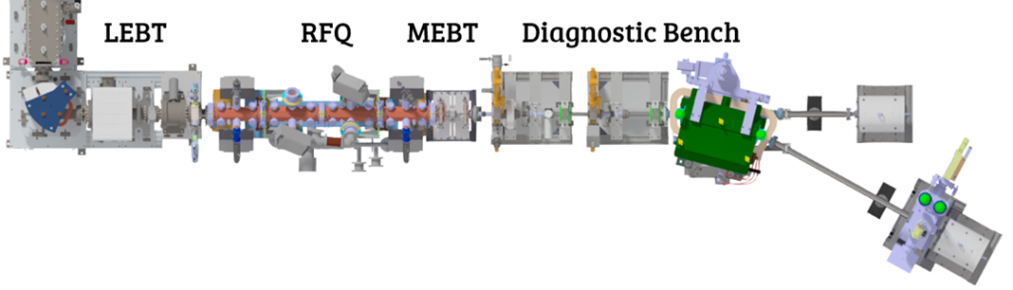
Radio Frequency Quadrupoles for societal use
LOW ENERGY PRE-INJECTOR for ADAM/AVO test facility at SA2
What is it//experience at CERN //potential future uses
The “750MHz” team (layout and beam dynamics, radio-frequeuncy and mechanics) : V. Bencini, A. Dallocchio, V. A. Dimov, M. Garlasché, A. Grudiev, A. M. Lombardi, S. Mathot, E. Montesinos, M. Timmins , H.W. Pommerenke, and M. Vretenar.

Slide 2
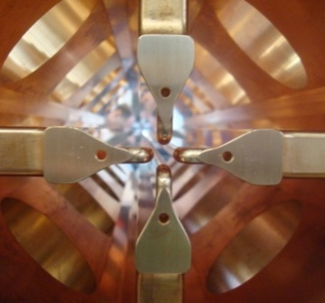
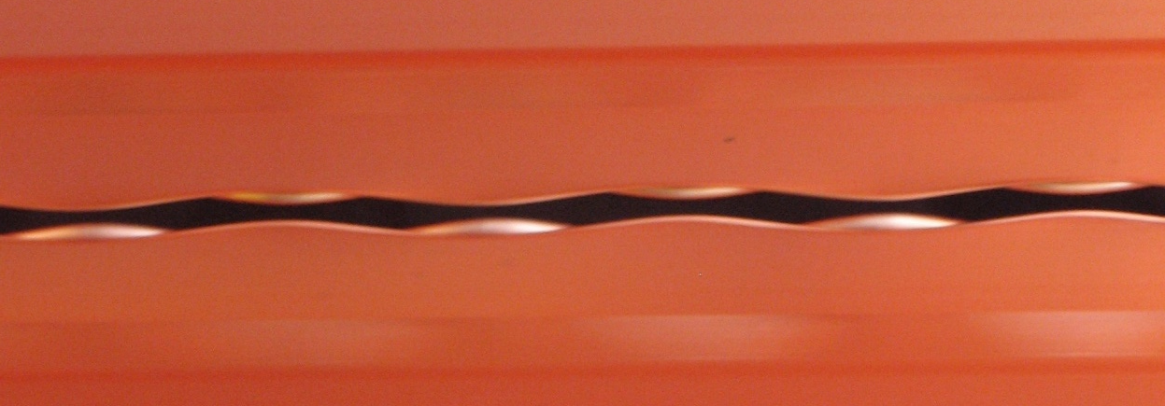
RFQ – first stage in a linear accelerator complex due to its low velocity acceptance
Radiofrequency cavity providing electrical focusing, capture and acceleration
Efficient and easy to operate accelerator for protons in the range 20keV to 5 MeV
Beam goes into the paper in between the 4 vanetips. Distance between the electrodes determines the beam size and the acceptance
Looking in from the RF port : these are adjacent electrodes – longitudinal field for acceleration

Slide 3
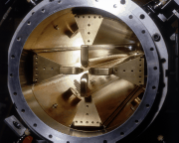
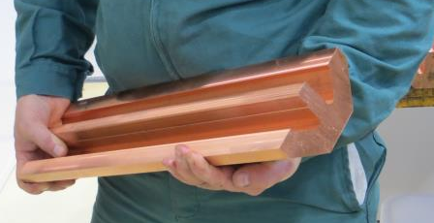
Milestones in the development of RFQ at CERN.
1990 RFQ2 200 MHz 0.5 MeV /m Weight :1200kg/m Ext. diametre : ~45 cm 200mA proton | 2007 LINAC4 RFQ 352 MHz 1MeV/m Weight : 400kg/m Ext. diametre : 29 cm 40 mA H- | 2014 HF RFQ 750MHz 2.5MeV/m Weight : 100 kg/m Ext. diametre : 13 cm 0.1 mA proton

Slide 4
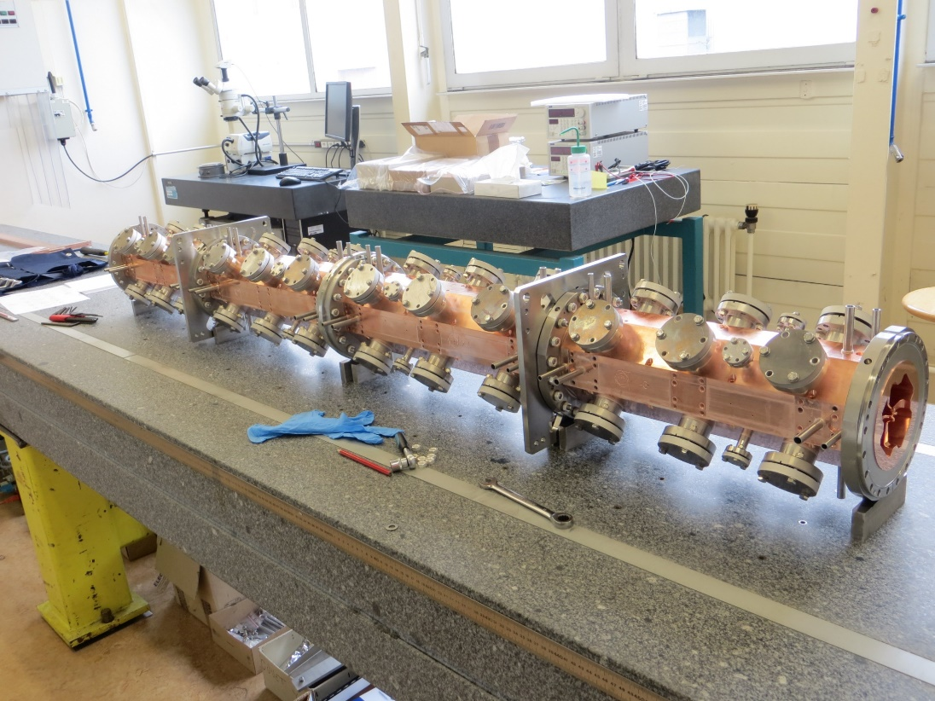
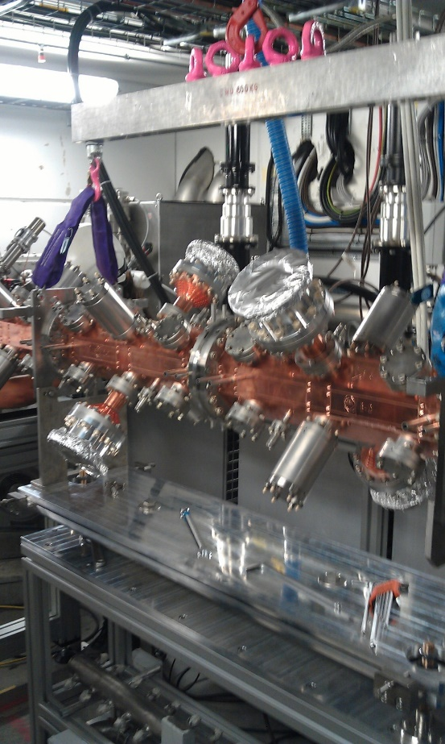
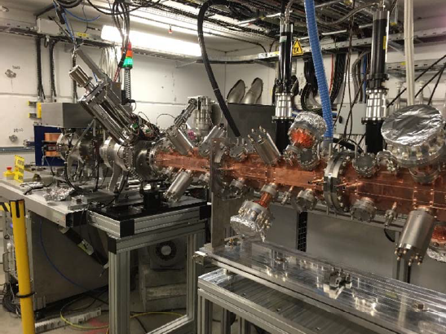

Latest RFQ
Source and RFQ parameters
RF Frequency | 750 MHz
Input | 40 keV
Output Energy | 5 MeV
Length | 2m
Vane voltage | 65kV
Peak RF power | 400kW
Duty cycle / max | 0.4% /(5%max)
Input/Output Pulse Current in 3GHz acceptance | 100/30 µA
Transv. emittance 90% | 0.1 pi mm mrad
Average aperture (r0) | 2mm
Maximum modulation | 3

Slide 5
History
2014
S. Myers : head of office for medical applications
Study efficient accelerator in the energy range few keV to 5 MeV for a LINAC-based hadron-therapy facility (3GHz)
2015-16
2015 Construction and assembly at CERN
2016 installation at SA2 includes a commercial proton source
2017
First beam in February
Validation of the beam dynamics
2017 - present
Used by ADAM/AVO at CERN as a pre-injector for a hadron based facility (tests up to 70MeV)
CERN was granted a patent

Slide 6
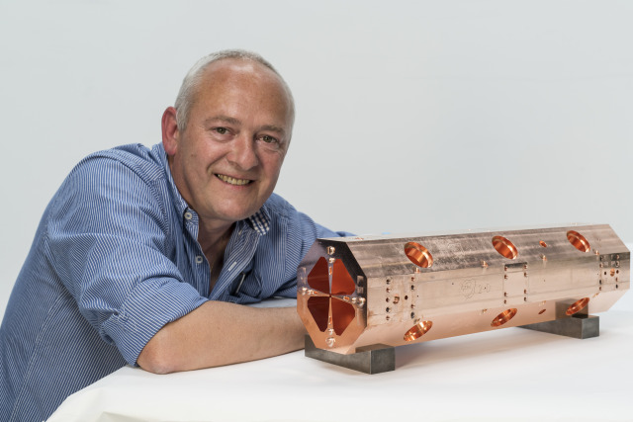

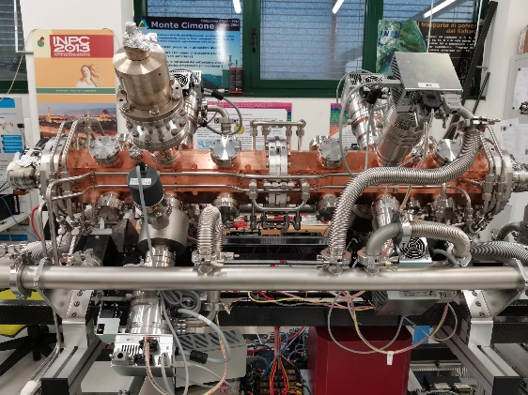
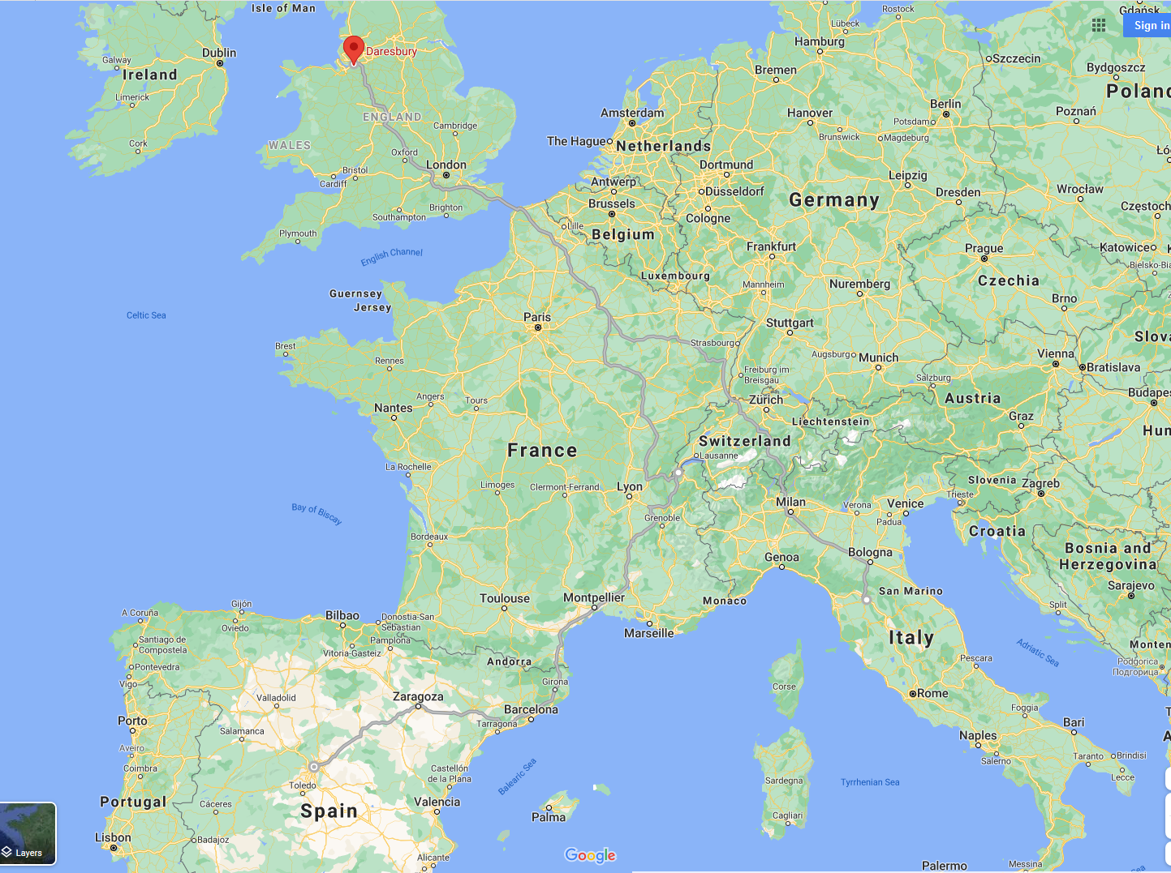

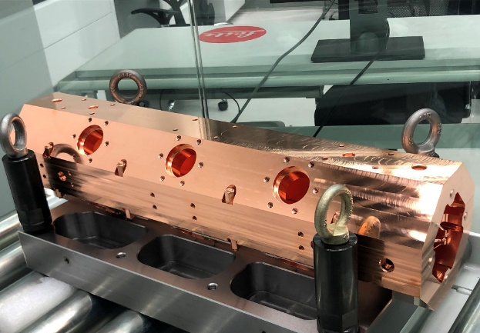
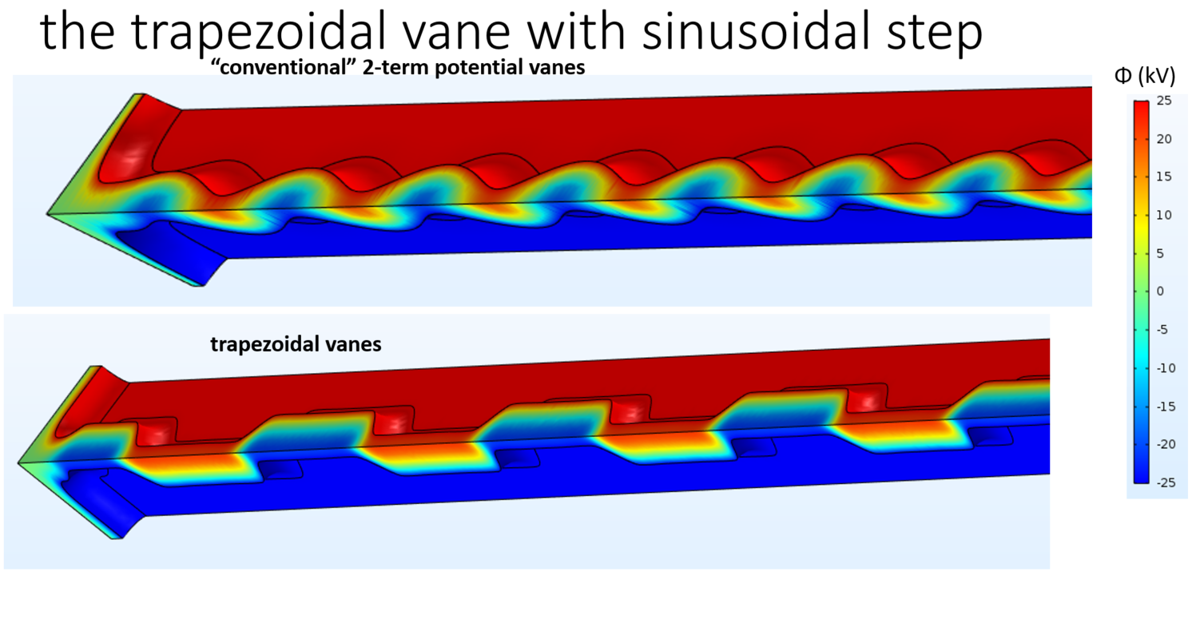

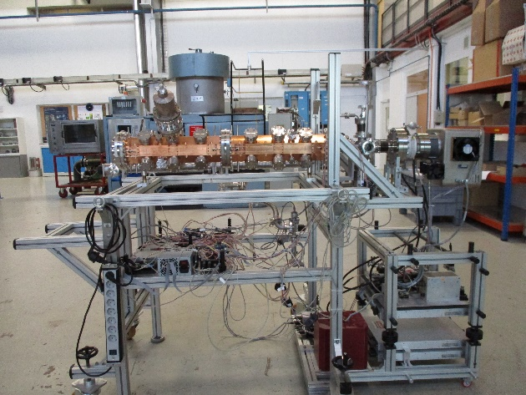
Foundation for 4 other RFQs
Redesigned for portability :
ELISA (2022 science gateway)
MACHINA (in Florence)
Copy for medical facility:
Built in Italian industry,
First beam July21
Redesigned for Carbon6+ :
Built (1 out of 4 modules) in Spanish industry collaboration agreement with CIEMAT, due in 2022
Test at CERN ideally in SA2

Slide 7
2014 – Studies
The “750MHz” team (layout and beam dynamics, radio-frequeuncy and mechanics) : A. Dallocchio, V. A. Dimov, M. Garlasché, A. Grudiev, A. M. Lombardi, S. Mathot, E. Montesinos, M. Timmins and M. Vretenar.
ABP - HSL proposed the use of a high frequency Radio Frequency Quadrupole with an unconventional beam dynamics approach to bridge the gap between the proton source and realise bunch-to-bucket injection in the 3GHz structures. Before this proposal the facilities made use of very inefficient and expensive injectors.
CERN Knowledge Transfer involved from the very beginning as the potential for the use of such development in society was very clear. KT applied for a patent.
Design with industrialisation in mind
Contract with ADAM/AVO for the realisation of such accelerator at CERN to be used for testing a linac-based facility up to 70MeV.

Slide 8
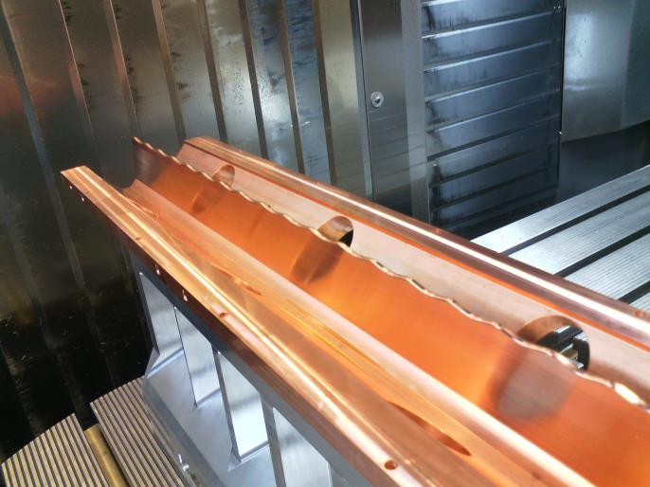
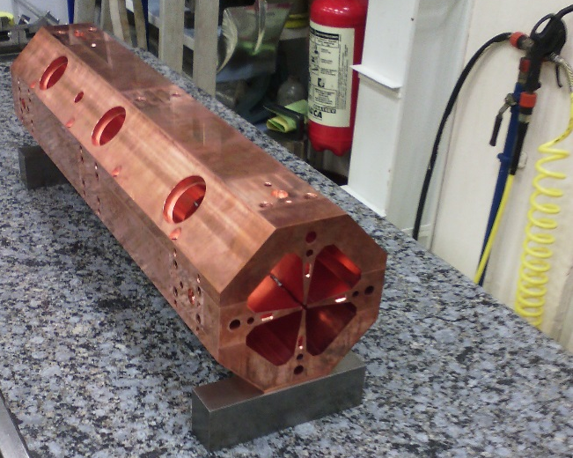
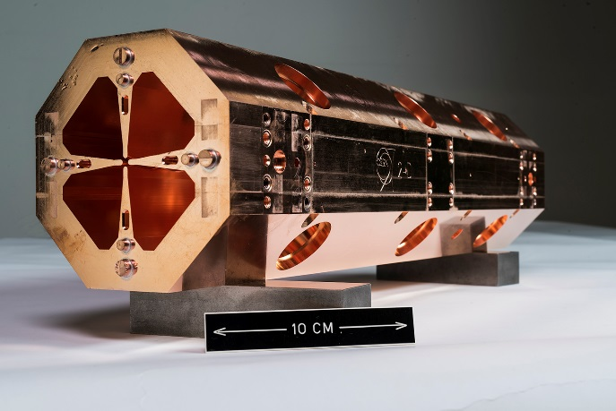
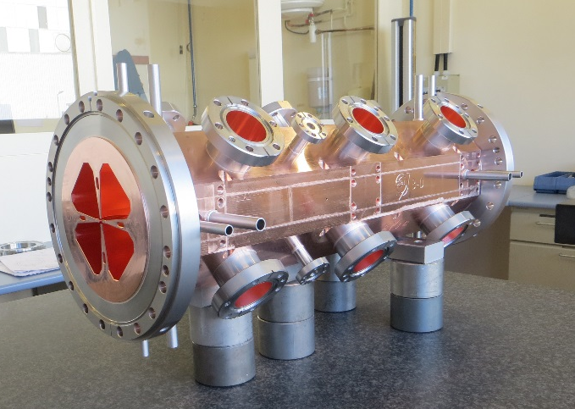
2015 - CONSTRUCTION
March 15 -Machining (±10 µm) | May 15- Assembling (±15 µm )
June 15 - First brazing | October 15 – Second brazing

Slide 9
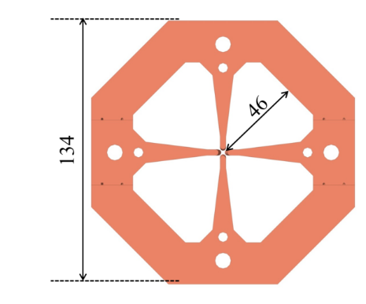
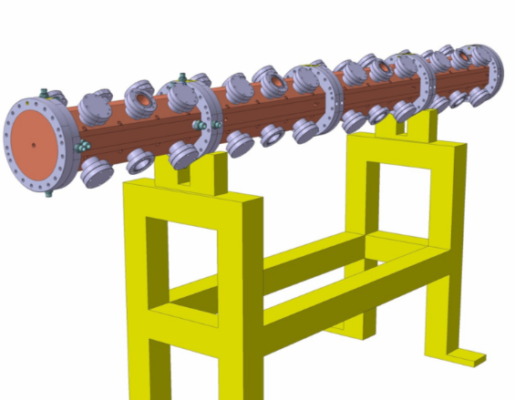
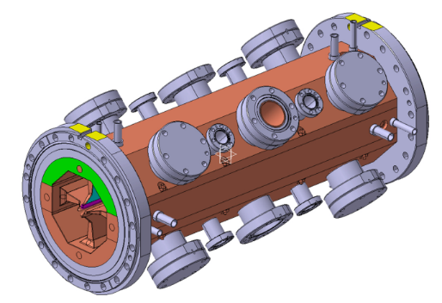
Mechanical design
Mechanical design and construction procedure based on the Linac4 RFQ: 4-vane structure with 2 brazing steps. Inner radius 46 mm; total weight 220 kg.
Mechanical tolerances ±10 µm (cavity), ±5 µm (achieved at cern on vane tip,not required ), factor 2 tighter than Linac4. Assembly tolerance for the four vanes ±15 µm. Surface finishing Ra=0.4 µm.
Modular design: assembly of 0.5 m long modules, each with 8 tuning ports and 4 combined tuner/power coupler ports. The modules differ only by the vane modulation (and for the end cells at both ends).

Slide 10
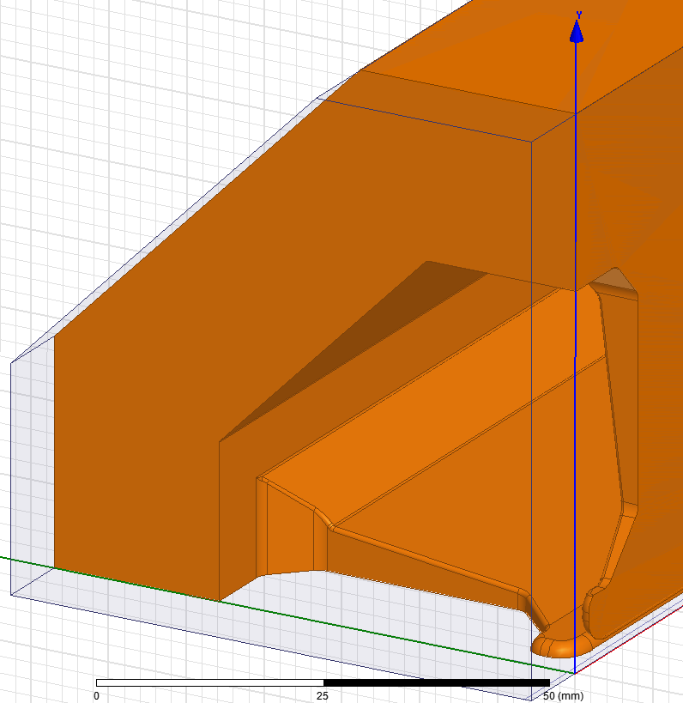
RF design
Challenge : length is 5 times the wave-length, limit for tuning the RFQ with simple tuners. 2 tuners/section with provision of a third one.
Minimisation of RF power losses
  Cavity geometry
  Number and shape of tuners
  3D simulations to keep into account all the effects
Input vane tip – 3d detail
Including all margins we need 0.043 kW/m (kV)2

Slide 11
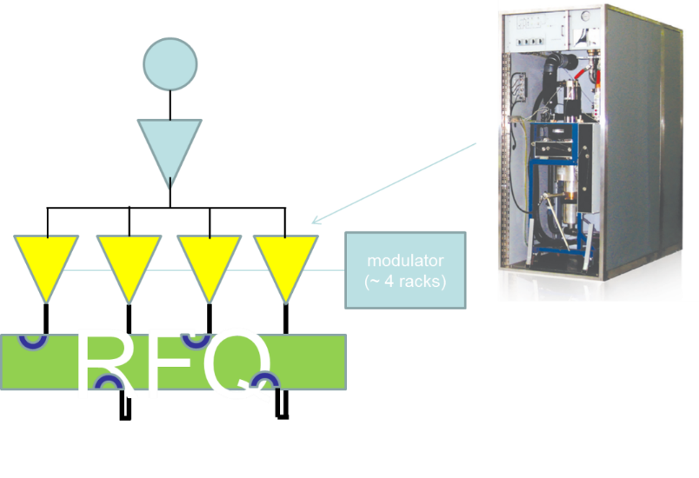
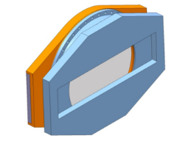
RF system
Basic concept:
Combine several small RF amplifiers into the RFQ (that acts like a combiner).
Testing of the prototype RFQ: arrangement of 4 IOT-based amplifiers on a common modulator, each connected to an RF coupler. Most economic and easier to procure option.
Work on reducing the cost of the RF system:
Use of solid-state amplifiers
«Stripped-down» units with minimum control and LLRF (RFQ does not need phase control and requires only a limited voltage control).

Slide 12
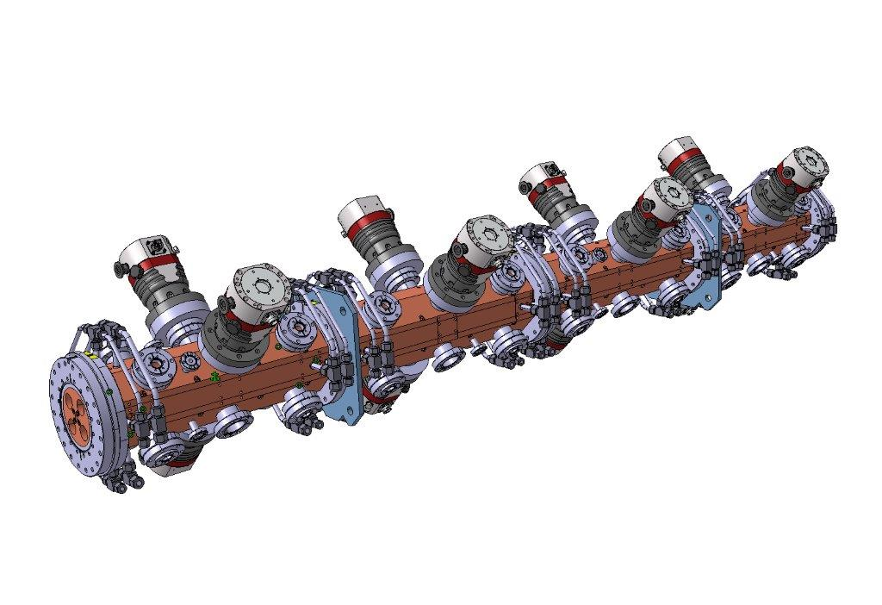
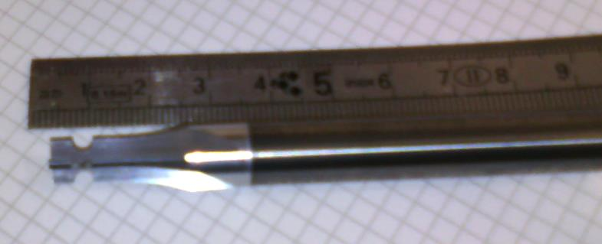
Error studies and alignment tolerances
Choice of constant transverse radius of curvature allows for a 2d machining with a relatively cheap and simple tool
Error | Tolerance | Part concerned
Field error | ±1% to ±2 | Tuning
Transverse radius of curvature | ±10 µm | Cutting tool
longitudinal profile | ±10 µm | Machining
X and y pole displacement | ±30 µm | Assembly before brazing and brazing process
Longitudinal pole displacement | ±40 µm
X and y pole tilt | ±30 µm
X and y segment tilt | ±60 µm | Assembly of sections
X and y segment displacement | ±20 µm
Shape tools made by the company BOUDON-FAVRE, Feillens (France).
Precision machining obtained with a CNC grinding machine ANCA type mx7 with camera control Iview

Slide 13
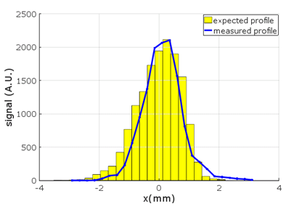
Measurements of Energy and Energy spread
Phase probes for Time of Flight (ToF)
 |  | Energy (MeV)
Expected |  | 5.00
Measured | Spectrometer | 5.07
 | ToF | 5.03
Validates a very different design that can be applied to other ions.
 | RMS Energy Spread (keV)
Expected | 7.5
Measured | 7

Slide 14
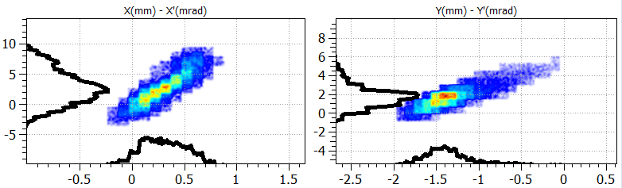
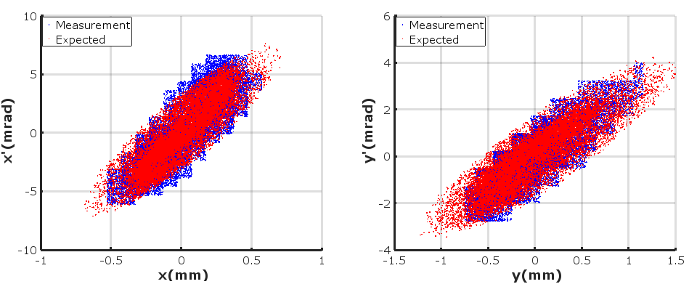
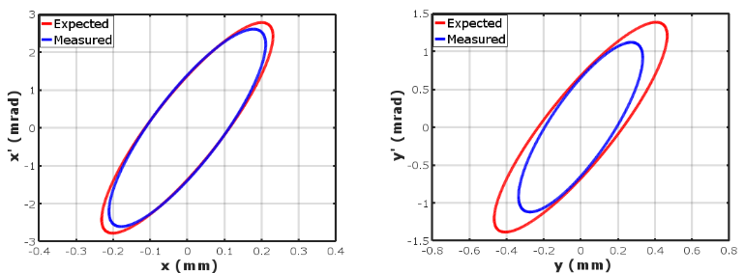
Transverse Emittance after the RFQ
Measured
phase-space distributions
Measured vs. Expected
phase-space distributions
Measured vs. Expected
rms emittance ellipses

Slide 15
Summary experience 750 MHz proton RFQ
Radically new design from the beam dynamics point of view- validated by beam measurements. It build on the experience of the LINAC4 RFQ for RF design and mechanical design.
Built in the CERN workshop : less than 2 years from start of construction to installation, this included RF tuning.
A copy is built in industry.
A new design , based on the same principle has been implemented in MAQUINA (see talk tomorrow by F. Taccetti) and ELISA. 1 m long RFQ for 2 MeV protons designed for low power consumption. (= low voltage)

Slide 16

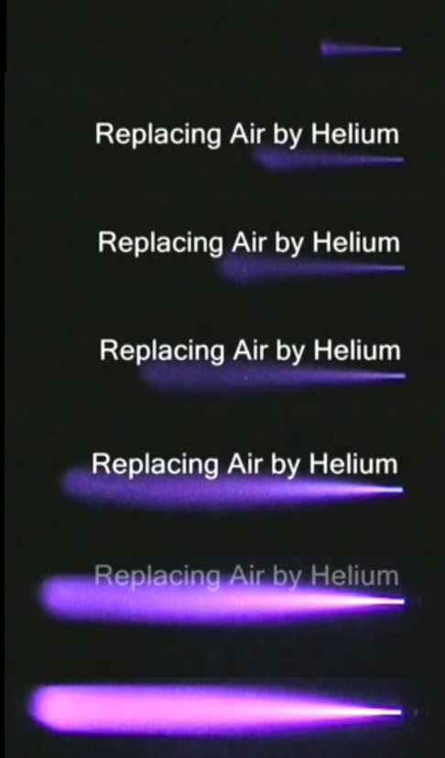
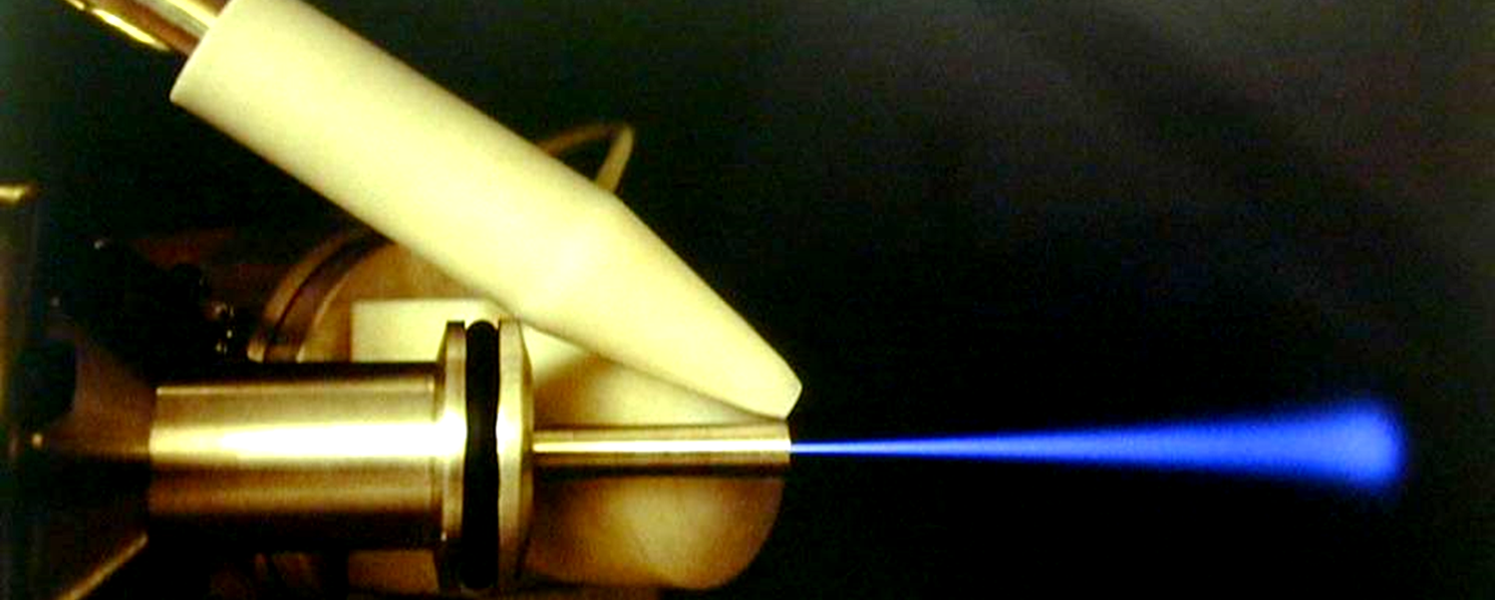
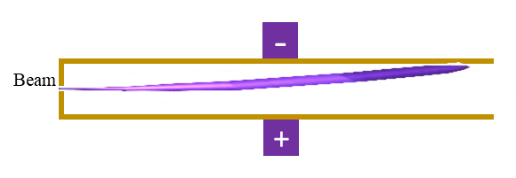
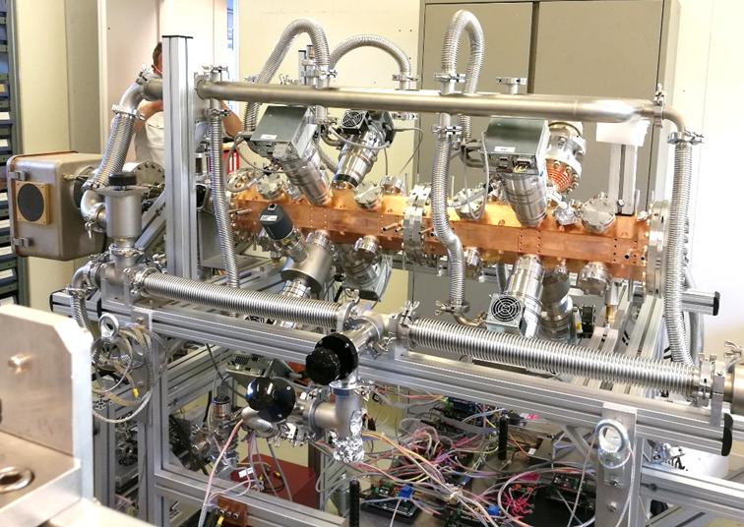
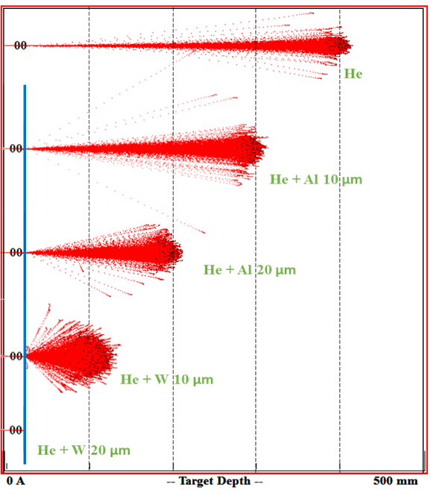
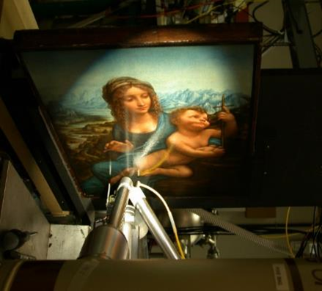
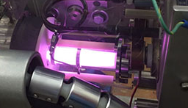
ELISA
Experimental Linac for Surface Analysis
A miniature proton accelerator for Science Gateway
The plan is to build at CERN a compact proton source where the plasma is well visible.
Demonstration / Experience in public with the beam

Slide 17

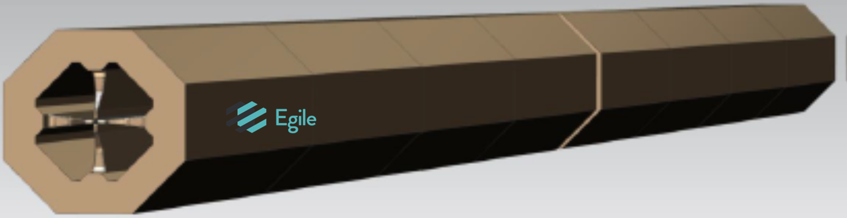
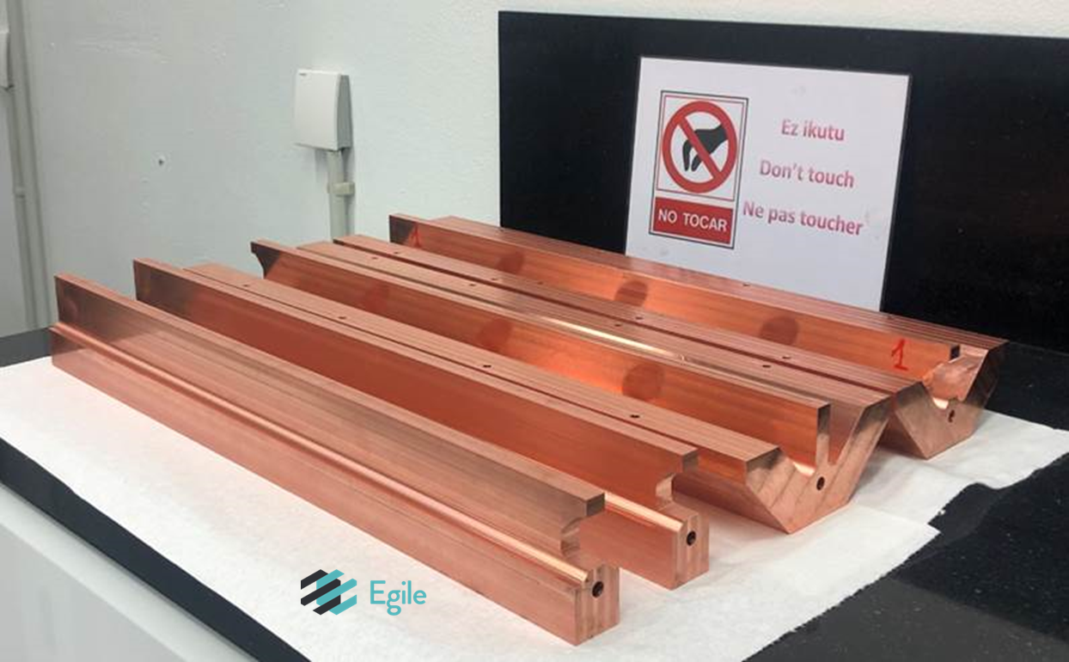

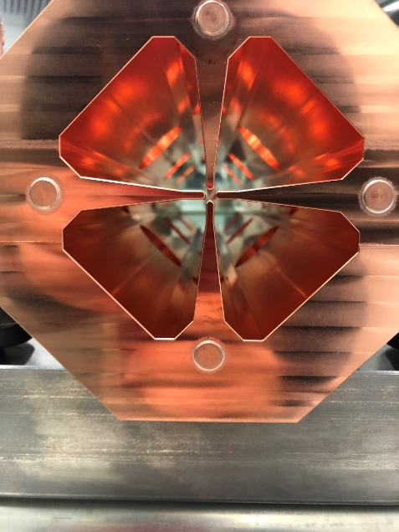

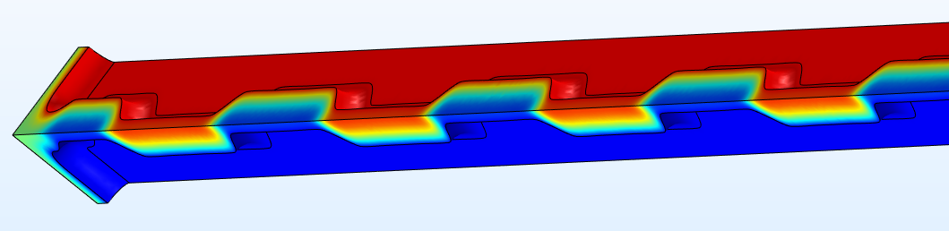
What next? Carbon or Helium
Collaboration CERN-CIEMAT-CDTI-Spanish Industry
1-Drawings
2-Precision machings
3-Assembly and brazing
2.0 m long
750 MHz
For Carbon (or Helium) at 2.5 MeV/u
Efficient vane design including trapezoidal shape
4-First (of 4) section completed

Slide 18
Potential future use/developments
Production of 2-5 MeV protons:
  Currents up to mA
  Duty cycle to 5%
  ……
Every RFQ should be tailored to its use :
  There is a validated design for 5 MeV protons to be injected in a 3GHz structure (medical facility)
  Two RFQ are built and will be tested soon for art diagnostics (2MeV protons)
  A RFQ with trapezoidal vanes for helium or carbon ions is being built and should be tested in 2023

