Slide 1
EIC Diagnostics
David Gassner
EIC Accelerator Collaboration Workshop
October 7-9, 2020

Slide 2
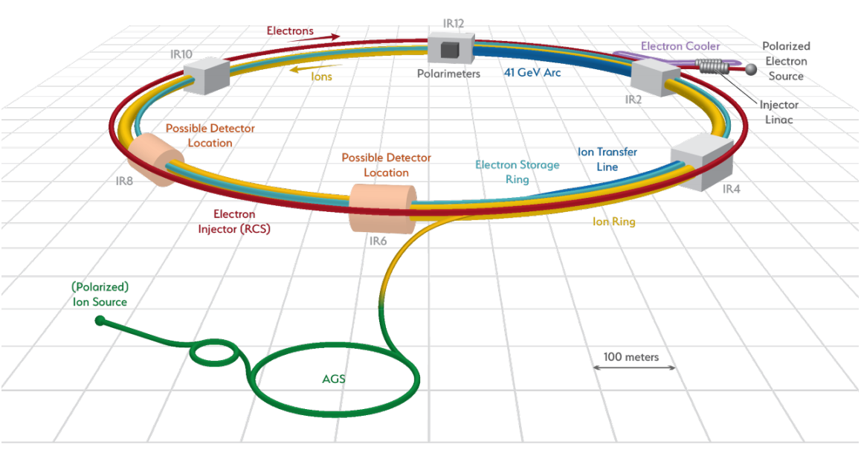
Outline
Electron Diagnostics
  Pre-Injector
  Transfer Lines
  RCS
  ESR
  IR
Hadron Diagnostics
  Upgrades to existing systems
Strong Hadron Cooling Diagnostics

Slide 3
Pre-Injector Instrumentation Requirements
Beam Position Monitors
  10 um position precision, 100pc - 7nC bunch charge range
  Single bunch capability, 4cm round beampipe
Current monitors (tuning)
  ICT, FCT, Faraday Cups
Profile Monitors: YAG/OTR
Bunch Length: (expect 1.5ns & 4.5ps)
  plunging radiator and streak camera,
  considering non-destructive relative methods done by Frisch at LCLS
Emittance: Scanning wire
Beam Loss Monitors (tuning)
  PMT/Scint detectors
Polarization Measurements (use Mott Polarimeters)
  at Cathode: 20 keV
  Gun diagnostics beam line: 350 keV

Slide 4

Pre-Injector Instrumentation
114MHz buncher
570 MHz buncher
Coil solenoids
Corrector
Diagnostic line 2
Here has other three tanks
Laser
3GHz buncher
Mott
Diagnostic line 1
2.856 GHz buncher TWP (8 tanks)
Mott
Polarimeter
Bunch length monitor station (streak camera) |  | 2
Faraday Cups |  | 2
Wire Scanners |  | 7
YAG/OTR |  | 9
ICT |  | 7
FCT |  | 1
BPM |  | 9
Ion Clearing Electrodes (BPM pick-up) |  | 1
Single Slit Scanner, emittance, 350 keV |  | 1
BLM - Optical Fiber |  | 5
Mott Polarimeter - Cathode prep, 20 keV |  | 1
Mott Polarimeter - Diagnostics line 1, 350 keV |  | 1
Parameter | Value
Energy | 400 MeV
Charge [nC] | 100pC to 5.85nC
Frequency [Hz] | 1, 2
εn [mm*mrad] | 15, 60
Bunch length | From 1.5 ns to 4.5 ps
dp/p | 0.01
Polarization [%] | 85
4

Slide 5
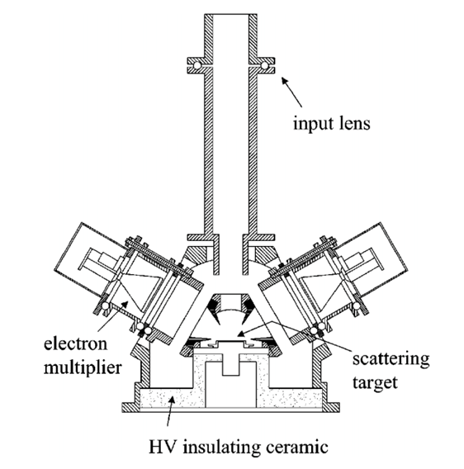
2 Mott e-Polarimeters at the pre-injector
A compact Mott polarimeter (~20 keV) at the cathode chamber will be used for checking the beam from the SL-GaAs wafer after activation. Similar to what P. Johnson from BNL built, and now offered by company SPECS.
  Have quote for device purchase.
Compact Mott polarimeter
(5-30 keV) for cathode preparation
A 350 keV Mott Polarimeter will be used in the pre-injector gun diagnostics beamline. We have a quote from Xelera Research for a complete system that is based on an upgrade to a 100 keV design. (Mayes & Dunham)
Xelera Research

Slide 6
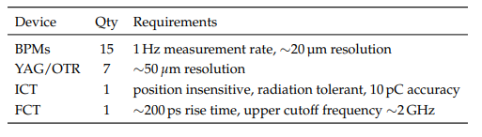
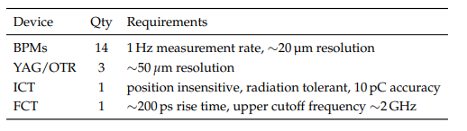
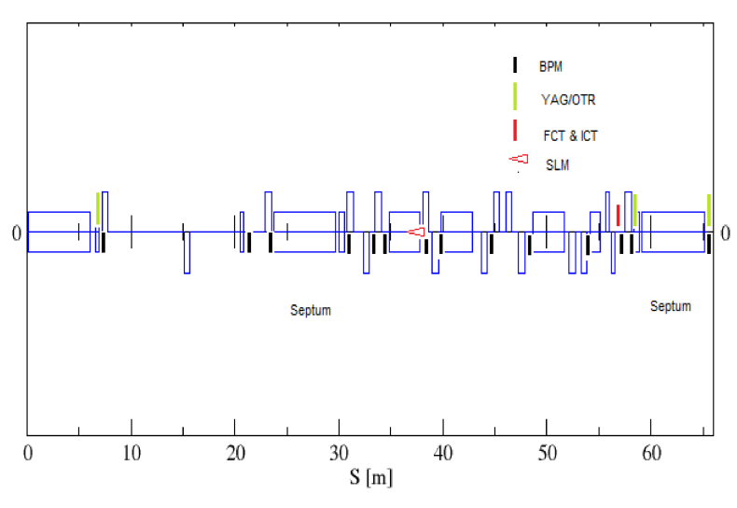
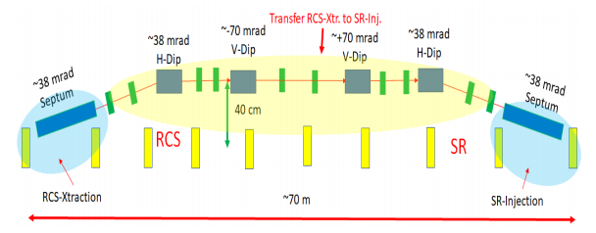
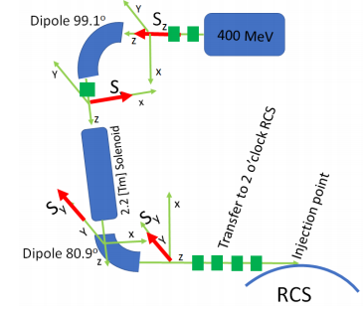
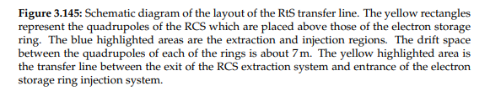
Transfer beamline Diagnostics
Linac to RCS
RCS to ESR
Linac

Slide 7
RCS instrumentation Requirements
Beam Position Monitors
  Dual plane pick-ups, one per quad (576)
  Precision 10 microns, from 1-28nC bunch charge
  Turn-by-turn capability
Synchrotron Light Monitors: 40-180ps bunch lengths (emittance 20nm H, 2nm V)
  Measure transverse beam size: determine emittance, energy spread
  Turn-by-Turn using gated cameras for injection matching
  Streak camera for bunch length, longitudinal profiles
Tune Monitors: fast kickers & BPMs
Current monitor (mA beam current)

Slide 8
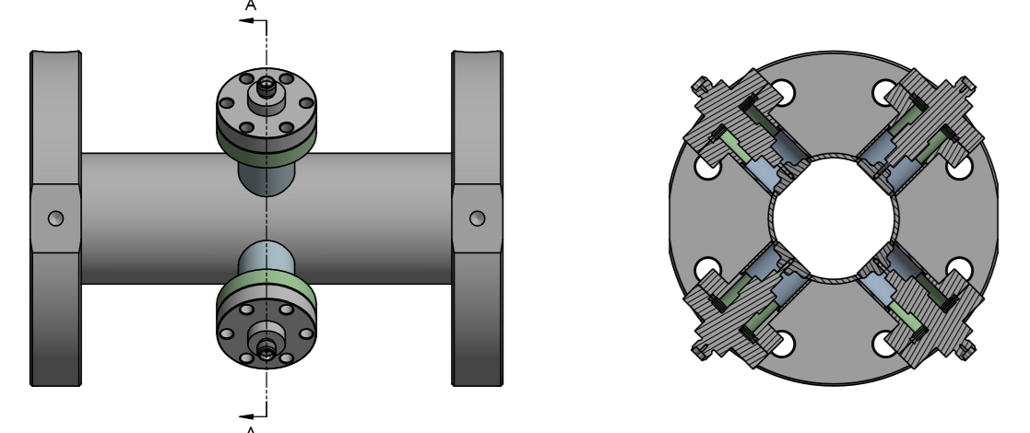
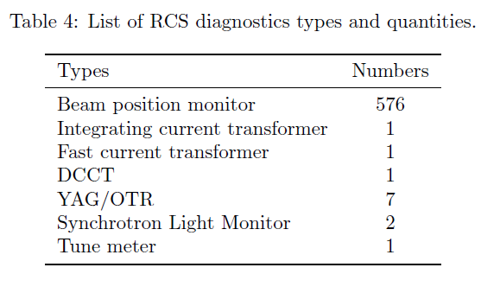
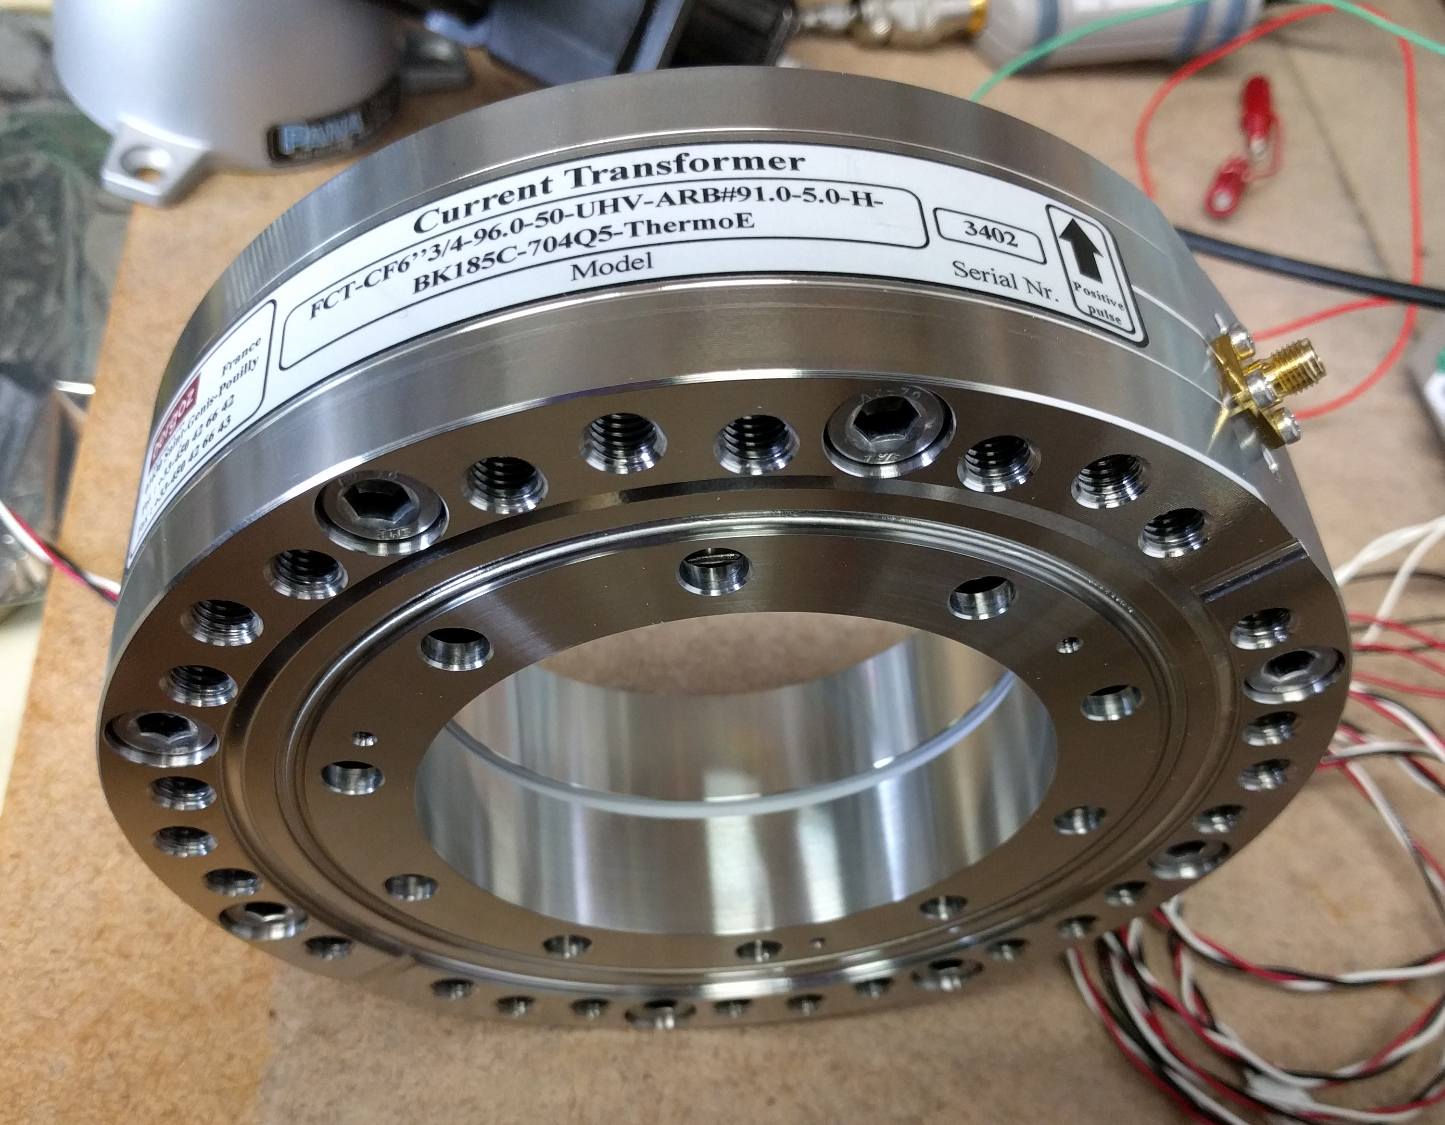
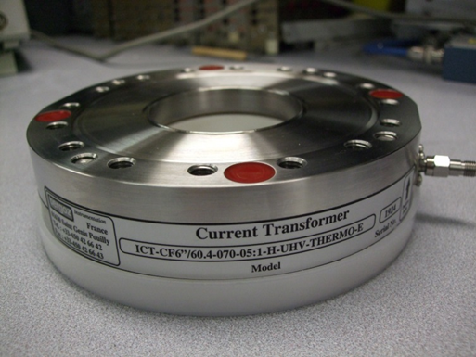
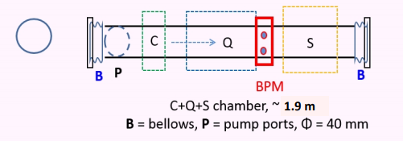
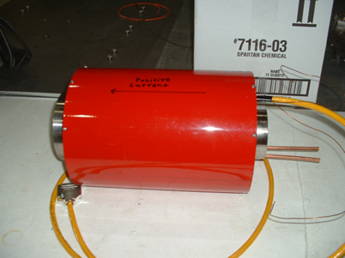
RCS Instrumentation
In-flange ICT
In-flange FCT
NPCT DCCT
Design based on NSLS-II BPM pick-up, 15mm button, 40mm round beam pipe.
Purchased from GMW, Bergoz
RCS half-cell Layout showing BPM location

Slide 9
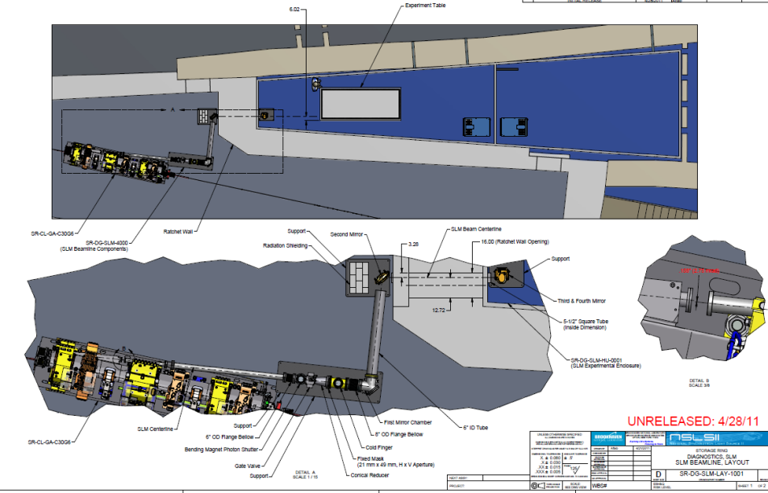
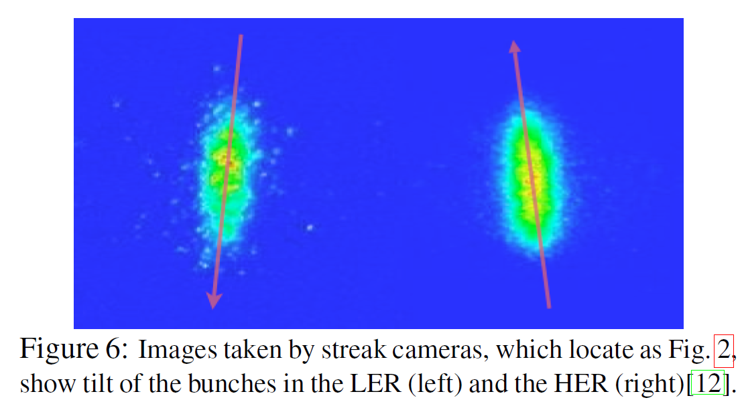
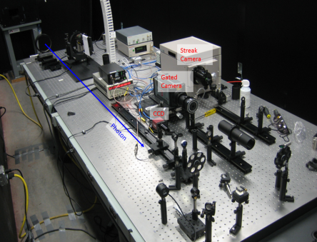
Synchrotron Light Monitors in RCS and ESR
Collaboration with the NSLS-II Synchrotron Light monitor experts;
Padrazo, Shaftan, Bacha, Kosciuk, Cheng
A cooled mirror will direct the visible portion of synchrotron radiation to an enclosed light transport, then to an optical table in a service building.
Measure transverse profile, turn-by-turn profile, longitudinal profile and phase space.
Streak camera with ~1ps resolution will provide longitudinal profile measurements.
NSLS-II Synchrotron Light Monitor layout
Electron Crabbing angle can be directly measured using a synchrotron light monitor with streak camera at a location TBD in the electron Storage Ring.
Crab cavity bunch tilt angles measured at KEKB
NSLS-II Optical table with Streak camera
Longitudinal
Horizontal
Compensation of the Crossing Angle with Crab Cavities at KEKB, Abe et al, 2007
9

Slide 10
ESR Instrumentation Requirements
BPM System:
Dual plane pick-up at each quad (494)
Turn-by-turn and single bunch DAQ
Precision 10 microns, from 1-28nC bunch charge
Synchrotron Radiation Monitors: (bunch length 60ps)
Transverse (60um resolution), Longitudinal (Streak Camera Res), Coupling
X-Ray Pin Hole Profile Monitor (H & V, 5um resolution)
emittance will be: 20nm V, 1.3nm H
Crabbing angle (SLM) with one crab cavity off
Feedback systems:
Slow orbit: 1Hz average positions, 5-micron accuracy
Longitudinal: Damp beam instability, use RF Cavity kicker
Transverse: Allows operation of the ESR at high intensity without beam in the ion ring.
Beam Loss Monitors:
At strategic locations; injection, extraction, collimators, absorbers, etc…
Tune Monitor: Strip-line kicker & TbT BPM
DC Current transformer: (1kHz BW, few uA resolution) 2.5 Amps beam current
Fast Current Transformer: (fill pattern)

Slide 11
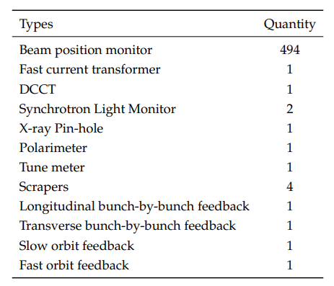
ESR Instrumentation

Slide 12
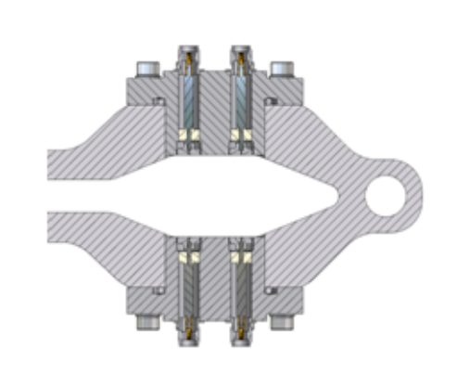
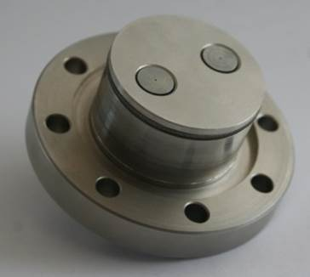
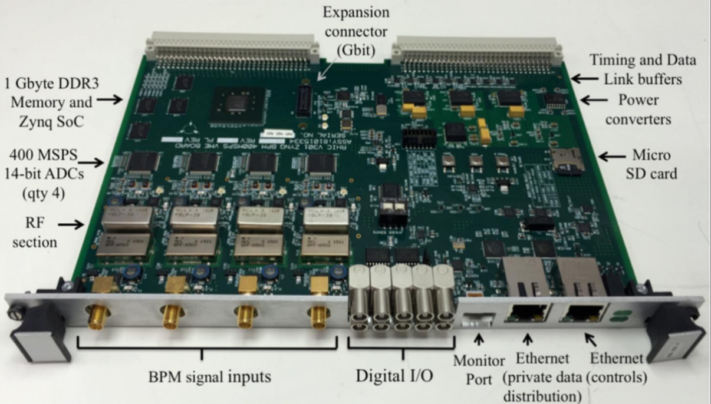
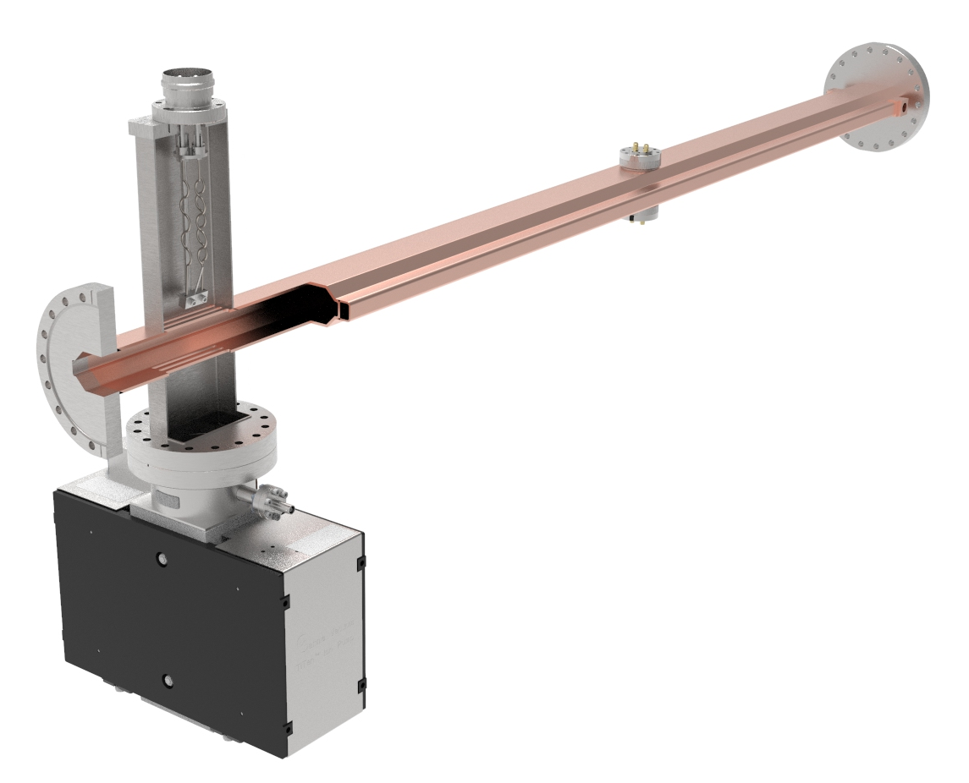
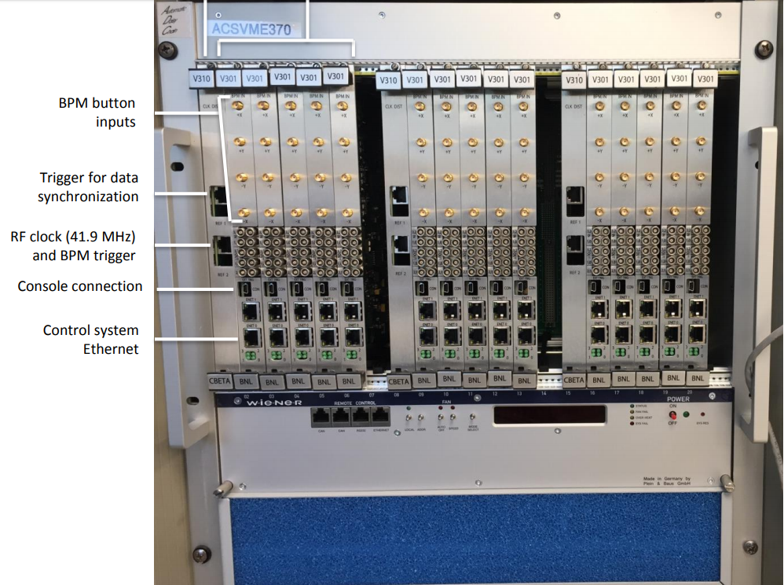
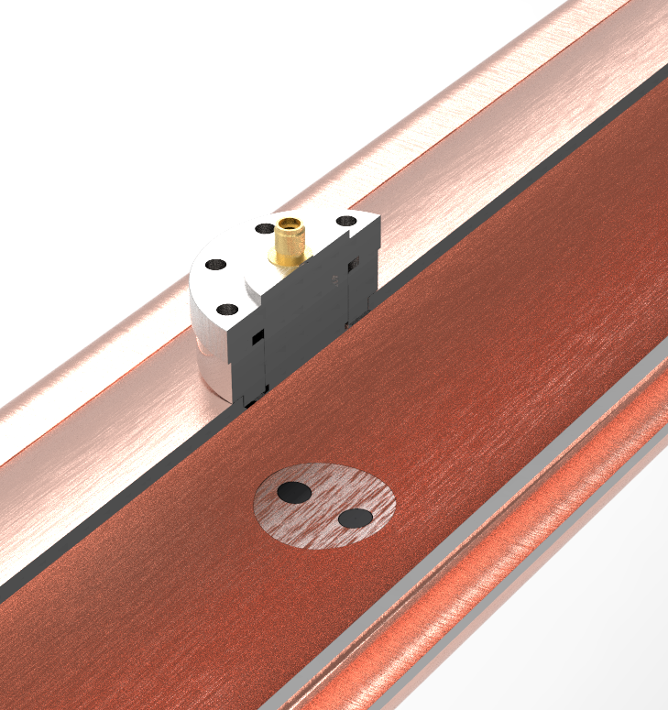
ESR Beam Position Monitors
494 ESR BPMs, one per quad, 36 x 80 mm chamber
Design and estimate based on NSLS-II Large-Aperture button BPM pick-up.
All EIC BPM electronics will be based on a
revised version of the BNL designed
V301 VME modules to meet EIC spec’s
NSLS-II Large Aperture BPM pick-up, dual 7mm buttons
NSLS-II SR LA BPM
Assembly cross section
Successfully Used at LEReC, CeC and
CBETA at Cornell
Beam position monitor
after quadrupole
ESR vacuum
chamber model
BPM electronics in VME chassis, 15 per

Slide 13
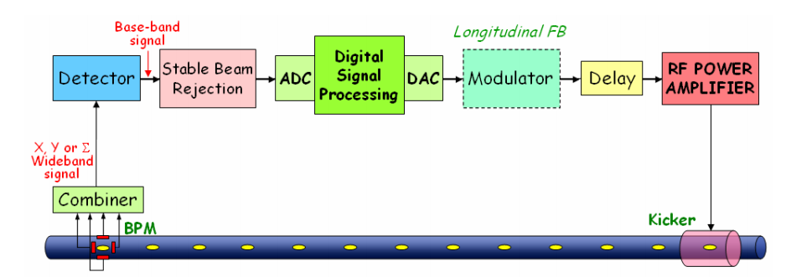
ESR Transverse BbB Feedback
Detector: A beam position monitor (BPM) with good sensitivity, at a location with large beta, zero dispersion
Signal processing unit: both commercial products (I-Tech, DimTel) and and in-house design possible
Kicker: A strip-line kicker (~1m) with high shunt impedance, good matching to avoid reflected power back to the RF PA.
ESR Longitudinal BbB Feedback
Detector: BPM sum signal, horizontal position measured by BPM at dispersive location or phase measurement
Signal processing unit: FPGA-based unit, DimTel provides transverse and longitudinal in the same box
Kicker: Considering using a similar cavity kicker design that was developed at DAΦNE

Slide 14
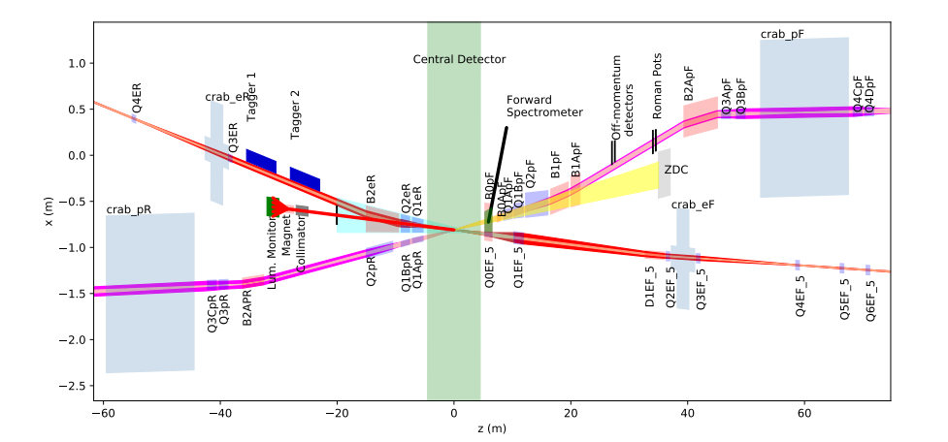
IR Instrumentation Requirements
Beam Position Monitors:
  Dual plane button pick-ups
  Position precision TBD, 1-28nC bunch charge range
  Some BPMs near IP might not have symmetrical chambers
  Special BPM pick-up near IP with wide band electronics to measure hadron crab tilt
Beam Loss Monitors:
  Ion Chambers, PMT/Scintillator, Pin Diodes distributed a critical locations
  Beam pipe temperature
Orbit Correction near the IP:
  BPMs and corrector magnets
EIC Interaction Region Layout

Slide 15
IR BPMs
- Total = 78
Cover 2 beamlines (e & h), +/- 125m
BPM Electronics based on
next generation BNL
designed V301 VME
modules.
15 IR hadron cold magnets with BPMs will be reused from elsewhere in RHIC
Used at LEReC, CeC
and CBETA
EIC IR layout
Michnoff et al

Slide 16
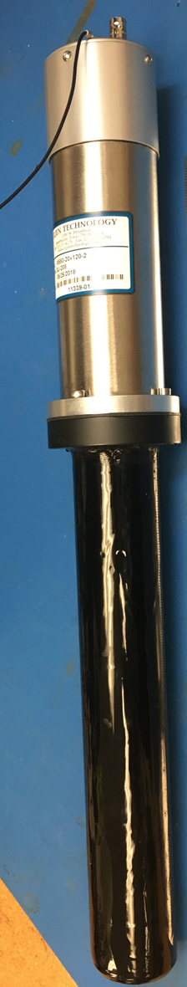
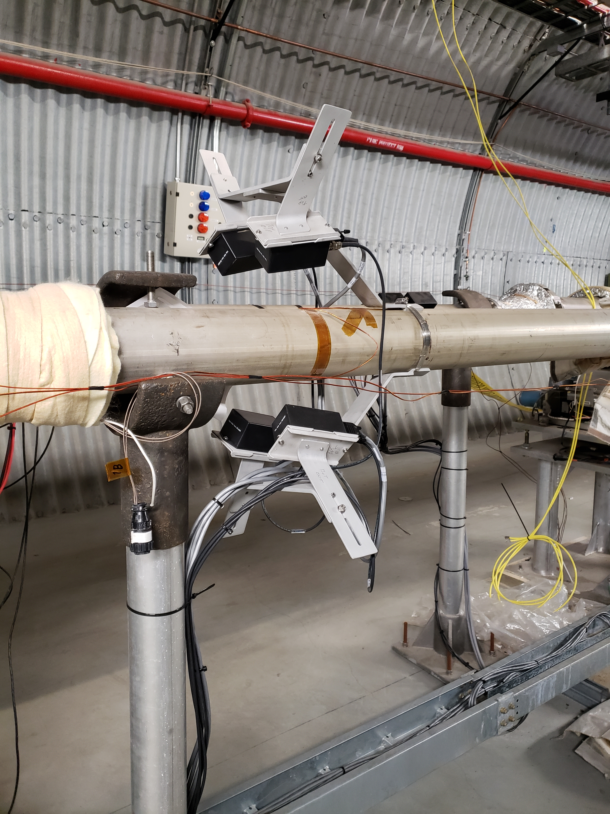
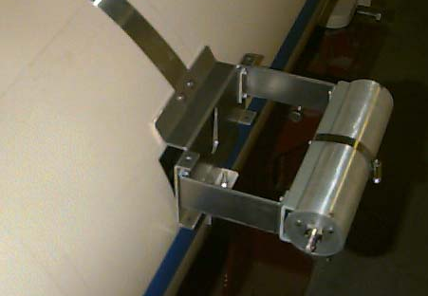
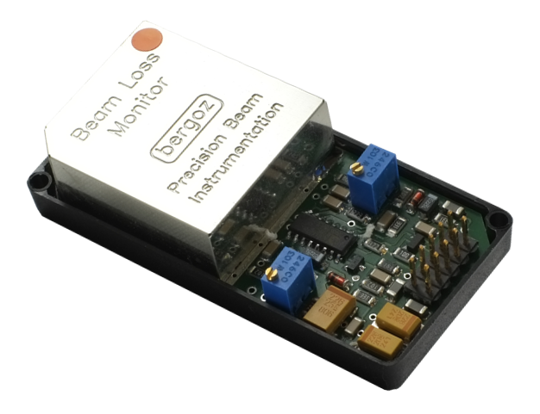
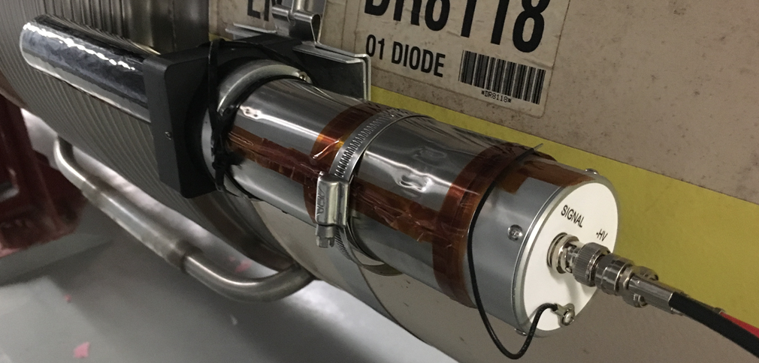
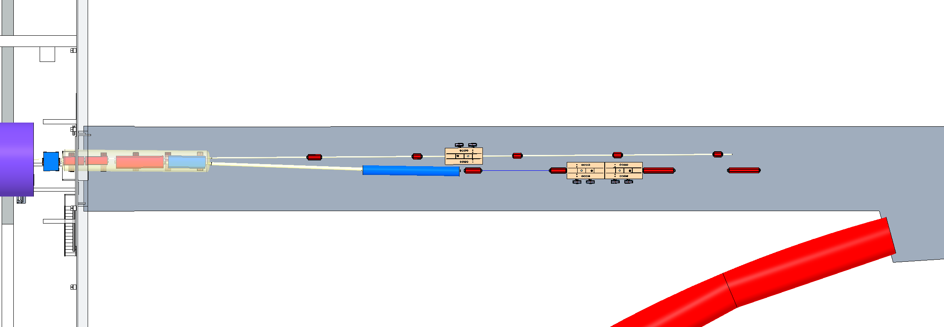
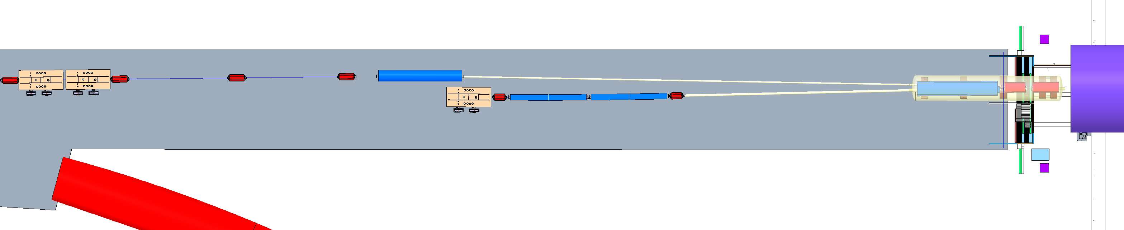
IR Beam Loss Monitors
Proven technology used for many years at C-AD.
  10 RHIC style BLM ion chambers on each side of IR (20)
  10 Pin Diode style Bergoz BLMs on each side of IR (20)
  2 Paddle Scint/PMTs on each side of the detector (4) measure background levels
RHIC style BLM Ion Chamber
Bergoz Pin Diode BLMs
Scint/PMT BLMs
Hadron Crab Cavities
electron Beamline
Hadron Beamline
Rear SC Magnet
System
Forward SC Magnet
System
electron Beamline
Detector
Hadron Beamline
e-Storage Crab Cavity
Hadron Crab Cavities

Slide 17
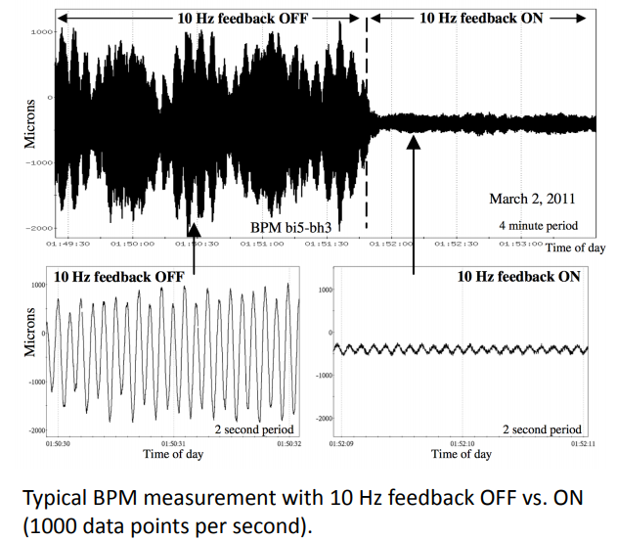
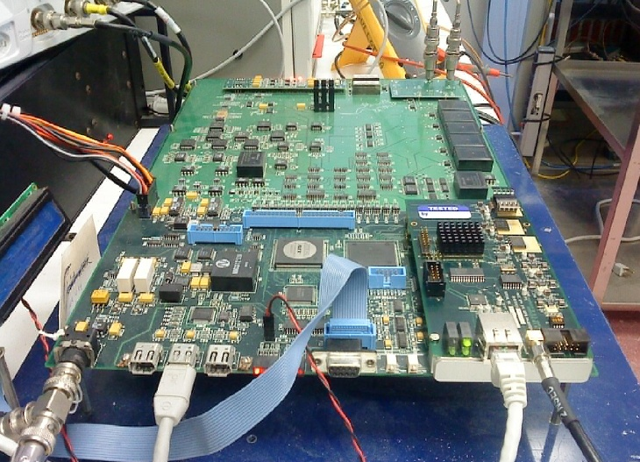
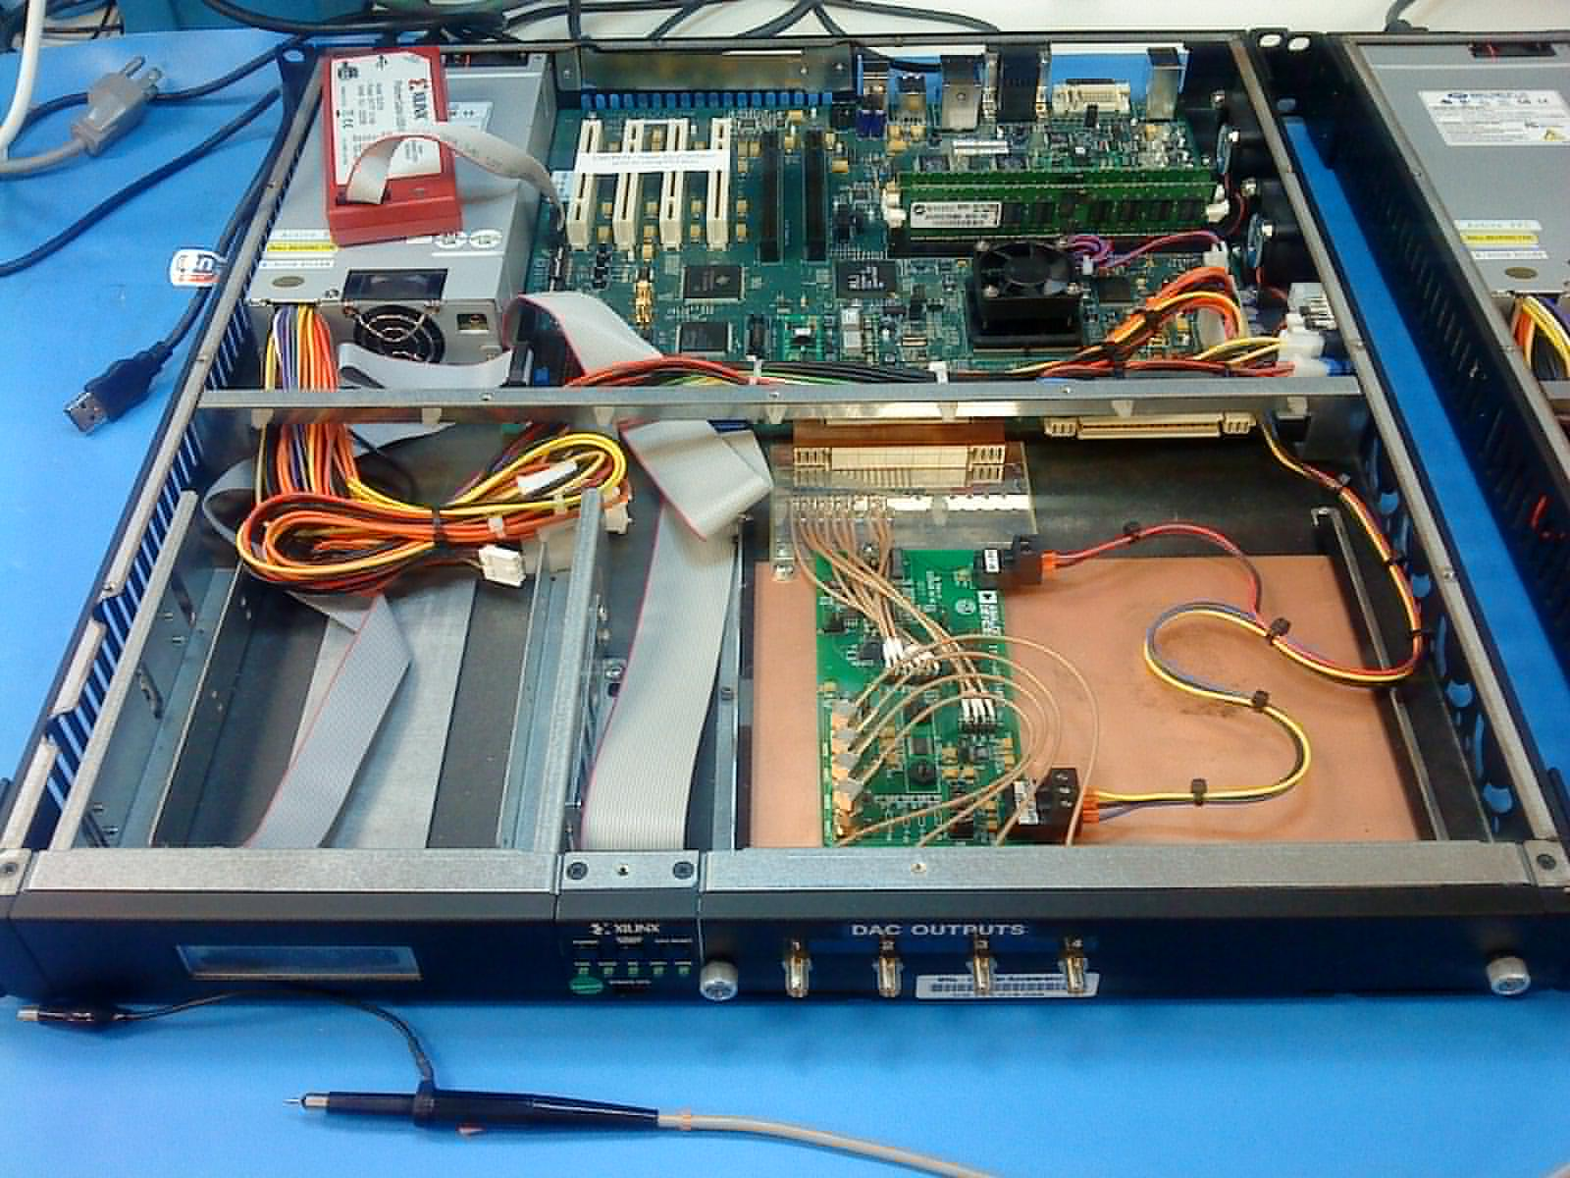
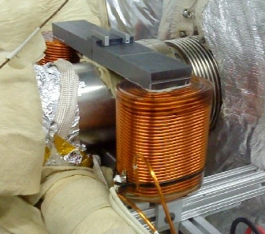
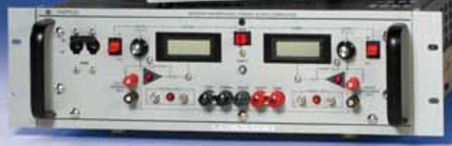
IR Orbit feedback
Compensation for modulated beam-beam offsets at the IP due to mechanical
vibration of IR magnets at frequency range of 2 to 30 Hz.
16 sets of orbit correction magnets and power supplies.
Design based on existing RHIC 10 Hz feedback system.
  12 electron, air-core steering magnets (8V + 4H)
  4V Hadron, air-core steering magnets
RHIC Orbit Feedback Off vs. On
RHIC BPM IFE board
with daughter card
Digital to analog converter
Electronics, Xilinx ML-510
IR BPMs
Kepco BOP-36-12M
Magnet Power Supply
Steel laminated core
magnet installed in RHIC

Slide 18
Hadron Ring Diagnostics
Upgrade most of the existing diagnostics systems
Instrumentation in the new hadron injection transfer line (IR6 to IR4)
  2 CT’s, 6 Profile Monitors, 6 BPMs, 10 BLMs
New button BPM pick-ups and electronics
Ionization Profile Monitors Upgrade
  Includes higher voltage bias and higher density MCP to improve performance
Wall Current Monitor Upgrade:
  Replace existing resistive WCM with a wider band electro-optical detector that can resolve the 6cm (180ps) proton bunch length.
Multi-use strip-line kicker upgrades:
  H & V Tune meter kicker, Longitudinal damper, Injection damper, Gap cleaner
Base-band Tune System (BBQ) Upgrade: new kicker, pick-up, electronics
Beam Loss Monitors: use existing IC detectors, new electronics, pin-diodes
HF & LF Schottky Upgrade: new pick-ups, electronics
Head-Tail Pick-up Upgrade: new pick-up
DCCT: upgrade detector and electronics (1 Amp beam current)
All upgraded hadron ring beamline component upgrades include improved impedance characteristics.

Slide 19
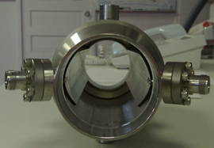
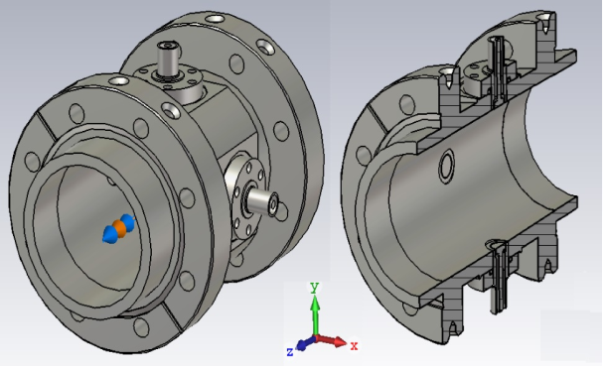
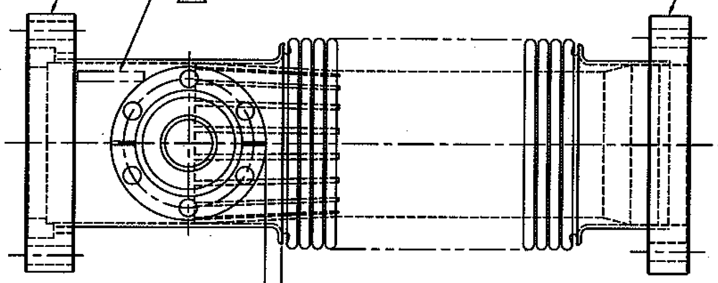
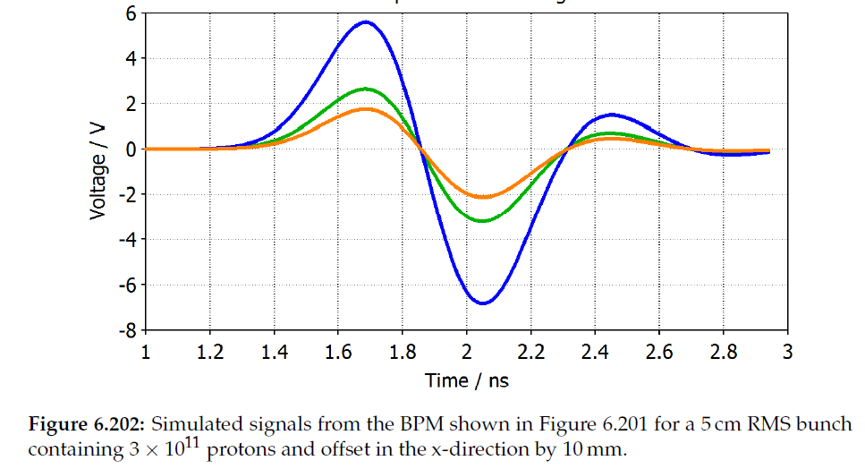
Hadron Ring BPM Upgrade
New BPM pick-ups, cryo-cables, electronics
To avoid heating of the cryogenic signal cables, the existing RHIC stripline BPMs will be shielded to minimize impedance; all Yellow Ring and one Blue sextant.
290 new button type BPMs will be installed in the hadron ring along the side shielded strip-line BPMs.
Replace existing Tefzel insulated rigid coax cryogenic cables with improved SiO₂ version, similar to what is used at LHC, quantity = 710.
Existing 12” bellow adjacent to strip line BPM that will be replaced with new button BPM and shorter bellows
New BPM design, 69 mm ID, 11mm diameter buttons
Existing strip line BPM
will be shielded
BPM Electronics based
on next generation
BNL designed V301
VME modules
Simulated BPM signals from a 5cm bunch, 3 X 10¹¹ protons, offset +/- 10mm
19

Slide 20
EIC Strong Hadron Cooling Parameters & Layout
 | Value
Proton energy [GeV] | 275
e-beam energy [MeV] | 150
e-beam normalized emittance [mm-mrad] | 2.8
e-beam rms beam size [mm[ | 0.7
e-beam energy spread | 1 x 10⁻⁴
Rep. Freq. [MHz] | 98.5
Average electron beam current [mA] | 120
Electron beam charge [nC] | 1
Cooling time [min] | 50
ERL RF system
Bunch compressor, focusing
Cryogenics
Electron source
ERL High Energy beam transport(HEBT)
ERL merger (Zigzag)
E. Wang

Slide 21
Strong Hadron Cooling Diagnostics Requirements
Utilize experience gained at LEReC and CeC PoP, possibly reuse some devices
Beam Position Monitors
  10 um precision, 100pc - 1nC bunch charge range
  Average position measurement
  Co-propagation transverse alignment (10u) of electron and ions in modulator and kicker
Current monitors (for tuning & MPS) (120mA beam, 1nC/bunch)
  DCCT, FCT, ICT, Faraday Cups
Profile Monitors (throughout 400m beam line) (e-beam size – few mm’s)
  YAG/OTR – plunging transverse profiles
  SLM (streak camera – longitudinal profile – expect 40ps bunch length)
  Emittance Slits, Wire scanners (expect electron rms normalized emittance 2.8um)
  Halo scrapers
Beam Loss Monitors (for tuning & MPS)
  PMT/Scintillators & Pin Diodes
  Beam pipe temperature
Sliced energy spread measurement at 150 MeV (ensure <10⁻⁴)
Electron & Ion bunch longitudinal relative alignment
  1 micron stability of the longitudinal alignment (e.g. path length changes due to magnet field ripple)
Energy Recovery Linac related diagnostics.

Slide 22
Summary
Most of the beam diagnostics are conventional and the methods have been employed here and at other facilities.
The following are diagnostics that we don’t presently have direct experience with at C-AD:
Synchrotron Light Monitors (RCS & ESR) NSLS-II support
  Longitudinal bunch parameters
  Horizontal & Vertical beam size (Double-slit Interferometer)
  X-ray Pin Hole Monitor
Crab angle monitoring and feedback:
  Hadron Storage Ring (E-O detector, fast BPM)
    E-O detector prototype testing planned at CeC PoP next year
  Electron Storage Ring (SLM)
ESR Transverse & Longitudinal BbB feedback
Strong Hadron Cooling
  Sliced energy spread measurement at 150 MeV (10⁻⁴)
  Electron & Ion bunch longitudinal relative alignment stability of 1 micron

