Slide 1
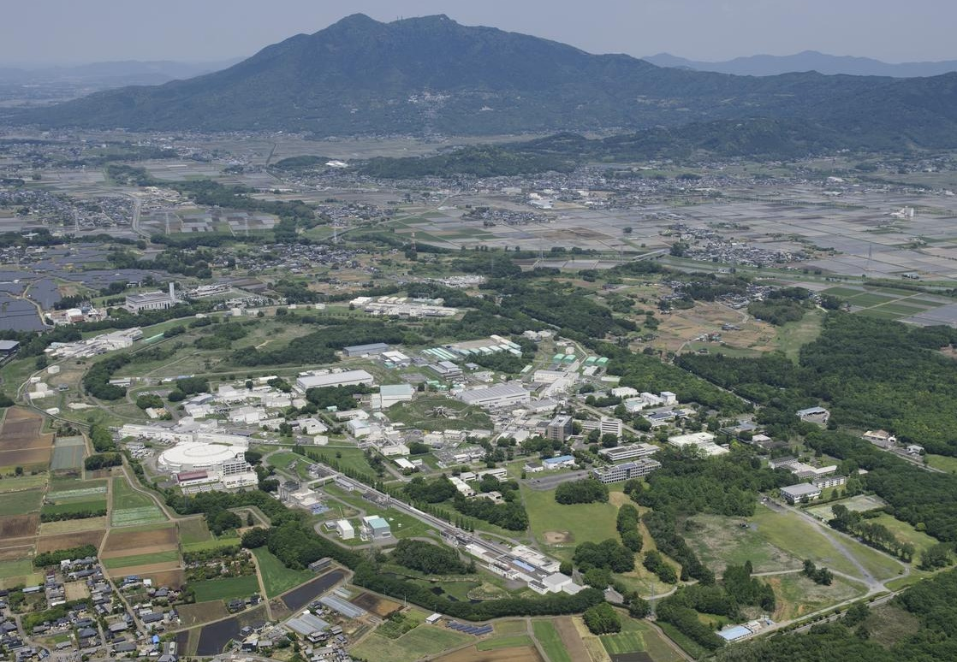
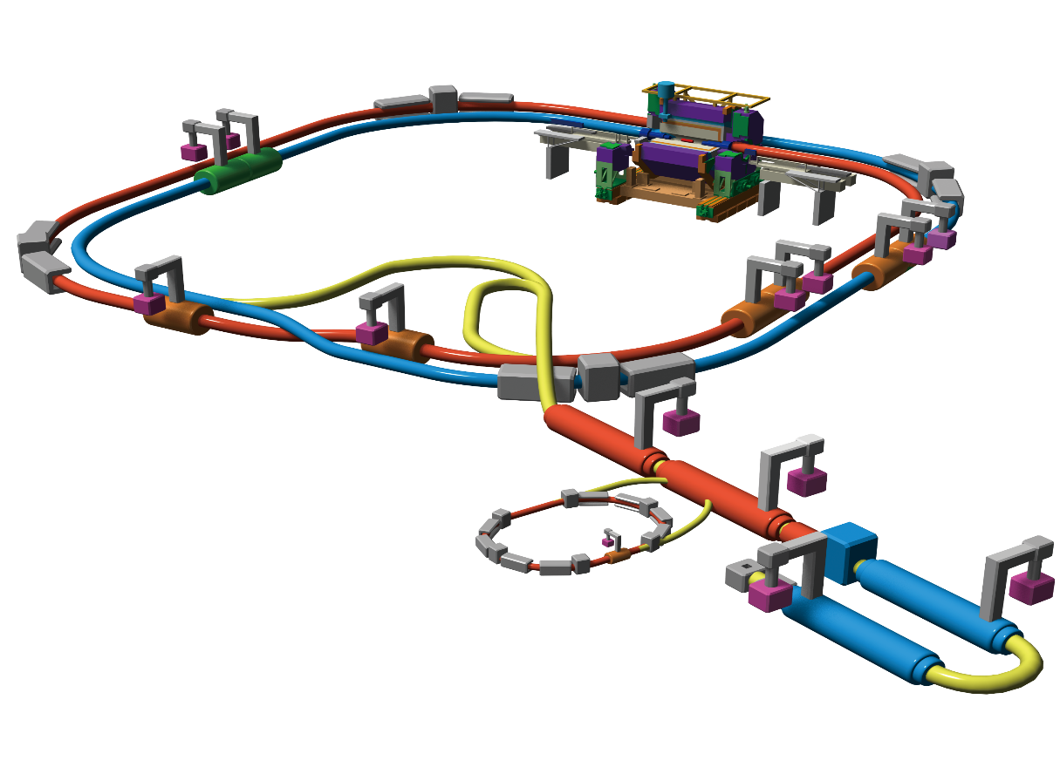
Mt. Tsukuba
SuperKEKB Accelerator
SuperKEKB Accelerator
Belle II Detector
KEK Tsukuba Campus
Makoto Tobiyama
KEK Accelerator Laboraotry

Slide 2
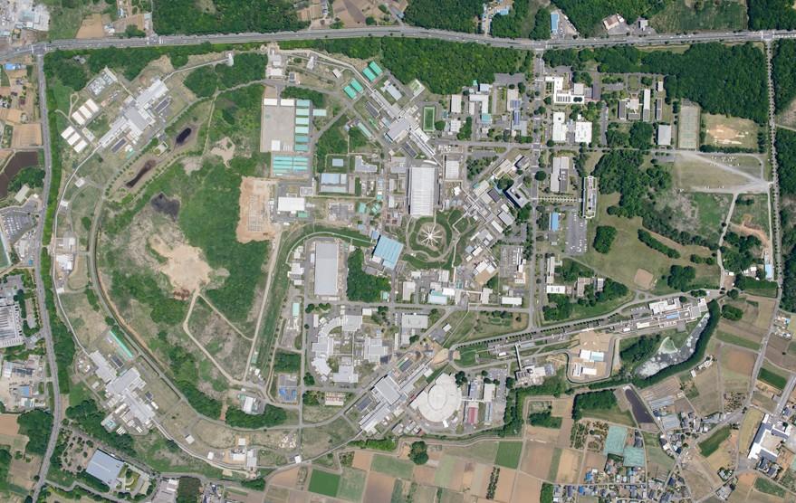
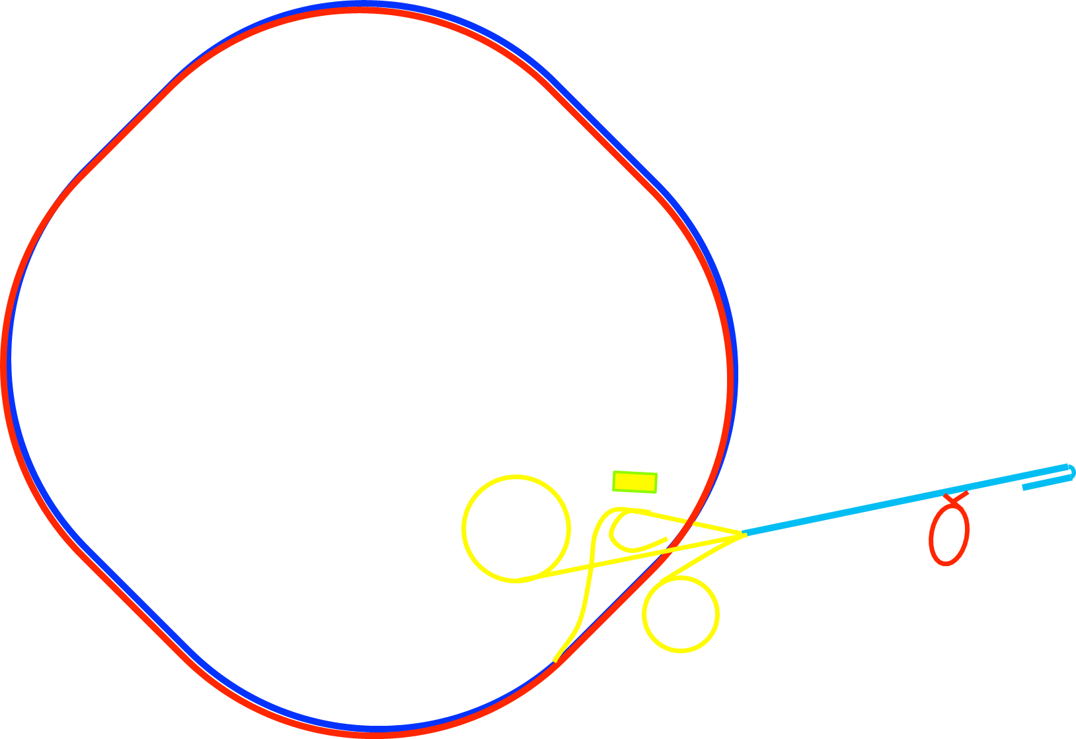
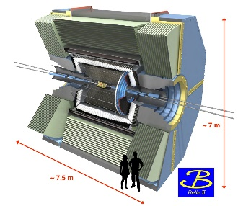

Layout
Belle II
e⁺
IP
HER
7 GeV, 2.6 A
e⁻
LER
4 GeV, 3.6 A
Super KEKB MR
~3 km
Injector (Linac)
Control room
PF-AR
Positron damping ring (1.1 GeV)
PF
2

Slide 3
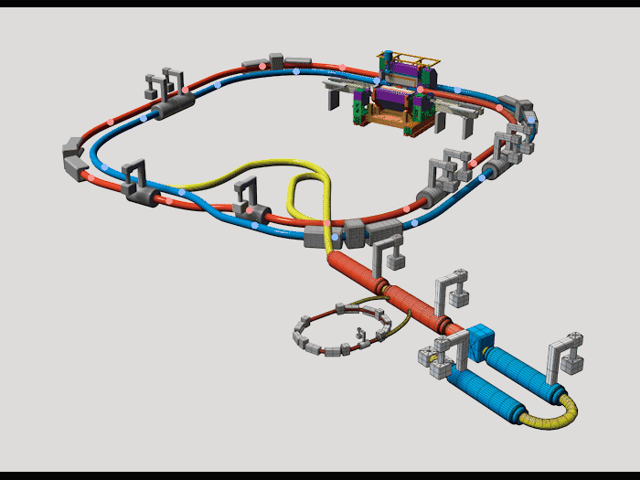

Configuration
  Injector (Linac)
    Length～700 m
    Generate e⁻ and e⁺
    Accelerate to the final energy
  Belle II Particle detector
Detector
  Positron damping ring (DR)
    Circumference ～136m
    1.1 GeV positron
Main ring
Electron ring (HER)
Positron ring (LER)
  Main ring (MR)
    Circumference～3016 m
    7 GeV electron ring (HER)
    4 GeV positron ring (LER)
    The largest e⁻ - e⁺ collider in Japan
Linac
Positron damping ring

Slide 4
Timeline
西暦
2010
2011
2012
2013
2014
2015
2016
2017
2018
2019
2020
2021
2022
・・・
年度
JFY2010
JFY2011
JFY2012
JFY2013
JFY2014
JFY2015
JFY2016
JFY2017
JFY2018
JFY2019
JFY2020
JFY2021
JFY2022
・・・
KEKB operation
SuperKEKB LER & HER construction
HER & LER Beam tuning
Startup work
Phase-1
w/o QCS
w/o Belle II
Collision tuning
Renovation for Phase-2
Phase-2
w/ QCS
w/ Belle II (no VXD)
Physics run
Positron damping ring (DR) construction
Belle II VXD
installation
DR commissioning
Phase-3
w/ full Belle II
Injector Linac upgrade
Based on K. Akai, Mar. 14, 2018 @KEKB review
2

Slide 5
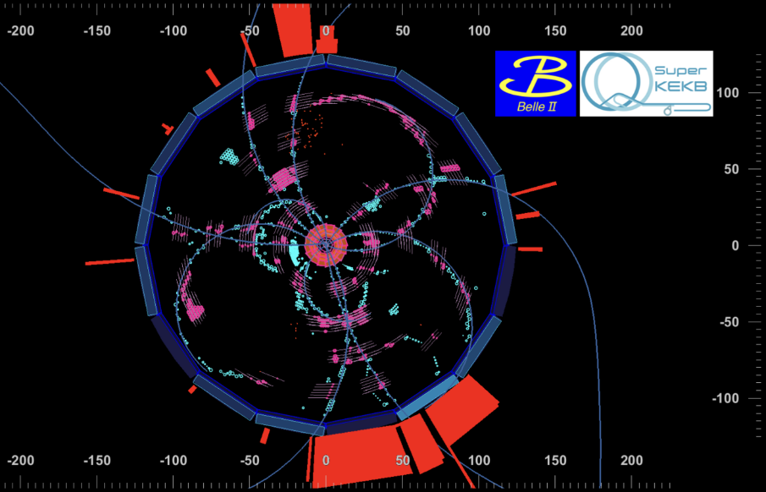
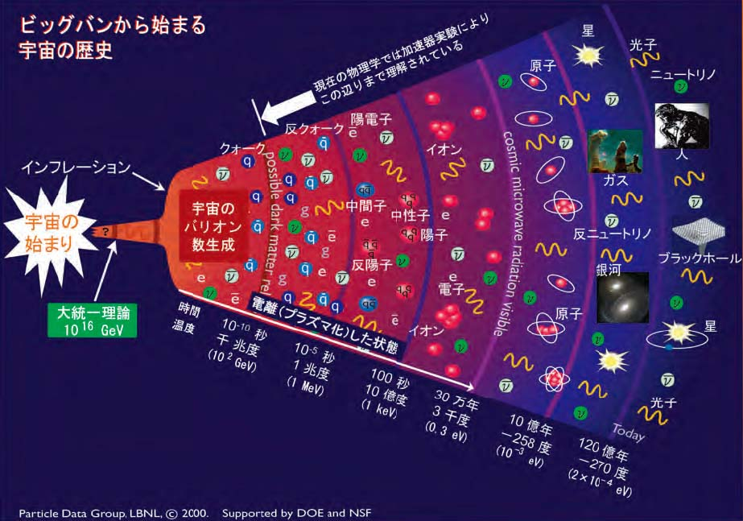
Goal
  To find a new elementary-physics theory beyond the standard model by investigating the collapse process of B-mesons in detail produced by the collision of e+ and e-.
Collapse process measured by Belle II
History of universe
SuperKEKB target

Slide 6
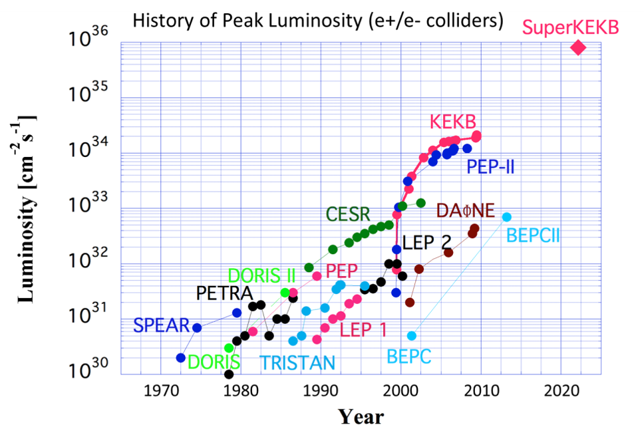
Feature
  Aim the world-highest luminosity (a measure of collision frequency) by using a novel “nano-beam scheme” collision.
Design value:
~8x10³⁵ cm⁻² s⁻¹

Slide 7
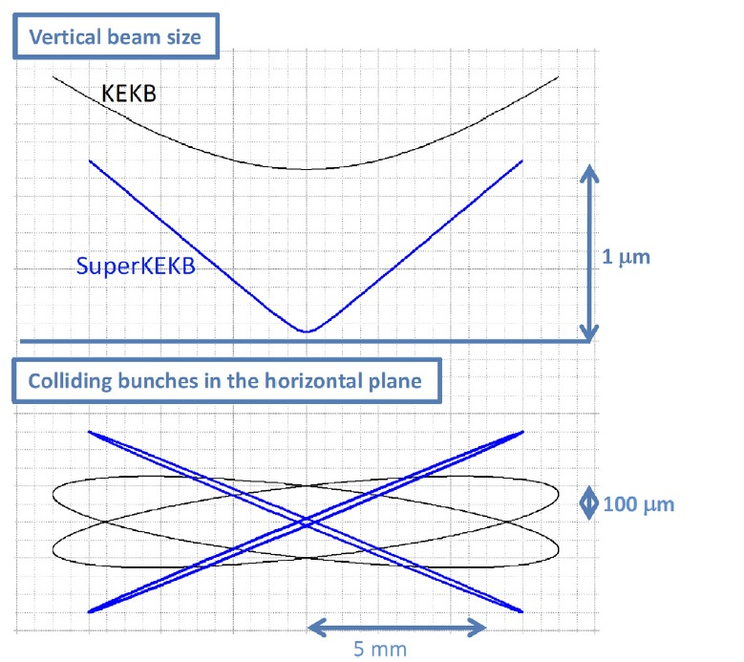
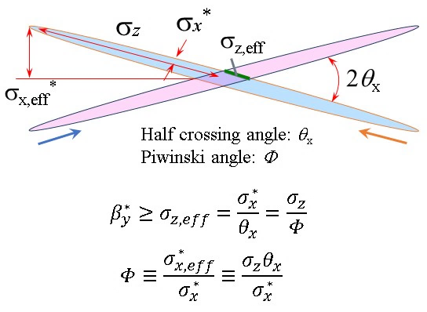
Nano-beam scheme
  Squeeze beams down to ~50 nm height and ~10 μm width at the collision point with a large crossing angle to avoid the hour-glass effect.
Comparison with KEKB
Nano-beam collision
β_{x}* and β_{y}* are squeezed to ~30 mm and ~0.3 mm, respectively, in the design.

Slide 8
Many challenges
  Low emittance, small beam size at IP
  Realize the low emittance optics using existing lattice as much as possible (to reduce construction costs)
  Sevier non-linear effect, small dynamic aperture
  Strong, ultra-fine tunable superconducting final focus
  Strong, stable and high-quality injector
    Positron damping ring, Photo cathode RF gun
  Wideband, fast IP feedback system
  Beam instrumentations
  High beam current
  Strong injector
  Low impedance vacuum components
  Strong RF systems
  Bunch feedback systems to suppress coupled-bunch instabilities

Slide 9
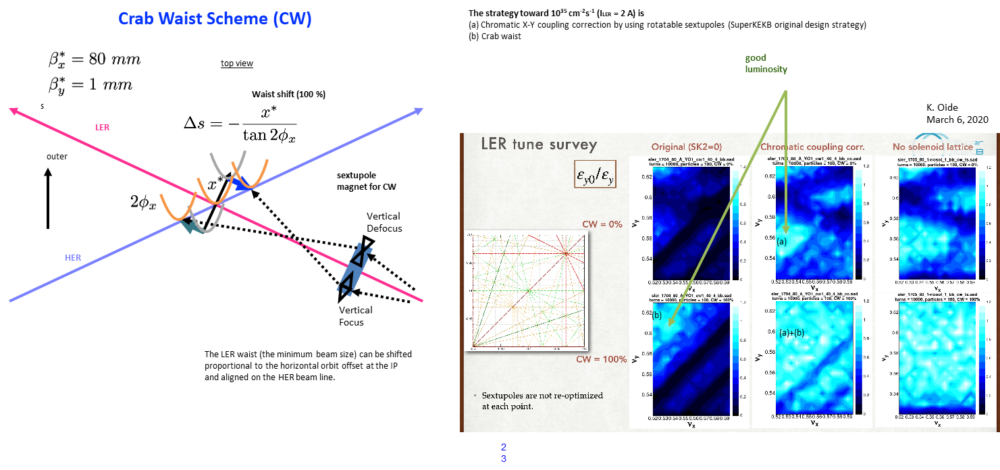
Crab waist mode

Slide 10
Cabling of Sextupoles for LCC

Slide 11
Cabling of Sextupoles for LCC

Slide 12
Cabling of Sextupoles for LCC

Slide 13
2020a,b operation

Slide 14
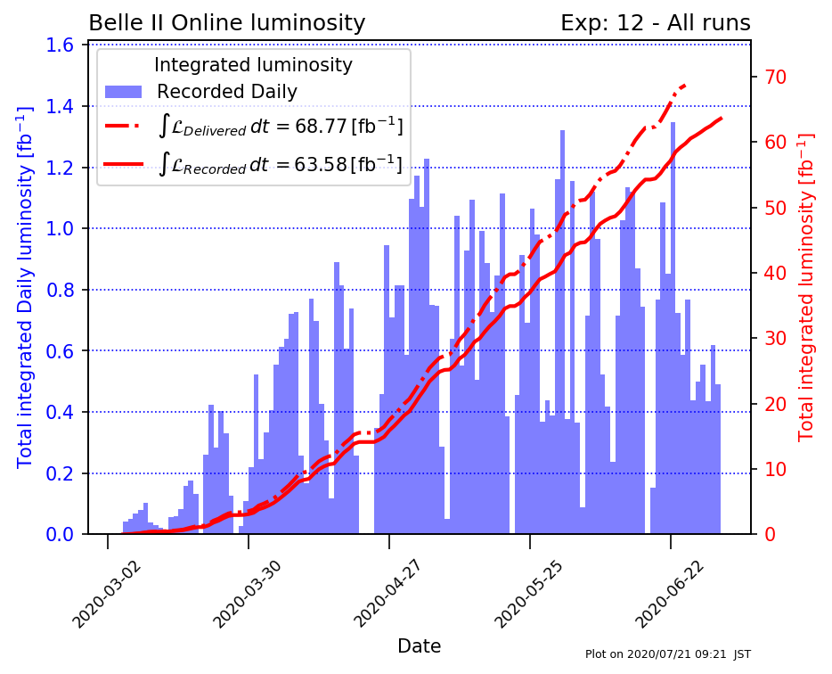
Integrated luminosity

Slide 15
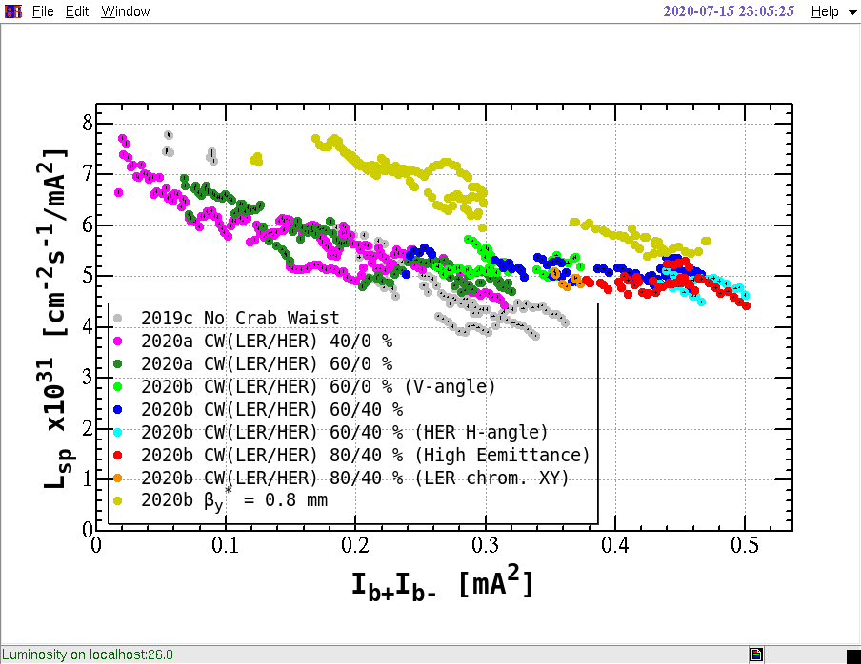
Specific Luminosity

Slide 16
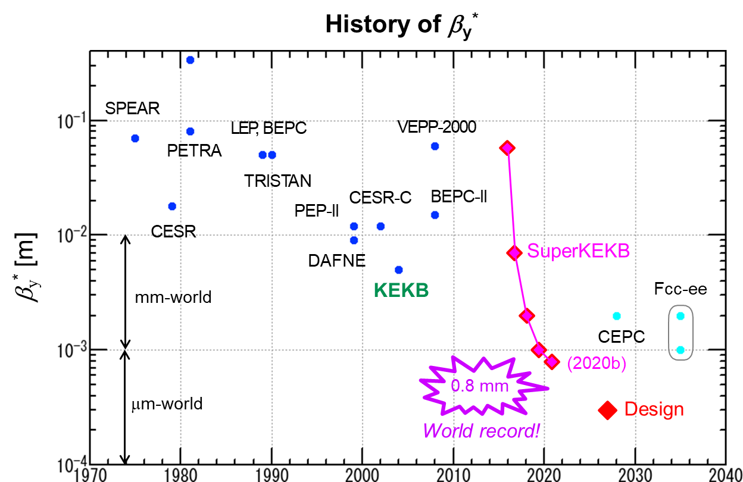
Present status
  Now operating with the world’s smallest β_{y}* of 0.8 mm, lower than the bunch length of ~6 mm.

Slide 17
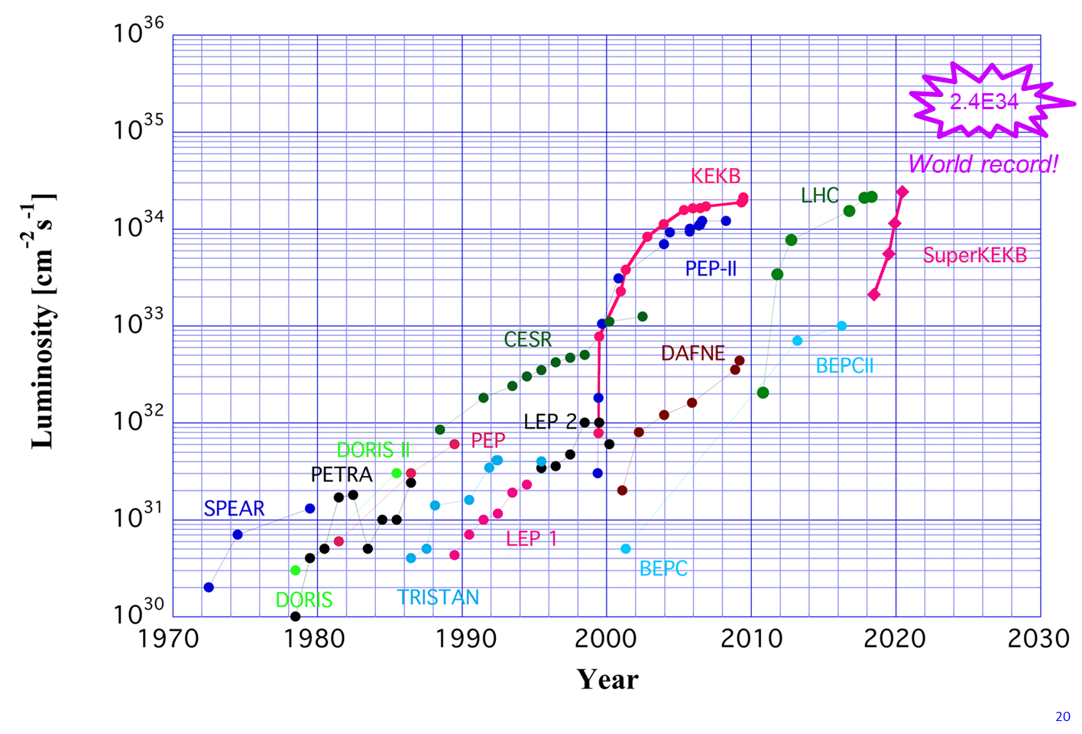
Present status
  We are now struggling every day to increase luminosity and deliver more data to Belle II detector.

Slide 18
International collaboration on SuperKEKB accelerator
commissioning and developments
  R&D for high luminosity colliers [MNPP-01]
    IJCLab: Fast luminosity monitor (LumiBelle2)
    CERN: Beam Commissioning
      Salim Ogur, Dima El Khechen, Marian Luckhof, Andreas Wegscheider, Jacqueline Keintzel, Frank Zimmerman, Renjin Yang, Adam Koval..
    IHEP Beijing: Beam commissioning
  US-Japan collaboration in HEP
    SLAC/Stanford:
      IP feedback, Beam background, Collimators, HOM suppression, BxB feedback, X-ray monitor
    University of Hawaii
      X-ray monitor
    Wayne State University : LABM
    BNL, FNAL: Superconducting final Quads

Slide 19
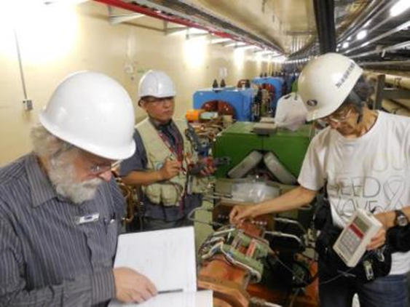
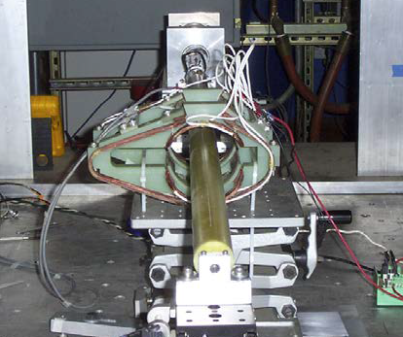
IP orbit feedback systems
Final check in SuperKEKB tunnel
Magnetic field measurement
Constructing dithering feedback systems collaborating with SLAC, ANL(US-Japan) and LAL-Orsay(MNPP-01).
  Horizontal FB: Tested and has shown good response.
  Vertical FB seems also promising. Preparing additional channels.

Slide 20
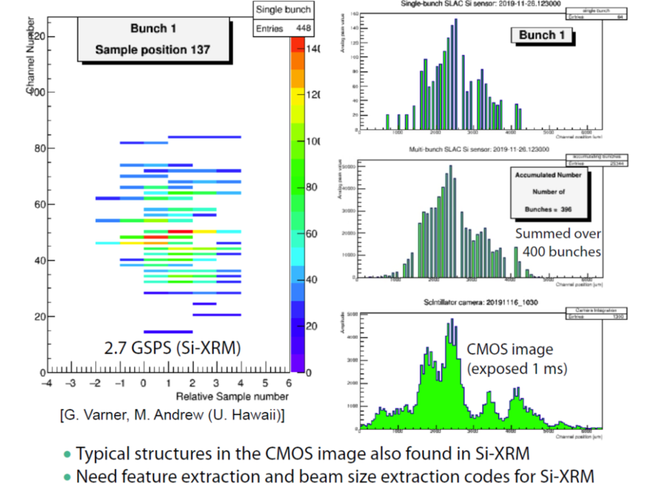
Development of Si-XRM
Developing ultra-fast Si-XRM collaborating with SLAC and U. Hawaii (US-Japan)
  Installed vertical detectors (64-ch) in both HER and LER.
  With very rough tuning (gain, offsets) the bunch structures has been observed, though still struggling with the noise from the accelerator environments, heavy radiation background to control circuits.

Slide 21
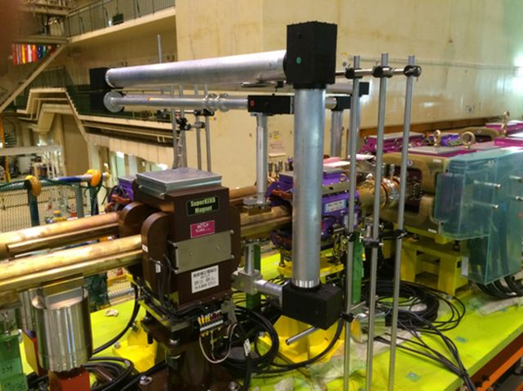
Construction of Large Angle Beamstrahlung monitors
LABM system at IP
First measurement using collision beam: Spatial distribution of lights
The telescopes and detectors were constructed to observe LABM at both side of IP (Wayne st. Univ.)
Accumulating data on the collision. Struggling with the background images from many sources.

Slide 22
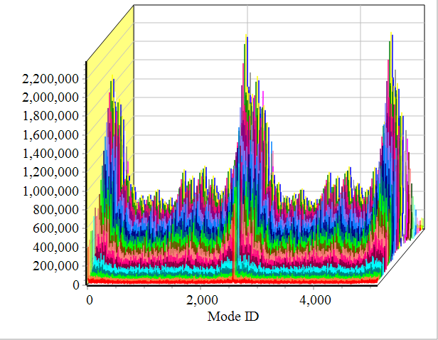
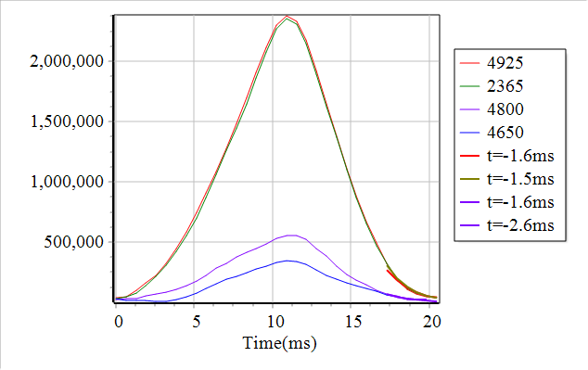
Bunch feedback systems
Example of LER longitudinal excite-damp experiment of the bunch feedback system. Unstable modes (left), excite-damp behavior (center) and damping rates vs feedback gain (right).
Improving the functions of bunch feedback processors (iGp12) (SLAC, Stanford Univ.)
Studying the transverse and longitudinal beam dynamics using bunch feedback systems collaborating with Stanford Univ.

Slide 23
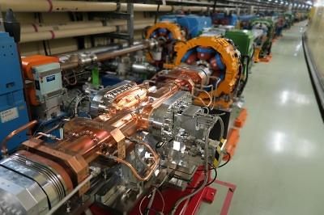
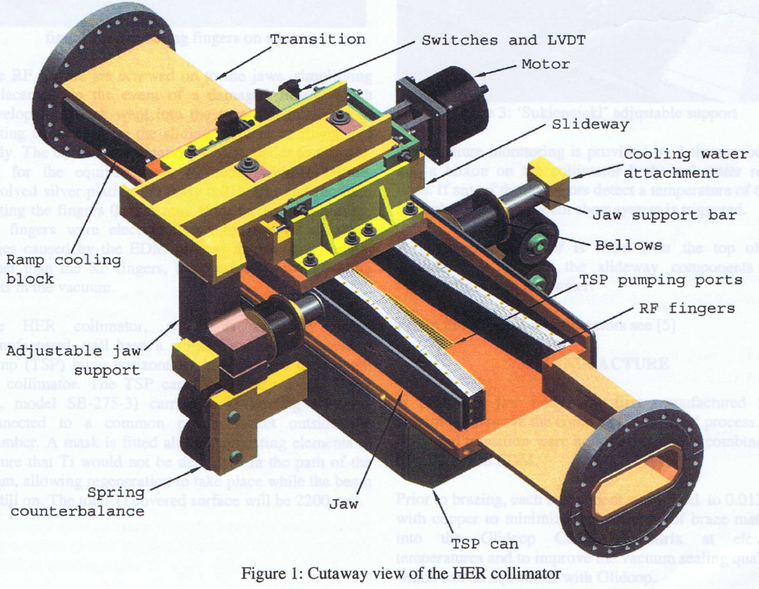
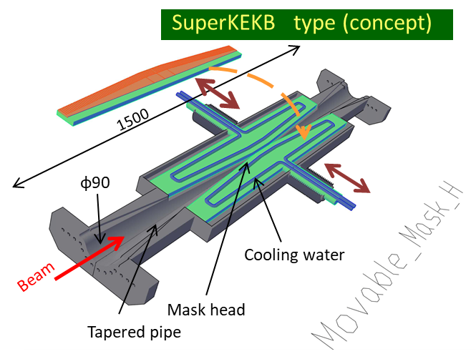
Beam collimator
PEP-II type
Collimator in the SuperKEKB
SuperKEKB-type beam collimators were developed based on the PEP-II type, SLAC.
  Lots of various information were provided from experts in PEP-II, such as selection of materials.
Structure was modified and optimized to fit the SuperKEKB specification.
The collimators are now functioning very well.

Slide 24
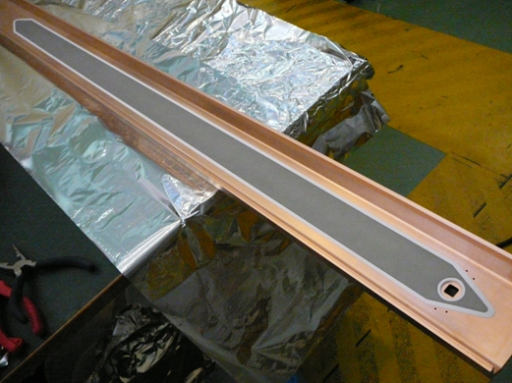
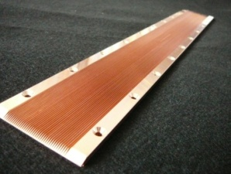
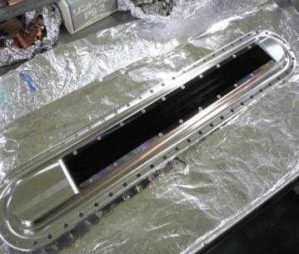
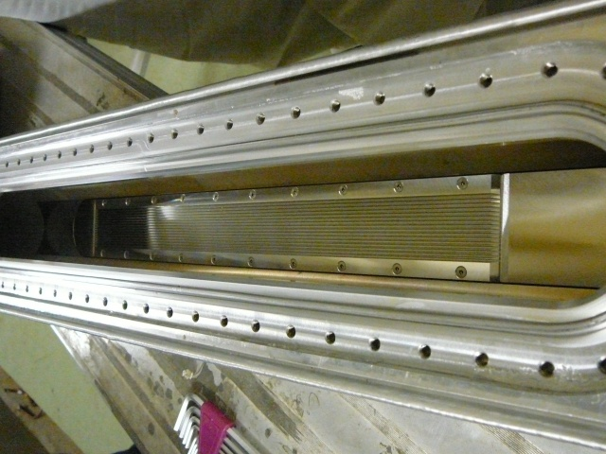
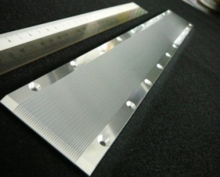
Mitigation of electron cloud effect
  Cu
  Al+TiN
  Al
  SS
Clearing electrode for CESR-TA
Grooves tested in CESR-TA and KEK
Various mitigation techniques against electron cloud effects, such as clearing electrodes, grooved surfaces, and TiN coating, were tested in CESR-TA and KEKB in collaboration with Cornell Univ. and SLAC.
These results were very useful and these techniques were adopted to the SuperKEKB positron ring.

Slide 25
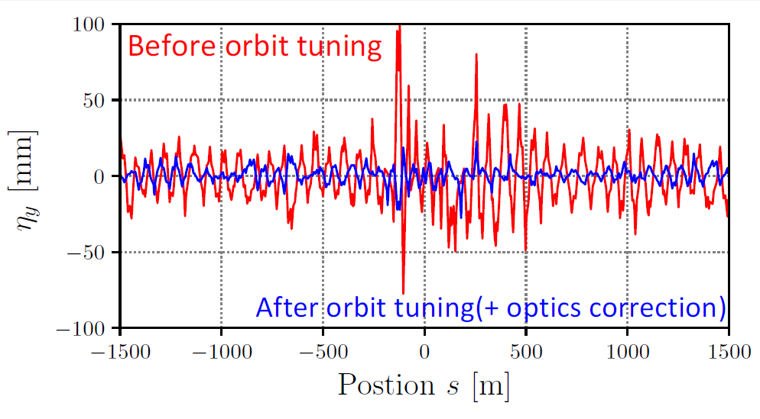
Challenges (1)
  Difficulties in optical correction of the rings
    Errors coming from the misalignment of the magnets have been enhanced with the lower βy*
    Non-linear optics, momentum-dependent effect of the lattice makes the corrections much difficult.

Slide 26
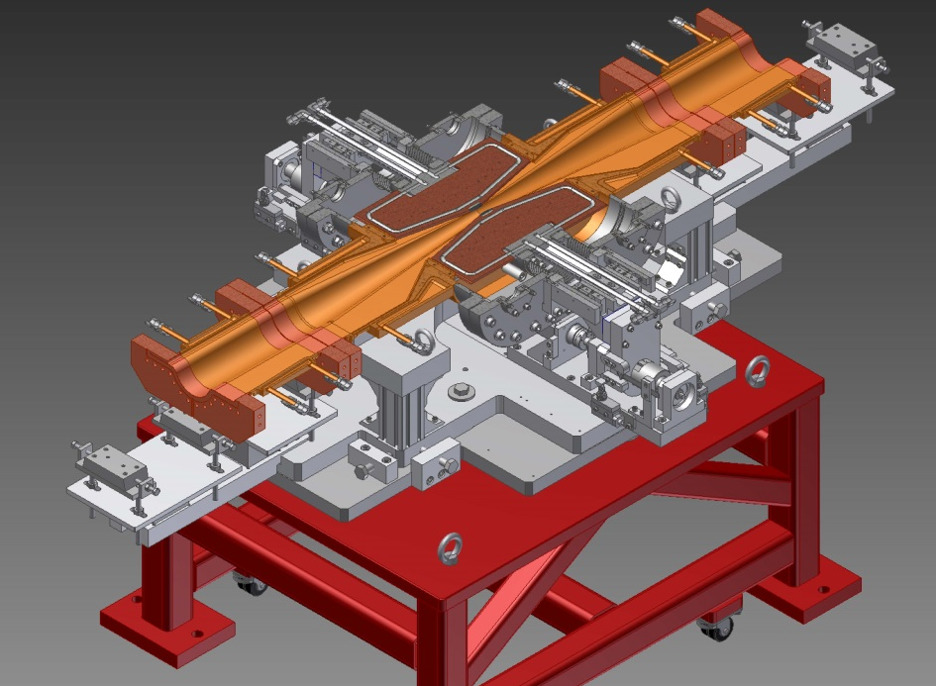
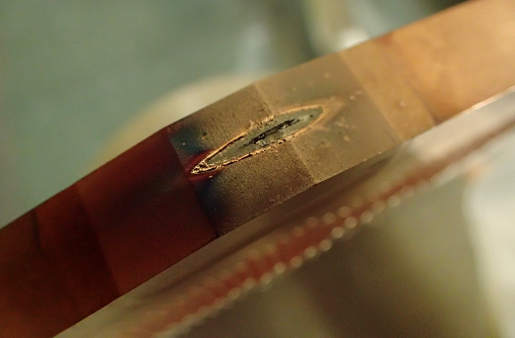
Challenges (2)
  Background noise to the detector
    Beam gas, Tousheck effect, Injection related background, + Radiative Bhaba
    Need to protect the detector (and final focus Qs) by using the beam collimators placed around the rings.
    Narrow gaps of the collimator increase beam impedance (mode coupling instability) and the possibilities of the damage of the heads.
Damage of head (D02_V1) generated 2019b run
Damage
Beam

Slide 27
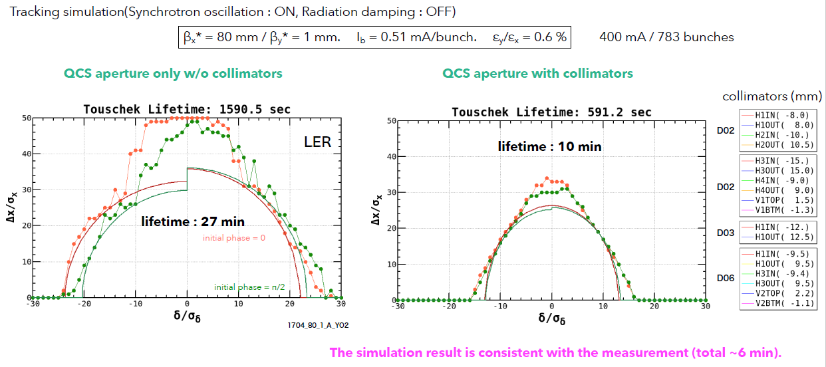
Challenges (3)
  Very short beam lifetime
    Physical aperture is strongly limited by the narrow gaps of the collimators.
    Beam-beam effect also reduces the beam lifetime
Ohnishi_SuperKEKB_Workshop_202003

Slide 28
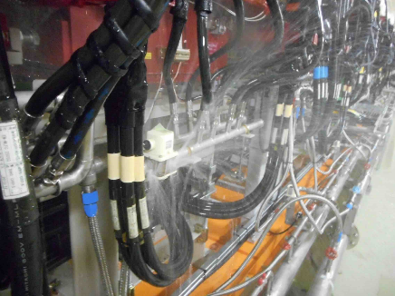
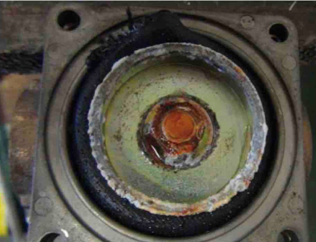
Challenges (4)
  Maintaining (very) aged hardware including buildings
    Most of the hardware have been used since KEKB time (>20 years), some has been used since TRISTAN time (>30 years)

Slide 29
Summary
  Achieved world highest luminosity of 2.4x10³⁴/cm²/s
    Nano-beam scheme works.
    Crab-waist scheme helped to operate the ring with higher bunch current
    Smallest IP vertical beam size (0.22um)
      IP vertical beam size of SLC was 0.7um
  Try to reduce the βy*, increase beam current, discover better optics– to achieve higher luminosity. Your cooperation is surely welcome!

Slide 30
Timeline
西暦
2010
2011
2012
2013
2014
2015
2016
2017
2018
2019
2020
2021
2022
・・・
年度
JFY2010
JFY2011
JFY2012
JFY2013
JFY2014
JFY2015
JFY2016
JFY2017
JFY2018
JFY2019
JFY2020
JFY2021
JFY2022
・・・
KEKB operation
SuperKEKB LER & HER construction
HER & LER Beam tuning
Startup work
Phase-1
w/o QCS
w/o Belle II
Collision tuning
Renovation for Phase-2
Phase-2
w/ QCS
w/ Belle II (no VXD)
Physics run
Positron damping ring (DR) construction
Belle II VXD
installation
DR commissioning
Phase-3
w/ full Belle II
Injector Linac upgrade
Based on K. Akai, Mar. 14, 2018 @KEKB review
2

Slide 31
Luminosity projection and
expected physics
S(K_{s}⁰π⁰γ)
S(φ K_{s}⁰)
X_{s}ℓ⁺ℓ⁻, C₉^{NP}
P’_{5ee}/P’_{5μμ}
S(η’K⁰)
B→τν
S(ρ⁰γ)
I_{sumrule}(Kπ)
20ab⁻¹
R(Dτν)
R(D*τν)
10ab⁻¹
2

Slide 32
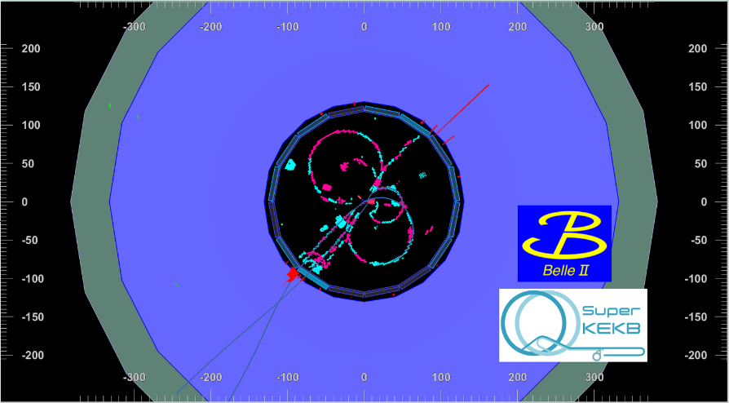
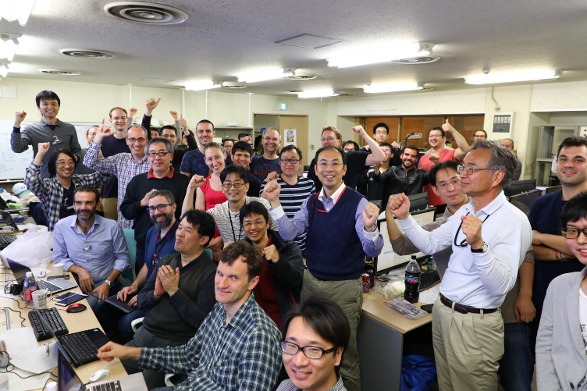
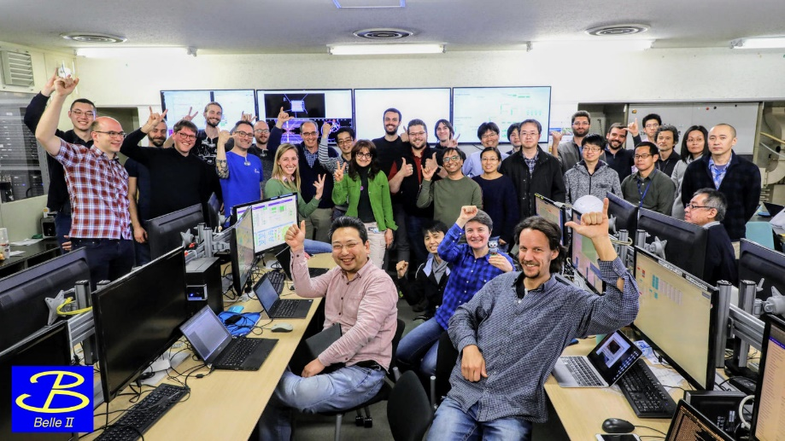
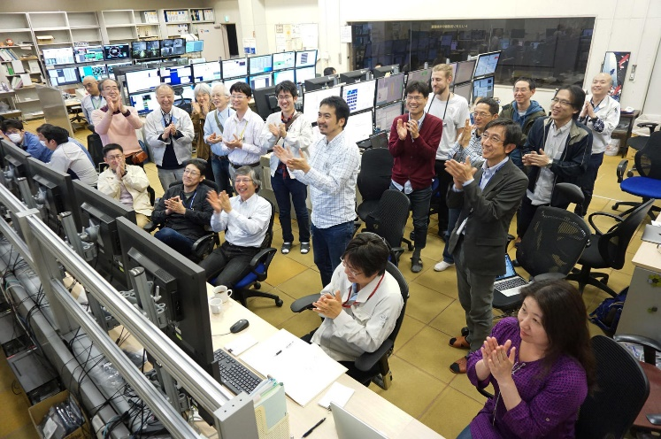
Milestones
2018/04/26
First collision event at SuperKEKB
2019/03/25
First B-anti_B event with full detector
2

