Slide 1
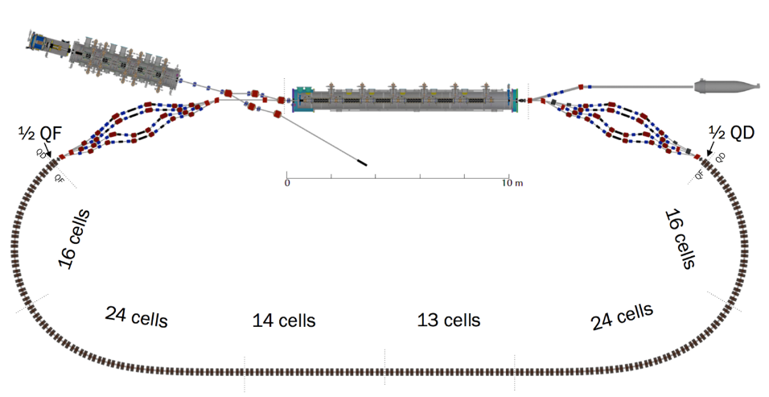




Ongoing and potential Cornell contributions to the EIC
Georg Hoffstaetter

Slide 2
The CBETA CDR
Potential contributions from Cornell
1) Ongoing work
a) Electron storage ring dynamic aperture optimizations
b) Hadron Accelerator Ring layout optimization
c) Hadron cooler design: source, merger, and ERL design and simulation, inc. space charge and CSR.
d) Polarized beam simulations
2) ERL tests at CBETA
DC gun toward 100mA.
Bunch distribution, smoothness, micro bunching, and CSR from a DC gun at the nC scale.
High-current ERL operation with a design limit of 100 mA.
3) SRF topics
SRF material qualification
Vertical bare cryogenic cavity tests
Horizontal dressed cavity testing in Cornell’s HTC
SRF component testing, e.g. cold tuners, HOM absorbers, couplers
HOM absorber material studies
SRF simulations, cavity design, RF component design
4) Cathode topics
Cathode testing, Q mapping, polarization measurement
Cathode fabrication and process qualification
5) DC guns
Design, construction, and testing of high-current DC guns for the hadron coolers
DC gun tests for polarized collider beams

Slide 3

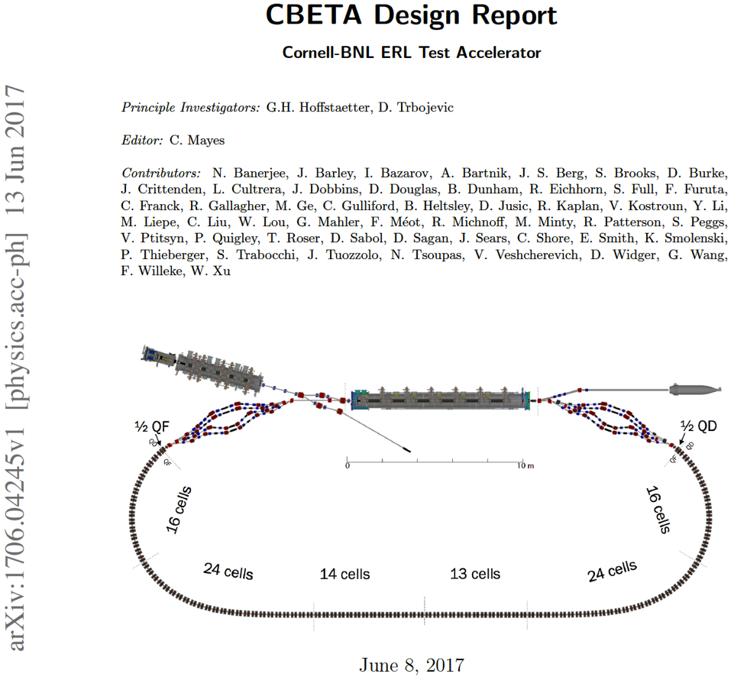
The CBETA CDR
Long collaboration with BNL
2005 Start of construction of DC photo-emitter gun; to world record current (75mA).
2012 PD-Design on a hard x-ray 5GeV Cornell ERL, not built.
2013 Cornell’s ERL injector achieved world record brightness.
2014 White paper for CBETA in Cornell / BNL collaboration.
2016 Construction funding by NYS
2017 CBETA Design Report
2018 1st beam thorough SRF chain, one separator and one PMA unit.
2019 ER with 1 turn & 1st ERL with 4-turns.
Starting in 2020, CBETA will be available for R&D on high power beams!

Slide 4
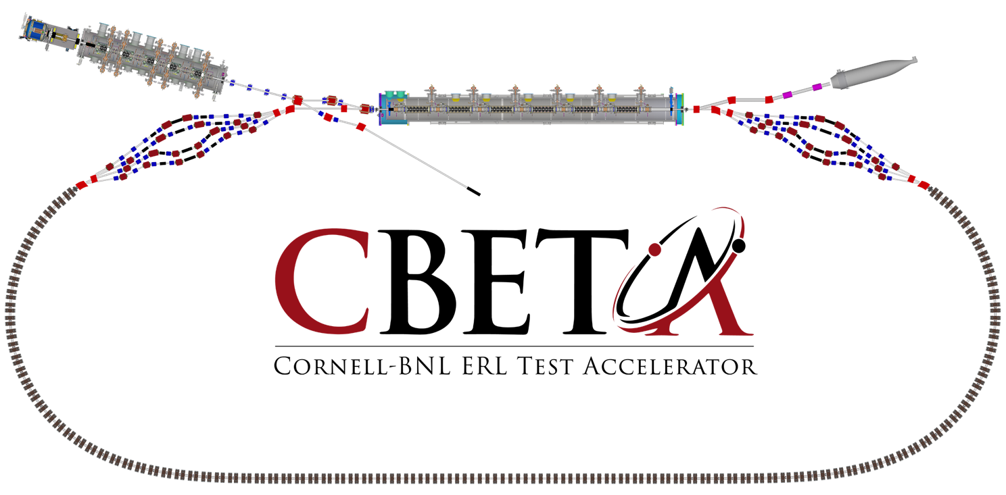
Design Parameters
4 spreaders and 4 combiners
FFA return loop
  Of permanent magnets
  For a factor 3.8 energy aperture.
  For 7 simultaneous beams
Cornell DC gun
100mA, 6MeV SRF injector (ICM)
600kW beam dump
100mA, 6-cavity SRF CW Linac (MLC)
6 MeV
6 MeV
+/- 36 MeV
Electron Current up to 320mA in the linac
Bunch charge Q of up to 2nC in the injector
Bunch repetition rate 1.3GHz/N
Beams of 100mA for 1 turn and 40mA for 4 turns
42, 78, 114, 150 MeV

Slide 5
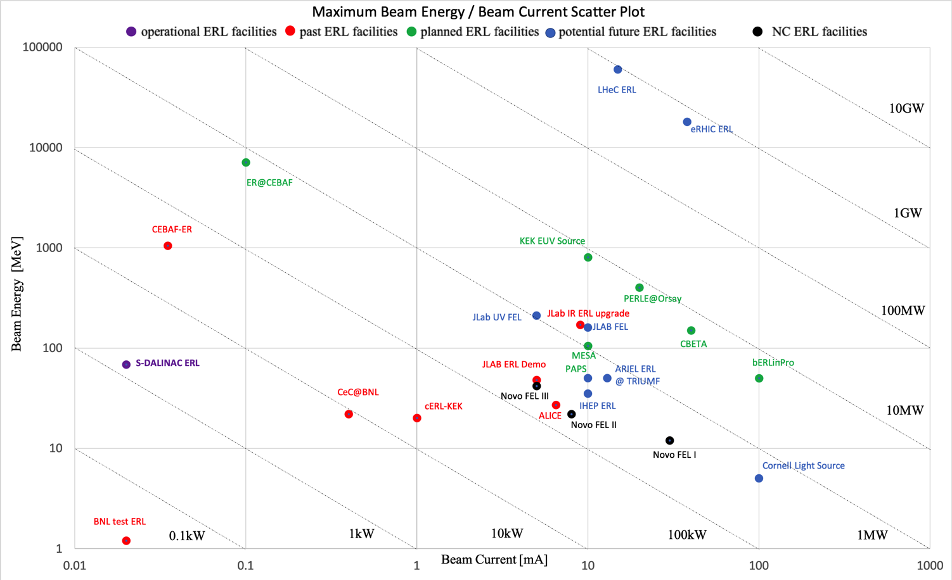
The beam power frontier
EIC cooler
Courtesy Chris Tennant
CBETA has 150MeV / 40mA or 60MeV/100mA: 6MW beam power
EIC cooler ERL has 150MeV and up to 100mA: up to 15MW

Slide 6
The beam power frontier
EIC cooler
Courtesy Chris Tennant
Home projects of collaborators who joint in recent CBETA running

Slide 7
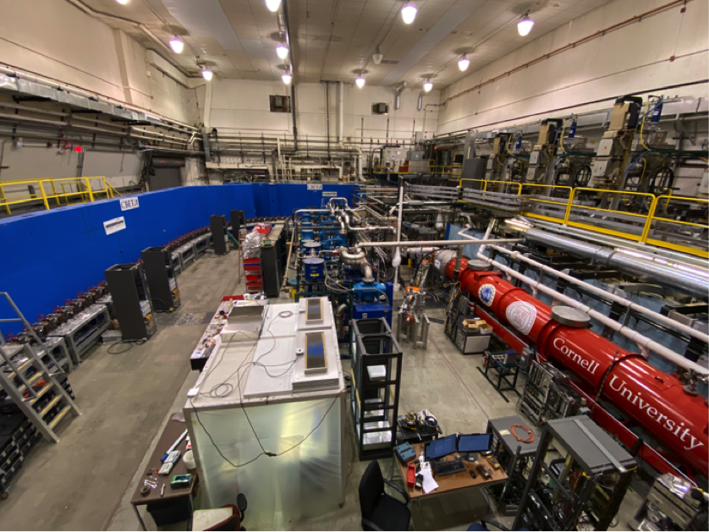
CBETA installation at Cornell, 2019

Slide 8
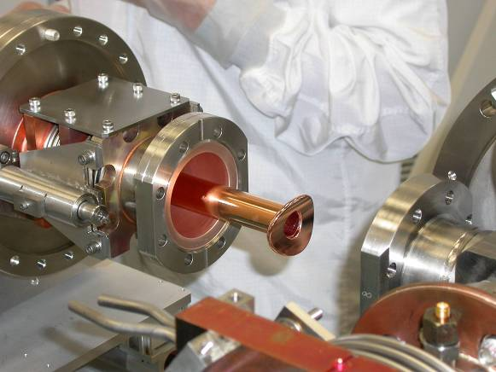
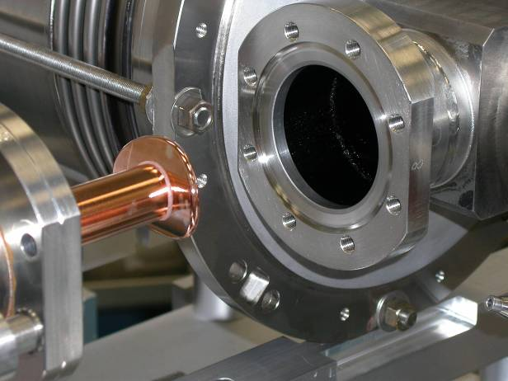
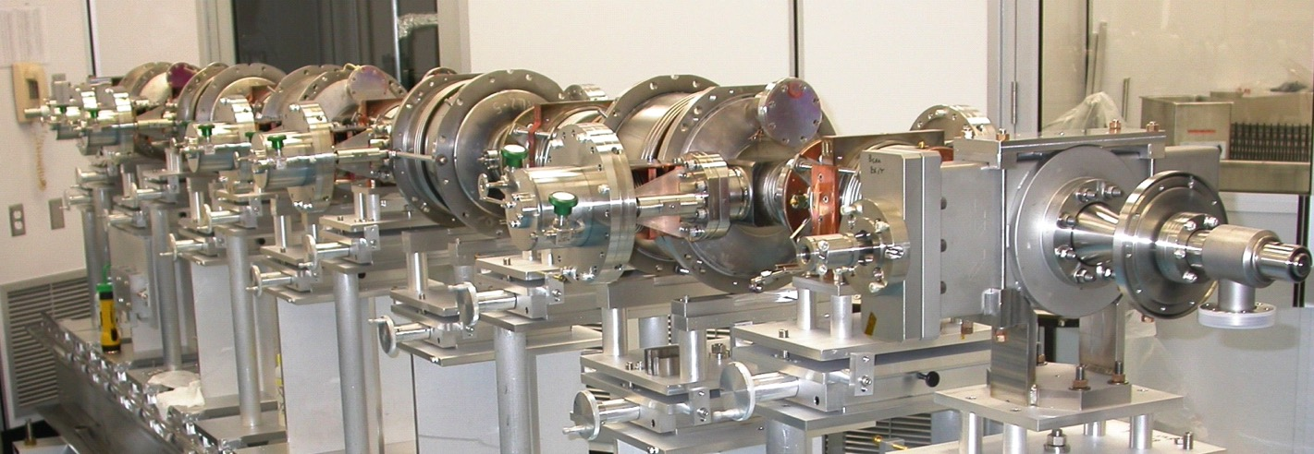
Cornell EIC opportunity: Cryomodule components
Gate valve internal
Gate valve internal
to cryomodule
to cryomodule
Vacuum vessel interface flange
Cleanroom assembly fixturing
Vacuum vessel interface flange
Cleanroom assembly fixturing

Slide 9
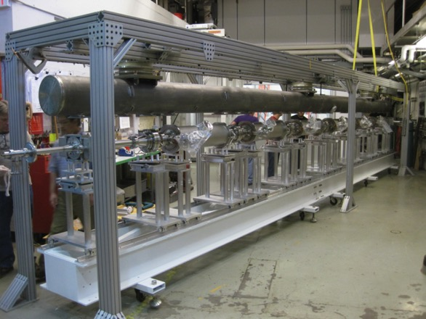
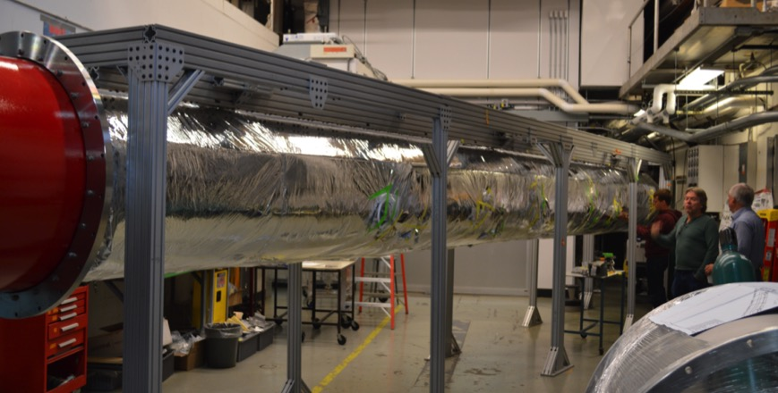
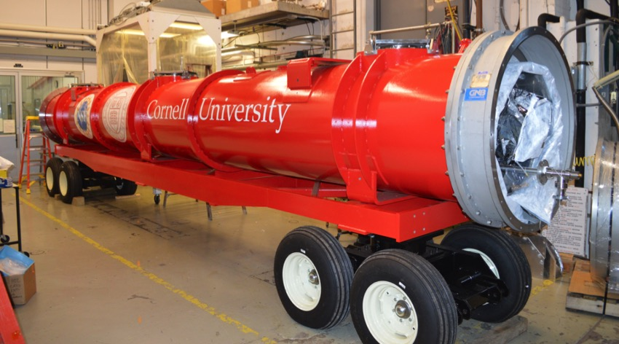
Cornell EIC opportunity: Cryomodule construction
MLC assembly was completed
Cooled down fall 2015, field, Q, and microphonics tested.
Further cold studies will start August 2016

Slide 10
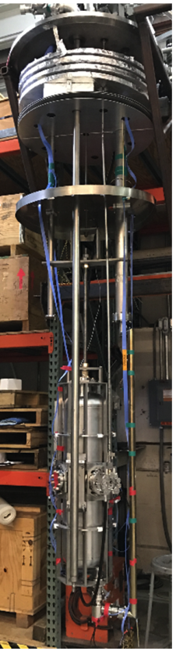
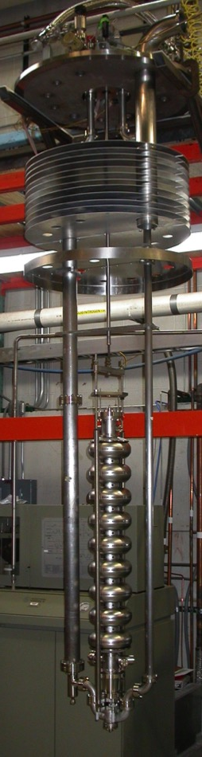
Potential Cornell SRF EIC Contributions
SRF simulations, cavity design
  CST Studio, ACE3P,…
Niobium material qualification
  E.g., trapped flux studies
SRF cavity fabrication
  Including in-house EB welding
Cavity preparation
  BCP, EP, CBP, furnace treatments, doping…
Vertical cryogenic cavity tests (200MHz–6GHz)
  Inside liquid helium bath
  With LHe in cavity tank only (e.g., for tuner testing)

Slide 11
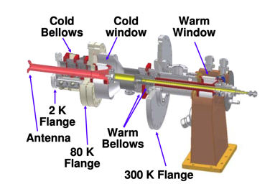
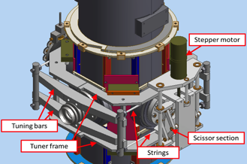
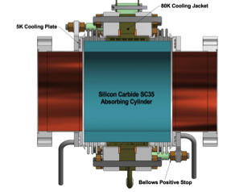
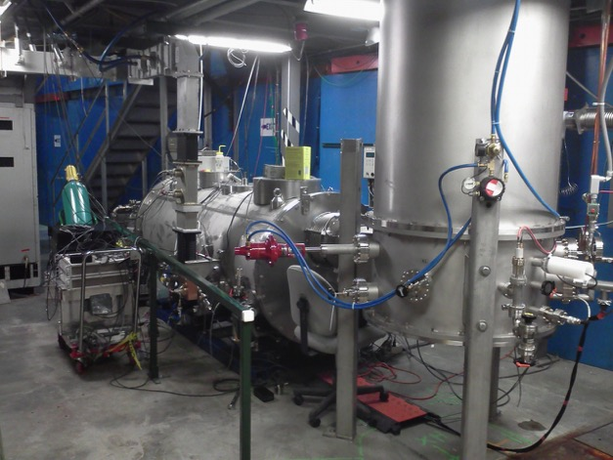
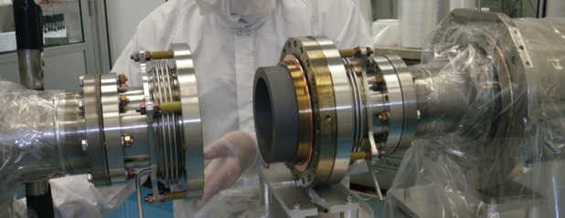
Potential Cornell SRF EIC Contributions
SRF component design and testing
  E.g. cavity tuner, HOM absorbers, RF coupler
  HOM absorber material studies
Horizontal dressed cavity testing in Cornell’s
Horizontal-Test-Cryomodule (HTC)
  1-cavity cryomodule, e.g. used for first LCLS-II HE 9-cell cavity cryomodule test
  Horizontal test bed to study cavity performance, RF coupler performance, cavity operation, LLRF controls…

Slide 12
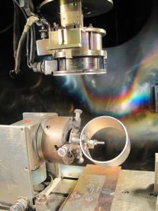
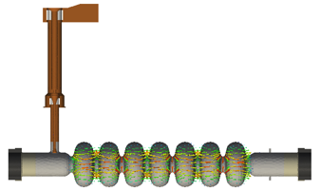

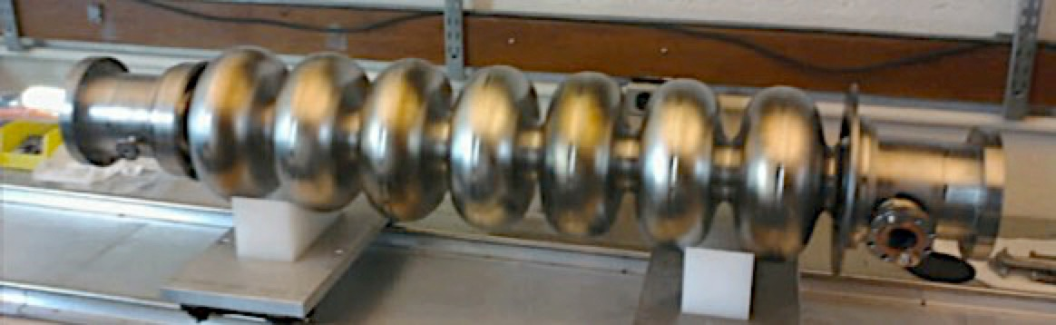
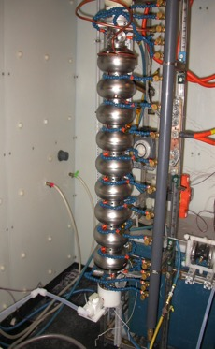
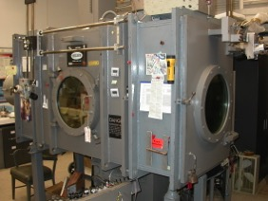
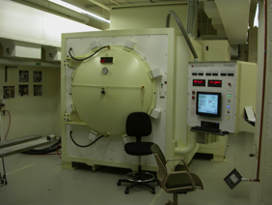
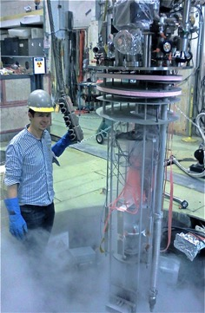
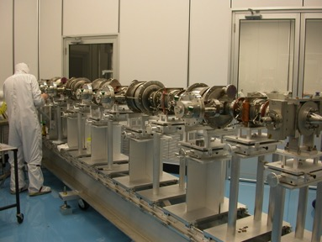
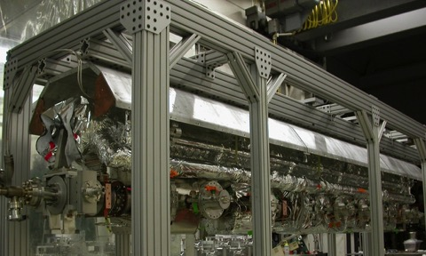
Cornell SRF Group Capabilities
Design and fabrication to full cryomodule
RF design
Material characterization
In-house cavity fabrication
Cavity surface preparation
SRF cavity vertical testing
Component R&D / testing
Cryomodule design,
assembly, and testing

Slide 13
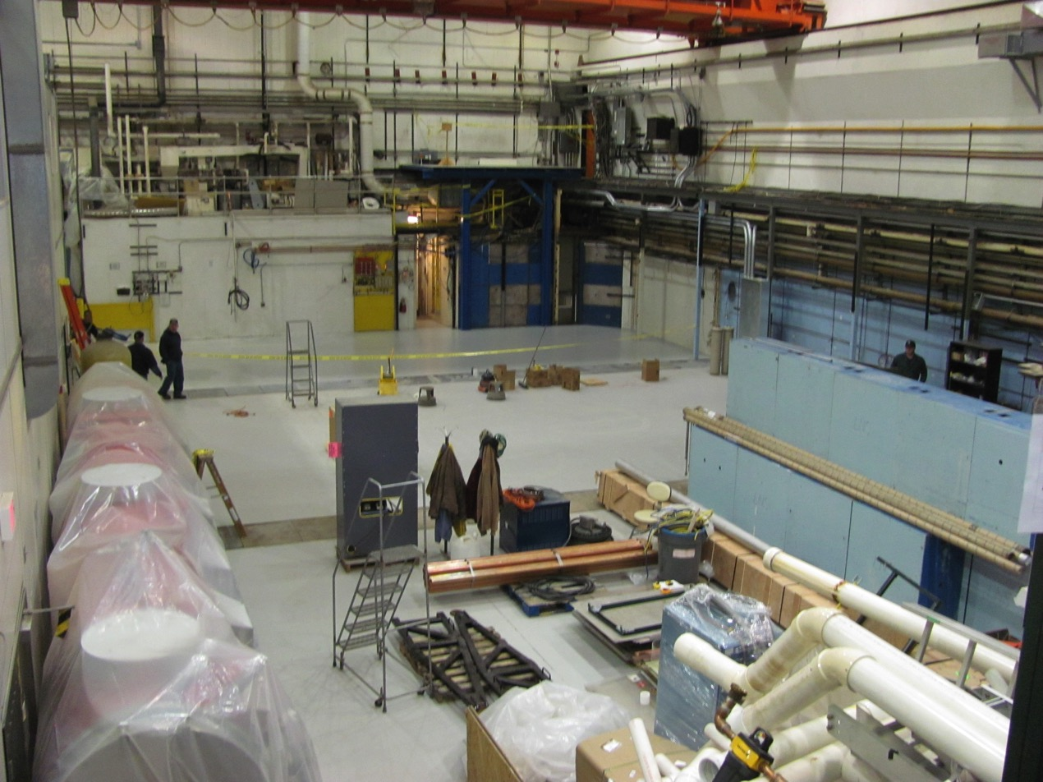
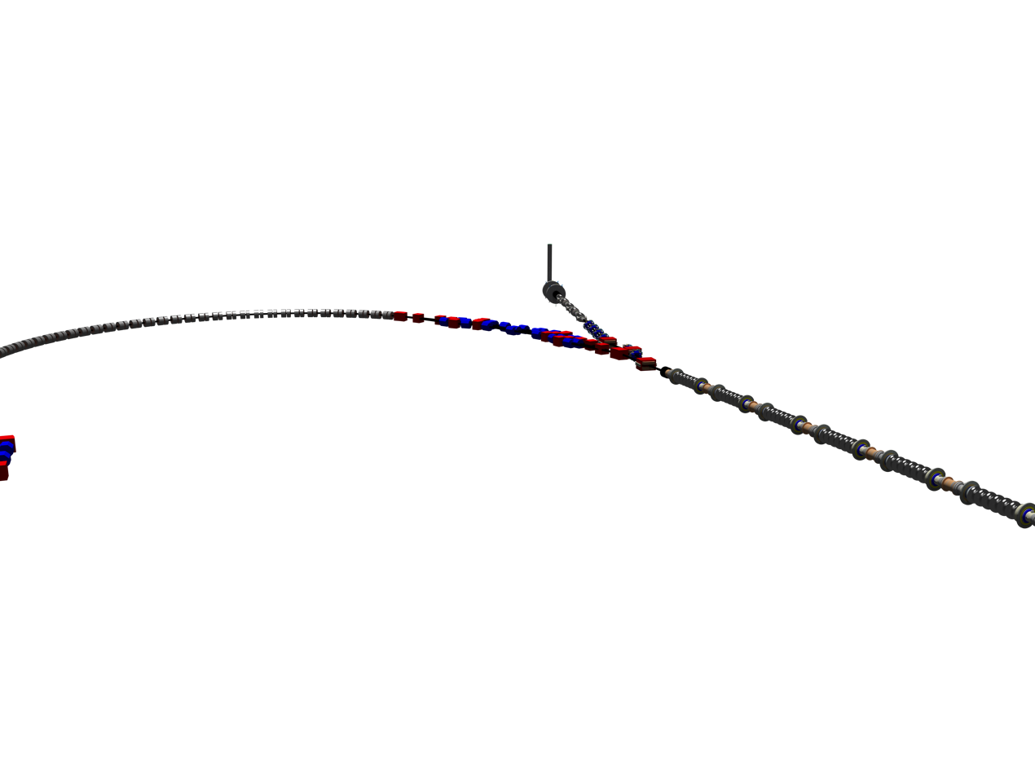
L0E cleaned with CBETA

Slide 14
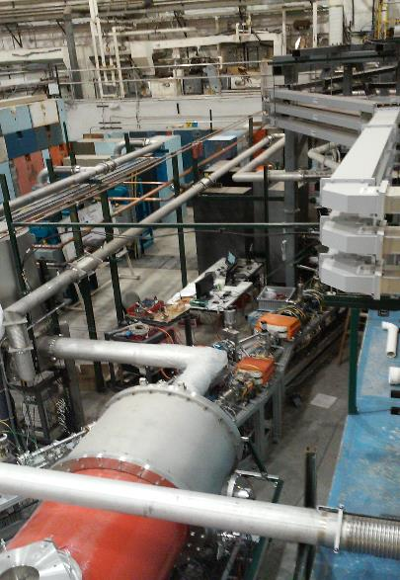
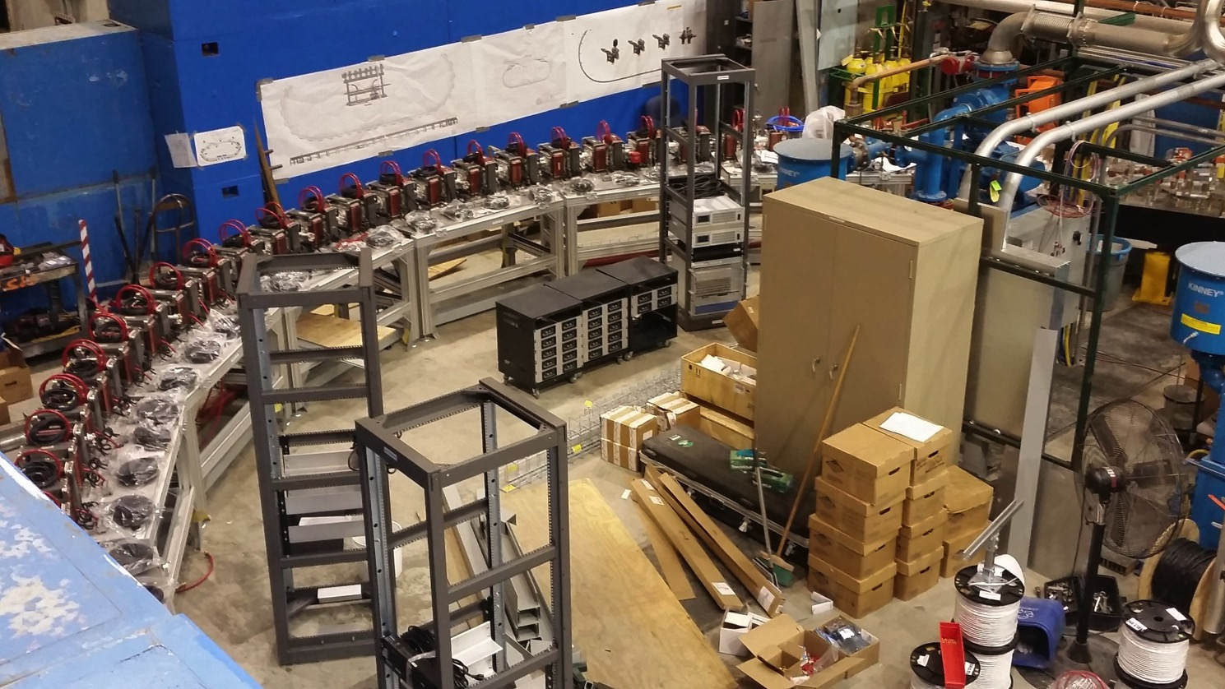
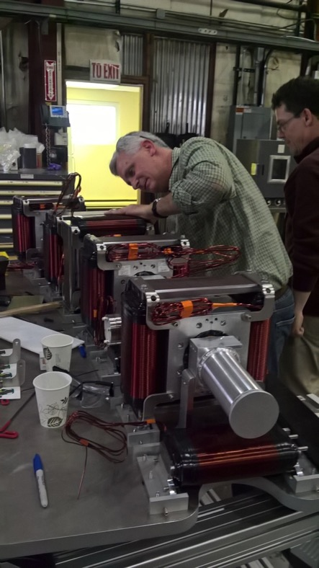
CBETA installation at Cornell
and Magnet work at BNL

Slide 15
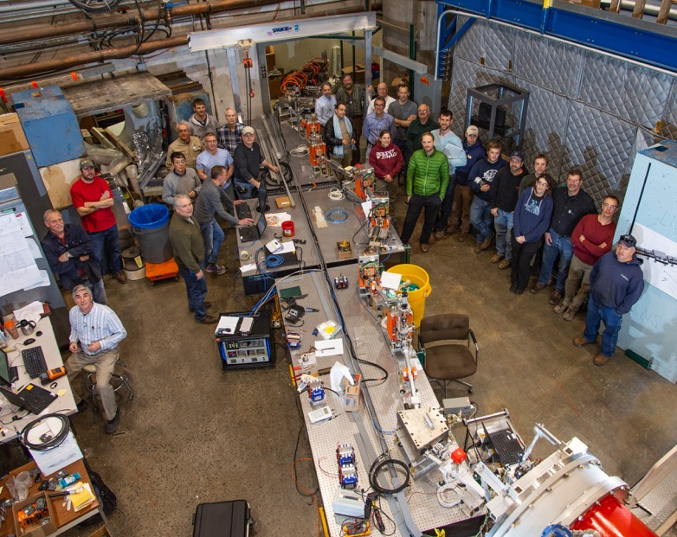
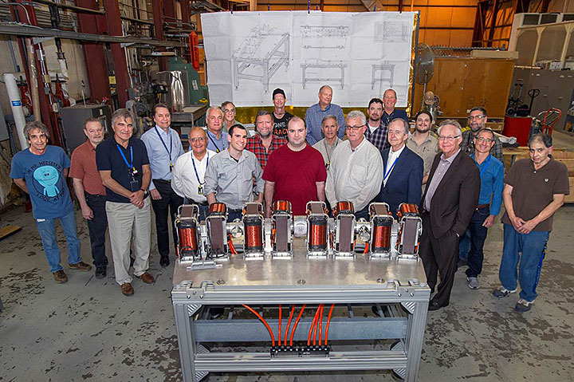
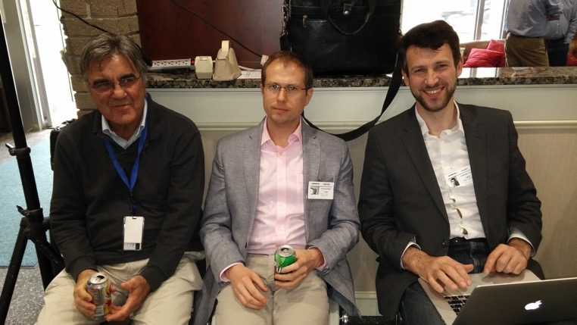
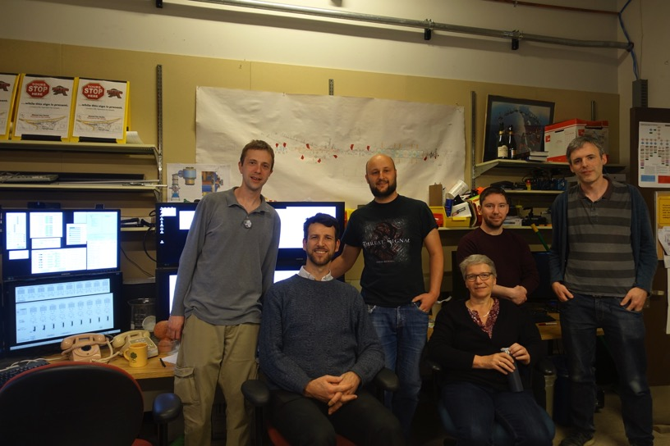
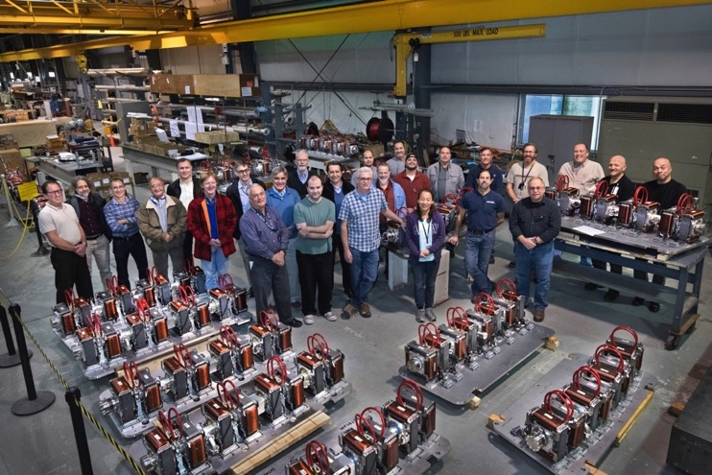
International ERL collaboration
BNL
Cornell
JLAB
HZ-Berlin
U-Mainz
Cockcroft Inst.
Ratherford Lab
KEK

Slide 16
Achieved parameters as of Spring 2020
Cornell DC gun
75mA short term, 65mA for hours
Detailed phase space diagnostics for space charge dominated beams.
Study of 2nC bunch charges
High power SRF injector linac
Tested up to 13.5MeV
Tested up to 75mA
Investigation of ion / beam interactions
ERL main SRF linac
Operated with 1-turn ERL and 99.6% ERL efficiency
Operated with 4-turn ERL
Detection of micro bunching
1-turn current limited to 70mu for radiation protection.
4-turn current limited to 1nA because of 50% beam loss in the last recovery loop.
FFA return loop
7 simultaneous beams (at 42, 78, 114, 150MeV)
Hardly measurable beam losses in the FFA region

Slide 17
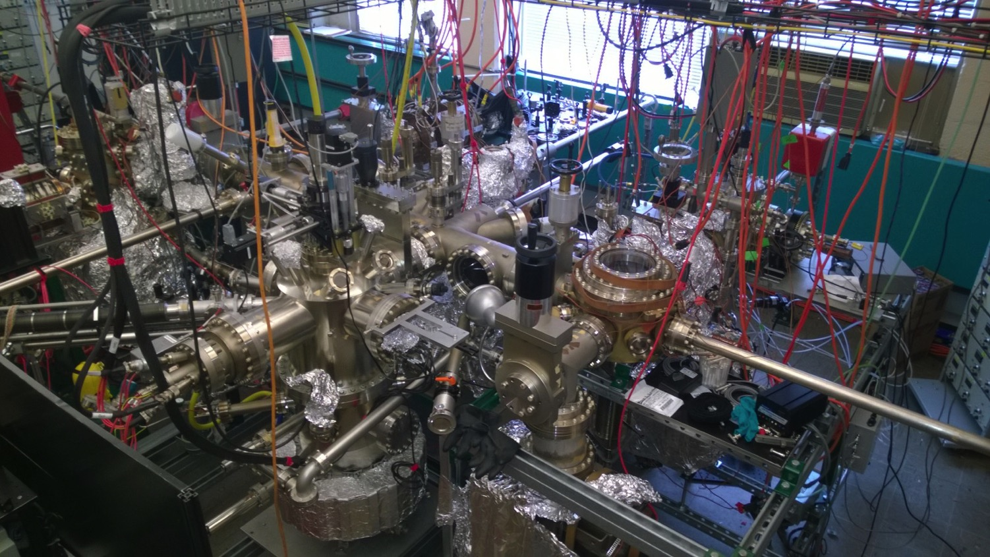
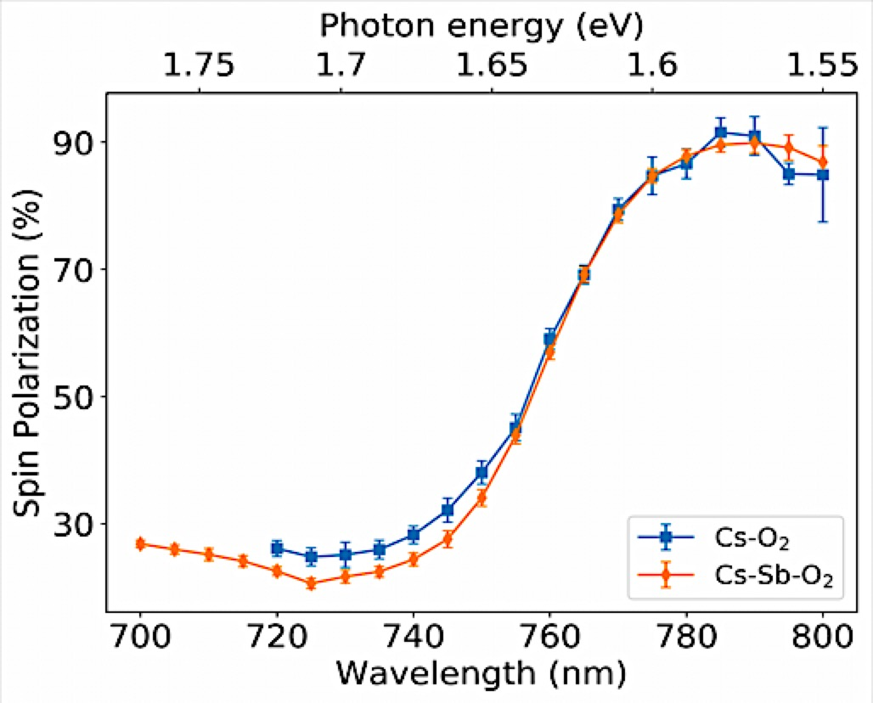
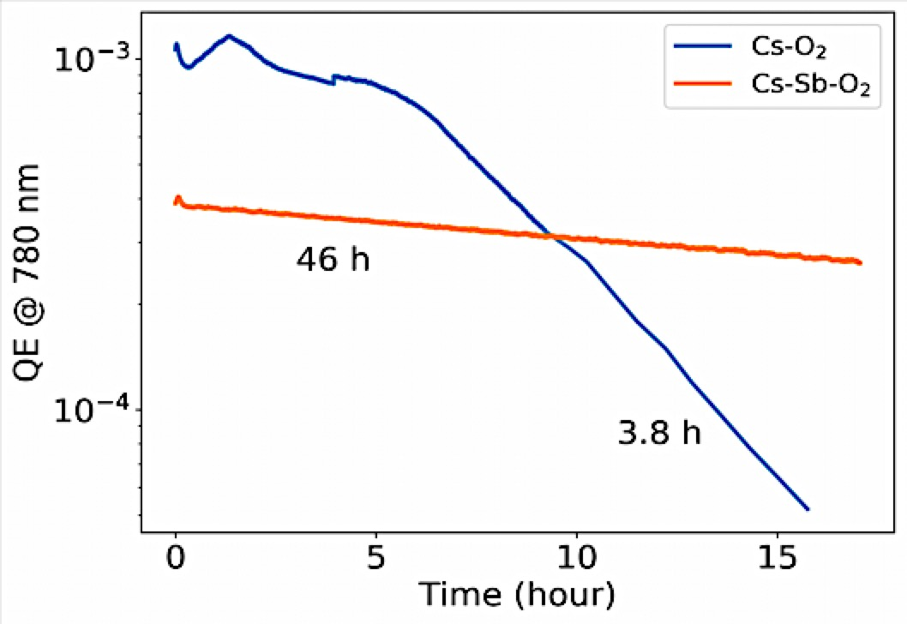
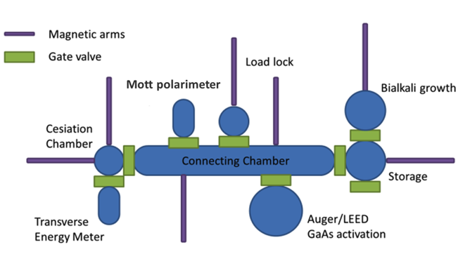
Spin polarized photocathode
Cornell EIC opportunity:
Cathode production (incl. polarized)
New activation methods that improve lifetime
90% ESP @ 780 nm
Lifetime x12!!

Slide 18
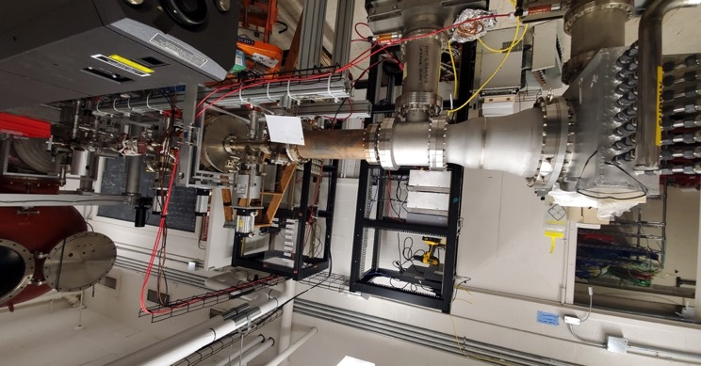
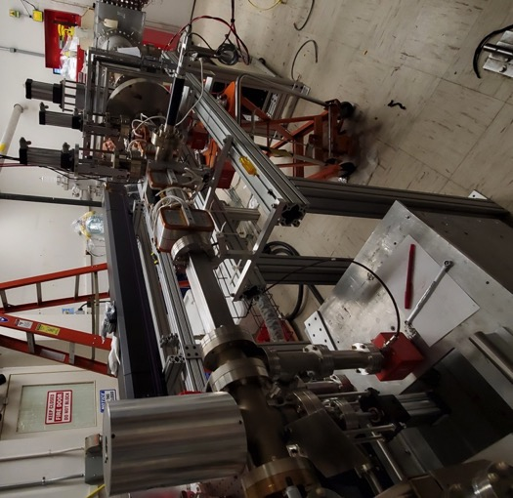
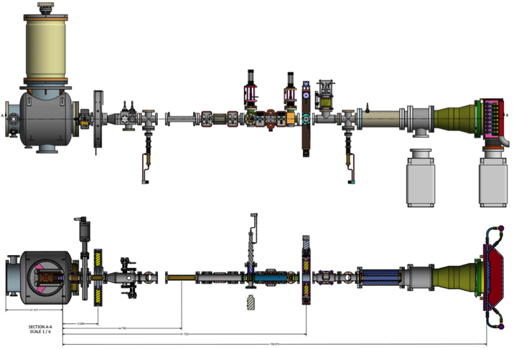
Cornell EIC opportunity:
High current gun development and construction
High average beam power beamline:
Old CU-ERL gun 400kV @ 100 mA;
Ion clearing electrodes;
Multiple lasers with tunable wavelength;
75 kW beam dump;
UHV photocathode load-lock/suitcase;

Slide 19
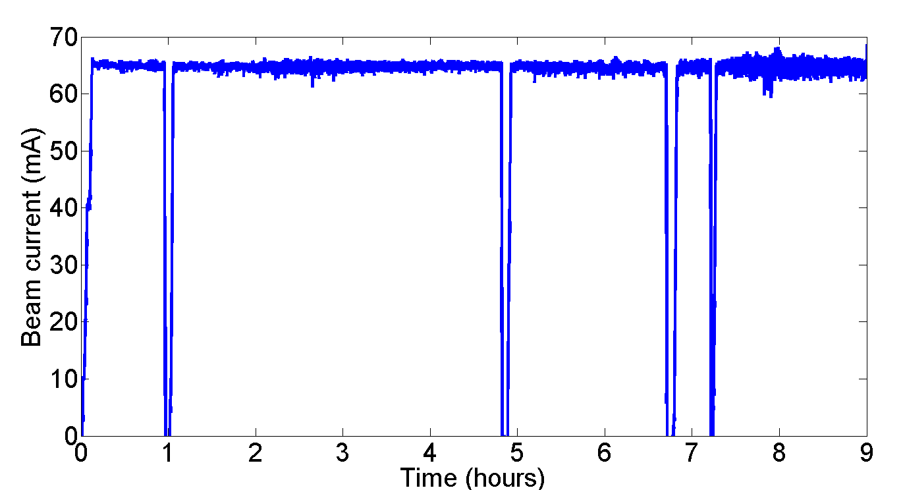
High Current Beams
Peak current of 75mA (world record)
NaKSb photocathode
High rep-rate laser
DC-Voltage source
Source achievements:
2.6 day 1/e lifetime at 65mA
8h at 65mA
With only 5W laser power (20W are available)
now pushing to 100mA
Simulations accurately reproduce photocathode performance with no free parameters, and suggest strategies for further improvement.
Source current can meet CBETA needs

Slide 20
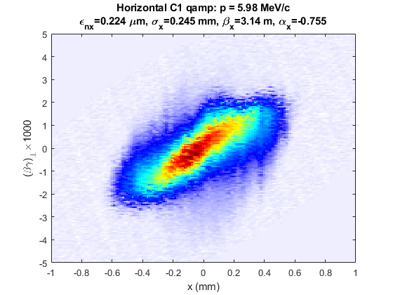
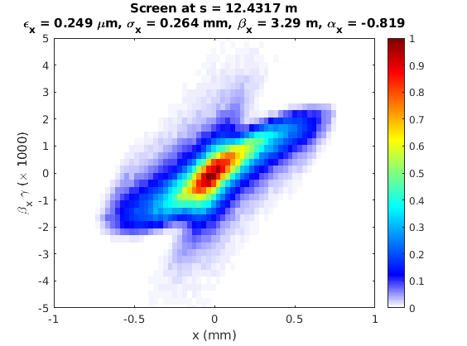
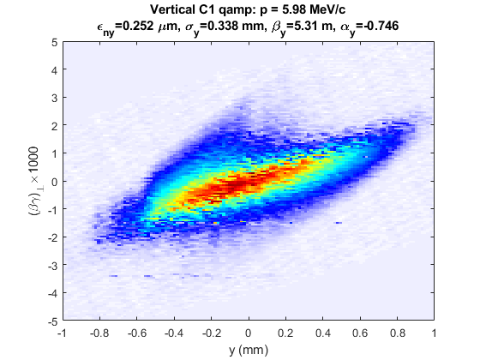
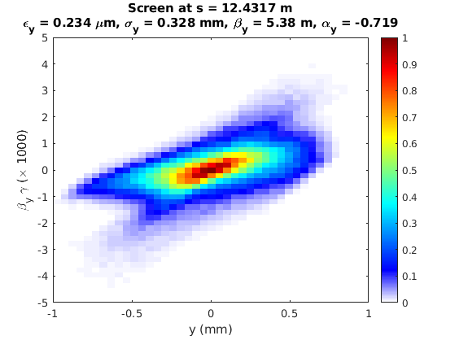
Measured
Simulation
Horizontal
Vertical

Slide 21
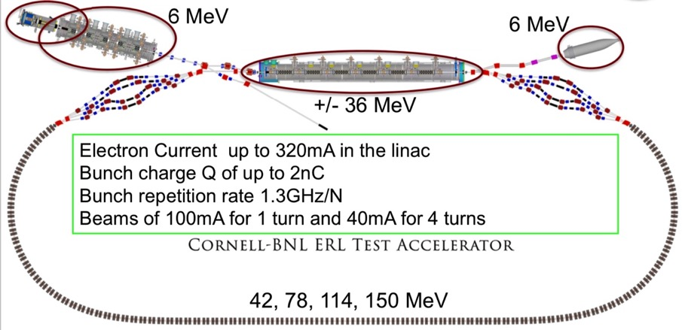
1st ERL turn in CBETA
At least 100 mA current will be needed for eRHIC hadron cooler
(design limit for 1-turn CBETA)
BNL and collaborators gained and demonstrated expertise in high-power ERLs
Successful operation, including energy recovery in each cavity (June 24th, 2019).
SRF linac
First 1-turn recirculated
beam spot @ CBETA
(June 10)
FFA recirculating pass

Slide 22


Energy Recovery in every cavity
Transmission 99.6 ± 0.1% ; energy recovery > 99.8%
Measured up to 8 μA
Each cavity accelerates beam without receiving external power for it.
Power need for acceleration
Power need with energy recovery

Slide 23

4-turn ERL Horizontal Orbits
Note: Final 42 MeV orbit (red) has systematic error due to poor transmission

Slide 24

Indications of micro-bunching
Entrance to S2: 1.3 pC

Slide 25

Indications of micro-bunching
Entrance to S2: 1.9 pC

Slide 26

Indications of micro-bunching
Entrance to S2: 2.5 pC

Slide 27

Indications of micro-bunching
Entrance to S2: 5.0 pC

Slide 28


Indications of micro-bunching
Occasionally, during operation a charge-dependent structure on the beam profile was seen
As early as the beginning of the second pass
Charge dependent
Single bunch effect
Optics dependent
➔ Capability to investigate CSR, CSR shielding, and micro bunching.

Slide 29








CSR energy spread and microbunching
Cornell EIC opportunity:
Beam dynamics, e.g. CSR & micro-bunching
Even for 5pC, correlated energy spread is very significant after 4 turns.
Consequences: Do not bend 1nC bunches of a cooler around ERL arcs but cool after a full 150MeV SRF linac and then have a 15MW single turn ERL.
Important contributions of CBETA:
4-turn RCL to measure CSR damage.
4-turn ERL for increase sensitivity to CSR damage
1-turn ERL for high currents
Z-pz
0.5%
X-px
Z-pz
10%
X-px
Final energy spread ≈ ± 5.0%
Opportunity: use CBETA for detailed phase space analysis of initial beam to check they don’t have micro-bunches and can be used for cooling.
These for CSR and micro-bunching during beam transport.

Slide 30
The CBETA CDR
Conclusion: Potential contributions from Cornell
1) Ongoing work
a) Electron storage ring dynamic aperture optimizations
b) Hadron Accelerator Ring layout optimization
c) Hadron cooler design: source, merger, and ERL design and simulation, inc. space charge and CSR.
d) Polarized beam simulations
2) ERL tests at CBETA
DC gun toward 100mA.
Bunch distribution, smoothness, micro bunching, and CSR from a DC gun at the nC scale.
High-current ERL operation with a design limit of 100 mA.
3) SRF topics
SRF material qualification
Vertical bare cryogenic cavity tests
Horizontal dressed cavity testing in Cornell’s HTC
SRF component testing, e.g. cold tuners, HOM absorbers, couplers
HOM absorber material studies
SRF simulations, cavity design, RF component design
4) Cathode topics
Cathode testing, Q mapping, polarization measurement
Cathode fabrication and process qualification
5) DC guns
Design, construction, and testing of high-current DC guns for the hadron coolers
DC gun tests for polarized collider beams

Slide 31
Questions ?
Check, for example:
CBETA: First Multipass Superconducting Linear Accelerator with Energy Recovery
Phys. Rev. Letters 125, 044803 (2020)

Slide 32
CBETA benefits (1): Hadron cooling for the EIC
Some challenges for Hadron cooling for the EIC (boosting luminosity by at least 3)
The needed beam parameters have not been demonstrated yet: 150MeV, 1nC, up to 100mA, with sufficient smooth distribution to imprint proton information and with sufficiently small emittances.
CBETA can address all these issues
CBETA energy: 150MeV, injector achieved > 1nC, separately 75mA, record small emittances at 80pC.
Are DC sources and SRF linacs good for 1nC with 100mA?
Can the microstructure be sufficiently small after a merger, i.e. in the cooling section?
Can an ERL loop (at 42MeV) transport 1nC, incl. CSR and micro bunching.
Does CSR scale with energy as expected to 150MeV?
Can CSR be effectively shielded by a vacuum chamber?
Accumulation of ions in high-current DC electron beam.

Slide 33
Future Test Facility Applications
The EIC needs hadron cooling to stably achieve its highest luminosities. The EIC cooling community determined that the ERLs needed for EIC hadron cooling require R&D that can all be addressed with CBETA.
CBETA is an accelerator physics treasure trove; it is able to investigate not only important topics for EIC hadron cooling, but it addresses topics important for many other potential new accelerator applications, e.g. medical isotope production, computer chip lithography, and future highest-energy electron/positron collider.
Phase space optimizations for highly optimized beams, e.g. for Ultrafast Electron Diffraction, for Compton scattering, or for a gas-jet collider.
Investigation of bunch smoothness, e.g. to avoid microbunching or for coherent electron cooling.
Investigation of CSR, CSR shielding, and microbunching
Investigation of ion / beam interactions
ERL studies for future ERL-based accelerators, e.g. the ERL FCC-ee.

