Slide 1
Accelerator R&D in Australia and Capabilities for the EIC
Rohan Dowd
Manager, Accelerator Physics
9th October 2020

Slide 2
Outline
Overview the accelerator community in Australia
Current Accelerator R&D programmes in Australia
Our capabilities and potential involvement

Slide 3
Australian Acclerator Community

Slide 4
The Accelerator Community in Australia (+NZ)
As the major holder of large accelerator infrastructure in Australia ANSTO is the natural organisation to hold a major coordinating role in accelerator R&D. ANSTO is hosting a workshop at the end of this month to bring together all of these communities.

Slide 5
Main Accelerator Facilities at ANSTO
Australian Synchrotron Light Source (AS)
  3 GeV 3rd Generation Light Source in Clayton, Melbourne.
  Electron storage ring, DBA lattice, 10 nm Hor. Emittance. 9+ Beamlines
Centre for Accelerator Science (CAS)
  A suite of 1-10 MV Ion accelerators at Lucas Heights, Sydney, for use in Ion Beam Analysis and Atomic Mass spectrometry
Medical Accelerators
  National Research Cyclotron Facility in Camperdown, Sydney. 18 MeV cyclotron for medical imaging radioisotope production
  Involved in proton therapy facilities currently being built in Australia and backing development of an ion therapy centre in Syndey.

Slide 6
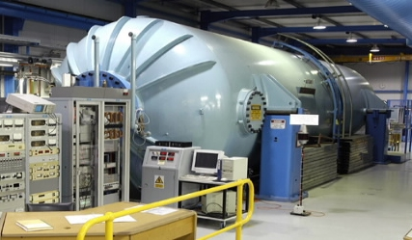
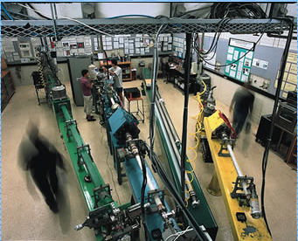
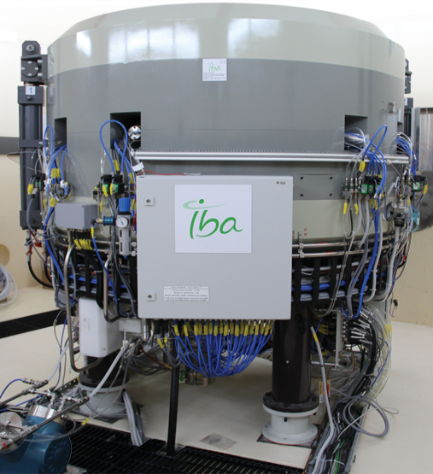
Proton & Heavy Ion Accelerators in Australia
ANU Heavy Ion Facility
14 MV Tandem
Melbourne University 5MV Pelletron Accelerator
Centre for Accelerator Science, ANSTO
4 Heavy ion accelerators: 1, 2, 6, 10 MV
Cyclotrons – PET
Isotope production
and Research.
Pictured:
ANSTO/NIF 18MV
Cyclotron

Slide 7
Electron Accelerators
Low energy Linacs used in industry and used for irradiation and X-ray production for imaging, and therapy.
These machines are commercially purchased form overseas. No complete accelerator manufacturing capability exists in Australia yet.
High energy electron accelerators are concentrated at the Australian synchrotron.

Slide 8
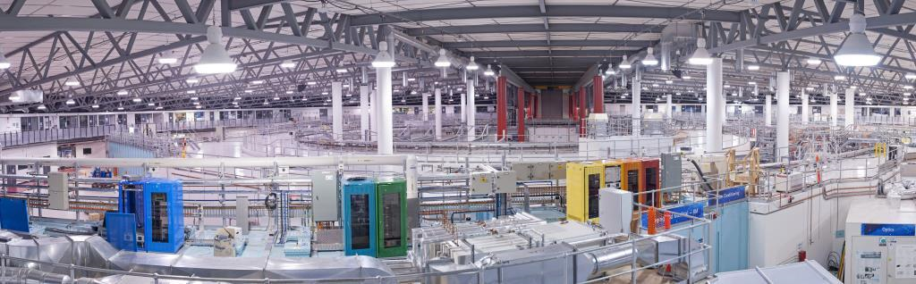
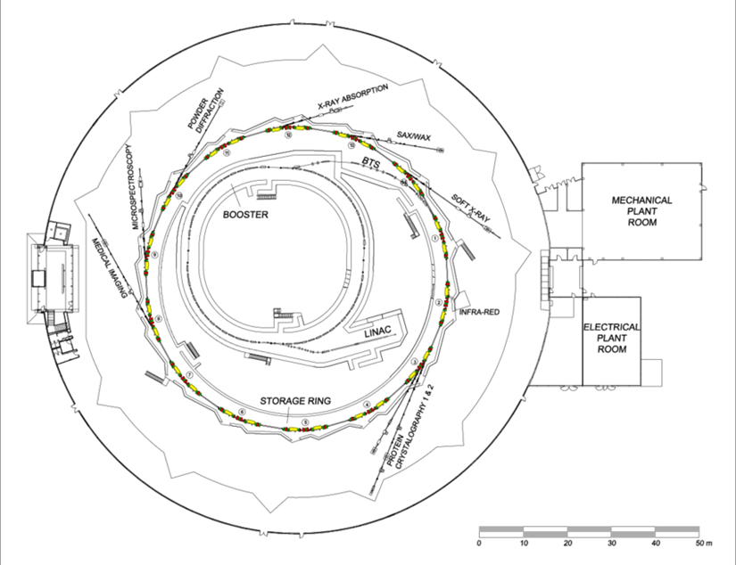
Australian Synchrotron
100 MeV linac
  Delivered by RI (Accel)
0.1-3 GeV booster synchrotron
  Delivered by Danfysik
3 GeV storage ring (216m)
  3rd Generation Light Source DBA lattice, 10 nm Hor. Emittance. 9+8 Beamlines
  Magnets by Buckley Systems

Slide 9
Accelerator Physics R&D in Australia

Slide 10

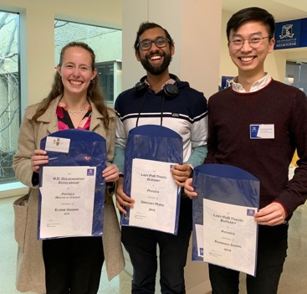
Melbourne University
Medical Accelerator Physics Group
“Our vision is to undertake world-leading research in accelerator physics in order to create positive societal impact – in Australia and globally. We will achieve this by creating a physics through to experimental demonstration pathway to take concepts from simulation to reality.” - Dr. Suzie Sheehy
Key aspects of the groups approach:
International collaborations
Multi-disciplinary research
Experimental and computational focus
Industrial connection
The group is involved in:
  Collaborating in NIMMS for next-generation ion therapy machines (See F. Zhang)
  Development of novel gantry systems which are smaller, cheaper & more flexible using novel accelerator physics ideas
  2 new joint PhD students (A. Steinberg, H. Norman) with Manchester University - involved in novel superconducting and/or FFA hadron therapy designs
Jacinta Yap (PDRA) - started October 2020
Frank (Xuanhao) Zhang (PhD student):
  Next-generation hadron therapy accelerators and beam delivery systems.
Greg Peiris (PhD student):
  Robust radiotherapy systems for challenging environments
Adam Steinberg (start Oct 2020 Manchester)
Hannah Norman (start Oct 2020 Manchester)
Elodie Higgins (Masters student):
  Beamline characterization and optimization for FFA test beamline
Slide courtesy of Suzie Sheehy

Slide 11
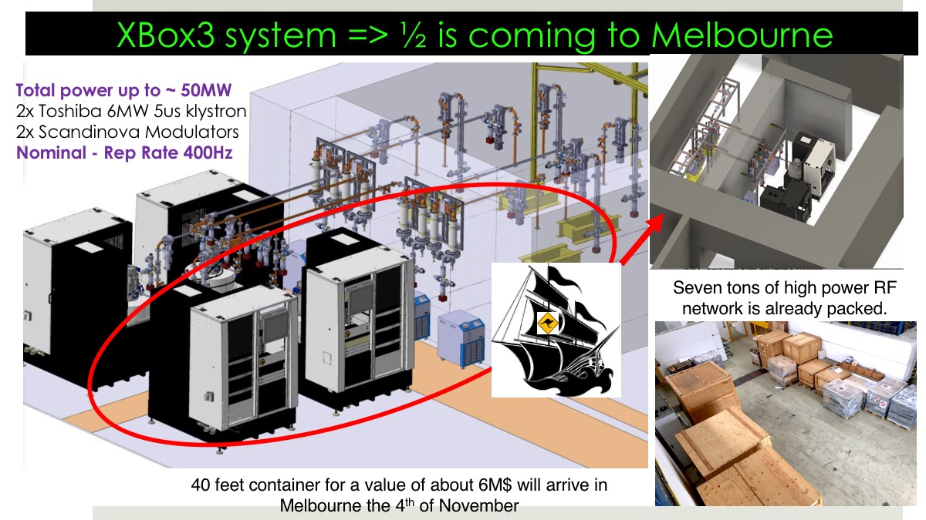
18th

Slide 12
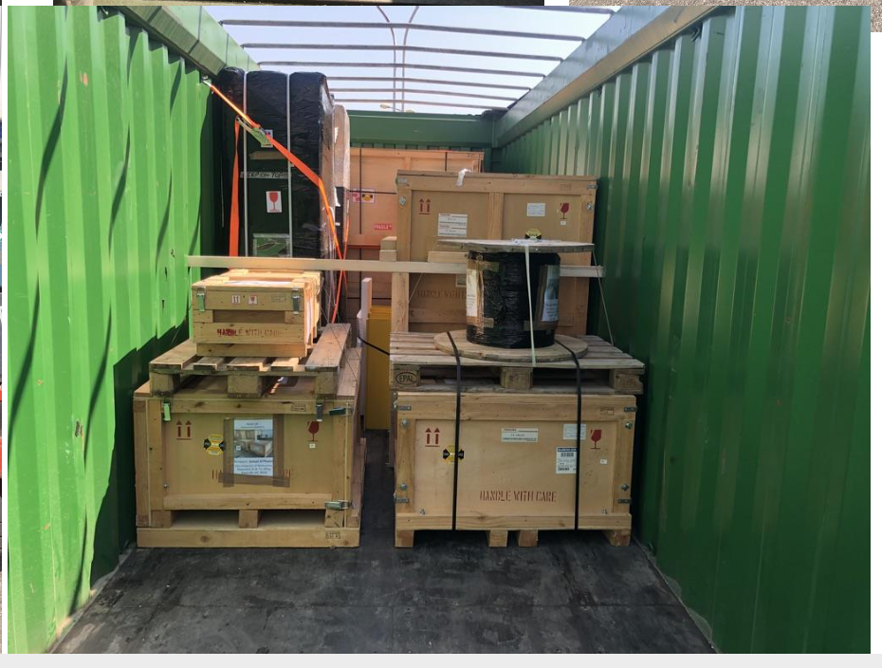
It’s on it’s way…

Slide 13
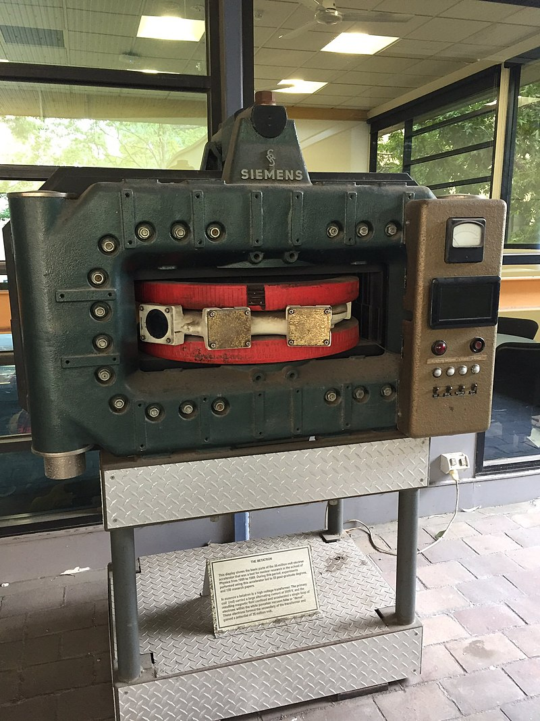
Basement Lab: The “X-Lab”
XBOX
Services
Control room
Medical LINAC
Un-shielded lab space
Pelletron
&
1-4 MeV proton (beamline test area)
Dark Matter
Clean Room Laboratory
Bunker used to house a 35 MeV betatron
Slide courtesy of Suzie Sheehy

Slide 14
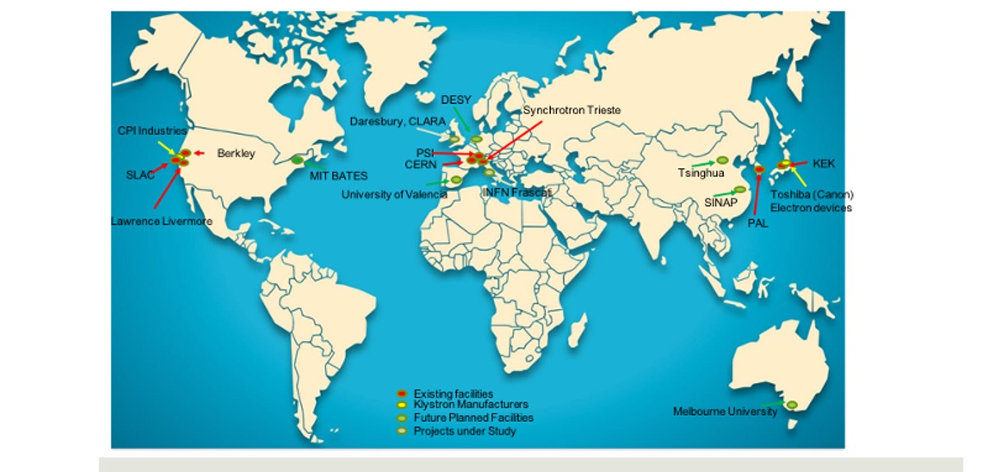
Melbourne will host the first high-frequency high-gradient accelerator lab in the Southern Hemisphere

Slide 15

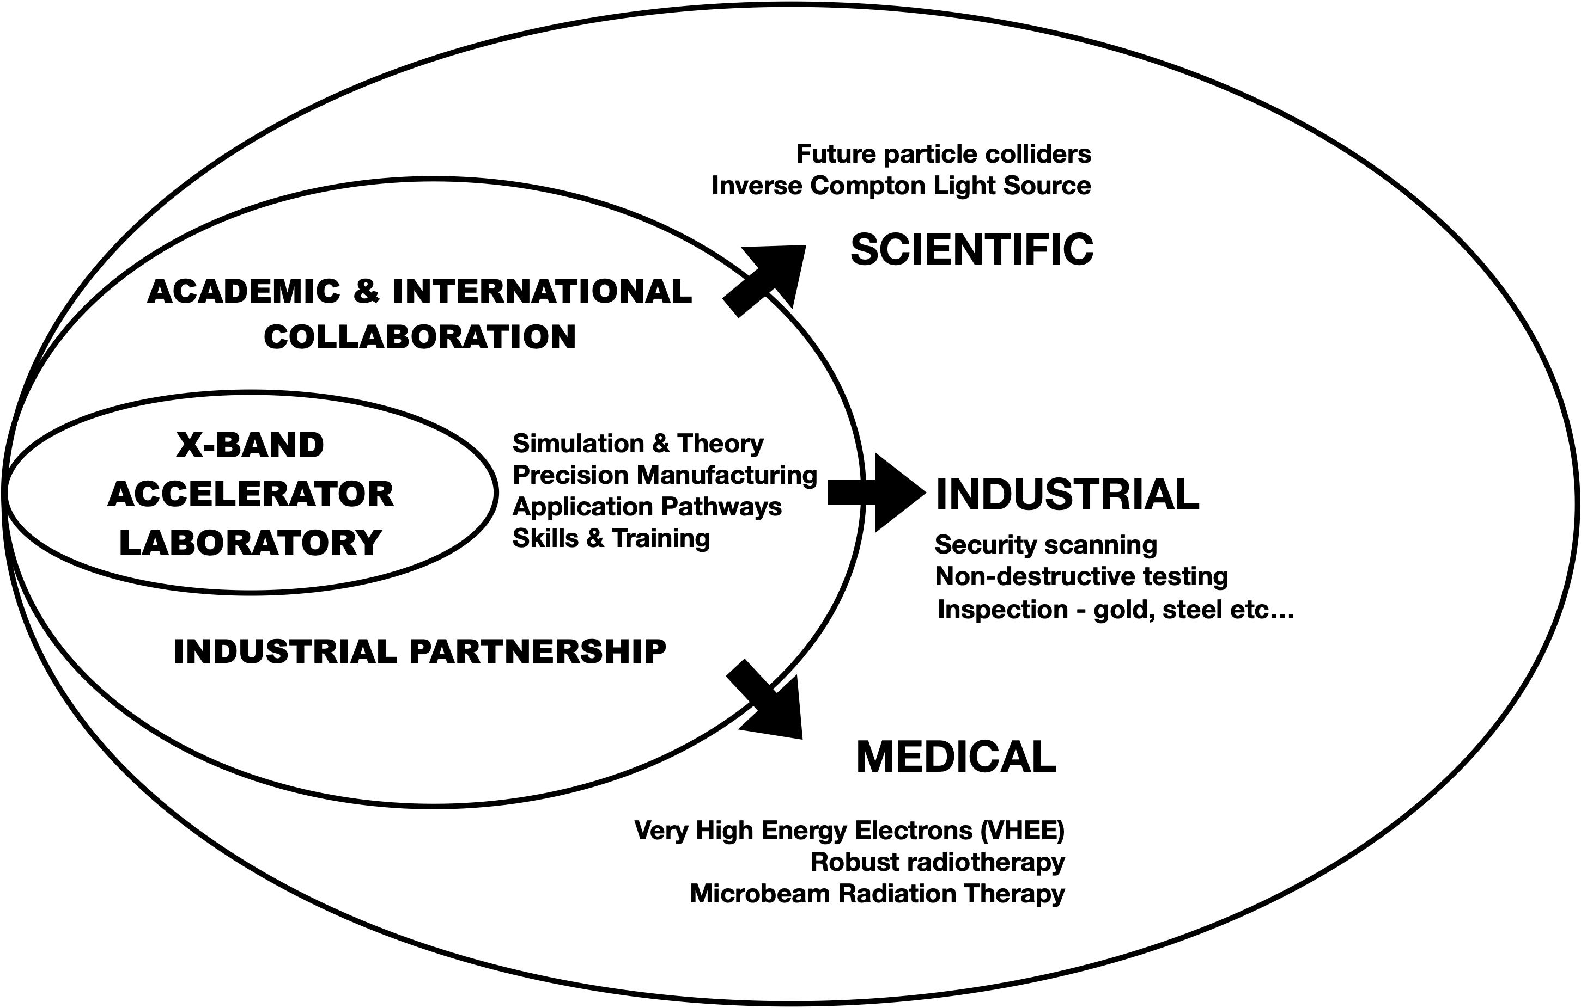





Developing the accelerator ecosystem in Australia

Slide 16
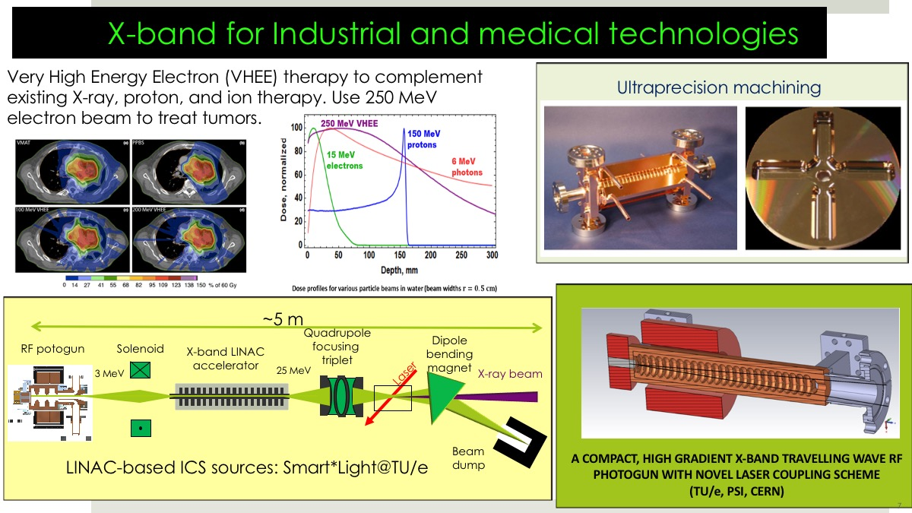
Which applications will we focus on?
+ Low energy security scanning systems

Slide 17
Australian Synchrotron Research Areas
Optimisation and applying Machine Learning to operations
Beam Coupling control
Diagnostics development ‘Real Time’ beam optics measurements
Compact Compton backscatter light source
International Collaborations:
  CompactLight - Undulator simulation and Beam buncher design
  XBPM optimisation with LNLS and Soleil
  X-LAB collaboration

Slide 18
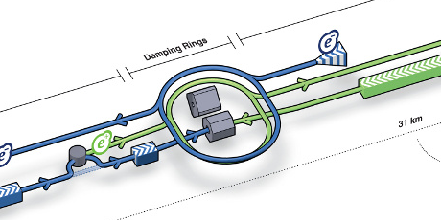
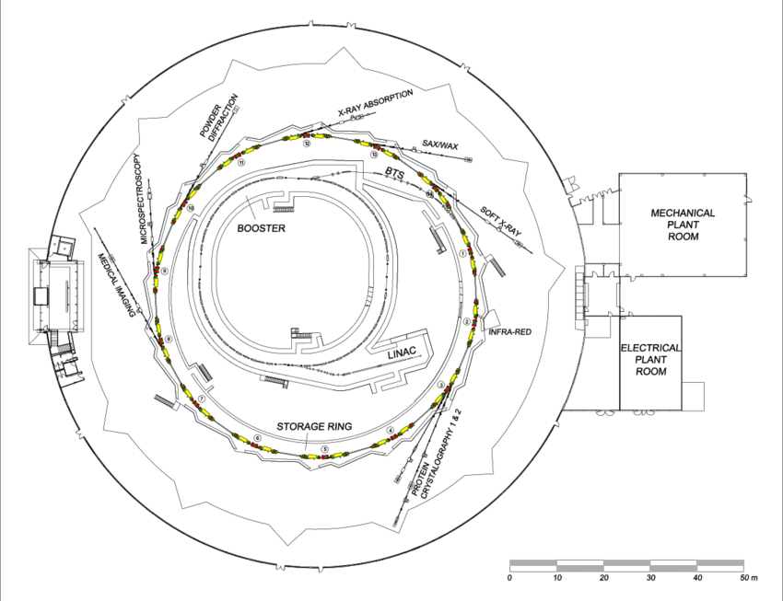
Light Sources as a testing ground
Light sources excel at beam stability and precision. Lessons learned at them can be applied to the collider community.
Physicists at light sources often have the time and ability to test beam dynamics theories and hardware on an operating machine
Light Sources are very similar to damping rings. Can demonstrate techniques needed for future accelerators.

Slide 19
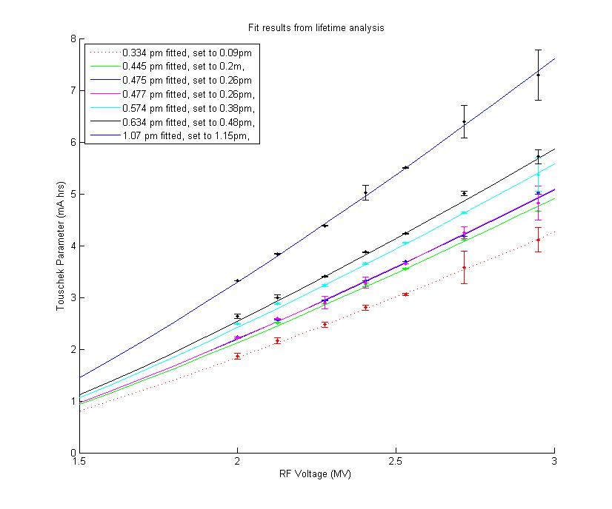
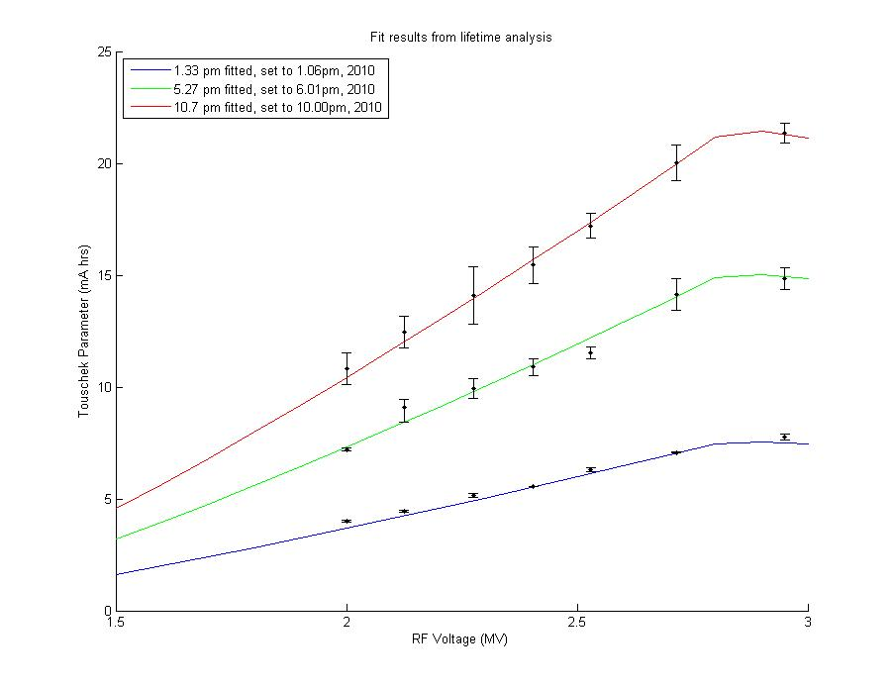
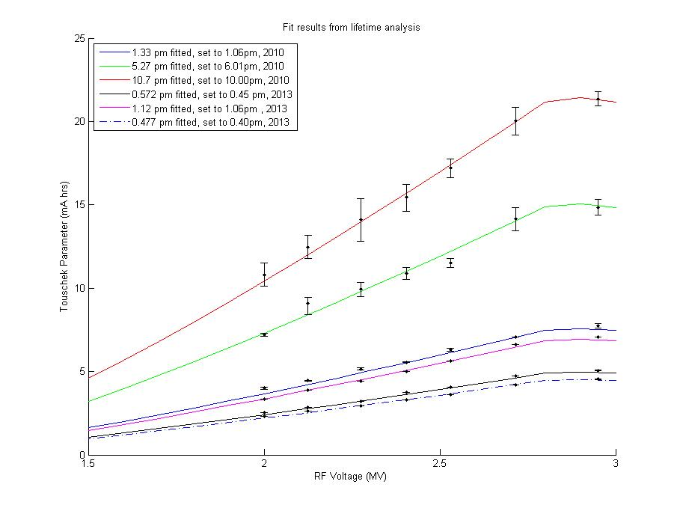
Towards the Quantum Limit
Demonstration of ultra-low vertical emittance important for future colliders.
Employed a model based minimization technique, beam based magnet alignment and indirect measurements to achieve 1.3 pm Vertical emittance – Phys. Rev. ST Accel. Beams 14, 012804 (2011)
Since then, we have refined the technique and come very close to the Quantum limit
Lessons learned in beam control have translated to better stability of AS beam

Slide 20
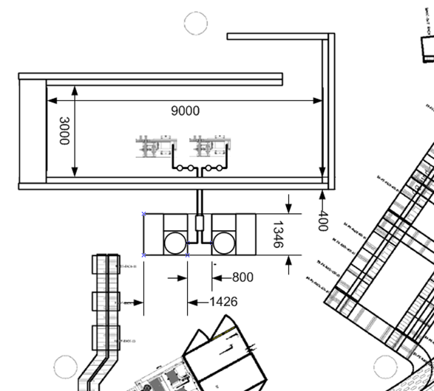
Accelerator Test Facility at ANSTO
ANSTO is developing an on site accelerator test infrastructure for the later stages of development into a Compton Source
Will provide a ‘Hands-on’ lab that will enable substantial accelerator R&D without being tied to the needs of the Light source.
Aiming to work in parallel with X-LAB lab to progress towards a Compton source, but will be a flexible facility.

Slide 21
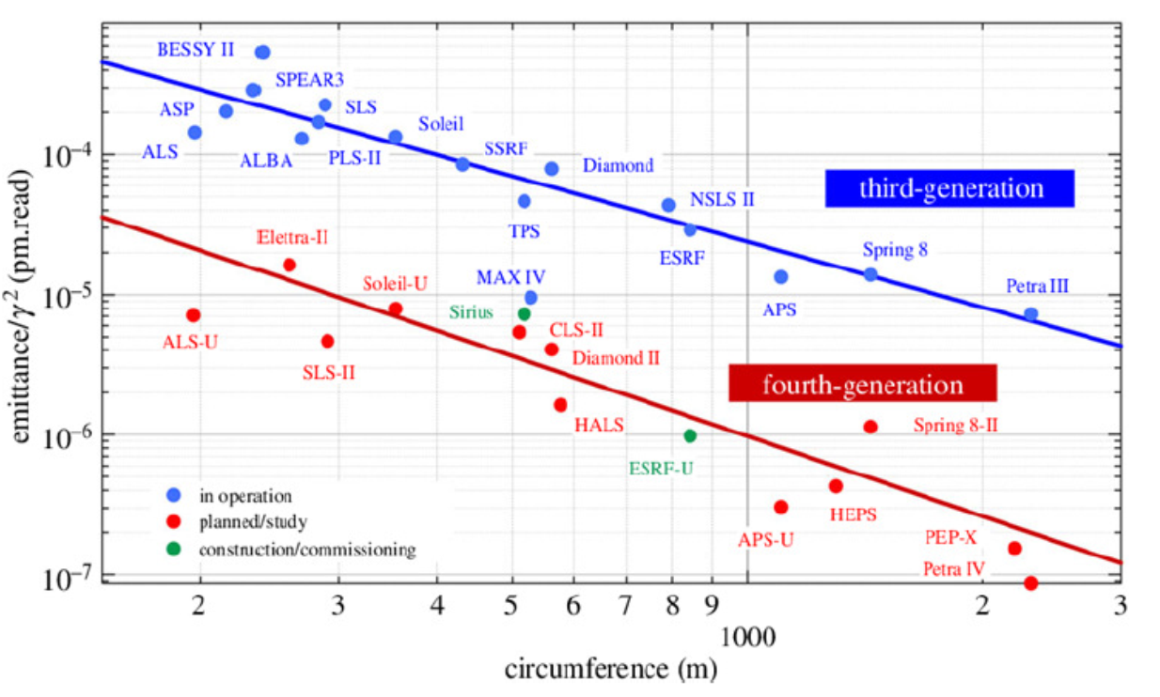
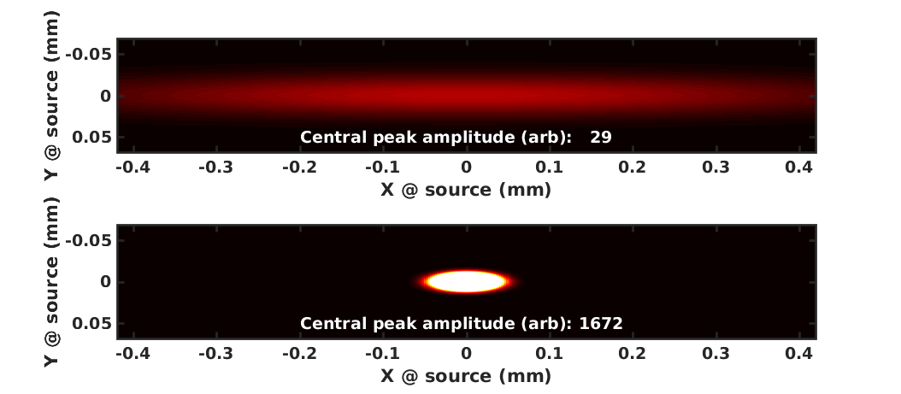
New Lattice design – 4BA with reverse bends
Design follows SLS-2 approach and uses ‘reverse bends’ as well as gradient dipoles
Parameter | Current DBA | 4BA at 3.0 GeV | 4BA at 2.5 GeV
Hor. Emittance (nm.rad) | 10.5 | 0.308 | 0.214
E Loss Per Turn (KeV) | 932 | 1946 | 938
Energy Spread (%) | 0.1027 | 0.1624 | 0.1353
Bunch Length [ps] | 29.36 | 9.19 | 6.49
Tousheck Lifetime (hrs) | 22 | 16.7 | TBD
Coupling (%) | 1 | 5 | 6
Dipole Critical Energy (KeV) | 7.7424 | 16.6 | 9.7472
Straight σx [um] | 322.75 | 19.115 | 15.928
Straight σy [um] | 17.464 | 5.317 | 4.431
Straight Length (m) | 4.5 | 3.0 | 3.0

Slide 22
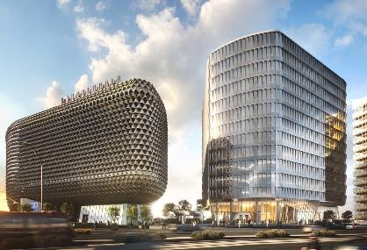
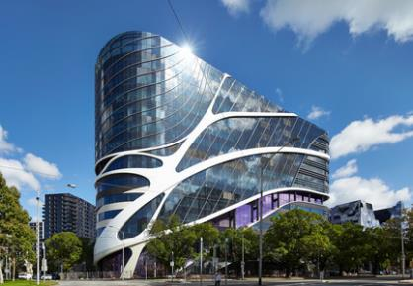
Status of Hadron therapy
Proposed network of facilities in Australia
Name | Proposed Location | Type of Centre
Australian Bragg Centre for Proton Treatment and Research | Adelaide SA | Proton
National Particle Treatment and Research Centre (NPTRC) | Sydney NSW | Carbon, proton, other ions
Queensland Proton Therapy and Research Centre (QPTRC) | Brisbane QLD | Proton
Victorian Proton Beam Therapy Centre | Melbourne Vic | Proton
Construction commenced! Completion due 2023, patients 2025

Slide 23
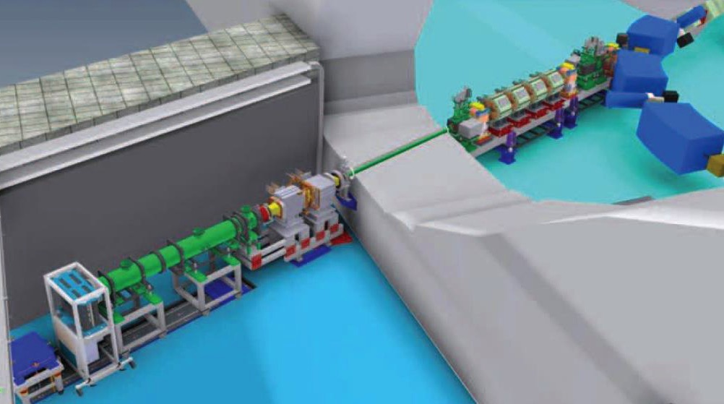
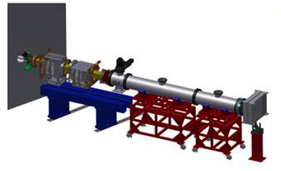
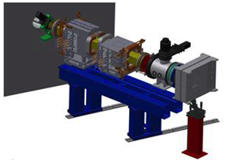
Flexible experimental room/beamline
Same delivery as for treatment room or deliver non-therapeutic beams
Possibility to run low to medium energy ion beams 6-7 MeV/u off the injection system
Physics/materials experimental beam lines directly off the accelerator vault
Research support services (biological, animal, materials analysis/storage, dosimetry, etc.)
Potential for radioactive beam delivery
The Experimental Beamline at CNAO
Pullia et al, Proceedings of IPAC2016
Wide FOV beamline with scanning
Intermediate 13.5x13.5 cm FOV
beamline with scanning

Slide 24
Capabilities for EIC

Slide 25

Capability for Australia to Contribute to EIC
Accelerator ‘Ecosystem’ in Australia is currently in its infancy, but we are planning to grow it. Limited capability for hardware contribution,
Most current expertise is in high energy electron machine design and operation so probably natural to concentrate on that part of EIC.
Immediate possibility is to contribute to design. Possible testing of prototype hardware on our infrastructure.
Early Australian Particle Accelerator

