Slide 1
EIC ring collimation and MPS considerations
A. Drees
EIC Accelerator Collaboration Workshop
October 7-9, 2020

Slide 2
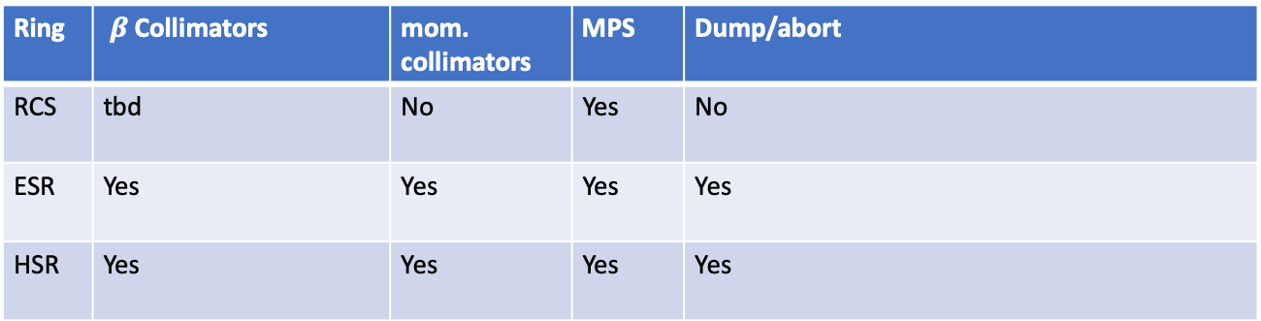
Introduction:
Task: define and design collimation and machine protection systems including emergency dumps for the three rings: RCS, ESR and HSR.
Ring | $β$Collimators | mom. collimators | MPS | Dump/abort
RCS | tbd | No | Yes | No
ESR | Yes | Yes | Yes | Yes
HSR | Yes | Yes | Yes | Yes
ring by ring details on the following slides
work in progress!
(?) unless needed to trim of tails before injecting into ESR?

Slide 3
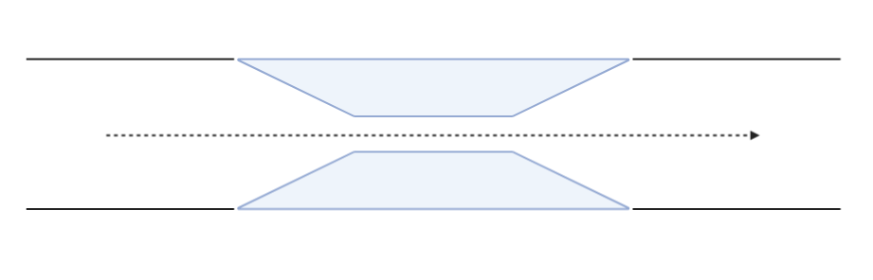
collimator requirements:
beam
Mask head
tapered
2 stage system for ESR and HSR
Two sided design for flexibility
Total length ~ 2m/collimator (expected)
For impedance purposes the collimators should be symmetric & tapered
Jaw material of primaries and secondaries should be different
Collimators will need cooling
Choices of collimator material and design could be part of a collaborative effort

Slide 4
RCS
1 Hz cycle, fast ramping, only 2 bunches circulating at a time, transfer into the ESR at IR12
Dedicated MPS abort system needed
  Need to prevent e-beam hitting components at normal angle
  Grazing angles not a problem but failures should inhibit the RCS-ESR injection cycle
MPS/abort reaction time determined by:
  Insertion devices (beam instrumentation or vacuum valves etc.)
  Drop of bending field (ps failures etc.)
  a few 10 ms
MPS monitoring needed for insertion devices, vacuum, bending magnets
No dedicated dump required

Slide 5
ESR
Variety of lattices: 5 GeV, 10 GeV and 18 GeV operation
High beam current: up to 1160 bunches, 17 10¹⁰ e/bunch (@10 GeV), 2.5 A total
small emittance beam (20/1.2) nm (H/V)
Need a flexible collimation system to support variety of lattices
  protect accelerator components
  and EIC detectors
2-stage system, with low density primary collimators
  First step: need to be placed in the beam lines/lattices ✓
Need MPS
Need dumps for
  transfer (1 Hz, 2 bunches at a time), location IR12
  AND abort dump, location TBD

Slide 6
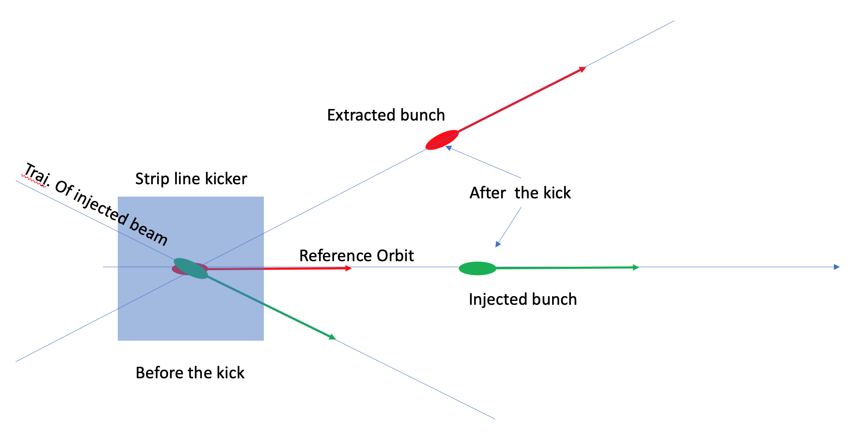
RCS to ESR transfer
Transfer dump
Extraction beam line
Crotch absorber needed to protect from potential kicker failure
Transfer dump for 2 bunches, 1 Hz
Transfer line to dilute beam sizes upstream of dump
PC: V. Ranjbar
absorber

Slide 7
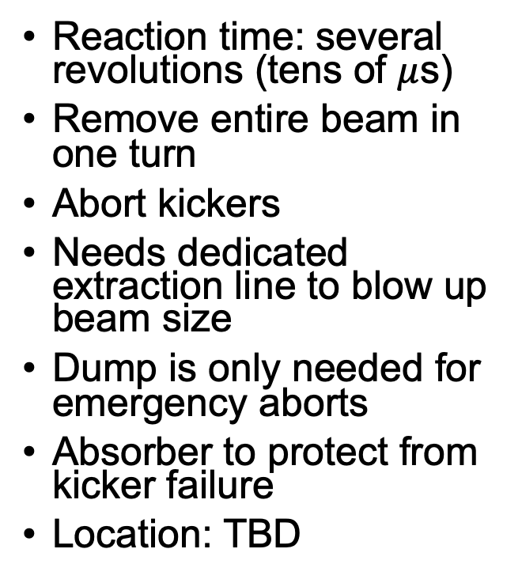
ESR MPS and abort
Input:
  BPMs
  BLMs
  Beam current
  Vacuum, valves
  Magnet current
  PS
  EIC detector background
  RF
  Other
Potential for collaboration: dedicated instrumentation (fast BLMs, diamond LM …)
Reaction time: several revolutions (tens of $μ$s)
Remove entire beam in one turn
Abort kickers
Needs dedicated extraction line to blow up beam size
Dump is only needed for emergency aborts
Absorber to protect from kicker failure
Location: TBD

Slide 8
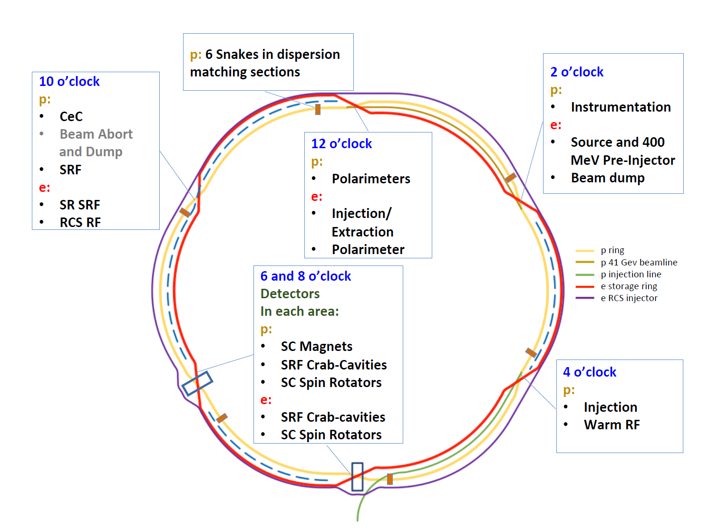
ESR: summary of proposed collimators & dumps
Vertical collimation in IR12 upstream of injection
Horizontal collimation downstream of injection (not ideal with dispersion) or in IR2 upstream of dump in the horizontal plane
Momentum cleaning in IR4
Abort & dump:
Transfer dump: IP12
Emergency dump (abort): necessary, but no location yet (tbd)
Phase advance from injection => x coll => experiment might have to be reviewed for new releases of optics

Slide 9
Hadrons: HSR
Variety of lattices: 41 GeV – 275 GeV
  41 GeV operation might require duplication of some collimators
Operation with a radial shift
High intensity: 7 10¹⁰ p/bunch, up to 1160 bunches, 1 A total
Smaller than RHIC emittances (9.6/1.5) nm (H/V)
Existing RHIC systems for collimation, dump and MPS

Slide 10
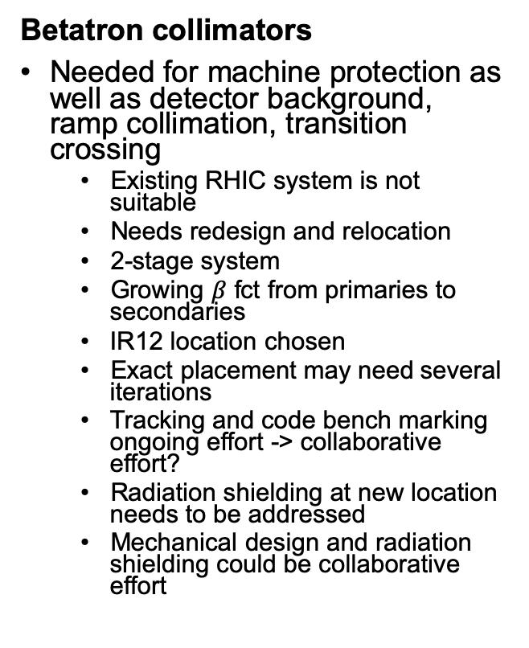
HSR collimators
Betatron collimators
Needed for machine protection as well as detector background, ramp collimation, transition crossing
  Existing RHIC system is not suitable
  Needs redesign and relocation
  2-stage system
  Growing $β$ fct from primaries to secondaries
  IR12 location chosen
  Exact placement may need several iterations
  Tracking and code bench marking ongoing effort -> collaborative effort?
  Radiation shielding at new location needs to be addressed
  Mechanical design and radiation shielding could be collaborative effort
Momentum collimators
Needed for ramp development and commissioning
Debunched beam (HI), recombined ions and radial shift operation
RHIC has no momentum collimator:
  New design needed
  1 stage only
The only suitable location is inside a cryostat and will need a cryo-bypass

Slide 11
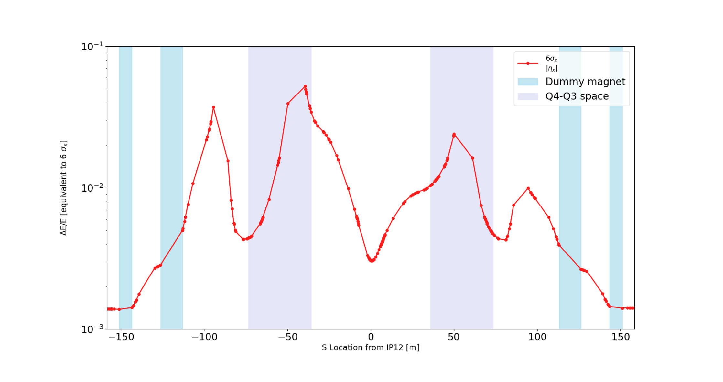

HSR momentum collimator
Momentum collimators need
  large dispersion
  small beta
  Warm area outside cryostat (not readily available)
Momentum collimation figure of merit: 6$σx/|ηx|$
D9 half cell
PC: G. Robert-Demolaize

Slide 12
HSR MPS and abort
MPS
Abort & dump
Existing system needs to be updated
Input (existing):
  BLMs: 20 y old
  BPMs (BPM MPS system is currently upgraded and tested for EIC purposes)
  Vacuum
  RF
  Corrector supplies
  Quench detection
  Detector magnets
Input (to be added):
  All PS
  dedicated fast BLMs, bunch by bunch signals, abort gap beam, EIC detector backgrounds etc.
  Dedicated instrumentation (detector and accelerator) could be a collaborative effort
Existing system at IP10 needs upgrade
RHIC has had ”pre-fire” issues, i.e. asynchronous spontaneous firing of 1(5) abort modules (with detrimental effect for detectors and magnets)
One potential solution (serial mechanical switches) is currently under testing in RHIC but might not be good enough for EIC
Studying other solutions (solid state?) could be a collaborative effort
Radiation shielding of the existing dump needs to be verified and perhaps upgraded -> collaborative effort possible

Slide 13
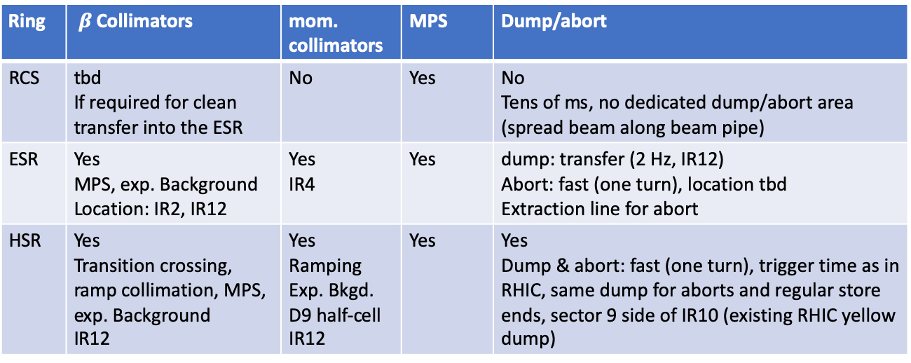
Summary
Ring | $β$Collimators | mom. collimators | MPS | Dump/abort
RCS | tbd If required for clean transfer into the ESR | No | Yes | No Tens of ms, no dedicated dump/abort area (spread beam along beam pipe)
ESR | Yes MPS, exp. Background Location: IR2, IR12 | Yes IR4 | Yes | dump: transfer (2 Hz, IR12) Abort: fast (one turn), location tbd Extraction line for abort
HSR | Yes Transition crossing, ramp collimation, MPS, exp. Background IR12 | Yes Ramping Exp. Bkgd. D9 half-cell IR12 | Yes | Yes Dump & abort: fast (one turn), trigger time as in RHIC, same dump for aborts and regular store ends, sector 9 side of IR10 (existing RHIC yellow dump)

