Slide 1
Asia/Oceania Focus: Session 5.1
Makoto Tobiyama
KEK Accelerator Laboratory

Slide 2
Dr. Makoto Tobiyama
Head of Accelerator Division 4 (SuperKEKB Accelerator), Accelerator Laboratory, KEK, Japan
Research Field
  Bunch-by-bunch feedback systems for circular accelerators
  Study of beam instabilities.
  Beam instrumentation for electron/positron ring

Slide 3
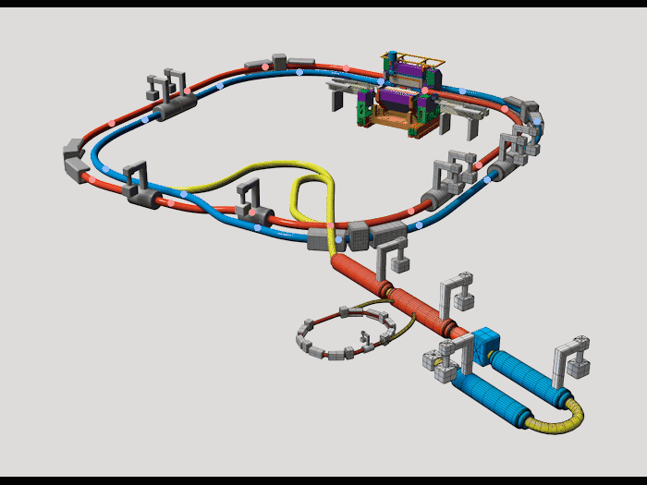

SuperKEKB collider
Detector
Main ring
Electron ring (HER)
Positron ring (LER)
Linac
Positron damping ring

Slide 4
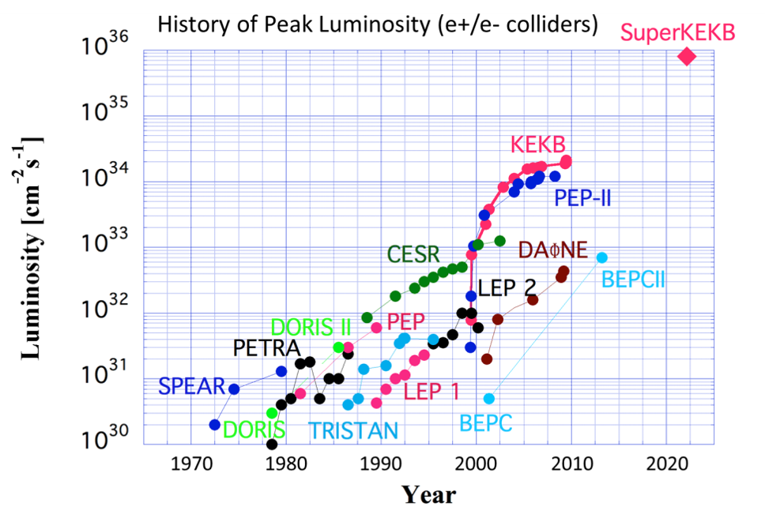
Feature
  Aim the world-highest luminosity (a measure of collision frequency) by using a novel “nano-beam scheme” collision.
Design value:
~8x10³⁵ cm⁻² s⁻¹

Slide 5
Many challenges
  Low emittance, small beam size at IP
  Realize the low emittance optics using existing lattice as much as possible (to reduce construction costs)
  Sevier non-linear effect, small dynamic aperture
  Strong, ultra-fine tunable superconducting final focus
  Strong, stable and high-quality injector
    Positron damping ring, Photo cathode RF gun
  Wideband, fast IP feedback system
  Beam instrumentations
  High beam current
  Strong injector
  Low impedance vacuum components
  Strong RF systems
  Bunch feedback systems to suppress coupled-bunch instabilities

