Slide 1


EIC Workshop – Promoting Collaboration on the Electron-Ion Collider
1
Mexican Universities Accelerator Science and Technology and EIC
Dr. Humberto Maury Cuna
CMAP overview
Members
Projects
Summary
Content:
Virtual Meeting
7-9 October 2020
Notes:
1

Slide 2
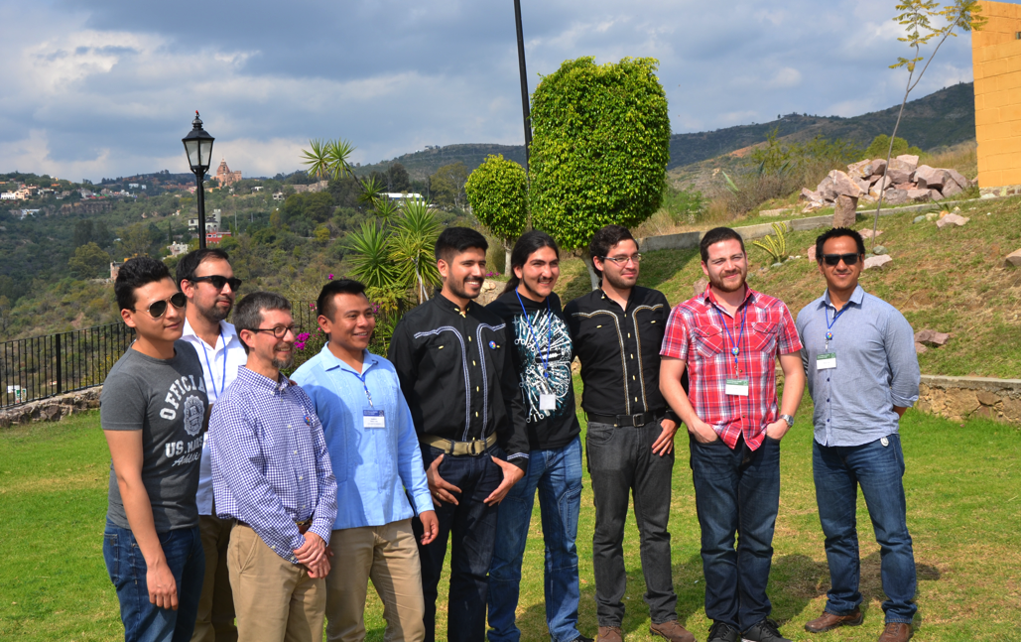
2
Comunidad Mexicana de Aceleradores de Partículas
Mexican Community for Particle Accelerators
CMAP was created in 2015 as a group of then grad students with the common vision of promoting and developing the science and technology of particle accelerators in Mexico.
Goals:
To establish collaborations with accelerator facilities abroad: CERN, JLab, LNLS, etc.
To develop our own research projects towards a Mexican national lab.
Specialization in different technical components or technologies specific of particle accelerators.
CMAP members in Guanajuato, Mexico, 2015.
Notes:
HR training in collaboration also with USA institution. Two HR training collaboration groups: CERN and USA. Gathering at MePAS2 and it gave rise to the CMAP
2

Slide 3
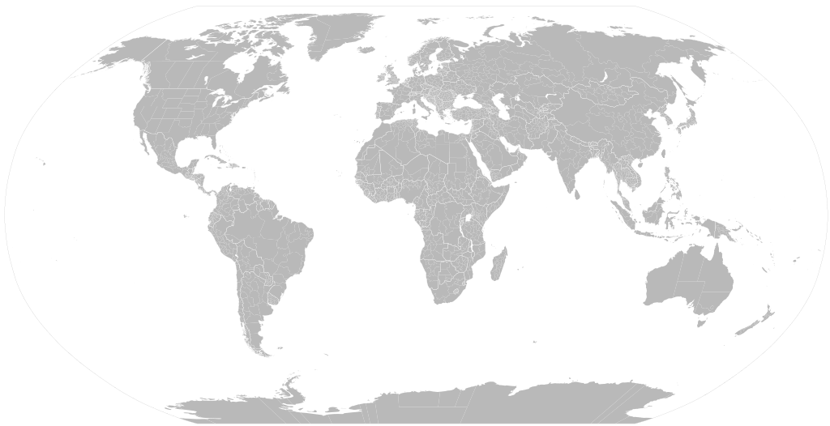
CMAP MEMBERS
3
U. Liverpool
David Pavel
U. New Mexico
Salvador Sosa
CERN
Alex Castilla
Marco Valdivia
Luis Medina
Old Dominion U.
Gabriel Palacios
U. Sinaloa
Cristhian Valerio
Carlos Duarte
Victor Lizarraga
Paris-Sud
Anahi Segovia
ESRF
Juan Reyes
UNAM
Alain Flores
J-PARC
Bruce Yee
IHEP
Gerardo Guillermo
U. Guanajuato
Karim Hernández
Humberto Maury
Daniel Chávez
Ricardo Montoya
Cecilia Araujo
Tec de Mexico, Orizaba
Berenice Espinoza
As of 2020, 22 CMAP members present in America, Europe and Asia. And it keeps growing…

Slide 4
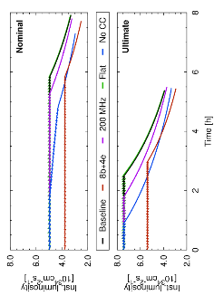
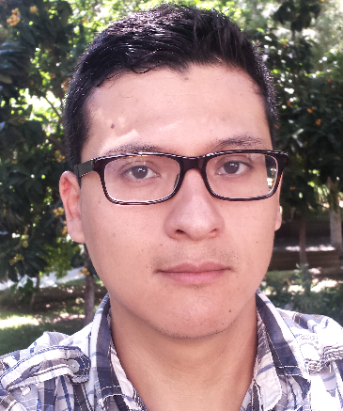
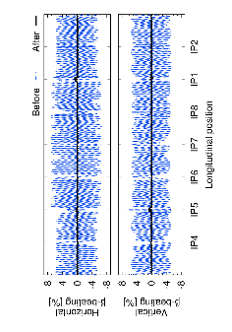
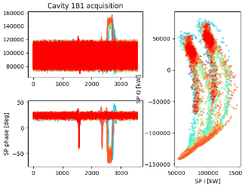
4
Name: Luis Eduardo Medina Medrano
Degree: PhD in Physics
Affiliations:
CERN, Beam Department – Switzerland
Universidad de Guanajuato – Mexico
Institutions where develops his research:
CERN, Beam Department – Switzerland
lmedinam@cern.ch
Current Project Topics:
Optimal RF injection voltage for the LHC and High-Luminosity LHC
Power consumption with transient beam loading and compensation schemes
Controlled emittance blow-up and stability
Previous Projects Topics:
Design and optimization of the interaction region of the FCC-ee (Master’s Thesis)
Assessment of the performance of the High-Luminosity LHC (PhD Thesis)
Areas of Interest:
Lattice design
Transverse and longitudinal beam dynamics
Beam measurements
Notes:
4

Slide 5
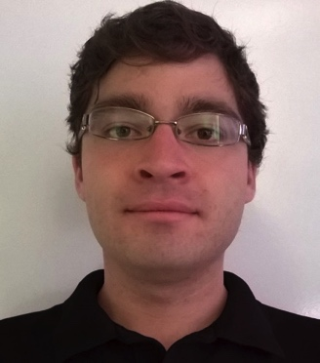
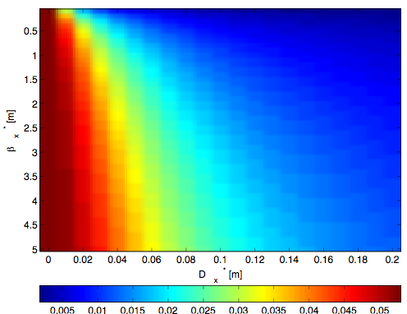
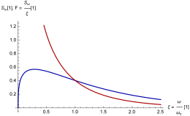
5
Name: Marco Alan Valdivia
Degree: Master in Physics
Affiliations: University of Guanajuato/CERN
Institutions where develops his research: CERN
alan.valdivia@cern.ch
Effect Towards a mono-chromatization scheme for direct Higgs productions: Direct Higgs production in e+e- collisions at the FCC is of interest if the center-of-mass energy spread can be reduced by at least an order of magnitude. A mono-chromatization scheme, to accomplish this, can be realized with horizontal dispersion of opposite sign for the two colliding beams at the interaction point (IP).
Effect of Beamstrahlung on Bunch Length and Emittance in Future Circular e+e− Colliders: In future circular e+e- colliders, beamstrahlung may limit the beam lifetime at high energies, and increase the energy spread and bunch length at low energies. If the dispersion or slop of the dispersion is not zero at the collision point, beamstrahlung will also affect the transverse emittance.

Slide 6
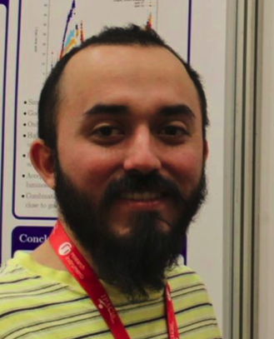
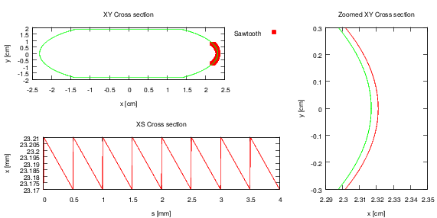
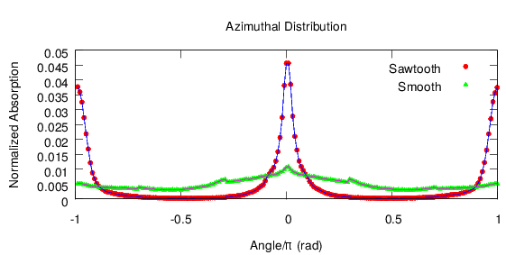
6
Name: Gerardo Guillermo Canton
Degree: Doctor in Theoretical Physics
Affiliations: CAS/IHEP – CSNS (pending)
Institutions where develops his research: CERN, Cinvestav, INFN-LNF, CLASSE.
gerardo.guillermo.canton@cern.ch
Study of adsorption sites due to the beam induced Synchrotron Radiation (SR)
By using Monte-Carlo tools it is possible to simulate SR photons along an accelerator and it is possible to track these photons along the vacuum chamber and check for reflections and adsorption sites.
The code Synrad3D, developed at Cornell University by D. Sagan in collaboration with G. Dugan is being employed to map the SR distribution a long the LHC and future colliders.
Effect of the sawtooth pattern of the LHC arc chambers and effects of the changes in the optics ATS of the HL-LHC
Notes:
TRADUCIR A INGLES
6

Slide 7
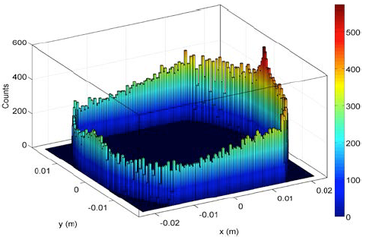
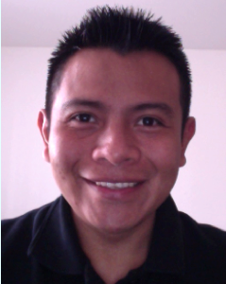

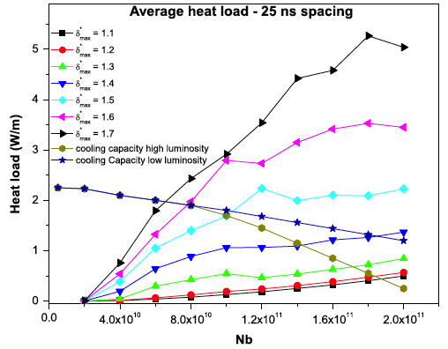
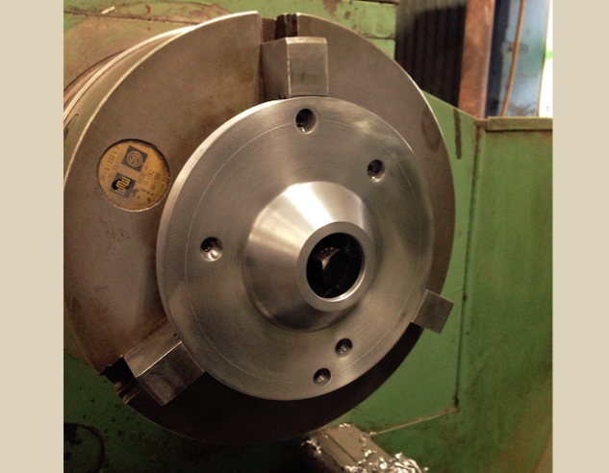
7
Name: Humberto Maury Cuna
(CMAP PR Officer 2020-2022)
Degree: Doctor
Affiliations: University of Guanajuato/CERN
Areas of interest: collective effects, synchrotron radiation, cyclotrons, accelerators for industrial applications and organization development.
israel.maury@ugto.mx
Electron cloud effects in the LHC and FCC: An electron cloud is an important issue for the LHC performance and beam quality. I am working on studies to mitigate this effect. In addition, how EC will affect the future accelerators like FCC is being investigated.
Member of:
CMAP (Former president)
Interinstitutional Collaboration for Research and Development of Particle Accelerator Technology in México (CIIDTAP)
RELIEF Project: Reducing Environmental impact of the Leather-tanning Industry with Electron beam Facilities (collaboration Mexico-UK) - Concluded
Particle Accelerator Group at UG: Currently, I am coordinating the particle accelerator group at Universidad de Guanajuato: 2 Full time researchers, 2 PhD students, 3 master students and 2 undergrads students:

Slide 8
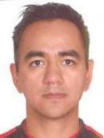

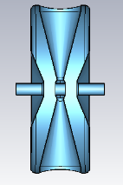
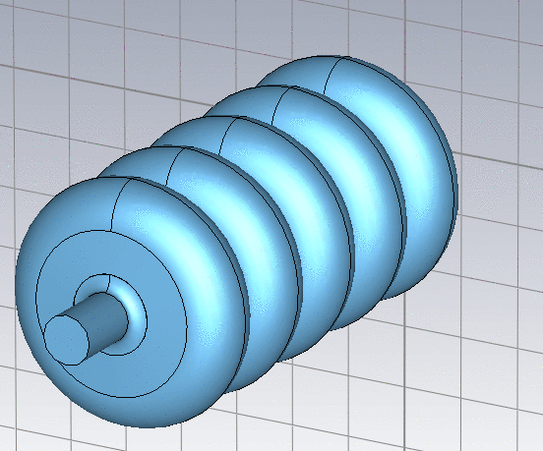
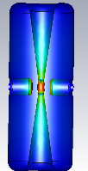
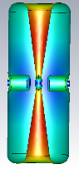
8
Name: Bruce Yee Rendón (CMAP president 2020-2022)
Degree: Doctor in Physics
Affiliation: Japan Atomic Energy Agency- Ibaraki, Japan
Institutions where he develops his research: Japan Proton Accelerator Research Complex (JAEA).
Areas of Interest: SRF cavities, beam dynamics and collective effects.
byee@post.j-parc.jp
Design of a Superconducting Proton Linac for the JAEA -ADS
Design the Superconducting RF Cavities.
Design of the beam optics.
Design the front-end
EM fields of the HWR cavities.
Design of the Spokes Cavities.
Design of the Elliptical SRF cavities for the final acceleration of the JAEA-ADS.
Notes:
8

Slide 9
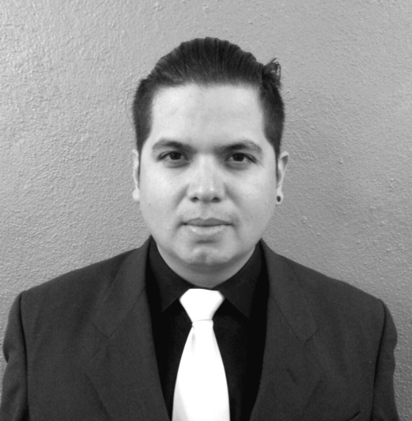
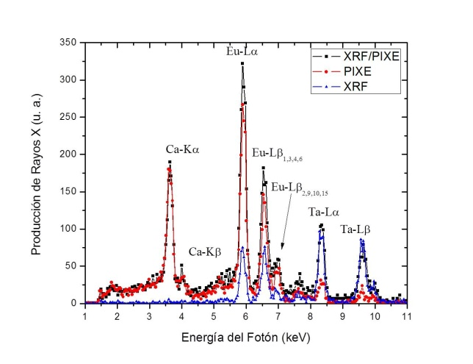
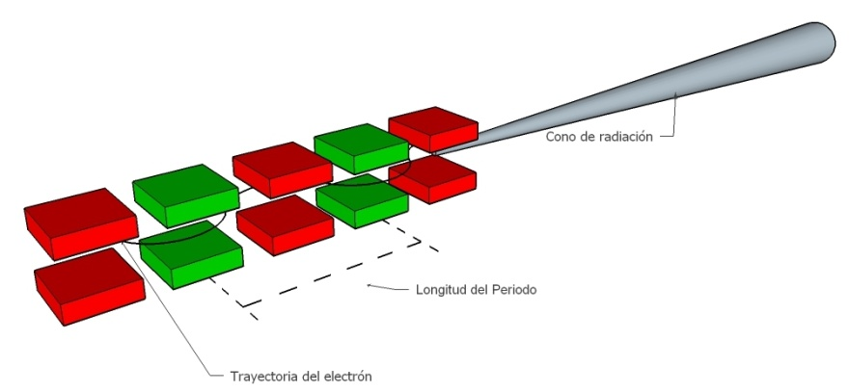
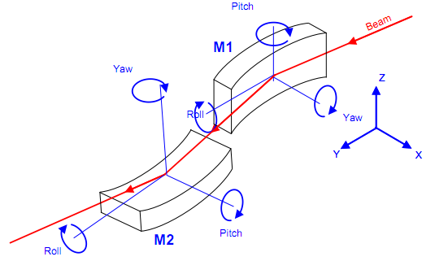
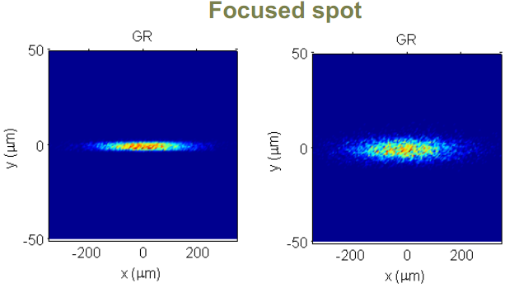
9
Name: Juan Reyes Herrera
Degree: PhD. in Physics
Affiliations:
Postdoc granted
by CONACyT in the ESRF, November 2017.
Institutions where develops his research:
Institute of Physics, UNAM – CDMX, México.
ALBA Synchrotron Light Source – Barcelona, Spain.
jureyherrera@gmail.com
PhD project Subject:
Simultaneous PIXE and XRF elemental analysis.
Areas of Interest:
X-ray spectroscopy techniques.
Synchrotron light sources.
X-ray optics and beamline design.
Surface plasma processes.
Accelerator physics.
Radiation detection.
Data acquisition and Analysis.
Vacuum Systems.

Slide 10
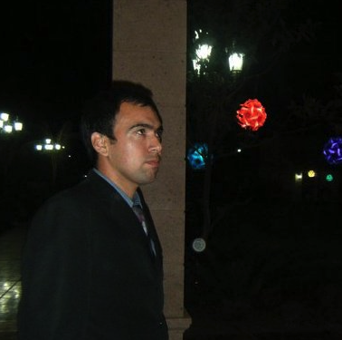
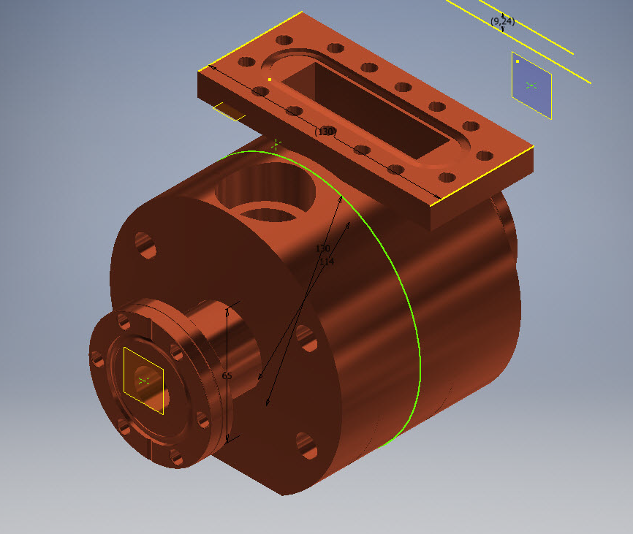
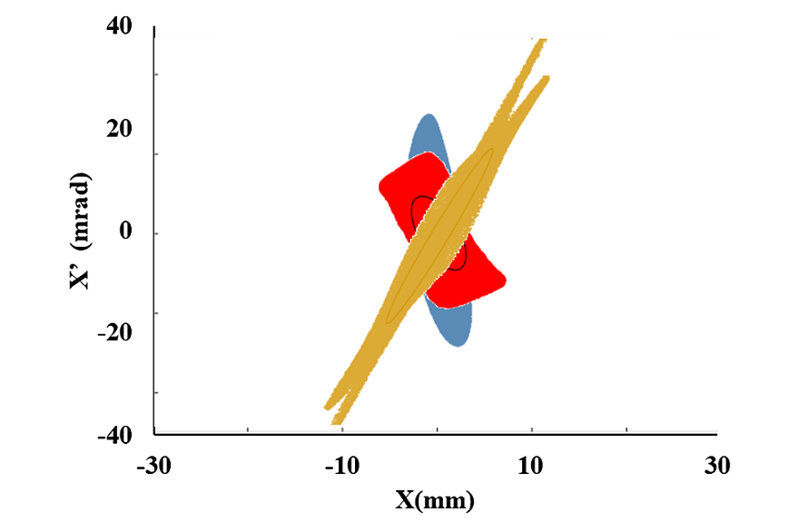
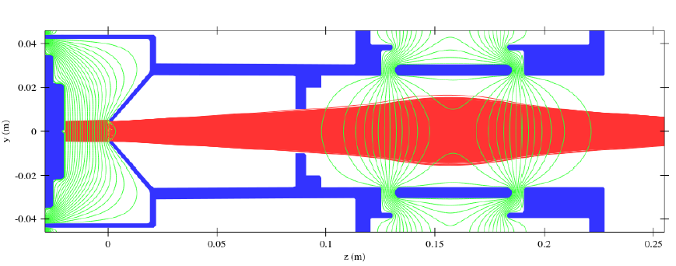
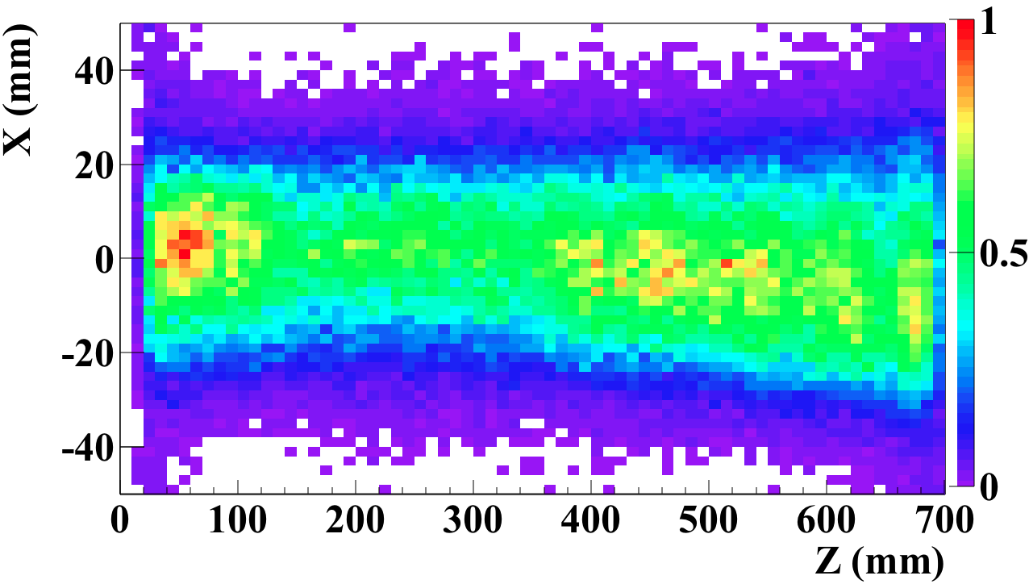
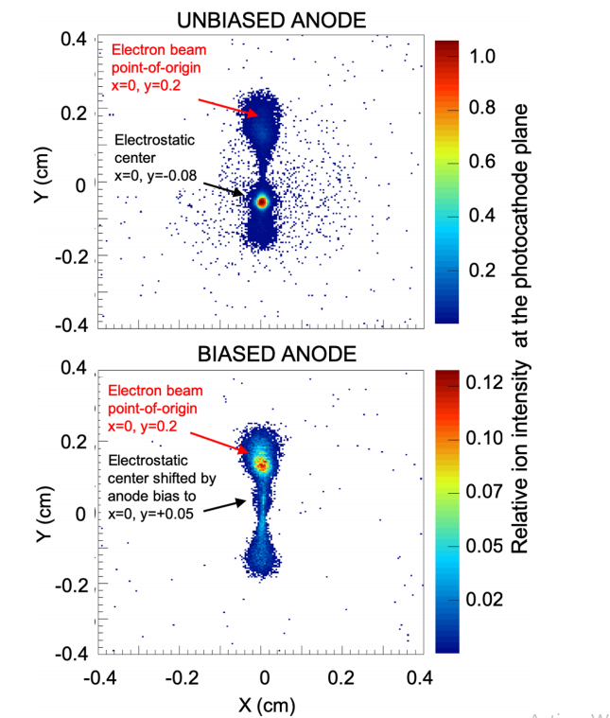
10
Name: Cristhian Alfonso Valerio Lizarraga
Degree: Doctor
Affiliations: Universidad Autonoma de Sinaloa
Institutions where he develops his research:
FCFM/UAS, CERN, LINAC4,JLAB,ININ
Normal conducting RF Cavity Design
10
3-D models of Space charge compensation
cvalerio@uas.edu.mx
Working Topics:
Particle Source Simulation and Design
Space charge effects
Negative Ion Beam
Electron Sources
Plasmas Physics
High intensity Beam Transport
Simulation of Ion back bombardment pattern on a Photocathode surface at JLAB
Simulation of the sputtering Ion source
Electodes(Blue)
H- Beam (Red)
Ion density of particles created by beam collisions with residual gas in a Drift

Slide 11

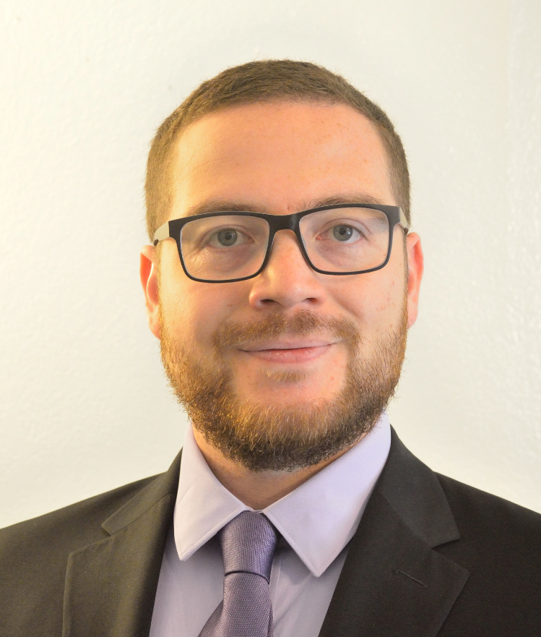
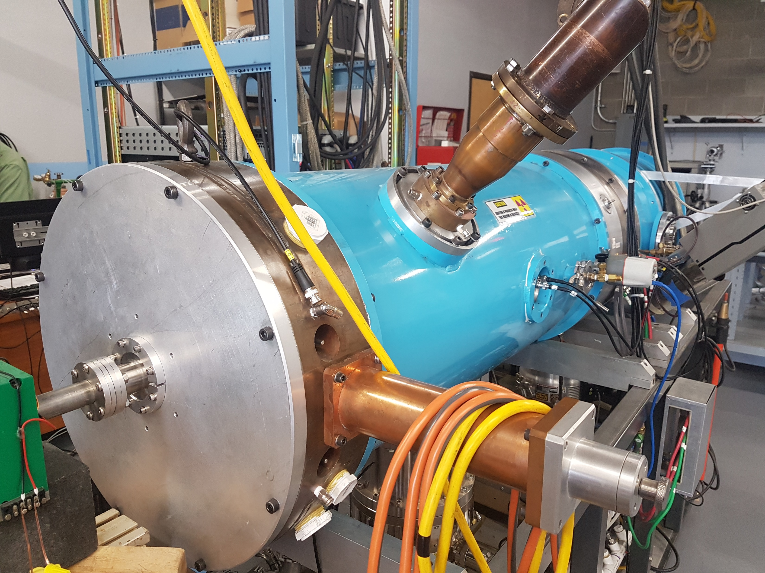
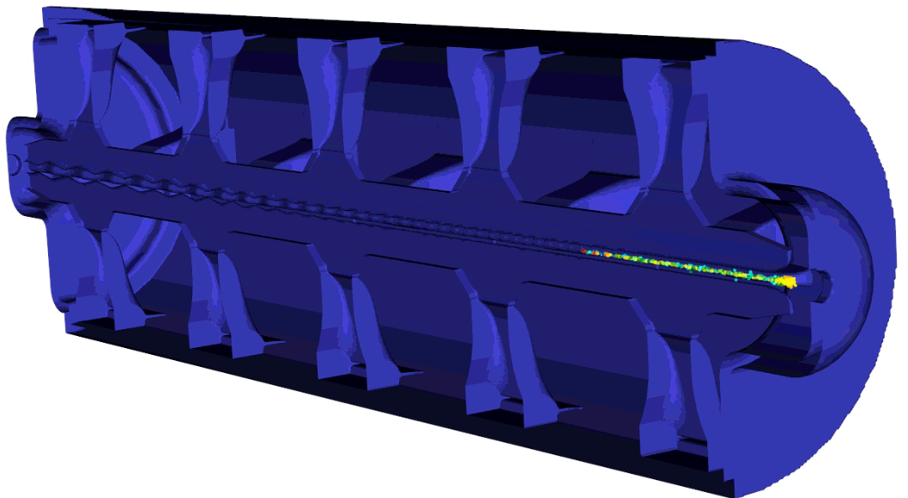
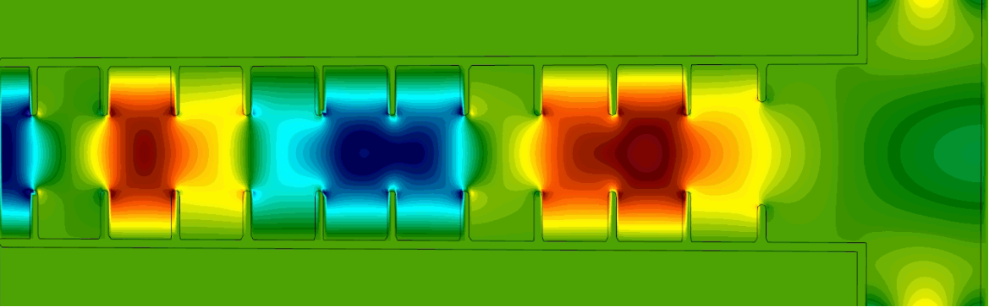
11
Name: Salvador I. Sosa Güitrón (CMAP secretary 2020-2022)
Degree: Ph.D. in Physics
Affiliation: University of New Mexico – Albuquerque, NM
Areas of Interest: Machine Learning and controls, RF for accelerators, SRF, beam dynamics.
Institutions where he develops his research:
Ion Linac Systems, Inc. Albuquerque, NM.
Argonne Leadership Computing Facility, Argonne, IL
salvadorsg@unm.edu
Current projects:
AI for accelerator controls: Development of intelligent controls for a compact proton linac using Machine Learning, surrogate models using VSim and HPC.
C-Band accelerators: Design of C-band, high-gradient, normal-conducting accelerating structures for driving future X-FELs.
Front-end RFQ to drive a high current proton beam for medical applications.
PIC Simulation of the RFQ using VSim on HPC.
EM simulation of a C-band, TW accelerator using VSim on HPC.
Notes:
11

Slide 12
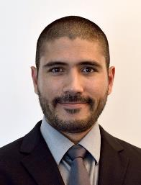
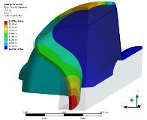
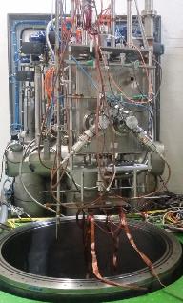
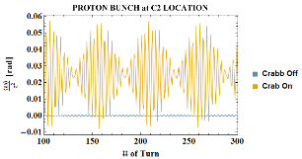
12
Name: Alejandro Castilla Loeza.
Degree: PhD. in Physics.
Affiliations:
CERN Beams Group RF-LRF – Geneva, CH.
Jefferson Lab – Newport News, VA.
Lancaster University – Lancaster, UK.
Institutions where he develops his research:
CERN Beams RF-LRF – Geneva, CH.
Areas of Interest: Superconducting RF, Beam dynamics at the Interaction Region, Machine Operations.
a.castilla@cern.ch
Project Subject:
Design and Operation of Superconducting and Normal Conducting Radiofrequency Cavities for Particle Accelerators.
Radiofrequency Applications Beyond Acceleration.
High Luminosity Future Colliders.
Notes:
12

Slide 13


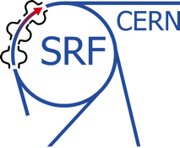

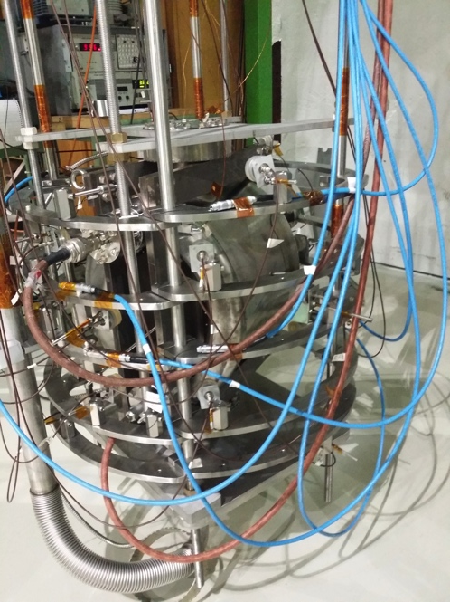
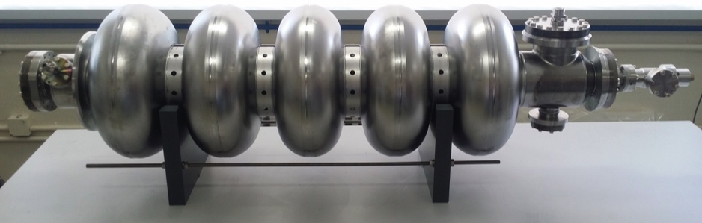
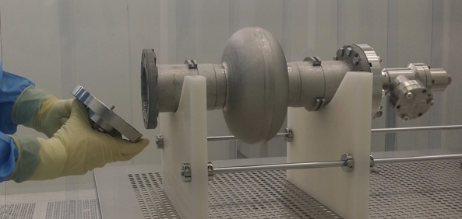
13
Name: Karim Gibrán Hernández Chahín (CMAP treasurer 2020-2022)
Degree: Master in Physics
Affiliation: Universidad de Guanajuato, División de Ciencias e Ingenierías Campus León – León Gto. México
Institution where develops his research: CERN
Areas of interest: Radio Frequency (RF), Superconductors (SC), Quench analysis, RF Cavities.
karim.gibran.hernandez.chahin@cern.ch
Superconducting Radiofrequency Cavities: Preparation techniques, performance measurements and quench analysis
The main limitation for the SRF cavities are the field emission and quench. This depends strongly in the surface quality and in the surface preparation
Objectives:
Reach operation requirement reducing:
  Quench
  Multipacting
  Field emission /Radiation
Optimize
  Mechanical/Chemical/ Thermal treatments
  High pressure rinse
  Handing and assembly in clean rooms
Measurement and data analysis
Temperature monitoring
Quench localization using OST signals
Magnetic field and estimation of the trapped flux in the superconductor
Correlation between field emission measurement with the surface defect size

Slide 14
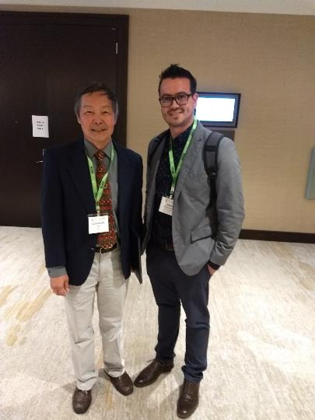
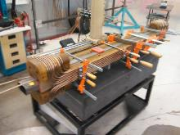
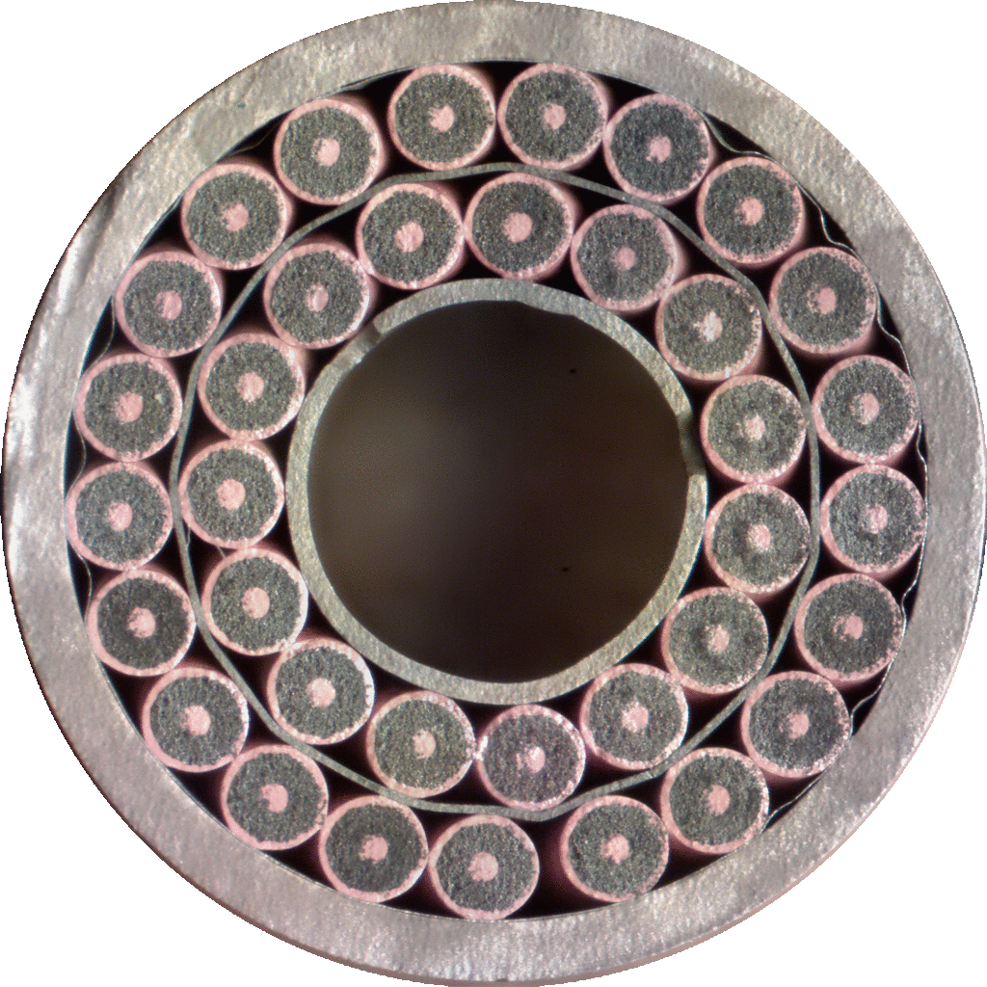
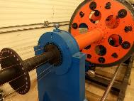
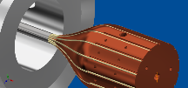
14
Skills
Superconducting /normal conducting magnet design
Accelerator technology design and development
Applied Superconductivity
NbTi, MgB2, Bi2212, Nb3Sn superconductors
HP VEE programming
Linux CNC programming
Engineering design
Finite Element Analysis modeling
Comsol Multiphysics: Thermal, Mechanical, AC&DC models
QC characterization
Gamma Ray Spectroscopy for environmental radiation detection
E&M analysis for accelerator technology
Thermal analysis for accelerator magnets
Mechanical and structural analysis
3D printing R&D
High temperature heat treatment on exotic materials
Ph.D. Daniel Chavez V.
Universidad de Guanajuato /
Texas A&M University
Accelerator Physicist
dchavez@fisica.ugto.mx | LinkedIn.com/in/dchavezmagnetlab | +1 (832) 858 8616
1301 Barthelow Dr. Apt. 31B. College Station, Tx. 77840, USA.

Slide 15

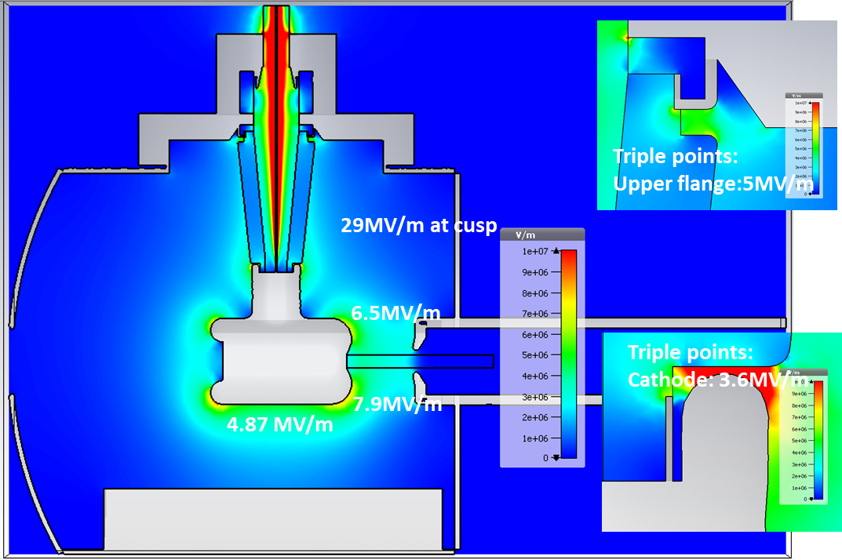

15
Name: Gabriel G. Palacios Serrano
Degree: Ph.D. candidate in electrical and computational engineering, M.S. in physics
Affiliation: Old Dominion University – Norfolk, VA
Areas of Interest: Accelerator physics, electrostatics, beam dynamics, computational physics.
Institutions where he develops his research:
Old Dominion University. Norfolk, VA.
Thomas Jefferson National Accelerator Facility, Newport News, VA.
CST longitudinal cross section false color plot of simulated inverted geometry photoelectron gun
gpala001@odu.edu
Design, simulation, and evaluation of electrostatic devices for accelerators.
Electrostatic shield for the Continuous Electron Beam Accelerator Facility (CEBAF) 200 kV photoelectron gun.
200 keV energy upgrade for the Wien filter spin rotator at CEBAF
Wien filter spin rotator at the Upgraded Injector Test Facility at Jefferson Lab
Notes:
15

Slide 16
CMAP members areas of expertise:
16
Particle Sources and Linacs: Cristhian Valerio (UAS), Gabriel Palacios (ODU)
Beam Dynamics: Luis Medina (CERN)
RF/SRF: Alejandro Castilla (CERN), Karin Hernández (CERN), Salvador Sosa (UNM)
Magnets: Daniel Chavez (Texas A&M)
Vacuum: Carlos Hernández (JLAB), Anahi Segovia (Paris-Sud)
Machine Protection: Bruce Yee (KEK)
Synchrotron Radiation: Gerardo Guillermo (CERN), Marco Valdivia (UG)
Beam lines for SLS: Juan Reyes (ESRF)
Machine Learning and controls: Salvador Sosa (UNM)
Electron cloud Effects and Radiology Protection: Humberto Maury (UG)

Slide 17
17
CMAP Projects

Slide 18
18
Linac Project
The first project under development for the CMAP is an electron Linac.
CMAP is designing the accelerator machine.
However, it is necessary the collaboration of several institutes and the SR Users Community to achieve this goal.
By building the LINAC in Mexico the cost can be considerably reduced.
Not a black box system.

Slide 19

19
Linac Basic Design
Pulse Length Max 4 us
Max acceleration 60 MeV per cavity
Electron source.
S-band.
Energy Gain in first cavity 10 MeV.
Magnetron or klystron
Other Cavities energy given up to 60 MeV.
Diagnostic created in Mexico.
Notes:
19
19

Slide 20


20
Beam dynamics new design
More realistic simulation considering particle distributions.
Space charge model is also included.
Bunch compressor are being design.
The quadrupole design has been done.
S-Band RF GUN longitudinal phase space.
Study of the first Mexican RF linear accelerator
C. A Valerio-Lizarraga, B Yee-Rendon, C Duarte-Galvan et al.
Rev. Mex. Fis. 64, 116, 2018
Field and Cost Optimization of a 5 T/m Normal Conducting quadrupole for the 10-MeV Beam Line of the Electron Linac of the Mexican Particle Accelerator Community
D. Chavez, GHIM Cuna, B Yee-Rendon, C. A. Valerio-Lizarraga et al.
Journal of Physics: Conference Series 1067 (8), 082014,2018
Science and Technology of Accelerators
C. A. Valerio-Lizarraga, A.C. Loaeza, G. G. Cantón, C. Duarte-Galvan, D. C. Valenzuela et al.
Journal of Physics: Conference Series 761 (1), 012005

Slide 21




Mexican Particle Accelerator Schools (MePAS)
21
MePAS I, Sept. 26 – Oct. 7, 2011.
MePAS II, November 12-21, 2015.
MePAS III, November 4-9, 2018.
Planned for November 2020, but due to the pandemic, it was postponed to November 2021.
Workshop CMAP-ININ, November 8-10, 2017.

Slide 22
22
This is where we are!

Slide 23
23
Summary
There are on-going collaborations of accelerator physics between international institutes and the main Mexican Accelerator Groups
  U. Sinaloa - ININ - UNAM - CERN – JLAB - LNLS
  U. Guanajuato – UADY– CERN – JLAB
  CINVESTAV - CERN
With the acquired knowledge so far, it is possible to start small projects.
To collaborate with industry, it is necessary to own the technology before starting the transfer of technology.
First projects starting with national funding and hosted by UAS and UG.
Training of the CMAP accelerator engineers already began.
We are happy and eager to collaborate with the EIC project.

Slide 24
24
Thank you very much for your attention!
http://www.cmapweb.org/
http://www.dci.ugto.mx
https://www.facebook.com/CMAPmex
http://ecfm.uas.edu.mx/portal/

