Slide 1
EIC cooling design and R&D status
Erdong Wang
Brookhaven National laboratory
EIC Accelerator Collaboration Workshop
October 7-9, 2020

Slide 2
Outline
Motivation
Cooling Scheme description
Accelerator design
Challenges and opportunities
R&D activities

Slide 3
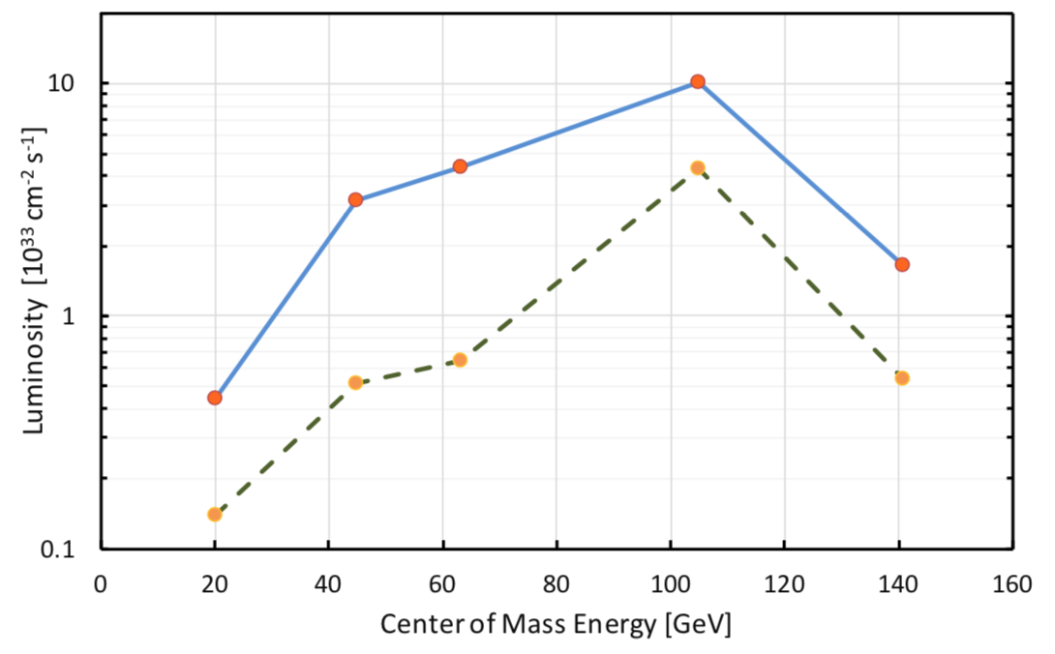
High Luminosity and Strong Hadron Cooling
Luminosity of lepton-hadron colliders in the energy range of the EIC benefits strongly (factor ≈ 3-10) from cooling the hadron’s transverse and longitudinal beam emittance
Reducing hadron beam emittance with strong hadron cooling enables reaching maximum strength of the beam-beam interaction and therefore achieving a maximum luminosity
Intra-beam scattering (IBS), a fundamental process prevents small emittance & causes emittance growth.
with SHC
Strong hadron cooling with modest cooling rate of 1h⁻¹, counteracts IBS
  EIC design luminosity L = 1·10³⁴cm⁻²s⁻¹ at Ecm=105 GeV is achieved & full range of EIC physics can be exploited.
  ➔ EIC design includes strong hadron cooling
w/o SHC

Slide 4
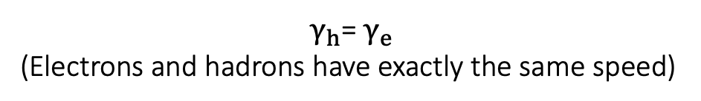
Coherent Electron Cooling scheme
Strong Hadron Cooling is based of the principle of well-established stochastic cooling
E<E₀
H⁺
Modulator
E>E₀
Kicker
R₅₆
R₅₆
R₅₆
e⁻
$γ_{h}$= $γ_{e}$
(Electrons and hadrons have exactly the same speed)
Imprinting: density fluctuation in hadron beam causes energy modulation of e-beam
Amplification: e-beam energy modulations are converted to density fluctuation by chicane
Hadron chicane: Controls hadron travel time with respect to electron path. Transfer to correlated energy modulation.
Kicker: longitudinal electric field of electrons reduces the hadron beam correlated energy spread.
The baseline design chooses Plasma enhanced micro-bunching
  Very broadband (~THz, slice size ~0.1 mm) amplifier
  Micro-bunching instability was well studied.
  Significant gain without saturation
4

Slide 5
Various topics were studied in last few years
SLAC/BNL/ANL
There is a well-developed theory of CeC (published in peer reviewed journals)
  The cooling rate is derived in 1D model for the longitudinal degree of freedom and is optimized with respect to the chicane strength.
  One and two amplification sections are studied and the cooling rate is obtained as a function of their parameters.
  Control of the dispersion in the modulator and kicker re-distributes the cooling rates between the longitudinal and transverse degrees of freedom.
  3D effects in cooling are analyzed. This analysis indicates that 1D model is a good approximation to a more realistic 3D one.
  Effects of energy deviations in electron and hadron beams is studied and tolerances established for various energy profiles.
  Noise effects and the associated heating process is taken into account. The cooling rate is maximized with account to the noise.
CeC-Pop experiment has been built and optimized at RHIC 29 GeV aiming to demonstrate strong hadron cooling in FY21-22
Conceptual design of strong hadron cooler for EIC worked out and published in pCDR and CDR

Slide 6
EIC Coherent Electron Cooling parameters
 | Value
e-beam energy [MeV] | 150
e-beam normalized emittance [mm-mrad] | 2.8
e-beam energy spread | 10⁻⁴
RMS beam size[mm] | 0.7
Average electron beam current [mA] | 120
e-beam bunch charge [nC] | 1
Cooling time [min] | 50
Two amplification sections.

Slide 7
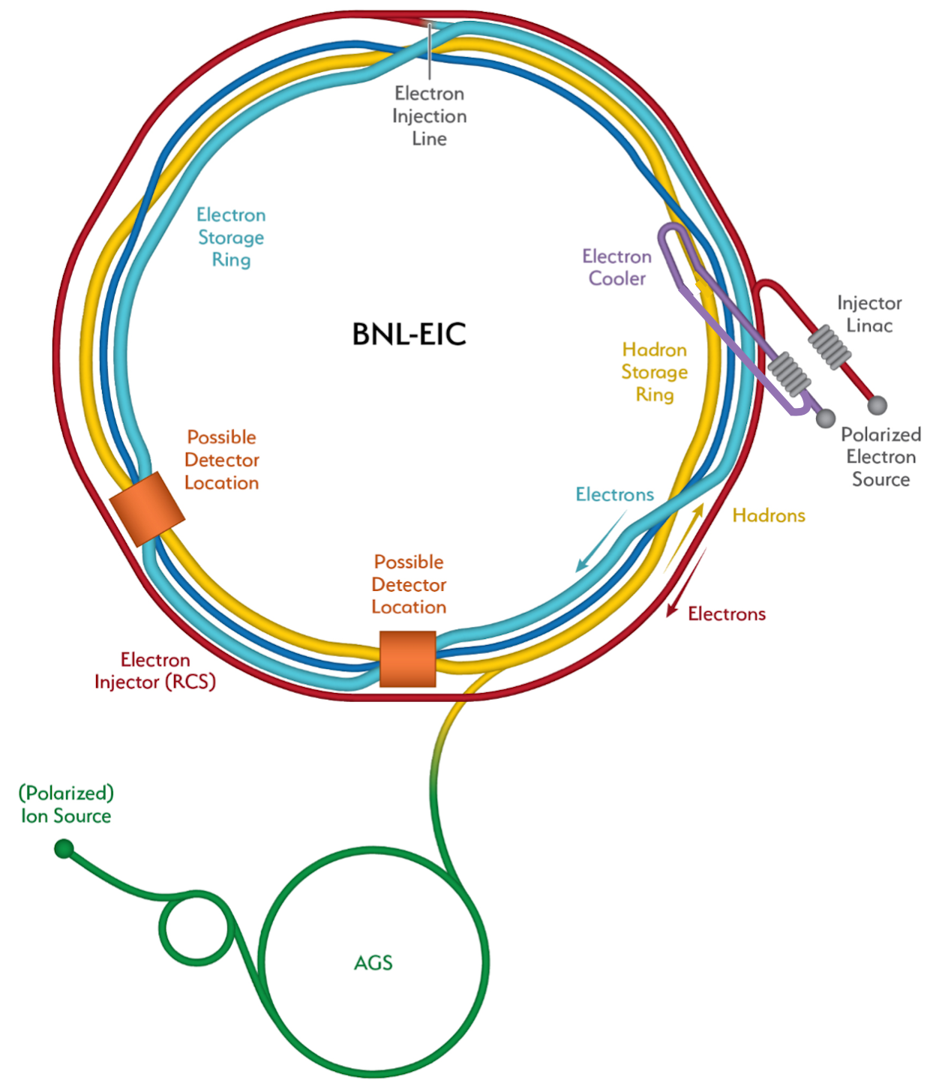
e-cooler facility layout
Share the same Linac tunnel and electron source building of EIC pre-injector
Hadron chicane for pathlength and R56 adjustment using displaced s.c. dipole magnets at IR2 straight section.
Notes:
Modulator to amplification=2.4 deg
Chi angle=16 deg
Accelerator to modu=

Slide 8
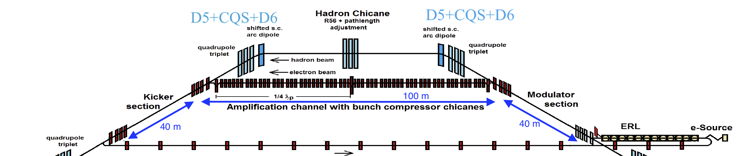
EIC Strong Hadron Cooling Facility
400kV DC gun for 100 mA of beam and 4 MeV SRF injector
Dogleg ERL merger
149 MeV Super conducting Energy Recovery LINAC ( in existing tunnel)
e Beam transport to merge hadron beam
Amplification section with chicanes for electrons
Hadron chicane (existing magnets) path length matching & R₅₆ adjust
Return transport of electron beam to ERL
2 K He sub cooler station, RF and power infrastructure
Electron beam instrumentation and diagnostics

Slide 9
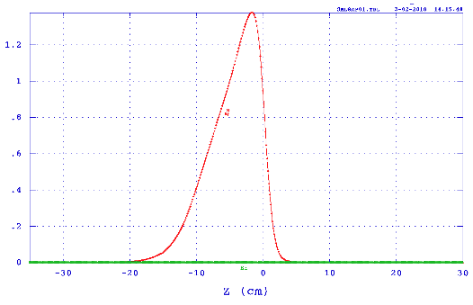
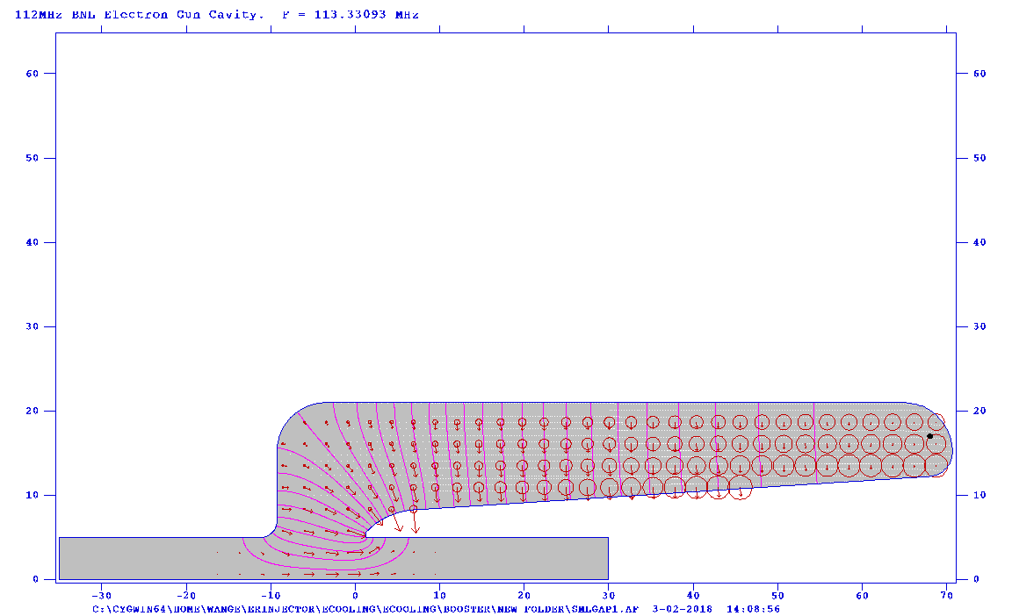
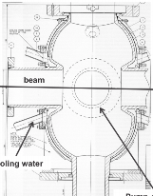
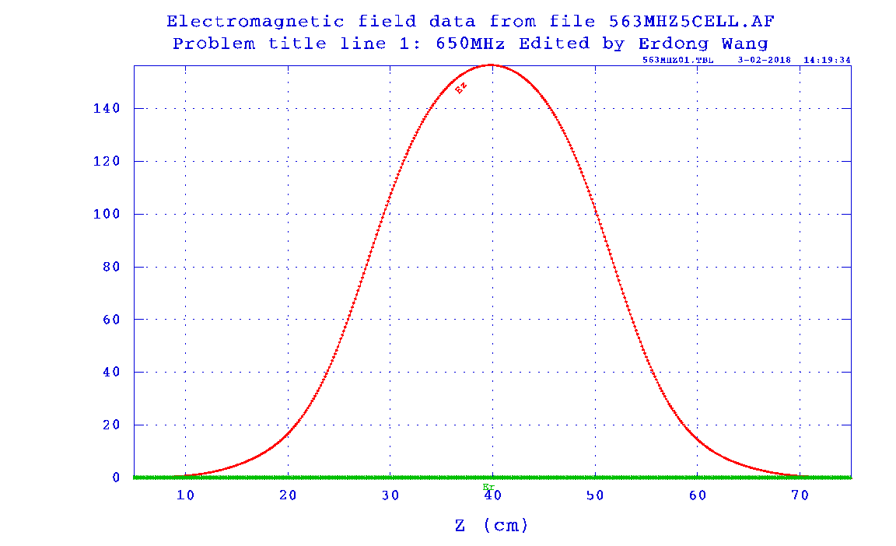
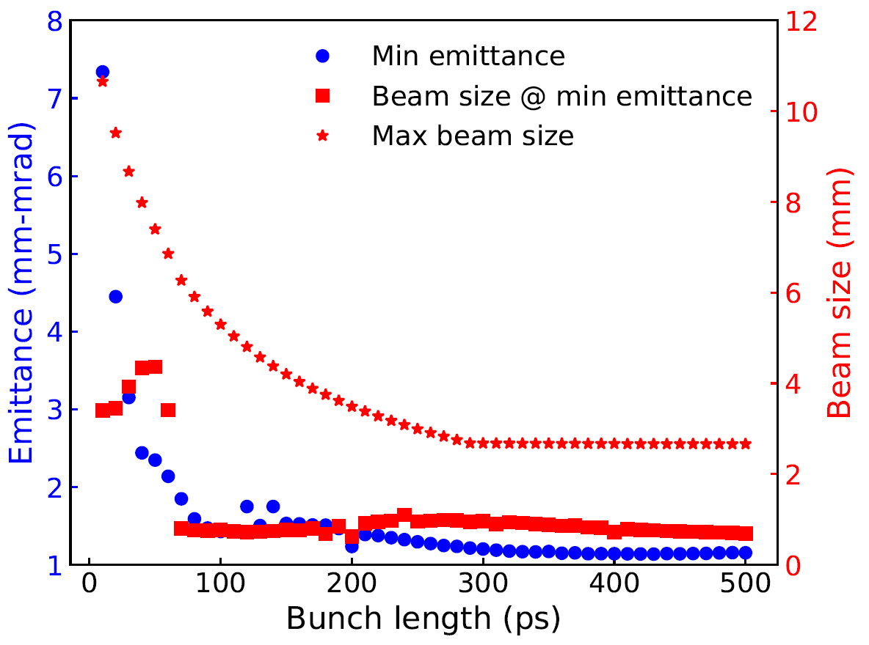
6.5.8.2 Electron source_injector
BNL/JLab/Cornell
HVDC
591 MHz buncher
197 MHz SRF
QWR
591 MHz harmonic
6.5 meters
Dogleg merger
The ERL injector includes 400 kV HVDC gun and SRF boosters.
The goal is 100 mA average beam with 1 nC bunch charge.
Normalized Emittance ~2mm-mrad
Initial bunch length

Slide 10
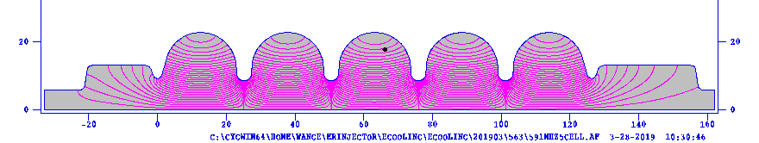
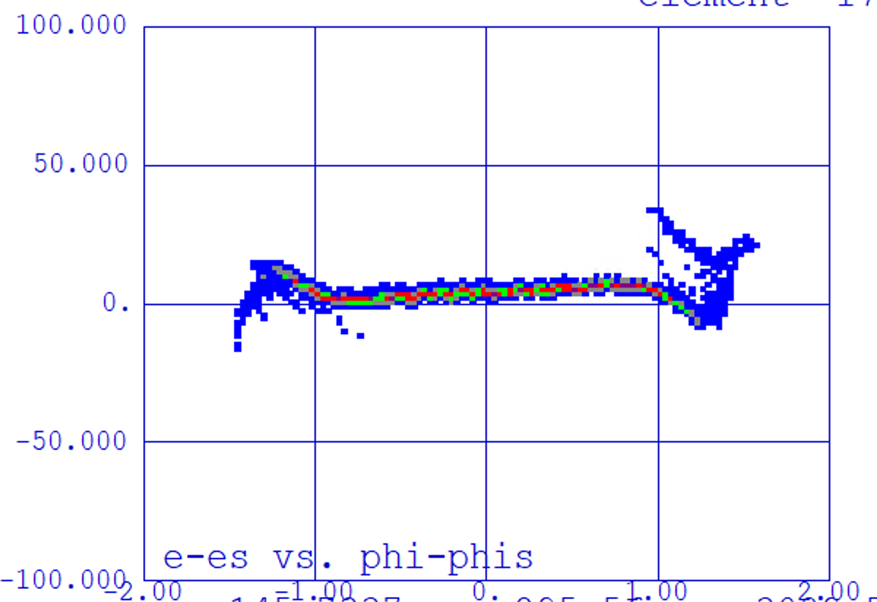

ERL_injector and Linac
Longitudinal phase space
591 MHz
4 MeV
150 MeV
DC gun
197 MHz
Merge_Dogleg
591MHz x4
1.77 GHz
591MHz x 4
400keV
Injector and Linac are simulated by Parmela with space charge effect. Verified with advanced 3D space charge code (CSR and wakefield yet to be included).
 | parameter
Bunch charge | 1 nC
Peak current | 30 A
RMS Bunch length | 5.1 mm
RMS Normalized emittance | 2.8 mm-mrad
Energy | 150 MeV
RMS dp/p | 5.5 e-5
High brightness injector for 120 mA CW
Dogleg merger scheme
150 MeV 591 MHz superconducting Energy Recovery LINAC

Slide 11
Electron lattice
Modulator
Kicker
Linac
Return
Total 20 quads triplets and 3 chicane (R₅₆=23mm)
Chicanes lengthen the pathlength by 45 mm

Slide 12
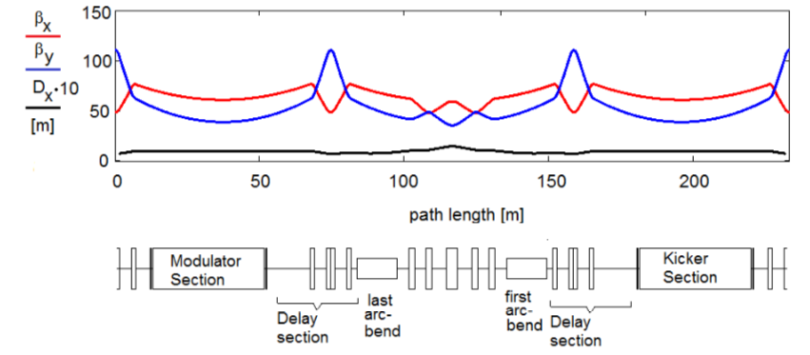
Hadron lattice
Proton R₅₆=4 mm
Transfer to correlated energy modulation
Lengthens the path by 45 mm matching to electrons chicanes length
In detailing the hadron lattice design now.
Notes:
Dis between e-h=1.5 meter

Slide 13
EIC strong hadron cooling activities
High current ERL
4 MeV injector
150 MeV Linac
CSR
Wake field
Shot noise
Lattice in tight tunnel
Beam dump
Theory and simulation
Develop a cooling tracking code
3D PIC tracking
Components R&D
Electron source
Active cooling
Enlarge cathode/anode size
Better vacuum
High power , stable laser
Hadron modifications
Hadron Chicane
Diagnostics/Controls
Beam noise
Phase
Energy spread
e-h alignment
SRF accelerator
High gradient and voltage
HOM absorber
Fundamental power coupler

Slide 14
Challenges and opportunities
CeC has not been experimentally demonstrated
Very low energy spread is required
Require: <10⁻⁴
- 2e-4 at LEReC; 1e-4 PAL XFEL
Very low shot noise from electron beam
- Laser heater LCLS; by optimizing optics at BNL
High current ERL
Require: 120 mA and 150MeV
- Jlab FEL 8 mA; Novo FEL 30 mA ( normal conducting )
High current high charge electron source
Require: 120 mA @1nC
Cornell 65 mA@ 60 pC; BNL 30 mA@100 pC
Beam diagnostics: beam noise, e-h alignment, energy spread measurement.
RHIC CeC experiment
GPT/Bmad simulation
IMPACT-T simulation
EIC components R&D
SHC R&D will push the frontier of accelerator science

Slide 15
Coherent electron Cooling experiment at RHIC
Courtesy V.N. Litvinenko
CeC with 4-cell Plasma Cascade μ-bunching amplifier
RHIC 26.5 GeV/u ion beam
1.25 MV SRF
photo-electron gun
Kicker
Plasma Cascade Amplifier
Modulator
Ballistic
bunch compression beamline
Time-resolved diagnostics beamline
13.1 MV SRF linac
1.5 to 10 nC per bunch
The 14.5 MeV CW SRF accelerator has unique SRF electron gun generating record-low emittance with beam quality sufficient for current experiment and for future IEC cooler.
Electron bunches are compressed to peak current of 50-100 , the e-beam is accelerated to energy of 14.5 MeV and merged with RHIC 26.5 GeV/u ion beam in the CeC system
Current CeC system has seven high field solenoids, five of which serve as a 4-cell Plasma-Cascade μ-bunching amplifier with 15 THz bandwidth and amplitude gain exceeding 100.
All necessary electron beam parameters – the beam energy, peak current, the beam emittances, energy spread, the low noise in the beam - had been demonstrated. The full CW beam was propagated with low losses through the newly built PCA CeC
The CeC run was completed in mid-September and preliminary analysis is that all goals for this run have been achieved.
The project plans are to demonstrate longitudinal CeC in 2021 and 3D (both longitudinal and transverse) CeC in 2022.
The CeC group invites all interested parties to collaborate on this incredibly challenging project in any of relevant areas: CeC theory, CeC and beam dynamics simulations, CeC experiment and diagnostics….
Details will be presented in the “Coherent Electron Cooling: talk by V.N. Litvinenko this Friday,
October 9, 2020, in Europe/Africa Focus: Session 6.1, 13:10 London time/ 8:10 am New York time

Slide 16
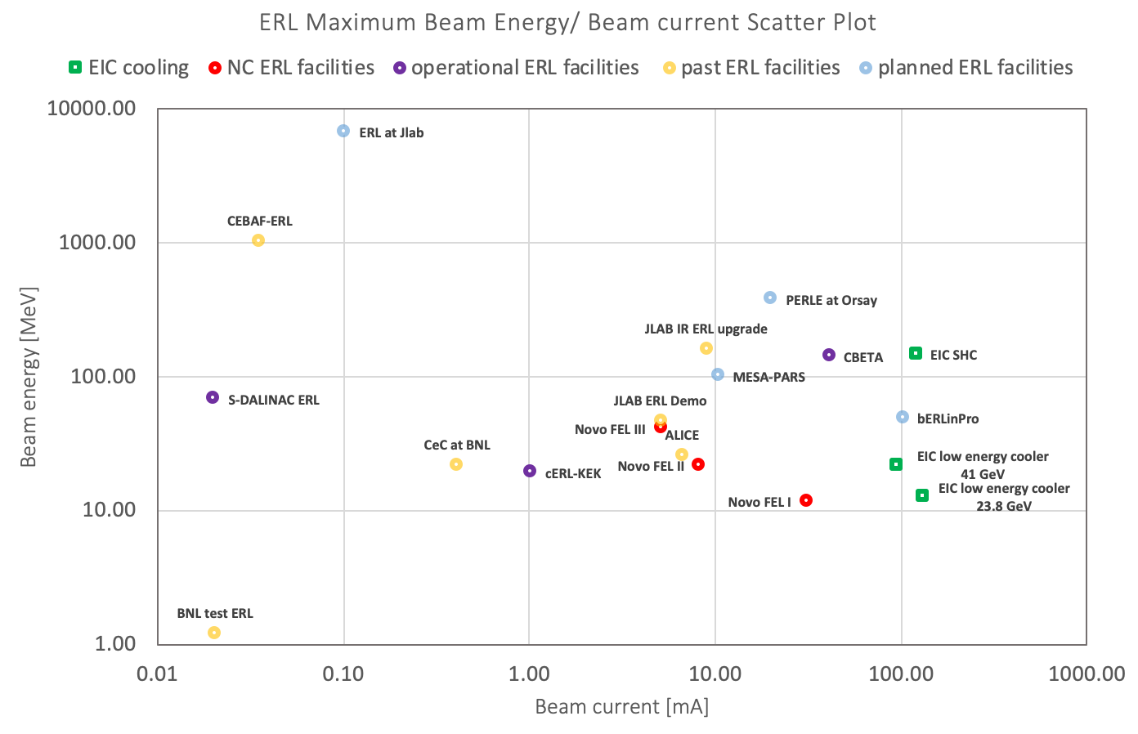
High current ERL
Many success facilities: Jlab- FEL, CBETA, cERL-KEK, ALICE, Novo-FEL et,al
Remain researches for high current ERL:
  Halo
  CSR
  Beam loading
  BBU
High current tests of cERL in KEK and potential research for EIC (Tsukasa Miyajima Thursday 22:25 GMT-4)
Cornell University contribution for EIC (G. Hoffstaetter Thursday 22:50 GMT-4)​

Slide 17
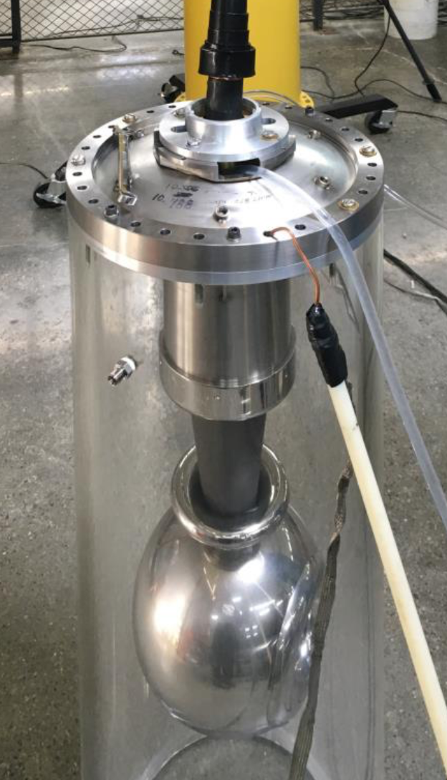
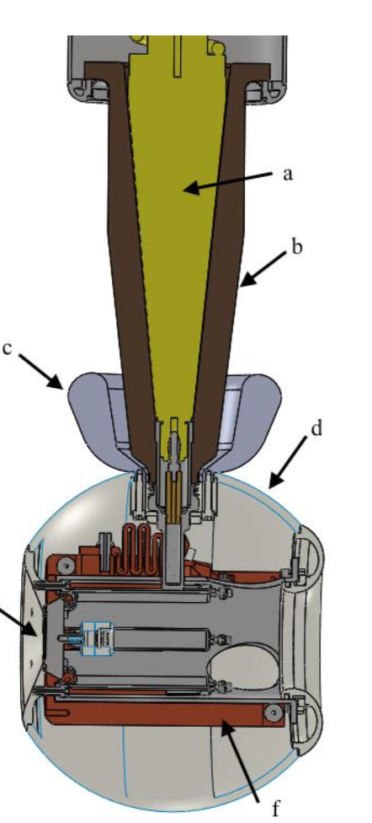
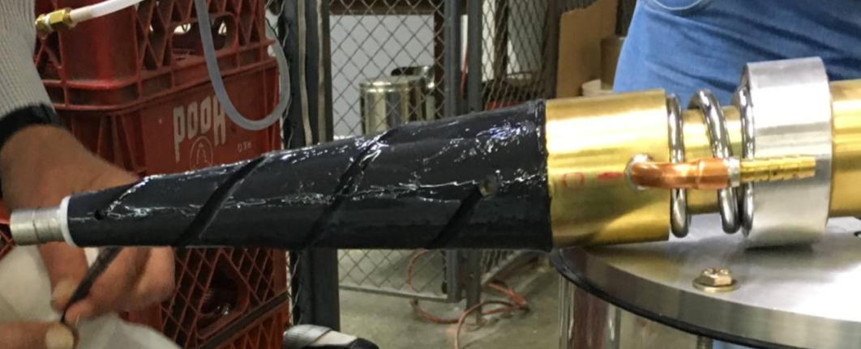
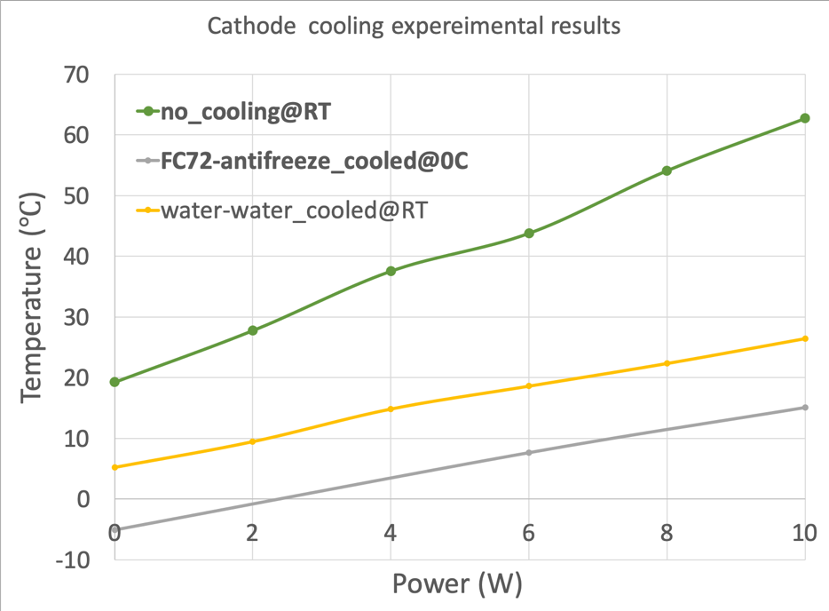
HVDC gun R&D_ active cooling
Cool the cathode:
Aiming to absorb the laser power up to 10 W. We are collaborating with Dielectric Sci. developed the active cooling HV feedthrough.
Tested up to 410 kV with flow
Fluorinert flowing
Fluorinert flowing

Slide 18
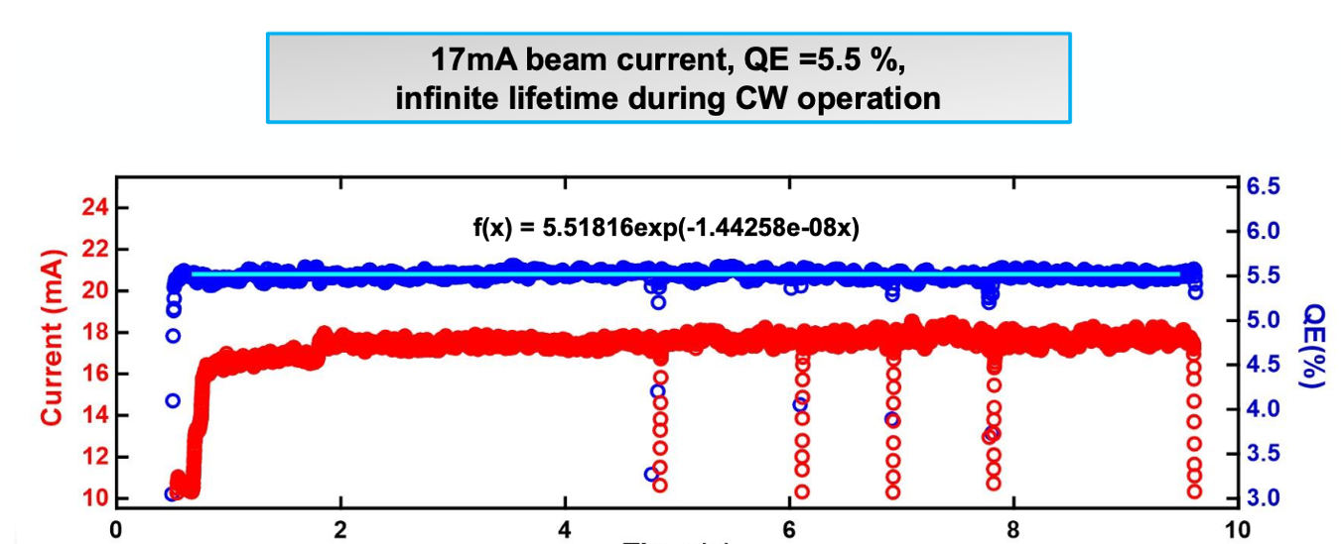
Electron source R&D_ Photocathode
 | parameters
Cathode QE(%) | 1%-8%
Average current [mA] | 120
Average laser power [W] | 23-3
Pulse energy [nJ] | 230-30
Charge lifetime [C/mm] | 20000/2.5
Extrapolated Cl [C/mm] | 80000/5~ 9 days
By increasing the multilakali cathode area, it looks promising to get reasonable charge lifetime with good vacuum
R&D focus on demonstration of high charge/ high current e-beam

Slide 19
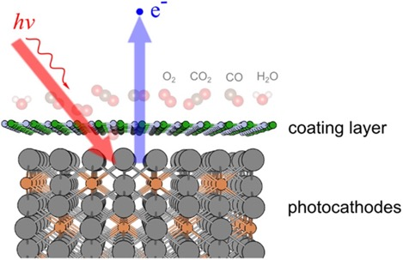
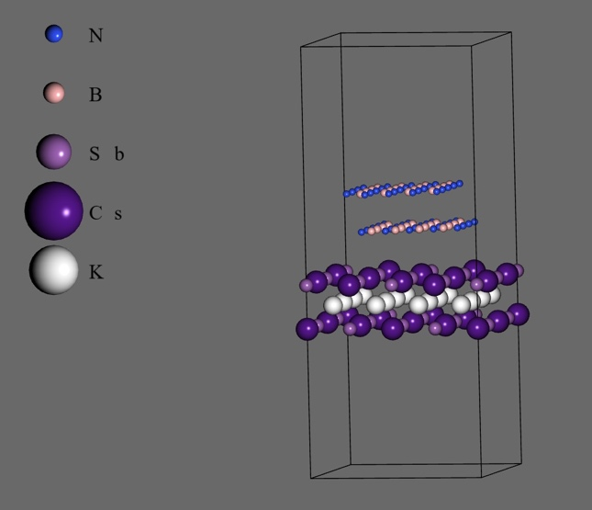
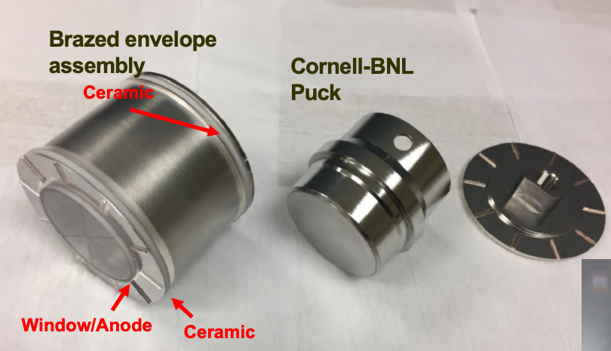
Multialkali photocathode R&D
BNL is working with Euclid Techlabs, LLC on investigating thin-film protection schemes for bi-alkali antimonide photocathodes
  Hexagonal boron nitride (hBN) are top candidates of materials
  Reject detrimental molecules such as H₂O, O₂, etc.
  Transparent to photoelectrons
  Investigating novel laser oscillator deposition enhancement system (LODES) based on existing sputtering chamber
BNL is working with Photonics and RMD on developing capsule sealed multialkali photocathode
  Outsourcing cathode production for alkali antimonides
  Overnight shipping /longterm storage;
Yamaguchi, et al, NPJ, 2018
Euclid
Euclid thin-film growth system
Both cathode R&Ds benefit to EIC cooler

Slide 20
SRF cavities R&D
 | Buncher | Booster | 3rd Harmonic Injector | 5 cell main Linac | 3rd Harmonic
Freq. (MHz) | 591 | 197 | 591 | 591 | 1773
Gap voltage (MV) | 0.2 | 2 | 0.5 | 18.78 | 6.3
High accelerator voltage
200 kW Fundamental power coupler
HOM absorber

Slide 21
Summary
We have developed a cooler conceptual design for EIC.
The Strong hadron cooler would establish a major advance in accelerator science and technology.
The challenges have been identified and components R&D are planned.
The potential broad collaboration topics are discussed. Welcome to collaborate on EIC cooling R&D.

Slide 22
Thanks for your attention!
Welcome to have collaborations!

Slide 23
Backup

Slide 24
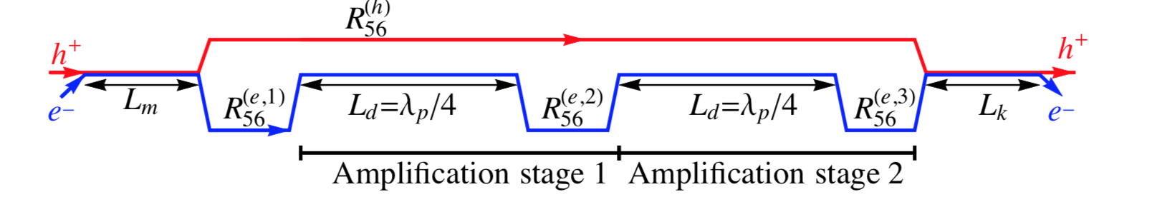
Strong Hadron Cooling for EIC Cooling for eRHIC
Requirements: eRHIC Peak Luminosity of 10³⁴cm⁻²s⁻¹ requires 6·10¹⁰ protons per bunch, 6 cm bunch length and small emittances of e_{x}= 9.2 nm, e_{y} = 1.3 nm ➔ beam subject to IBS, initial growth time of >2h in the hor. and long. direction
Method: Strong Hadron Cooling using coherent electron cooling with micro-bunched beams, bunching enhancement with 2 plasma amplification sections with a total of 3 bunching chicanes. Quarter of plasma wavelength as low as l_{p} =40 m
Cooling rate for short flat bunches ~1 h for longitudinal and transverse oscillations (theory & simulations)
Need an electron beam with 1nC bunches (100 mA CW) , dp/p~10⁻⁴ , normalized horizontal emittance ~2.5 mm-mrad

Slide 25
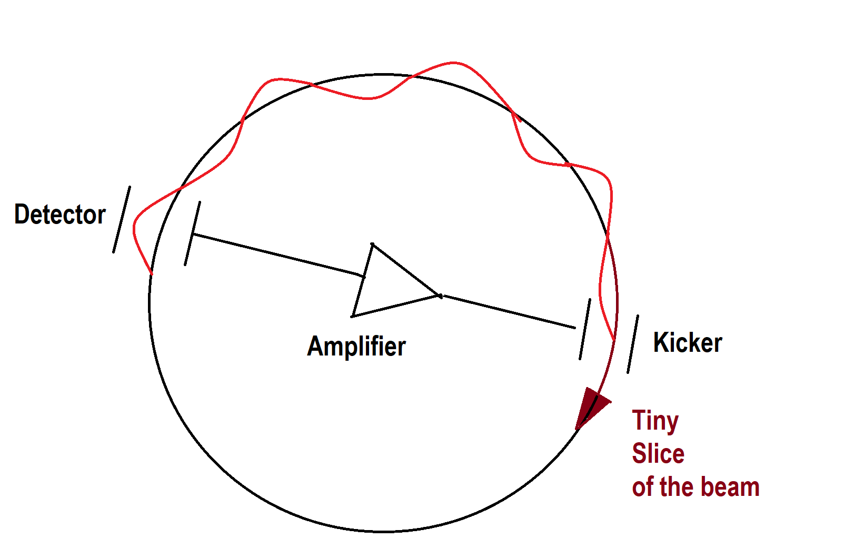
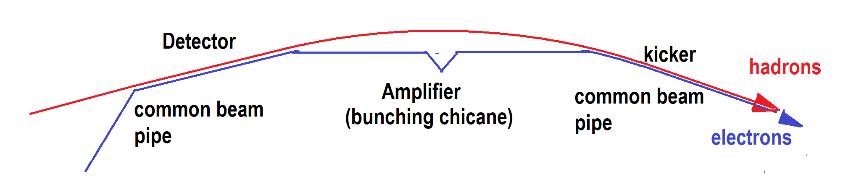
Coherent Electron Cooling
Like stochastic cooling, tiny fluctuations in the hadron beam distribution (which are associated with larger emittance) are detected, amplified and fed back to the hadrons thereby reducing the emittance in tiny steps on each turn of the hadron beam
High bandwidth (small slice size)
Detector, amplifiers and kickers
For high energy protons required bandwidth ( is much larger than possible with cables amplifiers and kickers
Use an electron beam instead to detect fluctuations, to amplify and to kick
Electrons vastly increase the bandwidth.

Slide 26
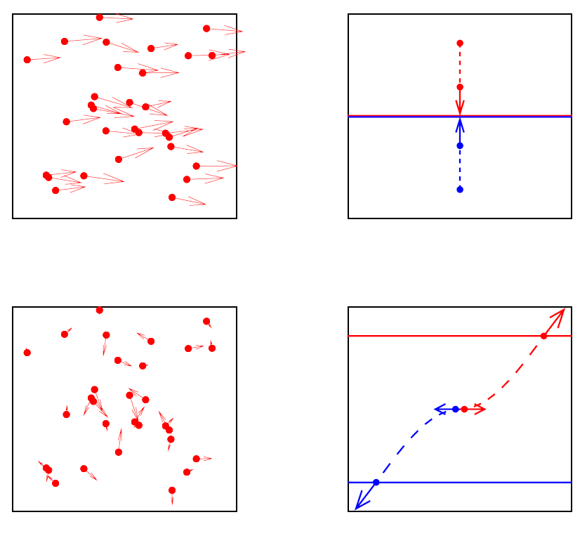
Why does the beam heat up?
Look at 2 particles
in the same beam
bouncing off
each other
Go to “rest frame”
Dispersion causes
average orbit to
change with energy.
Can get an increase
in transverse speed!

Slide 27
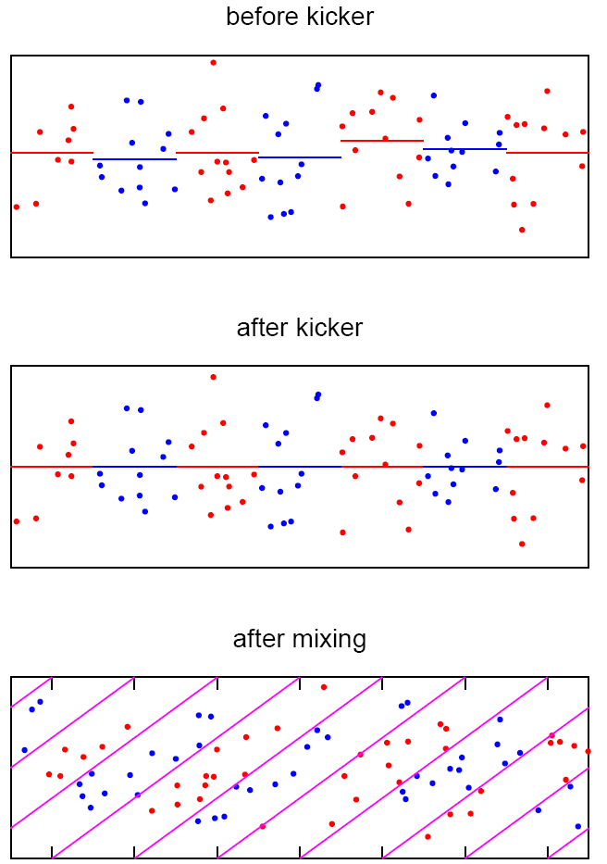
Basic Idea of
Longitudinal Cooling
Δv
Pickup gets average velocity
error in sample with respect to synchronous particle.
Flipping a coin 100 times rarely gives exactly 50 heads
Kicker is broad band RF
Subtracts the average from each sample.
The spread is reduced!
Longitudinal slip mixes into new samples
relative position

Slide 28
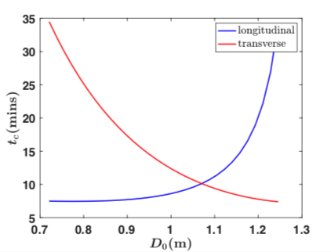
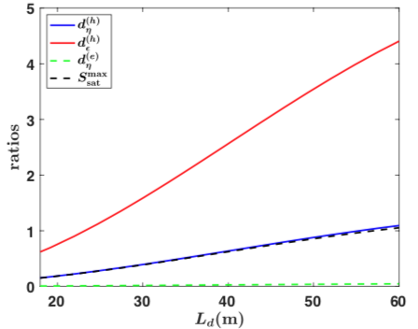
Various topics are addressed in theory
The cooling rate is derived in 1D model for the longitudinal degree of freedom and is optimized with respect to the chicane strength.
One and two amplification sections are studied and the cooling rate is obtained as a function of their parameters.
Control of the dispersion in the modulator and kicker re-distributes the cooling rates between the longitudinal and transverse degrees of freedom.
3D effects in cooling are analyzed. This analysis indicates that 1D model is a good approximation to a more realistic 3D one.
Effects of energy deviations in electron and hadron beams is studied and tolerances established for various energy profiles.
Noise effects and the associated heating process is taken into account. The cooling rate is maximized with account to the noise.
1D cooling simulation code is implemented in Matlab. Theoretical formulas are benchmarked against computer simulations.

Slide 29
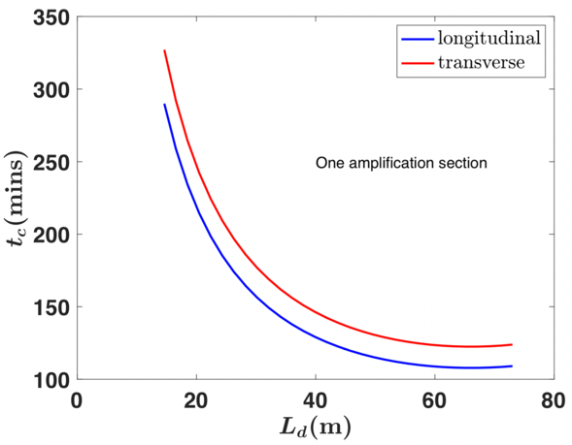
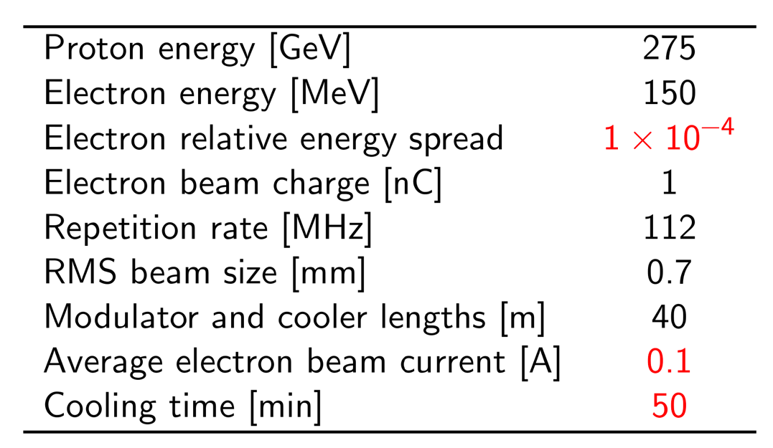
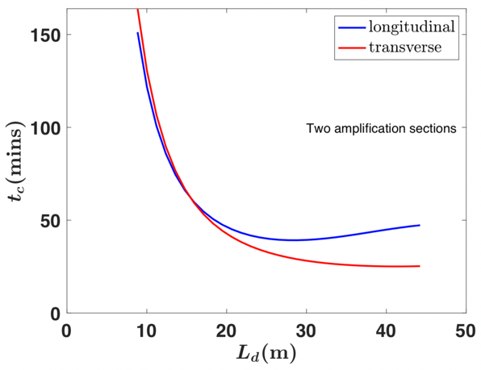
Conceptual parameters of the hadron cooler for EIC
﻿The electron bunch length, σ_{ze} =4mm, is much shorter than the proton bunch length, σ_{zh} =5 cm.
Two amplification sections, 20 m of each.
Cooling time as a function of the length of the amplification sections L_{d} for one (top) and two (bottom) amplification sections in the system.

Slide 30
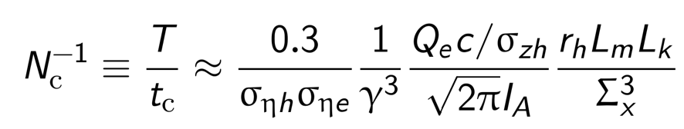
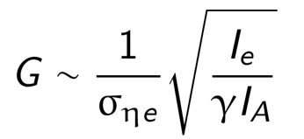
1D model developed
Scaling of the cooling rate N_{c}⁻¹ provides critical information about the feasibility of MBEC for cooling high-energy hadron beams and sets requirements for the parameter choice of the cooling sections,
Gain factor G to the cooling rate :
Our theoretical formulas are benchmarked against computer simulations
Transverse (N_{c}^{ε}) and longitudinal (N_{c}^{η})cooling rates versus dimensionless chicane strength
~10-20
Various topics are addressed in theory
Notes:
For effective cooling one needs a small energy spread in the electron beam (σ_{ηe}), long “modulator” and “kicker” sections (L_{m} and L_{k}), and small transverse size of the beams in the interaction regions (Σ_{x}).
Each amplification section adds a gain factor G to the cooling rate, typically ~10-20,

Slide 31
Micro-bunched cooling enhanced by plasma oscillations
E<E₀
H⁺
Modulator
E>E₀
Kicker
R₅₆
R₅₆
R₅₆
e⁻
Density modulated electron beam subject to plasma oscillations while drifting
(drift quarter of electron beam plasma wavelength)
➔More energy modulation ➔ another chicane ➔ more micro-bunching
EIC Strong hadron cooler: 2 such plasma amplification stages
Features of Plasma enhanced micro-bunching
Very broadband (~THz, slice size ~0.1 mm) amplifier
Micro-bunching instability was well studied.
Significant gain without saturation
High cooling rates
Notes:
evolution of a distorted charge distribution

