Slide 1
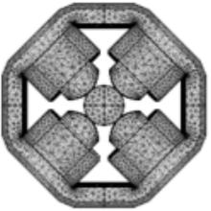

Superconducting magnet design in Mexico, challenges and opportunities
LABORATORIO DE SUPERCONDUCTIVIDAD
APLICADA
EIC Workshop – Promoting Collaboration
on the Electron-Ion Collider
Daniel Chavez
Mauro Napsuciale, Giovanni García-Valdivia, Yemby Huamani-Tapia, Arnold Mullisaca and Marco Ortiz
Universidad de Guanajuato, León, Guanajuato, 37150, México.

Slide 2
Outline
Group introduction.
Previous efforts towards the development of 3 and 6 T super-ferric magnets for the JLEIC.
Present projects at the Applied Superconductivity lab of Universidad de Guanajuato, and collaborations with Texas A&M University and Accelerator Technology Corp.
Challenges and opportunities.

Slide 3
Group introduction

Slide 4
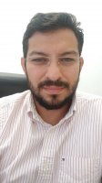
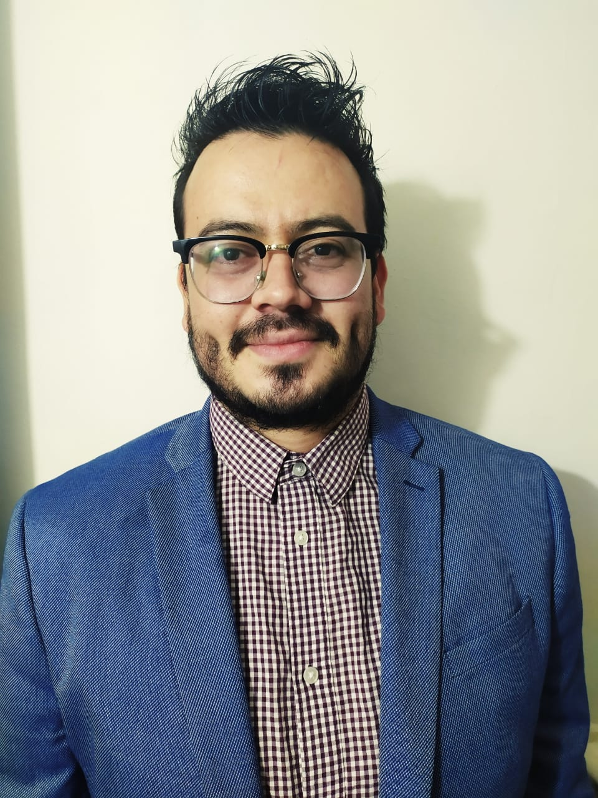
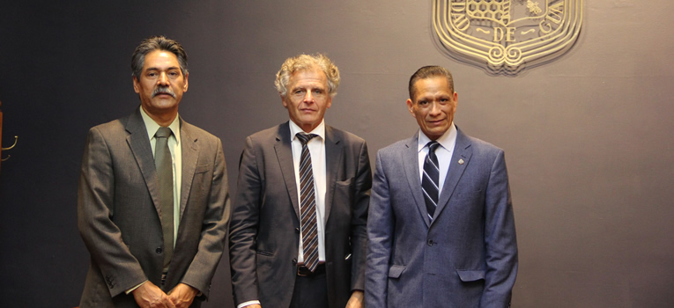
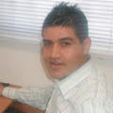
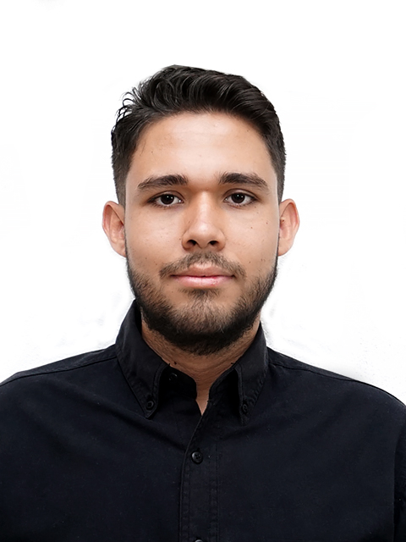
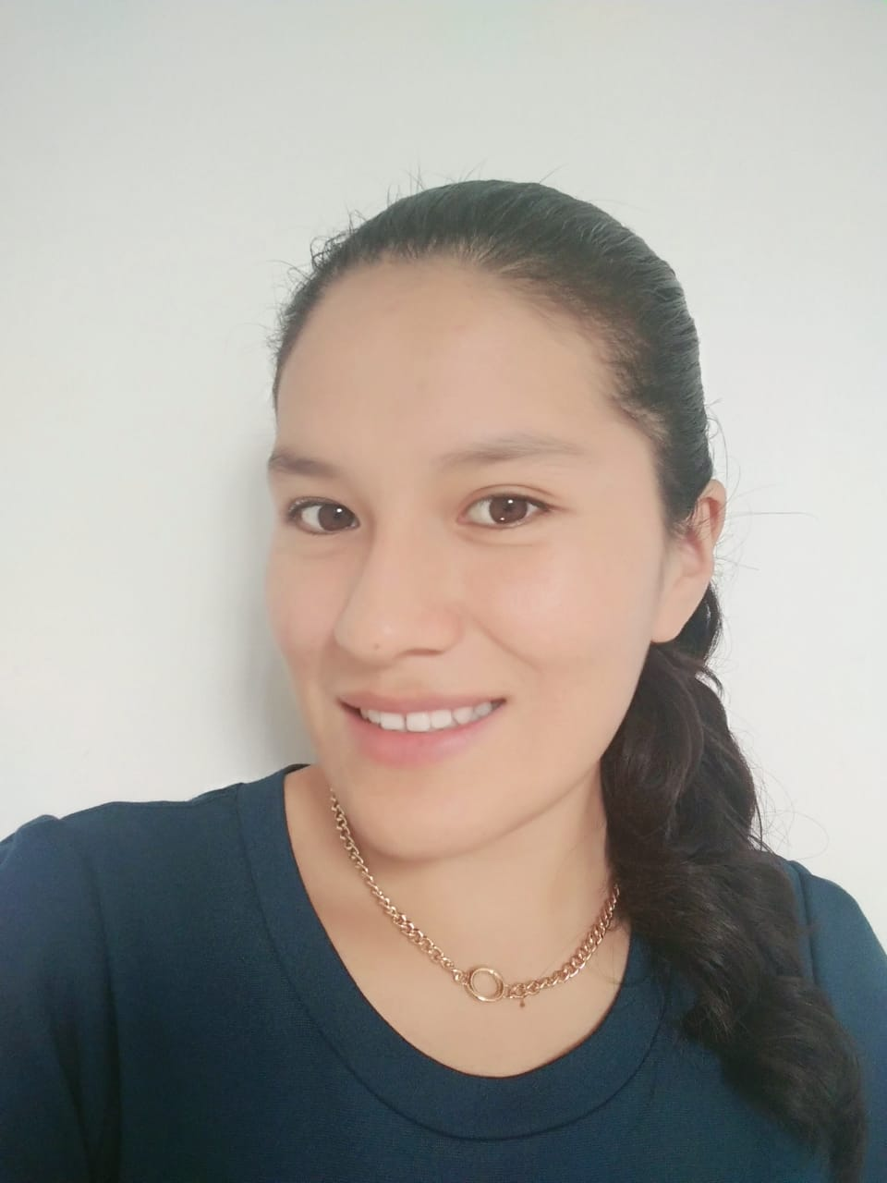
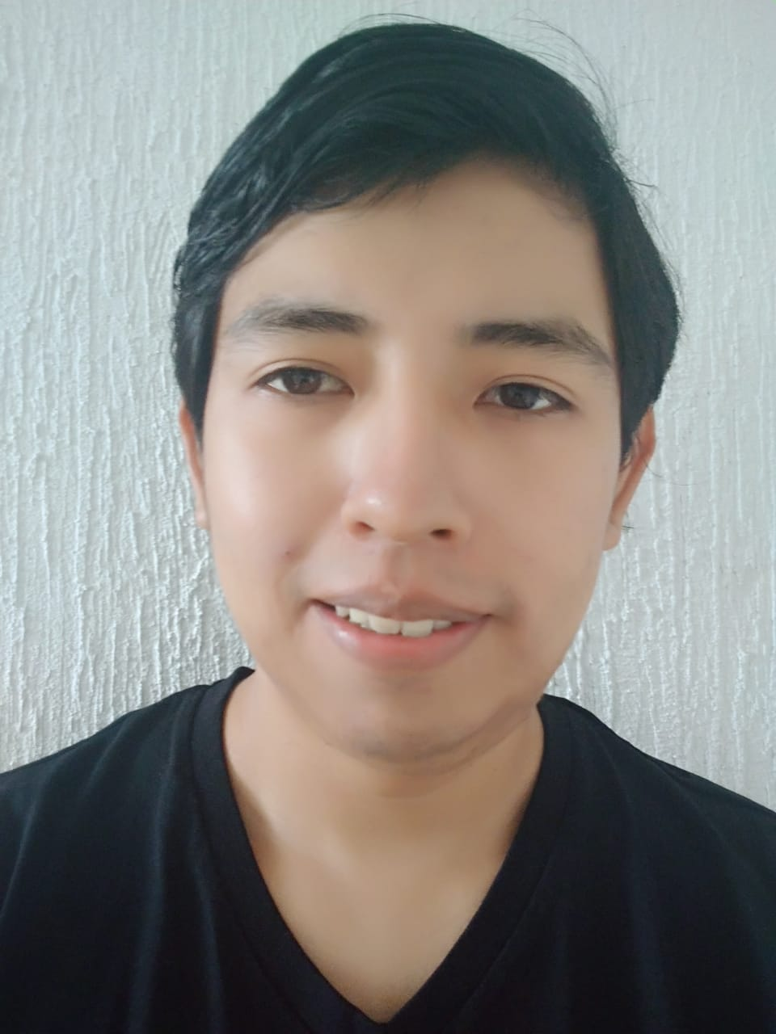
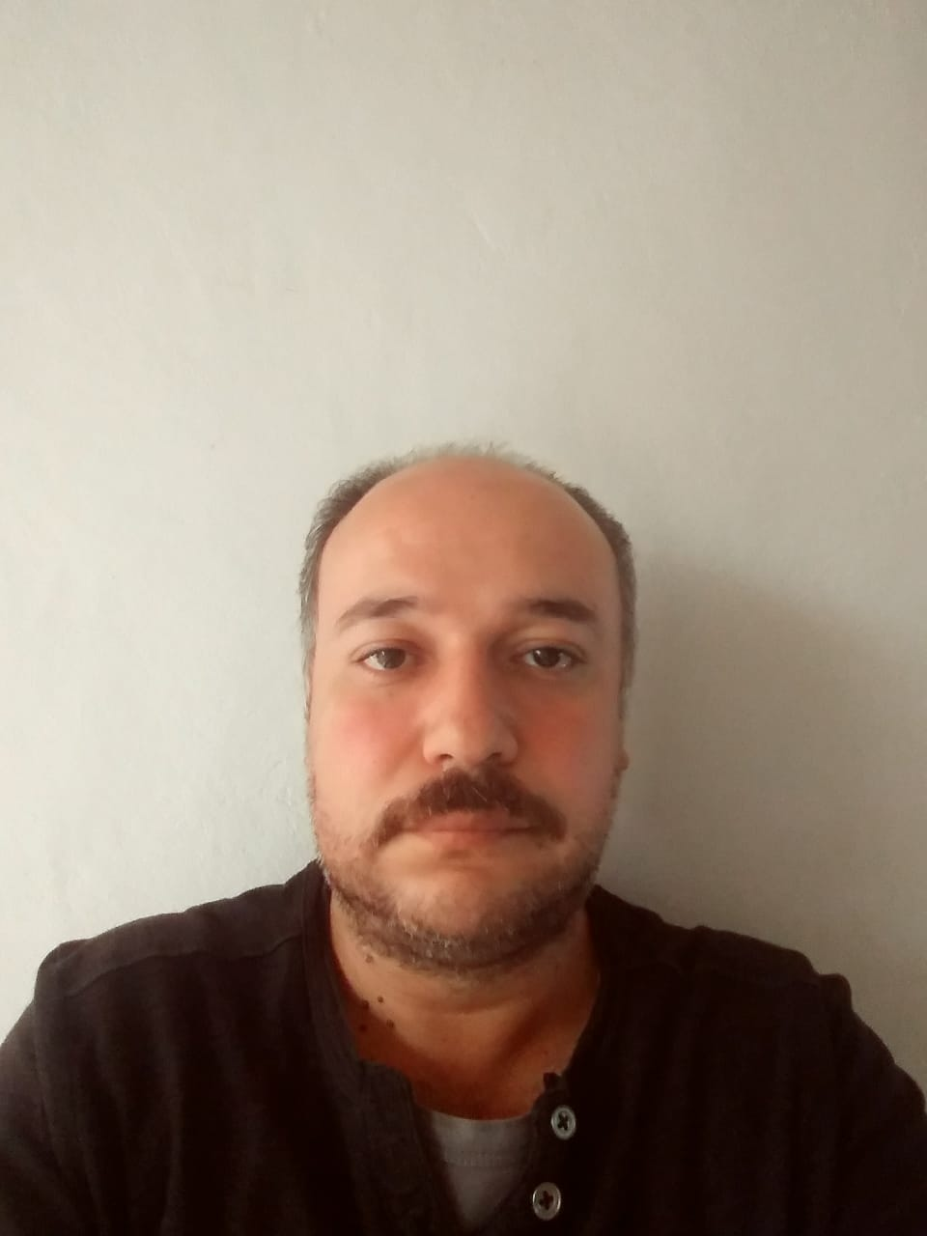
APPLIED SUPERCONDUCTIVITY LAB
Collaborators
August 2019
Dr. Gustavo Basurto
Neuroscientist
Dr. Alejandro Puga
Dynamical Systems
Dr. Daniel Chávez
Dr. Mauro Napsuciale
Yemby Y. Huamani
PhD. Student
Giovanni D. Valdivia
PhD. Student
Arnold F. Mullisaca
PhD. Student
Marco A. Ortiz
PhD. Student

Slide 5
Previous efforts towards the development of a 3 and 6 T
super-ferric magnets for the JLEIC, using Cable-in-conduit technology

Slide 6
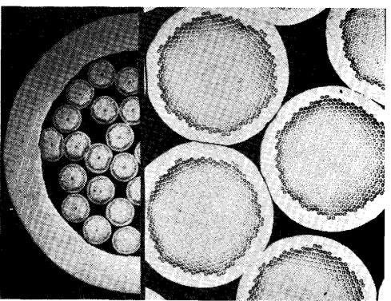
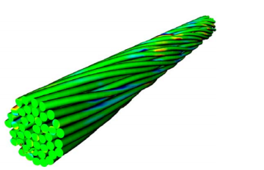
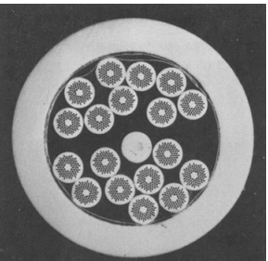
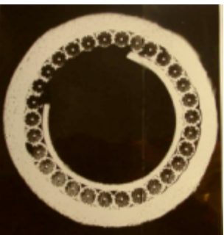
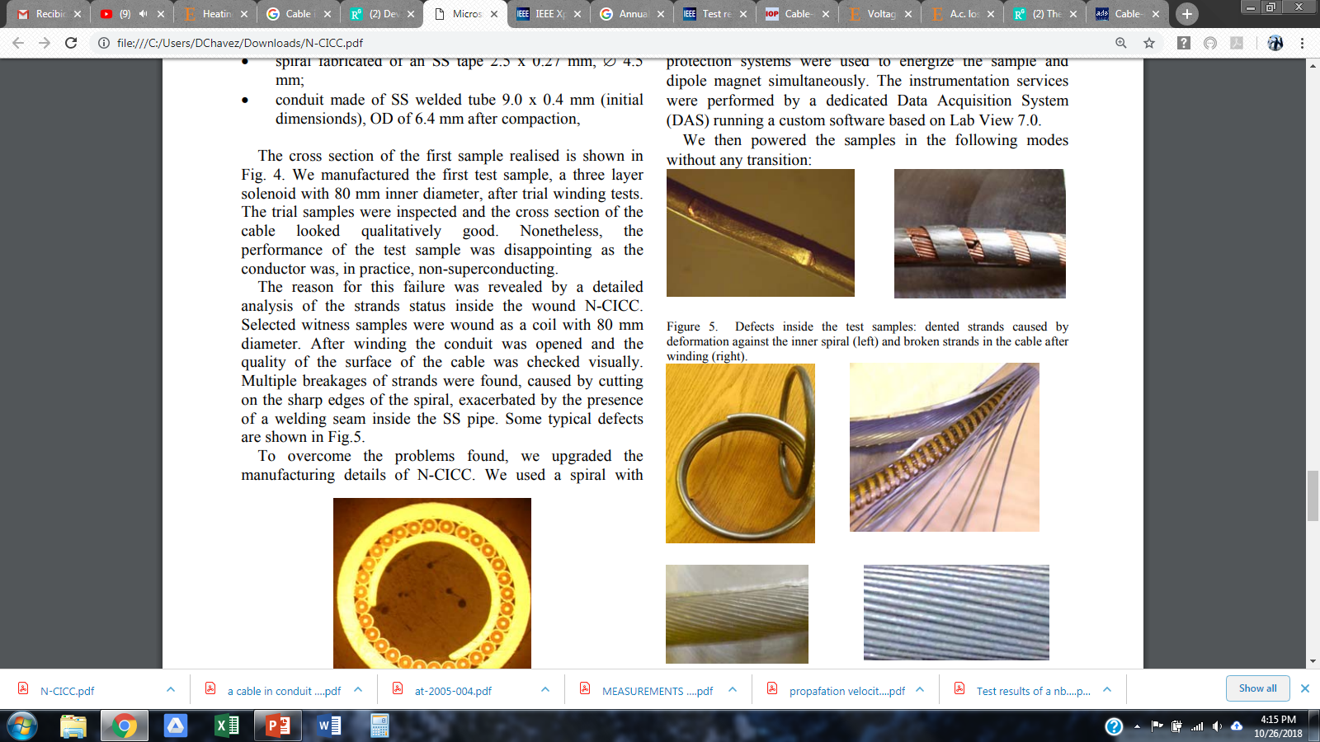
Cable-In-Conduits development
UG-TAMU
Some of the problems of previous designs
Current degradation
Restrictions on the bend radius and winding capabilities

Slide 7
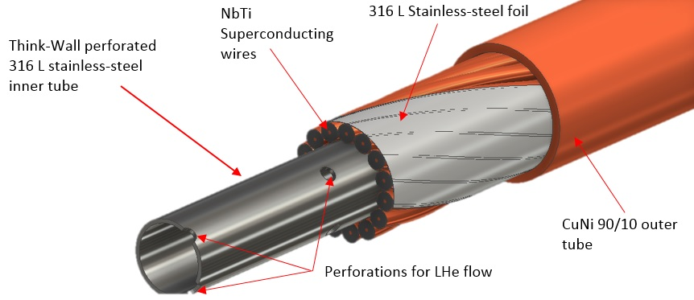
Cable-In-Conduit
Technology
2013-2018
Features
Components
Is its own cryogenic-vessel
High strength foil
Superconducting wire
Superconductor is
bathe in LHe, adding
thermal stability
High Strength
Perforated inner tube
Rigid structure
Full azimuthal contact
between wires.
(Current sharing)
High Strength
Outer sheath
Perforations for LHe flow
Allows for precise and complex bends,
in relatively small bend radius (25 mm)
This technology is readily expandable to wind & react superconductors

Slide 8
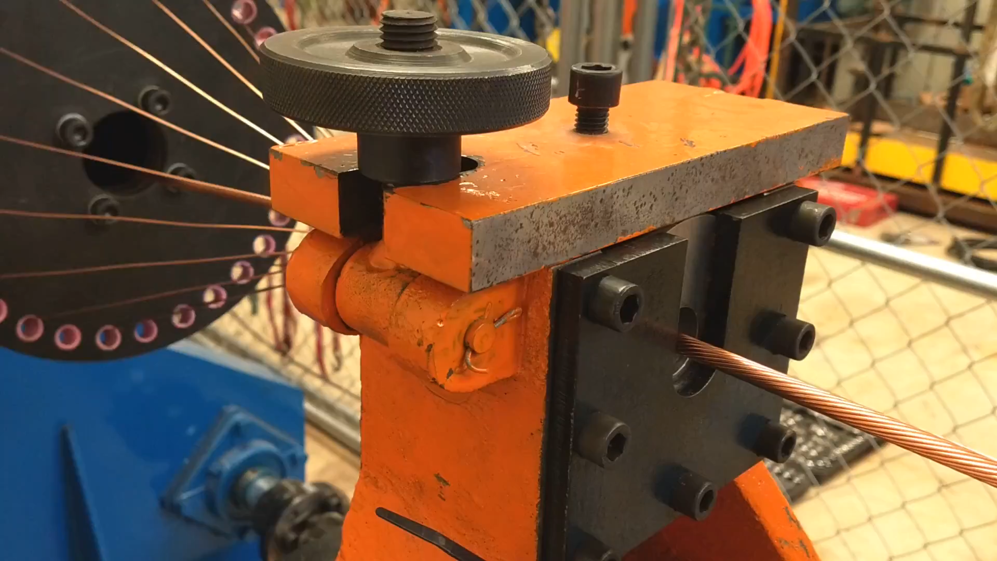
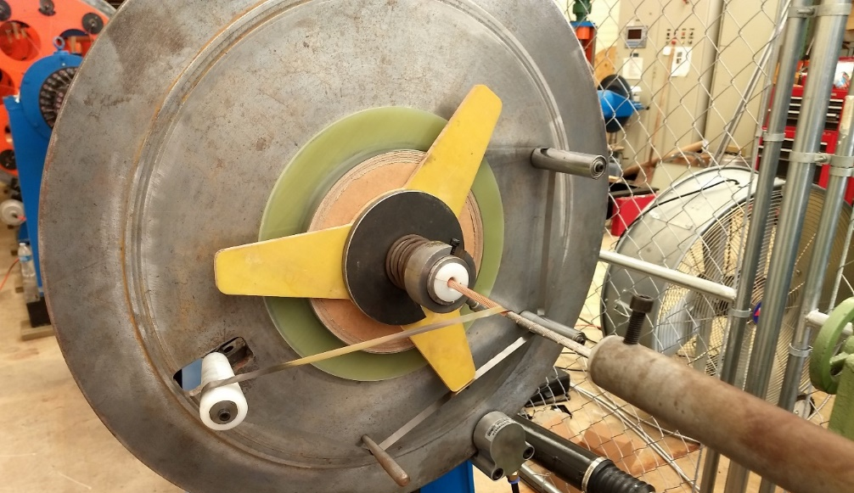
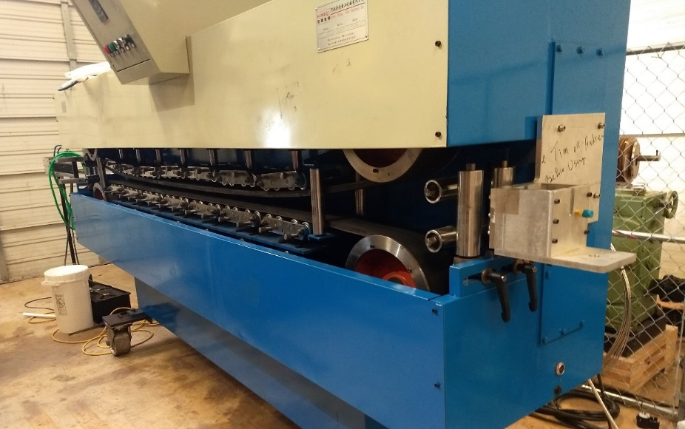
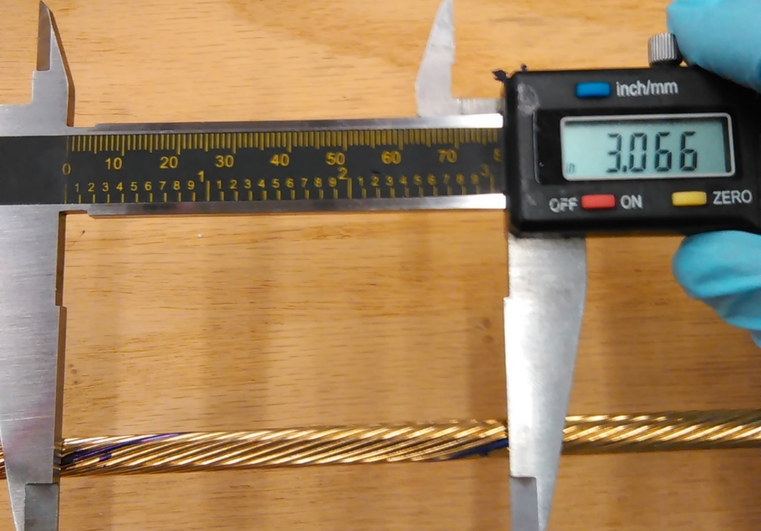
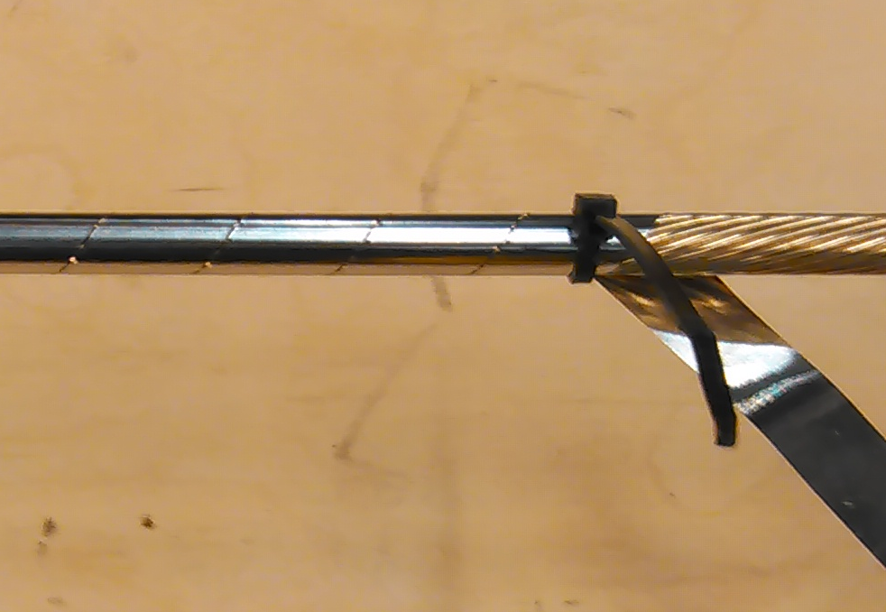
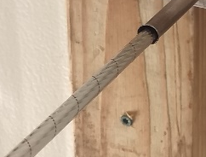
How is made?
Cabling
High strength foil
Drawing
In
Out
Superconductor
Twist-pitch
assessment
foil wrapping
No overlap
Core insertion into a
High strength inner tube

Slide 9
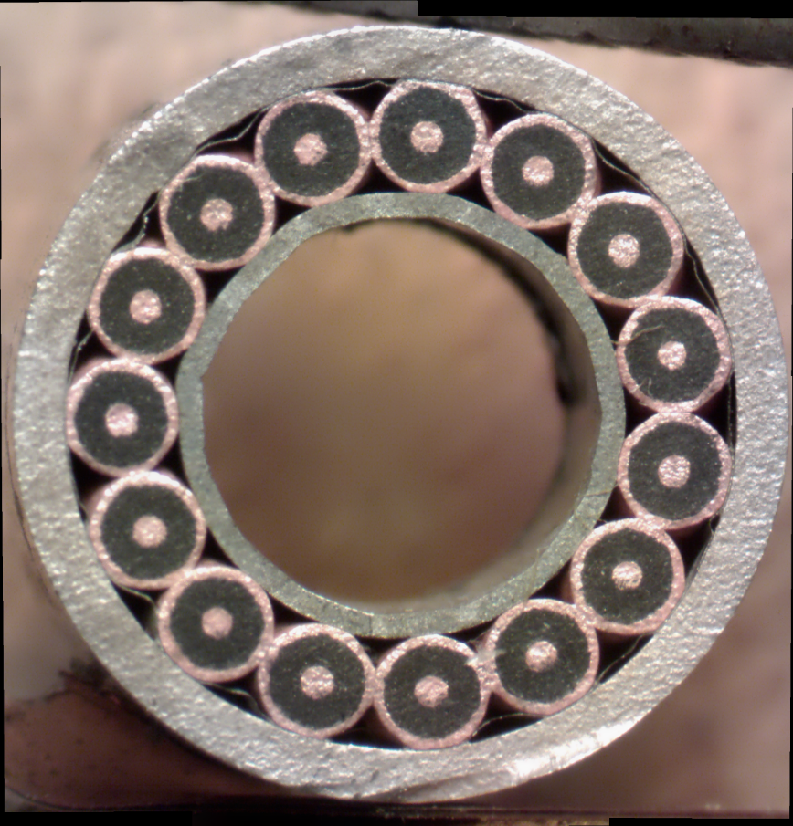
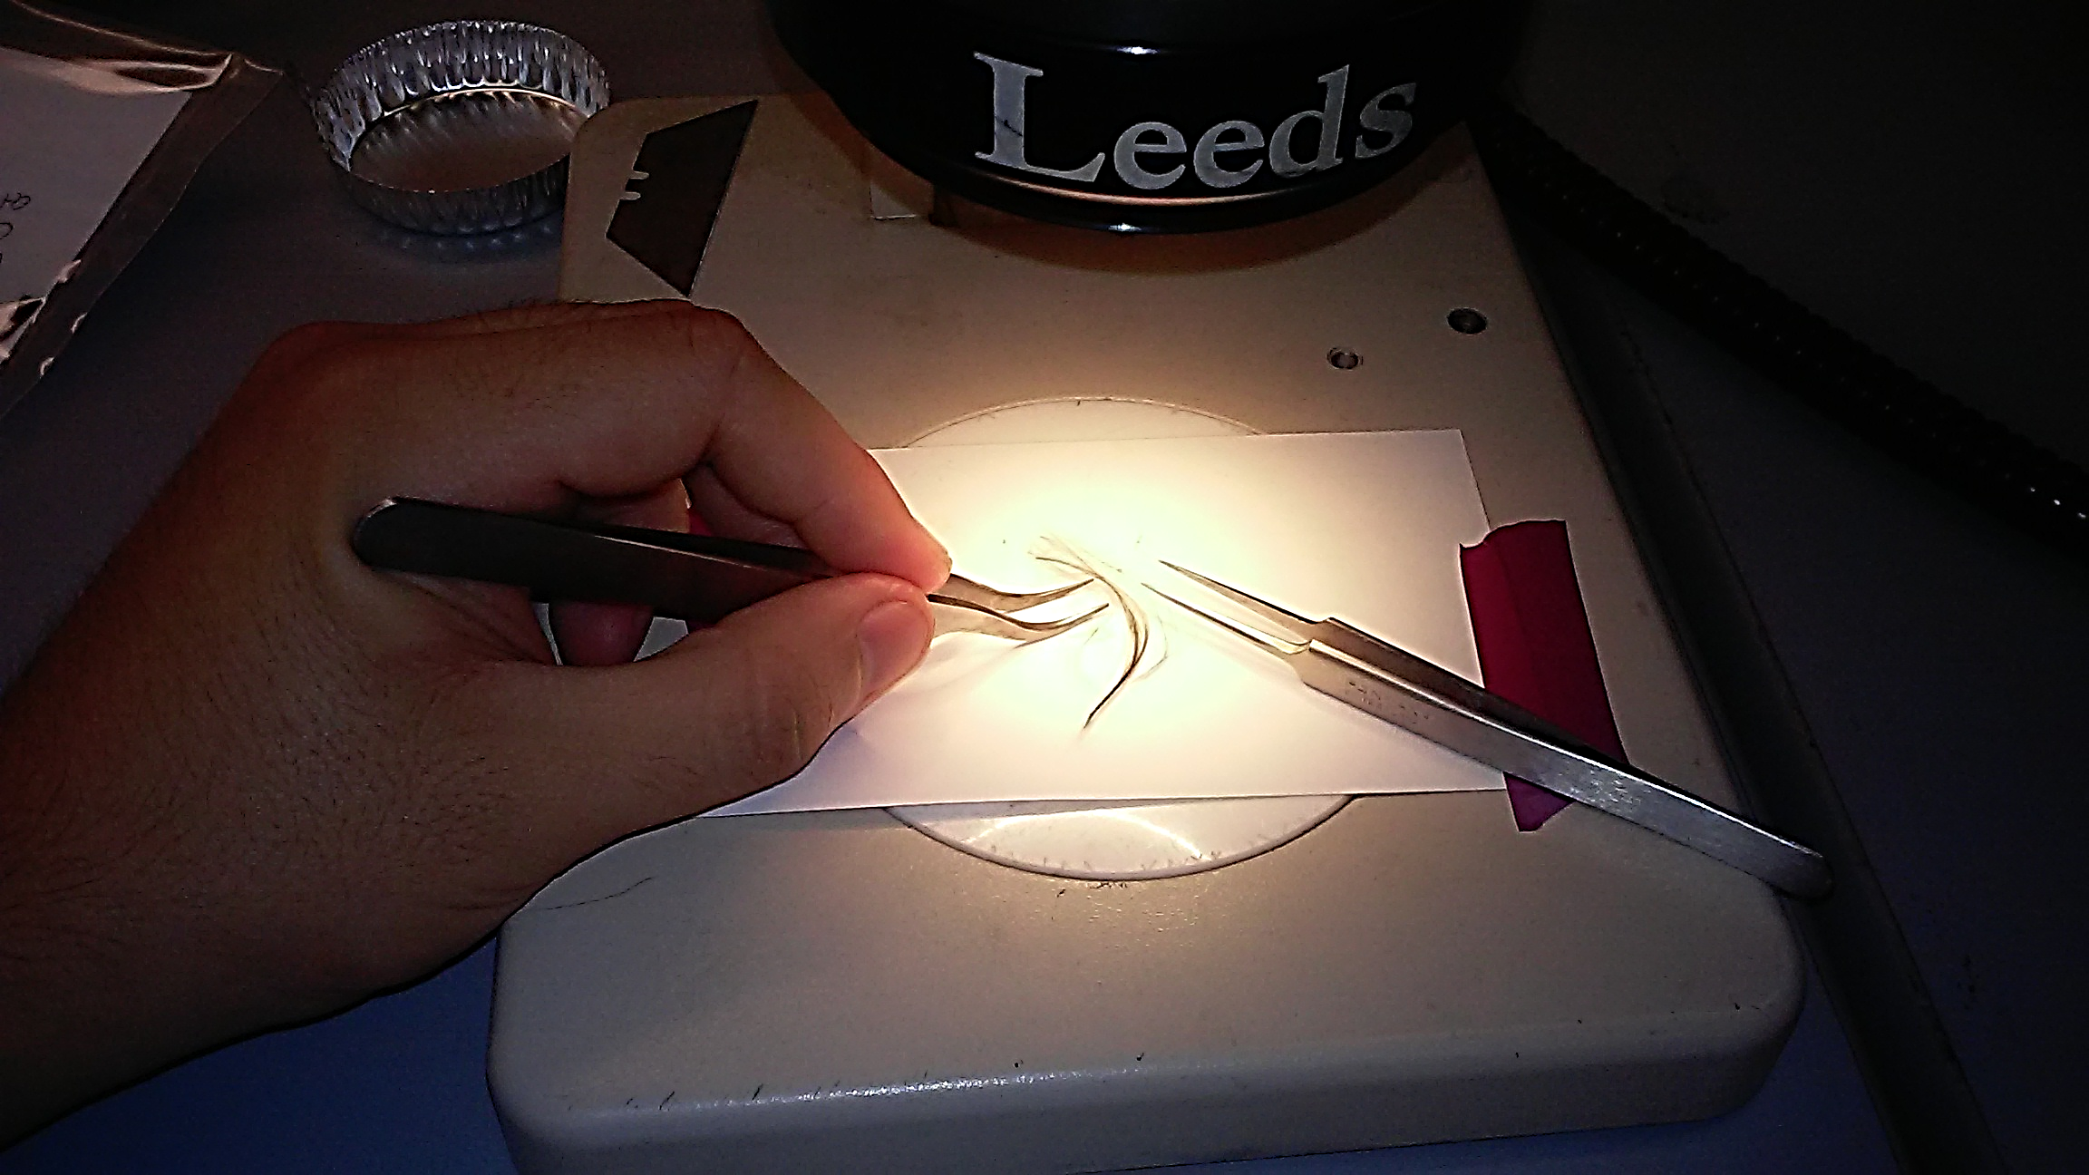
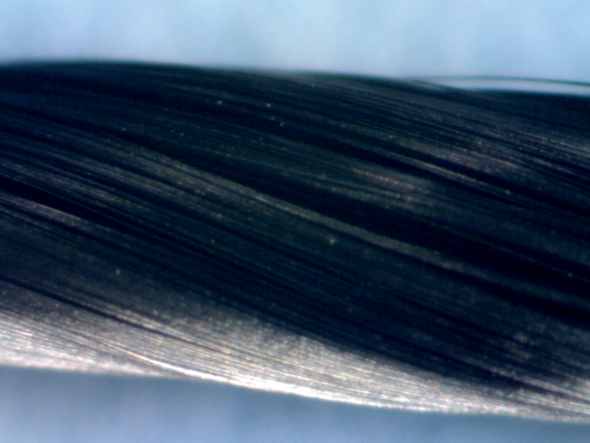
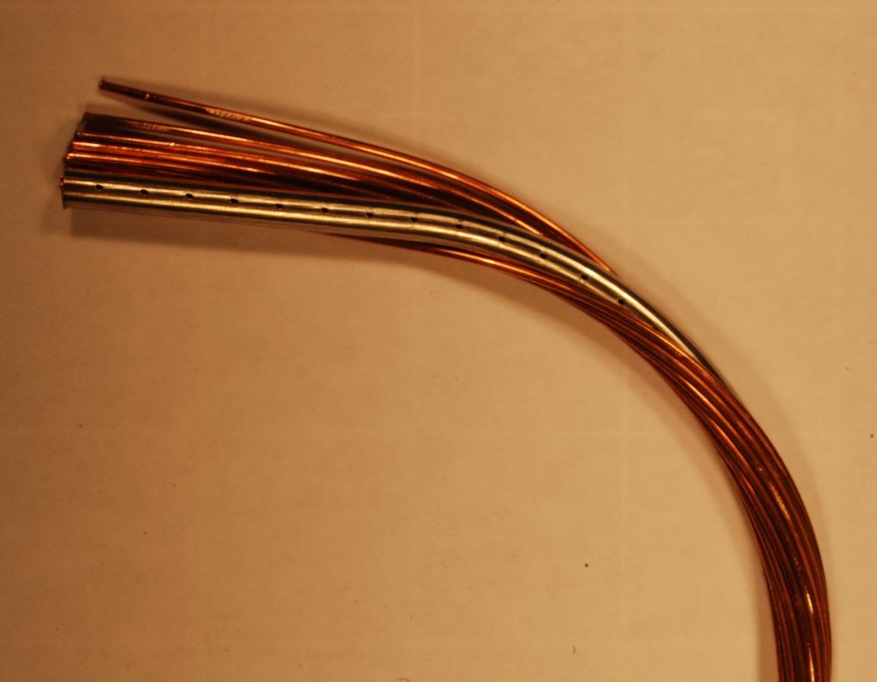
Quality Control
Superficial inspection
Filament Breakage
FeCl3 solution
Current Degradation
Measurement
14 kA CABLE
7600 filaments
Compaction
Spacing
Ovalness
Deformations
7400 Fil, 9 μm
1.5 Cu:Sc
1.2 mm OD

Slide 10
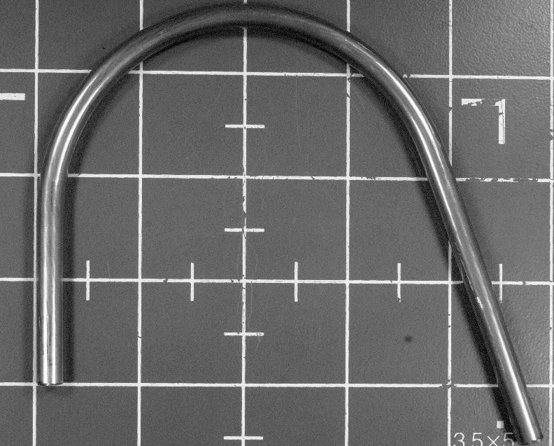
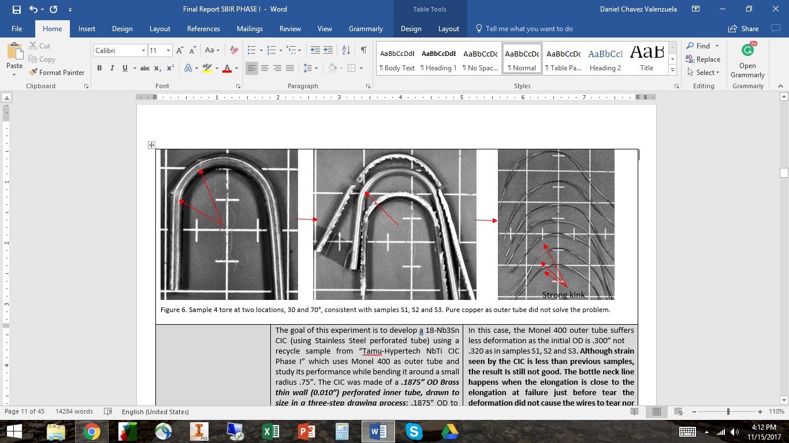
Short sample development
Wire integrity
Outer sheath
Inner tube
No damage to the CIC components
Mechanical behavior (Bends)
QC of samples (Etching, Current degradation)
Wind & React
superconductors
1.745” (44.45 mm) bend radius
(Nb3Sn, MgB2)
1” (25.4 mm)
Bend radius
(Superconductor experienced too much strain!)
No superficial deformation were found at any level: outer tube, superconducting wire,
Or inner tube.
Outer tube tared at various locations
Superconducting wires tare or bottle-necked

Slide 11
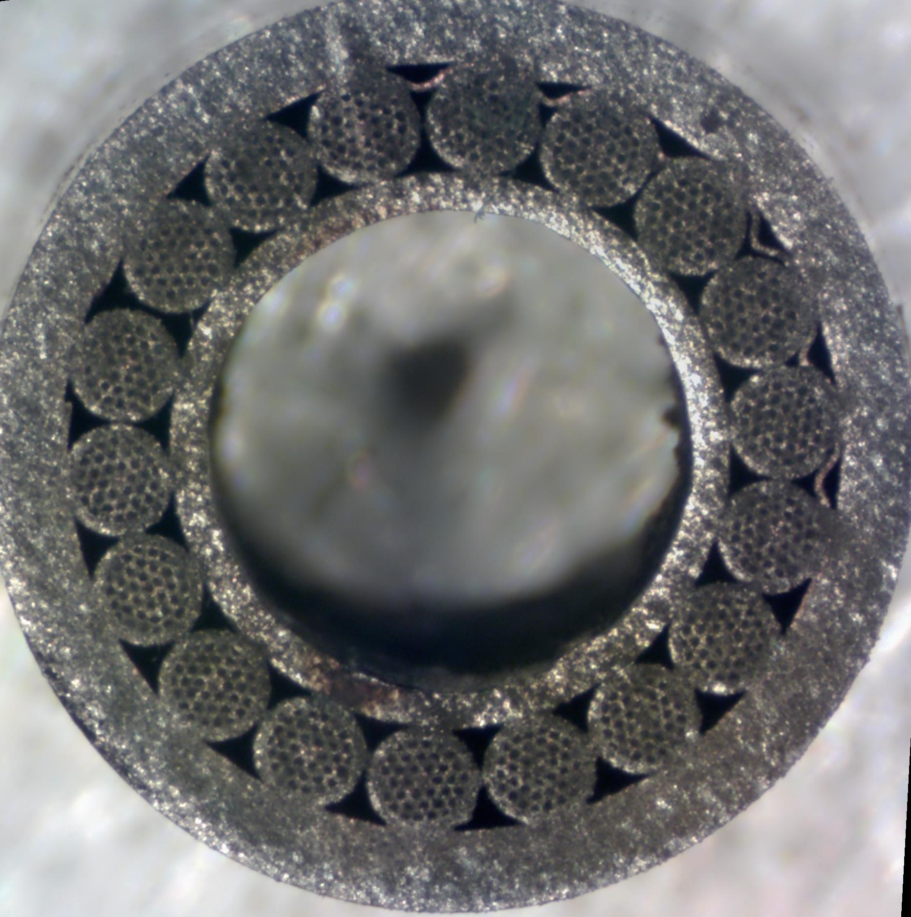
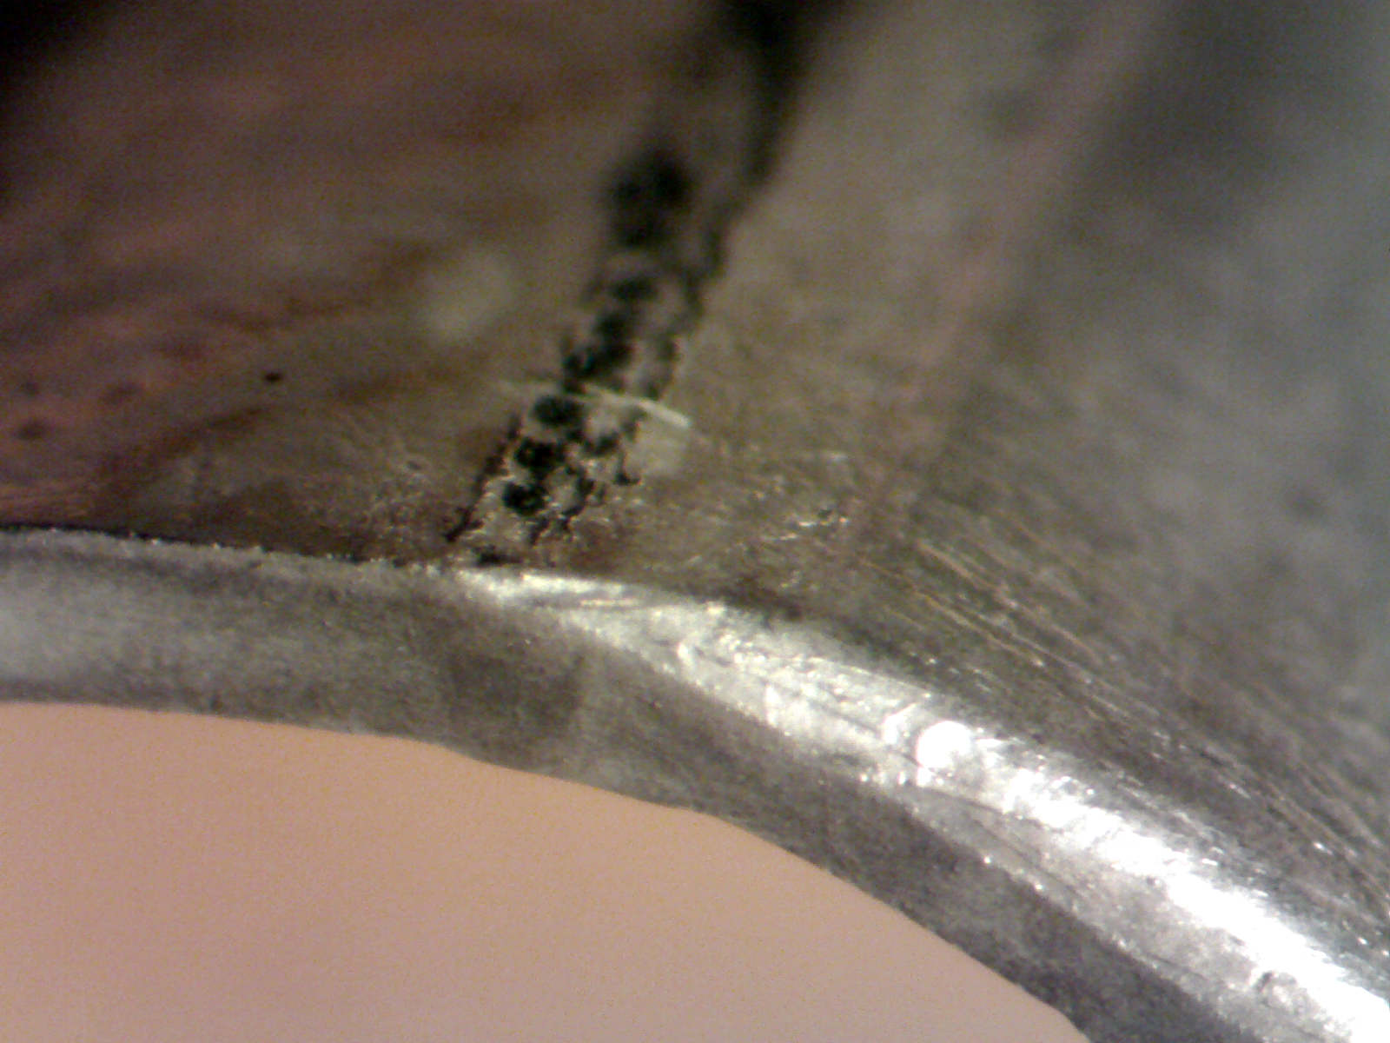
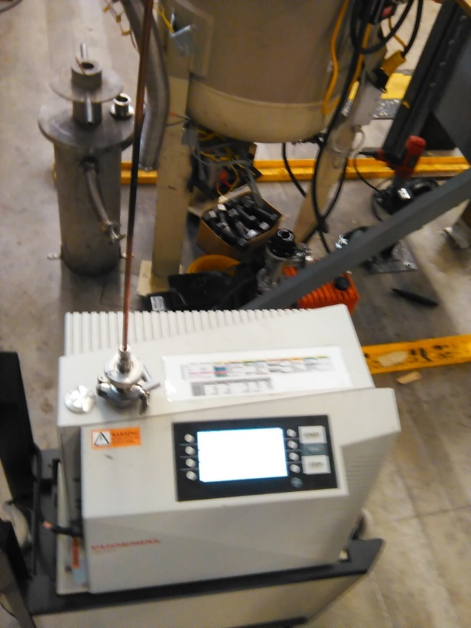
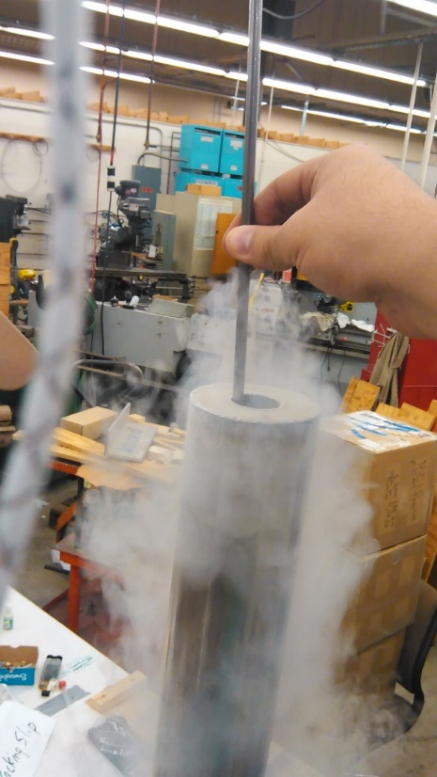
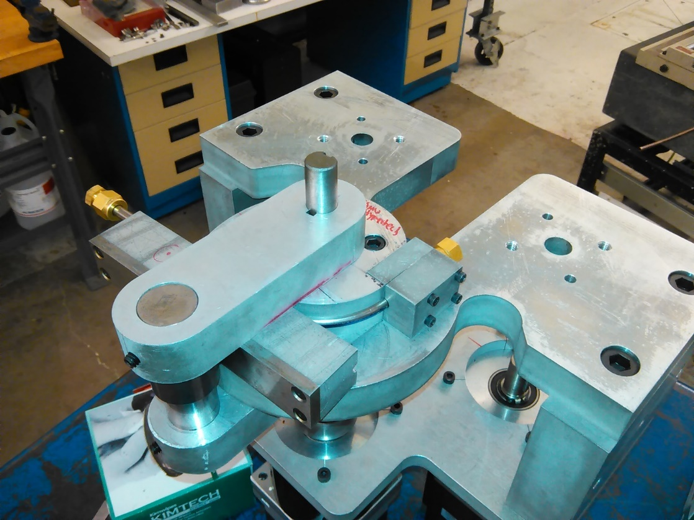
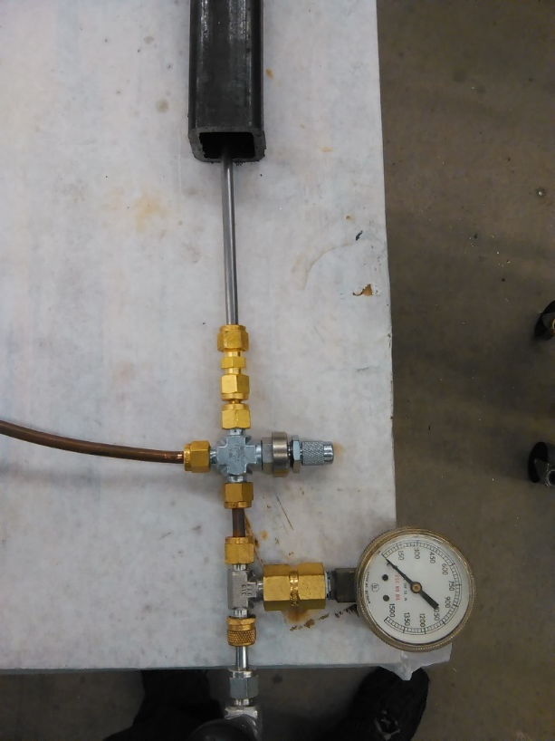

Standard Procedure (quality control) to assess performance of weld line
Weld line on Nb3Sn CIC
HLC
As
received
Pressurize at
600 Psi
for 10 min
Thermal shock
from
300 k to 77 k
Bend the samples 180° with weld line facing different directions
<1.0x10-12 atm*cc/s
3x10-3 Torr

Slide 12
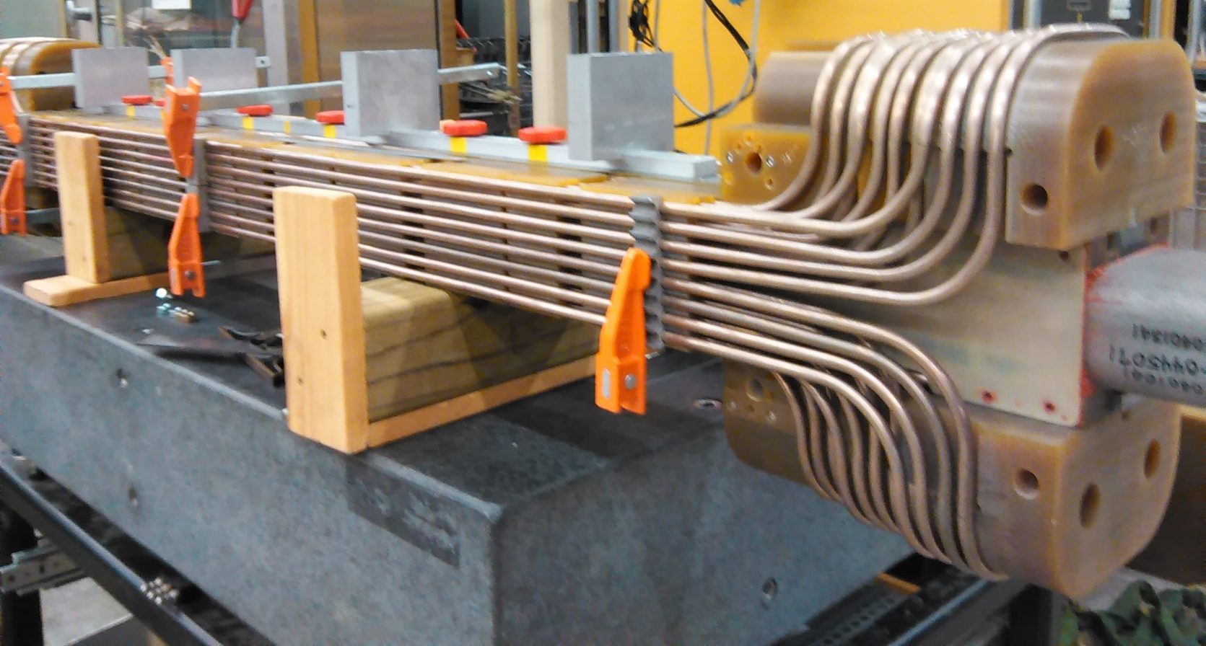
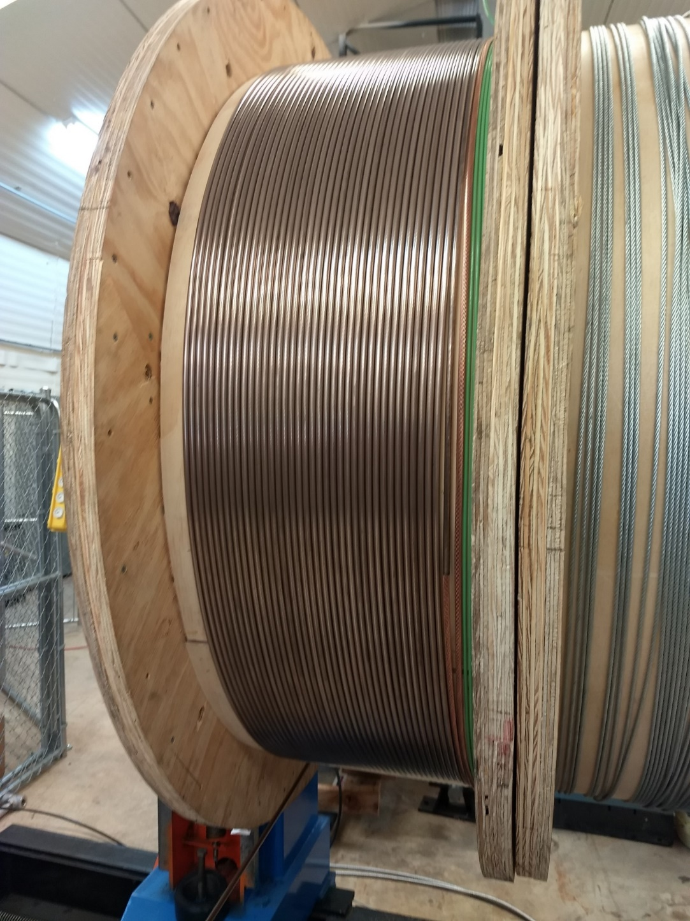
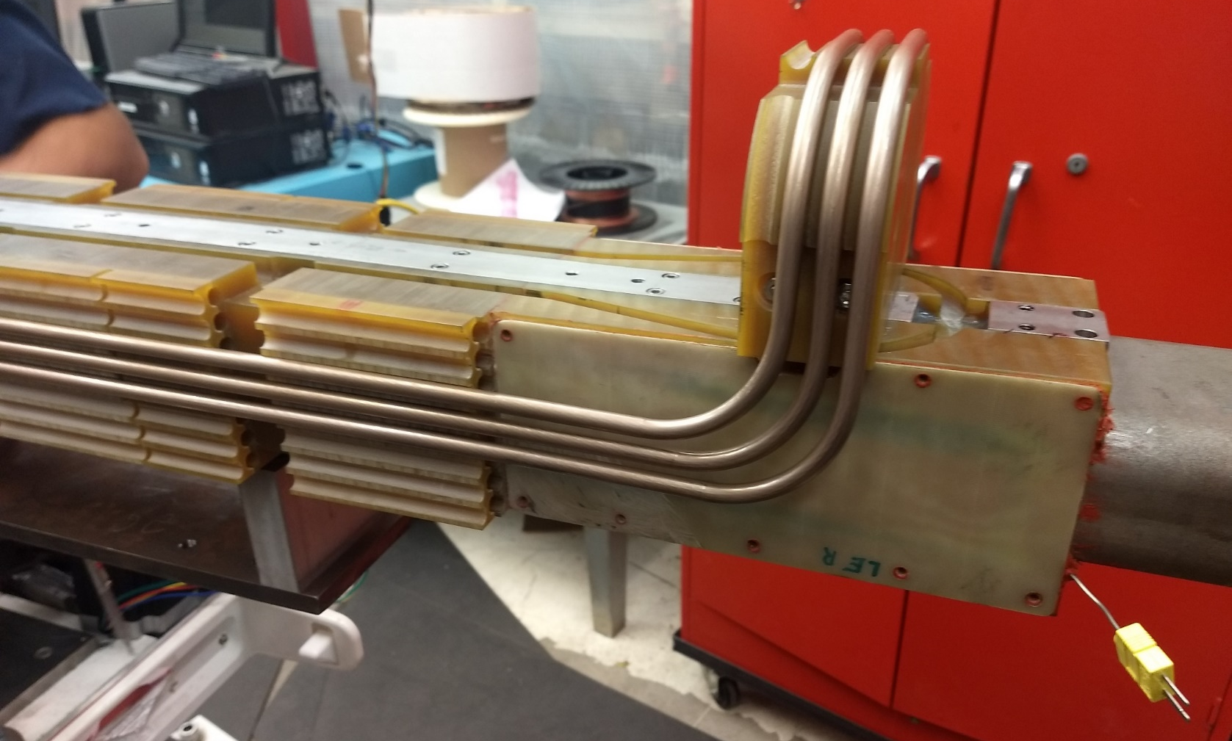
Complex Winding
3T Superferric CIC dipole
for the Ion Ring of the JLEIC
140 m of NbTi Seamless CIC

Slide 13
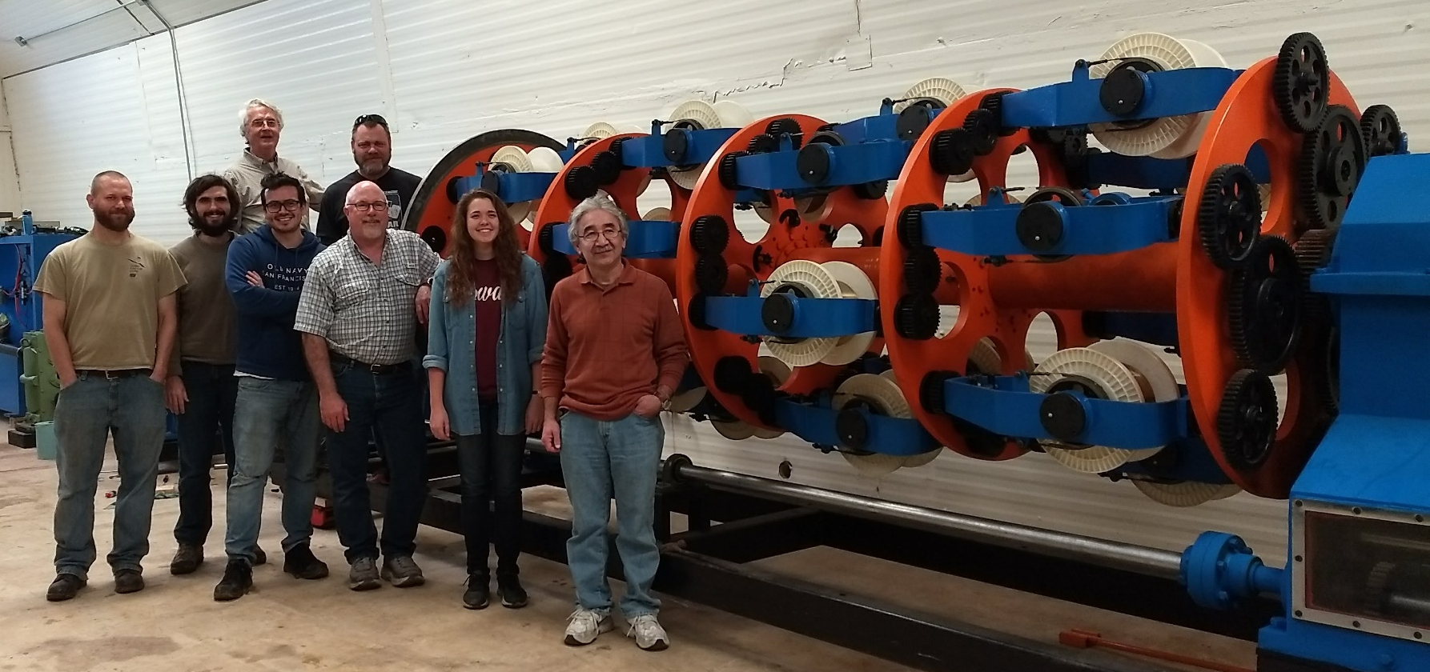
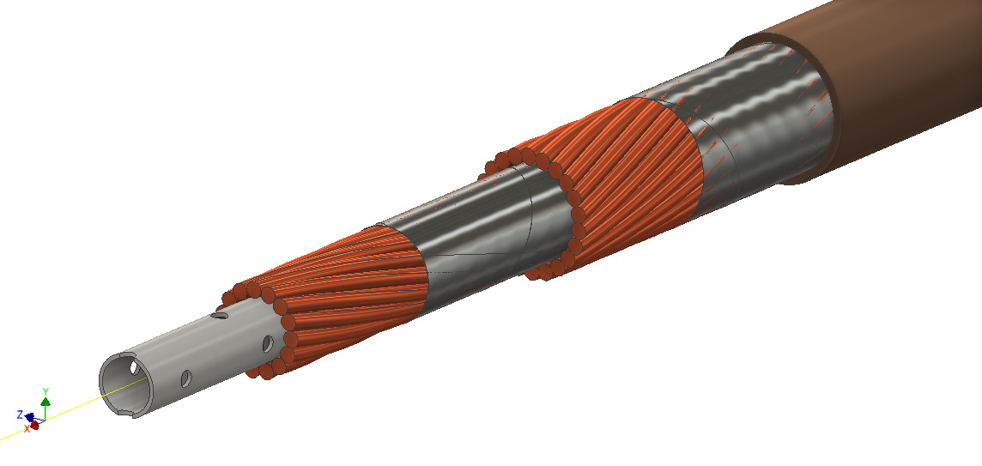
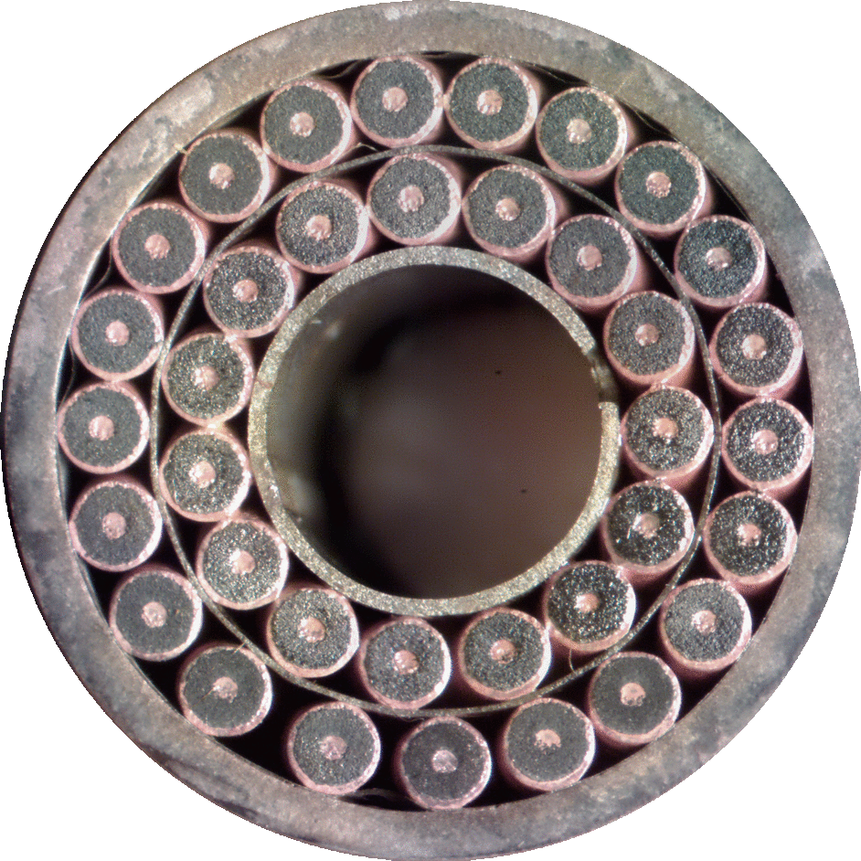
Texas A&M / ATC Team
Magnet Lab Team
Dr. Peter McIntyre
Dr. Akhdiyor Sattarov
Tim Elliot
Ray Blackburn
Joshua N. Kellams
James Gerity
Jeffrey Breitschopf
Karie O’Queen
We devoted 5 Years of our live towards the development
of a scale prototye for a 3 T superferric dipole
32 kA superconducting cable

Slide 14
Present projects at the Applied Superconductivity lab of Universidad de Guanajuato, and collaborations with Texas A&M University and Accelerator Technology Corp.

Slide 15
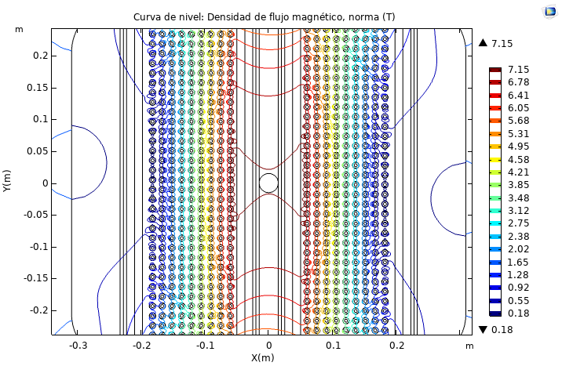
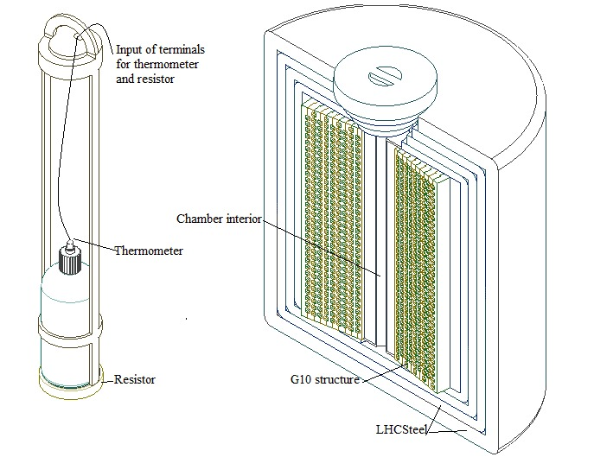
7 T solenoid for material science applications
Superconducting Electron Cyclotron Resonance Ion-Source
5 T Bi2212 CIC research dipole
Magnetic stimulation for Alzheimer deseas
Magentic field for agricultural research (Beans, corn, soy, jalapeño)
Research topics
7 T solenoid for material science applications
(Patent pending)
Yemby Y. Huamani
PhD. Student

Slide 16
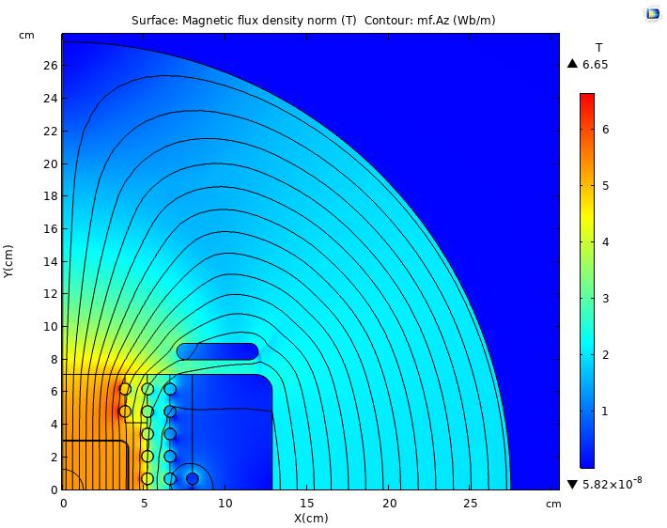
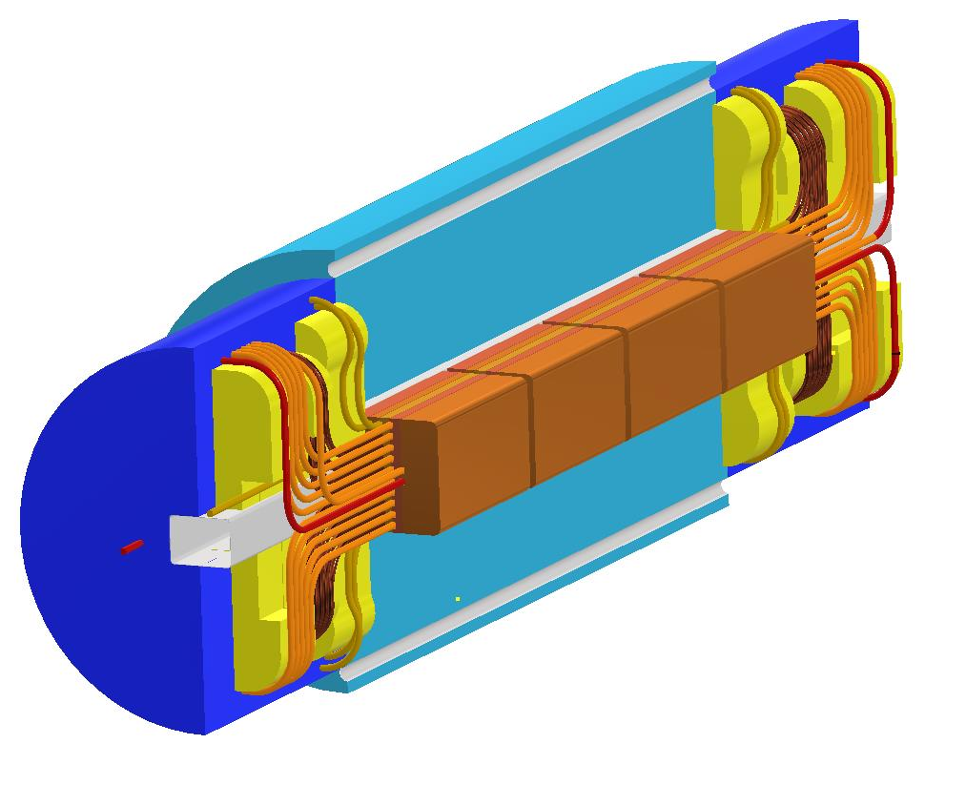
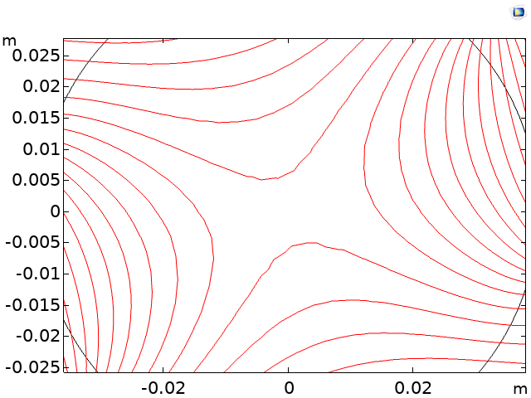
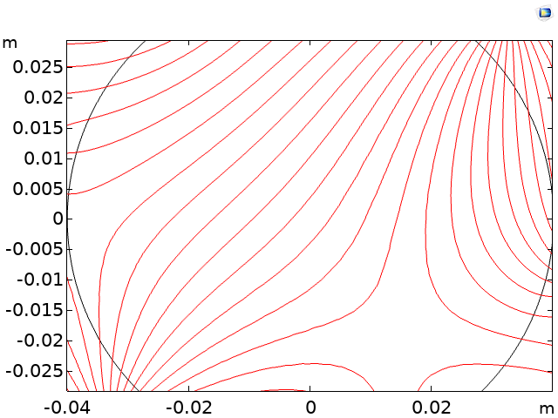
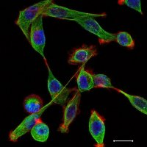
5 T Bi2212 CIC research dipole
Arnold F. Mullisaca
PhD. Student
Magnetic stimulation for Alzheimer deseas
(Patent pending)
Giovanni D. Valdivia
PhD. Student
More tan 1.8 million diferent configurations for magnetic fields

Slide 17
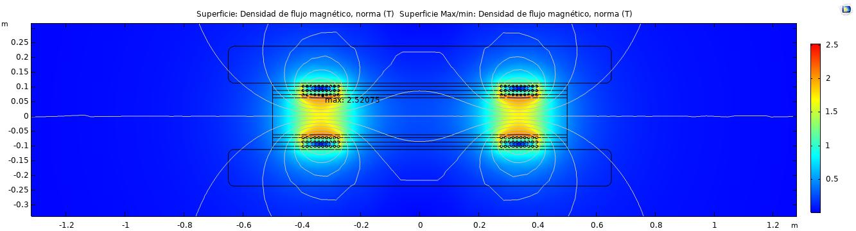
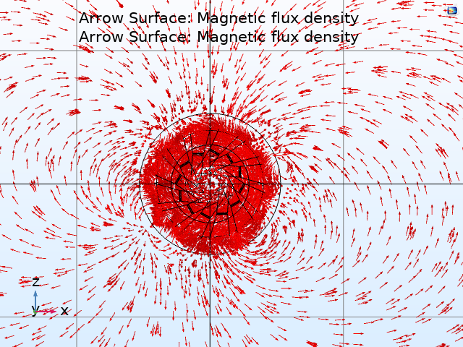
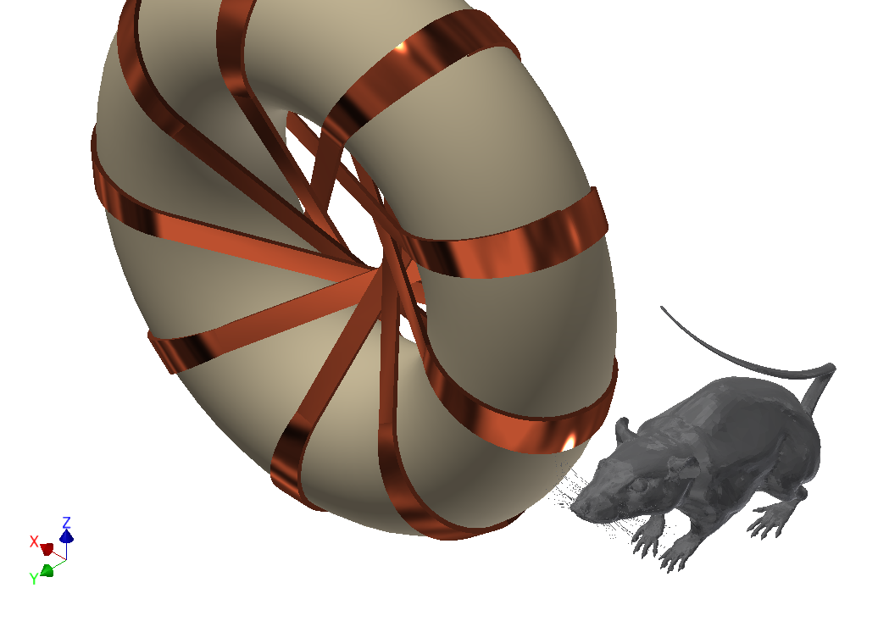
Superconducting Electron Cyclotron Resonance Ion-Source
Marco A. Ortiz
PhD. Student
Magnetic stimulation for Alzheimer deseas
(Patent pending)
Dr. Gustavo Basurto
Neuroscientist

Slide 18
Challenges and opportunities

Slide 19
Challenges
Opportunities
Applied superconductivity is a relatively new area in Mexico, and skepticism is inherited in innovation.
Specialized equipment.
Research Funds.
We are training specialized students in magnet desing and modeling, and production of new technology.
A lot of human resources eager to learn
It’s a new a research topic to Mexico.
Moving towards technology independence.

Slide 20
Thank you!

