Slide 1





Machine Learning and Software for Accelerator Operations
Jonathan Edelen*, Nathan Cook, Callie Federer, Christopher Hall
*jedelen@radiasoft.net
October 8, 2020
EIC 2020 Session 4.1
This material is based upon work supported by the U.S. Department of Energy, Office of Science, Office of High Energy Physics, under Award Number DE-SC0019979
Boulder, Colorado USA | radiasoft.net

Slide 2
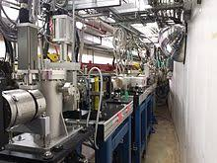
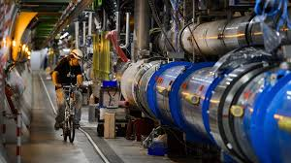
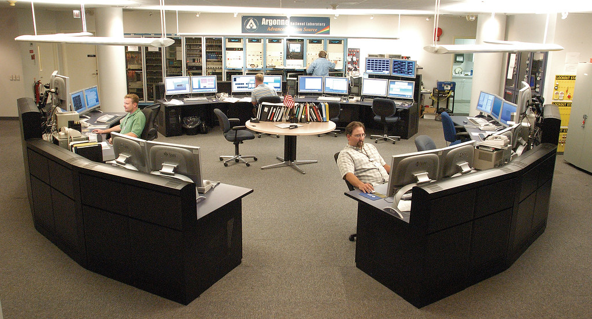
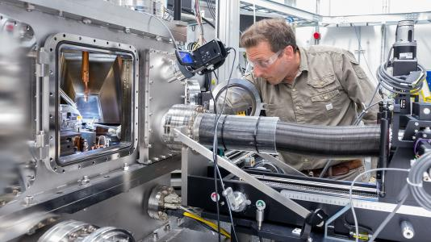
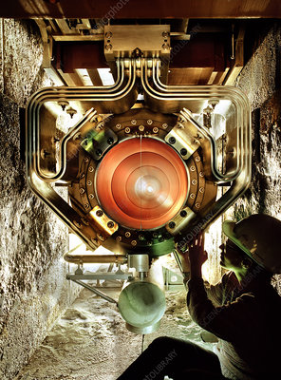
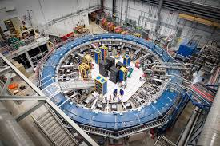
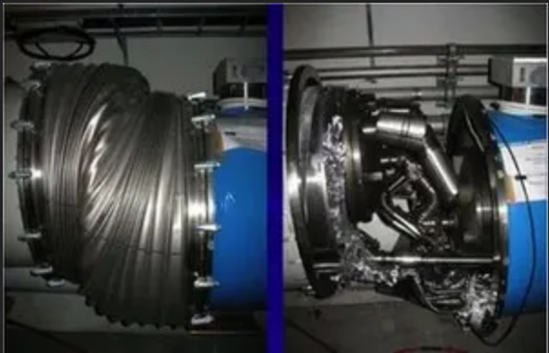
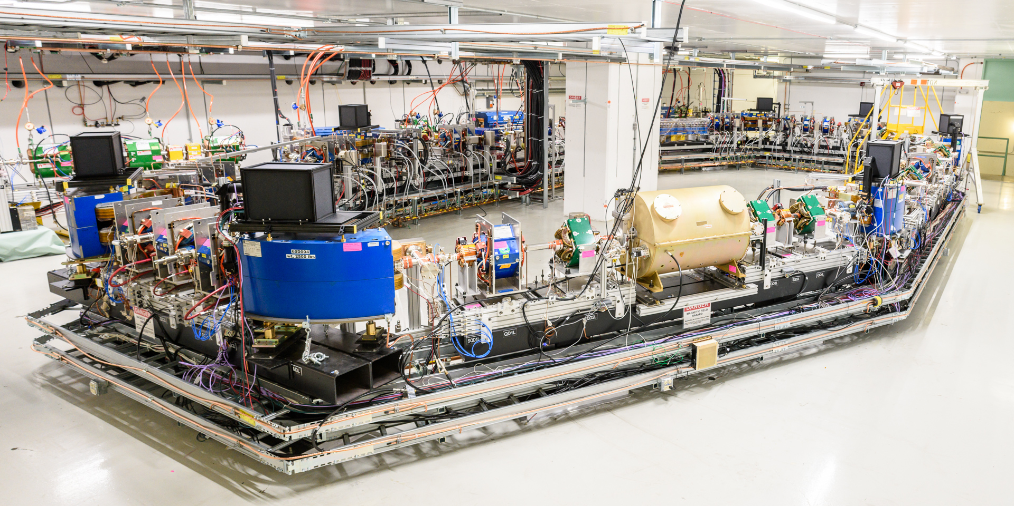
Overview of Accelerator Operations
Accelerator R+D
Beam for Experimentalists
Down Time
Machine Development Time
Small single user end stations
Scheduled Maintenance
Large experimental collaborations
Unscheduled Maintenance
Specialized R+D Facilities

Slide 3
Control System Hierarchy
User interface to control systems
  Synoptic displays
  Custom interfaces
  Communicate directly with front ends or with high level applications
High level applications / control scripting
  Programs to monitor and adjust subsystems
  Python / machine language scripts / ocelot / others
Online models
  Acquire machine parameters directly or through UI
Real Time Systems
  Often FPGA driven or other embedded system
Online Model
User Interface
High Level Applications
Control Scripting
Front End Software
Real Time Systems

Slide 4
Control System Hierarchy
User interface to control systems
  Synoptic displays
  Custom interfaces
  Communicate directly with front ends or with high level applications
High level applications / control scripting
  Programs to monitor and adjust subsystems
  Python / machine language scripts / ocelot / others
Online models
  Acquire machine parameters directly or through UI
Real Time Systems
  Often FPGA driven or other embedded system
Consolidated Toolkit
Front End Software
Front End Software
Real Time Systems
Real Time Systems

Slide 5

A controls toolbox powered by Sirepo
Real World Data Input
Machine Settings
Magnet / RF Curves
Archive Data
Accelerator Simulations
Visualizations
Browser based tools
MAD-X
Synergia
Elegant
OPAL
Jupyter Notebook
www.sirepo.com
ML Data Generation
Offline analysis
Optimization
Analysis and Machine Learning Tools
Deployable Code
Clustering and Data Analysis
Machine Learning

Slide 6
Machine Learning for Accelerators
Supervised Learning
  you know what the inputs and outputs are
  relatively balanced dataset
  surrogate modeling / control tools / fault prediction
Unsupervised Learning
  you don’t know what you’re looking for
  imbalanced dataset
  anomaly detection

Slide 7
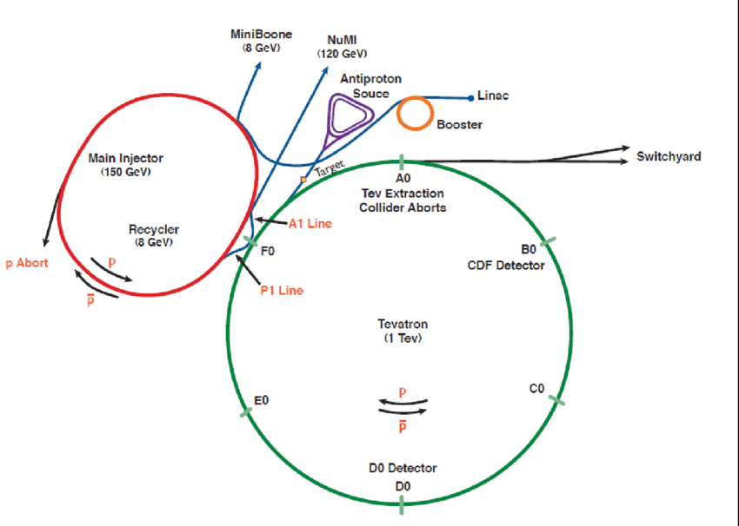
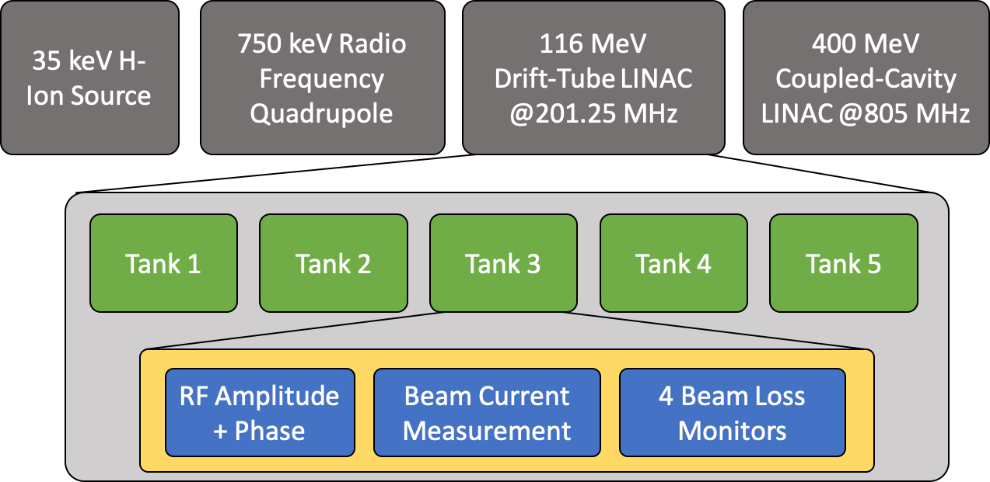
The Fermilab LINAC

Slide 8
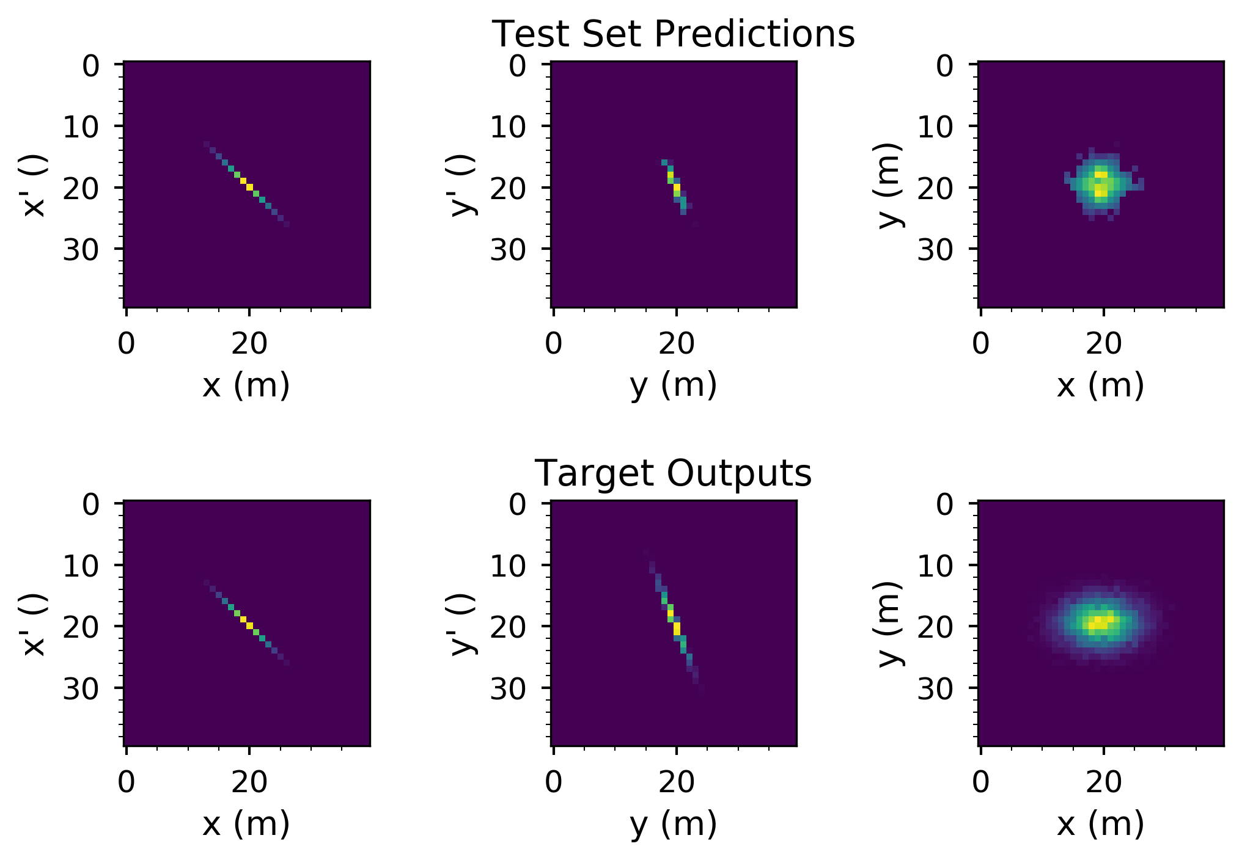
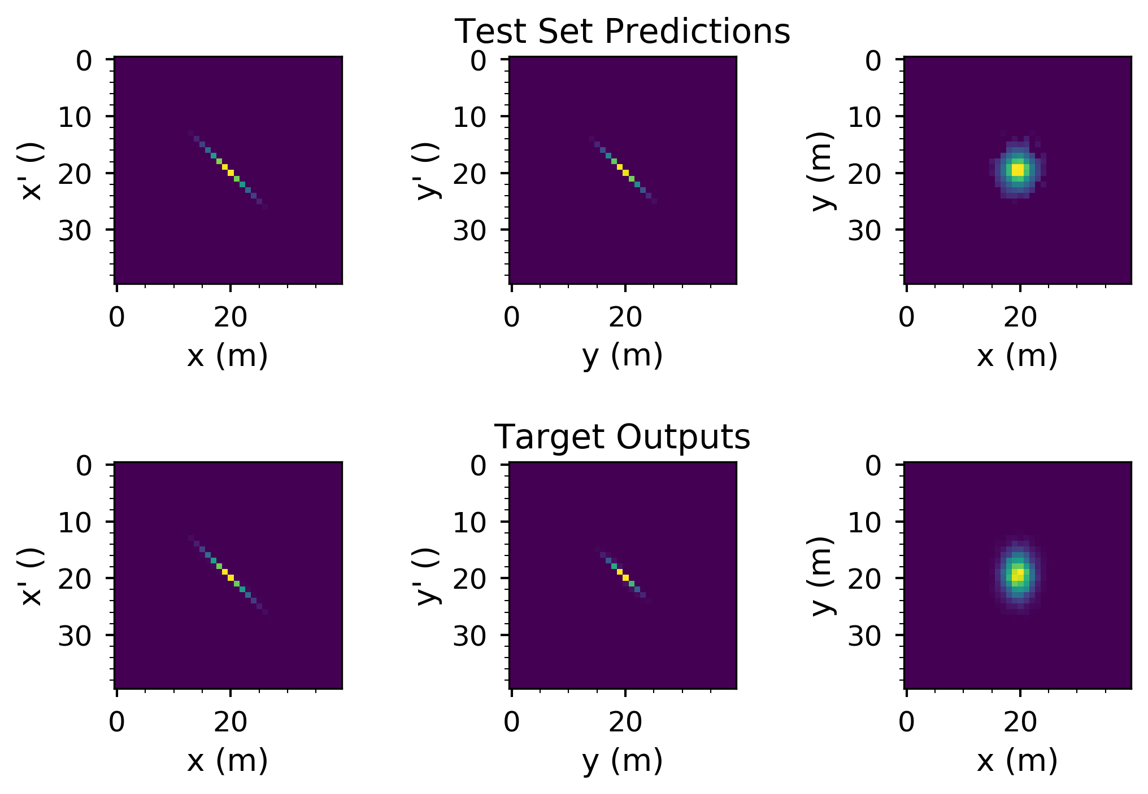
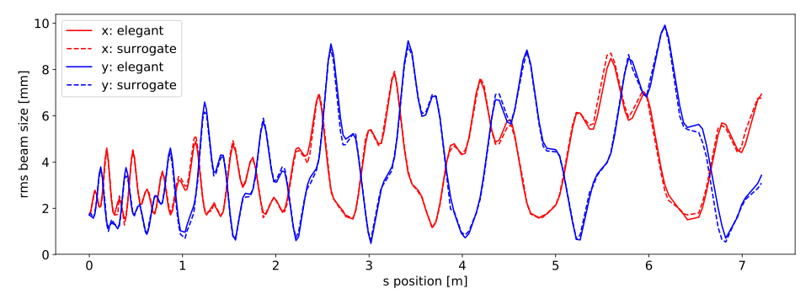
Surrogate modeling
Case Study: The Fermilab LINAC
Bottom: Predict RMS beam parameters as a function of position in one of the LINAC tanks
Right: Predict beam distributions and the exit of different DTL tanks.

Slide 9
Transfer learning enables portable solutions between accelerators
Case Study: The Fermilab LINAC
Neural networks trained on data from DTL Tanks 2, 3, and 4 for 1k epochs
  Model from tank 2 is trained on data from tanks 3 and 4 for 1k epochs
  Transfer learning trains faster and reaches a better overall solution

Slide 10

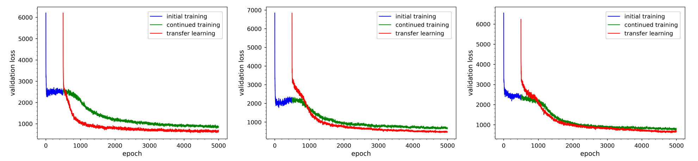
Transfer learning enables portable solutions between accelerators
Case Study: The Fermilab LINAC
Neural networks trained on data from DTL Tanks 2, 3, and 4 for 1k epochs
  Model from tank 2 is trained on data from tanks 3 and 4 for 1k epochs
  Transfer learning trains faster and reaches a better overall solution

Slide 11
Autoencoders for anomaly detection
Neural networks structures
  The encoder reduces the input dimension to some minimum number of nodes
  The decoder reconstructs the input data
  A trained autoencoder is essentially an identity transformation for the input data
Reconstruct unknown data using an autoencoder
  Train and validate the autoencoder on known good datasets
  Test on unknown data (may be good or bad)
  Measure the degree to which the autoencoder successfully reconstructs the unknown data
Encoder
Decoder
Encoder
Decoder
Latent Space
Latent Space

Slide 12
Detecting faulty magnet power supplies in the APS
Can we predict if a fault will occur?
  If yes, can we predict which magnet will fault

Slide 13
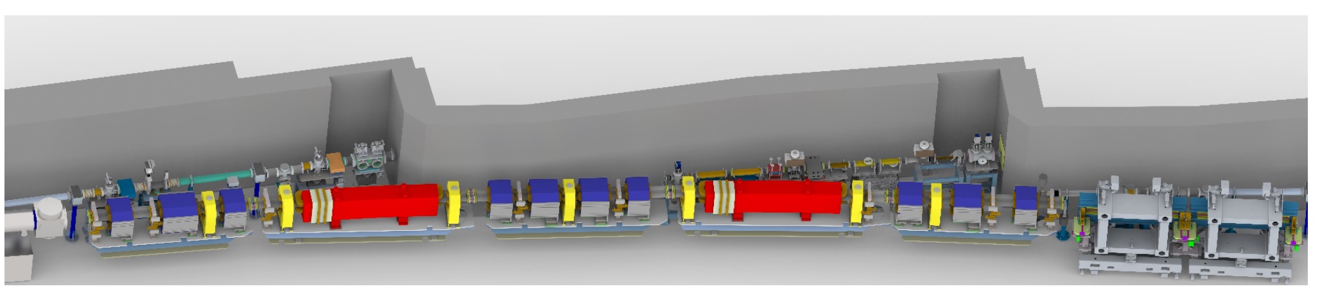
Detecting faulty magnet power supplies in the APS
Can we predict if a fault will occur?
  If yes, can we predict which magnet will fault
Components of interest
  1320 magnet power supplies / 40 sectors (each has A (green) and B (blue) sections)
Quadrupoles
Sextupoles
Correctors
https://www.energy.gov/sites/prod/files/2019/04/f62/Advanced-Photon-Source-Upgrade-Project.pdf

Slide 14
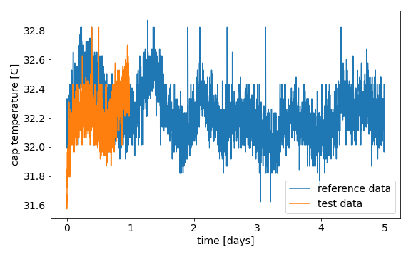
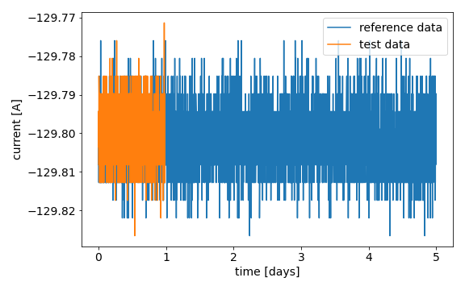
Detecting faulty magnet power supplies in the APS
Time series data for 1320 magnets
  Power supply cap temperature
  Current
  Magnet temperature
Reference data (blue)
  No fault occurs in vicinity, normal operations
Test data (orange)
  Magnet failure occurs
  Data is clipped and does not include final minutes prior to magnet fault

Slide 15
Detecting faulty magnet power supplies in the APS
Time series data for 1320 magnets
  Power supply cap temperature
  Current
  Magnet temperature
Simplifications
  Aggregate by each section in a sector: sum current across magnets in a sector (80 inputs/outputs)
  Aggregate by magnet type in sectors: sum current across each magnet type in a sector (320 inputs/outputs)
  Consider magnet current or temperature

Slide 16
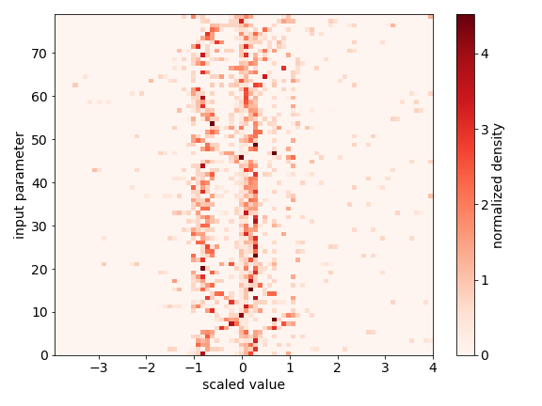
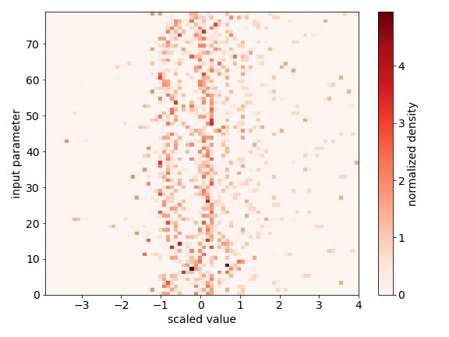
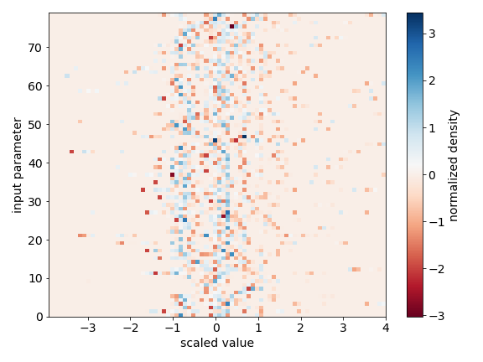
Aggregating by Sector
Overview of dataset
  Reference data (left) used for training and validation
  Test data (middle) with known anomalies
  Histogram difference (right)
Clear visual differences but datasets are qualitatively similar
Differences between sectors are apparent

Slide 17
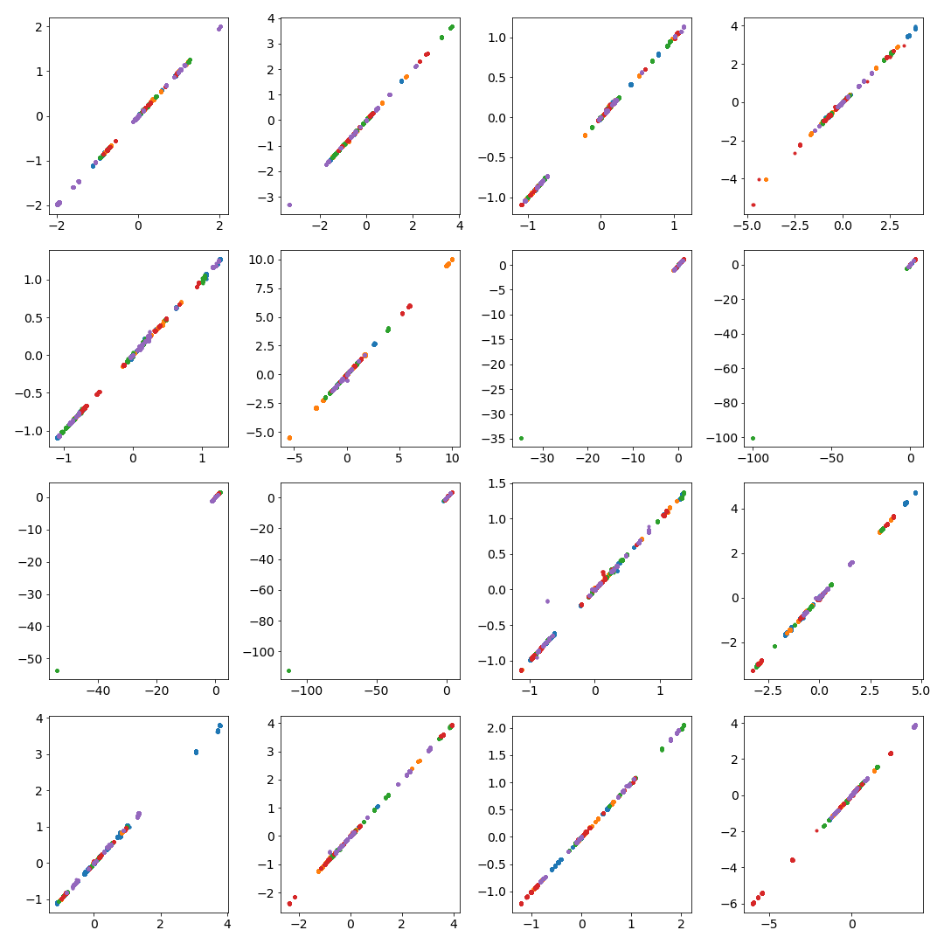
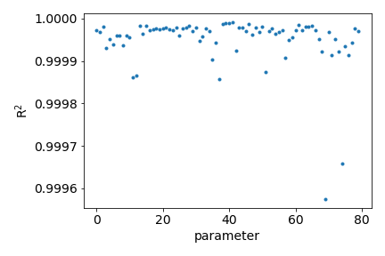
Autoencoder performance
Prediction results for the validation data
  Data aggregated by sector
  Layers: 60, 40, 20, 10, 8, 2, 8, 10, 20, 40, 60
  relu activation functions
  Gaussian noise for regularization

Slide 18
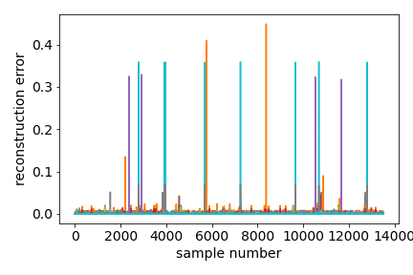
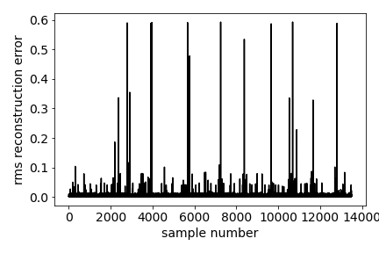
Reconstruction of reference data and test data (by sector)
Train autoencoder on reference data (no faults)
  Top: reconstruction error for each sector vs. sample number
  Bottom: rms reconstruction error
  Set reconstruction error threshold based on reference data performance
  Reconstruction threshold of 0.6 results in none of the reference data being flagged as faulty.

Slide 19
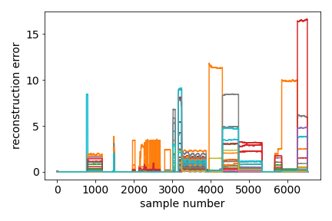
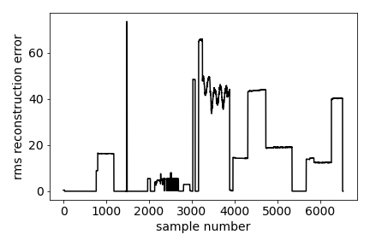
Reconstruction of reference data and test data (by sector)
Test autoencoder on fault data
  Note the actual time when the magnet faults is not in the dataset
  Top: reconstruction error for each sector vs. sample number
  Bottom: rms reconstruction error
  Reconstruction threshold of 0.6 results in 8% of test data being flagged as faulty.
  Correctly identifies 16/26 of the test runs as anomalous

Slide 20
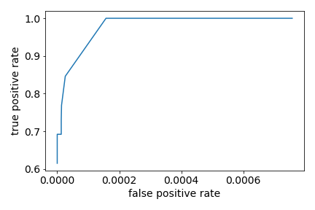
Reconstruction of reference data and test data (by sector)
Test autoencoder on fault data
  Note the actual time when the magnet faults is not in the dataset
  Top: reconstruction error for each sector vs. sample number
  Bottom: rms reconstruction error
  Reconstruction threshold of 0.6 results in 8% of test data being flagged as faulty.
  Correctly identifies 16/26 of the test runs as anomalous

Slide 21
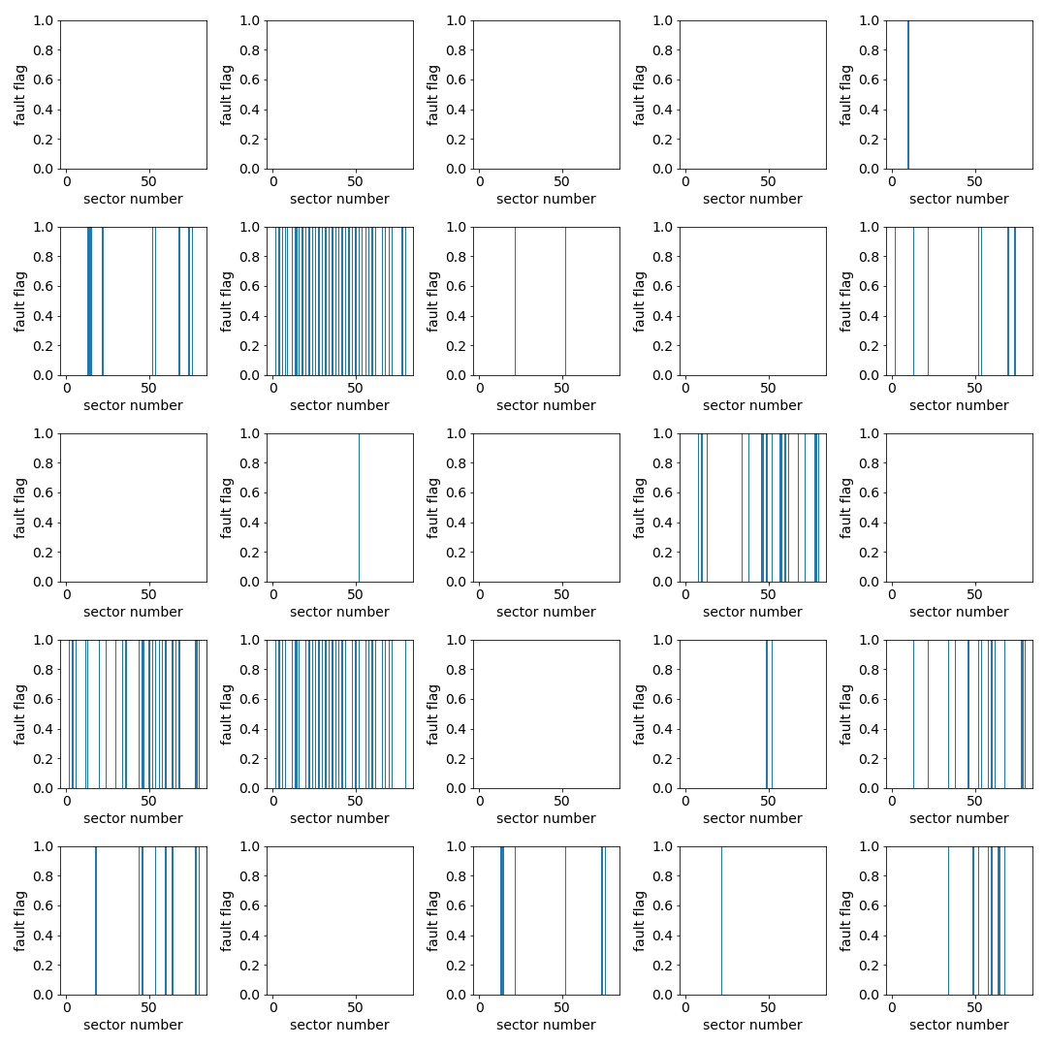
Testing of Reconstruction Error by Sector
Flag sectors that fail the reconstruction test and separate by run
  Showing 25 of the test runs
  In some cases many of the sectors fail the reconstruction test
  Difficult to identify which sector is faulty

Slide 22
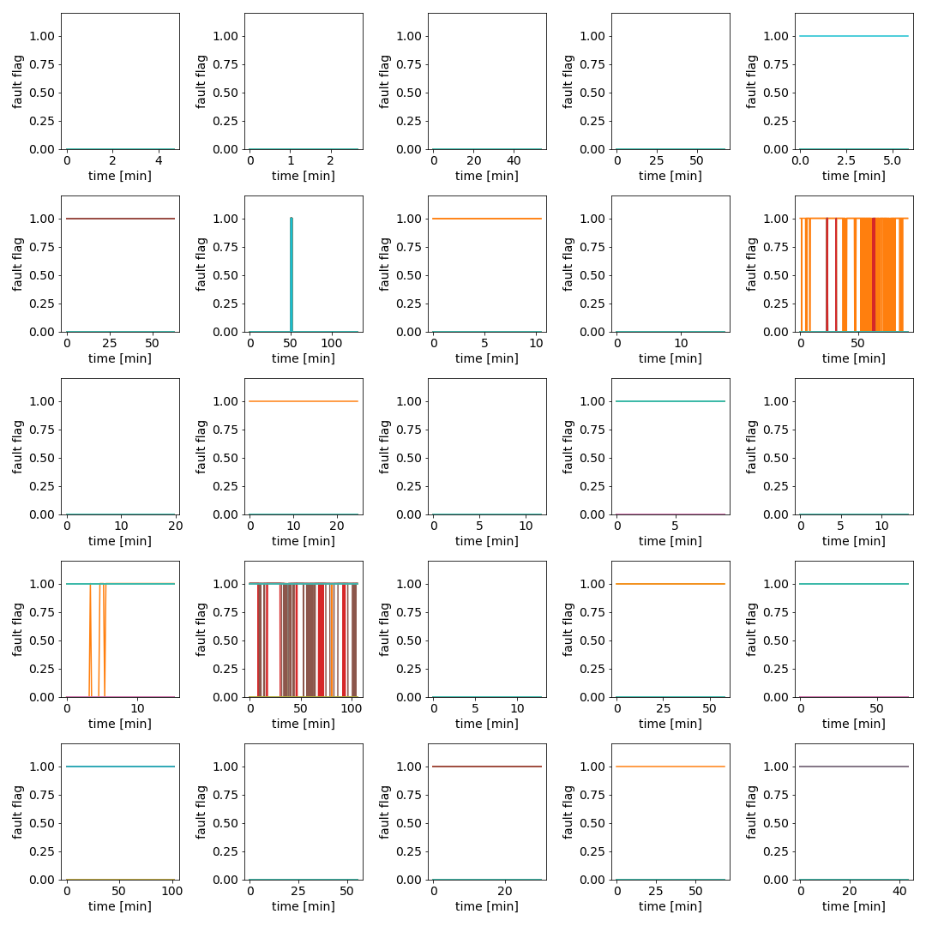
Testing of Reconstruction Error by Sector
Flag sectors that fail the reconstruction test and separate by run
  Showing 25 of the test runs
  In some cases many of the sectors fail the reconstruction test
  Difficult to identify which sector is faulty
Time domain analysis of the reconstruction error
  Several cases where the reconstruction error gives significant warning of a fault
  Data are down sampled by factor of 10 for processing
  Largest prediction window is ~1.5 hours

Slide 23
Conclusions and Acknowledgements
Software:
  developing machine agnostic tools that integrate machine learning, accelerator simulation codes, and accelerator operations
Machine Learning:
  Supervised Learning:
    active efforts for surrogate modeling, virtual diagnostics, inverse models, and transfer learning
  Unsupervised Learning:
    active efforts for anomaly detection,
Institutional Support
  Many thanks to Michael Borland at the APS for the magnet fault data
  Many thanks for Fermilab / SLAC / Jlab / BNL for their continued support and collaboration

Slide 24
Disclaimer
This report was prepared as an account of work sponsored by an agency of the United States Government. Neither the United States Government nor any agency thereof, nor any of their employees, makes any warranty, express or implied, or assumes any legal liability or responsibility for the accuracy, completeness, or usefulness of any information, apparatus, product, or process disclosed, or represents that its use would not infringe privately owned rights. Reference herein to any specific commercial product, process, or service by trade name, trademark, manufacturer, or otherwise does not necessarily constitute or imply its endorsement, recommendation, or favoring by the United States Government or any agency thereof. The views and opinions of authors expressed herein do not necessarily state or reflect those of the United States Government or any agency thereof.

