Slide 1
EIC/FCC-ee
Commonalities^{*)} of RF systems
EIC Workshop – Promoting Collaboration on the Electron-Ion Collider
Erk Jensen/CERN
Special thanks: K. S. Smith/BNL, R. A. Rimmer, A.-M. Valente-Feliciano/TJNAF,
M. Benedikt, O. Brunner, F. Gerigk, A. Grudiev, E. Montesinos, I. Syratchev/CERN, J. Cai/ULANC
… and probably many others (sorry)
^{*)} probably “Similarities” describes it better.

Slide 2
Outline
Introduction: EIC RF systems and FCC-ee RF systems
SRF and Cryomodules
Fundamental Power Couplers
HOM Damping
RF Power Generation
Crab Cavities

Slide 3
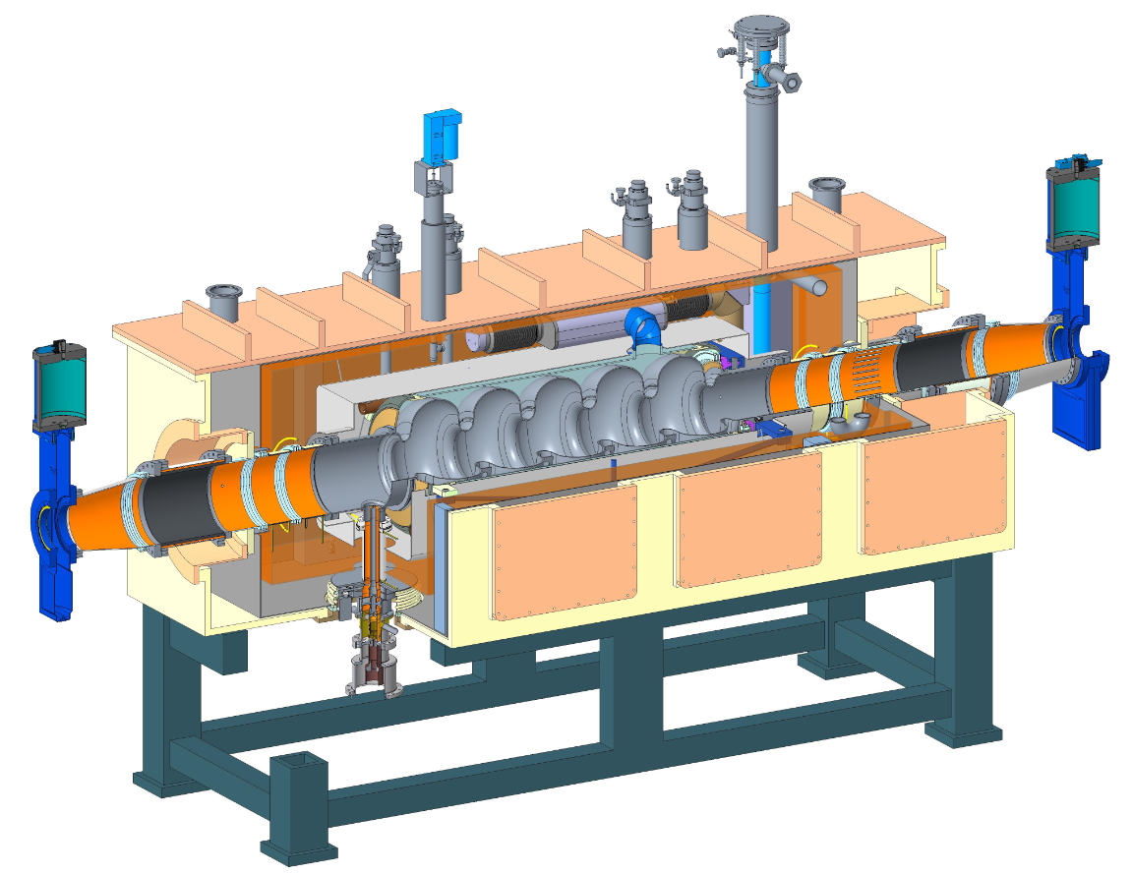
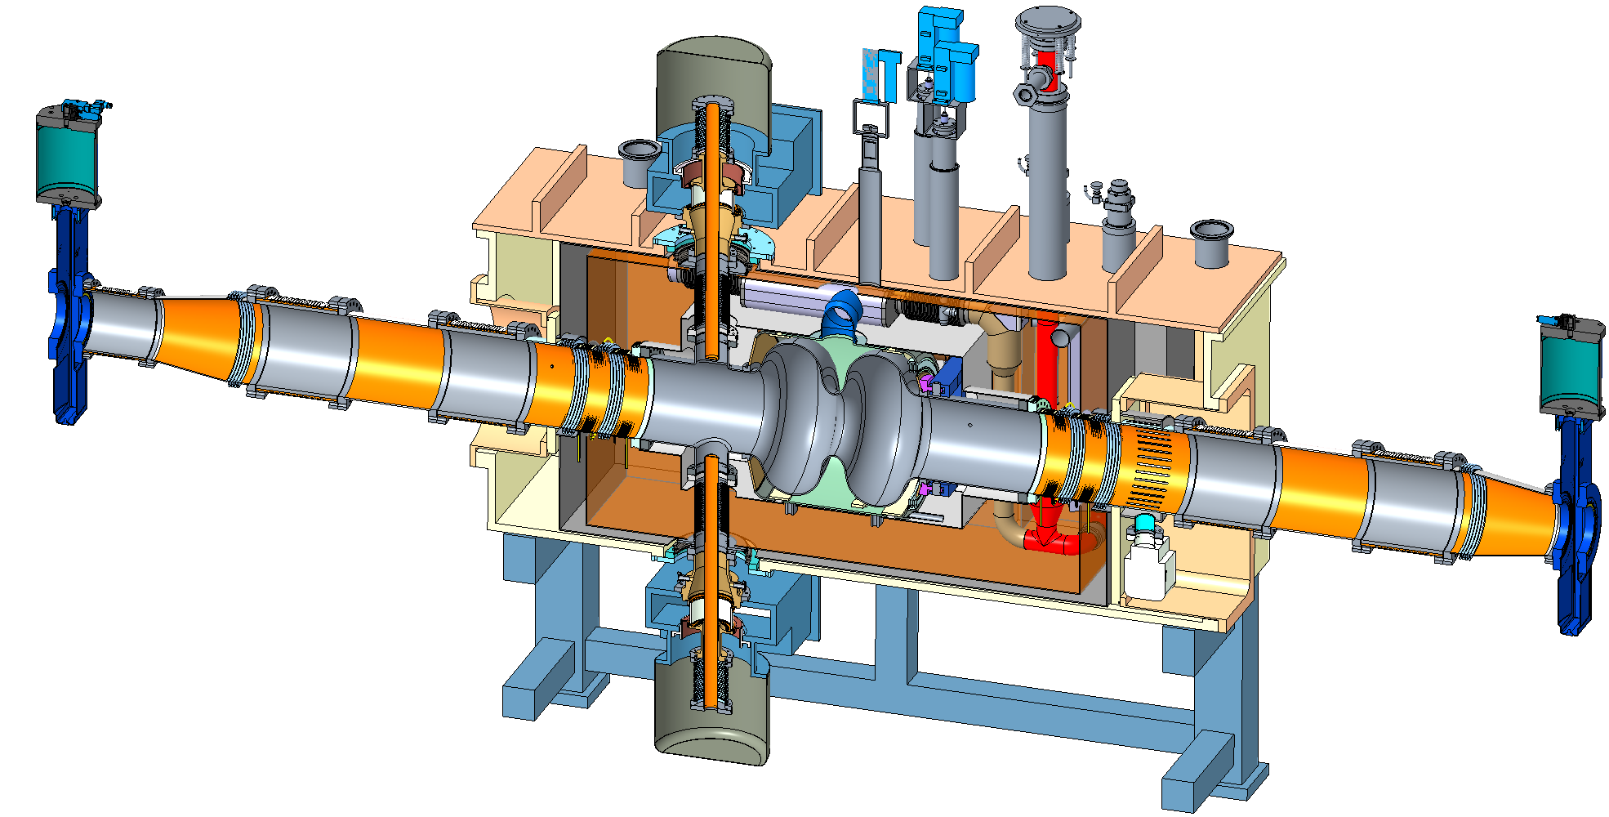
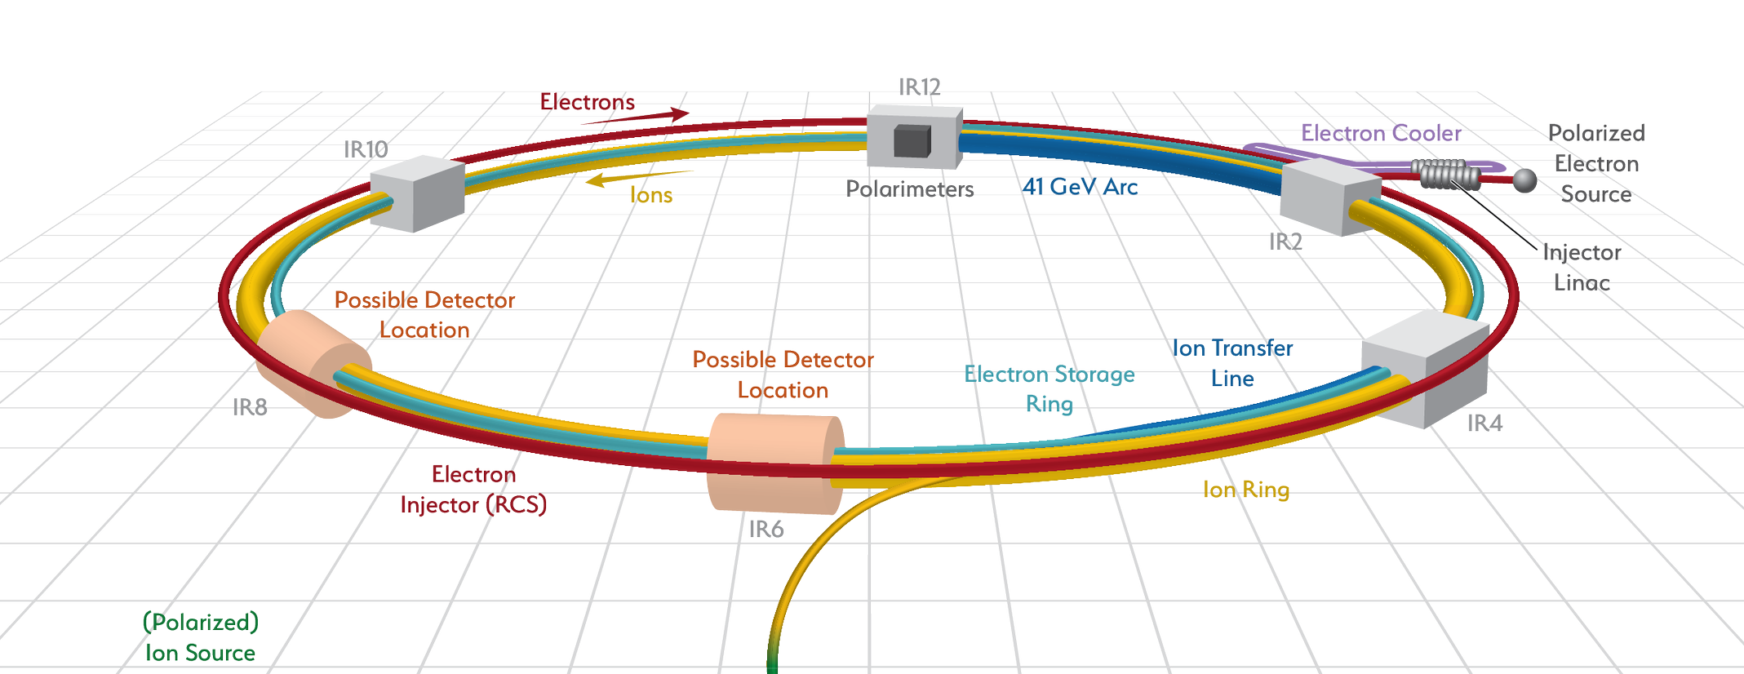
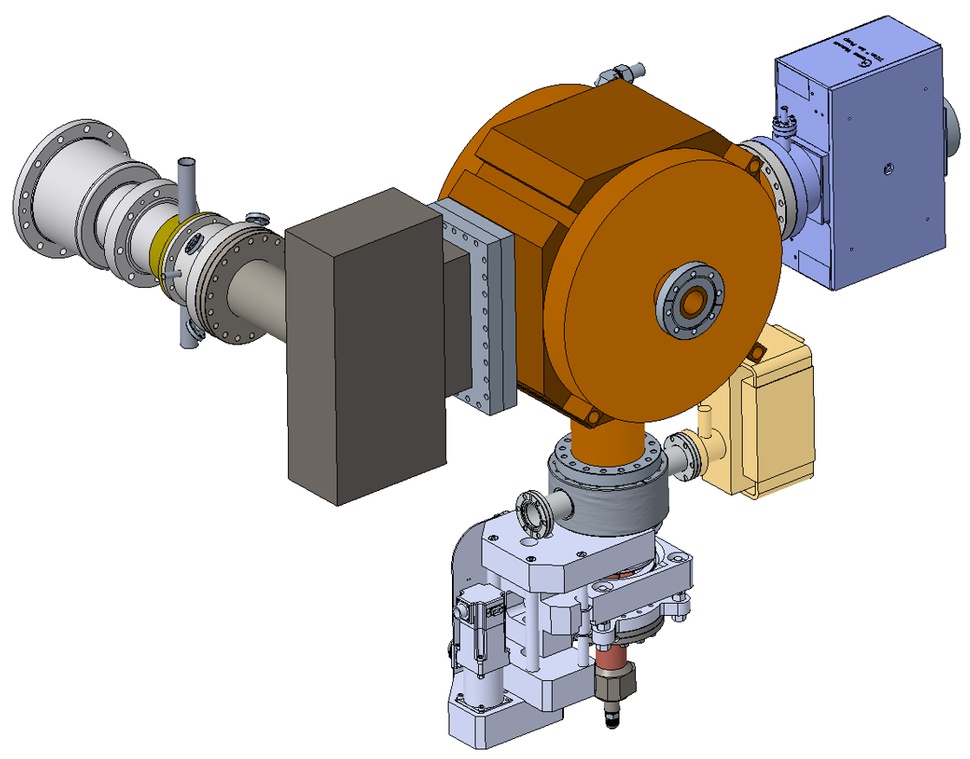
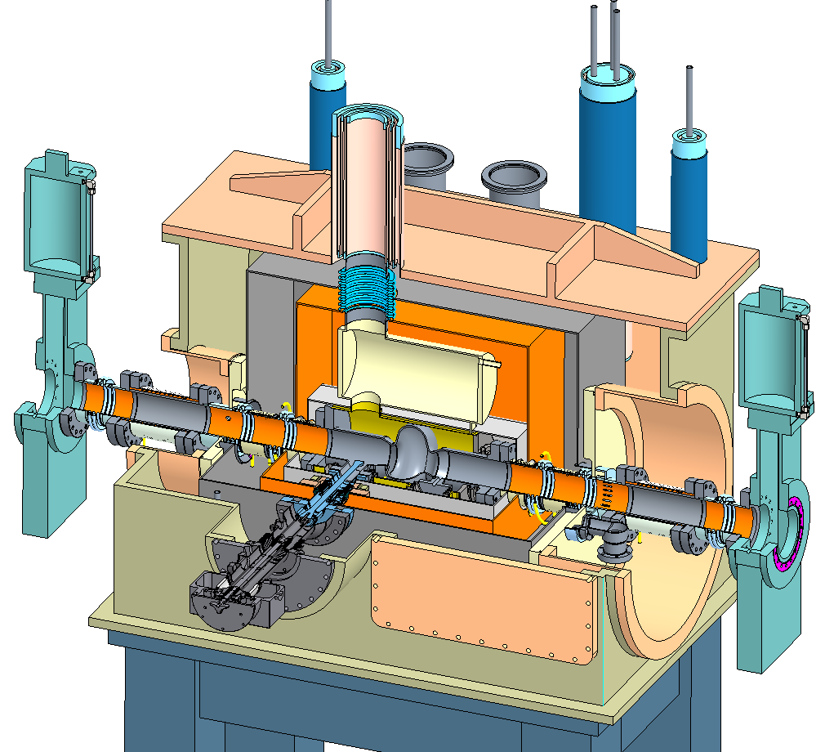
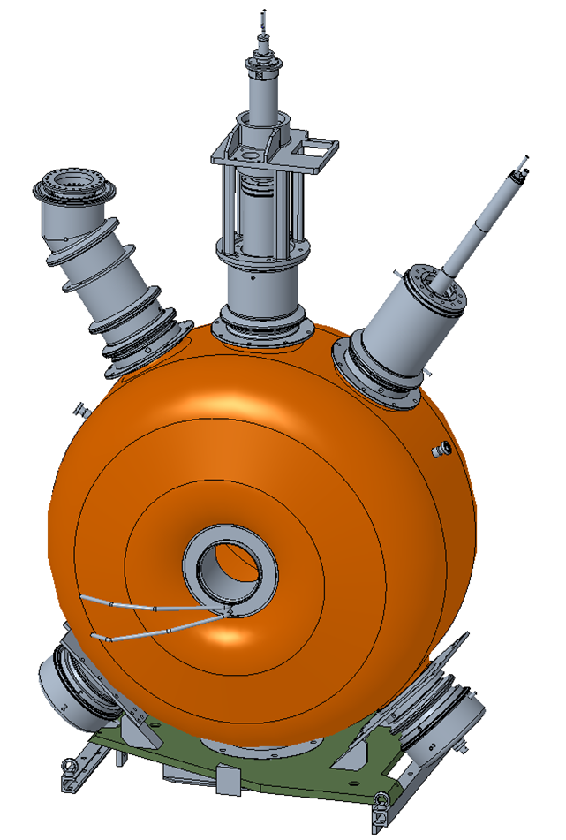
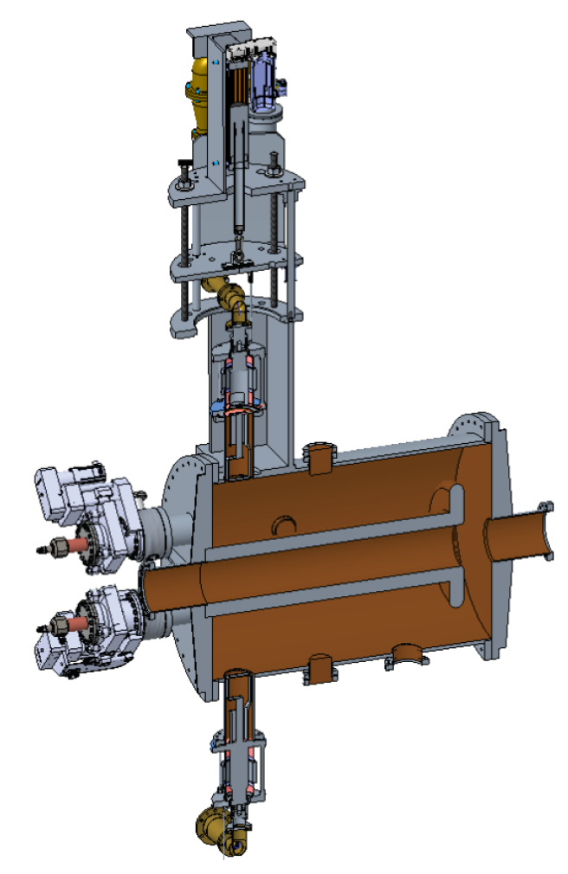
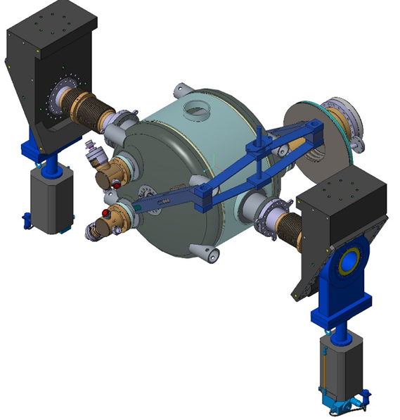
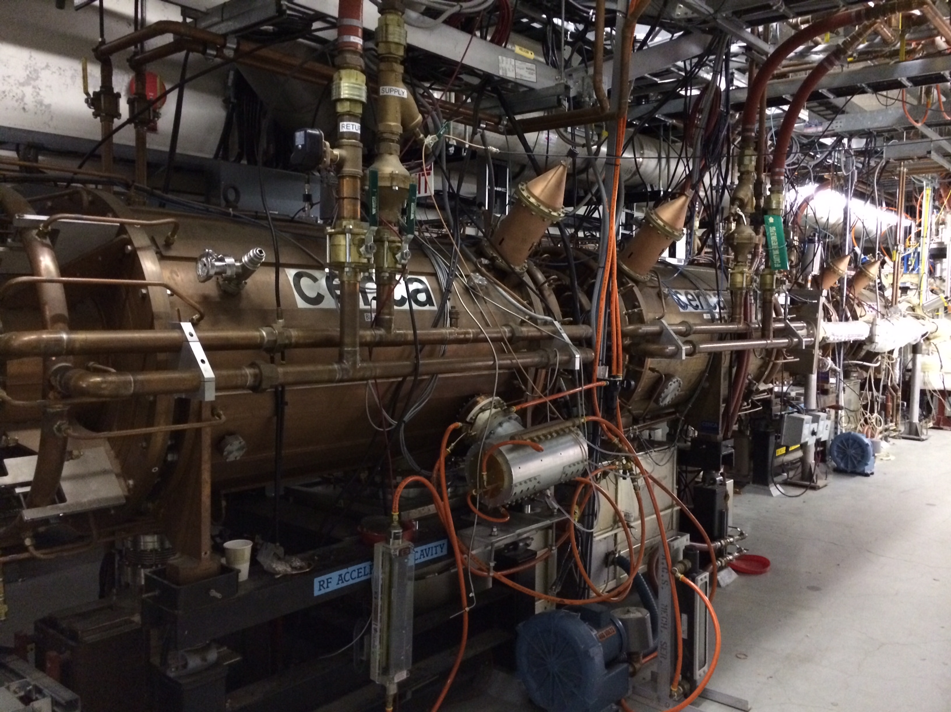
EIC RF systems overview
HSR
K. Smith, R. Rimmer
SHC
eSR
Hadron - 591 MHz bunch compression cavity
Hadron Cooling - 591 MHz acceleration cavity
Electron - 591 MHz electron storage cavity
Injector - 571 MHz bunch compression cavity
Electron - 1773 MHz 3rd harmonic cavity
RCS
Hadron - 197 MHz bunch compression cavity
Hadron – 24.5 MHz acceleration cavity
Rapid Cycling Synchrotron - 591 MHz acceleration cavity
Both rings – 394 MHz crab cavity
Hadron – 49.2 MHz and 98.5 MHz bunch splitter cavity
3

Slide 4
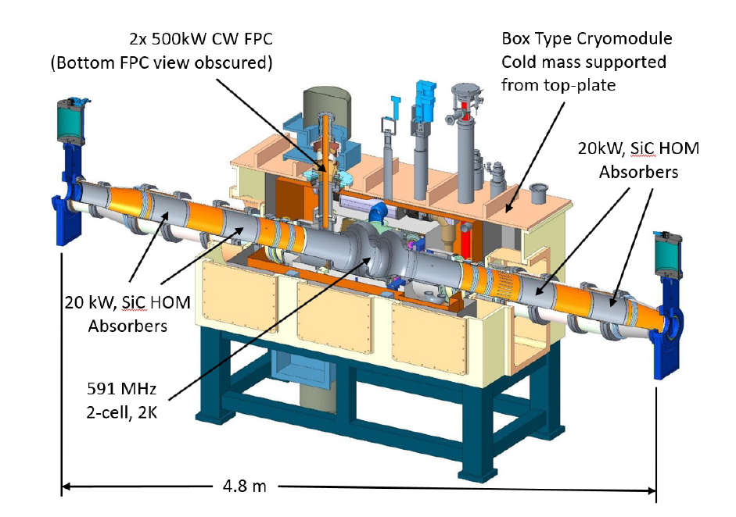
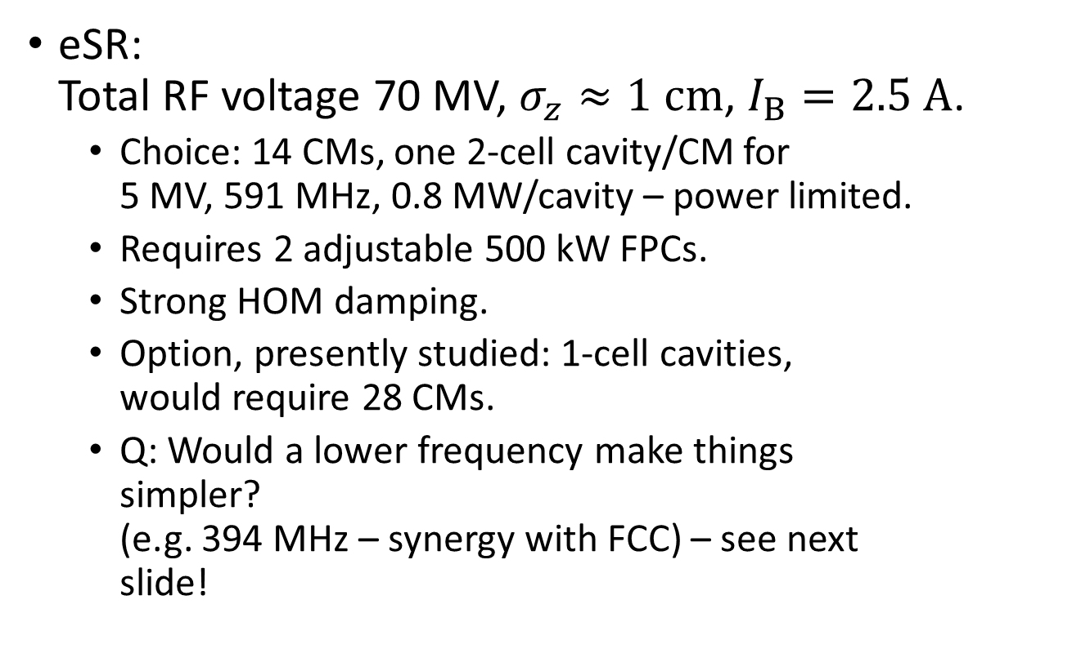
EIC RF systems (1/4)
K. Smith, R. Rimmer
eSR:
Total RF voltage 70 MV, $σ_{z}≈1 cm$, $I_{B}=2.5 A$.
  Choice: 14 CMs, one 2-cell cavity/CM for
  5 MV, 591 MHz, 0.8 MW/cavity – power limited.
  Requires 2 adjustable 500 kW FPCs.
  Strong HOM damping.
  Option, presently studied: 1-cell cavities,
  would require 28 CMs.
  Q: Would a lower frequency make things
  simpler?
  (e.g. 394 MHz – synergy with FCC) – see next
  slide!
Baseline eSR: 2-cell, single-cavity CM

Slide 5

EIC RF systems (2/4) – eSR choice of $f$
R. Rimmer
 | 394 | 591 | 788
#cells (eSR) | 14 | 28 | 32
#Amplifiers (eSR) | 14 | 14 | 16
impedance | least | reference | most
HOM power (kW) | 264 | 528 | 704
3H freq | 1182 | 1773 | 2364 (1572 2nd?)
Comments: | Synergy with LHC/FCC (e.g. crabs) | unique | Synergy with PERLE/FCC (e.g. crabs)
size | New cavity, cryostat, infrastructure | CDR reference design (also fits in JLAB mod. cryostat) | Fits in cryostat and infrastructure
transients | least | acceptable | most
Max bunch rate (MHz) | 394 | 197 | 788

Slide 6
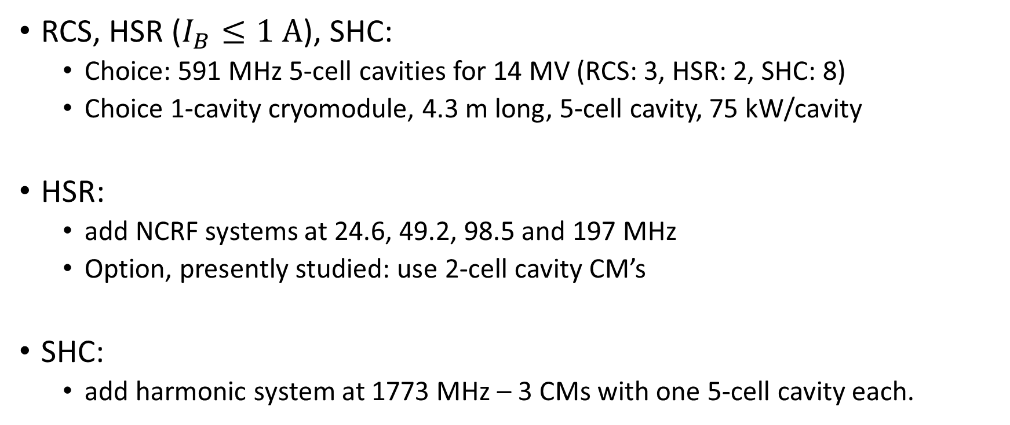
EIC RF systems (3/4)
K. Smith, R. Rimmer
RCS, HSR ($I_{B}≤1 A$), SHC:
  Choice: 591 MHz 5-cell cavities for 14 MV (RCS: 3, HSR: 2, SHC: 8)
  Choice 1-cavity cryomodule, 4.3 m long, 5-cell cavity, 75 kW/cavity
HSR:
  add NCRF systems at 24.6, 49.2, 98.5 and 197 MHz
  Option, presently studied: use 2-cell cavity CM’s
SHC:
  add harmonic system at 1773 MHz – 3 CMs with one 5-cell cavity each.

Slide 7
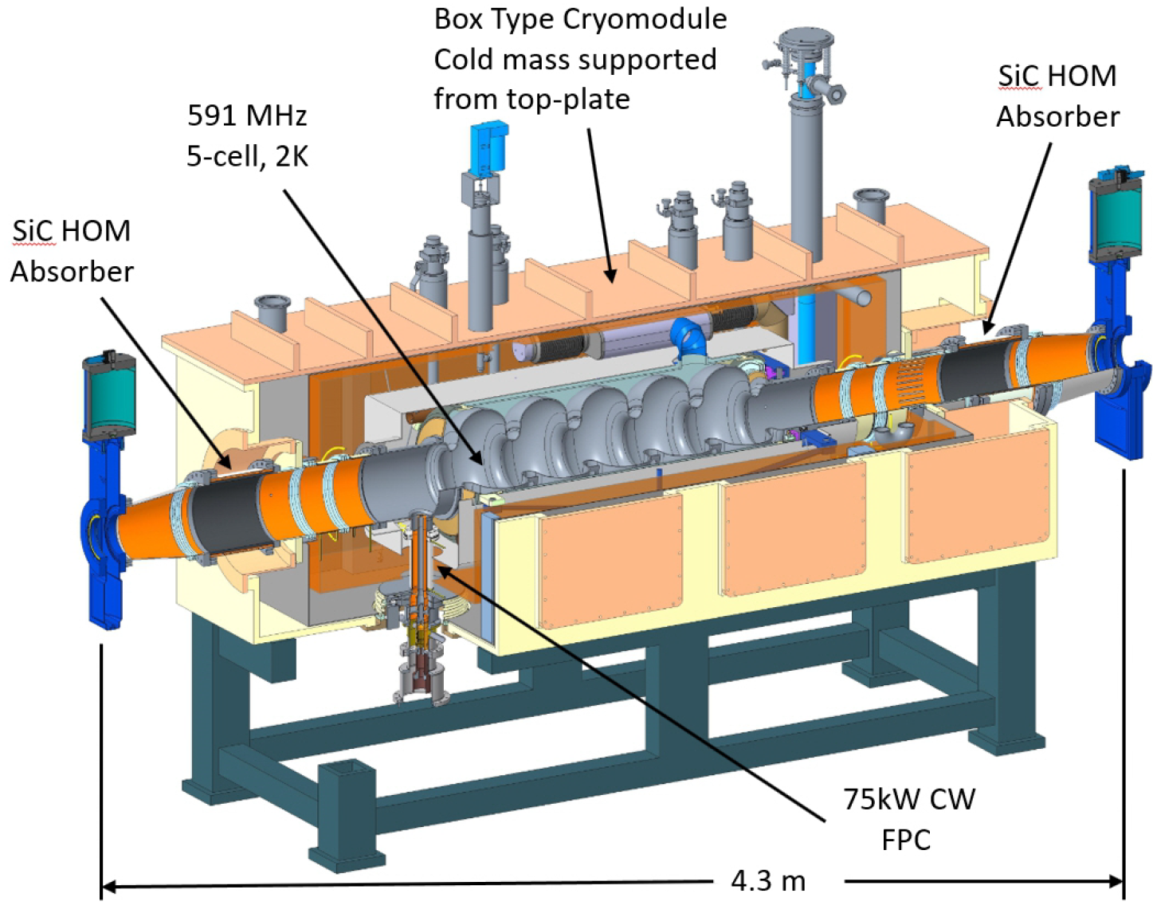
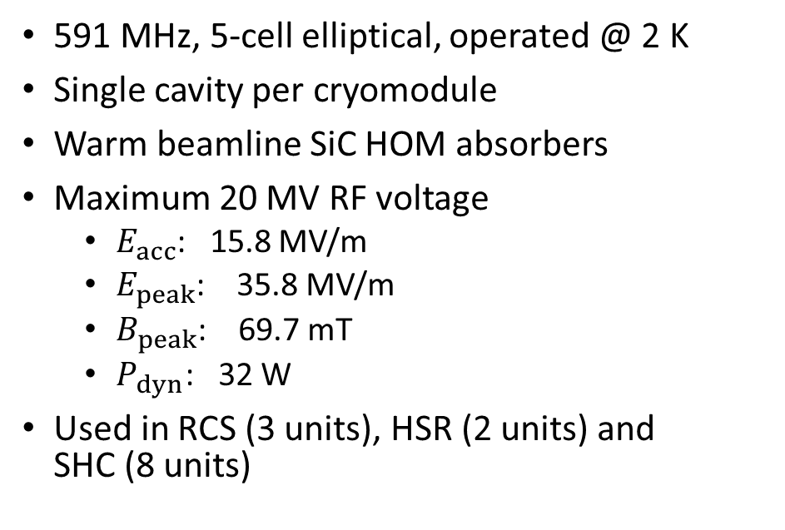
EIC RF systems (4/4): 5-cell Cryomodule
K. Smith, R. Rimmer
591 MHz, 5-cell elliptical, operated @ 2 K
Single cavity per cryomodule
Warm beamline SiC HOM absorbers
Maximum 20 MV RF voltage
  $E_{acc}$: 15.8 MV/m
  $E_{peak}$: 35.8 MV/m
  $B_{peak}$: 69.7 mT
  $P_{dyn}$: 32 W
Used in RCS (3 units), HSR (2 units) and
SHC (8 units)

Slide 8
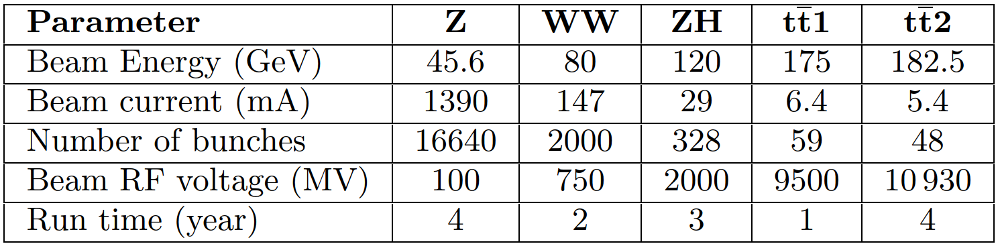
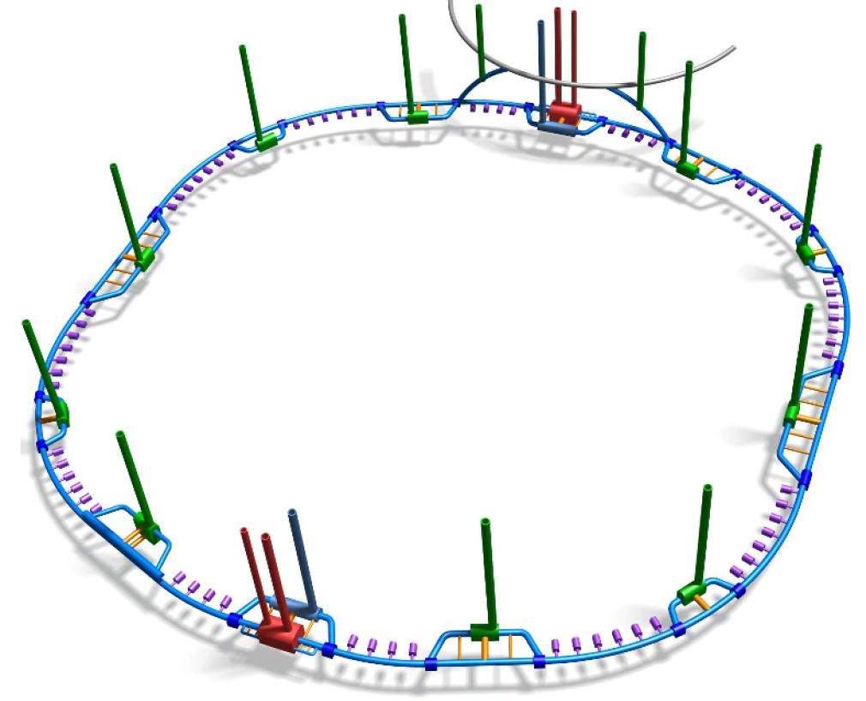
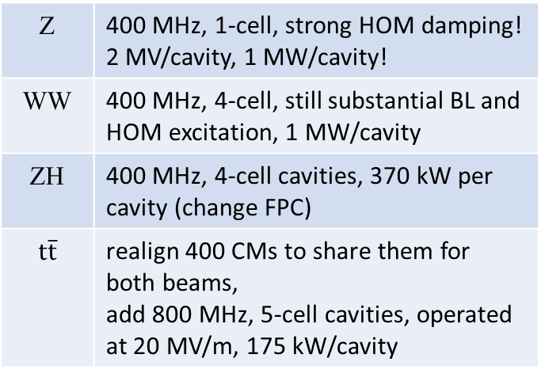
FCC-ee RF systems (1/2)
O. Brunner
PA
RF:
2.8 km
PB
PJ
PC
Z | 400 MHz, 1-cell, strong HOM damping! 2 MV/cavity, 1 MW/cavity!
WW | 400 MHz, 4-cell, still substantial BL and HOM excitation, 1 MW/cavity
ZH | 400 MHz, 4-cell cavities, 370 kW per cavity (change FPC)
$$t\overline{t}$$ | realign 400 CMs to share them for both beams, add 800 MHz, 5-cell cavities, operated at 20 MV/m, 175 kW/cavity
29.9 km
PD
RF:
2.8 km
PG
8

Slide 9
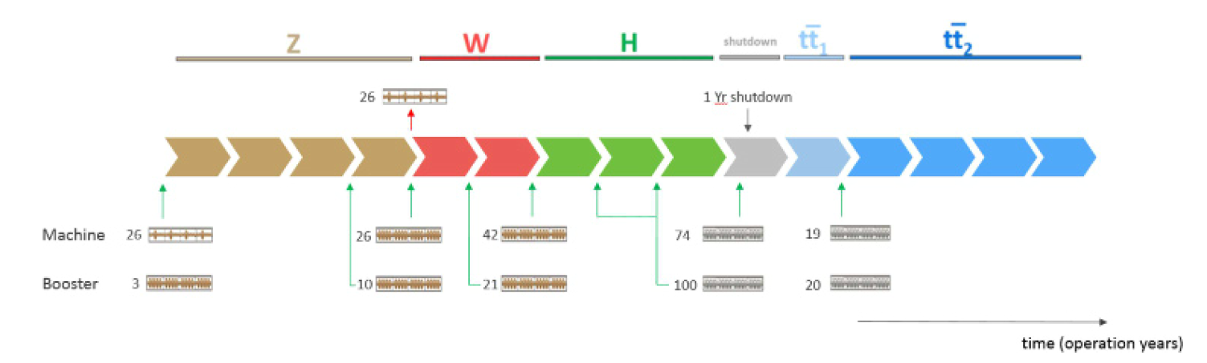
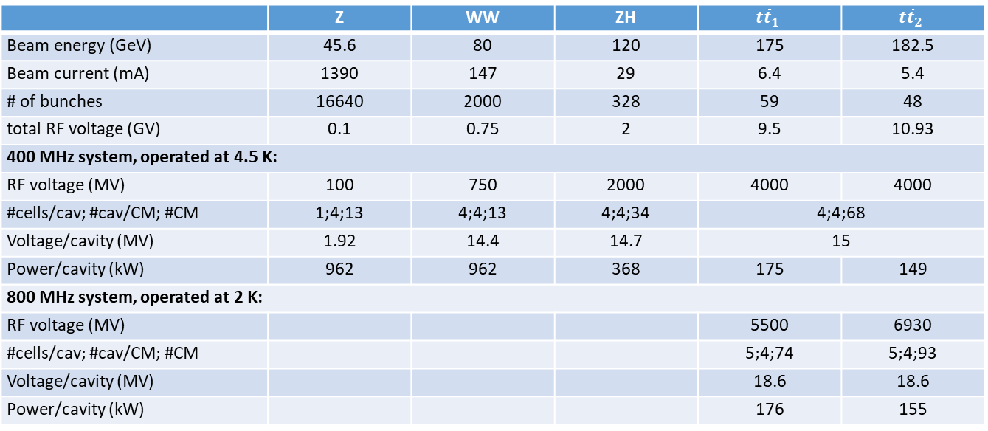
FCC-ee RF systems (2/2)
O. Brunner
 | Z | WW | ZH | $$t{\overline{t}}_{1}$$ | $$t{\overline{t}}_{2}$$
Beam energy (GeV) | 45.6 | 80 | 120 | 175 | 182.5
Beam current (mA) | 1390 | 147 | 29 | 6.4 | 5.4
# of bunches | 16640 | 2000 | 328 | 59 | 48
total RF voltage (GV) | 0.1 | 0.75 | 2 | 9.5 | 10.93
400 MHz system, operated at 4.5 K:
RF voltage (MV) | 100 | 750 | 2000 | 4000 | 4000
#cells/cav; #cav/CM; #CM | 1;4;13 | 4;4;13 | 4;4;34 | 4;4;68
Voltage/cavity (MV) | 1.92 | 14.4 | 14.7 | 15
Power/cavity (kW) | 962 | 962 | 368 | 175 | 149
800 MHz system, operated at 2 K:
RF voltage (MV) |  |  |  | 5500 | 6930
#cells/cav; #cav/CM; #CM |  |  |  | 5;4;74 | 5;4;93
Voltage/cavity (MV) |  |  |  | 18.6 | 18.6
Power/cavity (kW) |  |  |  | 176 | 155
9

Slide 10
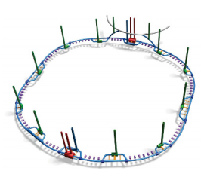
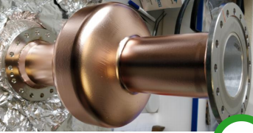
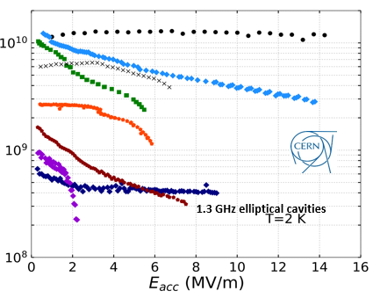
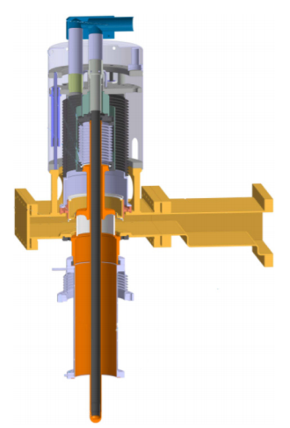
FCC SRF R&D Program structure
O. Brunner, F. Gerigk
Parameters and Design
Coordination and Review
Integrate Baseline Design and Parameters
Define Installation and Operational Scenarios
Perform Implementation Studies (cost, powering, cooling, civil engineering, safety)
Cavity Studies
Determine the Optimum Cavity Shape, Technology and Operating Temperature (complexity, power consumption, Q_{o}, E_{acc})
Design 1-cell and 4-cell Cavities for the new CM
Complete Beam-Cavity Interactions Studies
Identify Cavity Control System (LLRF) challenges
Complete HOM Damping Schemes and Coupler Design Optimization Studies
SRF & Substrate Technologies
Improve Engineering of Cavities: New SC Materials, Improved Fabrication, Substrate Surface Preparation and Coating Techniques
Fabrication and Testing of 1-cell and 4-cell Cavities for the new CM.
Promote R&D Activities in Collaboration with international Partners
Cryomodule Development
Improved design and engineering of 400MHz cryomodule including ancillaries
Built a 2 cavity CM which can host 1-cell / 4-cells 400MHz cavities
Promote R&D Activities in Collaboration with international Partners (e.g. JLAB)
800 MHz CM: Profit from Ongoing Development @ PERLE
FPC & HOM Couplers
Improved design and engineering of the ‘LHC-type’ 400 MHz FPC
Fabrication and Testing of the improved 400 MHz FPC for the new CM
FPC R&D:
  Pave the road towards 1MW CW fixed/movable FPC operating at 400 MHz
  Design and engineering of ‘adjustable’ FPC (external large adaptation of Q_{ext})
HOM coupler production

Slide 11
SRF and Cryomodules
FCC baseline is Nb/Cu at 400 MHz, operated at 4.5 K, (5 MV/m)
and bulk Nb at 800 MHz, operated at 2 K (20 MV/m).
FCC R&D: alternative materials (A15) thin films, novel cavity manufacturing, new CM concepts.

Slide 12
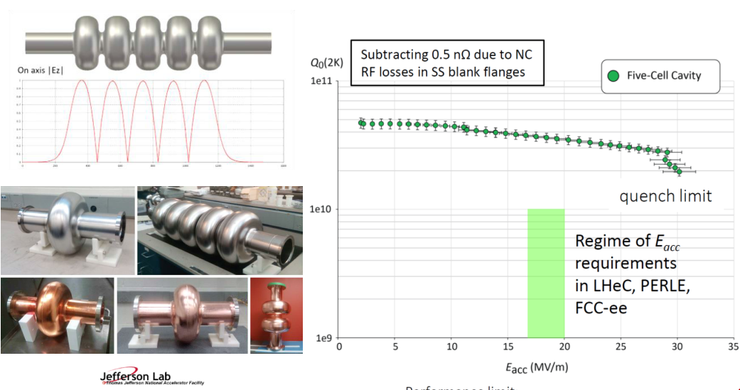
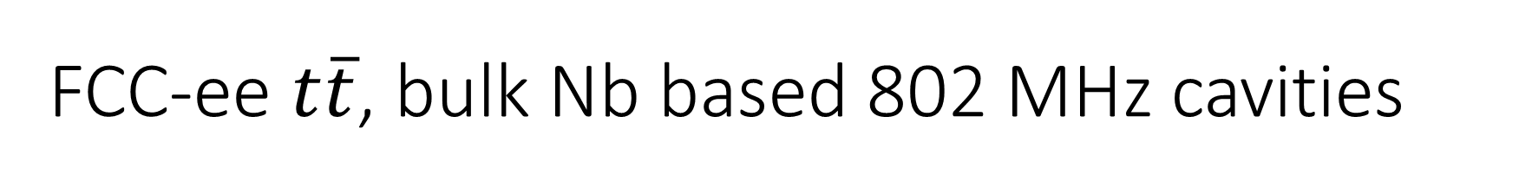
FCC-ee $t\overline{t}$, bulk Nb based 802 MHz cavities
A.M. Valente Feliciano, F. Marhauser
Existing collaboration with JLAB – relevant also for PERLE@ Orsay

Slide 13
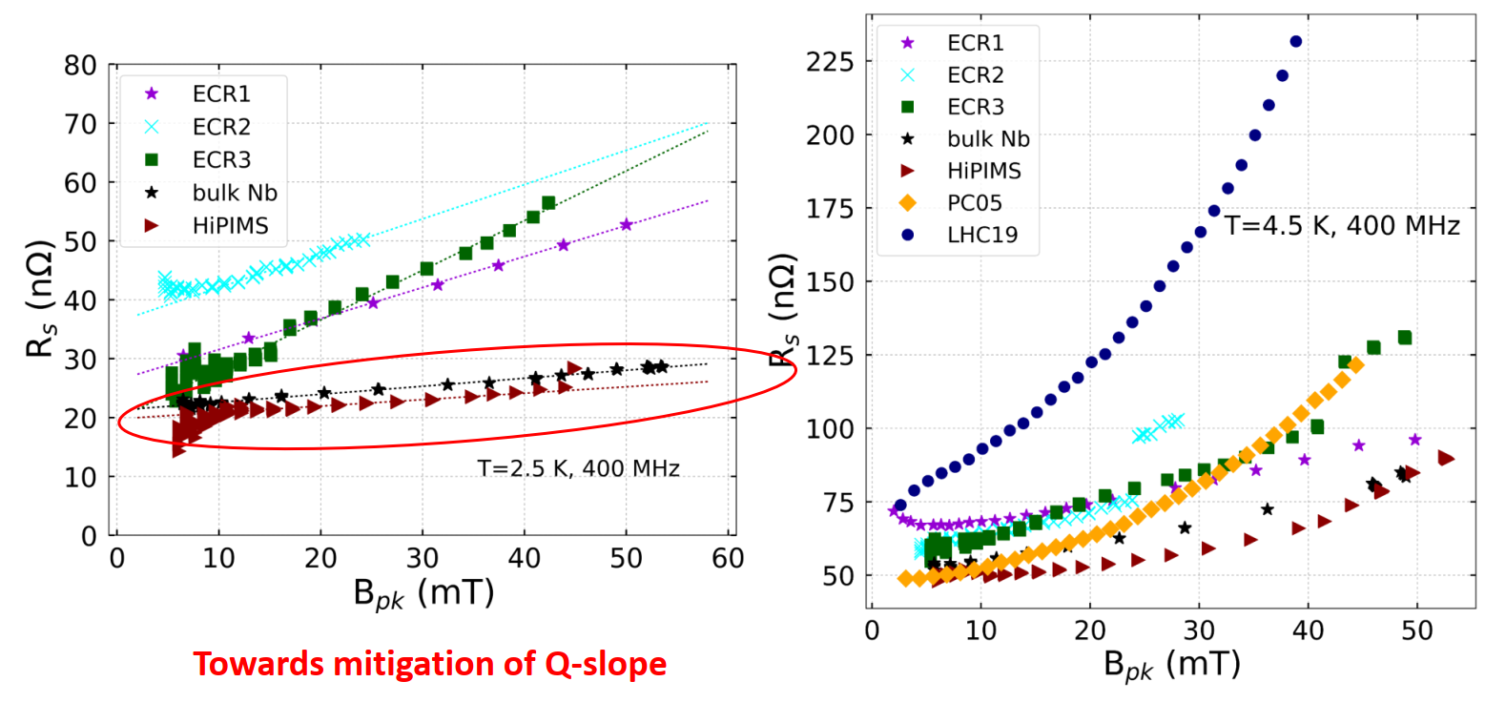
Nb/Cu Technology – Energetic Condensation
A.M. Valente Feliciano

Slide 14
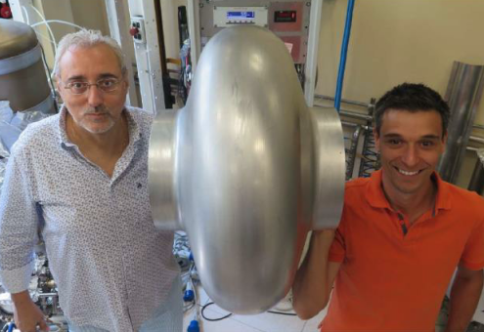
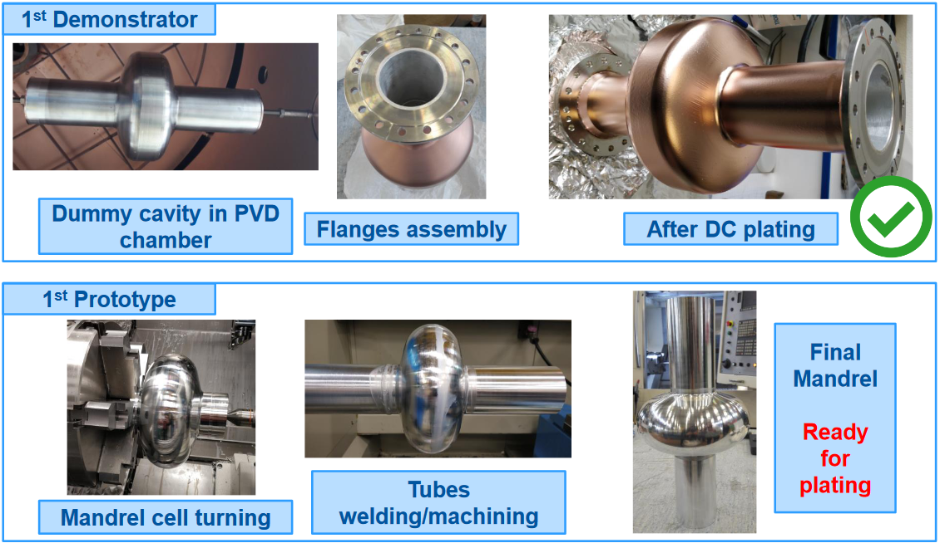
R&D on novel cavity fabrication techniques
Spun seamless 400 MHz cavity (INFN/LNL)
Electroforming on aluminium mandrel (CERN) – very promising!
…and also: Electro-hydroforming, hydroforming

Slide 15
Fundamental Power Couplers
Interest EIC: 500 kW power couplers 591 MHz.
FCC-ee in its different stages always requires to feed 100 MW RF in CW to the cavities. This requires hundreds of couplers!
The LHC has variable couplers capable of 500 kW CW – CERN is performing R&D and is building FPC’s for many international partners.
CERN is home to the “World-Wide FPC Meeting” of experts.

Slide 16
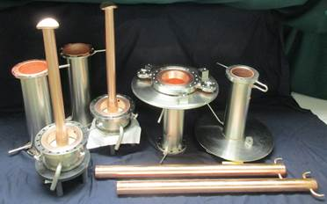
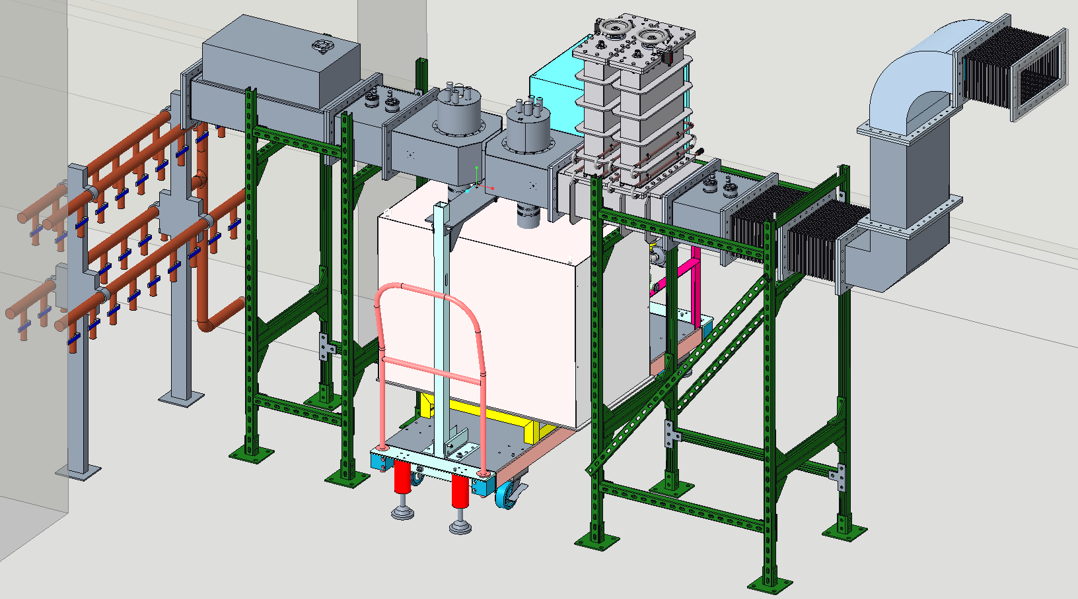
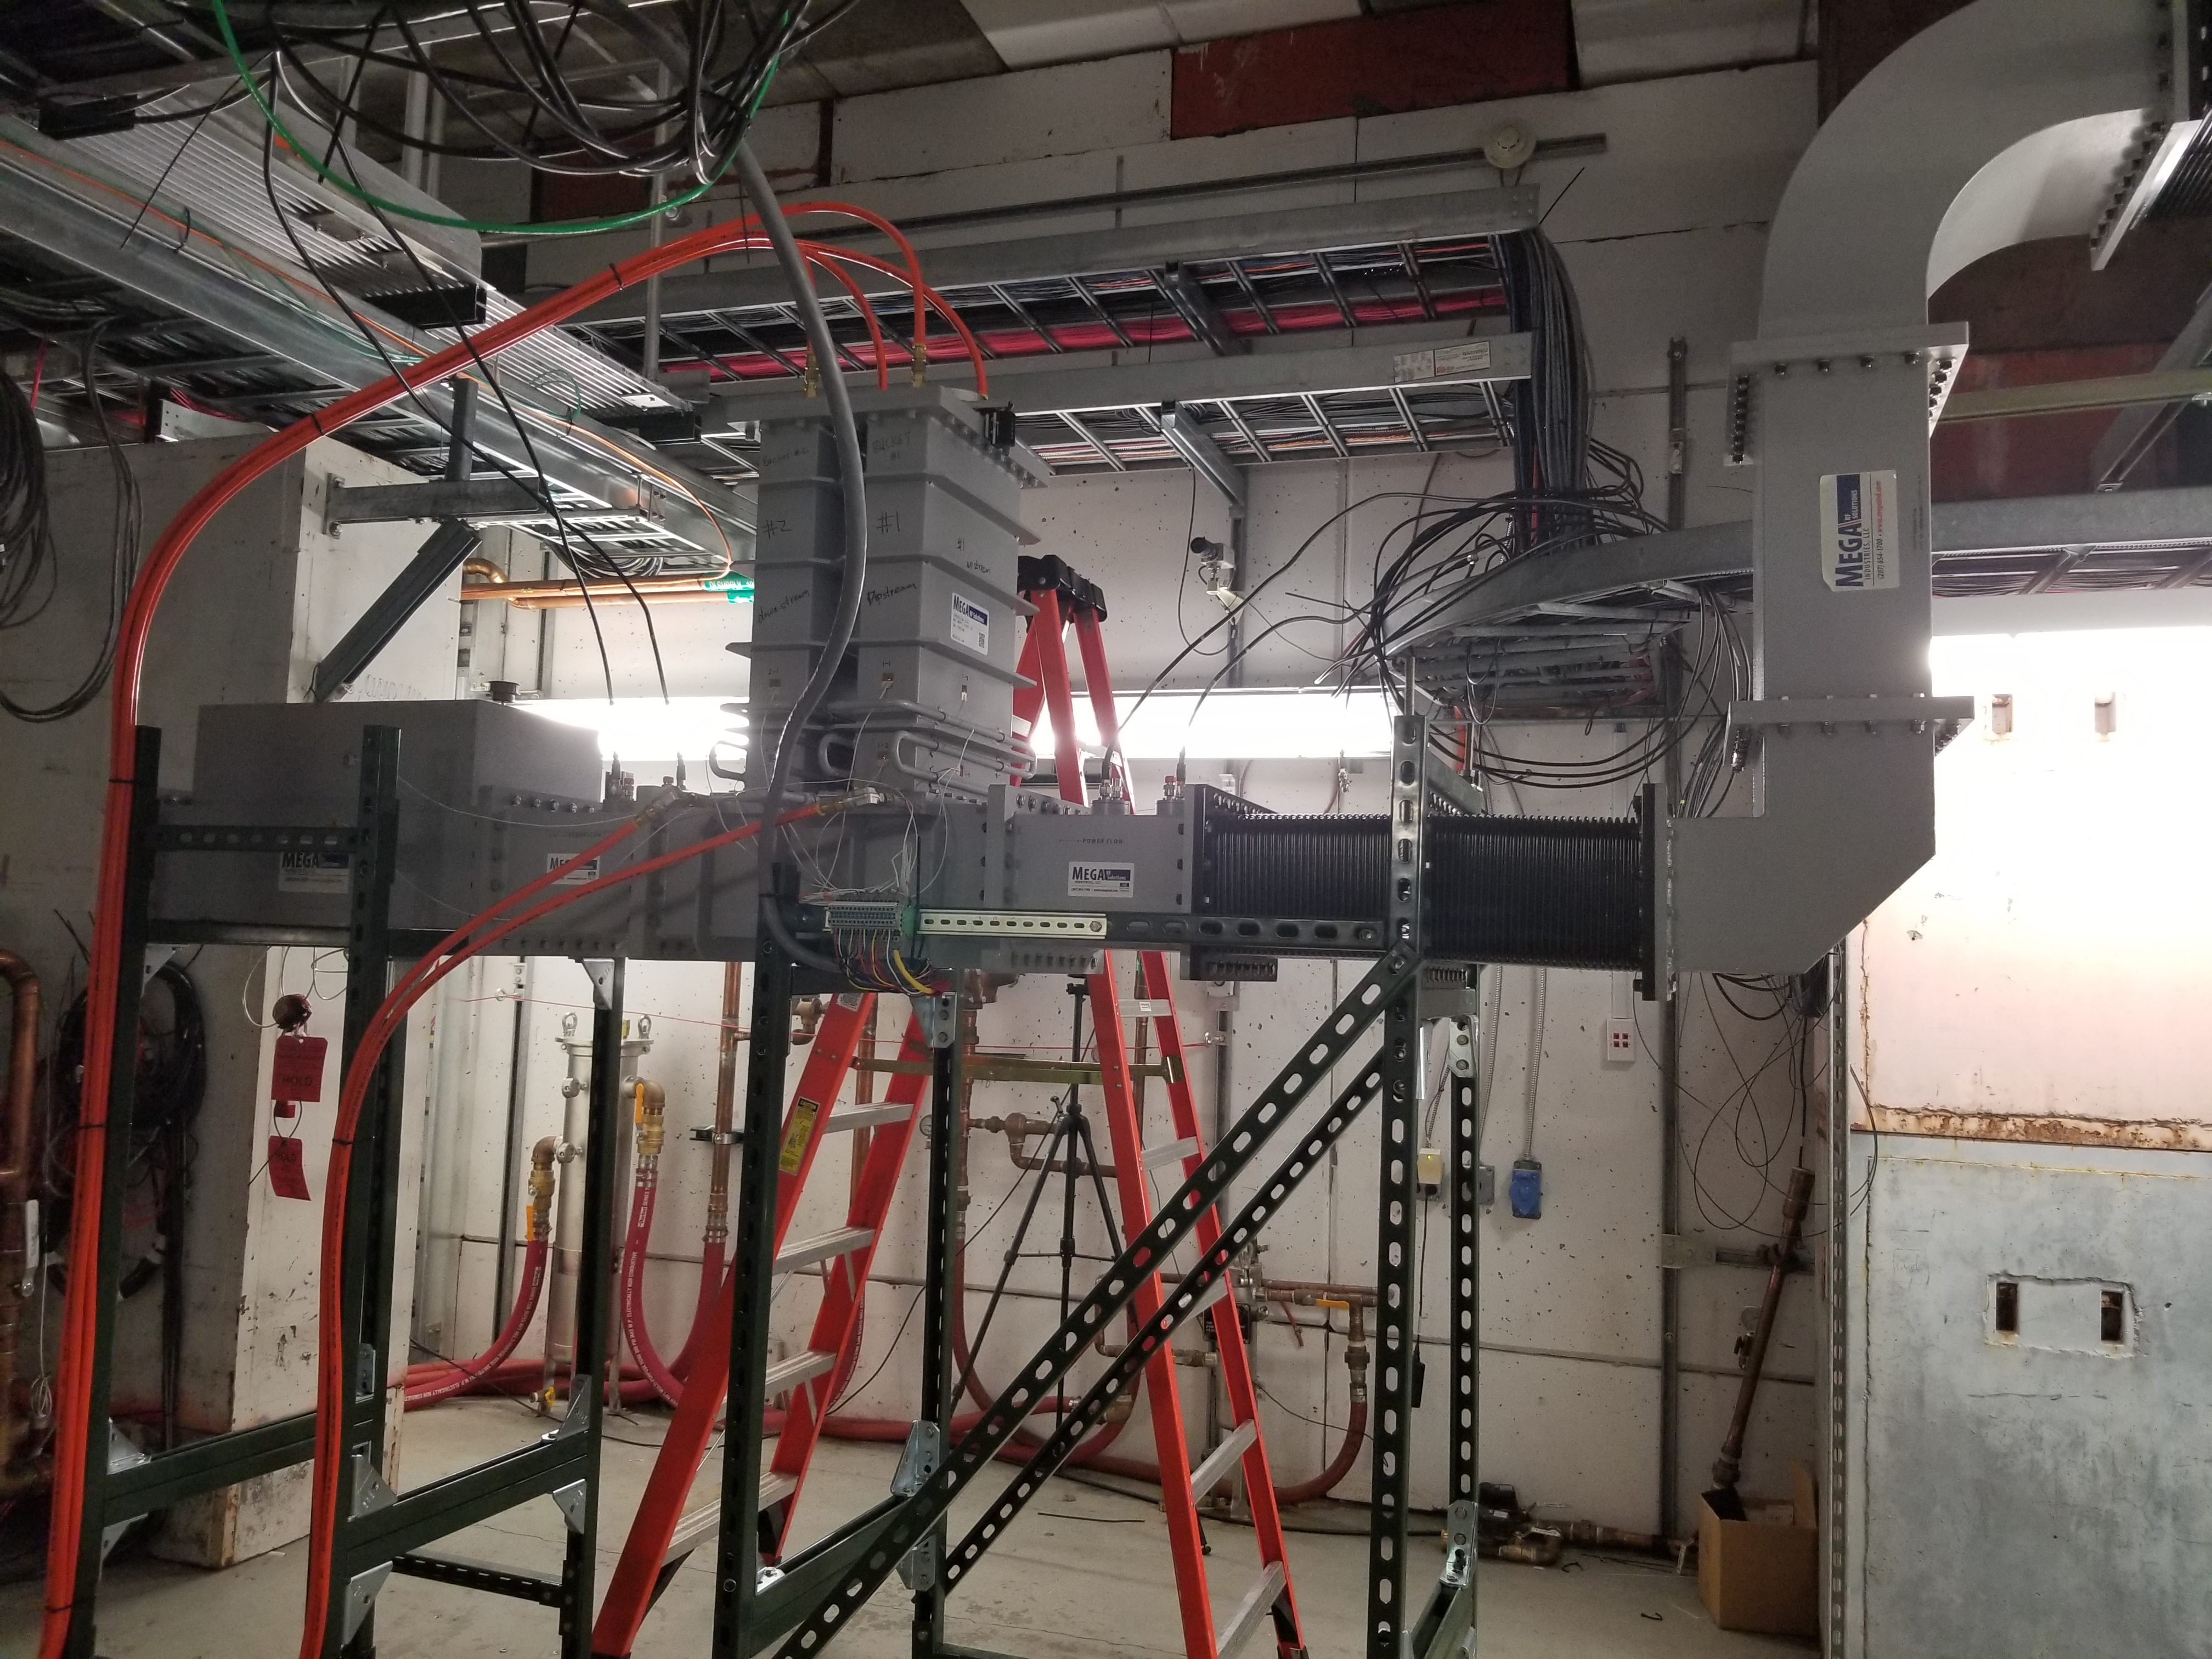
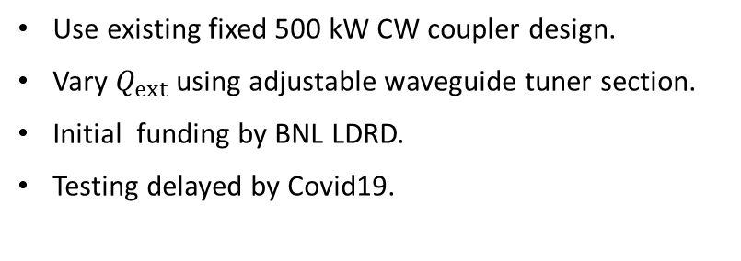
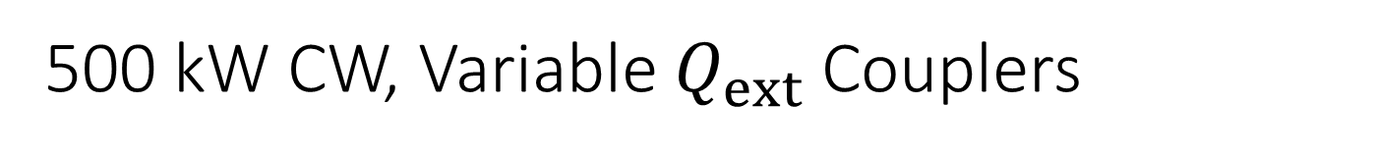
500 kW CW, Variable $Q_{ext}$ Couplers
K. Smith
Use existing fixed 500 kW CW coupler design.
Vary $Q_{ext}$ using adjustable waveguide tuner section.
Initial funding by BNL LDRD.
Testing delayed by Covid19.
16

Slide 17
FCC-ee needs:
Power need at FCC-ee Z-pole: 1 MW/single-cell cavity.
FCC baseline: use 2x 500 kW power couplers (LHC-type)
R&D towards 1 MW CW power couplers is only starting
Complication: to use the same 4-cell cavities in FCC-ee “WW” and FCC-ee “ZH”, the coupling must be changed.

Slide 18
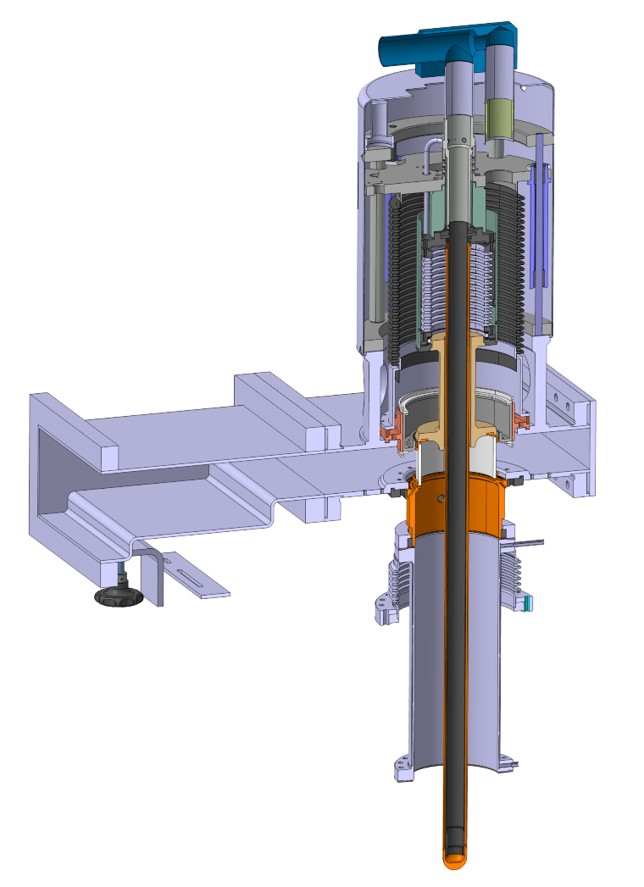
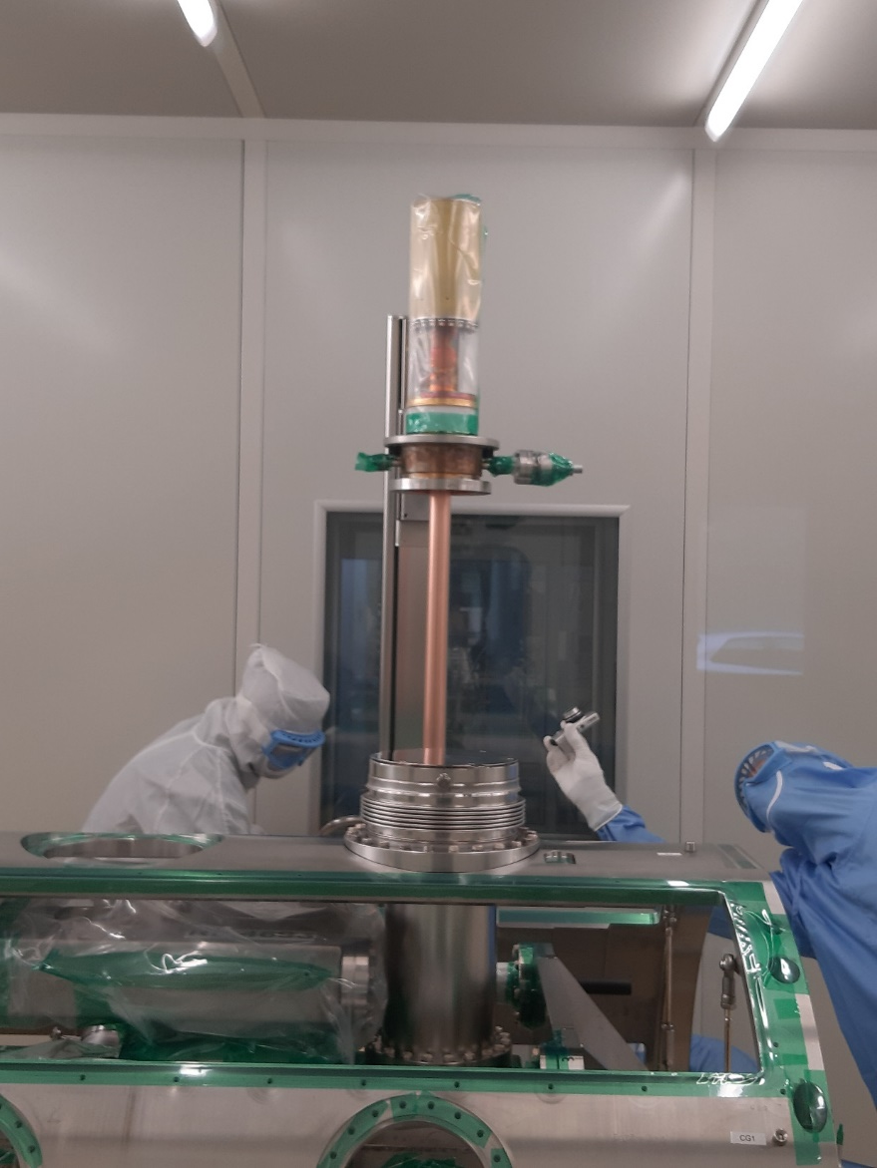

LHC power couplers (400 MHz, CW – variable coupling)
E. Montesinos
Tested up to 500 kW CW forward.
$Q_{ext}$ variable by a factor 20.

Slide 19
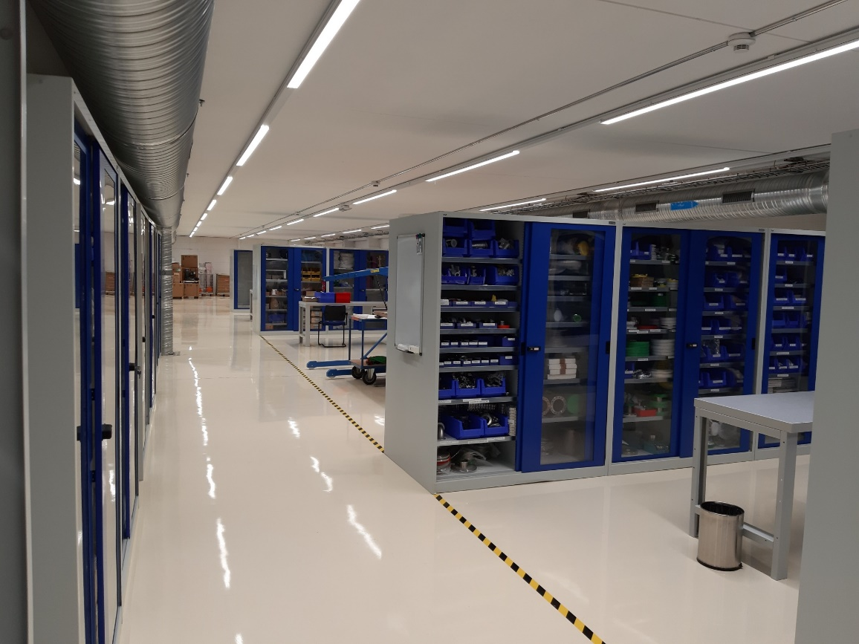
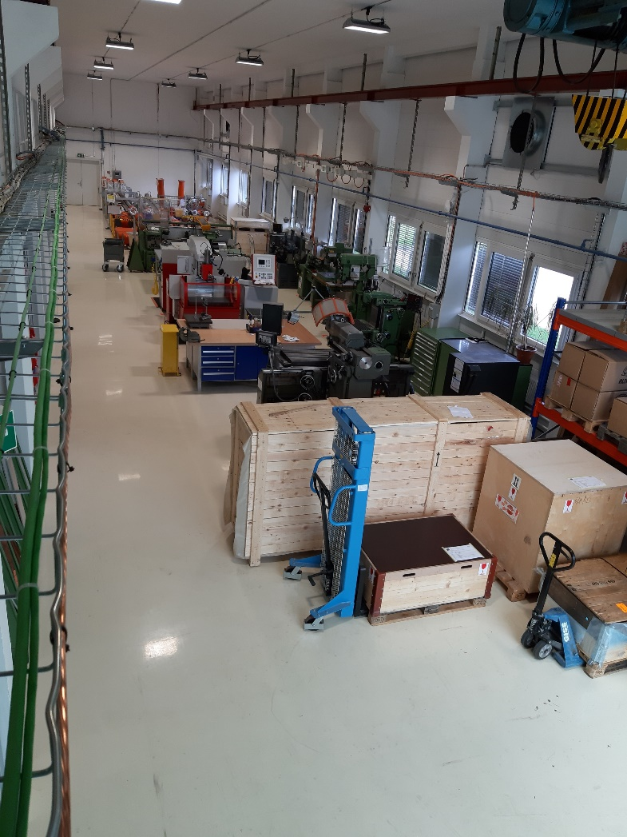
New FPC R&D Centre created in Prévessin
E. Montesinos
Mezzanine: 200 m²: Components clean storage, Test boxes, vacuum, metrology, assembly robots
Ground floor (600 m²): transport, heavy equipment, welding & brazing, machining, LLRF measurements and 1 kW processing, 1 MW processing with resonant ring

Slide 20
HOM Damping
EIC eSR has 2.5 A beam current and short bunches(!)
eSR HOM damping baseline: SiC warm beamline, HOM absorbers.
FCC-ee requires strong HOM damping in particular at the Z-pole (1.4 A), baseline requires “only” hook-type couplers.

Slide 21
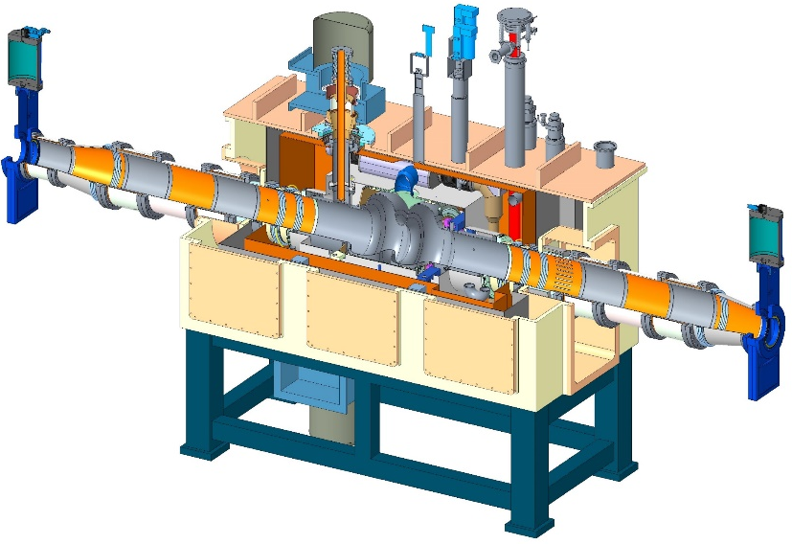
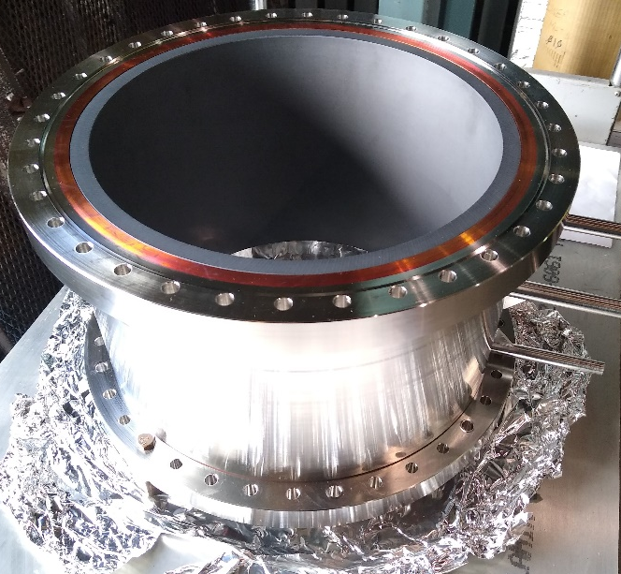
EIC eSR High-Power SiC HOM absorbers
R. Rimmer
Requirement and challenge
  High power (20 kW), broadband HOM damper
  Large size of SiC HOM damper for low frequency
Initial LDRD program on SiC HOM absorber:
  Low power test on a cavity to test effective damping bandwidth
  High power test to test the power handling capability
Results:
  Tests were delayed due to CoVID-19.
Inspiration
  Instead of one solid piece HOM damper, fabrication and RF study of piece-by-piece (tile) type HOM damper
  HOM damper suitable for various temperature environments.
eSR CM
SiC HOM Absorbers

Slide 22
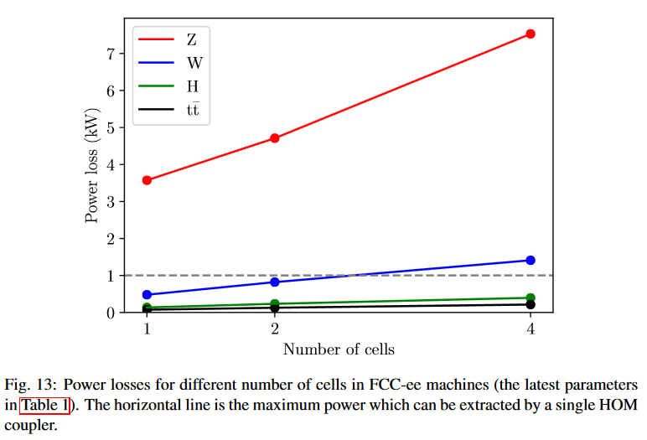
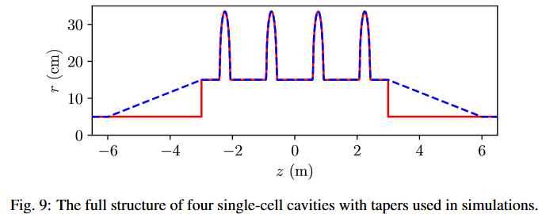
FCC-ee HOM power estimates
I. Karpov
From https://cds.cern.ch/record/2302276/files/CERN-ACC-2018-0005.pdf :
We believe that, even for the Z-pole machine, we can achieve the required HOM damping with hook couplers (4 per 1-cell cavity). This is possible at 400 MHz thanks to a judicious combination of bunch spacing, cavity design and cavity separations.

Slide 23
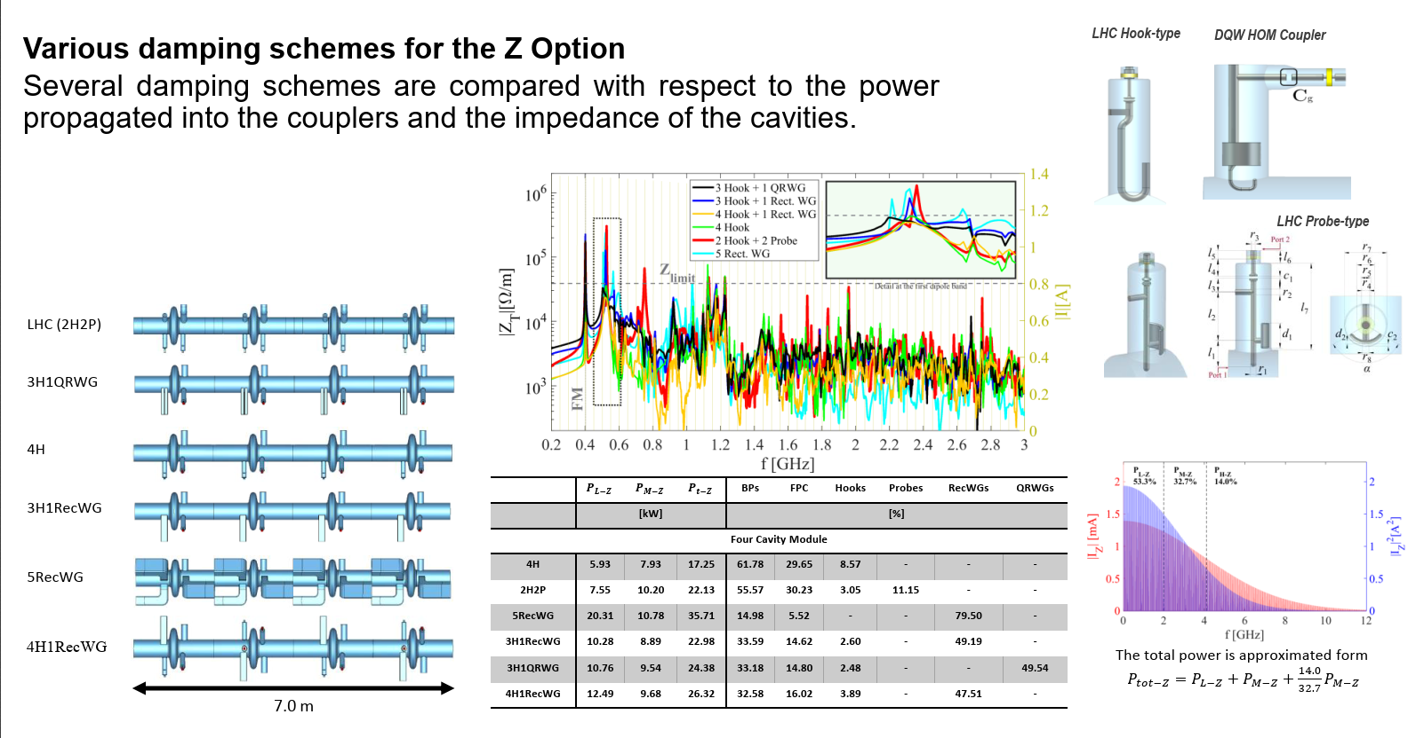
HOM Damping in FCC-ee
A.M. Valente Feliciano, S. Gorgi Zadeh
See also https://indico.cern.ch/event/656491/contributions/2932265/

Slide 24
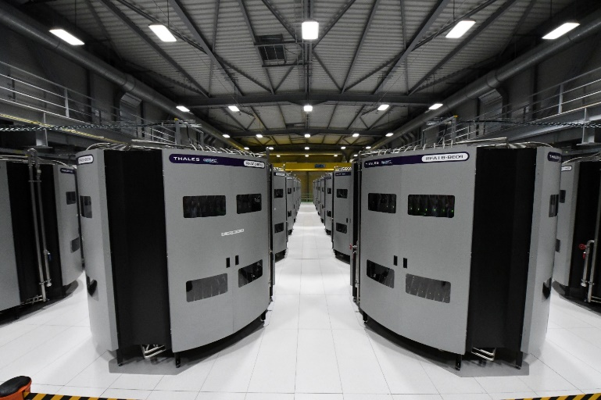
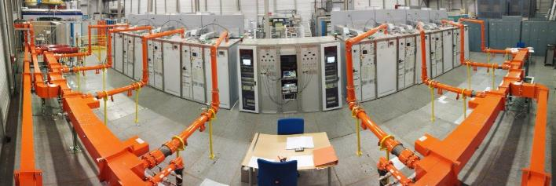
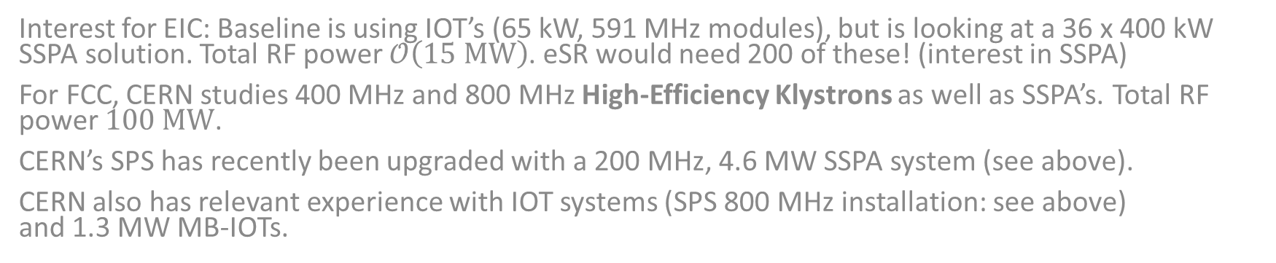
RF Power Generation
CERN SPS 800 MHz IOT installation, 2x 200 kW
CERN SPS 200 MHz SSPA, 4.6 MW
Interest for EIC: Baseline is using IOT’s (65 kW, 591 MHz modules), but is looking at a 36 x 400 kW SSPA solution. Total RF power $𝒪\left(15 MW\right)$. eSR would need 200 of these! (interest in SSPA)
For FCC, CERN studies 400 MHz and 800 MHz High-Efficiency Klystrons as well as SSPA’s. Total RF power $100 MW$.
CERN’s SPS has recently been upgraded with a 200 MHz, 4.6 MW SSPA system (see above).
CERN also has relevant experience with IOT systems (SPS 800 MHz installation: see above)
and 1.3 MW MB-IOTs.

Slide 25
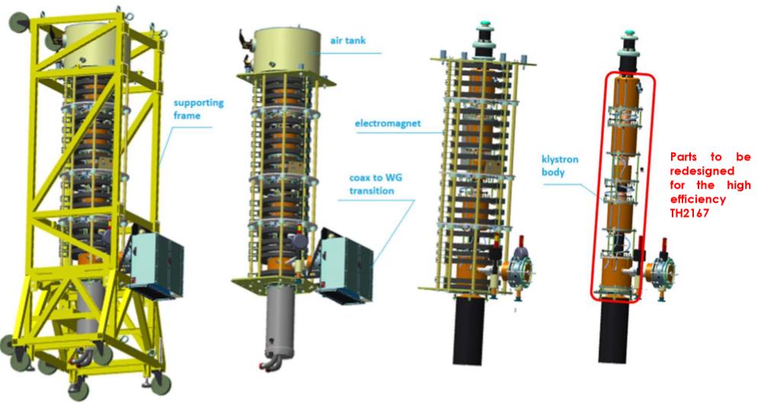
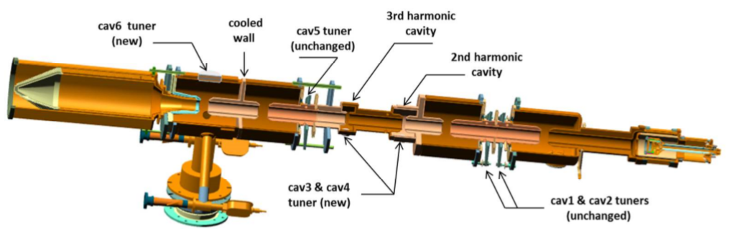
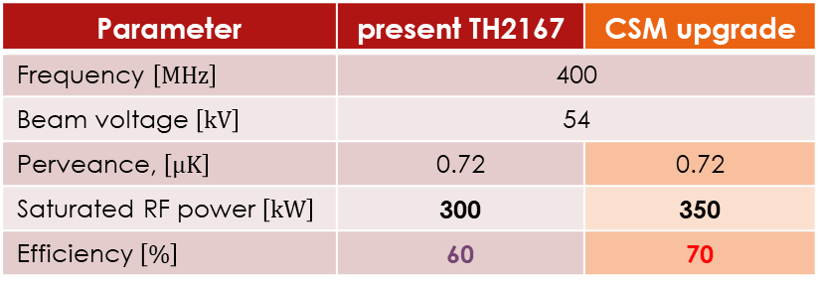
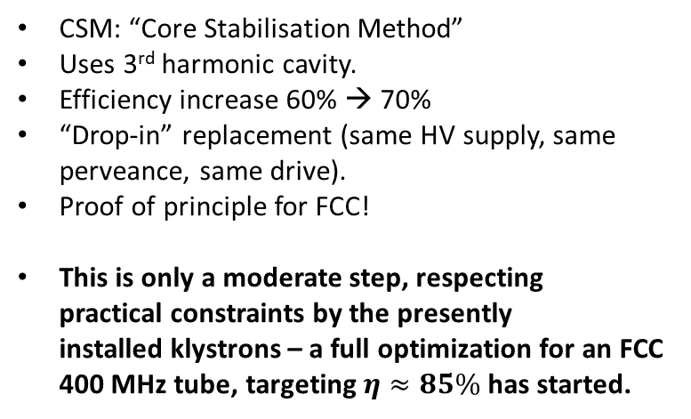
400 MHz – retrofitting the LHC klystron with a “High-Efficiency” version:
I. Syratchev, J. Cai, Thales AVS
Parameter | present TH2167 | CSM upgrade
Frequency $\left[MHz\right]$ | 400
Beam voltage $\left[kV\right]$ | 54
Perveance, $\left[μK\right]$ | 0.72 | 0.72
Saturated RF power $\left[kW\right]$ | 300 | 350
Efficiency $\left[\%\right]$ | 60 | 70
CSM: “Core Stabilisation Method”
Uses 3rd harmonic cavity.
Efficiency increase 60% → 70%
“Drop-in” replacement (same HV supply, same perveance, same drive).
Proof of principle for FCC!
This is only a moderate step, respecting
practical constraints by the presently
installed klystrons – a full optimization for an FCC 400 MHz tube, targeting $η≈85\%$ has started.

Slide 26
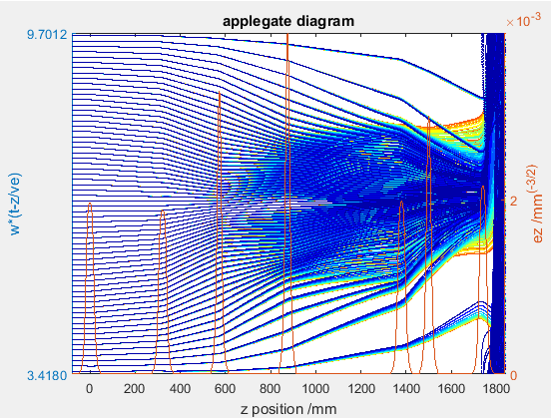







FCC-ee High-Efficiency 800 MHz Klystron:
134 kV × 12.5 A × 80% > 1.3 MW
I. Syratchev, J. Cai

Slide 27





Benchmark with PIC code
I. Syratchev, J. Cai
MAGIC2D
CST3D
Efficiency=80%, Time cost=12h
Efficiency=79%, Time cost=50h
B_{z}=0.07T (5xBr). Efficiency 79%

Slide 28






FCC#6. KlyC2D vs MAGIC
I. Syratchev, J. Cai
MAGIC (0.07T) 2D, 79.4%
MAGIC (20T) 2D, 79.6%
Beam settings:
Nz=256,Nr=4, η=79.9%,Tcpu= 20 min
Tcpu = 4000 min (~1ooo ns)
Nz=128,Nr=4
Saturation=97%
The radial bunch ‘expansion’ in output cavity (MAGIC2D) practically does not affect efficiency. This validates KlyC2D as an attractive (and fast) tool.
Convergent analysis

Slide 29

EIC Scope Detail: RF1010 Building
K. Smith, R. Rimmer
2020: RF1010 Support Building with 14.4 MW* total SSA based high power RF, interface to IR-10 and IR-10 cryomodule layout.**
  Remarkable power densities becoming realistic for solid state power across the digital TV broadcast frequencies.
  3D model is based on one of the vendor budgetary proposals.
* 14.4 MW is just the result of showing 36x 400 kW “units”. Vendor budgetary quote in this case is based on 400kW = 4x 100kW per amplifier.
** This layout is a conceptual layout to explore the space requirements for 18x single cell 591 MHz ESR cryomodules. The 18 cryomodules fit in the available IR space. The SSA power density leads to reduced building space needs.
591 MHz, 400 kW modular amplifier unit.
36 = 18 * 2 shown.
29

Slide 30





SPS 200 MHz, 4.6 MW SSPA System
Amplifier #1
1280 x 2 kW RF modules
16 Towers
300 m of 6-1/8 Lines
15 Hybrid combiners & loads
Amplifier #2
1280 x 2 kW RF modules
16 Towers
300 m of 6-1/8 Lines
15 Hybrid combiners & loads
19 m
12.5 m
36 m
2nd floor: 32 x 144 kW “towers”, arranged as 2 “amplifiers”
RF lines:
1200 m of 345 mm coaxial
1st floor: Power combiners
TWC200 Cavities (total now 6)
E. Montesinos, Thales/Gerac

Slide 31

SSPA for FCC (? – really big, $≈$ 200,000 transistors!)
Present baseline for FCC are High-Efficiency Klystrons.
CERN has also started R&D on higher power density SSPA’s new ideas of power combiners scalable to thousands of inputs, and GaN-based SSPA’s, jointly with academic and industrial partners.
… but: progress doesn’t come wandering along – one has to make it!

Slide 32

Crab Cavities
Interest for EIC: see next slide
CERN studies 400 MHz “WOW” (Wide Open Waveguide) crab cavities for the FCC-hh (R&D WP8).
And of course the 400 MHz crab cavities for LHC – result of a very successful, international collaboration (see above map, presented by L Rossi at 4th Cost&Schedule Review, Nov. 2019).

Slide 33


EIC Crabbing systems (1/2)
K. Smith, R. Rimmer
New SRF crabbing systems for both rings (eSR and HSR)
Large voltage needed for 25 mrad crossing angle
eSR system 394 MHz, 2.9 MV each side
HSR system 197 MHz, 34 MV each side
  Need second harmonic for linearization
IR 6 total 8 x 197 MHz cavities, 6 x 394 MHz cavities
Two candidates under consideration based on LHC experience, DQW and RFD
  Both meet voltage requirements
  Both can meet pressure code (even at 197 MHz)
  Both have been fabricated at 400 MHz
  Both need improved HOM damping for EIC

Slide 34





EIC Crabbing systems (2/2)
K. Smith, R. Rimmer
621
585
453
822
940
DQW 197 MHz crab cavity
“WOW” crab cavity
Courtesy: Zhenghai. Li
DQW 394 MHz crab cavity
RFD 197 MHz crab cavity
Courtesy: Qiong Wu, Silvia Verdú-Andrés, Doug Holmes, Binping Xiao
Courtesy: Suba Da Silva, HyeKyoung Park, Jean Delayen, ODU, Jim Henry Jlab.

Slide 35








The CERN crab cavities
R. Calaga, A. Grudiev
Bulk Nb:
E.g.: DQW crab cavity for HL-LHC
Nb/Cu:
Wide-Open Waveguide (WOW) crab cavity for FCC:
Nb/Cu, 1st prototype completed in 2018
1.4m
290kg
0.66 m
Dissipated P_{surf} [W/m²]
Total power loss ~ 60W
@ Q₀ = 4x10⁸ / 3 MV
B. Xiao et al, Physical Review Special Topics - Accelerators And Beams, 2015
A. Grudiev et al, Proceedings of SRF 2015.
3

Slide 36



Wide-Open Waveguide Crab Cavity
A. Grudiev, F. Avino, A. Sublet
E-field
Details (from SRF 2019):
https://indico.cern.ch/event/832933/contributions/3644032/
https://indico.cern.ch/event/832933/contributions/3644009/

Slide 37




RF and engineering design studies of the cavity
A. Grudiev, F. Avino, A. Sublet
Comprehensive design study has been performed including:
Cavity design and power loss calculation using different coatings
Beam coupling impedance and HOM characterization
Preliminary design of the fundamental and HOM couplers
Multipacting simulations
RF sensitivity to pressure
Preliminary design of the coupler for cold tests
See details in DOI: 10.1103/PhysRevAccelBeams.22.072001
FMC
HOM coupler
Impedance and HOM characterization
Coupler design and HOM damping
Multipacting analysis of the bare cavity
Pressure sensitivity

Slide 38



Fabrication of Copper cavity
A. Grudiev, F. Avino, A. Sublet
Copper cavity (substrate) assembly has been finished end of 2018
Visual inspection has been done showing good RF surface state and no visible defects

Slide 39


WOW coating challenge
A. Grudiev, F. Avino, A. Sublet
252 mm
Cylindrical magnetrons
  Coating surfaces at different:
  Distances (20 – 80 mm)
  Angles of incidence (0 – 90°)
V+
(Nb)
How to get a void-free and defect-free film?
Increase the fraction of metal ions -> HiPIMS
Increase metal ions energy:
  By a negatively biased substrate
  By a positive pulse (PP)
Nb+
V-
(Cu)
4

Slide 40
Summary
There are a number of “similarities” (if not commonalities) between the different versions of the FCC-ee and the EIC RF systems
Areas of common interest – possible collaboration:
  Cavity and CM design and optimisation
  Fundamental power couplers of MW class
  HOM damping
  RF Power generation (in particular SSPAs)
  Crab cavities
Synergies could be maximized when choosing similar frequencies (please reconsider 394 MHz for eSR)
CERN wishes to collaborate – it is a “win-win” scenario.
Thank you very much!

