Slide 1
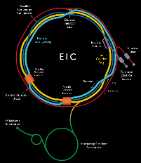



EIC Workshop – Promoting Collaboration on the Electron-Ion Collider
Cockcroft Institute
CEA PARIS-Saclay experience and EIC
Pierre Vedrine
CEA Saclay, IRFU/DACM
pierre.vedrine@cea.fr
October 2020

Slide 2
Overview

Slide 3











French research organisation
(nuclear, particle & astroparticle physics)
CNRS
34 000 staff
10 institutes
CEA
16 000 staff
4 directions
TGIR
ANR
CEA/DRF
6 000 staff
11 institutes
CNRS/IN2P3
3 300 staff
25 units
CNES
about 300 FTE on accelerators/magnets
(incl. GANIL-CNRS) in 13 labs/institutes
about 250 FTE on accelerators/magnets (incl. GANIL-CEA) in 1 institute

Slide 4
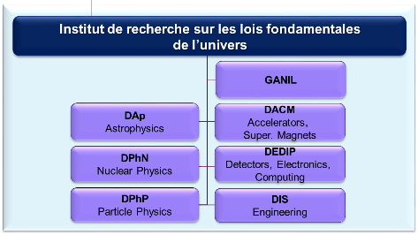
high technologies for accelerators
Institute of Research into the Fundamental Laws of the Universe
Irfu is developing and realizing particle accelerators, cryogenic systems and superconducting magnets for the scientific programs of Irfu and more widely of CEA.
Irfu develops R&D activities to support theses programs.
Irfu is involved in large scale projects in Europe, Japan and in USA.

Slide 5
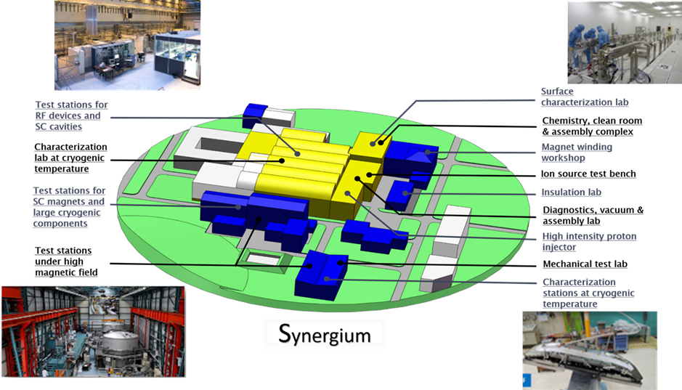
DACM technological infrastructures
(25 000 m²)

Slide 6
























ACADEMIC AND INDUSTRIAL PARTNERS
Notes:
Sigmaphi (refroidir le cyclotron du 192, programme LOTUS), Iter

Slide 7
Competences
High Intensity Light Ion Sources
Beam Transport Lines
Beam Diagnostics
Radio-Frequency Quadrupoles
Beam Dynamics
Superconducting RF Cavities and Cryomodules
Power sources, plasma accleration, targets
Superconducting Magnets
Cryogenics
Facilities

Slide 8
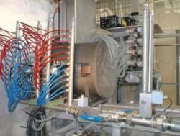
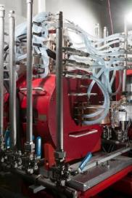
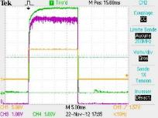
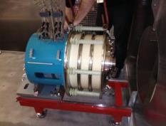

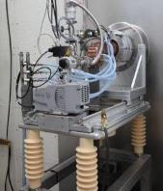
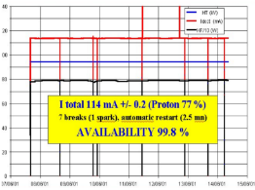
High Intensity Light Ion Sources
We are specialists of high intensity (5 – 100 mA) light ion (H⁺, D⁺) sources for accelerators
Current, emittance, species proportions, stability, reliability
Pulsed or continuous modes
IFMIF
140 mA
FAIR
Pulsed mode: duty cycle 20%
Vert: courant sortie source (25 mA/V)
Magenta: courant en fin de ligne (20 mA/V)
Orange: cadencement
Pulsed proton beam (30 ms - 300 ms @ 4Hz).
95 keV, 100 mA
Since 1996
95 kV, 100 mA
Fraction H⁺ > 80 %
Source of the IPHI project
Licence Pantechnik
SPIRAL2
SILHI reliability tests during 7 days, 114 mA : 99,8 %
8 trips > 3s
40 kV, 10 mA
Permanent magnets
Cost, size

Slide 9
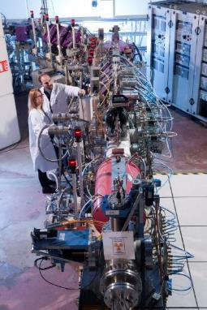
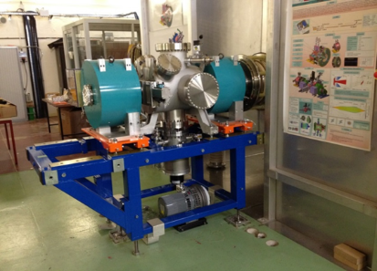

Low energy beam transport lines (LEBT)
Purpose of the LEBT:
House beam diagnostics
Focus the beam at the entrance of the acceleration stage
« Chop » the pulses
Challenge = keep the beam emittance small (in particular space charge effects at high intensity)
Source
D⁺
12m
Low Energy Beam Transport Line for the FAIR proton linac at CEA Saclay
SPIRAL2 LEBT at Saclay in 2012
Photo P.Stroppa/CEA

Slide 10
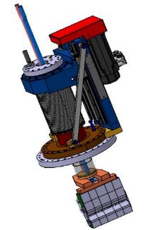






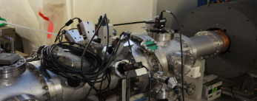
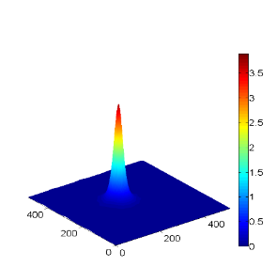

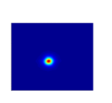

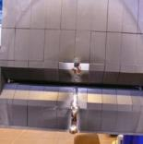




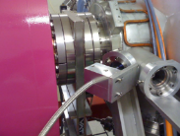
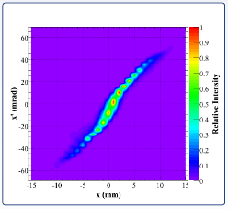
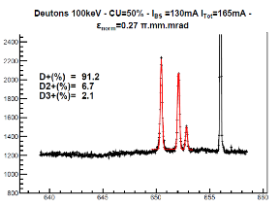
BEAM DIAGNOSTICS
Needed to characterize the beam: current, proportions, position, profile, emittance
High intensity = high power → non interceptive beam diagnostics
2D tomographic profile
Cooled emittance-meter
with thermal screen
30°
60°
90°
120°
150°
0°
Beam direction
0°
30°
60°
90°
120°
150°
Proportions measured by Doppler shift method
ε = 0.2 π.mm.rad

Slide 11
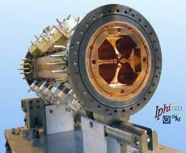

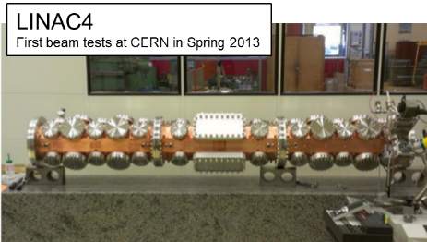
Radio-Frequency Quadrupoles (RFQ)
DACM has the following competences:
Beam dynamics simulations
RF design
Thermomechanical studies
Cooling
Mechanical design
Ancillary equipment
Realization with industries
Assembly
Tuning
Conditioning
Design and/or fabrication and/or tuning of the RFQs for IPHI, LINAC4 and SPIRAL2
Today, RFQ for ESS: design and realization of the RFQ, tuning, RF conditioning

Slide 12
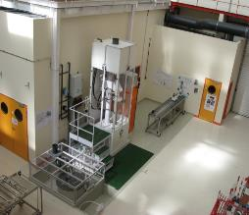
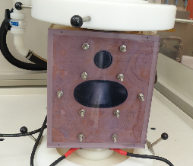
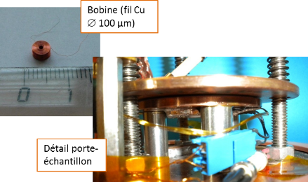
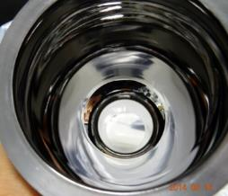
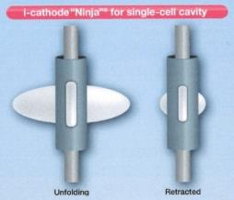
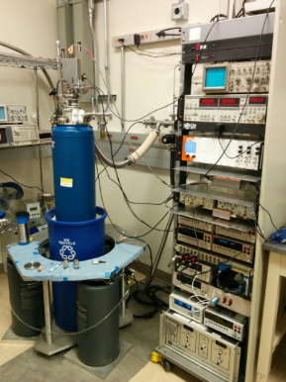
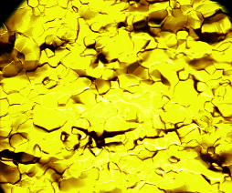
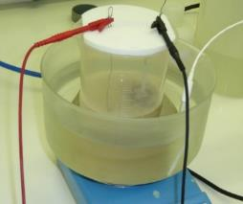
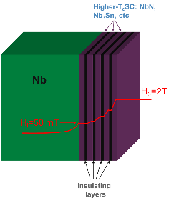
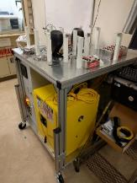
SC cavities
Electropolishing:
Test New Electrolytes
(Better speed, surface state)
To understand and improve hydrodynamics.
Magnetometer
Collaboration CEA-KEK :
Use of rotating cathode « ninja » (uniform polishing)
Scanning tunnelling spectroscopy
R&D BCP treatment:
Test reduction of Fluor concentration
Study Frequency Vs Chemistry
R&D Atomic Layer deposition (ALD):
Sample caracterisation of treatments HT (degassing H, N doping, ALD doping)
Tests of thermal treatments on samples and existing cavities

Slide 13
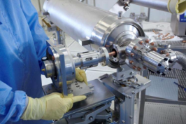
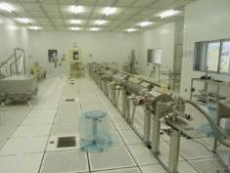
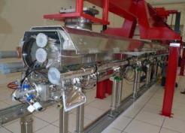
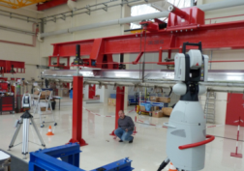
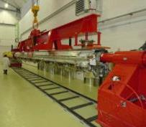
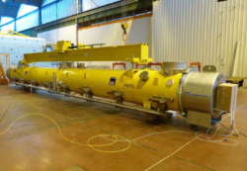
Superconducting RF technologies: from cavity design to cryomodules
Coupler assembly
Cavity train assembly
Cold mass assembly
Alignment
Insertion into cryostat
Shipment

Slide 14
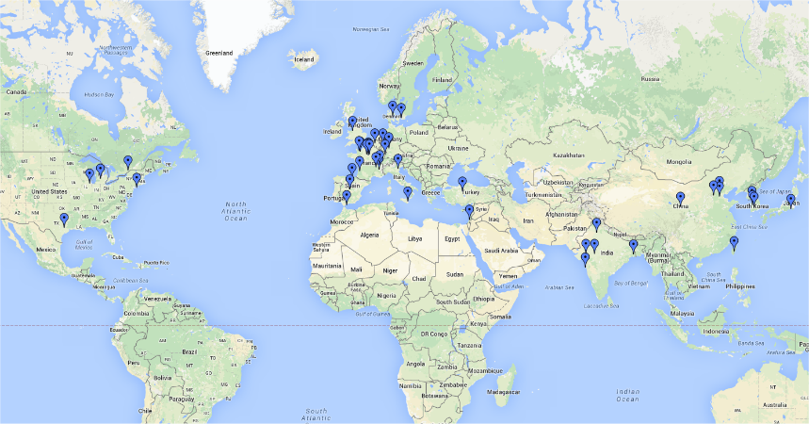
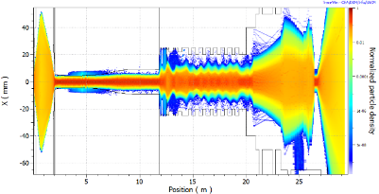
BEAM DYNAMICS codes
DACM is developing codes since 90’s. TRACEWIN is commercially distributed.
Beam dynamics codes are mandatory for accelerator optimization and commissioning
160 users, 47 laboratories, 3 companies, 18 countries
Source to target simulation of the IFMIF accelerator

Slide 15
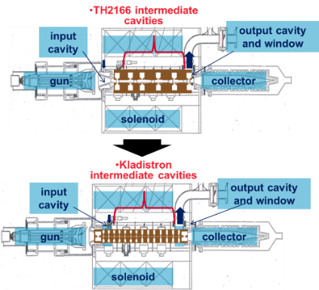
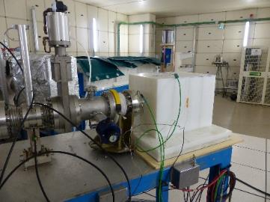
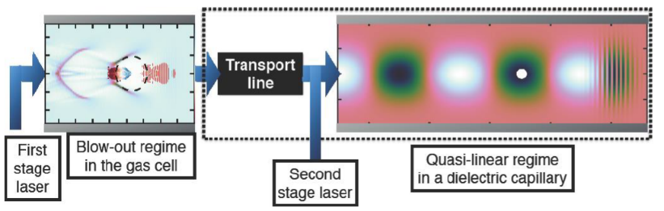
Power sources, plasma acceleration, target
  High-efficiency klystron with a large number of cavities
      Higher efficiency
      Working on a design at 12 GHz (70%)
      « kladistron version » of an existing klystron from Thales (TH 2166, 4.9 GHz, 50 kW, 6 cavities) to give a proof of principle.
Target Be + PE
Time of flight
  Enabling plasma accelerator
      Enabling multi-stage acceleration (EuPRAXIA, CILEX)
      Optimizing plasma profile
      Simulations
  R&D on Beryllium target and moderator at IPHI to produce neutrons
      Collaboration with LLB
      Target / moderator development

Slide 16









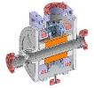







Superconducting magnets
NbTi
Nb₃Sn
Accelerator magnets for LHC
MQ MQYY
FRESCA 2
Dipole and Quad for FCC
Technology development
Other Accelerator Magnet
SARAF FAIR SuperFRS
MgB₂
HTS => ReBCO
LOTUS: radio isotope production
Conductor characterization
For accelerator magnets
EUCARD
EUCARD2
MRI magnet: ISEULT
For high field magnets
Special magnet
WAVE: neutron diffraction=> condensed matter physics

Slide 17
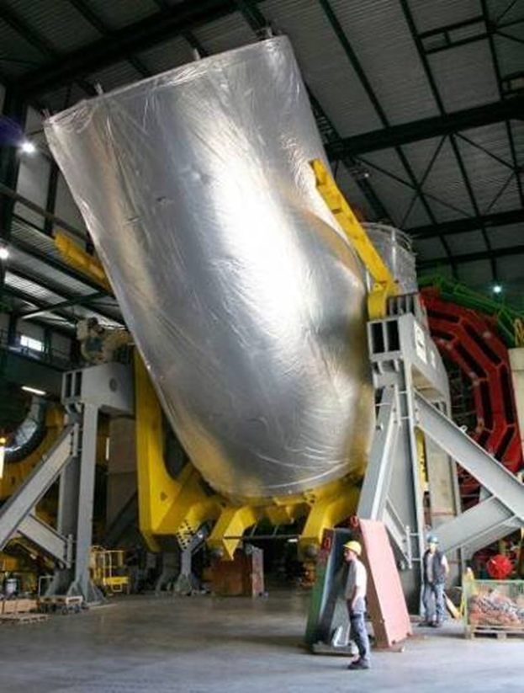
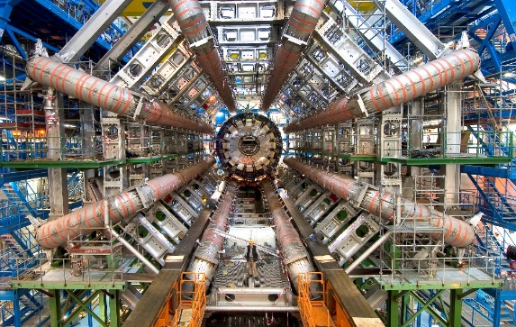
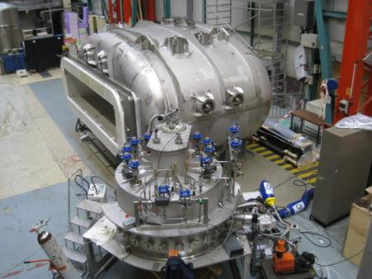
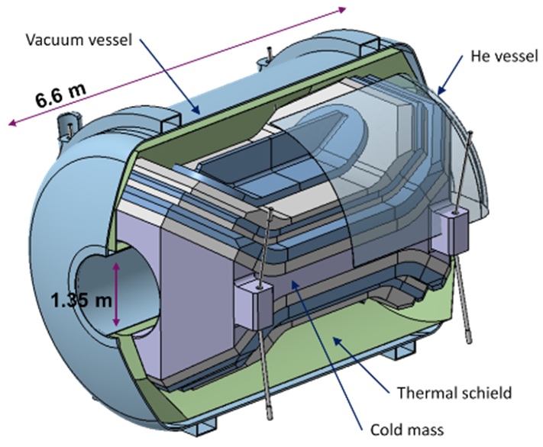
Superconducting magnets
SACM is also developing superconducting magnets for physics detectors
ATLAS Barrel Toroid Magnet (LHC, CERN)
CMS Solenoid Magnet (LHC, CERN)
Large acceptance SC dipole
(R3B-GLAD GSI Darmstadt)
MadMax Axion experiment
(MPI Munich)

Slide 18
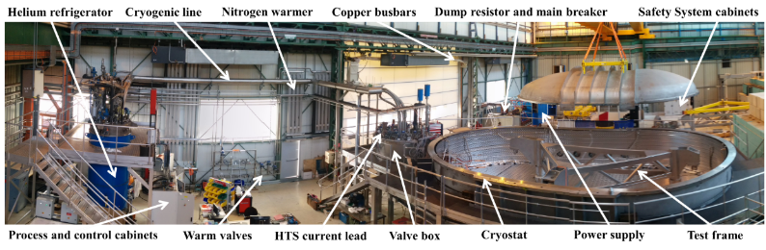
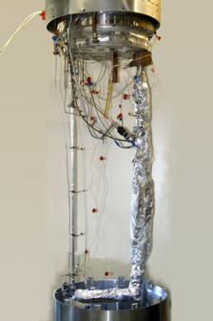
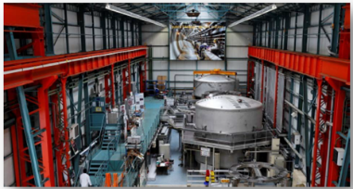
Cryogenics
Large coil testing facilities
R&D activities for new cooling solutions

Slide 19
Highlights

Slide 20













MQYY(M)
Quadrupole en NbTi
Operating Gradient | 120 T/m
Operating current | 4550 A
Bpeak at operation | 6.42 T
A 4 m test coil was wound by Sigmaphi and another by Elytt Energy.
The mechanical structures demonstration programme is in its final phase.
MQYY (3,67 m)
Aluminum collars
SS collars
MQYYM (1,35 m)
Assembly of the magnet at CERN by the CEA team with CERN/927 support
Manufacture of coils at the CEA

Slide 21




FRESCA 2 Nb3Sn dipole
14.6 T in FRESCA2, in collaboration with CERN, a niobium-tin dipole magnet with an aperture of 100 mm, tested in early August 2017 at the HFM test station at CERN.
World record, with a stored energy of 3 MJ/m and mechanical forces never before achieved in this type of magnet, with a magnetic field homogeneity of around one percent over a length of 540 mm.

Slide 22



Dipole model toward FCC
CERN-CEA collaboration agreement to design and fabricate a single aperture block model at CEA
FCC Flared-ends Dipole Demonstrator: F2D2 => as close as possible to ECC
Conductor parameters HF LF
Strand diameter | 1.1 mm | 0.7 mm
Cu/nonCu ratio | 0,8 | 2
Jc at 4.2 K and 16 T | 1200 A/mm2
Cable number of strands | 21 | 34
Unreacted bare cable width | 12.579 mm
Unreacted bare cable thickness | 1.969 mm | 1.253 mm
HT cable thickness dim. change | 4.6 % | 4.5 %
HT cable width dim. change | 1.3 %
Reacted bare cable width | 12.74 mm
Reacted bare cable thickness | 2.06 mm | 1.31 mm
Insulation thickness at 50 MPa | 0.150 mm
2D magnetic parameters
I_{op} | 10469 A
LL margin HF | 14.0 %
LL margin LF | 15.4%
B_{bore} | -15.54 T
B_{peak} HF | 16.20 T
B_{peak} LF | 11.85 T
b₃ at nominal | 2.98
b₃ at injection | -14.80
b₅ | -0.50
b₇ | -2.98
b₉ | -1.46

Slide 23




Toward HTS accelerator magnets: EUCARD
Nominal current | A | 2800
Central field wo / w SCIF (screening current induced field) | T | 5.4 / 4.7
Temperature | K | 4.2
Stocked energy | kJ | 12.5
Inductance | mH | 3.2
Temperature margin | K | 29
Load line margin | % | 47
Tested at CEA Paris Saclay and reached 5.4 T

Slide 24







MadMax
10 T NbTi coils
A new QCD Dark Matter Axion Experiment

Slide 25


ISEULT 11.75T WB MRI MAGNET
Iseult project magnet 11.72 T-900 mm has reached its nominal field strength
11.72 teslas on July 18, 2019.

Slide 26



HIGH FIELD HYBRID MAGNET LNCMI-Grenoble
Objective: Exceed 42 teslas in the LNCMI Grenoble Hybrid Station
The CEA is involved in the studies and realization of the superconducting magnet outsert, the cryogenic satellite and the heat pipe. CNRS LNCMI is prime contractor for this hybrid station.
  Superconducting magnet alone 8,5 T
    8,5 T n Φ 800 mm n (700 kW)
  Supercond. + Bitter (9 T)
    17,5 T n Φ 376 mm n (12 MW)
  Supercond. + Bitter + Polyhelix (25 T)
    42,5 T n Φ 34 mm n (24 MW)
25+ 9 + 8,5 = 42,5 T
NbTi 8.5 T – 500 mm Outsert
Magnet manufacturing
(BNG, Allemagne)
Magnet support post

Slide 27


NOUGAT
ANR-14-CE05-0005 'NOUvelle Génération d'Aimants pour la production de Teslas'
New Generation of Magnets for Teslas Production
Insert made of 9 double pancake (ReBCO) (inner diameter of 50 mm) using an innovative MI insulation (Metal-as-Insulation)
32.5 T obtained (14,5 T created by the HTS insert with a background field of 18T @ LCNMI Grenoble)

Slide 28




JT60 (broader approach)
      Superconducting Tokamak JT60-SA
      Construction of 18 (+2) coils (IRFM/IRFU) – 15 tons, 4.5 K
Cryogenic tests
    Nominal conditions ( 27.5 kA)
    All steps succesful ( fast discharge, quench)
Outer Intercoil mechanical structure integration
11 coils left Saclay → NAKA

Slide 29




Future Circular Collider
Objective: design of a p-p collider at CERN (100 TeV centre of mass, 100 km circumference, 16 T dipoles)
DACM involved in arc optics and magnet design.
Collider optics validated
Maximum fields of the magnets, protection, beam stability, ...
CDR published
Future: participation in the FCC-ee booster
http://fcc-cdr.web.cern.ch/
Collider scheme
Multi-turn injection stability (3.3 TeV)

Slide 30



RFQ European Spallation Source
Novembre 2019

Slide 31



ESS cryomodules
M-ECCTD in the test bunker at Lund
Cryomodules prototype M-ECCTD ( CM00):
February 2019: Transport of the prototype M-ECCTD cryomodules to Lund after the RF and 2K power tests carried out at CEA at the end of 2018.
The M-ECCTD cryo module will be tested at ESS. It is currently installed in the test stand...
Beta = 0.67
CM01 in the test bunker at Saclay
CM01: 1er cryomodule medium beta series tested at Saclay
CM30 in the assembly hall in Saclay
Cryomodules prototype H-ECCTD (CM30):
Assembly done, test is ongoing at Saclay
Beta = 0,86

Slide 32



SPIRAL 2 Cryomodules
12 Cryomodules type A (CMA) quarter wave cavity installed by the end of 2015
1st beam at LINAC output (33 MeV): 27/11/2019
A proton beam intensity of 4.7mA at the nominal energy of 33 MeV, produces a mono energetic neutron beam at 30 MeV : 09/2020

Slide 33


SARAF accelErator, SOREQ
Superconducting linear accelerator, providing proton and deuteron beams of variable energy between 5 and 40 MeV with an intensity of up to 5mA for SOREQ in Israel.
Delivery of the medium-energy line, MEBT to SOREQ-Israel in August 2020

Slide 34
interest in EIC

Slide 35
IRFU Potential interest to the EIC
DACM is interested in helping the EIC in its development.
We have clearly a number of expertise and facilities that could benefit developments for the future accelerator.
Expertise
  Beam physics and technologies
  SRF technology
  Superconducitng magnets
Facilities
  - SRF assembly and test facilities
  - Magnet assembly and test facilities
DACM welcomes future collaborations with the EIC team on the accelerator and the detectors.

