Slide 1

EIC Beam-beam Effects
Yun Luo
EIC Accelerator Collaboration Workshop
October 7-9, 2020

Slide 2
Outline
Introduction
Beam-beam Challenges for EIC
Simulation for e-p 10GeV * 275GeV collision
Important parameters to BB performance
Simulation for electron bunch replacement
Summary
Acknowledgement
Backup slides

Slide 3
EIC Design Goal
As stated in 2015 DOE/NSF Long Range Plan for Nuclear Science, the next generation of electron-ion collider will meet the following requirements:
1) Polarized (~70%) electrons, protons, and light nuclei,
2) Ion beams from deuterons to the heaviest stable nuclei, variable center of mass energies ~20-100 GeV, upgradable to ~140 GeV,
3) High collision luminosity ~10³³-10³⁴ cm⁻²sec⁻¹, and
4) Possibly have more than one interaction region.
Requirements 2), 3), and 4) are all related to beam-beam interaction.
3

Slide 4
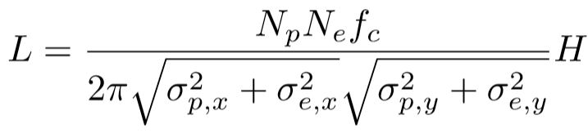
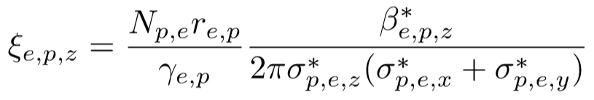
Luminosity and Beam-beam
Luminosity is given by:
To achieve such a high luminosity in EIC, we need to
  increase bunch intensities
  reduce transverse beam sizes at IP
  increase collision frequency.
However, methods 1) and 2) are limited by beam-beam interaction which is measured with beam-beam parameter:
Method 3) requires crossing collision which involves crab cavities.
4

Slide 5
Challenges in BB Interaction in EIC
High beam-beam parameters
Proton ring BB parameter~ 0.015, Electron BB parameter~0.1
Combination not demonstrated in early electron-ion colliders
Large crossing angle
Full crossing angle is 25mrad
Collision with crab cavities
Crab cavities had been used in KEK-B
Not used in any hadron collider
Other challenges
No SR damping in hadron ring, Flat beam at IP,
Near-integer electron tunes, Dynamic-beta effect (pinch effect),
and so on.
5

Slide 6
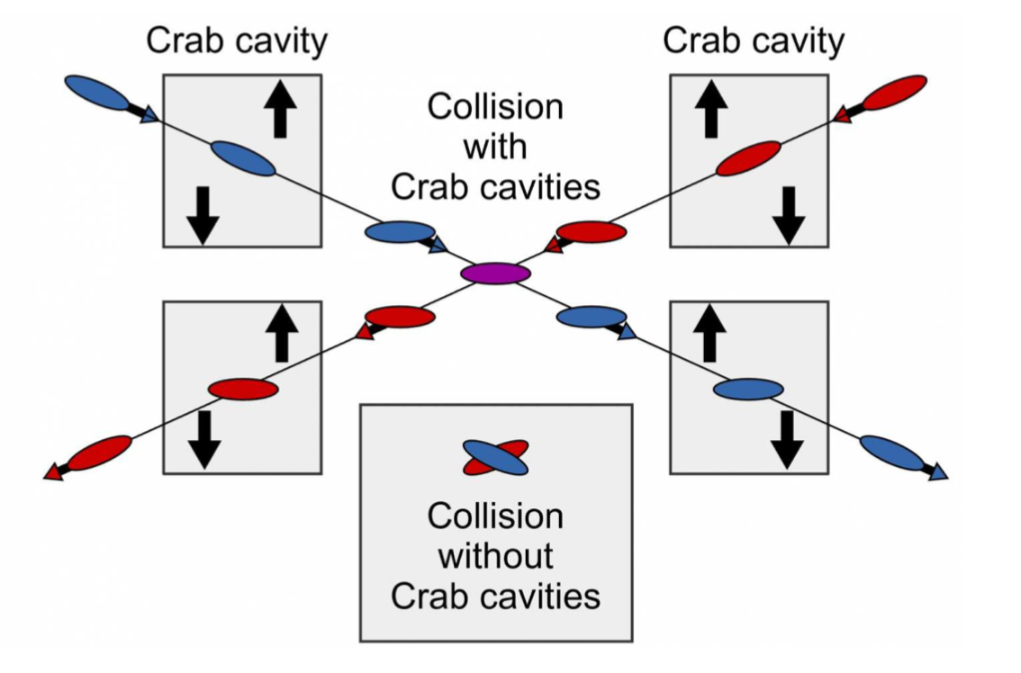
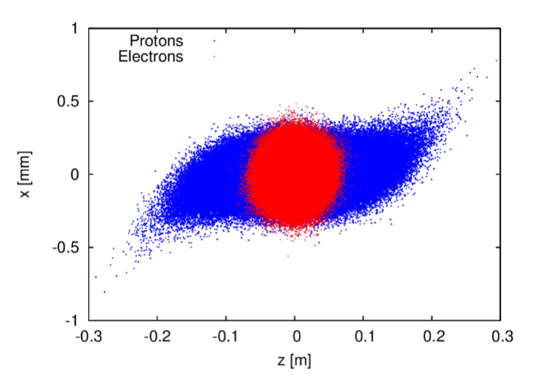
Collision with crab cavities
Crab cavities are needed in both rings. Due to long proton bunch length and finite wave length of crab cavities, crabbed collision causes offset beam-beam interaction, synchro-betatron resonance, and leads to poor beam lifetime.

Slide 7
Simulation tools and methods
Both strong-strong and weak-strong simulation methods have been used for EIC BB studies. Strong-strong simulations are mostly used for equilibrium beam sizes and luminosity calculation, coherent beam-beam studies. Weak-strong simulations are mostly used for long-term stability and dynamic aperture calculation.
Strong-strong codes:
BeamBeam3D by J. Qiang, BBSS by K. Ohmi
SimTrack by Y. Luo, EPIC by Y. Hao (Soft-Gaussian)
Weak-strong codes:
SimTrack by Y. Luo (symplectic, element-by-element)
BeamBeam3D by J. Qiang (LBNL) ( frozen electron distribution in S-S)
Checks and indicators for beam stabilities:
emittance growth, luminosity degradation ( related to numeric errors)
FMA, action diffusion, RDTs ( how to link to real beam lifetime)
dynamic aperture ( weak-strong, a robust measure).

Slide 8
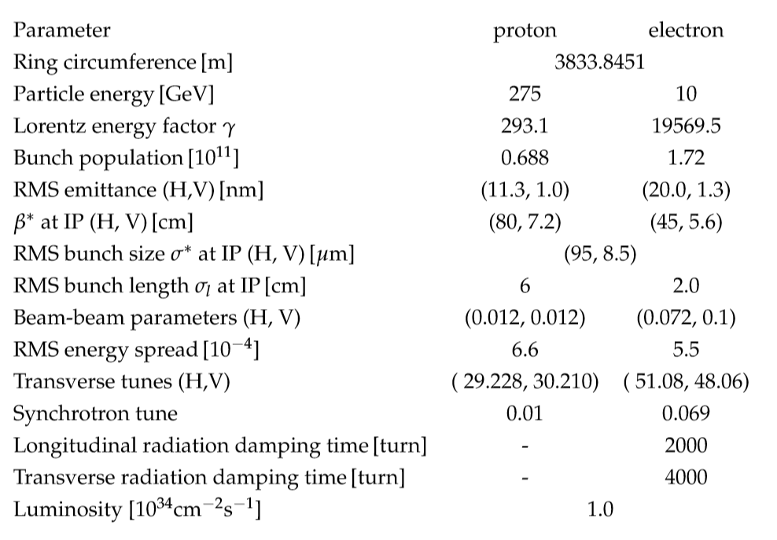
Design Parameters for e-p 10GeV * 275GeV collision

Slide 9
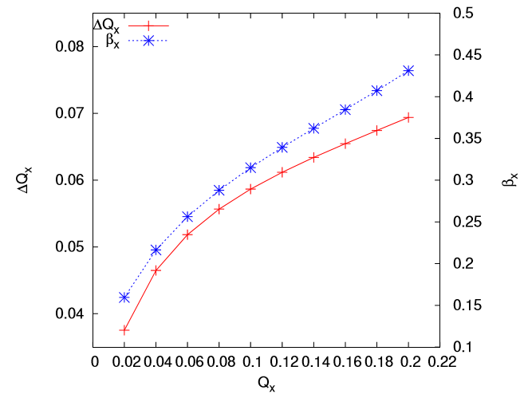
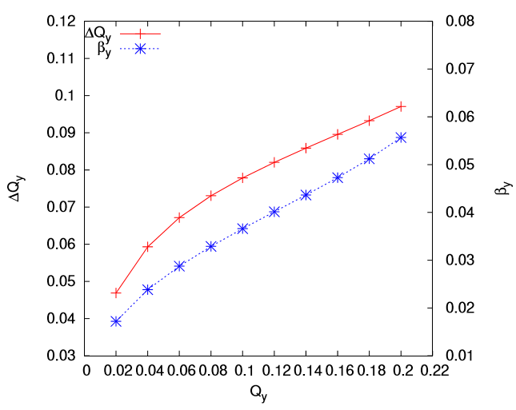
Dynamic-beta effect: electron
Design Qx
Design Qy
Horizontal
Vertical
Dynamic-beta reduces beta-functions at IP and generates even smaller beam sizes at IP, which enhances luminosity BUT increases proton’s beam-beam parameter.

Slide 10
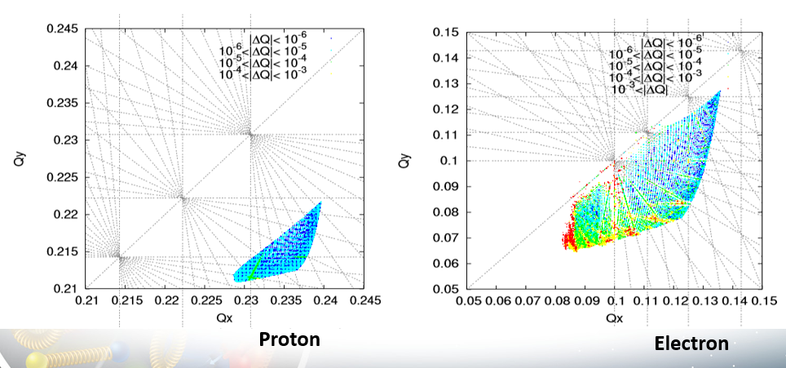
Tune Footprint ( Weak-strong)
Beam-beam generates amplitude dependent tune shift. Proton tune footprint crosses 9th order resonances. Electron tune footprint crosses 10th order resonances. Difficult colors represent different order of magnitudes of tune diffusion in above plots.

Slide 11
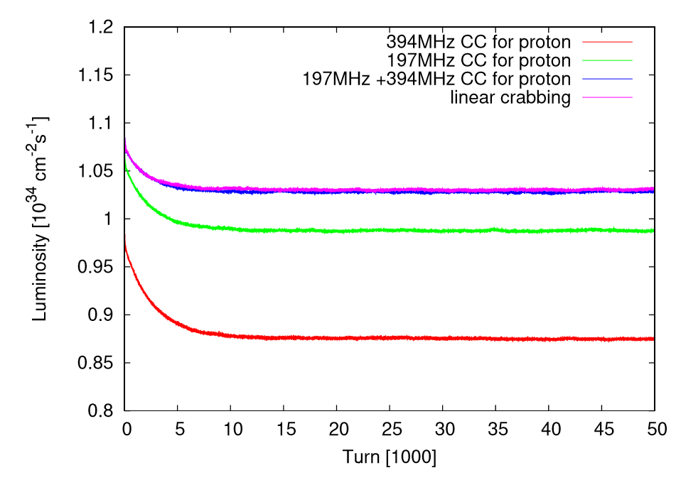
Luminosity Evolution
The design frequencies of crab cavities for the proton and electron rings are 197MHz and 394MHz. Second harmonic crab cavities 394MHz for protons are under consideration, which improves proton lifetime.

Slide 12
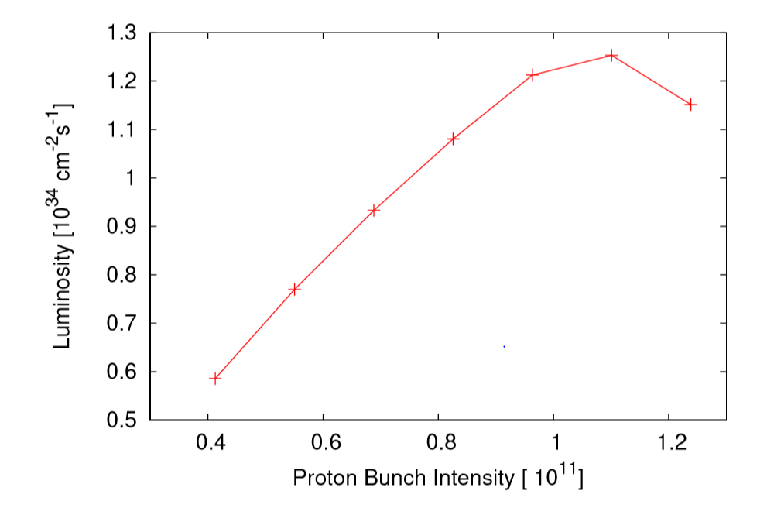
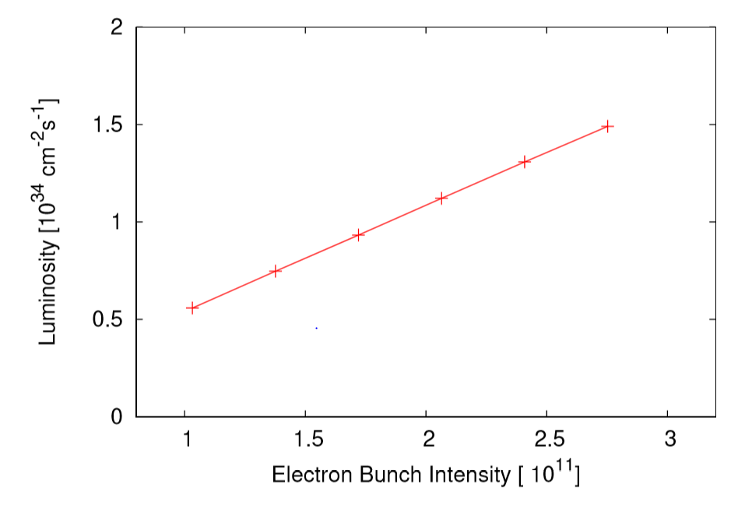
Bunch Intensity Scan
Np design: 0.688e11
Ne design:
1.72e11
The design beam-beam parameters for proton and electron beams are 0.012 and 0.1. Increasing bunch intensity will increase beam-beam parameter for the opposite beam. Current design bunch intensities are in a reasonable range.

Slide 13
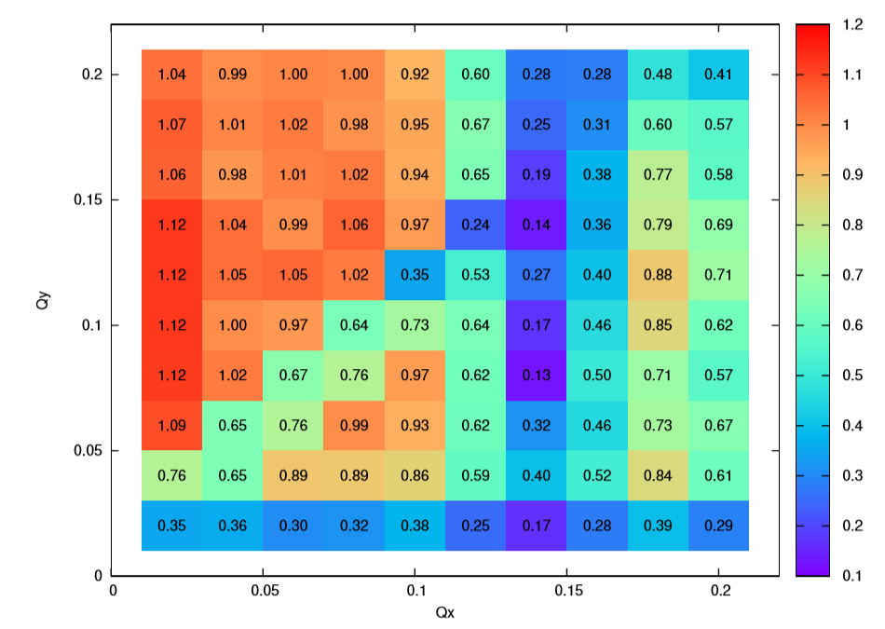
Electron Tune Scan: strong-strong
Luminosity
Higher luminosity can be obtained with lower horizontal tunes and higher vertical tunes. However, higher vertical tunes give relatively fast proton vertical emittance growth.
Currently we focus on two choices for electron tunes: (0.08, 0.06) and (0.10, 0.12).
Proton lifetime prefers lower electron vertical tune while polarization prefers higher electron vertical tune.

Slide 14
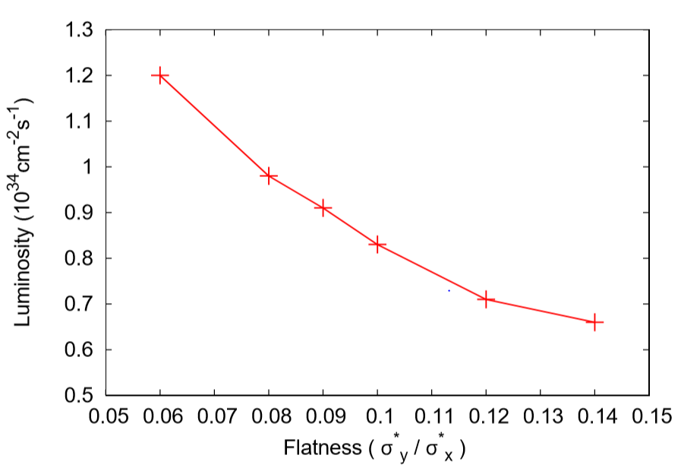
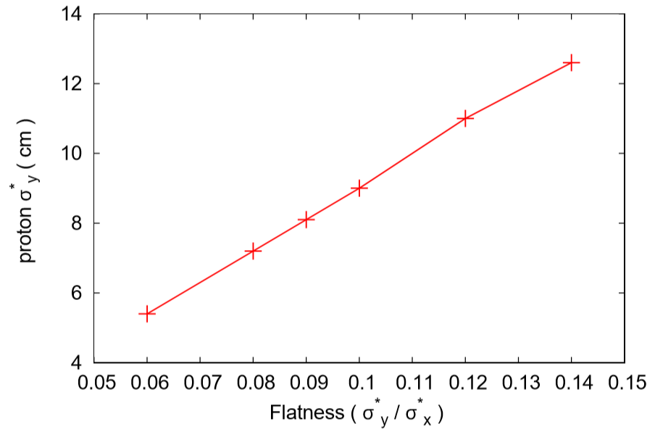
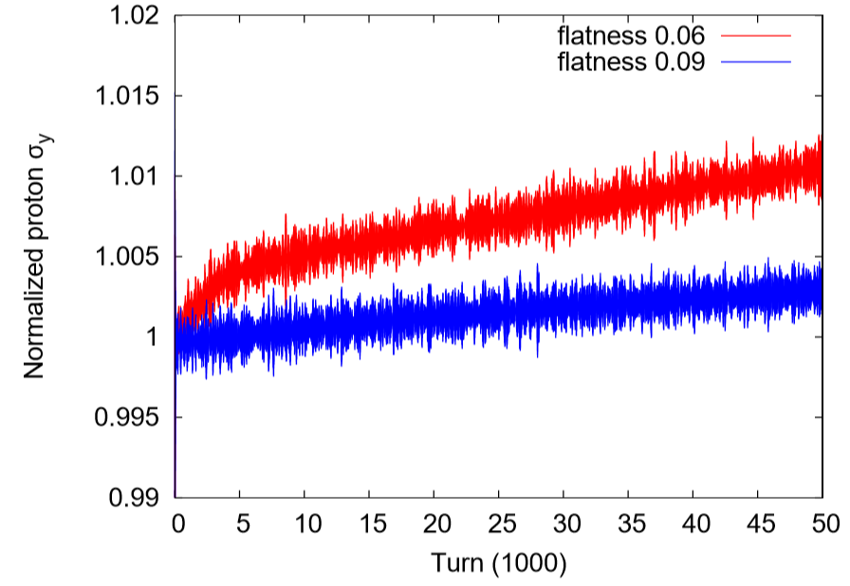
Flatness and BB performance
Luminosity
vs. flatness
β*y vs. flatness
Flatness is defined as σ*y/ σ*x at IP. Lower flatness needs lower betay* in lattices. Lower flatness or flatter beams yields a higher luminosity. However, through beam-beam simulation, we noticed that flatter beams cause faster proton vertical beam size growth.
Beam size growth vs. flatness

Slide 15
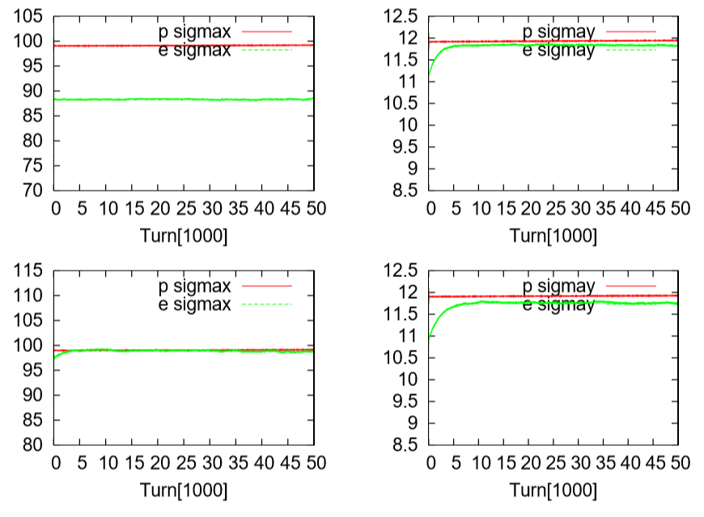
Beam Size Matching at IP
Example: flatness 0.12
Due to SR effect in electron ring and BB interaction , electron and proton beam sizes are not matched at IP in most cases.
We noticed that mismatched beam sizes will hurt beam lifetime, especially when electron beam sizes are smaller than proton’s sizes.
To match electron and proton’s beam sizes, we normally adjust electron’s β*x,y and /or emittances at IP.
Bema sizes in um
Before matching
Before matching
After matching
After matching

Slide 16
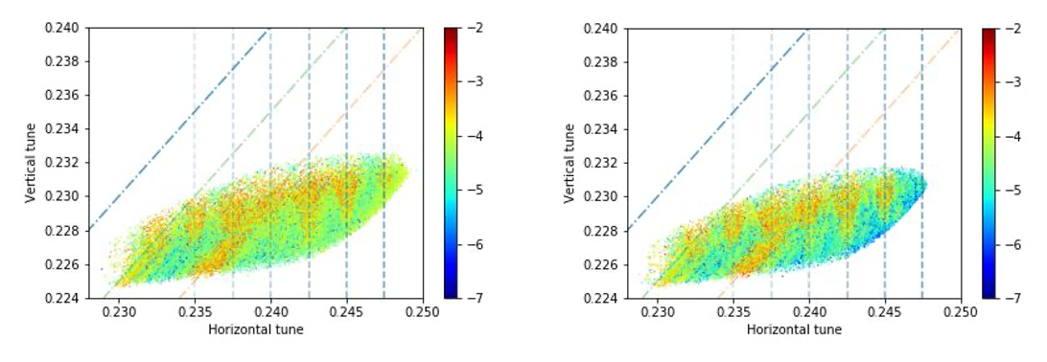
Synchro-Betatron Resonance
Strong-strong
Weak-strong
Resonances mQx+pQs and 2Qx-2Qy+pQs for protons are revealed from FMA in both strong-strong and weak-strong simulations. Those resonances are related to crossing collision. Second harmonic crab cavities help minimizing synchro-betatron resonances.

Slide 17
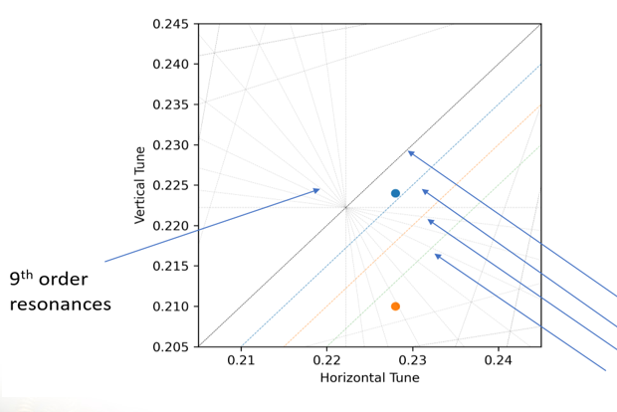
Proton Working Point
(0.228, 0.224)
Coupled synchro-betatron resonances
(0.228, 0.210)
Moving proton tunes from (0.310,0.305) down to (0.228, 0.224) helps minimizing mQx+pQs resonance effect. Further lowering vertical tune from diagonal helps minimizing 2Qx-2Qy+pQs resonance effect.

Slide 18
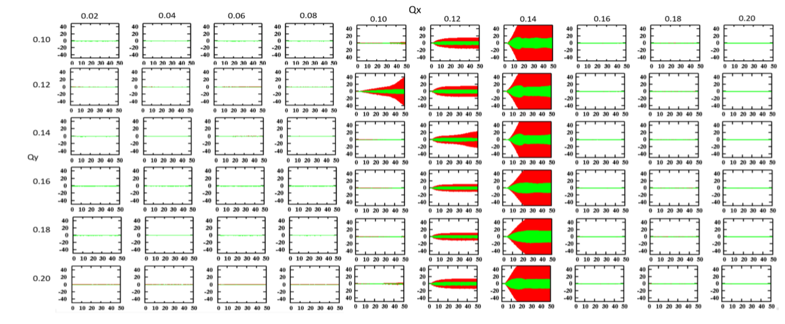
Coherent Beam-beam Instability
<Xp> and <Xe> in electron tune scan
Coherent BB instability was observed with the electron horizontal tune are between 0.1 and 0.14. More studies show these instabilities were caused by coherent coupling resonance between horizontal proton tune and horizontal electron tune.

Slide 19
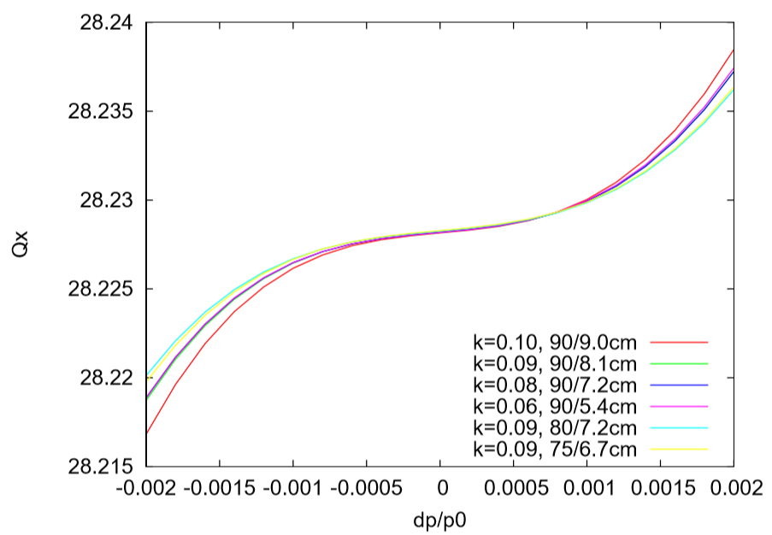
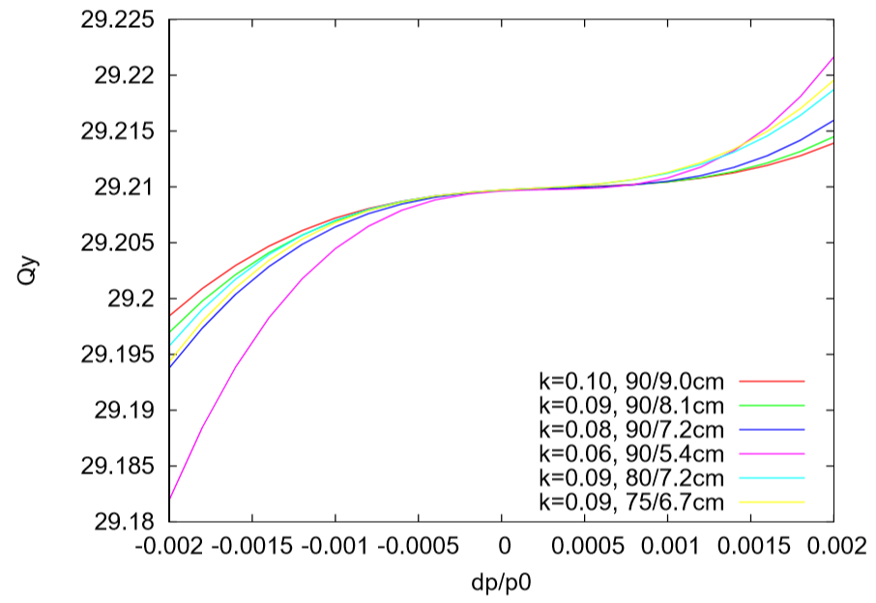
Proton Lattice Design
Hadron ring lattice design went side by side with strong-strong beam-beam simulation studies. Lattices with different design parameters are created and tracked.
Off-momentum tunes, (dp/p0)_{rms}=6.6e-4.
flatness, β*_{xp /} β*_{yp}
flatness, β*_{xp /} β*_{yp}

Slide 20
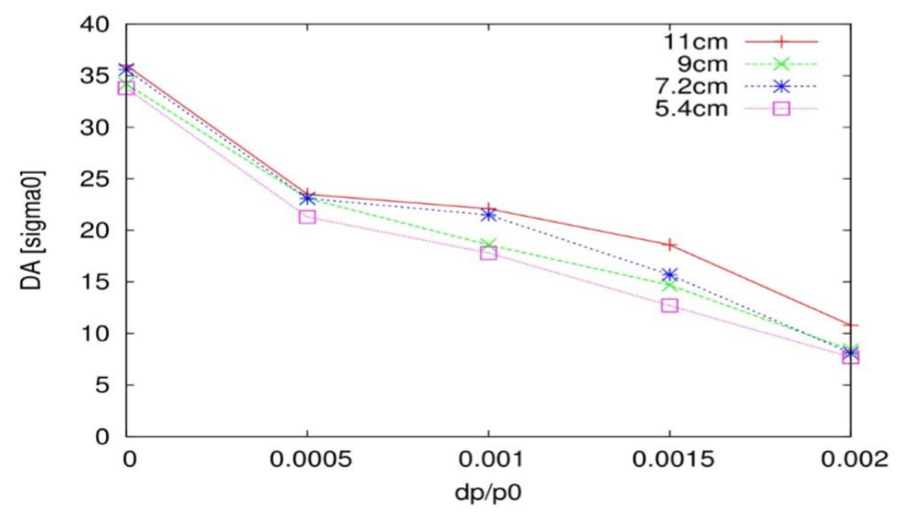
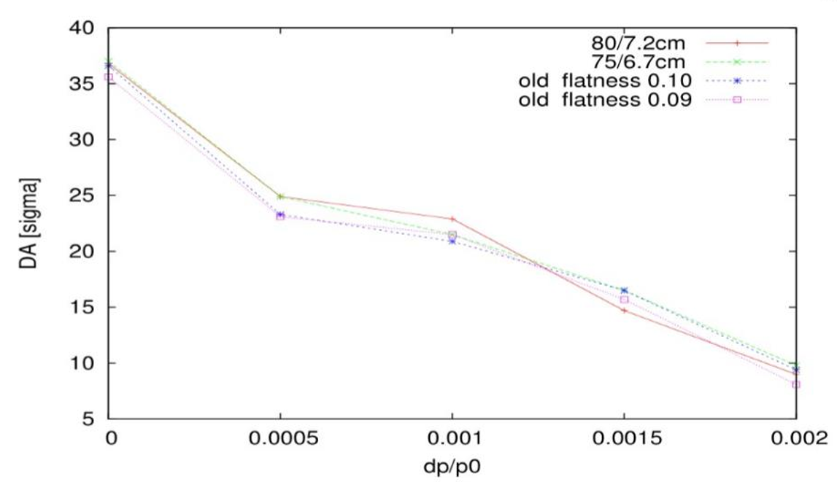
Dynamic aperture calculation
With β*_{xp} = 90cm
With β*_{xp} = 80cm and 75cm
Left: Dynamic aperture as function of different β*_{yp}. Right: Dynamic aperture with β*_{xp} =80cm and 75 cm . To reach the design luminosity 10³⁴ cm⁻²s⁻¹ with flatness 0.09, we reduced horizontal β*_{xp} slightly from 90cm to 80cm.

Slide 21
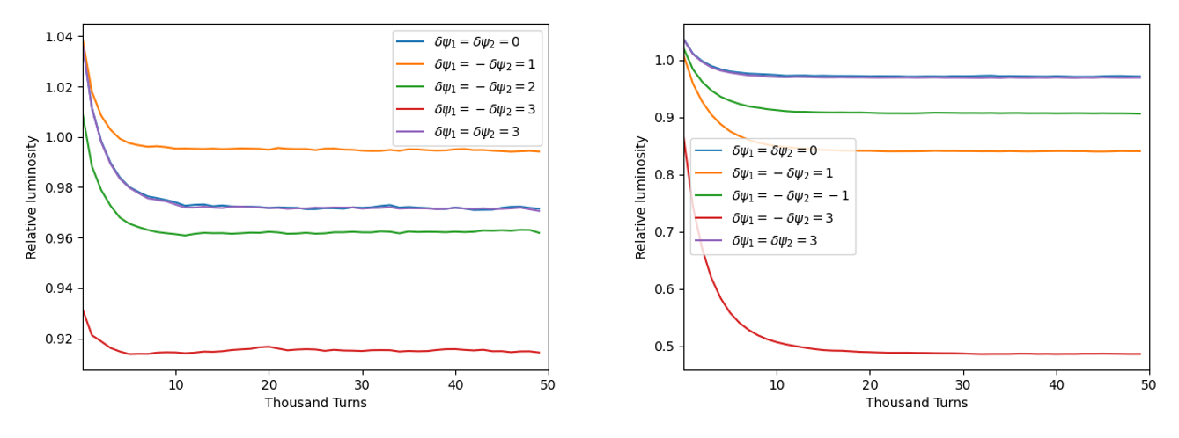
Imperfection with Crab Cavities
Imperfections with crab cavities have been studied. Imperfections include phase errors between crab cavity and IP, dispersion and dispersion derivative at crab cavities, crab cavity voltage mis-calibration, voltage and phase noises, detector solenoid effect, and so on. Imperfection with crab cavities are is still going on.
phase errors in proton ring
phase errors in electron ring
Simulations show that proton ring may tolerate 2 degrees phase error on each side of IP, if they are in opposite sign. The tolerance for electron ring is tighter, which can be reduced by choosing a higher vertical electron tune or a third crab cavity to create a closed bump.

Slide 22
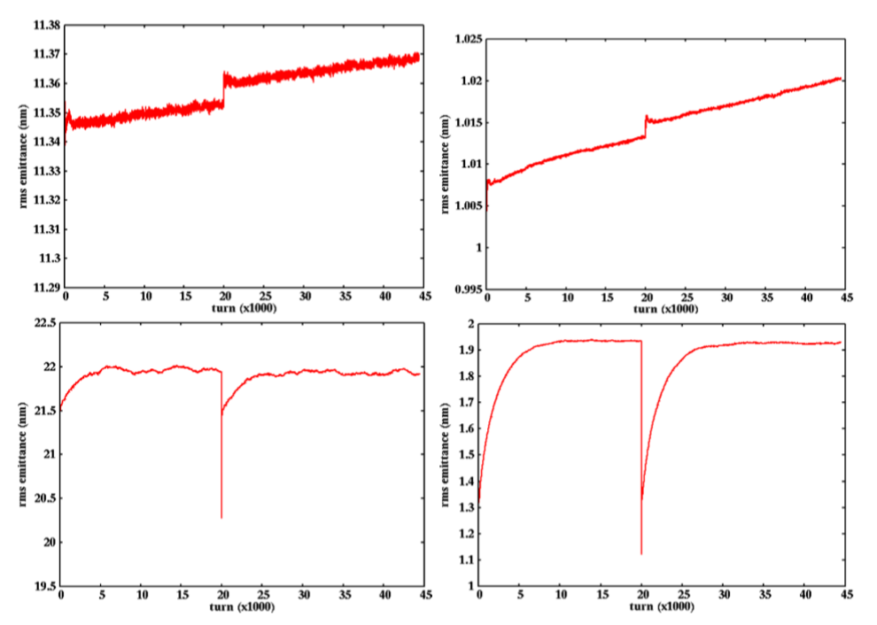
Electron bunch replacement
Due to short electron polarization lifetime, each electron bunch will be replaced in minutes. Transient beam-beam eﬀect during electron bunch replacement had been studied, especially for any possible proton emittance growth during this process.
electron replacement at 20,000th turn
Proton H emittance
Proton V emittance
No injection
error here.
Electron H emittance
Electron V emittance

Slide 23
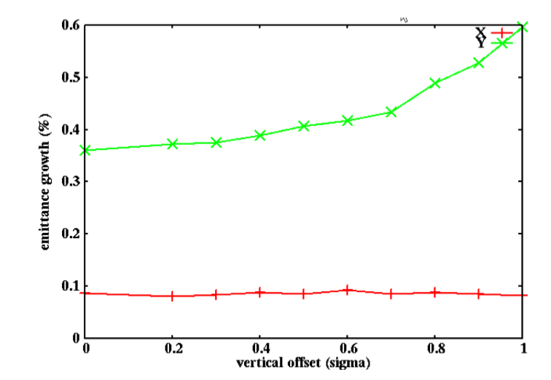
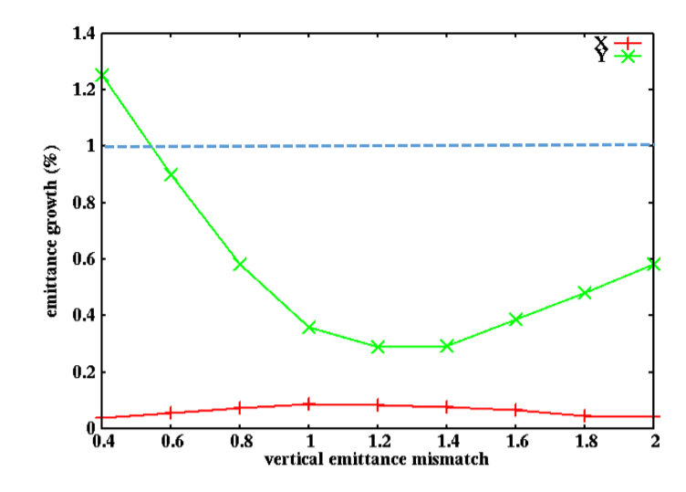
Simulation with injection errors
Electron injection errors include: H/V positions, H/V angles, energy and arrival time, emittance mismatching, etc.
Design
Example 1: The proton beam emittance growth percentage after one electron beam replacement as a function of electron beam’s vertical injection position error.
Example 2: The proton beam emittance growth percentage after one electron beam replacement as a function of initial electron beam vertical emittance mismatching.

Slide 24
Summary
During beam-beam related design parameter optimizing, we noticed that beam flatness, beam size matching at IP, both electron and proton’s working points and so on affect the proton vertical emittance growth.
To reach the design luminosity 1×10³⁴cm⁻²s⁻¹ with a relatively low proton beam size growth, we chose a set of design parameters with flatness =0.09 and proton β*_{x,y,p} =(80,7.2)cm as our base design set.
Hadron ring lattice design and dynamic aperture calculation were done. Current design parameters gives dynamic aperture more than 8 σs. Realistic IR magnetic nonlinearity is to be included in DA calculation.
Design parameter optimizing is still going on. Better understanding underlying physics is needed. Effects with realistic lattice nonlinearity and crab cavity imperfection need more studies.

Slide 25
Acknowledgement
EIC Beam-beam task force ( April-Sept. 2020):
Members: S. Berg(BNL), ), X. Gu (BNL), Y. Luo(BNL), J. Qiang (LBNL), Y. Hao (MSU), D. Xu(MSU), E. Nissen (JLAB)
Helpers and consultants: M. Blaskiewicz, W. Fischer, H. Lovelace III, C. Montag, B. Palmer, S. Peggs, V. Ptitsyn
And many more others.

Slide 26
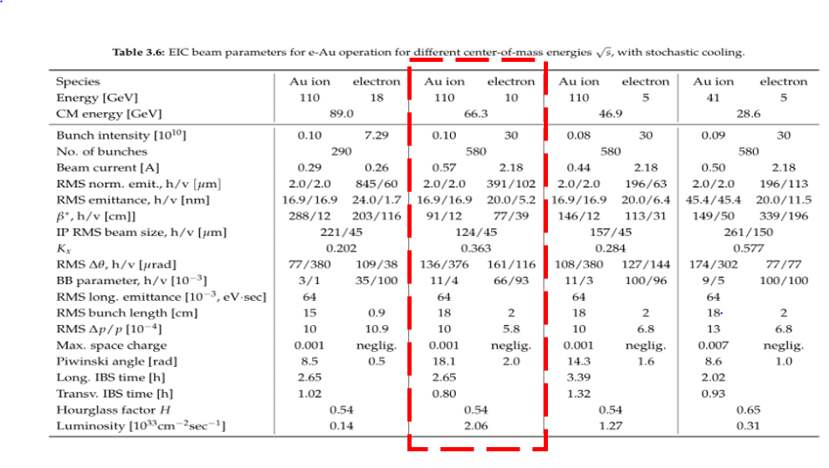
Backup slides: e-Au 10GeV*100GeV Collison

Slide 27
