Slide 1
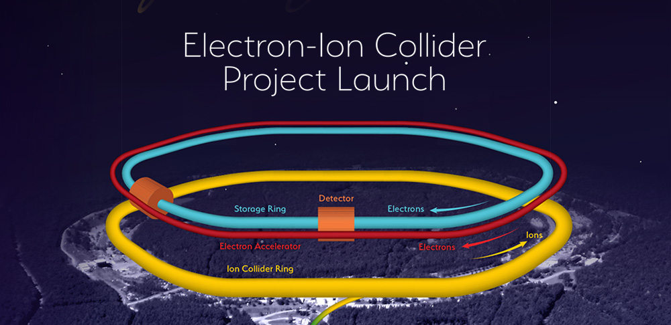
EIC Workshop – Promoting Collaboration on the Electron-Ion Collider
Europe/Africa Focus: Session 3.2
Conveners: Silvia Verdú Andrés (Brookhaven National Laboratory BNL),
Vasiliy Morozov (Jefferson Lab)
Chair: R. Cimino (LNF-INFN)

Slide 2
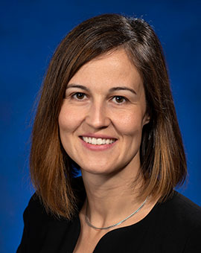
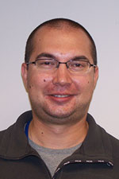
The Conveners:
Silvia Verdú Andrés
(Brookhaven National Laboratory, BNL)
Vasiliy Morozov
(Jefferson Lab)

Slide 3
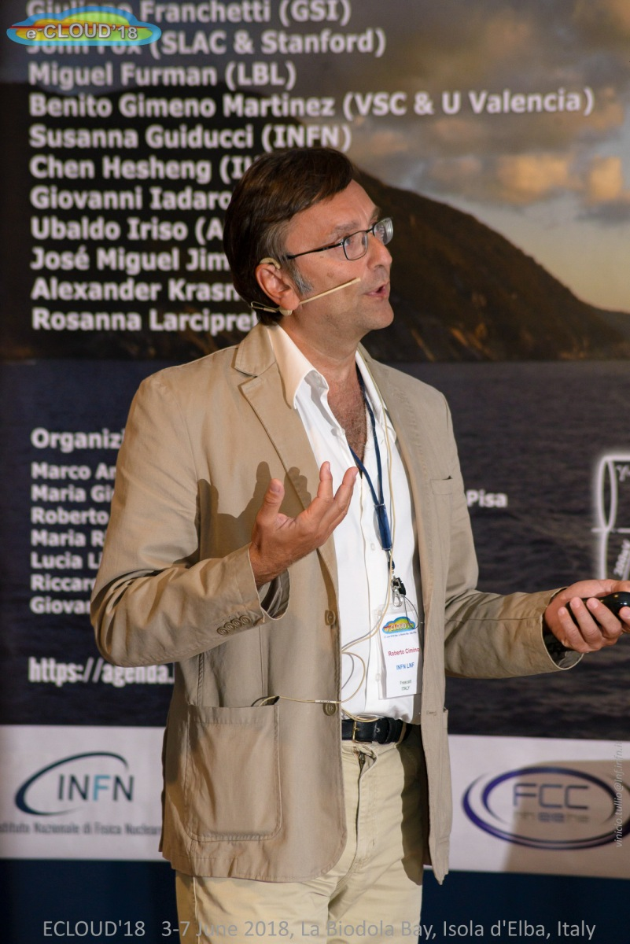
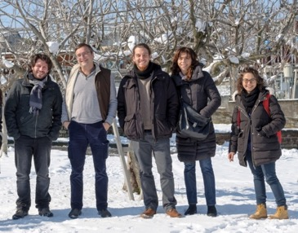
The chair:
Roberto Cimino (LNF – INFN)
Active in e-cloud experimental studies
Co-chair (with Frank Zimmermann) of ECLOUD12, ECLOUD18 and (hopefully) ECLOUD22.
Running an experimental group at LNF to study LT and RT SEY, XPS, temperature, electron and photon stimulated desorption etc..

Slide 4
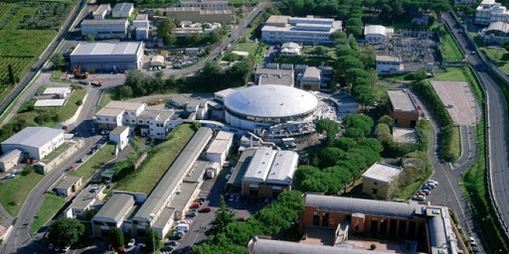
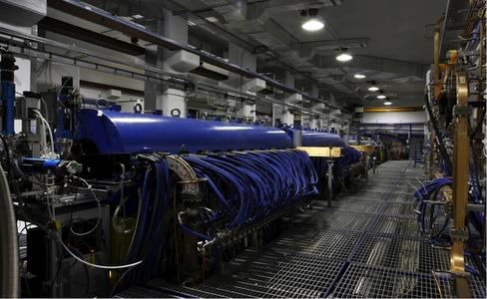
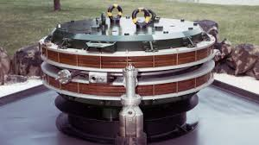
My Institute:
Laboratori Nazionali di Frascati dell’Istituto di Fisica Nucleare.
Has hosted ADA (1961 – 1966), ADONE (1967 – 1993), DAΦNE (1997- still running),
SPARC-Lab (2002 - still running) and EUPRAXIA (2018 – in construction)

Slide 5
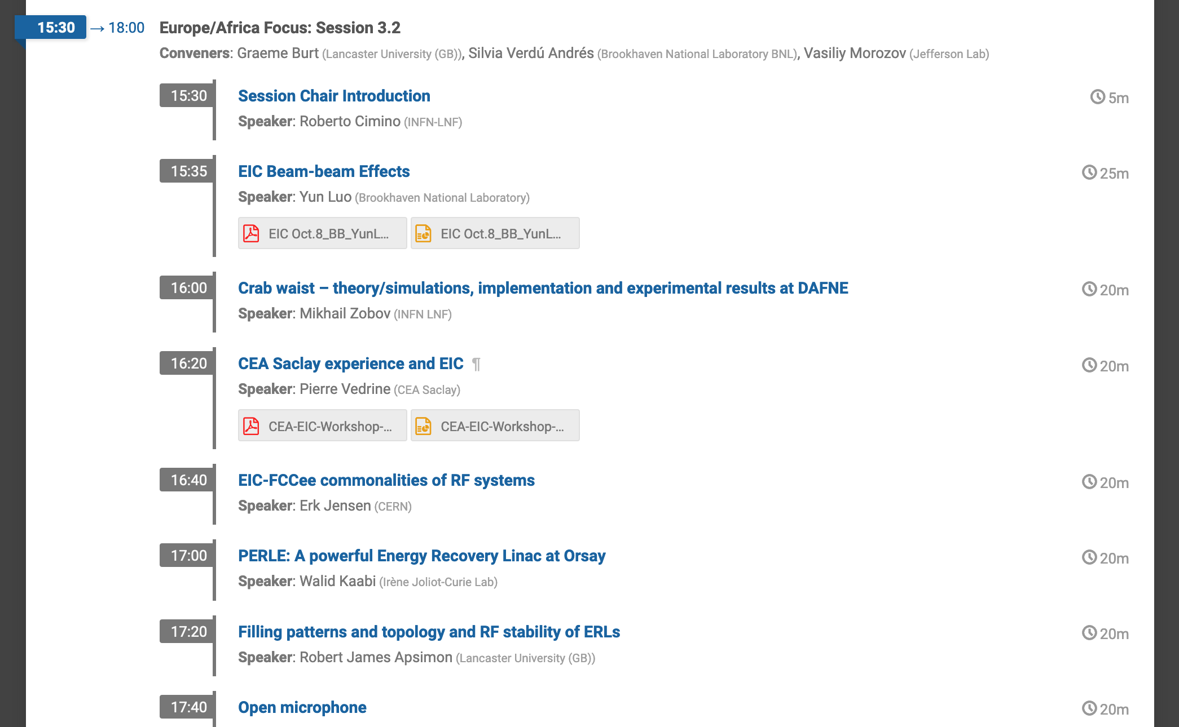
The Session:
The Session:

Slide 6
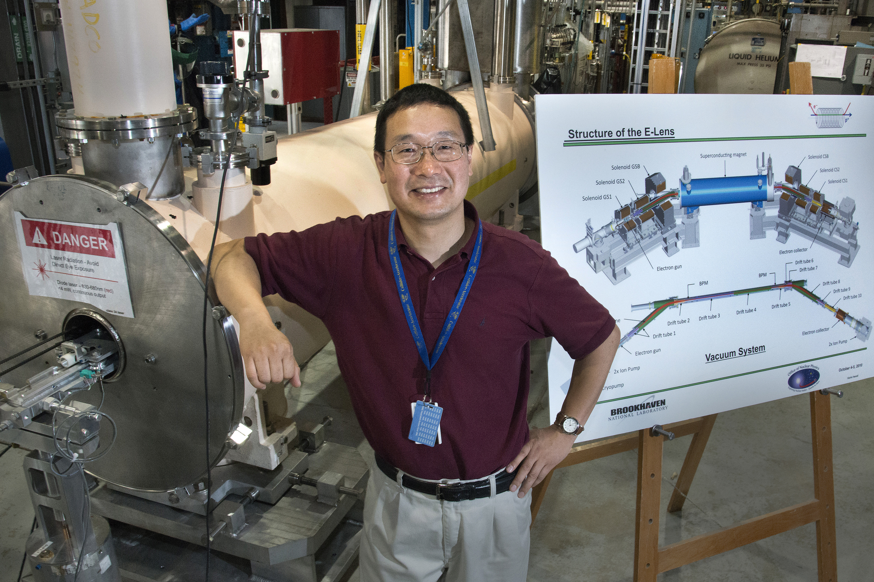
The Session:

Slide 7
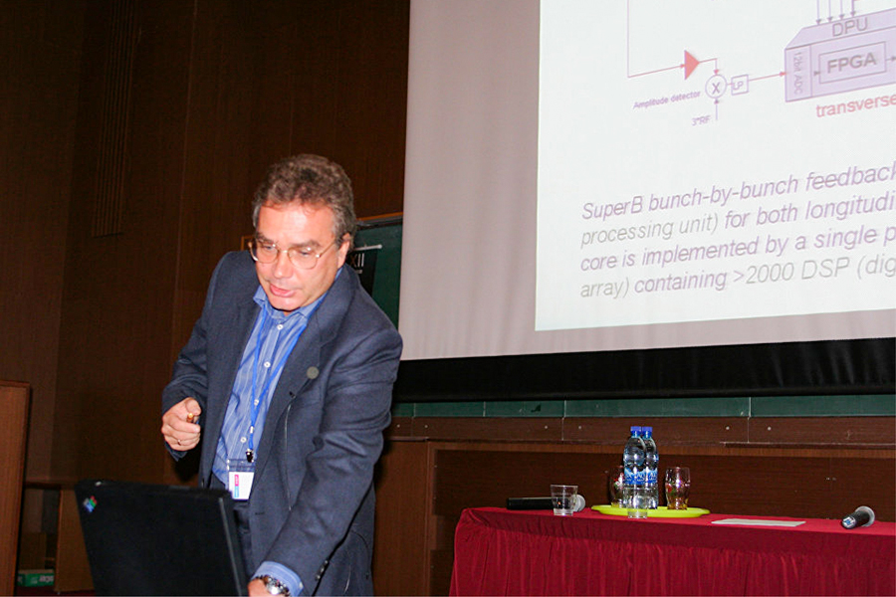

Slide 8
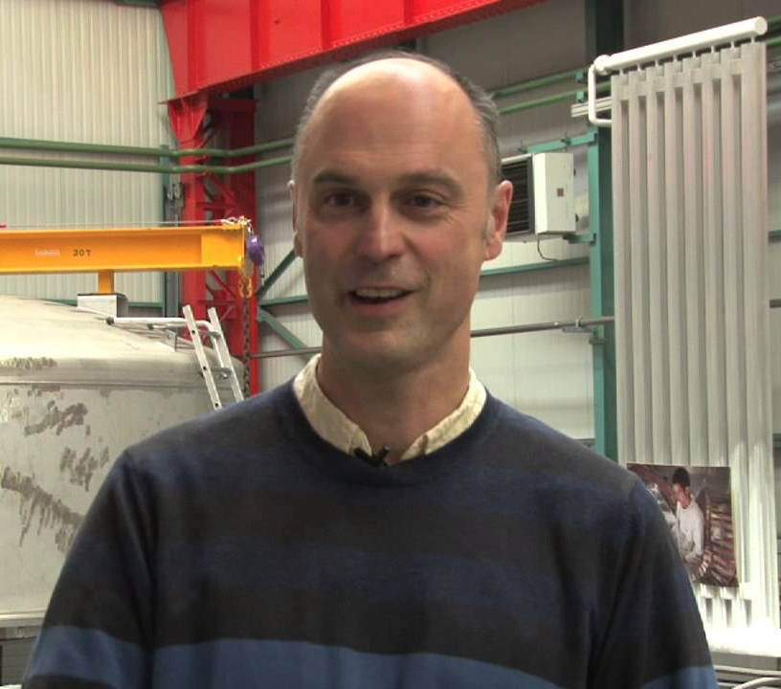

Slide 9
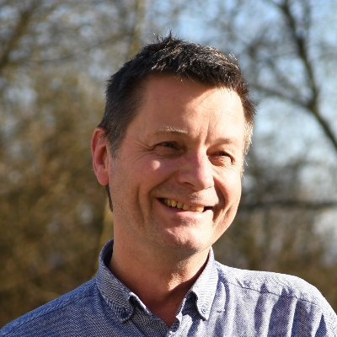

Slide 10

The Session:

Slide 11
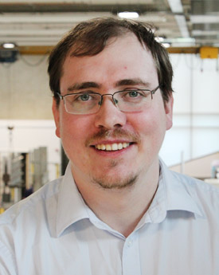
The Session:

Slide 12
The Session:

Slide 13
I kindly ask the speakers to stay in time and live some space to questions.

Slide 14
I kindly ask the speakers to stay in time and live some space to questions.
Enjoy the Session!

