Slide 1
Accelerator Education at the Joint Universities’ Accelerator School (JUAS) and the EIC
John Jowett (GSI, formerly CERN)
JUAS Director
Recently taken over from Philippe Lebrun
Deputy Director: Elias Métral (CERN)

Slide 2
JUAS and the EIC
Thanks to Andrei Seryi (former JUAS lecturer and Advisory Board member) for this opportunity to talk about the existing and potential relations between JUAS and the EIC.

Slide 3
JUAS mission
Since 1994, the Joint Universities Accelerator School (JUAS) has provided in-depth training in the science, technology and applications of particle accelerators to graduate students from its Partner Universities, as well as from other institutions
For this purpose, JUAS holds two five-week courses yearly at the European Scientific Institute (ESI) in Archamps, France, taught by renowned experts from universities and laboratories and accredited by the Partner Universities:
  A course on the Science of Particle Accelerators
  A course on the Technology and Applications of Particle Accelerators
http://www.juas.eu

Slide 4
















16 Partner Universities

Slide 5


























26 Sponsoring Institutes and European Programmes

Slide 6
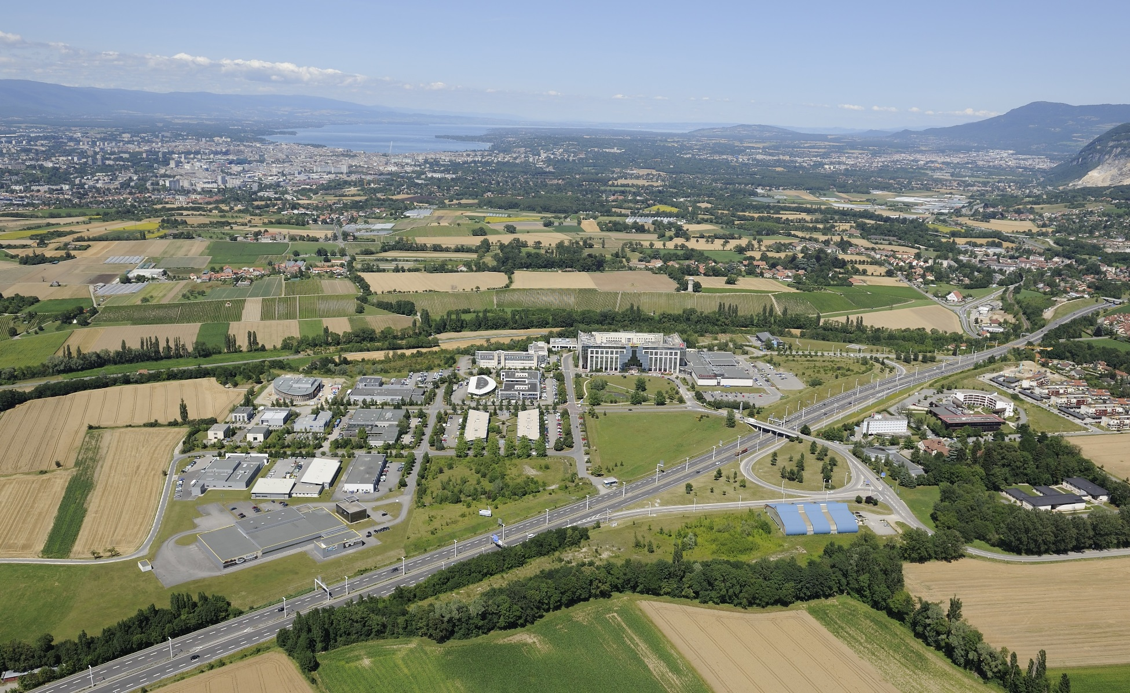
ESI Archamps Technopole, host of JUAS
Geneva
CERN
Chamonix, Turin
Paris, ESRF

Slide 7
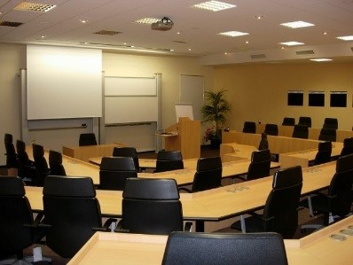
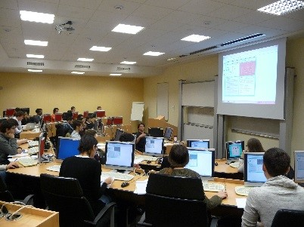
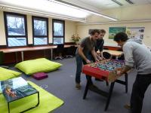
ESI Archamps Technopole, host of JUAS
Lecture hall
Computer room
Student foyer

Slide 8
JUAS pedagogy (up to 2020)
Two courses, each 4 weeks + 1 week exams
  The science of particle accelerators
  The technology and applications of particle accelerators
Expert lecturers from universities, national labs and CERN
Lectures + tutorials + seminars + workshops + practical work + lab visits
Syllabus and appointment of lecturers submitted to Advisory Board
Lecture notes available on line (Indico)
«Refresher» lecture and tutorial documents (E-M, Relativity, RF, Magnets)
Written exams
Written reports and oral presentations by students on design workshops and practical work
Subjects grouped weekly, hence possibility to register by week for specific subjects

Slide 9
JUAS Student Certification
JUAS and home institutions of students
  Master Students: Partner University may give ECTS credits to their students who have passed the examination for each Course
  Doctoral Students: credits may be given by the doctoral schools according to their own policy
  Professionals: JUAS Course may be considered part of professional training («Formation Continue» in France)
Certification
  JUAS issues a Certificate for each Course containing all information
  Subjects studied and numbers of hours
  Exam taken or not
  Marks obtained in relation to class averages
  Student ranking

Slide 10
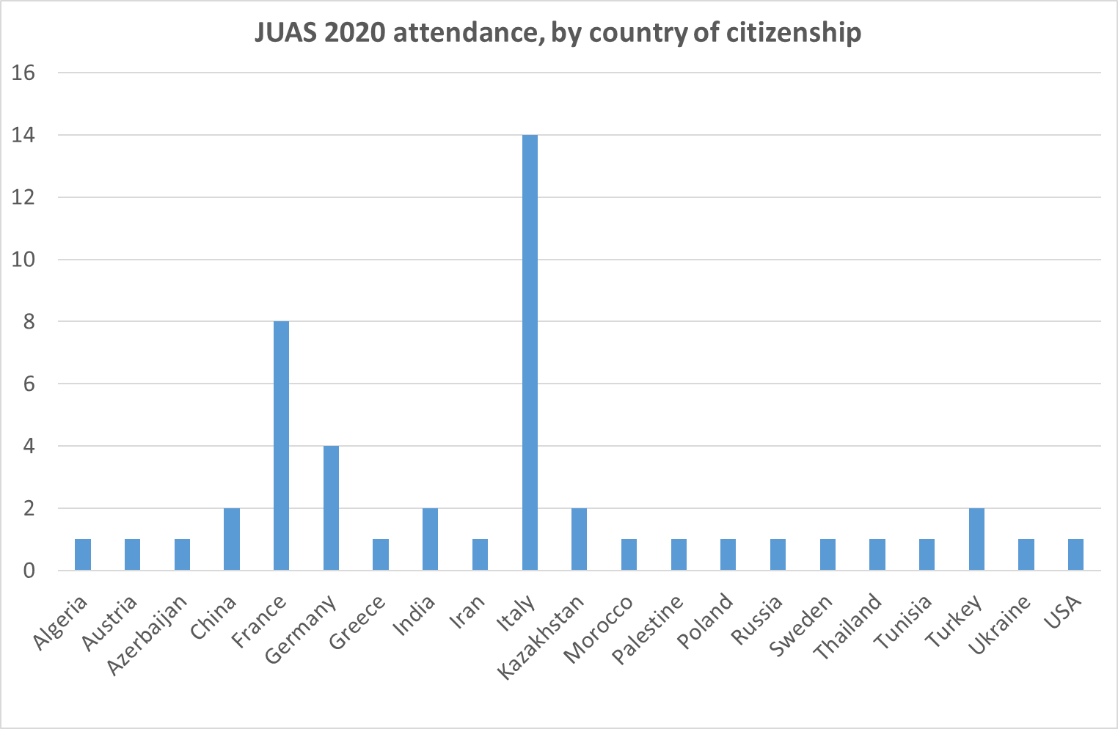
Origin of JUAS 2020 students

Slide 11
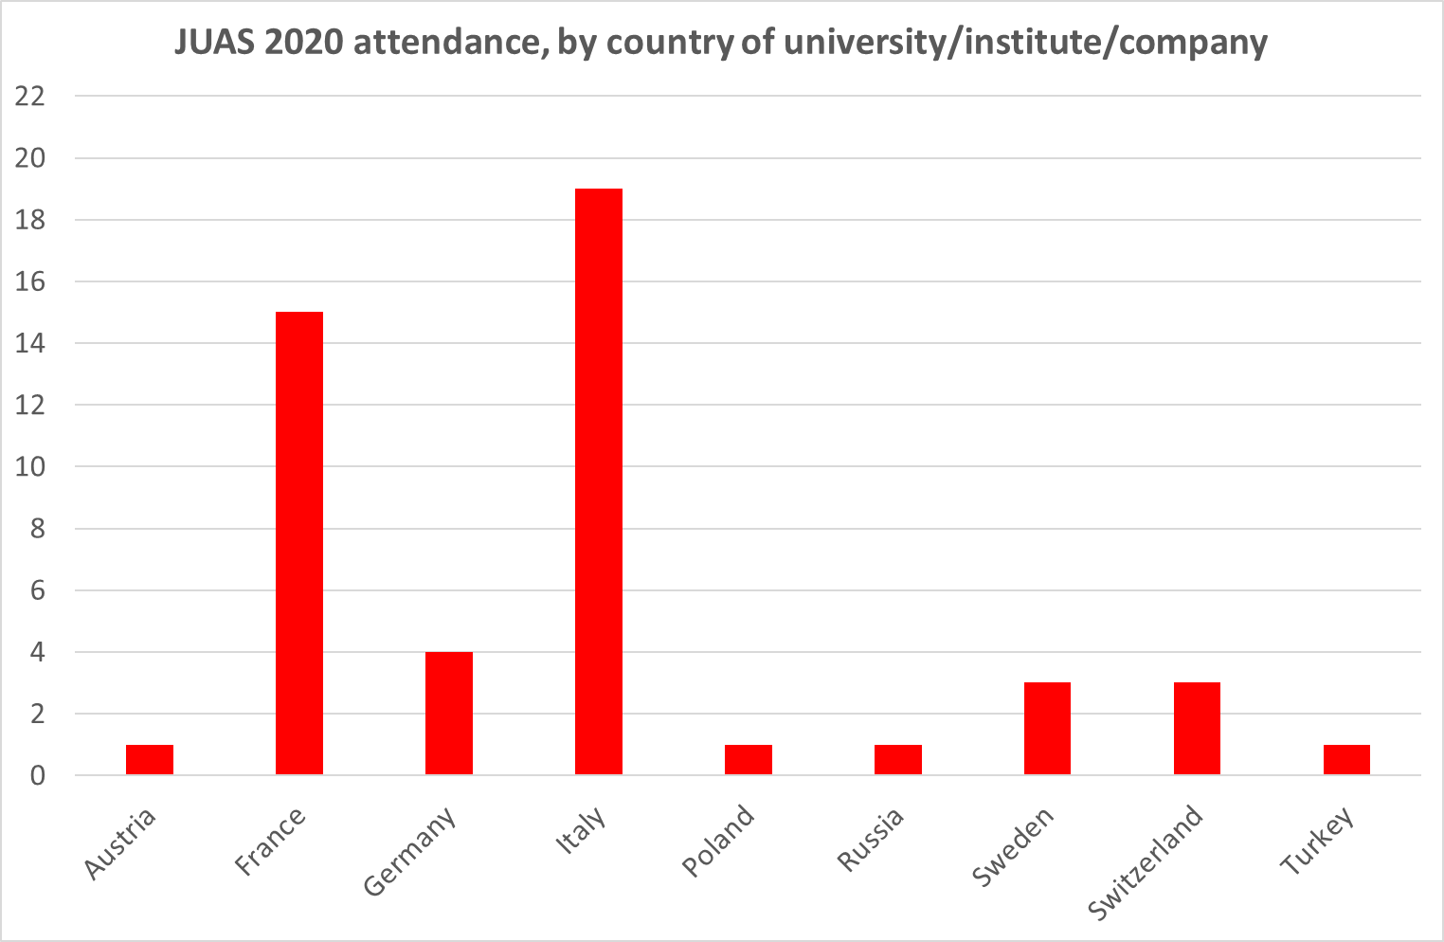
Origin of JUAS 2020 students

Slide 12
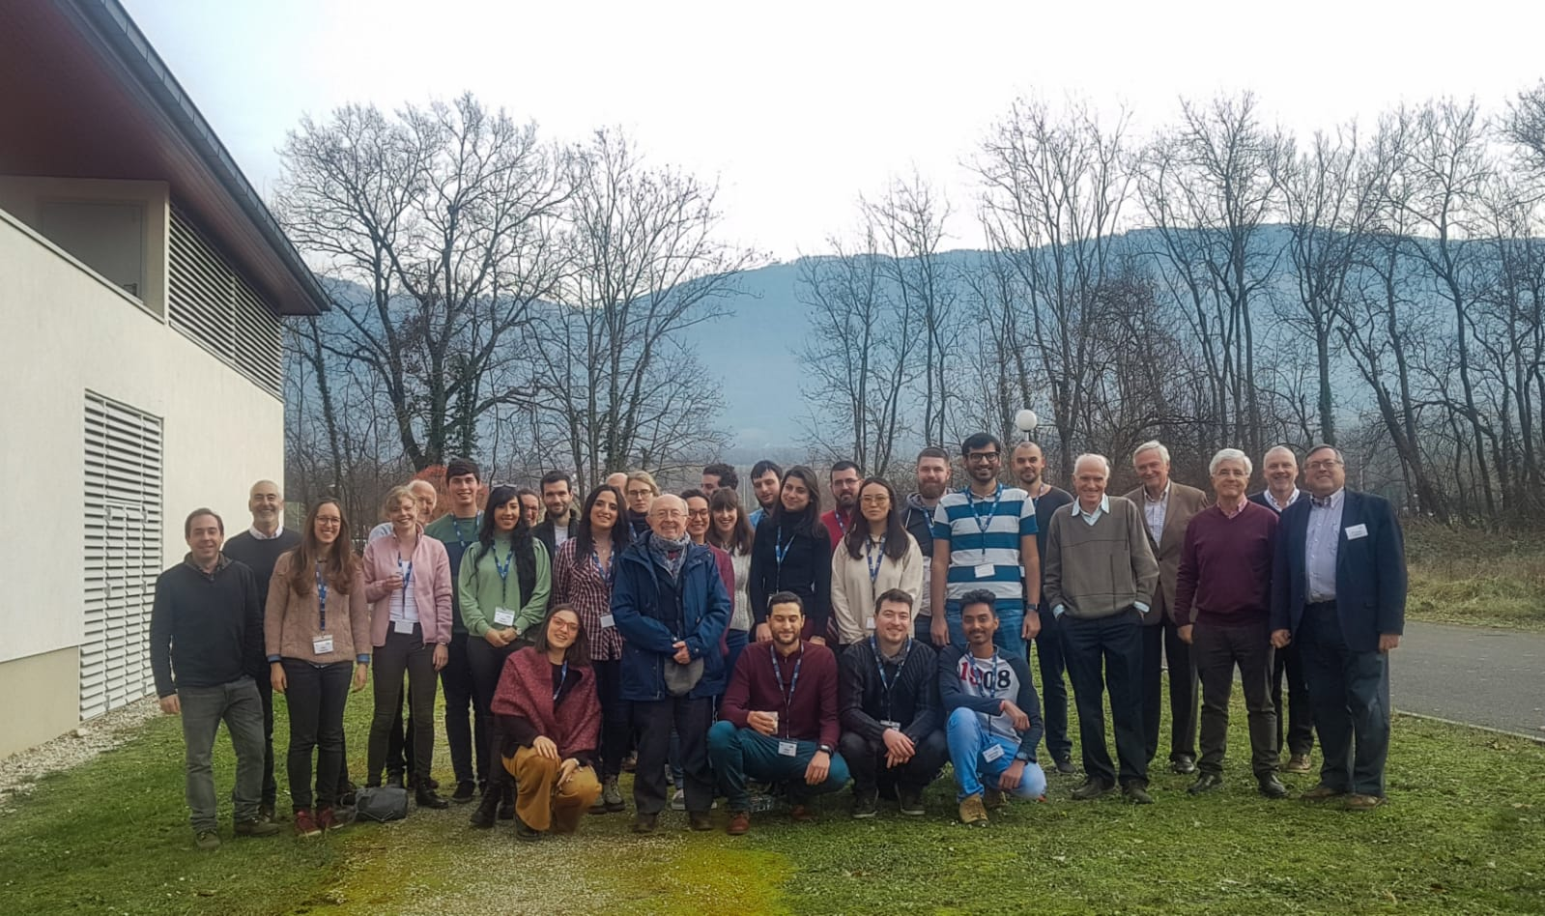
JUAS Course 1
The science of particle accelerators
13 January – 14 February 2020

Slide 13
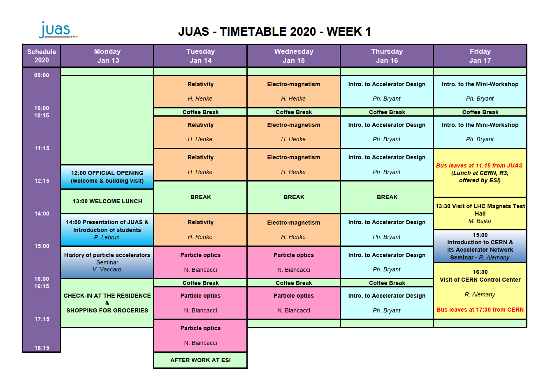

Slide 14
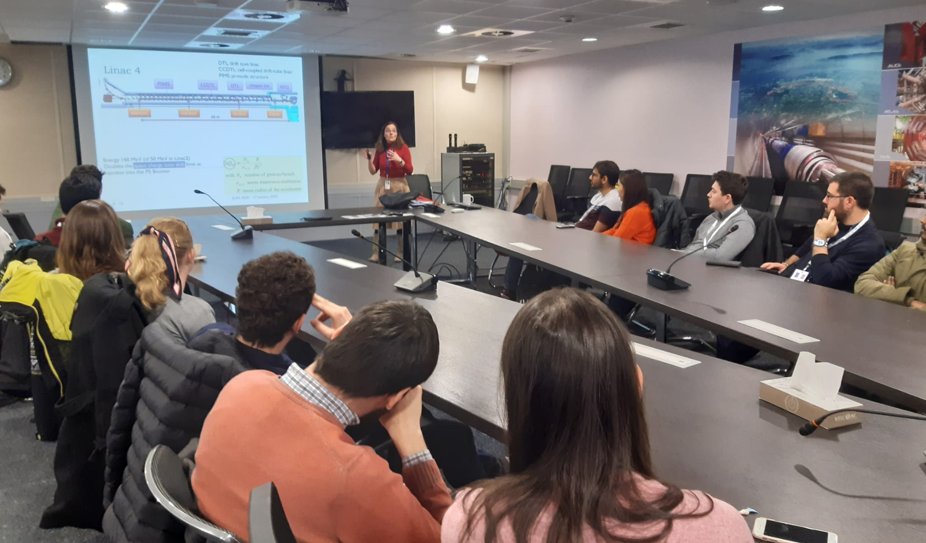
Visit to CERN on Friday 17 January 2020
R. Alemany presents the CERN accelerator complex

Slide 15
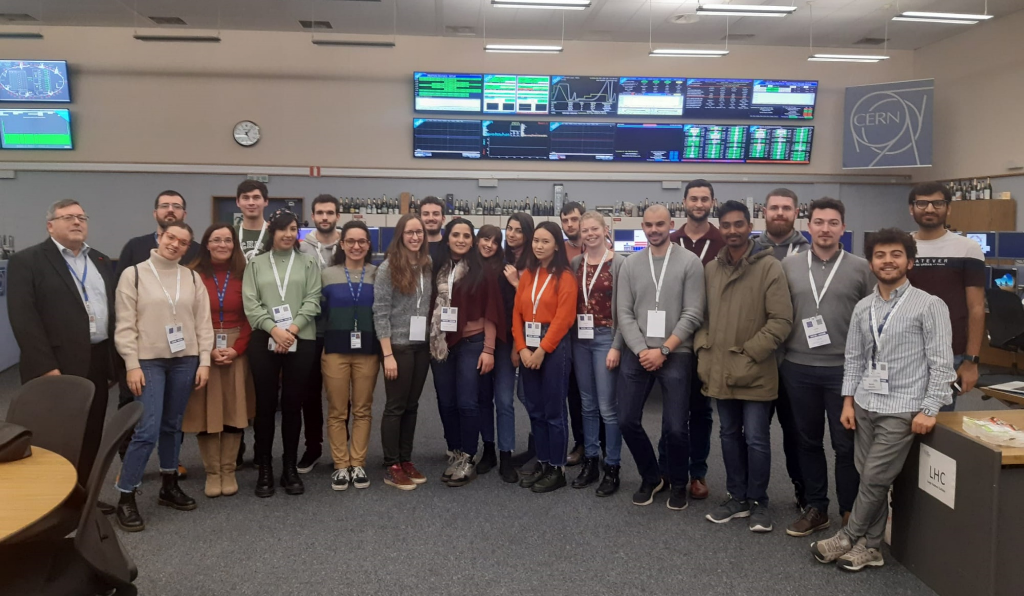
Visit to CERN on Friday 17 January 2020
Control Center

Slide 16
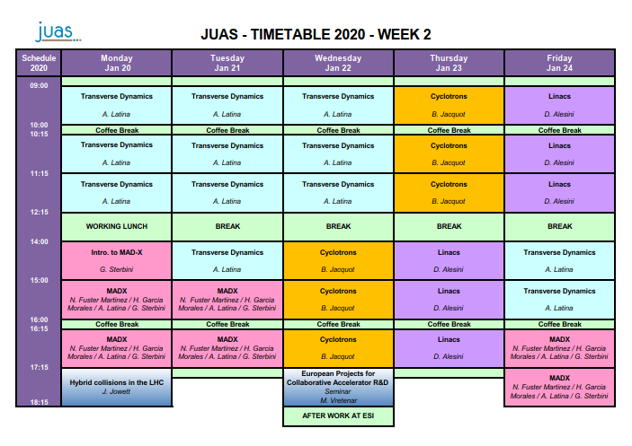

Slide 17
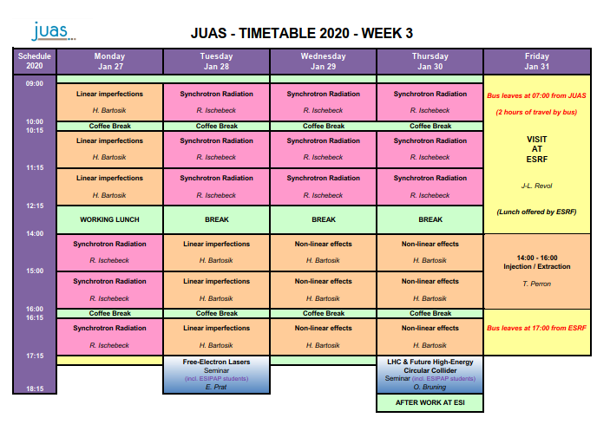

Slide 18
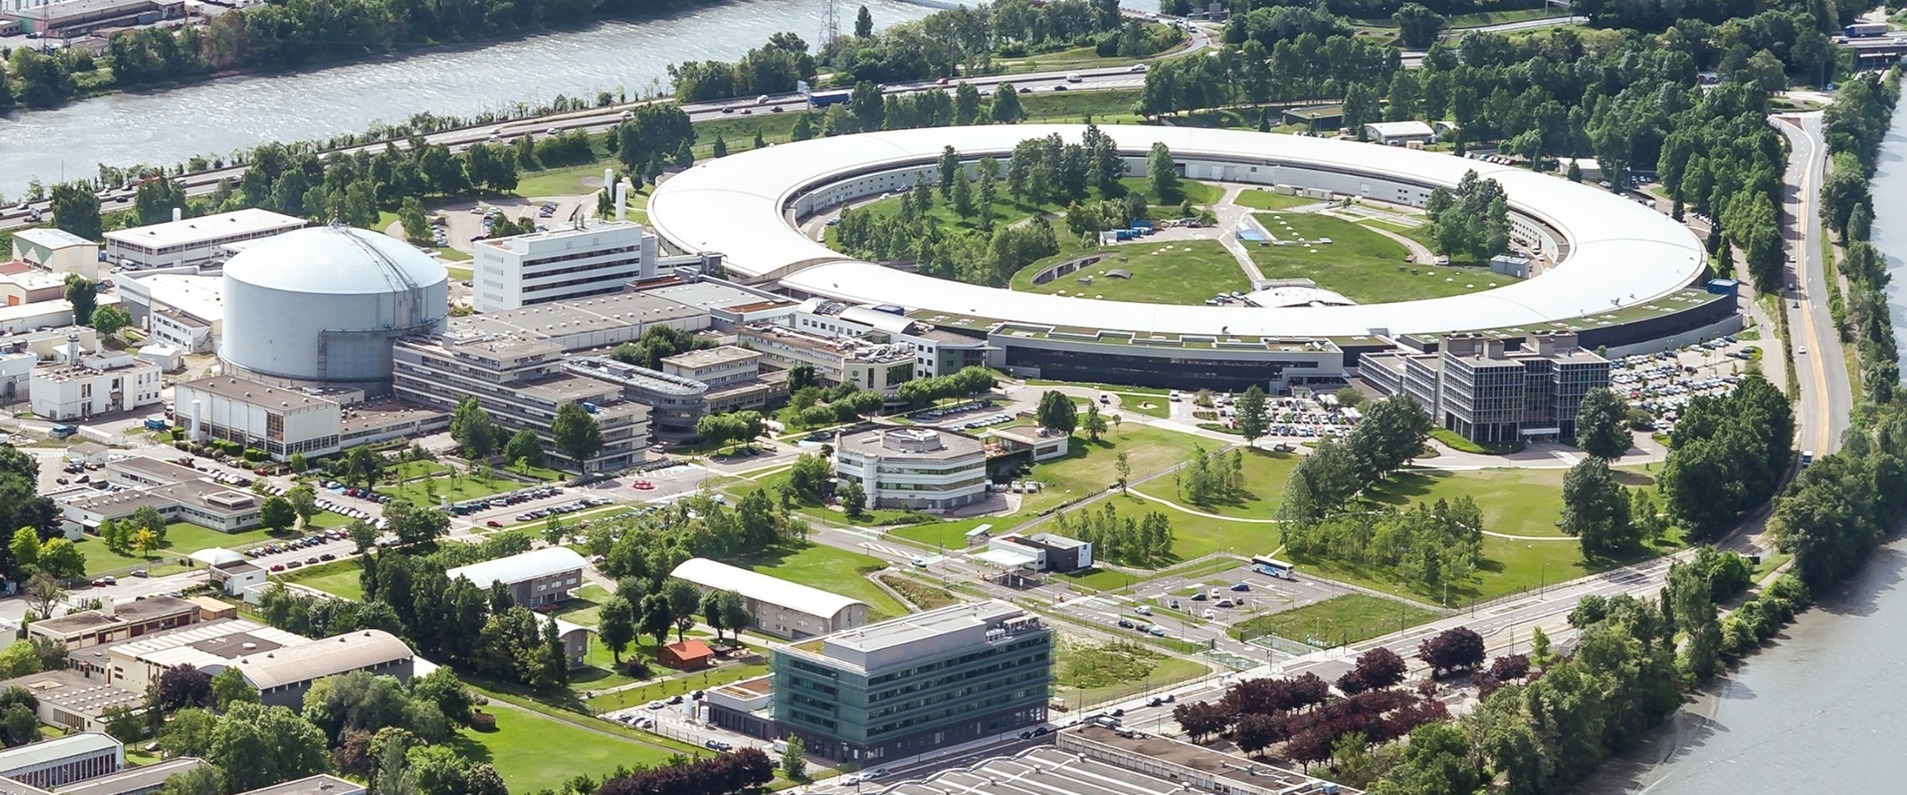

Visit to ESRF Grenoble
Friday 31 January 2020

Slide 19
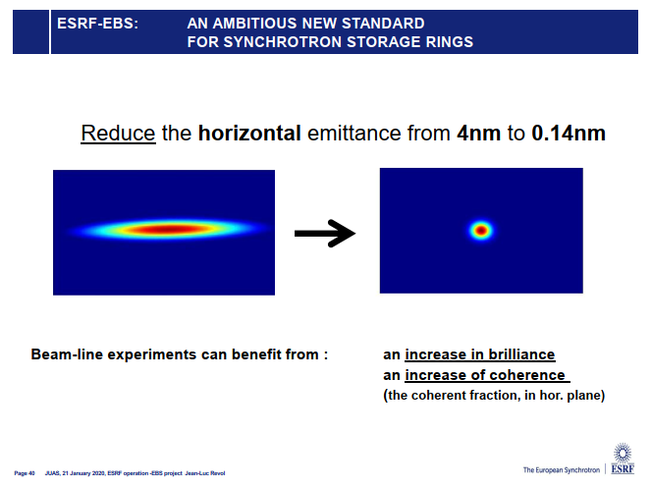
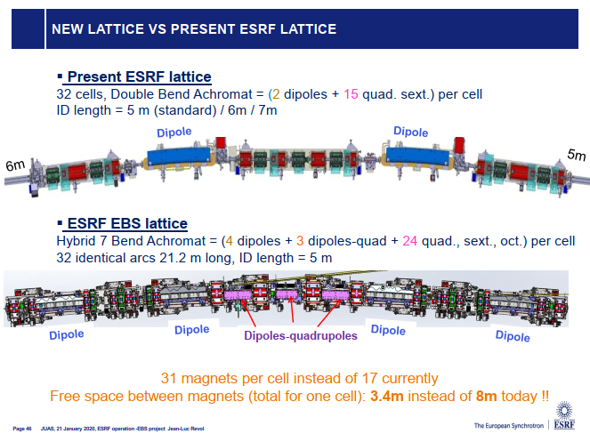
Visit to ESRF Grenoble
Friday 31 January 2020

Slide 20
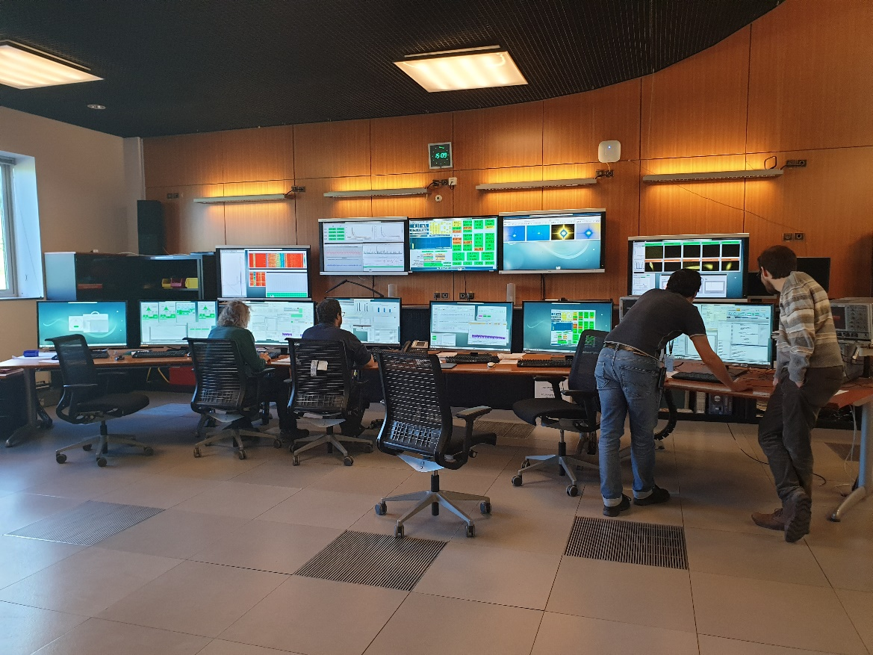
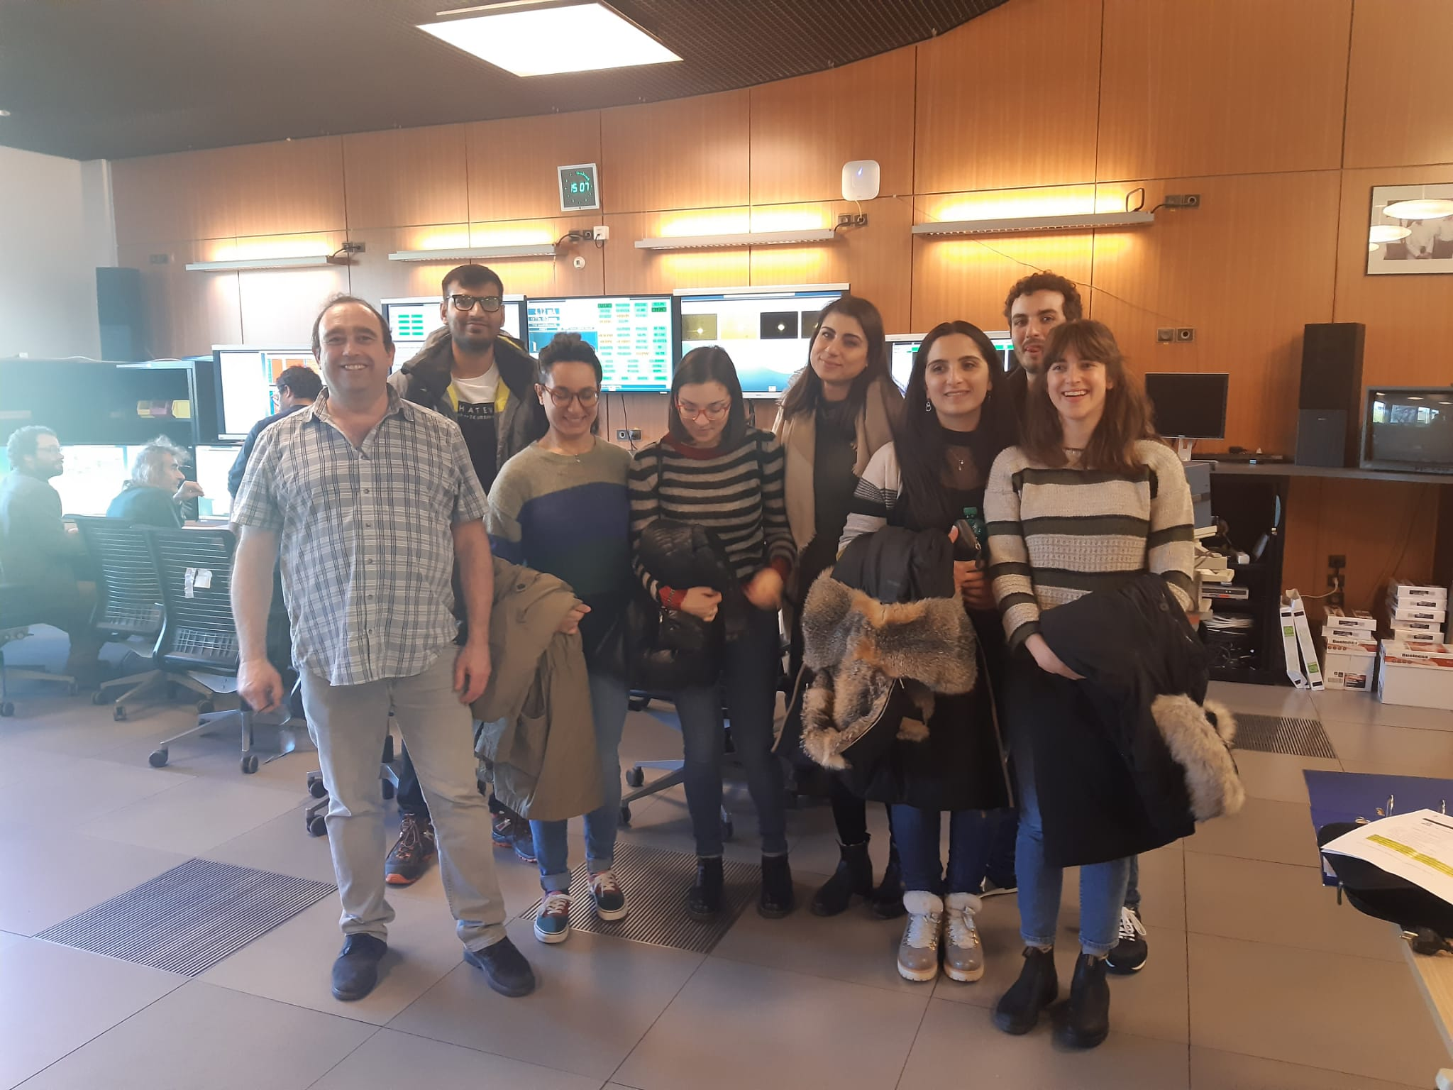
Visit to ESRF Grenoble
Friday 31 January 2020
During the commissioning of the new storage ring
P. Raimondi at the controls

Slide 21
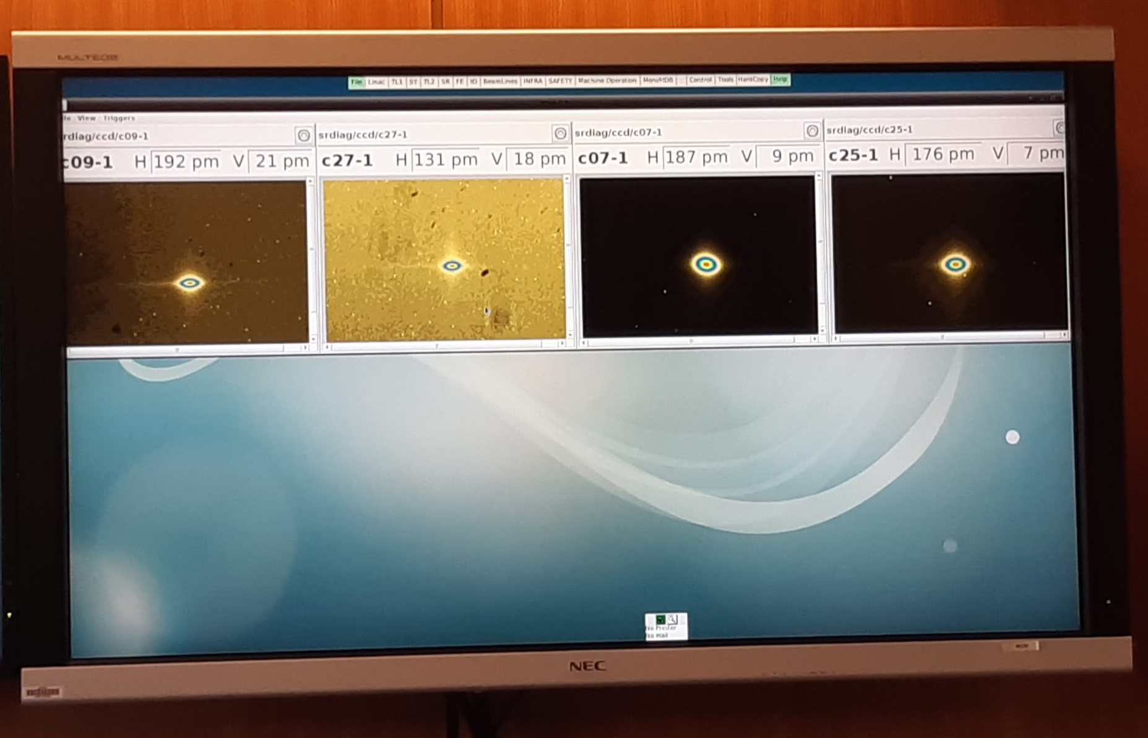
Visit to ESRF Grenoble
Friday 31 January 2020
Unprecedentedly small emittances measured on the new storage ring

Slide 22
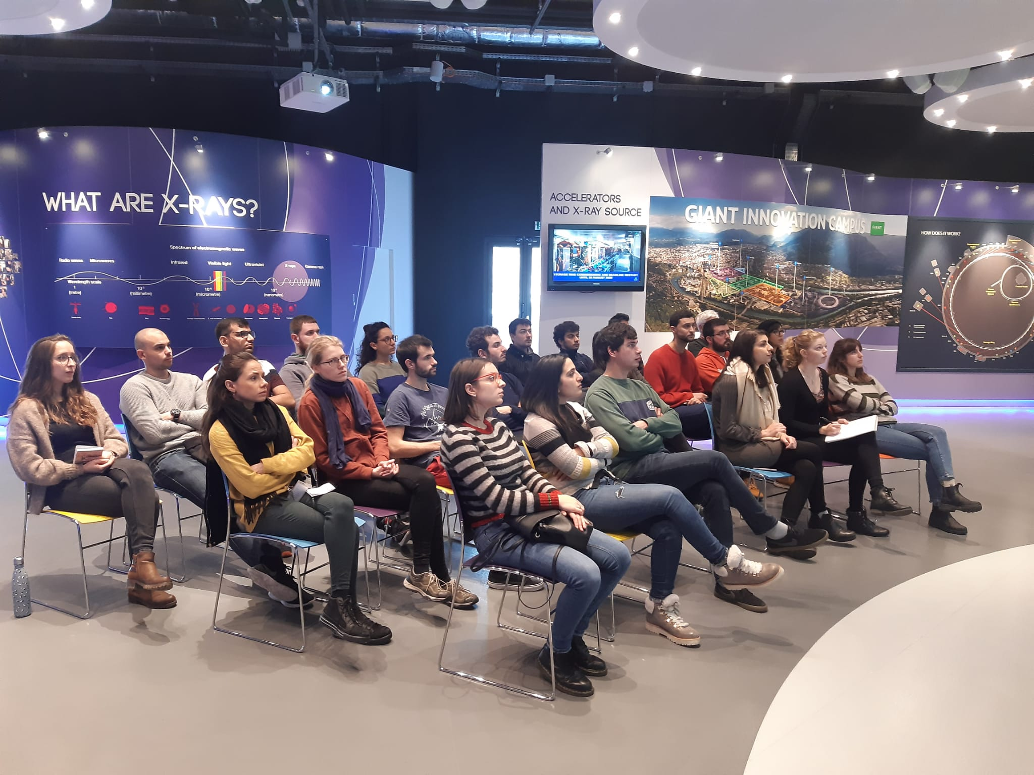
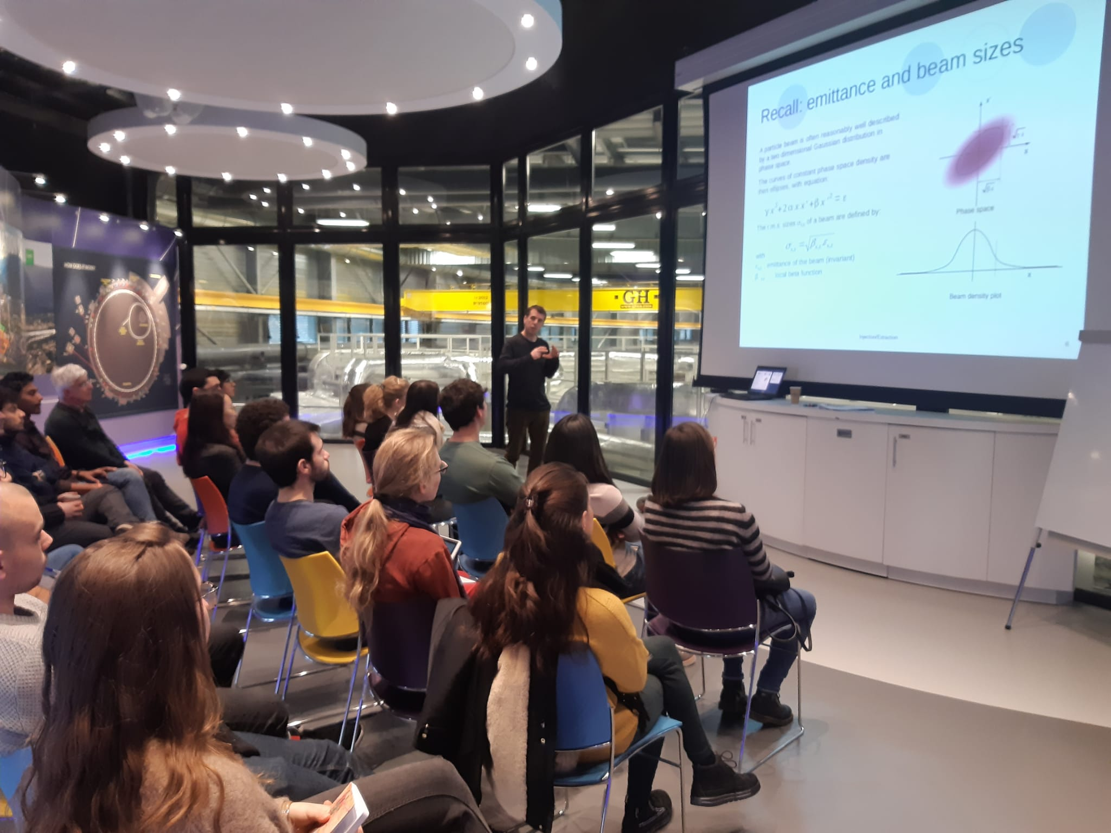
Visit to ESRF Grenoble
Friday 31 January 2020
Lecture and tutorial by Th. Perron on Injection & Extraction

Slide 23
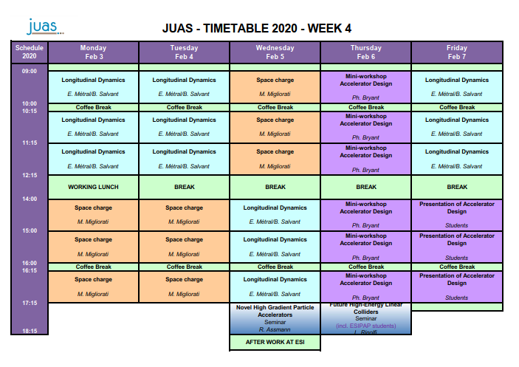

Slide 24
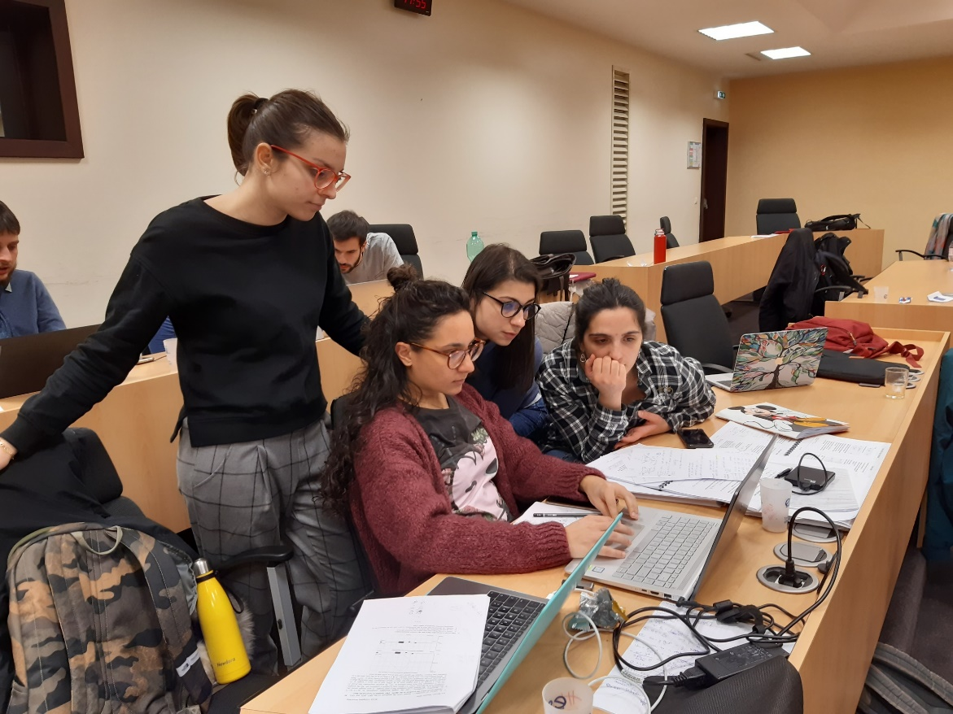
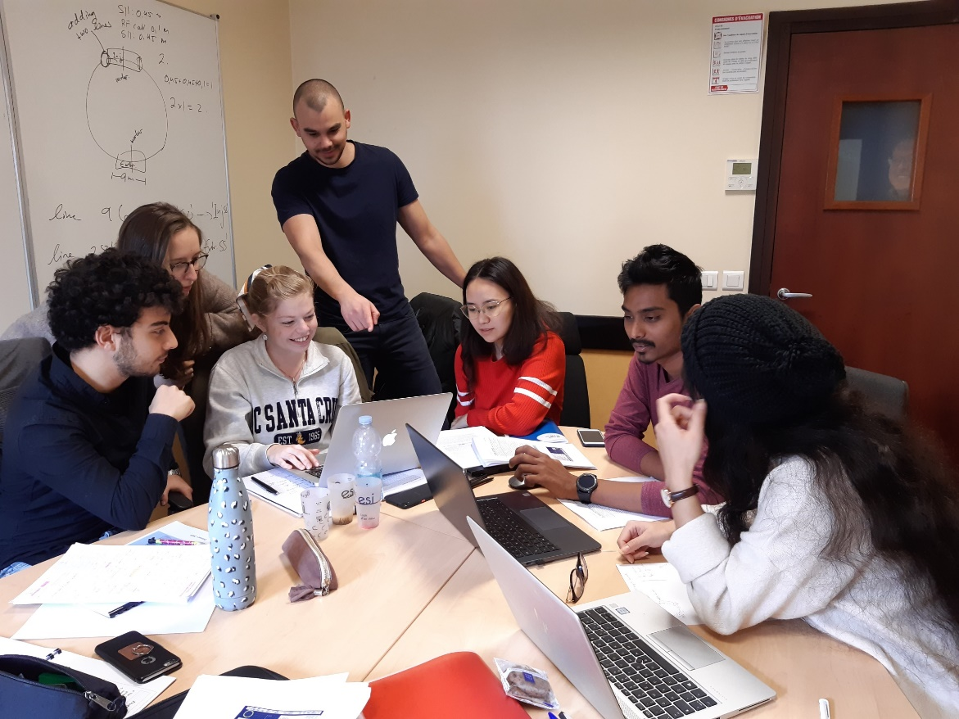
Mini-workshop on accelerator design
Upgrade of SR light source
Working in topical groups

Slide 25
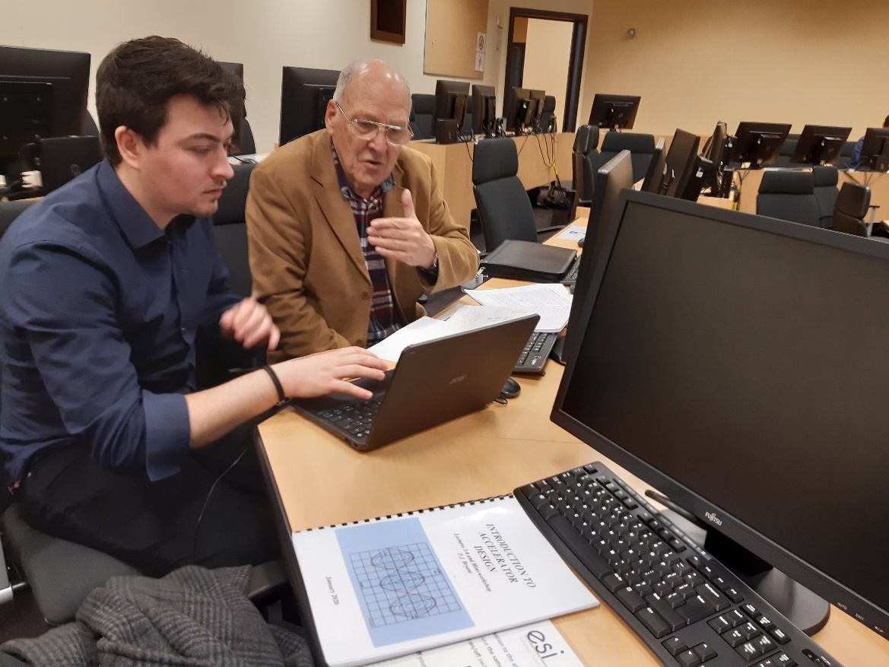
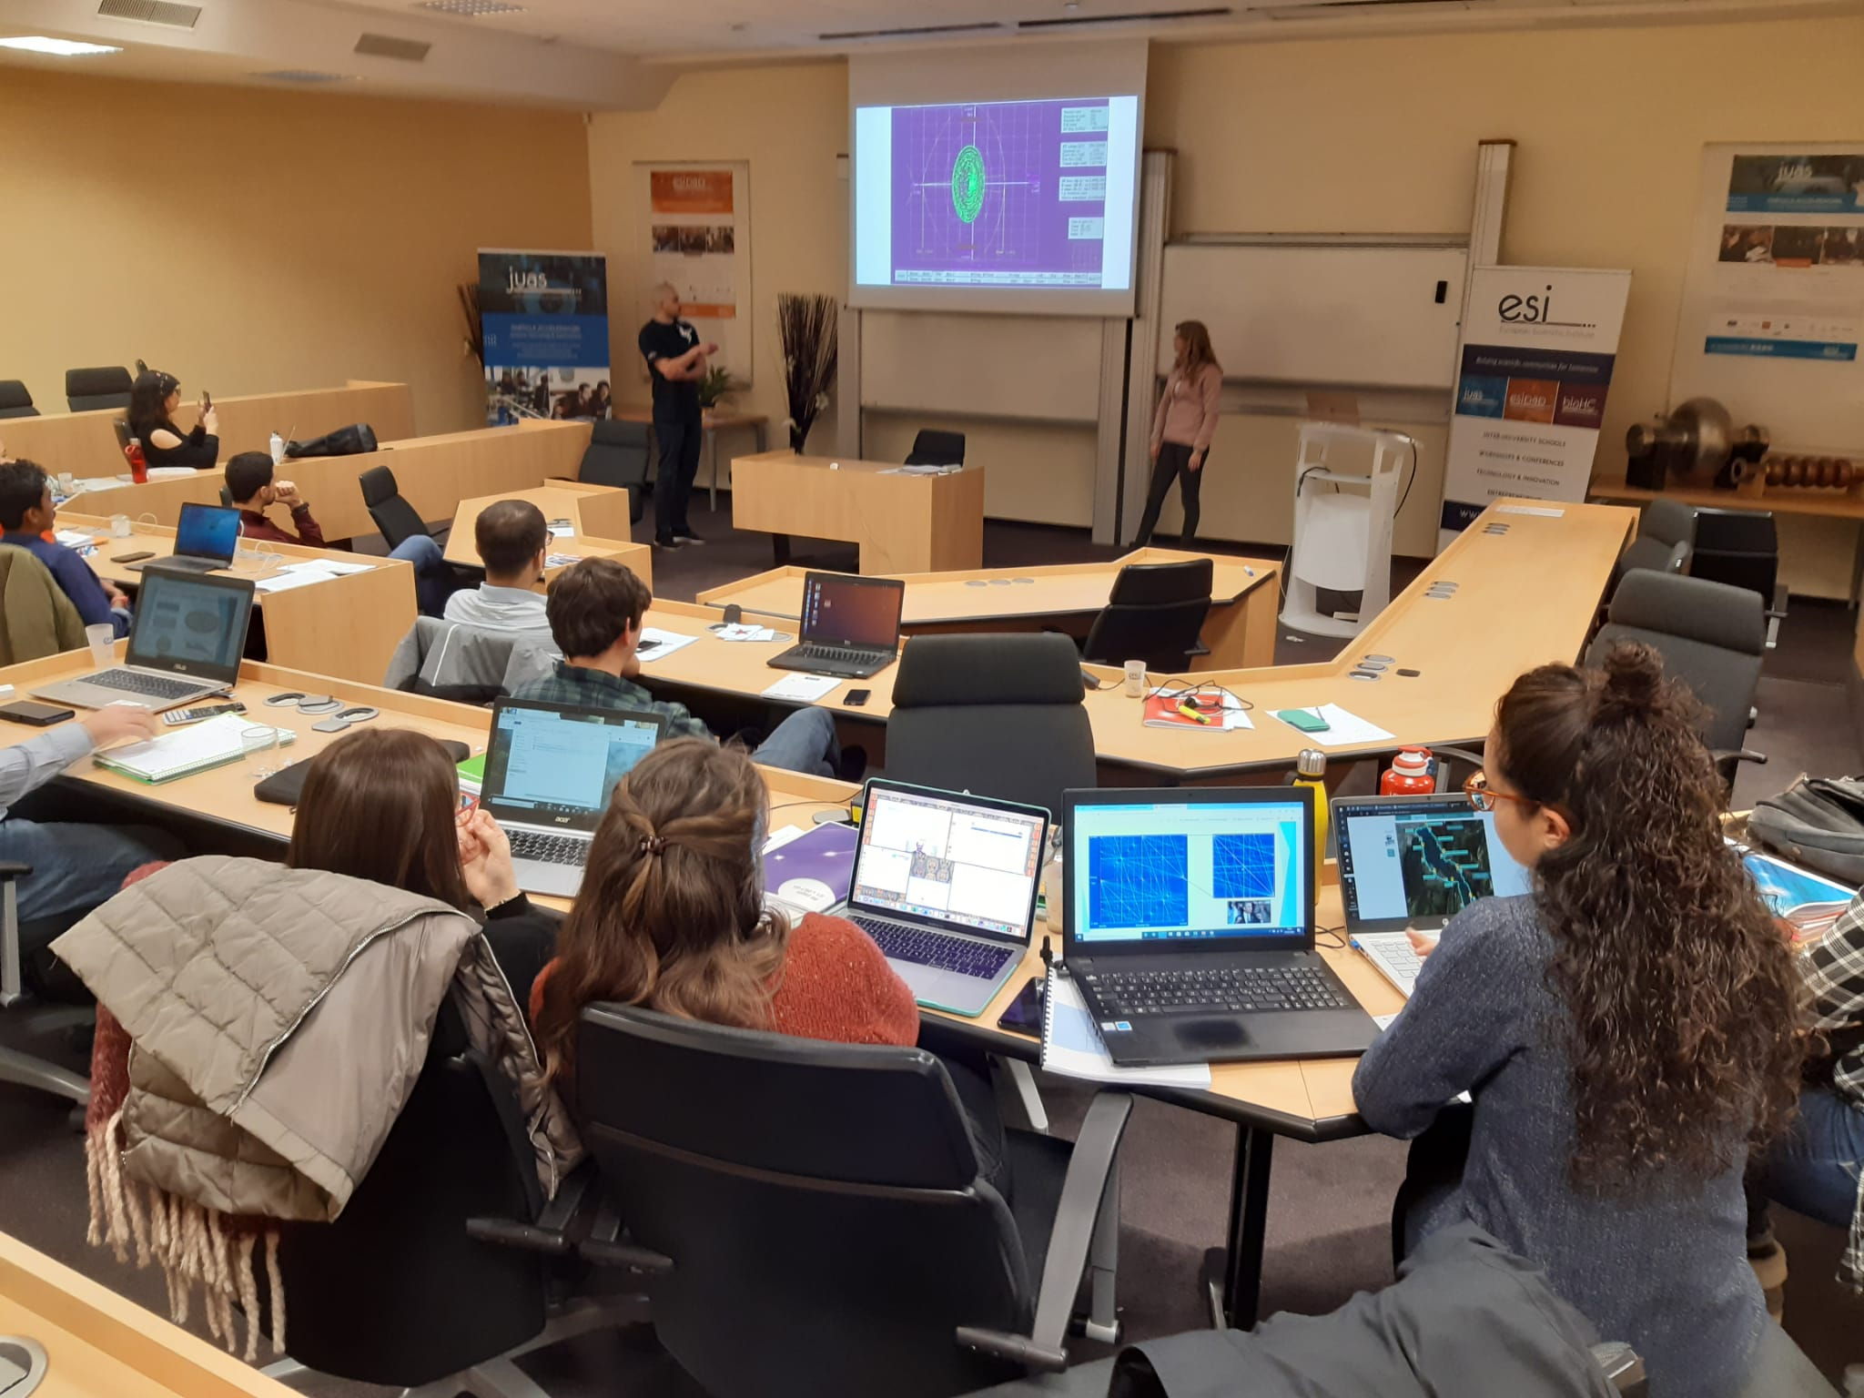
Report on accelerator design mini-workshop
Upgrade of SR light source
Ph. Bryant guiding the students
Oral presentations of the work

Slide 26

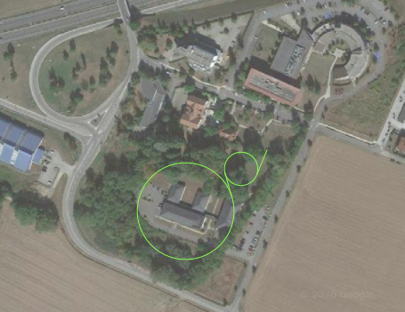
Report on accelerator design mini-workshop
Upgrade of SR light source

Slide 27
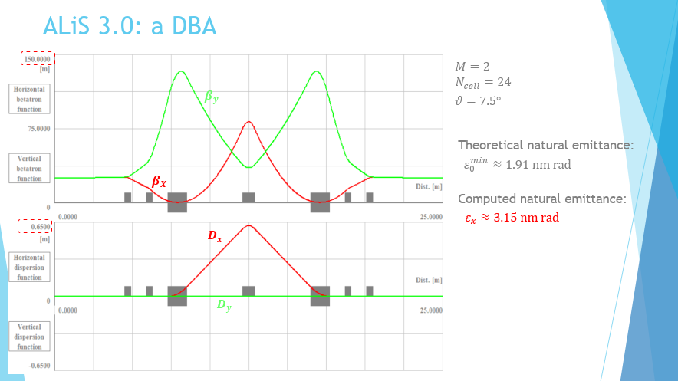
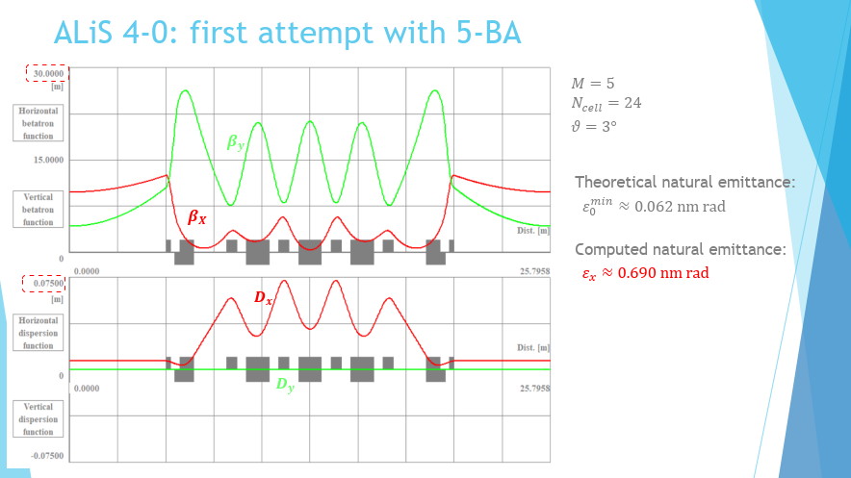
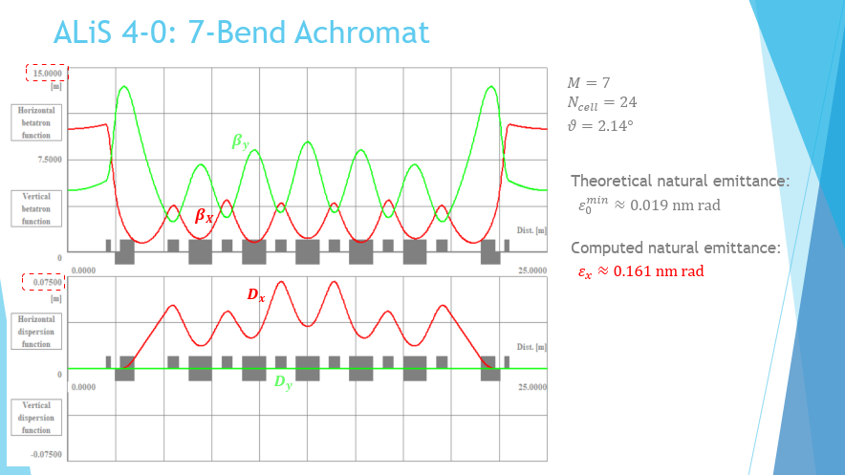
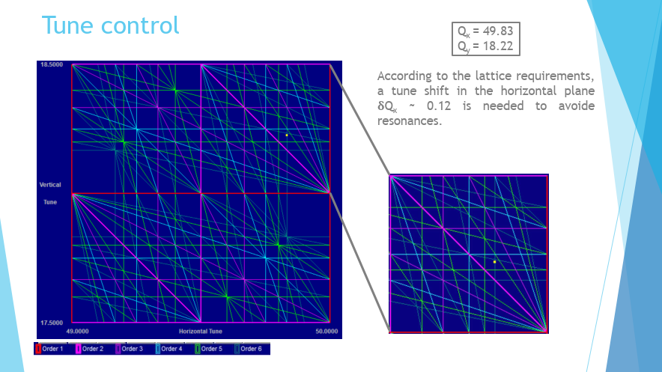
Report on accelerator design mini-workshop
Upgrade of SR light source: lattice, tune, chromaticity

Slide 28
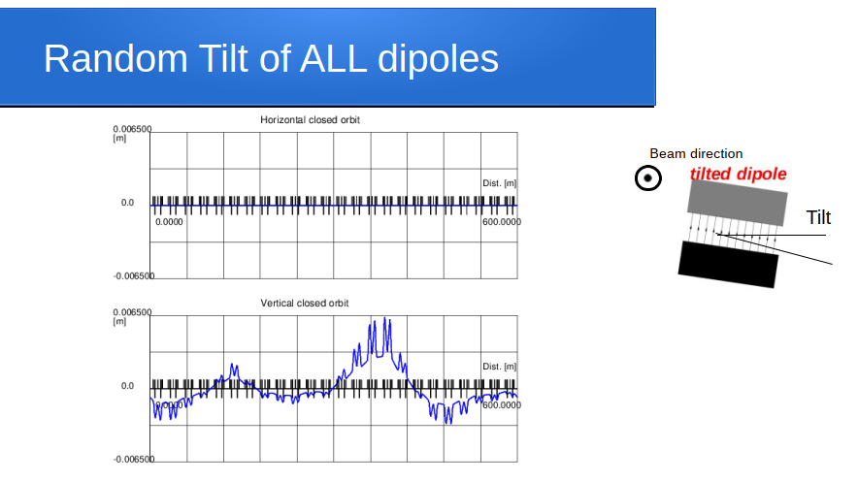
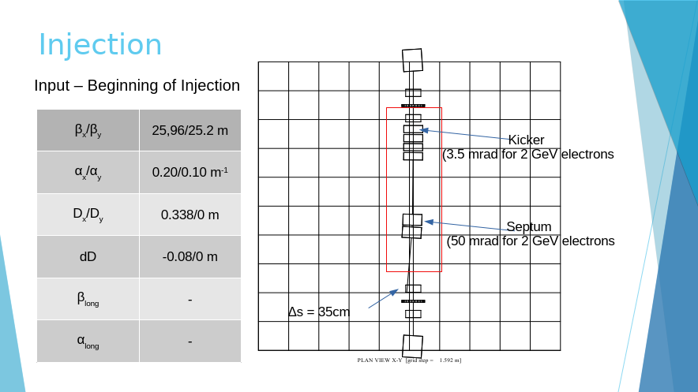
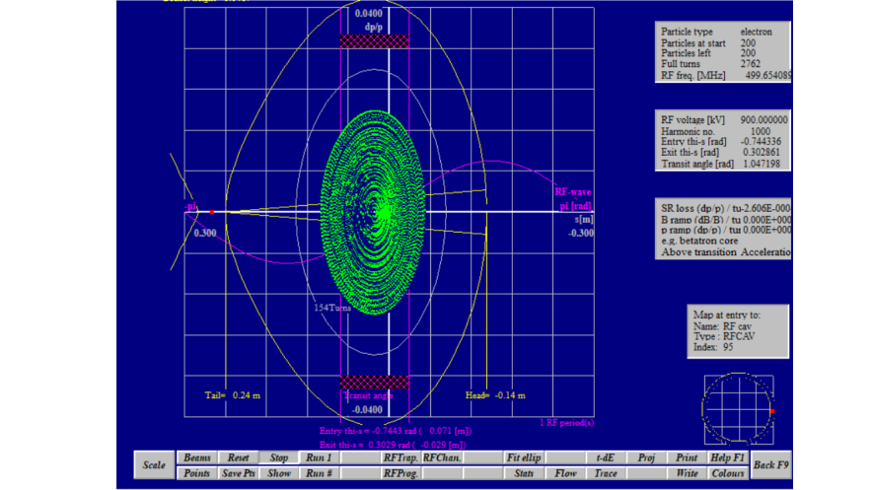
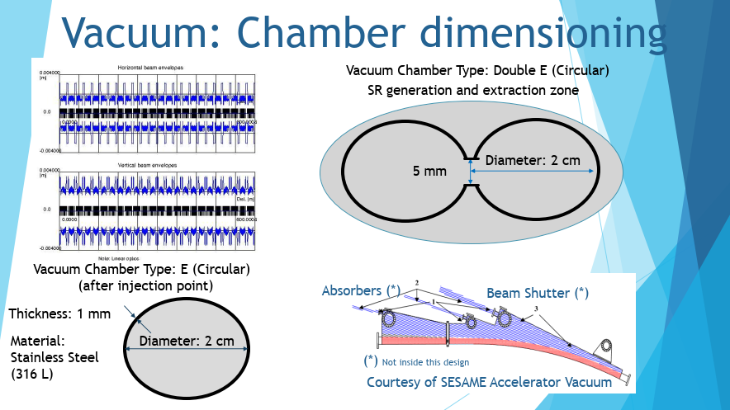
Report on accelerator design mini-workshop
Upgrade of SR light source: closed orbit, injection, RF, vacuum

Slide 29
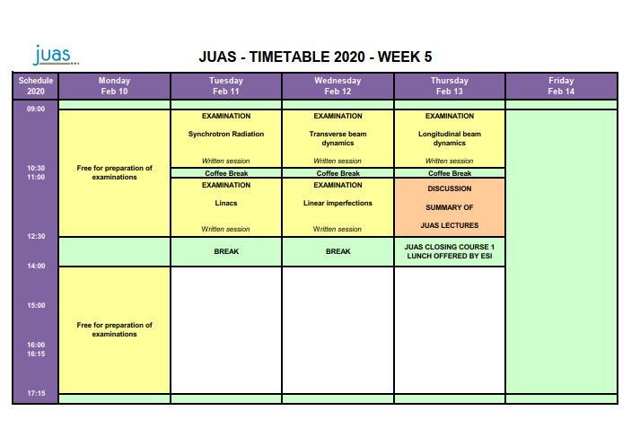

Slide 30
JUAS 2020 Course 1 in a nutshell [1/2]

Slide 31
JUAS 2020 Course 1 in a nutshell [2/2]

Slide 32
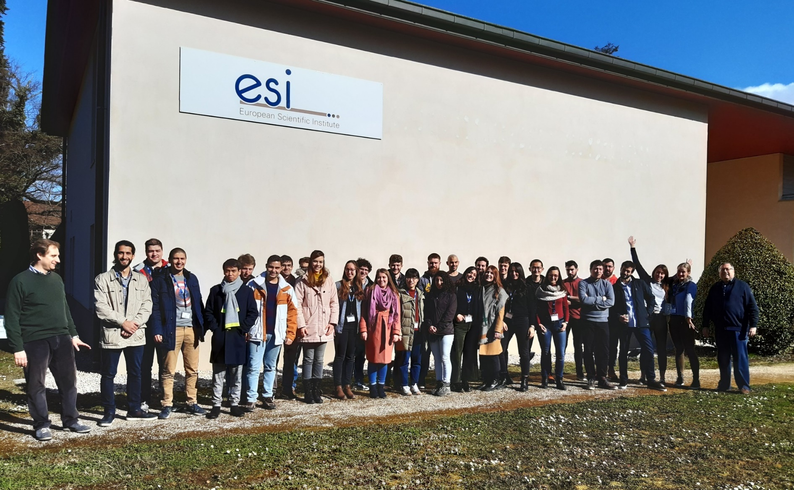
JUAS Course 2
The technology and applications of particle accelerators
17 February – 19 March 2020

Slide 33
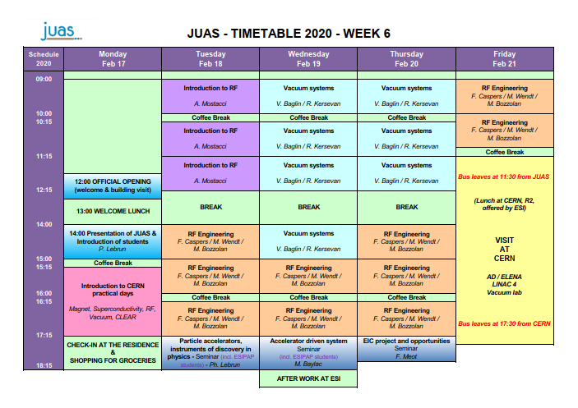

Slide 34
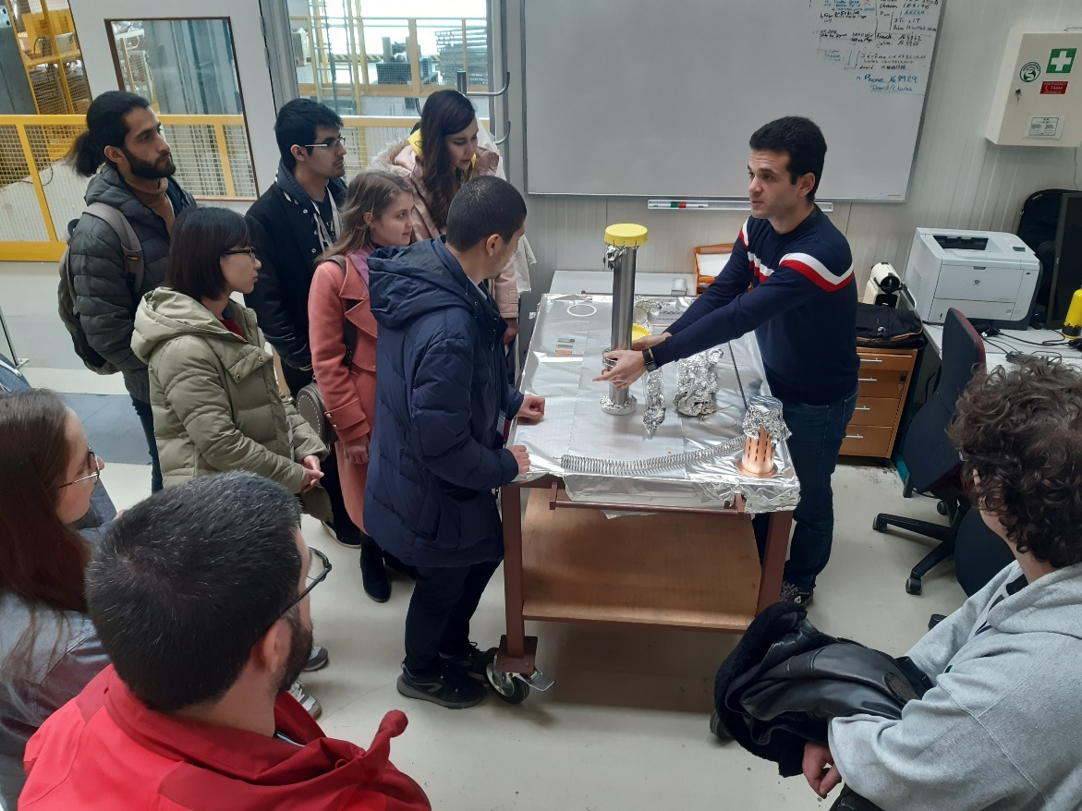
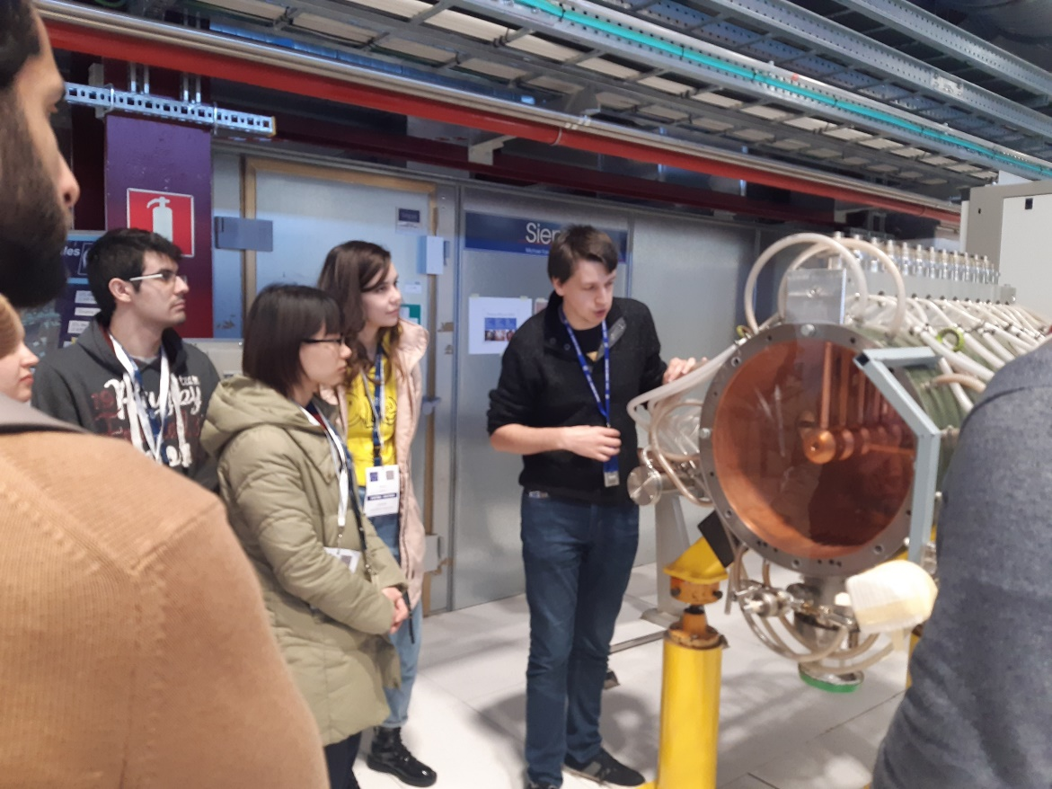
Visit to CERN
Friday 21 February 2020
JUAS alumnus
H. De Gransaignes showing Alvarez RF cavities at LINAC4
A. Sapountzis explaining surface treatments for UHV

Slide 35
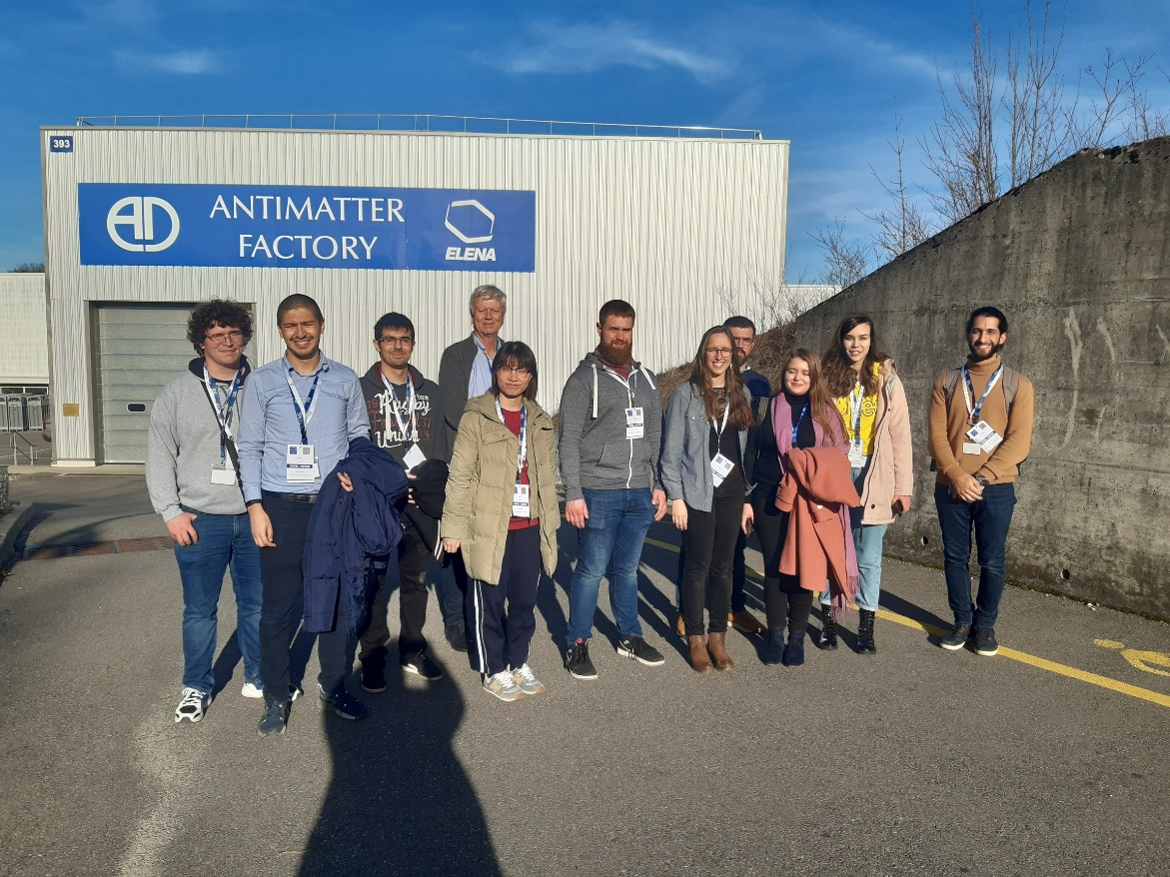
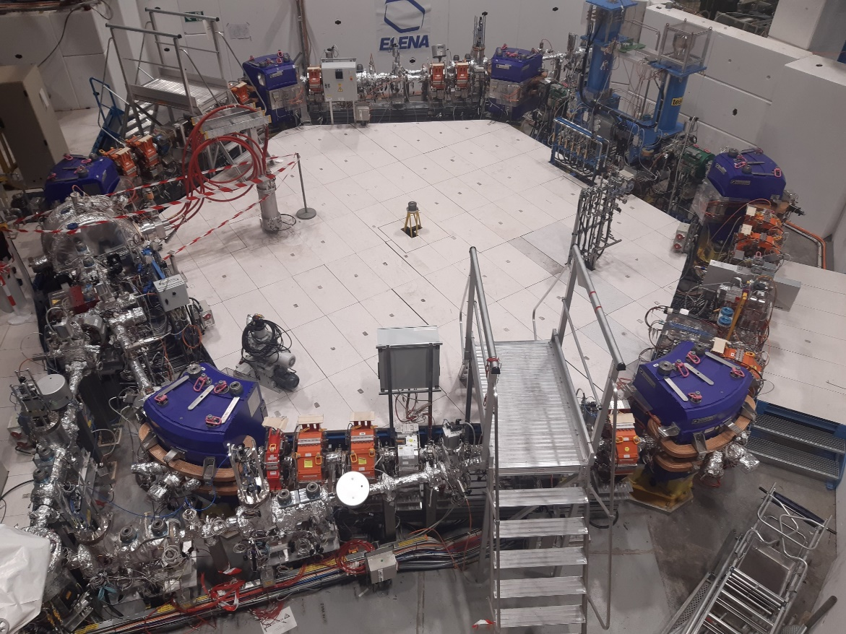
Visit to CERN
Friday 21 February 2020
Visiting the Antiproton Complex with F. Caspers

Slide 36
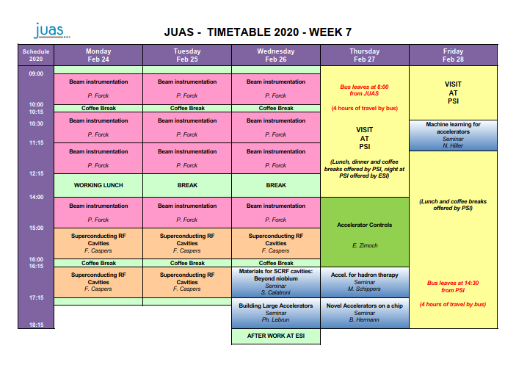

Slide 37
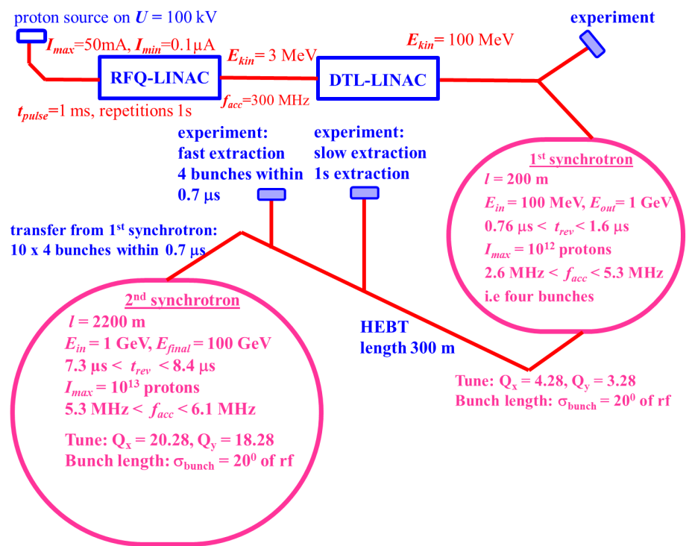
Beam diagnostics mini-workshop
26 February 2020
Design beam diagnostics for the accelerators and beam lines of this proton facility

Slide 38
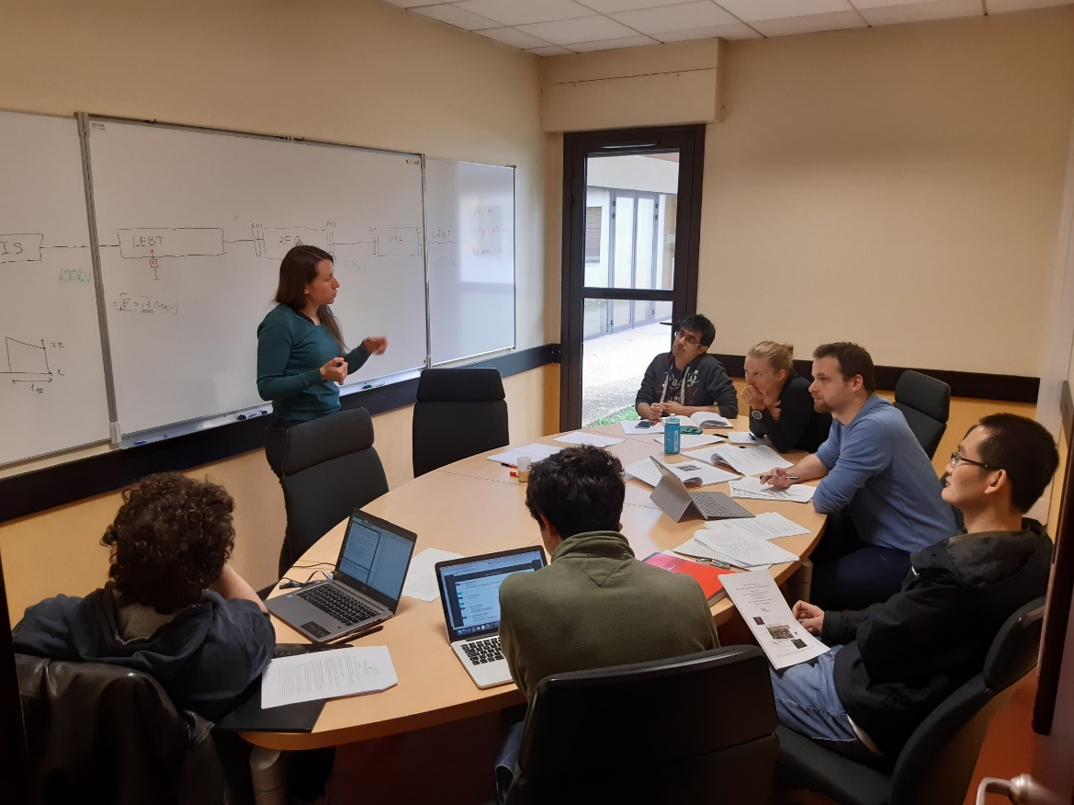
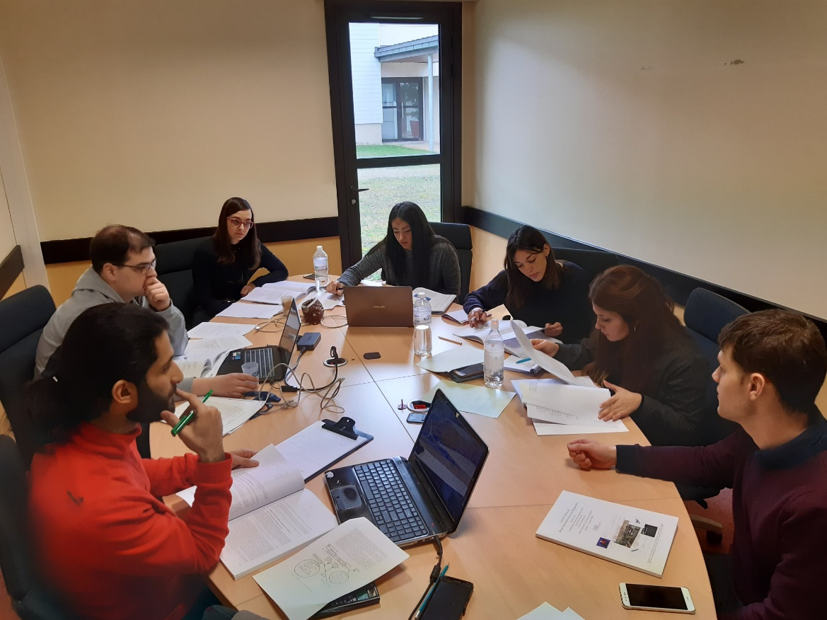
Beam diagnostics mini-workshop
26 February 2020

Slide 39
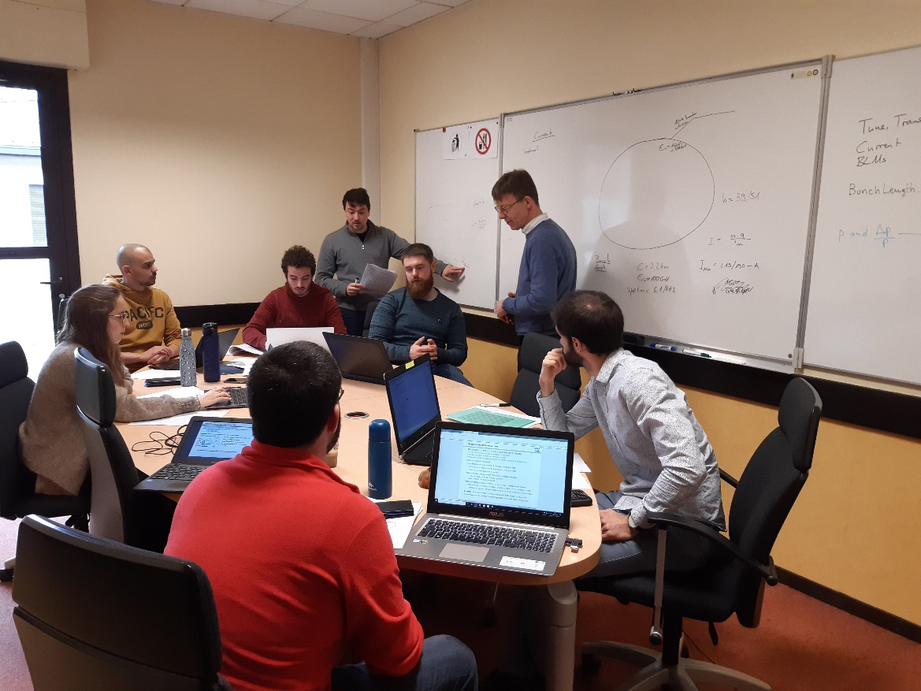
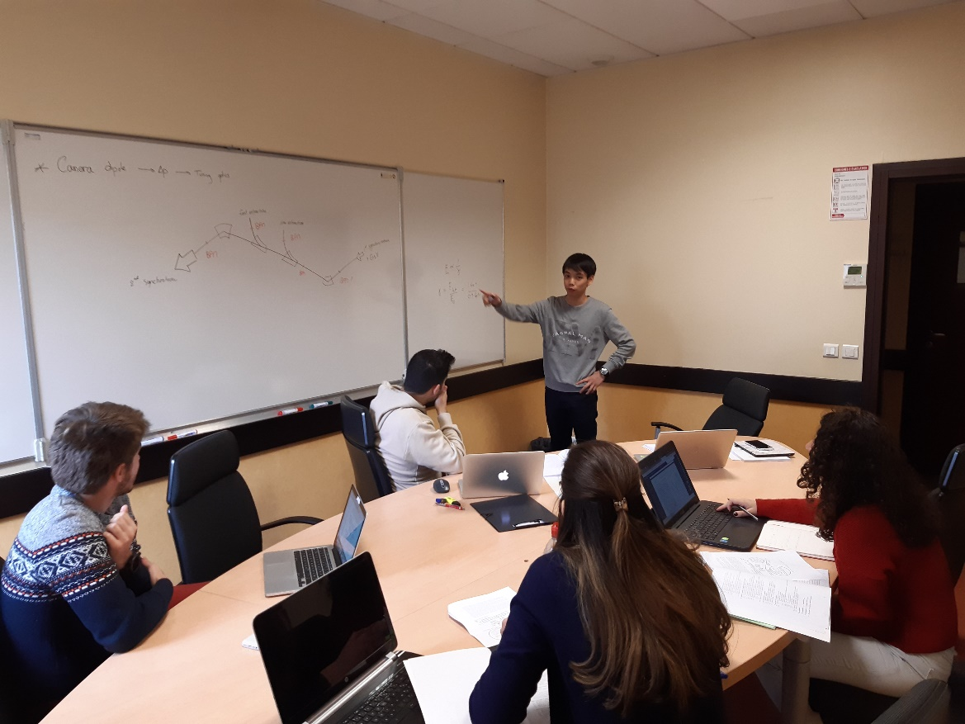
Beam diagnostics mini-workshop
26 February 2020
P. Forck guiding the students

Slide 40
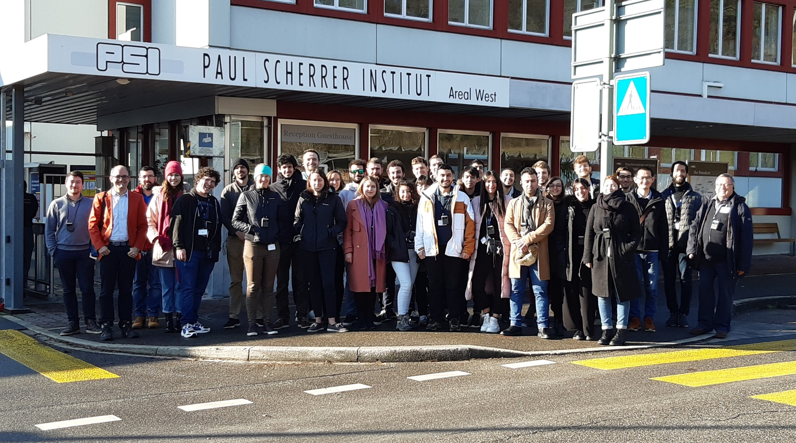
Visit to PSI Villigen
27-28 February 2020

Slide 41
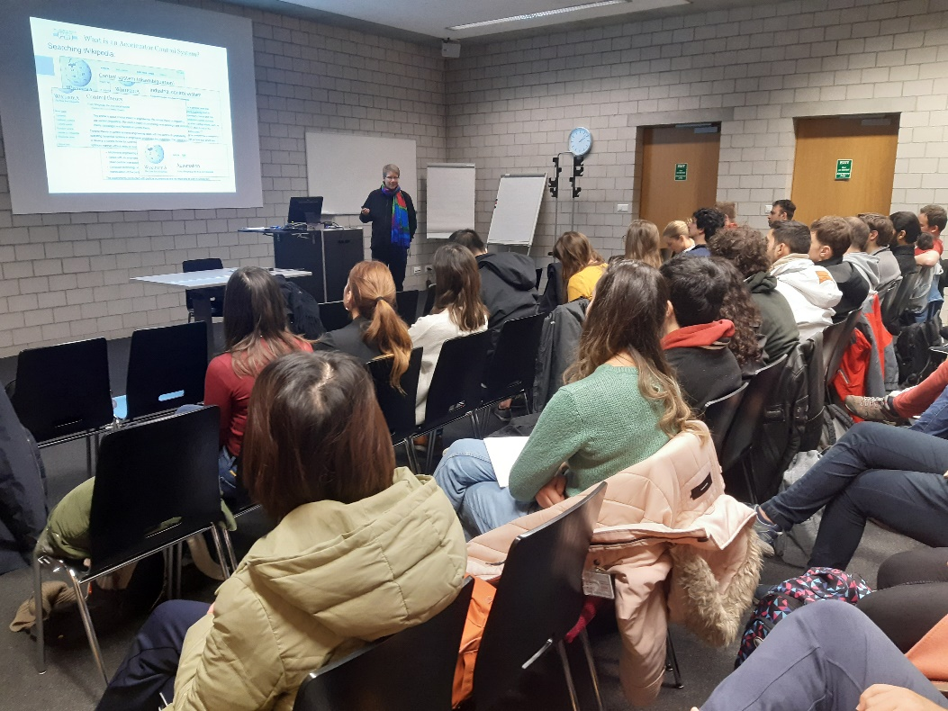
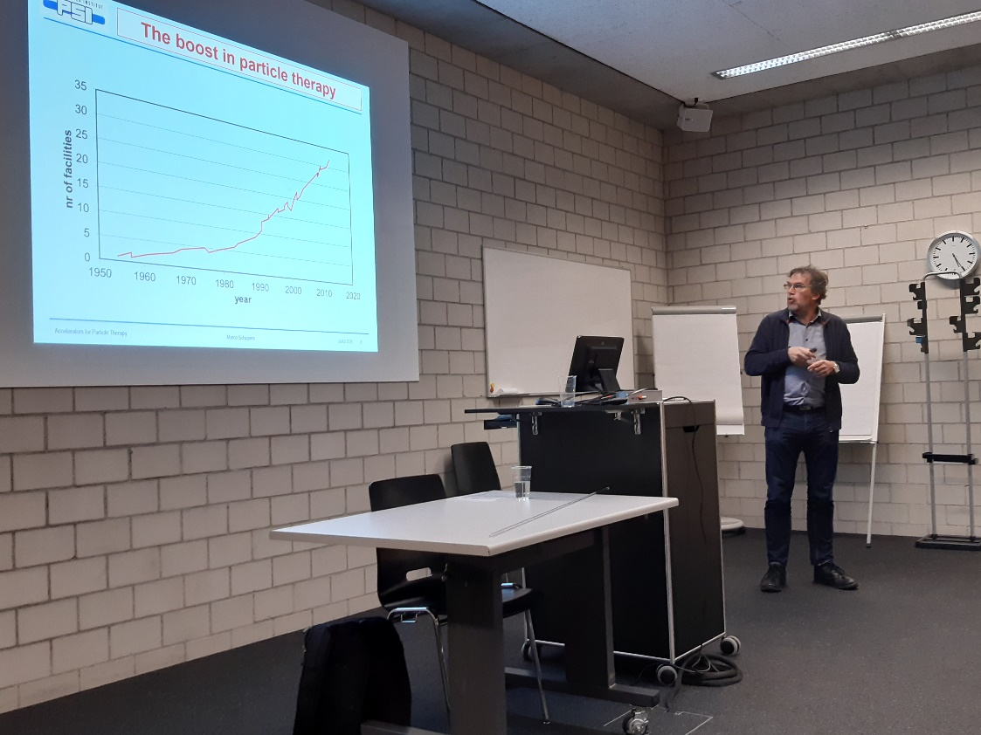
Visit to PSI Villigen
27-28 February 2020
E. Zimoch lecturing on accelerator controls
M. Schippers explaining hadron therapy

Slide 42


Visit to PSI Villigen
27-28 February 2020
With J. Raabe in the Swiss Light Source ring

Slide 43


Visit to PSI Villigen
27-28 February 2020
With R. Ischebeck in a soft X-ray scattering station of the SwissFEL

Slide 44


Visit to PSI Villigen
27-28 February 2020
Isocentric gantry for hadrontherapy,
as seen from the patient’s side…
… and from the accelerator physicist’s side

Slide 45


Visit to PSI Villigen
27-28 February 2020
B. Hermann’s after-dinner seminar on «Accelerators on a chip»

Slide 46


Slide 47


Lectures and workshop on SC magnets by teleconference
P. Ferracin from Berkeley

Slide 48
Practical Days at CERN on 5 & 6 March 2020
Organization
Two full days at CERN
  one subject per day per student
  Lunch at CERN covered by ESI
Five subjects proposed:
  RF (coordinators: F. Caspers, M. Wendt)
  Vacuum (coordinators: V. Baglin, R. Kersevan)
  Magnets (coordinators: J. Bauche, L. Fiscarelli)
  Superconductivity (coordinator: J. Fleiter)
  Beam measurements on CLEAR (coordinators: W. Farabolini, A. Gilardi)
Students were asked to indicate their preferences
All students could participate in the subjects they ranked first and second

Slide 49



Practical days at CERN
Magnet electrical tests with J. Bauche
Magnetic measurements with L. Fiscarelli
Vacuum measurements

Slide 50


Slide 51

Practical day at BERGOZ INSTRUMENTATION
Wednesday 11 March 2020 p.m.
E.Touzain CEO

Slide 52


Practical day at BERGOZ INSTRUMENTATION
Wednesday 11 March 2020 p.m.
Presentation of beam instruments
Performance measurements on beam monitoring instruments

Slide 53



Practical day at BERGOZ INSTRUMENTATION
Wednesday 11 March 2020 p.m.

Slide 54
JUAS 2020 Course 2 in a nutshell [1/2]

Slide 55
JUAS 2020 Course 2 in a nutshell [2/2]
EIC!!

Slide 56
Survey of JUAS alumni 2017-2018-2019
Summary & conclusions
Proper analysis can be made on a statistically significant number of answers, 92 representing 43% of the attendance over the last three years
Most students followed Course 2, and only about one out of five followed both Courses
Master and doctoral students were in about equal numbers, both more numerous than professionals
Three out of four Master students continued with a doctoral thesis
Almost four out of five alumni are still in the field of particle accelerators, with increasing proportions from Master to doctoral students to professionals
Those no longer in particle accelerators have migrated to a variety of high-tech domains
JUAS alumni are working or studying in 20 countries, with a majority in France and Switzerland+CERN
Most of alumni are in laboratories or university
JUAS experience is rated “very useful” to “essential” to their present activities by a majority of alumni
  In increasing proportions from Master to doctoral students to professionals
  In about equal proportions for Course 1 and Course 2 of JUAS
  Overwhelmingly for those still in the field of particle accelerators

Slide 57

JUAS Alumni at EIC
Article in our Alumni Network platform by Francois Méot (former JUAS director now at BNL) on
  Alumni who have worked at BNL and contributed to EIC

Slide 58


This applies mutatis mutandis to accelerator science and projects in Europe and other regions as well as in the USA.

Slide 59
Particle/nuclear frontier accelerators
HL-LHC project at CERN in coming years
EIC is very likely the next major collider project in the world
  Very rich in applications of accelerator physics and technology
Colliders beyond these (see European Strategy and/or Snowmass) will take some years …
To ensure that experienced and qualified accelerator physicists and engineers will be available, the future career path of students in accelerator physics from Europe, USA and elsewhere will likely intersect with all these projects.
  JUAS (and also CAS, USPAS, …) must help prepare them

Slide 60
EIC at JUAS 2021
I would like to extend an invitation to EIC project management to nominate a speaker for seminar on EIC in JUAS Course 1 early 2021
  Inspiring and clear speaker!
  Suitable level for students (mainly Masters) who started intense study of core accelerator physics a few weeks earlier
  Illustrate links to concepts in their basic courses where possible
Considering whether we have time for a second seminar on a more specific topic (possibly cooling, FFAs/CBETA)

Slide 61
Impact of the Covid-19 pandemic
Pandemic struck at the end of Course 2 in 2020
  Students sent home 1 week early, remote exams arranged
  Visit to Geneva University Hospital radiotherapy dropped
JUAS 2021 must be held in remote format
  No students in residence at Archamps
  Maintain academic standards but adapt pace of timetable
  Partner universities’ representatives support this, continue to recognise exams for ECTS credits
  Traditional lectures fairly straightforward
  Tutorials, computer workshops, quite feasible (small groups in smaller Zoom sessions, visited by teaching staff …)
  Working on replacements for lab visits, practical work but certainly more difficult, compromises
  Working to create social interaction among students
  Exams mainly on home university premises with local invigilation

Slide 62
Backup slides

Slide 63
ECTS credits for JUAS Master students from Partner Universities

Slide 64

IPAC Prize for JUAS Student 2020
A JUAS student is allotted a European Grant for attending the IPAC conference
The proposal is made by the JUAS director to the IPAC Conference Coordinator, based on the following criteria
  To obtain the best mark at the exam of Course 1
  To continue his/her career in the field of particle accelerators
  To present his/her work at the Conference
  To serve as required at the Conference (e.g. scientific secretary of session, JUAS booth,…)

Slide 65

IPAC prize for JUAS student 2020
The recipient is Daniele Butti (b. 1994)
  Italian national
  BSc, MSc Politecnico di Milano
  Doctoral student at Royal Holloway, with CERN as host laboratory (CERN supervisor Enrico Bravin)
  Thesis work: Development of optical interferometer based on synchrotron radiation for measurement of transverse beam size in the LHC
  Best mark (17.5/20) at the exams of JUAS Course 1 on “The science of particle accelerators”
Due to CoViD-19, the conference took place remotely and the prize was not given

Slide 66
JUAS 2021 Face-to-face or remote?
Earlier in the summer we had hoped to maintain the possibility of a JUAS in traditional format
  Students from several countries in residence at Archamps
  Face-to-face lectures, tutorials, computer workshops
  Visits and lab work at accelerators labs, companies, etc
Present evolution of pandemic and financial/logistical analysis ⇒ we must abandon that.
  Sister school ESIPAP has already adopted online only.
Of course, we hope to return to traditional format in 2022.

Slide 67
Ideas for remote lab visits
Lab visits and practicals have been an essential feature of JUAS up to now
How can we continue them remotely?
  This requires considerable thought and we may learn from experience in universities, other ESI schools, …
Video demonstrations, either live on Zoom, or probably better, filmed in advance
  Replay possibility for registered students
    Need technical solutions for video servers (CERN?, Vimeo?)
  Help from audio-visual services in the laboratories?
    Possibly use existing video material.
Replication of lab work by students
  Most difficult part
  Small groups participate in live practical sessions with same equipment and questions/answers (?)

Slide 68
Social Aspects of JUAS
Traditionally, JUAS students, lecturers and staff get to know each other well during the courses
  Shared accommodation
  Interactions during workshop and tutorials, at coffee, working lunches, after-works, visits to labs.
It is important to maintain this
  Students will very probably do it among themselves (Whatsapp, social media, etc) but these may not be fully inclusive
  Need to develop some remote frameworks, like virtual coffee breaks, to enhance personal interaction

Slide 69

Survey of JUAS alumni 2017-2018-2019

Slide 70

Survey of JUAS alumni 2017-2018-2019

Slide 71

Survey of JUAS alumni 2017-2018-2019

Slide 72

Survey of JUAS alumni 2017-2018-2019

Slide 73

Survey of JUAS alumni 2017-2018-2019

