Slide 1
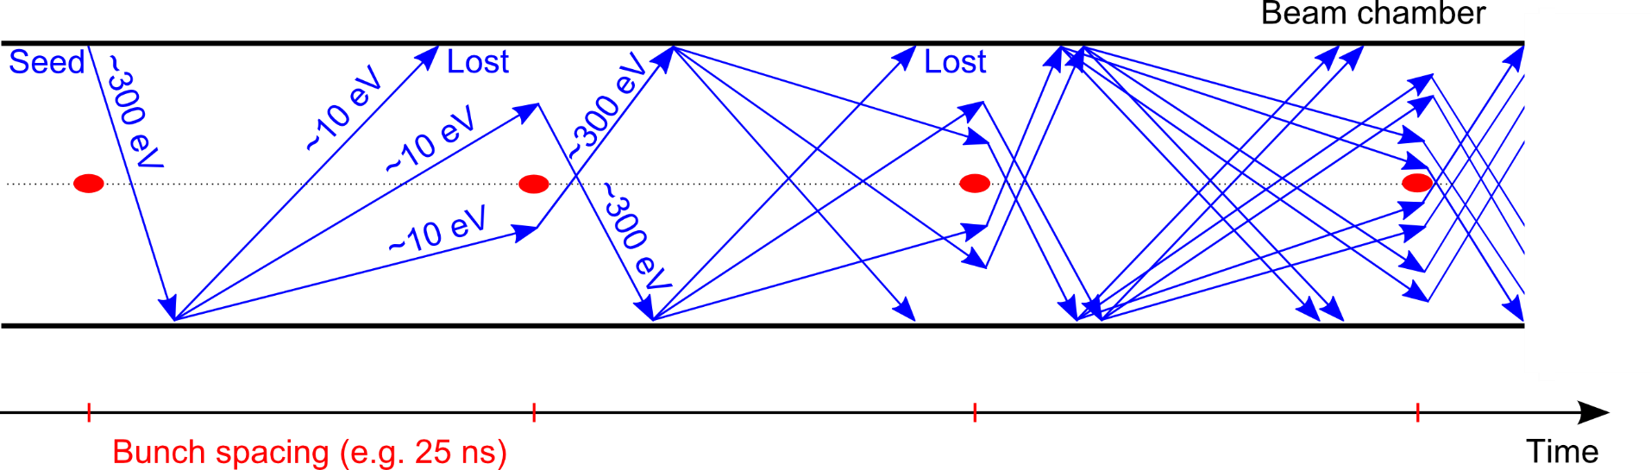
e—cloud, SEY studies and electron induced desorption from cryogenic surfaces.
R. Cimino LNF-INFN
Thanks to F. Ruggiero

Slide 2
OUTLINE
Introduction
e⁻cloud mitigation methods in a global scenario: compatibility with impedance, vacuum, etc.
Few examples: LASE/LESS – low SEY coatings (a-C)
Conclusions

Slide 3
Introduction
The performance reach of accelerators crucially depends on the vacuum system
1. The beam interacts with the rest gas in the vacuum chamber causing:
  reduced beam lifetime - and/or emittance growth - trigger avalanche multiplication processes
2. The vacuum system plays an important role for beam stability:
  Its material(s) conductivity, shape, coating mainly determine resistive wall impedance of a machine
  Transitions between pipes, bellows, etc. significantly contribute to the global machine impedance
  Total impedance needs to be kept below a certain budget to allow operation at the desired intensity.
3. The vacuum chamber also affects beam stability and lifetime otherwise
  Its inner wall surface properties in particular desorption and electron yields, are critical
  High desorption yields can lead to pressure runaway
  High electron yields can lead to electron cloud formation
  Distributed pumping from surface/design (e.g. NEG coating, pumping holes)
  Shape optimization for photon absorption (antechambers, slits)

Slide 4
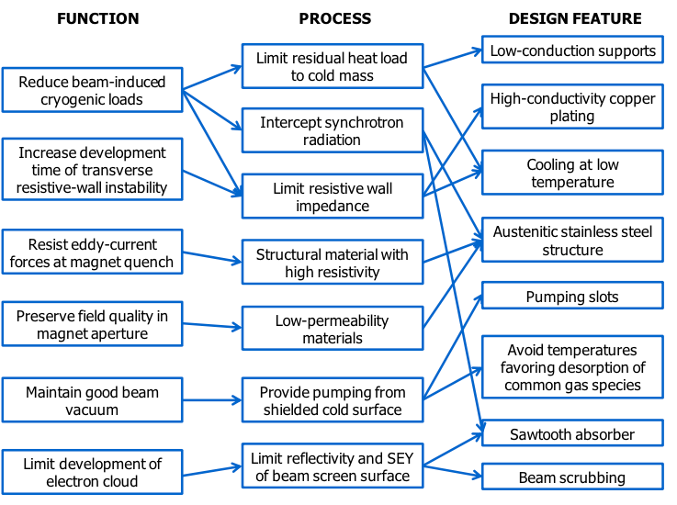
A Functional diagram (here shown for the BS of LHC) must be fulfilled.
EIC (with/without BS) will also have one.
LHC Beam Screen (BS)
Cu layer
Pumping slots
shields
Cooling tubes
Dipole cold bore at 1.9 K
“Saw teeth”
Pumping slots
V. Baglin et al. CERN-ATS-2013-006
e⁻ cloud control and mitigation is one (important) aspect in a much more general scenario.

Slide 5
e⁻ cloud formation
Generation of electrons inside the vacuum chamber
(primary, or seed, electrons)
R. Cimino and T. Demma “Electron cloud in Accelerators” Int. J. Mod. Phys. A 29 (2014) 1430023.
Residual gas ionization
Desorption from the losses on the wall
Photoelectrons from synchrotron radiation

Slide 6
e⁻ cloud formation
Generation of electrons inside the vacuum chamber
(primary, or seed, electrons)
R. Cimino and T. Demma “Electron cloud in Accelerators” Int. J. Mod. Phys. A 29 (2014) 1430023.
Acceleration of primary electrons in the beam field
Secondary electron production when hitting the wall
(F.Zimmermann)
Primary e⁻
θ
E
secondaries
elastically reflected
After bunch passage
R. Cimino et al PRL 2004

Slide 7
e⁻ cloud formation
Generation of electrons inside the vacuum chamber
(primary, or seed, electrons)
R. Cimino and T. Demma “Electron cloud in Accelerators” Int. J. Mod. Phys. A 29 (2014) 1430023.
Acceleration of primary electrons in the beam field
Secondary electron production when hitting the wall
Avalanche electron multiplication
Tx to F. Ruggiero

Slide 8
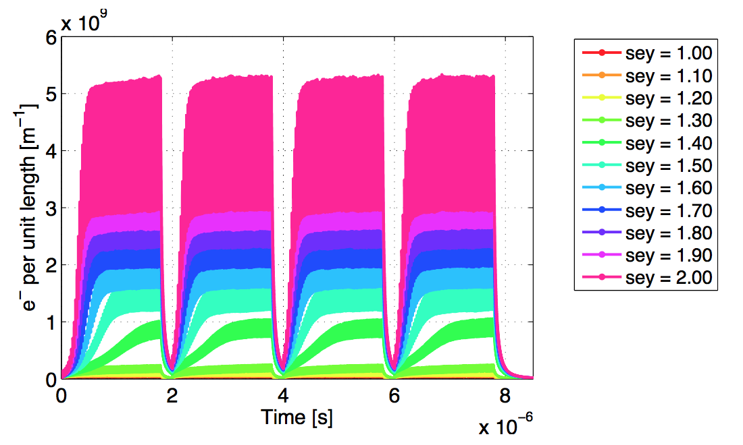
e⁻ cloud formation
Tx to F. Ruggiero
After the passage of several bunches, the electron distribution inside the chamber reaches a stationary state (electron cloud)
Tx to G. Rumolo
The presence of an e⁻cloud inside an accelerator has consequences on the machine (pressure rise, outgassing, heat load, etc.) and on the beam (Coherent instability, both single and multi-bunch driven, emittance growth, luminosity and Energy loss, etc.). Needs to be mitigated!

Slide 9
Existing and planned accelerator machines base the reaching of their design parameters to the capability of obtaining walls with a SEY ~1.1 or below!
Mitigation Strategies
External solenoid field
Electrodes in the lattice
Active elements
Geometrical modifications
Intrinsically low
SEY material
Surface
modification
Machine
operation
Electron and/or photon Scrubbing
Run with low e⁻ cloud
filling partners
Need to be compliant with all specs in the global scenario

Slide 10
Mitigation Strategies
Issues:
External solenoid field
Costly and not always applicable
Electrodes in the lattice
Costly, not always applicable, impedance?
e⁻ and/or Ph. Scrubbing
Time consuming, not stable and “asymptotic”
Run with low e⁻ cloud
filling partners
Costs machine performance (reduced n. of bunches)
Geometrical modifications
Impedance, dust, vacuum behavior.
Intrinsically low SEY material
Impedance, stability, adhesion, etc

Slide 11
Mitigation Strategies
Issues:
External solenoid field
Costly and not always applicable
Electrodes in the lattice
Costly, not always applicable, impedance?
e⁻ and/or Ph. Scrubbing
Time consuming, not stable and “asymptotic”
Run with low e⁻ cloud
filling partners
Costs machine performance (reduced n. of bunches)
Geometrical modifications
Impedance, dust, vacuum behavior.
Intrinsically low SEY material
Impedance, stability, adhesion, etc

Slide 12
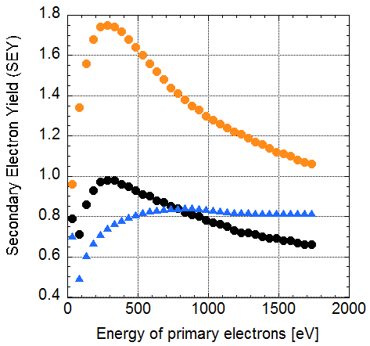
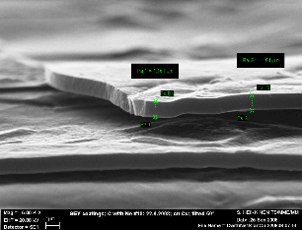
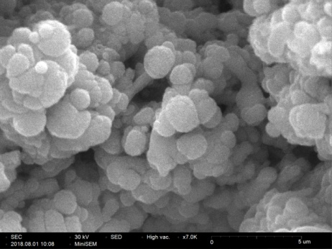
Mitigation Strategies
Intrinsically low
SEY material
Geometrical modifications
NEGs, a-C
- Nano -
LASE/LESS
LESS
a-C
Not-scrubbed
Cu
LASE
Threshold
for e-cloud
In HL- LHC triplets
R. Valizadeh, (2014, 17)
a-C
Low SEY results from the electronic properties
LESS/LASE
Low SEY is a
morphological effect

Slide 13
But, within the global context:
Mitigation Strategies
Issues:
External solenoid field
Costly and not always possible
Electrodes in the lattice
Costly, not always possible, impedence?
Machine Scrubbing
Time consuming, not stable and “asymptotic”
Run with low e⁻ cloud
filling partners
Costs machine performance (reduced n. of bunches)
Geometrical modifications
Impedance, dust, vacuum behavior....
Intrinsically low SEY material
Impedance, stability, adhesion, etc

Slide 14
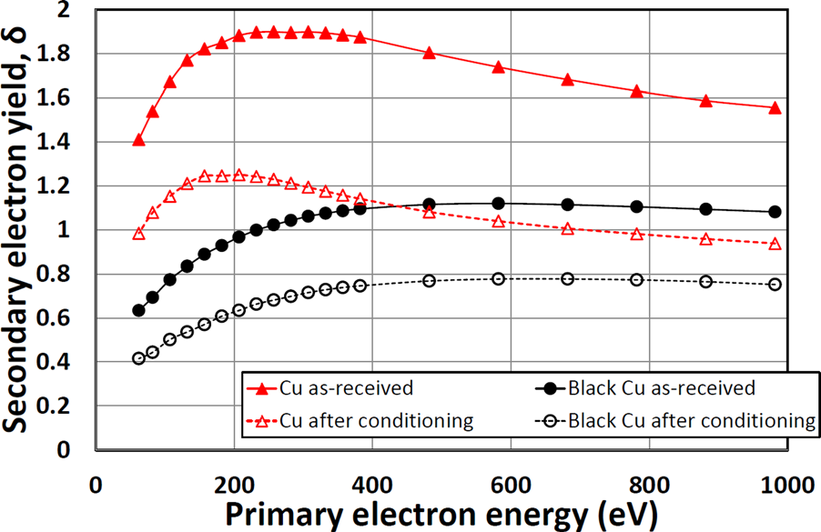
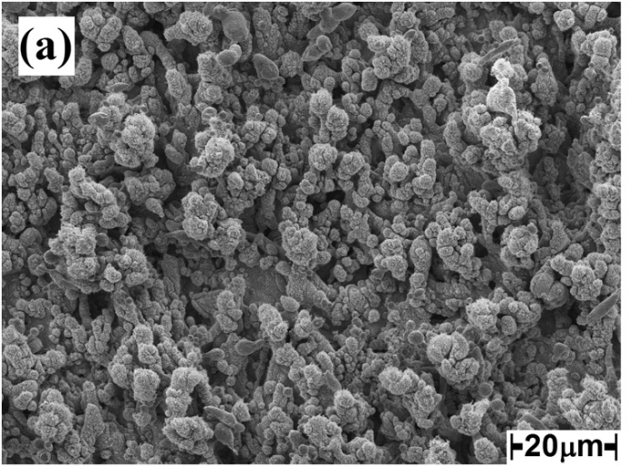
Limiting SEY with LASE/LESS -Cu
surface morphology of LASE/LESS
R. Valizadeh et al. , Appl. Phys. Lett. (2014)
Very low SEY
R. Valizadeh et al. , Appl. Surf. Sci. (2017)
R. Valizadeh, et al. Appl. Phys. Lett. 105, 231605 (2014)
The structure is expected to have higher impedance (by construction), to be prone of producing dust during formation and to have a much augmented vacuum surface

Slide 15
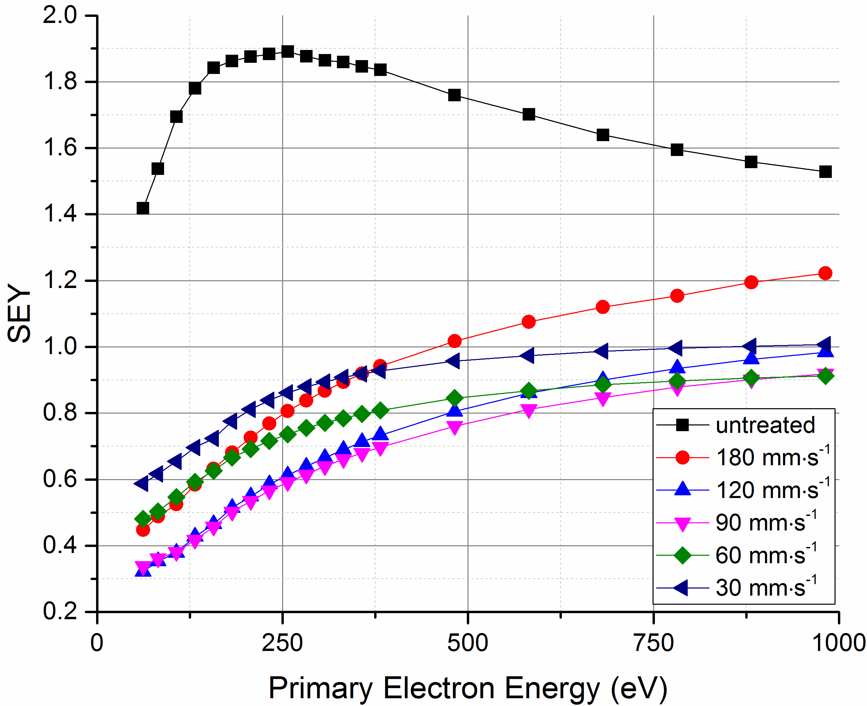
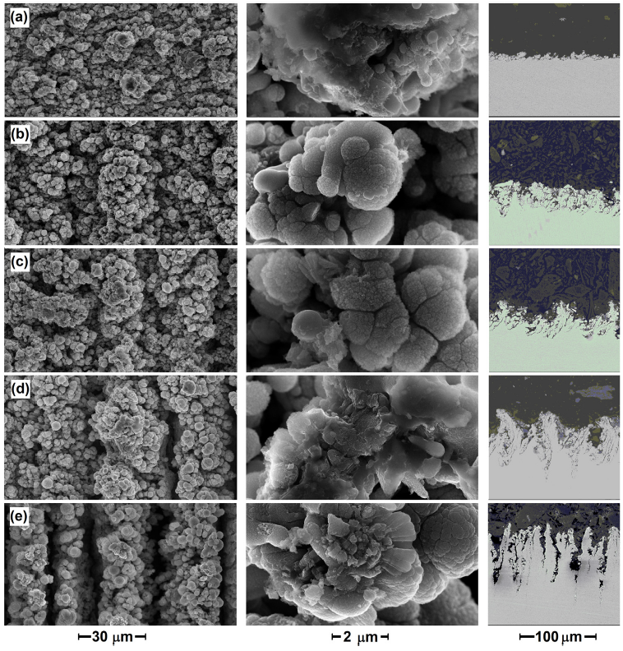
Ongoing LASE/LESS-Cu Impedance studies
See: O. Malyshev et al. e-cloud 2018 Proceeding (2020); R. Valizadeh, et al. Appl. Phys. Lett. 105, 231605 (2014)
Sample | Scan speed [mm/s] | Groove depth [μm] | R_{s} [Ω] | R_{s} [Ω]
 |  |  | average | 0° | 45° | 90°
Cu | untreated | - | 0.033
(a) | 180 | 8 | 0.078 | 0.11 | 0.11 | 0.095
(b) | 120 | 20 | 0.13
(c) | 90 | 35 | 0.14 | 0.15 | 0.19 | 0.20
(d) | 60 | 60 | −
(e) | 30 | 100
SEY and surface resistivity strongly depend on LASE structure (presence and groove directions)

Slide 16
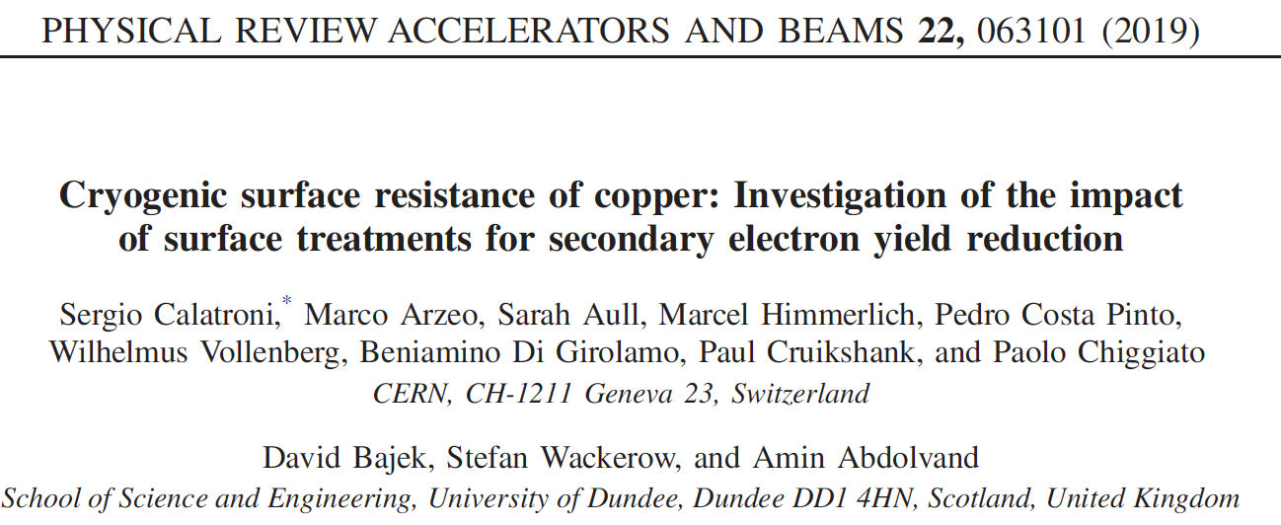
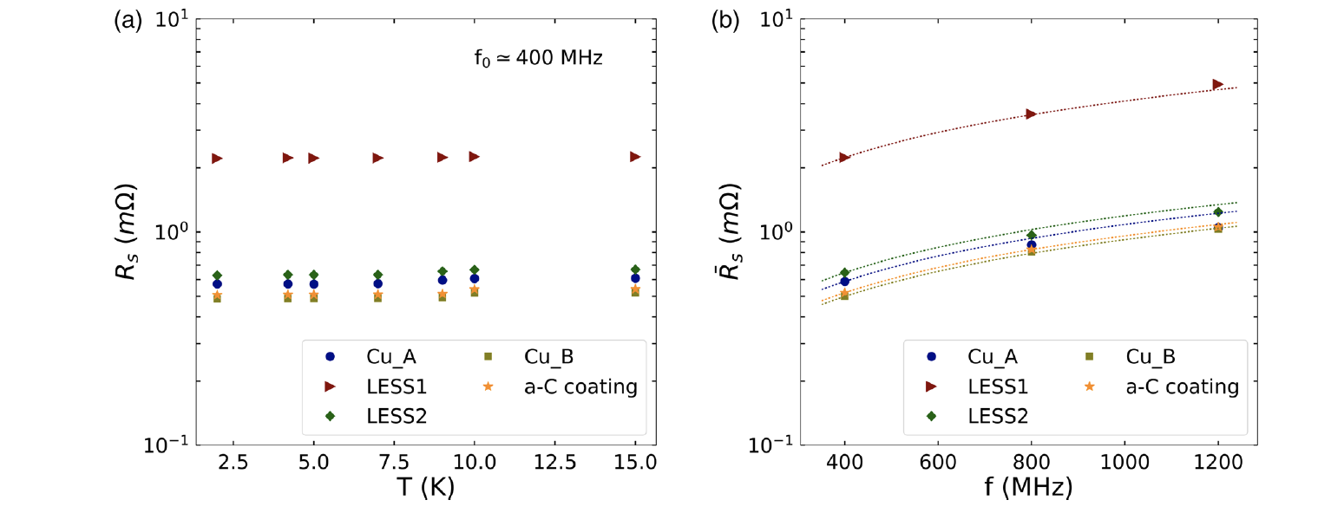
Ongoing LASE/LESS-Cu Impedance studies
Optimization is in progress!
1 µm
Impedance and dust production are still open issues
Collected particles after Ultrasounds cleaning

Slide 17
Mitigation Strategies
Issues:
External solenoid field
Costly and not always possible
Electrodes in the lattice
Costly, not always possible, impedence?
Machine Scrubbing
Time consuming, not stable and “asymptotic”
Run with low e⁻ cloud
filling partners
Costs machine performance (reduced n. of bunches)
Geometrical modifications
Impedance, dust, vacuum behavior.
Intrinsically low SEY material
Impedance, stability, adhesion, etc

Slide 18
Coatings:
Low intrinsic SEY (NEG and a-C)
Typically high surface resistance of impact to impedance.
We know that: - SEY is very surface sensitive
- Surface resistance skin depth ~ 0.1-10 μm
Can the coating be thin enough to reduce SEY without affecting material surface resistance within the skin depth?
(Of course NEG is deposited not only to reduce SEY but its thickness grant pumping reservoir so... It is a different story!)

Slide 19
How a Coating modify SEY?
(the case of a-C on Cu)
We followed the growth of thin a-C layers on Cu with XPS to measure its thickness
a-C thermal evaporator
XPS
Increasing C
Graphite road
M. Angelucci et. al; Rap. Comm in Phys. Rev. Report, in print

Slide 20
How a Coating modify SEY?
(the case of a-C on Cu)
We followed the growth of thin a-C layers on Cu with XPS to measure its thickness
a-C thermal evaporator
Cu 2p
C 1s
Increasing C
Graphite road
M. Angelucci et. al; Phys. Rev. Research Rapid comm. 2, 032030(R) (2020)

Slide 21


How a Coating modify SEY?
(the case of a-C on Cu)
We followed the growth of thin a-C layers on Cu with XPS to measure its thickness
In XPS:
where d is the unknown thickness and λ is the inelastic mean free path.
a-C thermal evaporator
Cu 2p
{
C 1s
Increasing C
We can convert
deposition Time in nm (+30%)
Graphite road
M. Angelucci et. al; Phys. Rev. Research Rapid comm. 2, 032030(R) (2020)

Slide 22
How a Coating modify SEY?
(the case of a-C on Cu)
By simultaneously follow SEY changes with a- C thickness we can measure SEY dependence on the actual a-C coverage.
Increasing C
M. Angelucci et. al; Phys. Rev. Research Rapid comm. 2, 032030(R) (2020)

Slide 23
How a Coating modify SEY?
(the case of C on Cu)
δ_{max}, E_{max} set to their (a-C) final values quite soon, while minor changes still occurs at higher doses in the very low (< ~ 20 eV) and at quite high primary energy (> ~400 eV) part.
E_{max} vs C coverages
δ_{max} vs C coverages
➔ δ_{max} (<1) and E_{max} are set after 6-8 nm of a-C
M. Angelucci et. al; Phys. Rev. Research Rapid comm. 2, 032030(R) (2020)

Slide 24
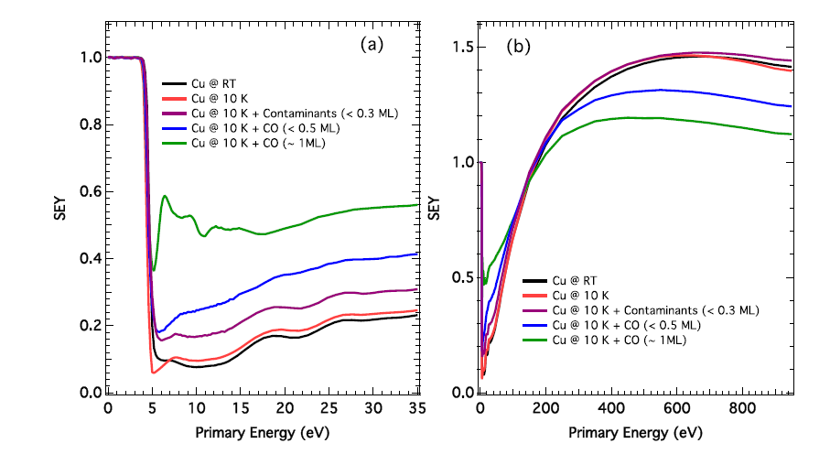
SEY is very surface sensitive:
at LT (10 K) small quantities of contaminants affects it!
L. A. Gonzalez et al., AIP Adv. (2017)
SEY is highly sensitive to the presence of adsorbates, even at sub-monolayer coverages
SEY of cold surfaces influenced by gas physisorption

Slide 25
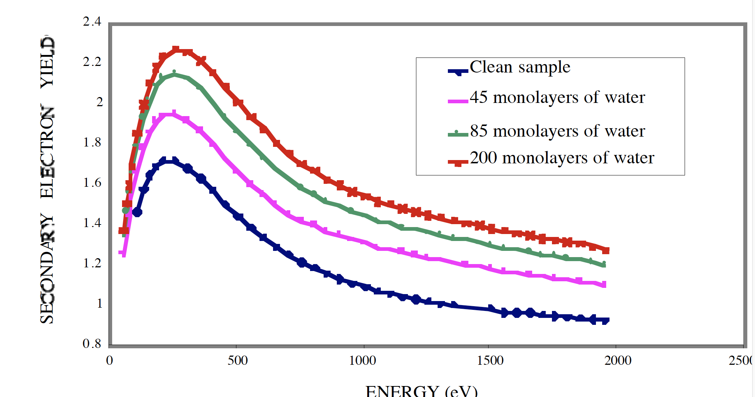
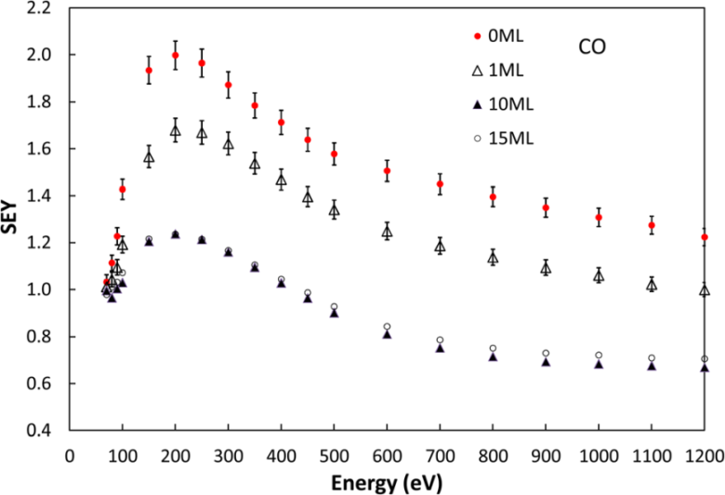
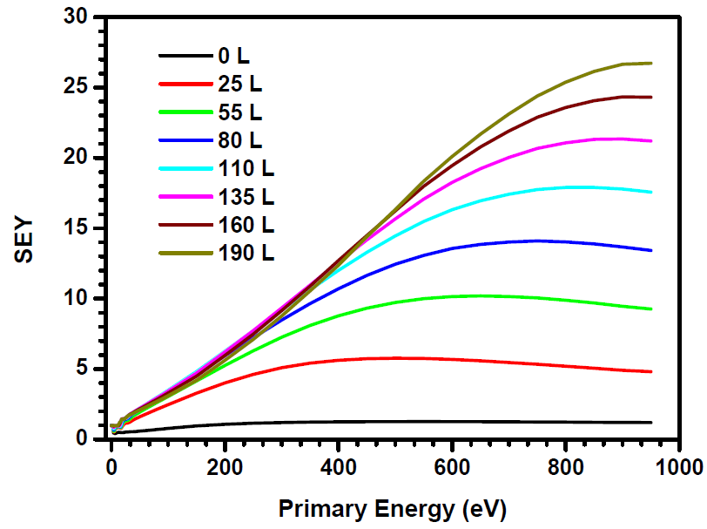
SEY Surface sensitivity: gases on LT Cu
CO thick layer coverage
Ar thick layer coverage
H₂O thick layer coverage
Kuzucan et al., J. Vac. Sci. Technol. A (2012)
L. Spallino, M. Angelucci and R. Cimino, Phys. Rev. Acc.& Beams 23, 063201 (2020)
V . Baglin, et al Proceedings of EPAC 2000, Vienna, Austria
SEY is an intrinsic material property strongly sensitive to the surface composition and chemical state
Element and coverage specific

Slide 26
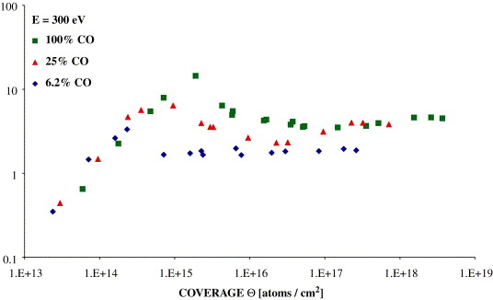
gases on Low Temperature surfaces will not only enhance/modify SEY but also electron (and photon, if present) induced desorption.
Studied for 300 eV electrons with (see: H. Tratnik et al., Vacuum 81, 731, 2007)
1) Pure gas 2) Equimolecular mixture of 4 gases 3) Standard LHC gas composition
Logarithmic scale!
CO₂ @ 300 eV
1 ML
CO @ 300 eV
Electron Induced desorption increase with coverages and may depend on substrate.

Slide 27
Conclusions
Specific:
LASE/LESS should be optimized and fully characterized (vacuum, el.desorption etc.)
< 6-8 nm are enough to completely reduce substrate SEY to one of the overlayer.
General:
All new materials should be validated in a global approach.
Material studies in conditions as close as possible to operational ones (preparation, Low Temperature & geometry) is mandatory.
EIC international collaboration:
A diffused community, at INFN (LNF, Rome and Naples) is collaborating since years to develop “state of the art” laboratories and theoretical competence to tackle e-cloud and impedance-related instabilities and is looking forward to define the most efficient involvement in the EIC of mutual interest.

Slide 28
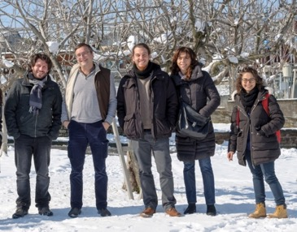





Thank you for your attention
Thanks to the low temperature team at LNF:
M. Angelucci, A. Liedl, R. Larciprete, A. Novelli e L. Spallino.
Tanks to the technical support of DAФNE-L Team:
A. Grilli, M. Pietropaoli, A. Raco, V. Tullio, V. Sciarra and G. Viviani
Thanks to ARYA supporting project funded by INFN-SNC5

Slide 29
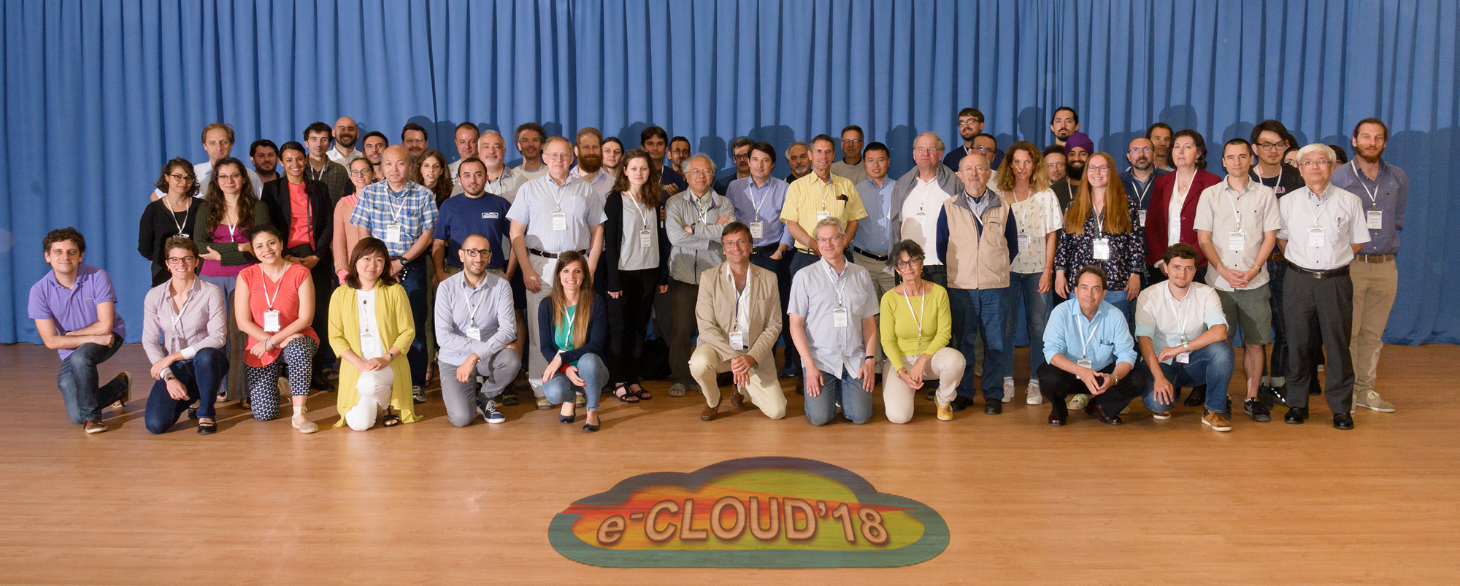
We thank all the e⁻ cloud community
See:
https://agenda.infn.it/event/13351/
We planned to reconvene in 2021 but we decided to plan ECLOUD22 from 25 to 29 September 2022 in La Biodola (Elba Island).
We hope to see a numerous participation from the EIC international collaboration.

