Slide 1
SACLA's thermionic low-emittance gun and the future perspective
Kazuaki Togawa
RIKEN SPring-8 Center
October 8, 2020
Electron-Ion Collider Workshop

Slide 2
Outline
Overview of the x-ray free-electron laser facility, SACLA
CeB₆ thermionic gun
A problem and a solution of the SACLA’s CeB₆ gun
Future perspective

Slide 3
Overview of the x-ray free-electron laser facility SACLA

Slide 4
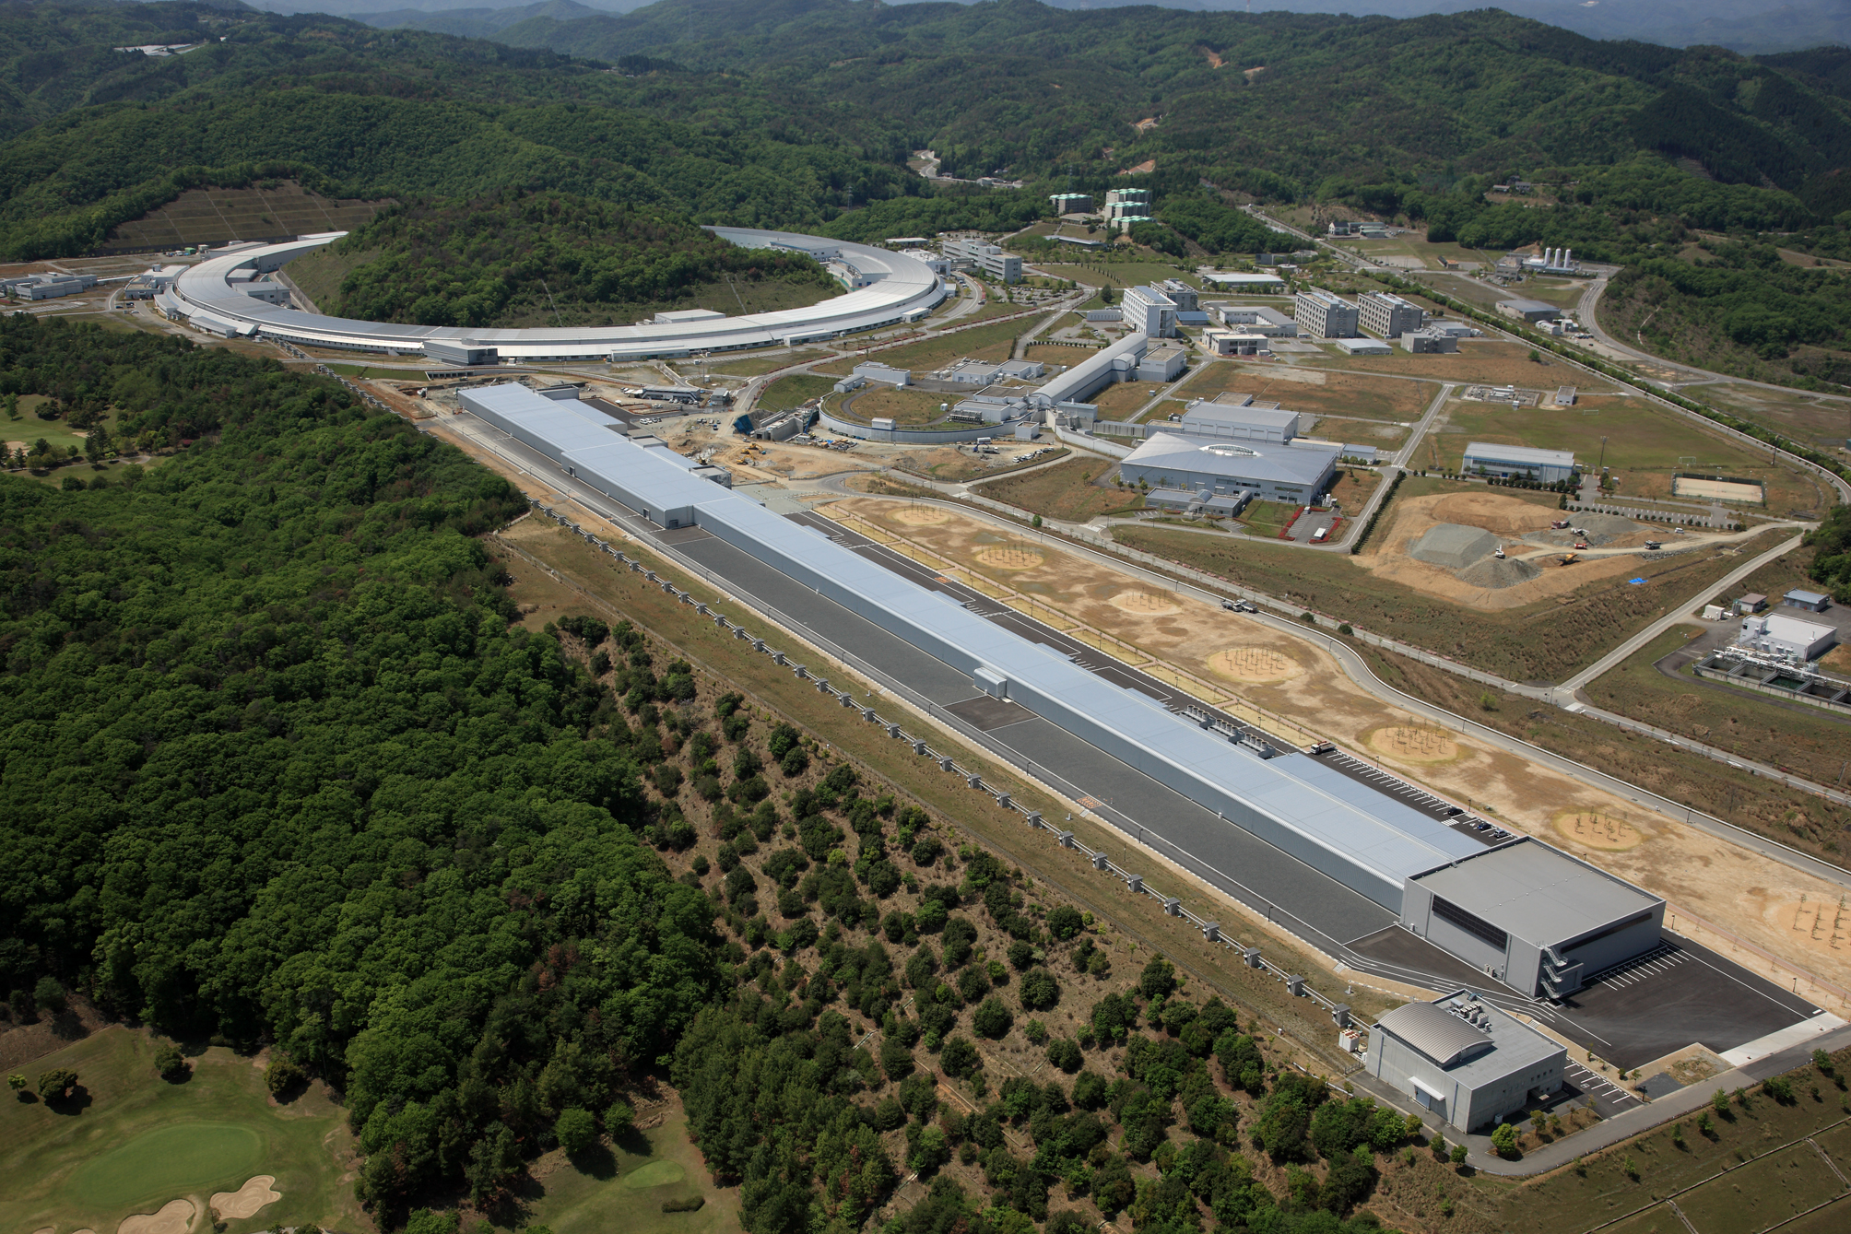
X-ray free-electron laser facility, SACLA
SPring-8 storage ring (8 GeV)
SACLA (8 GeV)

Slide 5
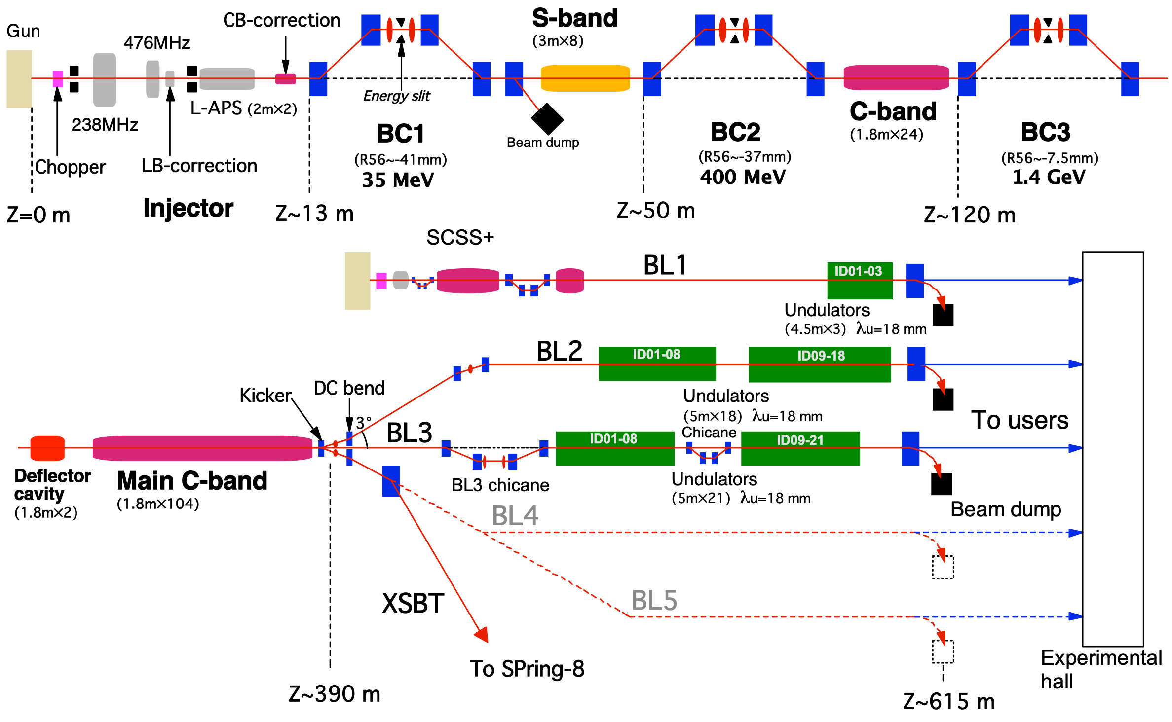
SACLA accelerator layout
Courtesy of T. Hara

Slide 6
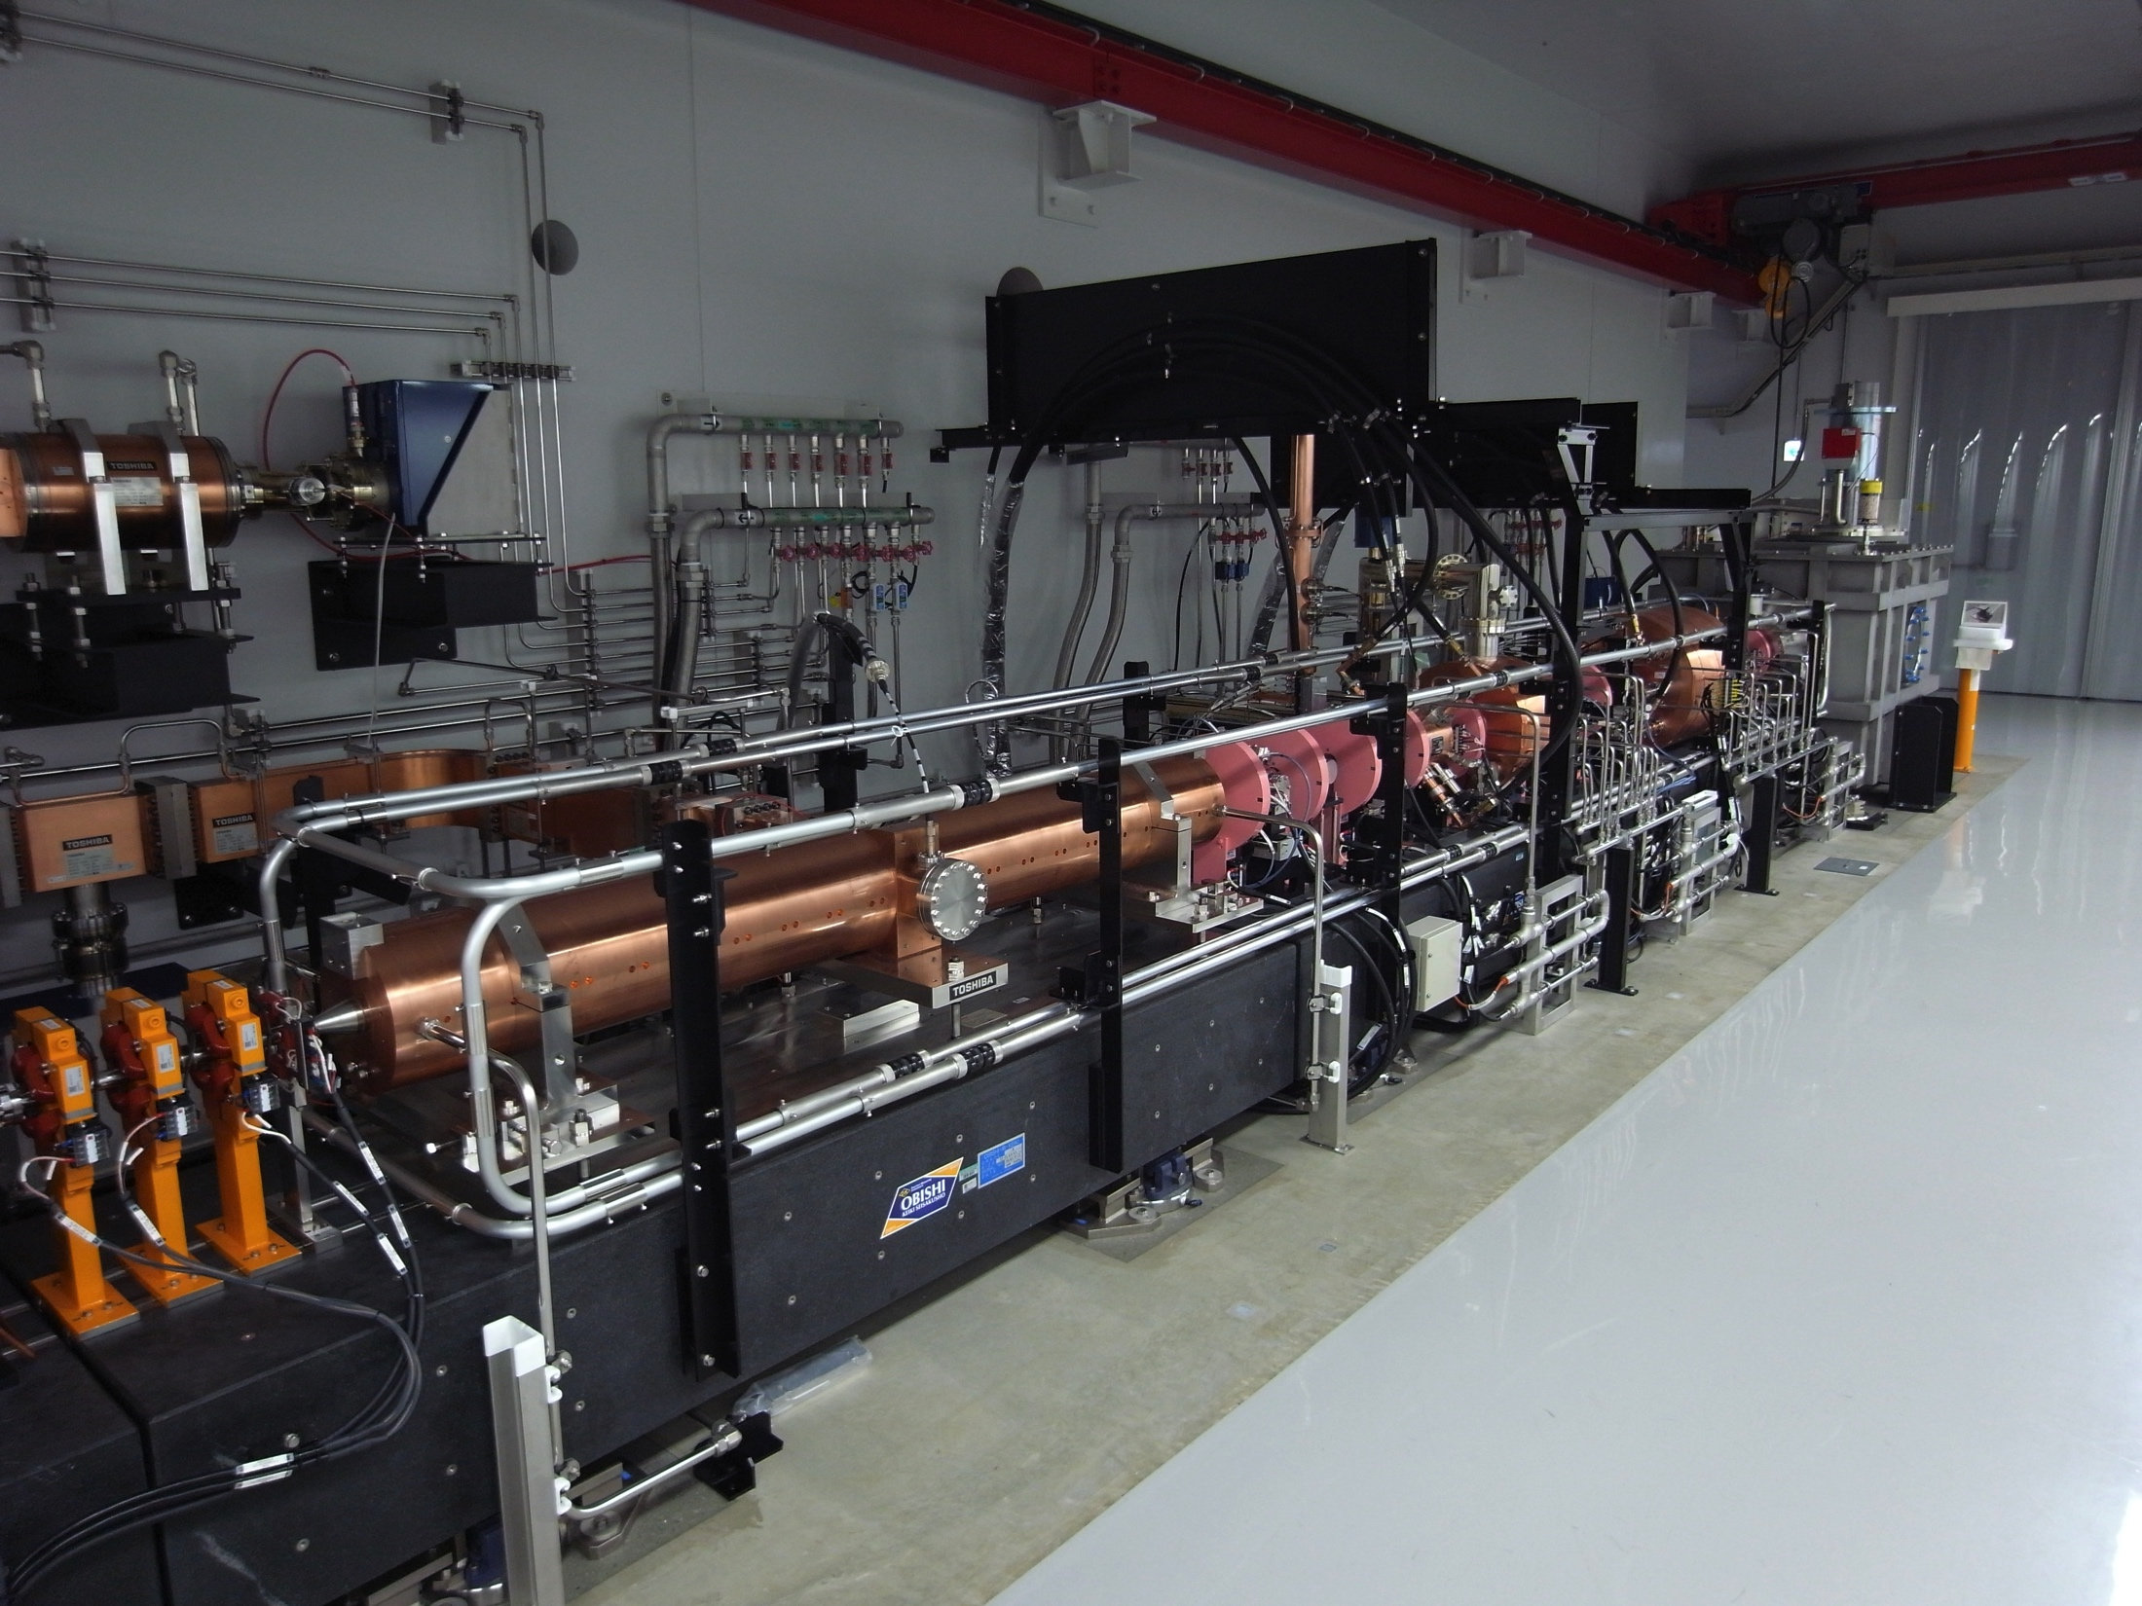
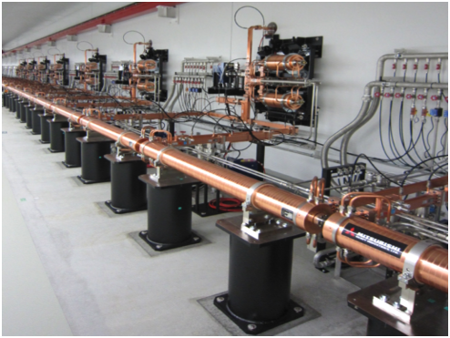
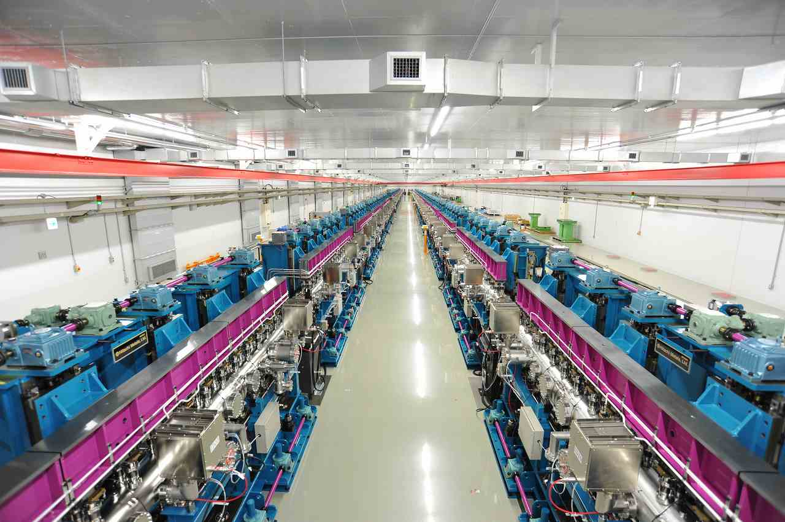
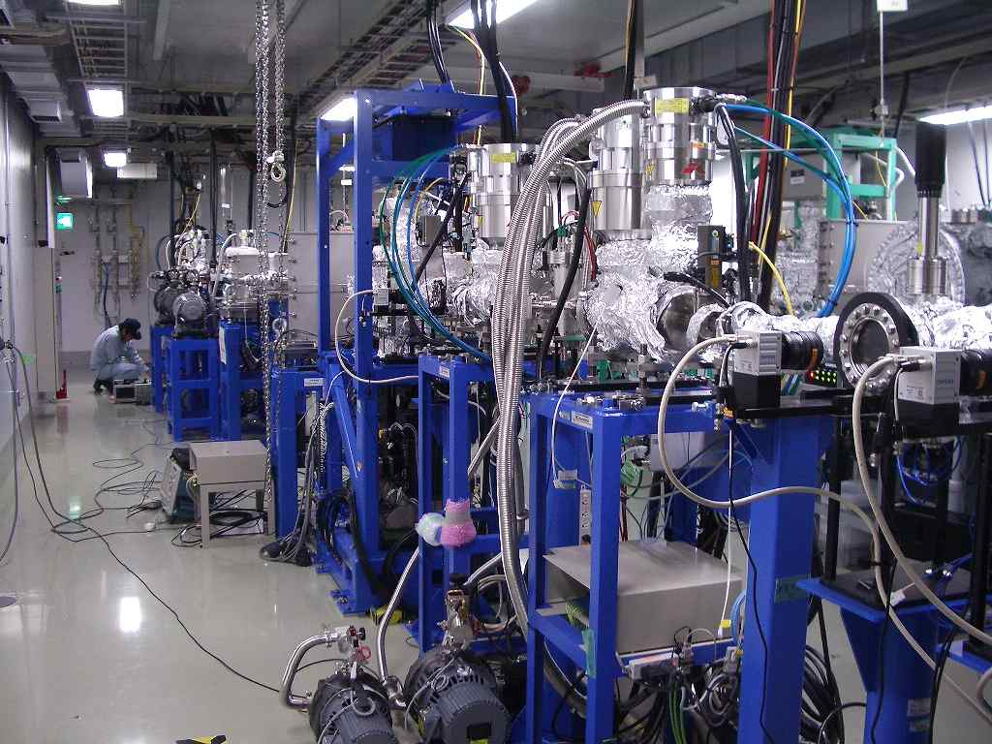
SACLA accelerator main components
Electron injector
C-band accelerator
In-vacuum undulator
Photon beamline

Slide 7
SACLA beam specifications
 | BL3 / BL2 | BL1
Electron beam energy | 8.5 GeV (max.) | 800 MeV (max.)
Bunch charge | 0.2 – 0.3 nC | 0.2 – 0.3 nC
Peak current | >10 kA | >300 A
Pulse repetition rate | 60 Hz (max.) | 60 Hz (max.)
Photon energy | 4 – 15 keV (0.08 – 0.3 nm) | 20 – 150 eV (8 – 60 nm)
FEL pulse energy | ~0.5 mJ @10 keV | ~100 μJ @100 eV
Pulse width | <10 fs | <1 ps
Spectrum band width | 0.5 % | 3%

Slide 8
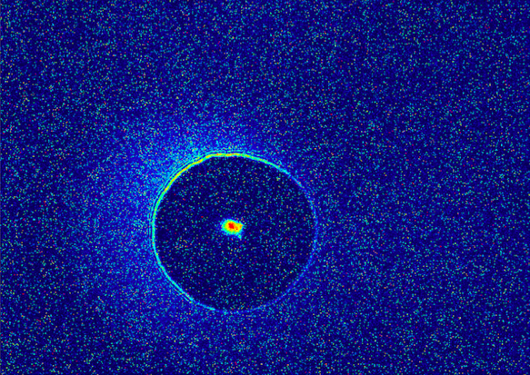
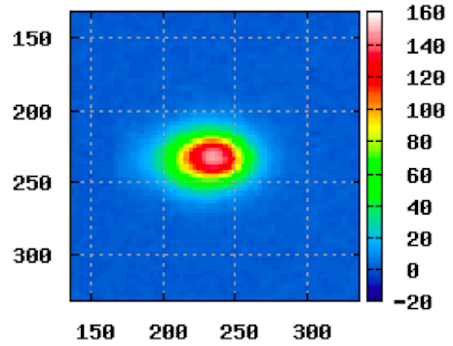
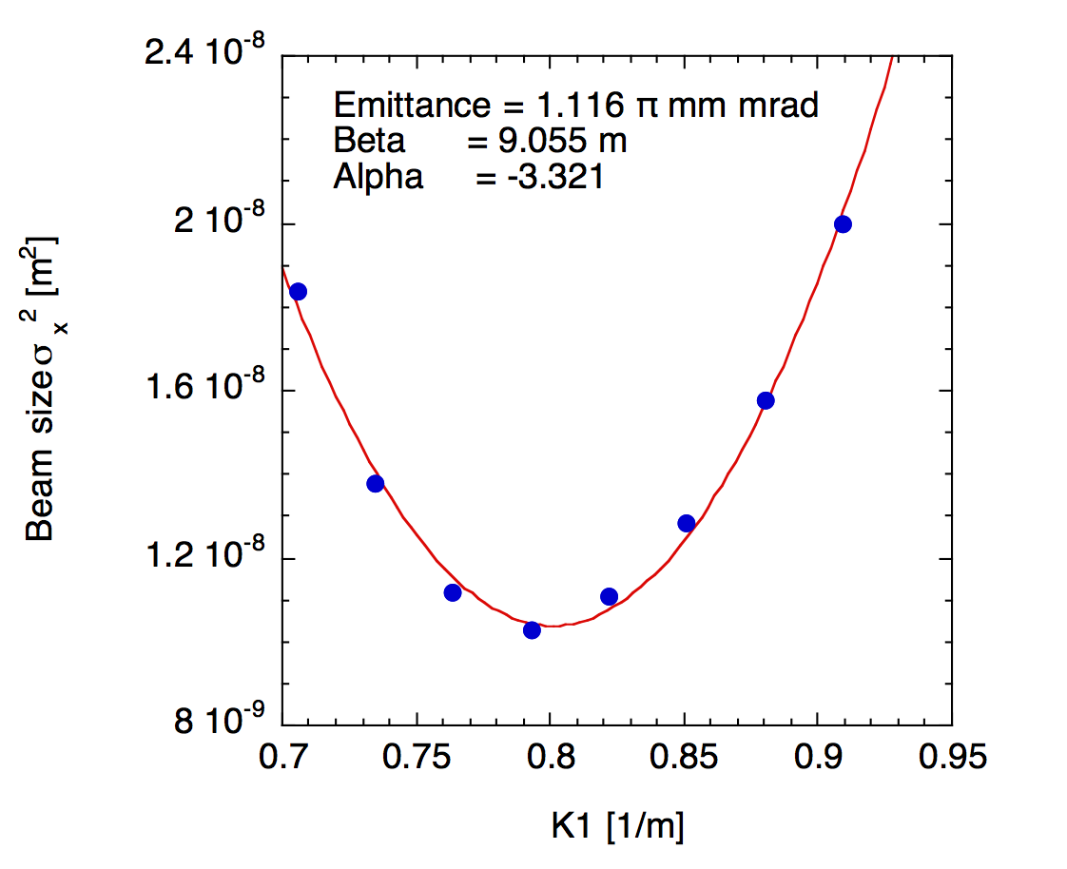
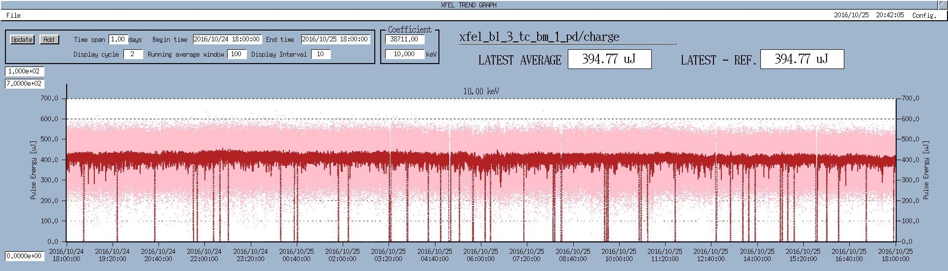
SACLA beam performances
Electron beam profile
XFEL beam profile
0.75 mm
15 mm
Emittance
Output trend

Slide 9
CeB₆ thermionic gun

Slide 10
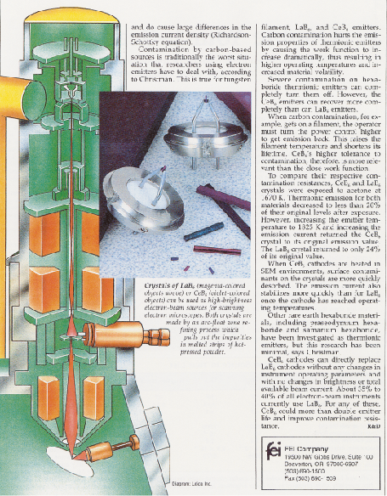
Cerium hexaboride cathode
Properties
Very flat surface by self evaporation
(surface roughness <1 μm)
Low work function (~2.4 eV)
Long lifetime (>10,000 hours)
Rapid recovery from contamination
Design Parameter (Ideal Case)
Thermal Emittance
Emission Density
Electron microscope
= 0.4 mm mrad
> 42 A/cm²

Slide 11
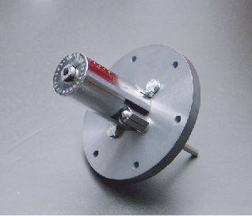
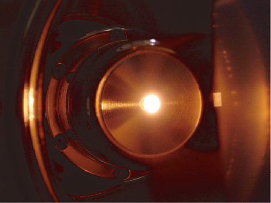
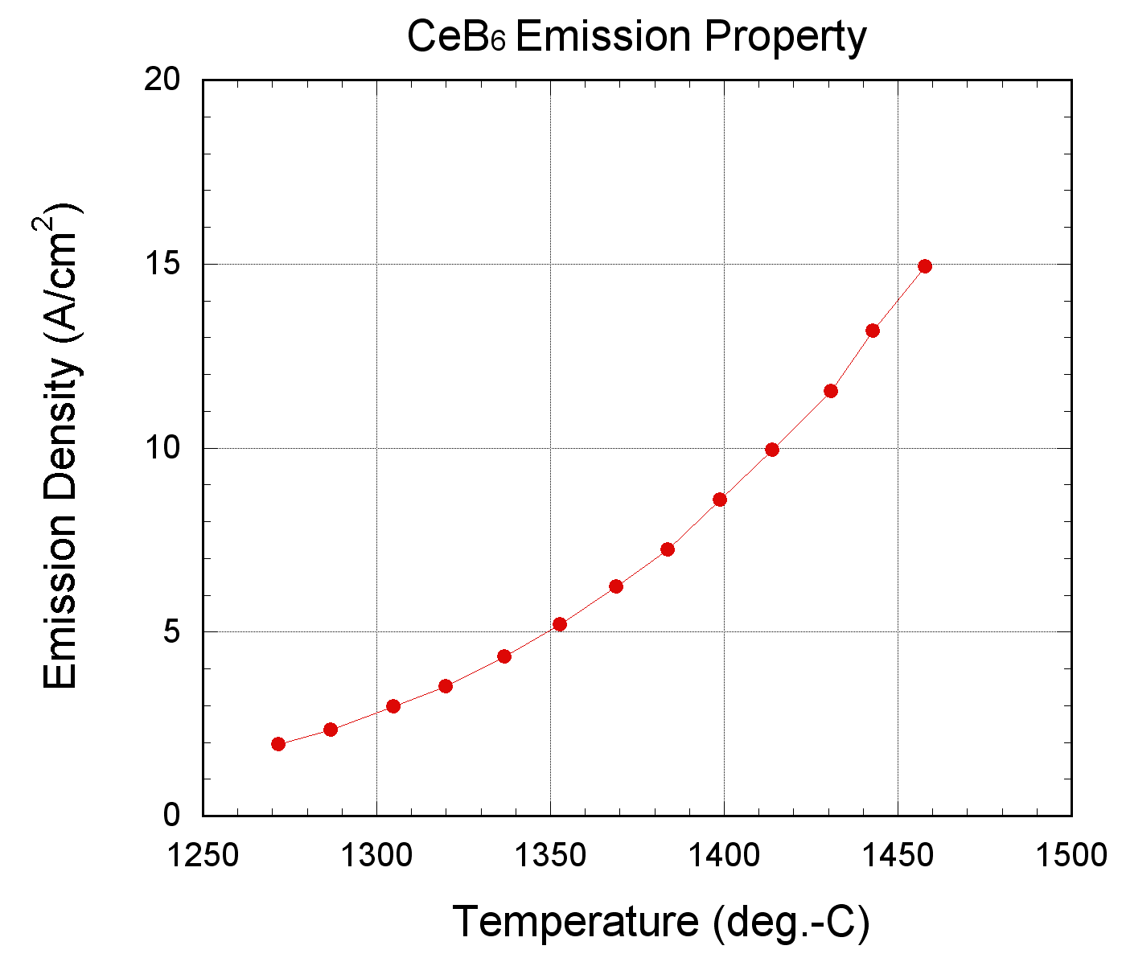
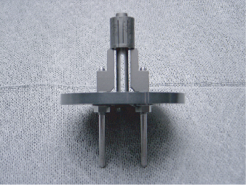
CeB₆ cathode assembly
CeB₆ Cathode (φ3 mm)
Tantalum Thermal Shield
Graphite Sleeve
Graphite Heater
SiN Ceramic Base
Molybdenum
Current Lead

Slide 12
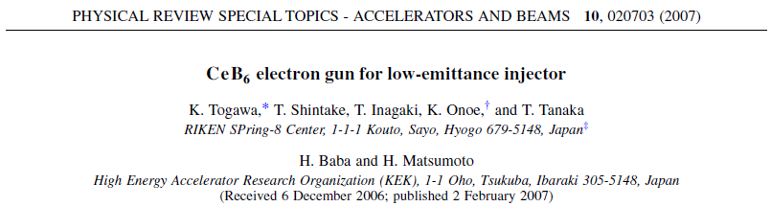
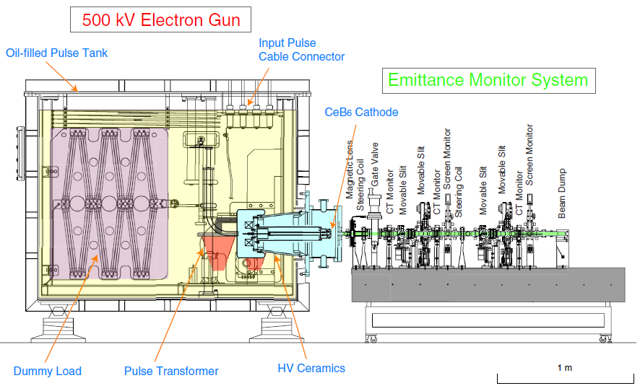
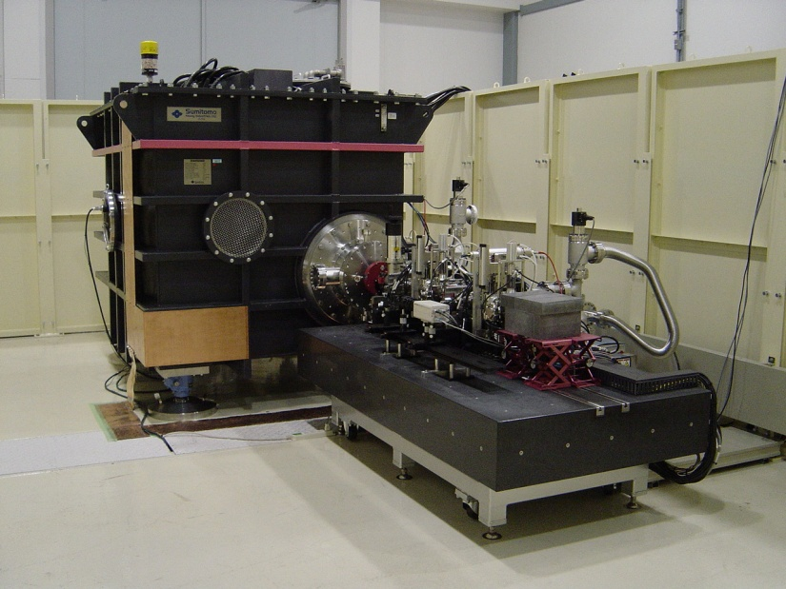
500-kV electron gun test stand (2003)

Slide 13
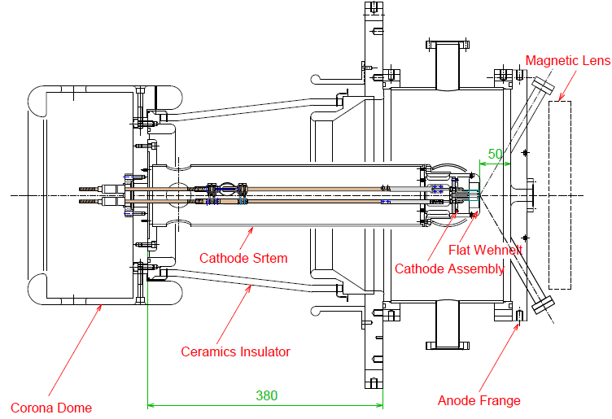
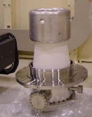
Electron gun chamber
Ground
Insulation Oil
-500 kV
High-voltage Wehnelt
Material : Super-clean SUS316L
Surface : Chemical etching+
Ultra-pure water rinsing
Vacuum
Pressure : <3x10⁻⁷ Pa
Baking is not needed.

Slide 14
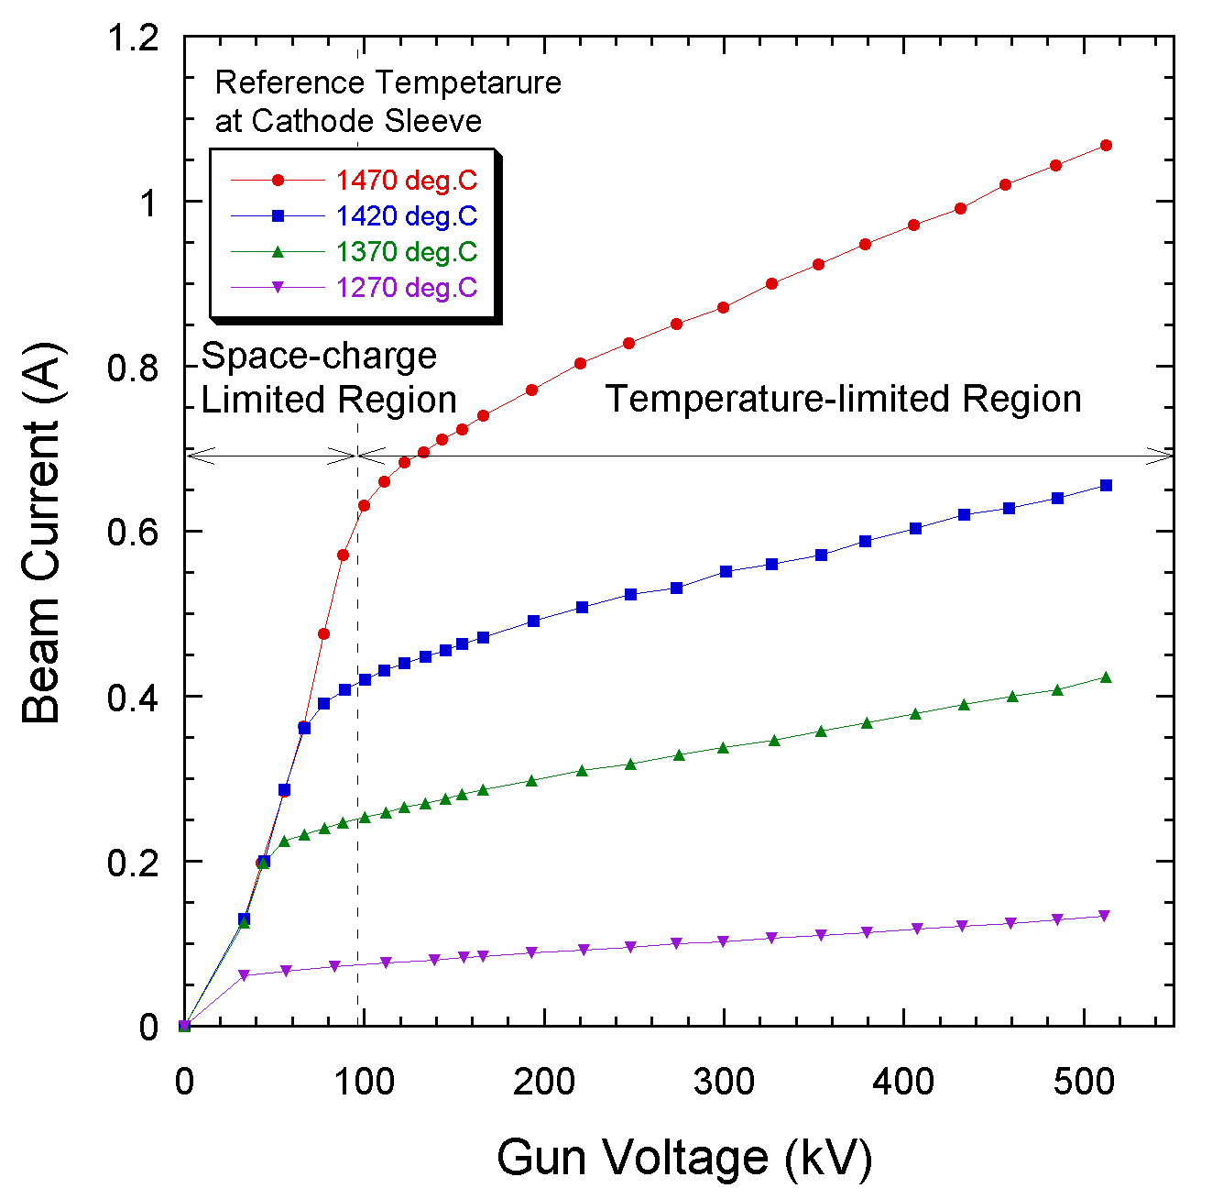
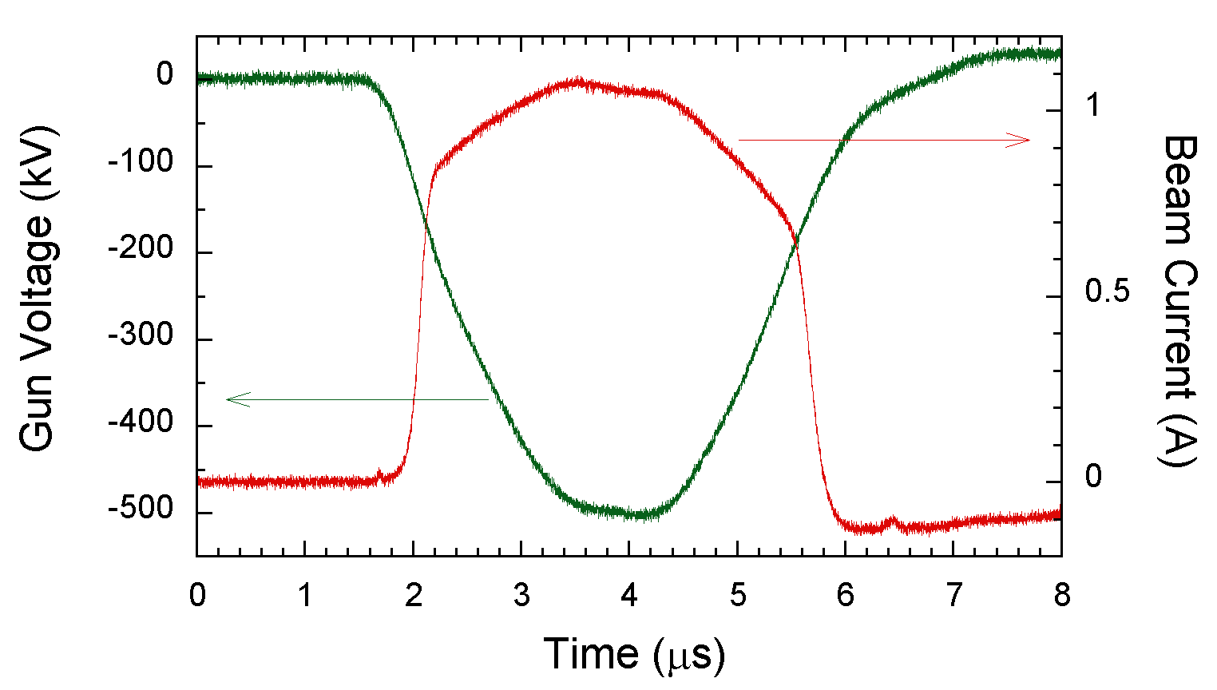
500-kV beam performance
Beam Waveform
I-V Curve
Space Charge Limit
Schottky Effect
Droop of CT Monitor
Beam Current
(CT Monitor)
Gun Voltage
(CVD Monitor)
~1 ns part is cut out from the flattop by a beam chopper.
The gun operates in temperature limited region to reduce emittance growth due to space charge.

Slide 15
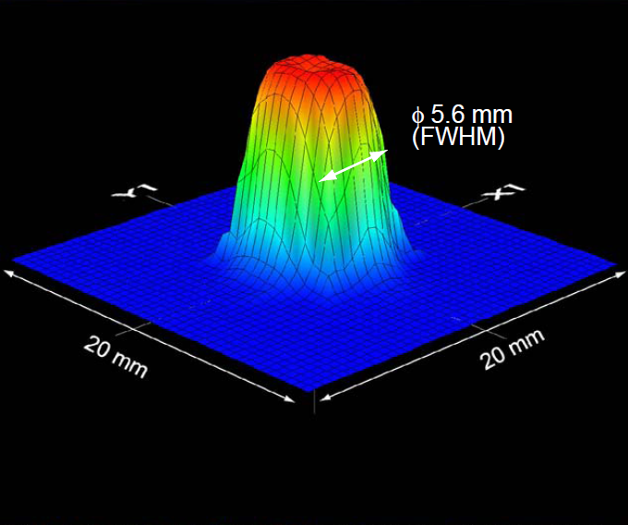
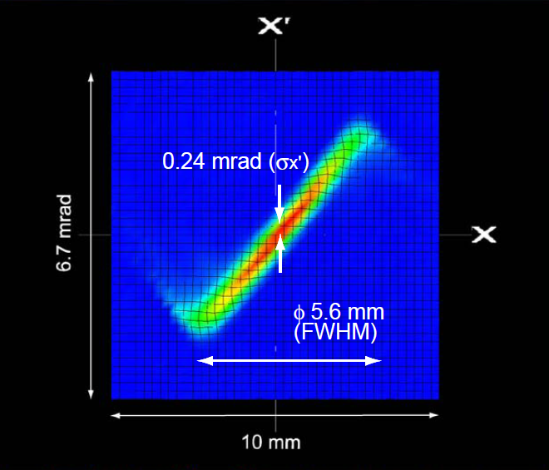
Emittance measurement
Transverse Beam Profile
Phase Space Distribution
Beam Energy : 500 keV
Peak Current : 1.0 A
Pulse Width : 3 μs (FWHM)
Normalized rms Emittance
: 1.1 mm mrad (full particles)
: 0.6 mm mrad (90% core)

Slide 16
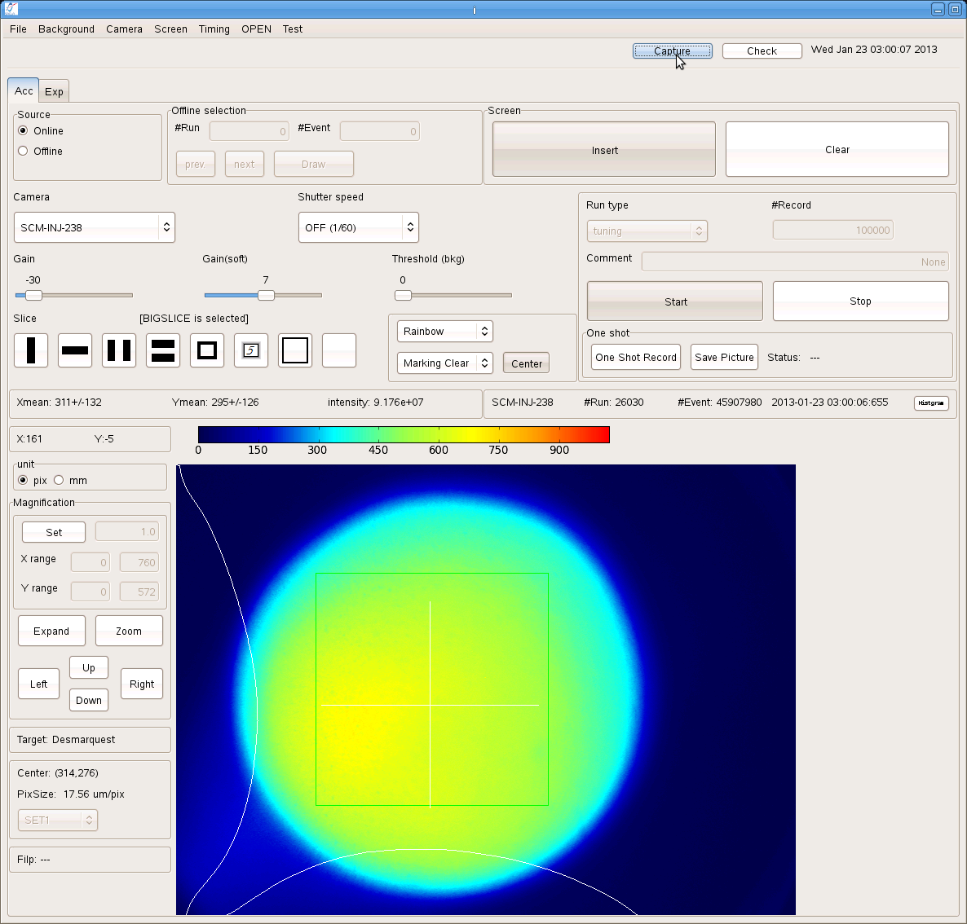
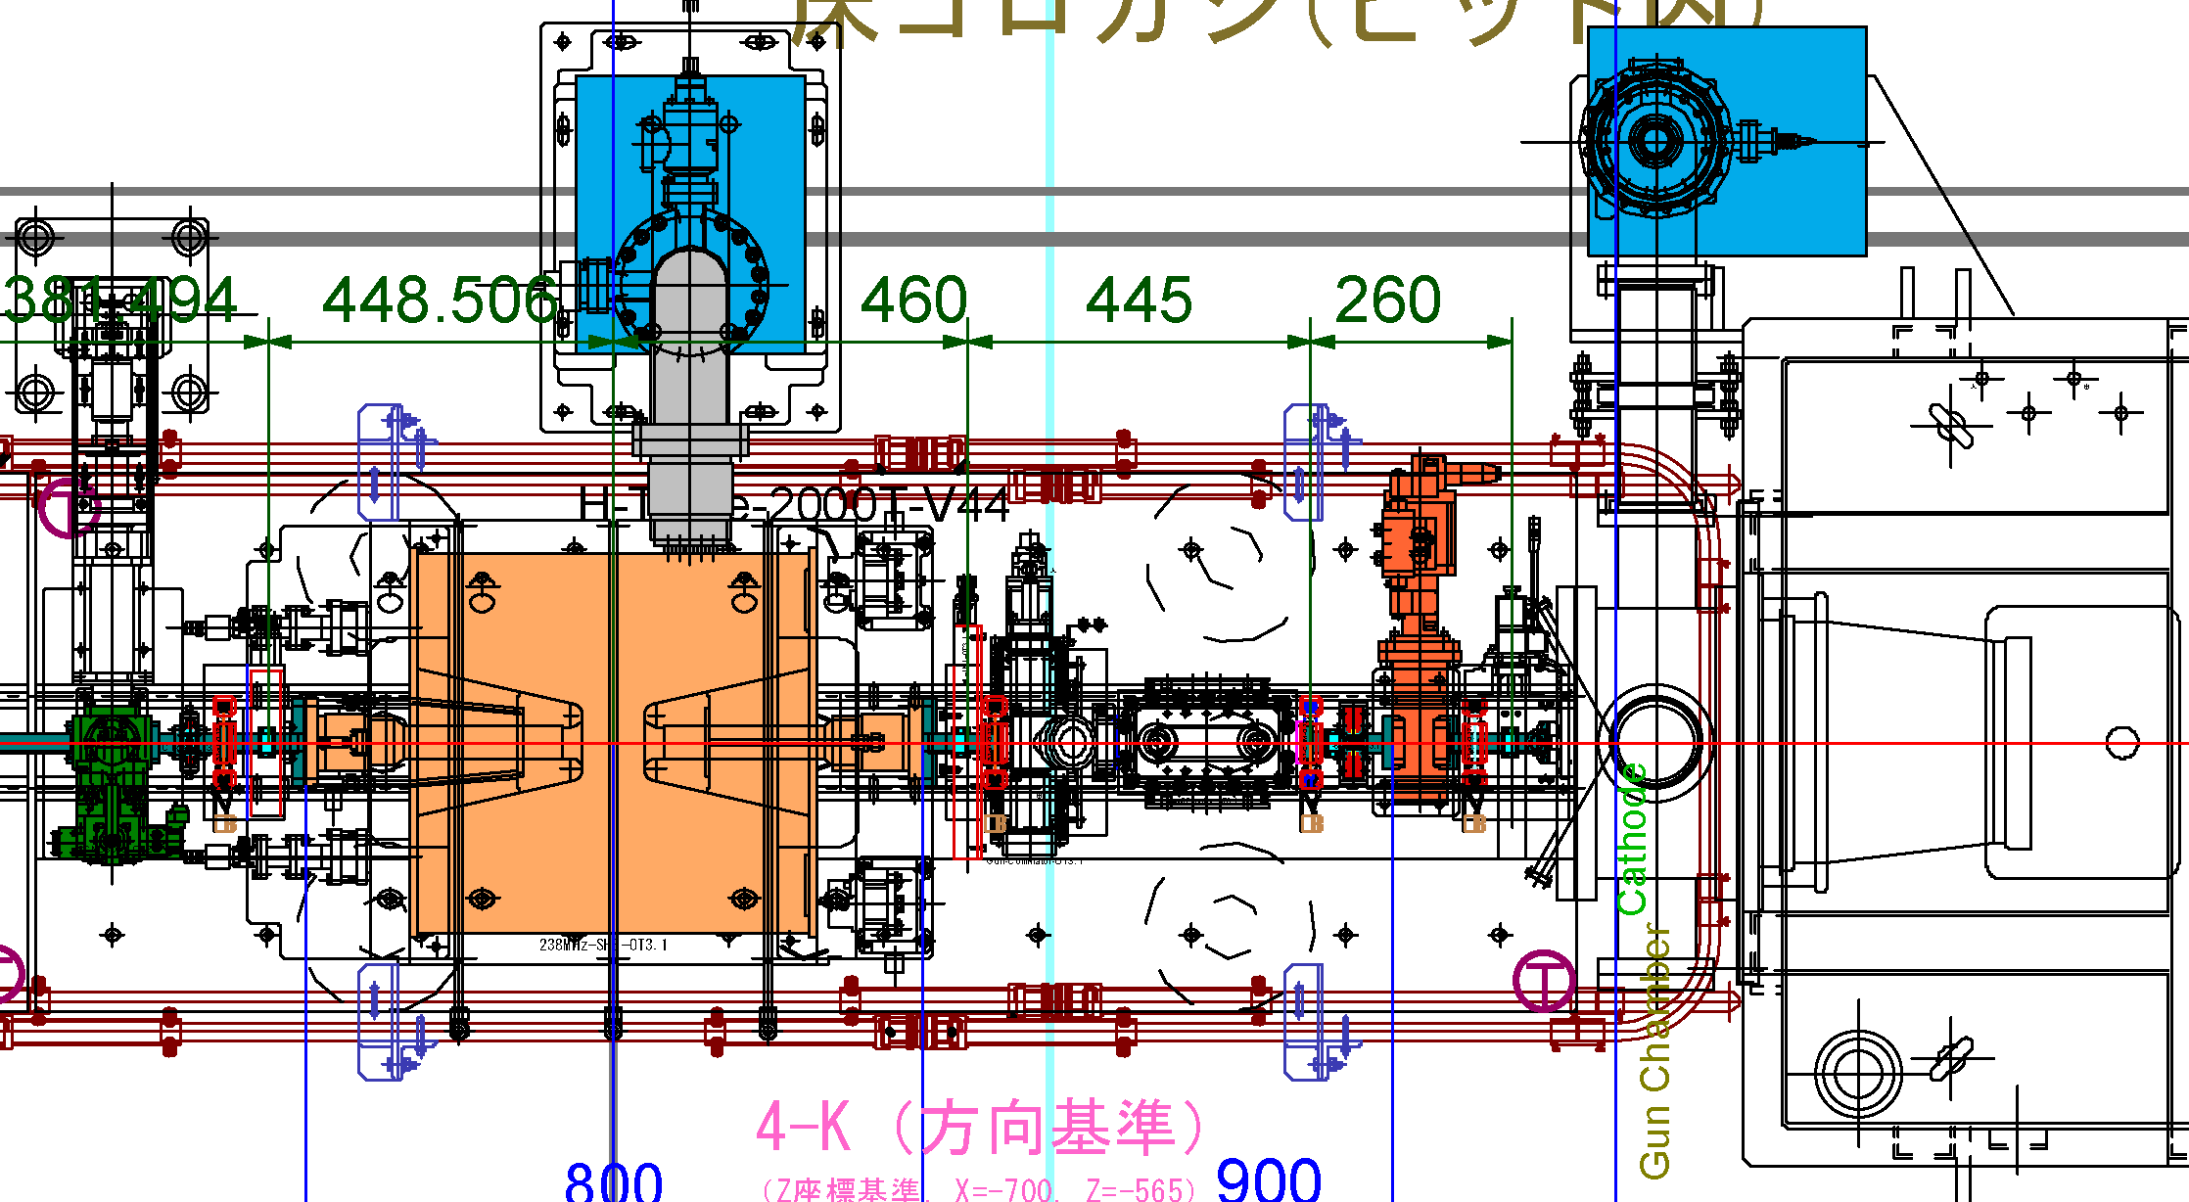
Clear beam at the SACLA injector
Beam
Buncher
CeB₆ Cathode
5 mm
Beam Chopper
Screen Monitor
(Alumina Ceramics)
Circular Collimator
(φ4 mm typical)
Hard edge and good uniformity is realized.
Low slice emittance ~0.4 mm mrad should be achieved.

Slide 17
A problem and a solution of the SACLA’s CeB₆ gun

Slide 18
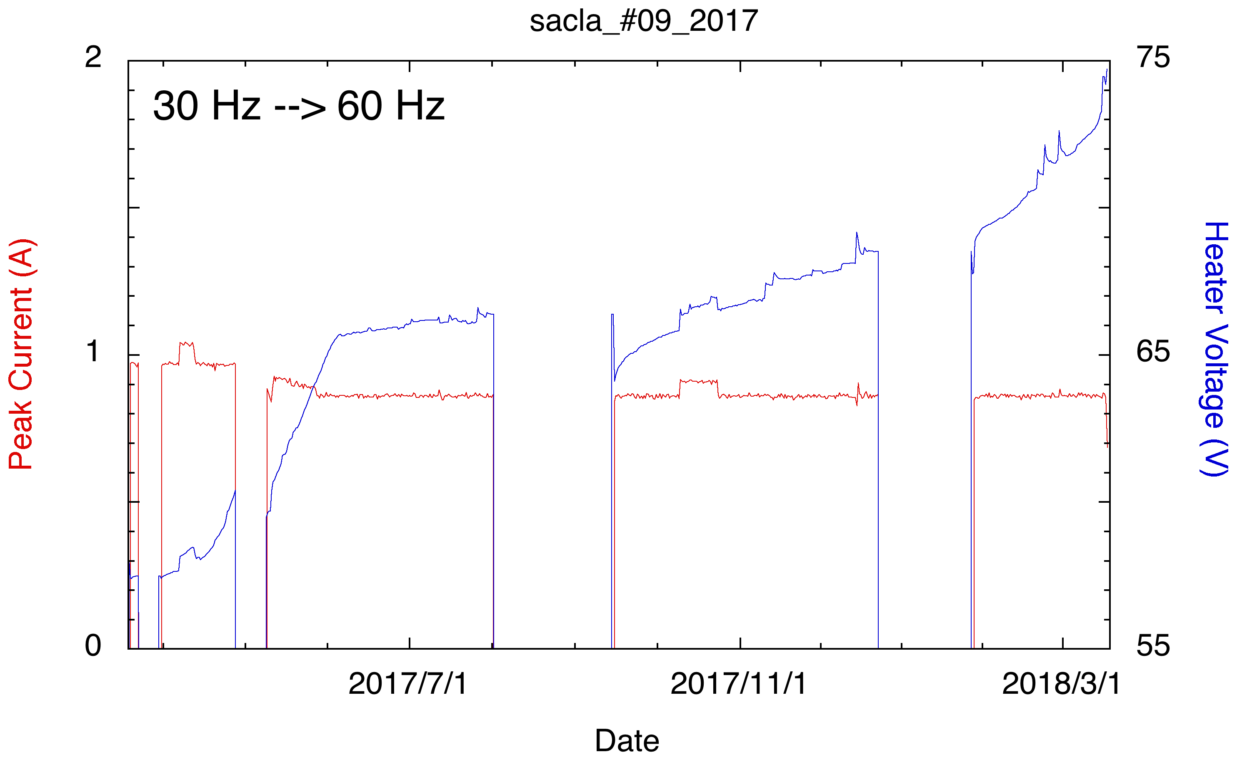
Cathode lifetime problem at SACLA
Power (temperature)
explosion
Cathode emission lifetime is restricted to 1-year at SACLA in spite of 2 or 3 years lifetime at the prototype accelerator SCSS.
Backward flow of the electrons from the L-band accelerator may be a source of the short lifetime.

Slide 19
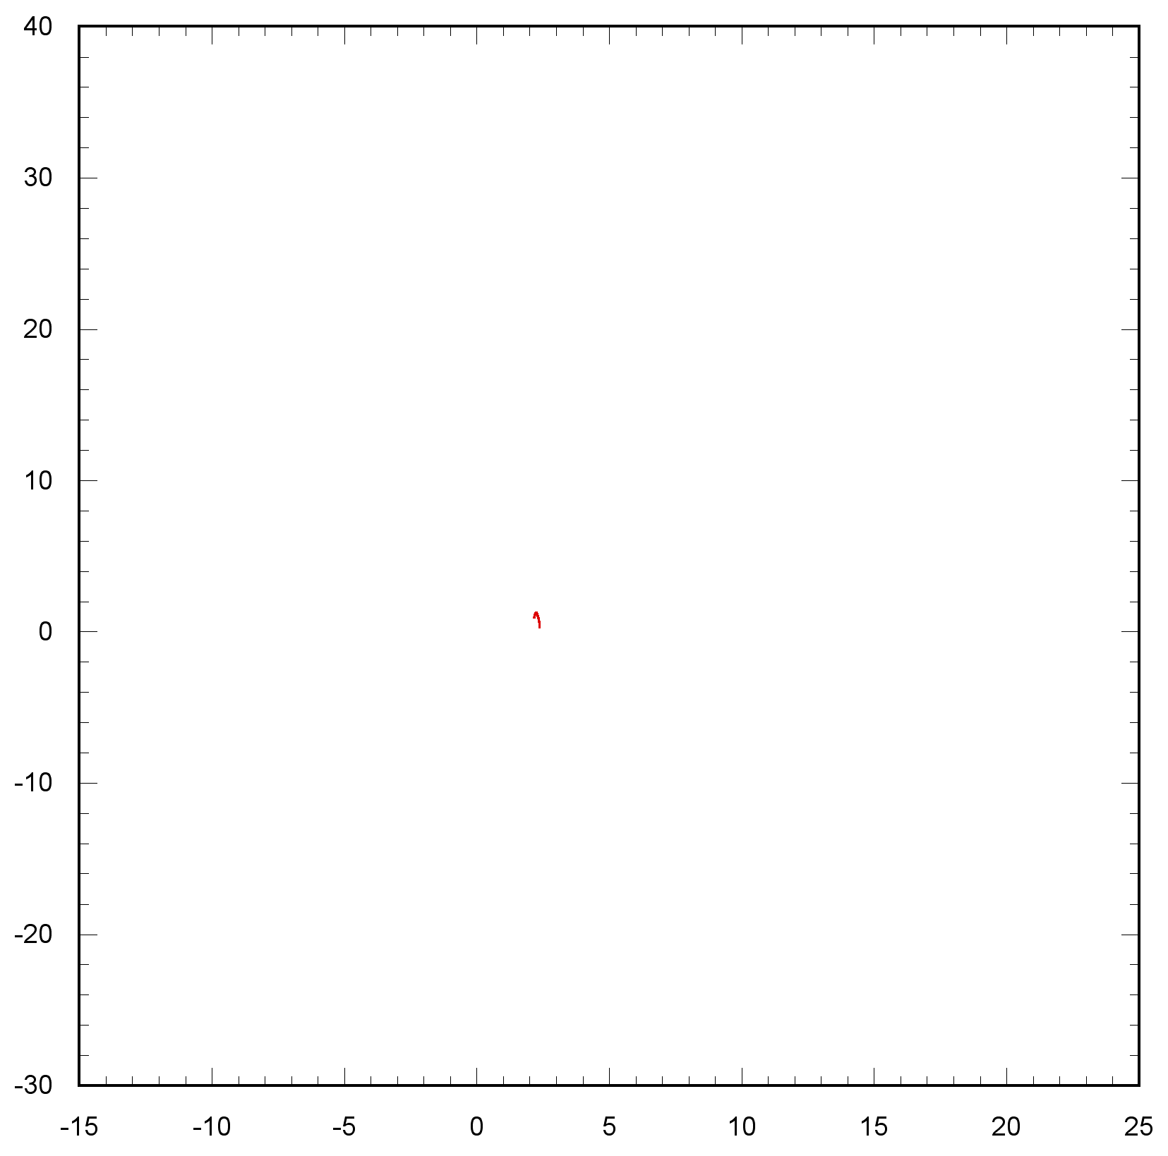
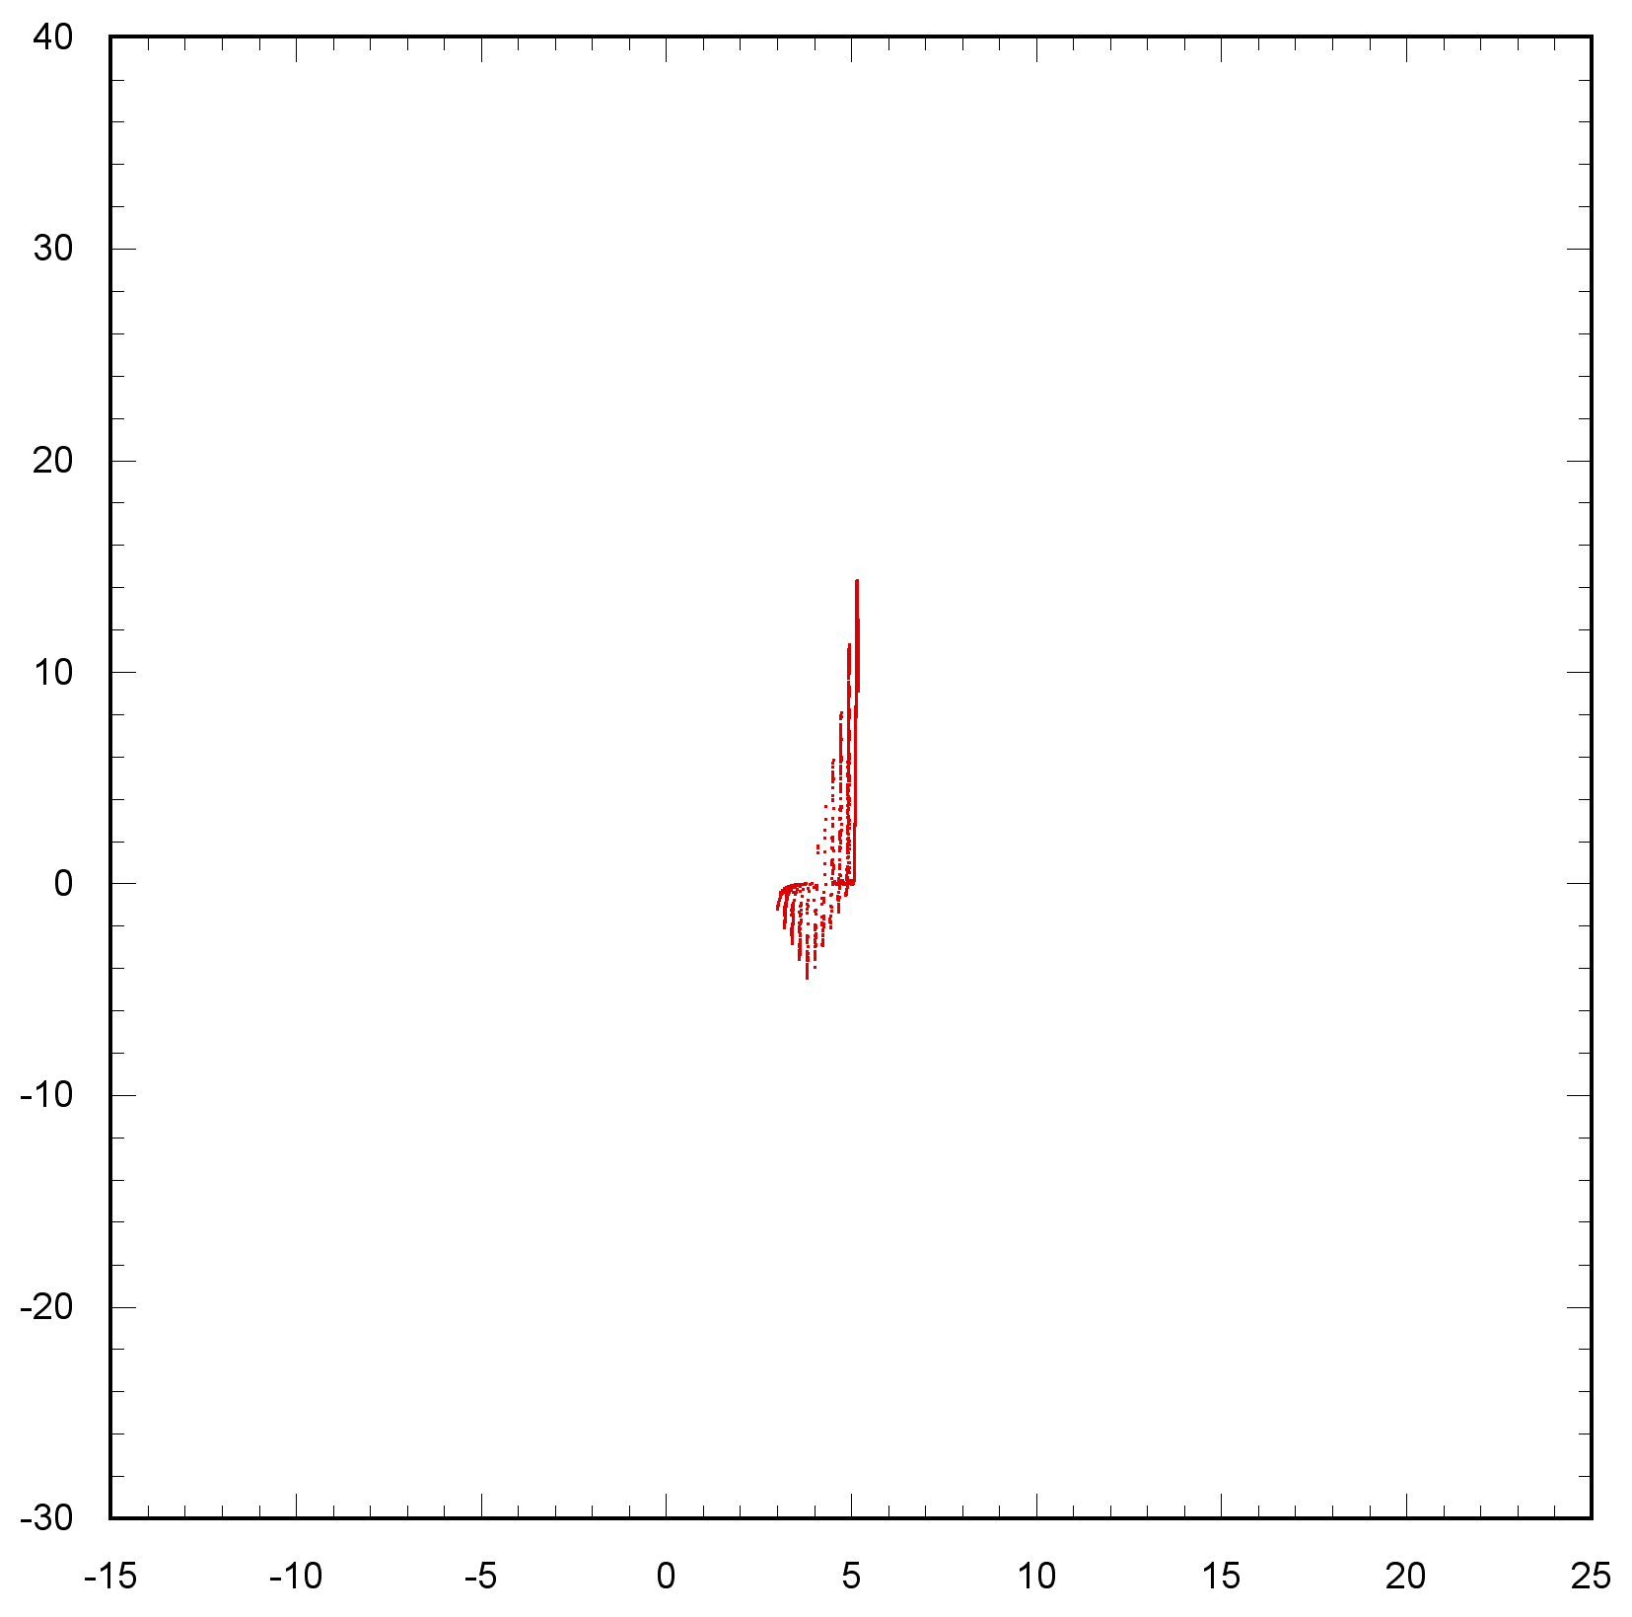
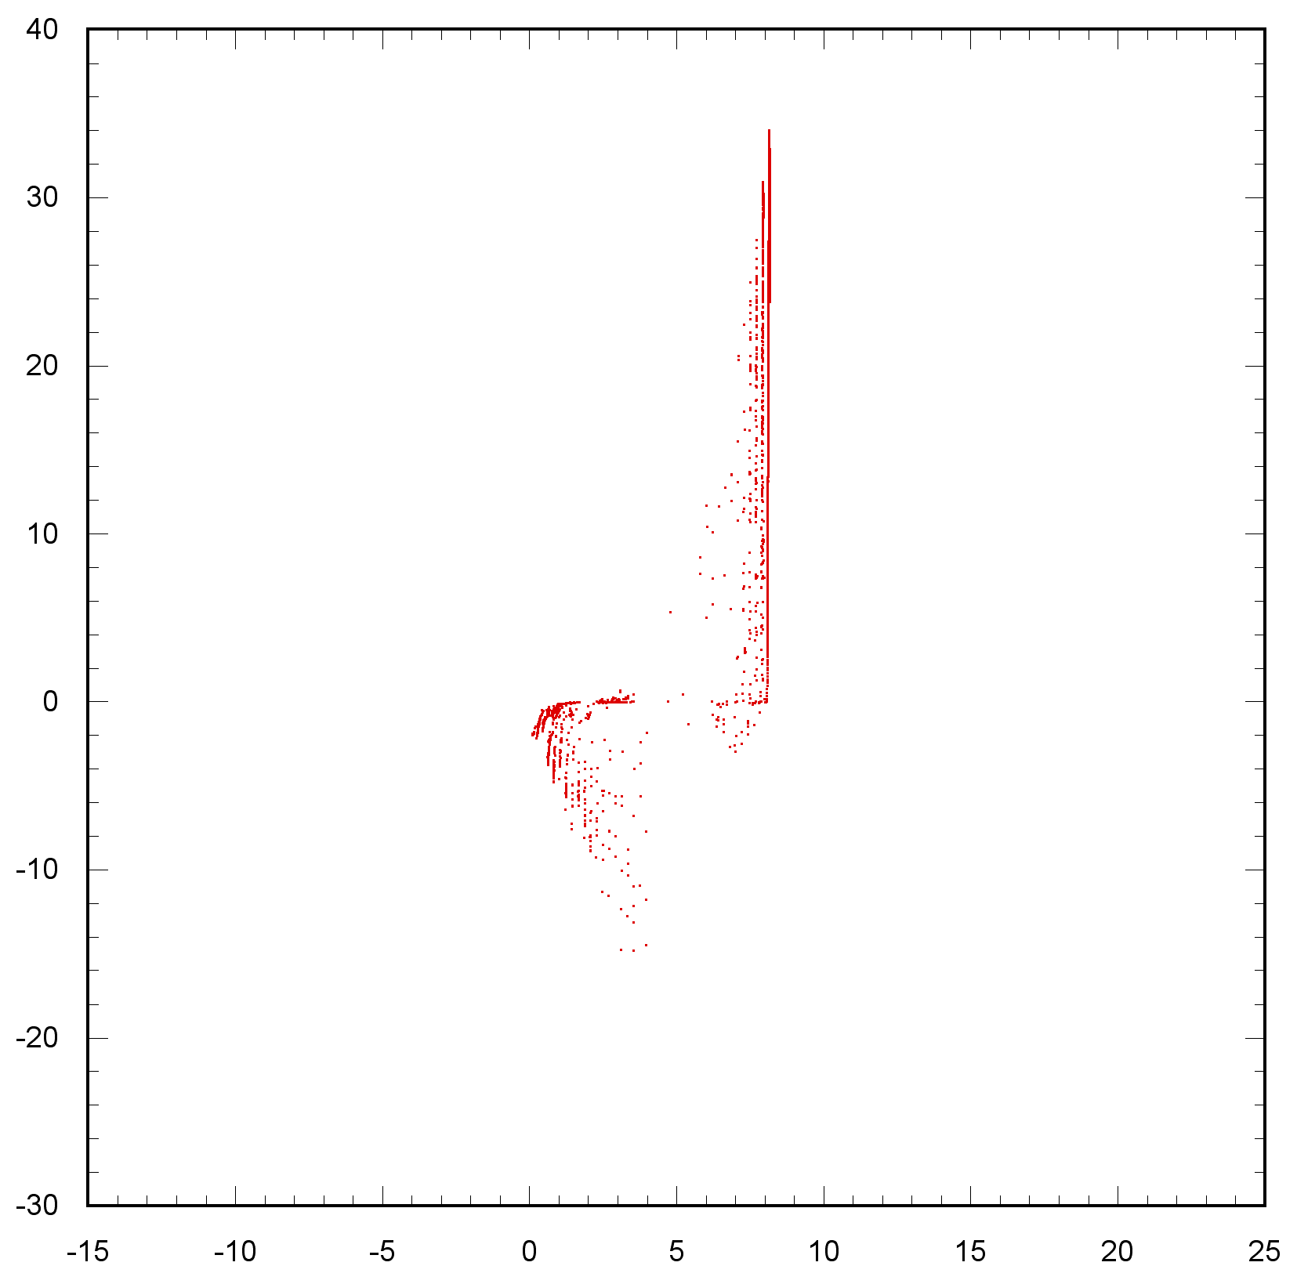
1D particle simulation of the SACLA injector
Energy (MeV)
10 ns
20 ns
30 ns
Backward flow
Reflection
Particle number：10001
Initial bunch length：1.8 ns
10 MeV
Gun exit (Collimator)
L-band in
20 MeV
Z (m)
30 MeV
1-dimensional particle simulation without space charge.
High-energy electrons can flow backward and cause damage to the cathode.
Beam kicker installed in front of the L-band accelerator will remove the backward electrons.

Slide 20
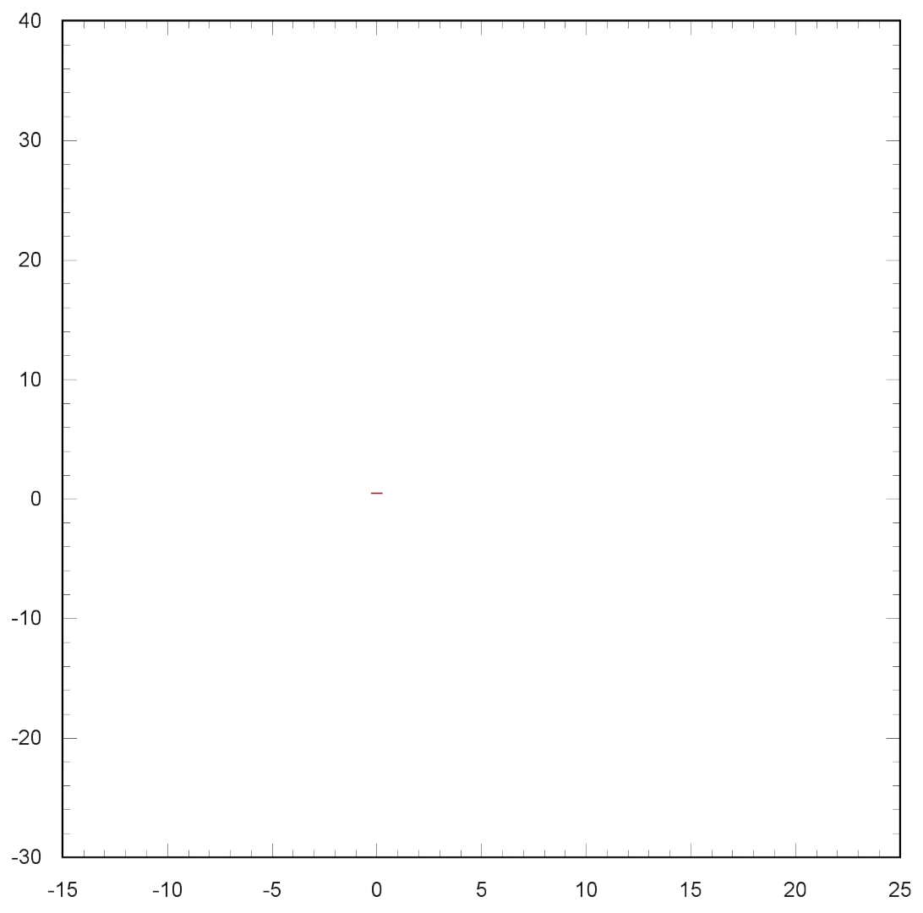

Slide 21
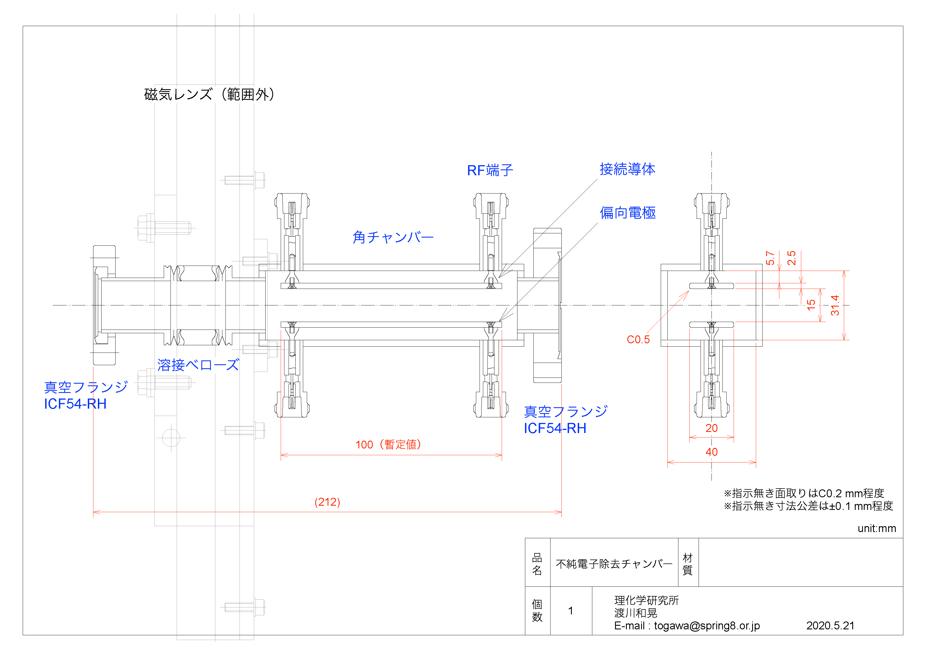
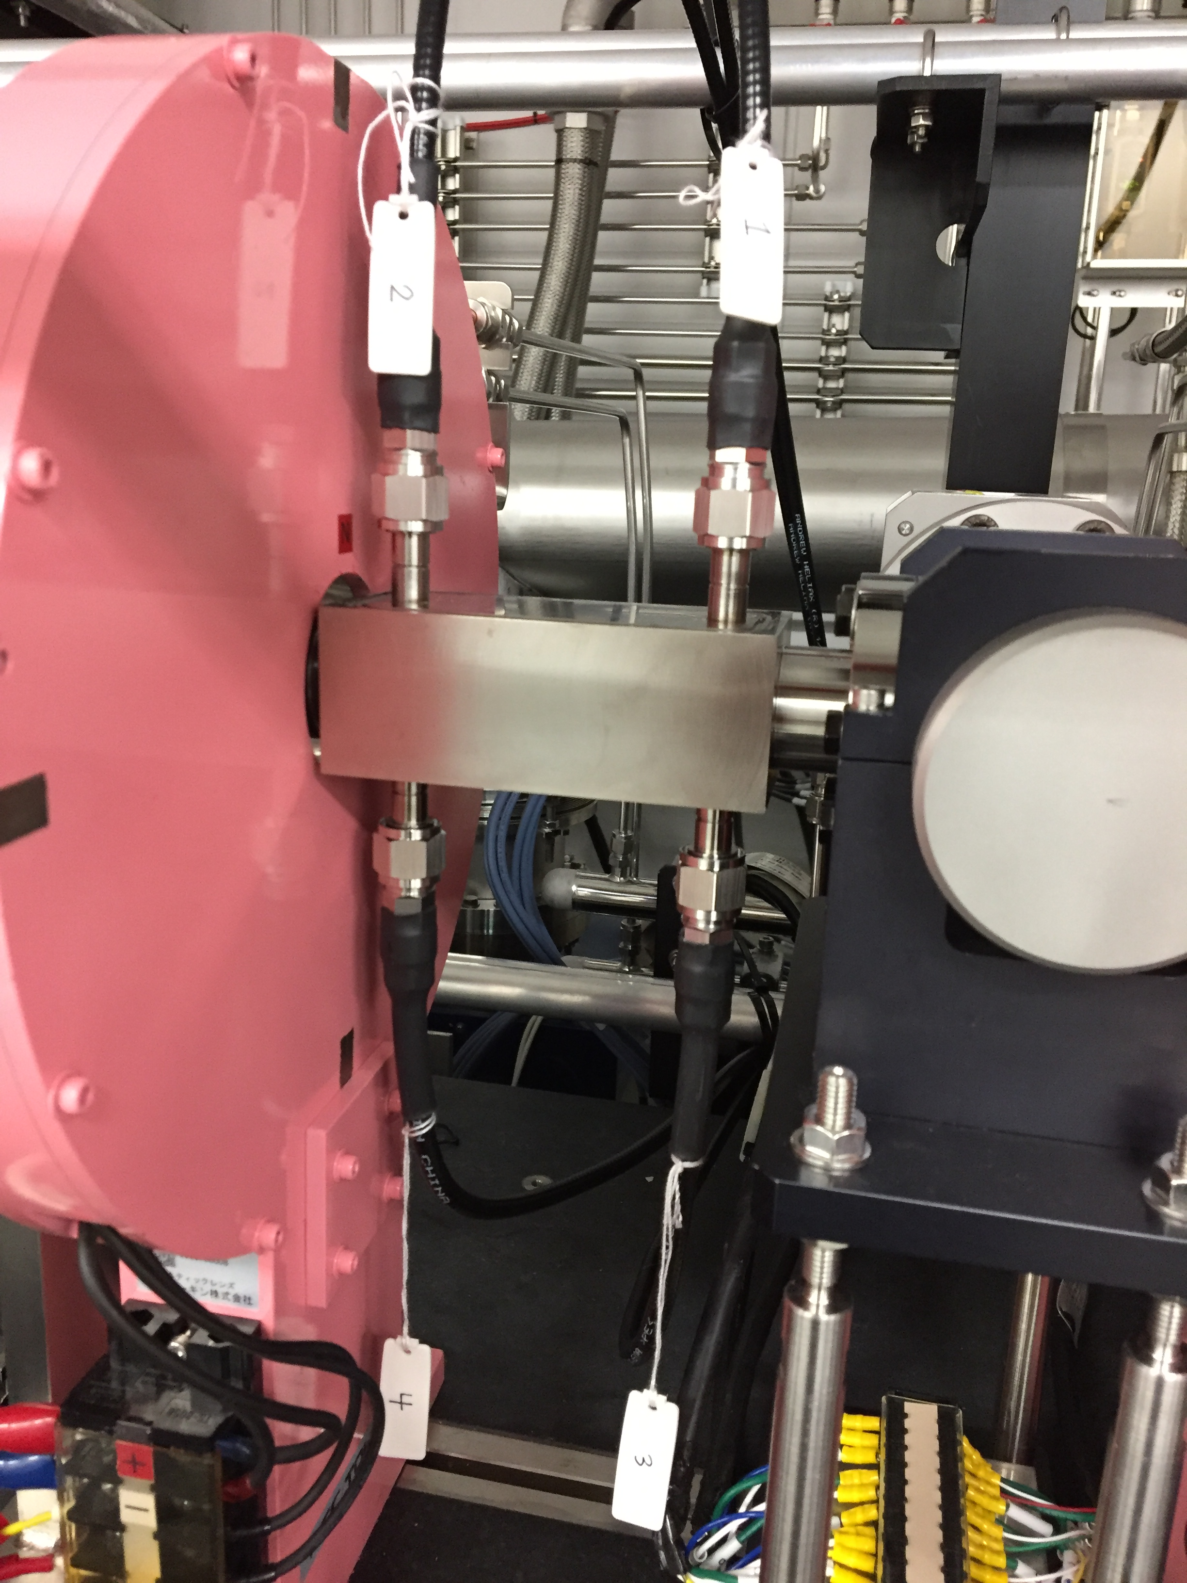
Impure bunch sweeper
An impure bunch sweeper was installed in front of the L-band injector linac to sweep out the unwanted bunch tail in this summer.
This was introduced to remove electron contaminations that mix in empty buckets in the storage ring.
The sweeper will work as a backward electron kicker.

Slide 22
Future perspective

Slide 23
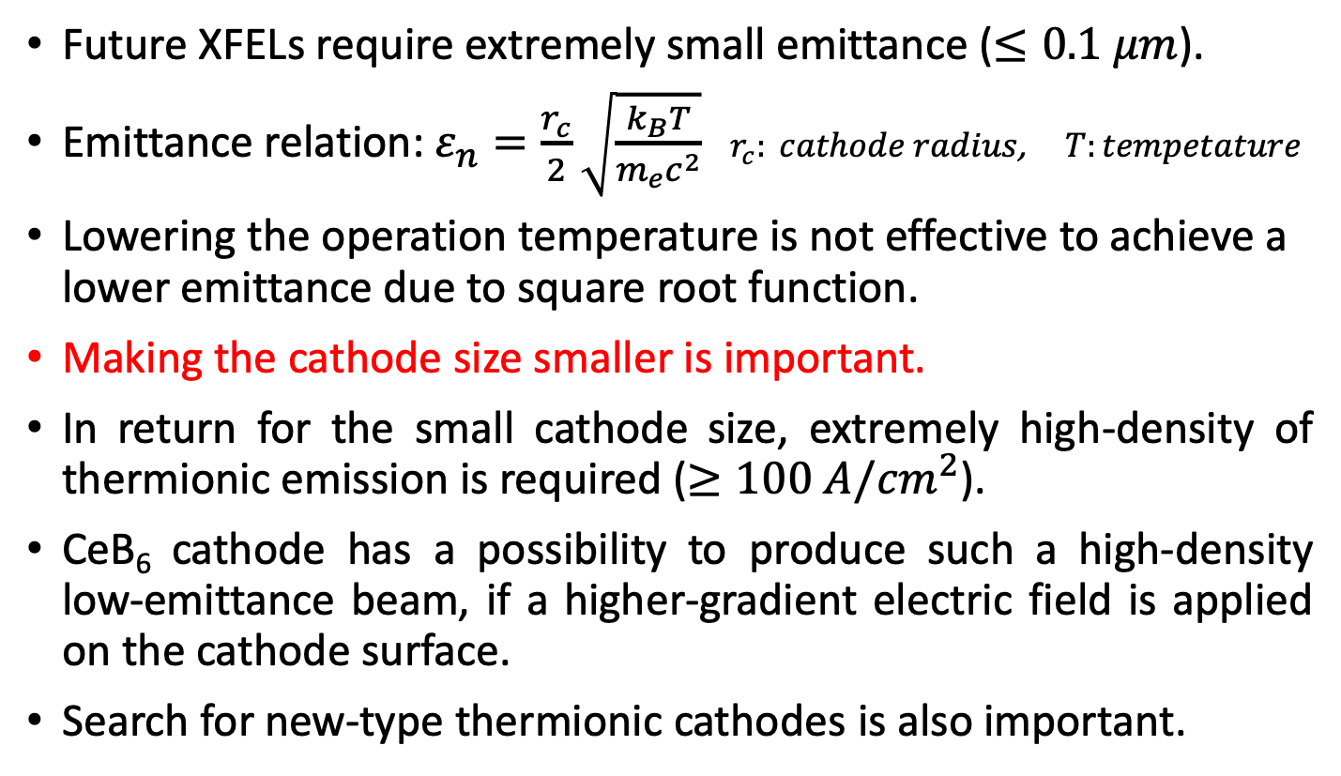
Future perspective
Future XFELs require extremely small emittance ($≤0.1 μm$).
Emittance relation: $ε_{n}=\frac{r_{c}}{2}\sqrt{\frac{k_{B}T}{m_{e}c^{2}}}$ $r_{c}: cathode radius$, $T:tempetature$
Lowering the operation temperature is not effective to achieve a lower emittance due to square root function.
Making the cathode size smaller is important.
In return for the small cathode size, extremely high-density of thermionic emission is required ($≥100 A/{cm}^{2}$).
CeB₆ cathode has a possibility to produce such a high-density low-emittance beam, if a higher-gradient electric field is applied on the cathode surface.
Search for new-type thermionic cathodes is also important.

Slide 24
Summary
CeB₆ thermionic gun has been derivering low-emittance high-intensity electron beams for SACLA for 10 years.
Cathode lifetime problem may be solved by removing or reducing the backward high-energy electrons from the injector linac.
Reducing an emittance of the cathode is essential to increase an XFEL output. The CeB₆ gun should have a possibility.

