Slide 1
Reverse phase operation
Yoshiyuki Morita
KEK

Slide 2
Motivation of reverse phase operation
SuperKEKB HER machine parameters at the early stage
  Lower total voltage: 6.7 MV
  Higher beam power: 7.65MW
To use existing SRF cavities for SuperKEKB
  Need lower external Q
  Need to change the length of high power coupler
  High risk for performance degradation
Develop reverse phase operation
  Several cavities operated with negative synchronous phase
  Each cavity can have the high cavity voltage
  Total voltage is as low as the design value
  Each cavity has equal beam power
  No need to change the external Q
To establish reverse phase operation
  Beam tests carried out using KEKB machine

Slide 3
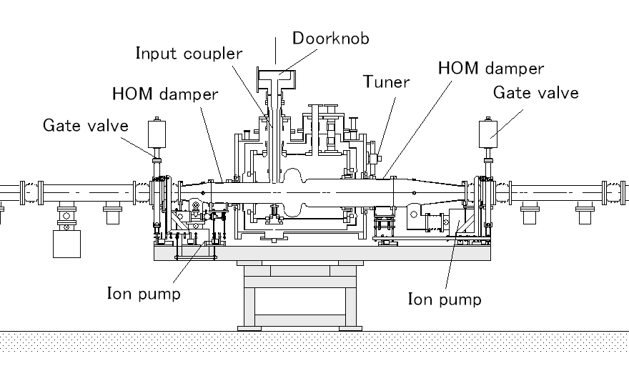
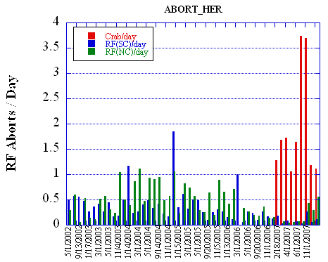
KEKB superconducting cavity
Designed and achieved parameters
A cross sectional view of the KEKB superconducting accelerating cavity. A 509 MHz single cell cavity with a large iris diameter of 220 mm has ferrite HOM absorbers on both sides and a coaxial-type power coupler. The cryomodules of 3700 mm in length are connected to the beam ducts of 150 mm in diameter.
Parameter | design | achieved | unit
Beam Current | 1.1 | 1.4 | A
Bunch charge | 2 | 10 | nC
RF voltage | 1.5 | 1.2-2 | MV/cav.
Beam power | 250 | 350-400 | kW/cav.
HOM power | 5 | 16 | kW/cav.
All eight superconducting cavities are used
for the SuperKEKB HER ring
Abort statistics @ HER
Trip rate
0.5/day at 1.4A
0.1/day at 0.85A
Eight superconducting cavities in HER

Slide 4
Machine Parameters of SuperKEKB
2010/Feb/08
 |  | LER | HER
Emittance | ε_{x} | 3.2(2.7) | 2.4(2.3) | nm
Coupling | ε_{y}/ε_{x} | 0.40 | 0.35 | %
Beta Function at IP | β_{x}* / β_{y}* | 32 / 0.27 | 25 / 0.41 | mm
Horizontal Beam Size | σ_{x}* | 10.2(10.1) | 7.75(7.58) | μm
Vertical Beam Size | σ_{y}* | 59 | 59 | nm
Bunch Length | σ_{z} | 6.0(4.9) | 5.0(4.9) | mm
Half Crossing Angle | φ | 41.5 |  | mrad
Beam Energy | E | 4 | 7 | GeV
Beam Current | I | 3.60 | 2.62 | A
Number of Bunches | n_{b} | 2503
Energy Loss / turn | U₀ | 2.15 | 2.50 | MeV
Total Cavity Voltage | V_{c} | 8.4 | 6.7 | MV
Energy Spread | σ_{δ} | 8.14(7.96)x10⁻⁴ | 6.49(6.34) x10⁻⁴
Synchrotron Tune | ν_{s} | -0.0213 | -0.0117
Momentum Compaction | α_{p} | 2.74x10⁻⁴ | 1.88x10⁻⁴
Beam-Beam Parameter | ξ_{y} | 0.0900 | 0.0875
Luminosity | L | 8x10³⁵ |  | cm⁻²s⁻¹
(): zero current parameters
Not the present machine parameters

Slide 5
Issues of low voltage and high beam power operation
Required RF parameters in SuperKEKB HER ring
Total voltage: Lower than KEKB
13-15 MV→6.7MV
Total beam power: Higher than KEKB
5MW→7.7MW@2.6A
(These are shared by normal (ARES) and 8 SRF cavities)
Low voltage and high beam power operation makes the cavity detuning larger than the revolution frequency
External Q must be lowered (Qext=50,000 at present)
Input couplers must be exchanged to adjust Qext
High risk for particle contamination
High risk for performance degradation
For example,
Operating voltage: 0.6 MV
Beam power: 300kW
Qext:50,000
Detunig Δf:100kHz
Equal to revolution frequency
Low voltage and high beam power operation is not suitable for KEKB cavities

Slide 6
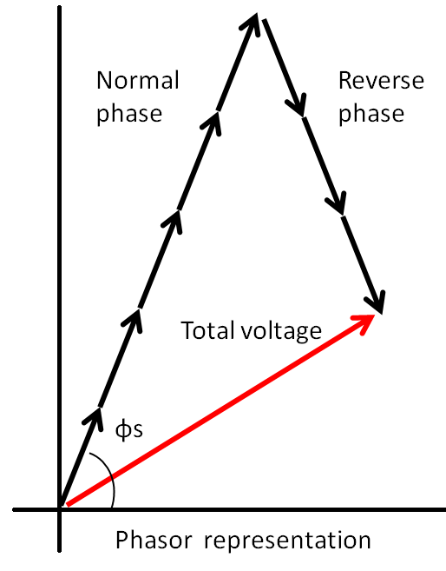
Reverse phase operation (RPO)
To use our cavity with high Vc for SuperKEKB, we developed RPO
New operating method
Synchronous phases of several cavities are reversed
The total RF voltage is kept as low as the designed value
Merits
Each cavity can have high voltage
Each cavity can share equal beam power
  Beam power: Pb=Vc x Ib x cosφs
No need to change external Q
  Detuning < revolution frequency
Vc
Reverse
phase
Normal
phase
RPO can make the SRF cavity operation possible w/o external Q modification
−φ_{s}
Phase
φ_{s}

Slide 7
RF parameters for the SuperKEKB HER ring
RF system of HER with normal cavities (ARES) and SRF cavities
Parameters |  |  | Unit
Beam energy | 7.0 (←8) |  | GeV
Beam current | 2.62 (←1.4) |  | A
# of bunches | 2503 (←1585)
Total beam power | 7.65 (←5) |  | MW
Total RF voltage | 6.7(←14) |  | MV
Cavity type | ARES | SCC
# of cavities | 8 | 8 (3 for RPO)
RF voltage/cav. | 0.48 | 1.3 | MV
Beam power/cav. | 556 | 400 | kW
Loaded Q factor | 1.8 x 10⁴ | 5 x 10⁴
Detuning frequency | 18.4 | 47.4 | kHz
Reverse phase operation
Detuning < Revolution frequency

Slide 8
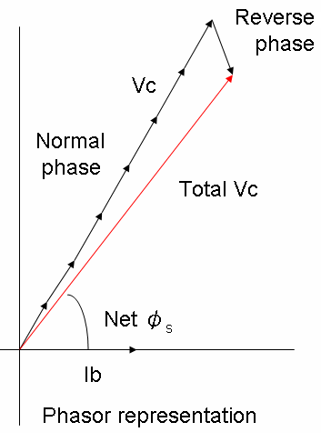
Beam studies of RPO
To establish RPO we carried out beam studies
Study items
1.56MV×(7-1)
Beam study at low currents of 150mA
  Each cavity has 1.56 MV
    Increased from 1.18 MV
  Adjust negative synchronous phase of one cavity
    Adjust beam power
  Measure RF rerated parameters
    Synchrotron frequency
    Bunch length
  Cavity trip test
Beam study at high currents up to 930mA
  Transient behavior of cavity voltage at cavity trip
  Transient behavior of cavity voltage at beam abort
Beam study at luminosity RUN
  Beam current up to 1.2A
  Test RPO for long-term operation
1.18MV×8

Slide 9
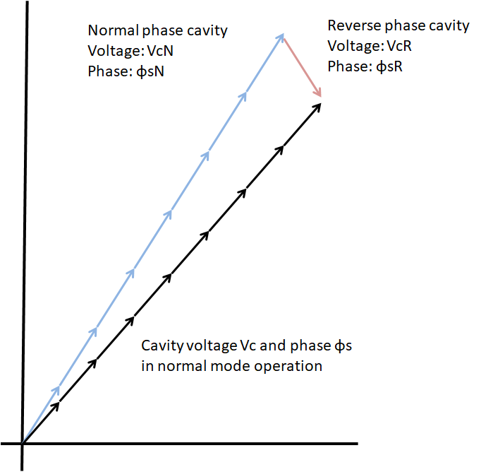
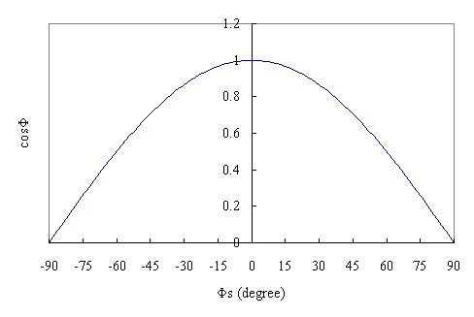
Voltage and phase settings
We increased cavity voltage from 1.18 to 1.56 MV
One cavity has the reverse phase
Cavity:D10A~D
Cavity:D11A,D11C,D11D
Cavity:D11B
Reverse phase
－Φs
Φs
How to set Vc and φs
Setting values are;
VcN=VcR=1.56MV
φsN= －φsR= φs + 3°
(Vc=1.18, φs=77.7°)
8 x Vc x Cos(φs) = 7 x VcN x Cos(φsN) + VcR x Cos(φsR)
8 x Vc x Sin(φs) = 7 x VcN x Sin(φsN) + VcR x Sin(φsR)

Slide 10
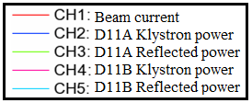
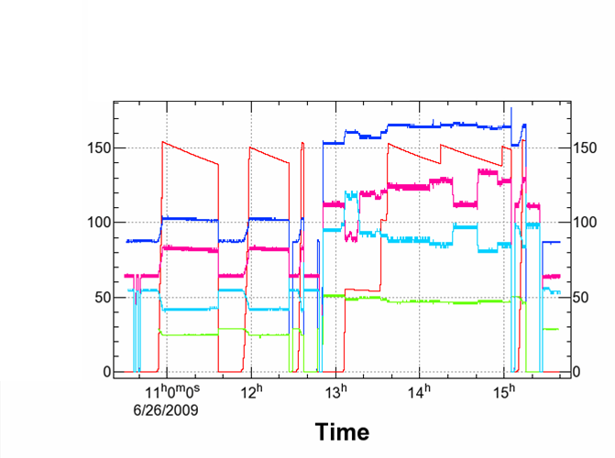
Beam study at low currents
Reverse phase cavity
Overload
Reversed
Study items
Normal mode OP
Measure νs, σz
Cavity trip test
Reverse phase OP
Adjust beam power
Measure νs, σz
Cavity trip test
0-phase
−φ_{s}
φ_{s}
Normal mode (Vc=1.18 MV)
Reverse phase (Vc=1.56 MV)
D11A trip
(15:05)
σz測定
D11B Klystron power
D11B trip
(15:16)
Recovering (Crab)
Overload
O-phase
Reverse phase
Deceleration
Beam abort test
(11:36)
D11A trip
(12:27,12:37)
Adjust beam power

Slide 11
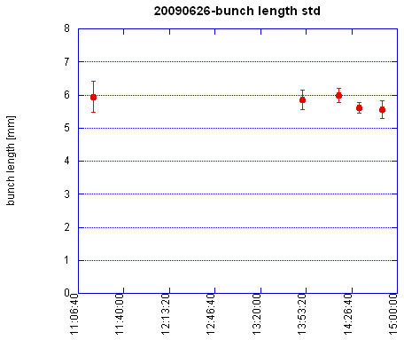
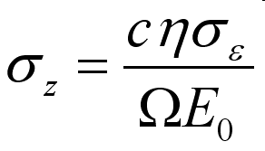
Bunch length
Bunch length was measured at several phase settings
by Ikeda-san
0-phase
Overload
Normal mode
Reverse phase mode
(light loading)
Reversed phase mode

Slide 12
Summary of low current beam study
Beam power of D11B, νs and σz
Beam current | 150mA | 151.7mA | 149.2mA | 142.5mA | mA
mode | Normal | Reverse | 0-phase | Overload
Phase |  | -82 | -89 | -79.5 | Deg.
Klystron Power |  | 129 | 115 | 135 | kW
Beam power |  | 33 | 4 | 43 | kW
Synchrotron frequency | 2.046 | 2.046 | 2.046 | 2.046 | kHz
Bunch length | 20 6 | 20 6 | 20-21 6-6.3 | 19-20 5.7-6 | Ps mm
Beam power was controlled by changing the phase
Reverse phase cavity could share the beam power
νs and σz were same in both operations
Reverse phase operation is applicable

Slide 13
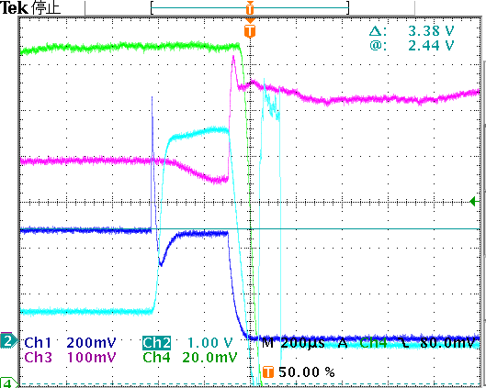
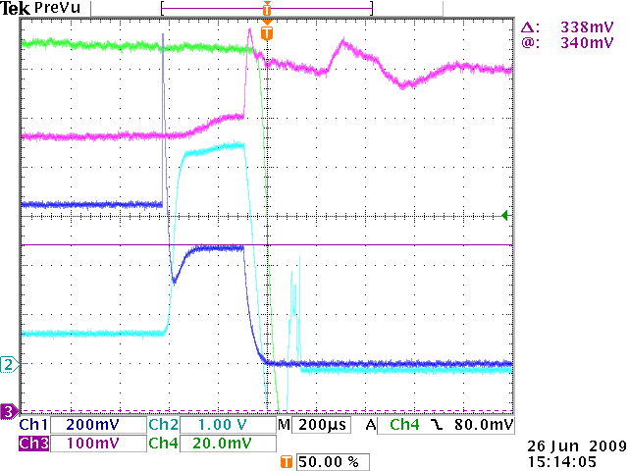
Trip test results
Reverse phase
Normal phase
In the normal operation, reflected power decreased as usual at the cavity trip. On the other hand, in the reverse phase operation reflected power increased. This increase is explained by the beam phase shift at the cavity trip. The beam phase shift increases the beam power of the normal phase cavity and decreases the beam power of the reverse phase cavity. Thus reflected power of the reverse phase cavity increased. This transient behavior has to be studied at high beam currents.
Δφ
Δφ
−φ_{s}
φ_{s}
D11B Pr
D11B Pr
D11A Pr
D11A φ
D11B Pr
DCCT
Normal operation (Vc=1.18 MV)
D11A trip
Reversed phase operation (Vc=1.56 MV)
D11A trip

Slide 14
Beam study at high currents
Beam currents up to 930 mA
Study transient behaviors of the cavity voltage and the reflected power
  Vc and Pr at cavity trip at the beam currents of 500, 700, 900 mA
  Vc and Pr at beam abort at the beam current of 930 mA

Slide 15
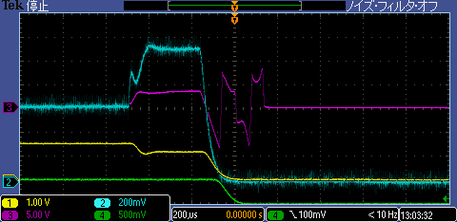
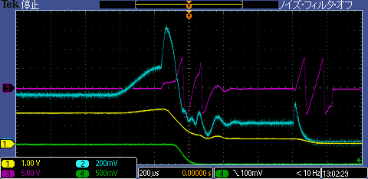
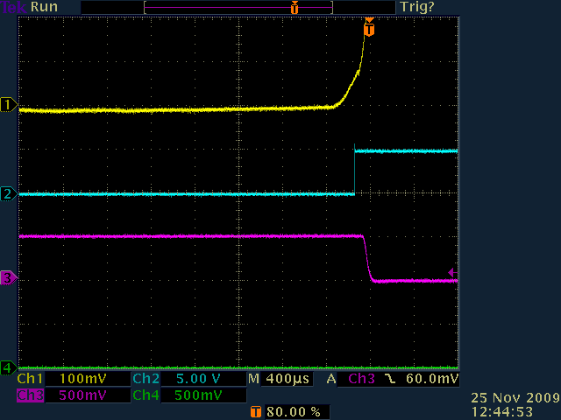
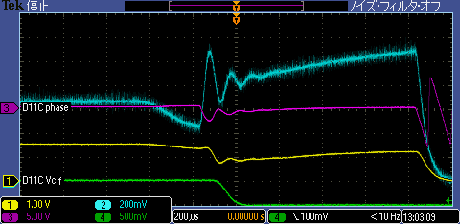
Transient behaviors of Vc and Pr at cavity trip
Beam current ：500 mA
D11A
D11A-RFoff
Beam abort
1 Vc: cavity voltage
2 Pr: reflected power
3 φ: tuner phase
4 DCCT: beam current
Cut off the RF power to the cavity D11A
Vc decreased
D11B (Reversed phase)
Vc increased, Pr increased
D11C (Normal phase)
Vc decreased, Pr decreased
Beam phase interlock made beam abort
Quench detector cut off RF power
D11B, Reverse
HER Beam Phase
D11C, Normal
1. HER Beam Phase
2. HER BPA Req.
3. HER Beam Pickup
4. HER Beam Pickup DET

Slide 16
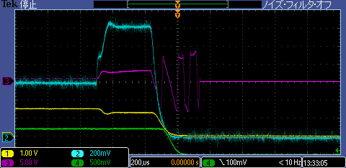
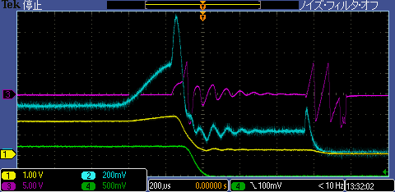
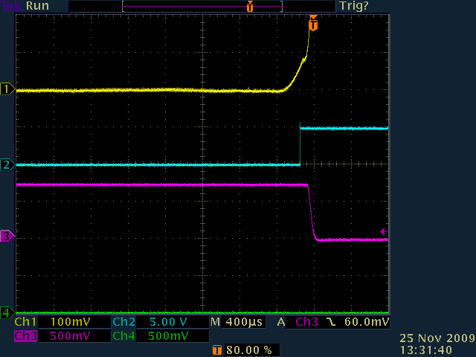
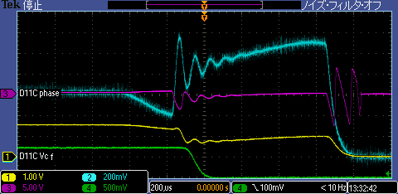
Transient behaviors of Vc and Pr at cavity trip
Beam current ：700 mA
D11A
D11A-RFoff
Beam abort
1 Vc: cavity voltage
2 Pr: reflected power
3 φ: tuner phase
4 DCCT: beam current
D11B, Reverse
HER Beam Phase
D11C, Normal
1. HER Beam Phase
2. HER BPA Req.
3. HER Beam Pickup
4. HER Beam Pickup DET

Slide 17
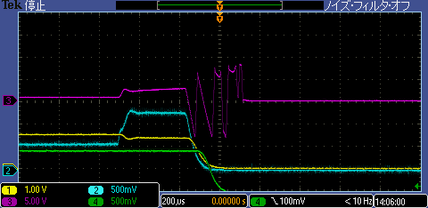
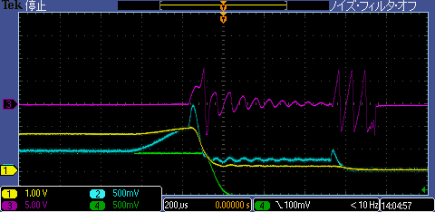
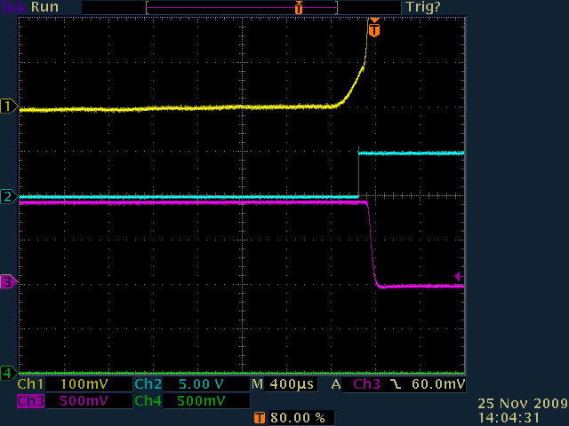
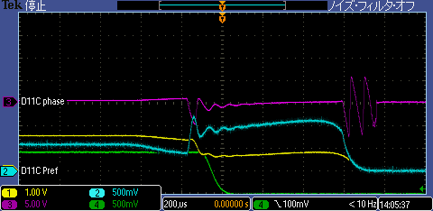
Transient behaviors of Vc and Pr at cavity trip
Beam current ：900 mA
D11A
D11A-RFoff
Beam abort
1 Vc: cavity voltage
2 Pr: reflected power
3 φ: tuner phase
4 DCCT: beam current
D11B, Reverse
HER Beam Phase
D11C, Normal
1. HER Beam Phase
2. HER BPA Req.
3. HER Beam Pickup
4. HER Beam Pickup DET

Slide 18
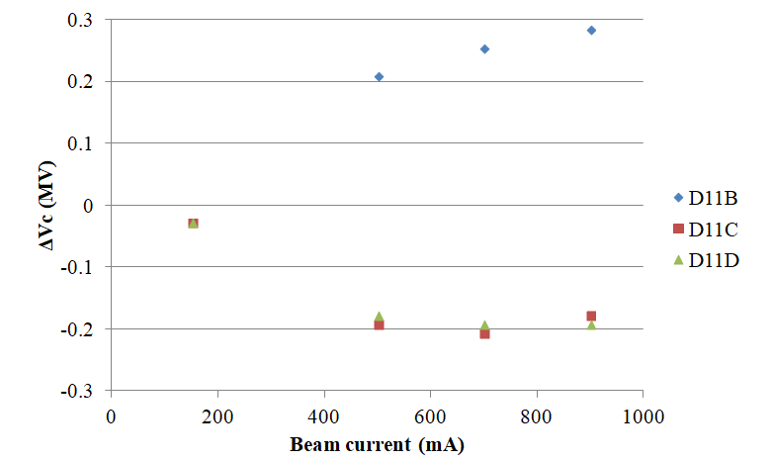
Cavity voltage variation at cavity trip
Reverse phase
Normal phase
Voltage increases as the beam current increases
Available voltage is higher than 2MV
Cavity voltage increase is acceptable

Slide 19
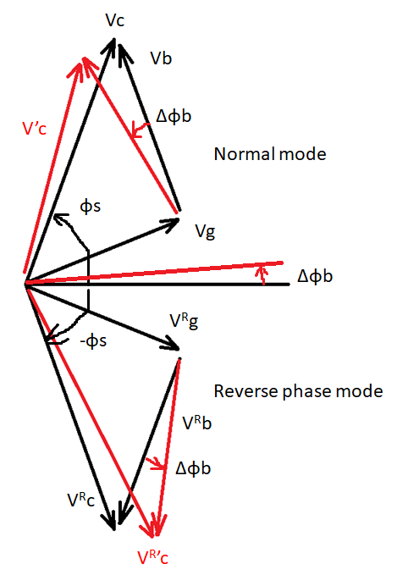
Voltage increase of the reverse phase cavity
When one of cavities trips, the beam phase shifts to compensate the beam power loss. The phase of the voltage induced by the beam current also shifts. The normal cavity voltage Vc decreases, while the reverse phase cavity voltage V^{R}c increases.
Rough estimation of Vc increase and synchronous phase shift;
ΔVc＝－Vb Sin(φs－ψ) Δφb
Vc Δφs＝－Vb Cos(φs－ψ) Δφb
Φs: Synchronous phase of normal cavity
Ψ: Detuning angle
Vc: Cavity voltage
Vb: Voltage induced by the beam
Vg: Voltage induced by the generator
Δφb: Beam phase shift
ΔVc: Cavity voltage increase
Δφs: Synchronous phase shift

Slide 20
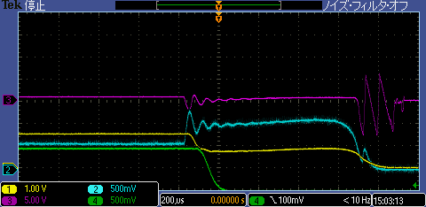
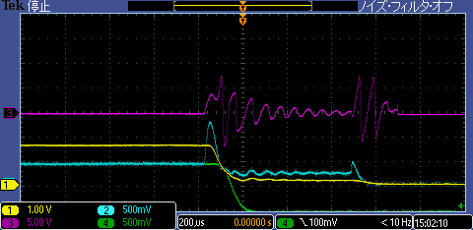
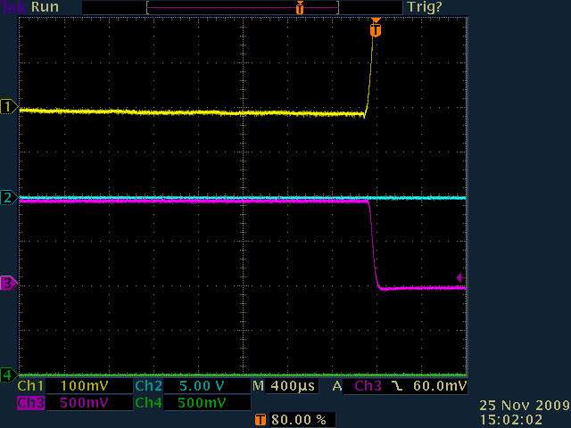
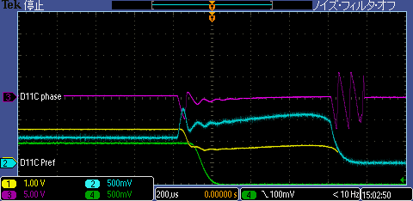
Transient behaviors of Vc at beam abort
Beam current ：930 mA
1 Vc: cavity voltage
2 Pr: reflected power
3 φ: tuner phase
4 DCCT: beam current
D11A
Beam abort
Beam abort
D11B (Reverse phase)
Vc: decreased, Pr: increased
D11A,D11C (Normal phase)
Vc: decreased, Pr: increased
Quench detector cut off RF power
D11B, Reverse
RPO applicable at high currents
Vc decreased with no abnormal behavior
HER Beam Phase
D11C, Normal
1. HER Beam Phase
2. HER BPA Req.
3. HER Beam Pickup
4. HER Beam Pickup DET

Slide 21
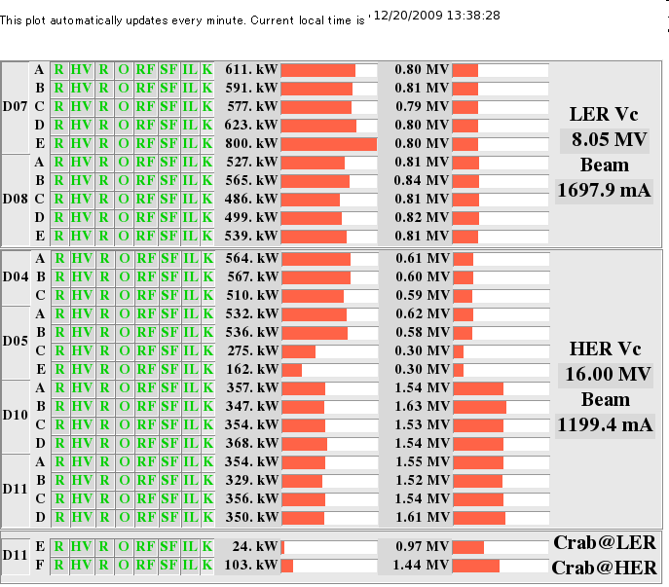
RPO at high luminosity RUN
Beam study at luminosity RUN
High luminosity RUN with reverse phase operation
  Dec. 18 to 24 , 2009
  5S RUN
  Operated stably at 1.2 A
    No beam abort caused by the cavity
    Beam power delivered to beam: ~300kW/cavity
Klystron powers and cavity voltages
at 5S-RUN@1200mA

Slide 22
Summary of the reverse phase operation study
Voltage and phase settings：well controlled
Synchrotron frequency： same as normal mode
Bunch length: same as normal mode
Beam power of reverse phase cavity: can share equal power
Beam acceleration: very stable
  At cavity trip
    Voltage increase in reverse phase cavity
    Acceptable
  High luminosity RUN
    No beam abort caused by the cavity
    Beam current of 1.2 A, with beam power of 300 kW
We concluded that the reverse phase operation is applicable for SuperKEKB

Slide 23
Present operating status of SRF cavities
SuperKEKB machine parameters have changed
  HER RF voltage increased to 15.8 MV because of lattice design change
  No need for RPO
Eight SRF cavities are operating stably for SuperKEKB in normal operating mode
  Present cavity voltage: 1.35MV/cav
  For the stable operation
    Two cavities were high-pressure-rinsed in the cryostat after the KEKB shutdown and their Q values recovered to 1x10⁹ at 2MV

Slide 24
Present RF rerated parameters for SuperKEKB
Parameter | unit | KEKB (achieved)
Ring |  | HER |  |  | LER
Energy | GeV | 8.0 |  |  | 3.5
Beam Current | A | 1.4 |  |  | 2
Number of Bunches |  | 1585 |  |  | 1585
Bunch Length | mm | 6-7 |  |  | 6-7
Total Beam Power | MW | ~5.0 |  |  | ~3.5
Total RF Voltage | MV | 15.0 |  |  | 8.0
 |  | ARES |  | SCC | ARES
Number of Cavities |  | 10 | 2 | 8 | 20
Klystron : Cavity |  | 1:2 | 1:1 | 1:1 | 1:2
RF Voltage (Max.) | MV/cav. | 0.5 |  | 1.5 | 0.5
Beam Power (Max.) | kW/cav. | 200 | 550 | 400 | 200
SuperKEKB (design)
HER |  | LER
7.0 |  | 4.0
2.6 |  | 3.6
2500 |  | 2500
5 |  | 6
8.0 |  | 8.3
15.8 |  | 9.4
ARES | SCC | ARES
10 | 8 | 8 | 14
1:1 | 1:1 | 1:2 | 1:1
0.5 | 1.5 | 0.5
550 | 400 | 200 | 550
Normal operation

Slide 25
Achieved parameters
Parameter | Achieved | Unit
Beam Current | 0.94 | A
Number of bunches | 1576
Number of cavities | 8
RF Voltage | 1.35 | MV/cav
Beam power | ~180 | kW/cav

Slide 26
Summary
RPO developed for SuperKEKB operation
  For the low total RF voltage and high beam power operation
Advantages of RPO
  Each cavity can have high voltage
  Each cavity can have equal beam power
  No need to modify external Q
Beam study of RPO
  RPO applicable
  Reverse phase cavity can share equal beam power
  No change in νs and σz
  Increase of Vc at cavity trip but acceptable
  Successfully operated at 1.2A for 5 days
Present SuperKEKB parameters
  High RF voltage because of lattice design change
  No need for RPO at present operation
  Reserve RPO for future option

Slide 27
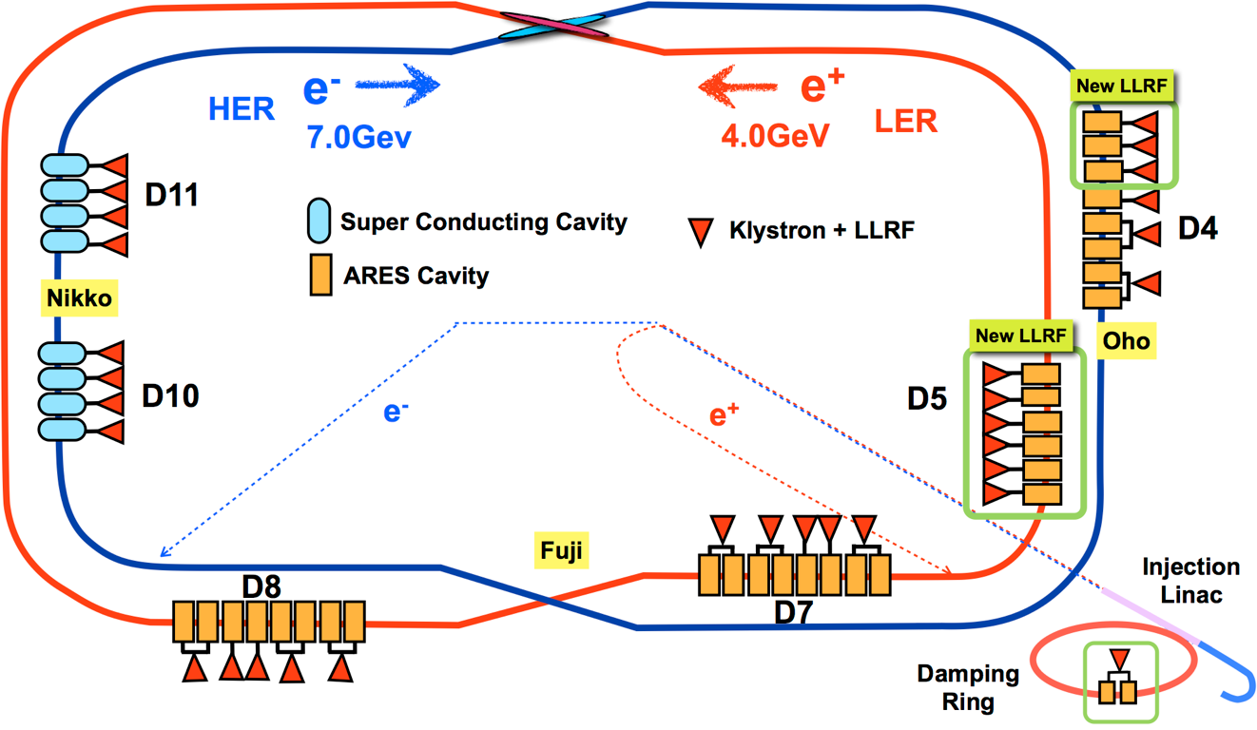
Super KEKB RF system (2020.7)
前回の運転と比較してRF関連の大きなアップグレード、システム変更はなし。
D04-H
D05-A
D05-F
D07-A1↔E2
D08-E2↔A1
直線部に近い方から、A,B,C,,,,空洞と名付けている

Slide 28
SuperKEKB Parameters (RF Related)
Parameter | unit | KEKB (achieved)
Ring |  | HER |  |  | LER
Energy | GeV | 8.0 |  |  | 3.5
Beam Current | A | 1.4 |  |  | 2
Number of Bunches |  | 1585 |  |  | 1585
Bunch Length | mm | 6-7 |  |  | 6-7
Total Beam Power | MW | ~5.0 |  |  | ~3.5
Total RF Voltage | MV | 15.0 |  |  | 8.0
 |  | ARES |  | SCC | ARES
Number of Cavities |  | 10 | 2 | 8 | 20
Klystron : Cavity |  | 1:2 | 1:1 | 1:1 | 1:2
RF Voltage (Max.) | MV/cav. | 0.5 |  | 1.5 | 0.5
Beam Power (Max.) | kW/cav. | 200 | 550 | 400 | 200
SuperKEKB (design)
HER |  | LER
7.0 |  | 4.0
2.6 |  | 3.6
2500 |  | 2500
5 |  | 6
8.0 |  | 8.3
15.8 |  | 9.4
ARES | SCC | ARES
10 | 8 | 8 | 14
1:1 | 1:1 | 1:2 | 1:1
0.5 | 1.5 | 0.5
550 | 400 | 200 | 550
Issues for RF systems
Beam current will be twice of KEKB.
Bunch length will be short.
Beam powers is so large, 1.5 times in HER and twice in LER of KEKB.
Notes:
For RF system, main issues are higher beam current, shorter bunch length and large beam power.
But Beam power can be shared with SCC and ARES, therefore the power not change for our cavities.

