Slide 1
EIC Polarized E-Injector Chain
Vahid Ranjbar
EIC Accelerator Collaboration Workshop
October 7-9, 2020

Slide 2
Outline
Requirements
  Proposed EIC electron injector
Pre-injector Concept
RCS Concept and Design
  Geometry
  Detector bypass
  Spin resonance strengths
Injection/Extraction and Charge accumulation
  RCS charge accumulation concept
  RF kicker concept
  ESR injection kicker concept
Summary

Slide 3
EIC Injector Requirements
A cost-effective design to generate and accelerate polarized electrons up to 5, 10, and 18 GeV
  For injection of polarized bunches with 10 to 28 nC into electron storage ring (ESR)
  Injection rate: two bunches per second (1 Hz)
  Maintain polarization transmission losses < 5%
  Must fit inside existing RHIC tunnel with bypass for detectors, with smaller buildings to house source and LINAC.

Slide 4
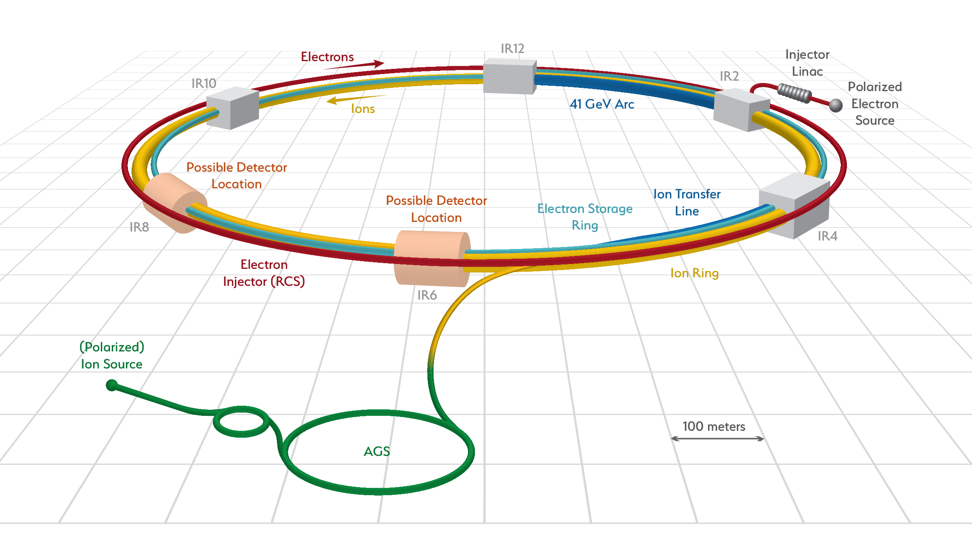
Layout of EIC e-injector
RCS to ESR Transfer Line
12 o’clock

Slide 5
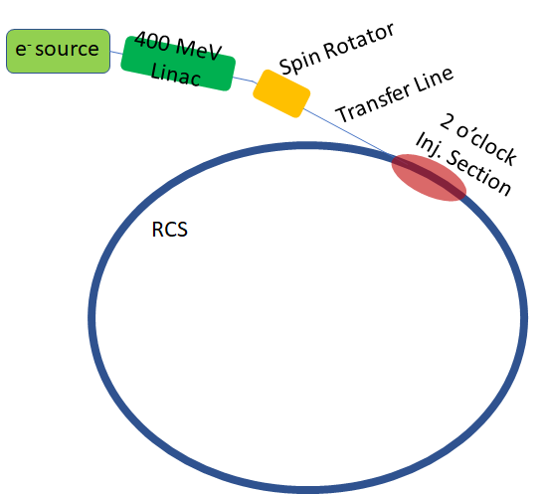
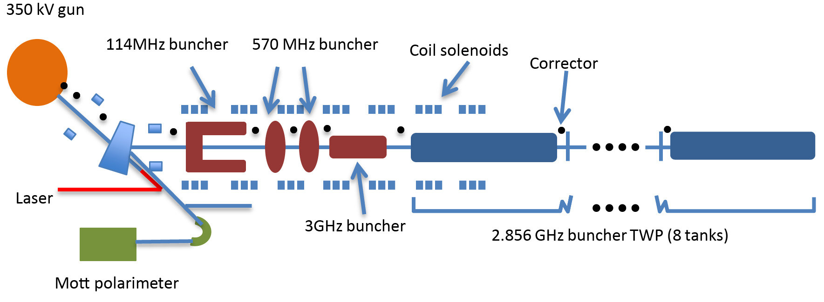
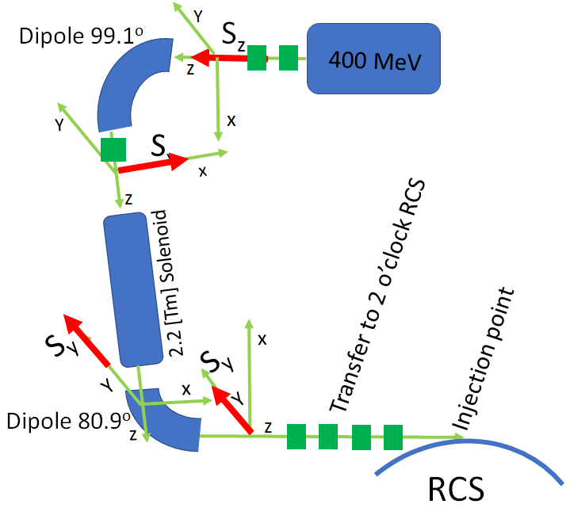
Electron Pre-Injector
E. Wang, J. Skaritka
Transfer Lines and Injection/Extraction
(LINAC to RCS part)

Slide 6

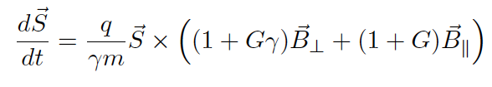
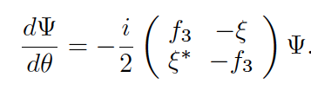
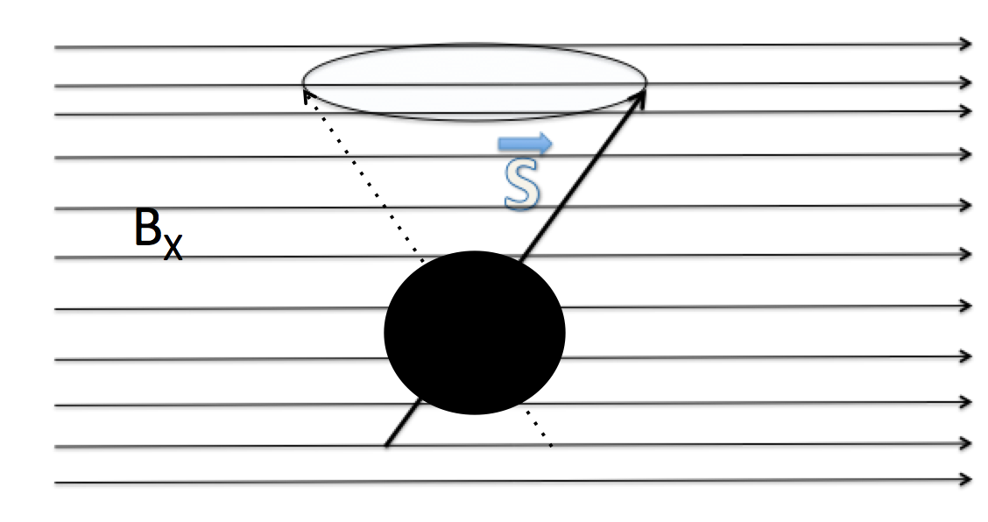
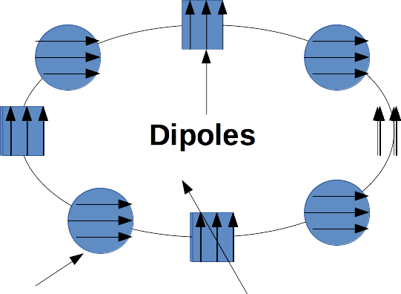
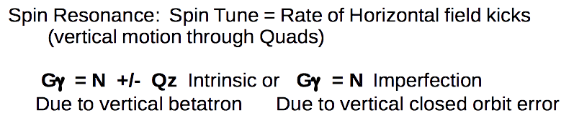
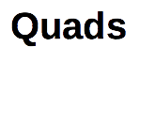
Spin Resonance Review
Spinor Form

Slide 7
Concept Overview: Spin Resonance Free Lattice
Both the strong intrinsic and imperfection resonances occur at:
  K = nP +/- Qy
  K = nP +/- [Qy] (integer part of tune)
This has been observed in the AGS, for example where the 12 Periodicity determines the location of the observed intrinsic spin resonances and the other intrinsic do not affect polarization.
To accelerate from 400 MeV to 18 GeV requires the spin tune ramping from
  0.907 < Gϒ < 41.
If we use a periodicity of P=96 and a tune with an integer value of 50 then our first two intrinsic resonances will occur outside of the range of our spin tunes
  K1 = 50+ν_{y} (ν_{y} is the fractional part of the tune)
  K2 = 96 – (50+ν_{y} ) =46-ν_{y}
  Also our imperfection will follow suit with the first major one occurring at K2 = 96 – 50 = 46

Slide 8
How to make this work in the RHIC tunnel?
It is easy to accomplish this with a perfectly circular ring. Just construct a series of FODO cells with bending magnets so that we have total periodicity of 96.
The problem is that the RHIC tunnel is not circular and has an inherent six-fold symmetry.
Solution: make the spin resonance integrals over the straight sections equal to zero.

Slide 9
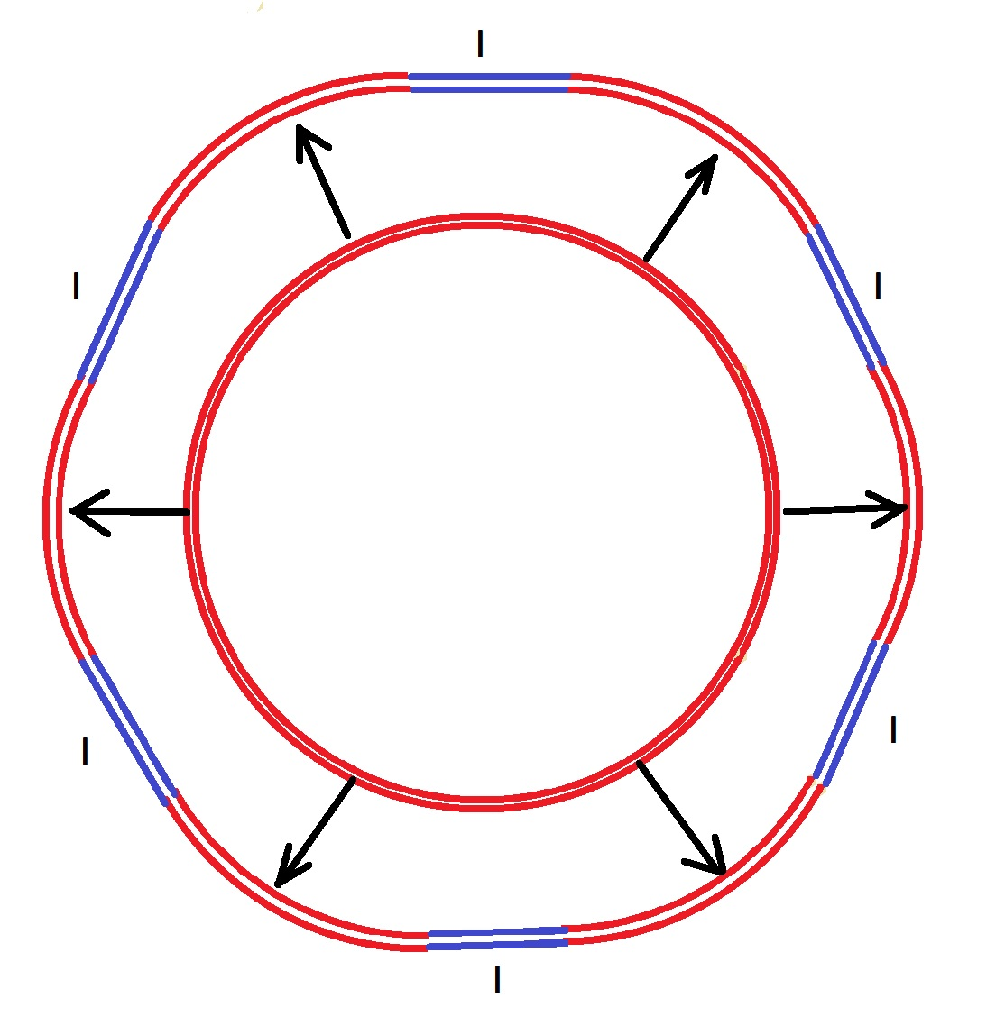
Project onto the RHIC tunnel
RHIC Tunnel

Slide 10
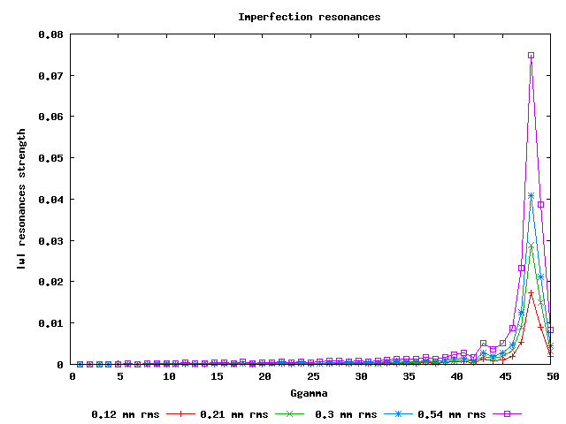
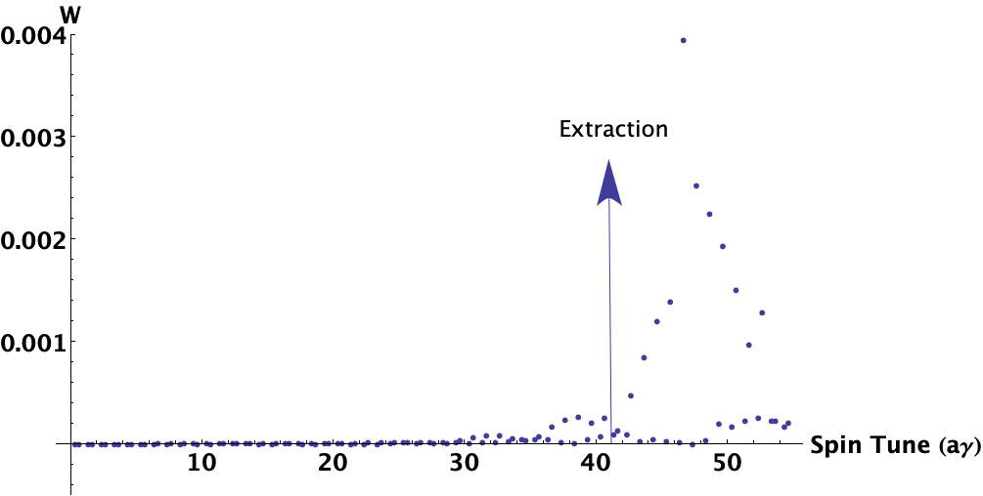
Calculating Spin Resonances
Intrinsic Resonance at 10 mm-mrad
Extraction
No polarization loss from cumulative effects of intrinsic spin resonances for distributions with RMS normalized emittance > 1000 mm-rad (100 msec ramp rate).
At 200 mm-mrad RMS normalized emittance, we can tolerate beyond 2% field errors and still maintain above 95% polarization transmission.
Issue to control: Imperfection spin resonances ~ vertical RMS orbit 0.5 mm to keep losses < 5%.

Slide 11
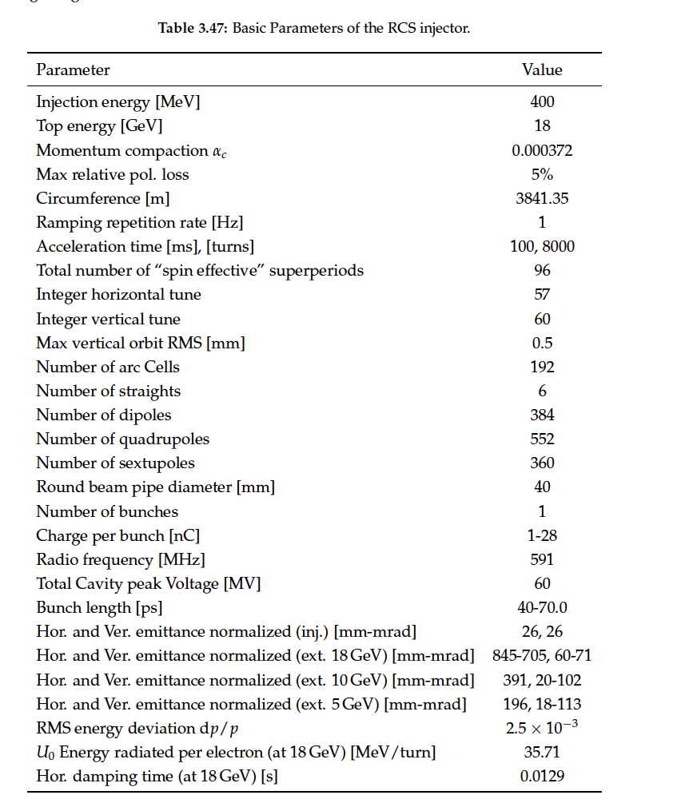
RCS Design Parameters
Design accommodates detector bypasses and RF physical needs
Two connecting arc designs
  Detector→ IP6, IP8
  RF, Extraction, Injection
    IP10→ RF
    IP12→ Extraction
    IP2 → Injection
    IP4
Achieved 4 meters bypass at the IP.
Impacts symmetry of lattice.
  However by optimizing the quad strengths in the bypass region we can recover low intrinsic losses.
  Spin resonance free electron ring injector Phys. Rev. Accel. Beams 21, 111003 – Published 27 November 2018

Slide 12
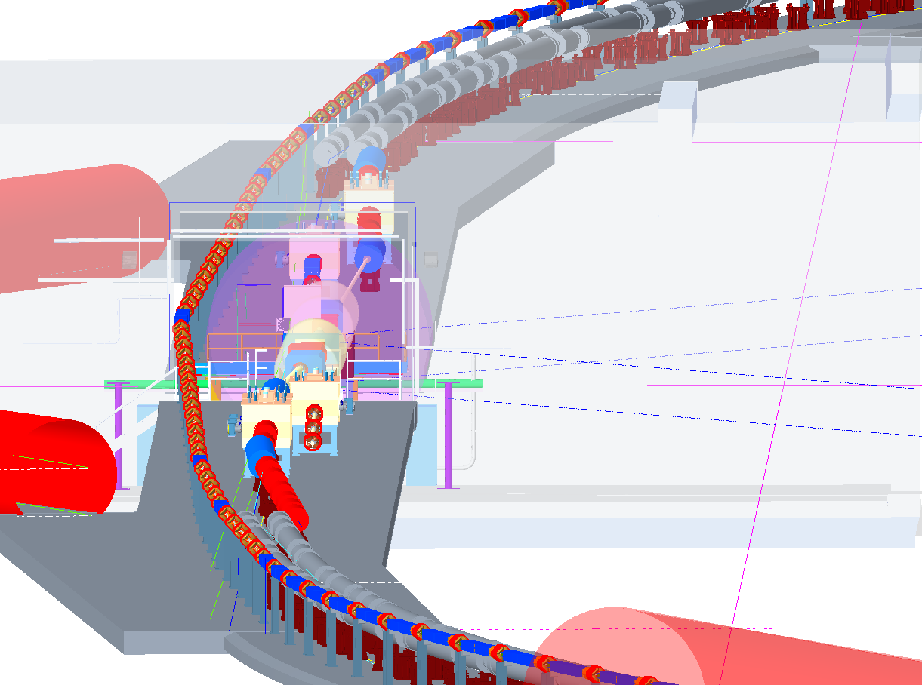
Detector bypass design IP6, IP8
courtesy D. Holmes

Slide 13
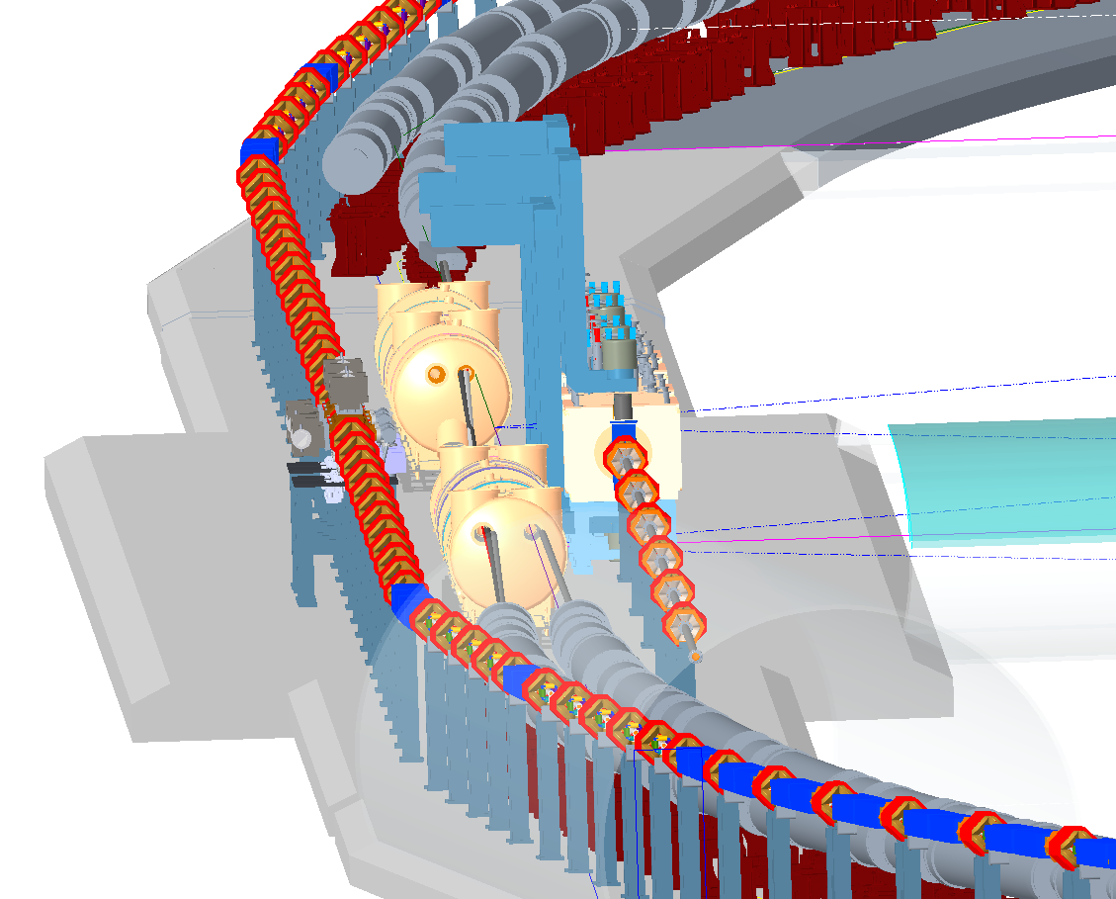
Design IP10,12,2 and 4 for RF, Extraction, Injection
courtesy D. Holmes

Slide 14
Polarization Performance
Intrinsic resonances as calculated by DEPOL yield no cumulative depolarization loss for a beam with up to 1,000 um RMS normalized emittance.
Imperfections could however potentially cause greater than 5% losses during ramp.
Polarization losses primarily due to quadrupole misalignment and dipole rolls.
  But these effects can be controlled to bring our losses below 5% on ramp.→ Orbit smoothing and imperfection bumps.

Slide 15
Analysis of Imperfections:
  Survey estimates are 0.2 mm RMS with a 2 sigma cutoff and +/- 1 mrad rolls. This yields an estimated RMS orbit distortion of 3 to 6 mm RMS.
  Extracting at 10 GeV, RCS can handle > 3 mm RMS orbit with < 5% pol. loss and 2 mrad uncorrected rolls.
  With appropriate BPM and corrector pairs this can be corrected down to below 0.5 mm RMS and push our polarization losses below 5%, extracting at 18 GeV.
  Once corrected, dynamical changes of the relative field strength in the quads and dipoles of greater than 0.5% can be tolerated with little effect on polarization transmission.
  Orthogonal imperfection bump scheme to fix any remaining losses beyond SVD orbit smoothing.

Slide 16
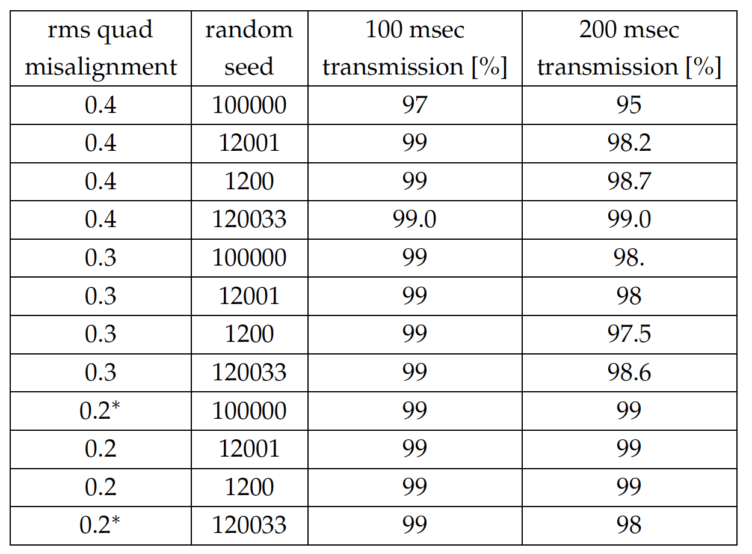
Studies with SVD orbit correction: Quadrupole misalignments
Polarization transmission to 18 GeV for random gaussian quadrupole misalignments with SVD orbit correction for 4 different random seeds. * indicates tests with BPM misalignments of 0.2 mm RMS

Slide 17
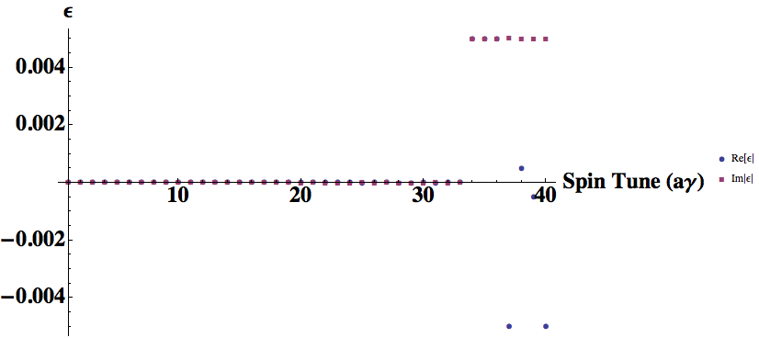
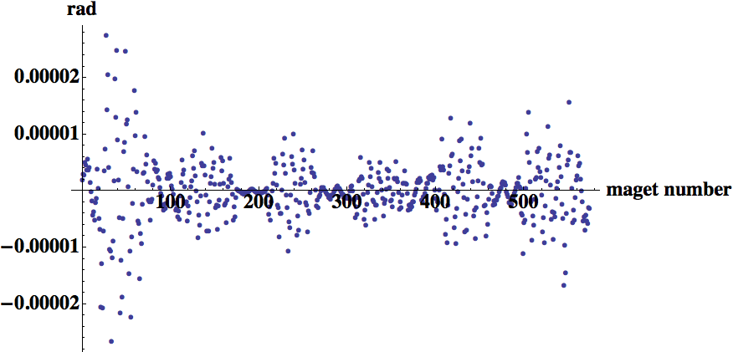
Orthogonal Imperfection Bump
Static imperfection bumps at any imperfection resonance "location" on the ramp.
Bumps are orthogonal to each other and localized in energy space → no required bandwidth beyond what is needed to ramp the dipoles with the energy.
Example shown on right: 10 to 15% (0.005 res.) Depolarization Kick Imaginary and Real no kicks anywhere else.

Slide 18
LINAC Pulse Pattern
RCS Charge Accumulation Concept
2 x 7nC bunches per shot
Spaced 2 usec
Pulsed 4 times at 100Hz
  2 bunch trains of 4 bunches
Total fill time 40 msec
40 ps bunch length RMS
2.5e-3 dp/p RMS
sigma_t*sigma_E = 4e-5 eV-s
Bunches filled in the RCS in neighboring buckets (1.6ns apart)
Two bunch trains at 400 MeV
Two final merged bunches at 1 GeV

Slide 19
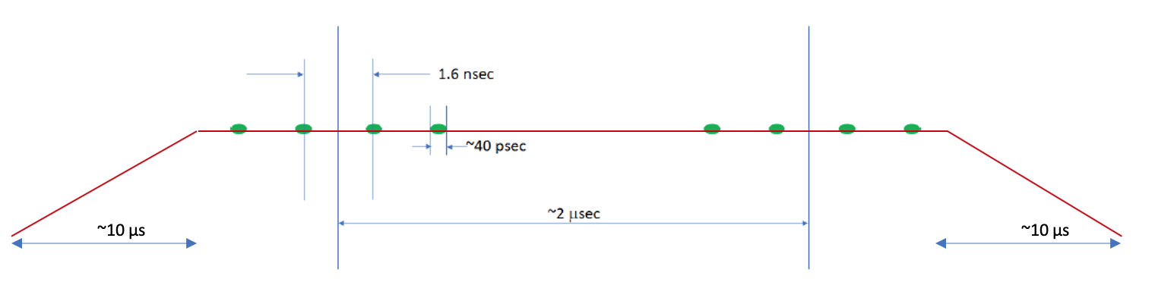
RF Injection Kicker
Y. Huang, J. Guo and N. Tsoupas
Composed of two RF crab-like cavities (C1, C2)
  C2: 147.8 MHz→ 150 kV
  C1: 295.5 MHz → 100 kV
  C2: 443.3 MHz→ 50 kV
Kick of 0.5 mrad
  Rise and fall in under one turn ~ 10 usec
Slow bump of 2.5 mrad
  Gives a total of 3 mrad necessary to kick bunch into RCS

Slide 20
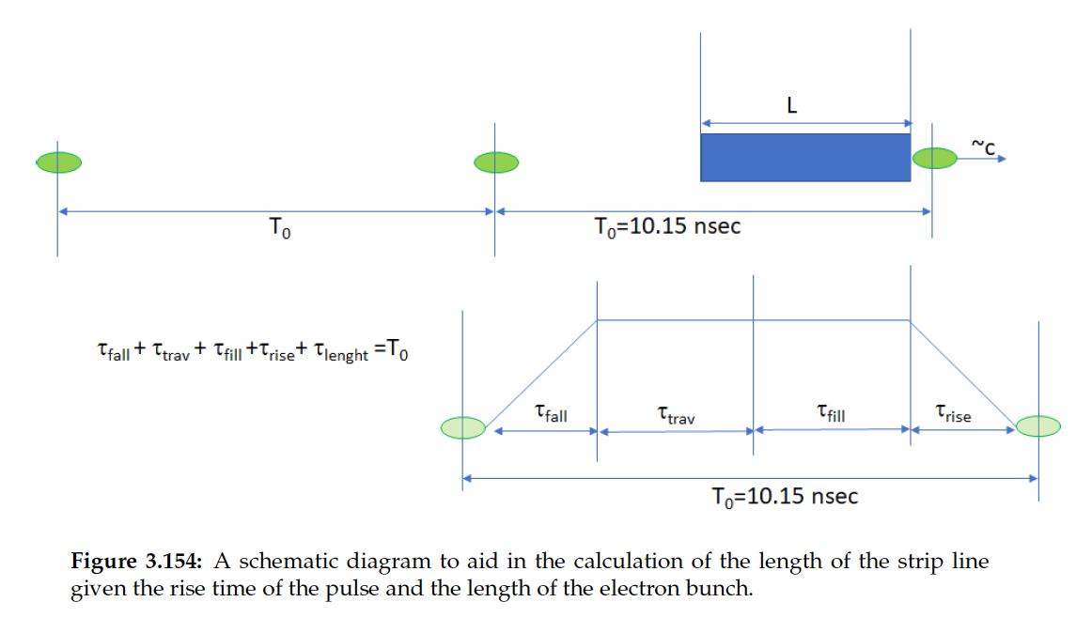
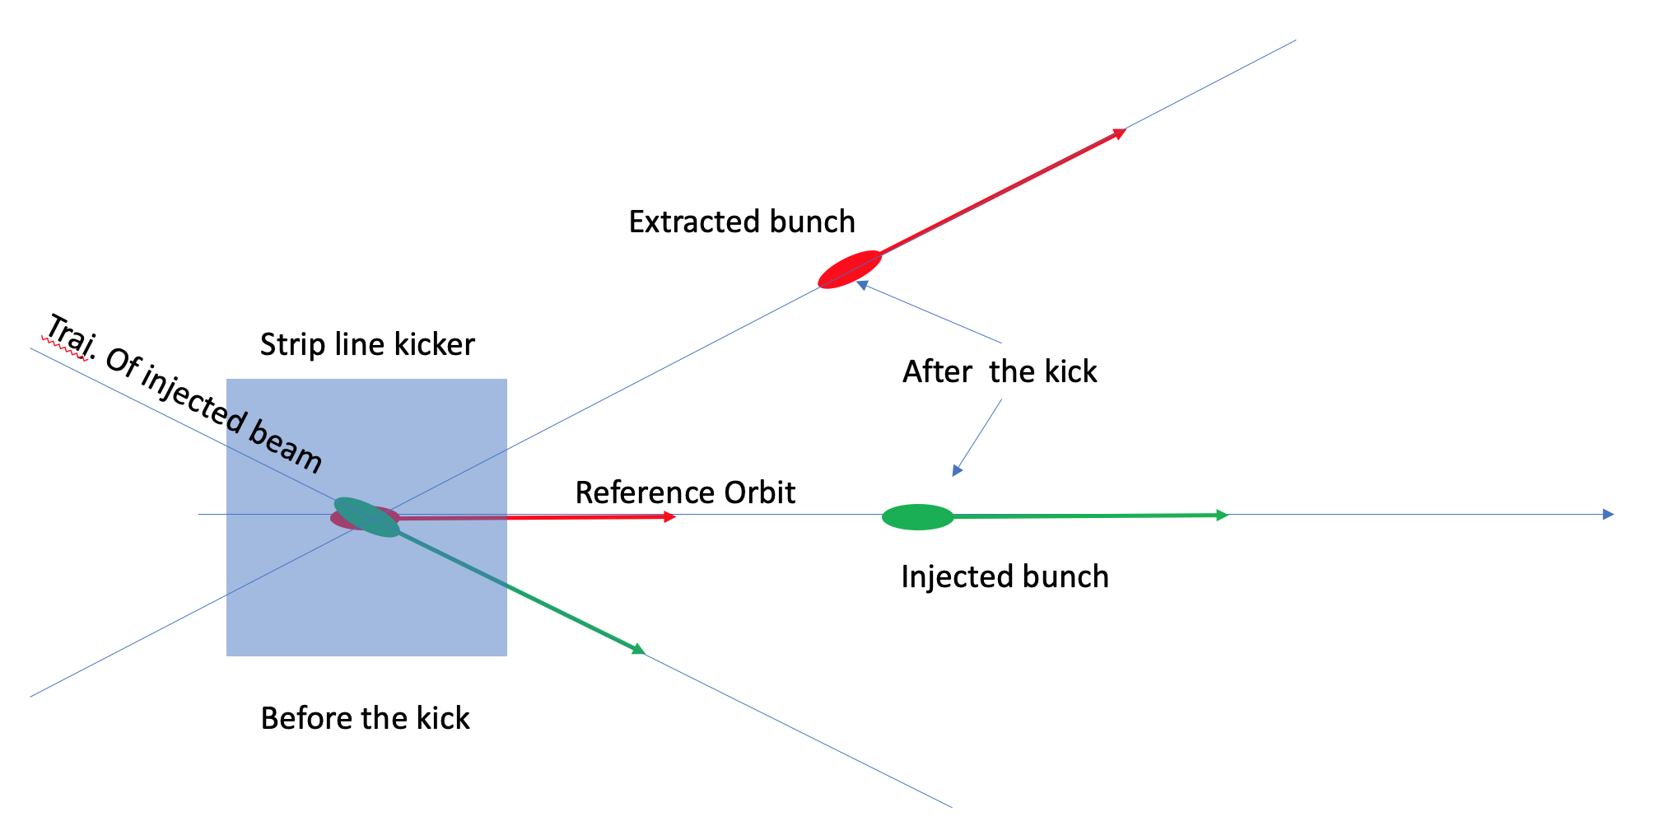
Injection Scheme into the ESR
F. Willeke, N. Tsoupas
Slow closed bump
  Rising in one turn ~13usec and falling in the other for at total of 26 usec
  Bump must be closed exactly (adjust quads or third corrector possible)
  All bunches will see the slow bump at different stages
  Bump should bring beam within 3-4 sigma of injection and extraction septa
Fast kicker
  Single kicker for extraction and injection. Kick every 10.15 nsec at 18 GeV
  Sum of slow and fast kick extracts/injects the bunch.

Slide 21
Summary
The EIC electron injector concept includes a source and a commercially available LINAC
A Rapid Cycling Synchrotron with a special spin transparent design
  Resonances in this lattice are driven by imperfections
  Intrinsic resonances are so weak that even large field distortions don’t hurt.
  Resilient to misalignments, dipole rolls and orbit distortions:
  To provide additional margin we show that fixed orthogonal imperfection bumps are capable of removing any residual polarization losses.
To achieve the high injected bunch charge in the ESR a merging scheme has been developed in the RCS using special RF 1.6nsec injection kicker
To inject the high charge bunches into the ESR a pair of fast stripline kickers are proposed to kick out the old and kick in the new bunches.

