Slide 1
EIC RHIC Updates
Silvia Verdú-Andrés
EIC Accelerator Collaboration Workshop
October 7-9, 2020
Notes:
Hello everybody and thank you to the organizing committee for asking me to give this talk. This talk will go through the EIC RHIC Updates so let’s first get a glance to the RHIC/ start with some RHIC highlights/overview.

Slide 2
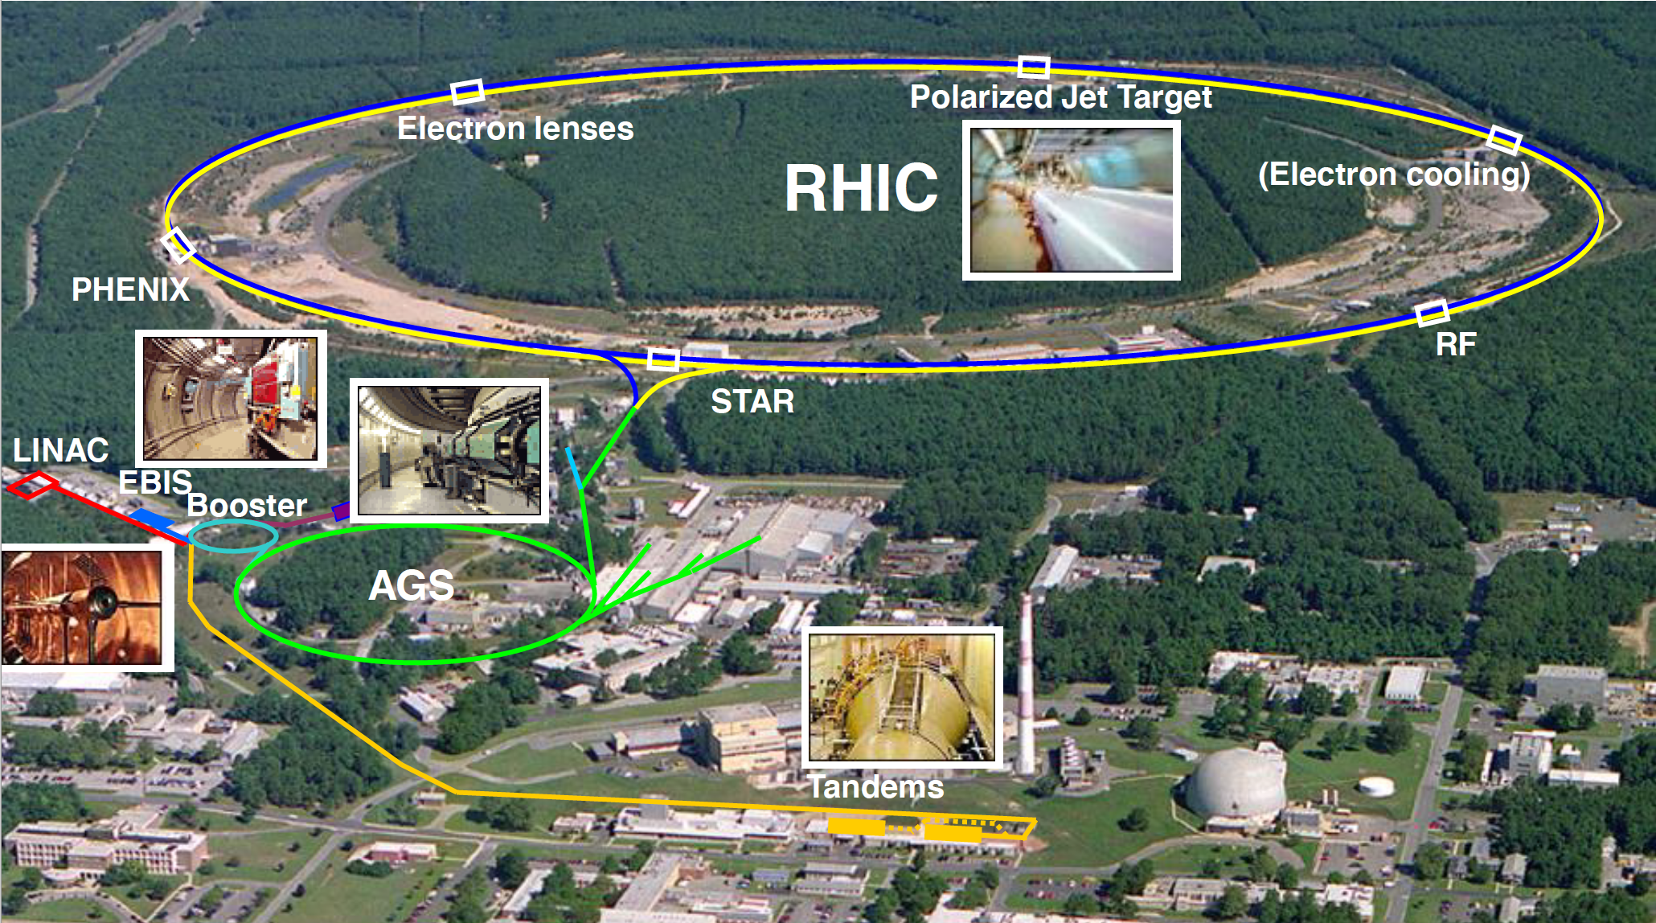
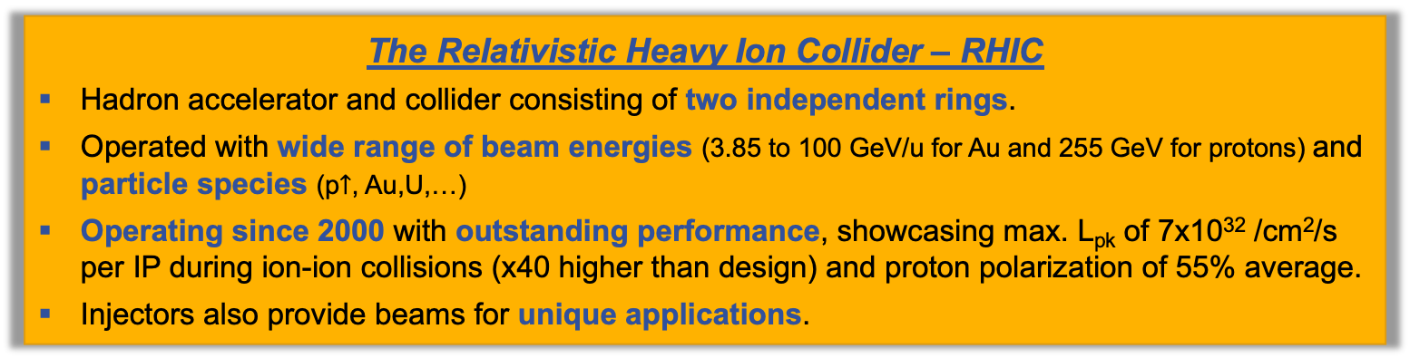
On the shoulders of giants
Courtesy of T. Roser
The Relativistic Heavy Ion Collider – RHIC
Hadron accelerator and collider consisting of two independent rings.
Operated with wide range of beam energies (3.85 to 100 GeV/u for Au and 255 GeV for protons) and particle species (p$↑$, Au,U,…)
Operating since 2000 with outstanding performance, showcasing max. L_{pk} of 7x10³² /cm²/s per IP during ion-ion collisions (x40 higher than design) and proton polarization of 55% average.
Injectors also provide beams for unique applications.
Notes:
https://www.rhichome.bnl.gov/RHIC/Runs/index.html#HadronCollider_Lumi
Indeed, RHIC is a great start for an EIC.

Slide 3
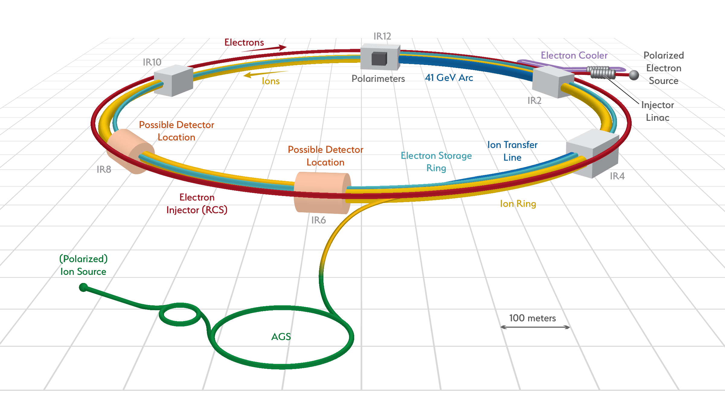
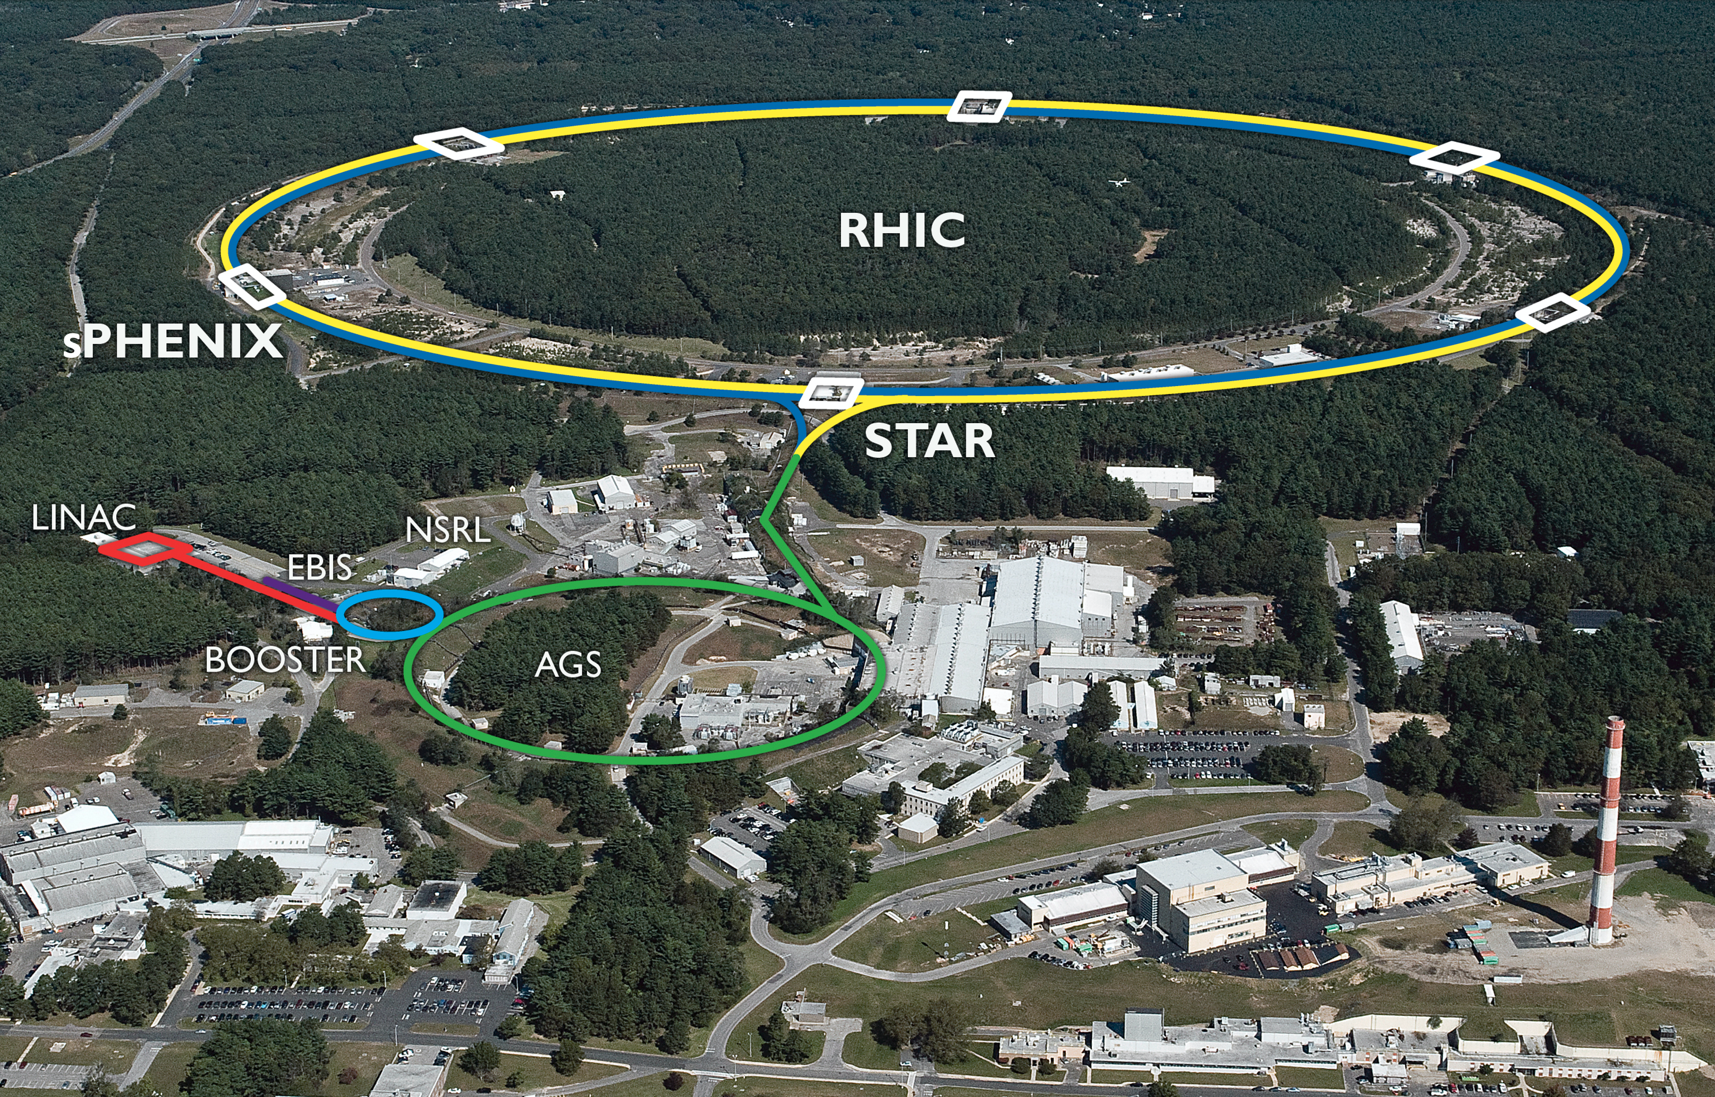
Existing RHIC accelerator complex will be re-used for EIC
EIC
Yellow RHIC ring will be used for EIC hadron beam.
Two arcs of Blue RHIC ring (12-2 and 4-6 o’clock) used as EIC hadron beamlines; one arc as a cryoline (2-4 o’clock). Most of remaining Blue ring components stay in tunnel.
On-going upgrade of ion source EBIS will provide capability of polarized ³He.
Present injector chain will be entirely re-used. (EBIS, Linac, Booster, AGS)
An electron ring will be added to the tunnel to complete the Electron-Ion Collider.
Notes:
As you all know by now, the existing RHIC accelerator complex will be reused for the EIC.

Slide 4
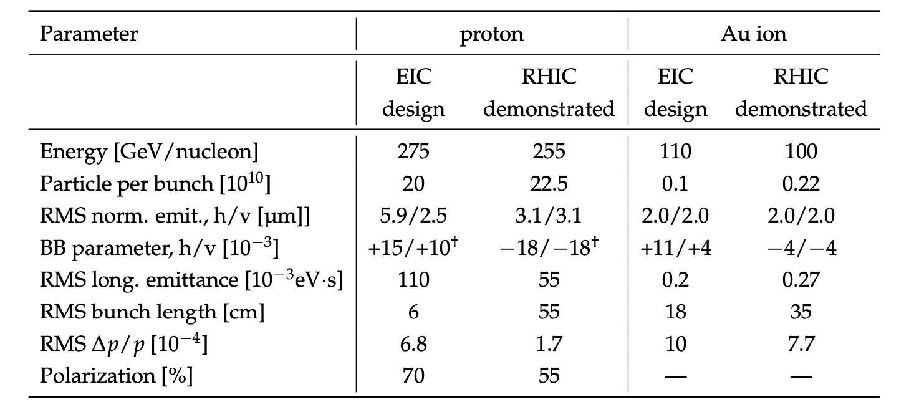
Existing RHIC accelerator complex will be re-used for EIC
Courtesy of W. Fischer (from CDR)
Notes:
Here this table displays the beam parameters demonstrated in RHIC and those for which EI has been designed. Indeed RHIC is a great start for the EIC. Highlighted you see the parameters that significantly change. For example, energy increase , BB and dp/p being monitored by Yun Luo, shorter bunches and deliver higher polarization according to plan explained by Vaim Ptitsyn.
Energy upgrade: magnet strength, power supplies, RF cavities
BB: receiving especial attention, as EIC will use crab cavities and impact of their RF frequency, RF noise (beam-beam studies by Task Force led by Yun Luo).
Shorter bunch length: heating, HOM power, ecloud
Larger momentum spread (dp/p): (dynamic aperture studies by Task Force led by Yun Luo).
Polarization: maximum polarization at center of beam (actually zero emittance beam would have highest polarization; the lower the emittance, the better the average polarization), almost the same as in source except if matching issues during injection through accelerators. The values quoted for polarization correspond to polarization measured during Run-17 Mode 1A averaged over storage time and transverse profile (thus conservative) for the two rings.
POC for beam-beam and dynamic aperture studies is Yun Luo.

Slide 5
Eight Key Updates of the RHIC Hadron Rings Towards EIC
Injection
System
Upgrade
Beam Instrumentation Upgrade
Path Length
Variation, Energy Upgrade
Vacuum Chamber Update
EIC
Interaction Regions
Strong Hadron Cooling
Additional Snakes
Hadron Ring RF Systems
L2 Manager: Vadim Ptitsyn
Notes:
We identify 8 key updates

Slide 6
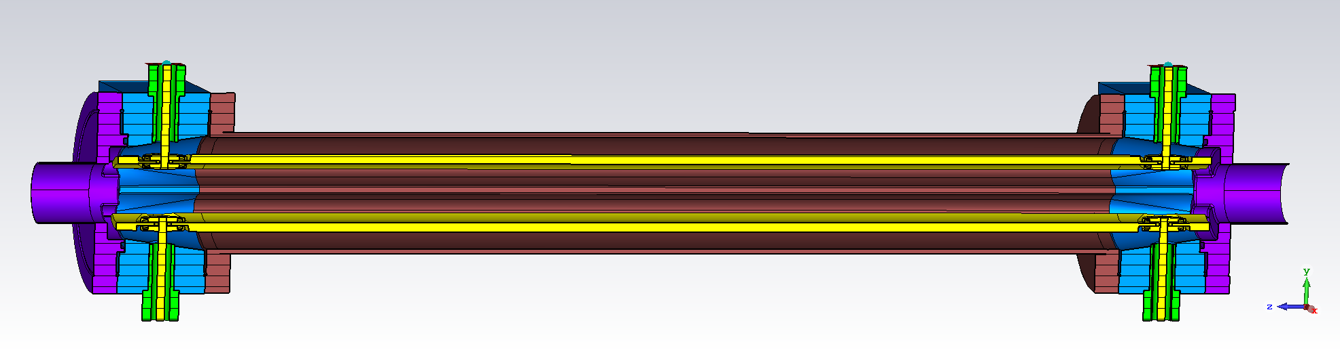
Transfer Line & Injection Upgrade
Tripling number of bunches requires longer injection kicker insertion (~20m) $→$ not enough space for this system in presently used injection area at 5 o’clock.
Required modifications:
Beam transported to IR4 area through inner Blue arc.
AtR Y-line for transfer into Blue 6-4 arc
4 o’clock transfer line and injection kicker system
Blue 6-4 arc SC bus connections and power supplies
EIC
Injection kicker area
Cross section of injection kicker [Courtesy of M. Sangroula]
POC: Nick Tsoupas

Slide 7
Path Length Variation to Synchronize Electrons and Hadrons at Different Energies
12 o’clock
Arc used for 100-275 GeV
Arc used for 41 GeV
Hadron ring
Required modifications in 12-2 o’clock:
100-275 GeV hadron beam travels through outer arc.
Slower 41 GeV hadron beam travels through shorter inner arc. (Effectively shortens hadron ring circumference by 94.2 cm.)
Modifications of power supply bus connections at 2 and 12 o’clock valve boxes.
New power supplies for inner arc and D0 magnets.
Two additional warm “switching” magnets to deviate 41 GeV beam
2 o’clock
POC: Steve Peggs
Notes:
Currently considering idea to move this arc between 10 and 12 oclock. The reason is because 2 o’clock is pretty busy with strong hadron cooling where switch between inner and outer arcs is currently thought to be.

Slide 8
Energy upgrade: from 260 to 275 GeV
Present RHIC proton energy limited to 260 GeV by DX separator magnets, to be removed for EIC. (In the center of each straight section.)
Arc magnets could ultimately go 30% higher in field. However, trying to avoid additional PS upgrade costs and required quench training, we limit the energy increase in EIC to 275 GeV.
Blue
Yellow
Yellow
Blue
100-275 GeV
41 GeV
POC: Vadim Ptitsyn
Notes:
The need for these switching magnets is clearly seen if we look at the sketches of the IRs.
In RHIC, the DX magnets, found in the straight sections, limit the beam energy to 260 GeV. The DX will be removed. We will remain with 3 types of IR. Here displayed two of them.
For IR8, IR10 and IR4 now we get direct connection.
For IR12 and IR2, we need a switching dipole to switch between Blue and Yellow arcs for beams of different energies.

Slide 9
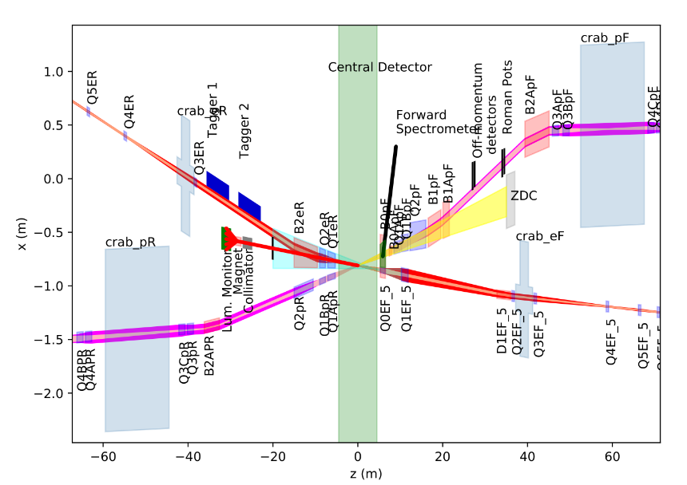
Interaction Region for Detector
REAR
FORWARD
EIC
Possible IR location: IP6
Need to match existing hadron ring lattice with new IR.
Most of IR magnets will be new, some SC (all NbTi; three main types: 9 direct wind magnets, 6 collared magnets, 1 special magnet + tapered double helix); others warm.
The IR also hosts crabs and spin rotators, and will precise new beam instrumentation.
POC: Holger Witte
Notes:
What brings us to a third class of IR, where the detector will be placed. This is a new detector, a new IR, a new beast.

Slide 10
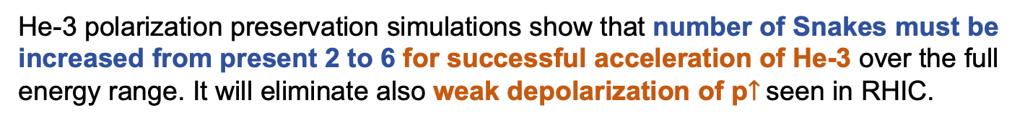
Additional Snakes for Successful Acceleration of He-3
He-3 polarization preservation simulations show that number of Snakes must be increased from present 2 to 6 for successful acceleration of He-3 over the full energy range. It will eliminate also weak depolarization of p$↑$seen in RHIC.
Crossing strongest spin resonances in RHIC
To add 4 Siberian Snakes to Yellow ring:
Use the 2 Blue Siberian Snakes
Sort the helical dipoles from the Blue Spin Rotators by their helicity and recombine them to make another pair of Snakes
Sy
F. Meot,
ZGOUBI
+/- indicate the magnet helicity
H1
+
H2
-
H2
+
H1
-
H1
+
H2
+
H2
+
H1
+
The RHIC Spin Rotator consists of four helical magnets with alternate helicity.
The RHIC Siberian Snake consists of four helical magnets, all having the same helicity.
POC: Vadim Ptitsyn

Slide 11
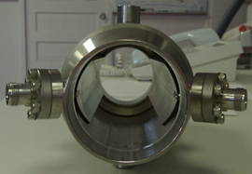
Beam Instrumentation Upgrade for High Beam Current
Beam Position Monitor Upgrade:
Present stripline BPMs cannot be used at EIC peak current values and large orbit radial shifts, because of BPM cable heating issues.
Manufacture sleeves to shield present BPMs in the entire Yellow ring and in Blue 2-12 sextant. [279 BPMs]
Procure and test new button BPMs and produce BPM-bellows assemblies ready for the installation.
[203 single plane and 76 dual plane BPMS. 710 cold SiO2 insulated cables.]
Upgrade BPM electronics: from old IFE to next generation V301 boards.
Existing stripline BPM (above) will be shielded;
button BPMs (below) will be installed adjacent
POC: David Gassner

Slide 12
Beam Instrumentation Upgrade for High Beam Current
Other instrumentation upgrades:
Instrumentation for the new hadron injection transfer line (IR6 to IR4): 2 Current transformers, 6 Profile Monitors, 6 BPMs, 10 BLMs
Wall Current Monitor - replace by a wider band electro-optical WCM pick-up that can resolve the 6 cm rms (150ps) proton bunch length
Ionization Profile Monitors (includes higher voltage bias to improve performance)
Multi-use Stripline kickers: H & V Tune meter kicker, Longitudinal damper, Injection damper, Gap cleaner
Base-band Tune system (BBQ)
HF Schottky and LF Schottky
Collimators
Head-Tail Pick-up
All upgraded hadron ring beamline components include improved impedance.
POC: David Gassner + Angelika Drees

Slide 13
Strong Hadron Cooling for High Luminosity
High lumi requires small beam size and small beam size requires small emittance.
Reduction of the hadron beam emittance beyond what can be naturally provided, particularly a strongly reduced vertical emittance, is needed to reach the EIC luminosity goal of L = 10³⁴cm⁻²s⁻¹
$⇒$Strong Hadron Cooling needed to produce the small emittance and against IBS
e-cooler
E-Cooler Parameters | Value
e-beam energy [MeV] | 150
e-beam normalized emittance [mm-mrad] | 2.8
e-beam energy spread | 10⁻⁴
RMS beam size[mm] | 0.7
Average electron beam current [mA] | 120
e-beam bunch charge [nC] | 1
Cooling time [min] | 50
EIC
POC: Erdong Wang
Notes:
Mention hardware when I go through e-cooler parameters

Slide 14
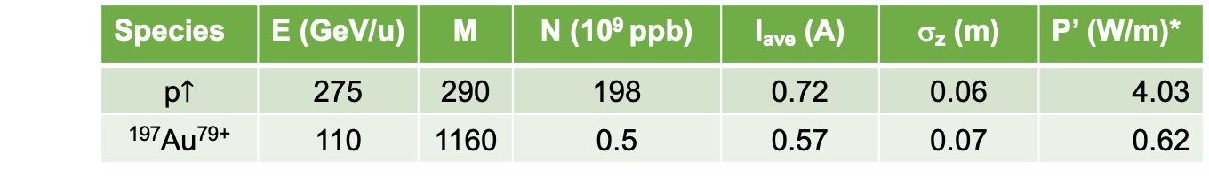
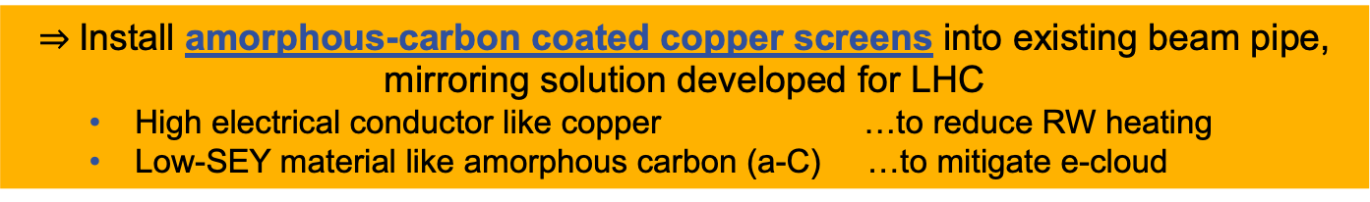
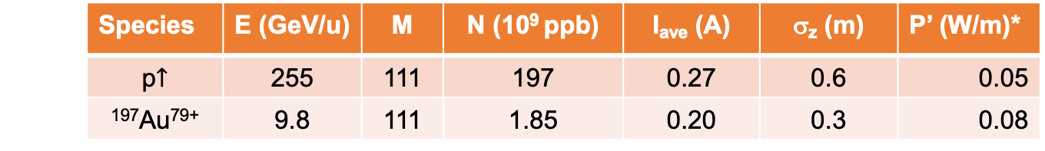
Vacuum Chamber Update
With the present RHIC beam pipe (stainless steel):
Higher intensity, shorter bunches of EIC lead to large resistive-wall heating
Higher intensity, short bunch spacing of EIC beam lead to e-cloud buildup
RUN | Species | E (GeV/u) | M | N (10⁹ ppb) | I_{ave} (A) | σ_{z} (m) | P’ (W/m)*
17 | p$↑$ | 255 | 111 | 197 | 0.27 | 0.6 | 0.05
19 | ¹⁹⁷Au⁷⁹⁺ | 9.8 | 111 | 1.85 | 0.20 | 0.3 | 0.08
RHIC
 | Species | E (GeV/u) | M | N (10⁹ ppb) | I_{ave} (A) | σ_{z} (m) | P’ (W/m)*
 | p$↑$ | 275 | 290 | 198 | 0.72 | 0.06 | 4.03
 | ¹⁹⁷Au⁷⁹⁺ | 110 | 1160 | 0.5 | 0.57 | 0.07 | 0.62
EIC
  RHIC experienced first e-cloud in 2001. Different mitigations implemented.
  No evidence of e-cloud in warm beam pipes where NEG was applied.
  PyECLOUD shows e-cloud builds up in the EIC Hadron Ring for SEY > 1.1. Scrubbed stainless steel (current RHIC pipes) has SEY ~ 1.35.
$⇒$Install amorphous-carbon coated copper screens into existing beam pipe,
mirroring solution developed for LHC
  High electrical conductor like copper …to reduce RW heating
  Low-SEY material like amorphous carbon (a-C) …to mitigate e-cloud
Notes:
Different mitigation countermeasures implemented in RHIC: baking, NEG coated warm beam pipes, solenoids, bunch patterns, anti-grazing rings, pre-pumped cold beam pipes, scrubbing, and operation with long bunches.

Slide 15
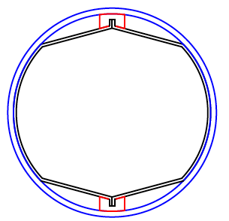
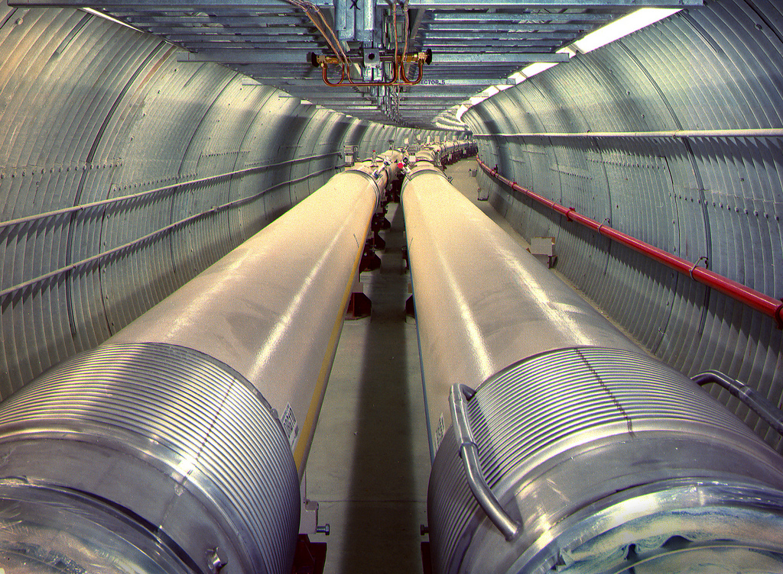
Vacuum Chamber Update
$⇒$Install amorphous-carbon coated copper screens into existing beam pipe
Cold-bore beam pipe - SS316LN, I.D. 69 mm
Screen - OFHE copper-clad austenitic stainless steel
- deposited 100 nm amorphous carbon layer
- cooled by contact to 4.55K cold bore
- perforations for vacuum pumping at cold bore
Still evolving!
Wedge
Challenges:
Design screen with minimal impact to aperture that can be installed through vacuum chamber of 10 m-long RHIC dipoles with large 45 mm sagitta.
Provide amorphous carbon film with good adherence, reduced coating time.
Ensure low impedance, adequate mechanical, vacuum and thermal stability.
Thanks to N. Kos, V. Baglin, P. Costa-Pinto, M. Taborelli, P. Chiggiato, L. Prever-Loiri, E. Todesco, G. Willering, I. Aviles-Santillana, A. Gallifa-Terricabras, O. Capatina (CERN), R. Zwaska, R. Ainsworth (FNAL) for useful discussions
POC: Silvia Verdú-Andrés

Slide 16
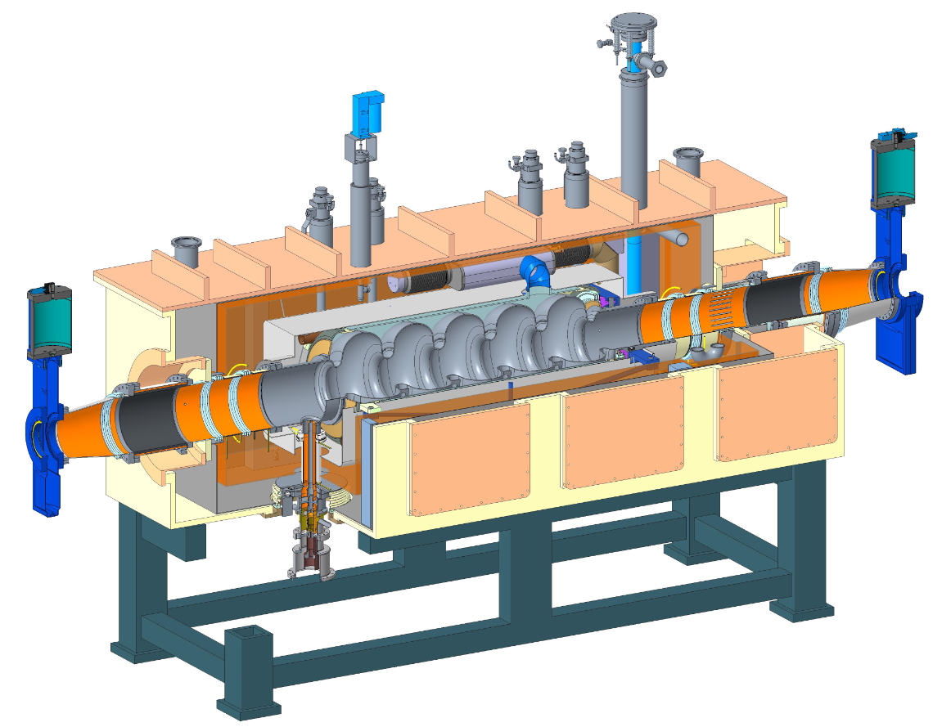
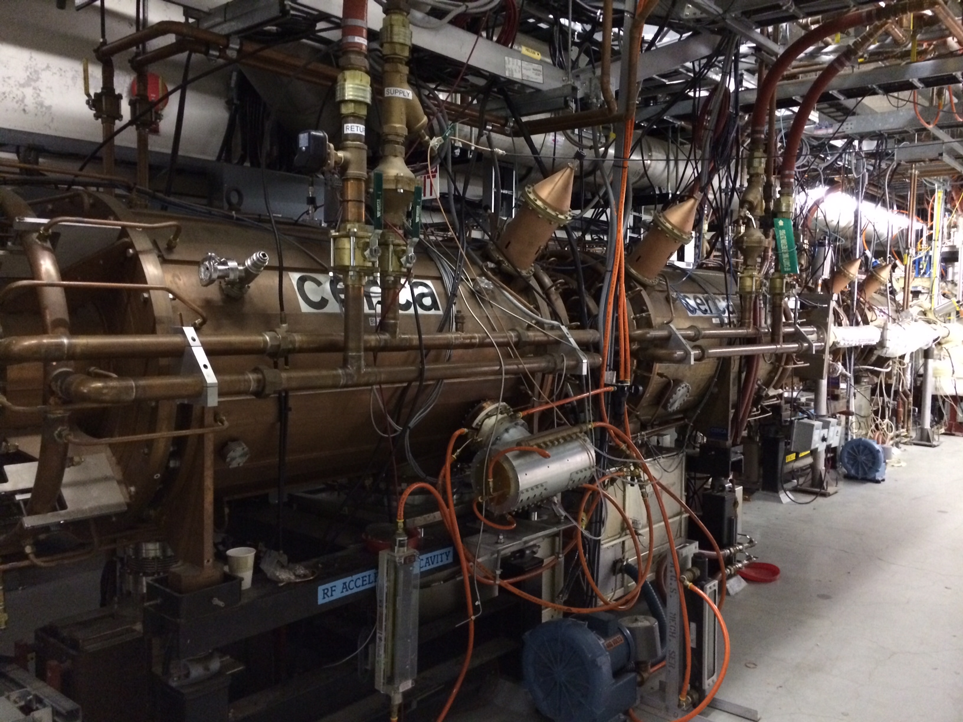
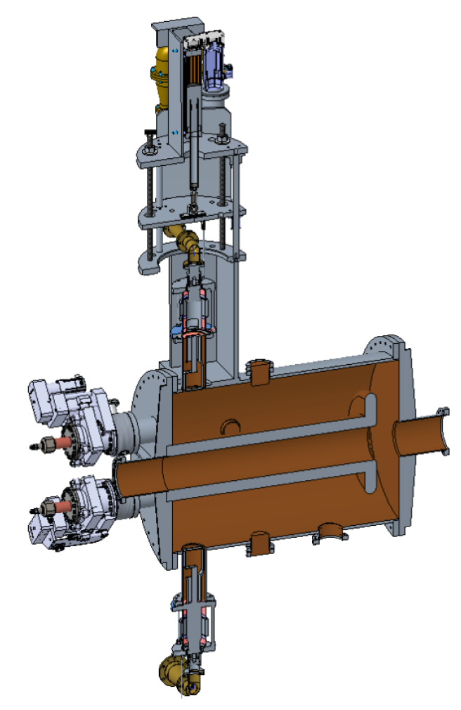
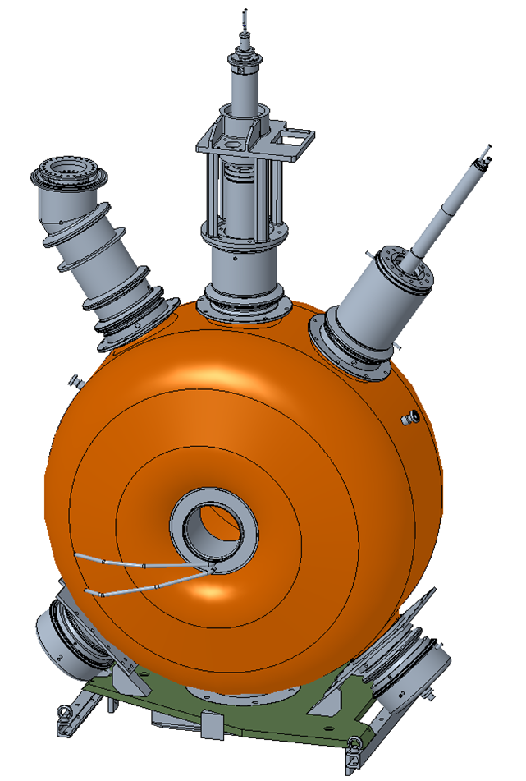
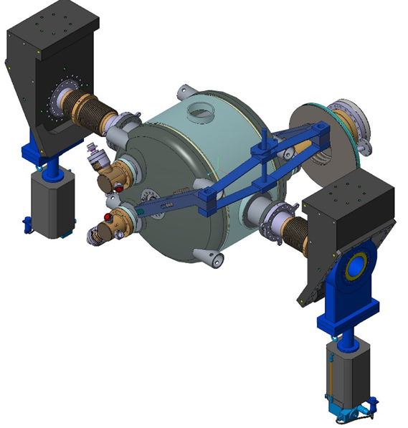
Hadron Ring RF Systems
NEW SYSTEMS
MODIFY/REUSE EXISTING SYSTEMS
Two 591 MHz SRF for bunch compression to 6 cm rms bunch length. Same as RCS and SHC ERL cavities.
Two 28 MHz NCRF cavities in Yellow ring tuned to 24.5 MHz. Power amplifiers will be reused.
49 MHz & 98 MHz NCRF cavities for two-step splitting of hadron bunches from 290 to 1160 after acceleration.
Twelve 197 MHz NCRF cavities from Blue and Yellow RHIC rings together with their power amplifiers, to increase total voltage.
  Eight 197 MHz and four 394 MHz SRF crabs for reestablishing head-on collision in 25 mrad x-angle. Several valid cavity types under consideration: DQW, RFD, WOW.
POC: Kevin Smith

Slide 17
Hadron Ring RF Systems
Notable challenges:
High currents (up to 1 A): HOM power, RF stability, heatingU
High bunch charge (up to 20e10 ppb): single bunch instabilities, wakefields, heating
High beam power: RF power, couplers, collimators; gap transients
Crabbing: high voltage, HOMs, linearity, synchronization, noise
Variety of filling patterns: abort gaps, filling, bunch splitting
Work in progress:
Beam loading transient and collective effects studies started; focus on understanding stability margins and mitigation efforts if needed.
Design of 197 MHz crab with improved HOM impedance
Evaluating RF power options
Starting to think about cavity production phase and facility requirements
POC: Kevin Smith

Slide 18
Summary and Overview
RHIC is a solid backbone to build upon the future EIC.
Eight key updates were identified, involving a broad variety of systems that require the implication of experts in multitude of disciplines.
There exist challenges and R&D opportunities, an ambitious project, as well as synergies with work for LHC, HL-LHC, LCLS-II and with accelerators currently under study: sufficient strong motivations to join forces.
“None of us is as smart as all of us”
Ken Blanchard
Let’s collaborate!

Slide 19
Acknowledgements
Thanks to the following colleagues for providing materials for this talk:
  Vadim Ptitsyn (EIC)
  Erdong Wang (EIC)
  Kevin Smith (EIC)
  Holger Witte (EIC)
  Medani Sangroula (EIC)
  David Gassner (EIC)
  Wolfram Fischer (EIC)
  Yun Luo (EIC)
  Thomas Roser (CAD)
  Robert Rimmer (JLab)
  Themis Mastoridis (UCLA San Luis Obispo)
…and to you for your attention!
Notes:
And let me show you already some collaborative people who contributed with materials for this talk.

Slide 20
BACK-UP SLIDES

Slide 21
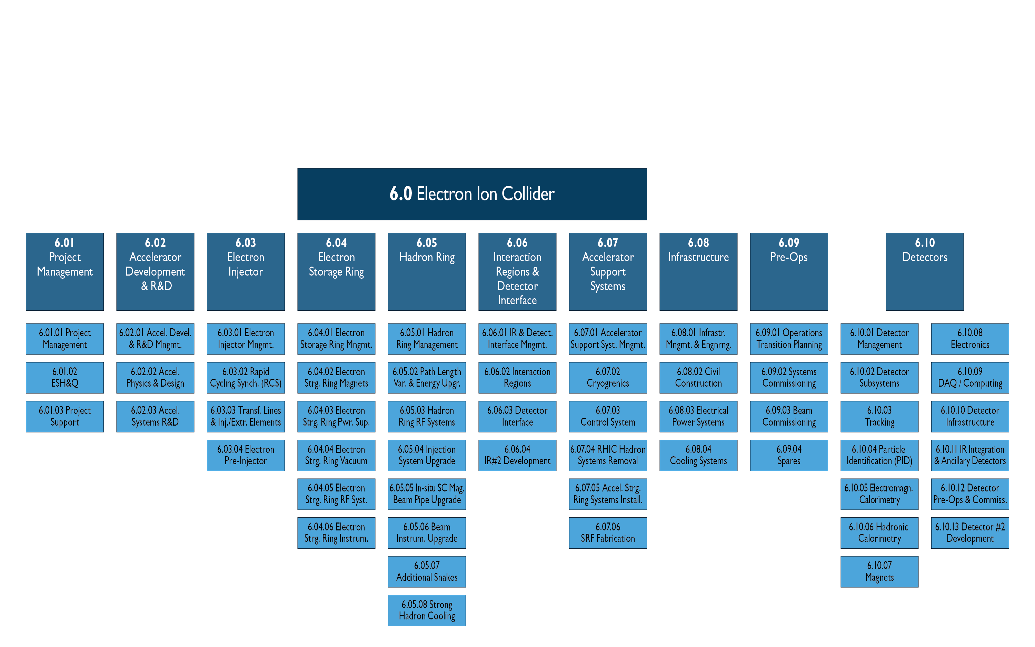
Scope
Courtesy of Vadim Ptitsyn

Slide 22
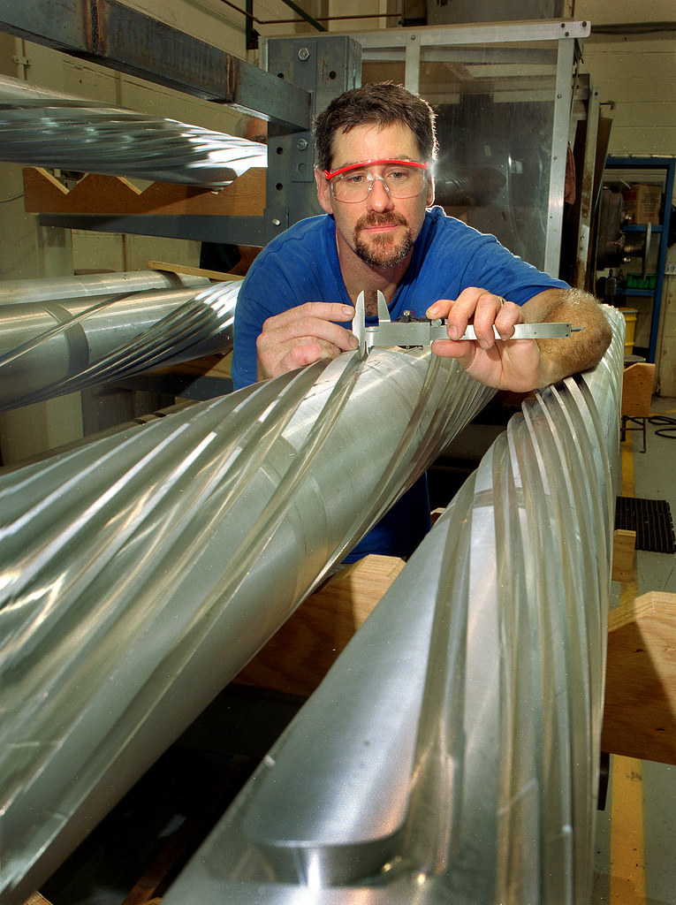
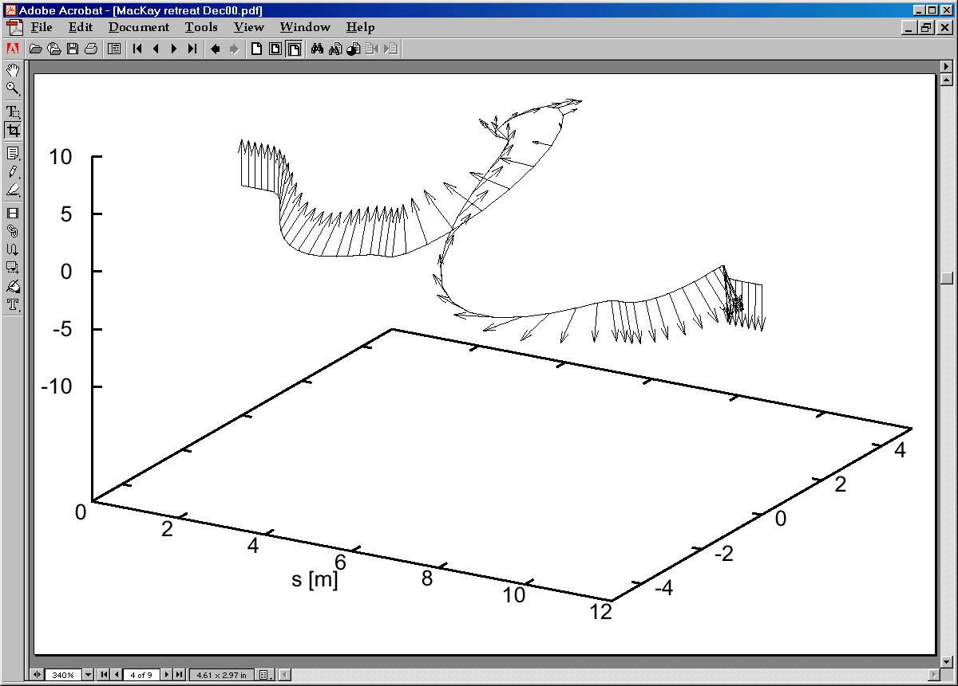
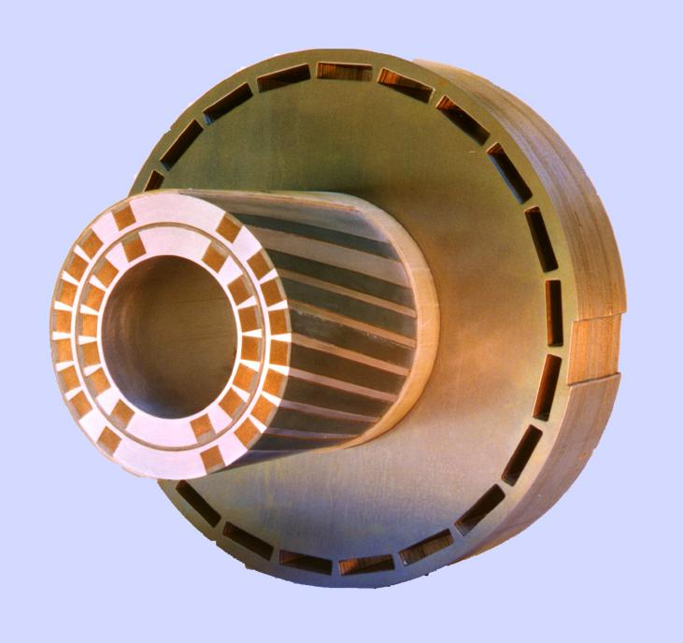
Siberian Snakes
Courtesy of Vadim Ptitsyn
RHIC Siberian Snakes: 4 SC helical dipoles, 4 T, each 2.4 m long and full 360° twist
Particle trajectory in the Snake
Particle and spin trajectories in the Snake

Slide 23
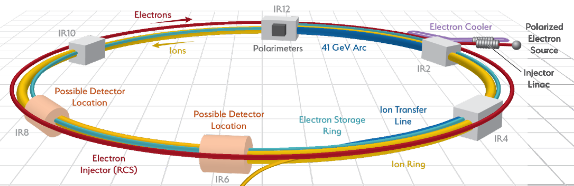
Overview of RF for EIC at BNL
RCS: Rapid Cycling Synchrotron
eSR: electron Storage Ring
400 MeV – 18 GeV Full Energy e- Injector
1 Hz Repetition Rate
100 ms ramp
28 nC per bunch
5 GeV – 18 GeV
2.5 A maximum beam current (10 GeV)
  1160 bunches, 28 nC per bunch
Up to 10 MW synchrotron radiation power
Up to 38 MeV loss per turn (18 GeV)
Strong Hadron Cooling
ERL, Single Pass Up/Down
150 MeV, 100 mA
IR Crab Cavities
Hadron Ring
25 mrad crossing angle
8x Hadron Crab Cavities
6x electron Crab Cavities
Up to 275 GeV Proton Store Energy
1 A maximum beam current
  1160 bunches, 11 nC per bunch

Slide 24
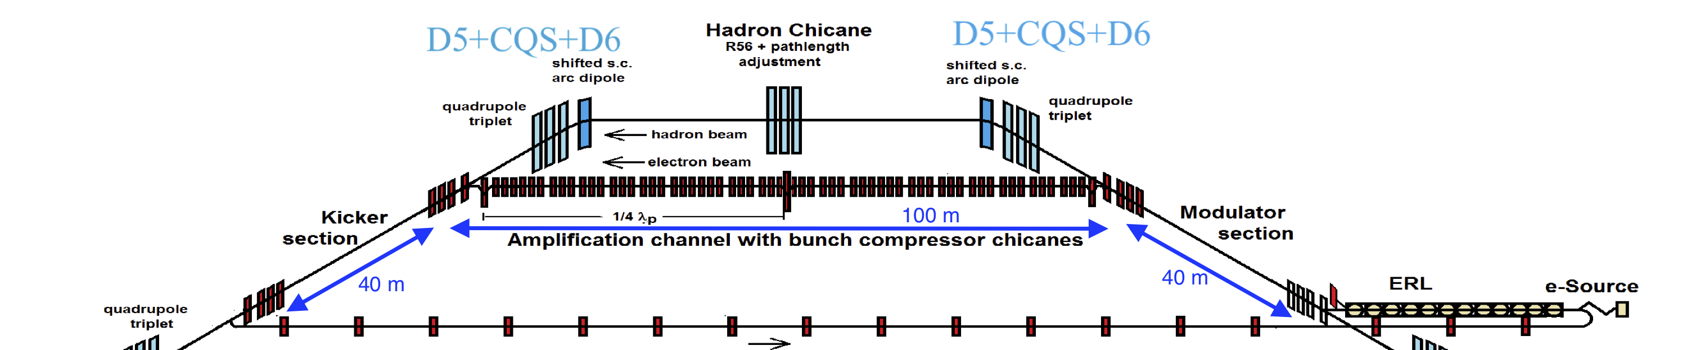
Strong Hadron Cooling for High Luminosity
Design based on Coherent Electron Cooling with Micro-bunched amplification
150 MeV electron accelerator utilizing: 120 mA injector, ERL consisting of five 591 MHz and three 1773 MHz SRF cavities; beam transfer lines, 2K cryogenics system for ERL.
Hadron chicane for pathlength and R56 adjustment using displaced SC dipole magnets at IR2 straight section.
Two-stage amplification section uses three chicanes and two λ_{p}/4 drifts
Modulator and kicker section common for both hadron and electron beams
POC: Erdong Wang

Slide 25
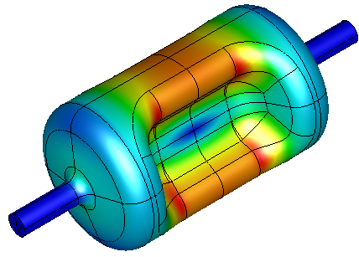
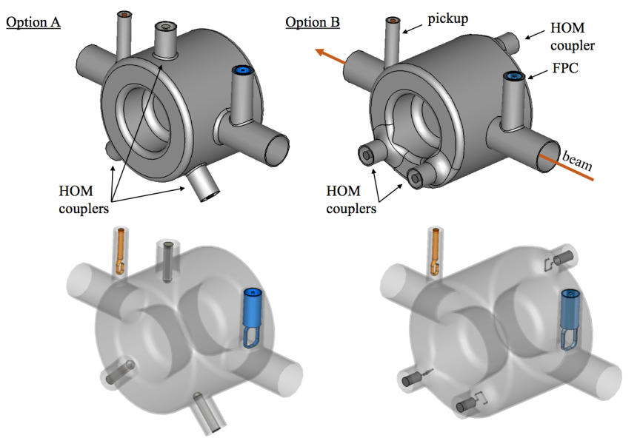
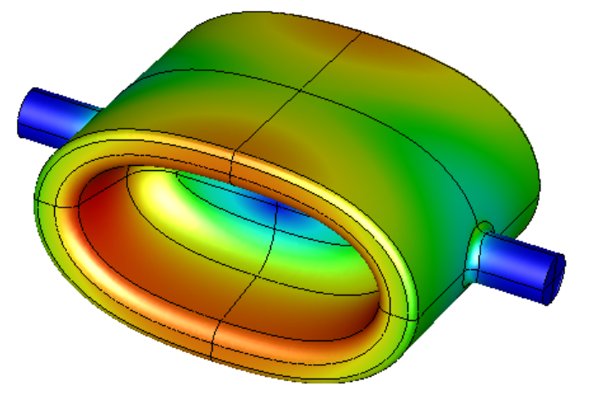
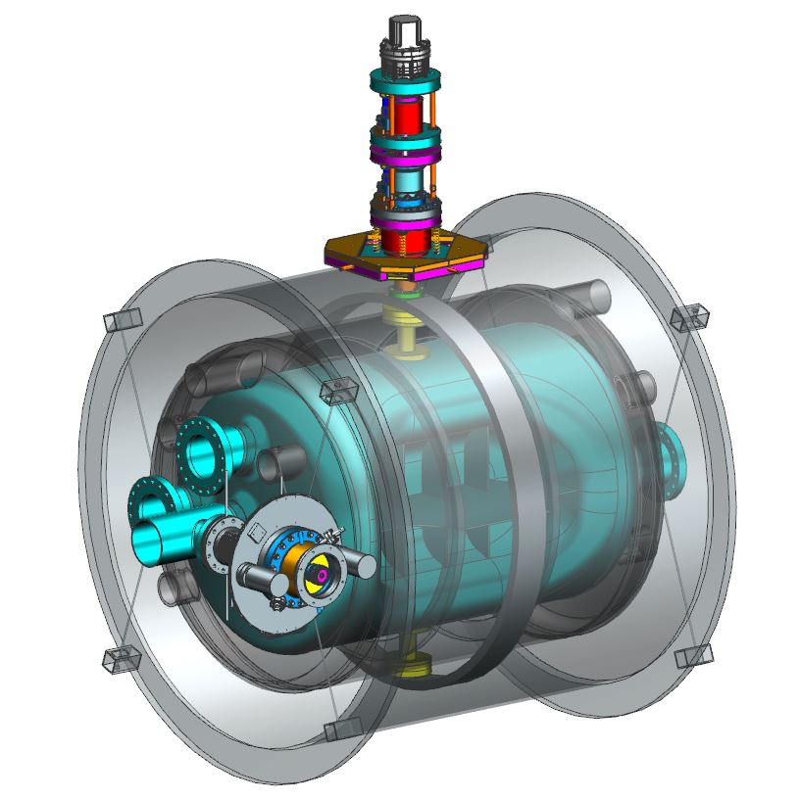
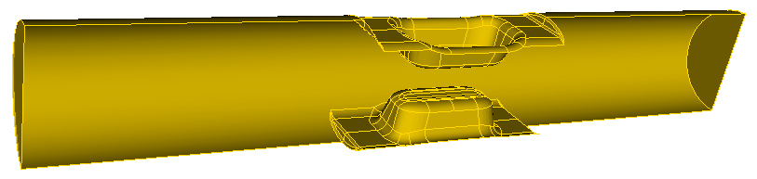
Crabbing Systems
Courtesy of Kevin Smith, Robert Rimmer
621
585
453
822
940
DQW 197 MHz crab cavity
“WOW” crab cavity
Courtesy: Zhenghai. Li
RFD 197 MHz crab cavity
DQW 394 MHz crab cavity
Courtesy: Suba Da Silva, HyeKyoung Park, Jean Delayen, ODU, Jim Henry Jlab.
Courtesy: Qiong Wu, Silvia Verdú-Andrés, Doug Holmes, Binping Xiao

Slide 26
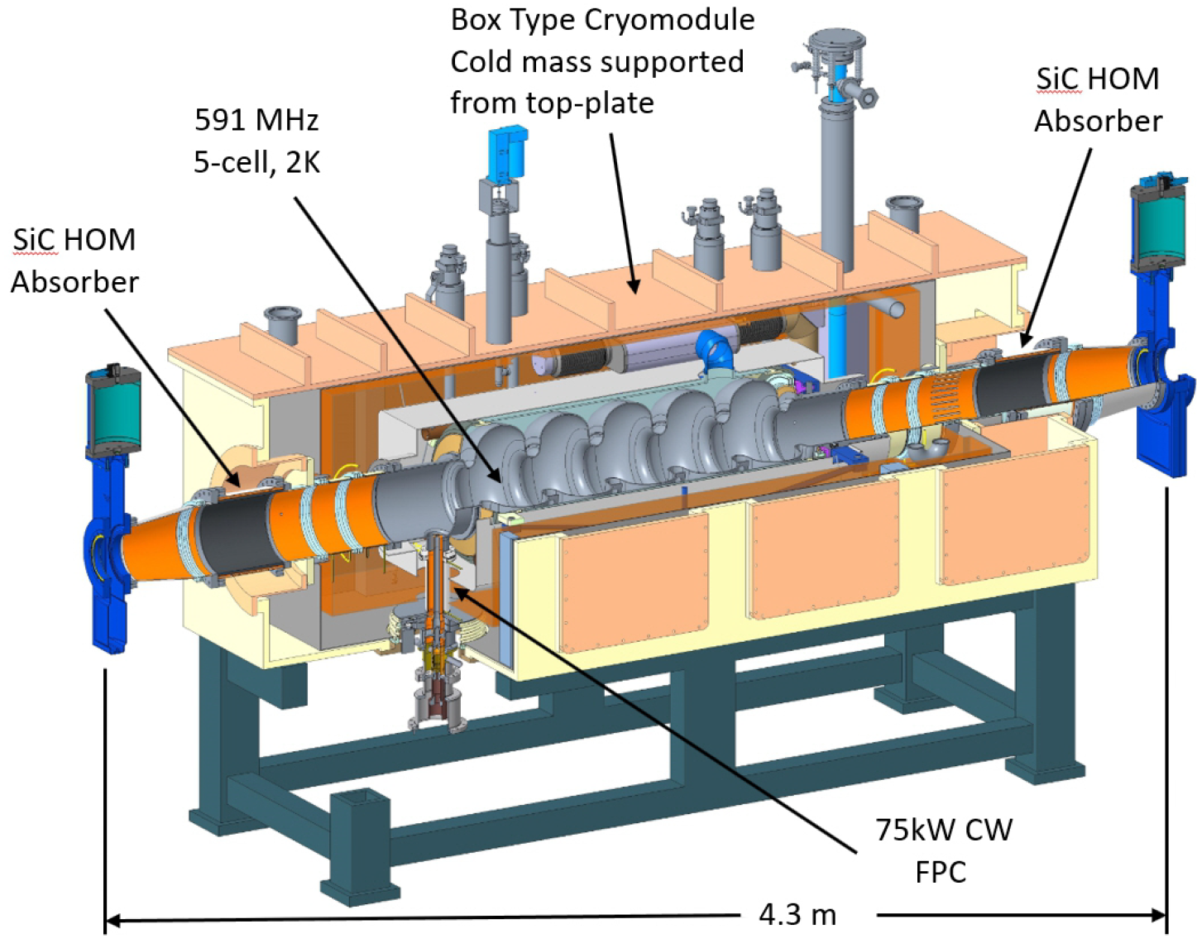
Strong Hadron Cooling RF System Parameters and Concept
Cryomodules
  9x 591 MHz, 5-cell elliptical, 2K (ERL)
  Single cavity per cryomodule
  Warm beamline SiC HOM absorbers
  Maximum 180 MV installed voltage
    E_{acc}: 15.8 MV/m
    E_{pk}: 35.8 MV/m
    B_{pk}: 69.7 mT
    P_{dyn}: 32 W
  Reusing the same design as the RCS 5-cell single cavity cryomodules.
RF Power Amplifiers
  9x 591 MHz, 65 kW CW, IOT
  Commercial transmitter units
Beam Parameters
  Single Pass 150 MeV ERL (1 up, 1 down)
    Maximizes beam breakup threshold current
  1 nC per bunch
  100 mA single pass current
    98.5 MHz bunch frequency
  HOM power well below the 20 kW per absorber rating.

Slide 27
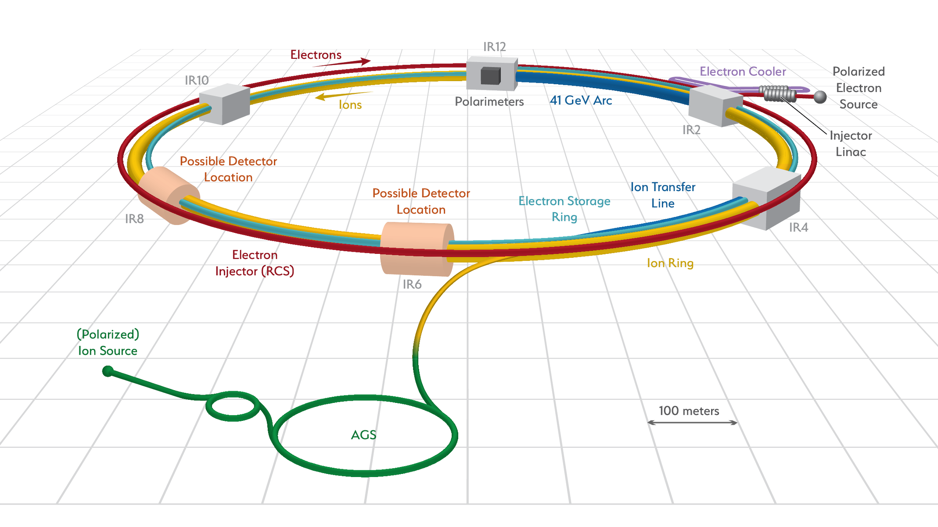
Hadron Ring
RF Systems
Hadron - 591 MHz bunch compression cavity
Hadron - 591 MHz strong hadron cooling
Both rings – 394 MHz
crab cavity
Hadron - 197 MHz bunch compression cavity
[Courtesy of R. Rimmer]
Hadron – 24.5 MHz acceleration cavity
Hadron – 49.2 MHz and 98.5 MHz bunch splitter cavity
POC: Kevin Smith

Slide 28
Hadron Ring RF Systems
New systems:
Two 591 MHz SRF used for bunch compression to 6cm rms bunch length. Same as RCS and SHC ERL cavities.
49 MHz and 98 MHz NCRF cavities for realizing two steps splitting of hadron bunches from 290 to 1160 after acceleration.
Eight 197 MHz and four 394 MHz SRF crabs for reestablishing head-on collision in 25 mrad x-angle. Several valid cavity types under consideration: DQW, RFD, WOW.
Modifications and reuse of existing systems:
197 MHz NCRF cavities from Blue and Yellow RHIC rings will be re-used in EIC hadron (Yellow) ring together with their power amplifiers, in order to increase the total voltage.
Total of 12 cavities.
Two 28 MHz NCRF cavities in Yellow ring will be modified to the 24.5 MHz frequency. Power amplifiers will be reused.
“WOW” crab cavity
[Zhenghai Li]
RFD 197 MHz crab cavity [Da Silva, Park, Delayen, Henry]
DQW 197 MHz crab cavity [Verdu-Andres, Xiao]
POC: Kevin Smith
Notes:
Last but no least, the RF systems.

Slide 29
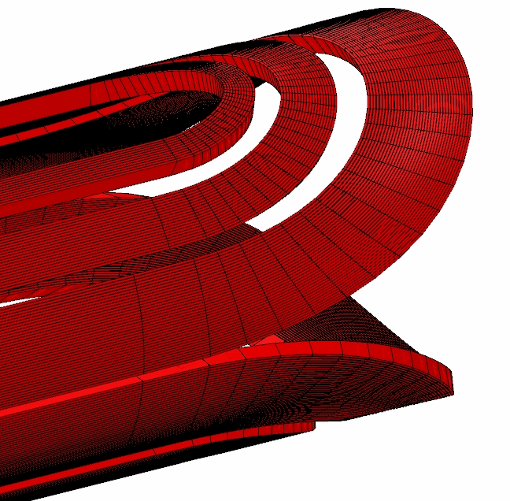
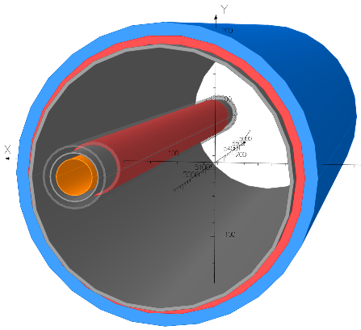

IR Magnets - Overview
Three groups of superconducting magnets
  All NbTi
(Also: normal conducting magnets, not addressed here)
9 Direct Wind Magnets
(S-MD)
6 Collared Magnets
1 Special Magnet
Courtesy of Holger Witte

Slide 30
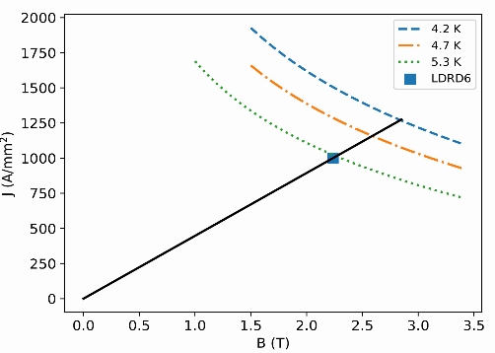
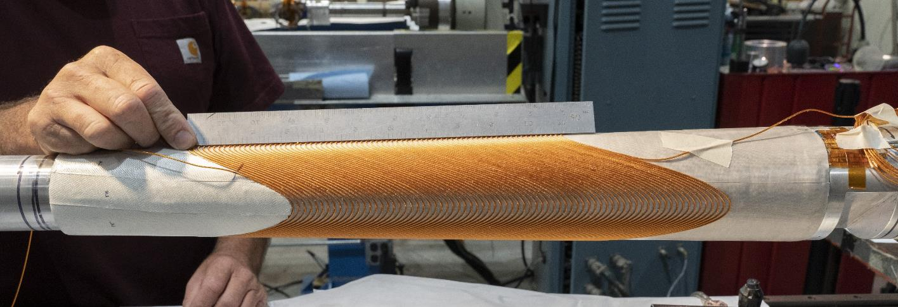
Tapered Double Helix Magnet
Demonstrator presently under construction
4 layer coil
  Aperture: 60..80mm
  L=0.4m
Compatible with direct wind process
H. Witte et al. http://dx.doi.org/10.1109/TASC.2019.2902982
40 T/m
Courtesy of Holger Witte

