Slide 1
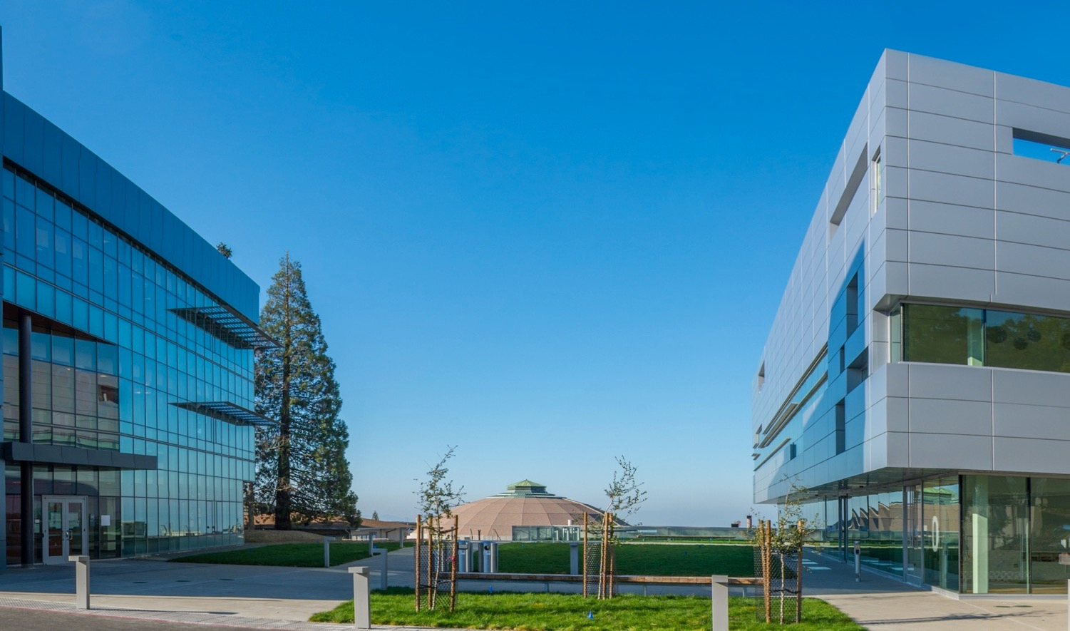
Berkeley Accelerator Controls and Instrumentation (BACI) Center for the Electron-Ion Collider
Derun Li
EIC Workshop – Promoting Collaboration on the Electron-Ion Collider
October 7, 2020

Slide 2
Outline
Introduction of Berkeley Lab’s BACI Center;
BACI’s capabilities and past contributions to accelerator projects;
HiRES and BEG optical laser lab
Current R&D activities and efforts relevant to EIC, and potential collaboration opportunities
Summary

Slide 3
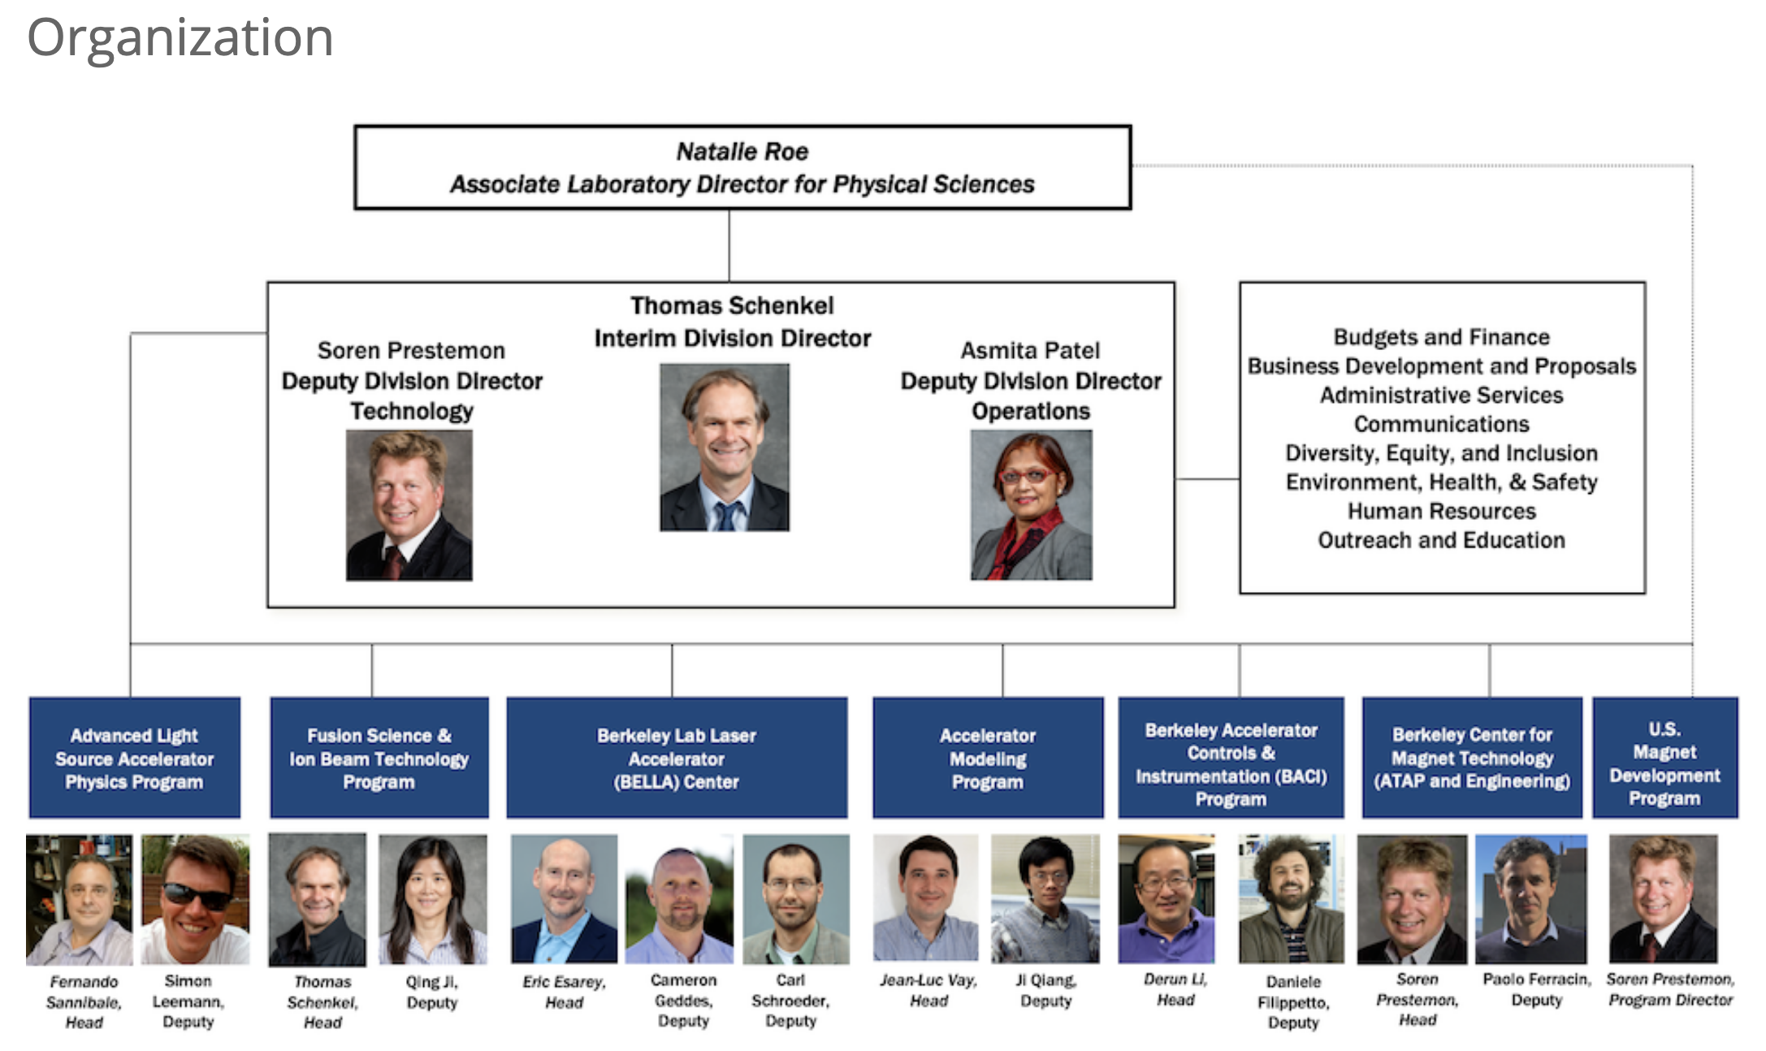
Introduction to Berkeley Accelerator Controls and
Instrumentation (BACI) Center
BACI is in Accelerator Technology and Applied Physics (ATAP) Division,
supported by the US DOE HEP GARD program.

Slide 4
Research activities and expertise at BACI Center
BACI (formed in 2017, spin-off from CBP), a world-leading center in innovative RF structure design and advanced digital RF controls, enabled by decades of investment under the US DOE. BACI has made significant contributions to the accelerator R&D and facilities worldwide.
BACI’s unique skill set (and team) and world-leading capabilities allow for new opportunities & potential contributions to EIC.
BACI has maintained clear competitive advantages in three areas:
  Advanced RF Design and Engineering
    CW Normal conducting cavities and RF structures
    Beam impedance modeling and measurement
  Ultrahigh Precision Controls
    RF controls and femtosecond synchronization
    Controls for complex systems
  High Dynamic Range Beam Instrumentation
    Beam orbit feedback systems and beam loss measurement and control
    Femtosecond electron beams

Slide 5
Our RF Capabilities
RF design and construction capabilities
  EM structure designs (general) and advanced RF MOGA design
    RF cavities, kickers, crabbing cavities, BPMs and linear accelerators
  Engineering , mechanical design, fabrication, assembly and system integration (long-term partnership with Berkeley Lab’s Engineering Division)
    Thermal and stress analyses (FEA)
  Numerical modeling and simulations
    Impedance and wakefield in accelerators
    HOM damping
    RF coupler design
  Low power RF measurements
  High power RF measurements and testing (APEX and ALS)
  RFQ accelerators
    Beam dynamics design
  Decades of successful collaboration on accelerator projects domestically and internationally.

Slide 6
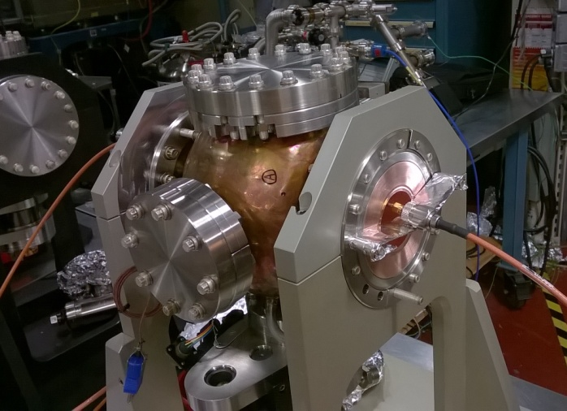
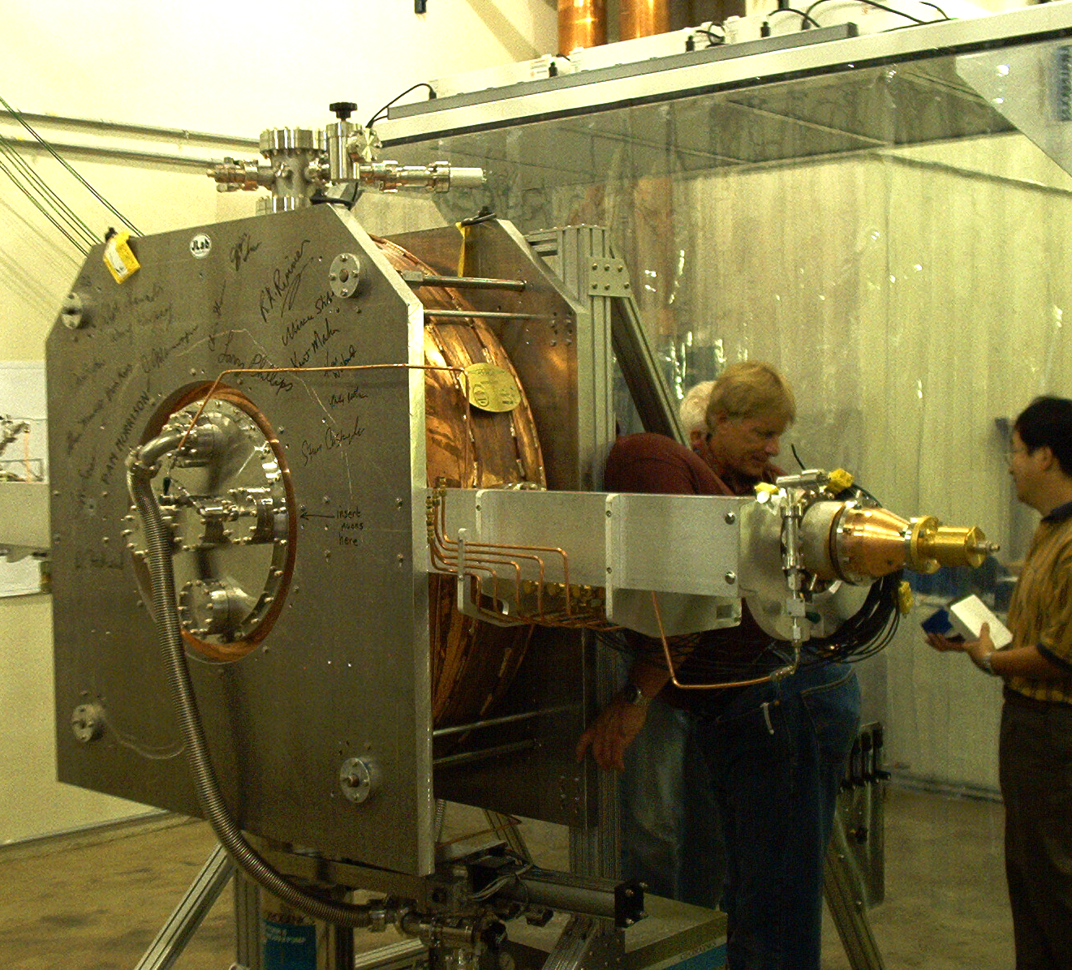
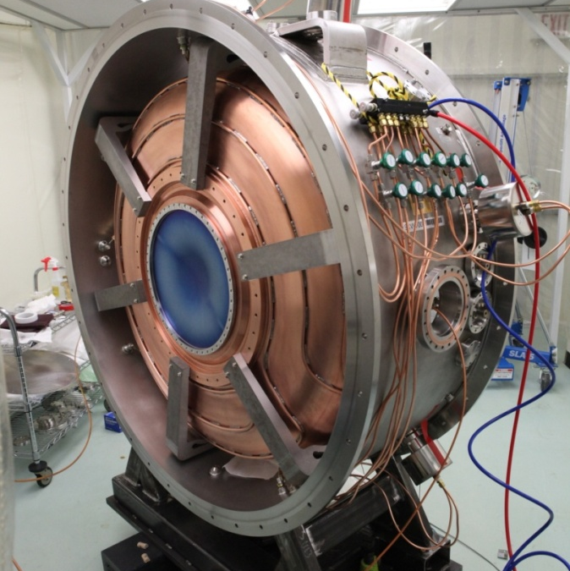
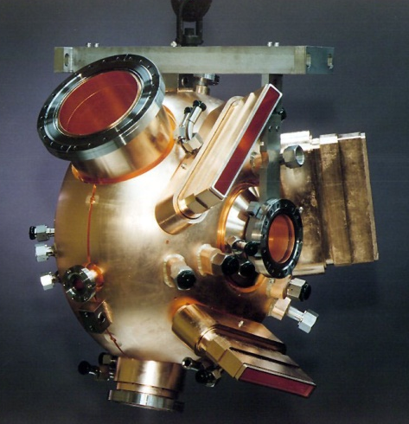
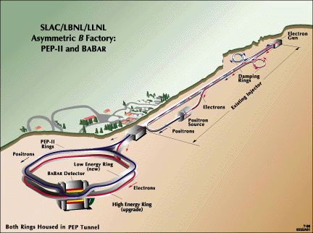
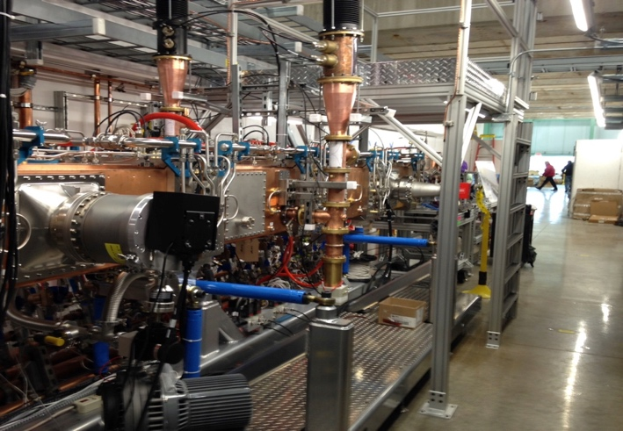
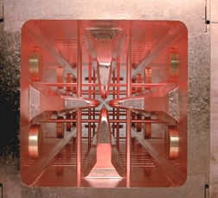
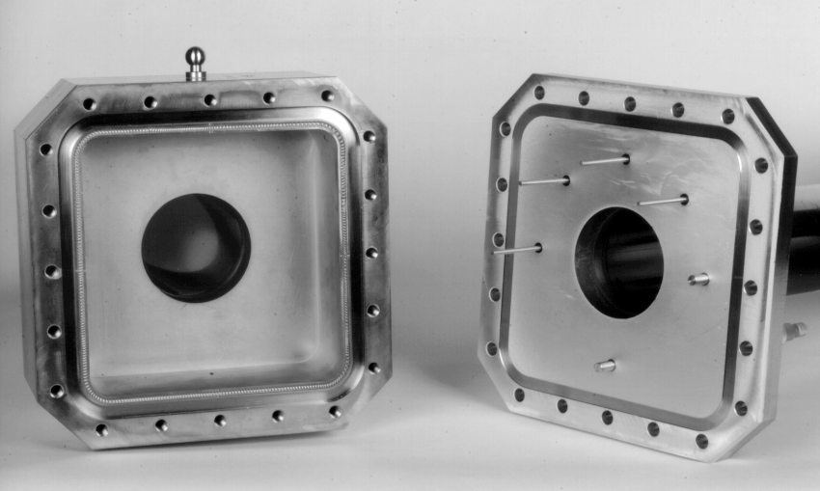
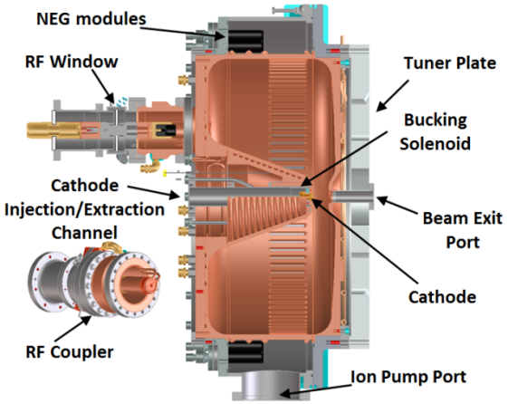

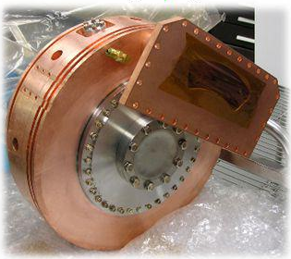
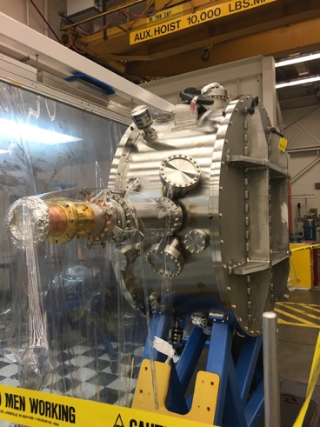

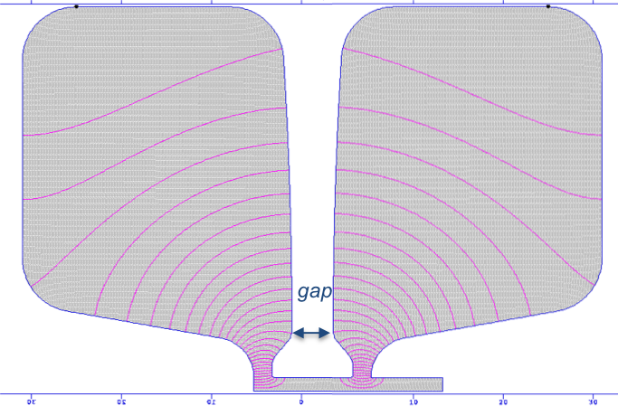

BACI’s RF design, engineering, fabrication and system integration serve DOE’s accelerator projects in HEP, BES and NP
PEP-II HOM
Damped Cavity
The 3rd harmonic
cavity at ALS
2020
LCLS-II Injector (Gun & buncher)
MUCOOL 805 &
201 MHz Cavity
at Fermilab
SLAC
2010
Schottky cavity for RHIC
2005
162.5 MHz CW RFQ for PIP-II
2000
MICE RF module
SNS RFQ and
Front-end system
1995
APEX 186 MHz CW Gun Cavity
at ALS, LBNL
APEX2 (RF design)

Slide 7
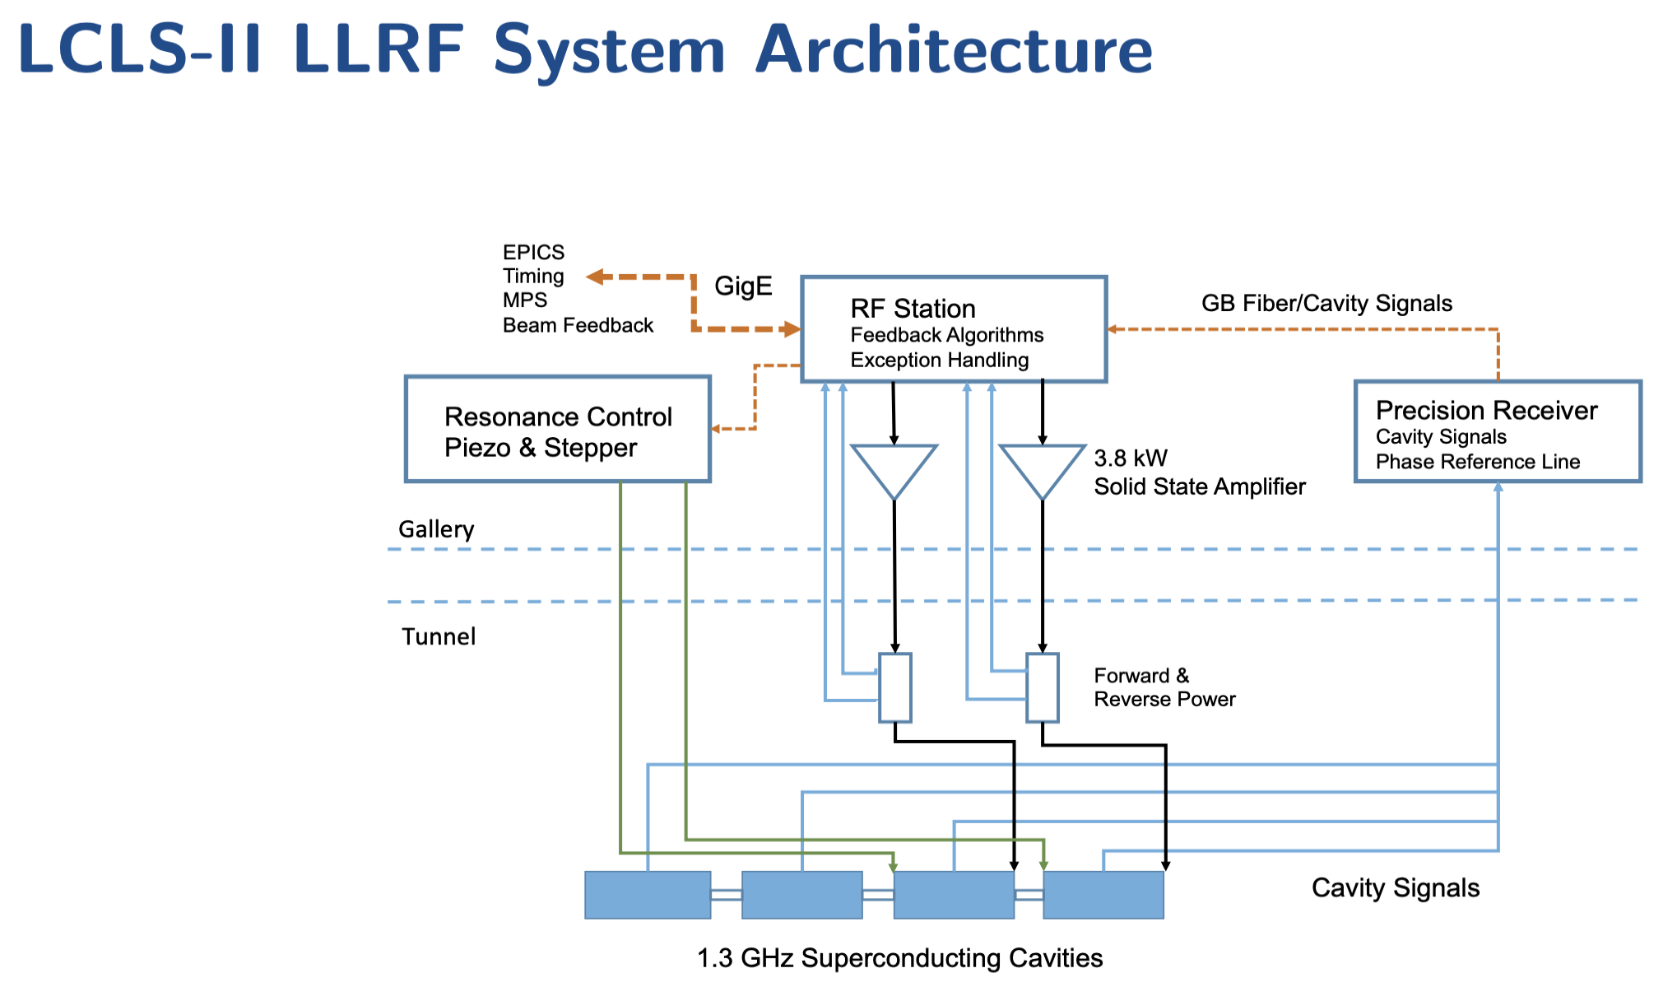
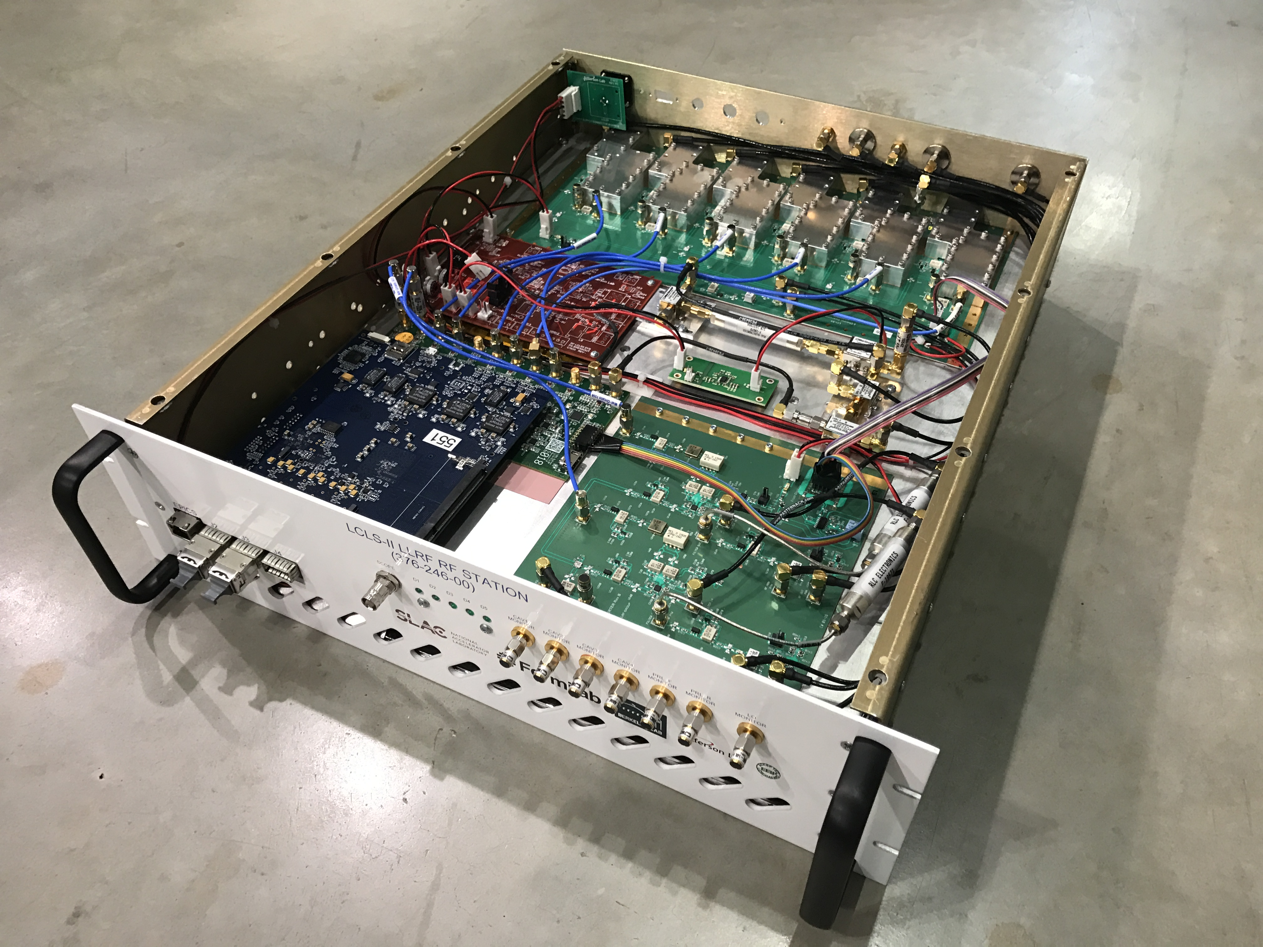
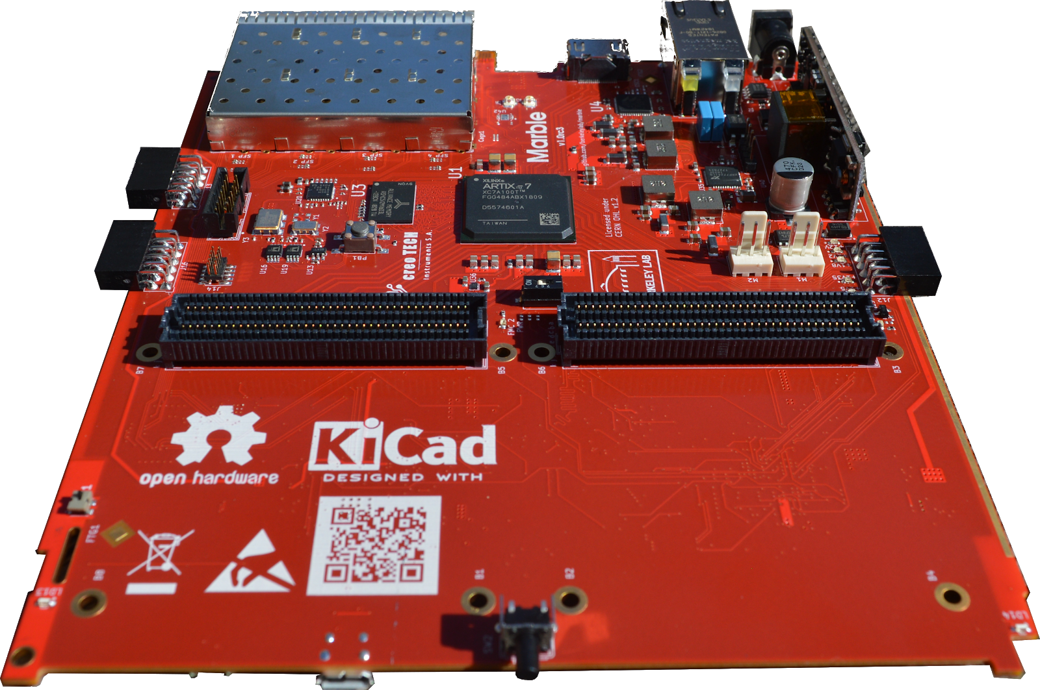
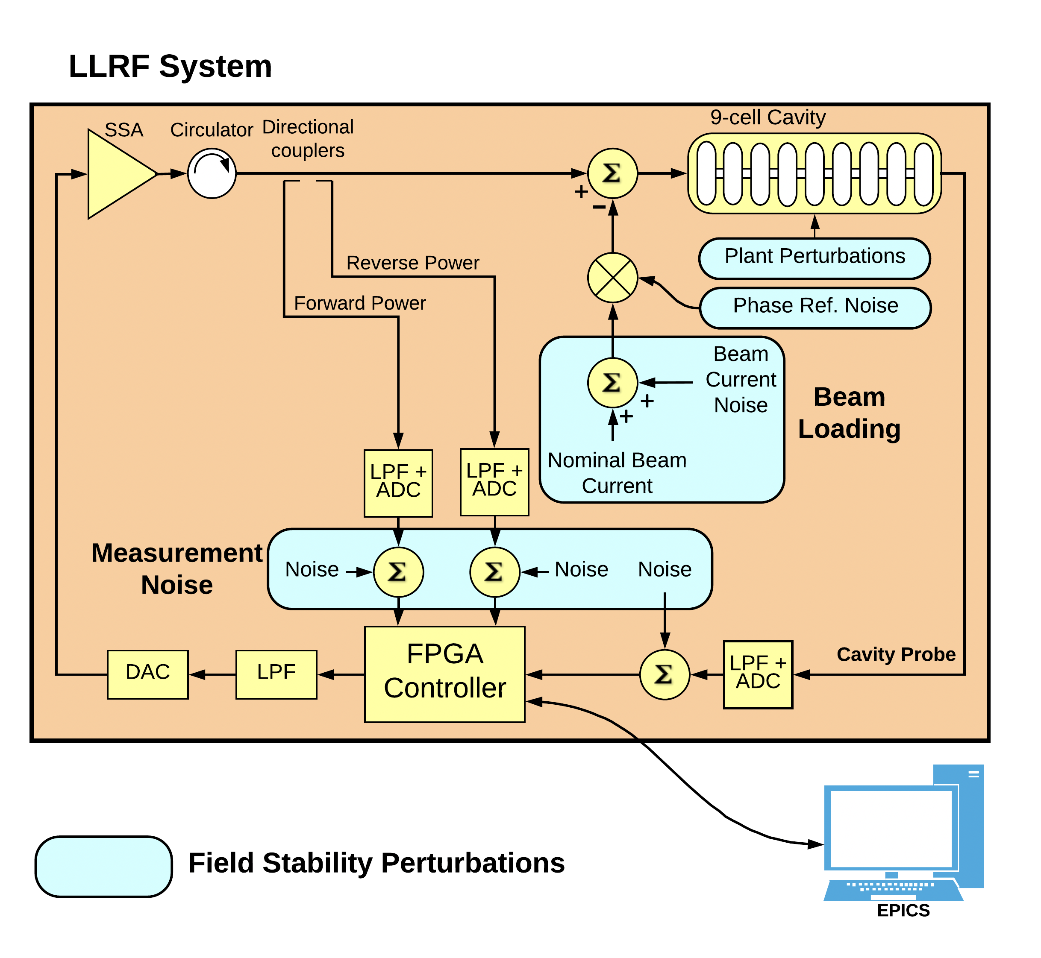
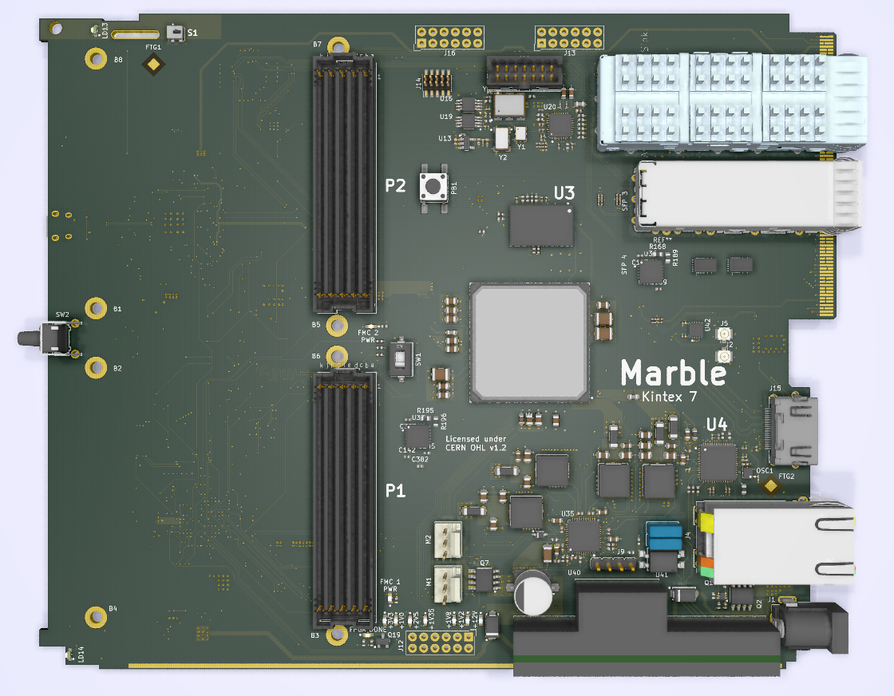
Our Ultrahigh Precision Control Capabilities
Courtesy of Dr. C. Serrano
We’ve collaborated on many projects
  PIP-II project;
  LCLS-II;
  LCLS-I;
  Fermi@Elettra;
  ALS and ALS-U;
  APEX HiRES UED beamline;
  Bella Center;
  APS;
  SNS;
  AWA at ANL, …
We continue developing open source hardware (LLRF boards) and BIDS system;
We apply the precision control techniques to fiber-based laser technology for high average power and quantum qubits controls;
We are ready to collaborate on EIC.
LCLS-II chassis
Development of new
LLRF board: Marble

Slide 8
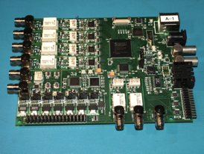
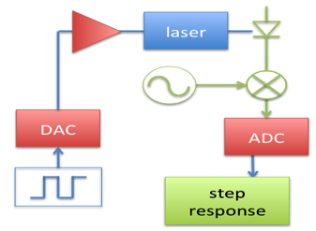
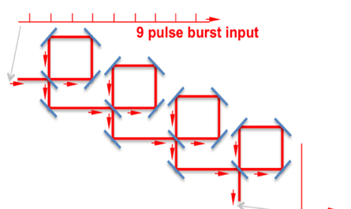

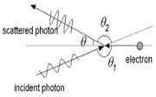
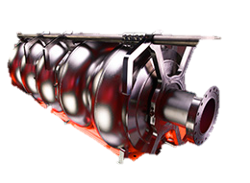
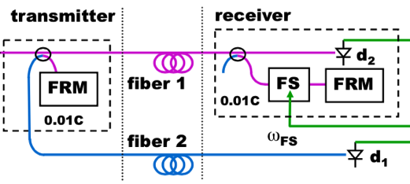


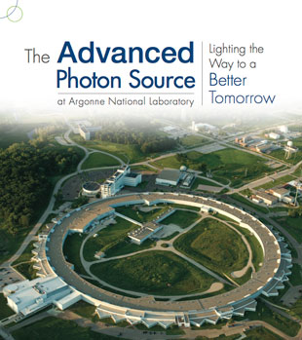
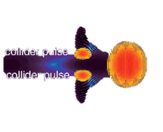
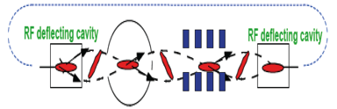

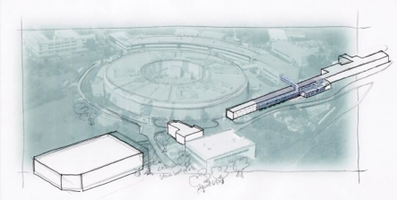

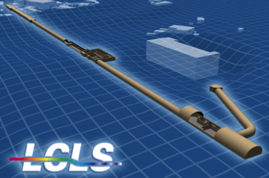
BACI has world-leading technology in FPGA-based RF control and timing and serves accelerator projects
QUBITS
Coherent Combination
EIC
2020
2015
Next-gen atto-second timing
Tsinghua XGLS
Precision Digital Control
Stabilized MLOs
2014
SSRC
2010
LCLS-II Injector
HiRES
2008
Stabilized Fiber Links
2007
Controlled LPA injection
Optical
Timing
Lab (orig.
BEG Lab)
founded
KHz
2004
Over a decade of innovation in precision control & timing technology and application under the US DOE support.

Slide 9
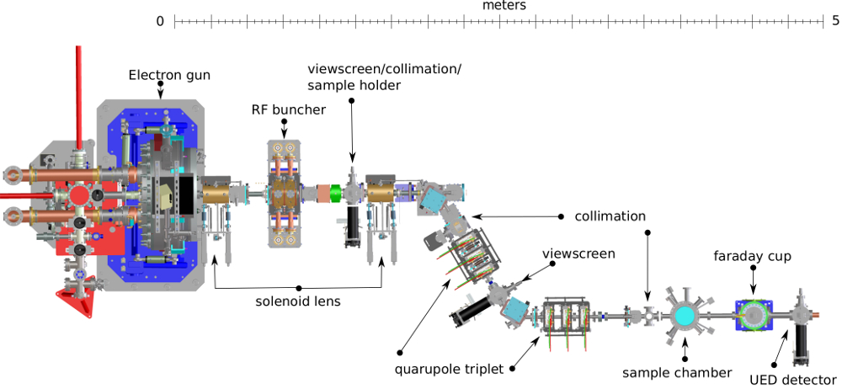
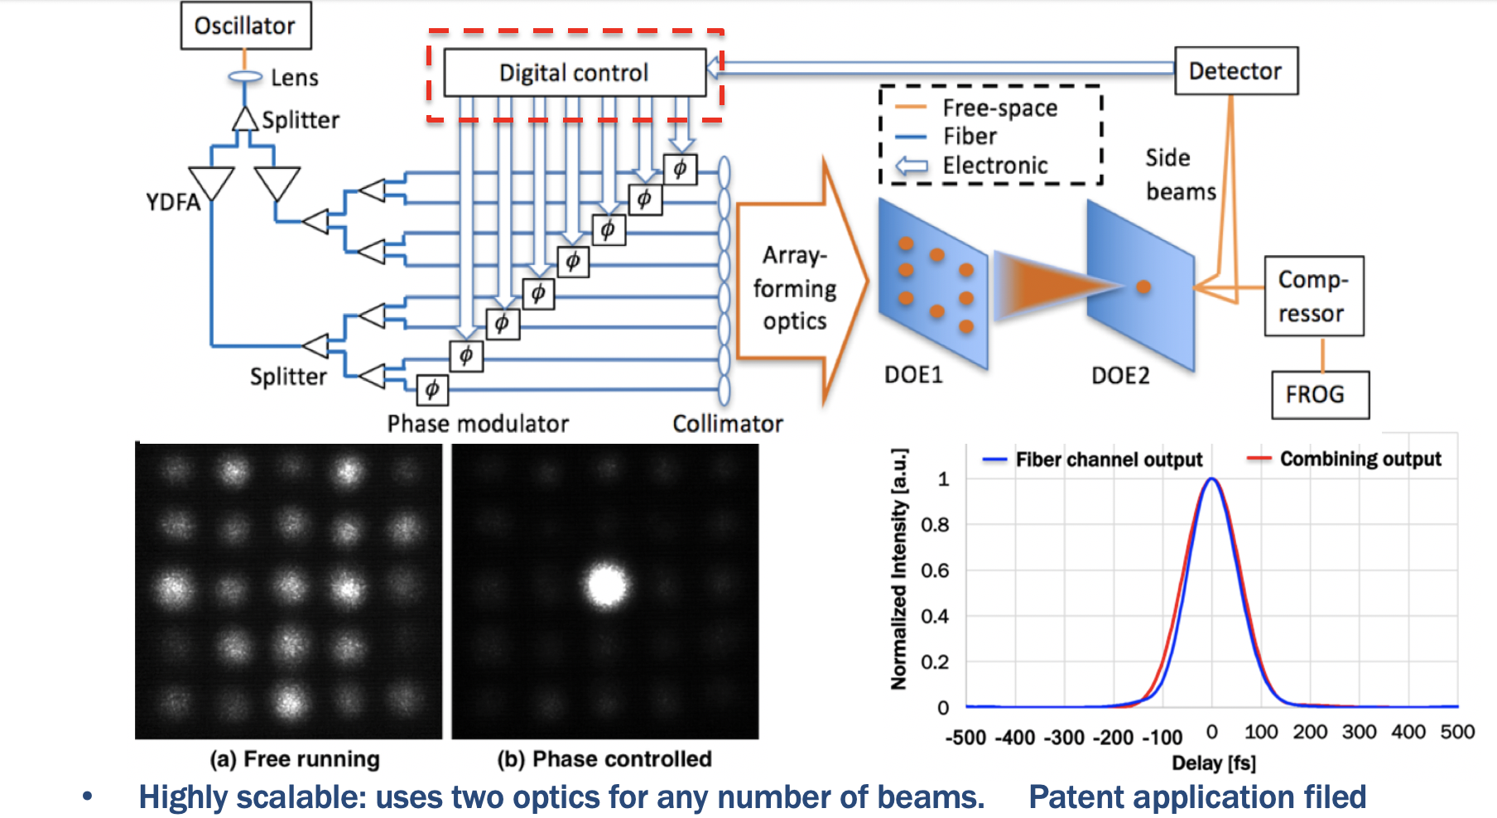
BACI is the home of HiRES UED beamline and fiber-based high average laser technology development (BEG lab)
HiRES and BEG optical lab are ideal test-beds for the development of advanced precision RF controls, timing and synchronization, and electron beam diagnostics;
We are applying ML (machine learning) algorithm/techniques to further improving the performance of the HiRES beamline and coherent laser combination techniques;
High gradient RF and cathode studies.
Berkeley Lab’s HiRES beamline for UED experiments using NC CW APEX electron gun;
2nd APEX-like gun was designed & built for
LCLS-II as the current injector.
Experimental results at BEG Lab for 8, 120 fs
pulses spatially combined, optical scheme with
advanced digital controls.

Slide 10
Current R&D relevant to EIC, and potential collaboration opportunities
Front-end system, ion sources and RFQ
  Five pulsed RFQs and one CW RFQ for PIP-II
Advanced RF structure design and impedance
  Development of advanced MOGA RF design (2D) and application to the spare RF gun design of LCLS-II injector and HHC design for the ALS-U
  ALS-U stripline kicker design
  High brightness electron source APEX2 (2-cell) gun design for LCLS-II HE
  Broad-band impedance studies of ALS-U.
Testbeds for development of high precision FPGA-based RF controls systems, diagnostics and ML (machine learning)
  HiRES UED & cathode studies;
  High average power laser system.

Slide 11
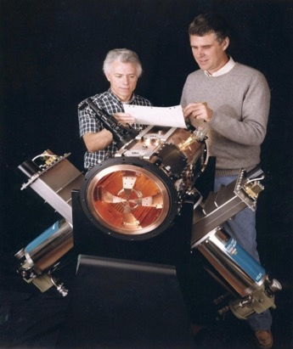
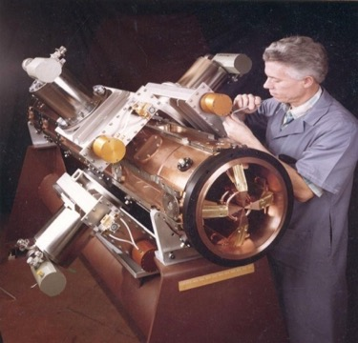
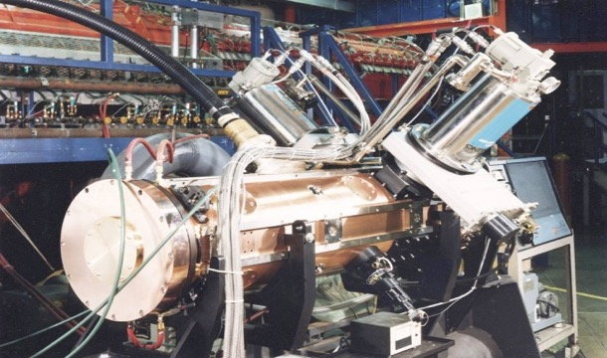
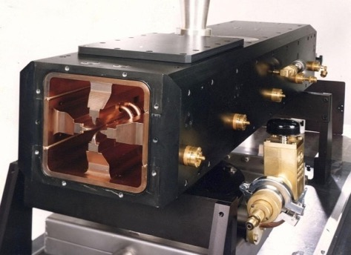
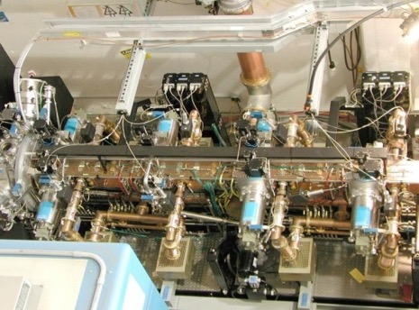
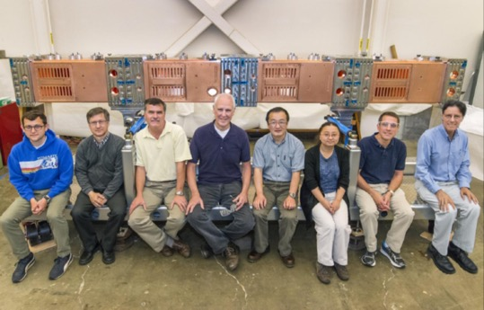
We have designed & built six RFQs, they all work !
LBNL has designed and built six RFQs
RFQ1 - Bevatron
RFQ2 – CERN
RFQ3 – BNL Injector
RFQ4 – LBNL Proton
RFQ5 - SNS
RFQ6 (CW) – FNAL PIP-II RFQ

Slide 12
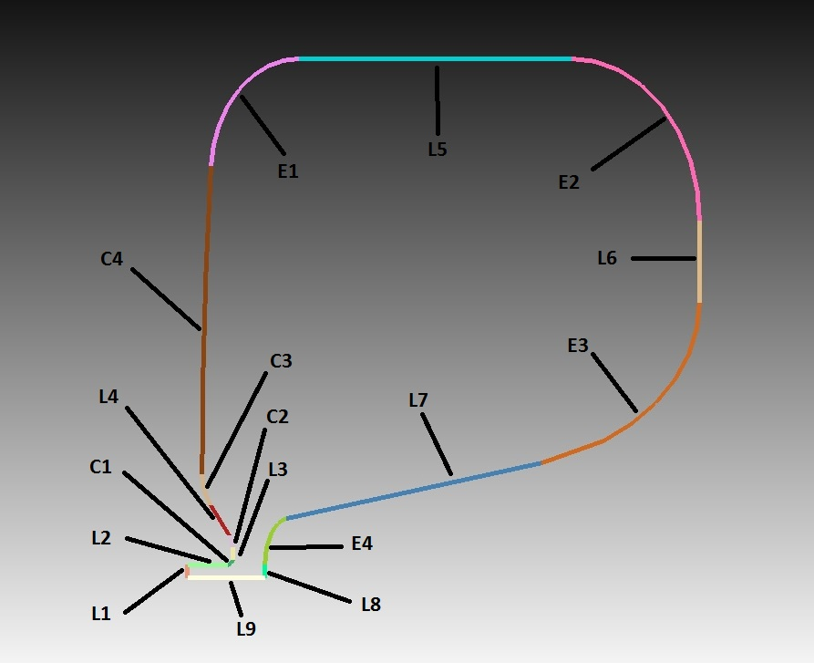
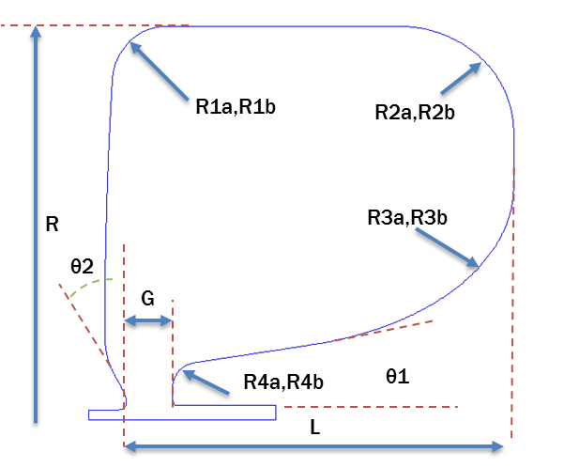
Development of RF MOGA design technique (supported also by Berkeley Lab’s LDRD) for cavity geometry
Multi-Objective Genetic Algorithm (MOGA) for the cavity geometry design:
  Parameterize cavity geometry description and solve the cavity RF field by SUPERFISH.
  Optimize the cavity geometry by Non-dominant Sorting Genetic Algorithm II (NSGA-II).
  Implement parallel computing through Message Passage Interface (MPI).
APEX2 cavities are described by 21 geometric parameters. 2D SUPERFISH models consist of straight lines, circular arcs and elliptical arcs. A flexible geometry description is one key to achieve a good cavity design.
Courtesy of Dr. Dan Wang
Major geometric parameters
12

Slide 13
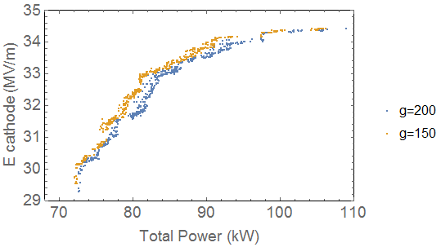
Cavity geometry design with MOGA
Cavities design goals and requirements are defined as “objectives” and “constraints” in NSGA-II to steer the direction of “evolution” in GA. Most of the optimizations were carried out with 720 populations. Good convergence were achieved after 200 generations.
An example of Pareto front evolution in MOGA for APEX2 (upgraded version of APEX with 2-cell for higher energy and lower emittance) gun cell design (2D SUPERFISH)
The technique can be applied to the design of any 2D cylindrical RF structures.
13

Slide 14
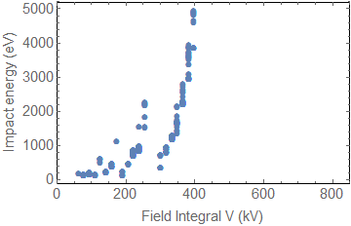
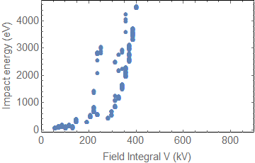
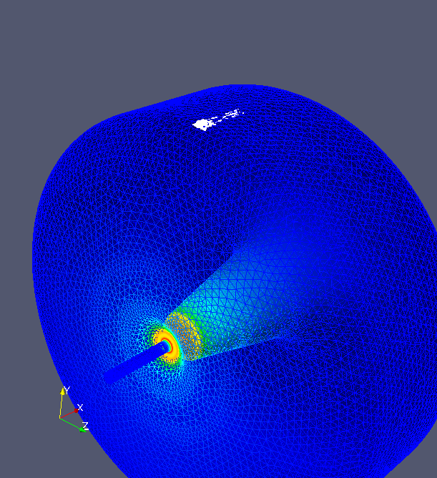
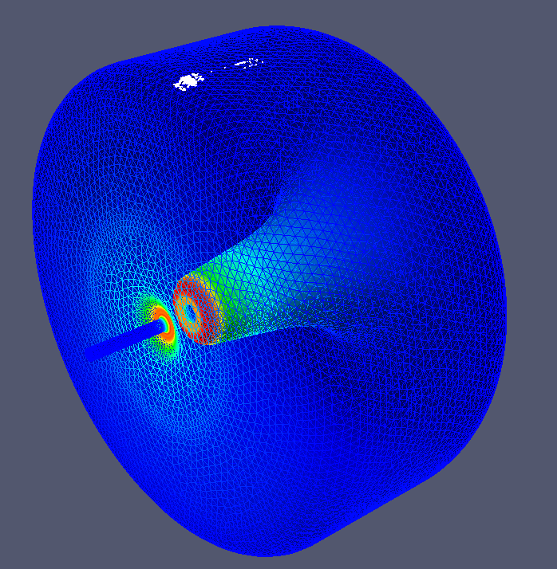
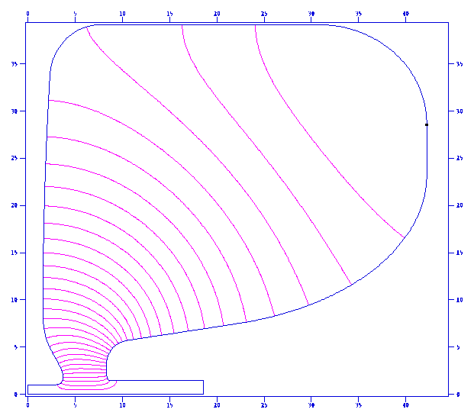
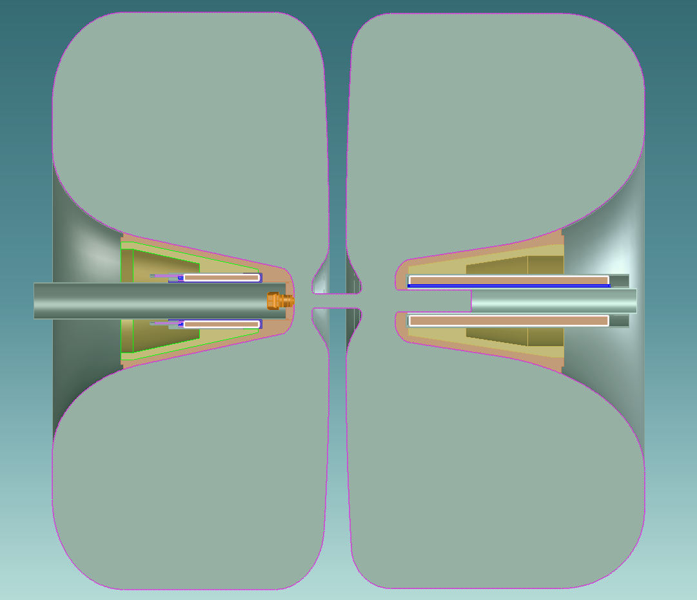
Complete RF Design of APEX2, comparison with APEX
(need 3D modeling to include vacuum slots, RF coupler, … )
Further optimized cell geometries (2D): elliptical curves to further reduce peak surface field and peak power density;
Iterations with beam dynamics and engineering designs;
Multipacting simulation studies
Multipacting studies
Gun cell
2nd cell
Parameters | Gun cell | 2nd cell | APEX
Frequency (MHz) | 162.5 | 162.5 | 185.7
Cavity inner radius R (cm) | 39.3 | 39.1 | 36.0
Cavity length L (cm) | 38.7 | 36.0 | 35.0
Accelerating Gap (cm) | 2.5 | 4.6 | 4.0
Beam Iris r (cm) | 1.0 | 1.0 - 1.5 | 1.5
Operation mode | CW | CW | CW
Gradient at cathode (MV/m) | 34 (30) | N/A | 19.5
Energy gain V (kV) | 820 (724) | 820 | 750
E_{max} (MV/m) | 37.0 (33) | 24.7 | 24.0
Power (kW) | 90.7 (70.6) | 85.4 | 88.5
Max. power density (w/cm²) | 32.1 (25) | 29.8 | 22.8
Gun cell
2nd cell
Bucking
solenoid
Cathode
Long narrow
solenoid

Slide 15
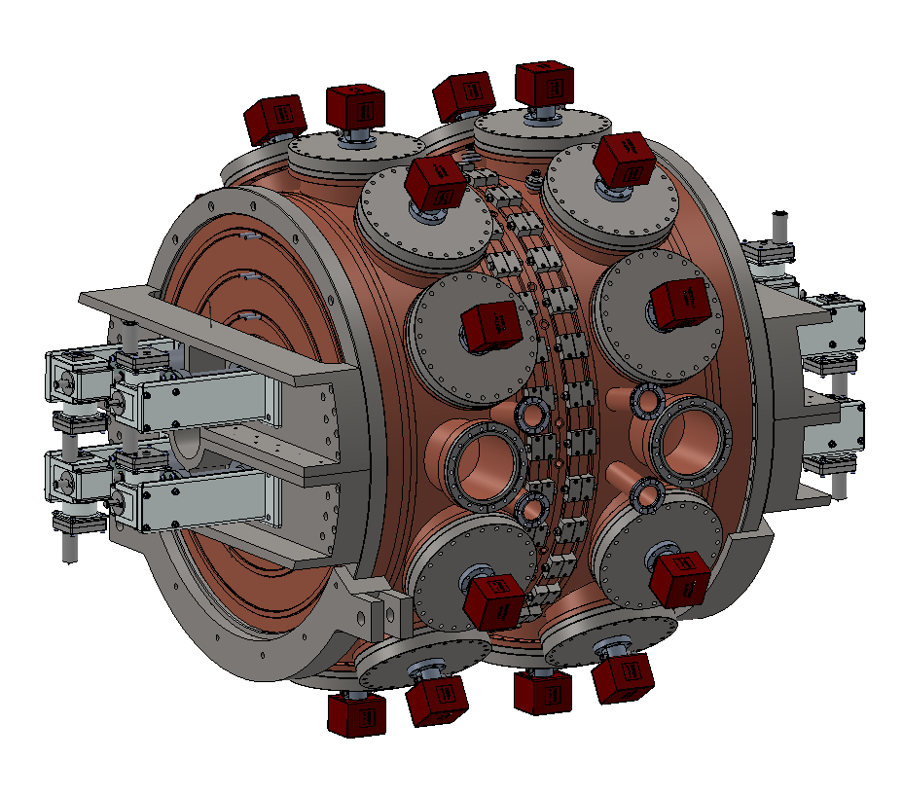
Mechanical design of APEX2 with all the features included and studied by FEA
Vacuum ports and pumps (10 per cell)
Cell-2 end-plate
Tuners
APEX2 (using LCLS-II injector layout) provides very good beam dynamics performance
over wide range of RF gradient at the cathode (20 MV/m up to 37 MV/m)
2 vacuum
mea. ports
2 RF probes
Gun cell end-plate
center wall
RF coupler port (x2)

Slide 16
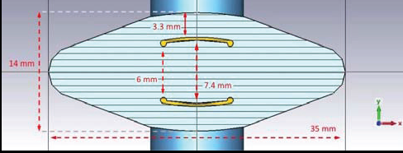
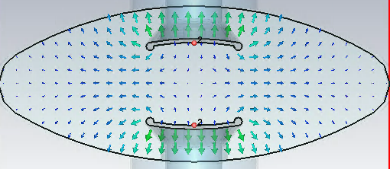



Development of fast stripline kicker for the ALS-U
(Pulser rise/fall time ~ 7 ns), a seminar has been scheduled late-Oct at BNL
ALS
Test kicker has to satisfy ALS horizontal aperture requirements;
ALS-U kicker will include midplane “fenders” to bring the even mode impedance closer to 50 Ω.
Kicker parameters
Maximum length: < 2 m
Total deflection: 3.15 mrad
Gap between trains: < 10 ns
Train length: 50 ns
ALS kicker single module was successfully tested with beam.
Beam oscillation amplitude matched the estimated kick strength and residual kick on bunches outside targeted train satisfied rise/fall time requirements.
Good reproducibility, acceptable rise time and flat top
even
odd
ANSYS Maxwell
CST Microwave Studio
Courtesy of Dr. S. DeSantis

Slide 17









NCRF-CW guns are a mature technology for producing high intensity beams: a potential electron source for EIC applications
Low Frequency NC electron guns are driving the next generation of MHz- class FELs
  Leap on injector parameters (20+ MV/m, MHz)
  mA-class currents
  Low emittance, high peak currents
  Nanometer-scale electron beams and diagnostic,
  for injection in advanced accelerators and nanobeam control studies
  High precision control of beam parameters
Additional key features
  Low vacuum levels compatible with semiconductor cathodes (CsTe2 and multialkali routinely used)
  Compatibility with large magnetic fields at cathode
  Load lock system for cathode replacement (20 mins)
  Reliability and RF stability (in-house development of LLRF controls).
Possible EIC-relevant applications:
  Flat beams
  Generation of tens of mA for cooling & beam loading?
  Pulse format ideal for injection into Advanced accelerators
  Polarized e-beams…?
CsTe₂
Nano-cathodes
Courtesy of Dr. D. Filippetto
17

Slide 18


RF and impedance studies for the ALS-U project
BACI has full capabilities of RF and impedance modeling (started from PEP-II HOM-damped cavities and wakefield/impedance studies)
BEG lab for low power RF measurements;
CST MWS studio suite and SLAC’s ACE3p;
Strong collaboration with ALS accelerator physics group on
  RF design and impedance
Responsible for HHC RF cavity design and impedance simulations;
We are well-positioned for impedance study collaboration with EIC project
Examples of impedance studies for ALS-U project
Courtesy of Dr. Dan Wang

Slide 19
Summary
We are committed to helping with the EIC;
We have developed important capabilities from past experience that can be helpful for EIC:
  Skilled team with specialized experience in RFQ accelerator design, fabrication and integration;
  Specialized in advanced RF design and impedance modeling;
  High precision digital RF control for accelerator complex, timing and synchronization for crab cavities;
  We have testbeds for the development of precision controls, diagnostics and ML: HiRES & BEG laser lab;
  Existing strong accelerator physics collaboration with Berkeley Lab’s high performance modeling program, Bella Center and magnet program.
Berkeley Lab is the partners-of-choice for almost all DOE accelerator projects.

Slide 20
Thank You

