Slide 1
TRIUMF and EIC
Bob. Laxdal, TRIUMF

Slide 2
Introduction to TRIUMF

Slide 3
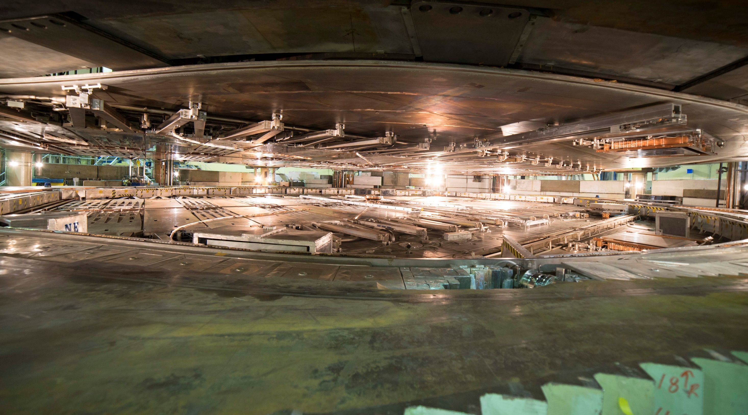
TRIUMF has five decades of experience in building a rich particle accelerator infrastructure that enables cutting-edge research while growing accelerator expertise.
Our mission is to serve as Canada’s particle accelerator centre.

Slide 4
This mission is reflected in the wide variety of accelerator technologies that populate the campus.
Our strategy is to use internal projects and external collaborations as springboards to expand core competencies or gain new ones.
Rather than import technology, we typically develop it, accumulating a broad expertise within a relatively small lab.
ISAC-II
High energy
ARIEL
ISAC-I
Low and
medium
energy
Isotope Cyclotrons
elinac
520 MeV
Cyclotron

Slide 5
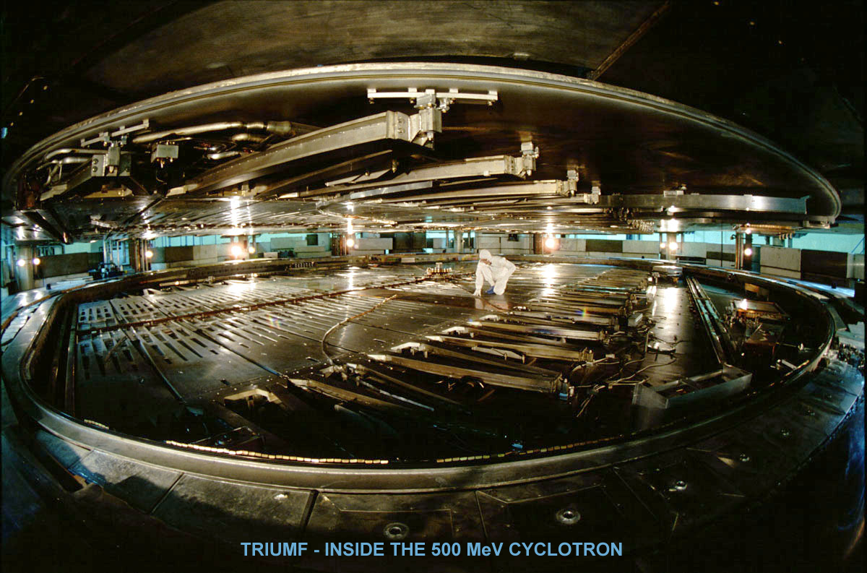
H- Cyclotrons – our first major core competence – also gave us experience in high power rf, high power targets, electrostatic and magnetic beamlines, remote handling, high intensity sources, polarized sources, physics of space charge dominated proton beams, Fixed Field Accelerator (FFA) optics

Slide 6
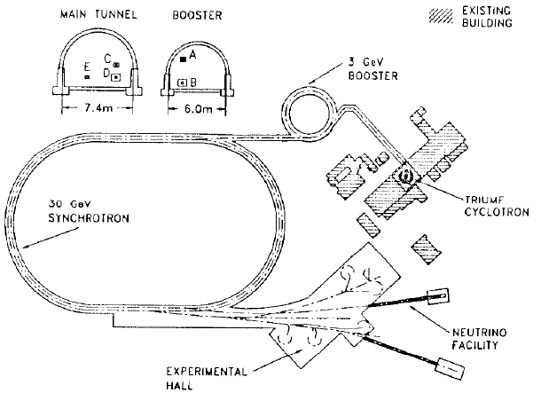
KAON Factory Proposal (1985-1995) – significantly enhanced our skill set – synchrotron design, high intensity beam dynamics, pulsed HV systems

Slide 7
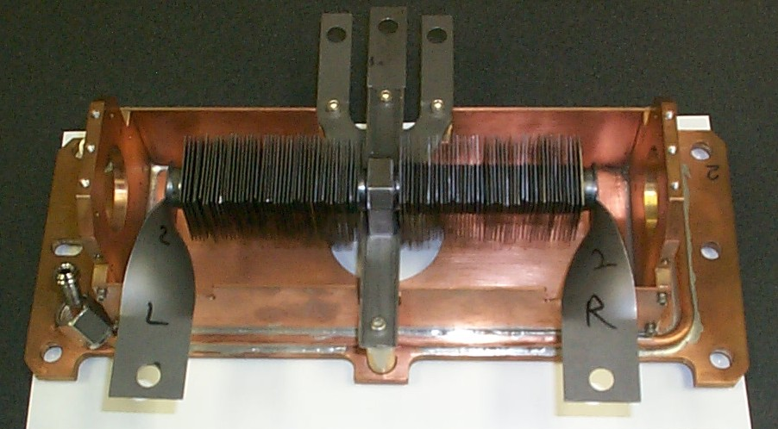
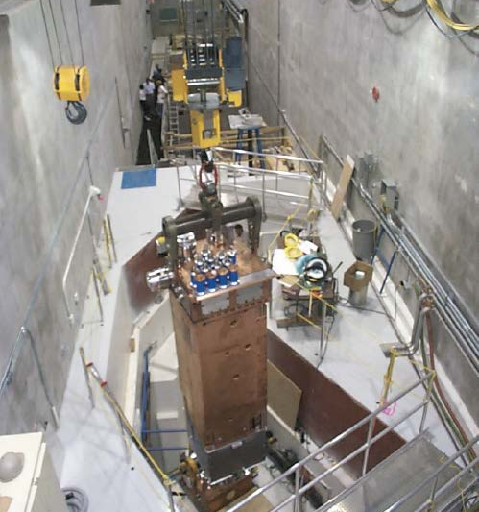
ISAC (1995 - present)
ISAC marked a renaissance
for Accelerator physics and technology at TRIUMF
high power RIB targets,
ISOL ion sources,
laser ion sources,
beam diagnostics for low intensity beams,
electrostatic optics,
remote handling,
ISAC Target Hall

Slide 8
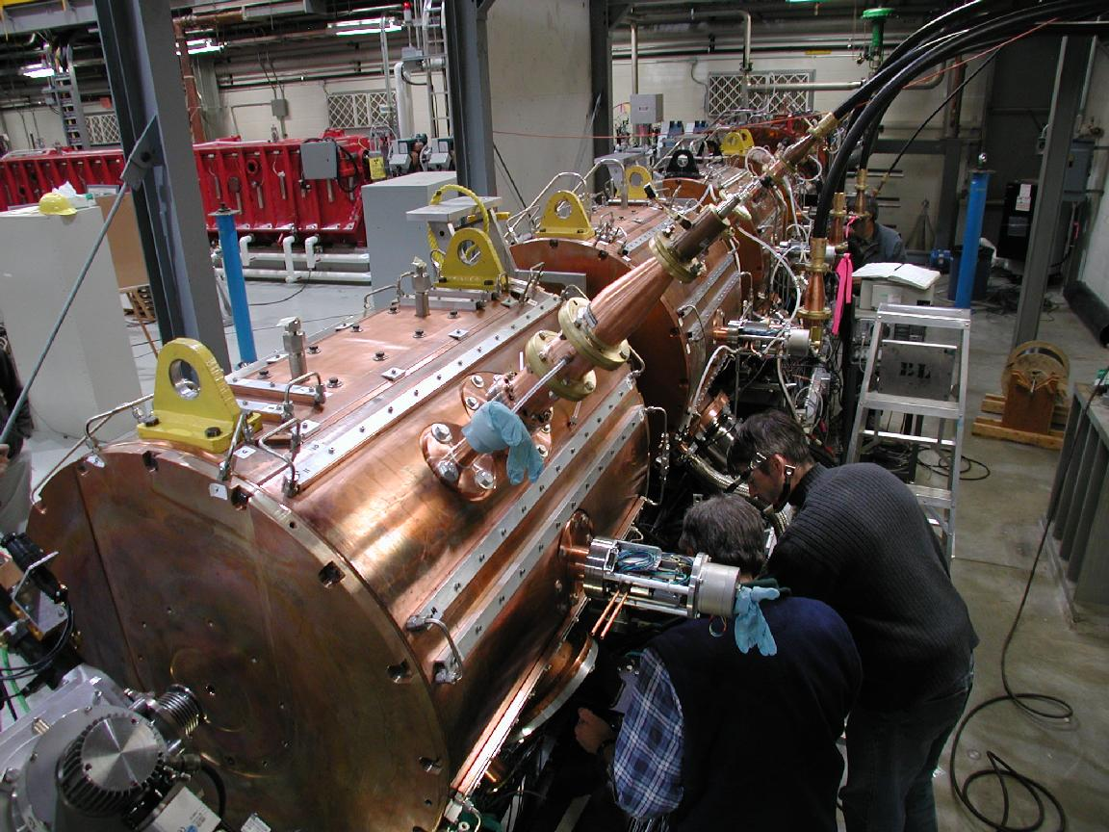
ISAC Post accelerator (1995-2001)
Room temperature linac design and fabrication for heavy ions
ISAC RF Quadrupole
ISAC Drift Tube Linac
RF bunchers/choppers
Low level rf (LLRF) systems
High power rf amplifiers
ISAC DTL with RFQ in the background

Slide 9
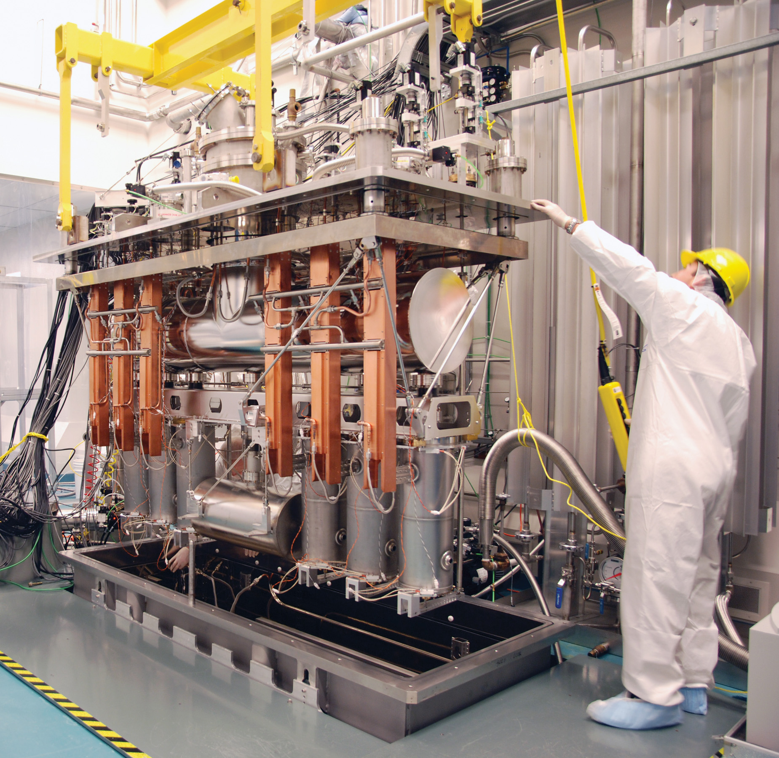
ISAC-II Post accelerator
(2001-2010)
Superconducting RF technology for heavy ions
Cryomodule design and assembly
Design and operation of cryogenic systems
ECR Charge breeders
ISAC-II Cryomodule

Slide 10
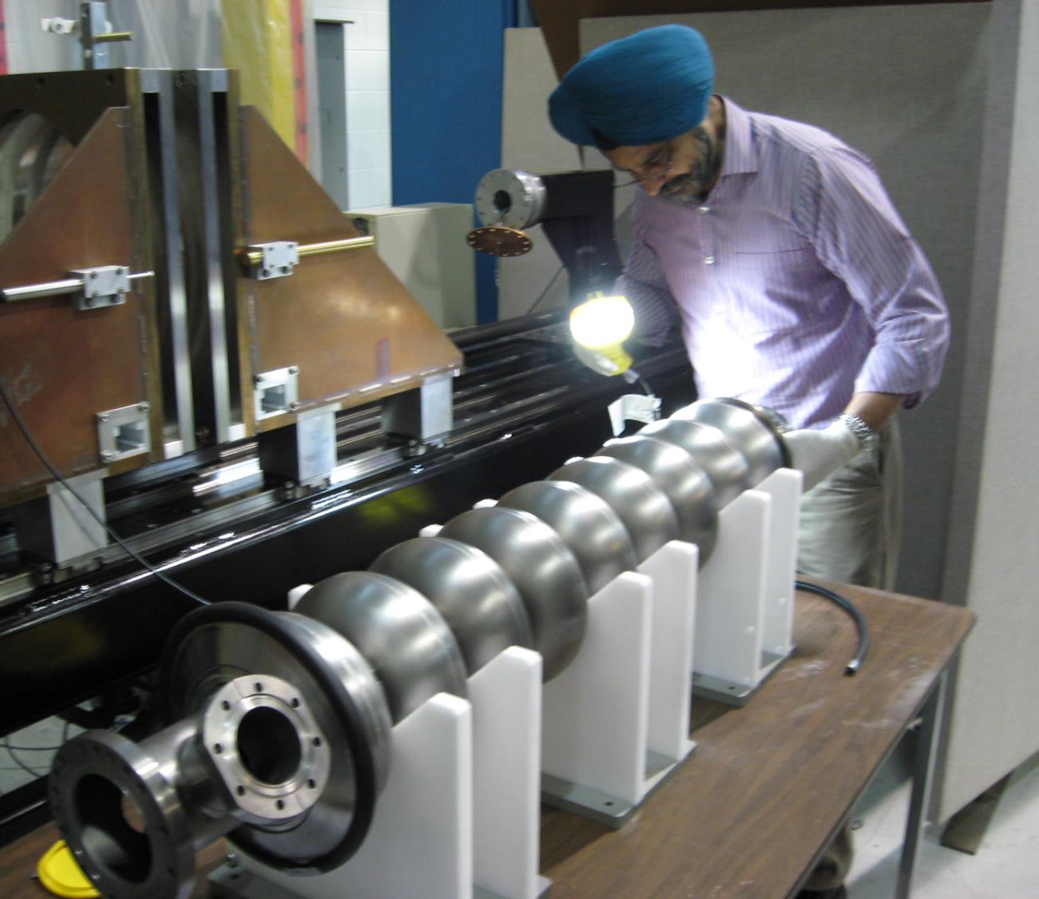
ARIEL e-Linac (2008-2014)
Superconducting RF technology for electrons
High Voltage DC gun
Beam physics of high intensity electrons
High Intensity beam diagnostics
High power klystrons

Slide 11
ARIEL Phase II (2014-present)
  High power target design for electrons
  EBIS Charge breeding
  High resolution spectrometers
  Machine protection systems
  ISOL systems
  Remote handling
  FFA optics

Slide 12
TRIUMF and International Collaborations

Slide 13
Accelerator research at TRIUMF
    The legacy from this on-going development is diverse cutting-edge infrastructure and staff with expertise in a wide range of technologies
    Accelerator science at TRIUMF provides Canada with a world-class platform in
      beam physics and instrumentation
      secondary particle production, and
      SRF technologies.
    Accelerator science supports the high performance and availability of TRIUMF’s accelerator complex, new projects like ARIEL, the training of HQP, and international projects and collaborations.

Slide 14
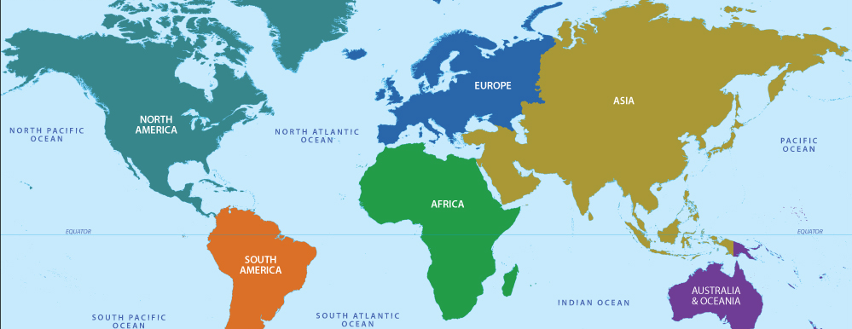
Collaboration map
TRIUMF accelerator scientists are engaged in a number of international collaborations. The international projects aid the community but also nurture our internal expertise while training HQP.

Slide 15
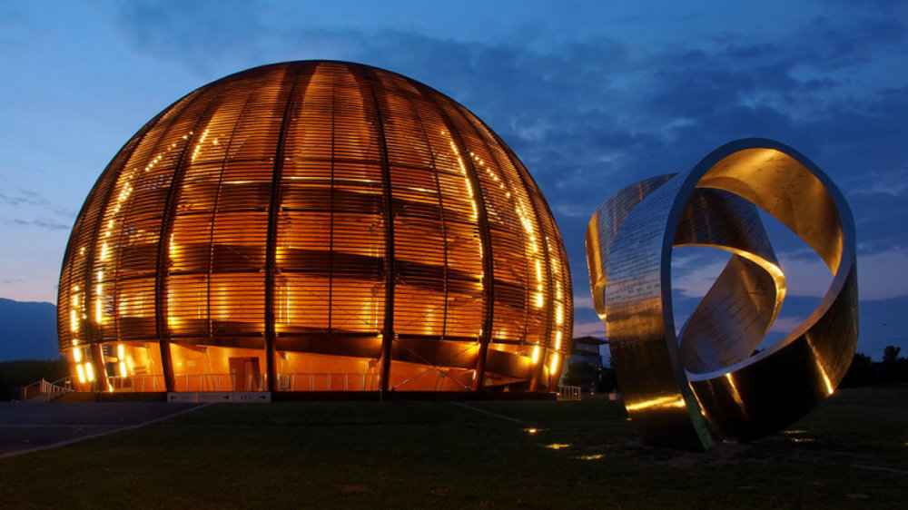
CERN
TRIUMF has had an active engagement with CERN historically with important contributions to LEP and the LHC (48 twin aperture quads).
This continues in the TRIUMF FYP through collaborations and contributions towards LHC, Hi-Lumi and AWAKE:
Crab cavity cryomodules,
Beam physics,
Beam diagnostics

Slide 16
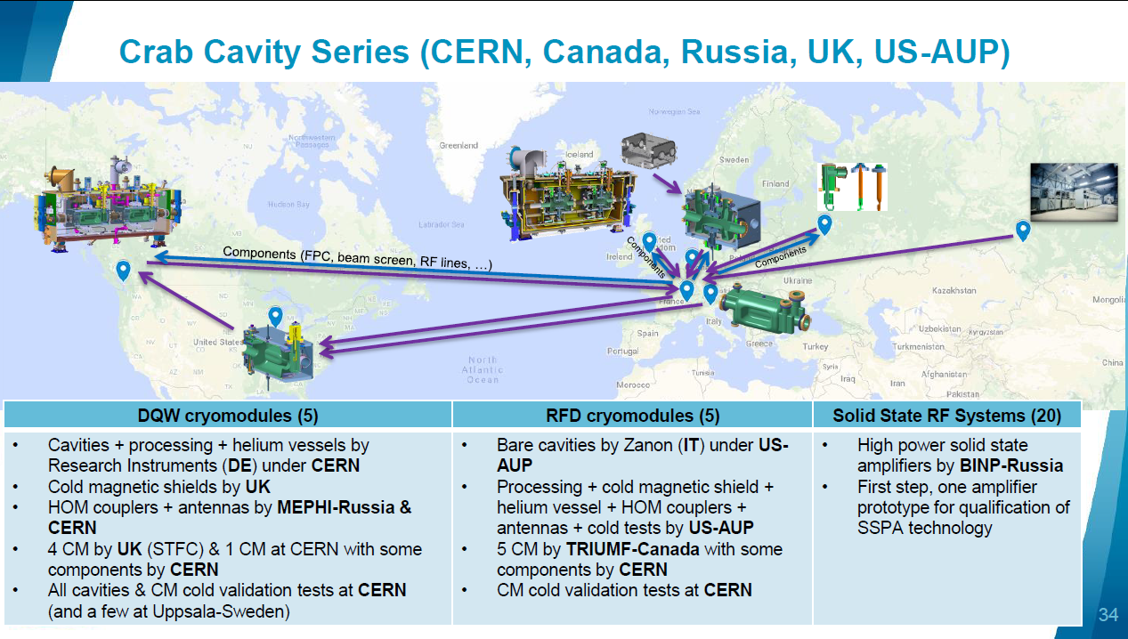
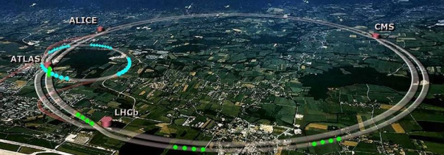
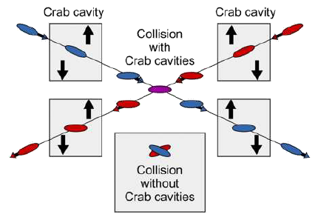
Hi-Lumi Crab Cavities – increase luminosity by skewing the intersecting beams longitudinally at ATLAS and CMS – collaboration with CERN, Russia, UK, USA

Slide 17



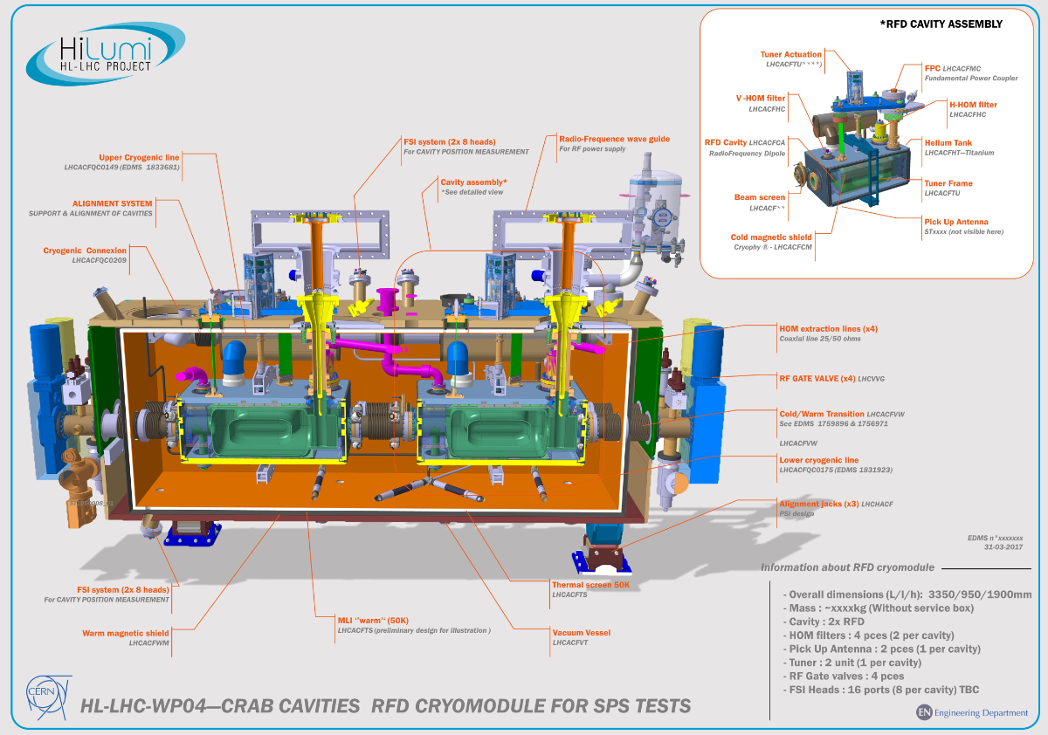
HL-LHC Crab Cavity Cryomodules
TRIUMF to receive 10 RFD resonators produced and qualified by US DOE lab consortium (AUP), to assemble each pair of RFDs into five cryomodules
TRIUMF to qualify the cryomodules through testing at TRIUMF before packaging and shipping to CERN
The project supplies critical infrastructure to CERN, supporting both the HL-LHC and the Canadian IPP community
R. Laxdal
17

Slide 18
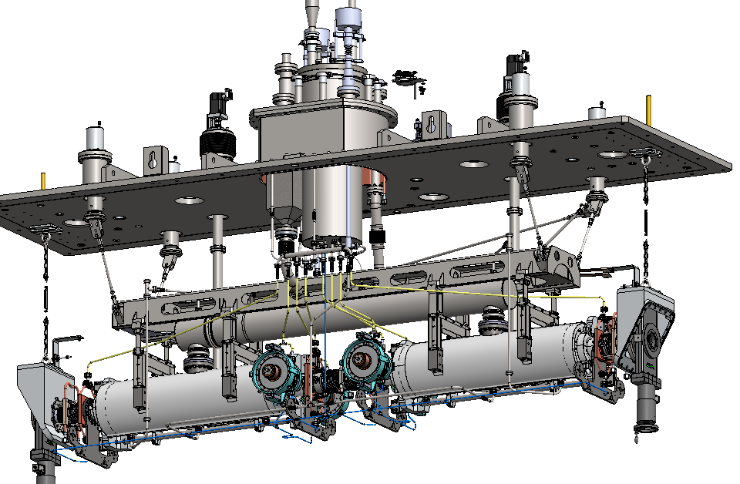
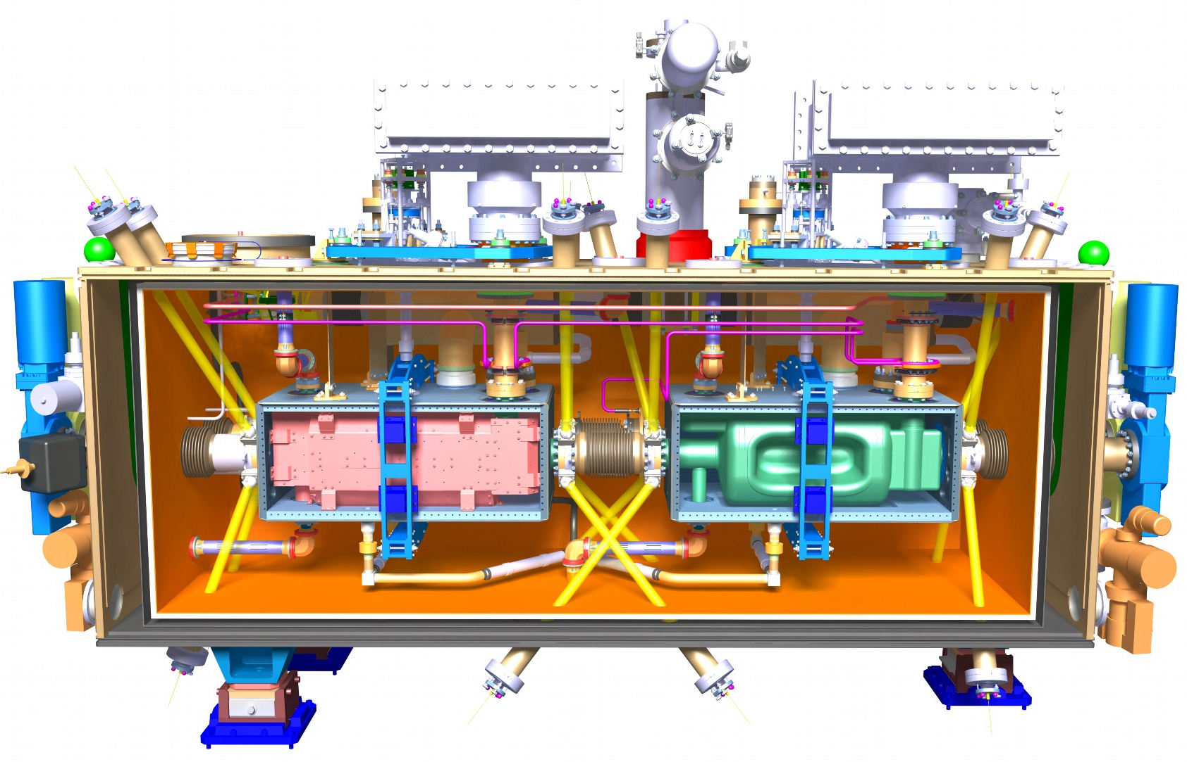
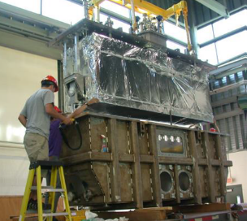
Hi-Lumi Cryomodule vs ARIEL
4K phase separator
Tuner motor
4K-2K Cryoinsert
Support Post
Heat exchanger
Strongback
WPM bracket
Power coupler
The Hi-Lumi cryomodule design borrows from the ARIEL e-Linac module developed and fabricated at TRIUMF.
A prototype will be assembled in 2021 and series production at TRIUMF will span 2022-24
ARIEL Cryomodule
18

Slide 19
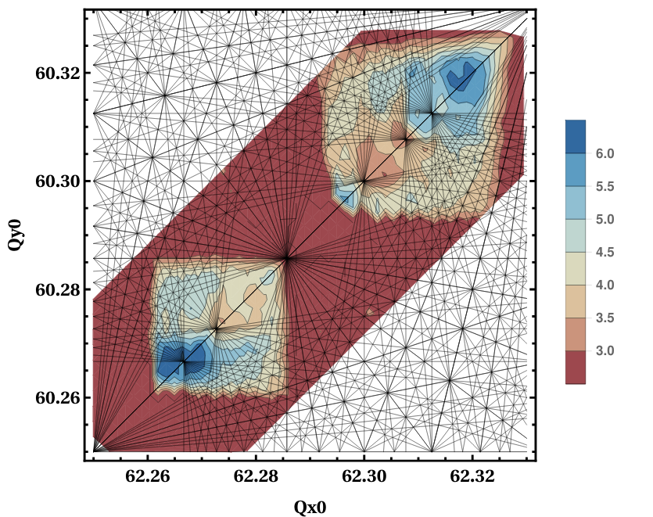
D. Kaltchev, R. Baartman
Collaboration on Beam Dynamics in High-Luminosity LHC
Beam physics studies focus on the general understanding of the impact of resonances to the choice of the optimal working point at collision.
Tune-scans: look for dependencies of the dynamic aperture of HL-LHC on the tune working point (WP) as part of a detailed tracking campaign aimed at luminosity optimization
Beam – beam effects at IR: including optimization of wire compensation
HL-LHC nominal working point (WP)
Resonance lines
​
DA
Good WP candidate
19

Slide 20

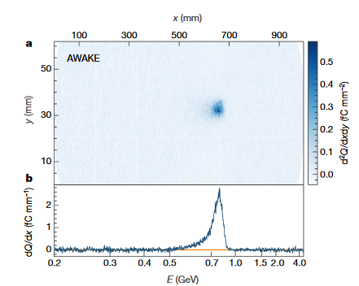
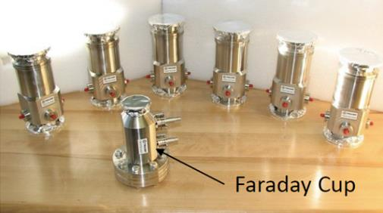
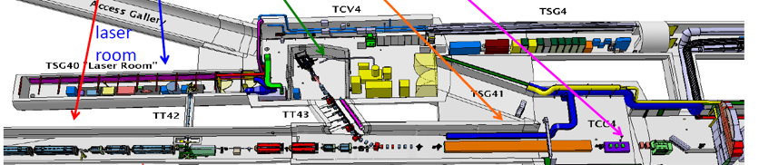
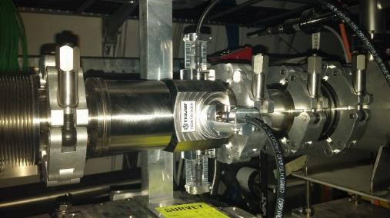
TRIUMF and AWAKE experiment
Ultra high gradients
V. Verzilov
AWAKE is an R&D experiment at CERN - Exploits acceleration of electrons by plasma waves driven by high energy protons from SPS
TRIUMF scope (NSERC funded)
  Design and construction of diagnostics (strip-line beam position monitors, Faraday cup and associated electronics for electron and common beam lines
Now preparing for AWAKE Run 2

Slide 21
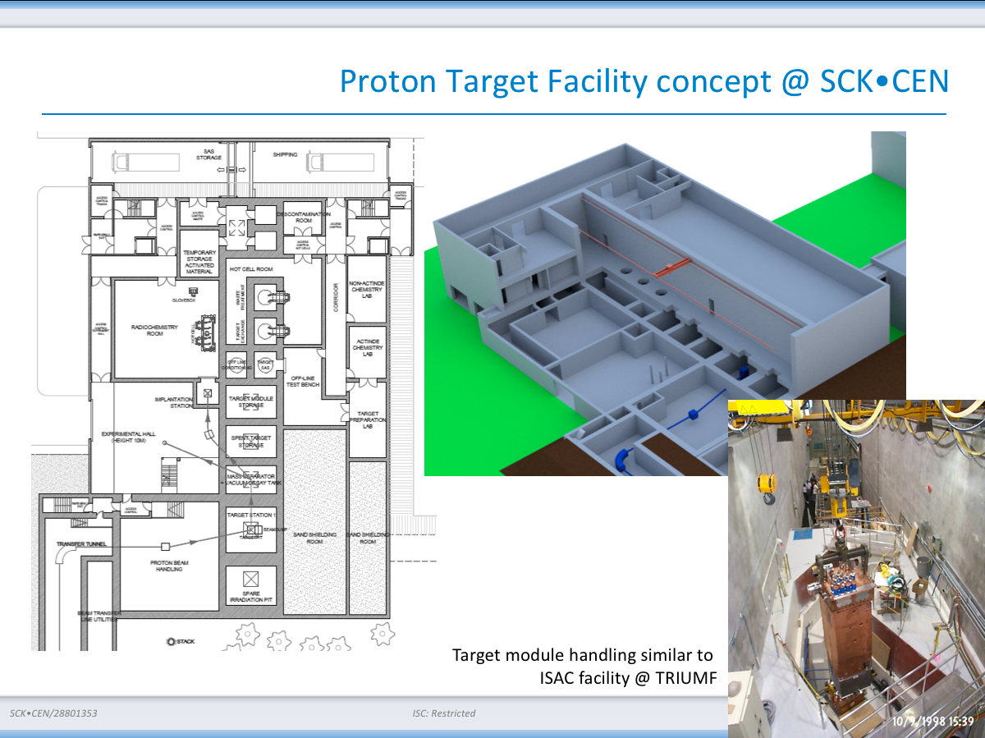
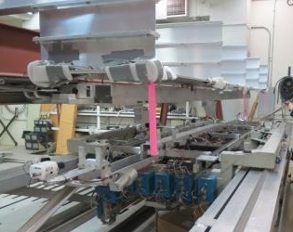
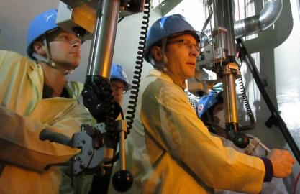
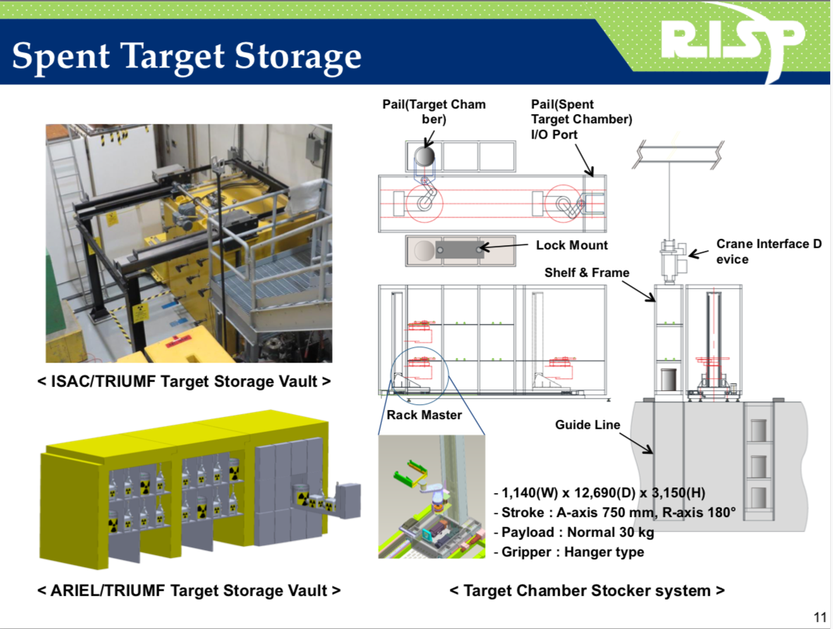
TRIUMF Remote Handling
A. Gottberg
TRIUMF is internationally recognized for its leading role in remote handling, hot cell design and operation.
TRIUMF remote handling and target technologies as well as the know-how of HQP are valued by international collaborations (T2K, MYRRHA, RISP)
Examples of international
designs based on TRIUMF RH:
TRIUMF RH specialists assisting in T2K target repair
RH robotics development

Slide 22
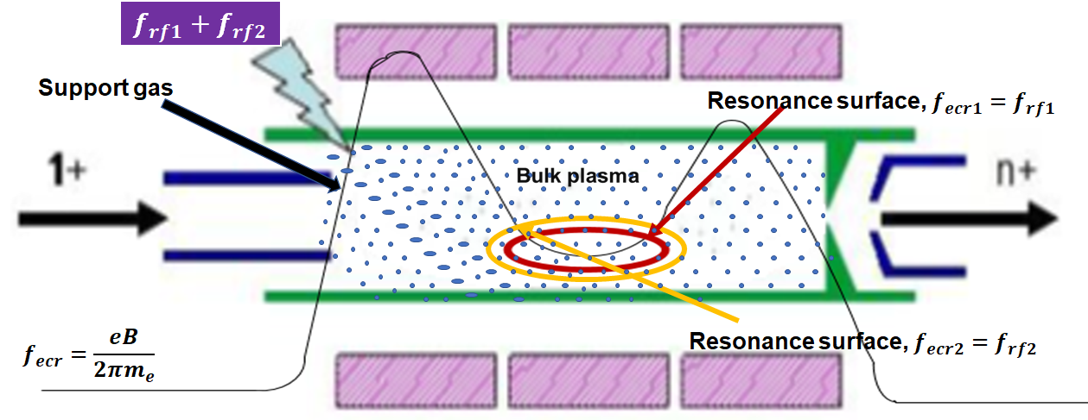
Ion Source Development
Internal TRIUMF development on high intensity hadron sources
Collaboration with Ganil on ECR sources
Charge breeding efficiency
  two-frequency heating technique that provides two resonance zones
Beam extraction
  Simulations with the code IGUN©
  Benchmarking with beam emittance measurements
F. Ames, O. Kester

Slide 23
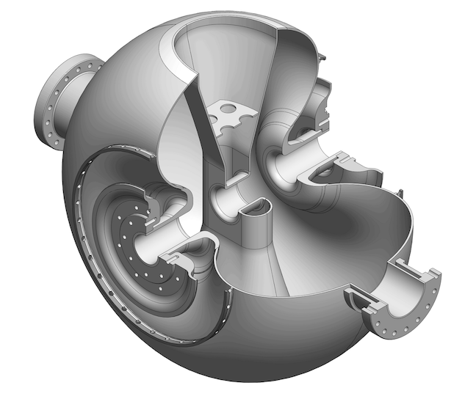
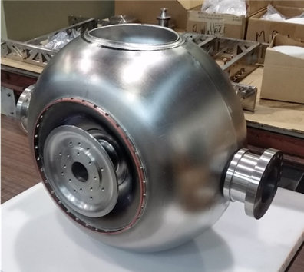
SRF Technology Development for RISP
TRIUMF has developed and successfully tested a new variant (balloon geometry) of a single spoke resonator for Hadron acceleration
Virtually eliminates the high level multipacting that plagues standard geometries
The cavity design and prototyping was sponsored by RISP (Korea) and is being used in their heavy ion driver linac
TRIUMF also designed and delivered a prototype tuner and a power coupler design
Z. Yao

Slide 24
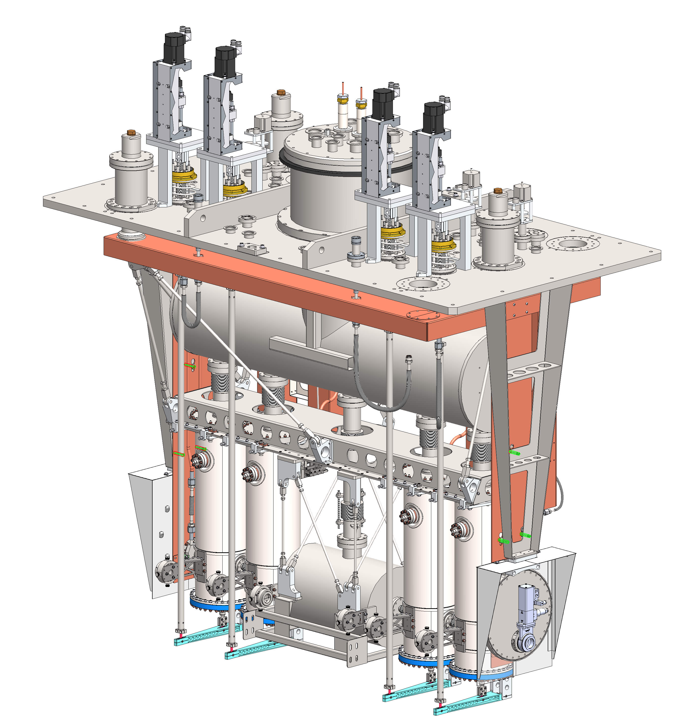
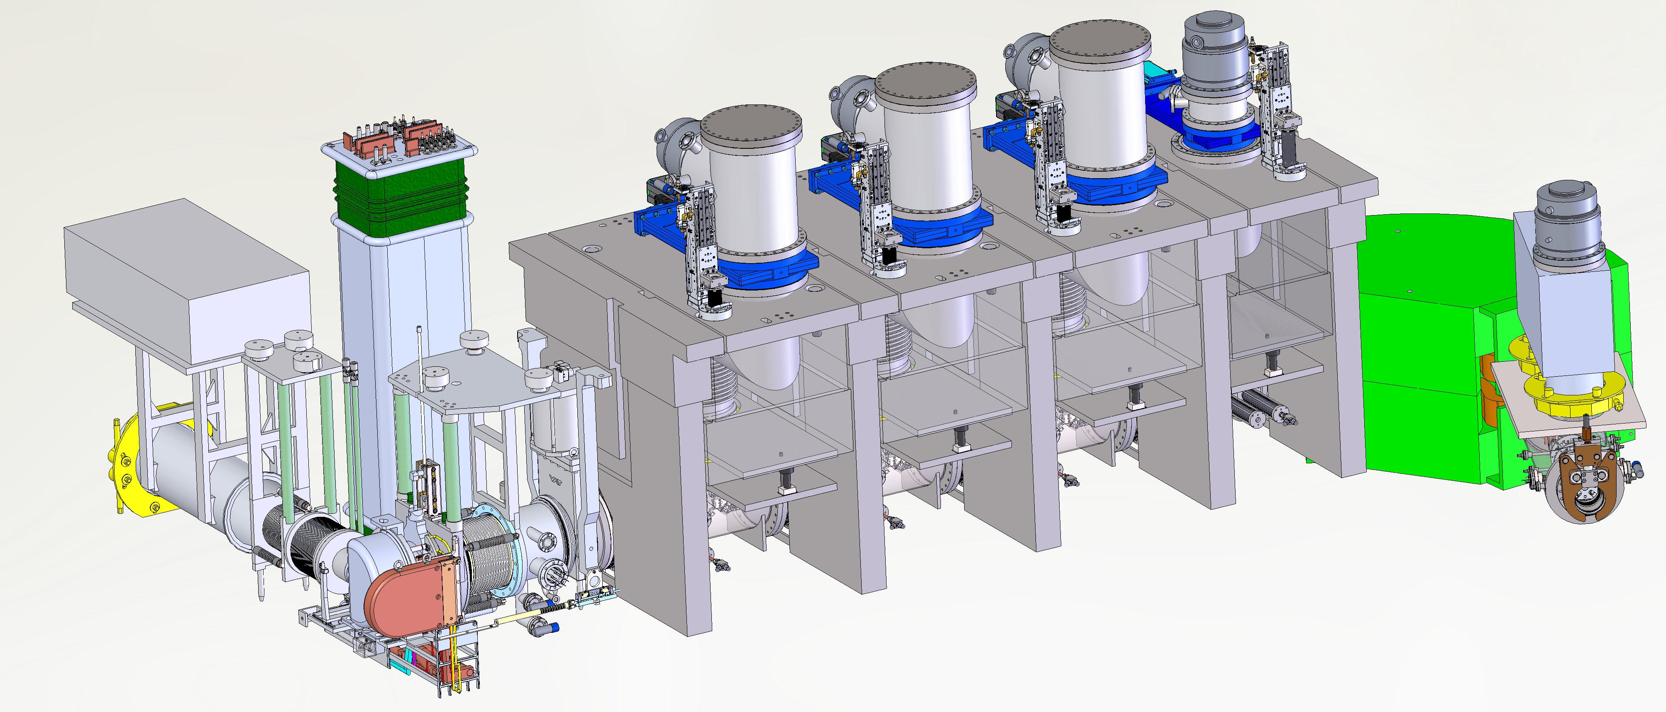
TRIUMF and VECC (Kolkata)
TRIUMF and VECC have been collaborating on mutually aligned projects since 2008 – ANURIB in Kolkata and ARIEL in Vancouver
An electron cryomodule has been delivered to VECC
Future deliverables - heavy ion cryomodule, an ARIEL target module and RIB extraction line
The cryomodule will be completed this year (all cavities are now qualified)
The RIB target module and beamline will be delivered in 2022.
R. Laxdal

Slide 25
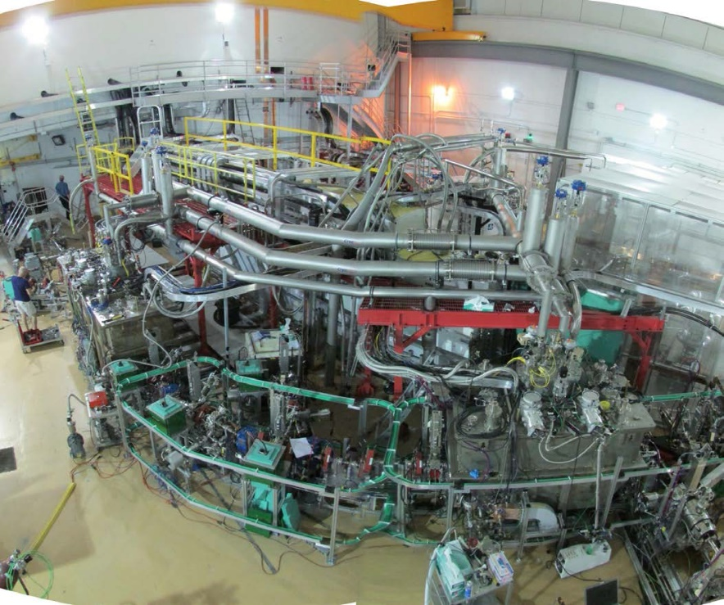
FEL research for IR and THz radiation
TRIUMF’s e-linac opens the door to a new avenue of accelerator R&D with strong interest from the Canadian community in IR and THz radiation
Initial studies could be done downstream of the existing linac
Requires high brightness gun development
An ERL ring could be added to the electron hall for dedicated R&D and user engagement
V. Verzilov

Slide 26
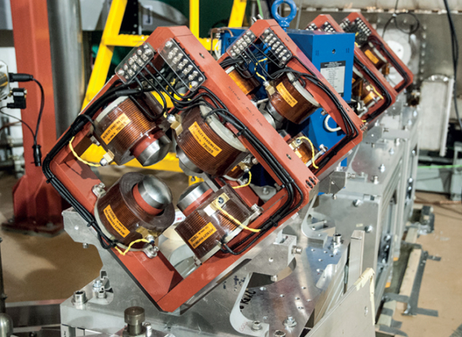
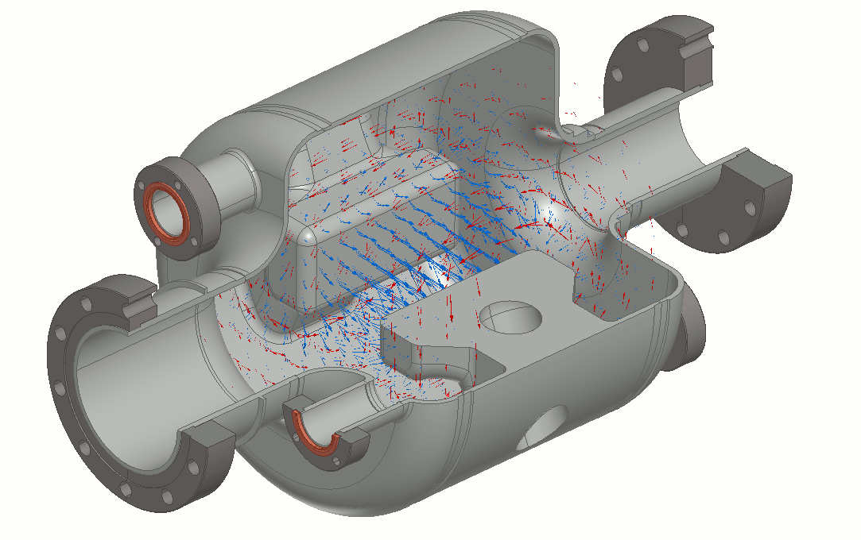
E-Linac (other developments)
Specially designed short quadrupoles present minimum electron-beam aberrations by shaping the poles to be locally spherical, with radius 1.54 times the aperture radius (Baartman 2012) -> FFA optics
A new unique rf separator cavity was designed to allow ARIEL e-Linac to operate in recirculating mode – First SRF cavity fully fabricated at TRIUMF
300kV 10mA DC thermionic gun with rf bunch formation
T. Planche

Slide 27
TRIUMF and EIC

Slide 28
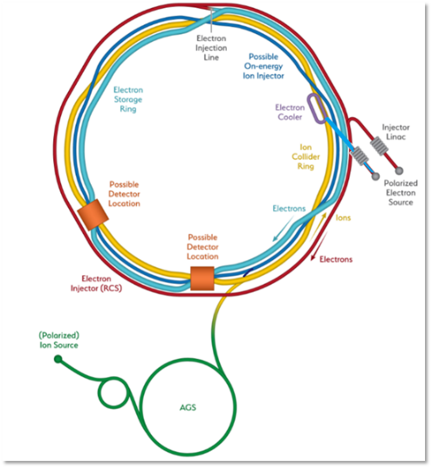
Electron Ion Collider (EIC) related R&D
Contributions of Canada via TRIUMF
Canadian contributions to international projects are typically driven by the corresponding science community within Canada
The EIC-Canada collaboration will make the case for Canadian participation in EIC and lead funding initiatives with domestic agencies
TRIUMF would work with the EIC-Canada team to help define work packages and seek funding to support in-kind contributions

Slide 29

Potential areas of Canadian Contribution to EIC via TRIUMF
  SRF/RF (crab (or other) cavities, cryomodules, rf ancillaries)
  beam physics (FFA optics, spin)
  high brightness electron gun
  Polarized sources
  e-beam technology including beam diagnostics
  Fast kickers and RF bunch switcher
  Normal conducting magnets (also permanent magnet optics for e-beam lines)

Slide 30
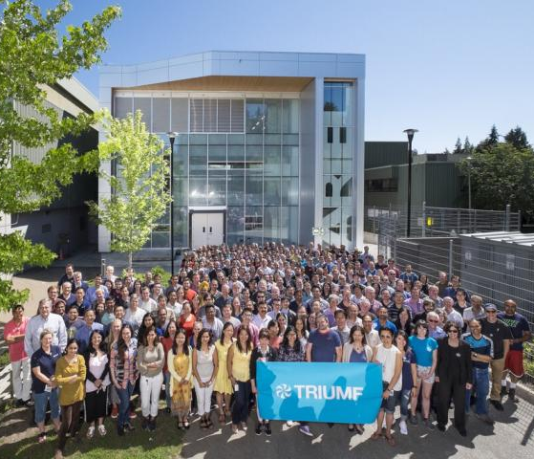
TRIUMF and EIC
TRIUMF maintains an active program in International collaboration
The collaborations support global partners, the Canadian science community, strengthen our core competences and engage students

Slide 31
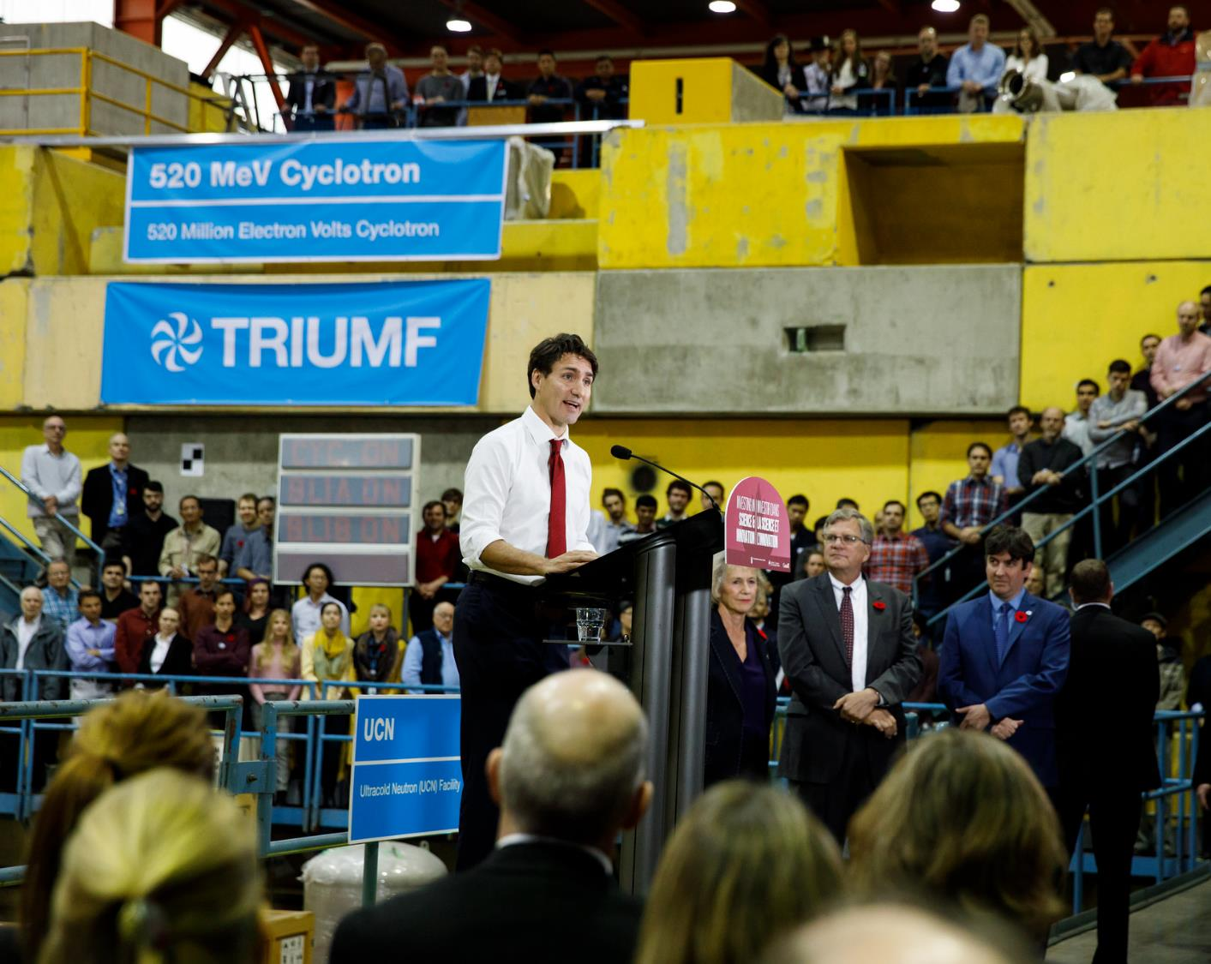




Thank you
Merci
www.triumf.ca
Follow us @TRIUMFLab

