Slide 1
EIC Ion Source.
Hadron Polarization.
Vadim Ptitsyn
EIC Project, BNL
EIC Collaboration Workshop
October 7, 2020

Slide 2
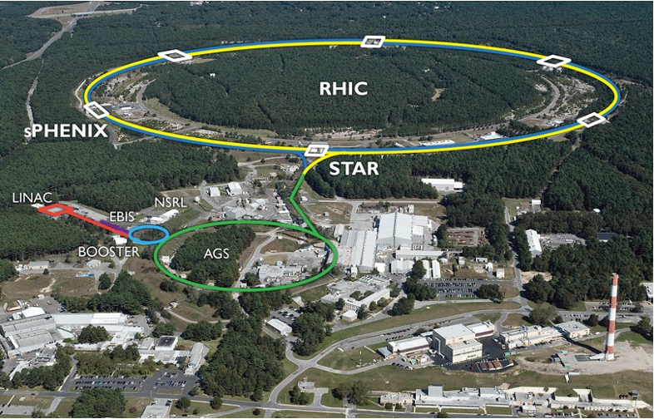
EIC Hadron Ring
Existing RHIC ion accelerator complex will be re-used for EIC.
Yellow RHIC ring will be used for EIC hadron beam.
Electron ring (RCS and Storage ring) will be added into existing RHIC tunnel.
Two arcs of Blue RHIC ring will be used as EIC hadron beamlines (12-2 and 4-6 o’clock. Most of remaining Blue ring components will remain in the tunnel.
On-going upgrade of ion source EBIS will provide capability of polarized ³He.
Present injector chain will be entirely re-used.
(EBIS, Linac, Booster, AGS)
The talk by Silvia Verdu Andres in Session 2.1
on hadron ring upgrades.

Slide 3
Species in the EIC
p
70% polarized protons
41 - 275 GeV
Luminosity:
10³³ – 10³⁴ cm⁻² s⁻¹
80% polarized electrons:
5 – 18 GeV
Light ions (d, Si, Cu)
Heavy ions (Au, U)
41 – 110 GeV/u
e⁻
Pol. He-3
41 - 184 GeV/u
Pol. d (?)
Center-of-mass energy range: 20 – 140 GeV
Full electron polarization at all energies
Full proton and He-3 polarization with six Siberian snakes
Any polarization direction in electron-hadron collisions:
protons
electrons

Slide 4
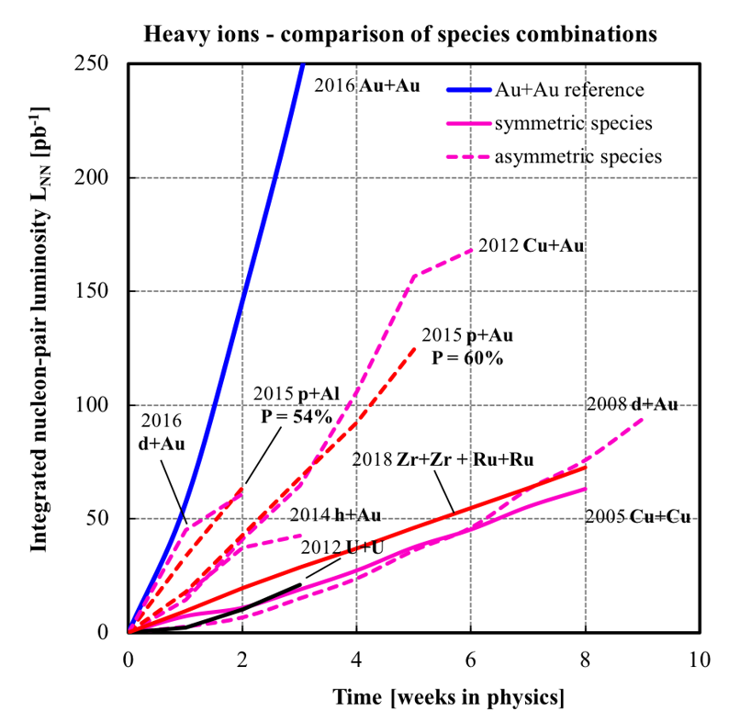
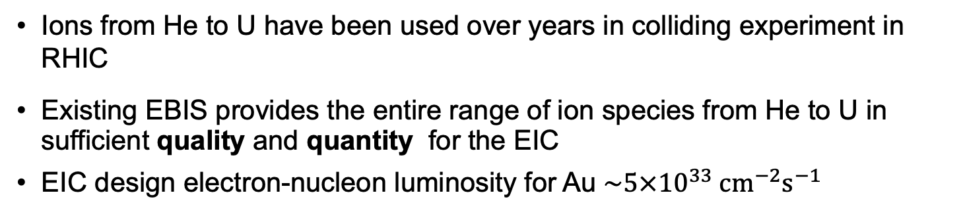
Ion Beams
Ions from He to U have been used over years in colliding experiment in RHIC
Existing EBIS provides the entire range of ion species from He to U in sufficient quality and quantity for the EIC
EIC design electron-nucleon luminosity for Au $\sim 5×{10}^{33} cm^{−2}s^{−1}$
Ion Pairs
in the RHIC Complex
Zr-Zr, Ru-Ru (2018)
Au-Au (2016)
d-Au (2016)
p-Al (2015)
h-Au (2015)
p-Au (2015)
Cu-Au (2012)
U-U (2012)
Cu-Cu (2012)
d-Au (2008)
Cu-Cu (2005)
Ion-Ion Luminosity Runs in RHIC 2005-2018
Accumulated Luminosity [pb⁻¹]
Operation Time [weeks]

Slide 5
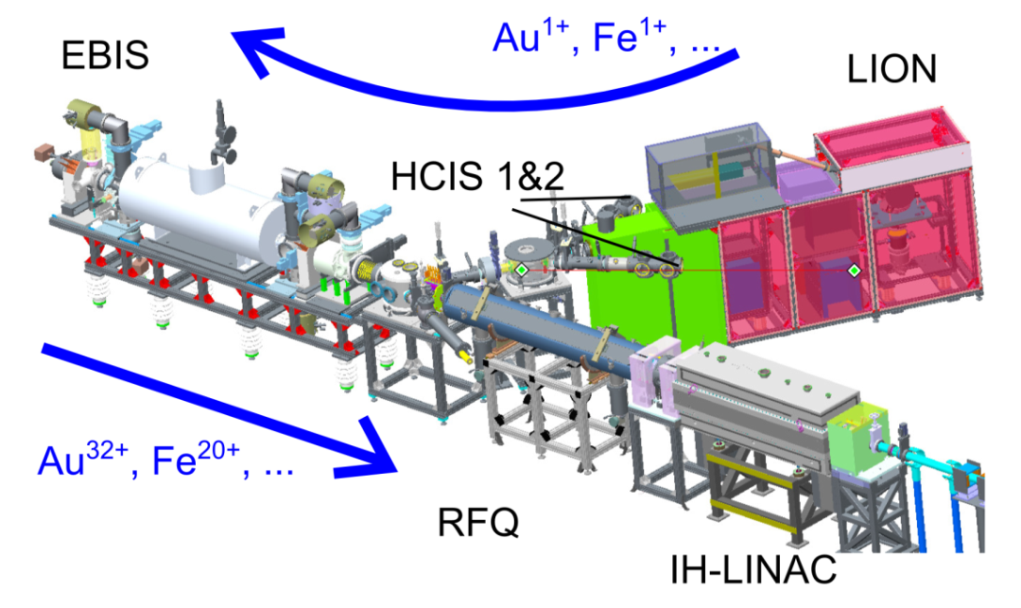
RHIC EBIS Ion Source
Provides multiple high charge state heavy ion species for RHIC and NASA RadLab (NSRL, which uses beams from Booster), often at simultaneous operation of RHIC and NSRL.
Fast switching between the species (in Galactic Cosmic Ray Simulator ~30 species changes /h)
Initial low charge ions, received from Laser Ion Source (LION) are ionized to high charge by intense electron beam current
Successful operation since 2014
For RHIC (and EIC) the intensity
of heavy ion bunches produced by
EBIS is increased by factor 4-6
using bunch merging in Booster
and/or AGS

Slide 6
Polarized He-3 source and Extended EBIS
Developed by BNL-MIT collaboration
He-3 is polarized using Metastability Exchange Optical Pumping (MEOP) mechanism
Ionized in the ionization cell using electron beam (up to 10A)
High magnetic field (5T solenoid)
Intensity ~ 2∙10¹¹ 3He⁺⁺ ions in 10 us pulse ~4.0 mA
Maximum polarization > 80%
Polarized He3 in RHIC in 2022-23
Extended EBIS
The He3 source is presently being realized as a part of an extension of existing EBIS ion source
Additional solenoid extends the trap length
leading to 40-50% heavy ion intensity increase
trap length
extension

Slide 7
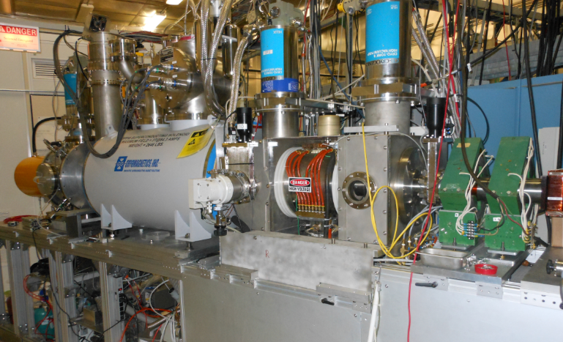
Optically pumped polarized ion source (OPPIS)
Used for RHIC p↑+p↑ program from 2000
Protons pickup polarized electrons in an optically pumped Rb vapor cell
Electron polarization of H atoms is transferred to protons in a magnetic field reversal region (Sona-transition)
H⁻ ions are produced then by passing through Na-cell
Polarized protons are obtained by charge exchange injection of H⁻ into the Booster
Several upgrades and modifications over years increasing polarization and intensity
up to 84% polarization
reliably 0.5 - 1.0 mA (max 1.6 mA)
up to 1・10¹² H⁻/pulse polarized H⁻ ions

Slide 8
RHIC Polarized Beam Complex

Slide 9
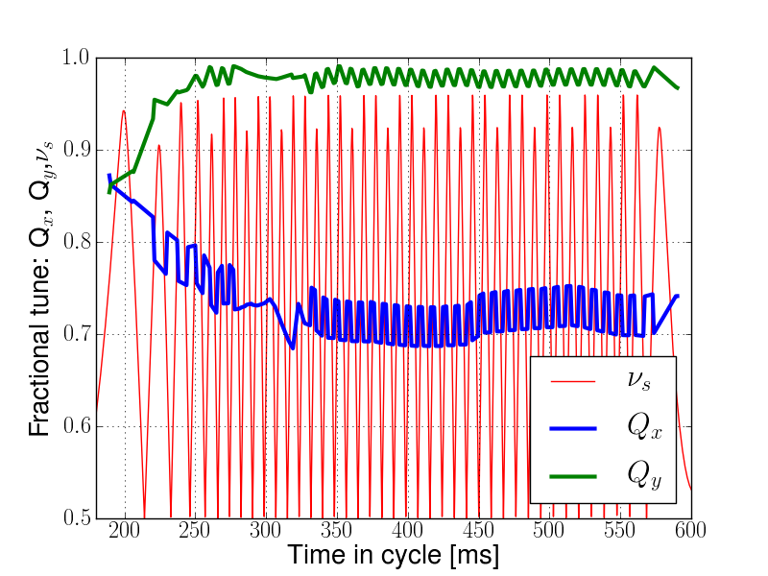
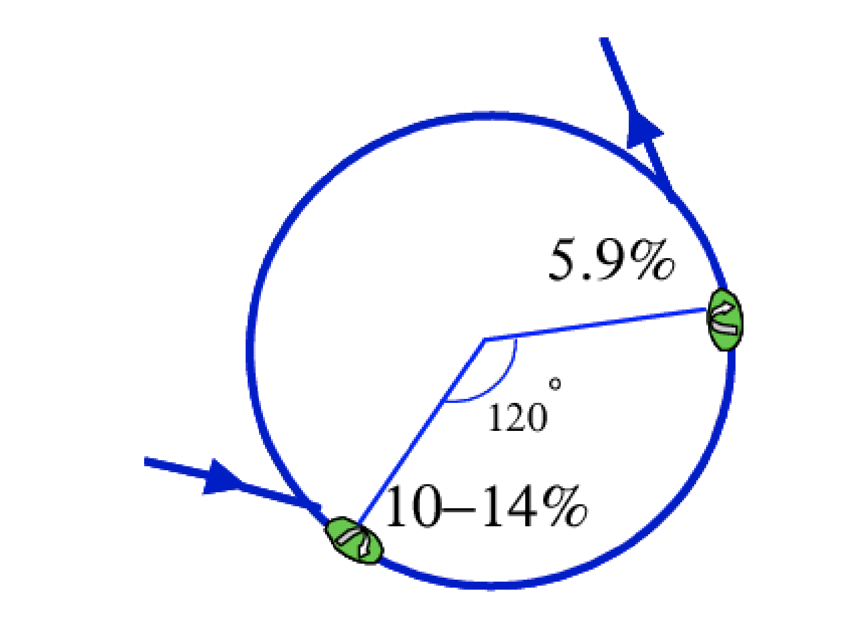
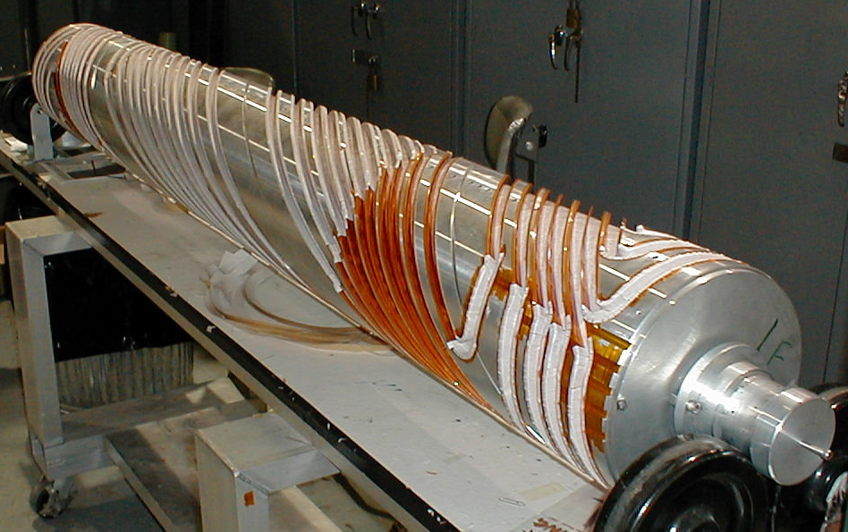
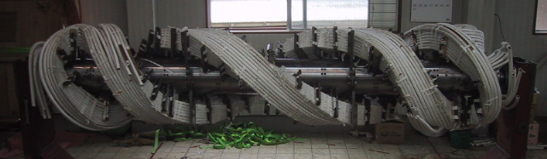
Polarized Techniques in AGS
AGS has two partial snakes (10% and 6%)
Provides spin tune ‘gap’ where imperfection and vertical intrinsic resonance condition are never met
  ν_{s} != N
  ν_{s} != N +/- Q_{y}
Horizontal resonance condition still met
  ν_{s} != N +/- Q_{x}
  Horizontal resonance are weak, but many (82 crossings)
  Currently handled with tune jump
  A technique which uses skew quads to reduce horizontal resonance strength will be tried next run
Spin tune
gap
Hor resonance crossings
Tune
jumps
Extraction
2.6 m
2.6 m
Injection

Slide 10
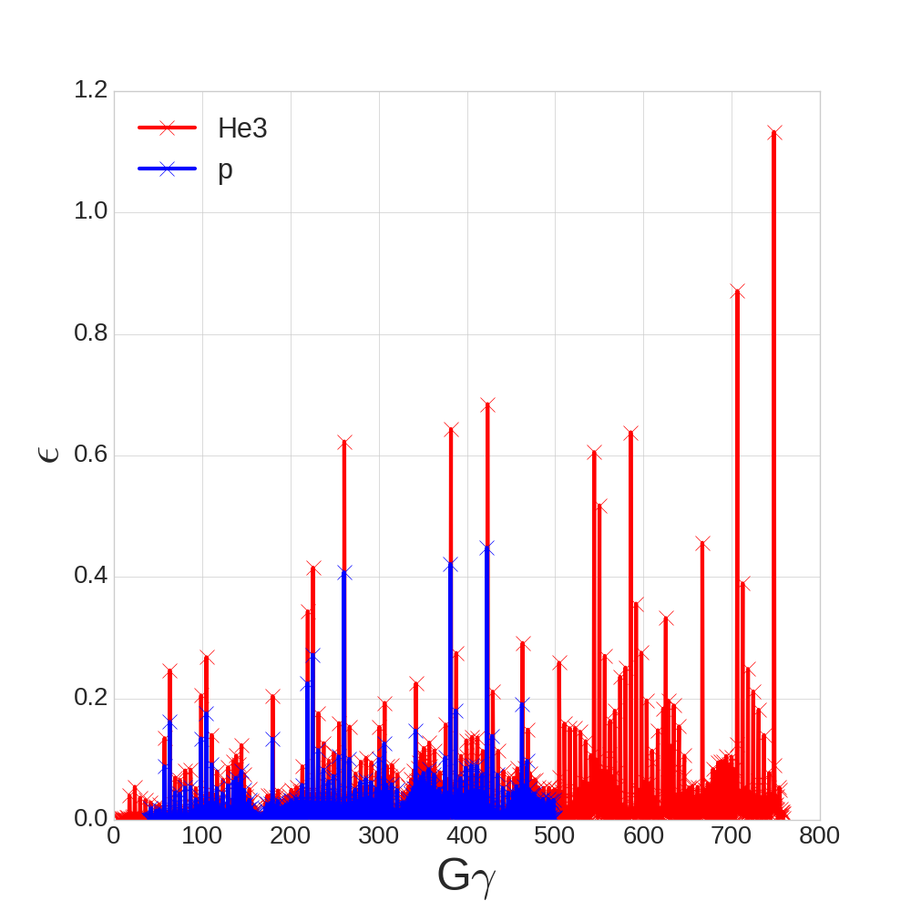
Siberian Snakes in RHIC
Numerous spin resonances are encountered during acceleration
To overcome proton spin resonances during acceleration in RHIC Siberian Snakes are used (two per ring)
Magnet field in Snake
Particle orbit and spin trajectory
Siberian Snake (or full snake) produces spin rotation by 180 degree around a rotation axis in horizontal plane
Proper located Snakes produce hold the spin tune at constant value (1/2) avoiding spin resonances
Each Siberian Snake: 4 SC helical dipoles, up to 4 T, each 2.4 m long and full 360° twist
60% polarization has been achieved at 255 GeV
For EIC the number of snakes will be increased from 2 to 6
RHIC Intrinsic Resonance Strength (DEPOL, RHIC lattice)

Slide 11
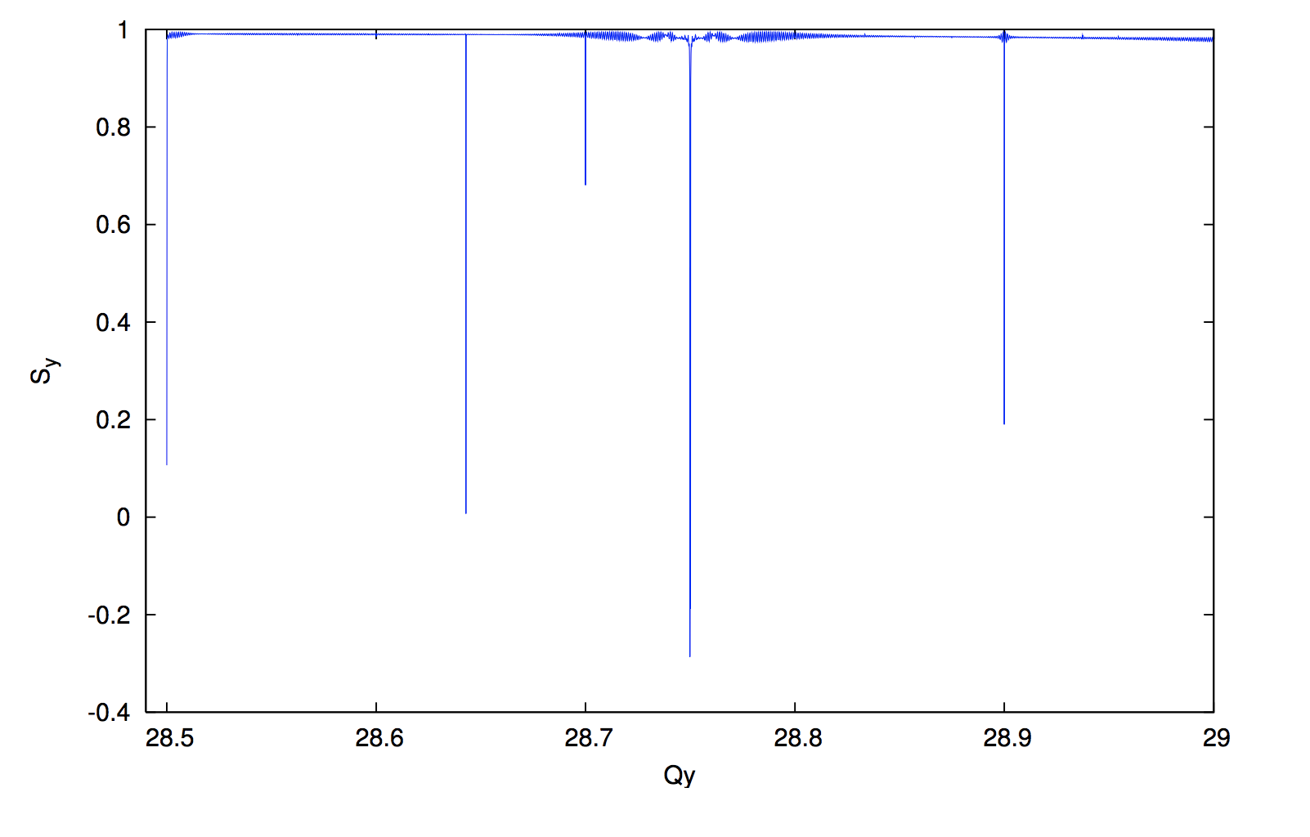
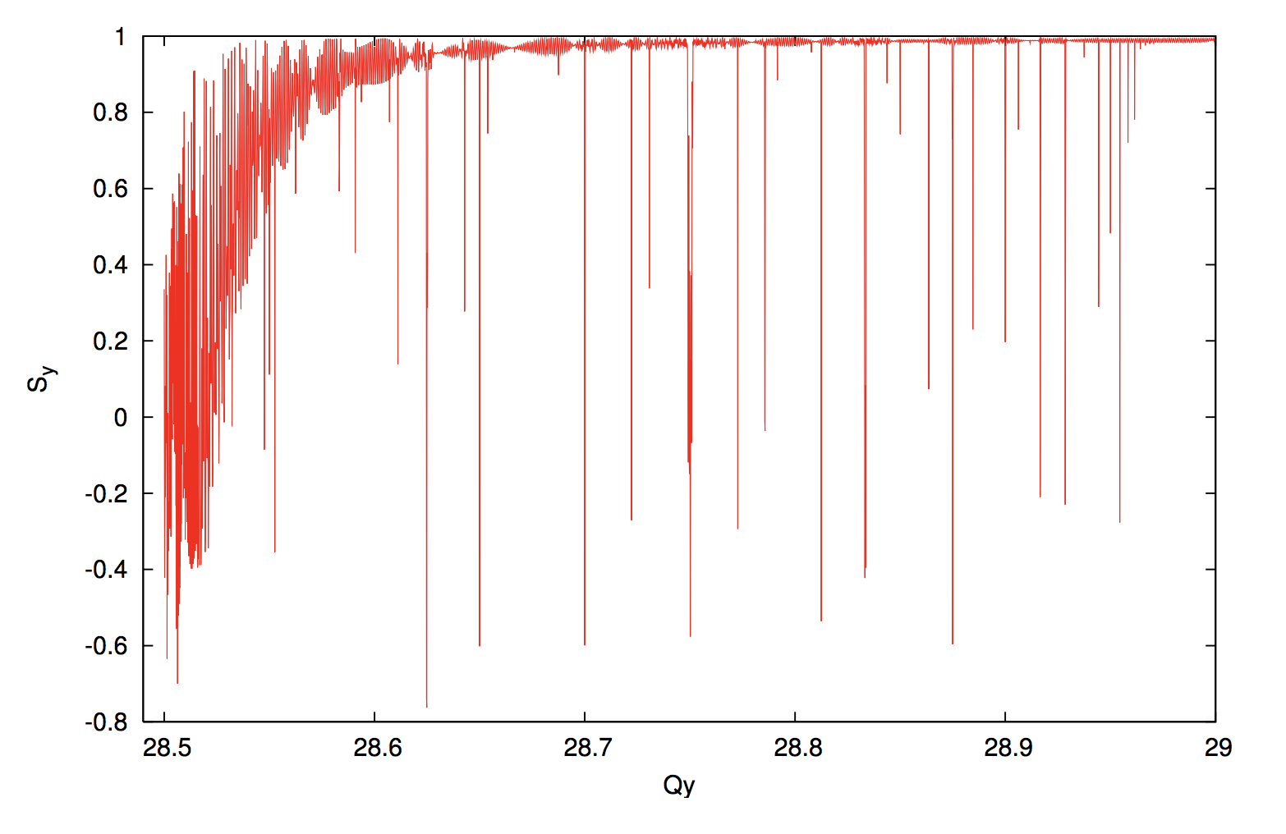
Snake Resonances in RHIC
Experimental observation of
Snake Resonances in RHIC
Depolarization can still happen at certain vertical betatron tunes due to higher order resonances:
½ =m +/- nQ_{y}
Far more tune space available in six snake configuration
  Important for flexibility in the face of complicated beam dynamics (high peak currents, interaction with coolers, etc)
RHIC with 2 Snakes
Snake resonance spectrum
EIC Hadron Ring with 6 Snakes
S_{y}
S_{y}
RHIC tune space
6-snakes
2-snakes
Q_{y}

Slide 12
Polarized He-3 Acceleration
 | p | ³He⁺²
m, GeV | 0.938 | 2.808
G | 1.79 | -4.18
E/u, GeV | 24-275 | 16-183
|Gγ | | 46.5-525.5 | 72.6-819.4
Crossing strongest spin resonance with 2 and 6 Snakes
RHIC Siberian snakes and spin rotators can be used for the spin control, with less orbit excursions than with protons.
More spin resonances. Larger resonance strength.
6 Snakes are necessary to preserve He3 polarization at acceleration

Slide 13
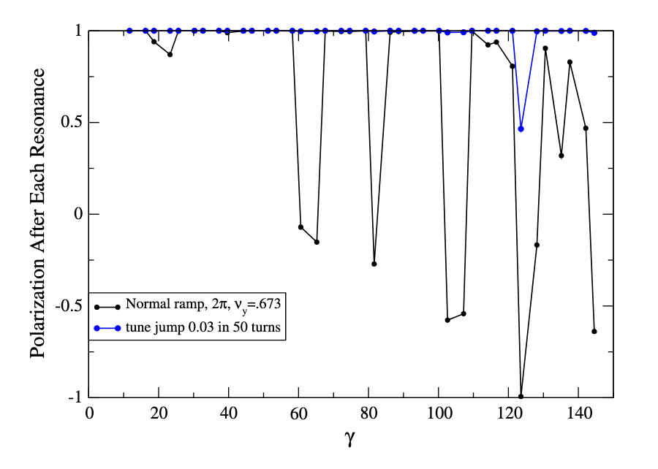
Polarized deuterons
 | p | d
m, GeV | 0.938 | 1.876
G | 1.79 | -0.143
E/u, GeV | 24-275 | 12-137
|Gγ | | 46.5-525.5 | 1.6-20.9
Polarized deuteron possibility in EIC has been explored.
The imperfection resonances can be overcome by partial snakes on the base of the planned detector solenoid(s).
The intrinsic resonance can be overcome with modest tune jump.
At Gγ =3n (3, 6, 9, 12, 15, 18), longitudinal polarization can be reached at both 6 o’clock and 8 o’clock IRs. 22.5 GeV interval.
The deuteron polarimetry presents a challenge.
D polarization at acceleration with and without tune jumps

Slide 14
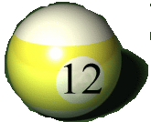
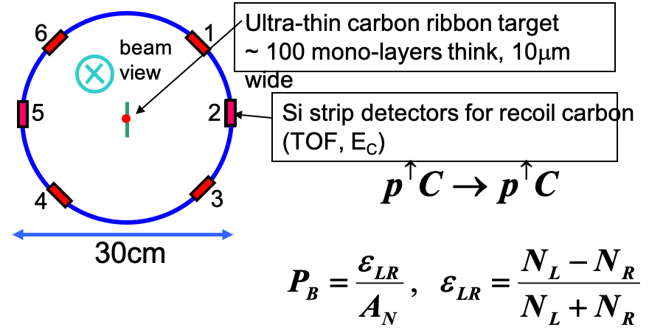
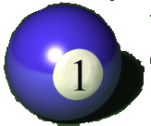
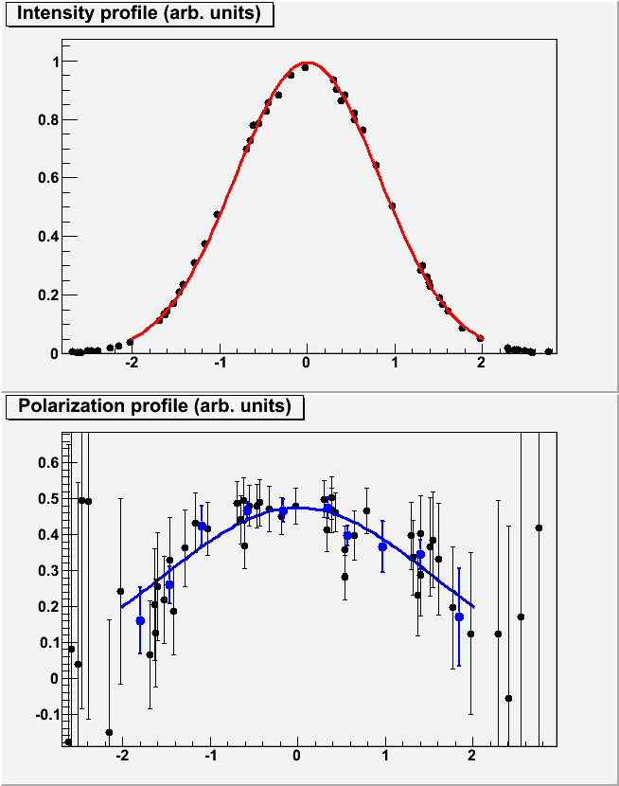
Hadron Polarimetry
Polarimetry exploits left-right asymmetry in elastic scattering due to spin orbit interaction
Carbon target
Polarized proton
Recoil carbon
Proton-Carbon Polarimeter (pC) @ RHIC and AGS
  Very fast and high precision ⇒ main polarization monitoring tool
  Measures polarization profile (polarization is higher in beam center) and lifetime
  Statistical precision 2-3%
  Needs to be normalized to HJet
Polarized hydrogen Jet Polarimeter (Hjet: pp scattering)
  Makes absolute polarization measurement (normalization of other polarimeters)
  Slow (low rates ⇒ needs long time to get precise measurements)
Intensity
Polarization
Target Position

Slide 15
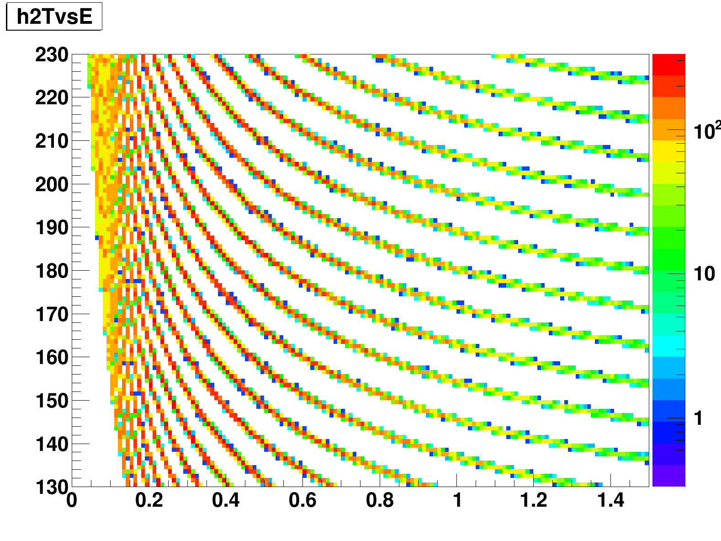
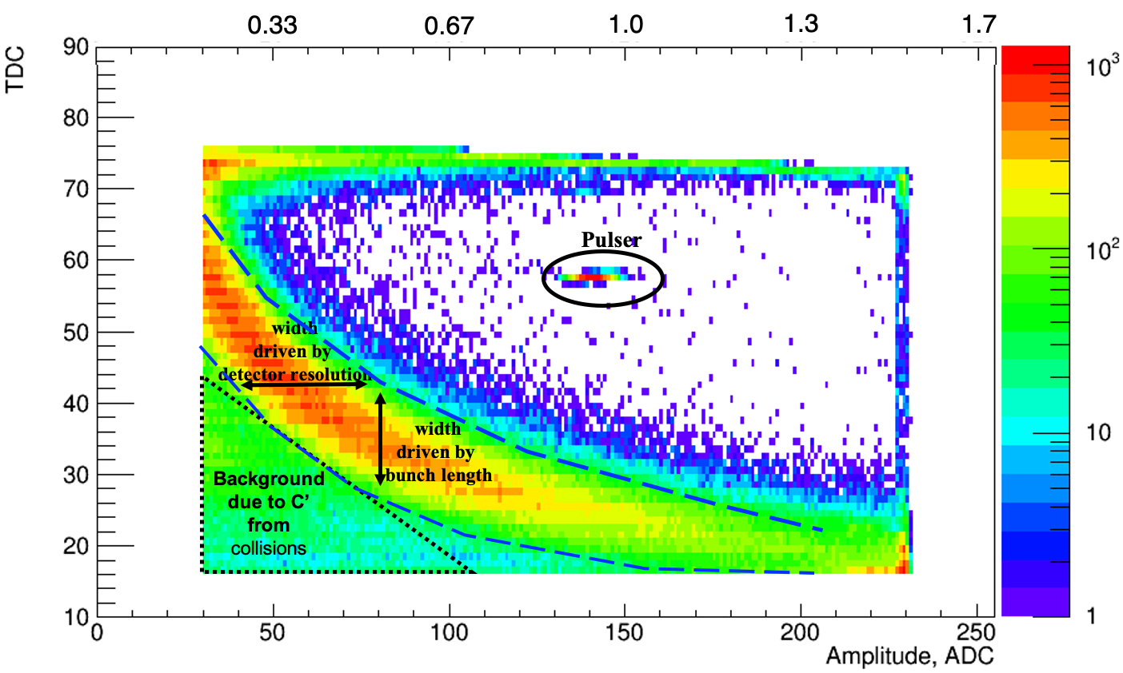
EIC Polarimetry Challenges
In RHIC precise polarization measurement includes
Energy-TOF correlation analysis to cut background
In EIC the bunch spacing is reduced by factor 12 (to 9ns) creating problem with background separation
Challenges for EIC: 1% systematic uncertainty requirement, expected small spin asymmetries for d, bunches closer in time, background not yet totally understood, temperature of pC polarimeter targets
Deuteron polarimeter challenge: small asymmetry in dC scattering: ~8% of pC asymmetry

Slide 16
Summary
Electron-Ion Collider will re-use existing RHIC injector chain, including ion sources.
EIC will take full advantage of existing tools and techniques used to preserve proton polarization in injectors and RHIC.
EBIS source upgrade with polarized He-3 capability is underway.
Additional Snakes will be added to the EIC Hadron ring for preserving He-3 polarization.
Hadron polarimetry has challenges coming from short bunch distance and increased beam current.

