Slide 1
Fermilab Accelerator Technology and EIC
Sergey Belomestnykh
EIC Workshop – Promoting Collaboration on the Electron-Ion Collider
7 October 2020

Slide 2
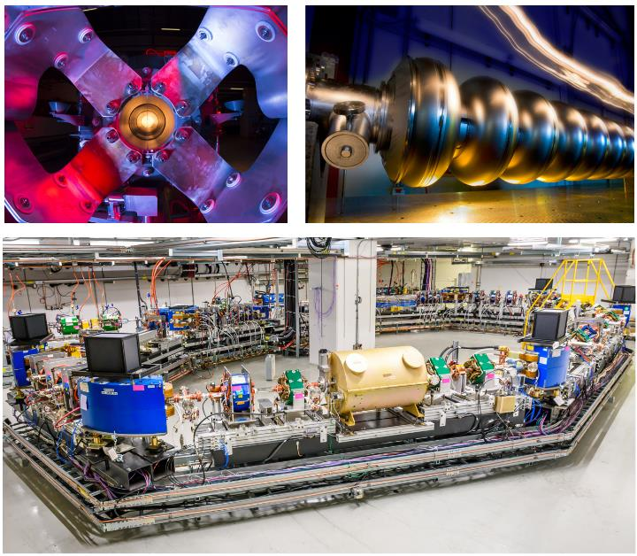
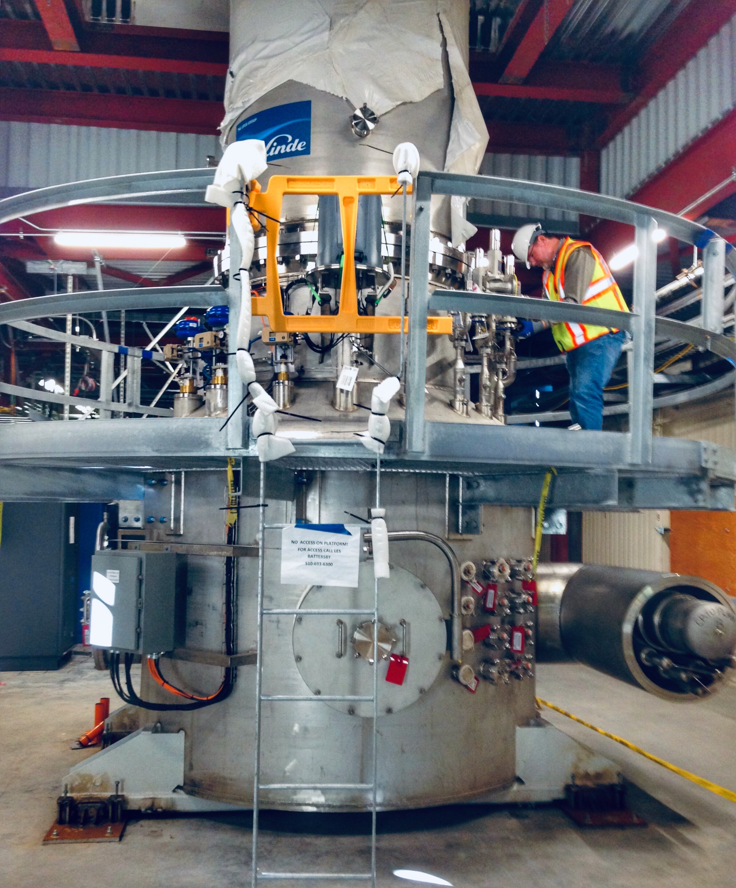
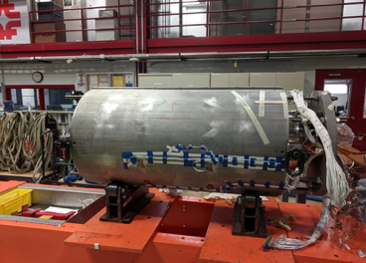
Talk outline
In this talk I would like to briefly describe three Accelerator Technology areas where Fermilab can contribute to Electron-Ion Collider
Superconducting Radio-Frequency technology
Magnet technology
Cryogenic technology
In each area I will show some recent R&D achievements at Fermilab, contributions to projects demonstrating our capabilities and try to highlight relevance to EIC
Several facilities at Fermilab will become available in coming years
SRF technology
Cryogenic technology
Magnet technology

Slide 3
Superconducting RF

Slide 4
SRF at Fermilab: Brief summary
Fermilab capabilities in SRF include a complete technological cycle:
  RF design of various cavity shapes (spoke resonators, elliptical cavities, compact crab cavities, SRF guns)
  Developing innovative cavity treatment recipes to increase cavity Q and/or gradient specific to project demands
  Design of cryomodules and auxiliary components
  Testing for design verification, e.g. horizontal teste of fully-dressed cavities
  Procurement and fabrication of components
  Component preparation, e.g. cavity treatment (EP/BCP, HPR at FNAL and joint ANL/FNAL facility; doping/baking at FNAL), and testing, e.g. vertical cavity testing, FPC testing
  Cryomodule assembly: two large clean room for cavity string assembly, two high-bay cryomodule assembly areas
  Shipping cryomodules to final destination
RF design
Cavity treatment optimization
Cryomodule and components design
Design verification
Procurement and fabrication
Component preparation and testing
Cryomodule assembly
Cryomodule testing
Shipment
Current Frontier projects which build upon our SRF facilities + experience include the following:
PIP-II, LCLS-II, LCLS-II-HE, HL-LHC AUP

Slide 5
SRF cavity R&D
Highlights from SRF cavity R&D:
  Original nitrogen doping recipe – applied to LCLS-II – high Q at ~16 MV/m, 1.3 GHz
  Modified nitrogen doping for LCLS-II-HE – high Q at ~21 MV/m
  Nitrogen doping for PIP-II 650 MHz cavities – R&D in progress
  Breakthrough in understanding oxygen diffusion mechanism for reaching very high gradients – impact to all high gradient cavity applications
  Medium temperature baking at ~300 C to dissolve oxide and enhance performance of SRF cavities wrt nitrogen doping

Slide 6
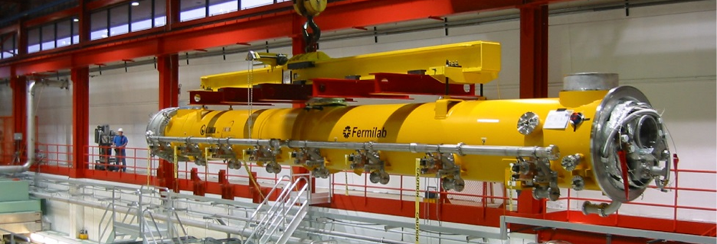
Research towards ILC and pulsed SRF linacs
Present ILC spec 31.5 MV/m (per TDR)
Many new advances in SRF technology since ILC TDR. New treatments may enable significant reduction in ILC cost: flux expulsion, two-step bake (75/120), cold EP
This year with ILC Cost Reduction R&D funds from DOE, Fermilab plans to assemble a cryomodule with cavities with new treatments. We would like this to be a collaborative effort (JLAB, Cornell, KEK, …)
Goal is to reach higher gradient than has ever been demonstrated in CM test
Aim will be 38 MV/m average gradient with Q₀ >1.0x10¹⁰ and a stretch goal of 40 MV/m
Achieving this would be a key demonstration of the potential for cost reduction for ILC
Will reuse CM1, the first SRF cryomodule assembled at Fermilab in 2007

Slide 7
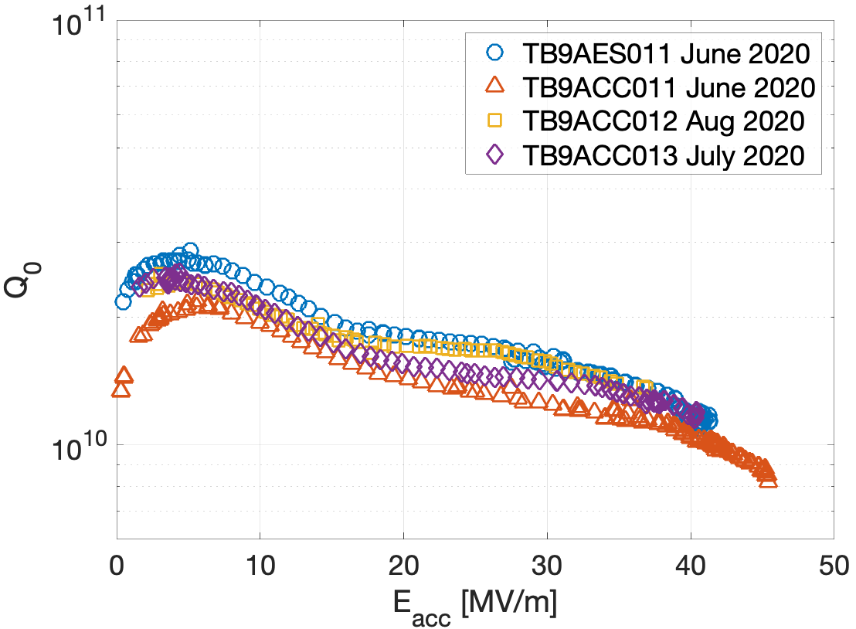
New life of CM1
The cavities will be replaced by high performing cavities that had achieved ILC specifications and been set aside ~10 years ago for future modules. The cavity will be subjected to the new treatment plan
Improved magnetic shielding to minimize trapped flux. Encapsulated piezo tuner designs will be used for improved reliability
Four cavities have been re-treated and tested with max fields:
  TB9AES011 – 41.3 MV/m (x-rays at max field ~1000 mR/hr)
  TB9ACC011 – 45.5 MV/m (x-rays at max field ~background)
  TB9ACC012 – 36.9 MV/m (x-rays at max field ~1 mR/hr)
  TB9ACC013 – 40.4 MV/m (x-rays at max field ~100 mR/hr)
Average of 41.0 MV/m

Slide 8
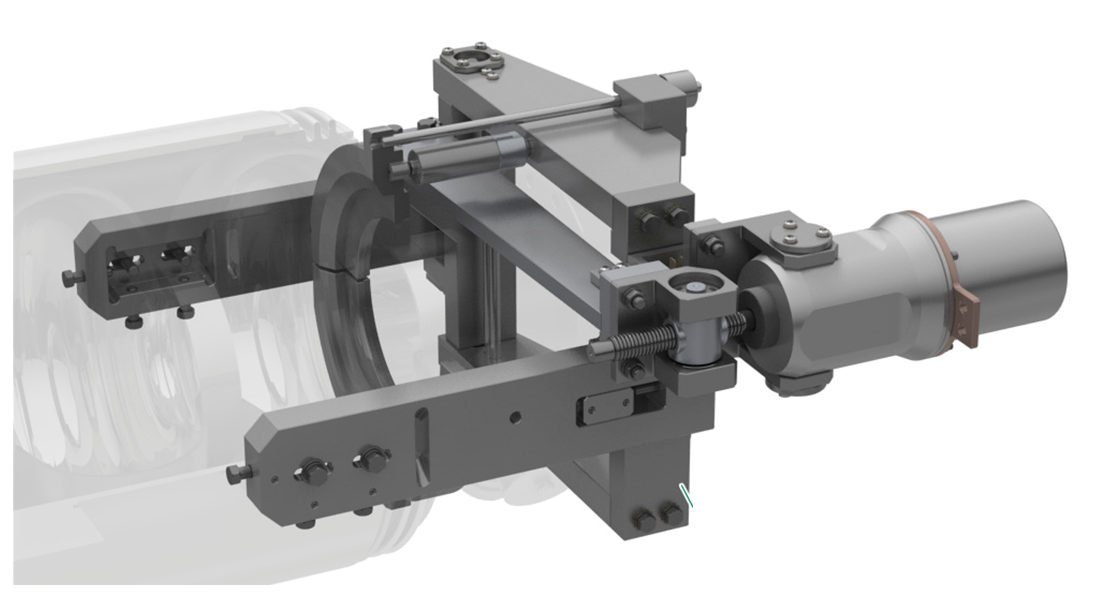
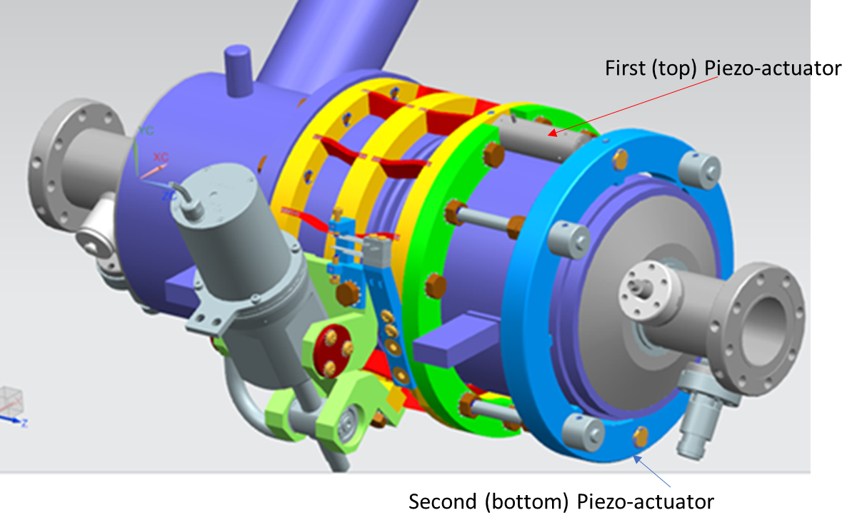
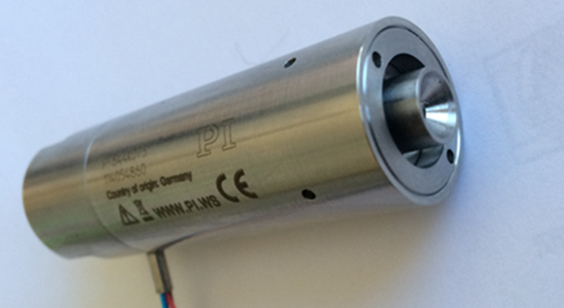
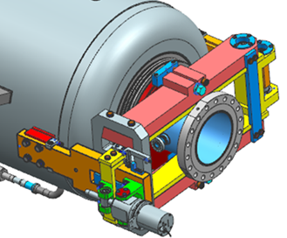
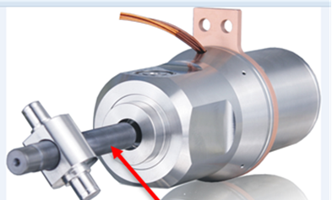
Resonance control of SRF cavities: Frequency tuners
Frequency tuners:
  Developing reliable, inexpensive, simple in installation and maintenance tuner systems
  Collaboration with industry experts to develop (and deploy) extremely reliable active tuner components: stepper motors & piezo actuators
LCLS-II
1.3 GHz cavity tuner
3.9 GHz cavity tuner
PIP-II
Piezo actuator
Electromechanical stepper motor actuator
325 MHz SSR1 cavity tuner
650 MHz cavity tuner

Slide 9
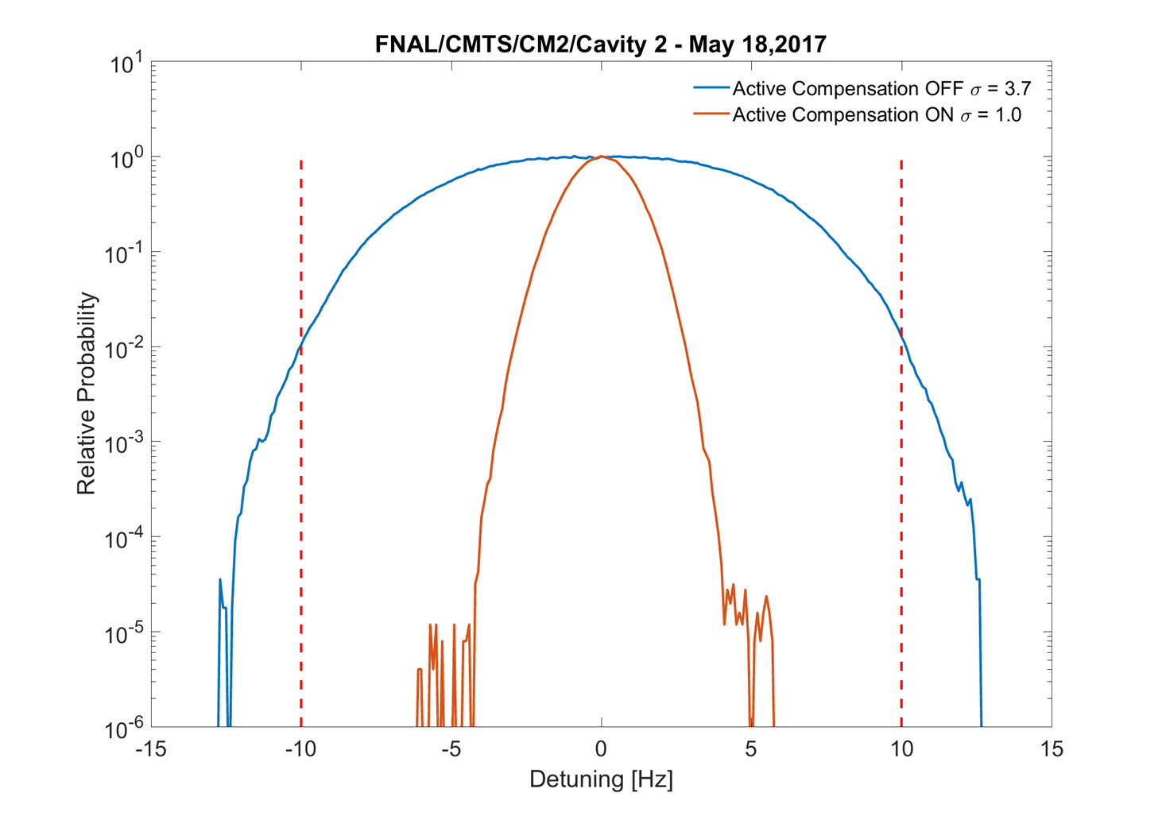
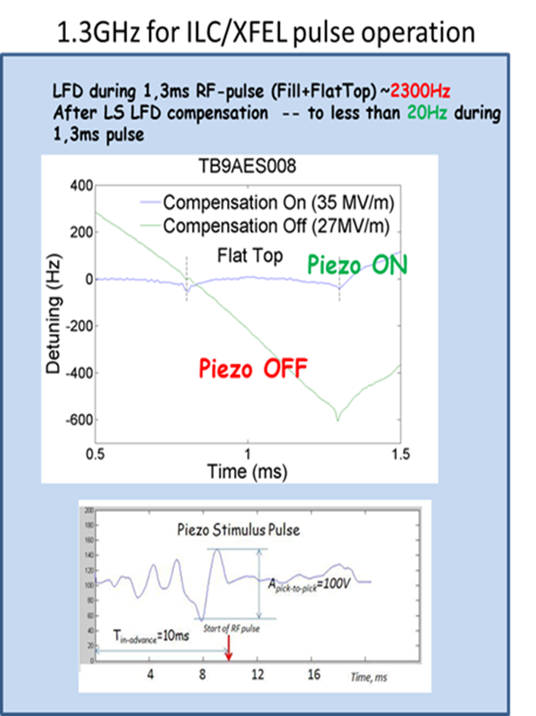
Resonance control of SRF cavities: Active compensation
Active LFD and microphonics compensation:
  Feed-forward Adaptive Least Square algorithm (for pulsed mode of operation), developed during ILC R&D program
  System deployed at FNAL (FAST cryomodules) and during S1Global collaboration
  Microphonics compensation for cavities operating in CW-mode: feedback algorithms for LCLS II Project
1.3 GHz ILC/XFEL pulsed operation
1.3 GHz LCLS-II microphonics suppression

Slide 10
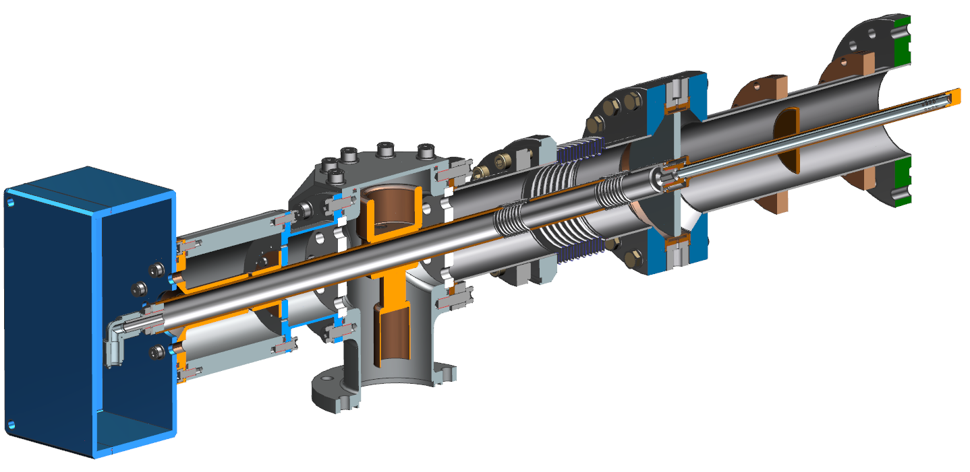
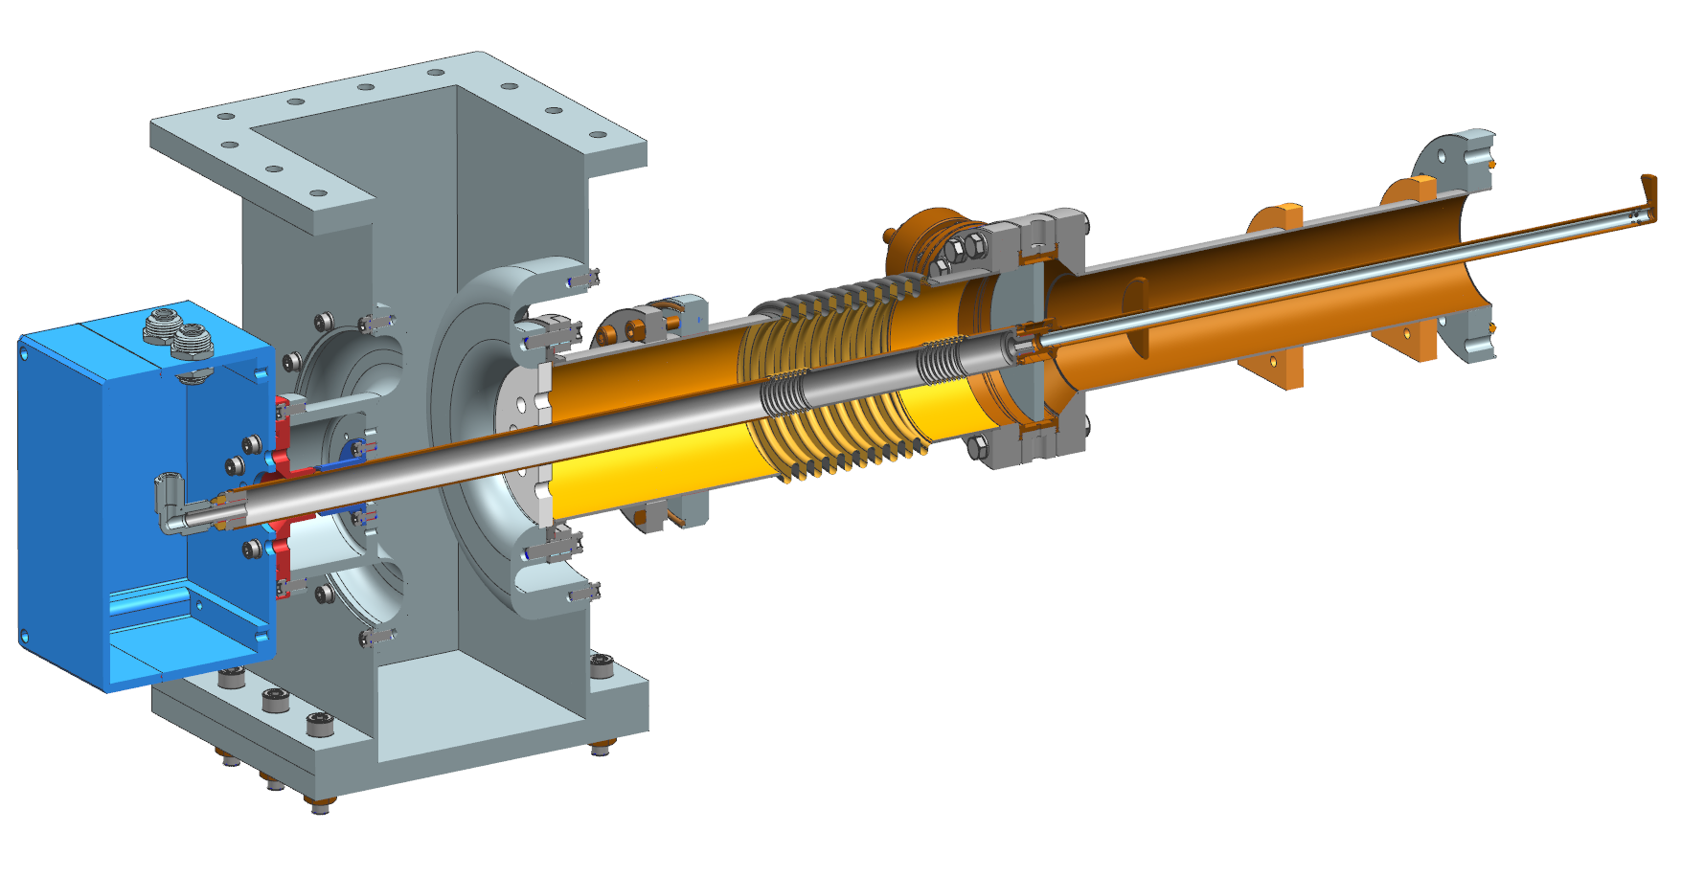
Fundamental power couplers for SRF cavities
Two examples of coaxial FPCs for PIP-II
  for 325 MHz Single Spoke Resonators (SSR2): 12 kW CW, ± 5 kV DC bias, single ceramic disc RF window, 50 K and 5 K heat intercepts, dry-air-cooled antenna
  for High-beta 650 MHz cavities (HB650): 50 kW CW, ± 5 kV DC bias, single ceramic disc RF window, 50 K and 5 K heat intercepts, dry-air-cooled antenna
SSR2 FPC assembly
HB650 FPC assembly
WR 1150 waveguide assembly
Antenna and ceramic window assembly
Capacitor assembly
Air side assembly
Vacuum gage
Vacuum end assembly
Vacuum snd assembly
T-junction
Inner conductor
Outer conductor
Instrumentation box
Instrumentation box

Slide 11
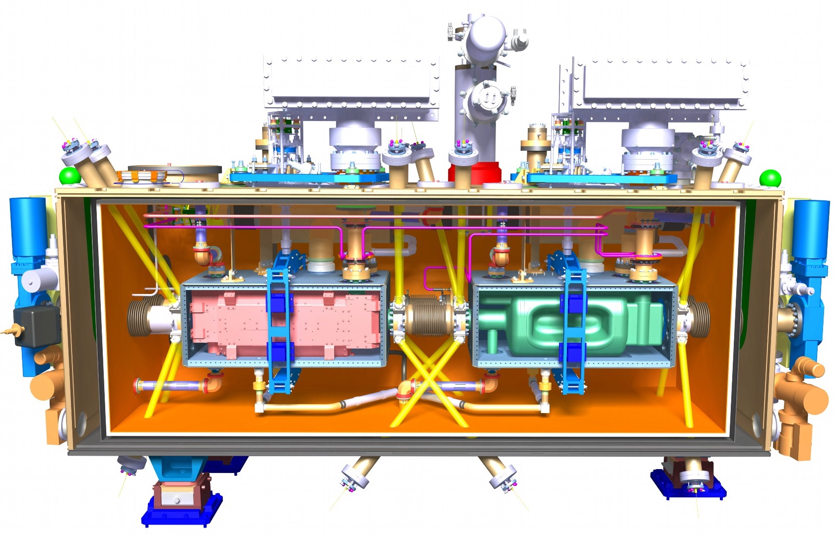
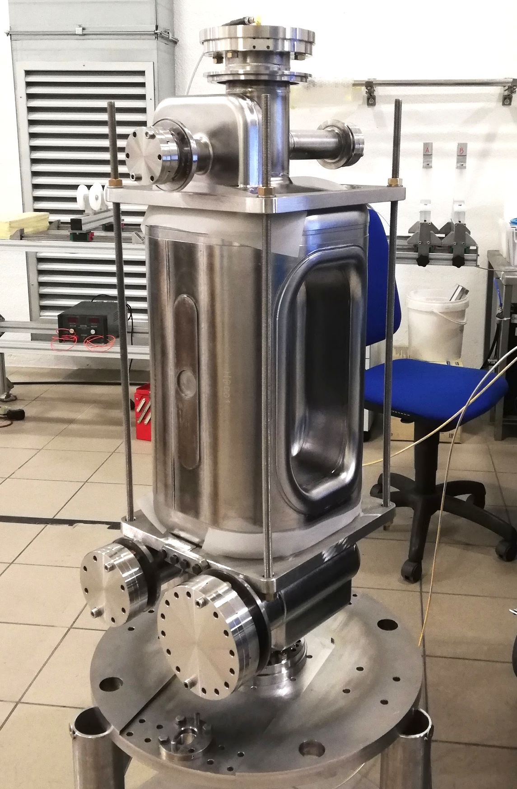
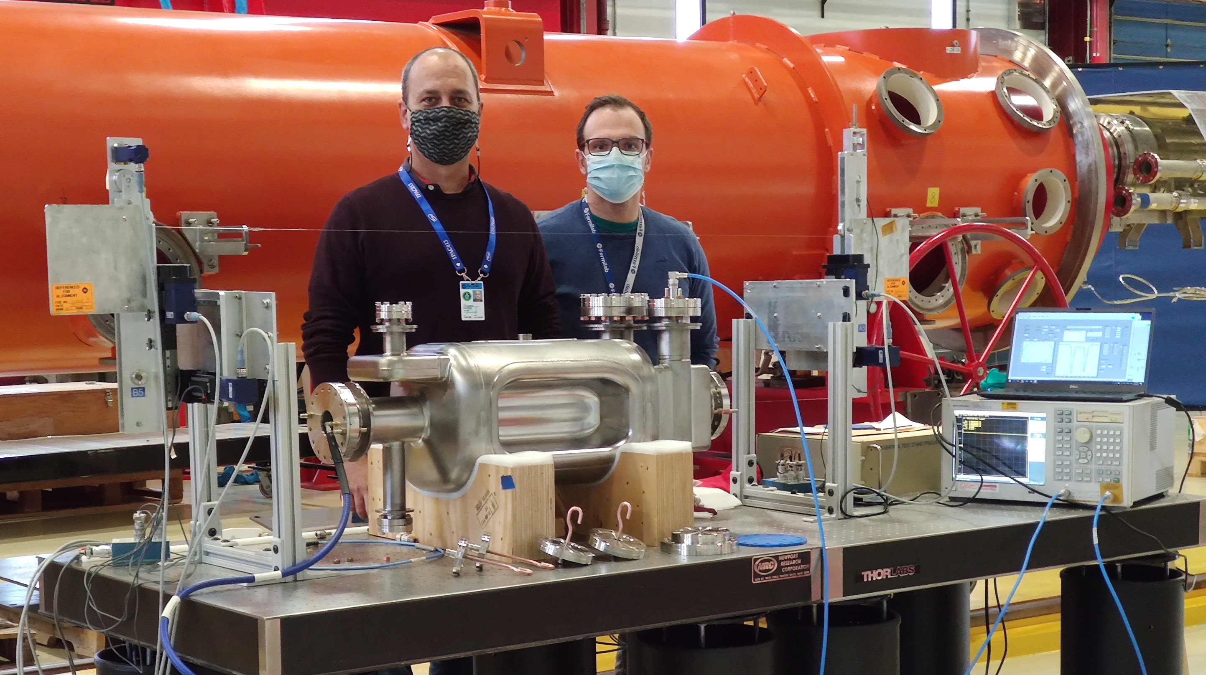
RFD crab cavities for HL-LHC
The scope of US HL-LHC Accelerator Upgrade Project (AUP) includes RF crab cavity design (RF Dipole), fabrication, and qualification. FNAL is the lead lab with contributions from SLAC, JLAB, ODU, BNL
In particular, this effort includes cavity procurement and processing + cold magnetic shield + helium vessel + HOM couplers + antennas + cold tests
The dressed cavities will be shipped to TRIUMF (Canada) for assembly of 5 cryomodules (with some components coming from CERN) and then cold validation test at CERN
Trim-tuning at Zanon
(2020)
Bead-pull measurements at FNAL on AUP Prototype #1 (Sept 2020)
Cryomodule Design (CERN)

Slide 12
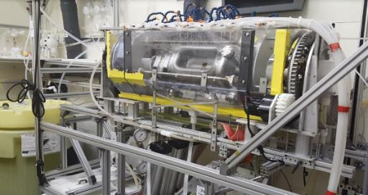
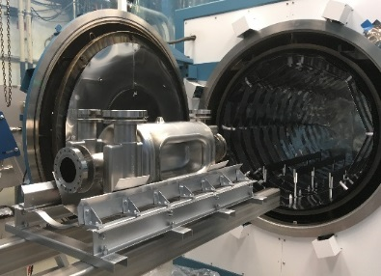
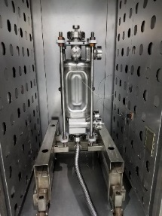
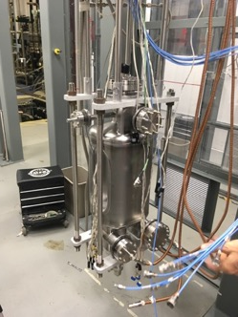
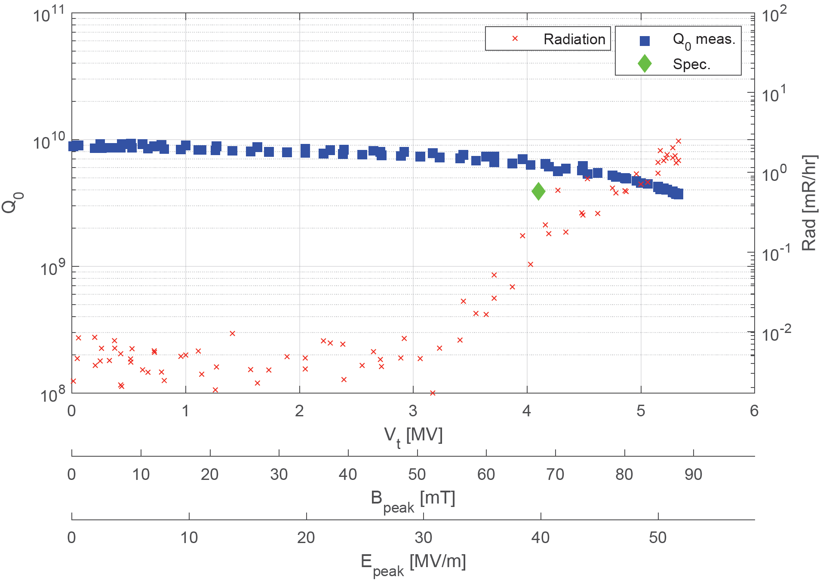
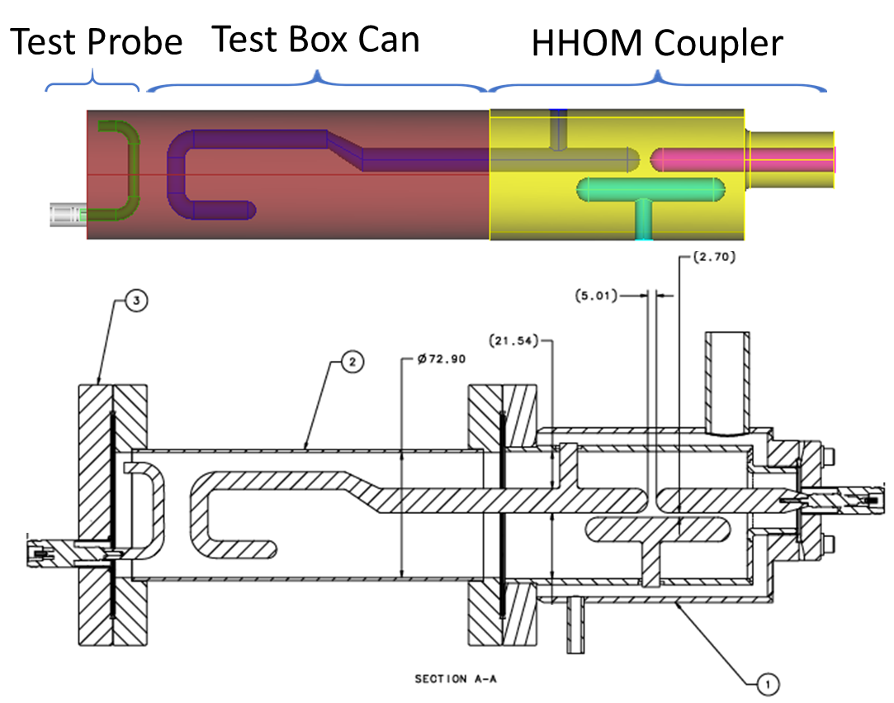
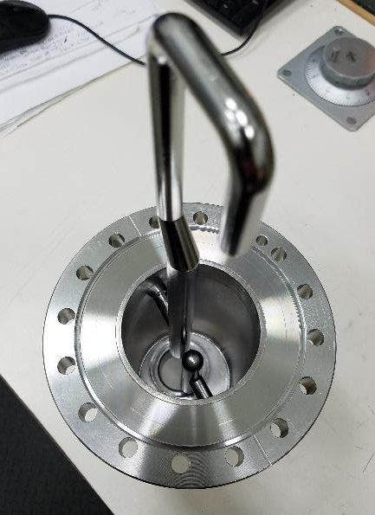
Facilities for RFD and tests
Rotational BCP tool for RFD cavity (ANL/FNAL facility)
600◦C Heat Treatment (FNAL)
120◦C Bake (FNAL)
VTS preparation (FNAL)
RFD-LARP-001 exceeded requirements for HL-LHC after processing at FNAL/ANL
AUP successfully qualified RFD crab cavities with both HOM dampers installed

Slide 13
LCLS-II
LCLS-II was the first large-scale SRF CM production for Fermilab
The scope was to design, build, test and deliver (17) 1.3 GHz and (3) 3.9 GHz CMs. JLAB is delivering the other ~50% of CMs
XFEL-like CMs, but operating in CW mode, nitrogen-doped cavities (1.3 GHz)
Results exceed specifications
  1.3 GHz energy gain/CM = 158 MV (spec 128 MV), average Q₀ = 3x10¹⁰ (spec 2.7x10¹⁰)
  3.9 GHz energy gain/CM = 46.5 MV (spec 41 MV), average Q₀ = 3.45x10⁹ (spec 1.5x10⁹)
Final cryomodule ships to SLAC in February 2021
Many lessons learned and incorporated during the product run
For future projects
  When pushing the state of the art for SRF performance, ensure adequate time for R&D, prototyping, qualification of vendors and feedback of initial test results into production
  When adopting a previous design, pay strict attention to design changes even if deemed to be minor
  Incorporate transportation requirements into the design process
LCLS-II cryomodule at CMTF

Slide 14
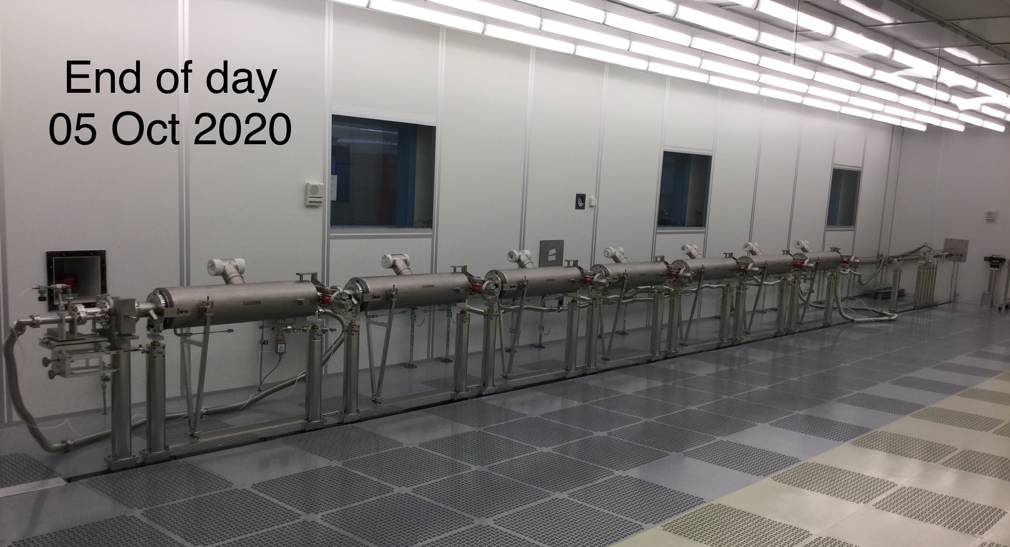
LCLS-II-HE
For High-energy upgrade of LCLS-II, LCLS-II-HE, Fermilab will build one verification CM and 10+ 1.3 GHz CMs
  Same CM design with minor changes based on lessons learned
  New cavity treatment (2N0 nitrogen doping + cold EP) to reach higher gradient at the same Q₀
  Successful transfer of protocols to industry
  Performance of 10 cavities exceeded specification with
  average Q₀ = 3.6x10¹⁰ and E_{acc} = 25.6 MV/m
  8 fully dressed cavities are ready for vCM
7 LCLS-II-HE cavities are assembled into vCM string

Slide 15
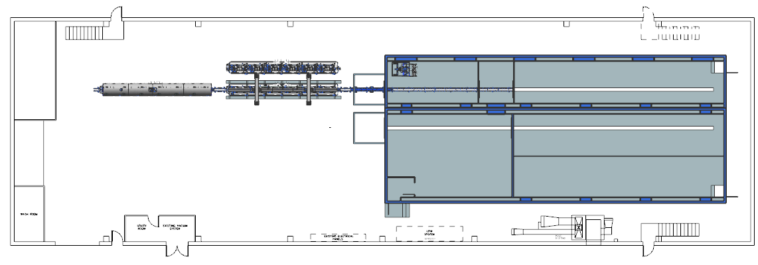
Cryomodule assembly at Fermilab
The throughput is one cryomodule per month (single production line for LCLS-II, limited by cavity availability and CM testing, not assembly)
After adding second production line (already funded), two cryomodule production per month can be achieved
Some production capacity will be available after CM production for LCLS-II-HE is complete
Existing Clean Room 1 New Clean Room 2
PIP-II cryomodule
WS2
WS1
LCLS-II cryomodule
WS1
WS2
WS0

Slide 16
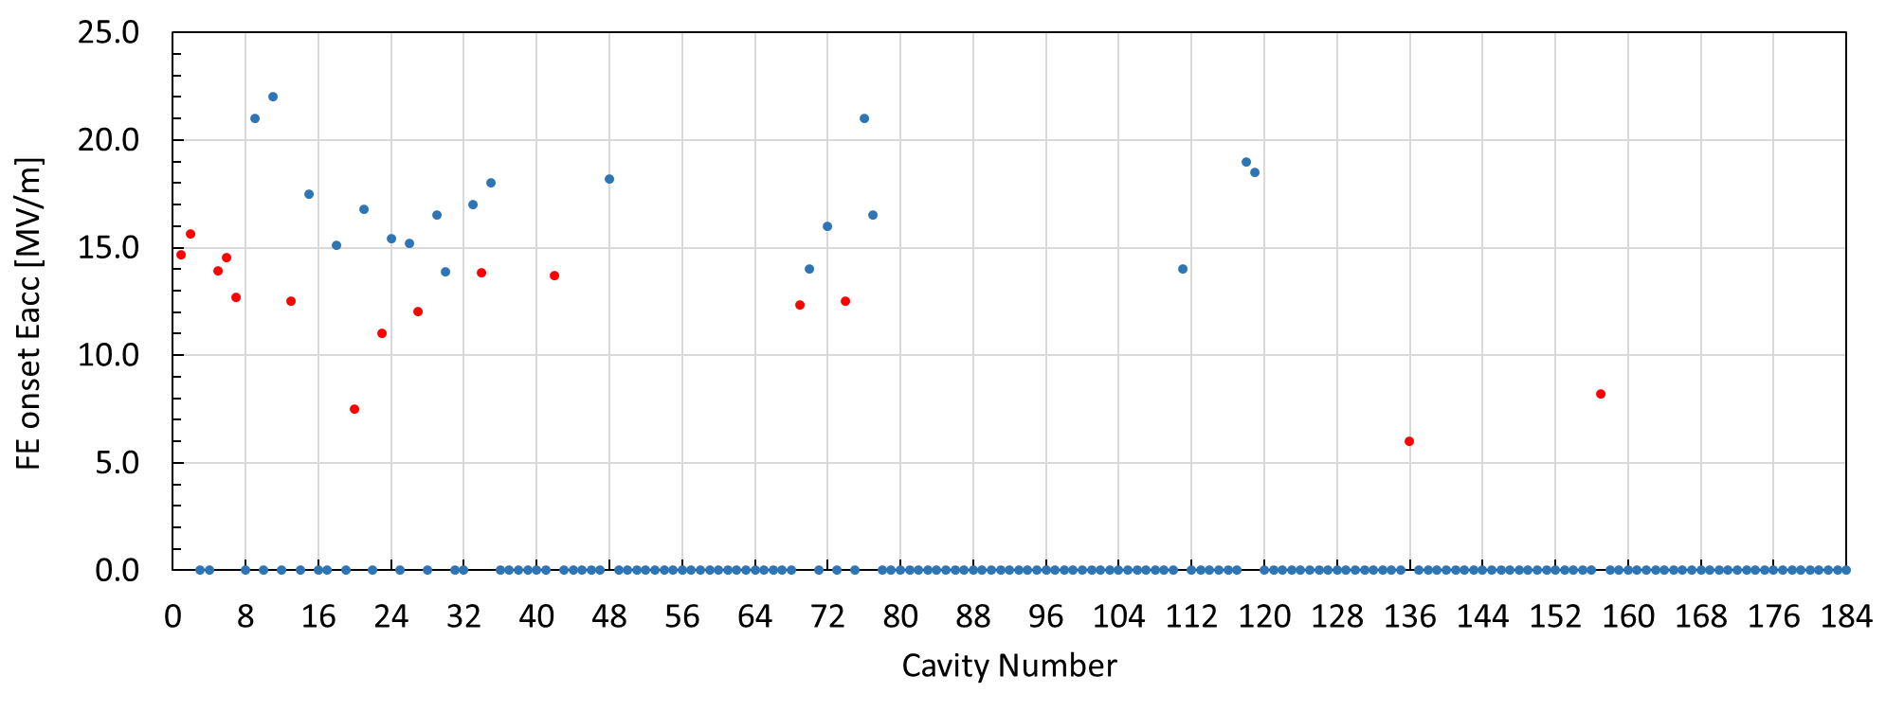


Achieving FE-free cryomodules
Twenty 1.3 GHz cryomodules + three 3.9 GHz cryomodules
Performance-limiting field emission
Non-performance-limiting field emission
No X-ray detected

Slide 17
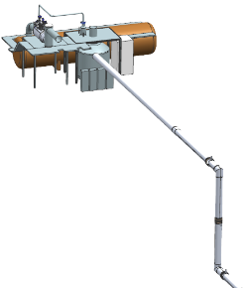

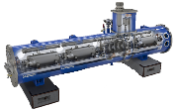


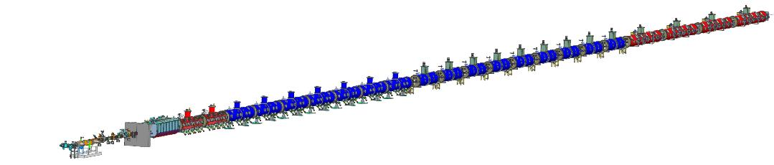

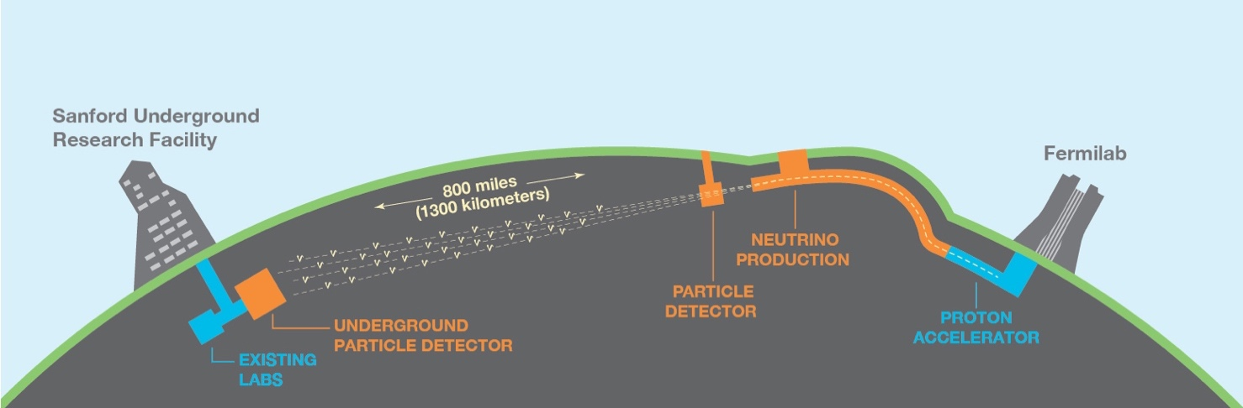
PIP-II superconducting CW linac
PIP-II linac is technically complex, state of the art superconducting RF accelerator
Elliptical HB650
Cryoplant
Elliptical LB650
Single Spoke SSR2
Single Spoke SSR1
Half Wave
833 MeV
516 MeV
RFQ
177 MeV
Superconducting
H- ion source
32 MeV
2.1 MeV
10 MeV
Room Temperature

Slide 18
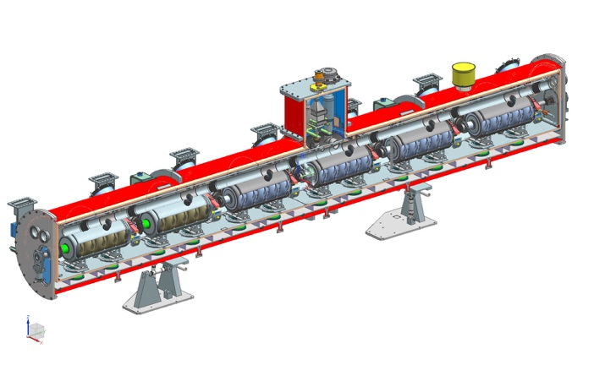
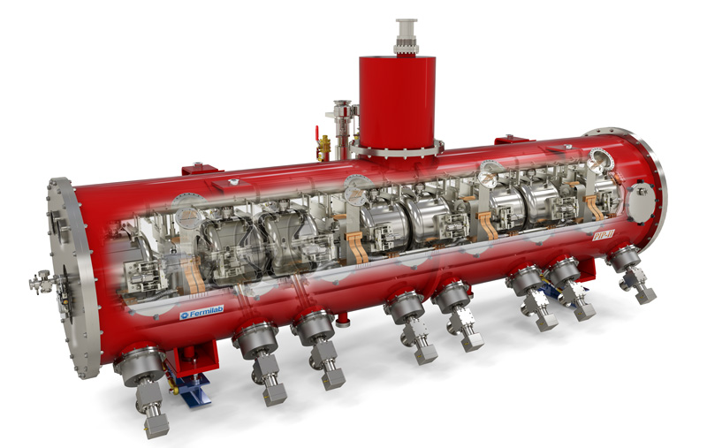
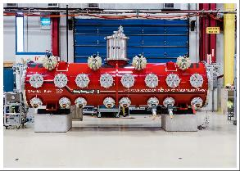
PIP-II cryomodules
All PIP-II cryomodules are of a strongback type
Single Spoke Resonator (SSR1)
High-beta 650 MHz (HB650)
SSR1 is at 2 K, RF tests in progress

Slide 19
Summary for SRF
A number of ways Fermilab can potentially contribute to EIC in the area of SRF:
  Complete SRF systems for a particular accelerator (pulsed or CW) from design to testing
  Smaller systems, e.g. crab cavities
  Cryomodule procurement and FE-free assembly, experience with different types of cryomodules: ILC/XFEL type (long string of interconnected cryomodules) and segmented cryomodules (strongback design for PIP-II)
  Developing customized cavity treatments
  Developing sub-systems and components, e.g. resonance control and frequency tuners, fundamental power couplers

Slide 20
Magnets

Slide 21
SC magnets at Fermilab
Fermilab has capability to perform electromagnetic and mechanical design, manufacture and test SC magnets for projects and R&D
NbTi (since Tevatron times) and Nb₃Sn technologies are readily available, developing HTS capabilities
Examples
  Projects
    Q1/Q3 IR quadrupoles for Hi-Lumi LHC / US HL-LHC Accelerator Upgrade Project (AUP)
    LCLS-II / LCLS-II-HE SC magnet package (combined quadrupole and two dipole correctors)
    Solenoids for Mu2e experiment
    CLAS12 toroidal coils
  R&D
    LARP quadrupoles
    US Magnet Development Program dipoles
    Small conduction-cooled SC HTS magnet magnets for linacs

Slide 22
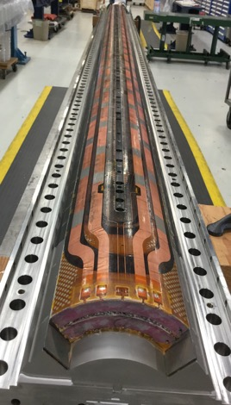


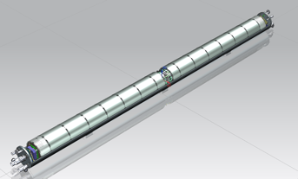
US HL-LHC AUP
US contribution to HL-LHC includes Q1/Q3 IR quadrupole magnets (10 cryoassemblies with 2 Nb₃Sn magnets in each)
Multi-lab collaborative effort:
  Cable fabrication at LBNL
  Coil production at FNAL and BNL
  Magnets are assembled at LBNL and vertically tested at BNL
  Cold mass and cryoassembly at FNAL
  Cryoassembly horizontal test at FNAL
MQXFA
Magnet
Coils
Cold Mass
Assembly
Cryo-Assembly

Slide 23
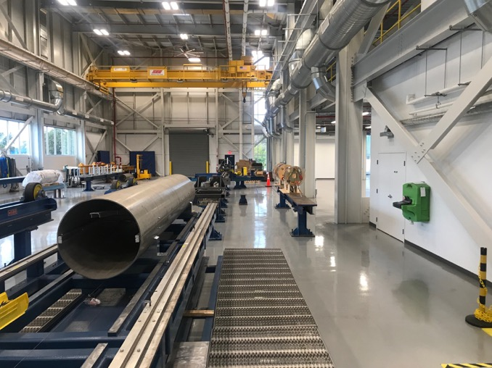
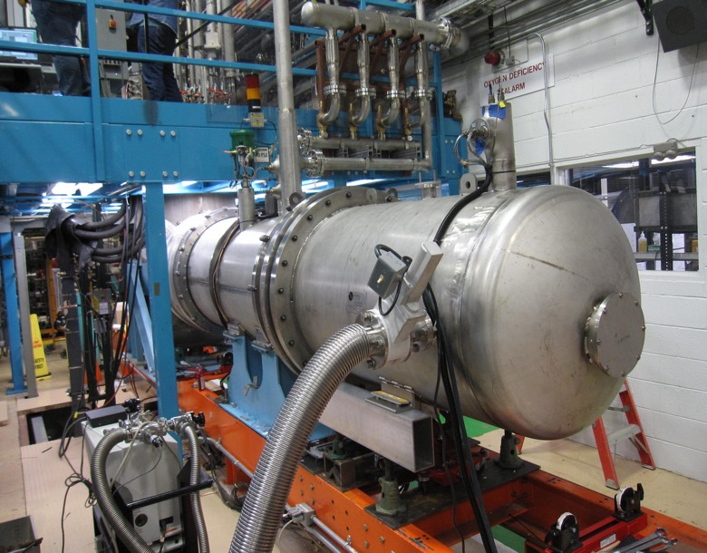
US HL-LHC AUP facilities
New assembly facility
Upgraded cryostat horizontal test stand – the only commissioned test location for cryostatted magnets
New IBC-A Building
Test Stand 4 @ Fermilab
Cold Mass Welding Table under Alignment
Upgraded Horizontal Test Stand at Fermilab

Slide 24
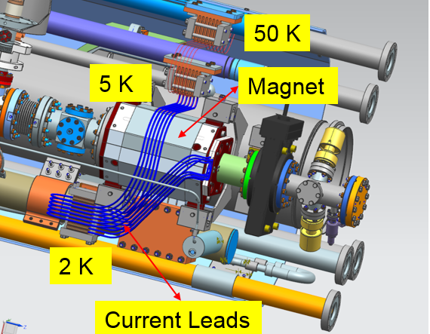
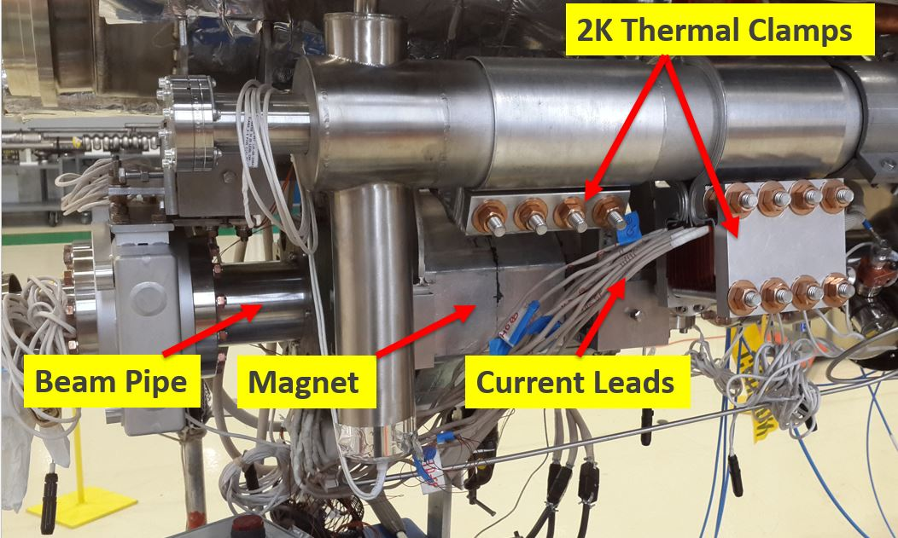
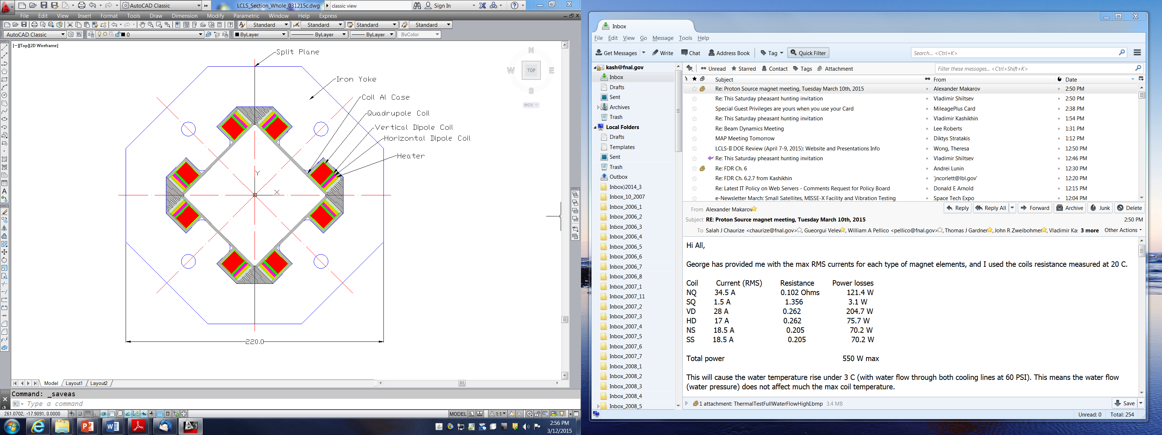
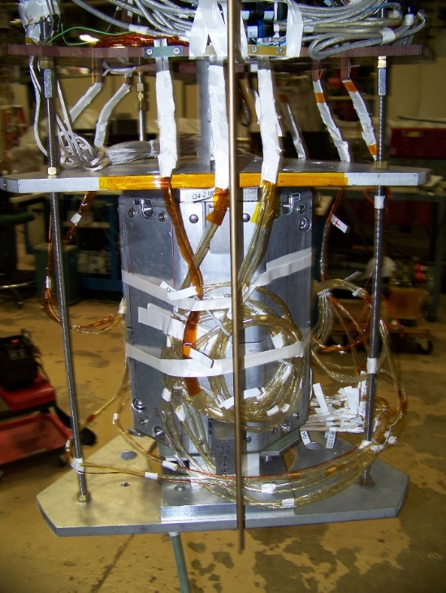
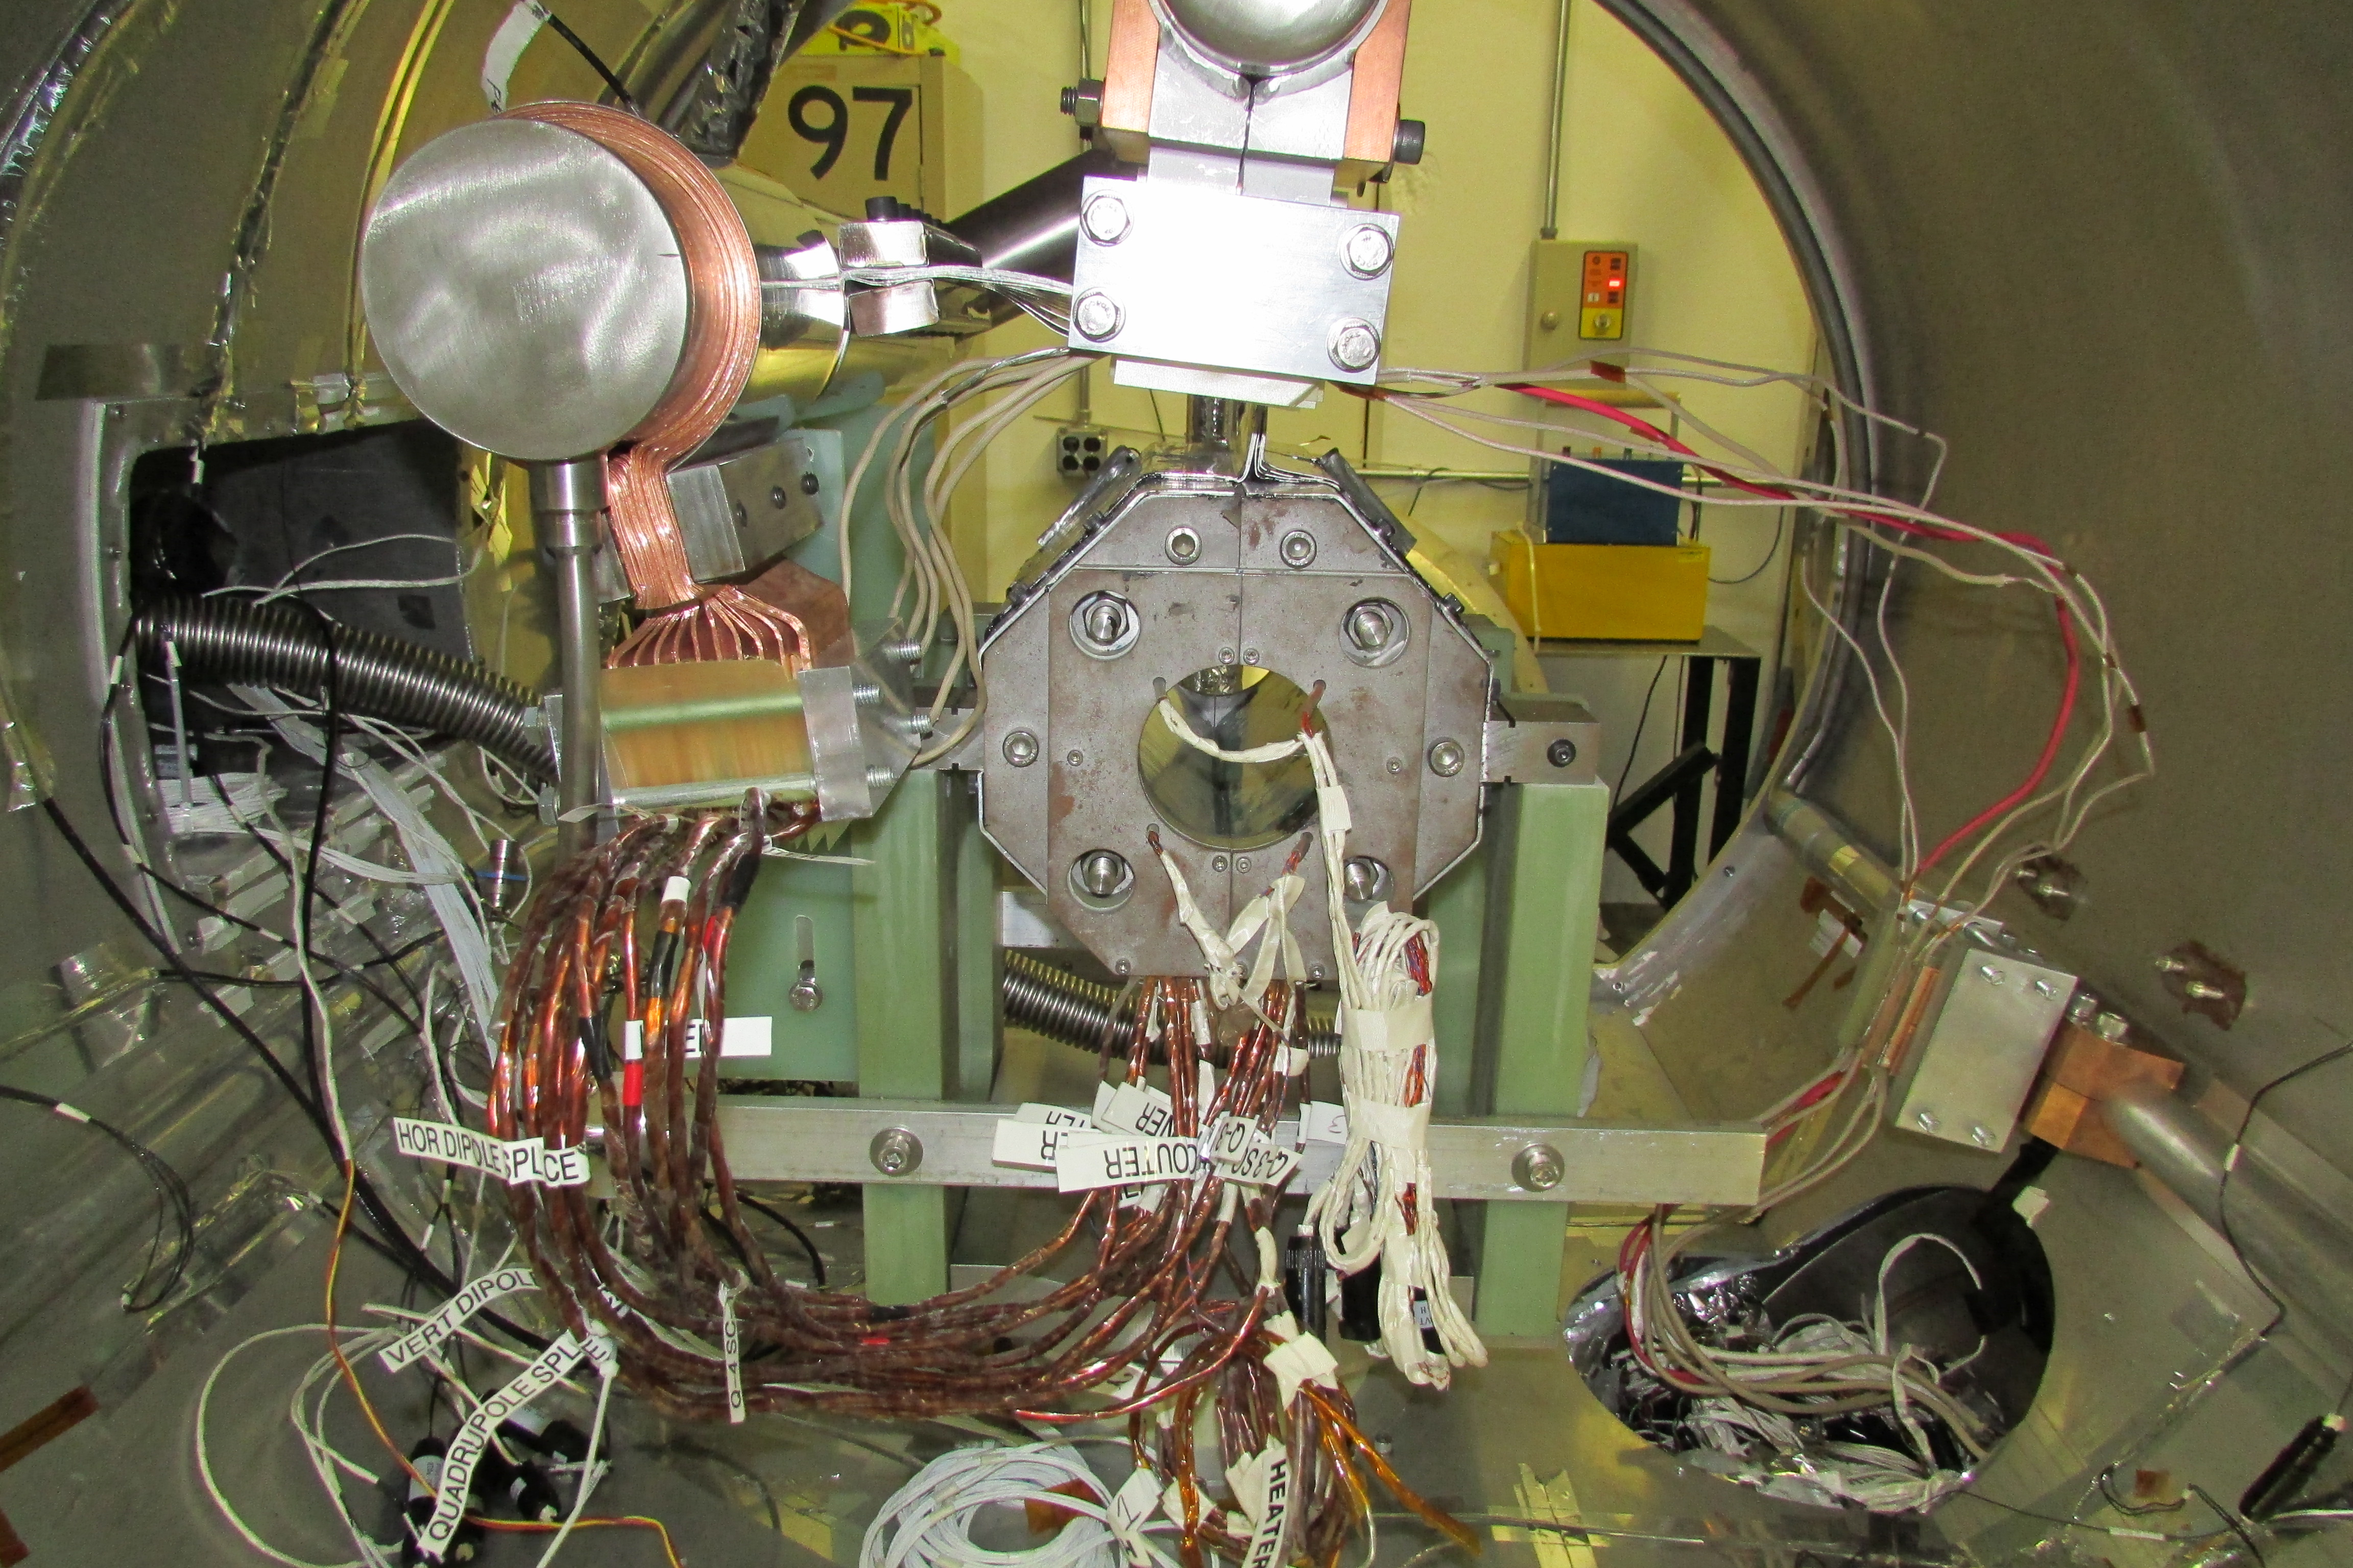
SC NbTi magnet package for LCLS-II / LCLS-II-HE
Splittable conduction-cooled quadrupole magnet combined with 2 dipole correctors
Magnet cross-section LHe bath test Conduction cooling test

Slide 25
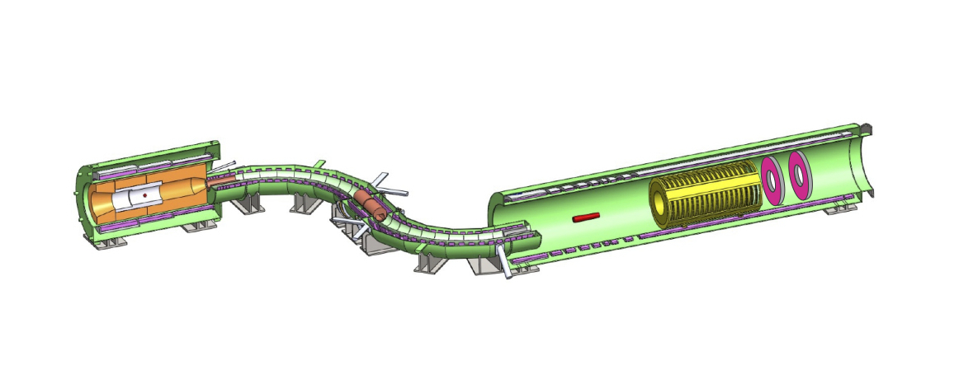
Mu2e solenoids
Mu2e detector is embedded in a series of SC solenoids
The magnets are designed to create a low-energy muon beam that can be stopped in a thin aluminum stopping target and provide a constant magnetic field for accurate measurement of momentum of electrons
Large NbTi magnets
  Production Solenoid (PS): 12 ft long, 4.5 T
  Transport Solenoid (TS): (2 magnets): 40 ft long, 2 T
  Detector Solenoid (DS): 30 ft long, 1 T
Transport Solenoid
Production Solenoid
Detector Solenoid

Slide 26
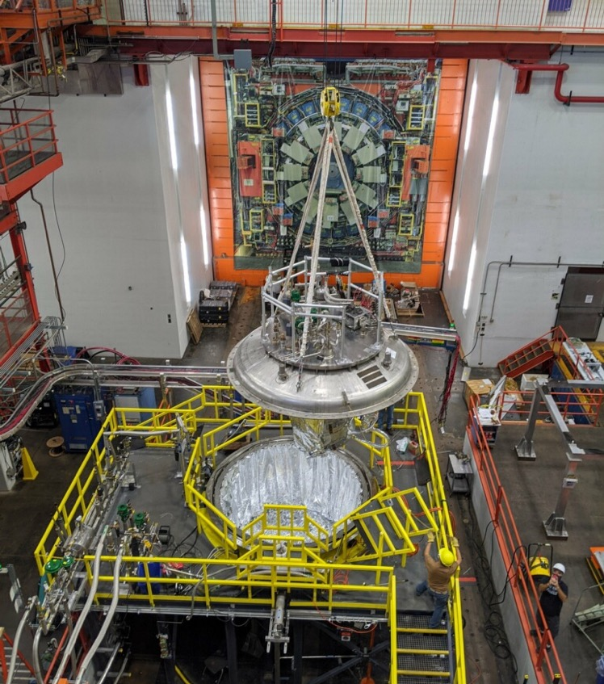
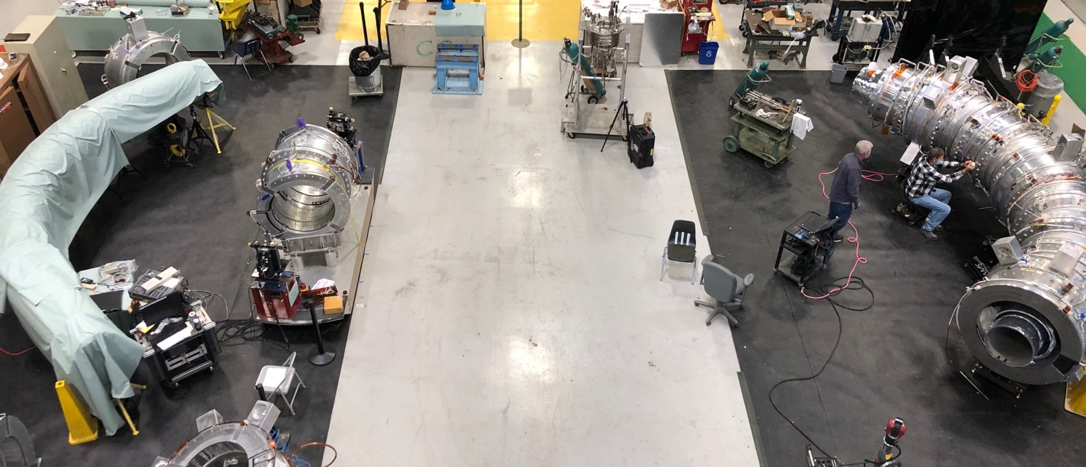
Mu2e TS testing and assembly area
Dedicated area for Transport Solenoids
Cryogenic vacuum vessel for testing conduction-cooled superconducting magnets
Tevatron satellite LHe refrigerator providing 600 W @ 4.5 K
2,500 A power supply
Quench detection and energy extraction system
Nano-ohm splice resistance measurement system
50 T crane coverage
Air bearing system for handling
Magnetic measurement system: vibrating stretched wire
Building metrology network
Ultrasonic welding machine
Bespoke lifting fixture and tooling

Slide 27
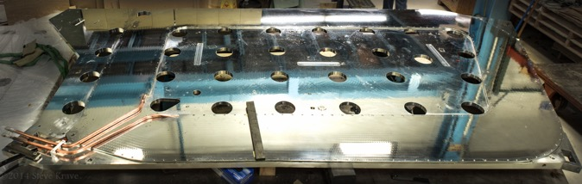
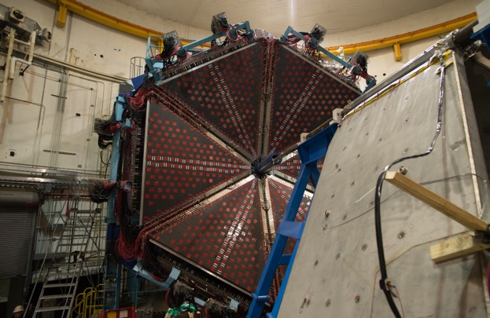
CLAS12 toroidal coils
The toroidal magnet coils (8) for CLAS12 experiment were fabricated at Fermilab and delivered to JLAB
Reached the operating current of 3,770 A – never quenched
Torus coil
JLAB CLAS12 torus

Slide 28
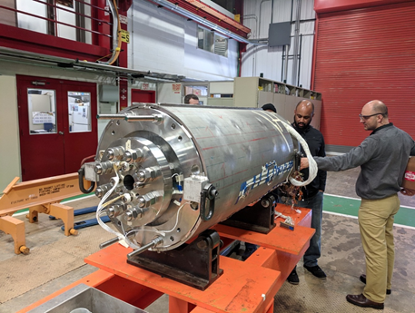
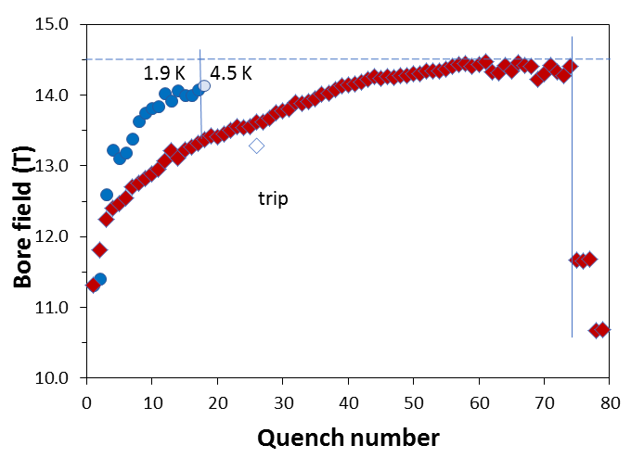
US MDP R&D: 15 T dipole demonstrator
1 m long, 60 mm bore diameter Nb₃Sn dipole magnet
The magnet achieved record fields for accelerator type dipole: 14.5 T at 1.9 K and 14.1 T at 4.5 K
Paving way toward 16-17 T magnet
14.5 T
Magnet assembly

Slide 29




Novel SC HTS magnets for linacs
The main goal of this R&D is to design, fabricate, and test the novel configuration of HTS multipole magnets with circular coils
Advantages:
  Round coils make possible to use HTS react and wind technology, one coil could generate multipole field
  Magnet could operate at elevated temperatures up to 77 K
Secondary Coil
Primary Coil
HTS quadrupole test setup
Single coil quadrupole
Double Coil Sextupole

Slide 30
High Field Vertical Magnet Test Facility (HFVMTF)
New HFVMTF is under construction at Fermilab
Cable testing:
  Dipole background magnetic field – 15 T at 1.9 K
  Samples will be placed in an anti-cryostat providing variable temperature between 4.5 K and 55 K
Testing high field superconducting magnets, including hybrid magnets, produced by the U.S. MDP
Jointly funded by of DOE offices of HEP and FES.
High Field Vertical Magnet Test Facility

Slide 31
Room temperature magnets
Design and manufacture of room temperature magnets for Fermilab accelerator complex and other DOE Labs (recent examples: ANL, ORNL). A large variety, from permanent magnets to injection/extraction kicker magnets with fall/rise time of 50-100 ns, to dipoles running CW at 5 MHz for the Mu2e extinction system.
We develop specialized magnets, such as
  Gradient magnets
  Pulsed septum magnets
  Injection and extraction Lambertsons
  Complex corrector packages
Magnetic measurement analysis and development of hardware and software tools and systems for magnetic measurements

Slide 32



Magnets for Argonne APS-U
Longitudinal gradient magnet prototype
Injection Lambertson

Slide 33



Examples of Fermilab magnets
Booster ring corrector package
Pulsed septum magnet for muon delivery ring
Six magnets in one package
  Normal and skew dipole (3.24 T-m/s)
  Normal quadrupole (88 T-m/m/s)
  Skew quadrupole (0.8 T-m/m/s)
  Normal and skew sextupole (2350 T–m/m²/s)

Slide 34



Magnetic measurements & Quench protection
Probe development – printed circuit boards are routinely used for rotating coil probes, featuring
  micron level placement of wires; multi-layer designs with high sensitivity
  geometries which allow high levels of suppression of effects from main fields (“bucking”)
  cost effective way of building probes
  Designed and built probes for ANL and LBNL, have a contract with BNL
Newly-built rotating coil and Single Stretched Wire Systems (SSW) for alignment and harmonics measurements. A SSW system was built for KEK
New Quench Protection and Monitoring system was designed and assembled for the cryo-assembly horizontal test
  Three-tier design: Tier 1 – primary QD, Tier 2 – secondary QD, and Tier 3 – System Monitoring and Data Management
Next Generation of Digital Quench Protection and Monitoring System.
Chassis with 32 Isolated Analog Channels and Digital Controller.

Slide 35
Summary for Magnets
Potential Fermilab contributions to EIC in the area of Magnets:
  SC NbTi or Nb₃Sn magnets: design, fabrication and testing (vertical and horizontal)
  Small conduction-cooled HTS magnets
  Specialized normal conducting magnets
  Probes for magnetic measurements
  Quench protection systems

Slide 36
Cryogenics

Slide 37

Cryogenic distribution systems development at Fermilab
Fermilab has extensive experience in developing CDS for projects
Scope of work includes
  Developing reference model designs
    Used as input for project tunnel space allocation
    Used as input for final design and build to specification procurements
  Developing procurement specification and managing procurements
  Fabrication of multi-channel cryolines
  Installation
Recent project experience
  Mu2e Experiment at Fermilab (2012 – 2021)
  LCLS-II at SLAC (2013 – 2018)
  LCLS-II High Energy at SLAC (2020 – 2024)
  PIP-II at Fermilab (2018 – 2025)

Slide 38

Mu2e cryogenic distribution
Features
  Four superconducting solenoids refrigerated by two repurposed Tevatron Satellite Refrigerators (1,200 W @ 4.5 K)
  One Distribution and four Feed cryogenic valve boxes allow for independent solenoid cooldown and warmup
  Unique cryogenic superconducting transfer lines route both cryogens and power to the solenoids
  Solenoid commissioning in 2022

Slide 39

LCLS-II tunnel cryogenic distribution system
Project awarded to vendor: 2016
Delivery and installation: 2017
Features
  Consists of Feed Caps, End Caps and Transfer Lines
  Supplies all cryogenic circuits to cryomodules
  Creates cryogenic bypass for warm beamline components
  Transfers vacuum loading to the floor

Slide 40

LCLS-II Distribution Box
Project awarded to vendor: 2016
Delivery and installation: 2018
Features
  Connects cryomodules in the linac tunnel with surface portion of cryogenic distribution
  Provides pressure relieving for all process lines for linac cryomodules and cryogenic distribution system
  Contains central 4 K to 2 K heat exchanger for flow to cryomodules

Slide 41


PIP-II cryogenic distribution
Features
  Contains 200 m of transfer line containing six cryogenic pipes
  Distribution valve box for flow control and relieving of each cryogenic circuit
  25 bayonet cans to connect cryomodules using U-tubes

Slide 42
Summary for Cryogenics
Fermilab has expertise and recent experience in developing cryogenic distribution systems (CDS) for internal and external projects (SRF accelerators and detectors)
This might be a contribution to EIC

Slide 43

Thank you!

