Slide 1
EIC Electron Storage Ring
Christoph Montag, BNL
EIC Accelerator Collaboration Workshop
October 7-9, 2020

Slide 2
BNL EIC Design Concept
Take one RHIC ring (“Yellow”) with its entire injector complex as the EIC hadron ring
Add electron cooling to lower emittance and counteract IBS
Modify the hadron ring to be suitable for EIC beam parameters
Add an electron storage ring in the existing tunnel
Use a spin-transparent rapid-cycling synchrotron as full-energy polarized electron injector for rapid bunch replacement to counteract depolarization
Build a high luminosity interaction region that fulfills acceptance requirements

Slide 3
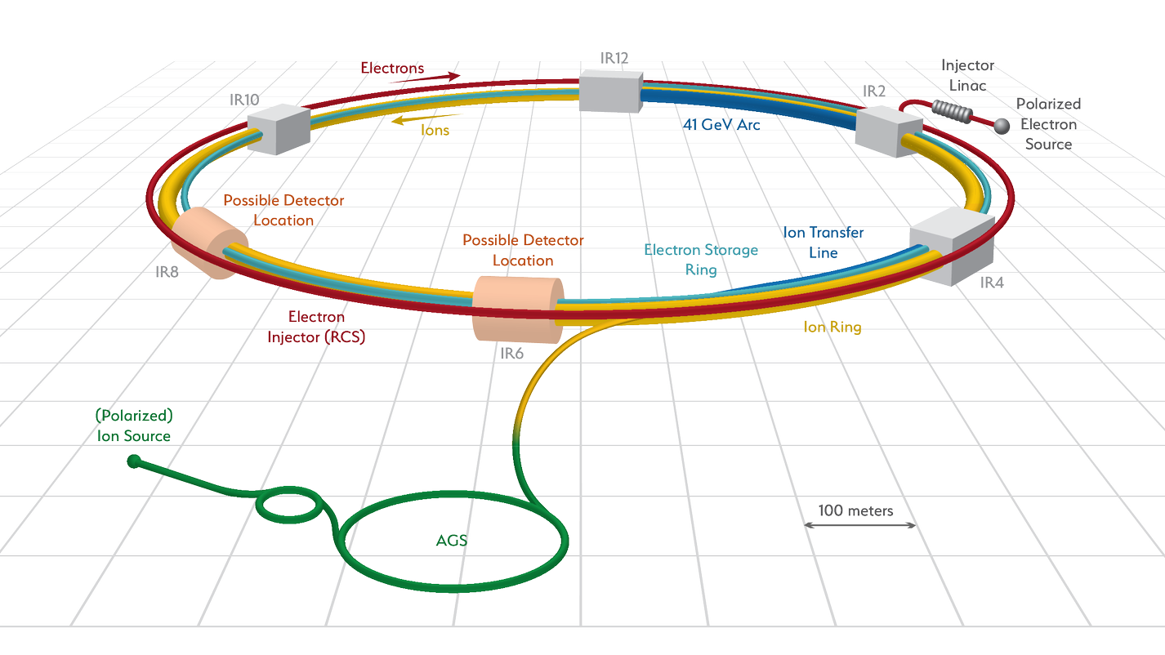
Facility layout
Electron complex to be installed in existing RHIC tunnel – cost effective

Slide 4
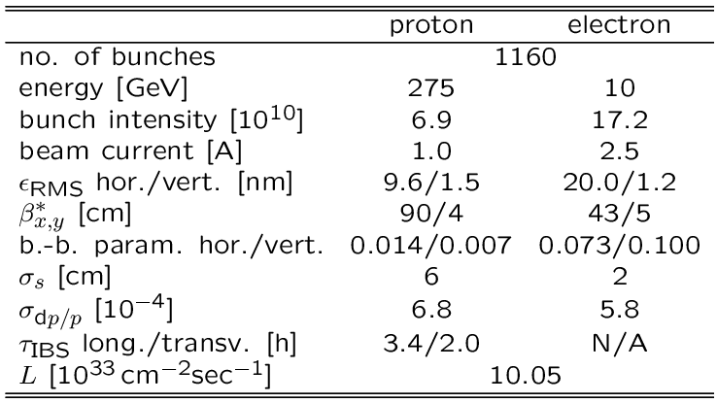
Parameters for Highest Luminosity
Hadron beam parameters similar to present RHIC, but smaller vertical emittance and many more bunches
2 hour IBS growth time requires strong hadron cooling
Electron beam parameters resemble a B-Factory

Slide 5
Electron Ring Lattice Choice
FODO cell provides highest dipole packing factor and is most cost effective
Arc cell length ~16m
EIC design requires the same horizontal electron ring emittance at all energies (5, 10, and 18 GeV)
Required emittances achieved by proper phase advance (90 degrees at 18 GeV, 60 degrees at 10 and 5 GeV), plus radial shift and/or super-bends

Slide 6
Synchrotron Radiation
Conflicting Requirements:
- At high energy, radiation power needs to be minimized by a large dipole packing factor to allow high beam currents
At low energy, synchrotron radiation power needs to be intentionally increased to optimize radiation damping, thus allowing large beam-beam parameters ξ=0.1
Solution: Super-bends

Slide 7
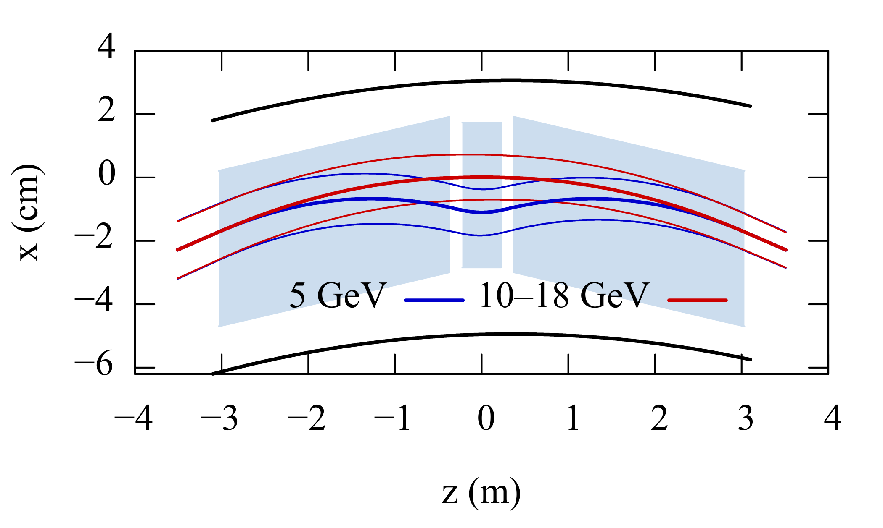
Super-Bends
Arc dipoles to be split into 3 segments:
Above 10 GeV, all segments powered uniformly to reduce SR power
At 5 GeV, short center dipole provides a reverse bend to increase damping decrement
Vacuum chamber aperture

Slide 8
Dynamic Aperture
Minimum dynamic aperture requirements:
  10 sigma transverse on-momentum aperture
  10 sigma momentum acceptance
18 GeV, 90 degree lattice is most challenging:
  Additional constraints on phase advance to first sextupoles in the arc
  Large RMS momentum spread, nearly 1e-3
Strategy:
  Compensate chromatic β-beat over two arcs on each side of the IP
  Correct nonlinear chromaticity

Slide 9
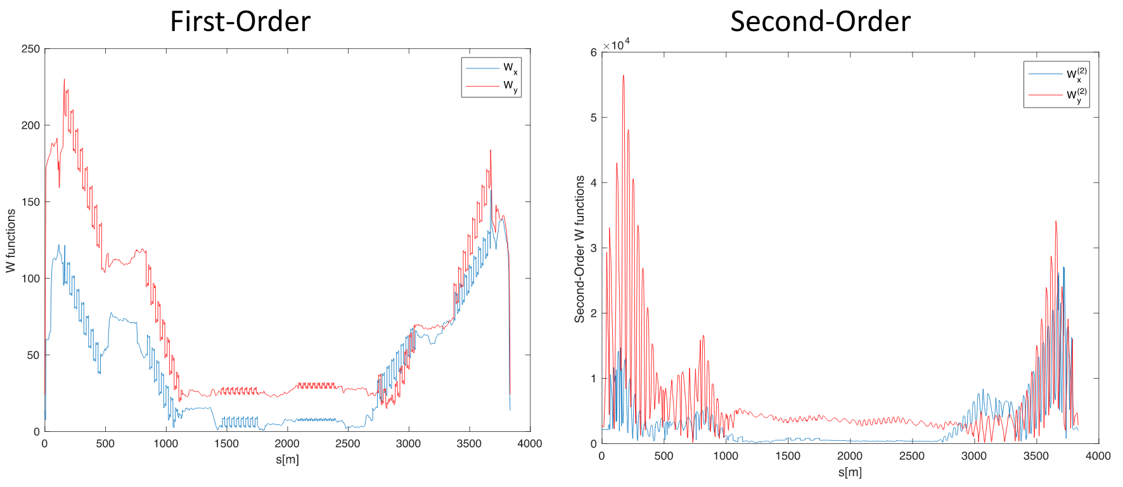
Off-Momentum β-Beat
First and second-order chromatic β corrected over two arcs on each side of the IR

Slide 10
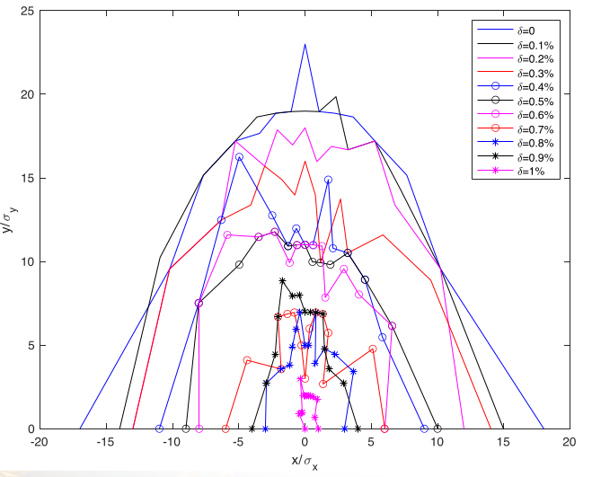
Dynamic Aperture at 18 GeV, 90 degree lattice
17 sigma transverse dynamic aperture
1% momentum acceptance (10 sigma)
Results obtained with 10 GeV, 60 degree lattice indicate sufficient margin for misalignments and magnet multipole errors

Slide 11
Dynamic Aperture with two IRs
Each IR is a large source of off-momentum β-beat
If the two IRs (sources) are 90 degrees betatron phase apart, the off-momentum β-beat forms a closed “β-bump”
Remainder of the ring has very little off-momentum β-beat
Concept was successfully applied at HERA

Slide 12
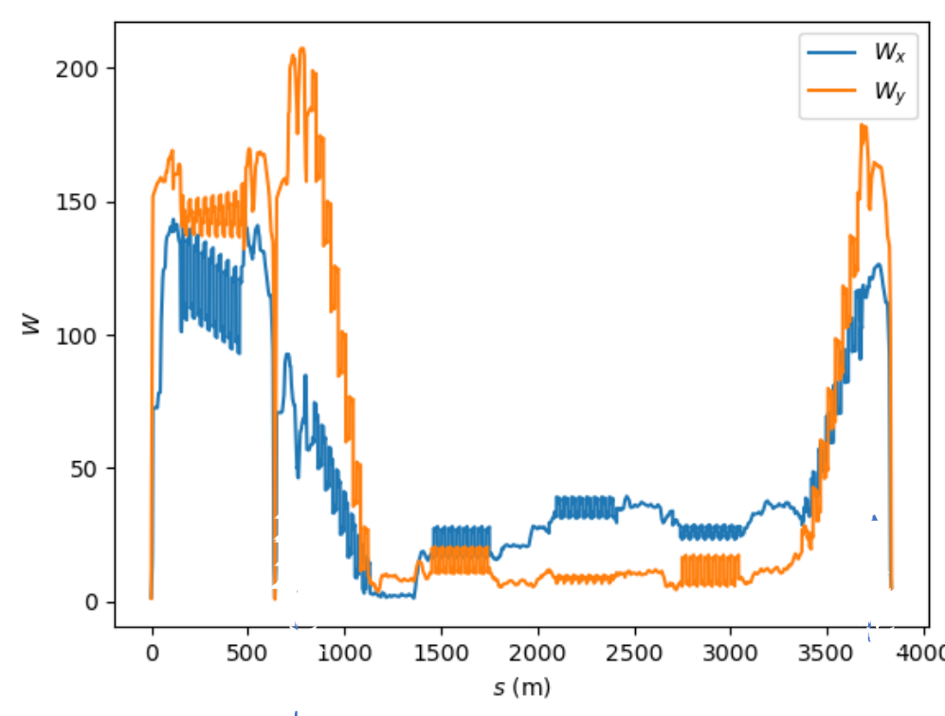
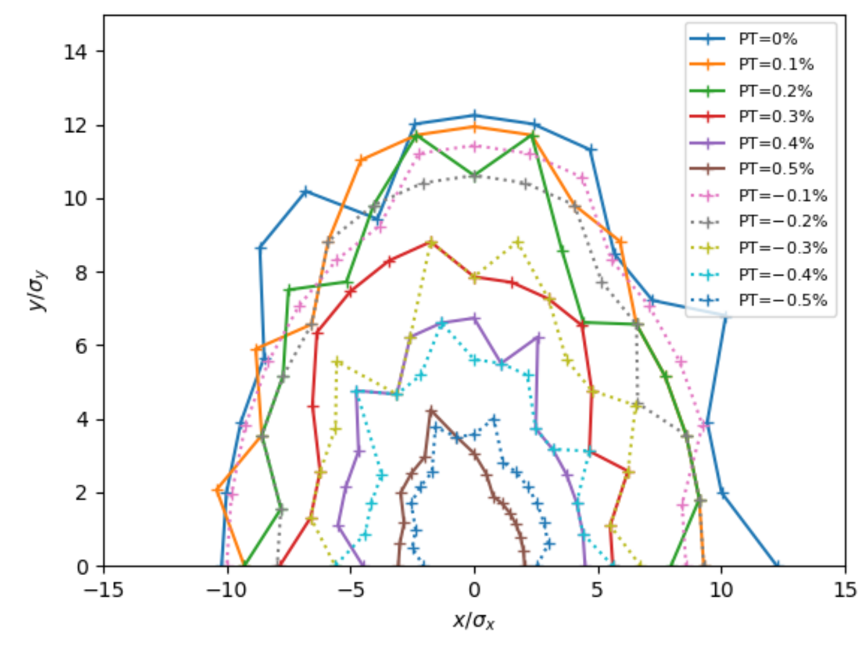
Closed “β-bump” and dynamic aperture with two IRs
10 sigma on-momentum dynamic aperture, 0.5% momentum acceptance with relatively simple sextupole scheme
Further optimization of sextupole families underway
See talk by Yunhai Cai

Slide 13
Polarization in the ESR
Experiments require both spin “up” and “down” in the same store – need a full energy polarized injector (Bunch replacement by Rapid Cycling Synchrotron, RCS)
High initial polarization of 85% will decay towards equilibrium polarization P∞ due to Sokolov-Ternov effect
Time evolution of high polarization of bunches injected into the ESR at 18 GeV (worst case)
B P
Re-injection
B P
Refilled every 1.4 minutes
Refilled every 4.2 minutes
85%
P_{av}=80%
P∞= 40%
-85%
Re-injections

Slide 14
Spin Rotators
Experiments require longitudinal polarization, while spin in arcs is vertical
Solenoid based spin rotators, based on 105 Tm, 7 T solenoids followed by 92 mrad dipoles
Spin rotator modules are long “blocks” of fixed geometry – challenging to fit into existing tunnel

Slide 15
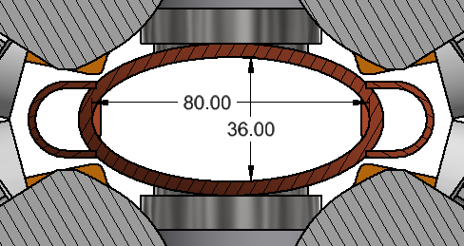
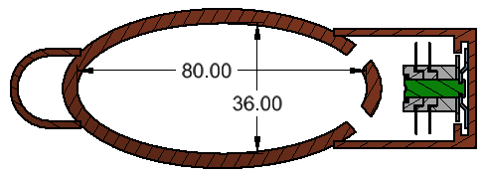
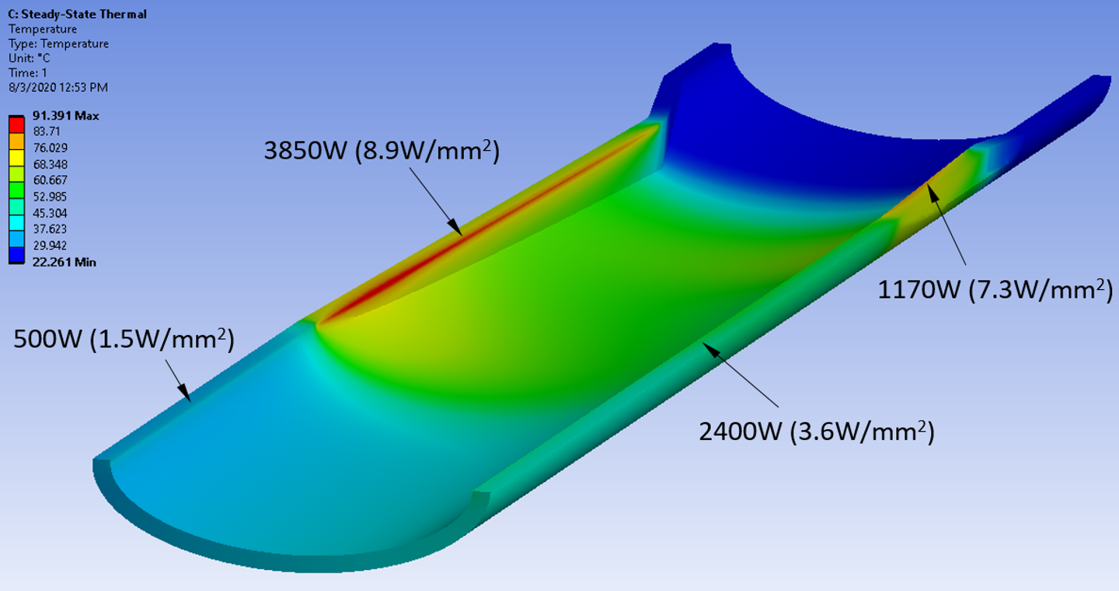
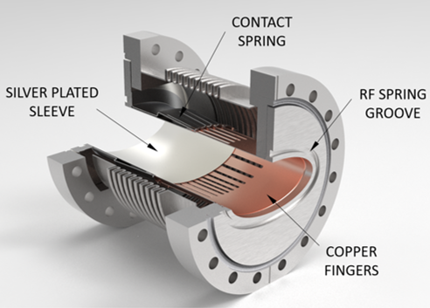
Vacuum System
3.8km vacuum chamber from
OFS copper (C10700)
Good thermal properties
Weldable
Easily available
Multichannel extrusion possible
Thermal SR power load
Maximum temperature <100°C at 10 MW total power
Pumping based on
distributed NEG Pumps
Multipole
Dipole
RF Bellows:
Critical element of the vacuum system
Improved NSLS-II bellows with outside fingers
See talk by Charles Hetzel

Slide 16
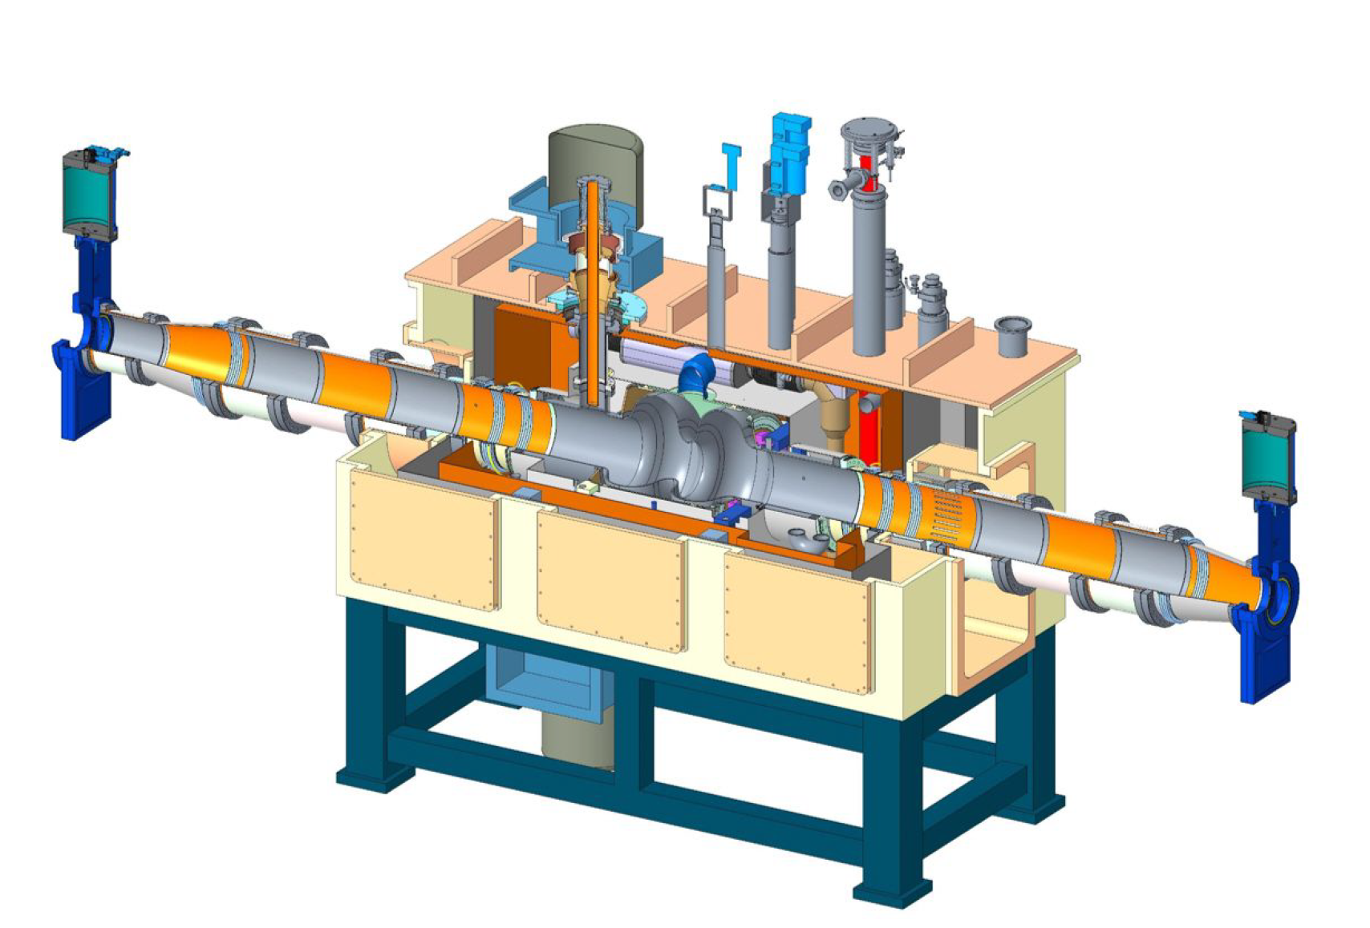
Superconducting RF
591 MHz SRF, one cavity per cryomodule
V = 8 MV/cavity
2x 500 kW adjustable fundamental power coupler.
4x SiC Beamline HOM Absorbers (BLAs)
14 cryomodules in total
Power source: Likely solid state amplifiers
2K operating temperature
591 MHz Cavity Cryomodule

Slide 17
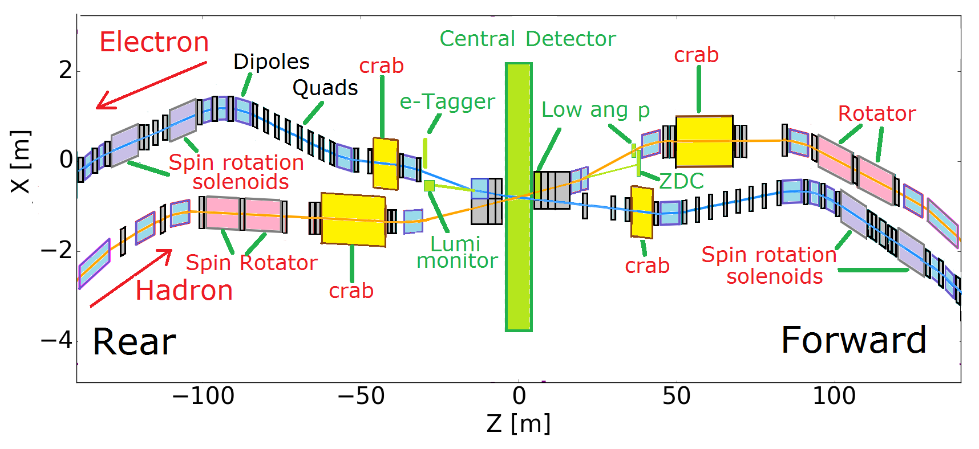
Interaction Region
+/- 4.5 m machine-element free space for central detector
25 mrad total crossing angle
Transverse momentum acceptance down to 200 MeV/c
Peak magnetic fields below 6T (NbTi sufficient)
Most magnets direct-wind; few collared magnets
Challenging synchrotron radiation issues from 2.5A beam
See talk by Holger Witte

Slide 18
Summary
EIC electron beam parameters are similar to a B-Factory
Need different phase advances and super-bends to achieve high luminosity over large energy range
Dynamic aperture requirements are met. Studies with two IRs just started
High polarization in two spin states achieved by continuous bunch replacement
Spin rotators make geometric layout in existing tunnel next to hadron rings very challenging
Conceptual designs for all major components exist

