Slide 1
Infrastructures for Fundamental science from the EU perspective
Patricia Postigo McLaughlin
Research Infrastructures
European Commission
April 2025

Slide 2
How the EU supports fundamental science
The European Union’s research framework programme does not have thematic programmes in fundamental science
The programmes that fund fundamental science are grouped in the ‘excellence’ pillar of the programme:
    ERC
    MSCA
    Research Infrastructures
    These three programmes, combined, offer 25 billion euro of funding for the period 2021-27

Slide 3
What is the EU research infrastructures programme
Beginning of the century: national research infrastructures + few intergovernmental organisations (e.g. CERN, European Southern Observatory, European Molecular Biology Laboratory) – fragmented, un-coordinated
Single European Act 1986, EU competences in research / European Research Area policy in 2000. A vision of an interconnected research space, without barriers, where collaboration would flourish.
European RI policy aimed at
  Pooling resources
  Open access
  Avoiding duplication and fragmentation
  Connecting national research communities
  Exchanging best practices

Slide 4
What is the EU research infrastructures programme/2
EU’s Research Framework Programme € 95b for 2021-2027 / RI part € 2.4b
The RI programme invests money in
    Transnational access (already in FP2, 1988)
    Defining a joint roadmap (since 2006) of new RIs / upgrades / ERICs (ERIC regulation 2009). This is done through ESFRI advisory group.
    Technology development for scientific services
The RI programme does not BUILD RIs. MS and other countries come together to build new RIs with Structural Funds & National Funding/in-kind contributions.

Slide 5
How the RI programme has supported fundamental physics
Particle physics
  Accelerators: CARE (2004-2008), TIARA (2011-2014), EUCARD2 (2013-2017), EUCARD2 (2013-2017), ARIES (2017-2021), I-FAST (2021-2025)
  Detectors at accelerators: EUDET (2006-2010), AIDA (2011-2015), AIDA2020 (2015-2020), AIDAInnova (2021-2025)
Nuclear physics
  FINUPHY, EURONS,ENSAR (2010-2014), ENSAR2 (2016-2021), EURO-LABS (2021-2024)
Astrophysics
  Optical: OPTICON (2000-2005, 2004-2008, 2009-2012, 2013-2016, 2017-2021)
  Radio: RADIONET (2000-2004, 2004-2008, 2009-2012, 2012-2015, 2017-2020), OPTICON RADIONET (2021-2024)
  Planetary: EUROPLANET (2005-2008, 2009-12, 2015-2019, 2020-2024)
  Multi-messenger: ACME (2024-2028)
  Other types of grants: Concept and technical design, preparatory phase, other (example QUACO)

Slide 6
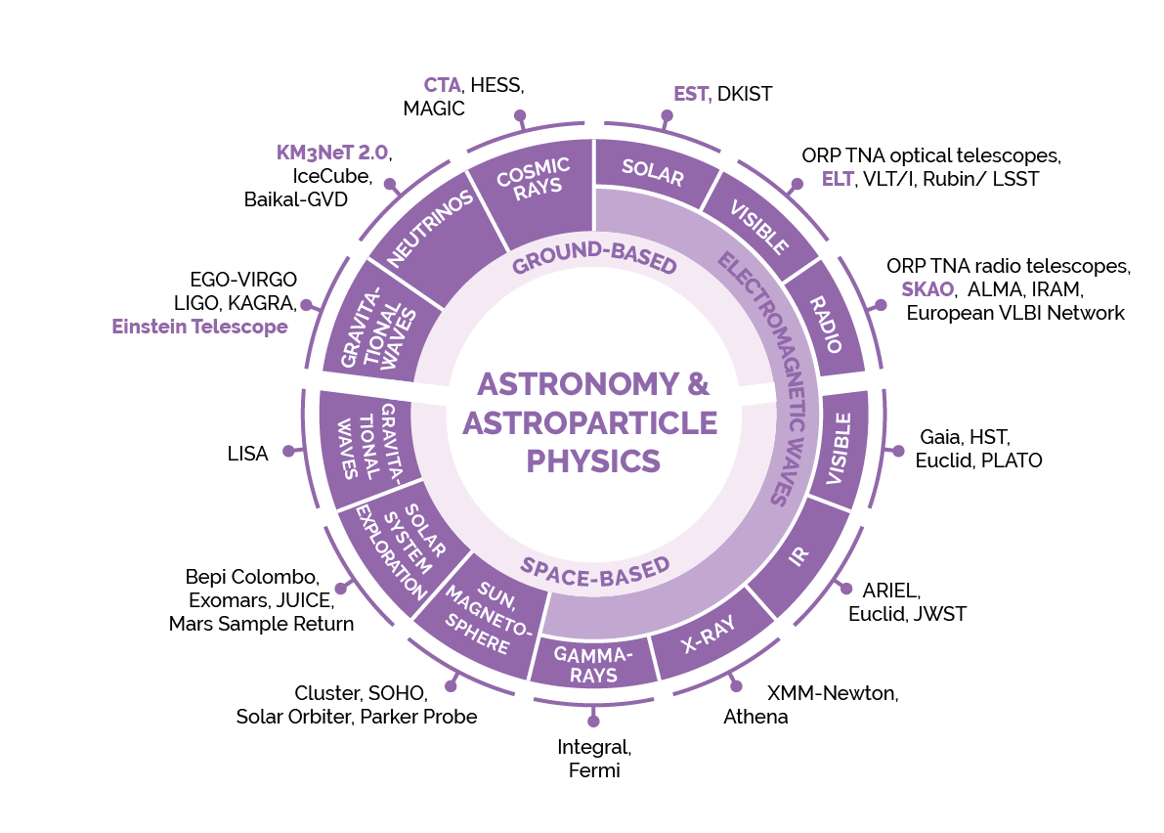
ESFRI landscape analysis

Slide 7
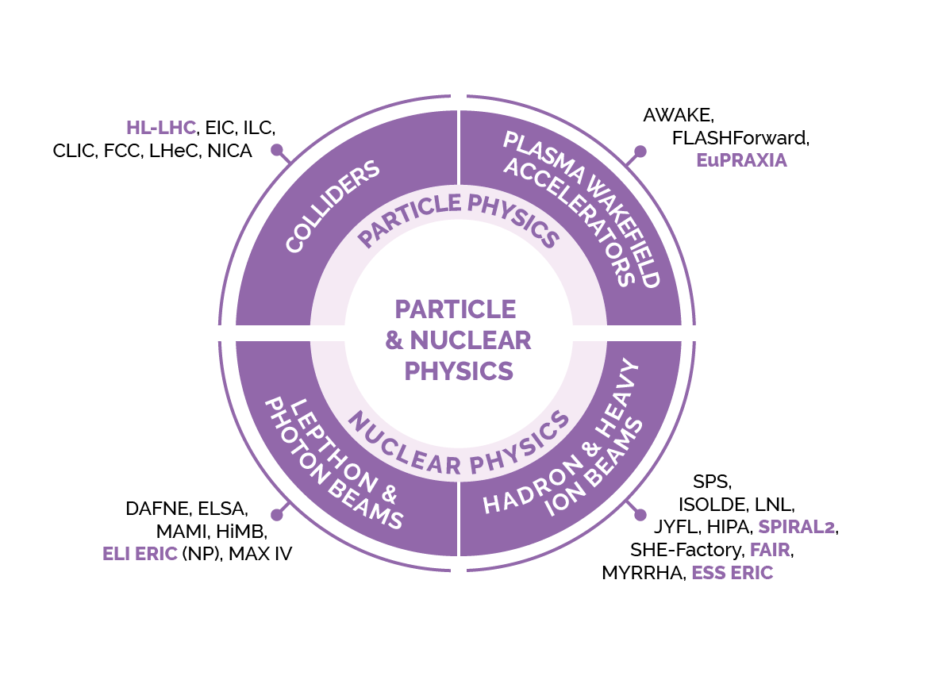
ESFRI landscape analysis

Slide 8
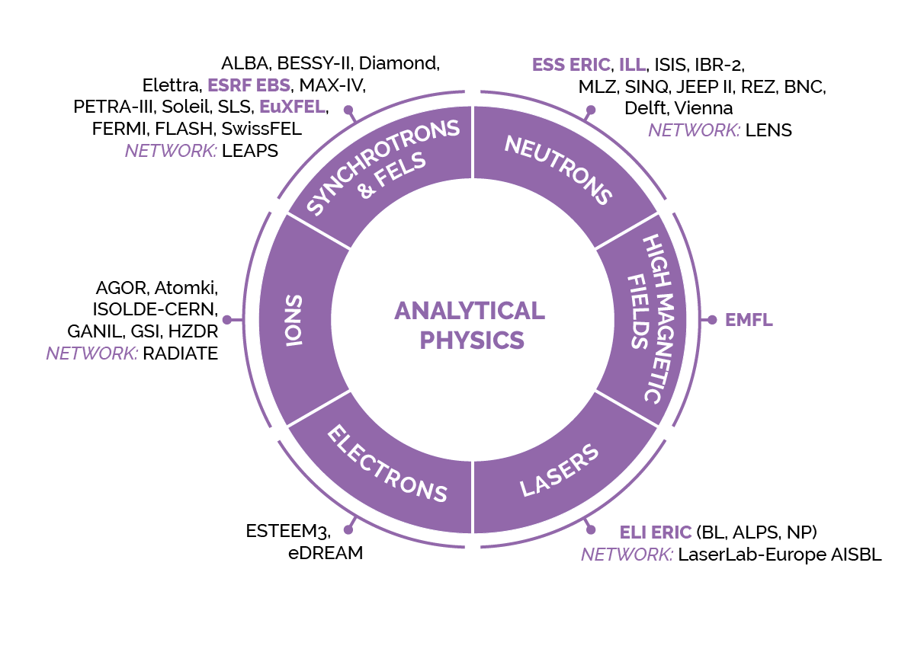
ESFRI landscape analysis

Slide 9
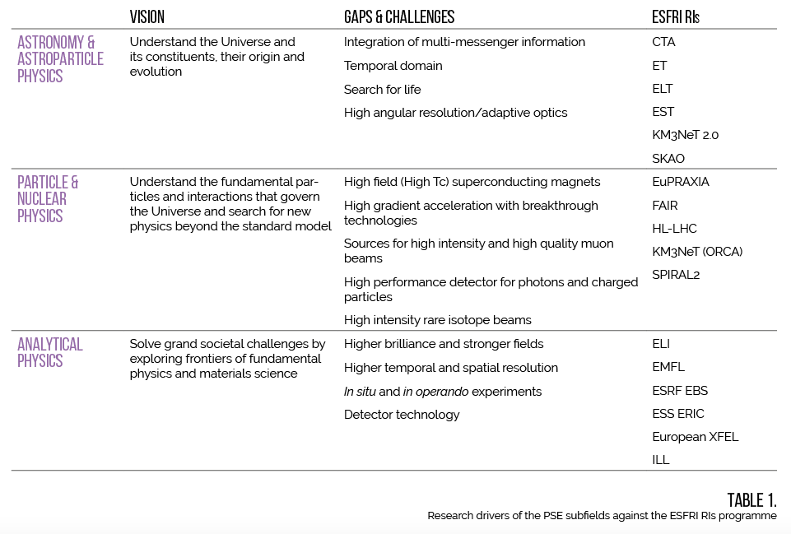
gaps and challenges

Slide 10
Evolution of the EU RI programme
Political changes have an impact
      Priorities of HE: Green deal and digital transition
      (pandemic, war in Ukraine)
      Priorities for FP10 (2028 – 2034)
Against that context, the EU RI programme has been evolving
      Changes in HE
      Changes in FP10
          Evolution towards a TNA scheme
          Evolution towards a stable technology collaboration
Evolution in RI landscape – sustainability, monitoring, strategic planning

Slide 11
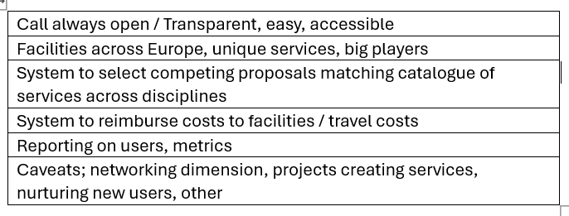
Ideas for a long-term transnational access scheme

Slide 12
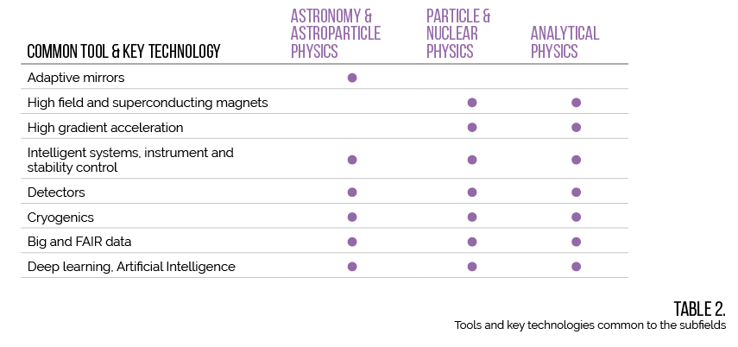
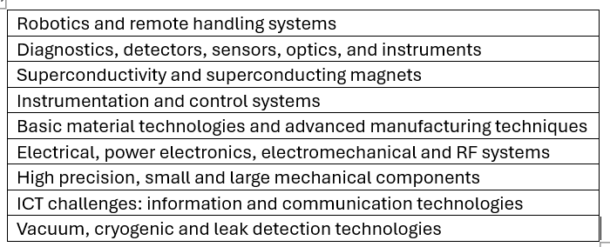
Ideas for a long-term tech collaboration scheme

Slide 13
patricia.postigo-mclaughlin@ec.europa.eu
One last thought
“I mourn a world in which science must defend itself through its end products, rather than its underlying search for truth and beauty,” Daniel Bauman, 25-year-old Stanford University graduate student
Opinion | The Uncertain Fate of the Young American Scientist - The New York Times

