Slide 1
Review: Linux & ROOT
Harinder Singh Bawa
California State University Fresno

Slide 2
Review:
You have linux installed on your computers
Questions
You have ROOT installed on your computers
Questions
Linux:
File creation/listing/copying/moving
Editors: To Write code
File permissions
Remote login: ssh/scp(file transfer)

Slide 3
Review:
ROOT
Rootfile:
Opening/accessing the rootfile [TFile]
Browsing the contents [TBrowser]
Scanning the variables [Scan]
Drawing histograms/graphs on Canvas [Draw]
Example: QCD (Dijet events), plotted jet kinematics/leading-subleading jet kinematics/Invariant mass

Slide 4
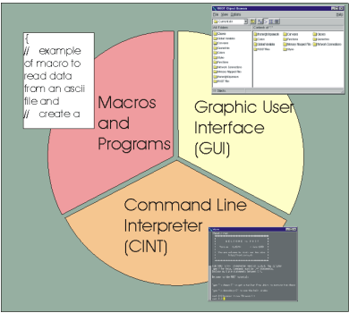
Rootfile
Download: http://zimmer.fresnostate.edu/~hbawa/rootfiles/user.bawa.7531825._000086.tree.root

Slide 5
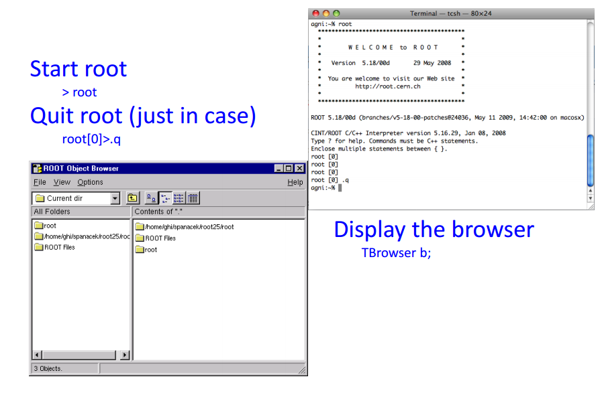
GUI Basics

Slide 6
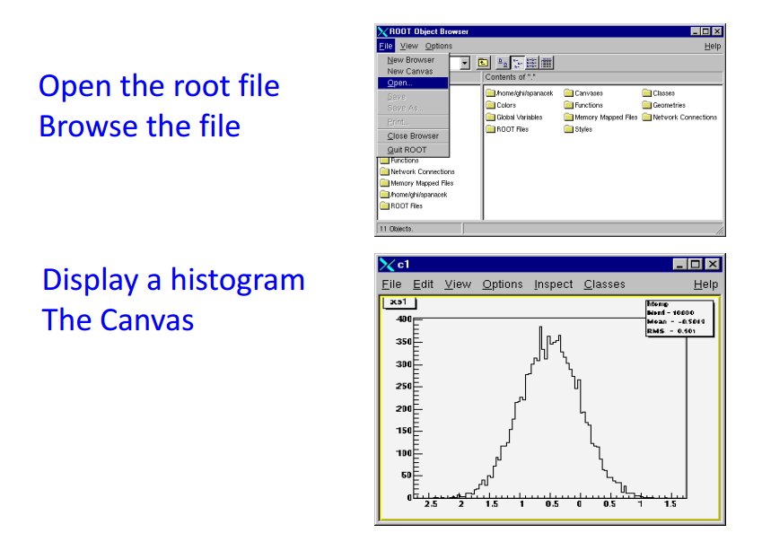
Displaying a Histograms

Slide 7
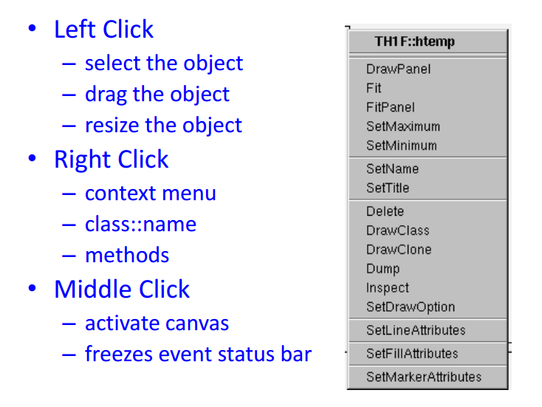
Basic Navigation by clicking

Slide 8
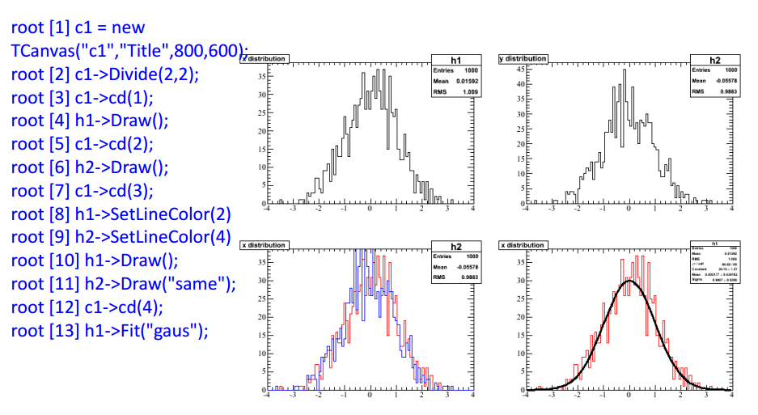
Canvas: Demo

Slide 9
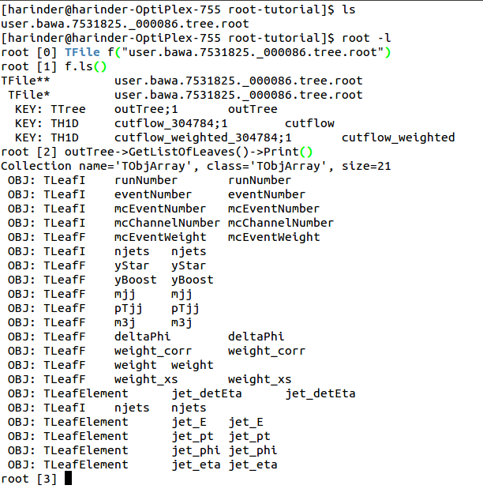
CINT (Command Line)

Slide 10
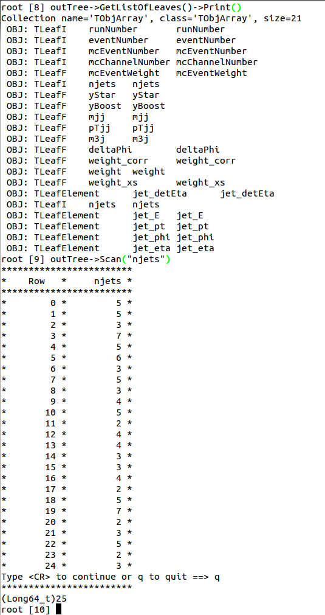
Rootfile: Scan

Slide 11
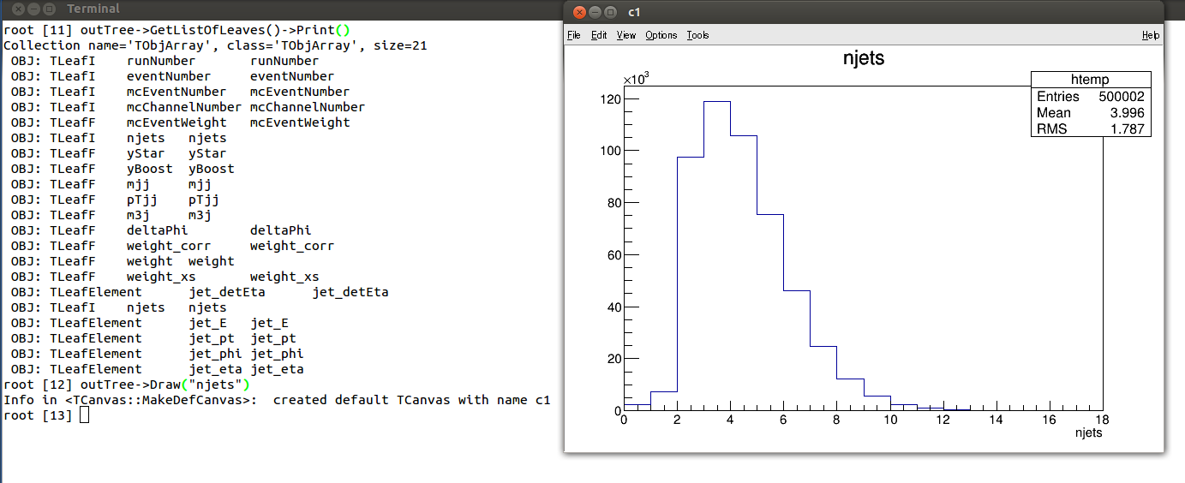
Rootfile:Draw()

Slide 12
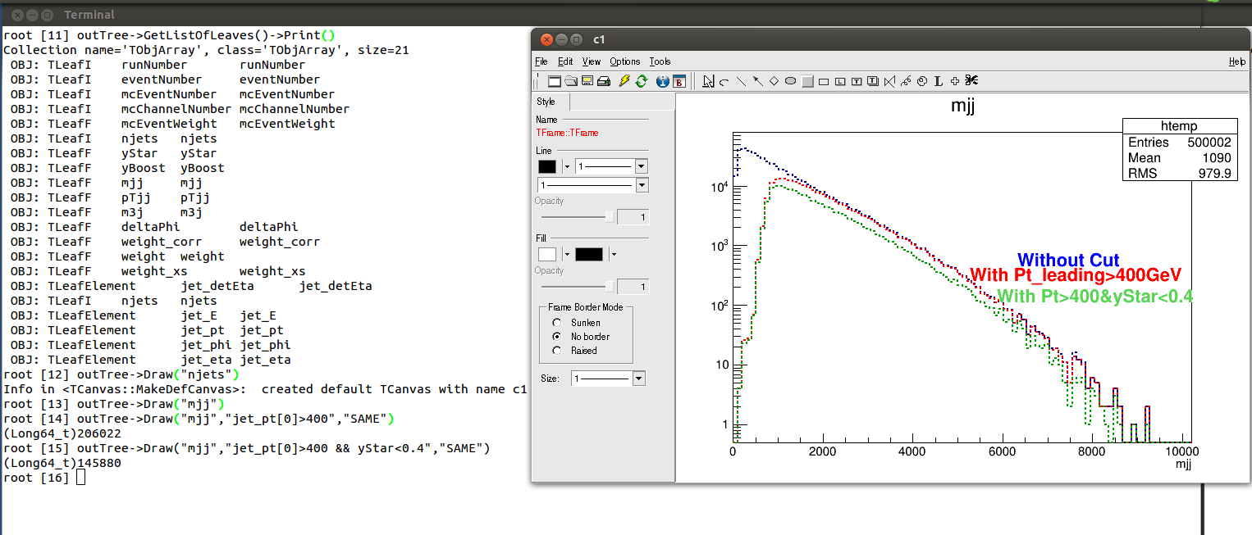
Rootfile: Draw(with cuts)

Slide 13
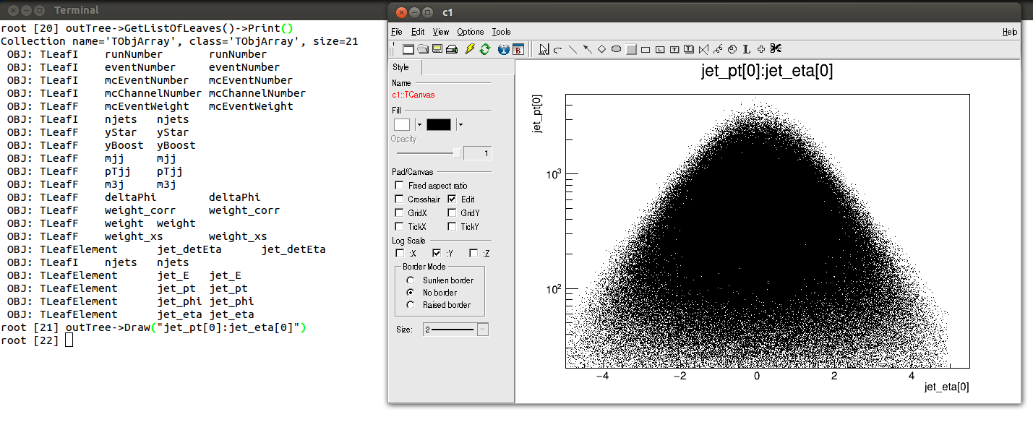
Rootfile:Draw(x Vs y)

Slide 14
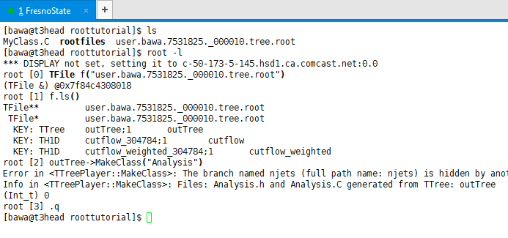
Analyses (Using macro/Code)
Open rootfile using TFile.
Use MakeClass (It will create .h & .C)

Slide 15
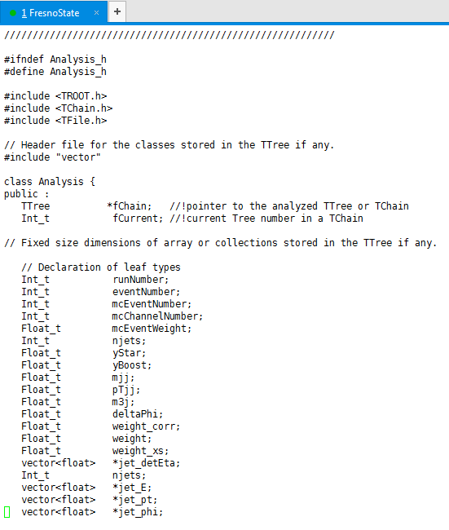
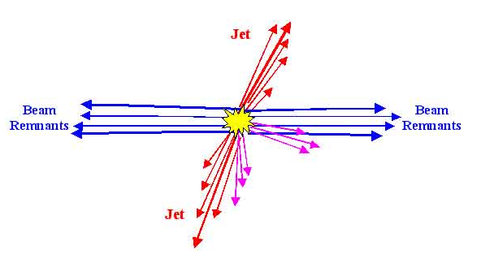
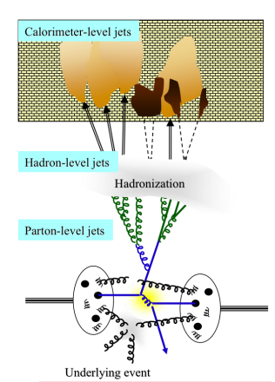
Closer look into header file

Slide 16
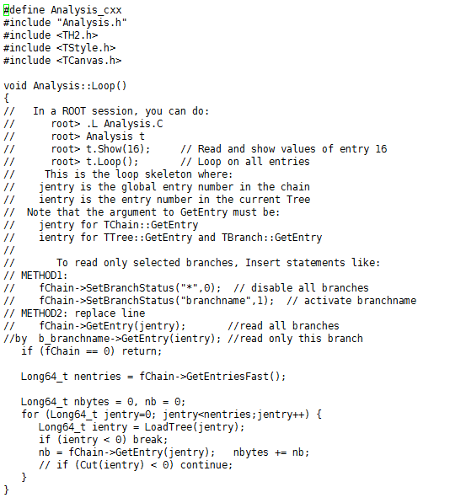
Closer look into .C file
You can define your histograms before loop
Event loop
You can Draw or save histograms after loop

Slide 17
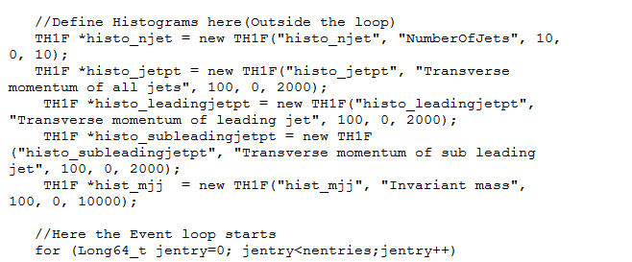
Example
Define

Slide 18
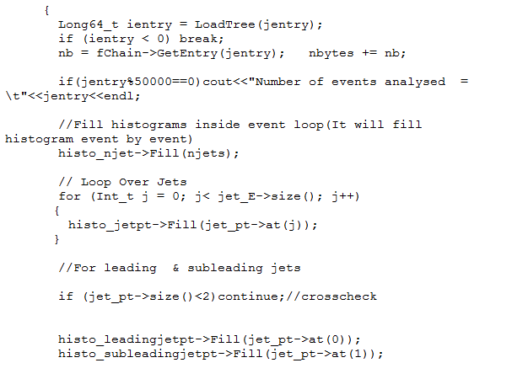
Filling inside Event loop

Slide 19
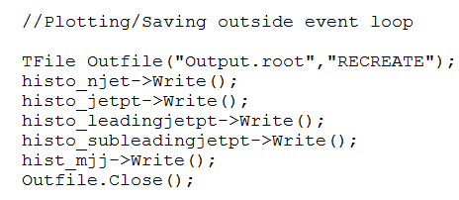
Saving the Plots
We can save the plots/histograms in a root file
Advantage: You can edit/decorate the histograms
No Need to run over event loop again

Slide 20
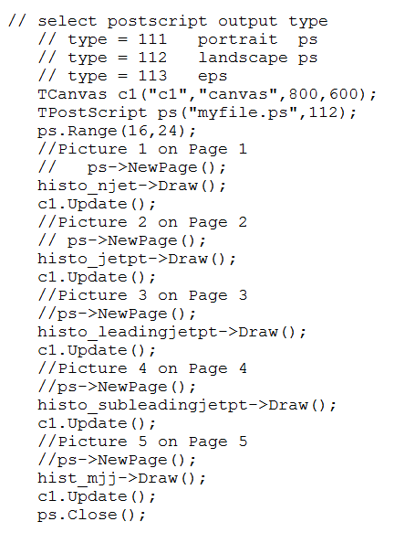
Saving plots in ps/pdf file too
Can arrange all plots in one file
Easy to share within collabortion

Slide 21
Make run file
To run: Make a “run_analysis.C” file and write the steps inside.
{
gROOT->ProcessLine(".L Analysis.C"); //Loading in c compiler
gROOT->ProcessLine("Analysis t"); //Make an object “t” for executable
gROOT->ProcessLine("t.Loop()"); //Loop over events
}
Root> root –b –q run_analysis.C

Slide 22
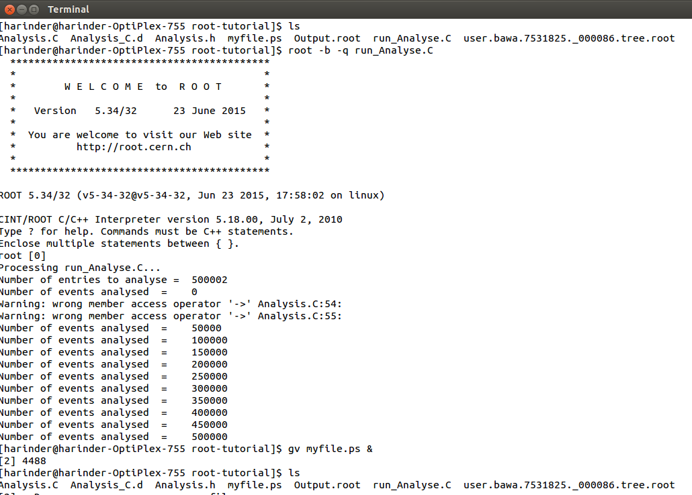
Running the Code

Slide 23
Exercise
Draw the distribution of Jet Energy, pseudorapidity (eta), Azimuthal angle(phi)
Draw Jet Energy Vs Jet_Pz
Draw Jet Energy Vs Jet_Pz with those jets with pT>100GeV
Draw distribution sqrt(Jet_px*Jet_px + Jet_py*jet_py ) and superimpose with jet_pT
Make Scatter plot: eta of Leading Jet vs eta of sub-leading jet

Slide 24
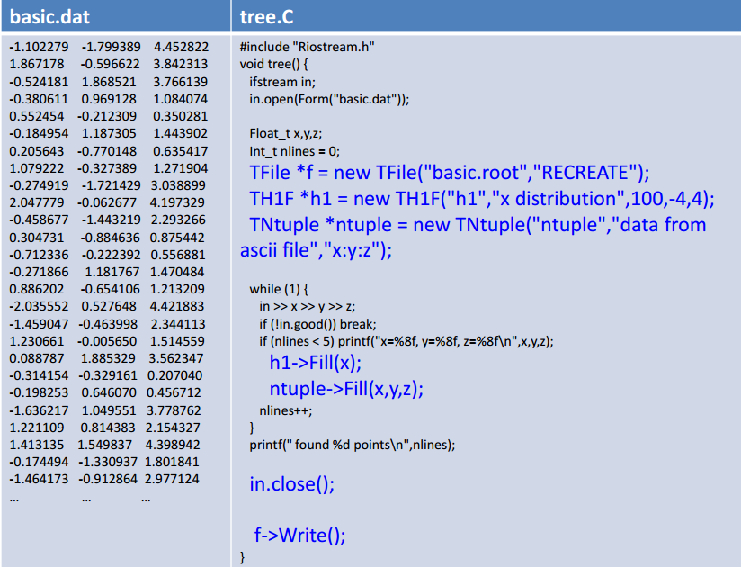
Reading ASCII file

