Slide 1



An introduction to CERN
- where the UK does particle physics
All images in this presentation are © CERN unless otherwise indicated
Notes:
Questions in chat and we’ll answer as many as possible at the end.
CERN rule #1: There’s no such thing as a stupid question!
CERN rule #2: you can photograph everything

Slide 2
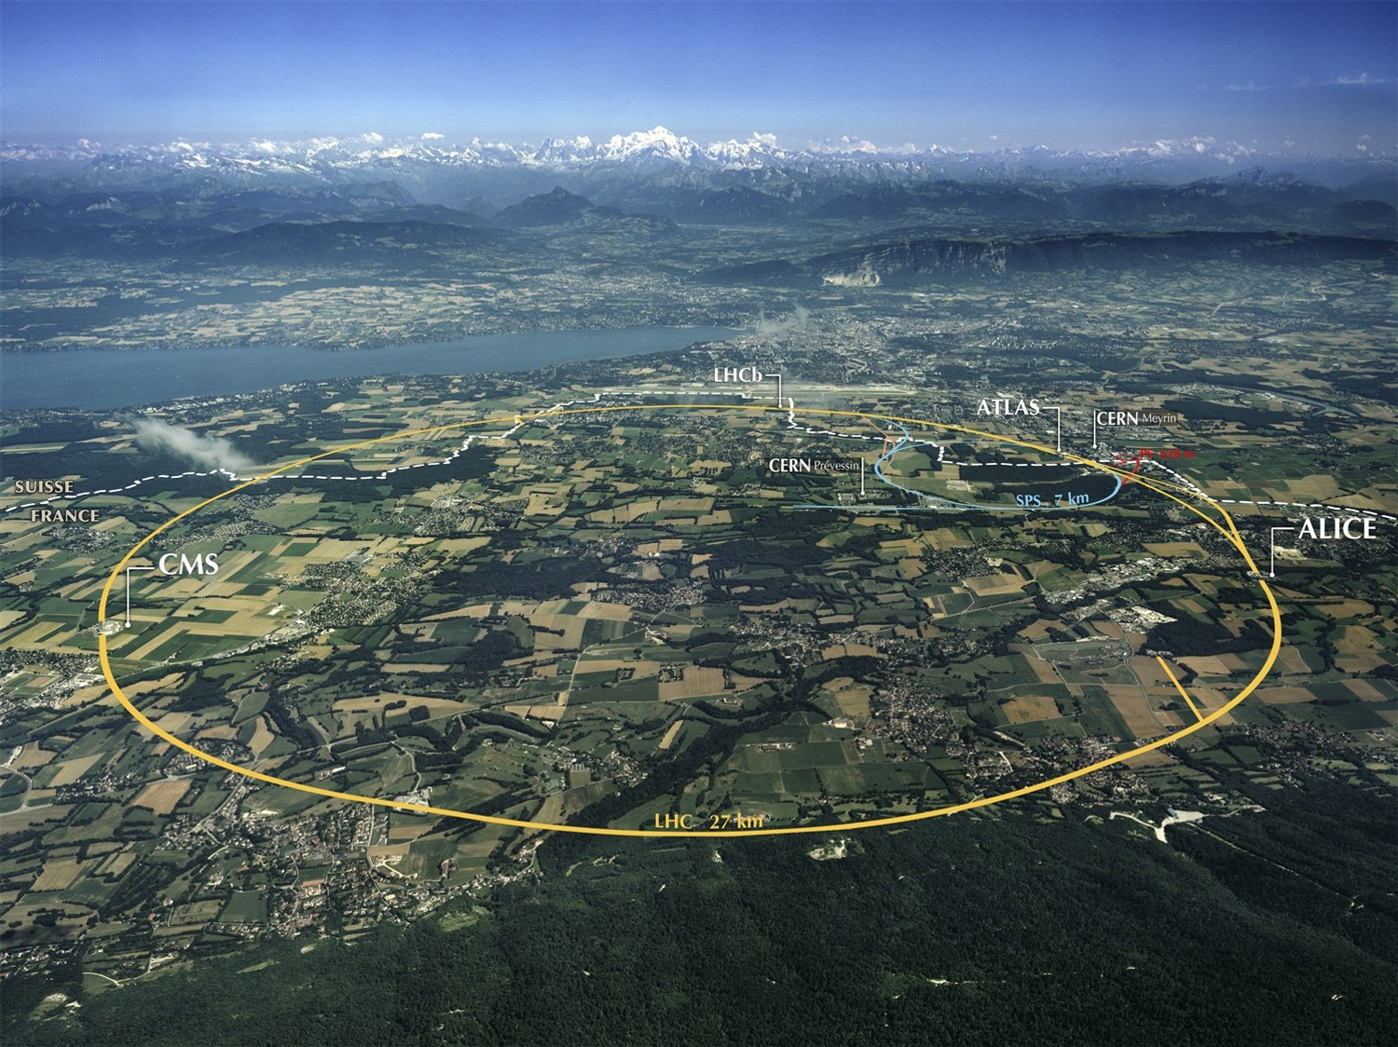
Notes:
Where are we?
Point out border, and what you would see if you were here.
27km tunnel underneath French/Swiss countryside
World’s largest particle accelerator
100m underground
11,000 times per second

Slide 3

Notes:
Recap – what is the LHC?
27km tunnel underneath French/Swiss countryside
World’s largest particle accelerator
Two beams of particles traveling in opposite directions at almost speed of light
Collisions recreate what happened in the moments after the Big Bang
Too big and expensive for one country to have a lab this complex. CERN brings together the best of the best with different cultural approaches to solving problems.

Slide 4

How did our universe begin?
What is our universe made of?
Where is the antimatter?
Why do particles have mass?
Notes:
CERN exists to answer these questions. It’s the only place on the planet that can recreate the conditions in the moments after the Big Bang as the Universe was forming. It’s the only place that can make Higgs bosons, and nowhere else has an antimatter factory
Big Bang 13.7 billion years ago
We use telescopes to look out into the universe and back in time – but the Universe was opaque for the first 300,000 years so the only way to understand what happened at the Big Bang is to recreate those conditions.
Visible matter (you, me and everything around us) makes up 5% of the Universe. We think the remaining 95% is Dark Matter and Dark Energy but we have yet to make any direct observations of either. Imagine not knowing what 95% of your Universe is made of?!

Slide 5
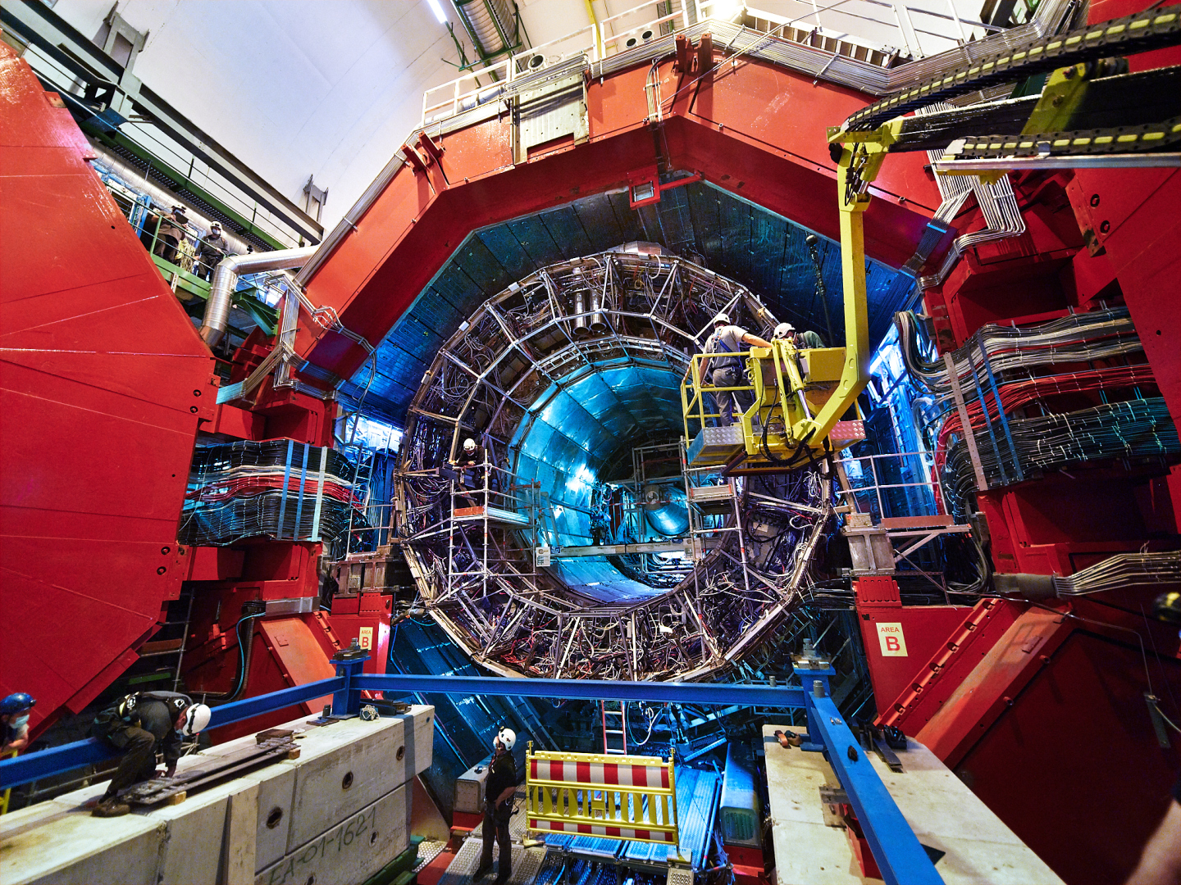
Notes:
Particles are collided in the heart of four huge detectors.
This is Alice….
It’s mostly doing nuclear physics and is especially interested in quark gluon plasma, the primordial soup of particles that existed before matter formed.

Slide 6
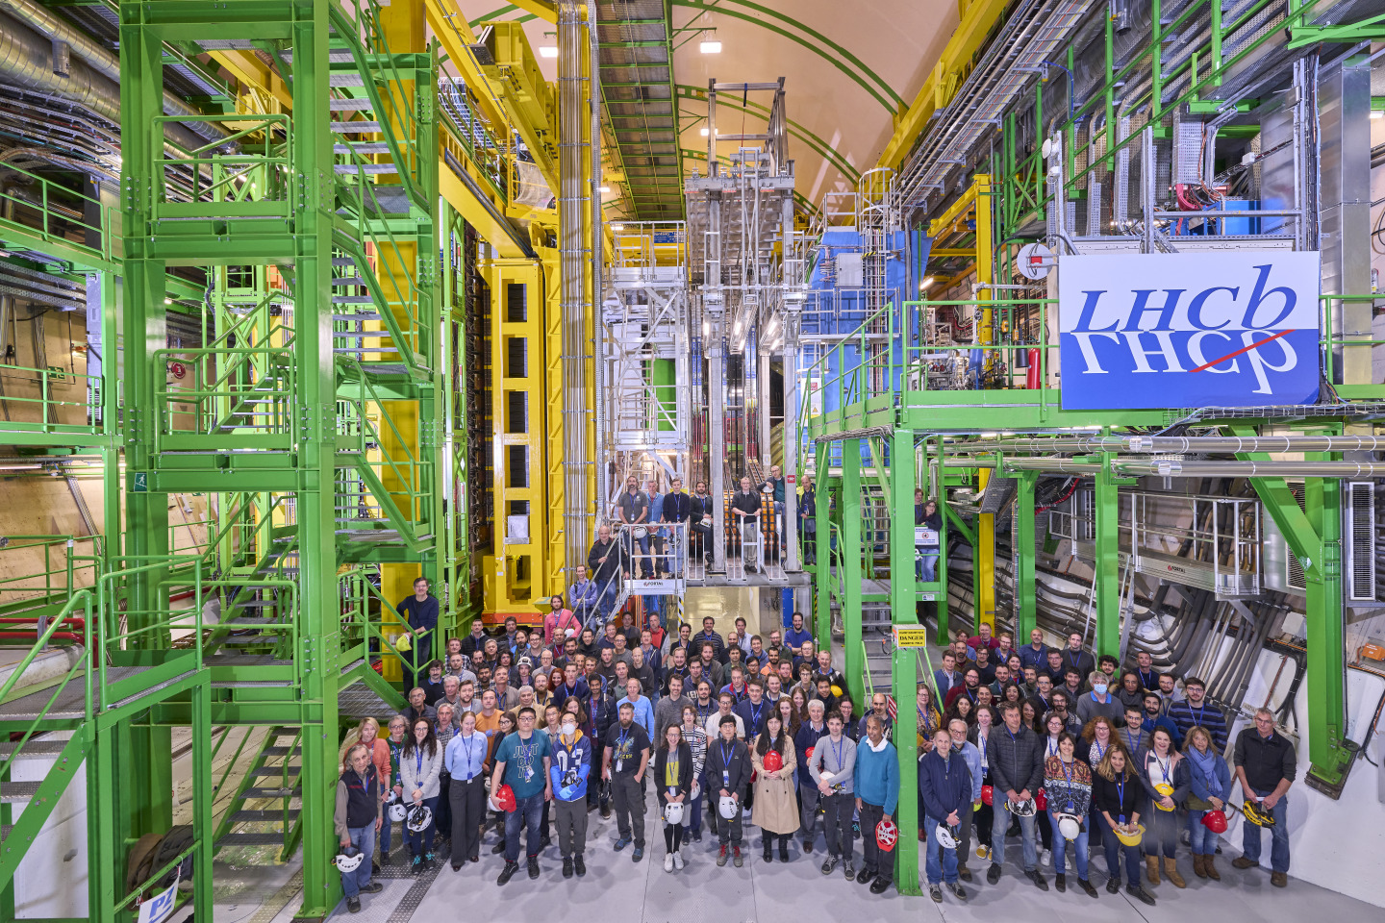
Notes:
This is LHCb
CP violation (posh name for matter:antimatter asymmetry) and unexplained physics beyond the Standard Model

Slide 7
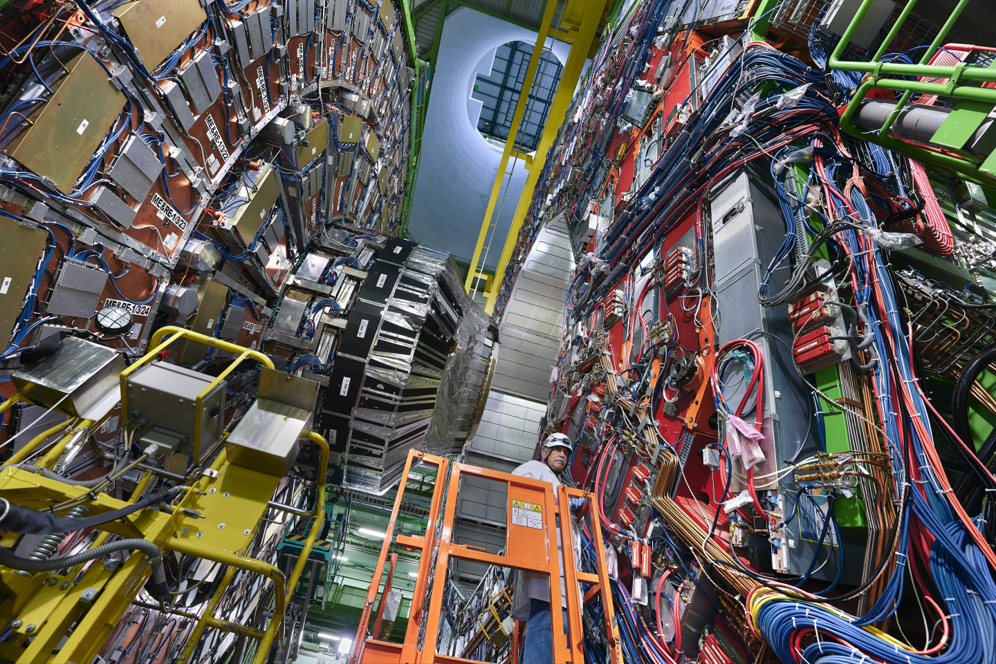
Notes:
This is CMS, one of the experiments that found the Higgs.

Slide 8

Notes:
This is ATLAS, the other experiment that found the Higgs boson

Slide 9
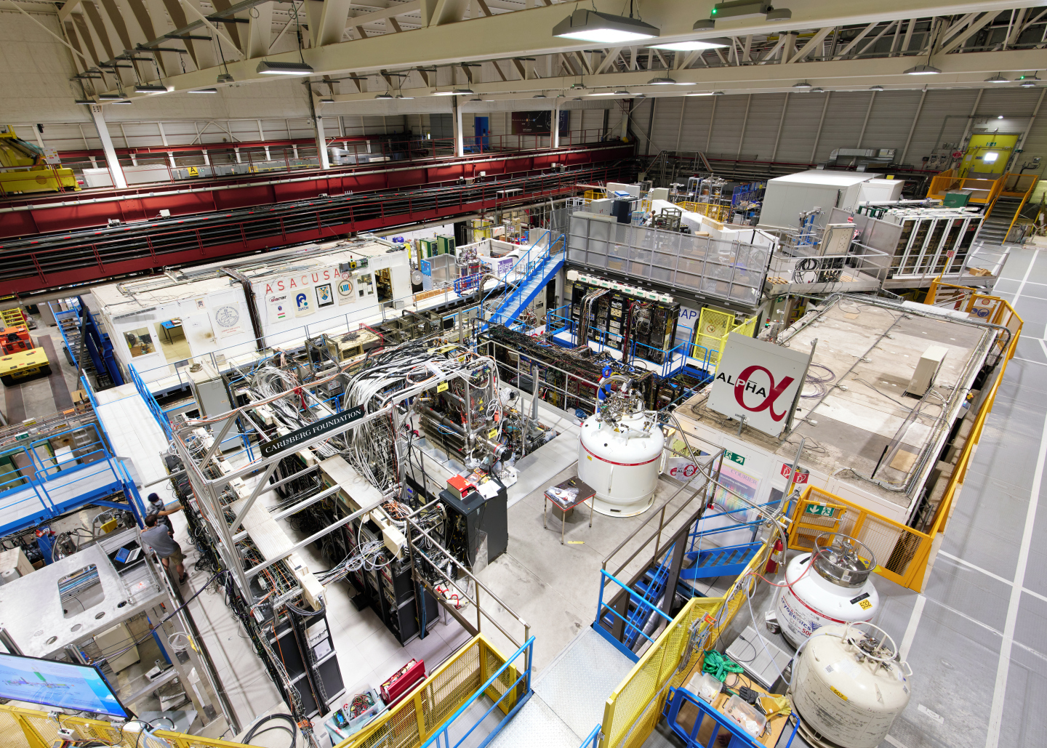
Notes:
EPSRC – antimatter research in the Antimatter Factory
Making antihydrogen antiatoms and learning more about its properties – why is our Universe dominated by matter?
ALPHA does things like make antihydrogen atoms and drops them to see if gravity interacts with antimatter in the same way as matter (sadly the answer was yes. Antimatter doesn’t go up ☹)

Slide 10
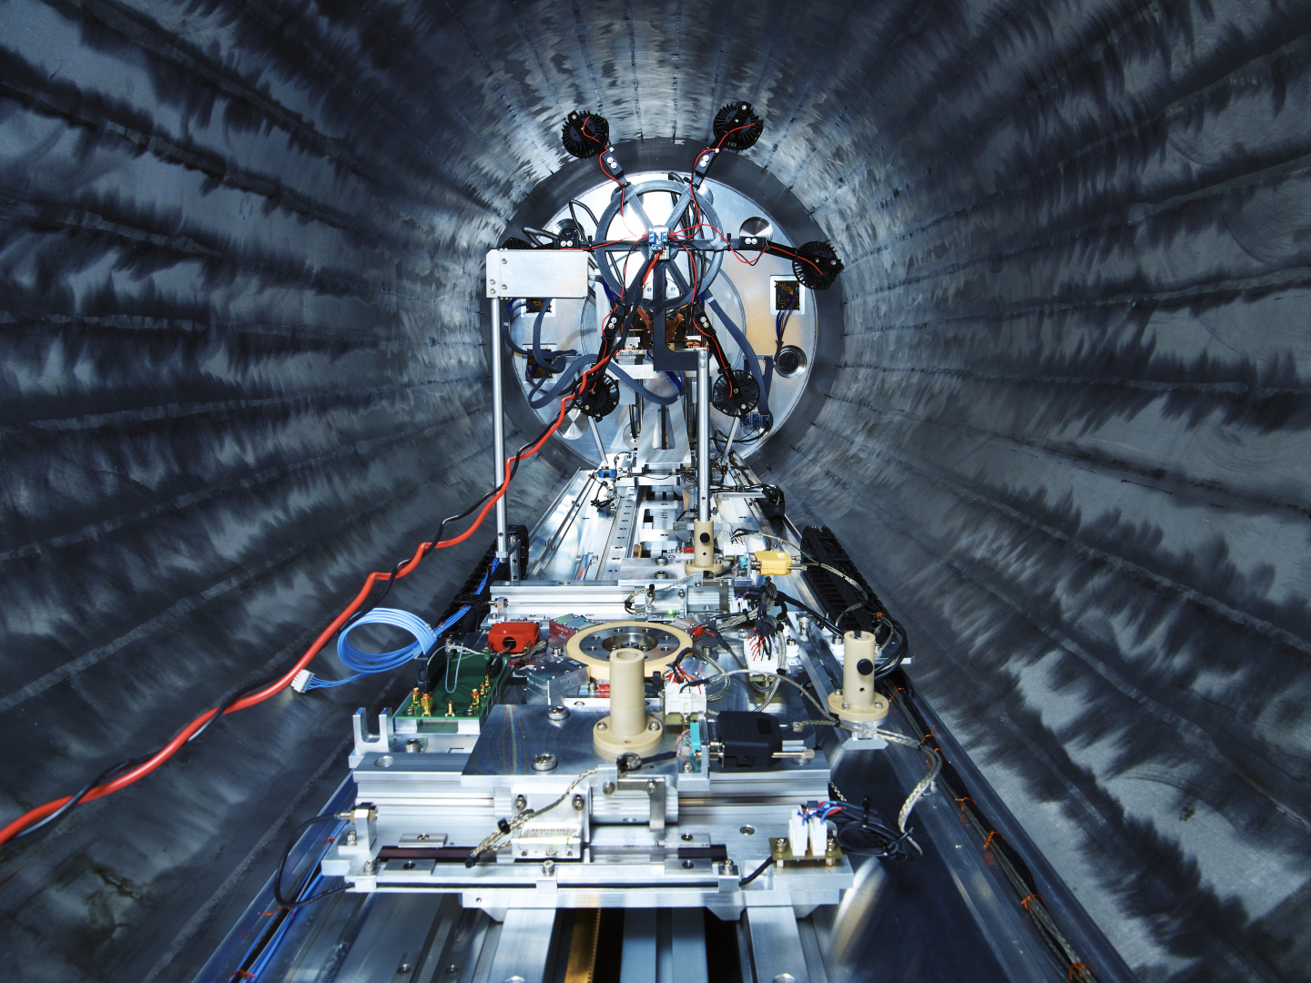
Notes:
ISOLDE nuclear physics facility – CERN isn’t just particle physics
Photo shows ISS, Isolde Solenoidal Spectrometer, built at Daresbury. The magnet is recycled from an old MRI machine.

Slide 11
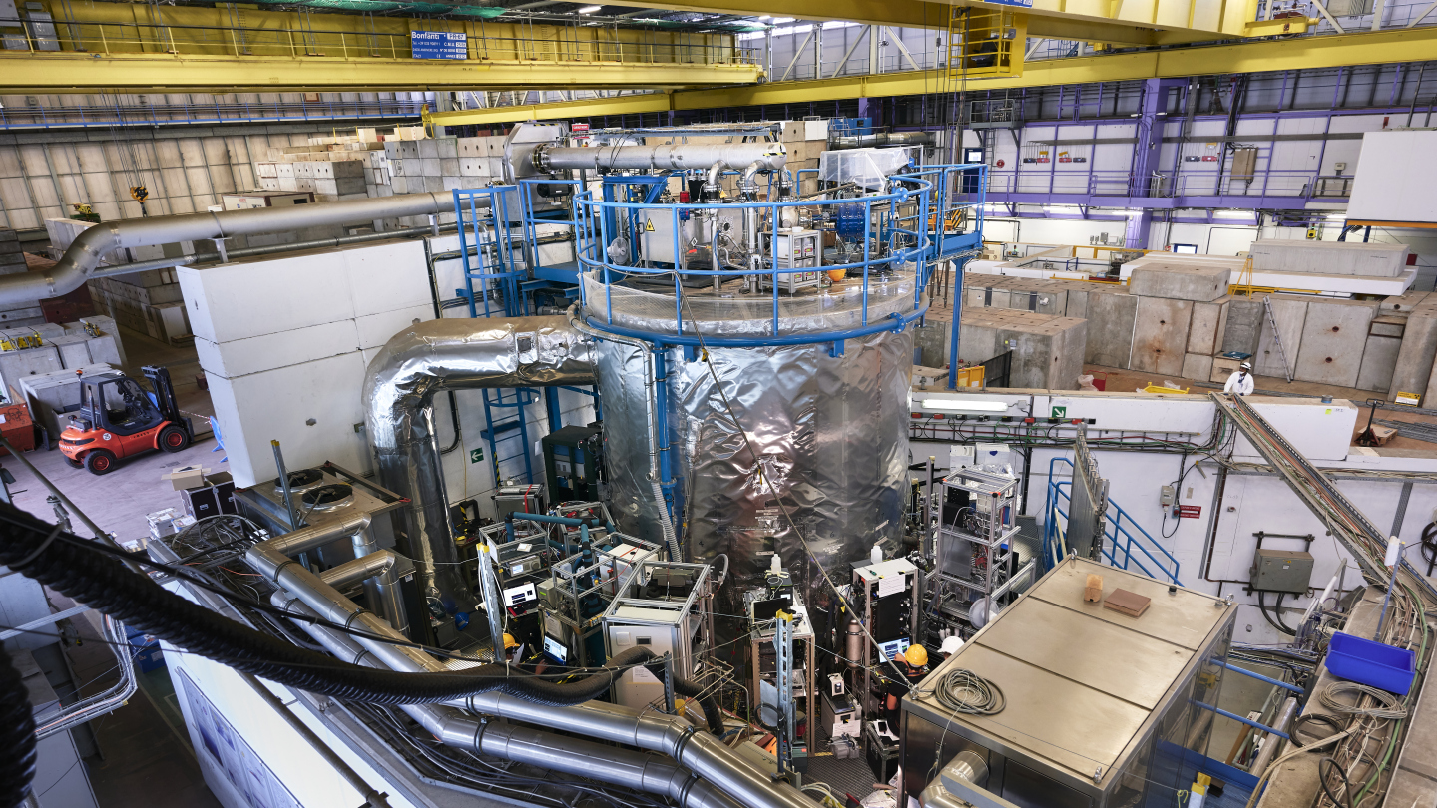
Notes:
Climate science – CLOUD experiment
No UK involvement at the moment, but previously funded by NERC
Using protons to understand the effects of cosmic rays on cloud formation.

Slide 12
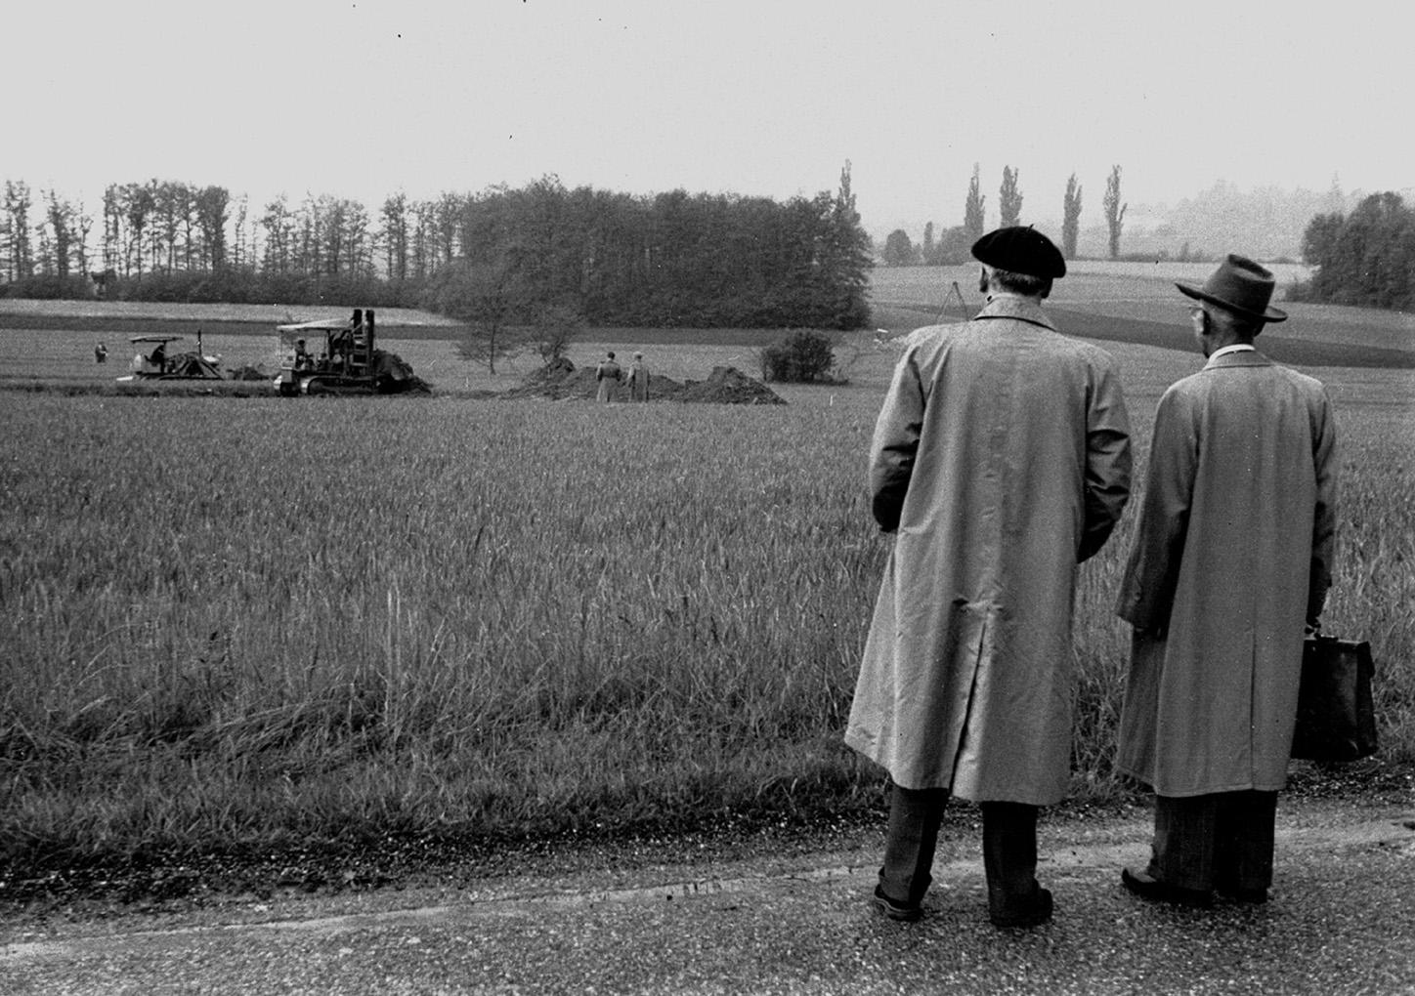
Notes:
15 May 1954 – earthworks start for first CERN office buildings
UK was a founding member – now 23 Member States
Post-war – science for peace and to stop brain drain to US

Slide 13
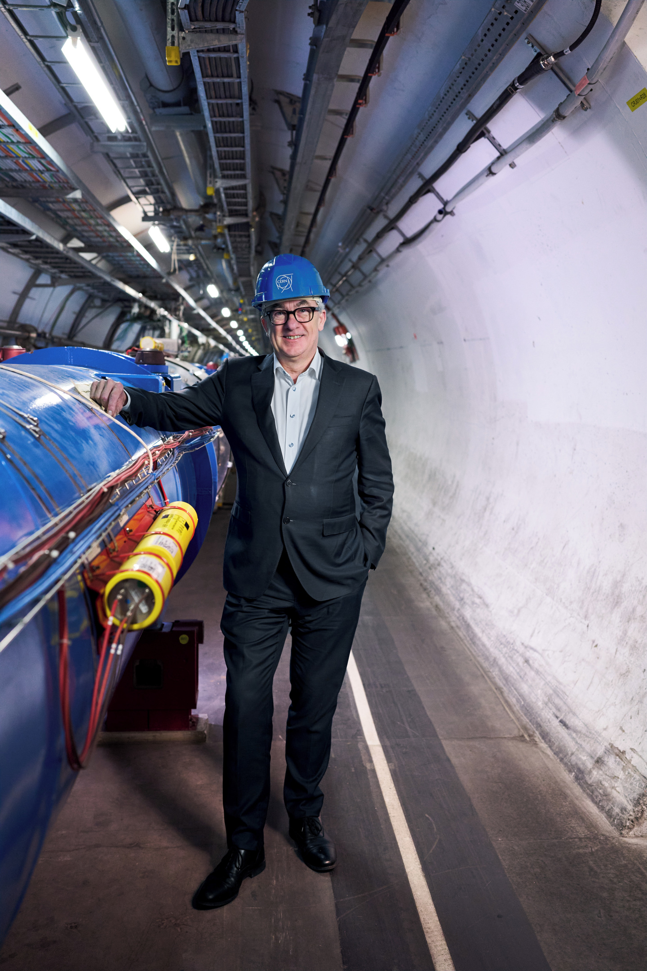

The benefits
Access to a unique research facility and leadership roles
UK schools can visit
UK teacher CPD programme
Career opportunities – not just physics
UK companies can bid for contracts
Notes:
2023 – DSIT and STFC published UK Strategy for Engagement with CERN – first strategy of its type
Total UK investment in CERN is ~£160M, plus £20-30M on contributions to experiments like ATLAS and LHCb, computing infrastructure (budget for regional teaching hospital in Oxford - £822M 2019-20, Warwick Uni income £680M 2019-20)
Flagship for UK participation in international and fundamental science.
Mark T starts his new role as CERN Director General in Jan 2026 – currently deciding how he wants the organization to be structured and then appointing his senior team.

Slide 14
Operational schedule to 2036
2008 LHC starts operations
2012 Higgs boson discovery
2013 Long Shutdown 1 (and Nobel Prize)
2015 LHC restarts (Run 2)
2018 Long Shutdown 2 (ALICE and LHCb upgrade for HL-LHC)
2022 LHC restarts (Run 3)
2026 Long Shutdown 3 (HL-LHC upgrades plus ATLAS/CMS upgrades)
2030 HL-LHC starts (Run 4)
2033 Long Shutdown 4
2036 HL-LHC restarts (Run 5)
Steph Hills | UK NMV 2025

Slide 15
HL-LHC goals
A peak luminosity of L_{peak} = 5×10³⁴ cm⁻²s⁻¹ with levelling, allowing:
An integrated luminosity of 250 fb⁻¹ per year, enabling the goal of L_{int} = 3000 fb⁻¹ twelve years after the upgrade.
What this means in practice:
140 collisions per bunch in ATLAS and CMS (~40 currently)
15 million Higgs bosons per year (3 million in 2017)

Slide 16
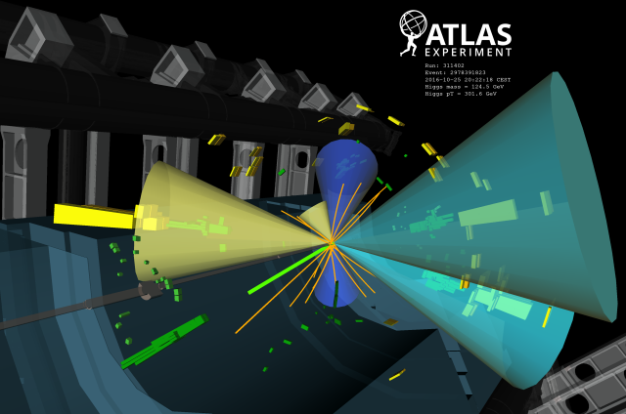
Why upgrade the LHC?
Higgs discovery in 2012
But many questions remain, and the search continues…
Higgs properties [coupling]
More than one Higgs?
BSM Physics? Dark Matter & Dark Energy?

Slide 17
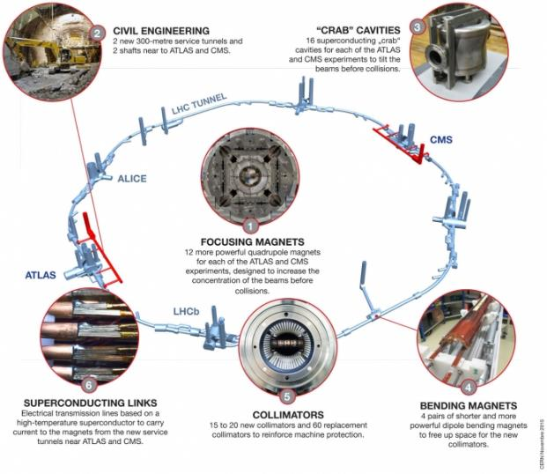
Plus new requirements for Beam Diagnostics and Machine Protection
Plus extensive upgrade of the experiments

Slide 18
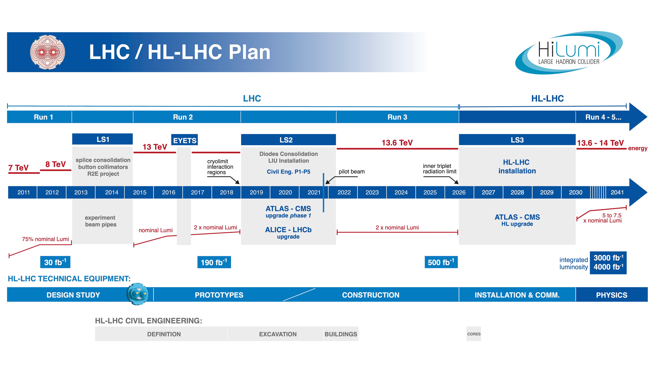

Slide 19
Other stories
FCC Feasibility Study (March 2025)
Moriond conference (23-30 March – no indications yet)
Transporting antimatter (June)
EPS Marseille (7–11 July – no indications yet)
New DG starts in January 2026
European Strategy for Particle Physics Update (June 2026) – to confirm the next collider at CERN, or alternatives if FCC is not feasible or competitive
General interest
NA62 – ultra-rare kaon decays that could point to BSM physics – Karim Massri (Lancaster)
FASER – light and weakly interacting particles could give clues to DM, CP violation, origin of neutrino mass – Monica D’Onofrio (Liverpool)
Project Stella – designing a radiotherapy machine for low and middle income countries - Manjit Dosanjh (Oxford)

Slide 20
Working together
STFC Media Team
  Wendy Ellison
  Jake Hepburn
  Henry Northmore (UKATC)
CERN Press Office
  Sophie Tesauri
  Anais Gerard
  Smaragda Andrikaki
Both
  Steph Hills
CERN photo archive
CERN video archive
Talk to your physicists!
Constant flow of stories
Support the UK Strategy for Engagement with CERN

Slide 21
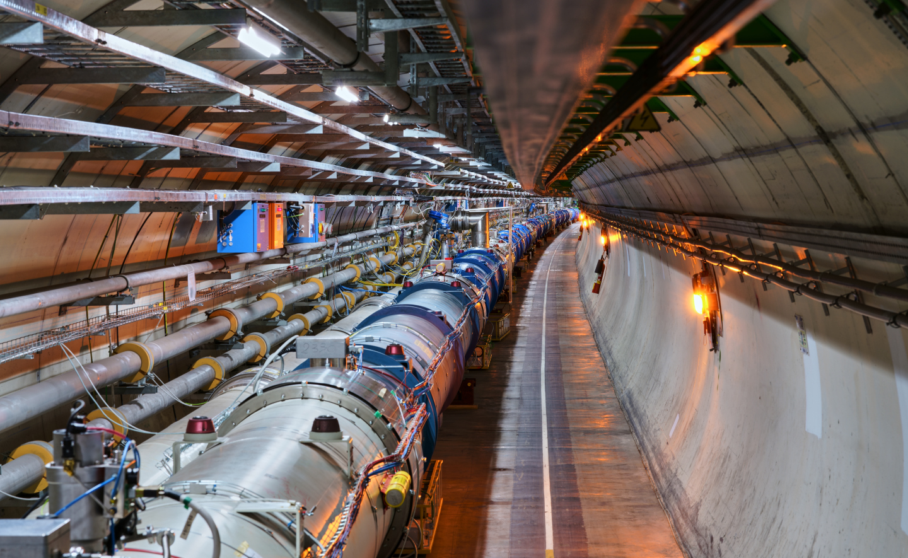
@stephhills.bsky.social
#UKatCERN

