Slide 1
UK National Media Visit 2025
Stephanie Hills
29 January 2025

Slide 2
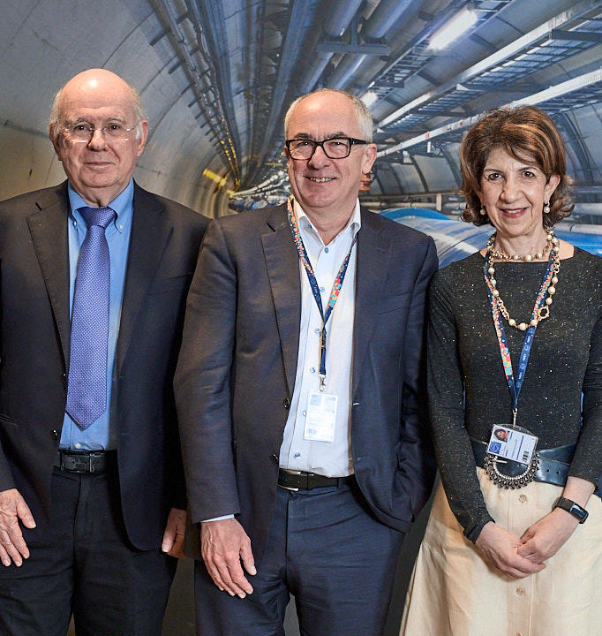
Welcome!
Busy schedule – lots to see
HL-LHC focus
Underground to see ATLAS
Time for interviews on Thurs (or zoom)
Not one but two DGs!
Let us know if you’re particularly interested in a story and we’ll find an interviewee.

Slide 3

Current team
Arnaud Marsollier – CERN Spokesperson
Sophie Tesauri – Head of the Press Office
Anais Gerard – Press Officer
Smaragda Andrikaki – Press Officer
Steph Hills – UK (STFC and CERN)
Sarah Charley – US (Fermilab and CERN)
STFC team
Wendy Ellison – Media Manager
Jake Hepburn – Press Officer

Slide 4
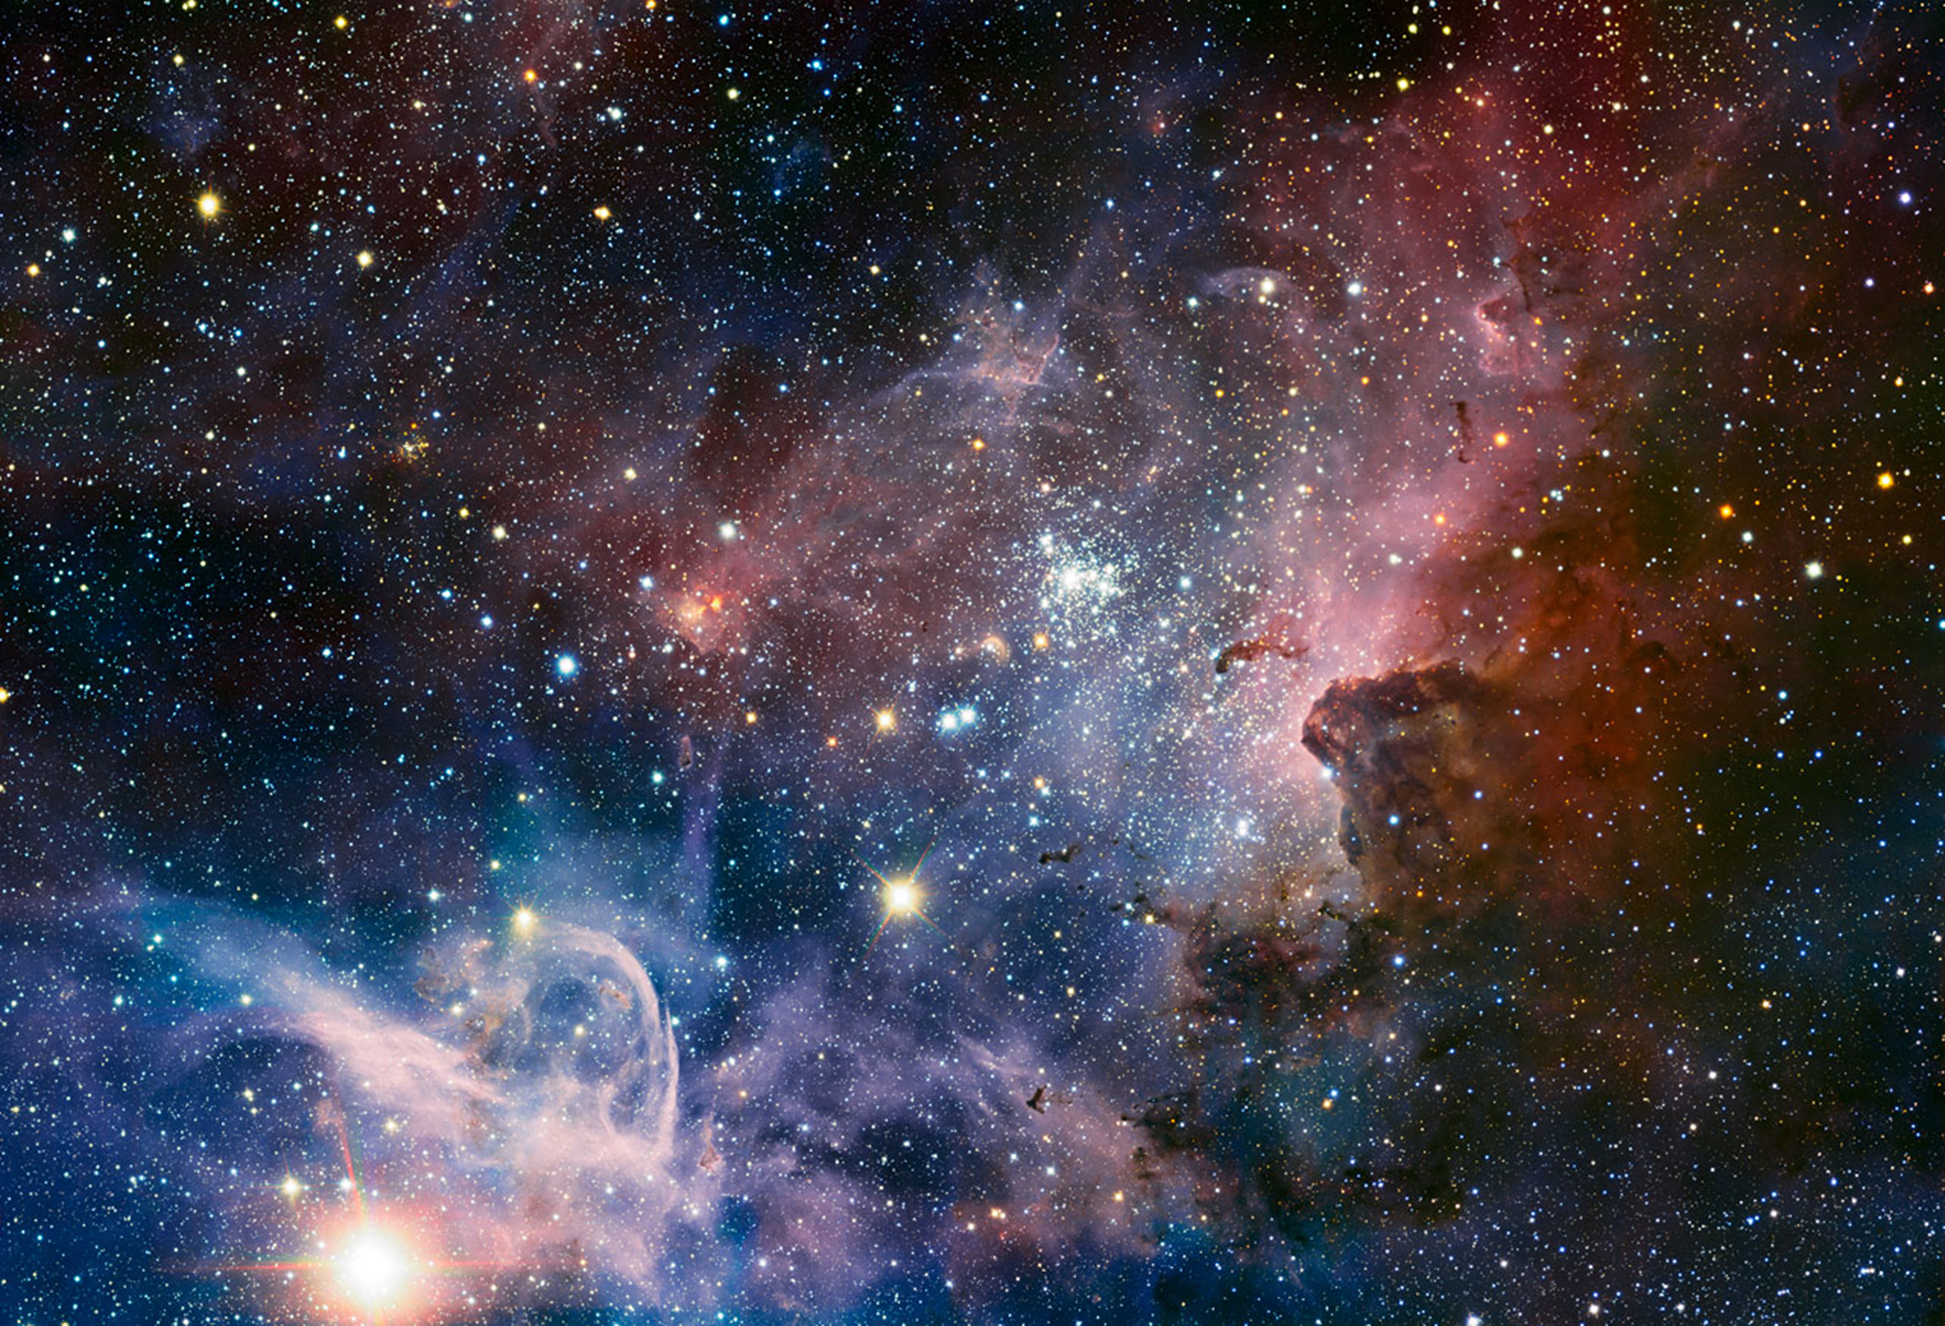
How did our universe begin?
What is our universe made of?
Where is the antimatter?
Why do particles have mass?
Notes:
CERN exists to answer some of humanity’s biggest questions.

Slide 5
Operational schedule to 2036
2008 LHC starts operations
2012 Higgs boson discovery
2013 Long Shutdown 1 (and Nobel Prize)
2015 LHC restarts (Run 2)
2018 Long Shutdown 2 (ALICE and LHCb upgrade for HL-LHC)
2022 LHC restarts (Run 3)
2026 Long Shutdown 3 (HL-LHC upgrades plus ATLAS/CMS upgrades)
2030 HL-LHC starts (Run 4)
2033 Long Shutdown 4
2036 HL-LHC restarts (Run 5)
Steph Hills | UK NMV 2025

Slide 6
HL-LHC goals
A peak luminosity of L_{peak} = 5×10³⁴ cm⁻²s⁻¹ with levelling, allowing:
An integrated luminosity of 250 fb⁻¹ per year, enabling the goal of L_{int} = 3000 fb⁻¹ twelve years after the upgrade.
What this means in practice:
140 collisions per bunch in ATLAS and CMS (~40 currently)
15 million Higgs bosons per year (3 million in 2017)

Slide 7
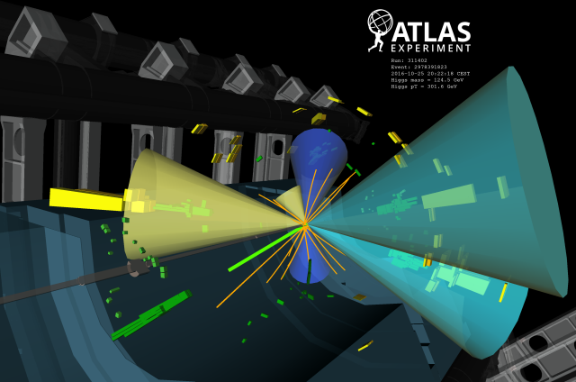
Why upgrade the LHC?
Higgs discovery in 2012
But many questions remain, and the search continues…
Higgs properties [coupling]
More than one Higgs?
BSM Physics? Dark Matter & Dark Energy?

Slide 8
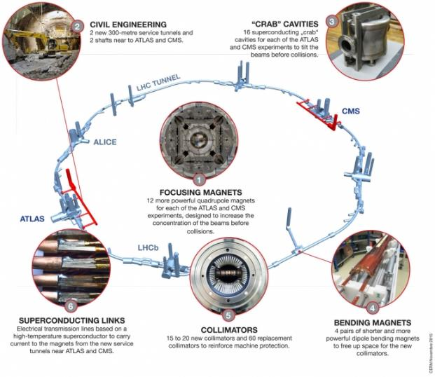
Plus new requirements for Beam Diagnostics and Machine Protection
Plus extensive upgrade of the experiments

Slide 9
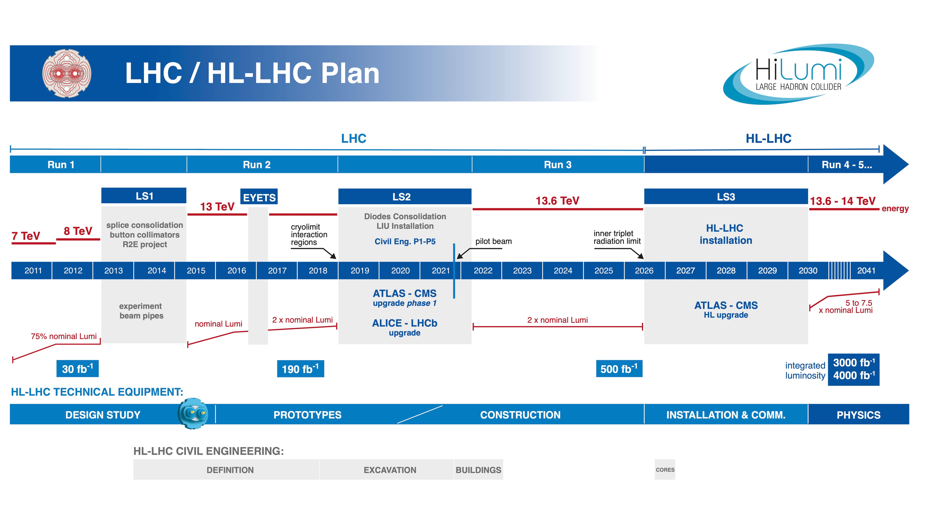

Slide 10
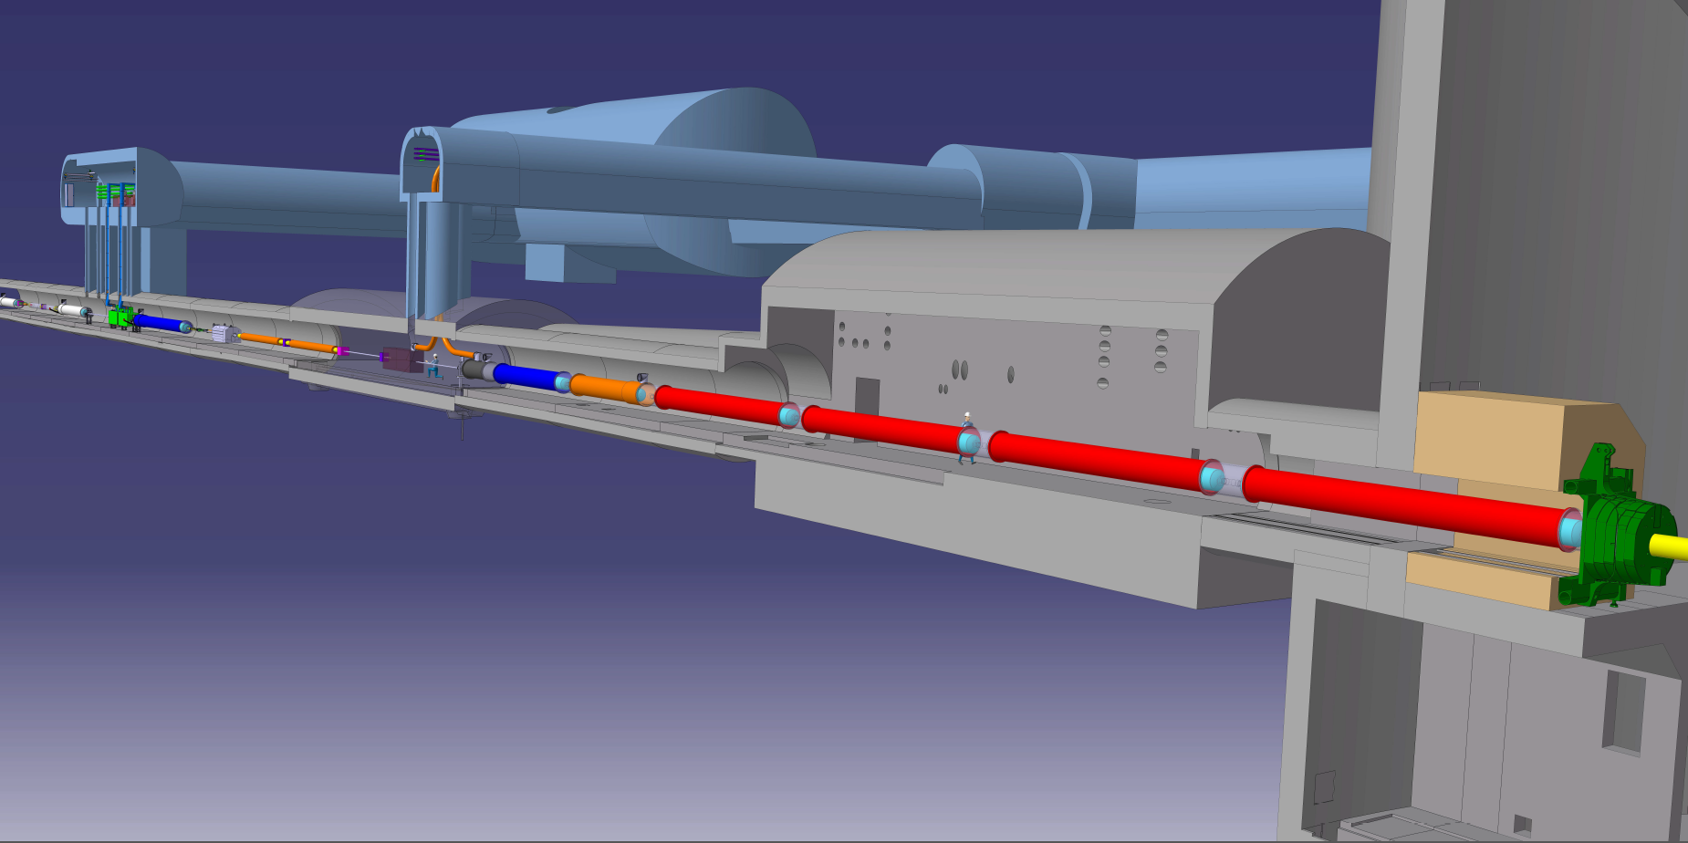








An International Collaboration
Connection to LHC (UL)
Service gallery (UR)
UA Gallery
Service cavern
SC Links
Q4
Collimators
D2
Crab cavities
D1
CP
Q3
TAXN
DFM
DFX
Q2b
Q2a
Q1
TAXS
UK HL-LHC Spokes is Rob Appleby Robert.Appleby@manchester.ac.uk
Steph Hills | UK NMV 2025

Slide 11
Other stories
FCC Feasibility Study (March 2025)
Moriond conference (23-30 March – no indications yet)
Transporting antimatter (June)
EPS Marseille (7–11 July – no indications yet)
New DG starts in January 2026
European Strategy for Particle Physics Update (June 2026) – to confirm the next collider at CERN, or alternatives if FCC is not feasible or competitive
General interest
NA62 – ultra-rare kaon decays that could point to BSM physics – Karim Massri (Lancaster)
FASER – light and weakly interacting particles could give clues to DM, CP violation, origin of neutrino mass – Monica D’Onofrio (Liverpool)
Project Stella – designing a radiotherapy machine for low and middle income countries - Manjit Dosanjh (Oxford)

Slide 12
Steph Hills
press@cern.ch
Bsky: @stephhills.bsky.social
LinkedIn: stephanie-hills-UKatCERN

