Slide 1



An introduction to CERN
- where the UK does particle physics
All images in this presentation are © CERN unless otherwise indicated
Notes:
Questions in chat and we’ll answer as many as possible at the end.
CERN rule #1: There’s no such thing as a stupid question!
CERN rule #2: you can photograph everything

Slide 2
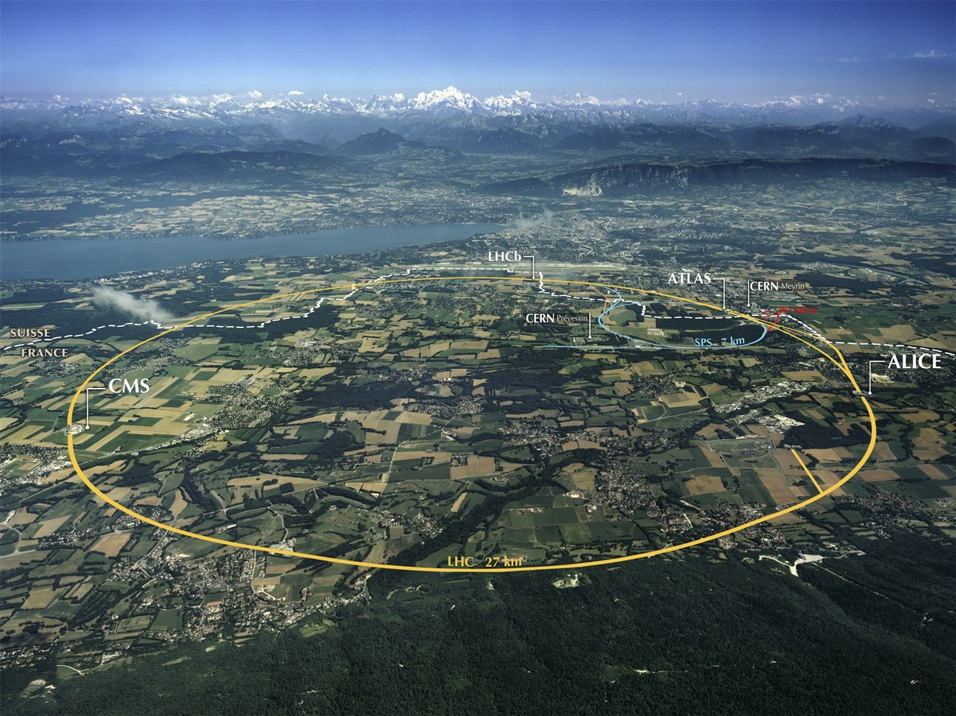
Notes:
Where are we?
Point out border, and what you would see if you were here.
27km tunnel underneath French/Swiss countryside
World’s largest particle accelerator
100m underground
11,000 times per second

Slide 3

Notes:
Recap – what is the LHC?
27km tunnel underneath French/Swiss countryside
World’s largest particle accelerator
Two beams of particles traveling in opposite directions at almost speed of light
Collisions recreate what happened in the moments after the Big Bang
Too big and expensive for one country to have a lab this complex. CERN brings together the best of the best with different cultural approaches to solving problems.

Slide 4
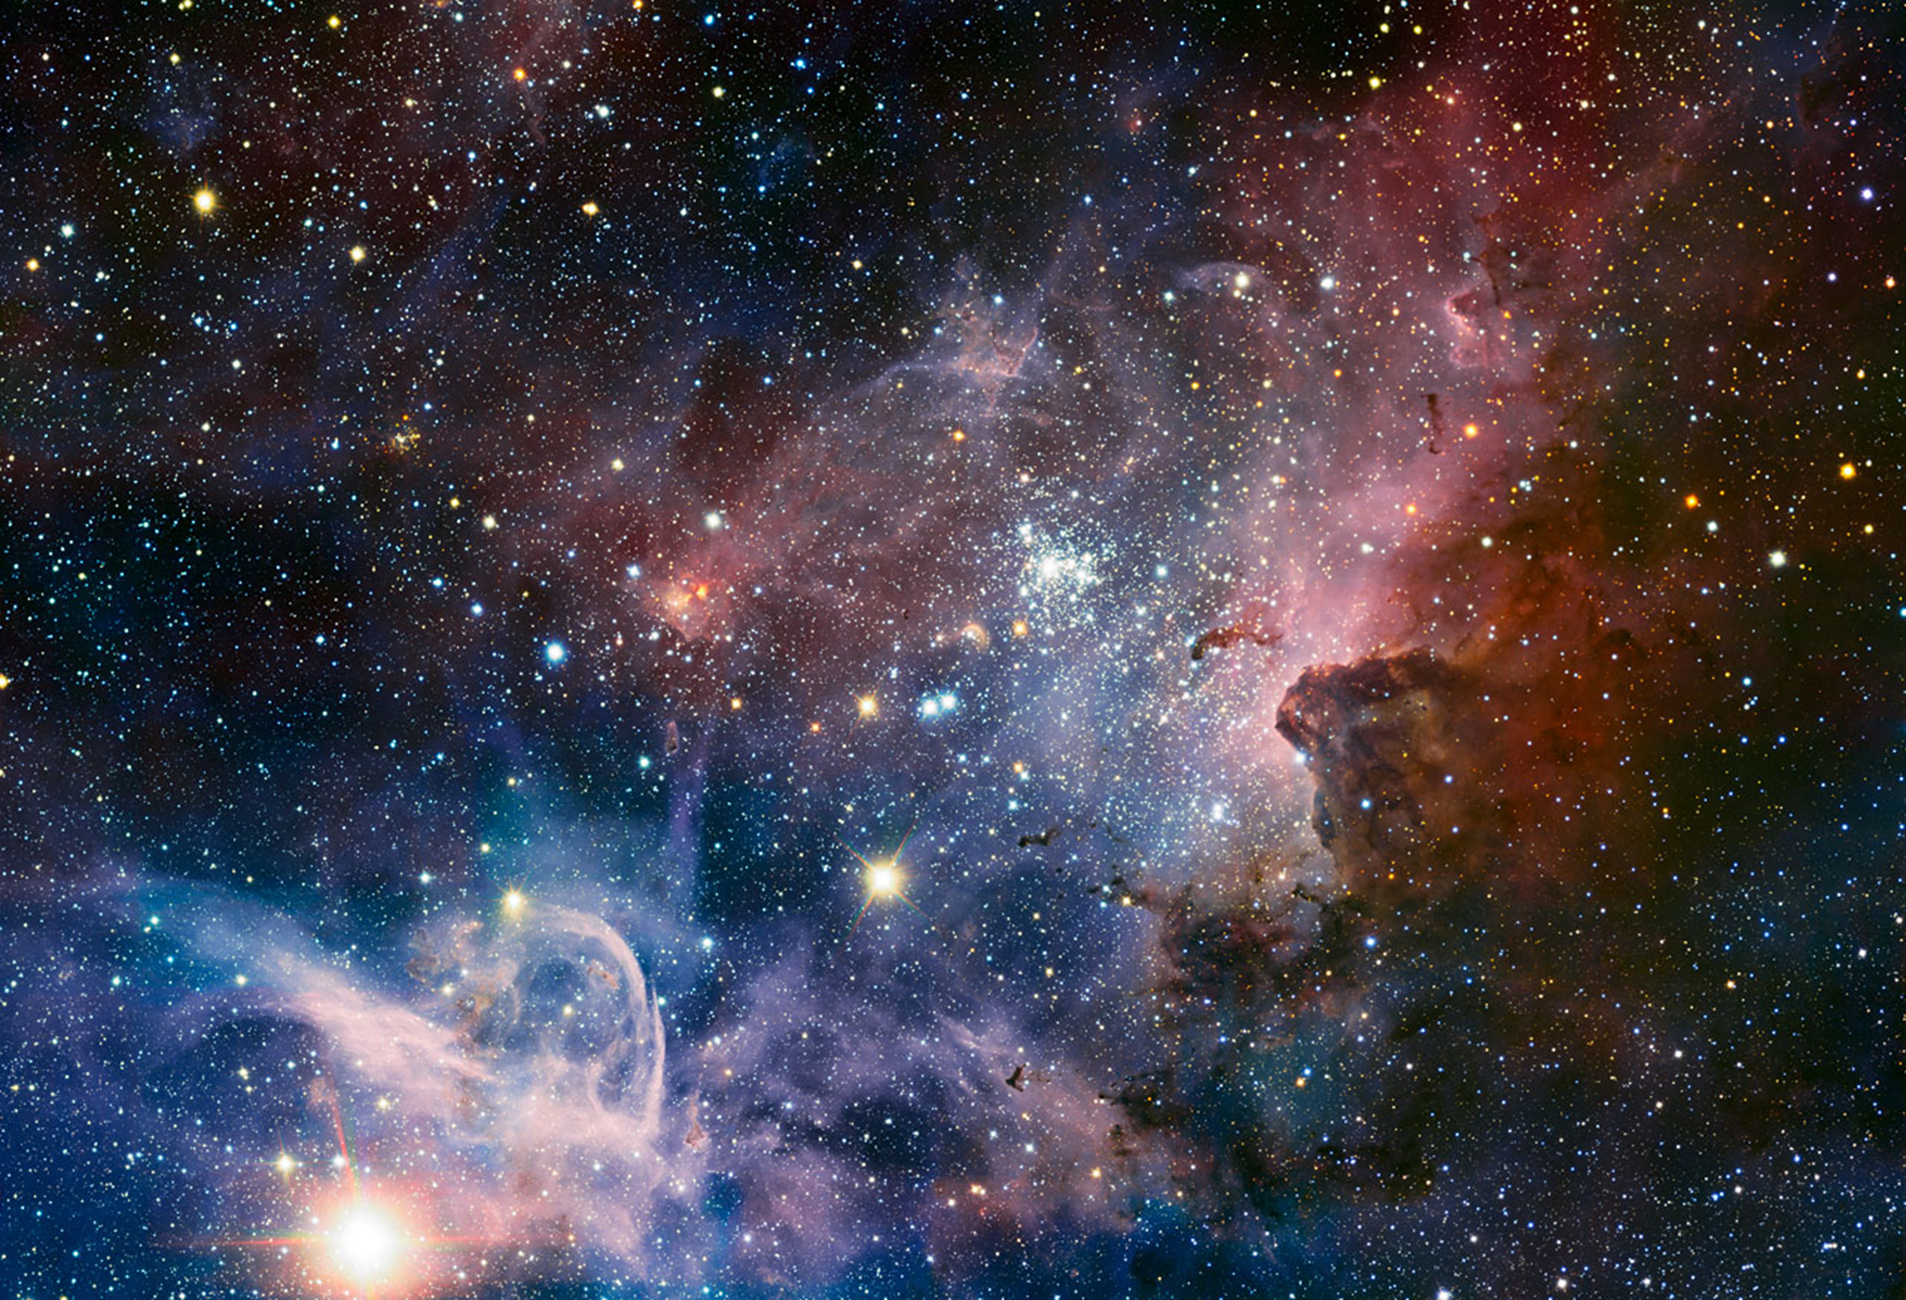
How did our universe begin?
What is our universe made of?
Where is the antimatter?
Why do particles have mass?
Notes:
CERN exists to answer these questions. It’s the only place on the planet that can recreate the conditions in the moments after the Big Bang as the Universe was forming. It’s the only place that can make Higgs bosons, and nowhere else has an antimatter factory
Big Bang 13.7 billion years ago
We use telescopes to look out into the universe and back in time – but the Universe was opaque for the first 300,000 years so the only way to understand what happened at the Big Bang is to recreate those conditions.
Visible matter (you, me and everything around us) makes up 5% of the Universe. We think the remaining 95% is Dark Matter and Dark Energy but we have yet to make any direct observations of either. Imagine not knowing what 95% of your Universe is made of?!

Slide 5
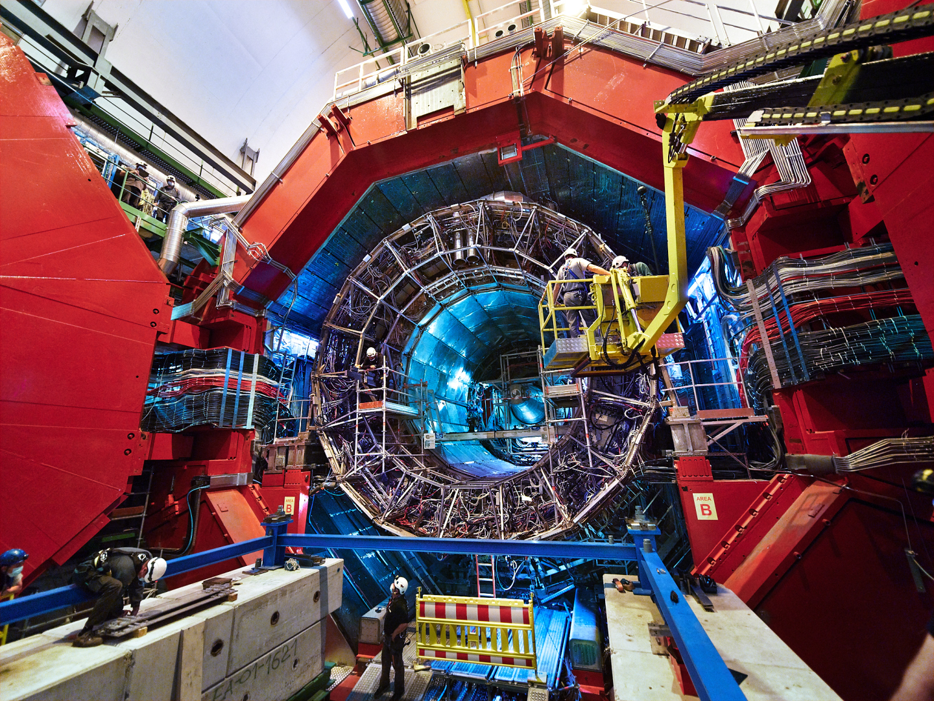
Notes:
Particles are collided in the heart of four huge detectors.
This is Alice….
It’s mostly doing nuclear physics and is especially interested in quark gluon plasma, the primordial soup of particles that existed before matter formed.

Slide 6
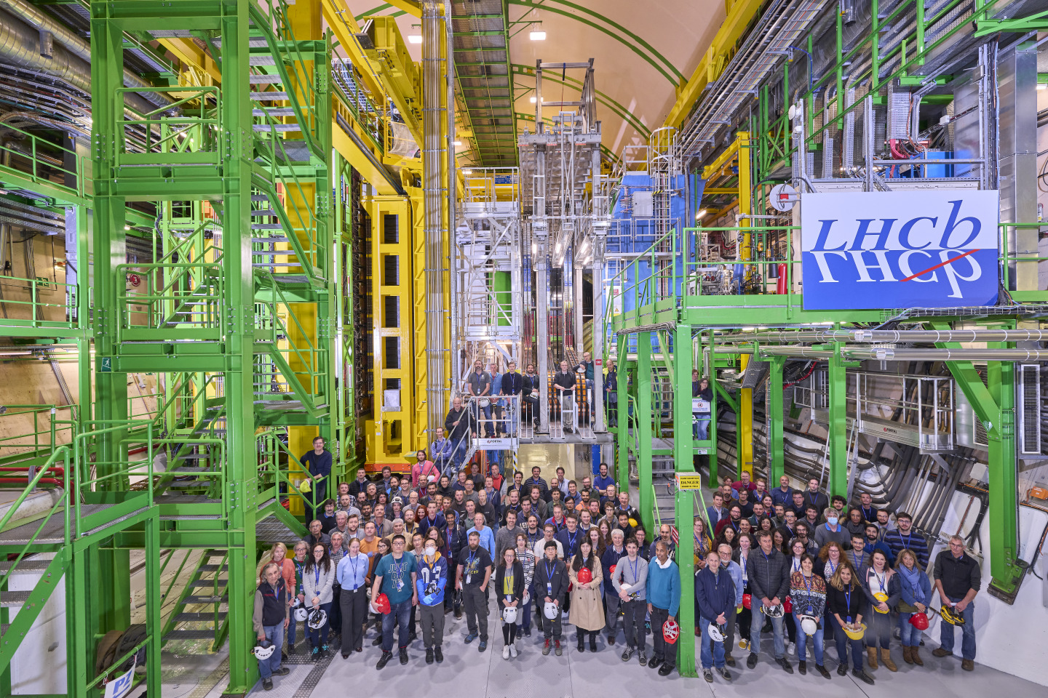
Notes:
This is LHCb
CP violation (posh name for matter:antimatter asymmetry) and unexplained physics beyond the Standard Model

Slide 7
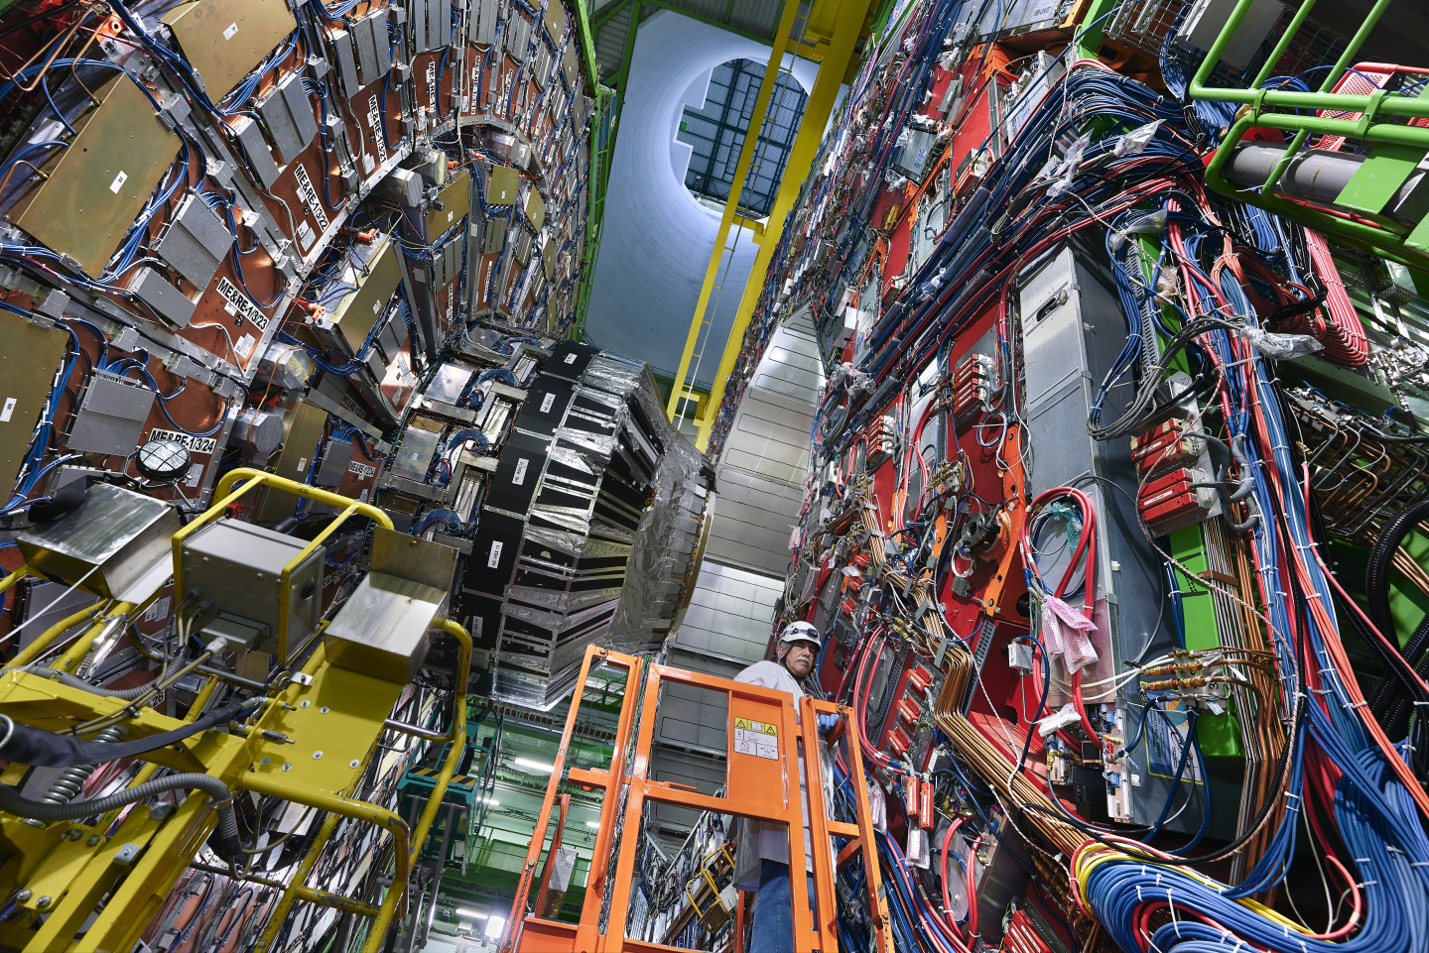
Notes:
This is CMS, one of the experiments that found the Higgs.

Slide 8

Notes:
This is ATLAS, the other experiment that found the Higgs boson

Slide 9
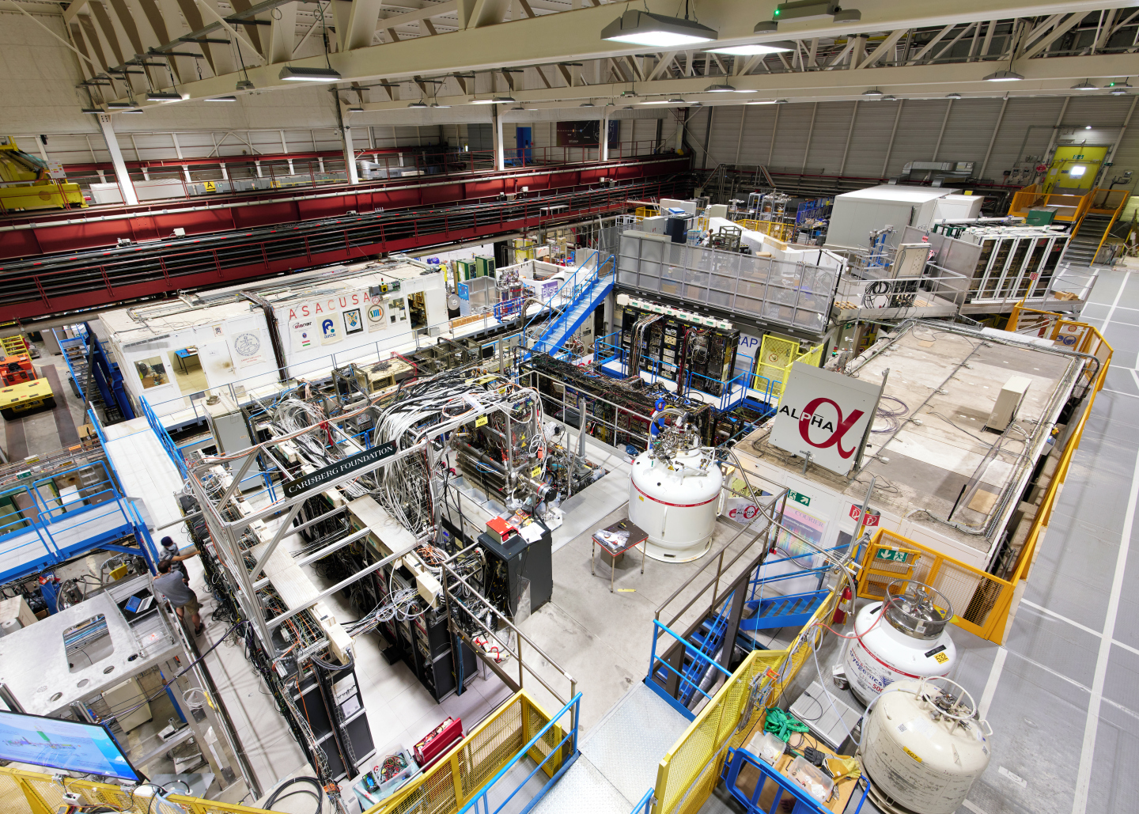
Notes:
EPSRC – antimatter research in the Antimatter Factory
Making antihydrogen antiatoms and learning more about its properties – why is our Universe dominated by matter?
ALPHA does things like make antihydrogen atoms and drops them to see if gravity interacts with antimatter in the same way as matter (sadly the answer was yes. Antimatter doesn’t go up ☹)

Slide 10
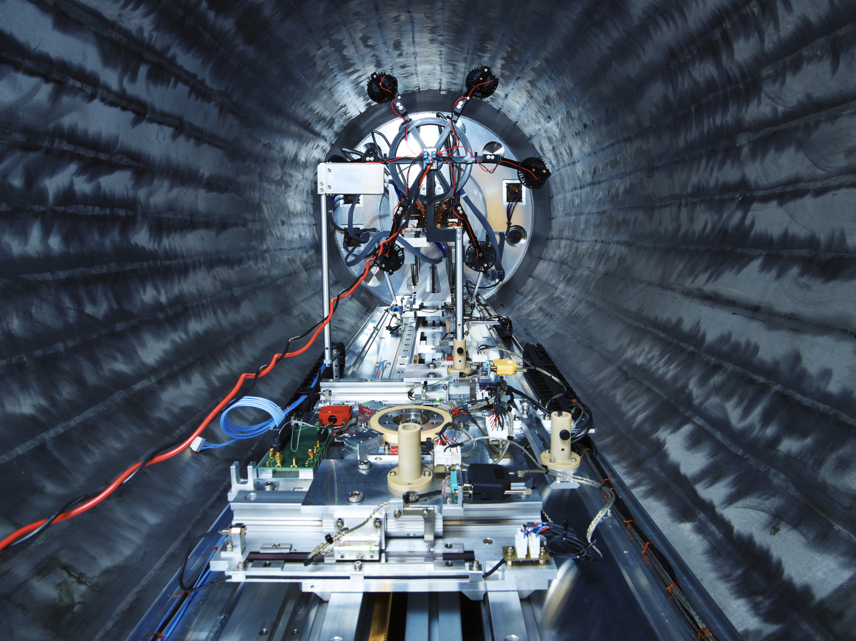
Notes:
ISOLDE nuclear physics facility – CERN isn’t just particle physics
Photo shows ISS, Isolde Solenoidal Spectrometer, built at Daresbury. The magnet is recycled from an old MRI machine.

Slide 11
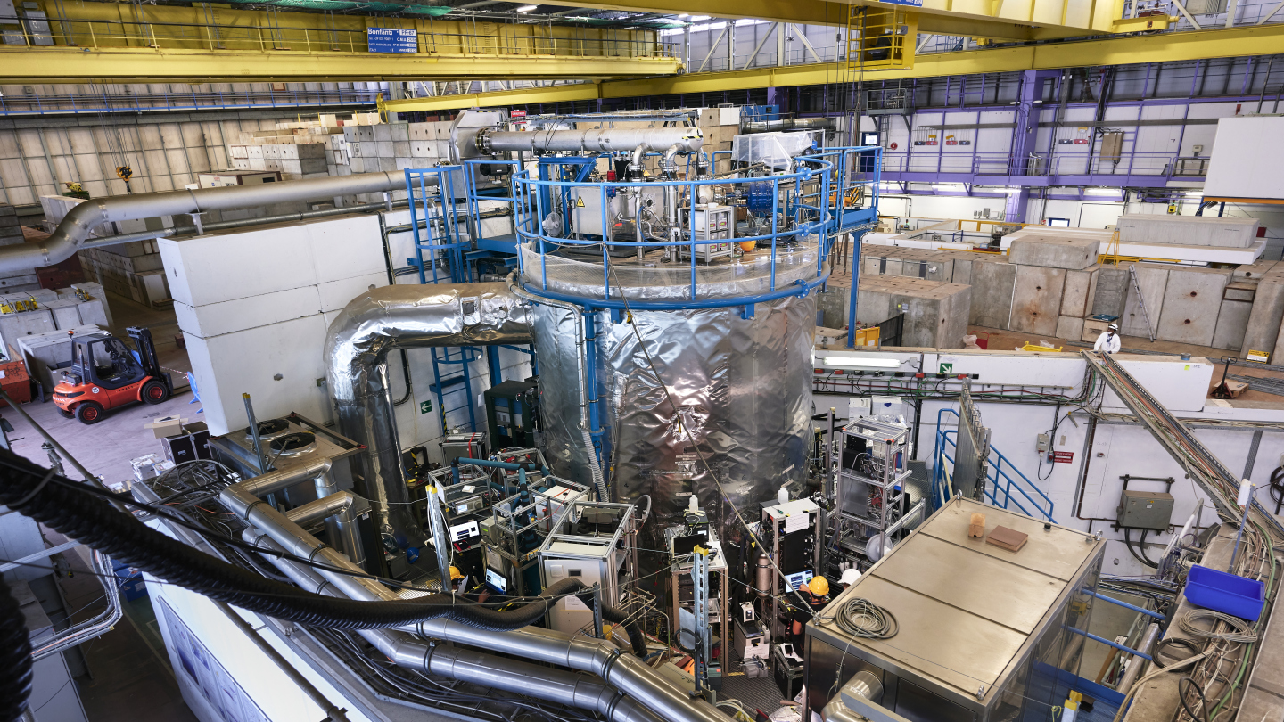
Notes:
Climate science – CLOUD experiment
No UK involvement at the moment, but previously funded by NERC
Using protons to understand the effects of cosmic rays on cloud formation.

Slide 12
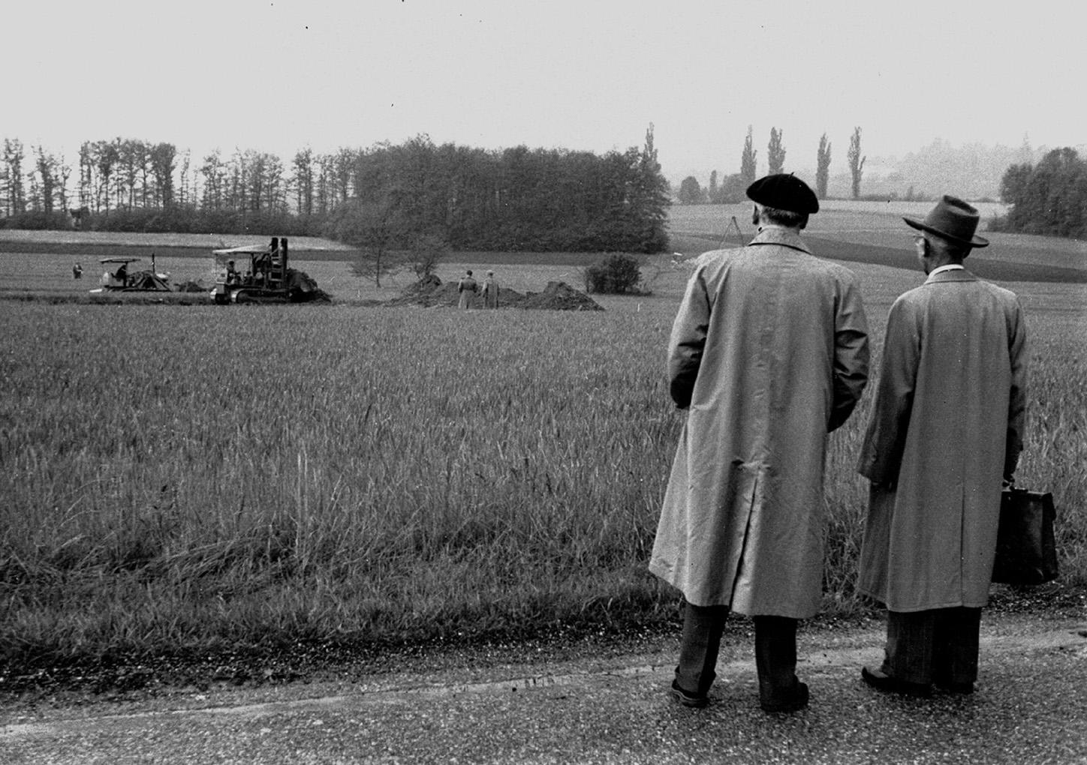
Notes:
15 May 1954 – earthworks start for first CERN office buildings
UK was a founding member – now 23 Member States
Post-war – science for peace and to stop brain drain to US

Slide 13
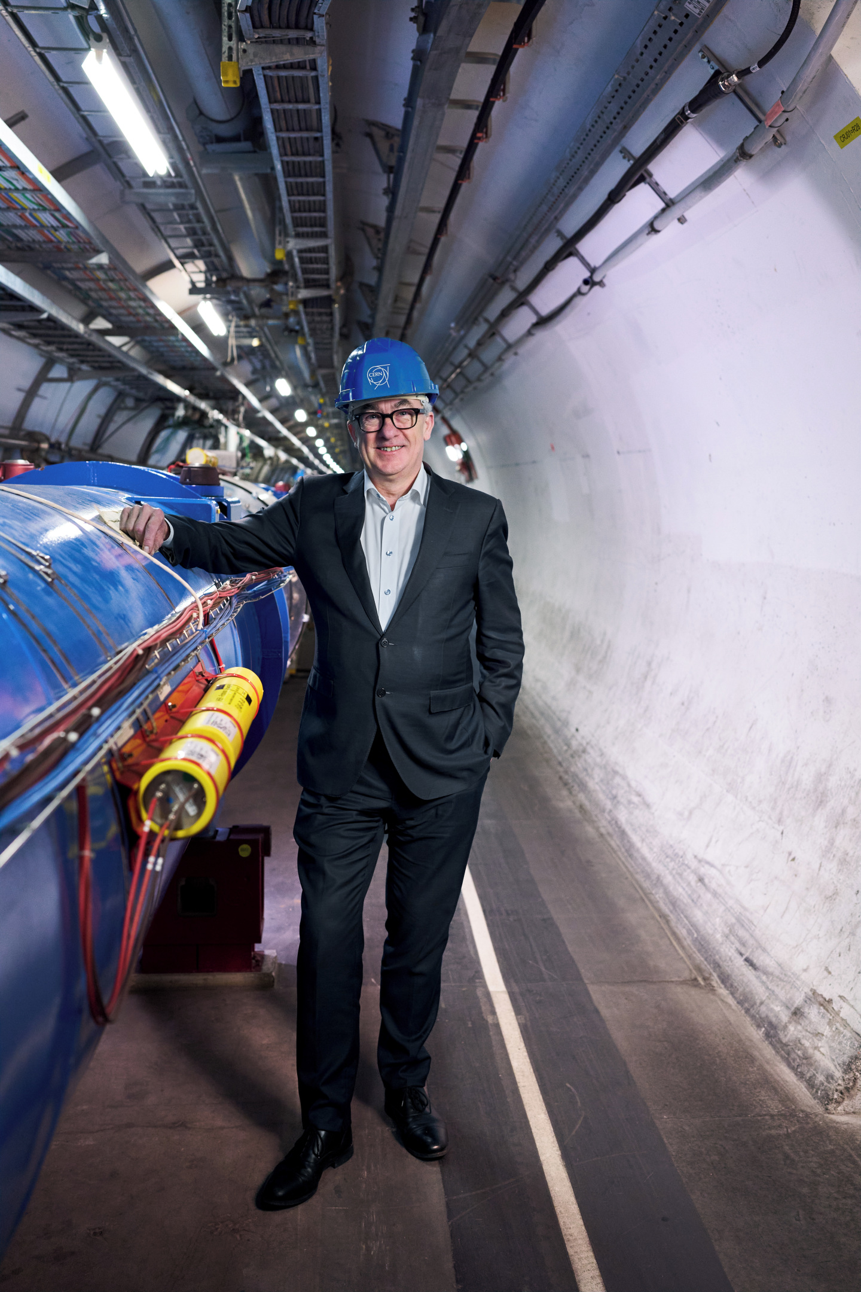

The benefits
Access to a unique research facility and leadership roles
UK schools can visit
UK teacher CPD programme
Career opportunities – not just physics
UK companies can bid for contracts
Notes:
2023 – DSIT and STFC published UK Strategy for Engagement with CERN – first strategy of it’s type
Total UK investment in CERN is ~£160M, plus £20-30M on contributions to experiments like ATLAS and LHCb, computing infrastructure (budget for regional teaching hospital in Oxford - £822M 2019-20, Warwick Uni income £680M 2019-20)
Flagship for UK participation in international and fundamental science.
Mark T starts his new role as CERN Director General in Jan 2026 – currently deciding how he wants the organization to be structured and then appointing his senior team.

Slide 14
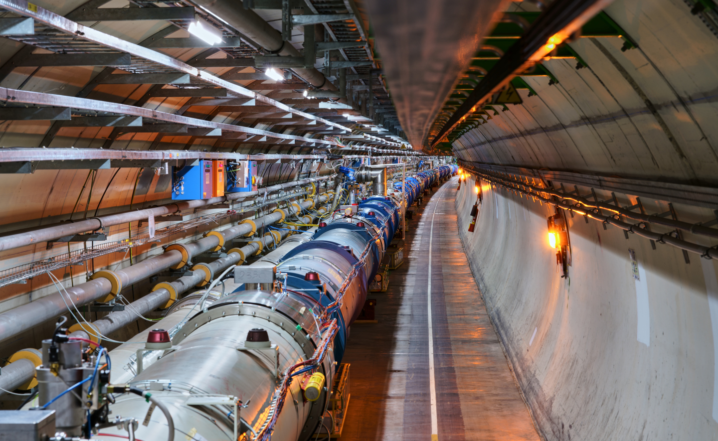
@stephhills.bsky.social
#UKatCERN

