Slide 1



An introduction to CERN
- the UK’s national lab for particle physics
All images in this presentation are © CERN unless otherwise indicated
Notes:
CERN rule #1: There’s no such thing as a stupid question!

Slide 2
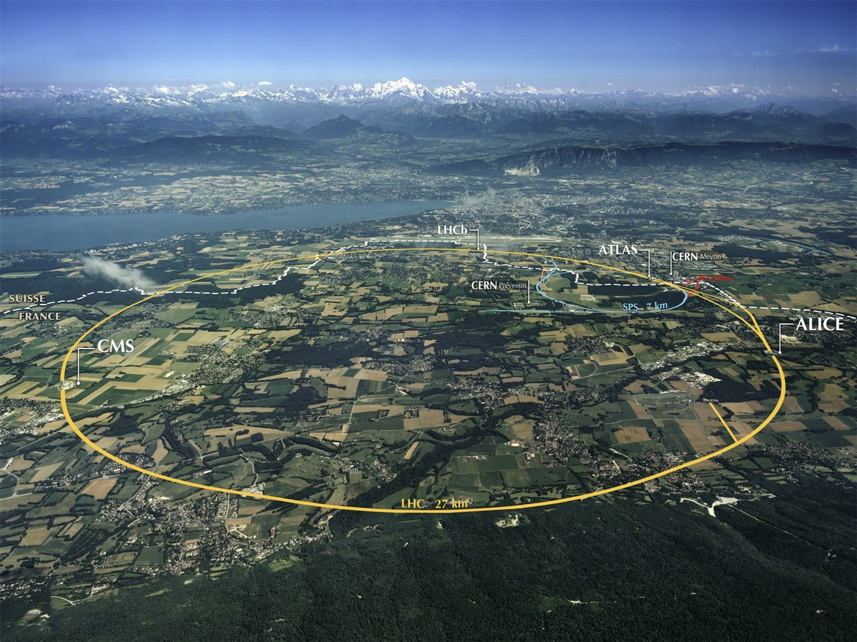
Notes:
Where are we?
Point out border, and what you would see if you were here.
27km tunnel underneath French/Swiss countryside
World’s largest particle accelerator
100m underground
11,000 times per second

Slide 3

Notes:
Recap – what is the LHC?
27km tunnel underneath French/Swiss countryside
World’s largest particle accelerator
Two beams of particles traveling in opposite directions at almost speed of light
Collisions recreate what happened in the moments after the Big Bang
Too big and expensive for one country to have a lab this complex. CERN brings together the best of the best with different cultural approaches to solving problems.

Slide 4
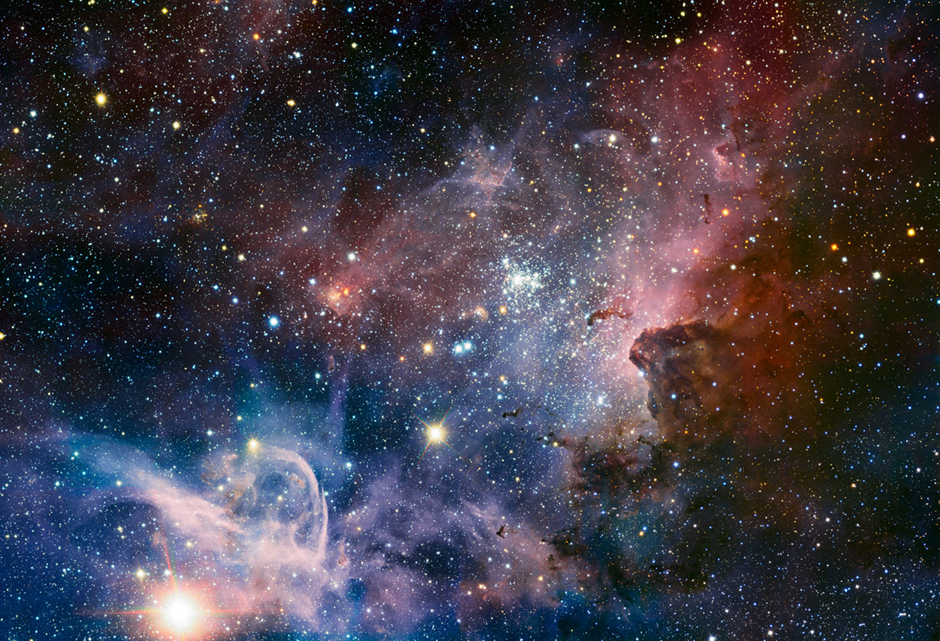
How did our universe begin?
What is our universe made of?
Where is the antimatter?
Why do particles have mass?
Notes:
CERN exists to answer these questions. It’s the only place on the planet that can recreate the conditions in the moments after the Big Bang as the Universe was forming. It’s the only place that can make Higgs bosons, and nowhere else has an antimatter factory
Big Bang 13.7 billion years ago

Slide 5
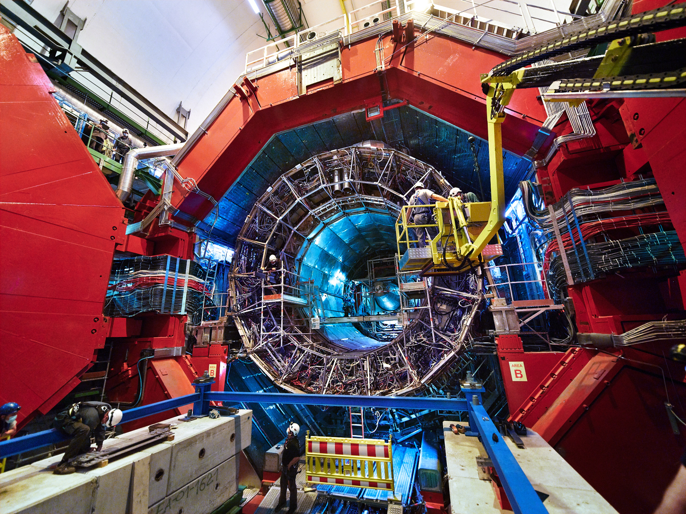
Notes:
Particles are collided in the heart of four huge detectors.
This is Alice….

Slide 6
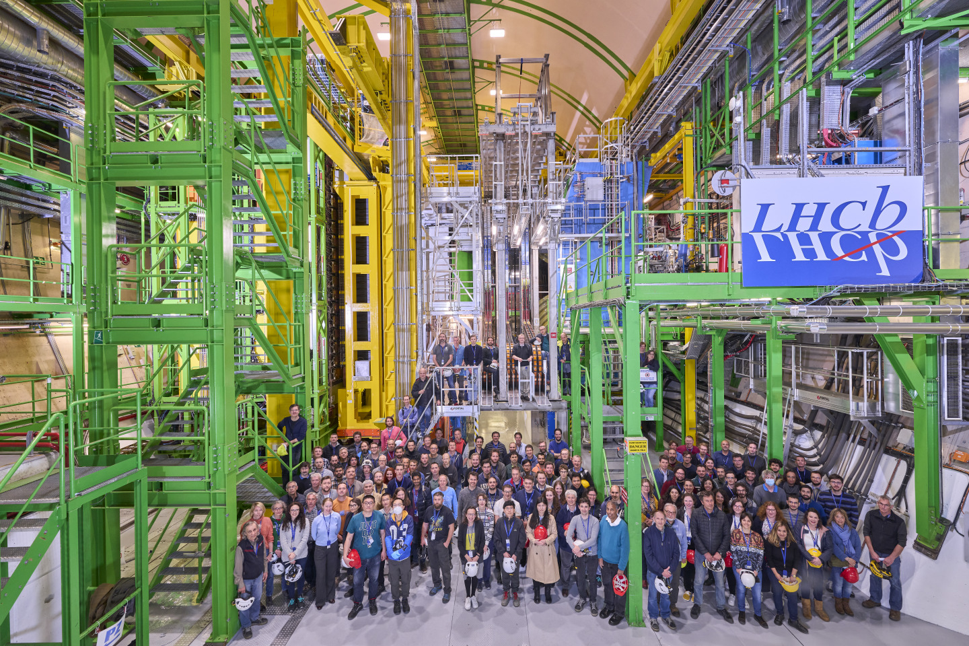
Notes:
This is LHCb
Recently – hints of unexplained physics beyond the Standard Model

Slide 7
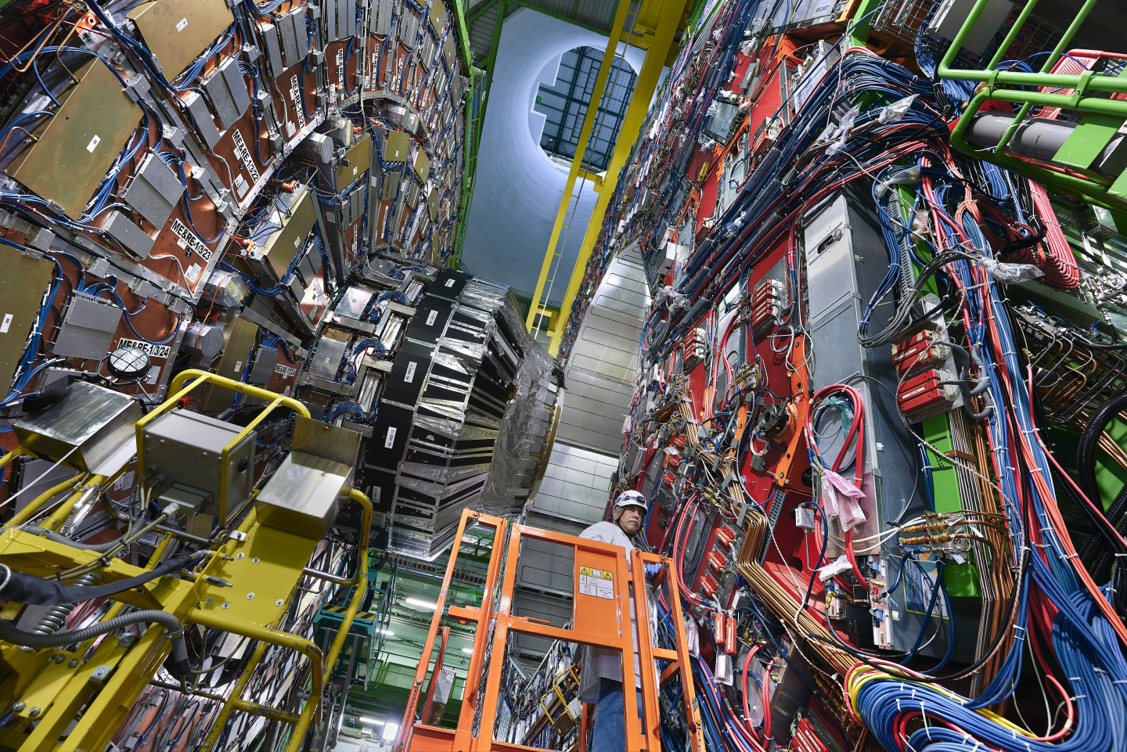
Notes:
This is CMS, one of the experiments that found the Higgs.

Slide 8

Notes:
This is ATLAS, the other experiment that found the Higgs boson

Slide 9
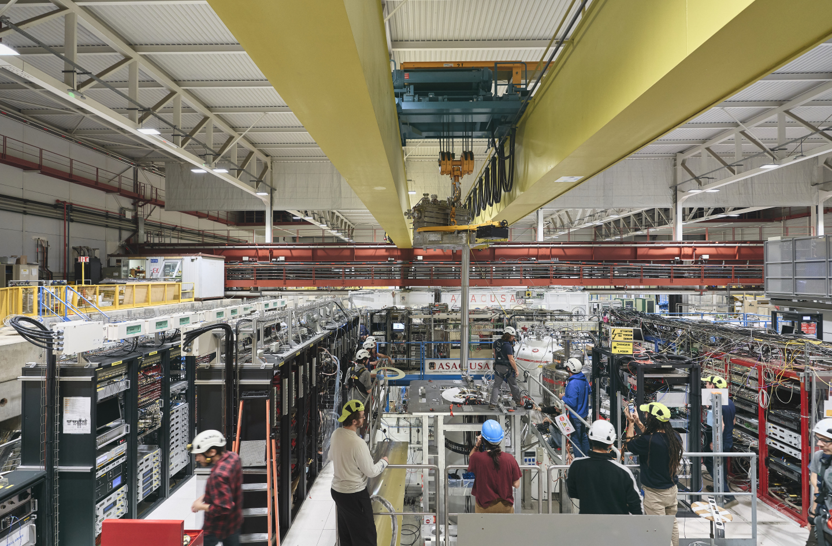
Notes:
EPSRC – antimatter research in the Antimatter Factory
Making antihydrogen antiatoms and learning more about its properties – why is our Universe dominated by matter?
Could it be gravity?

Slide 10
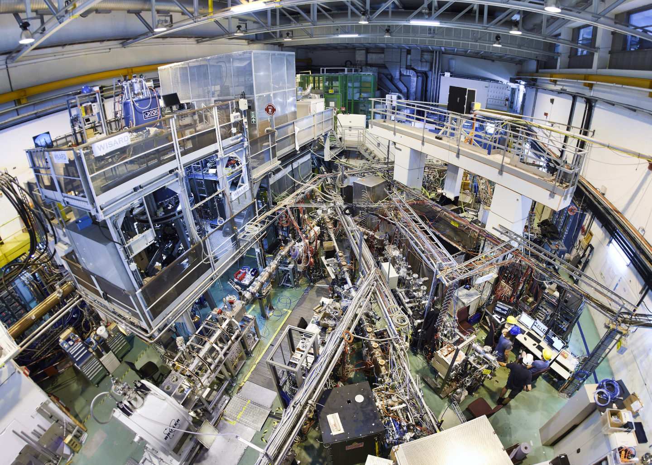
Notes:
ISOLDE nuclear physics facility – CERN isn’t just particle physics

Slide 11
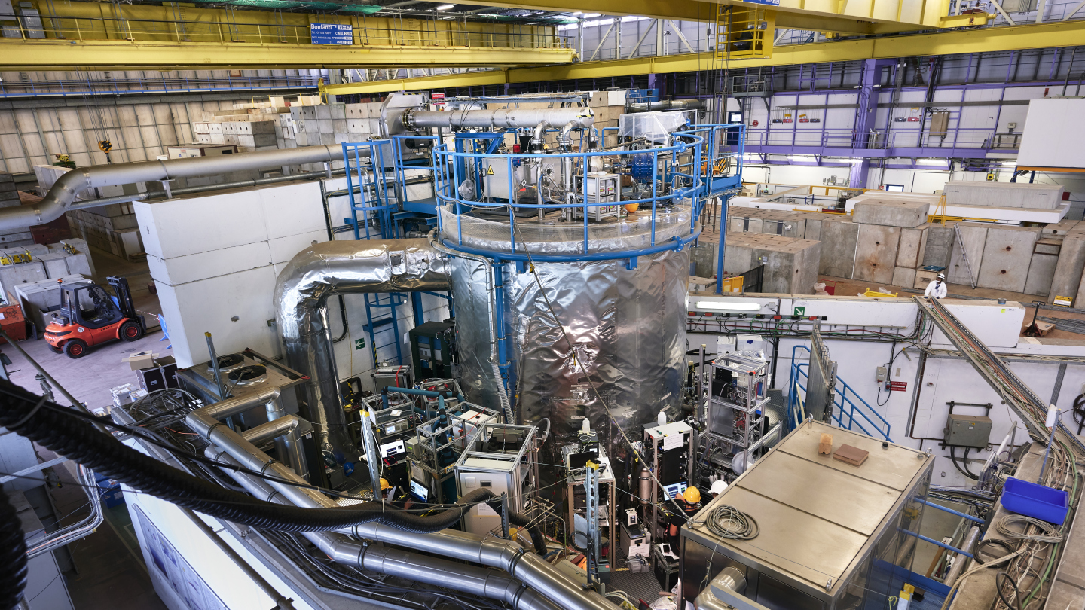
Notes:
Climate science – CLOUD experiment
Funded by NERC
Using protons to understand the effects of cosmic rays on cloud formation.

Slide 12
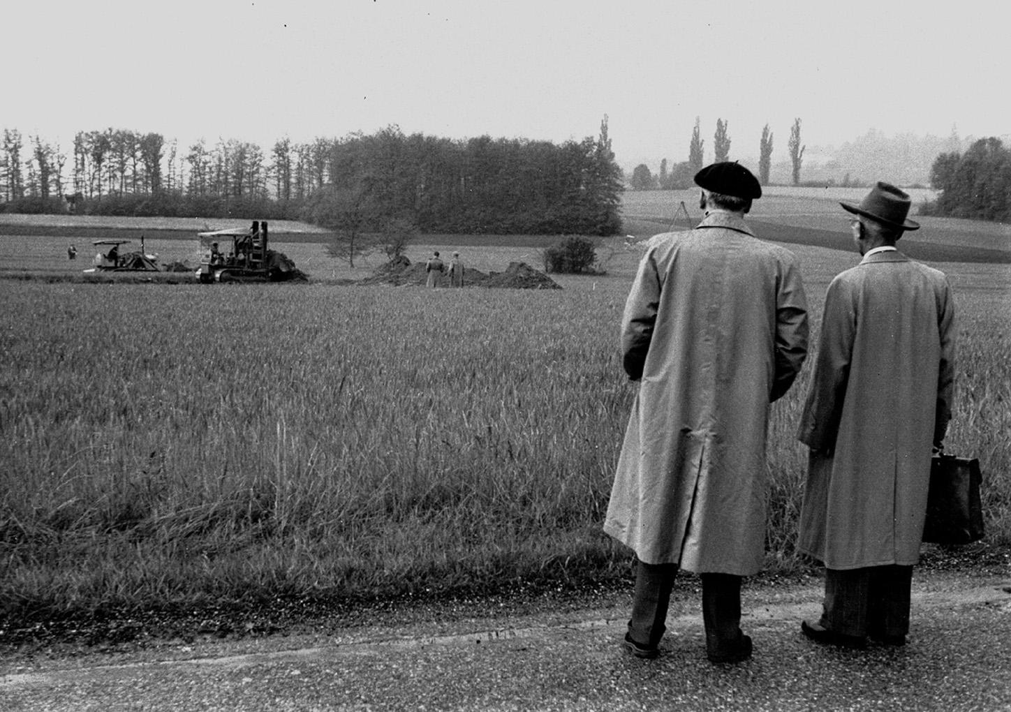
Notes:
15 May 1954 – earthworks start for first CERN office buildings
UK was a founding member – now 23 Member States
Post-war – science for peace and to stop brain drain to US

Slide 13

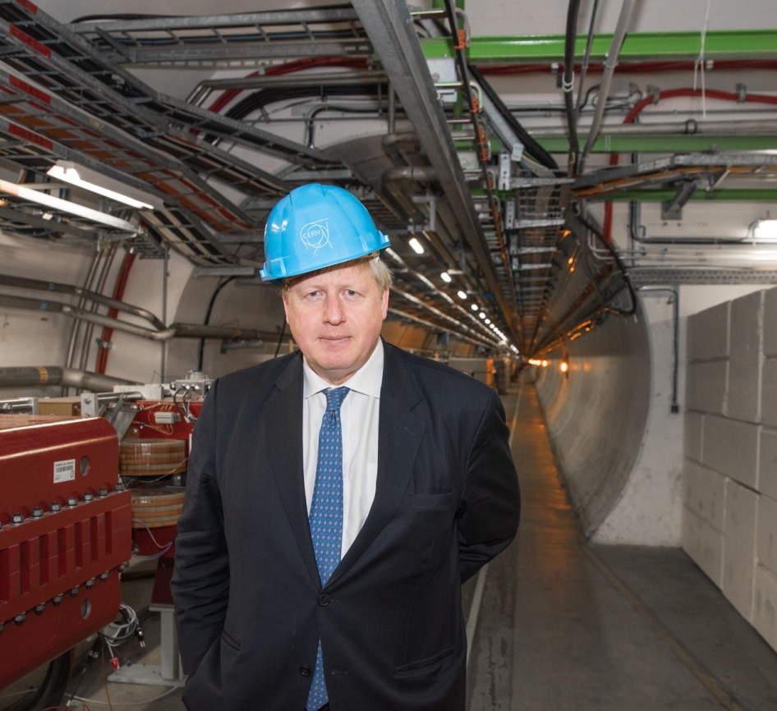
The benefits
Access to a unique research facility and leadership roles
UK schools can visit
UK teacher CPD programme
Career opportunities – not just physics
UK companies can bid for contracts
Notes:
Total UK investment in CERN is ~£175M pa (budget for regional teaching hospital in Oxford - £822M 2019-20, Warwick Uni income £680M 2019-20)
Flagship for UK participation in international and fundamental science.

Slide 14
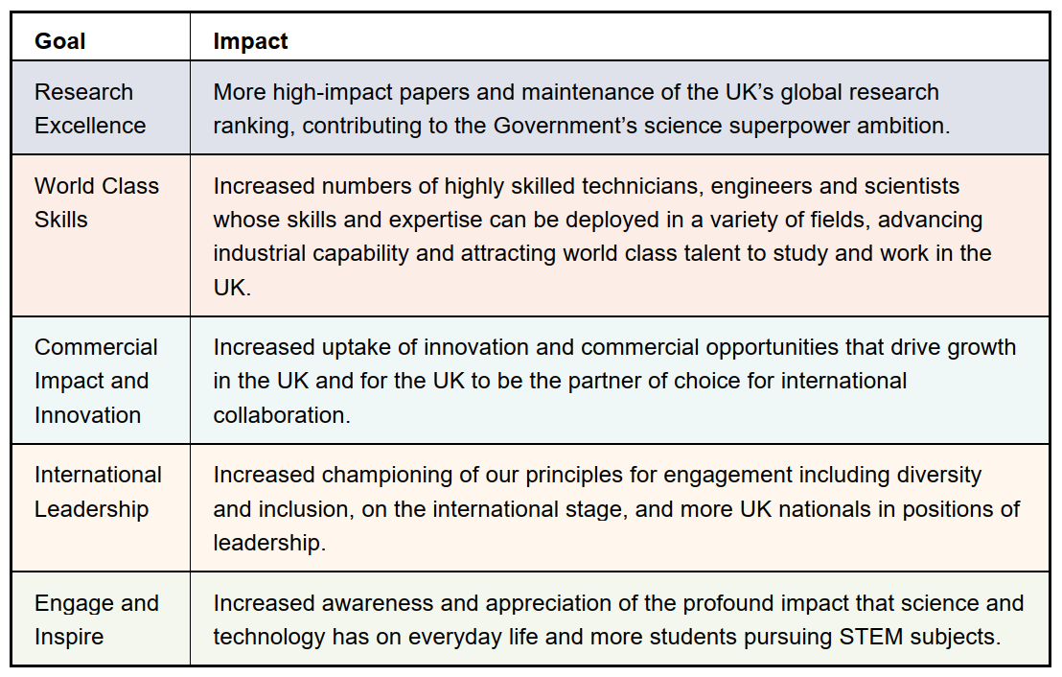

UK Strategy for Engagement with CERN
Notes:
Published October 2023
Co-written by DSIT and STFC
Forewords by Science Minister and Mark Thomson

Slide 15
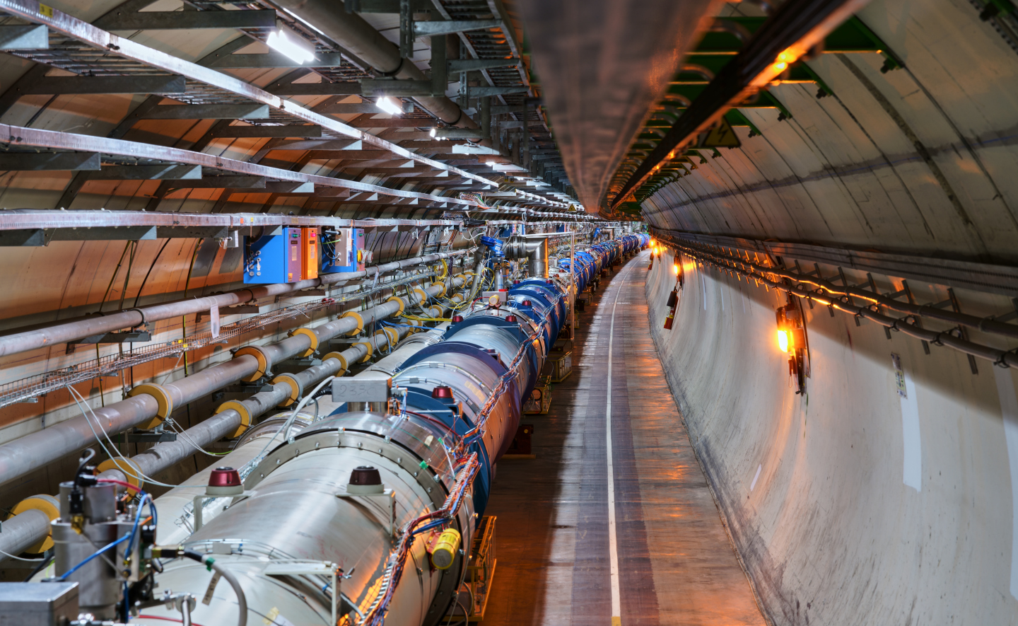
@Sci_of_Steph
#UKatCERN

