Slide 1
Paul Demarest – Career History
Harwell Laboratories – United Kingdom Atomic Energy Authority UKAEA –
Mechanical Engineering Apprenticeship: 1987 – 1991.
Harwell Laboratories UKAEA – Draughtsman: 1991 – 1993.
Rutherford Appleton Laboratory RAL –
Senior Craftsman - ISIS Synchrotron: 1993 – 1998.
RAL - Mechanical Technician, ISIS – Riken Muon facility: 1998 – 2004
RAL - Diamond Light Source - Insertion Device Assembly Supervisor:
2004 – 2007
Outside Industry – Business Manager: 2007 - 2011
CERN – Vacuum Technician - 2011 – Now.
Qualifications:
BTEC – ONC, HNC & HND in Mechanical Engineering.
BTEC – ONC in Electrical Engineering

Slide 2
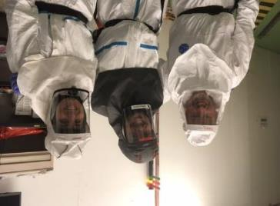
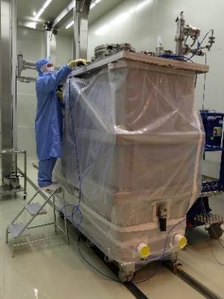
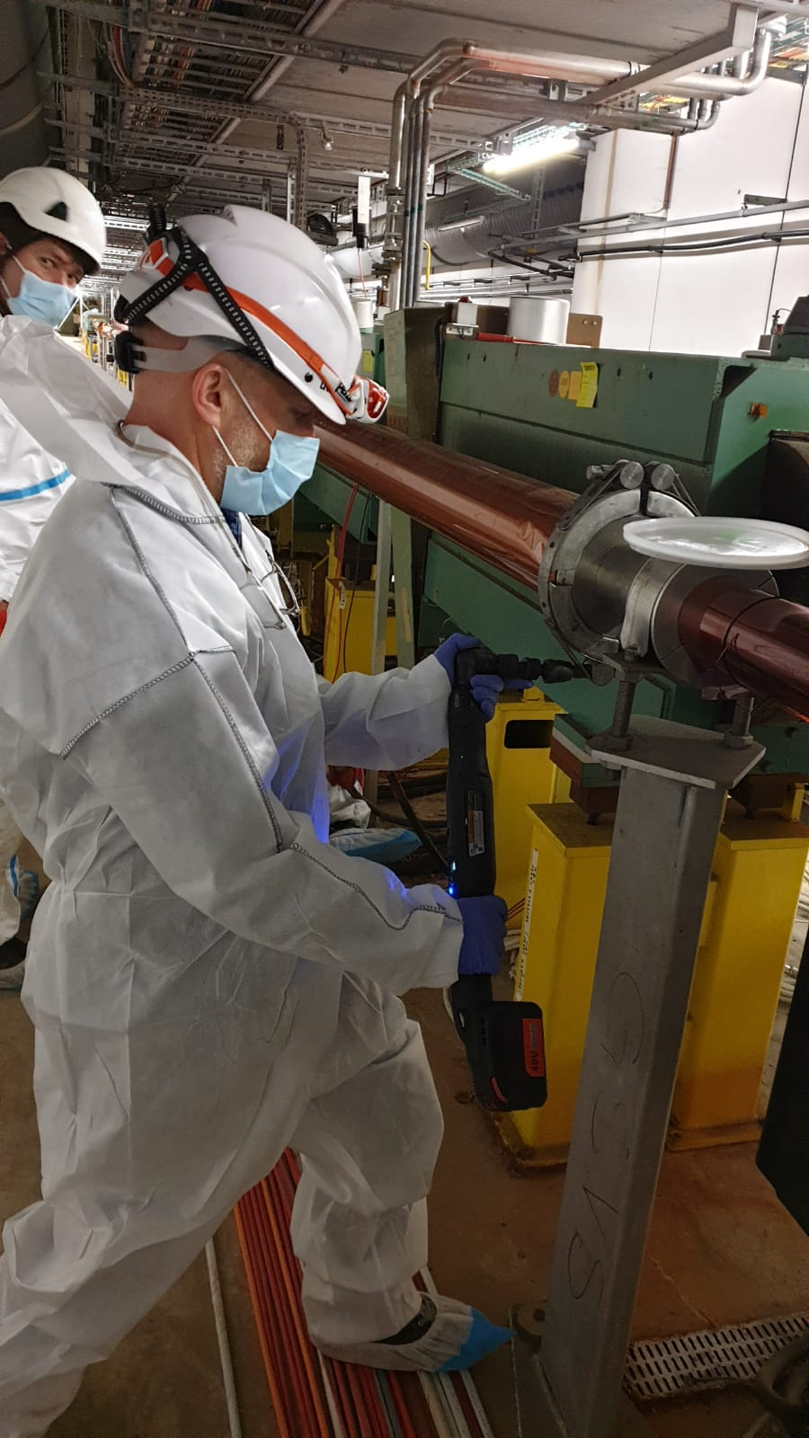
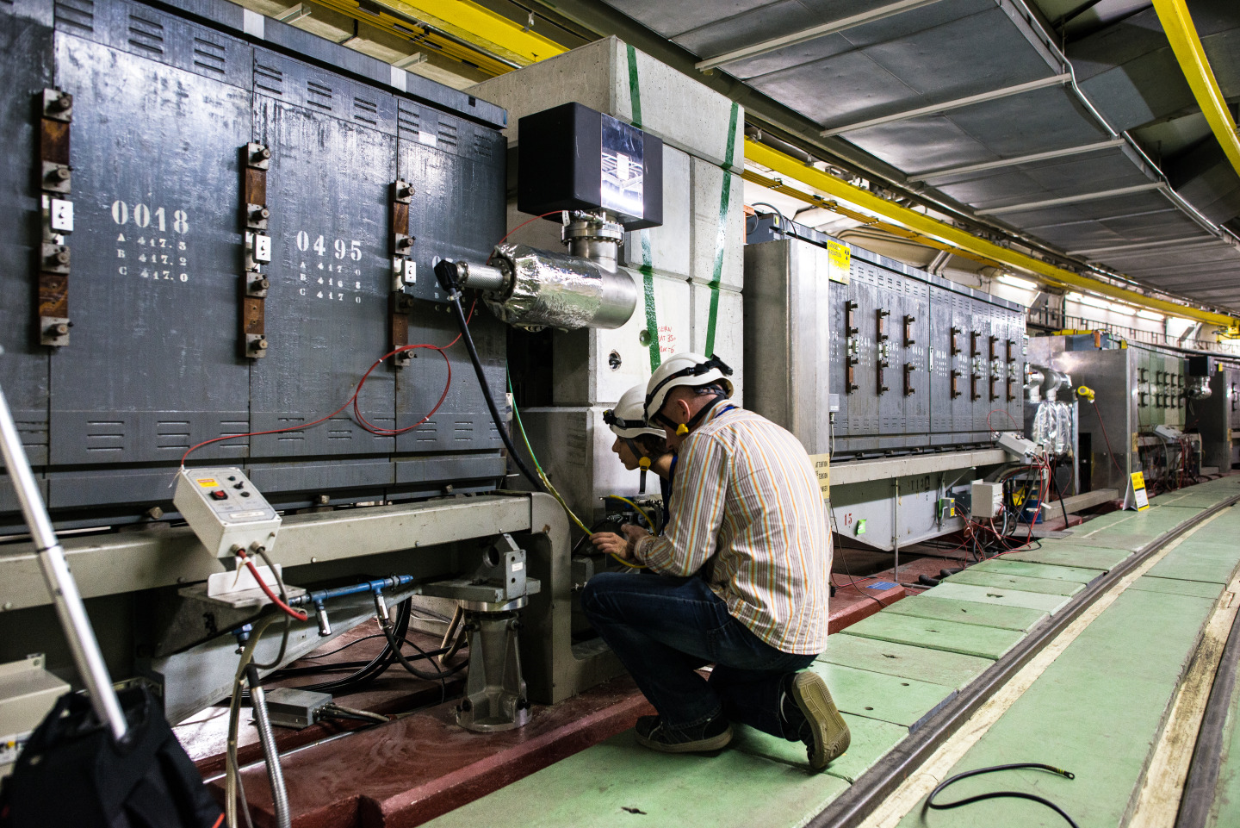
Process Operations Technical Engineer

Slide 3
Graeme Barlow – Career History
Harwell Laboratory – United Kingdom Atomic Energy Authority UKAEA –
Mechanical Engineering Apprenticeship: 1982 – 1986.
Final qualification: Instrument maker
Harwell Laboratories UKAEA – Mechanical Technician: 1986 – 2005
Culham laboratory working on DITE, MASS and JET fusion projects
Diamond Light Source - Senior Beamline Technician:
2005 – 2012
CERN –Technicien Supérieur: Magnets group - 2012 – April 2023
CERN –Technicien Supérieur: Vacuum group – April 2023- present
Original Qualifications:
City and Guilds Certificate in Mechanical Engineering

Slide 4
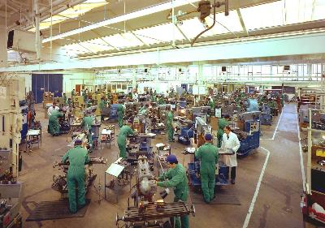
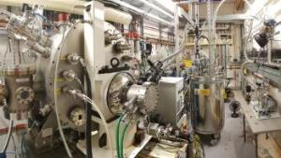
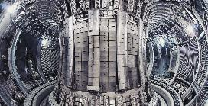
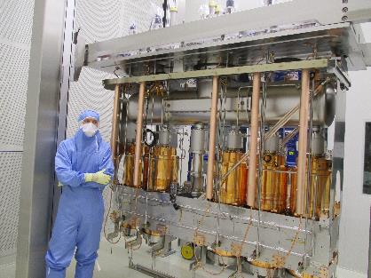
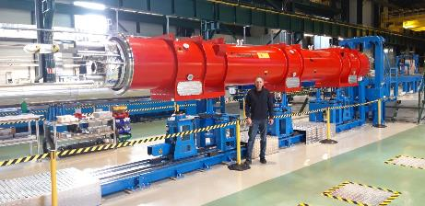
Technicien Supérieur - Vacuum

Slide 5
Abigail Rhian Lee – Career History
2015-17 BTEC Level 3 Extended Diploma in General Engineering, Cronton Sixth Form College, Widnes, UK.
2017-18 Performing Engineering Operations NVQ, Trafford college, Manchester, UK.
2017-2020 Engineering Apprentice at MWH Treatment, UK.
July 2020- TTE Technician at CERN
  07/2020 – 05/2022: SY-RF-AC (Systems-Radio Frequency-Amplifiers & Couplers). Mechanical technician, working on HL-LHC designs and documentation.
  01/2023- Present: SY-BI-ML (Systems-Beams Instrumentation-Mechanics & logistics). Mechanical technician, working on instrumentation designs new & old.

Slide 6
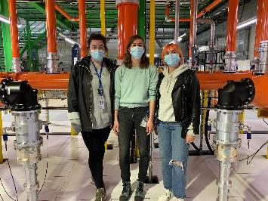
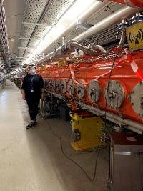
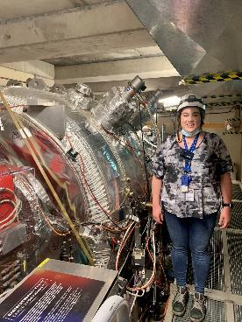
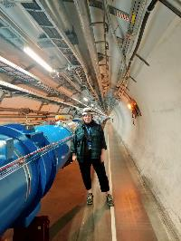
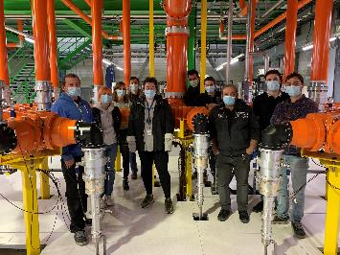
TTE Technician
SPS
AD
LHC

Slide 7
Joel Murray Davies – Career History
2006–2007
Introduction to Engineering
Performing Engineering Operations NVQ level 2
2007–2012
Modern Industrial Apprenticeship
BTEC level 3 Electrical engineering
Performing Engineering Operations NVQ level 3
HNC in Electrical Engineering
2012–2015
CERN TTE
EP-ADO
Cutting edge tech
2016–2021
Commissioning Technician
Pharmaceutical industry
Leadership experience
2021- Present
CERN Computing Technician IT-FA-IO
Language skills
Mentorship
International experience
Fundamental electrical/ mechanical appreciation.

Slide 8
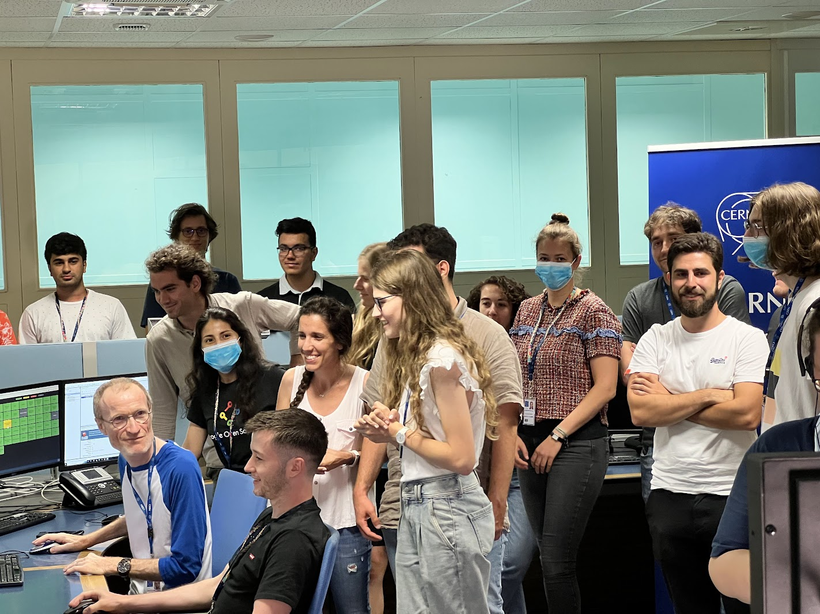
Computing Technician

Slide 9
Jamie Pinnell– Career History
STFC - Rutherford Appleton Laboratory –
Mechanical Engineering Apprenticeship: 2010-2014
CERN – ATLAS Technical Coordination and Project Office
  Design and Drawing production for New Small Wheel Detector
  Machining and testing of kinematic prototypes and installation tooling
  Large scale assembly of New Small Wheel and installation to ATLAS cavern
  Piloting of the ATLAS Movement System, 1 of 2 in the world who do this
  Designing the network feeding our new generation CO2 cooling system for ITK
  Mechanical simulation for large mechanical assemblies
Qualifications:
A-Levels – Physics, Chemistry & Graphic Design
  NVQ lvl 3 – Mechanical Manufacturing Engineering
  BTEC 4 HNC – Mechanical Engineering
  City & Guilds 2330 - Electrotechnical Installation

Slide 10
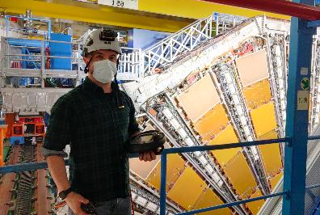
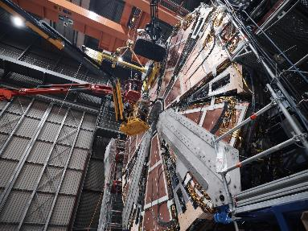
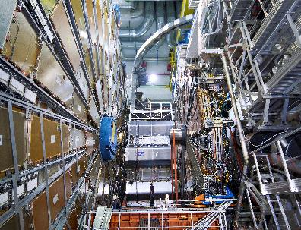
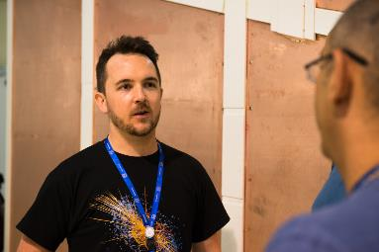
Mechanical Engineering Design Technician

Slide 11
Want to work at CERN?
If you’ve liked what you’ve seen:
Placement during your apprenticeship (talk to Steph for more info)
CERN Technician Training Experience
Google ‘CERN Jobs’

