Slide 1

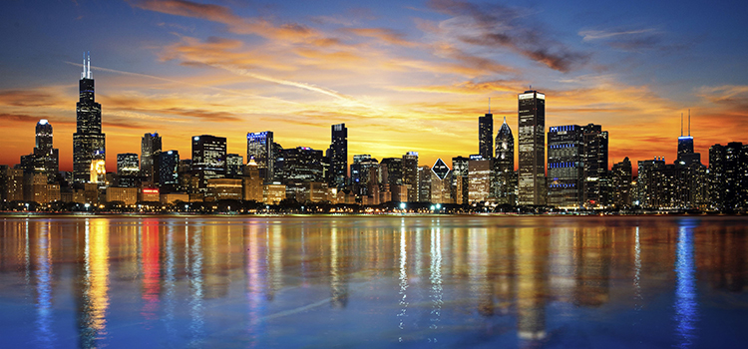


Observation of Efimov States in
Ultracold Atoms
24th European Conference on Few-Body Problems in Physics, University of Surrey, 9/2/2019
Cheng Chin
The University of Chicago

Slide 2
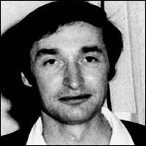
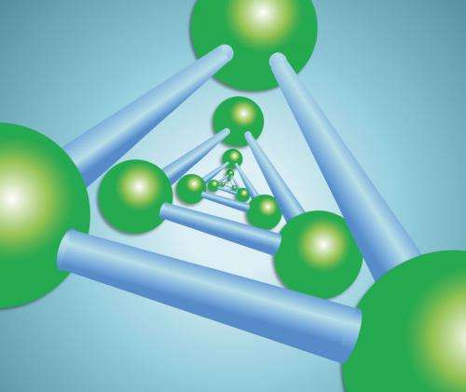
Synopsis
Prediction Vitaly Efimov (1970)
  α+α+α → C
  H+H+H → T
Appearance Cs, Li, K, Rb, LiCs, LiRb, He 2006…
Properties Geometric scaling, universality…
Molecular size:
1, λ, λ² …
Molecular size ~
Scattering length a ∝
van der Waals length

Slide 3
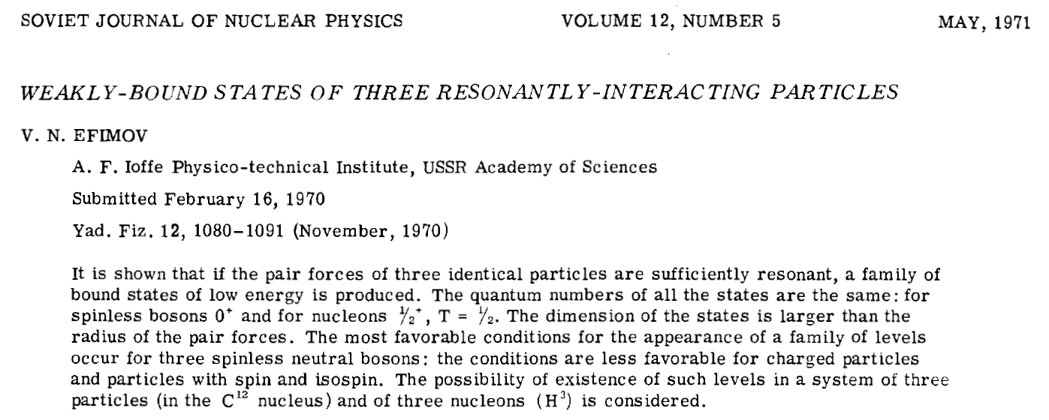
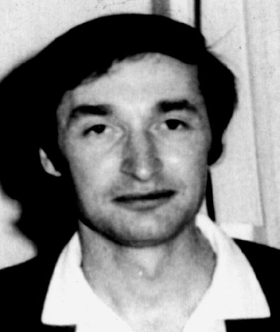
Hyperspherical
equation:
⇒ Invariant under dilation transformation R→λR and E→λ⁻²E
Scaling factor λ=exp(π/s₀)
Vitaly Efimov

Slide 4
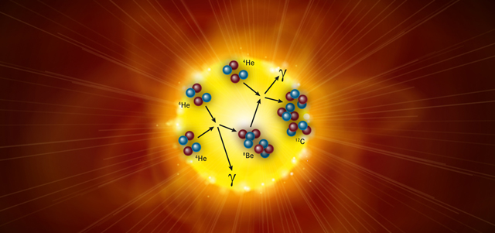
Holye state of carbon in nucleosynthesis
Epelbaum, et al. Scientific American (2012)

Slide 5
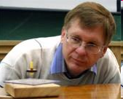
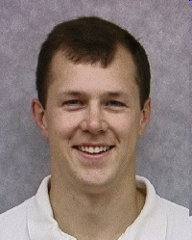
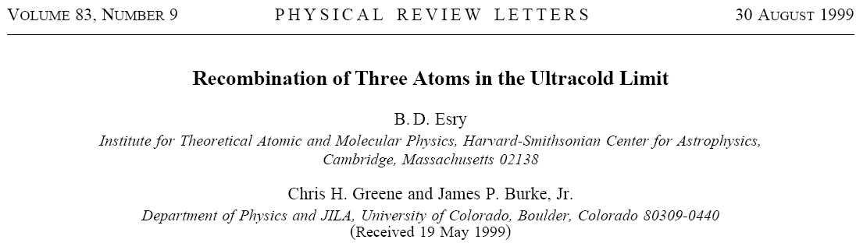
From Nuclear Physics to Ultracold Atoms
Chris Greene (Purdue)
Brett Esry (Kansas State)

Slide 6
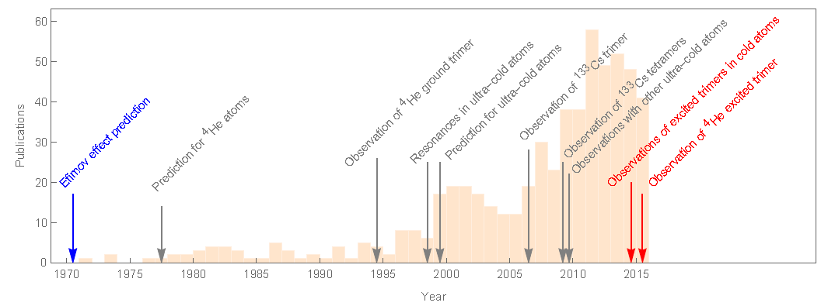
Efimov effect in nuclear physics, helium and ultracold atoms
Prediction in cold atoms
Observation of Efimov
Resonance in Cs-133
Test of vdW universality
Observation of scaling symmetry
van der Waals universality conjecture
Pascal Naidon, Shimpei Endo, Rep. Prog. Phys. 80 056001 (2017)

Slide 7
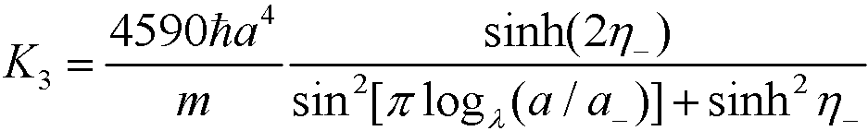
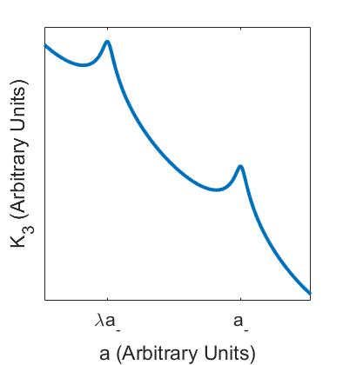
Efimov Resonances in recombination
K₃: 3-bdy Recombination rate
a₋: Efimov resonance position
λ: scaling constant
η₋: Efimov resonance width parameter (Lorentzian)
Esry, Greene and Burke, PRL (1999)
Notes:
Formula is for three identical bosons
Only three parameters: width (think Lorentzian), resonance position, and scaling constant
Practical limitations for measuring this: large scaling constant (22.7 for identical bosons) means you need extremely low temperature and fine magnetic field control to see much

Slide 8
Recombination in cold atoms
n^{-1/3} = 300~400 nm
Recombination length

Slide 9
Recombination in cold atoms
n^{-1/3} = 300~400 nm
Recombination length

Slide 10
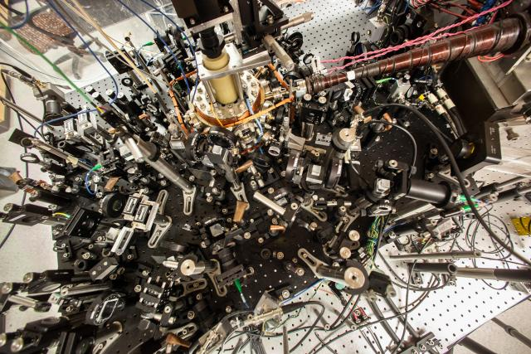
Ultracold atom lab at the Univ. of Chicago
CCD
atoms
Laser
Laser

Slide 11
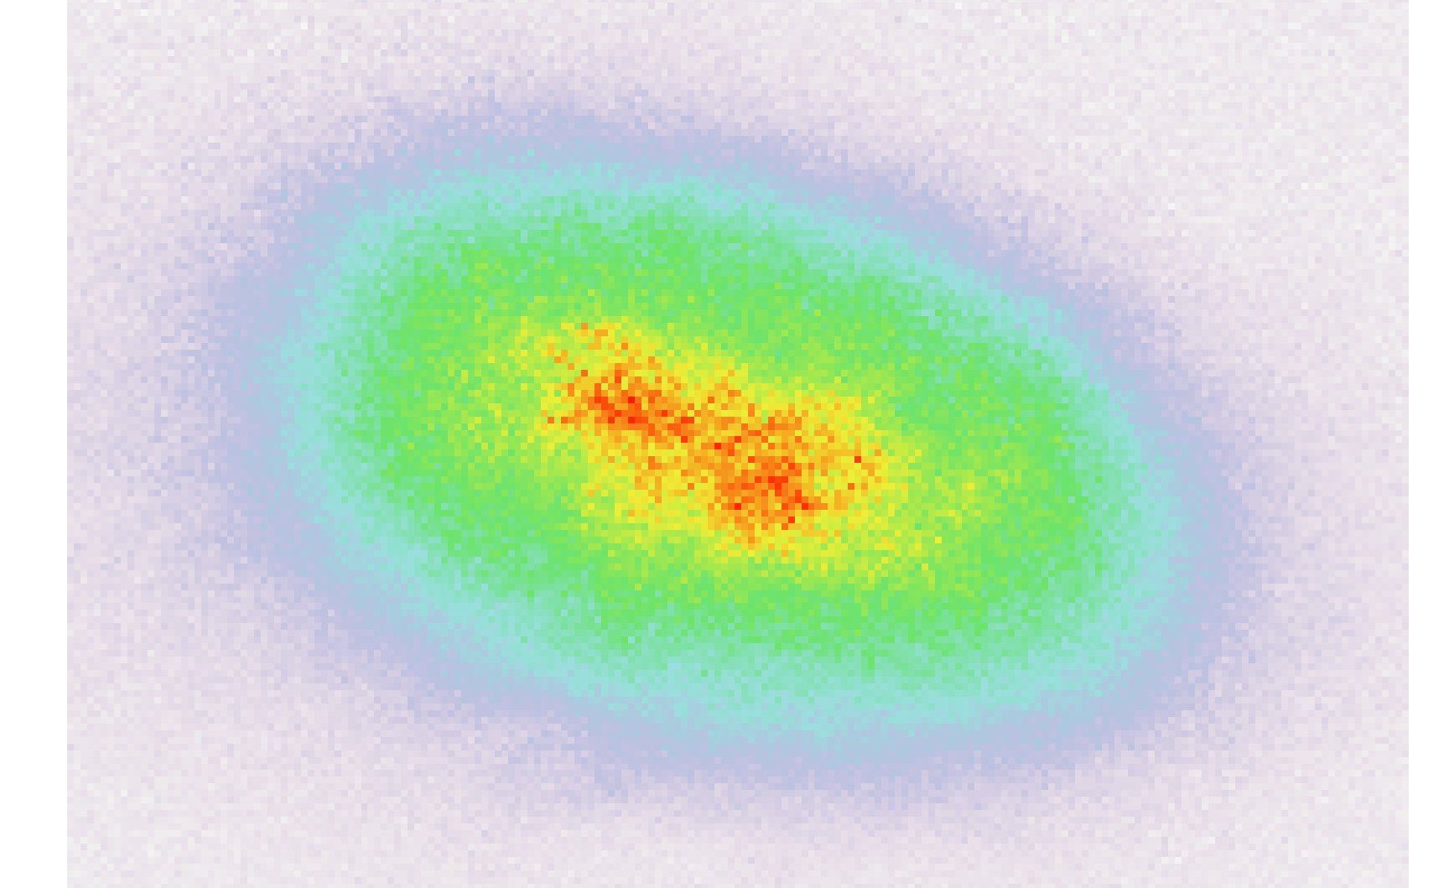
Imaging of ultracold atoms
Cs superfluid: 20,000~100,000 atoms
Imaging resolution: 1.0 µm
Sample size: 25 µm
20~100 atoms/µm³
Nature 2009, Nature 2011

Slide 12
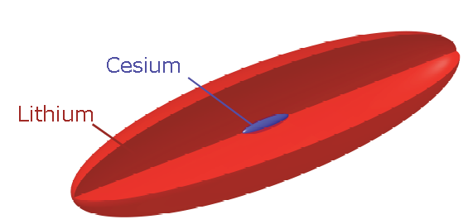
Bose-Fermi quantum mixture in dipole trap
Laser beam
x-y plane
Magnetic field in z direction
Atom number: 20,000~30,000
Fermi temperature: 500 nK
Condensate Tc = 15 nK
Interactions: tunable

Slide 13
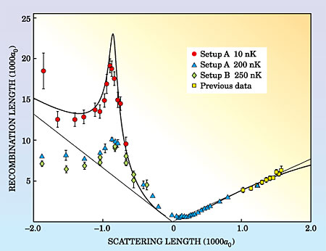
Observation of Efimov Resonance in ultracold atoms
Lifetime ~ 1ms
Other species:
Li6 (Penn State,
Heidelberg),
Li7 (Rice, Bar-Ilan)
K39 (LENS),
Rb85 (JILA),
KRb (LENS),
LiCs (Chicago,
Heidelberg)
Other observables:
Binding energy
4- and 5-body states
Coherent coupling
Lifetime > 10 s
Kraemer et al., Nature 2006
Physics Today 2006

Slide 14
Tuning scattering length with Feshbach resonances
a>0
a<0
diatomic
mol. state
CC, R. Grimm, P. Julienne and E. Tiesinga, RMP (2010)

Slide 15
Efimov states near a Feshbach resonance
Energy^{1/2}
Scaling
a_{N+1}=λ a_{N}
E_{N+1}=λ⁻² E_{N-1}
a_{N-1}
a_{N}
a_{N+1}
E_{N}
E_{N+1}
Dimer
state
E_{N-1}
Efimov trimer
states
Binding energy^{1/2}

Slide 16
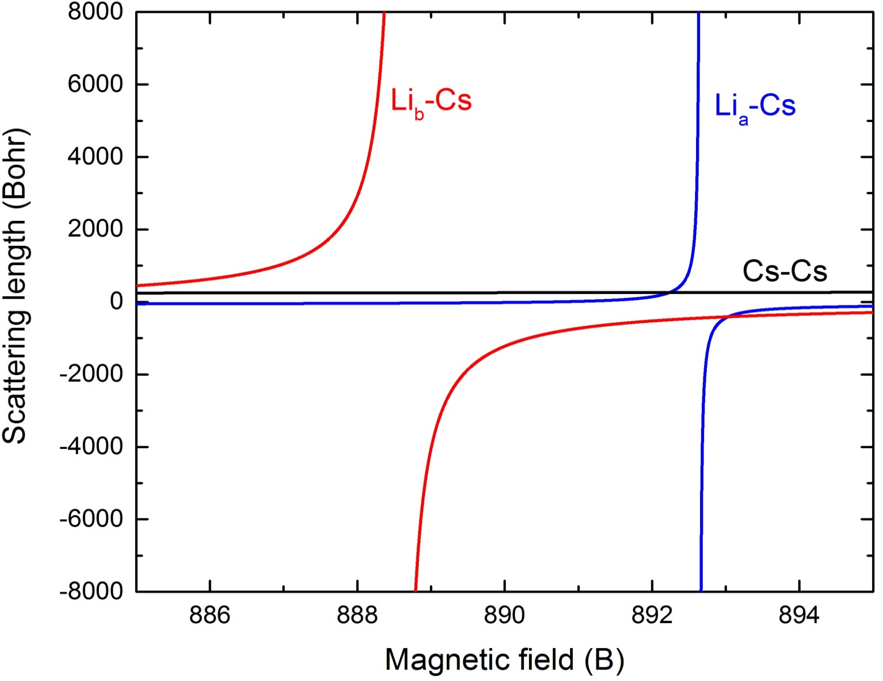
LiCs Feshbach resonances
S.K. Tung et al., PRA (2013) See also (Heidelberg group) M. Repp et al., PRA(2013)
Ulmanis et al., PRL(2016)

Slide 17
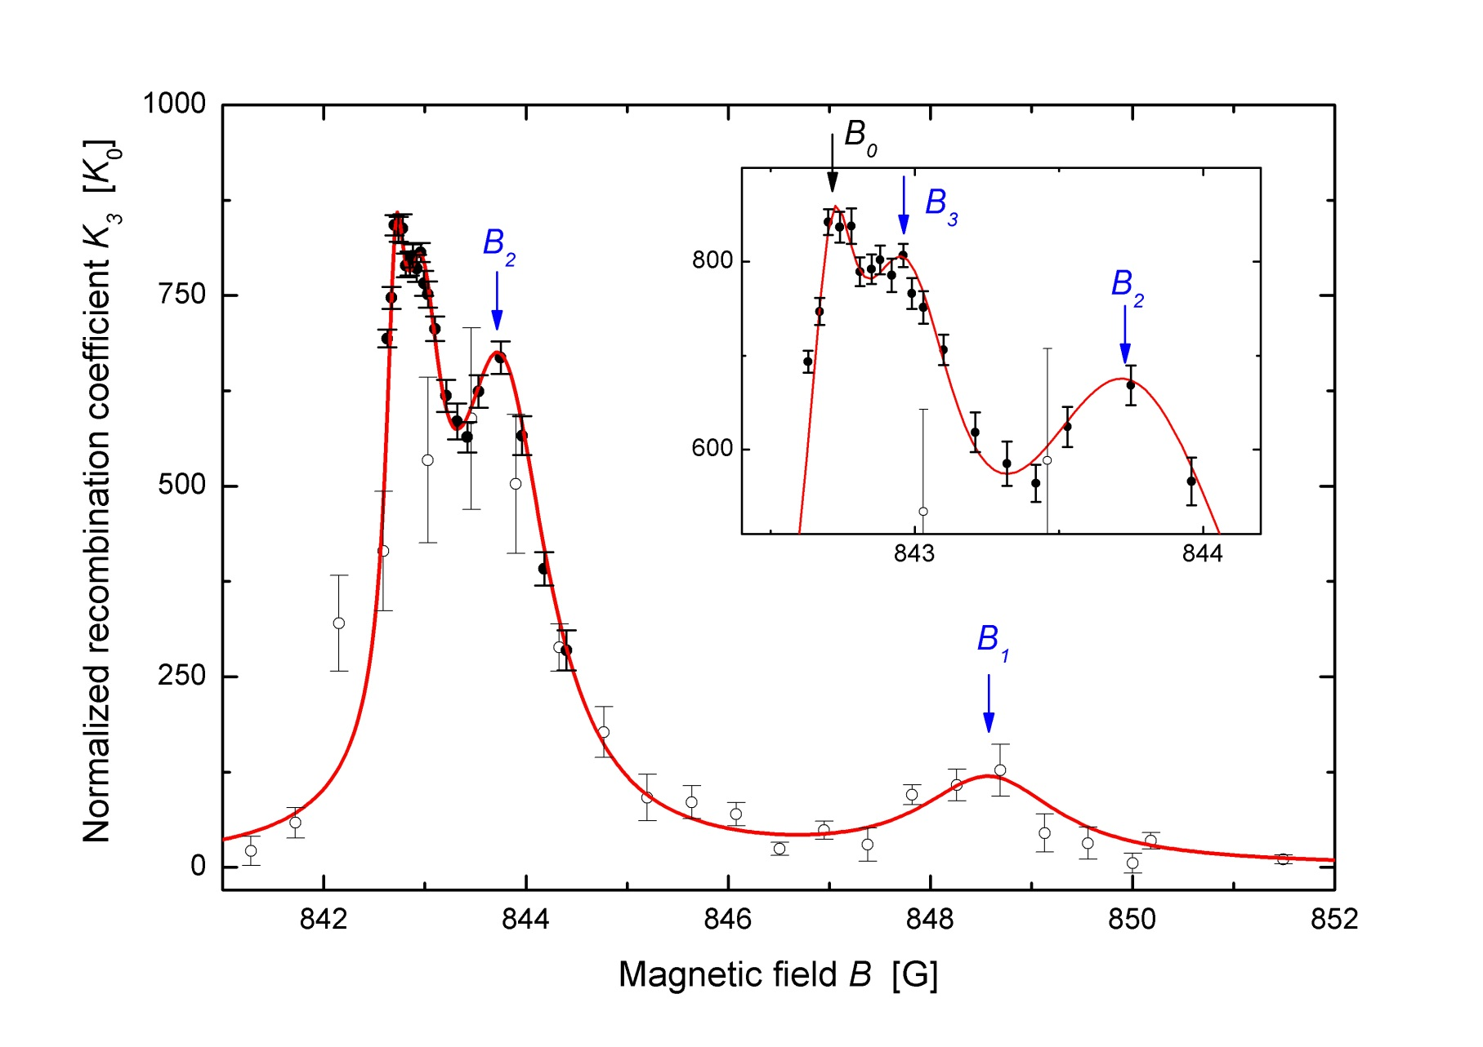
Geometric scaling of Efimov resonances in Li-Cs system (λ=4.9)
Feshbach resonance
0.20 G
1.1 G
5.3 G
Tung et al., PRL (2014), see also Heidelberg and Innsbruck groups PRL (2014)

Slide 18
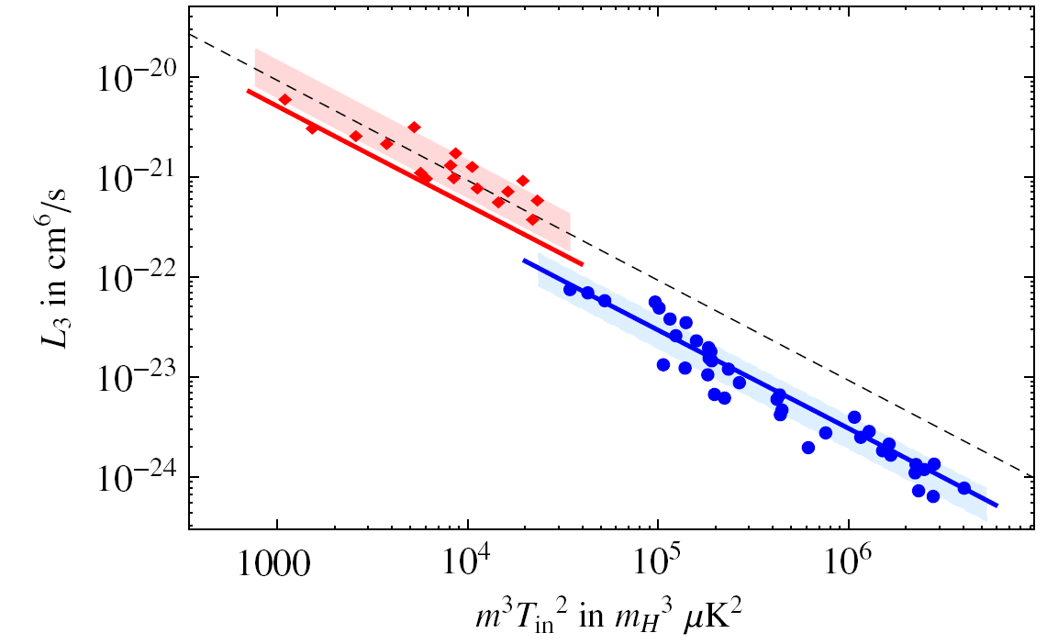
Universal scaling of resonant Bose gas
Li7
Cs 133
(ENS-Chicago Collaboration) U. Eismann et al, PRX (2016)
Related works: ENS, PRL (2013), Cambridge, PRL (2013), JILA: Nature Physics (2014)

Slide 19
Short summary: Efimov states in cold atoms
Prediction Vitaly Efimov (1970)
  α+α+α → C
  H+H+H → T
Appearance Cs, Li, K, Rb, LiCs, LiRb, He 2006…
Properties Geometric scaling, universality…
Molecular size:
1, λ, λ² …
Molecular size ~
Scattering length a ∝
van der Waals length

Slide 20
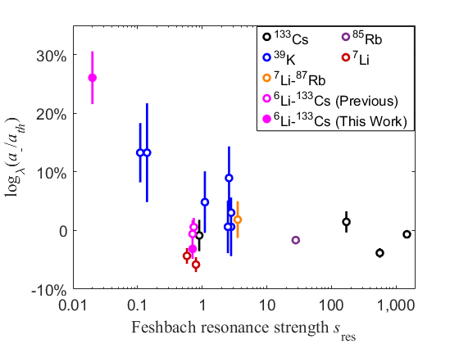
van der Waals Universality? (Grimm, 2011)
Universal Theory
a₋ ≈ 9.5 r_{vdW}
for identical
bosons
Model for identical bosons: Chin C. arXive: 1111.1484, Wang J. et al., PRL (2012)
Review: CC, Y. Wang, Nature Physics (2016)

Slide 21
Broad vs. narrow resonances
Prediction
Narrow
resonance
Broad
resonance
S. Roy et al., Phys. Rev. Lett. 111, 053282 (2013)
Prediction: (Red curve) R. Schmidt et al., The European Physical Journal B 85, 1 (2012)
Other predictions: Petrov (2004), J. Wang et al., PRL (2012), Ueda, (2014), W. Zwerger, 1709.00749
Notes:
Most theories including resonance strength predicted a strong dependence
Experiment has disagreed so far
Orange open diamond: theory in universal (broad) regime
Red curve: theory including resonance strength
Blue circles: data
Shaded region: approximate region where Efimov resonances have been seen in general

Slide 22
vdW Universality Hypothesis
Cs
Cs
Li
|a_{LiCs}|>>|a_{CsCs}|
Does Efimov resonance position only depend on the van der Waals length(s)?

Slide 23
LiCs Feshbach resonances
Broad
Δ=58.2 G
S_{res}=0.66
Narrow
Δ=1.95 G
S_{res}=0.05
S.K. Tung et al., PRA (2013) See also (Heidelberg group) M. Repp et al., PRA(2013)
Ulmanis et al., PRL(2016)

Slide 24
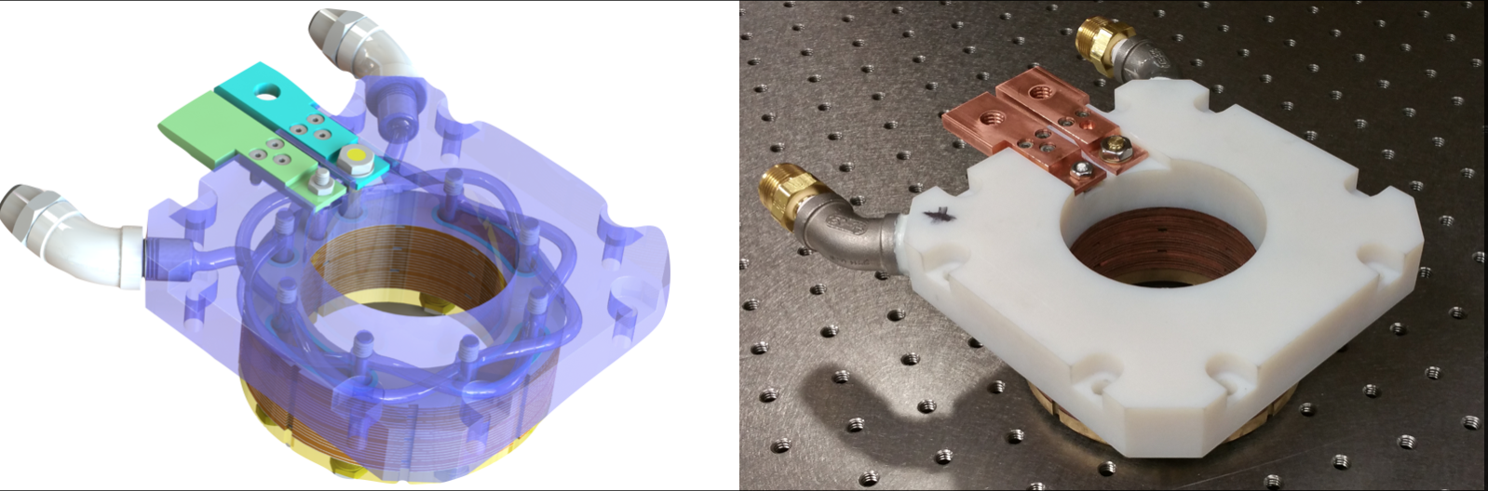
High Precision Bitter coil
Precision field control at 2x10⁻⁶ at 1000G
Highe packing ratio, 10x cooling, no epoxy, low thermal drifts
Prototype : Rev. Sci. Instrum. 84, 104706 (2013)

Slide 25
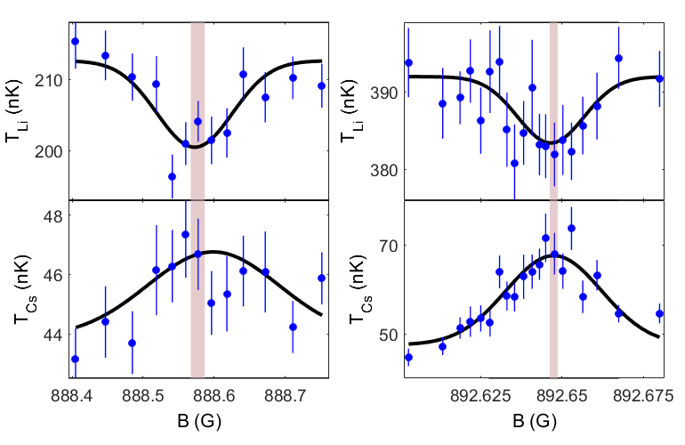
Interspecies Thermalization
s_{res}=0.66 (Broad)
s_{res}=0.05 (Narrow)
Notes:
Decent published model but we need higher precision
Cross-thermalization measurement
The broad resonance agrees very well with the previous model, the narrow resonance is off by about 1% of the resonance width, about 19 mG, but is within error bars
888.577(10)(4) and 892.648(1)(4)
With this, we can say the scattering length to quite high precision, assuming the 1% shift in resonance position doesn’t lead to the model being off by a much larger amount

Slide 26
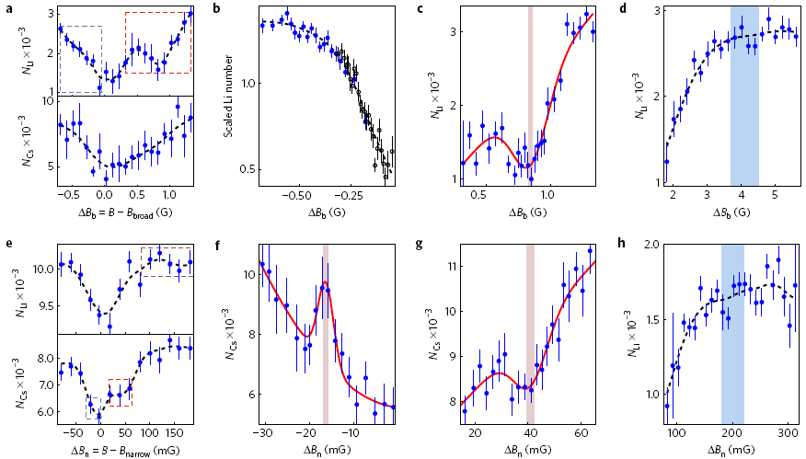
Searching for Efimov resonances…

Slide 27
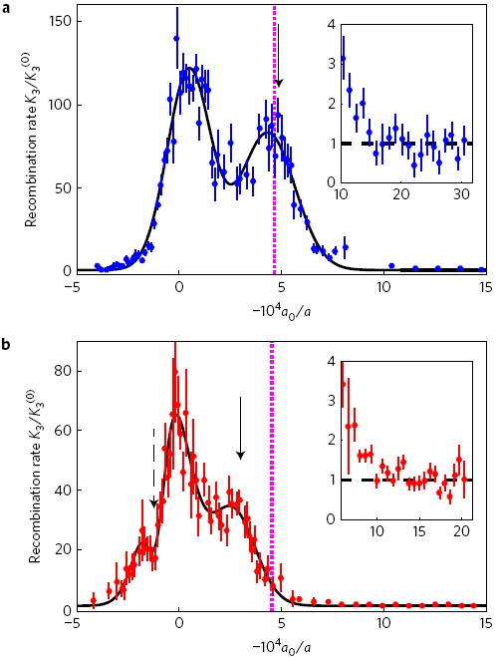
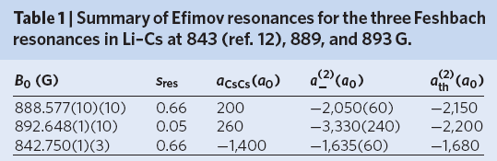
Results
Feshbach resonance
Universal Theory:
-2150 a₀
Broad Feshbach (S_{res}=0.66)
a_= -2050(40) a₀
Universal Theory:
-2200 a₀
Narrow Feshbach (S_{res}=0.05)
a_= -3330(220) a₀
Theory: Yujun Wang,
Chris Greene,
Paul Julienne
J. Johansen, B.J. DeSalvo, K. Patel and C.C., Nature Physics (2017)
Notes:
We developed a model to calculate K3 from our loss measurements to allow further comparison
visible mismatch in Efimov resonance positions
This result holds as long as the Feshbach resonance widths previously calculated are within a factor of 1.5 (though obviously the effect size changes for smaller changes in the resonance width)
Note that the (1) refers to the first excited Efimov state, since that’s what you can compare directly because the lowest Efimov resonance is missing

Slide 28
Deviation from the van der Waals Universality
5 σ effect
Universal Theory
J. Johansen, B.J. DeSalvo, K. Patel and C.C., Nature Physics 13, 731 (2017)

Slide 29
Conclusion
Over a dozen Efimov states seen in recombination
Geometric scaling symmetry: confirmed
van der Waals universality…
  Broad resonance: consistent with universal theory
  Narrow resonance s_{res}=0.05: +51(10)% deviation
Emergence of new length scale(s).
Future: Efimov trimers in Fermi sea

Slide 30
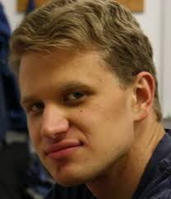
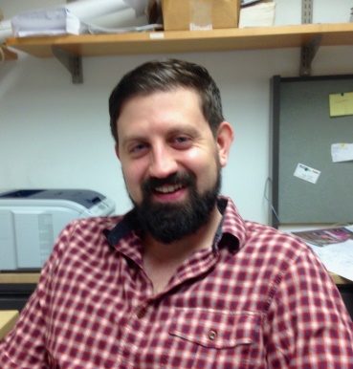
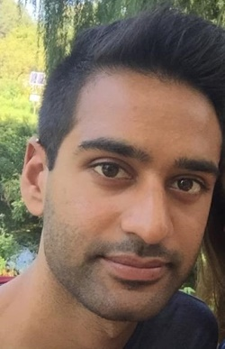
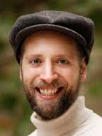
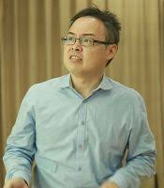
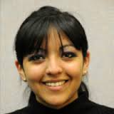
Efimov experiments at the University of Chicago
Jacob Johansen
Now at NW Univ.
Prof. Brian
DeSalvo
Krutik
Patel
Prof. Colin
Parker
George
Institute of
Technology
Prof. S.K.
Tung
National
Tsinghus
University
Prof. Karina
Garcia
Univ. of
Mexico

Slide 31
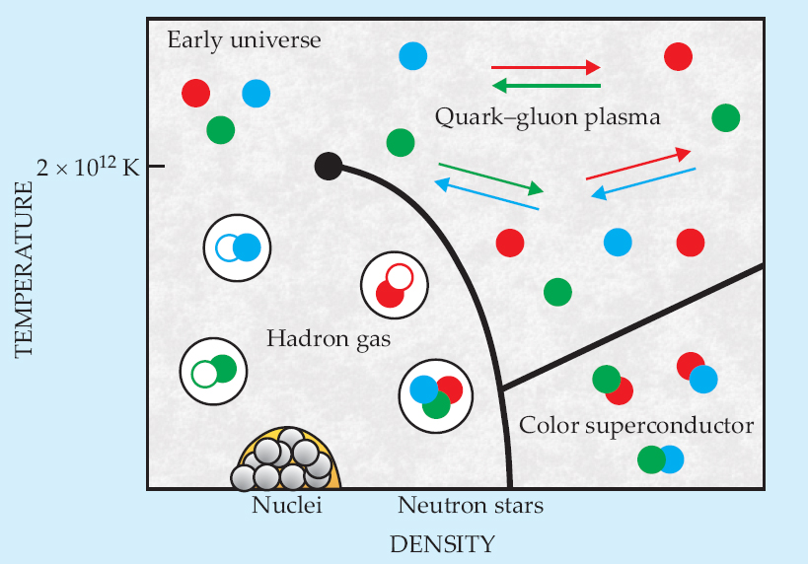
QCD Phase Diagram
C. Sa de Melo, Physics Today, Oct. 2008

Slide 32
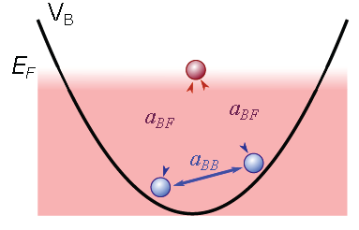


Efimov-RKKY interactions in quantum gas
DeSalvo, Patel, Cai, and CC, Nature 568, 61 (2019)

Slide 33
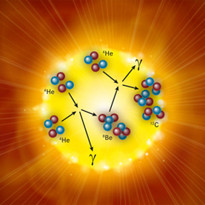
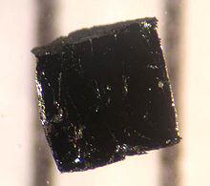

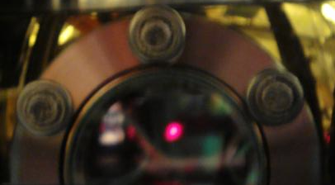
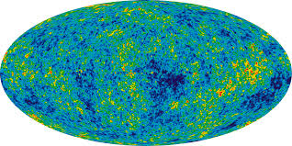
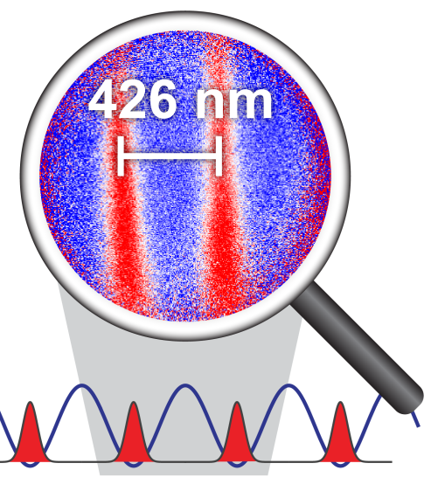
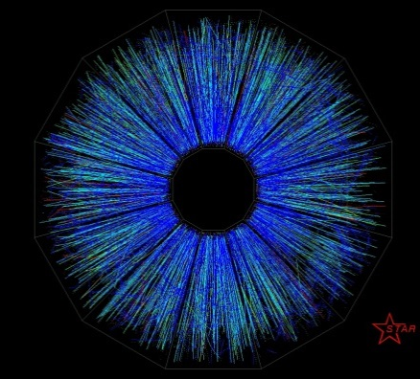
Quantum simulation in our lab
Nuclear Physics:
Feshbach resonances
Efimov physics
Condensed Matter:
Quantum criticality
RKKY interactions
BEC-BCS crossover
Particle Physics
Jet formation
Pattern
formation
Cosmology
Sakharov oscillations
Kibble mechanism
Inflation, Unruh radiation
Super
resolution
imaging

Slide 34
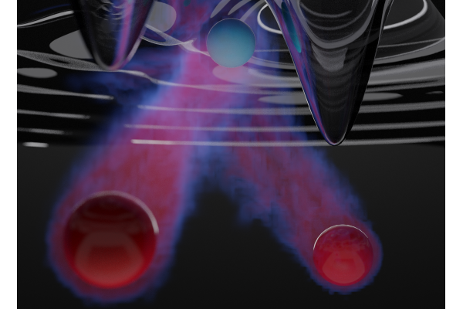
Ruderman–Kittel–Kasuya–Yosida mechanism in quantum gas
Li
Fermi sea
Cs
atoms
By Frankie Fung

