Slide 1


How to determine the shape of nuclear molecules with polarized γ-rays :: EFB24 – 05/09/2019
Lorenzo Fortunato
Univ. Padova & INFN
Italy

Slide 2
Outline of the presentation
Polarized gamma beams: scenario for future measurements
Molecular nuclear structure and discrete symmetries
Electromagnetic probes
Polarizability and active modes
Depolarization ratio and character identification
The case of 12C and more exotic structures
Transition densities

Slide 3

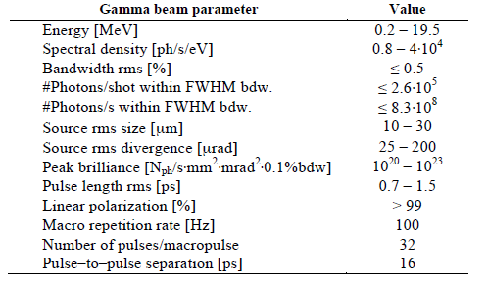
Polarized gamma-ray facilites around the globe:
Mainz Microtron MAMI (Continuous Wave, beam polarization 80%, En. resol. 0.1 MeV, but energy too high 50-800 MeV)
Triangle University Higs facility (FEL type, quasi CW operation, 2-60 MeV, flus 10^8-10^9 phot./s)
ELI-NP in Romania (0-20 MeV, high flux, high resolution, 100% polarization)
LEPS – Japan (very high energy)
NewSubaru
…
With the advent of the new facility in Romania, beams of high brilliance, focused, polarized gamma rays produced with Inverse Compton Scattering will become available with energies ranging from 0.2-20 MeV
From C. Ur, AIP Conference Proceedings 1645, 237 (2015)

Slide 4
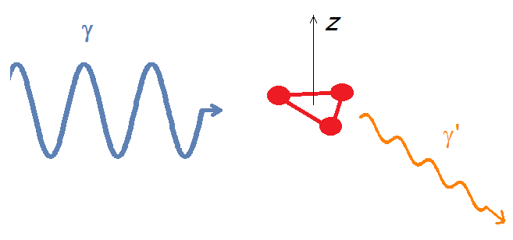
One can shoot linearly polarized gamma rays (Electric field oscillating in a given direction constant in time) of appropriate energy (tuned to match the resonances of interest) and observe the outcoming gammas of the same or different energies with a polarizer/analyzer.
Polarz.
Eγ’ ≤ Eγ
If the nucleus has a definite geometrical symmetry (i.e. if there is an underlying discrete group structure), very strict selection rules apply.
Experimentally the polarization can be measured with another inverse Compton scattering

Slide 5
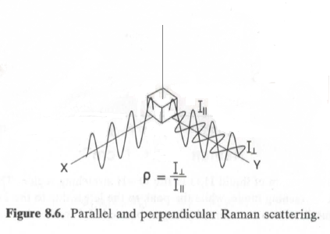
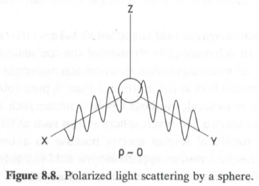
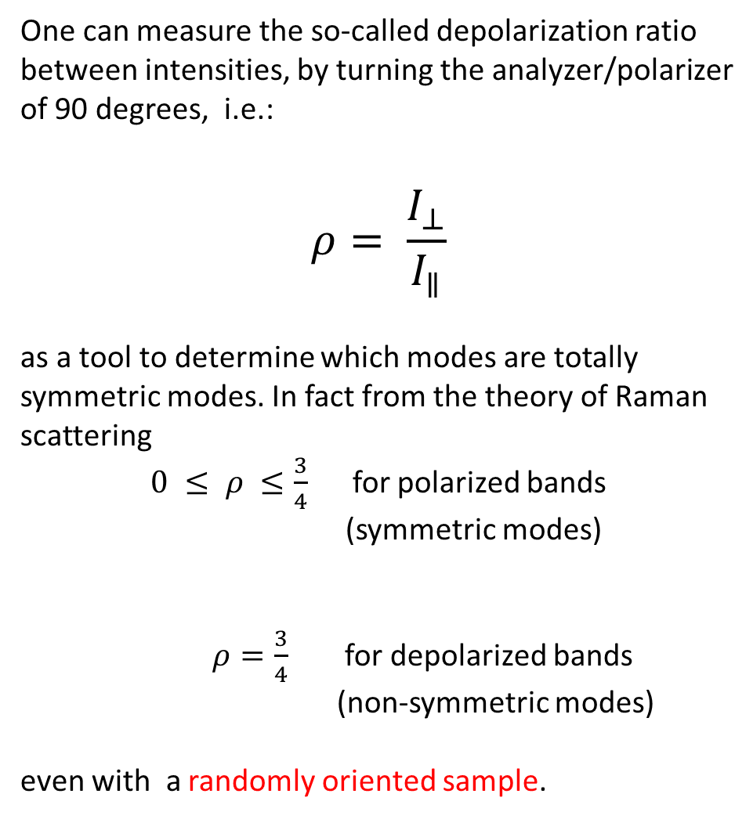
Depolarization ratio
One can measure the so-called depolarization ratio between intensities, by turning the analyzer/polarizer of 90 degrees, i.e.:
$$ρ= \frac{I_{⊥}}{I_{∥}}$$
as a tool to determine which modes are totally symmetric modes. In fact from the theory of Raman scattering
$0 ≤ ρ ≤\frac{3}{4}$ for polarized bands
(symmetric modes)
$ρ=\frac{3}{4}$for depolarized bands
(non-symmetric modes)
even with a randomly oriented sample.
Figures from book by P.Bernath

Slide 6
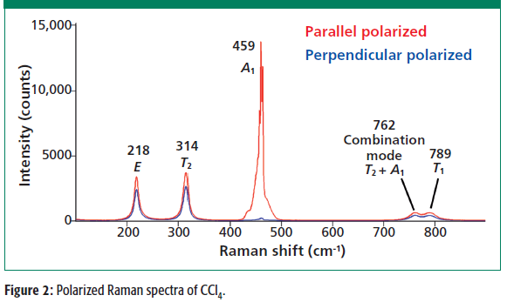
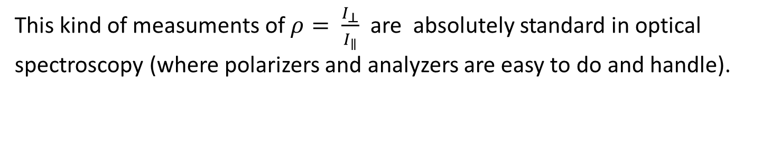
Depolarization ratio : a chemical example CCl₄
This kind of measuments of $ρ= \frac{I_{⊥}}{I_{∥}}$ are absolutely standard in optical spectroscopy (where polarizers and analyzers are easy to do and handle).
Figure from D.Tuschel – Spectroscopy (2014)

Slide 7
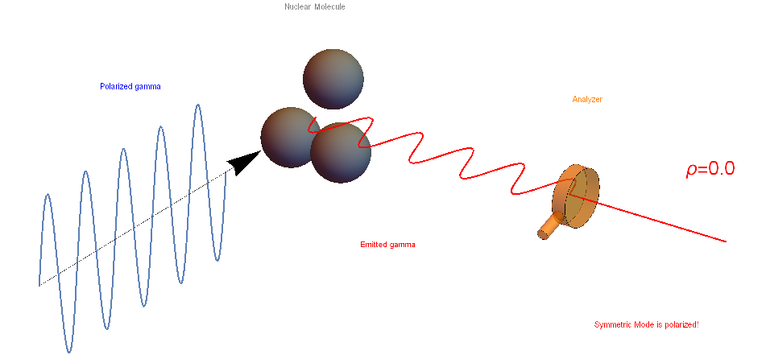
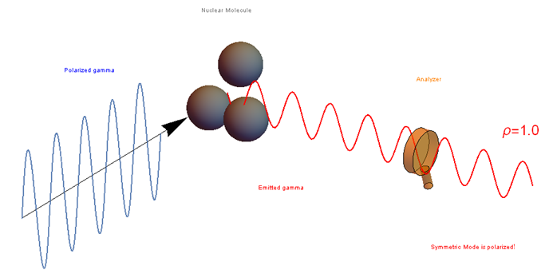
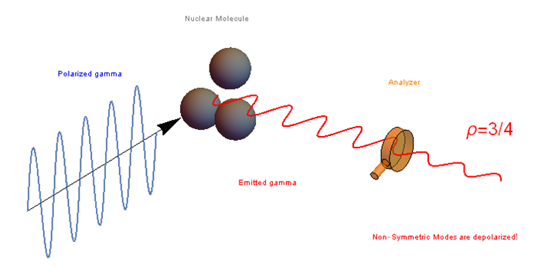
Depolarization ratio

Slide 8
Panoply of different models …
(Too) many models have been proposed for 12C where the triangle is not equilateral, isosceles, scalene or even a linear chain (Morinaga). Therefore I have set forth to determine all possible outcomes and the patterns that can be predicted are intended as a guidance as to which configuration is right and the tell-tale method is clearly through measurements of the depolarization ratio in Raman-like experiments of nuclear fluorescence that will be feasible at ELI-NP or in other labs where gamma-rays are available.

Slide 9
AMD
Figures from: Freer et al. (2018)
Microscopic clustering in Light Nuclei

Slide 10
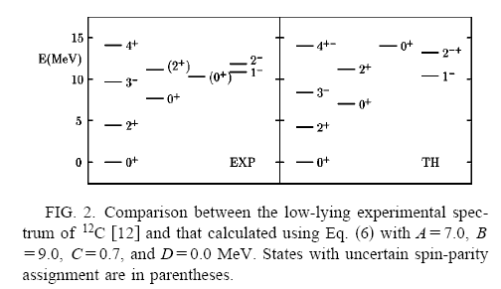
Algebraic cluster model for 3 alphas
Bijker and Iachello have clearly demonstrated the succesfull application of the ACM, or algebraic cluster model, to the vibrational-rotational spectrum of alpha-conjugate nuclei like 12C and 16O.
E
A

Slide 11
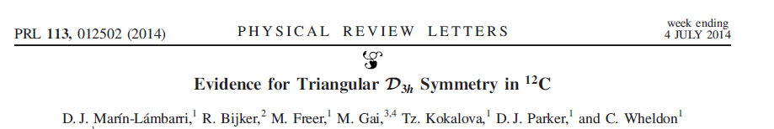
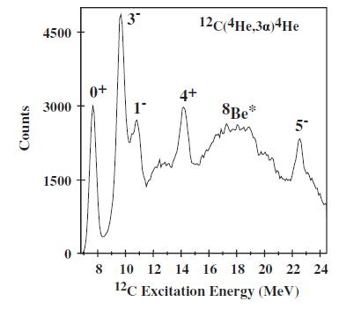
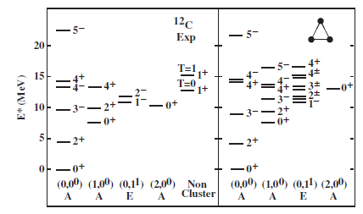
This lovely paper confirms the assignation of the 5- state at 22.4(2) MeV to the g.s. band of an equilater triangular structure.
Note the uncommon spin-parity of bands (the doublet 4+/ 4- has a natural explanation in terms of D3h symmetry!).

Slide 12
Different geometric arrangements of equilibrium points
Discrete symmetry group
Precise selection rules
Work plan:
Decide arrangement of N particles
This means 3N-6 d.o.f (or 3N-5 d.o.f. for linear arrangement)
Identify the underlying discrete group structure
Find the character under transformations of the group Γ_{3N}
Subtract translations and rotations to single out character of vibrational modes Γ_{vib}
Identify patterns of totally symmetric modes
Check models against measures of intensities → Eureka !!

Slide 13
Tables in PRC 99 (2019) paper: 3 equal clusters
The number of totally symmetric peaks over total is different in each case, therefore one can disentagle the various possibilities

Slide 14
Tables in PRC 99 (2019) paper
There might be more than just one configuration! The picture complicates a little, but not too much ! One can invoke the concept of descent in symmetry ans still aplly some of the rules.
Group chains

Slide 15
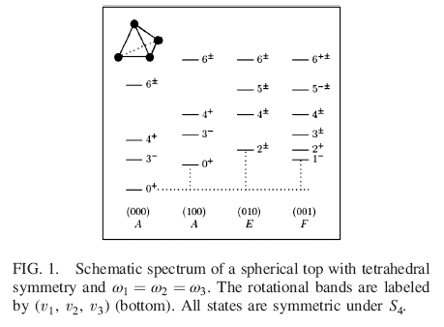
Tetrahedral shape in 16 Oxygen
Bijker, Iachello
PRL 112, 152501 (2014)

Slide 16
They use a somewhat simplified notation based on the permutation (sub)groups S₃ and S₄ of the full discrete groups D_{3h} and T_{d} respectively , but the essence is the same.
F
E
E
A
A
¹²C
¹⁶O

Slide 17
Tables for 2 clusters and for 3 clusters of type AAB

Slide 18
Tables for 4clusters, only some have been worked out
 One might gather information on polarization due to alpha particles’ substructures

Slide 19
Recent work on transition densities in 12C
In collaboration with A. Vitturi, E. Lanza and J. Casal
A-band
Ground state
E-band

Slide 20
Summary
I have suggested to use the highly polarized monochromatic gamma rays that will be available at ELI-NP as a tool to study the molecular vibrations of clusterized nuclei, taking as a definite example the 12C nucleus as composed of 3 α particles. Extended to 2, 3 unequal and 4 clusters.
I believe that, if a measure of depolarization ratio could be done in a sort of Raman nuclear fluorescence experiment, this would yield precise patterns of vibrational spectra, that will correlate directly with a given geometric configuration possessing a discrete point-group symmetry.
I have shown some preliminary transition densities for 12C in a molecular model.

Slide 21
A few points for discussion
if the g.s. rotational band contains the same multipolarity that one is trying to excite in the vibrational bands, this is also to be included in the above patterns.
in principle the degree of polarization might be close to 3/4 also for polarized (A) bands, therefore it might become hard to distinguish between them
non-cluster degrees of freedom might come into play at a certain energy, thus blurring the picture
in nuclei with a cluster structure including t or h clusters, the interplay with single-particle orbits around a molecular center might also be very relevant
I guess a BEC gas would show no geometric arrangments (no equilibirum points) and would behave as an L=0 state (a sphere), thus offering only 1 such bands of A type (polarized).

Slide 22
A word of caution
DISCLAIMER:
It is perfectly clear to us that molecular models of nuclei are FUNDAMENTALLY DIFFERENT from molecular physics, where the Born-Oppenheimer approximation is valid and one can think of nuclear motion as a small vibration, happening only close to the minimum of a very deep potential energy surface (in molecular energy scales).
Nuclei have large kinetic energy <T>, comparable to the potential energy <V> and the zero point motion inside the P.E.S. is a large fraction of the well depth, therefore there are LARGE FLUCTUATIONS around the equilibrium points and we SHOULD NOT EXPECT that the vibrational levels are deeply lying in the potential well, at most they can be weakly bound states, close to threshold, or more probably resonances in the continuum!
Dispite this, it is instructive to look at
  the normal modes, i.e. the «best» internal coordinates
  symmetry-adapted vibrational orbitals
  the energy scale and structure of the vibrational levels

Slide 23
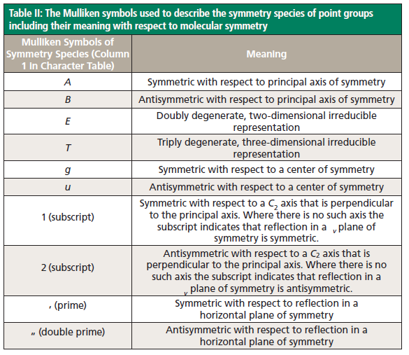
From D. Tuschel – Spectroscopy : Molecular Spectroscopy workbench (2014)

