Slide 1
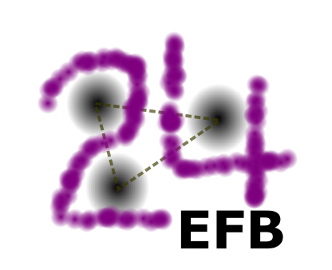
24th European Conference on Few-Body Problems in Physics
2 – 6 Sep, 2019 (Univ. Surrey, UK)
Three-nucleon force effects in nucleon-deuteron scattering at backward angles
Souichi ISHIKAWA, Hosei University

Slide 2
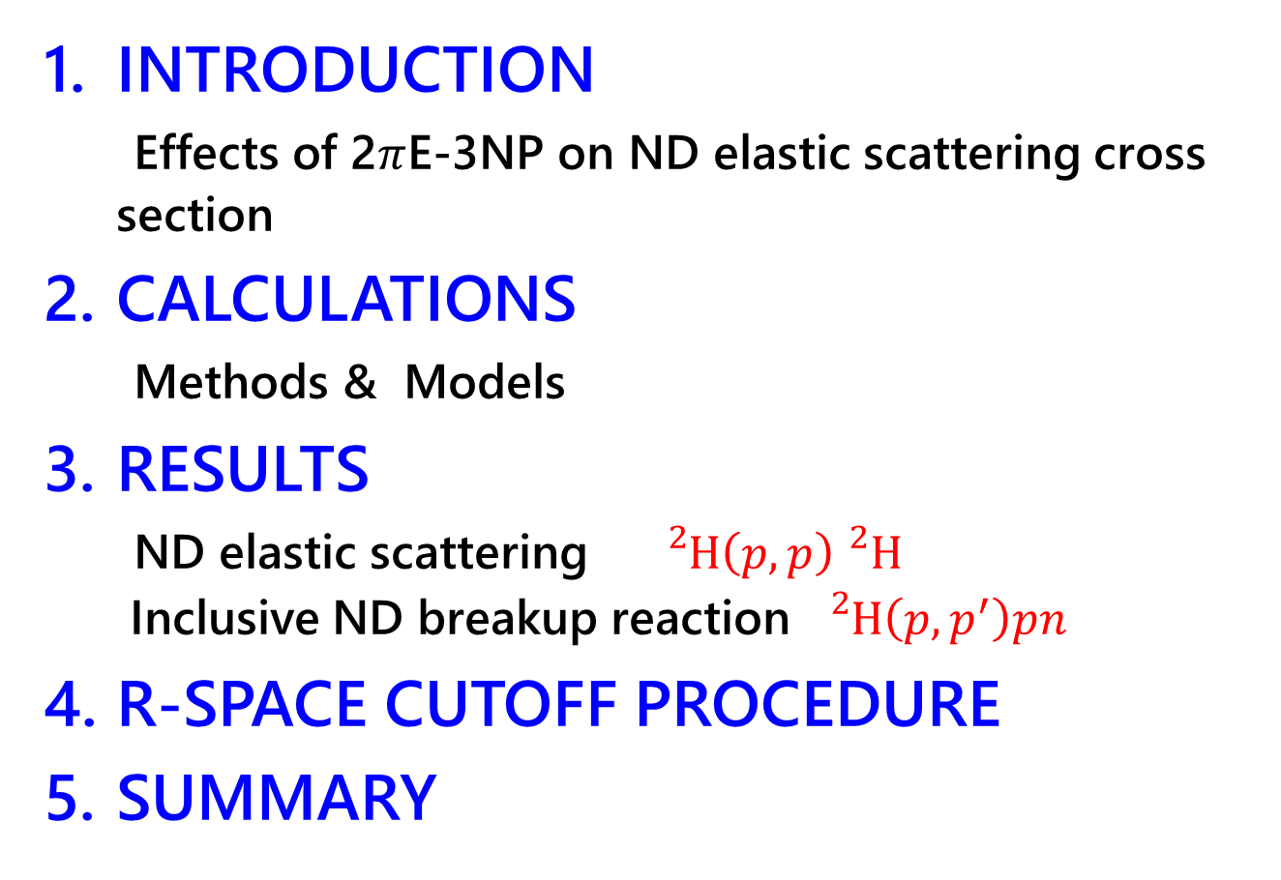
CONTENTS
INTRODUCTION
Effects of 2$π$E-3NP on ND elastic scattering cross section
CALCULATIONS
Methods & Models
RESULTS
ND elastic scattering ${}_{}^{2}H\left(p,p\right){}_{}^{2}H$
Inclusive ND breakup reaction ${}_{}^{2}H\left(p,p^{′}\right)pn$
R-SPACE CUTOFF PROCEDURE
SUMMARY

Slide 3
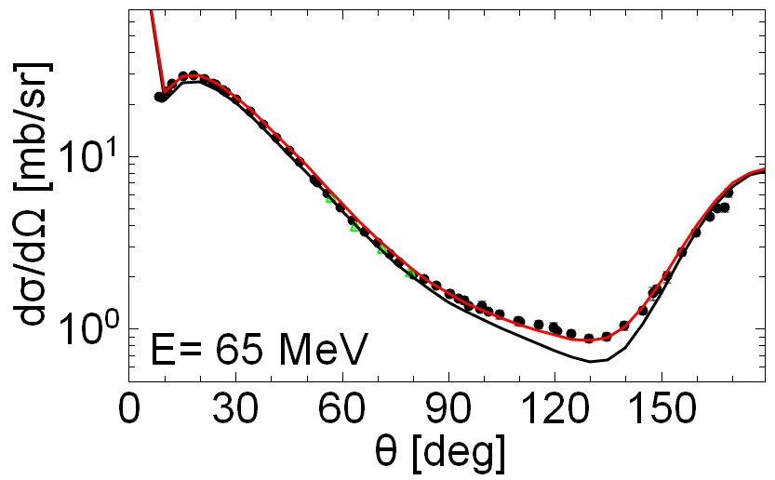
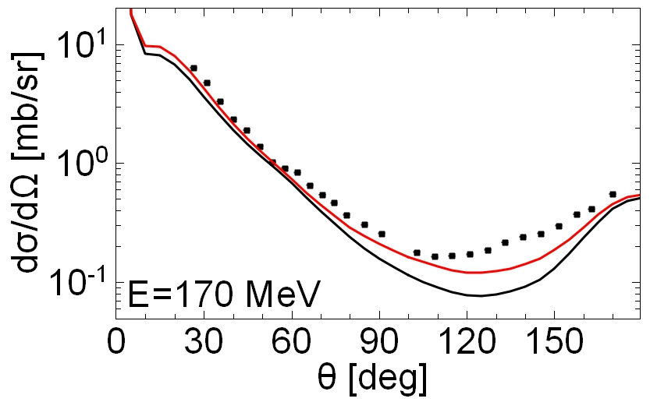
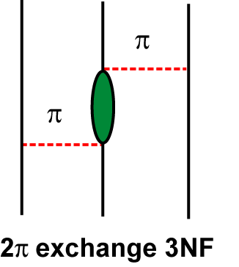

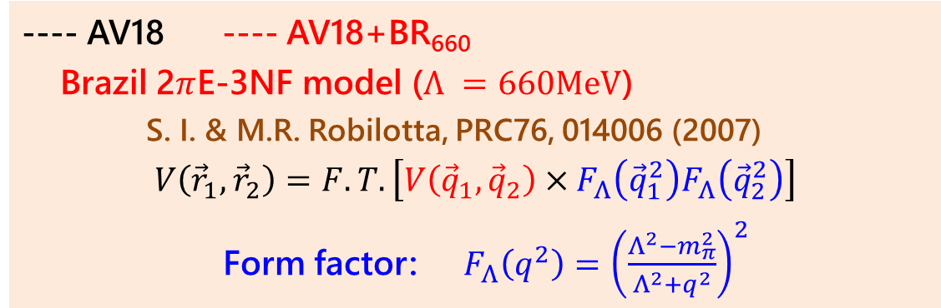

1. INTRODUCTION
Effects of Two-pion exchange three-nucleon force (2$π$E-3NF) on $pd$ elastic scattering cross section at $E_{p}=65 MeV$ and $E_{p}=170 MeV$
---- AV18 ---- AV18+BR₆₆₀
Brazil 2$π$E-3NF model ($Λ =660MeV$)
S. I. & M.R. Robilotta, PRC76, 014006 (2007)
$$V\left({\vec{r}}_{1},{\vec{r}}_{2}\right)=F.T.\left[V\left({\vec{q}}_{1},{\vec{q}}_{2}\right)×F_{Λ}\left({\vec{q}}_{1}^{2}\right)F_{Λ}\left({\vec{q}}_{2}^{2}\right)\right]$$
Form factor: $F_{Λ}\left(q^{2}\right)={\left(\frac{Λ^{2}−m_{π}^{2}}{Λ^{2}+q^{2}}\right)}^{2}$
$$V\left({\vec{q}}_{1},{\vec{q}}_{2}\right)$$
Data: 65MeV: H. Shimizu et al. NPA382, 242 (1982), 135MeV: K. Ermisch et al. PRC68, 051001(R) (2003)

Slide 4






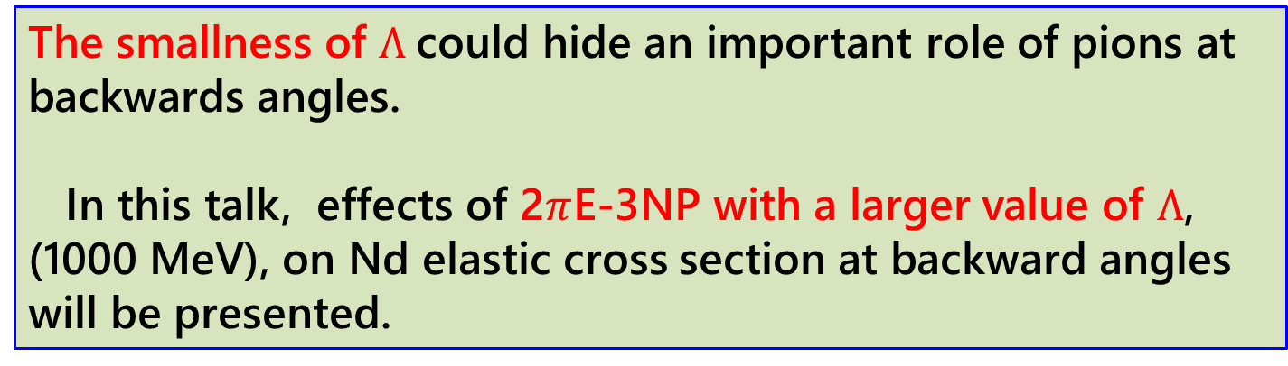

Momentum transfer ($q$) becomes larger than $Λ$ at backward angles
$$p$$
$$d$$
$$q>660MeV/c$$
$$\vec{q}$$
$$p$$
$$d$$
The smallness of $Λ$could hide an important role of pions at backwards angles.
In this talk, effects of 2$π$E-3NP with a larger value of $Λ$, (1000 MeV), on Nd elastic cross section at backward angles will be presented.

Slide 5
2. CALCULATION
Method
3N Faddeev calculations
Integral equation approach in coordinate space
Ref: S. I., PRC80, 054002 (2009)
Partial waves:
2N angular momentum: J=0,1,2,3,4,5
Total angular momentum: J₀=1/2, …., 27/2

Slide 6
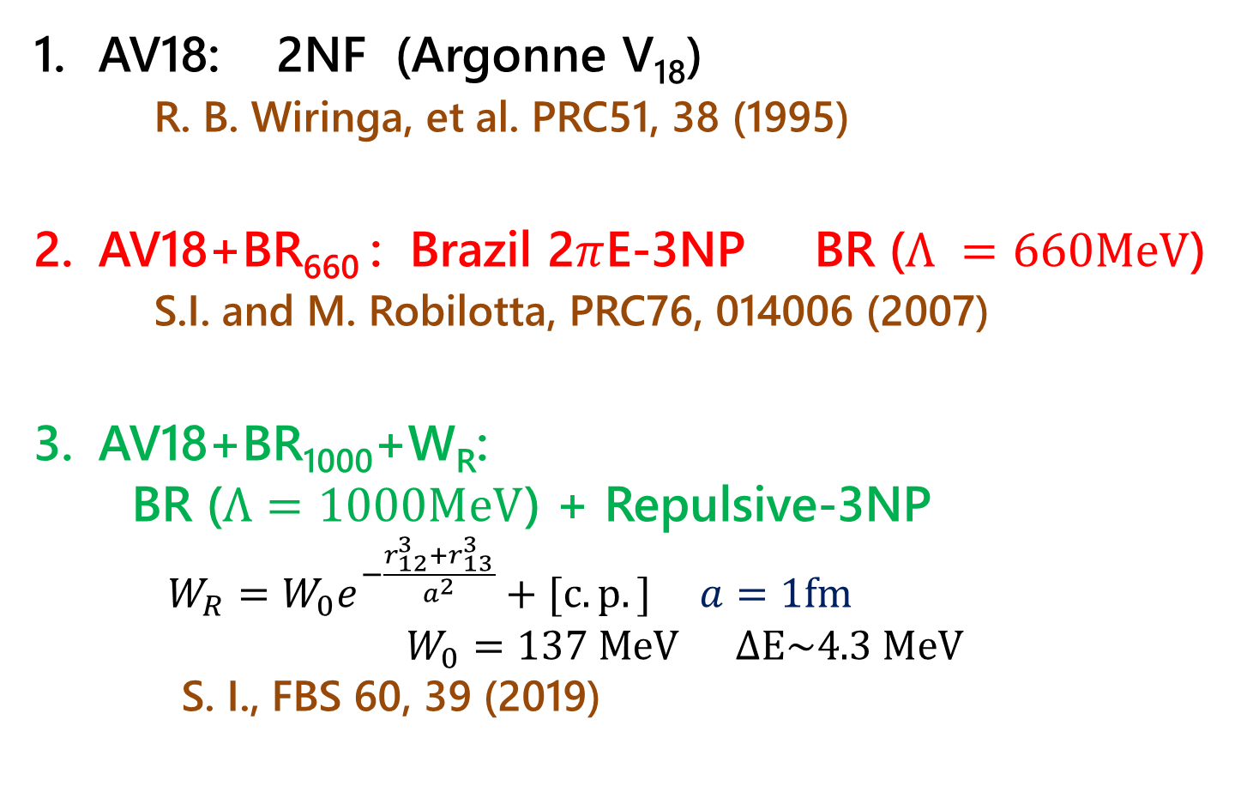
Models
AV18: 2NF (Argonne V₁₈)
R. B. Wiringa, et al. PRC51, 38 (1995)
AV18+BR₆₆₀ : Brazil 2$π$E-3NP BR ($Λ =660MeV$)
S.I. and M. Robilotta, PRC76, 014006 (2007)
AV18+BR₁₀₀₀+W_{R}:
BR ($Λ=1000MeV$) + Repulsive-3NP
$W_{R}=W_{0}e^{−\frac{r_{12}^{3}+r_{13}^{3}}{a^{2}}}+[c.p.]$ $a=1fm$
$W_{0}=137 MeV ∆E\sim 4.3 MeV$
S. I., FBS 60, 39 (2019)

Slide 7
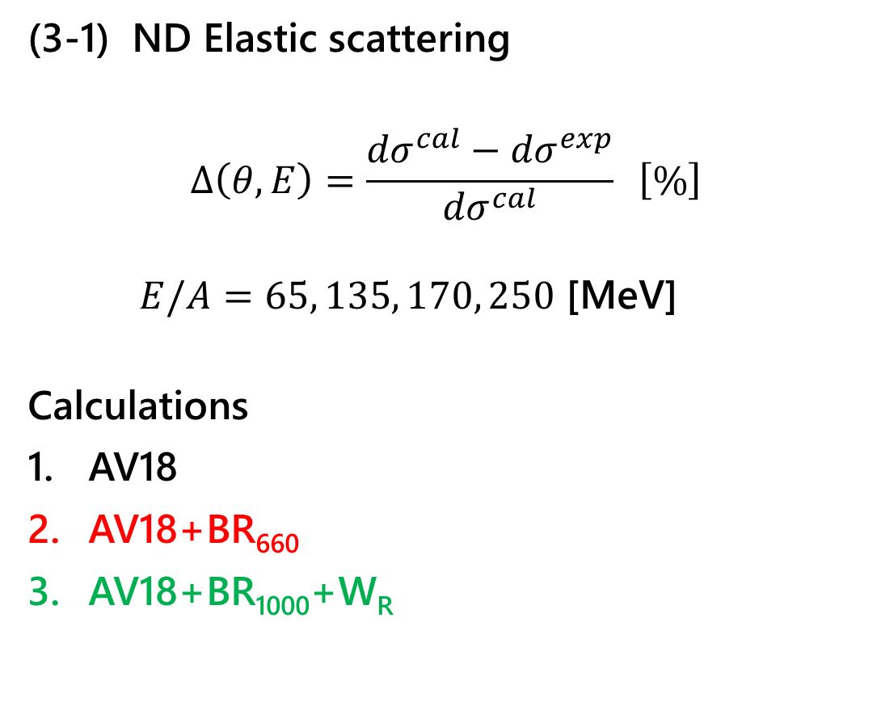
3. RESULTS
(3-1) ND Elastic scattering
$$Δ\left(θ,E\right)=\frac{{dσ}^{cal}−{dσ}^{exp}}{{dσ}^{cal}} \left[\%\right]$$
$E/A=65, 135, 170, 250$ [MeV]
Calculations
AV18
AV18+BR₆₆₀
AV18+BR₁₀₀₀+W_{R}

Slide 8
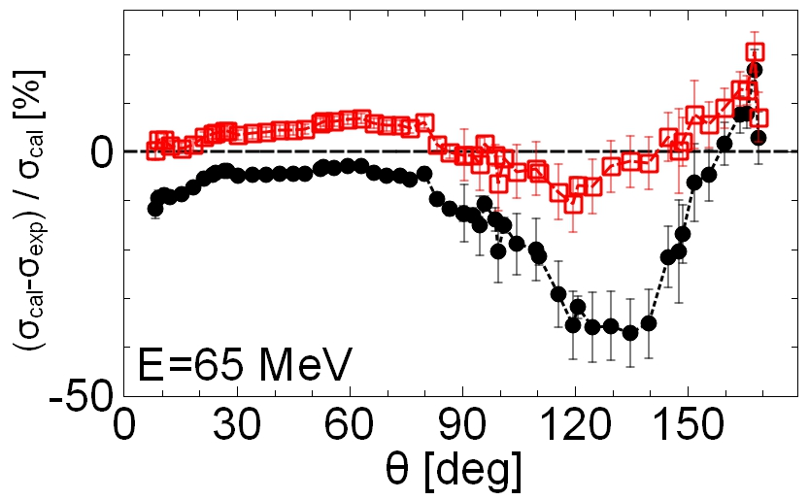
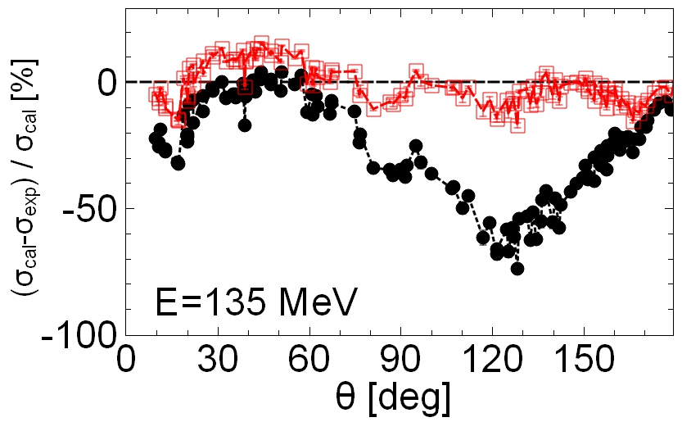
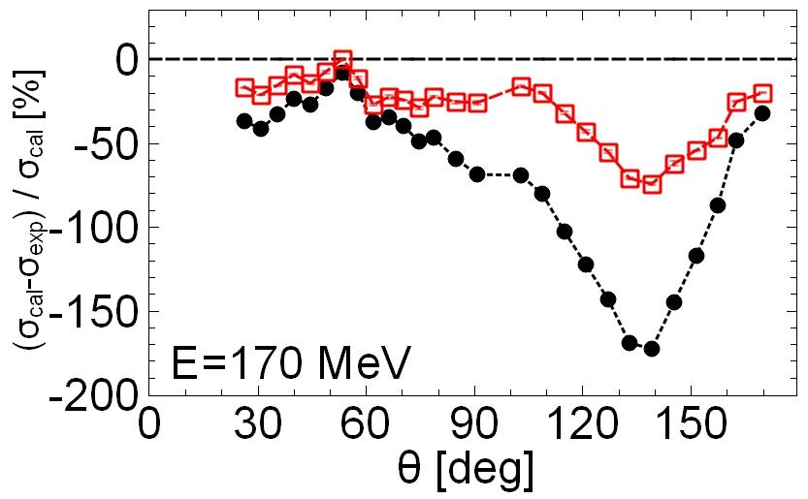
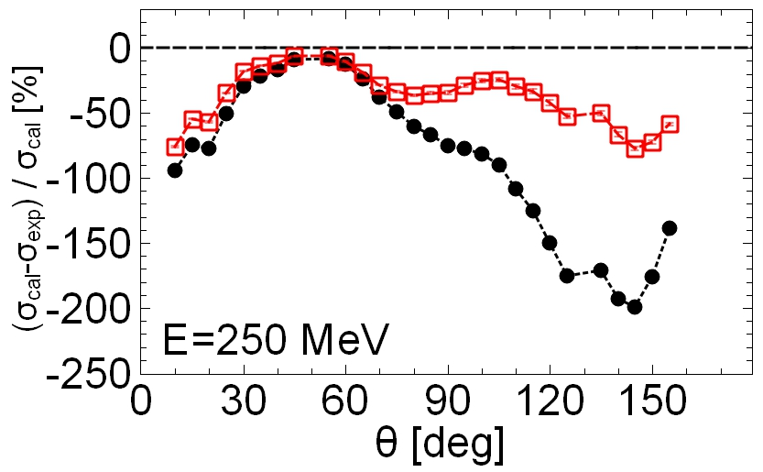

$$Δ\left(θ,E\right) \left[\%\right]$$
----- AV18
----- AV18+BR₆₆₀

Slide 9
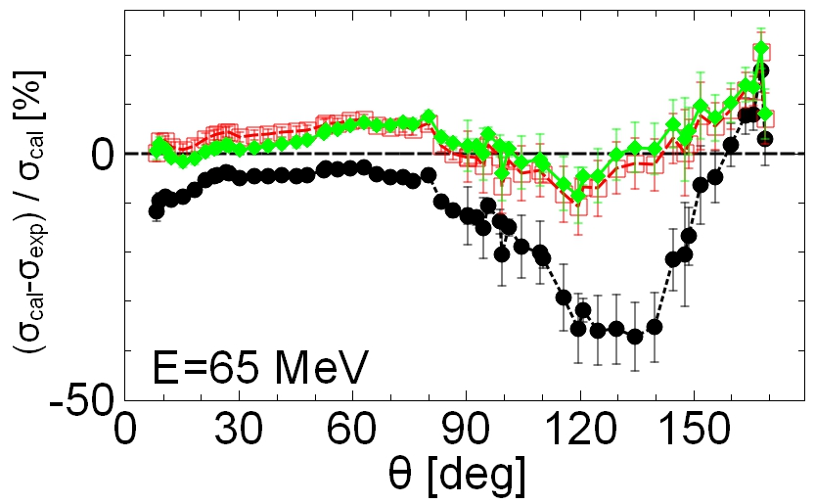
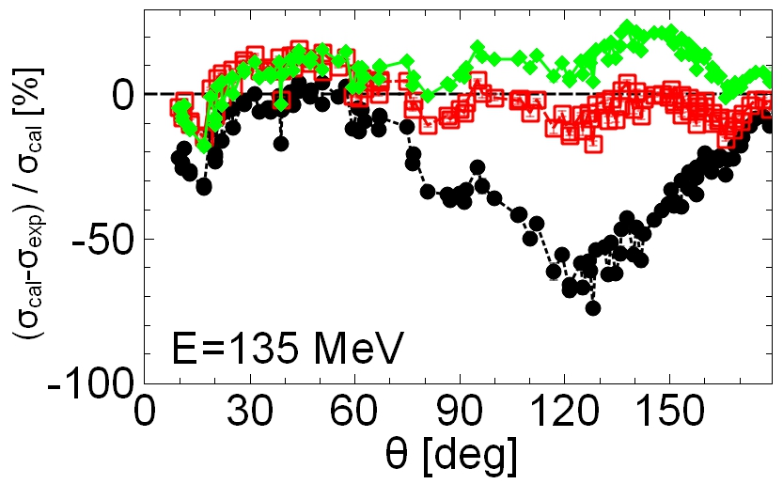
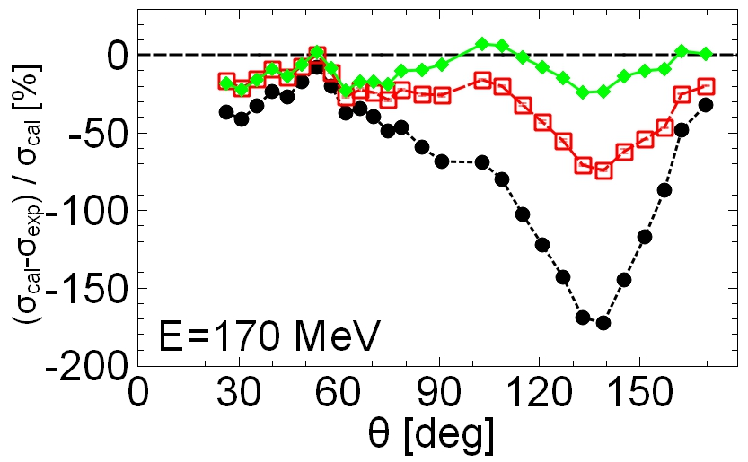
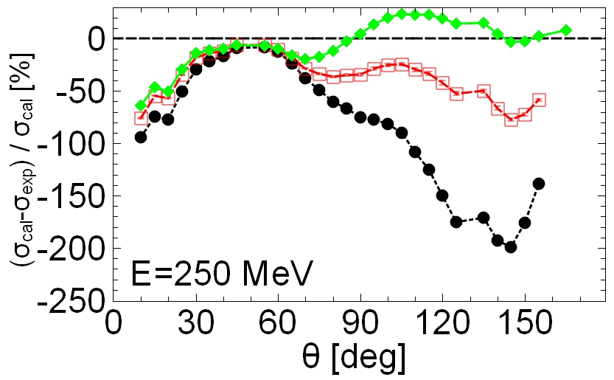
$$Δ\left(θ,E\right) \left[\%\right]$$
----- AV18
----- AV18+BR₆₆₀
----- AV18+BR₁₀₀₀+W_{R}

Slide 10
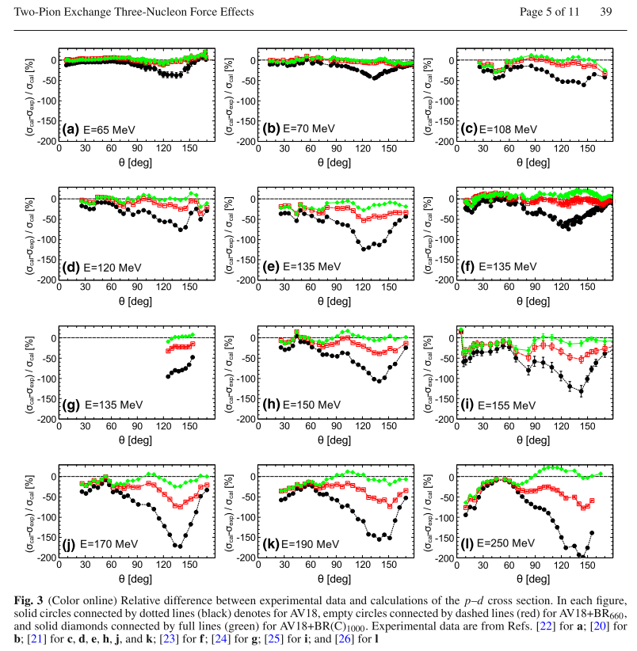

$$θ=140°$$
----- AV18
----- AV18+BR₆₆₀
----- AV18+BR₁₀₀₀+W_{R}
S. I., FBS 60, 39 (2019)

Slide 11
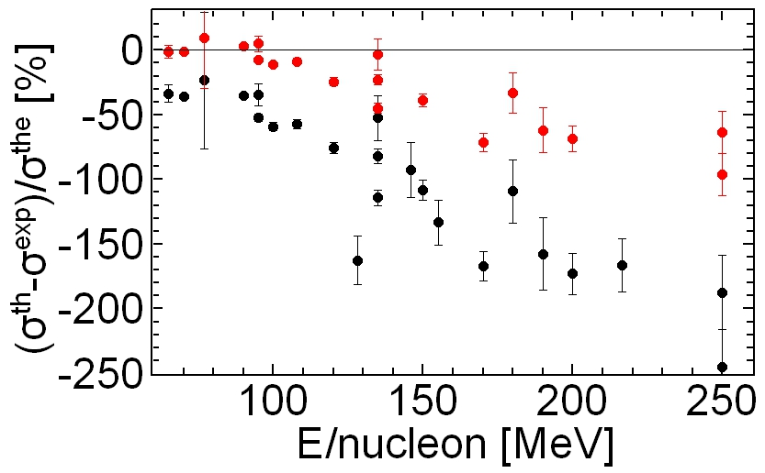

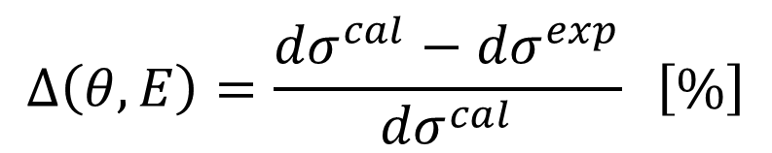
$$Δ\left(θ=140°,E\right) \left[\%\right]$$
AV18+BR₆₆₀
AV18
$$Δ\left(θ,E\right)=\frac{{dσ}^{cal}−{dσ}^{exp}}{{dσ}^{cal}} \left[\%\right]$$

Slide 12
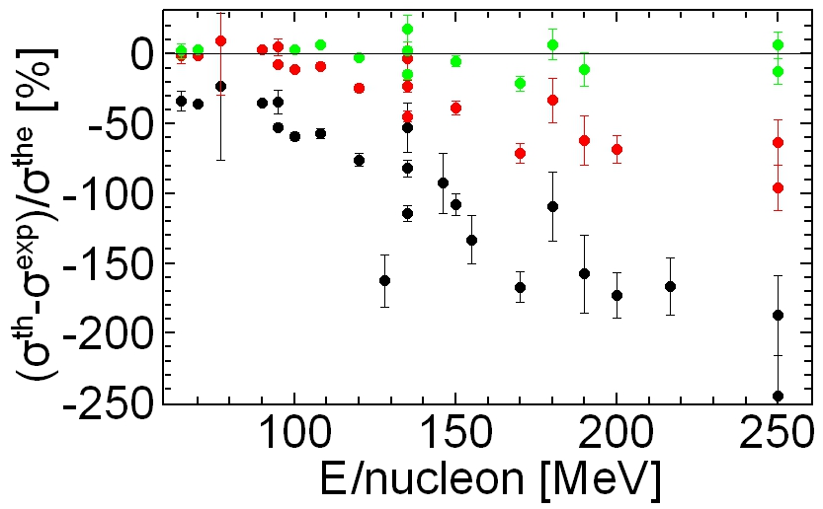
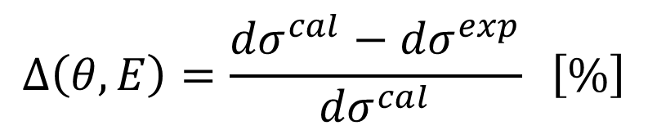
$$Δ\left(θ=140°,E\right) \left[\%\right]$$
AV18+BR₁₀₀₀+W_{R}
AV18+BR₆₆₀
AV18
$$Δ\left(θ,E\right)=\frac{{dσ}^{cal}−{dσ}^{exp}}{{dσ}^{cal}} \left[\%\right]$$

Slide 13



(3-2) Inclusive ND breakup reactions
$${}_{}^{2}H\left(p,p^{′}\right)pn$$
$$θ_{Lab}$$
Residual “$pn$” systems
${}_{}^{2}H$:Elastic scattering
Continuum
(Inclusive breakup)
or

Slide 14
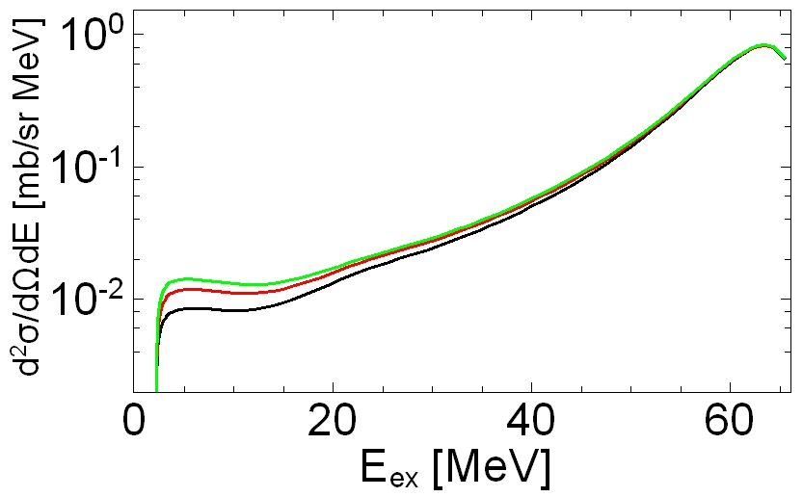
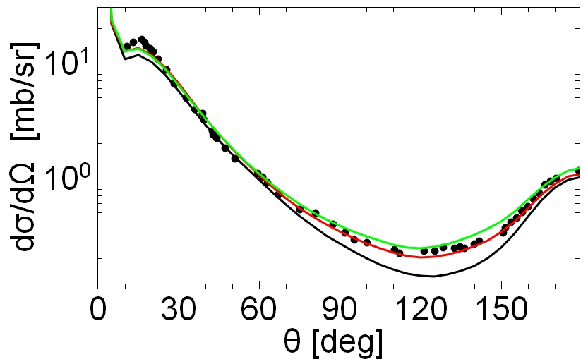


$${}_{}^{2}H\left(p,p′\right)pn E_{p}=135 MeV θ_{p^{′},Lab}=110°$$
----- AV18
----- AV18+BR₆₆₀
----- AV18+BR₁₀₀₀+W_{R}
$$θ_{cm}=140°$$

Slide 15
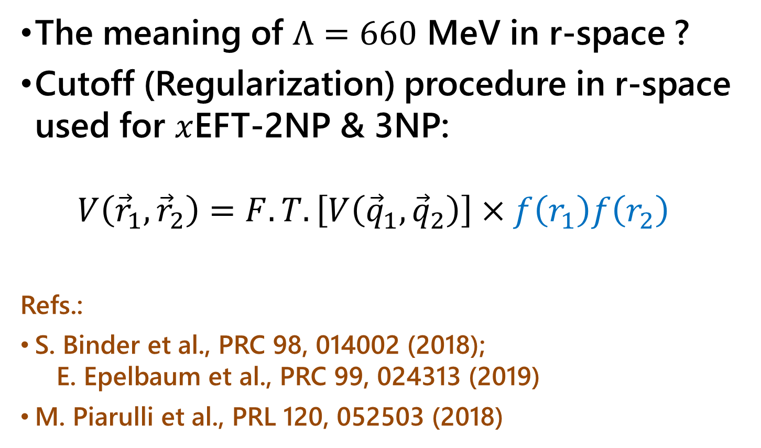
4. R-SPACE CUTOFF PROCEDURE
The meaning of $Λ=660$ MeV in r-space ?
Cutoff (Regularization) procedure in r-space used for $x$EFT-2NP & 3NP:
$V\left({\vec{r}}_{1},{\vec{r}}_{2}\right)=F.T.\left[V\left({\vec{q}}_{1},{\vec{q}}_{2}\right)\right]×f\left(r_{1}\right)f\left(r_{2}\right)$
Refs.:
S. Binder et al., PRC 98, 014002 (2018);
E. Epelbaum et al., PRC 99, 024313 (2019)
M. Piarulli et al., PRL 120, 052503 (2018)

Slide 16
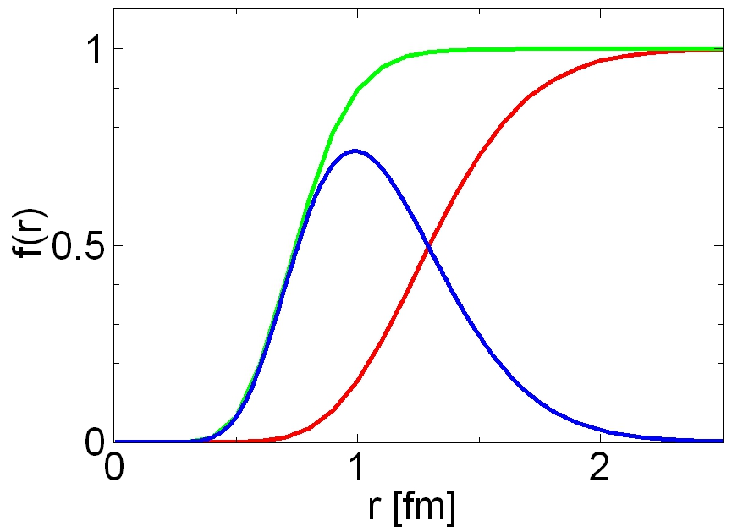

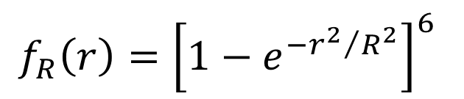


Equivalent Regulator functions
Parameter R is determind to produce the same 3N binding energy as ${BR}_{Λ}$
$f_{R}\left(r\right)={\left[1−e^{−{r^{2}}/{R^{2}}}\right]}^{6}$
BR₁₀₀₀ $↔$ $f_{1} \left(r,R=0.50fm\right)$
BR₆₆₀ $↔$ $f_{1} \left(r,R=0.87fm\right)$
Difference
Pion exchange around $r=1$ fm

Slide 17
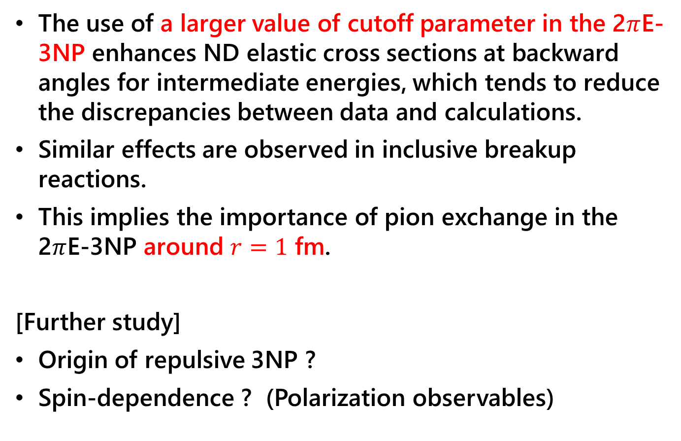
4. SUMMARY
The use of a larger value of cutoff parameter in the 2$π$E-3NP enhances ND elastic cross sections at backward angles for intermediate energies, which tends to reduce the discrepancies between data and calculations.
Similar effects are observed in inclusive breakup reactions.
This implies the importance of pion exchange in the 2$π$E-3NP around $r=1$ fm.
[Further study]
Origin of repulsive 3NP ?
Spin-dependence ? (Polarization observables)

Slide 19
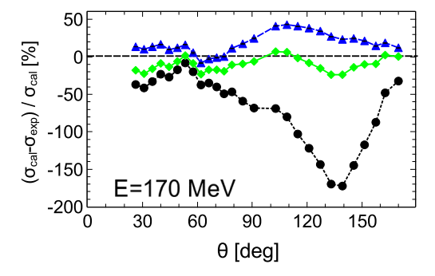

AV18 +${BR}_{1000}$+${BR}_{1000}+W_{R}$
----- AV18
----- AV18+BR₁₀₀₀+W_{R}
----- AV18+BR₁₀₀₀

Slide 20
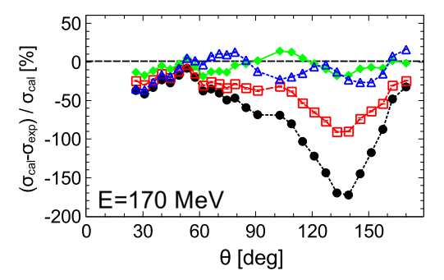
AV18 +BR_{0.87} +BR_{0.5}+W_{R} +BR(UR)+W_{R}
----- AV18
----- AV18+BR_{0.87}
----- AV18+BR_{0.5}+W_{R}
----- AV18+BR(UR)+W_{R}

