Slide 1
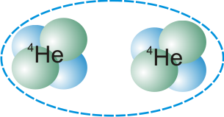
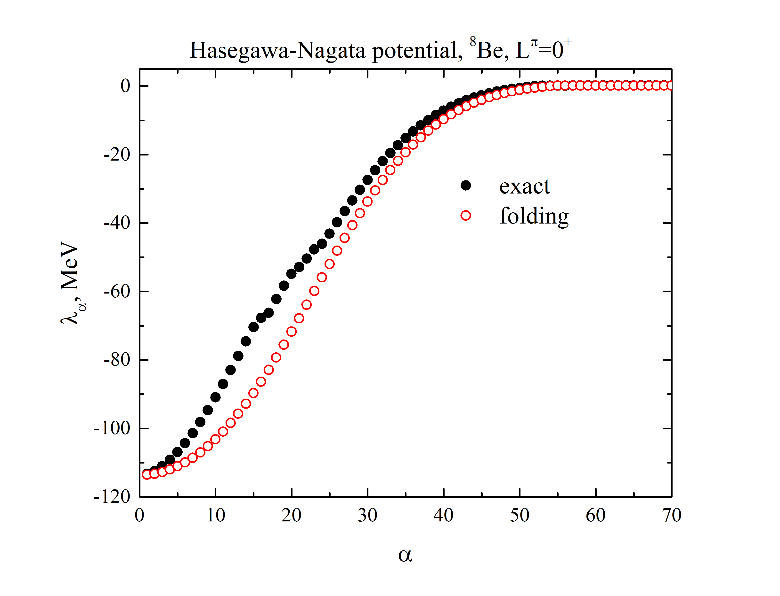


Influence of the Pauli principle
on two-cluster potential energy
=
+
Yuliya Lashko, Viktor Vasilevsky and Gennady Filippov
Bogolyubov Institute for Theoretical Physics Kyiv, Ukraine
Notes:
The aim of this paper is to investigate effects of the Pauli principle on the potential energy of a two-cluster system within a microscopic method.
The Pauli principle has been investigated many times and from different points of view. It seems that everything is known about the Pauli principle.
Many results have been obtained revealing effects of the antisymmetrization on the structure of bound states and dynamics of reactions in two- and three-cluster systems. Many publications are devoted to calculations of eigenvalues of the norm kernel and construction of the Pauli allowed states. Meanwhile, we are going to demonstrate that some interesting properties of the Pauli principle were hidden and we are going to reveal some new interesting features. We will demonstrate how the antisymmetrization affects cluster-cluster potential energy.

Slide 2

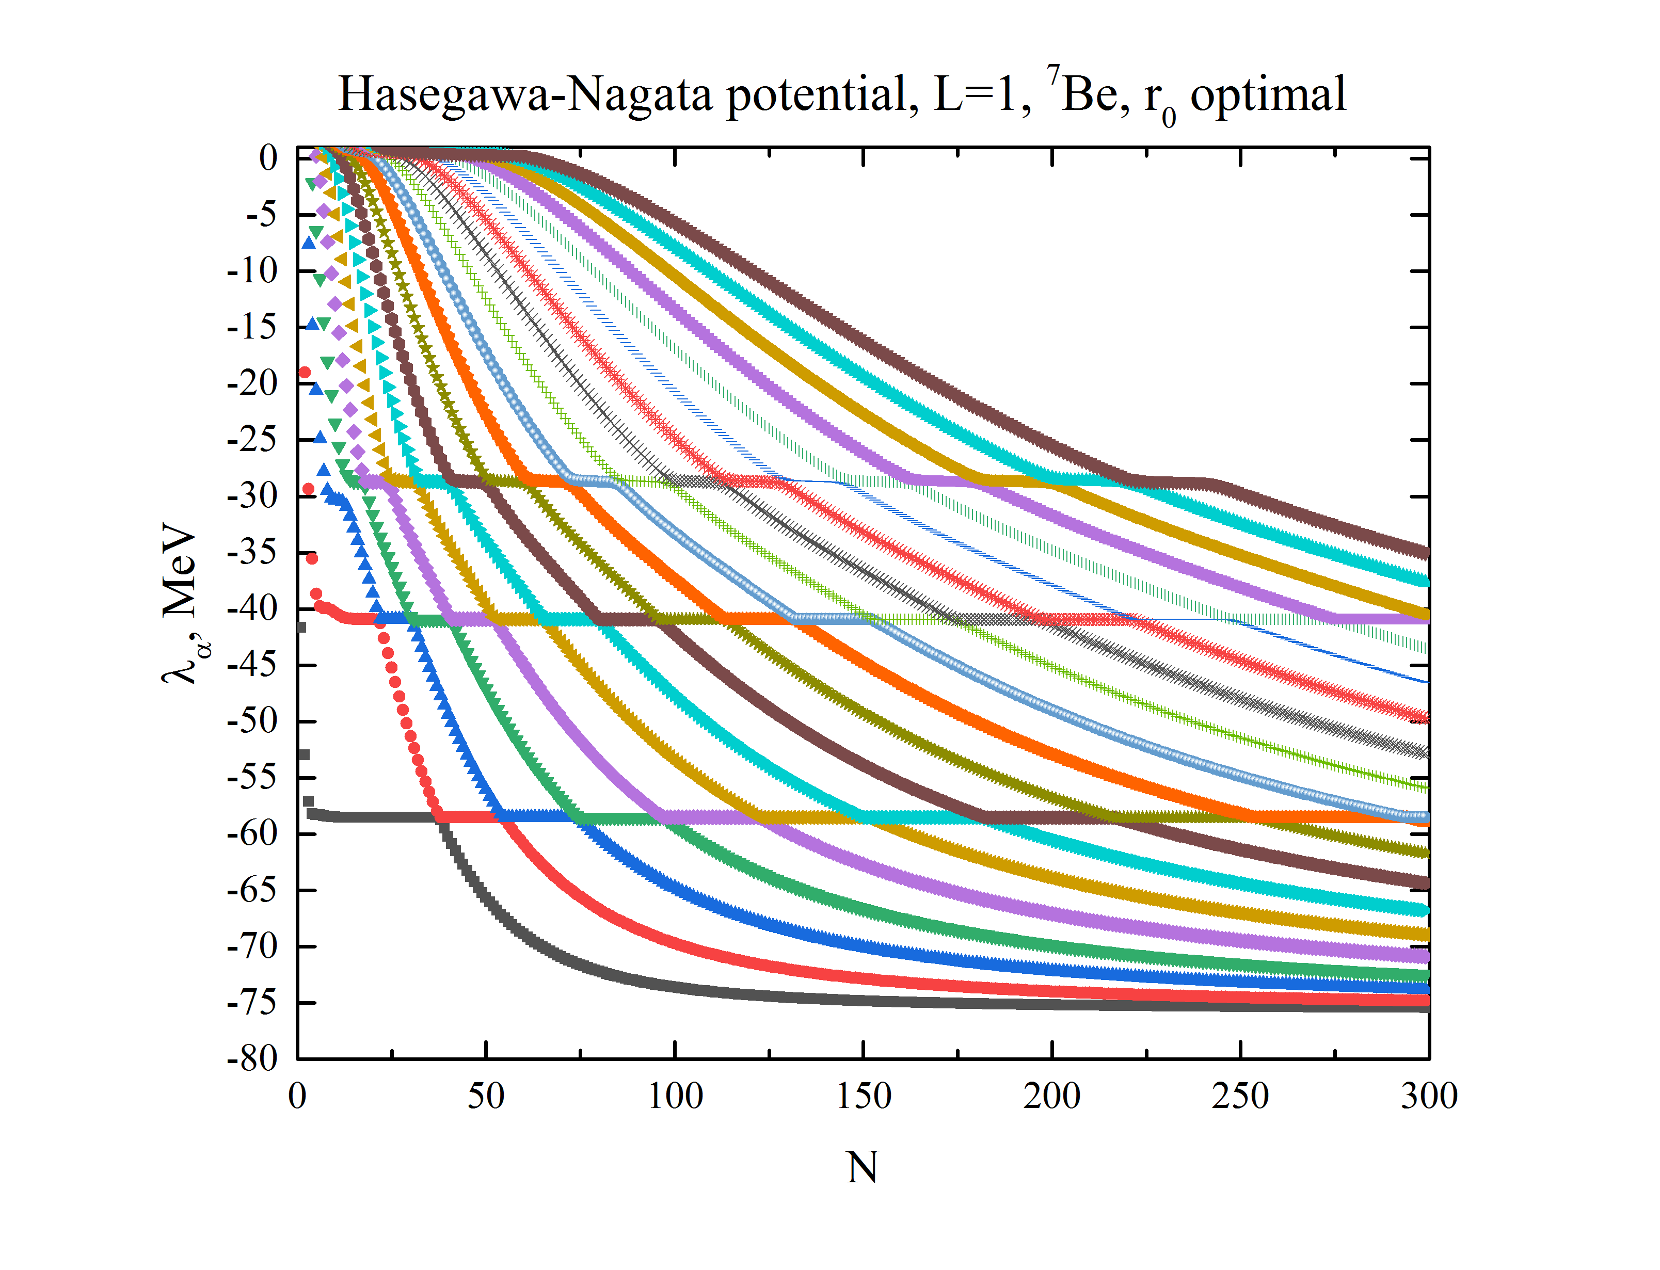
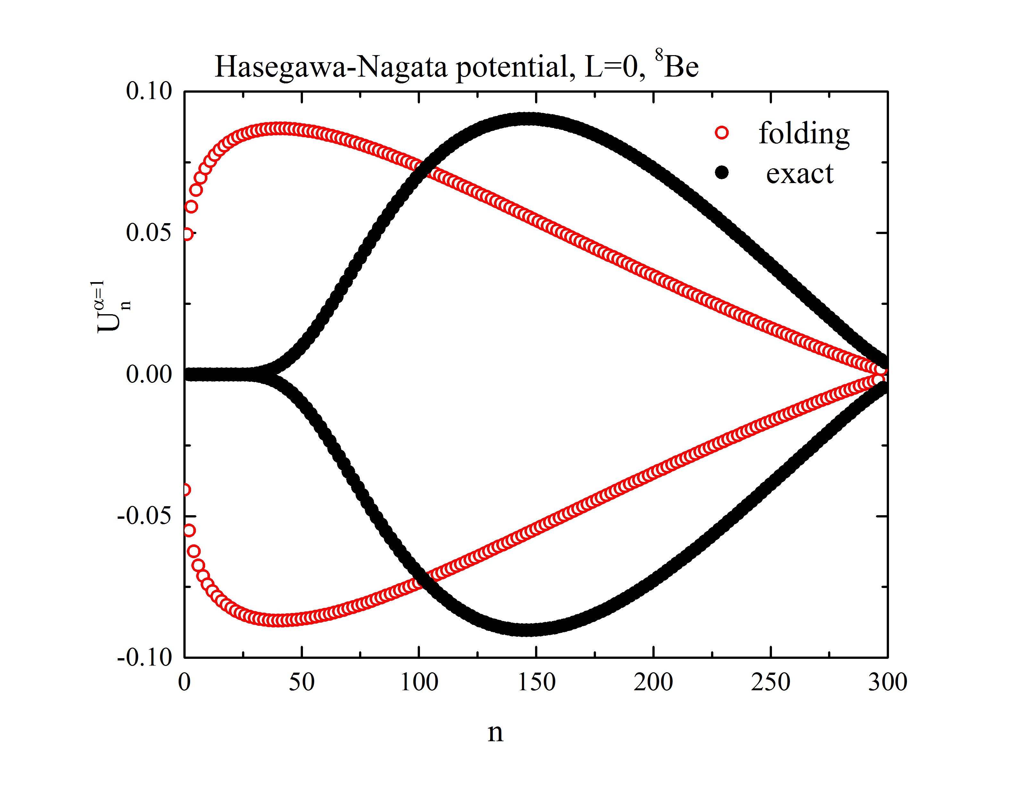
This presentation studies effects of the antisymmetrization
on potential energy of two interacting nuclear clusters
Potential energy matrix
Eigenvalues of potential energy operator: folding vs exact potential
Eigenfunctions of potential energy operator : folding vs exact potential
Notes:
It is important to notice that the total interaction of two-cluster system originates from nucleon-nucleon interaction and also from the kinetic energy operator. However, in the present paper will consider only the first part of the cluster-cluster potential.

Slide 3
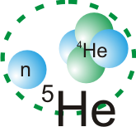
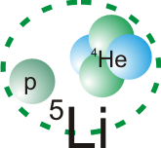
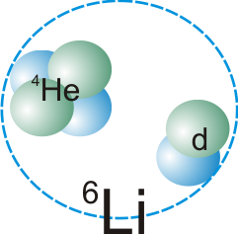
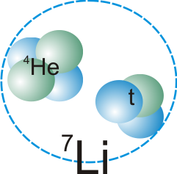
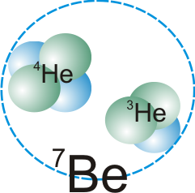
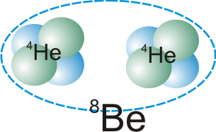
We analyse two-cluster potential energy for the lightest nuclei of p-shell with a pronounced two-cluster structure
Notes:
The object of the investigation is the lightest nuclei of p-shell with a dominant alpha-cluster channel

Slide 4




We explore a microscopic two-cluster model of light nuclei
Intrinsic cluster w.f.
Antisymmetrization
operator
W.f. of relative motion
number of quanta
Algebraic version of Resonating Group Method:
Cluster oscillator functions
A set of linear equations is solved to find expansion coefficients C_{mL}:
Eigenvalues of the norm kernel
Notes:
The resonating group method is a powerful tool for studying properties of two-, three- and many cluster systems. This method works perfectly
for describing both bound states and different types of reactions. The main advantages of the method are that (i) it takes into account the internal structure of interacting clusters and (ii) correctly treats the Pauli principle. An important peculiarity of the RGM is that being applied to two- or three-cluster systems it reduces in a self-consistent way the A-body problem to a two- or three-body problem.
RGM strongly relies on the translationally invariant many-body shell model as this model supplies the wave functions describing the internal structure of clusters. It is natural also to use oscillator wave functions for describing the inter-cluster motion.
We assume that we deal with the s-clusters only, it means that the intrinsic orbital momentum of each cluster equals to zero. The total spin S is a vector
sum of the individual spins s1 and s2.

Slide 5


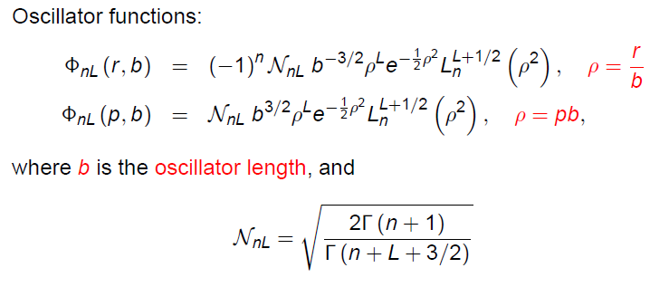
Inter-cluster wave function in r- and p-space can be expanded into a set of h.o. functions with the same coefficients
Notes:
It is well-known that the inter-cluster wave function fL (q) is a solution to the integro-differential equation. This equation has a simple form and can be much easily solved, when the function is expanded into full set of the oscillator functions. The oscillator length b for oscillator function is selected the same as for many-particle oscillator functions describing the internal structure of interacting clusters.
Cluster models, which involve the oscillator basis, have been used for many years. However, only after publication in 1980-
1981 papers of Filippov and co-authors about the possibility to use this basis for considering continuum spectrum states, this model started to deal with scattering processes.

Slide 6

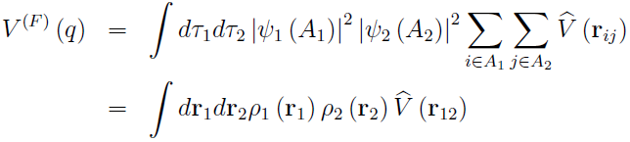
Neglecting Pauli principle gives folding approximation
solution of the two-body Schrödinger equation
with folding potential
single particle local densities of the clusters
Notes:
If we omit the antisymmetrization operator in the expression for the wave function, we have got the so-called folding approximation. This approximate form is valid when the distance between clusters is large and effects of the Pauli principle is negligible small.

Slide 7

The idea is to compare the exact and folding two-cluster potentials via separable representation of the potentials
Exact two-cluster potential is a nonlocal operator
Notes:
As a tool for this study we employ the method suggested in our recent paper to be published in Annals of Physics. We will construct matrix
of potential energy and then analyze its eigenvalues and eigenfunctions of the matrix. The eigenfunctions will be analyzed in the oscillator, coordinate and momentum representations. Involving three different spaces allows us to get more complete picture on the nature and properties of potential energy eigenfunctions.
Operator P(q) reduces the A-body space to effective two-body space.

Slide 8
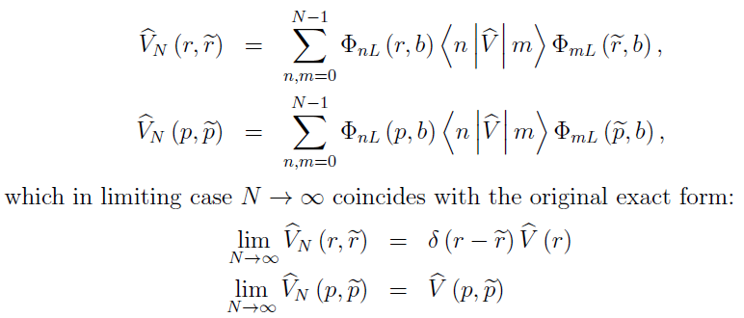
The potential energy matrix of dimension NxN approximates the exact potential as follows:
Notes:
The method, which we suggested in [36], allows reducing nonlocal inter-cluster interaction to a local or separable form.

Slide 9
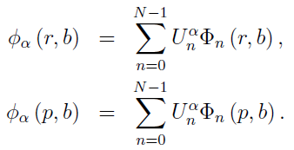

Potential energy matrix can be reduced to a diagonal form
Orthogonal matrix
Eigenvectors of the potential energy matrix define new eigenfunctions
Notes:
Actually we use the decomposition of the matrix onto diagonal matrix and orthogonal one. The functions and eigenvalues enable us to construct inter-cluster nonlocal potential

Slide 10
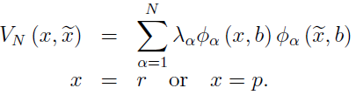
Oscillator basis realizes specific form of separable potentials
The eigenvalues λ_{α} coincide with potential energy V(r) at some discrete points r_{α}
λ_{α}=V(r_{α})

Slide 11
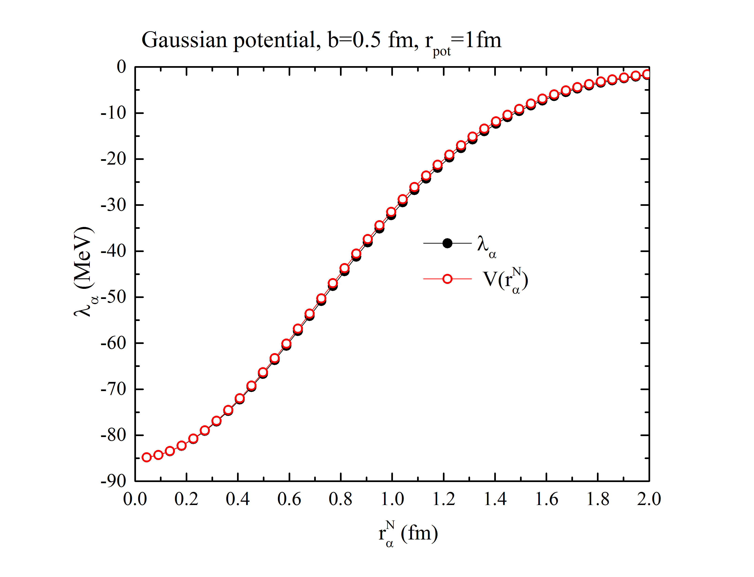
Eigenvalues perfectly coincide with the original potential energy in discrete points for oscillator length b=r_{pot}/2

Slide 12


Eigenfunctions of the folding potential operator are universal
Eigenfunctions of the folding potential energy operator in the momentum representation are Bessel functions
Eigenfunctions of the folding potential energy operator in discrete representation are harmonic oscillator functions

Slide 13
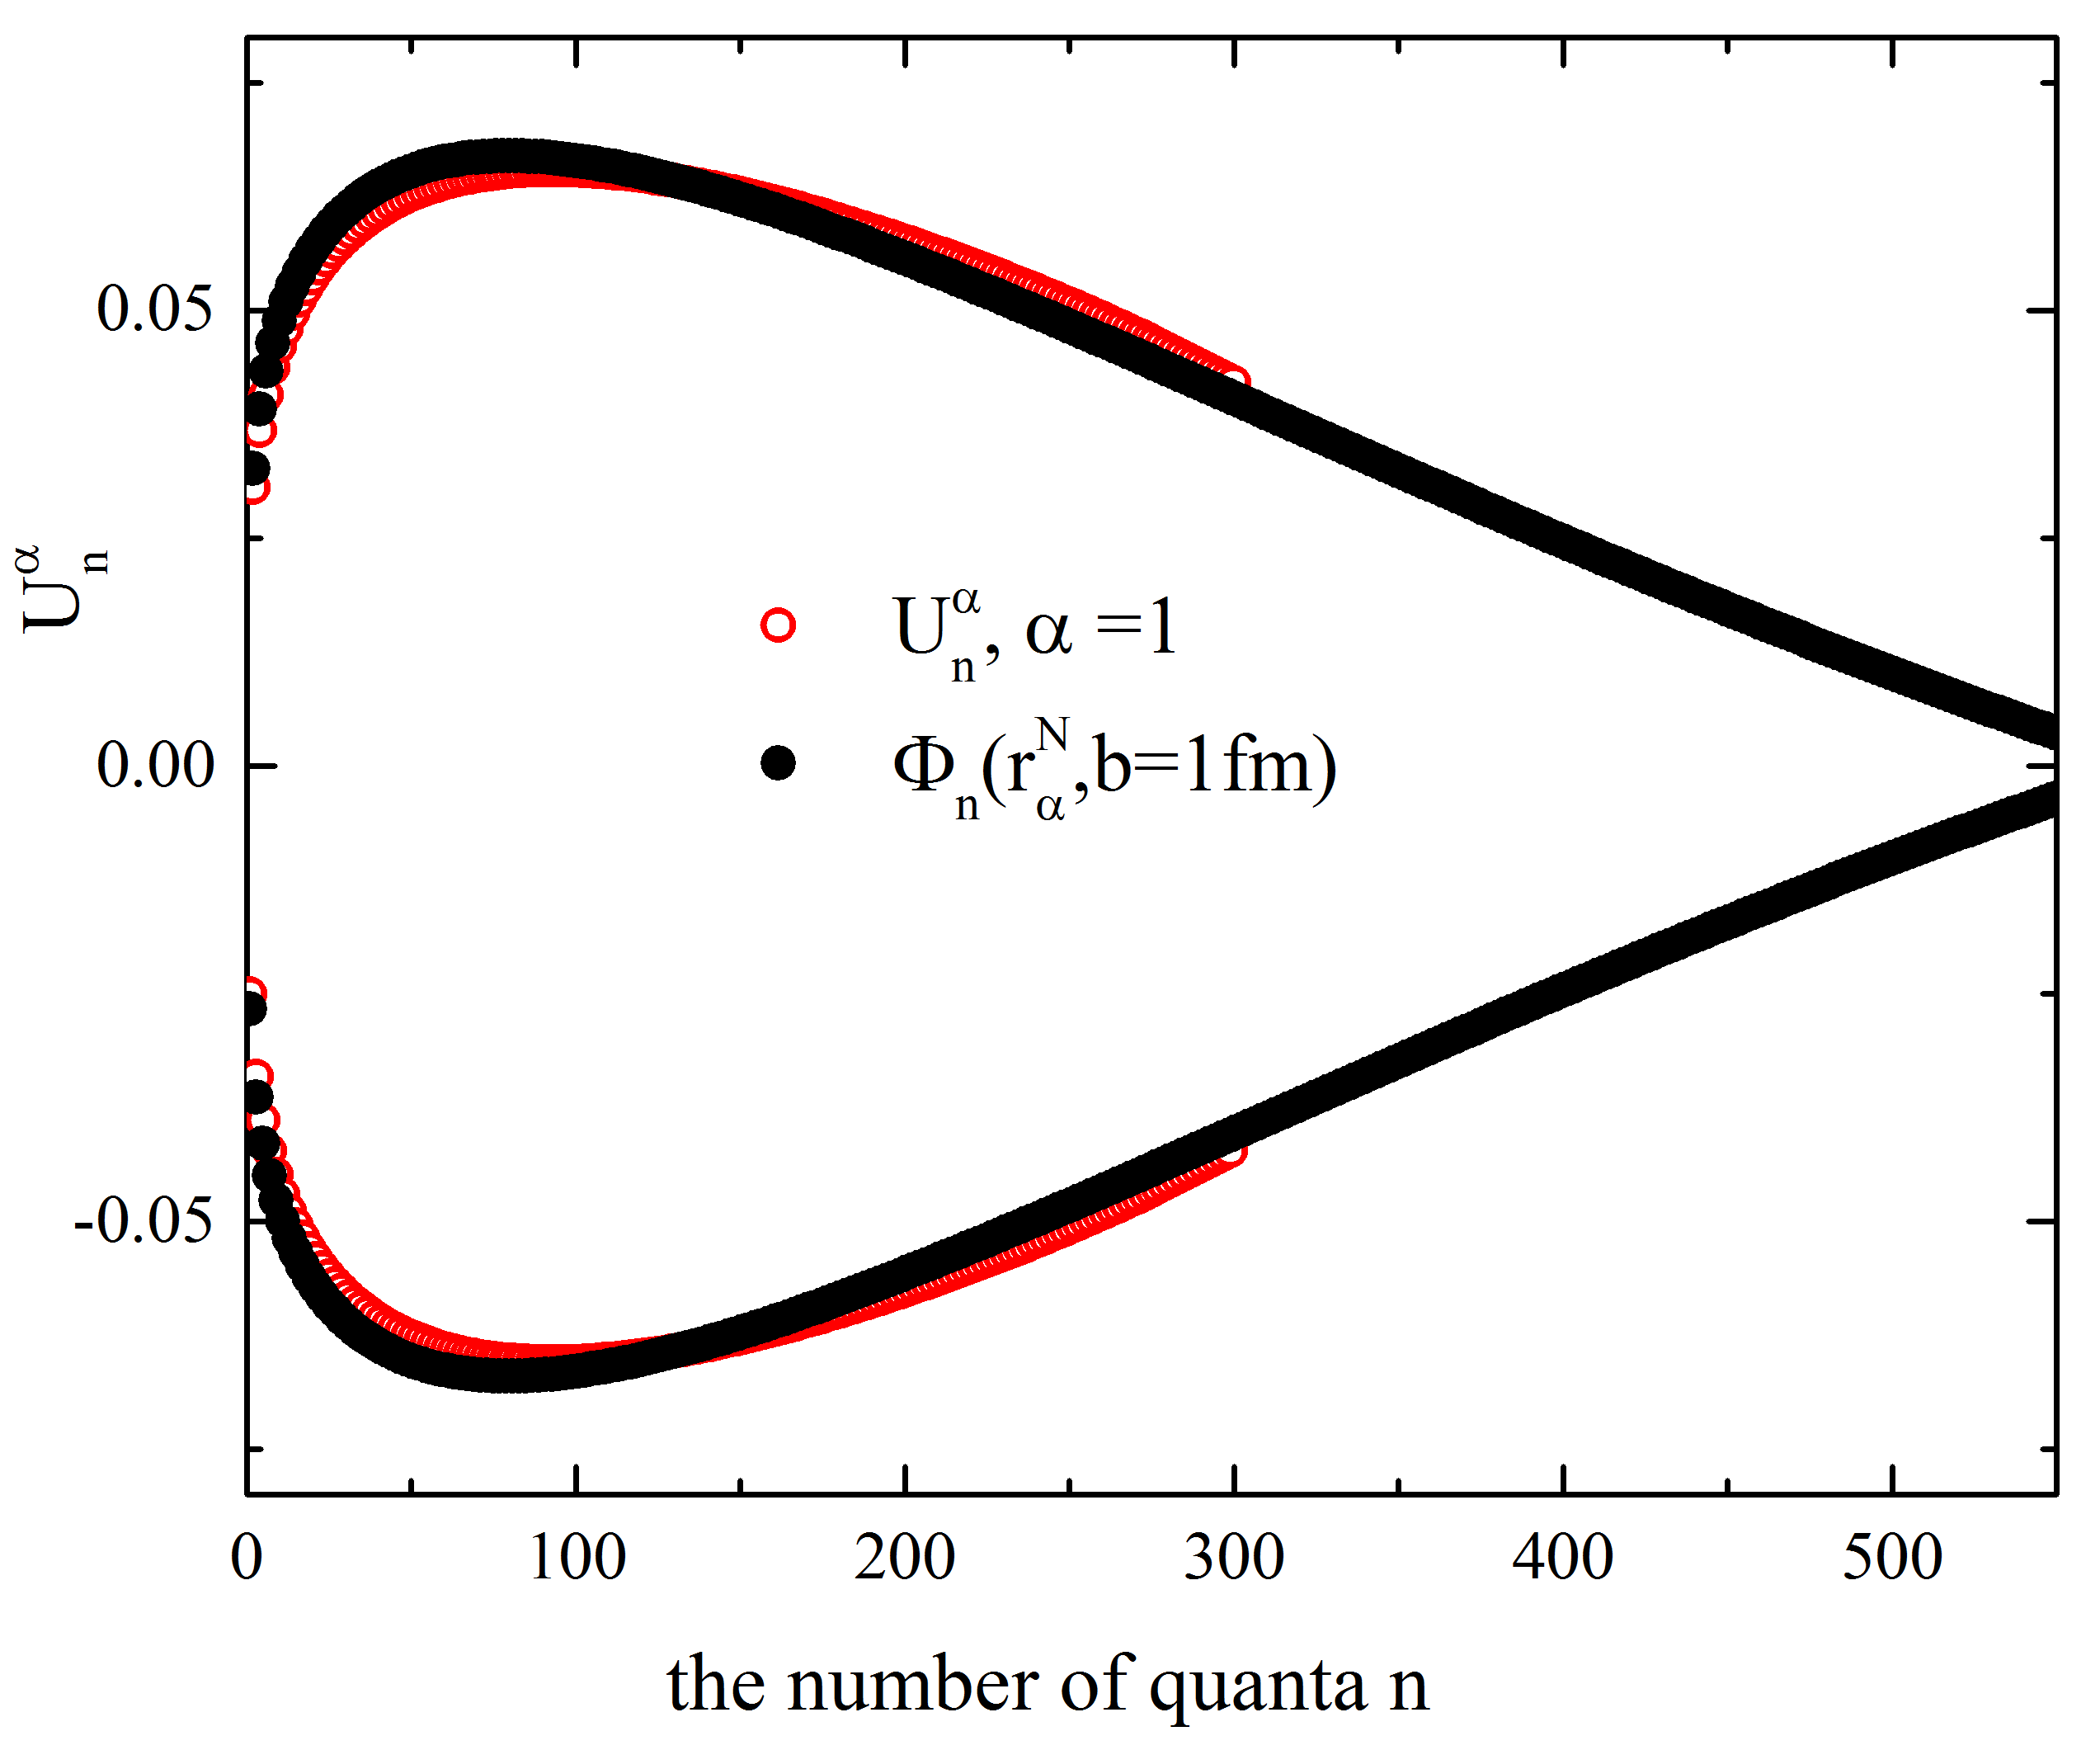
Eigenfunctions U_{α}^{N} of folding potentials in discrete representation are harmonic oscillator functions Φ_{n}(r_{α}^{N},b)

Slide 14
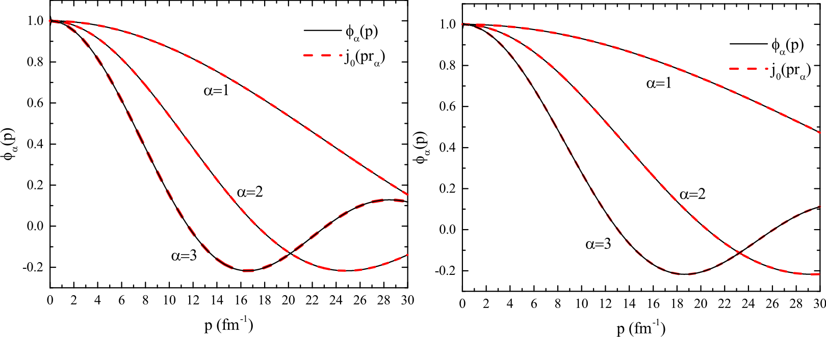
Eigenfunctions ϕ_{α}(p) of the folding potential operator in the momentum representation are Bessel functions j₀(pr_{α})
Gaussian potential, b=r_{pot}
Yukawa potential , b=r_{pot}

Slide 15
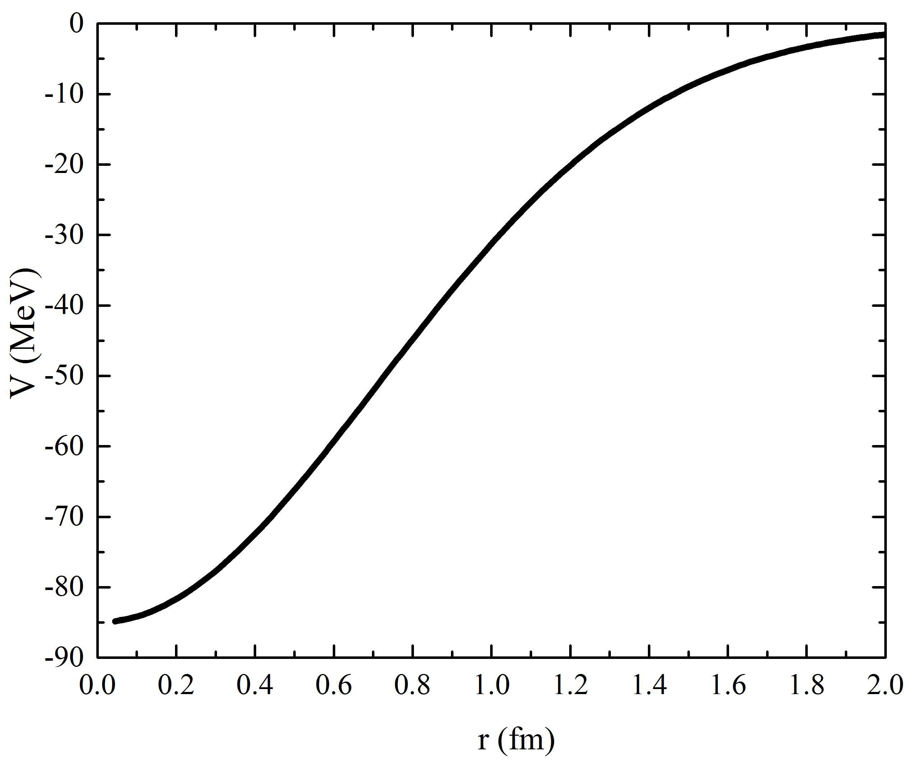
Eigenvalues of the potential energy operator reproduce
the behavior of the potential in some discrete points
A limited number of eigenstates of a short-range potential
energy matrix gives nonzero contribution to the S-matrix

Slide 16
Eigenvalues of potential energy operator: folding vs exact potential
the number of basis functions

Slide 17
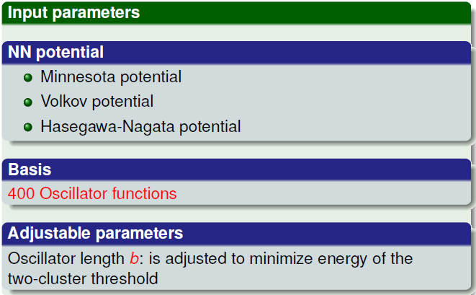
We employ three nucleon-nucleon potentials (+Coulomb) which have been often used in cluster models
(MP)
(VP)
(MHNP)
300
Notes:
We employ three different nucleon-nucleon potentials which are often used in many-cluster
calculations. These potentials will help us demonstrate how eigenvalues and eigenfunctions
of the potential energy operator depend on the shape of nucleon-nucleon potential.

Slide 18
The larger is the core in the nucleon-nucleon potential,
the deeper is its attractive part
Even components of the potentials as a function of distance between nucleons
Attractive part of the even components
of the potentials
Notes:
Figures demonstrate the main differences between the MHNP, MP and VP potentials. In these figures we display only the even components V31 and V13 of all three NN potentials. It is known, that the even components are strongest as, for example, the V31
components provides a bound state in a deuteron and the V13 component generates a virtual
state in the neutron-neutron system. One can see that the MHNP has largest repulsive core
at small distances, and the VP has a negligibly small core. The MP has a soft core. Fig.
2 provides detailed view of these potentials, here we see that the larger is the core in the
potential, the deeper is the attractive part of the potential.

Slide 19
Despite of the huge core in MHNP nucleon-nucleon potential, there is no such a core in cluster-cluster folding potential
Folding potentials generated by the VP
Folding potentials generated by the MHNP
Notes:
It is worthwhile noticing that despite of the huge core in this nucleon-nucleon potential, there is no such a core in cluster-cluster folding potential. Only in 5He and 5Li nuclei we can see a small repulsive core at small inter-cluster distances.
The lower part of Fig. 5 demonstrates behavior of the folding potential for large values of distance between interacting clusters. This part of the potential is created by the Coulomb force. Different NN-potentials create approximately the same shape of the folding potential. Main difference between the folding
potentials, generated by different NN-potentials, is depth and width of the potential well. In Fig. 6 we display the folding potentials created by the VP. This nucleon-nucleon potential has no repulsive core. However it creates a small repulsive core in 5He. In general, the shape of both potentials a approximately the same. The main difference between them is the depth and width of a potential well: the potential well for the MHNP has the larger depth but smaller width than the potential well for the VP.

Slide 20
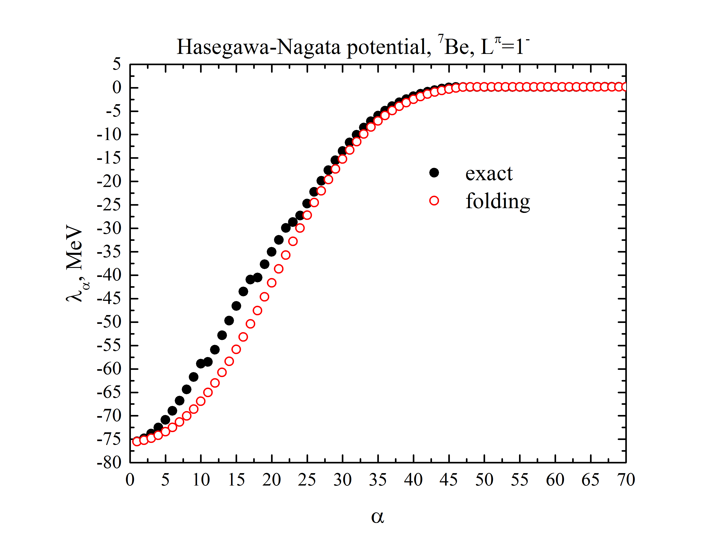
Eigenvalues of the exact and folding potential energy matrix are quite close to each other
resonances
eigenvalue number α
Notes:
the eigenvalues of the potential energy matrix, calculated with antisymmetrization, are very close to the ones, determined in the folding approximation. The lowest eigenstates are almost coincide, indicating that both potentials have the same depth. One can also see that exact potential has less strong
attraction at the range 5 -30. For a> 50 exact potential is very close the folding potential. Similar behavior of eigenvalues is observed for all lightest nuclei of the p-shell and for all NN potentials involved in our calculations.

Slide 21

Dependence of eigenvalues of the exact potential on the number of functions exhibits resonance behavior
resonances
the number of basis functions

Slide 22
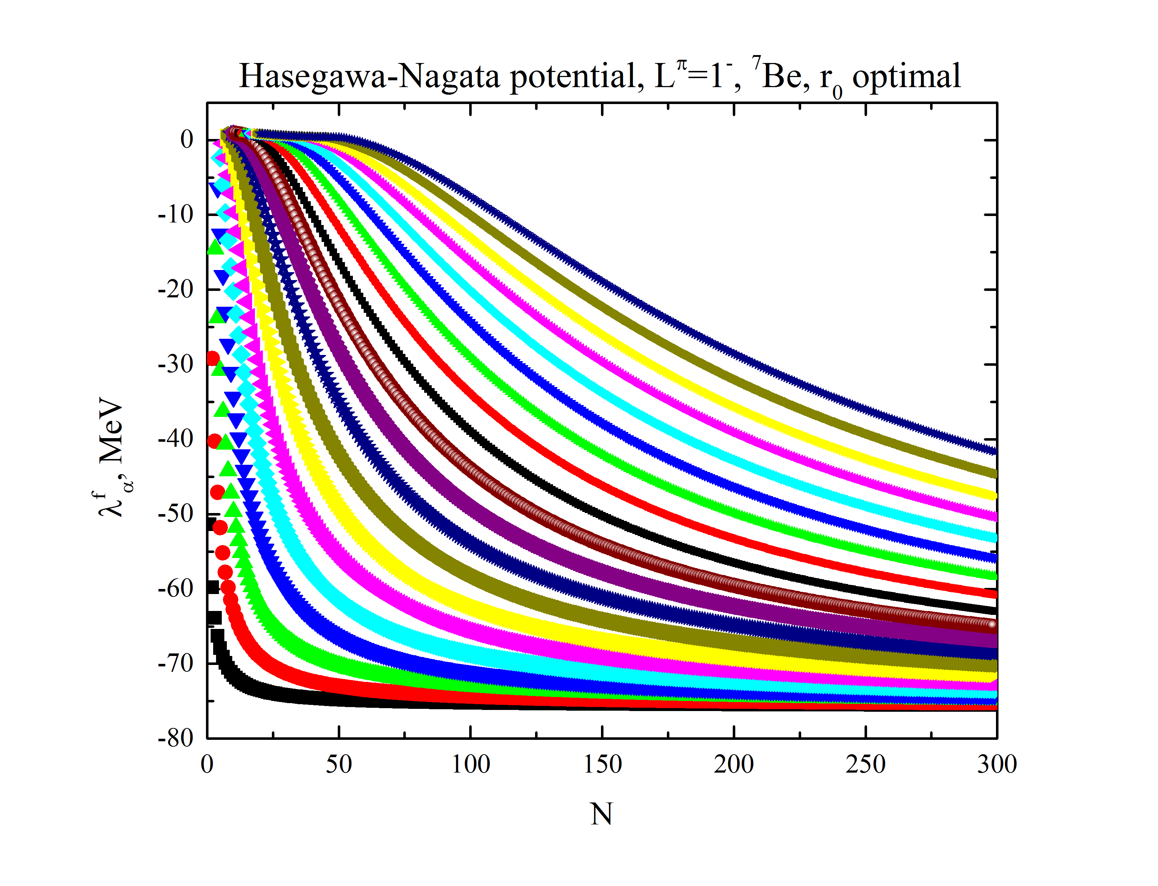
Contrary, none of the eigenstates of the folding potential has a resonance behavior
the number of basis functions

Slide 23
Eigenfunctions of potential energy operator : folding vs exact potential
the number of quanta n
Notes:
Mapping slide for the presentation (note that a background slide or a slide justifying the importance might precede this slide). A common mistake with mapping slides is to give the audience simply a boring and unmemorable vertical list of topics (including the names “Introduction” and “Conclusion” and “Questions”). Such a list is quickly forgotten after the slide is removed.
On a mapping slide, take the opportunity to show a key image or perhaps a representative image for each major section of the presentation. In the second case, each image would be repeated on the first visual of the corresponding section and would remind the audience that they have arrived to a major section of the presentation’s middle.
In regards to the names “Introduction” and “Conclusion,” every talk has those sections, and the names are ignored by audiences. So why state them? Also, for the divisions that you do have, find a logical and parallel grouping. Note that groups of two’s, three’s, and four’s are much easier to remember and are not so nearly intimidating as groups of five’s, six’s, and seven’s. See the example mapping slide in the textbook. (CSP, pages 55-56, 74-75, 86, 143, 147, and 148)

Slide 24
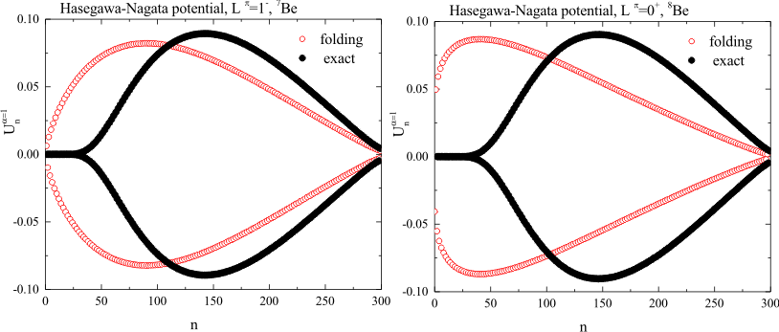
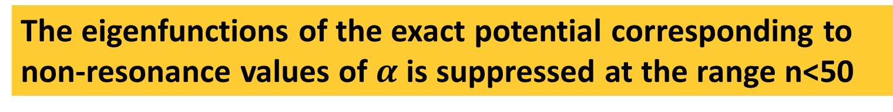
The eigenfunctions of the exact potential corresponding to non-resonance values of $α$is suppressed at the range n<50
⁷Be
⁸Be
the number of quanta n
the number of quanta n

Slide 25
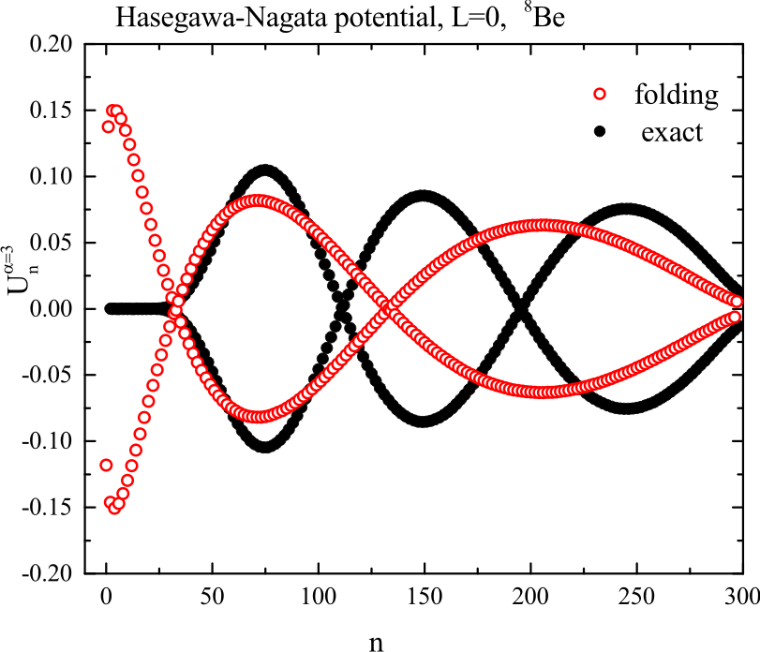
Eigenfunctions of folding potential has a maximum at lower number of quanta n than eigenfunctions of exact potential
the number of quanta n

Slide 26
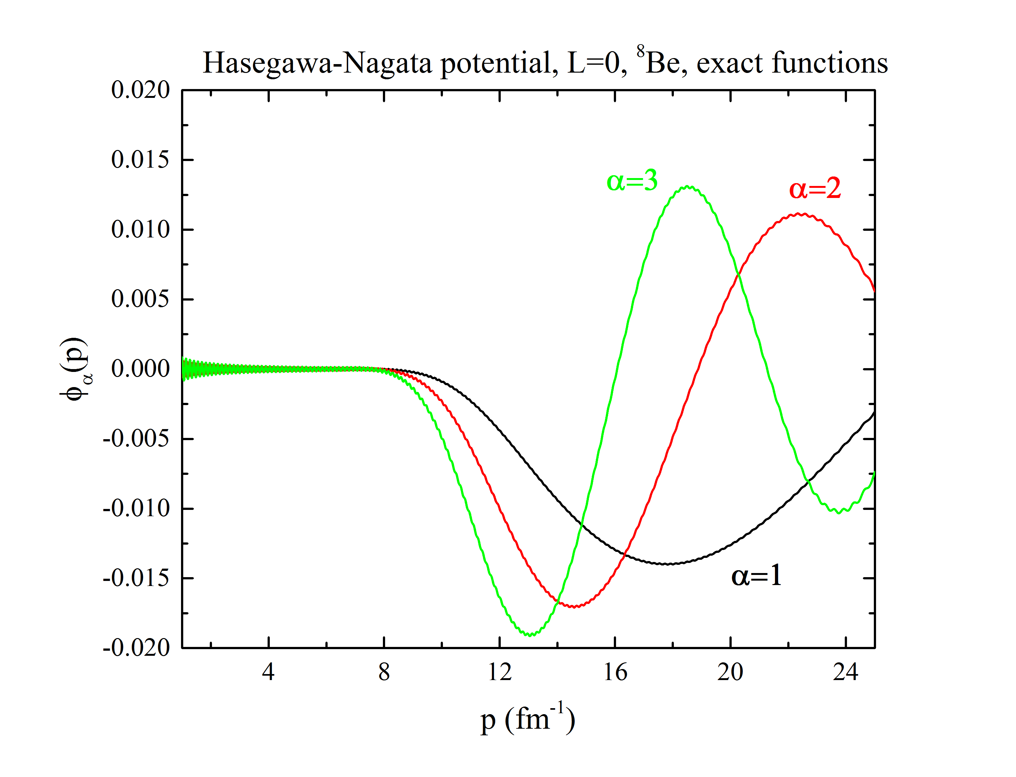
Non-resonance eigenfunctions of the exact potential in
p-representation are suppressed in the range p<10 fm⁻¹

Slide 27
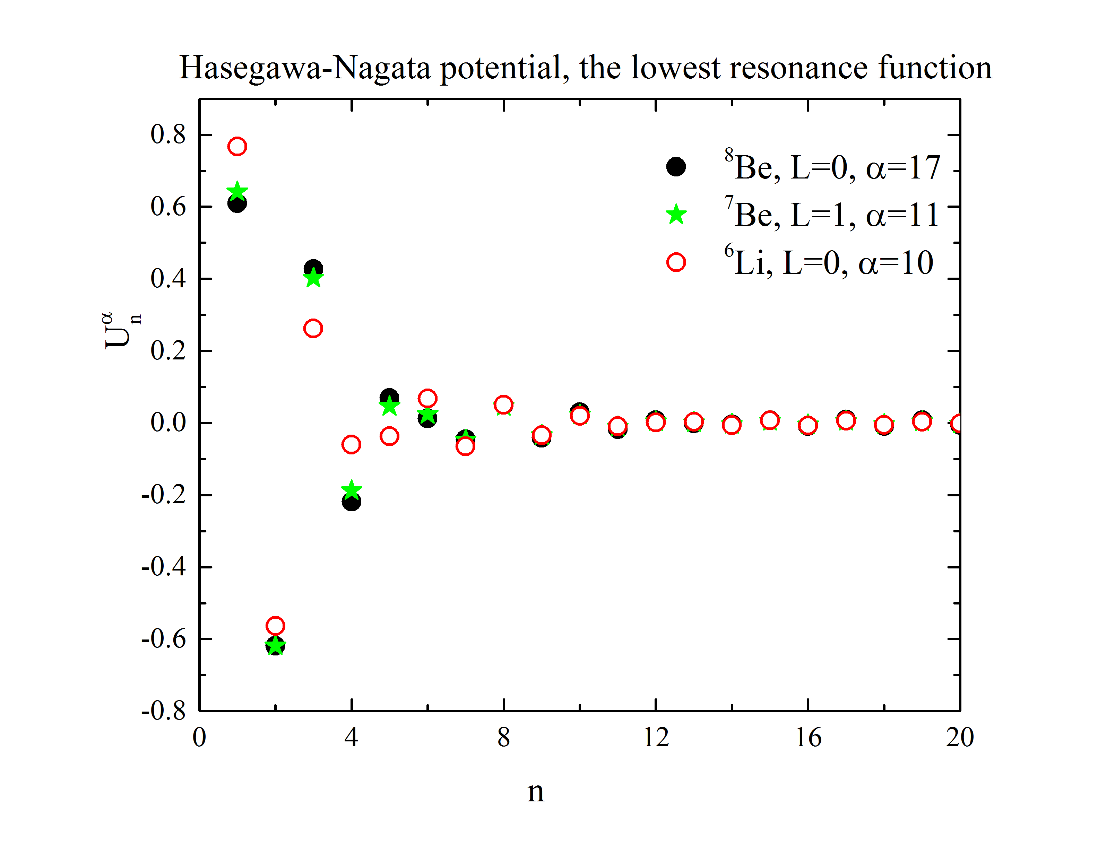
Eigenfunctions of resonance states of the exact potential
are localized at low values of oscillator quanta n<10
the number of quanta n

Slide 28
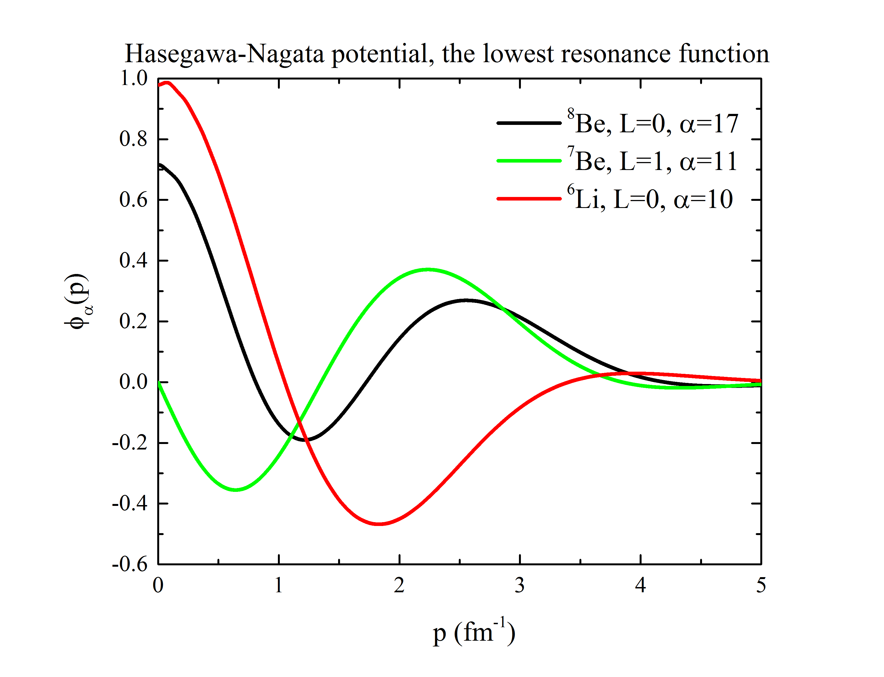
Eigenfunctions of resonance states of the exact potential
in p-representation are localized at low values of p

Slide 29
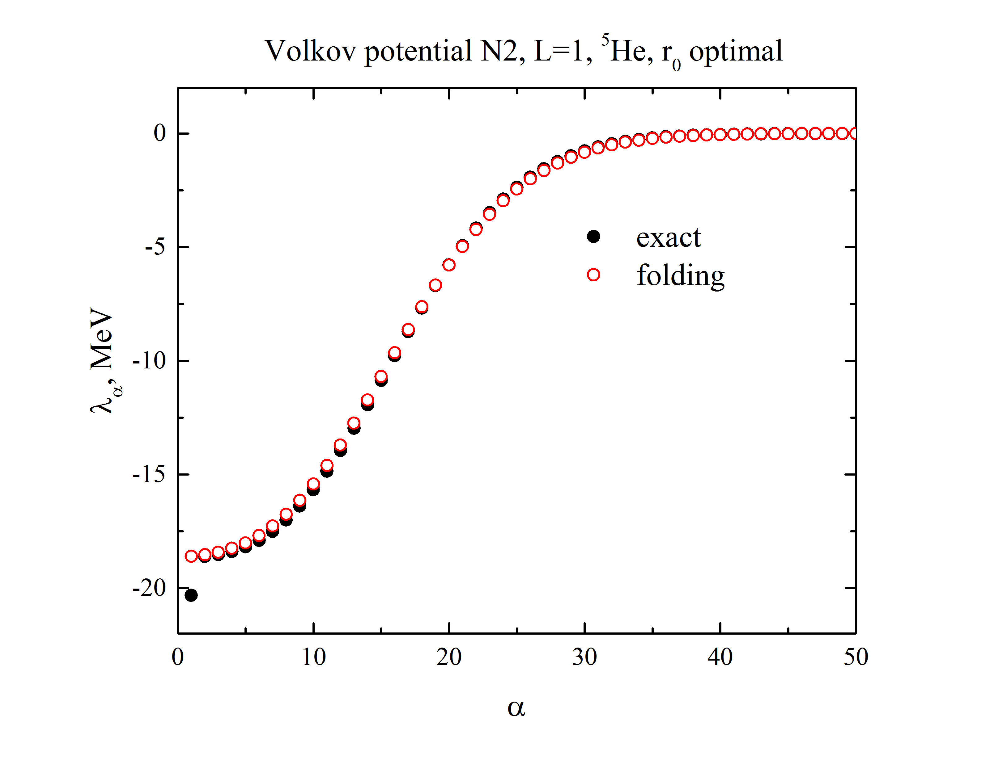
The eigenvalues of the exact Volkov N2 potential differ from those of the folding potential at a single point α=1
“trapped” state
eigenvalue number α

Slide 30
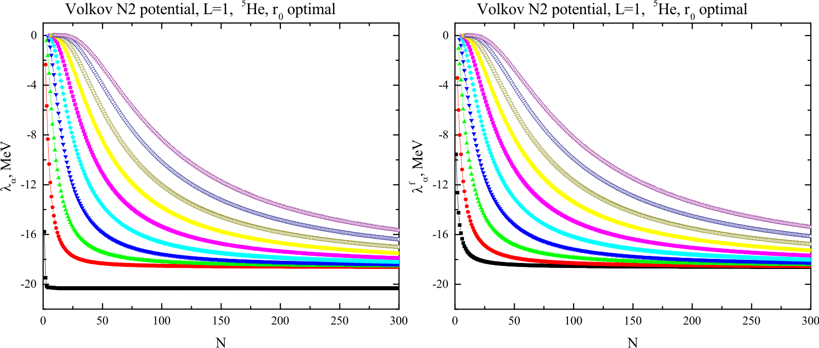
Dependence of eigenvalues of the exact Volkov N2 potential on the number of basis functions shows the existence of a “trapped” state at α=1
exact
folding
“trapped” state
the number of basis functions
the number of basis functions

Slide 31
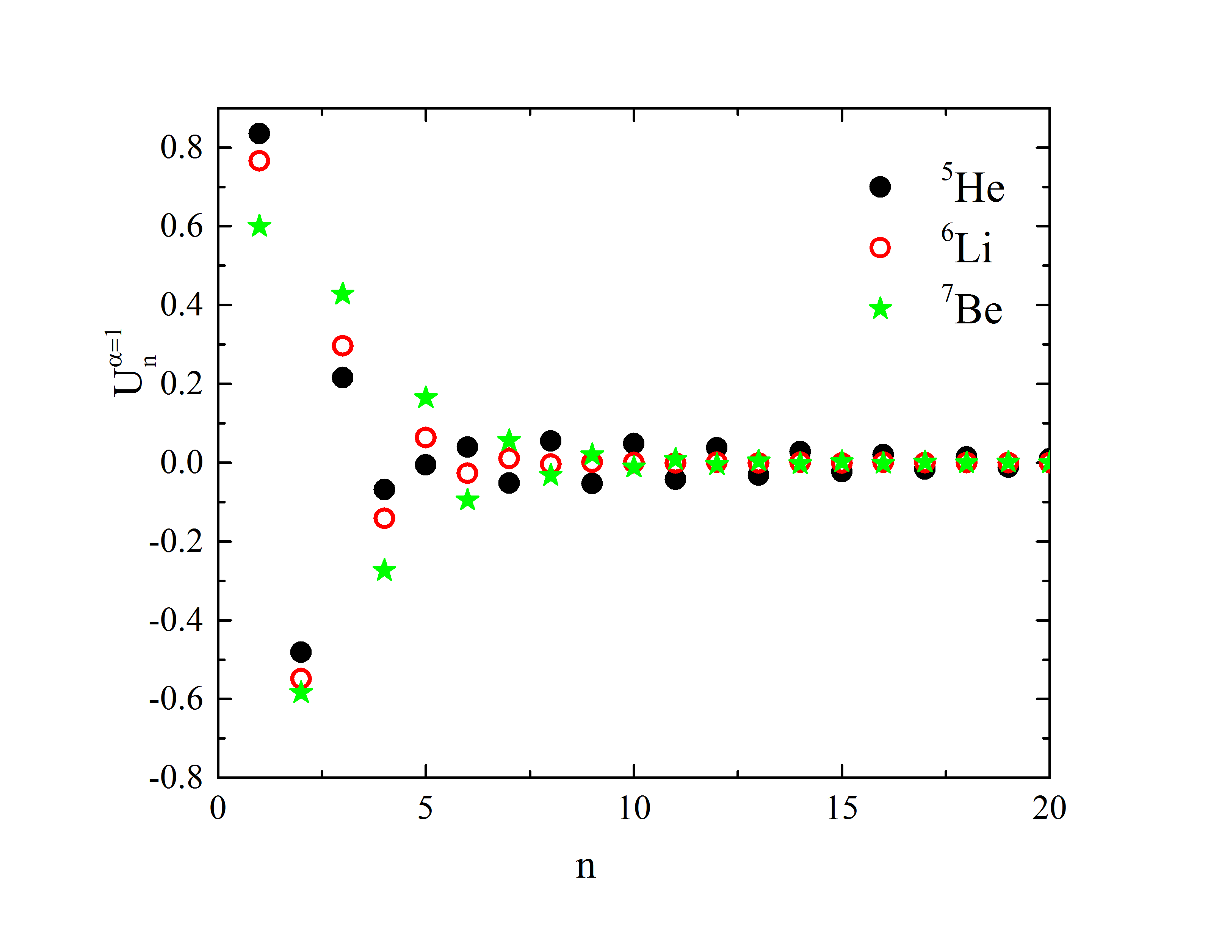
Eigenfunction of a “trapped” state in Volkov N2 potential
is similar to the resonances in Hasegawa-Nagata potential
the number of quanta n

Slide 32
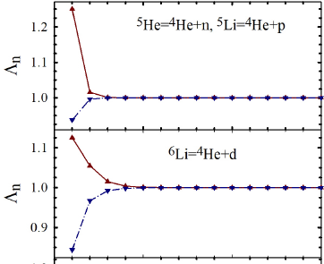
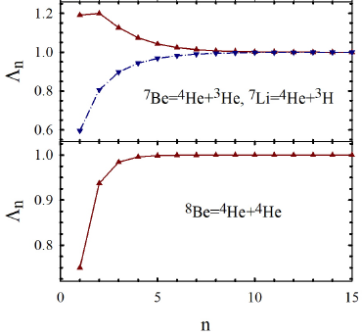

A “trapped” state in Volkov N2 potential appears only for the cluster configurations characterized by eigenvalues of the norm kernel Λ_{n}>1
the number of quanta n
the number of quanta n
Eigenvalues of the norm kernel for lightest p-shell nuclei

Slide 33
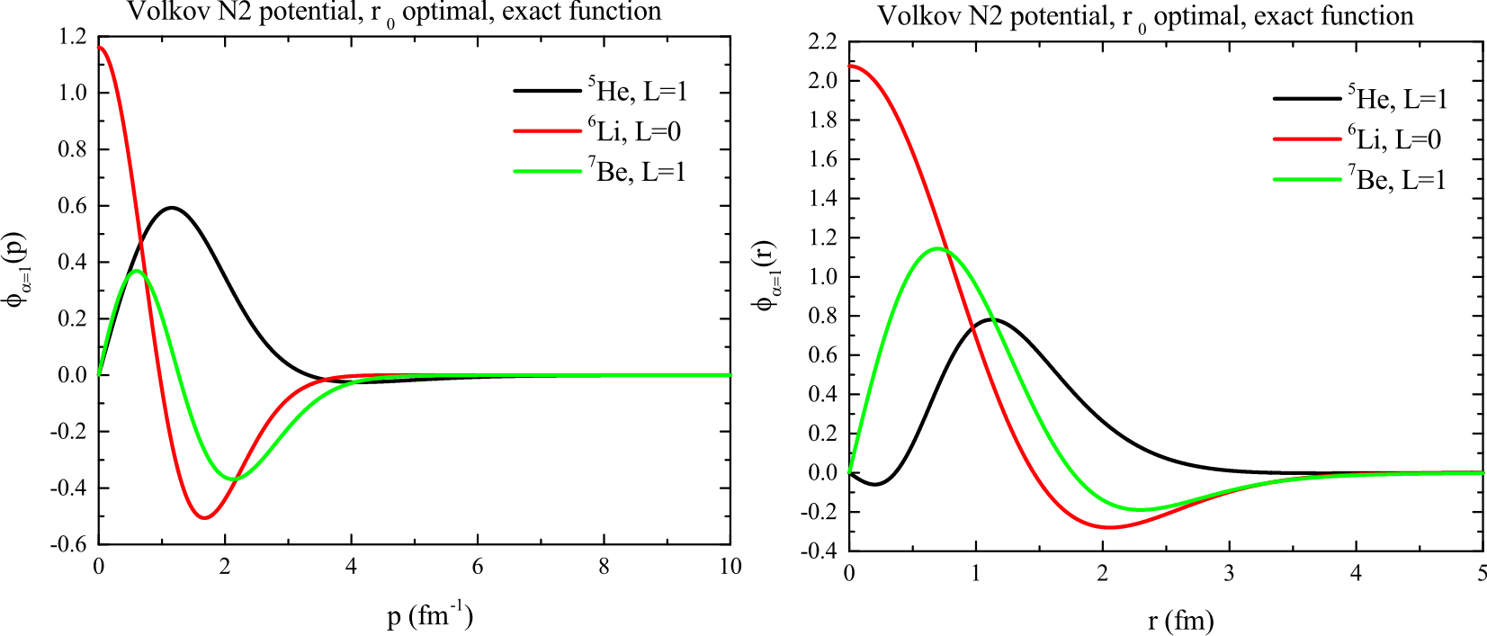
With increasing momentum eigenfunctions of a “trapped” state in p-representation decrease exponentially
Exponential tail
Momentum representation
Coordinate representation

Slide 34
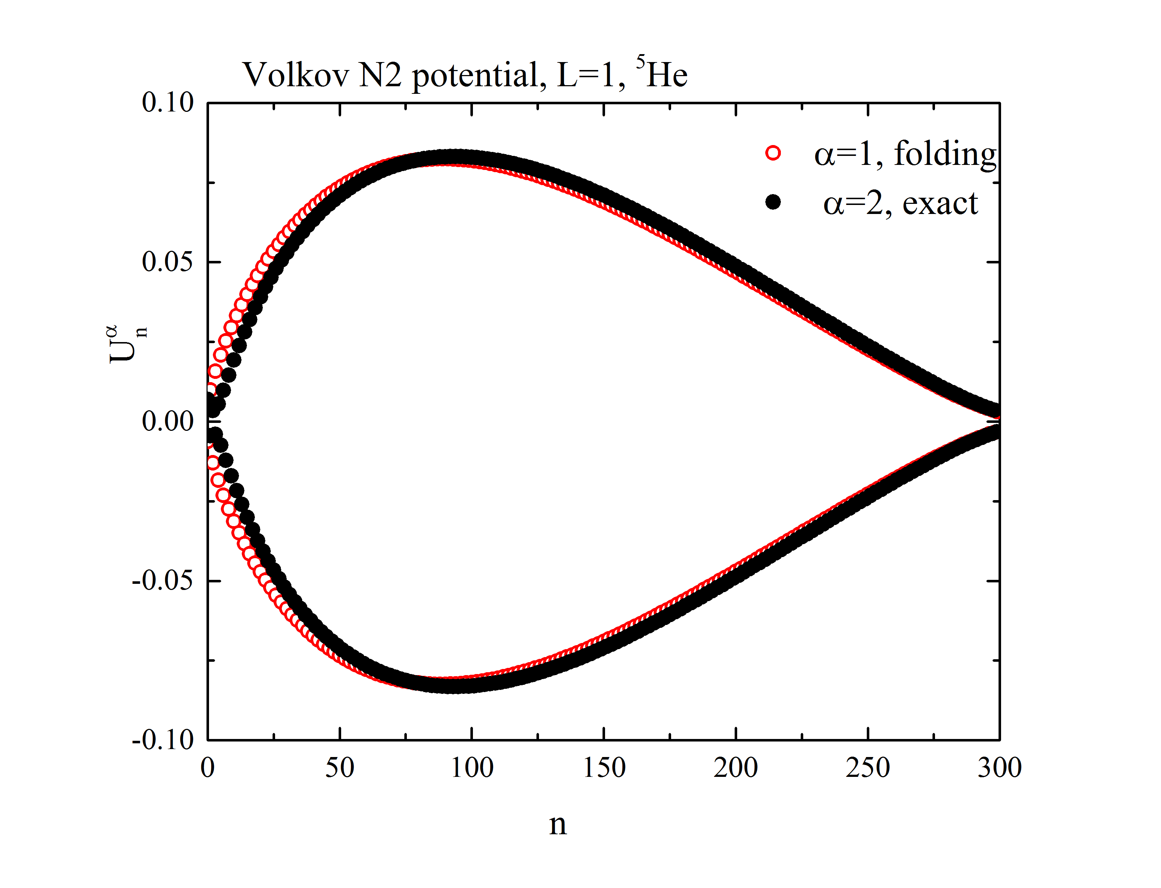
All other eigenfunctions of exact Volkov potential are quite close to those of the folding potential
the number of quanta n

Slide 35

Diagonalization of the potential energy matrix proposes
a self-consistent way of reducing a nonlocal potential of
two-cluster systems to the local form
1. Dependence of eigenvalues of the exact potential on the number of functions exhibits resonance behavior
2. Eigenfunctions of the exact potential essentially differ from those of folding potential
Notes:
Mapping slide for the presentation (note that a background slide or a slide justifying the importance might precede this slide). A common mistake with mapping slides is to give the audience simply a boring and unmemorable vertical list of topics (including the names “Introduction” and “Conclusion” and “Questions”). Such a list is quickly forgotten after the slide is removed.
On a mapping slide, take the opportunity to show a key image or perhaps a representative image for each major section of the presentation. In the second case, each image would be repeated on the first visual of the corresponding section and would remind the audience that they have arrived to a major section of the presentation’s middle.
In regards to the names “Introduction” and “Conclusion,” every talk has those sections, and the names are ignored by audiences. So why state them? Also, for the divisions that you do have, find a logical and parallel grouping. Note that groups of two’s, three’s, and four’s are much easier to remember and are not so nearly intimidating as groups of five’s, six’s, and seven’s. See the example mapping slide in the textbook. (CSP, pages 55-56, 74-75, 86, 143, 147, and 148)

Slide 36
Slides for answering questions

Slide 37
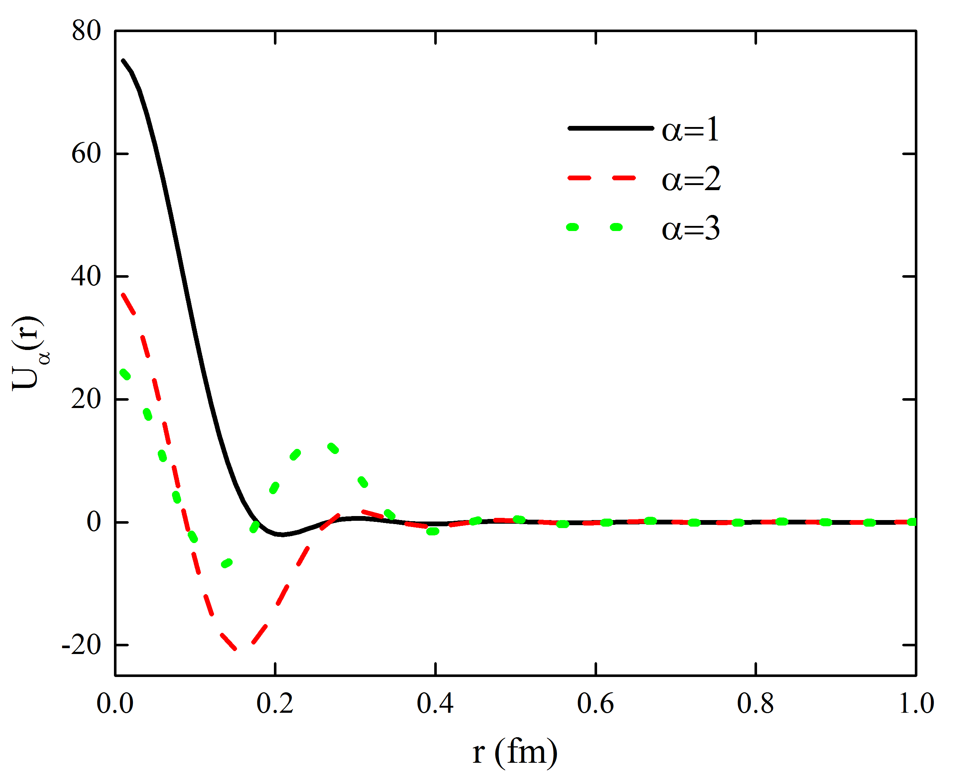
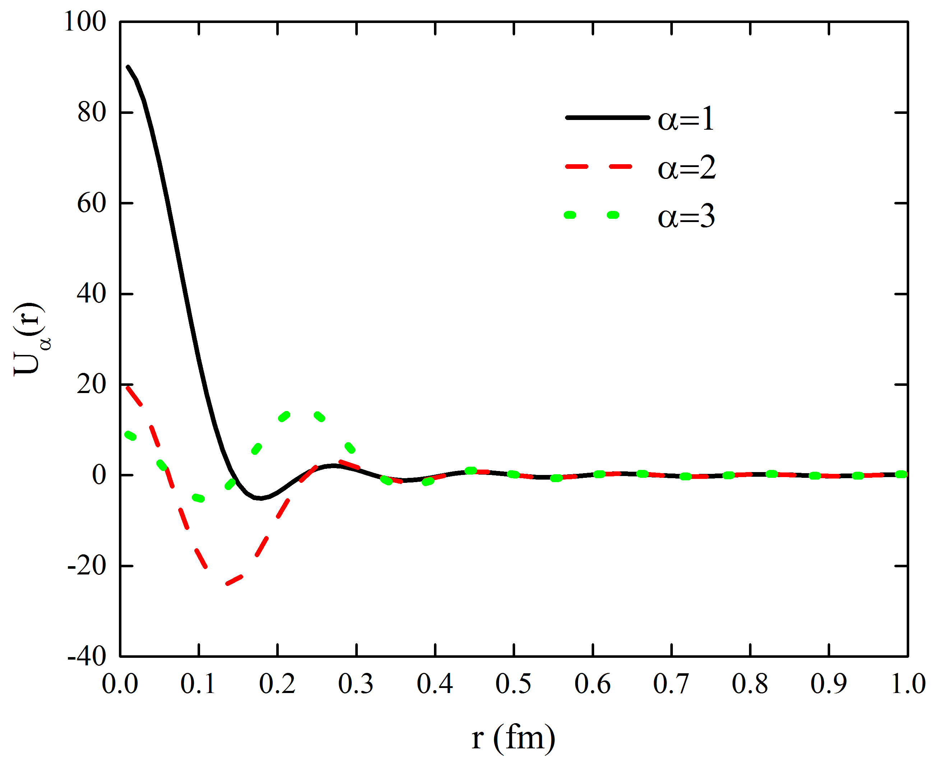
The smaller is the eigenvalue number α, the more
the corresponding eigenfunction U_{α}(r) resembles δ-function
Gaussian potential, b=r_{pot}
Yukawa potential , b=r_{pot}

Slide 38





Discrete coordinates r_{α} define the location of the α-th zero of the eigenfunction in harmonic oscillator representation
They are the zeros of the Laguerre polynomial
For ρ=

