Slide 1
Multi-neutron transfer in the scattering of ⁸He at Coulomb barrier energies
I. Martel, N. Keeley, K. Rusek and K. Kemper

Slide 2
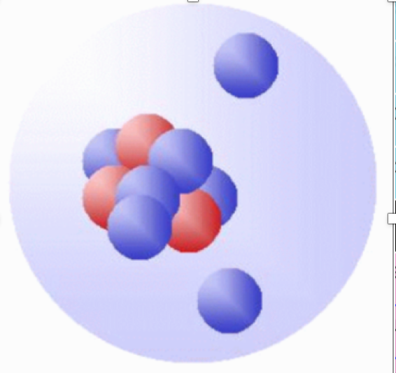
Halo nuclei
Exotic nuclear systems formed by a core and some weakly bound valence nucleons:
Extended mass distribution and large radius ~ “halo”
Large reaction cross sections
Narrow momentum distributions following fast fragmentation reactions
Concentration of dipole strength at low energies close to BU threshold
Gudveen Sawhney et al., J. Phys. G: Nucl. Part. Phys. 41 (2014) 055101
Neutron haloes ¹¹Li, ⁶He, ⁸He, ¹⁶Be offer an ideal test bench to study n-n correlations by measuring neutron transfer and breakup.
I. Tanihata, et al. Phys. Lett., B289:261, 1992.

Slide 3
Searching for di-neutrons and tetra-neutrons
Scattering of ⁸He +²⁰⁸Pb at Coulomb barrier energies
⁸He is the most neutron-rich bound nucleus, with a ratio of N/Z = 3 → excellent test bench for multi-neutron transfer.
Spherical, well known double-magic target nucleus ²⁰⁸Pb
Coulomb barrier → large probability of neutron transfer
Existing ⁶He + ²⁰⁸Pb elastic scattering data at similar incident energies ~ 22 MeV (Coulomb barrier).
Comparing ⁶He and ⁸He scattering is interesting:
  → Rms. matter radii of ⁶He and ⁸He are very similar (2.33 fm, 2.49 fm), but they are halo and skin nuclei, respectively
  → Remove “geometrical” effects due to differences in size → better understanding of structure/dynamics of the reaction process
N. Keeley et al., PLB 646, 222 (2007). F. Skaza et al., PRC 73, 044301 (2006). L.V. Chulkov et al., NPA 759, 43 (2005).
S_{1n} and S_{2n}: higher in ⁸He → smaller coupling to the continuum in ⁸He ~ smaller breakup yield.
Q_{1n} and Q_{2n}: 1n and 2n better Q-matched in ⁸He ~ larger 1n and 2n transfer yield.
SF(1n): higher in ⁸He ~ larger 1n-transfer yield.
SF(2n): Similar values ~ similar yields for 2n transfer.
4-neutron transfer. Unique mechanism for ⁸He.
Relative strength of the neutron transfer channels?
Sequential or direct?
Di-neutrons and tetra-neutrons?

Slide 4
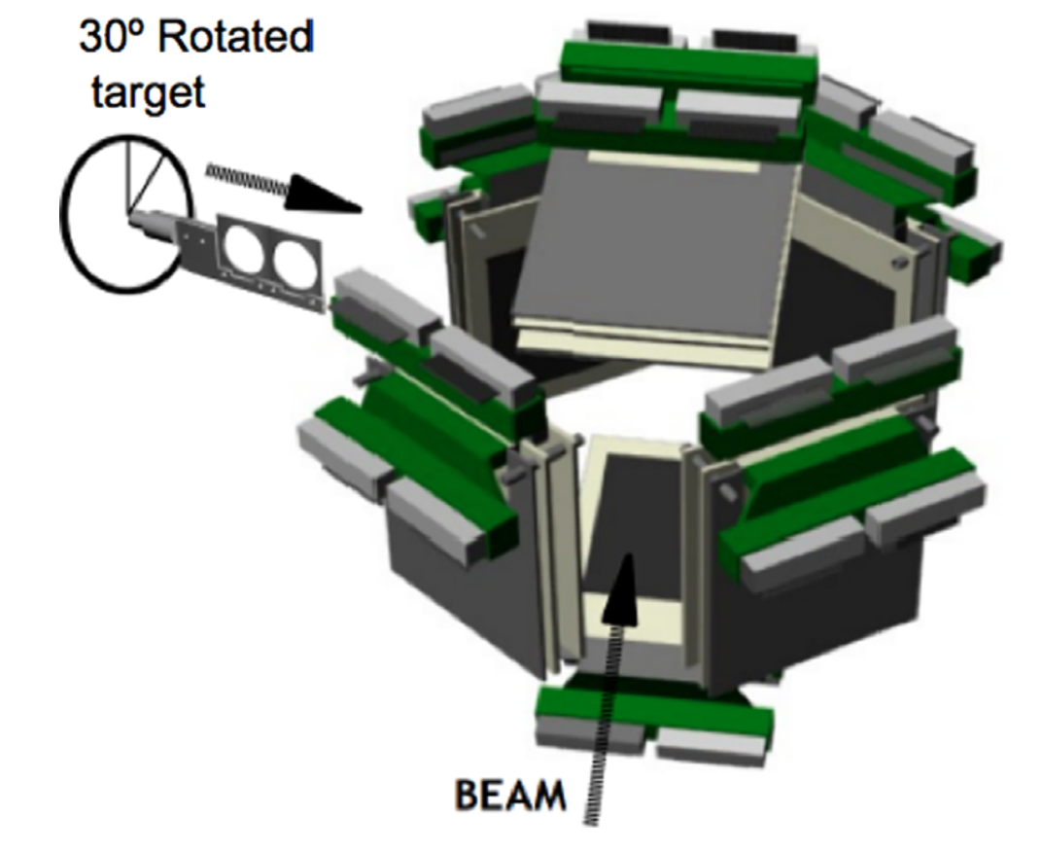
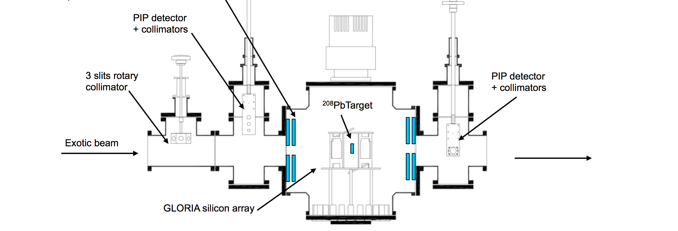
Scattering of ⁸He +²⁰⁸Pb at 16 and 22 MeV
GLObal ReactIon Array (GLORIA)
6 x DSSSD Si particle telescopes
40 um DE & E, 1 mm
Total solid angle: 26 %
Angular range: 15 -165 deg.
Angular res. ~ 3 deg.
Caen, France
Proposal E587S (2010)
Measure the angular distribution of the elastic channel and the yields of ⁶He and ⁴He from 15° to 165° Lab.
G. Marquínez-Durán et al. Nucl. Inst. Meth. A 755, 69 (2014).

Slide 5
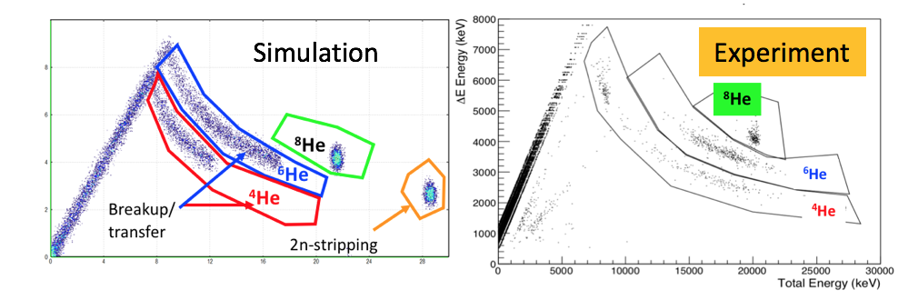
Particle identification
E= 22 MeV

Slide 6
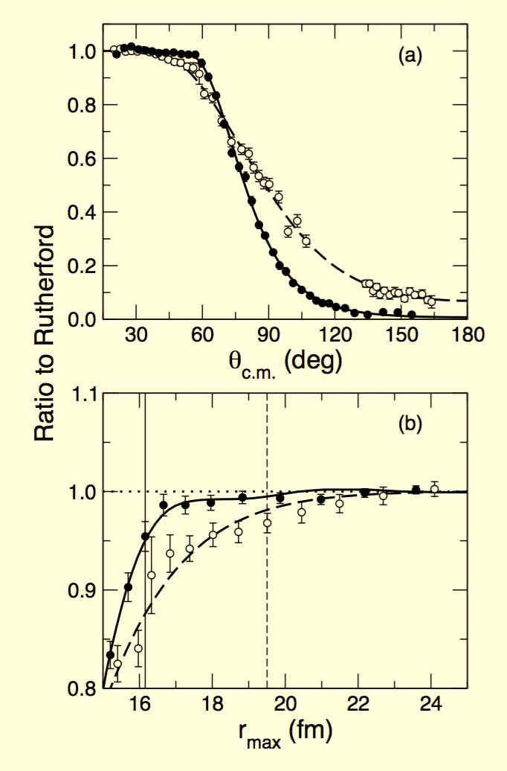
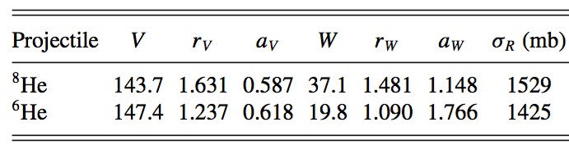
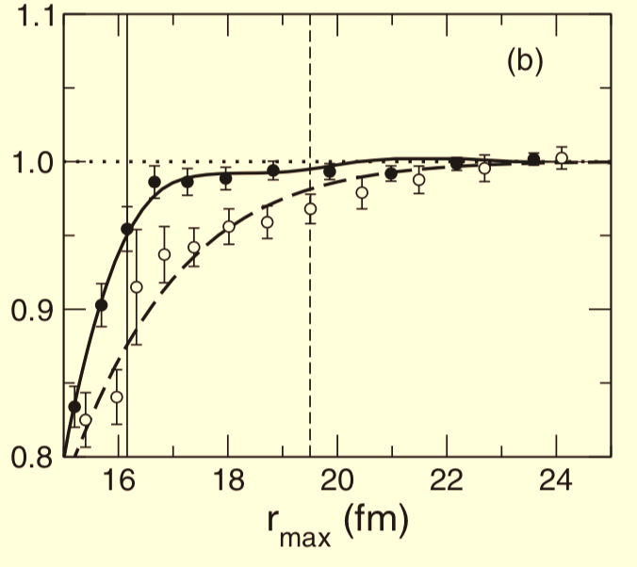
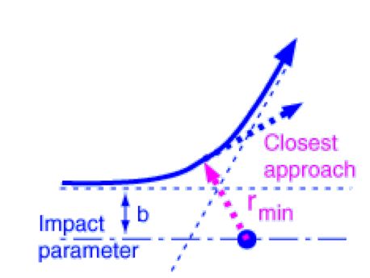
Elastic cross sections
Elastic cross sections
OM calculations: Vr, Wi Woods-Saxon
⁶He (LLN)
⁸He (GANIL)
Larger total reaction cross section for ⁸He than for ⁶He → larger neutron transfer as compared to ⁶He.
Consistent results of Z. Podolyák, et al., in ⁸He + ²⁰⁸Pb @ 26 MeV
  γ decay of low-spin states in ²⁰⁹Pb → suggests strong one-neutron stripping process,
  Strength comparable to fusion-evaporation channel ²⁰⁸Pb(⁸He,4n)²¹²Po
Z. Podolyák, et al., Nucl. Instr. Meth. A 511, 354 (2003).
Elastic cross sections
⁶He (LLN)
⁸He (GANIL)
r_{min} (fm)

Slide 7
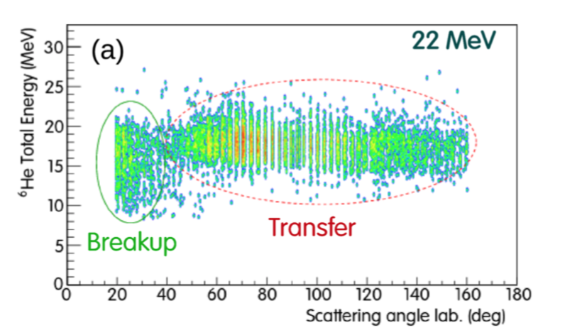
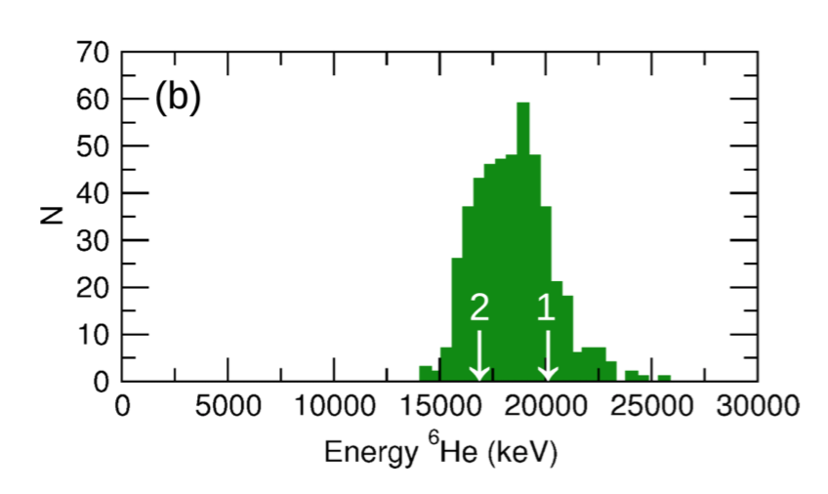
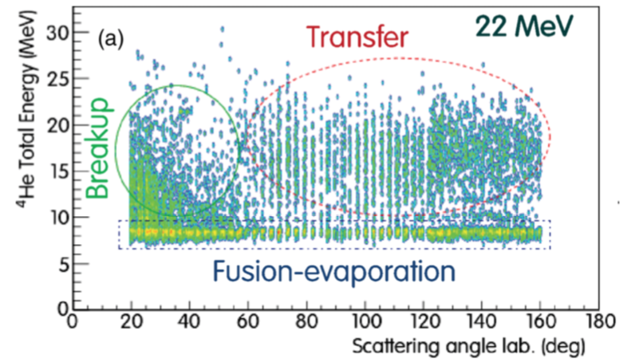
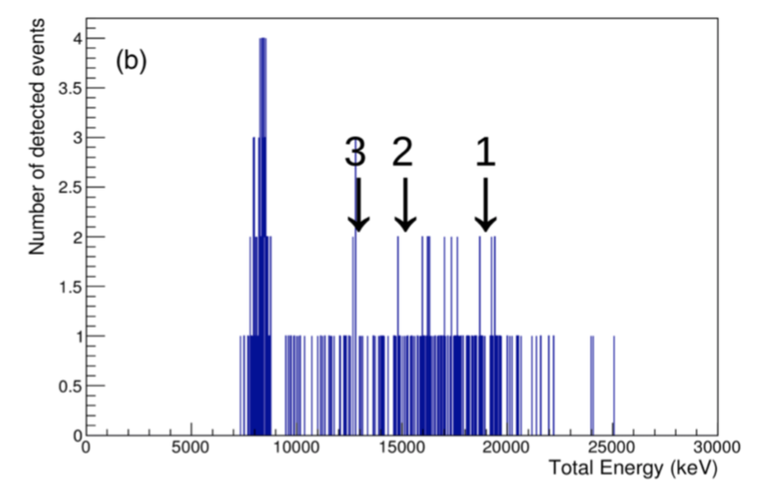
⁴He and ⁶He yields
“TRANSFER”
(1) 2n transfer: ²⁰⁸Pb(⁸He, ⁶He)²¹⁰Pb
(2) 1n transfer: ²⁰⁸Pb(⁸He, ⁷He → ⁶He + n)²⁰⁹Pb
⁶He yield
Clear separation between breakup/transfer
50◦ - 160◦ from neutron transfer reactions
20◦ - 40◦ , from ⁶He → ⁴He + 2n breakup
θlab = 70◦
“TRANSFER”
(1) 4n transfer: ²⁰⁸Pb(⁸He, ⁴He)²¹²Pb
(2) 3n transfer: ²⁰⁸Pb(⁸He, ⁵He → ⁴He + n)²¹¹Pb
(3) 2n transfer: ²⁰⁸Pb(⁸He, ⁶He*1.8 → ⁴He + 2n)²¹⁰Pb
⁴He yield
Moderate separation between breakup/transfer and fusion-evaporation
α from fusion-evaporation events ²¹²Po
60◦ - 160◦ from neutron transfer reactions
20◦ - 40◦ , from ⁸He → ⁴He + 4n breakup
²¹²Po, Fus-evap
θlab = 94.5°
Kinematics consistent with neutron transfer channels
G. Marquínez-Durán et al., Phys. Rev. C 98, 034615 (2018).

Slide 8
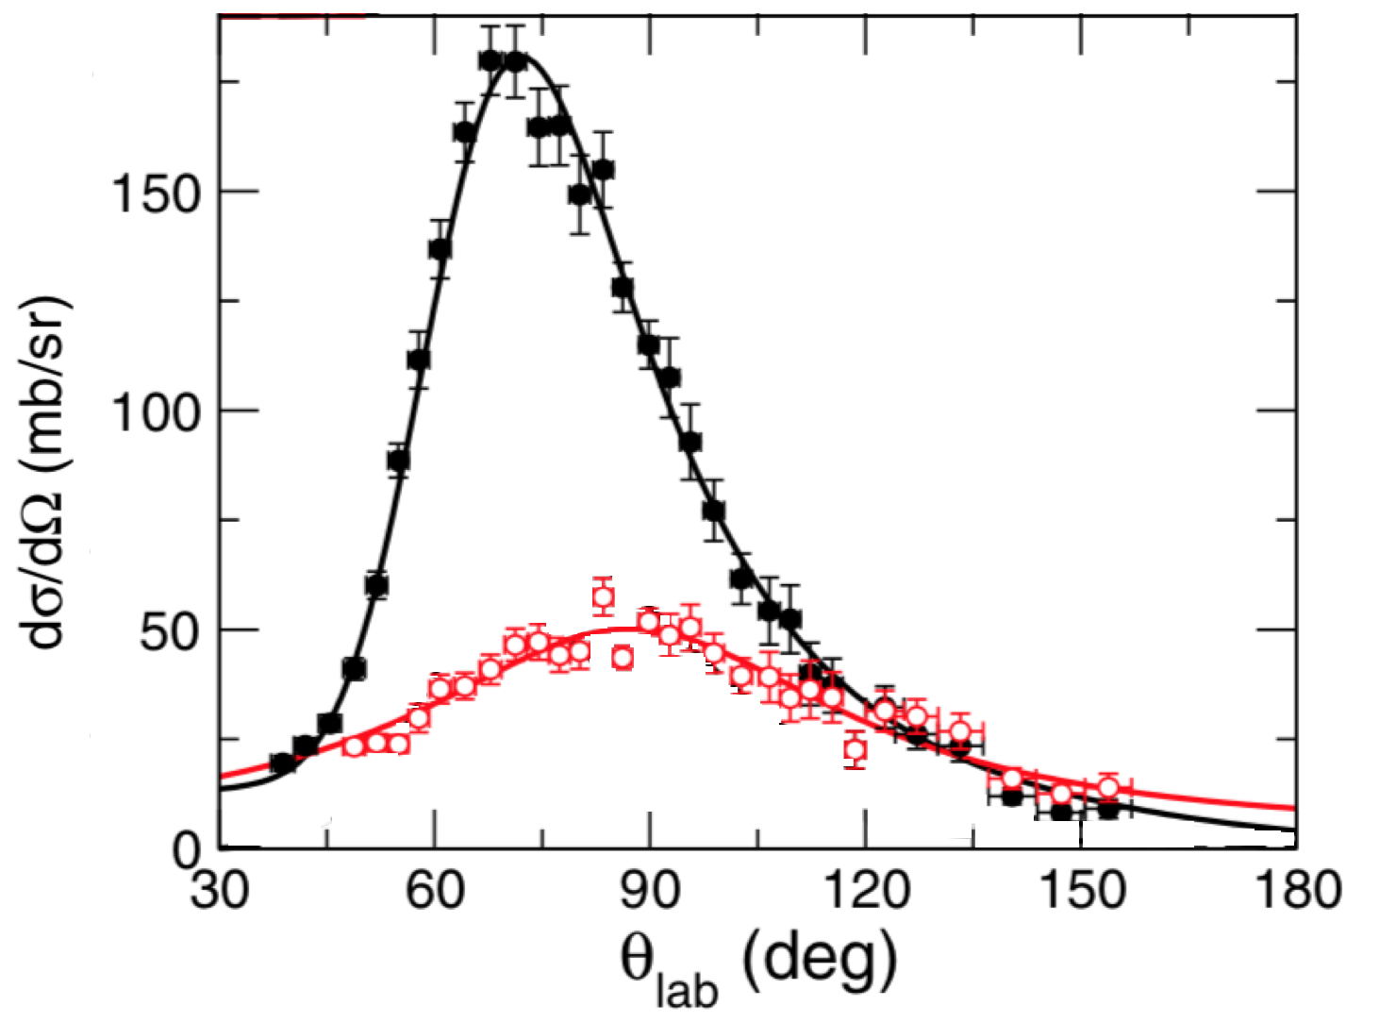
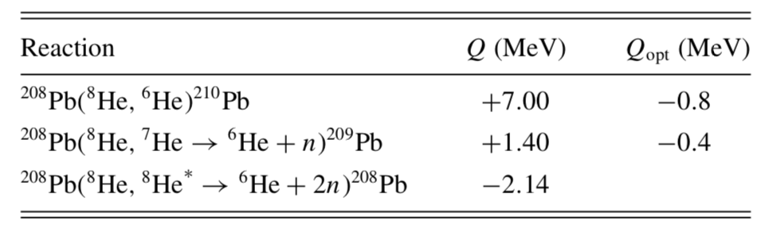
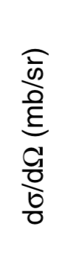
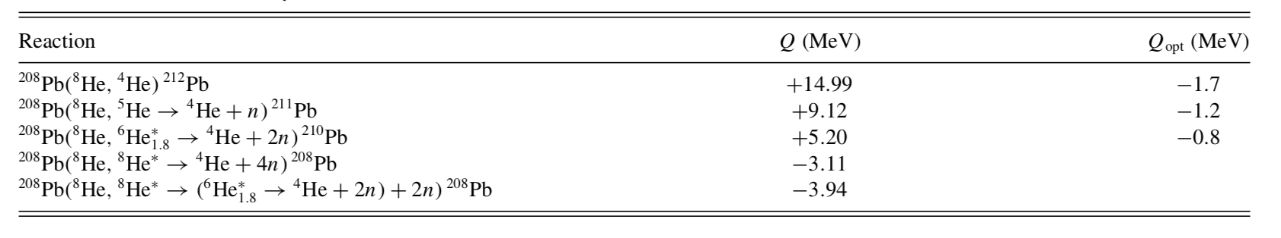
Cross sections
^{6,4}He cross sections
Reaction mechanisms
22 MeV
⁶He
2n transfer →
1n transfer →
2n breakup →
⁶He
⁴He
⁴He
4n transfer →
3n transfer →
2n transfer →
4n breakup →
4n breakup →
^{6,4}He: The shape of the angular distributions consistent with a transfer reaction mechanism.
⁶He:
Competition of 1n and 2n transfer
⁴He:
Small spectroscopic factor for the ⟨⁸He| ⁶He∗_{1.8} + 2n⟩ overlap → expected 3n or 4n transfer to ²¹¹Pb and ²¹²Pb, respectively.

Slide 9
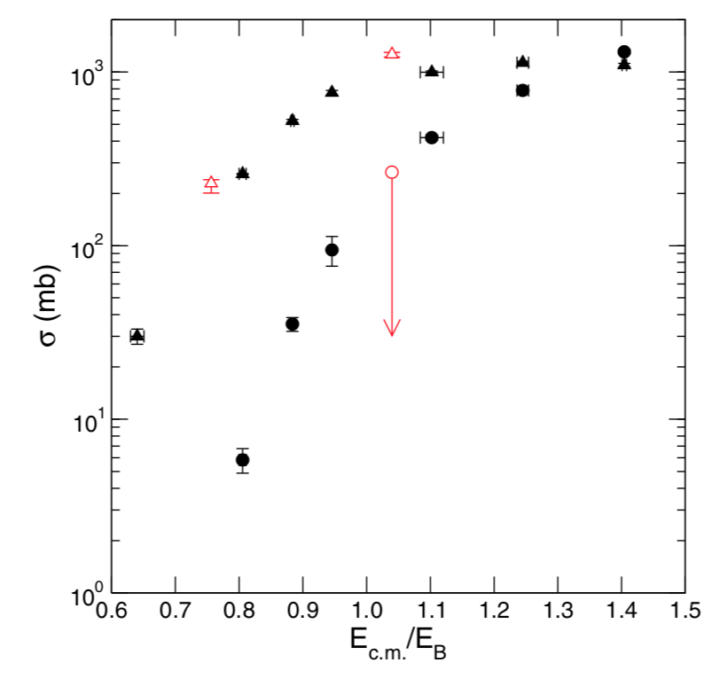
Total cross sections
Assume:
σ_{Trans =} σ_{6He} + σ_{4He} σ_{Fus} = σ_{R}– σ_{Trans}
Good overall agreement between ⁸He + ²⁰⁸Pb and ⁸He + ¹⁹⁷Au.
⁸He+¹⁹⁷Au, Transfer
A. Lemasson, et al., Phys. Lett. B 697, 454 (2011).
A. Lemasson, et al., Phys. Rev. Lett. 103, 232701 (2009)
G. Marquínez-Durán et al., Phys. Rev. C 98, 034615 (2018).
⁸He+¹⁹⁷Au, Fusion
→ Scattering of ⁸He + ²⁰⁸Pb dominated by transfer channels

Slide 10
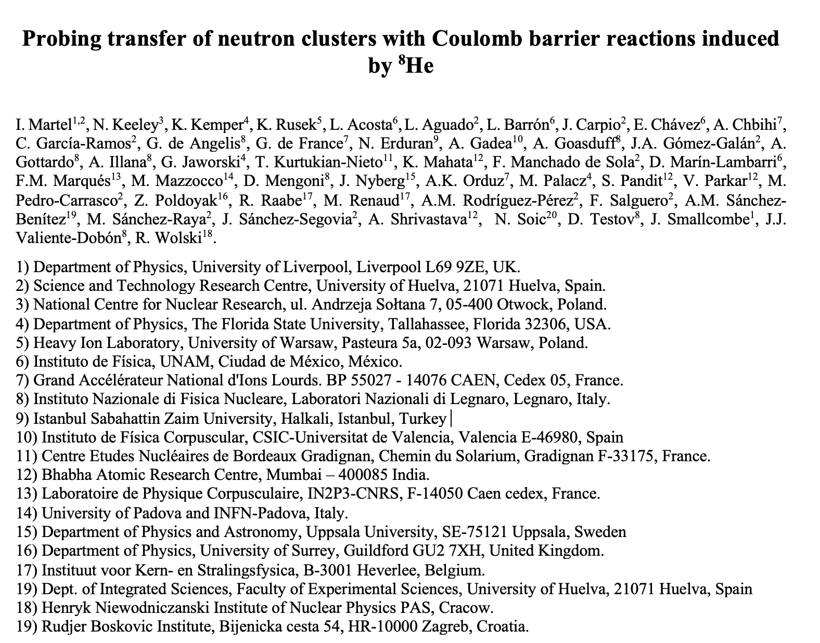

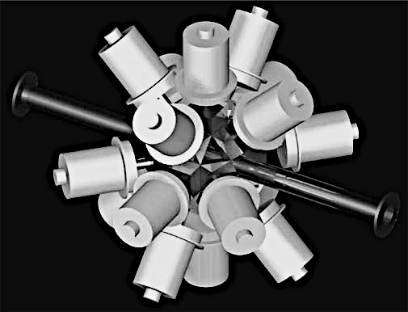
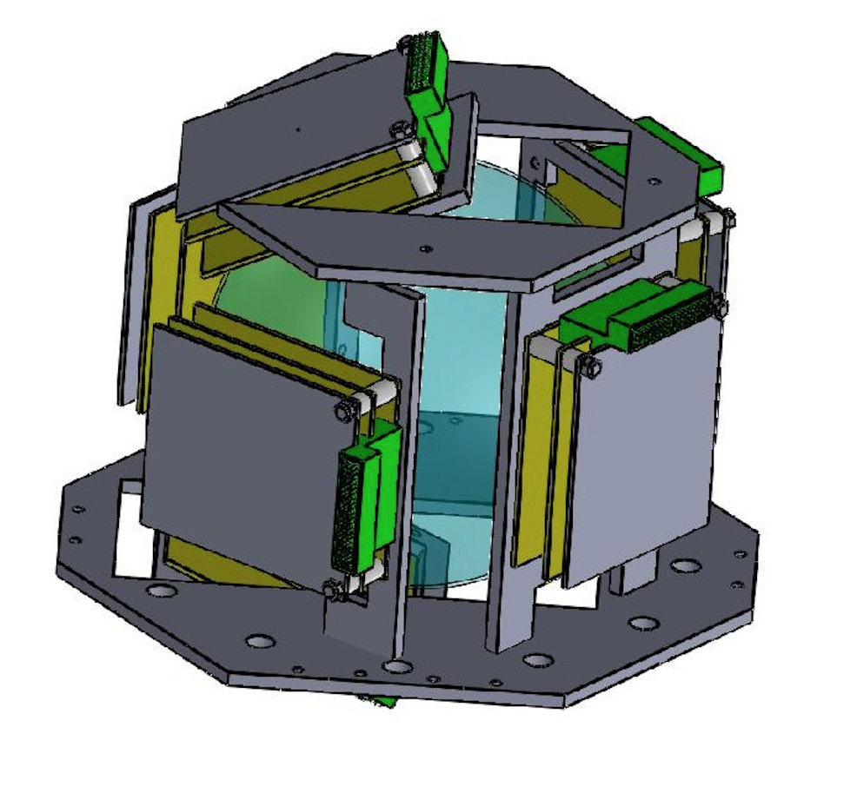
Objective. Measurement of the angular distributions of transfer cross sections for ⁶He and ⁴He yields in coincidence with neutrons and gammas, in the scattering of ⁸He+²⁰⁸Pb at the energy of 22 MeV.
EXOGAM
NEDA +NEUTRON WALL
GLORIA
GLORIA
⁸He Beam
NEDA
EXOGAM
NEUTRON WALL

Slide 11
Summary and conclusions
Sequential 1n-transfer to low-energy levels in ²⁰⁹Pb seems to dominate the ⁶He angular dsitribution.
The data on ⁴He is well reproduced by including a direct tetraneutron transfer component to highly excited states in ²¹²Pb.
However, model uncertainties are too large to withdraw conclusive results.
New proposal at SPIRAL1/GANIL to measure ^{6,4}He exclusive data in coincidence with gammas an neutrons.
Everybody welcome to join the new proposal, just send me an email to imartel@uhu.es
Thanks!!

