Slide 1
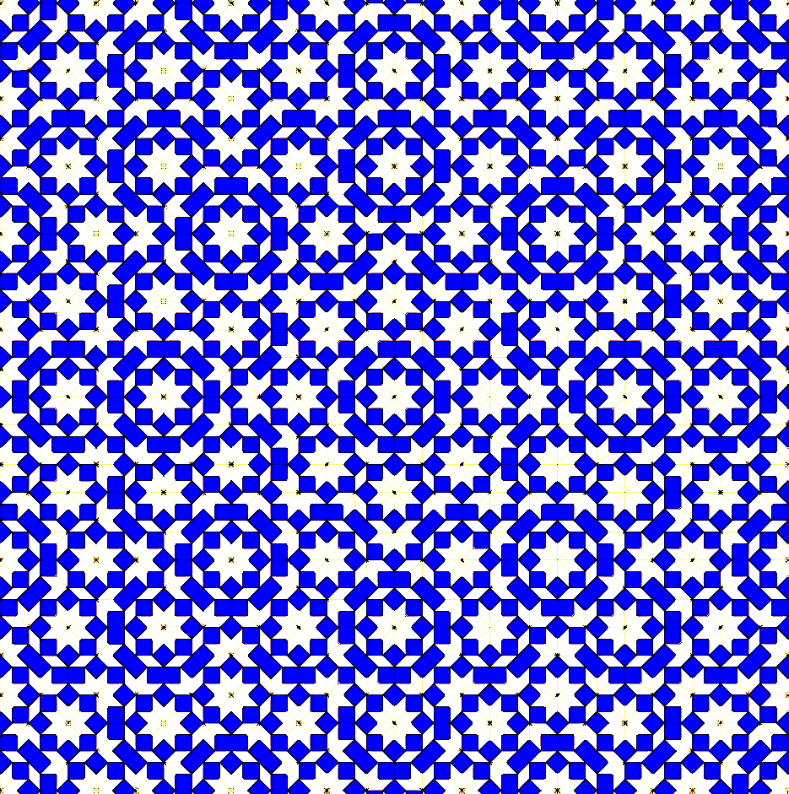

Phases of an Ultracold Gas:
Bosons in a Quasicrystalline Lattice
Dean Johnstone

Slide 2

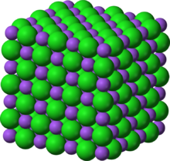
Crystals
Periodic arrangement of atoms on a discrete set of points.

Slide 3

Periodic Tiling
Vertex model of a Euclidean plane tiling can seen as an effective tight-binding model.
Edges correspond to bonds.
Intersection of edges/vertices correspond to lattice sites.

Slide 4
Periodic Tiling
Vertex model of a Euclidean plane tiling can seen as an effective tight-binding model.
Edges correspond to bonds.
Intersection of edges/vertices correspond to lattice sites.

Slide 5
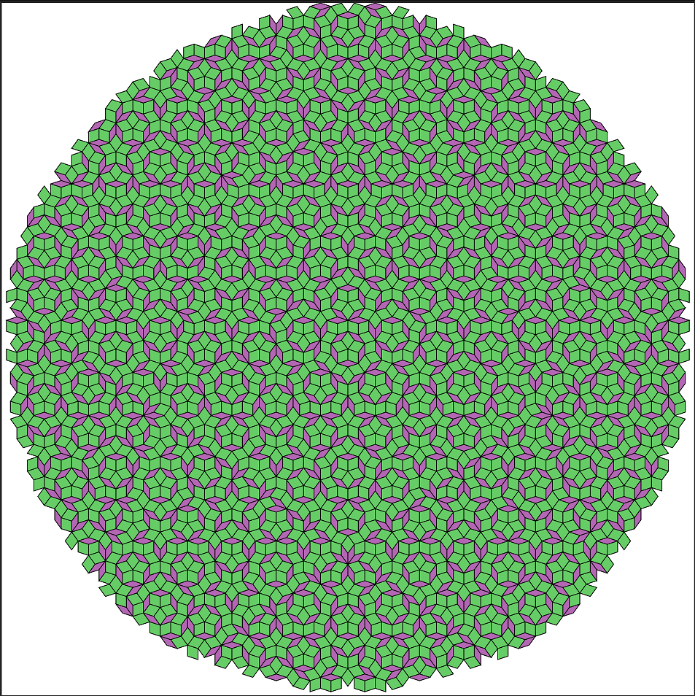
Aperiodic Tiling
Penrose Tiling
No translational invariance, but still possess long-range order.
Self-similar pattern that fills all of space continuously.
Can have rotational symmetries outwith Crystallographic Restriction Theorem.

Slide 6
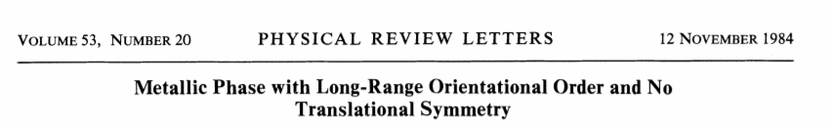

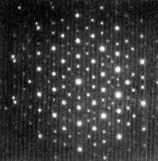
Discovery of Quasicrystals
Dan Shechtman

Slide 7
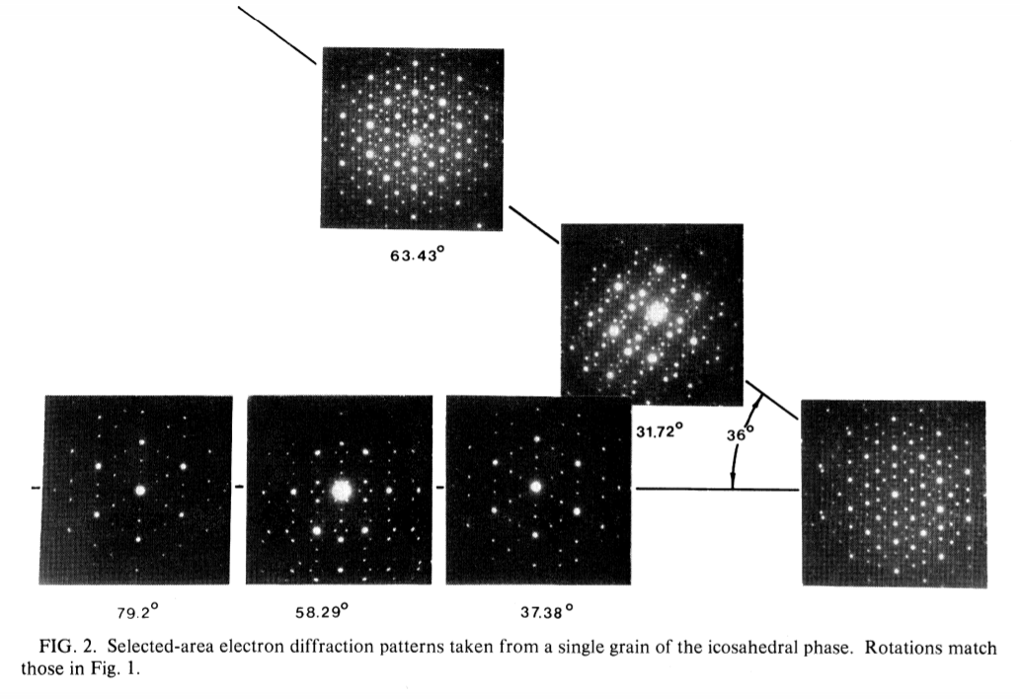
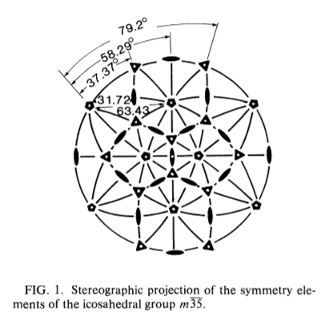
Discovery of Quasicrystals

Slide 8
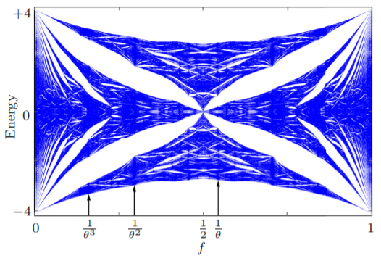
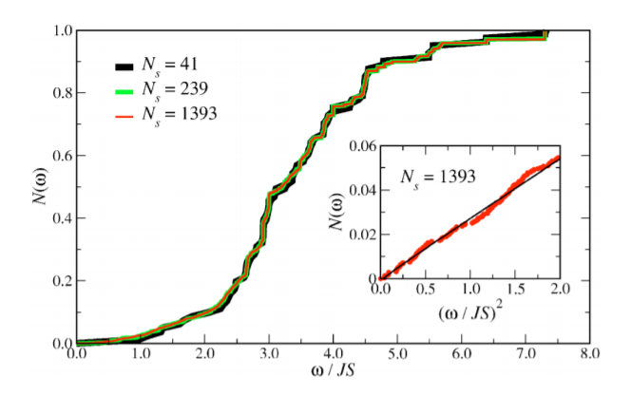
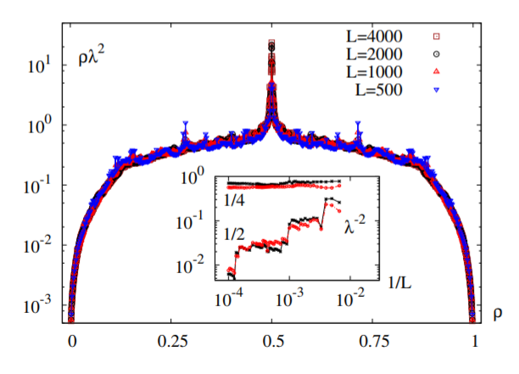
“Hofstadter Butterfly of a Quasicrystal”
“Quantum Fluctuations and Excitations in Antiferromagnetic Quasicrystals”
Phys. Rev. B 94, 205437 (2016)
“Conduction in quasi-periodic and quasi-random lattices: Fibonacci, Riemann, and Anderson models”
Phys. Rev. B 71, 104427 (2005)
Phys. Rev. B 94, 214204 (2016)

Slide 9
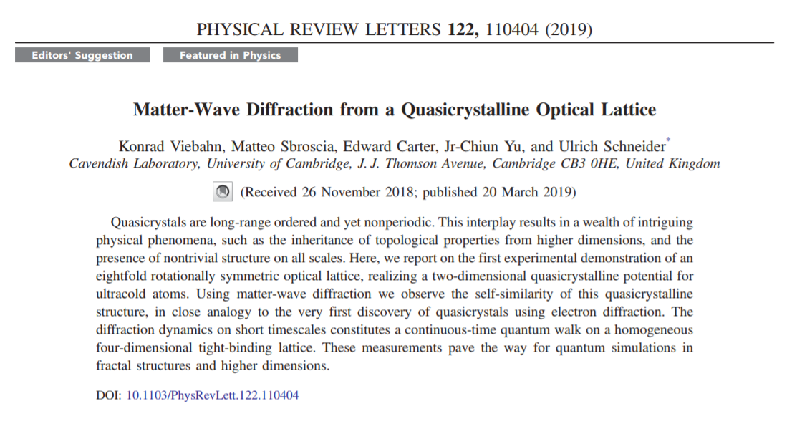
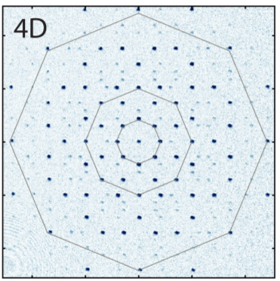
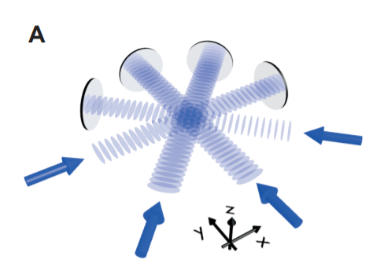

Slide 10
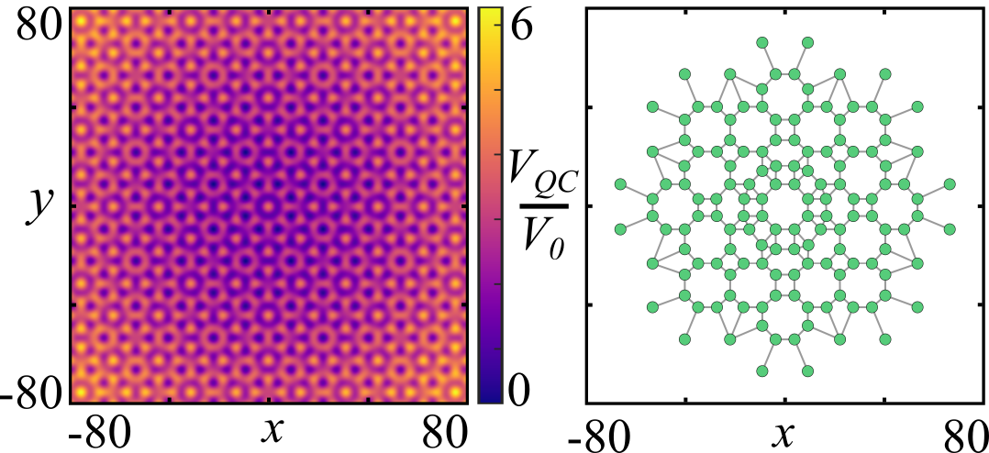





Quasicrystalline Potential
$$G_{2}$$
$$G_{4}$$
$$G_{3}$$
$$G_{1}$$
$$V_{0}\sum_{i=1}^{4}{\cos^{2}\left(\frac{G_{i} . r}{2}\right) }$$
Lattice Potential

Slide 11

Tight-Binding Model
$$\hat{H}=\sum_{i}{\left(ε_{i}−μ\right){\hat{n}}_{i}}+\sum_{i}{\frac{U_{i}}{2}{\hat{n}}_{i}\left({\hat{n}}_{i}−1\right)} −\sum_{<i,j>}{J_{ij}{\hat{b}}_{i}^{†}{\hat{b}}_{j}}+\sum_{<i,j>}{V_{ij}{\hat{n}}_{i}{\hat{n}}_{j}}$$
Lattice chain

Slide 12

Tight-Binding Model
$$\hat{H}=\sum_{i}{\left(ε_{i}−μ\right){\hat{n}}_{i}}+\sum_{i}{\frac{U_{i}}{2}{\hat{n}}_{i}\left({\hat{n}}_{i}−1\right)} −\sum_{<i,j>}{J_{ij}{\hat{b}}_{i}^{†}{\hat{b}}_{j}}+\sum_{<i,j>}{V_{ij}{\hat{n}}_{i}{\hat{n}}_{j}}$$
Homogenous Lattice
$$\hat{H}=\left(ε−μ\right)\sum_{i}{{\hat{n}}_{i}}+\frac{U}{2}\sum_{i}{{\hat{n}}_{i}\left({\hat{n}}_{i}−1\right)} −J\sum_{<i,j>}{{\hat{b}}_{i}^{†}{\hat{b}}_{j}}+V\sum_{<i,j>}{{\hat{n}}_{i}{\hat{n}}_{j}}$$

Slide 13




Ground States
μ = 0
μ ≠ 0
Fixed N atoms for L sites
Max z atoms for L sites
$$D_{f}=\frac{\left(N+L−1\right)!}{N!\left(L−1\right)!}$$
$$D_{g}={\left(z+1\right)}^{L}$$
{N, L, z} = 10
$$D_{f} \sim {10}^{5}$$
$$D_{g} \sim {10}^{10}$$

Slide 14




Gutzwiller Mean-Field
$$\left|\left.Ψ\right\rangle \right.=\prod_{i}^{L}{\sum_{n=0}^{z}{f_{n}^{(i)}}\left|\left.n_{i}\right\rangle \right.}$$
$$\hat{H}→\sum_{i}^{L}{{\hat{H}}_{i}}$$
$${\hat{b}}_{i}^{†}{\hat{b}}_{j}→\left\langle {\hat{b}}_{i}^{†}\right\rangle {\hat{b}}_{j}+\left\langle b_{j}\right\rangle {\hat{b}}_{i}^{†}−\left\langle {\hat{b}}_{i}^{†}\right\rangle \left\langle b_{j}\right\rangle$$
$$D_{g}=z+1$$
$${\hat{n}}_{i}{\hat{n}}_{j}→\left\langle {\hat{n}}_{i}\right\rangle {\hat{n}}_{j}+\left\langle {\hat{n}}_{j}\right\rangle {\hat{n}}_{i}−\left\langle {\hat{n}}_{i}\right\rangle \left\langle {\hat{n}}_{j}\right\rangle$$

Slide 15




Observables and Phases
Transport Order Parameter
Density Order Parameter
$$φ_{i}=\left\langle b_{i}\right\rangle =\sum_{n=0}^{z}{\sqrt{n}}f_{n}^{\left(i\right)}f_{n−1}^{∗\left(i\right)}$$
$$ρ_{i}=\left\langle n_{i}\right\rangle =\sum_{n=0}^{z}{n{\left|f_{n}^{\left(i\right)}\right|}^{2}}$$
$$\overline{φ}=\max\left(φ\right)−\min\left(φ\right)$$
$$\overline{ρ}=\max\left(ρ\right)−\min\left(ρ\right)$$

Slide 16
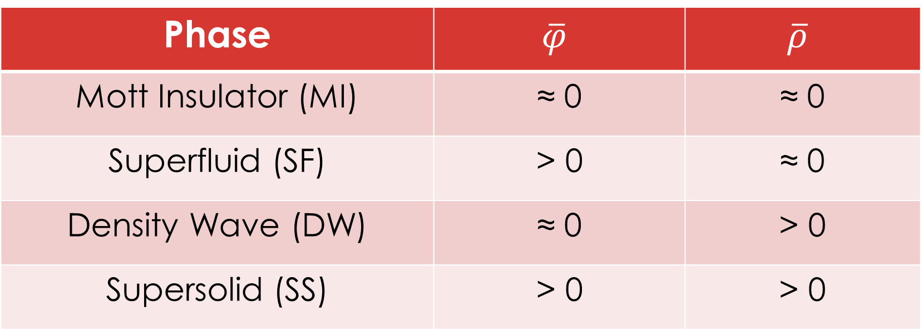
Observables and Phases
Phase | $$\overline{φ}$$ | $$\overline{ρ}$$
Mott Insulator (MI) | ≈ 0 | ≈ 0
Superfluid (SF) | > 0 | ≈ 0
Density Wave (DW) | ≈ 0 | > 0
Supersolid (SS) | > 0 | > 0

Slide 17
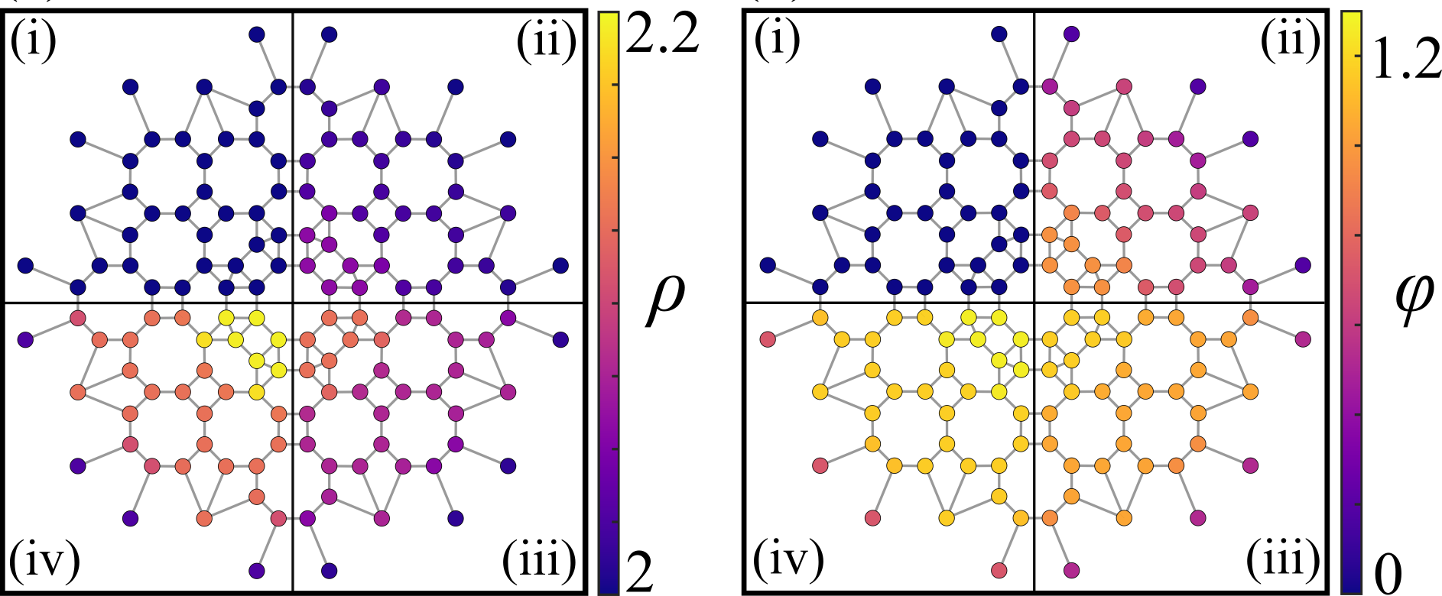
MI-SF
J/U = 0.02
J/U = 0.04
J/U = 0.08
J/U = 0.06
μ/U = 1.5

Slide 18
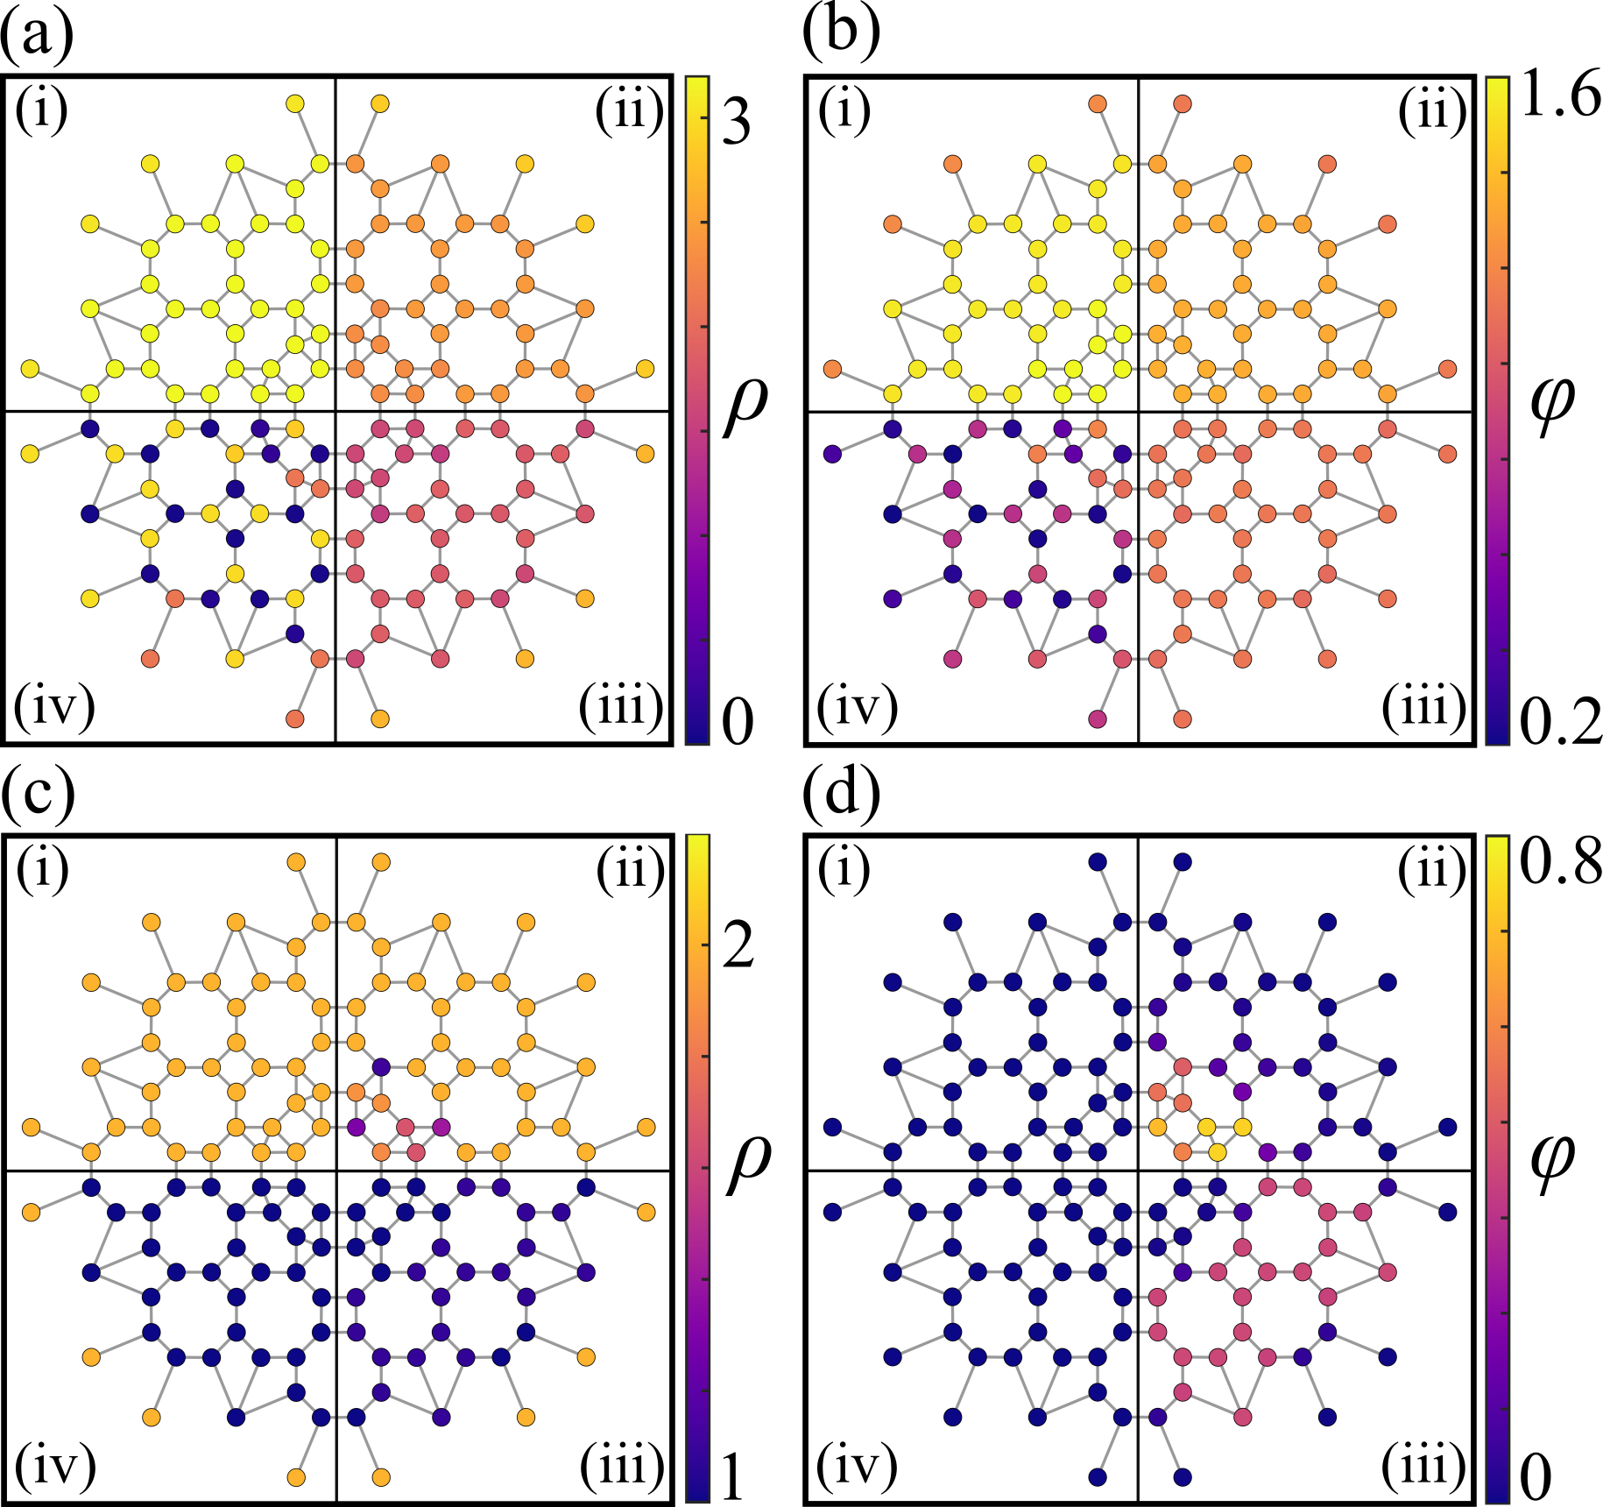
SF-SS
V/U = 0.00
V/U = 0.10
V/U = 0.40
V/U = 0.25
μ/U = 2.5, J/U = 0.1

Slide 19
MI-DW
V/U = 0.00
V/U = 0.07
V/U = 0.25
V/U = 0.17
μ/U = 1.5, J/U = 0.01

Slide 20
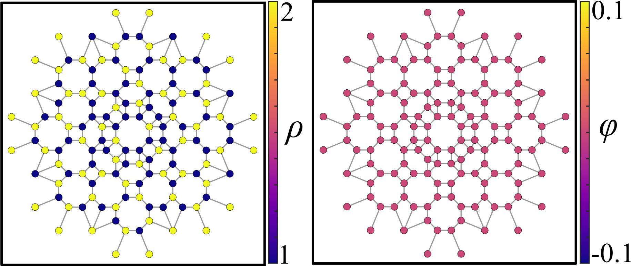
Symmetry Breaking
μ/U = 1.5, J/U = 0.01, V/U = 0.1

Slide 21
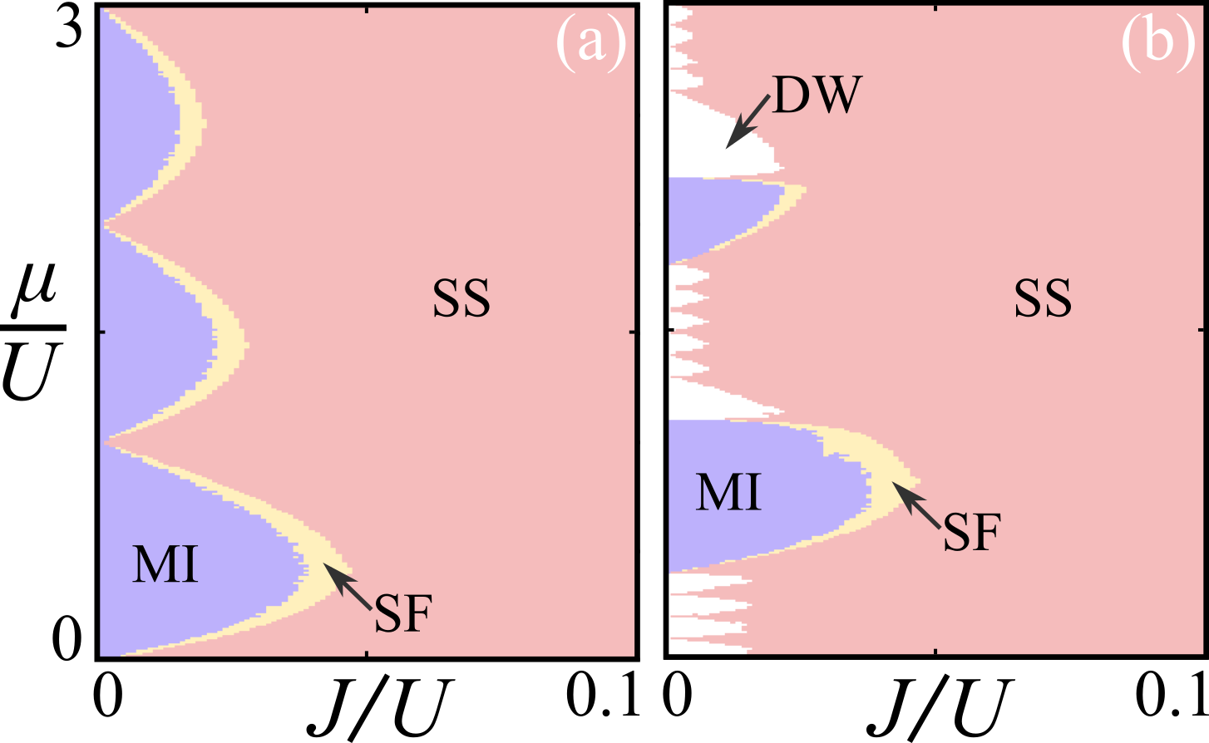
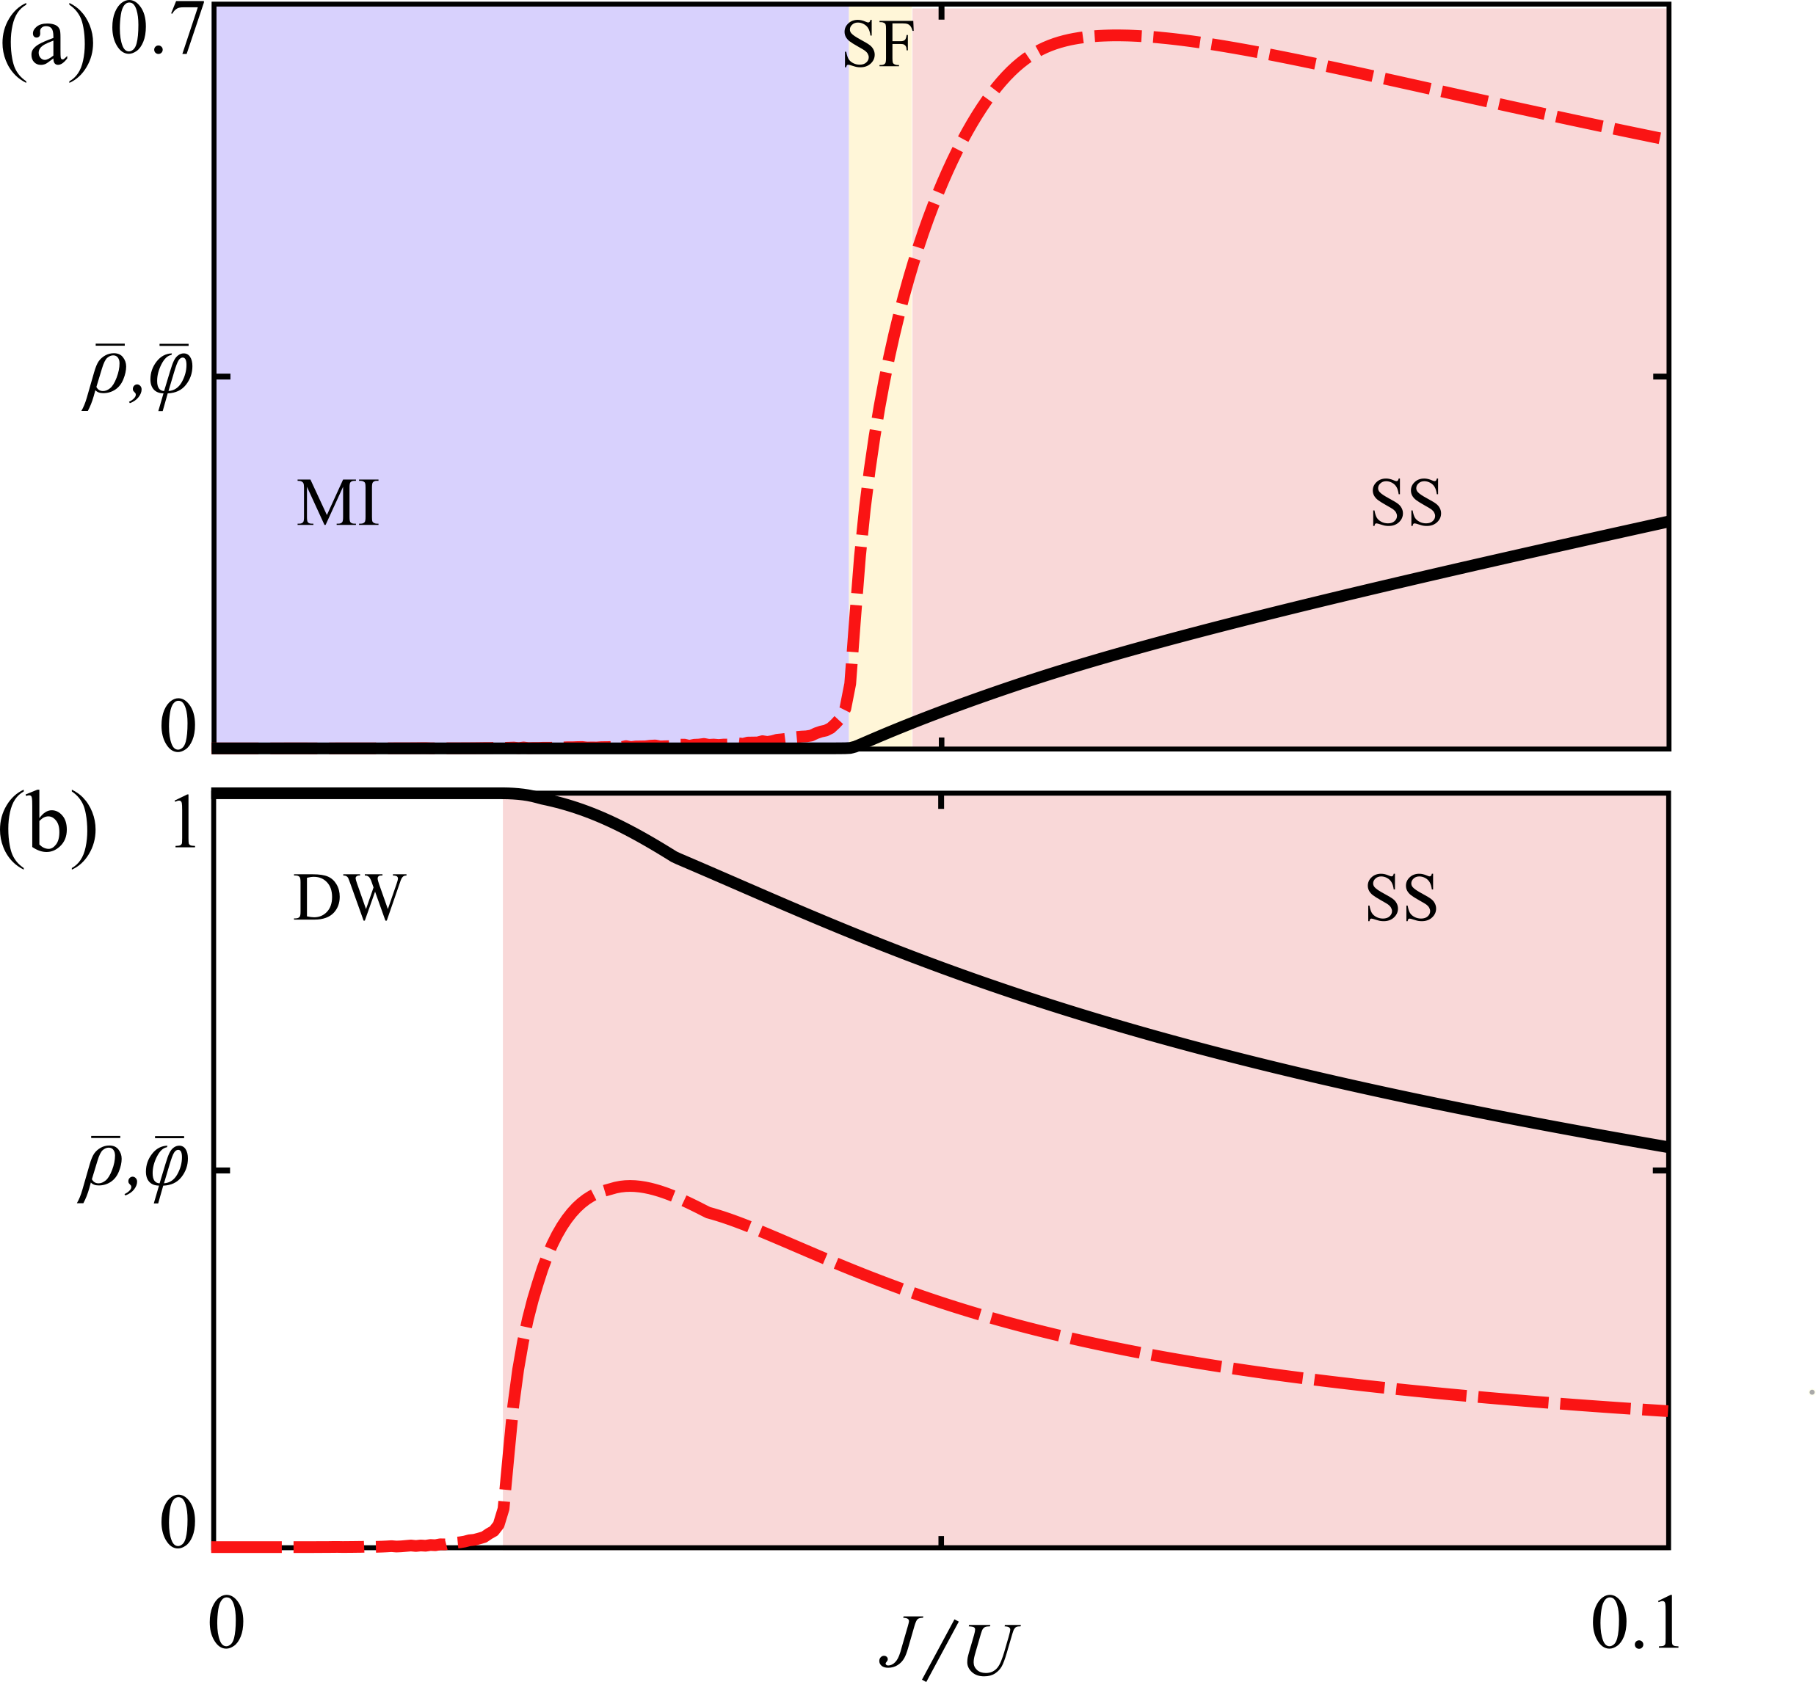


Phase Diagrams
$$\overline{ρ}$$
V/U = 0
$$\overline{φ}$$
μ/U = 0.5

Slide 22
Phase Diagrams
$$\overline{ρ}$$
V/U = 0.1
$$\overline{φ}$$
μ/U = 2.4

Slide 23
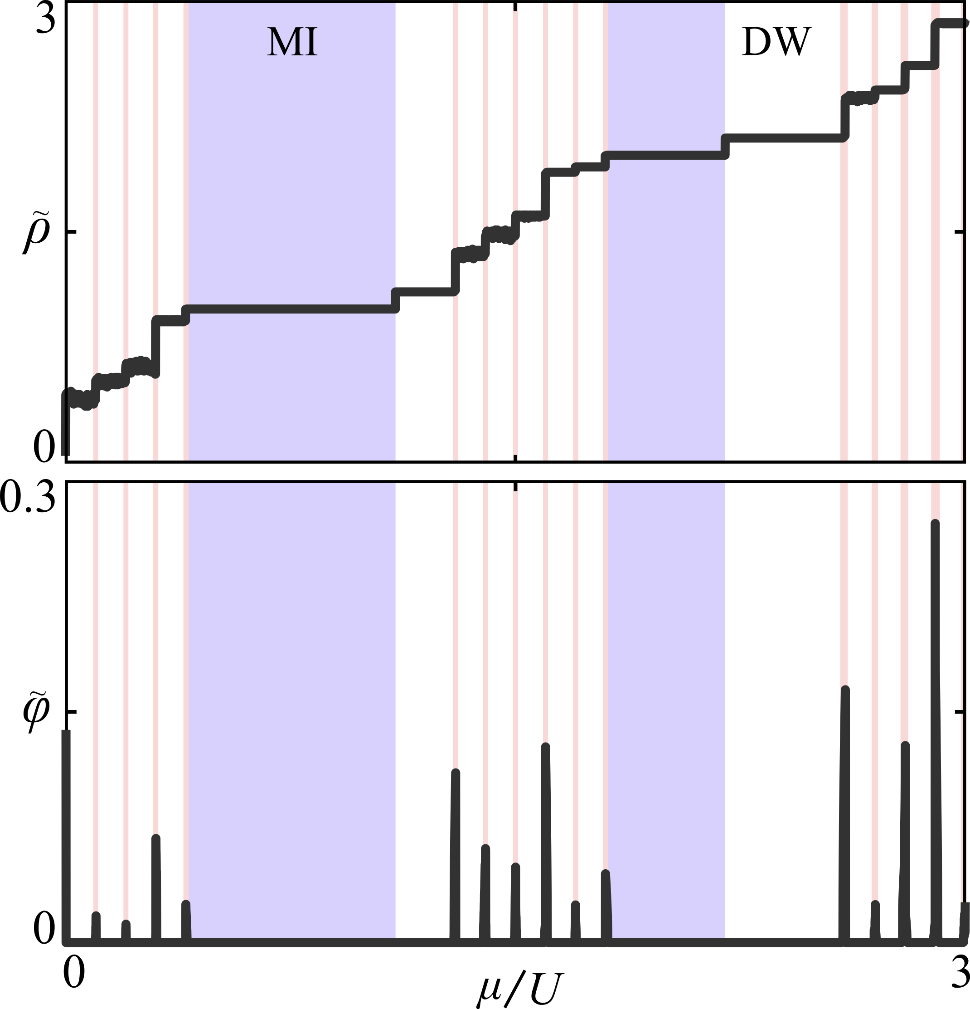

J/U = 0.001
$$\tilde{ρ} \& \tilde{φ}$$
Average order parameter across entire lattice
Fractionalised set of DW states between each MI plateau.

Slide 24
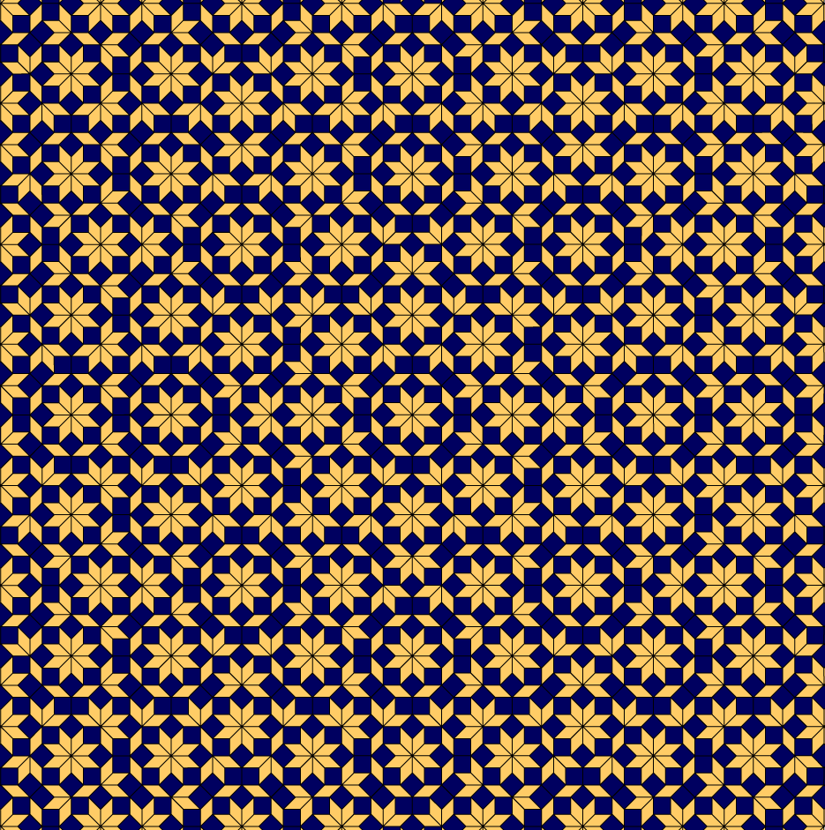
Conclusions
Can observe interesting phenomena in quasicrystals without invoking disorder.
Fluctuations in local coordinate number plays an important role.
Rotational symmetries of Quasicrystal can be broken.

Slide 25
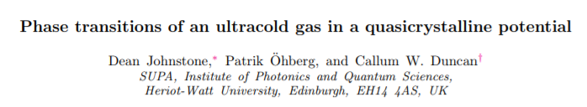





https://arxiv.org/abs/1904.12870
Prof. Patrik Öhberg
Callum W. Duncan

Slide 26
https://arxiv.org/abs/1904.12870
The End

