Slide 1
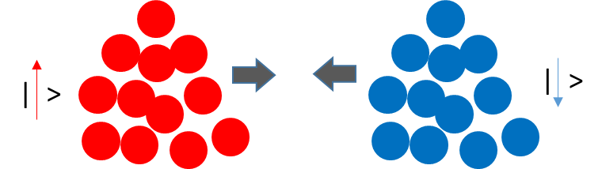
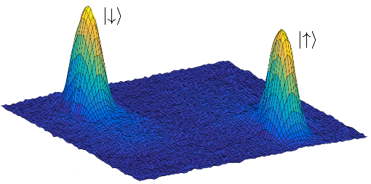
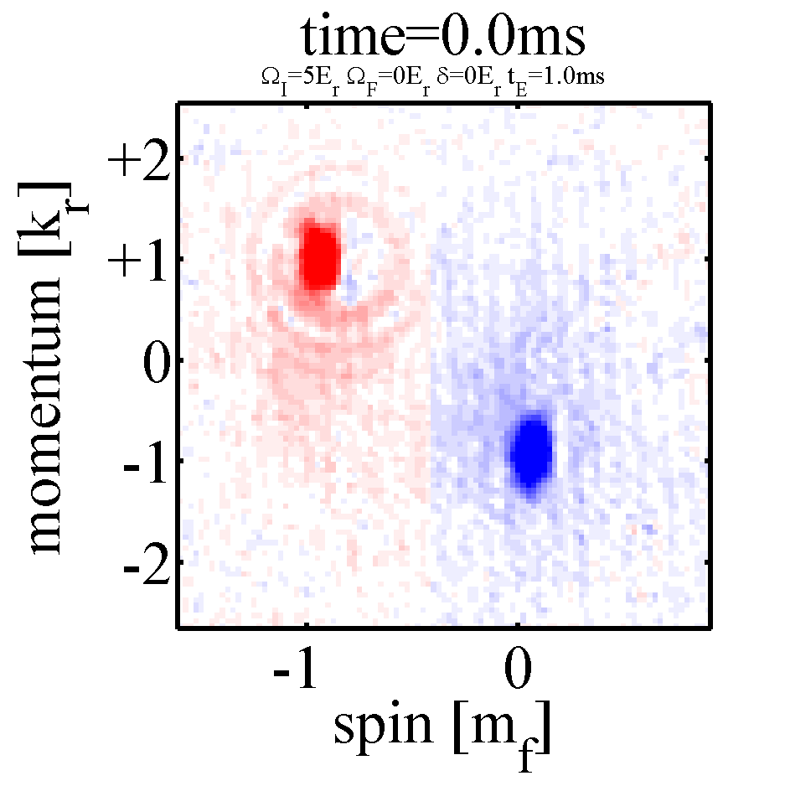
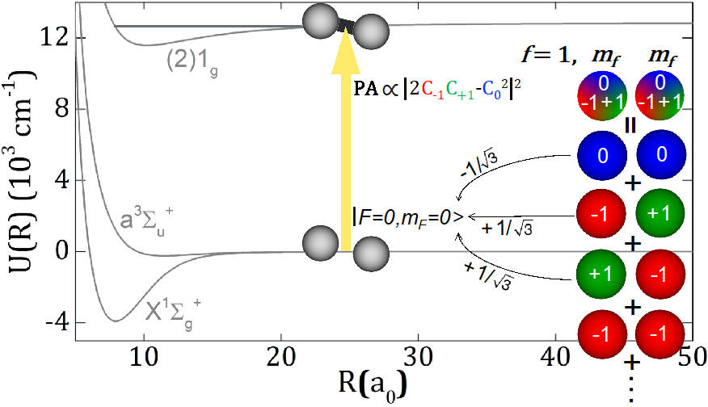
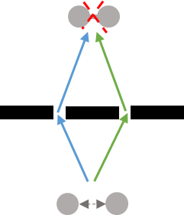
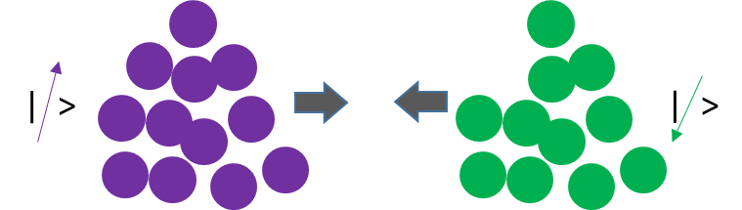
Spin-orbit-coupled Bose-Einstein Condensate as playground to explore quantum collision and chemistry
Euro Few-body Conference @ Surrey, 9/6/2019
Yong P. Chen (yongchen@purdue.edu)
¹Dept. of Physics & Astronomy; School of Electrical & Computer Engineering;
Birck Nanotechnology Center; Purdue Quantum Science & Engineering Inst.
Purdue University, West Lafayette, IN 47907 USA
(Quantum Matter and Devices Laboratory : www.physics.purdue.edu/quantum)
²Dept. of Physics & Astronomy, Aarhus University, Aarhus, Denmark
(starting a new lab & Villum Center for Hybrid Quantum Materials & Devices, from 2020;
Looking for PhDs/postdocs/Assistant Profs, e.g. Quantum Optics/Quantum Devices/Scanning Probe)

Slide 2
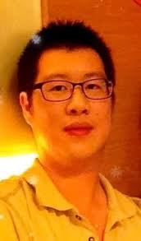
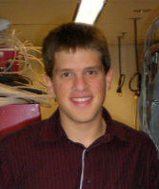
Spin-orbit-coupled Bose-Einstein Condensate as playground to explore quantum collision and chemistry
Outline
Intro. to experimental platform: “spin-orbit-coupled (SOC) BEC”
[“spin-helical atoms”] (by optical dressing)
(Spin) transport & Spinor BEC collider [how is it affected by SOC?]
Quantum Synthesis: Interferometry in quantum (photo)chemistry
C. Li et al.,
Nature Comm.
10, 375 (2019)
“2x2”
Chuan-Hsun Li
D.Blasing et al.
PRL 121, 073202
(2018)
“3x3”
David Blasing
(→ Crane)
Acknowledge Research Support by: Purdue Univ.; ARO; NSF;DOE

Slide 3
Light can probe, control & create new matter
(coherent light-matter interaction)
Quantum optics (broadly defined):
Light (radiation) & light-matter interaction
where quantum physics matters
[further generalization: extend from light to
other waves (including matter/particle waves)]
X (light or other particles)
Matter
Light (in)
Light (out)
Y (light or other particles)
(from Y.Chen, Purdue PHYS 522 “Introduction to Quantum Optics and Quantum Photonics”)

Slide 4

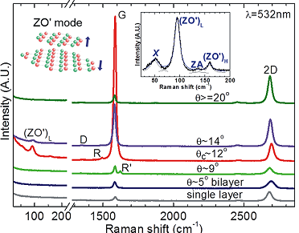
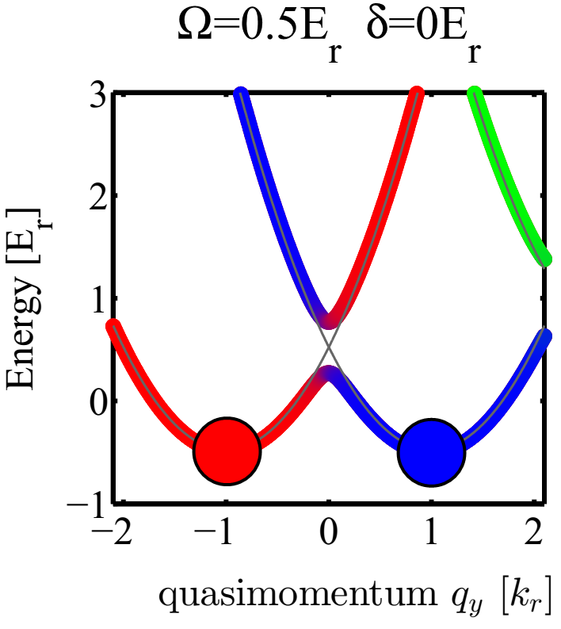

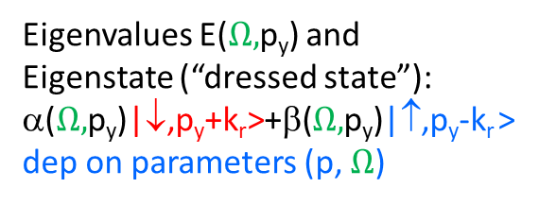

Example: Raman process as light-matter interaction
--- from optical scattering (incoherent) to optical dressing (coherent)
Can generalize to/realize 3x3, 4x4 .. NxN matrix Hamitonian…
ω
ω’
(incoherent) Raman
scattering
Spectroscopy
on Graphene
ω
ω’
“matter”
“light”
$$\left(\begin{matrix}\frac{ℏ^{2}}{2m}{(p_{y}+k_{r})}^{2} & Ω \\ Ω & \frac{ℏ^{2}}{2m}{(p_{y}−k_{r})}^{2}\end{matrix}\right)$$
G
Raman (optical) dressing
→ Synthetic “bandstructure”/spin-orbit coupling
Twisted bilayer graphene
ω’
ω
↑
↓
Eigenvalues E($Ω,$p_{y}) and
Eigenstate (“dressed state”):
α($Ω,$p_{y})|↓,p_{y}+k_{r}>+β($Ω,$p_{y})|↑,p_{y}-k_{r} >
dep on parameters (p, $Ω$)
$$p_{y}$$
R.He, T. F. Chung et al., Nano Lett. 13, 3594 (2013)

Slide 5
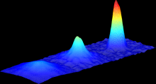

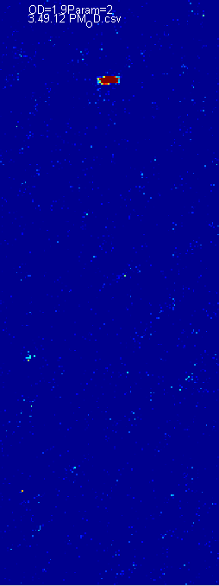
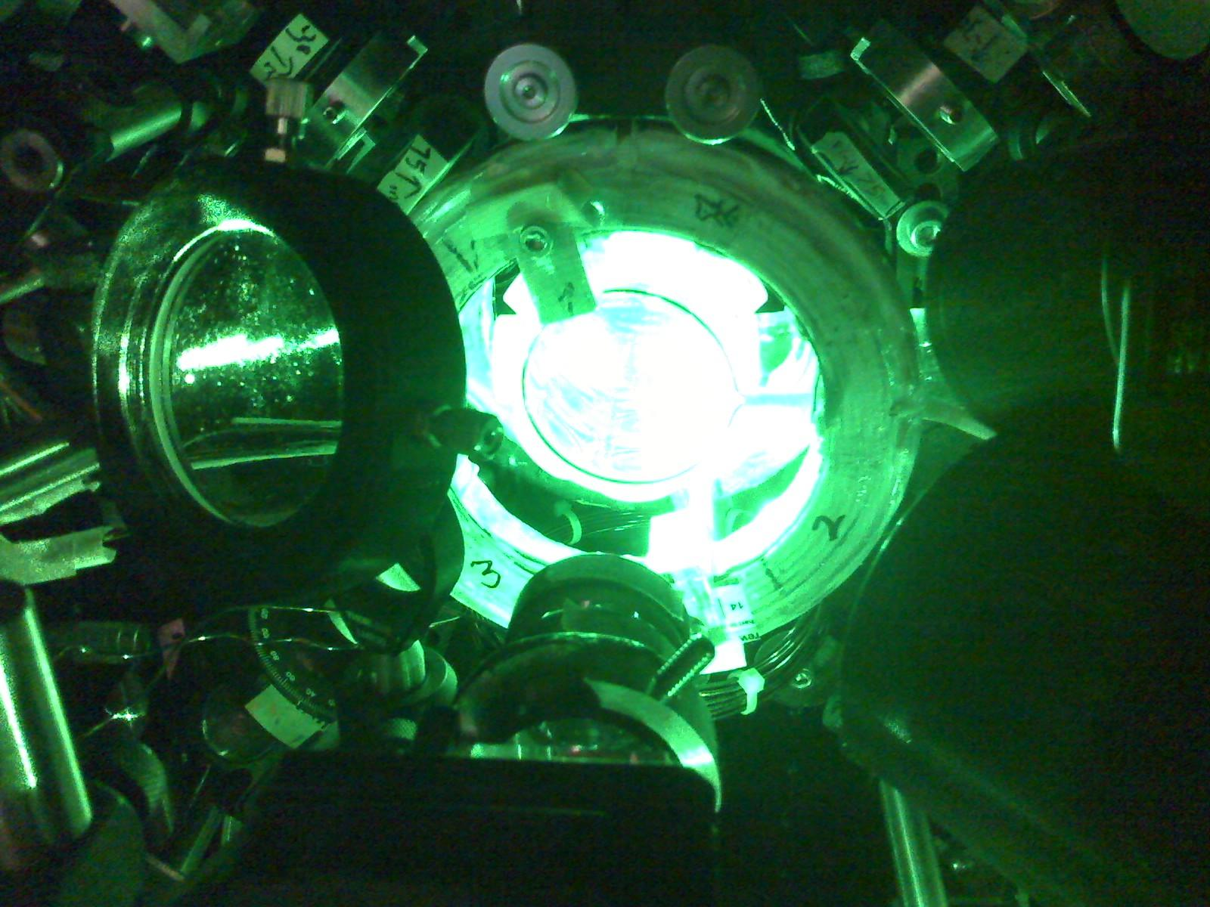
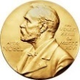
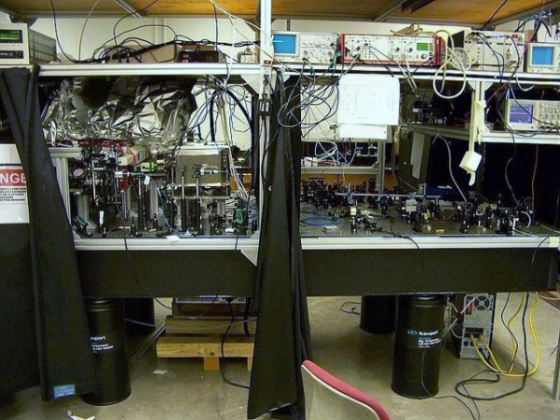
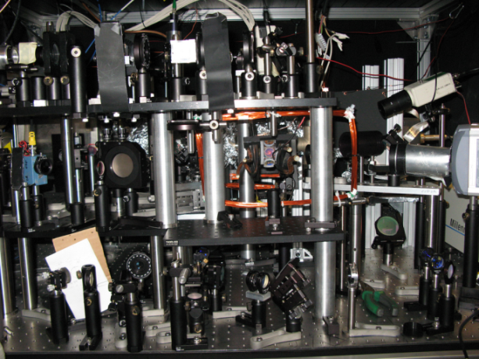
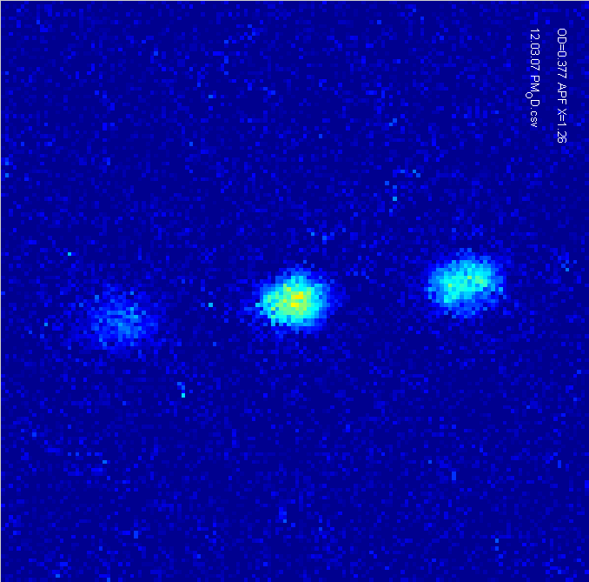
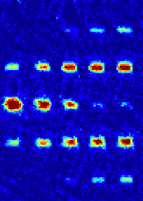
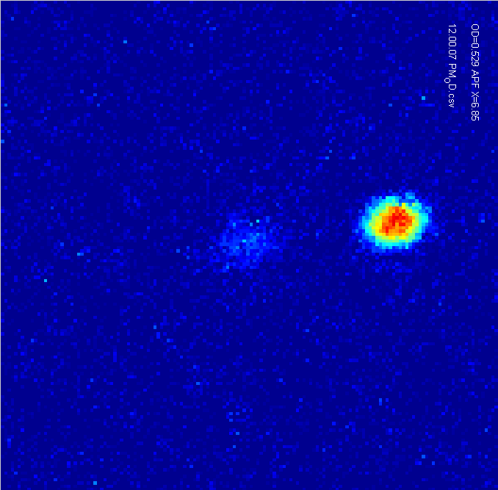
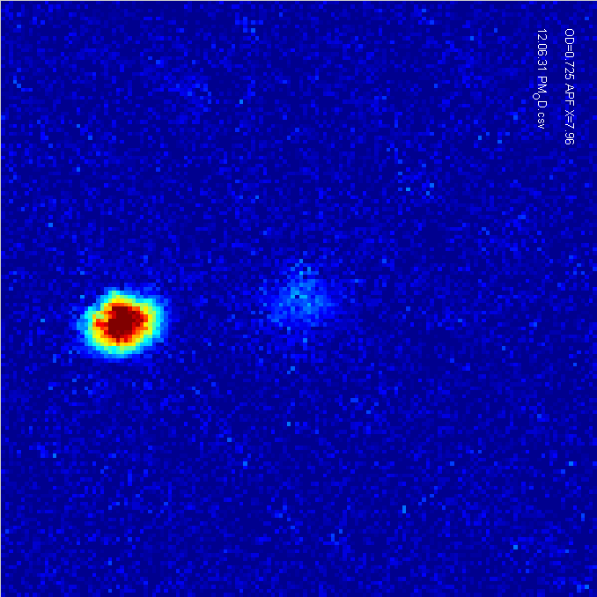
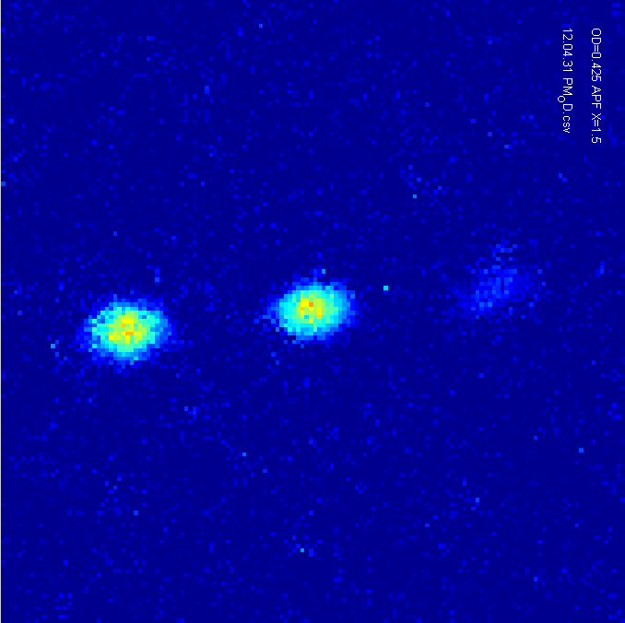
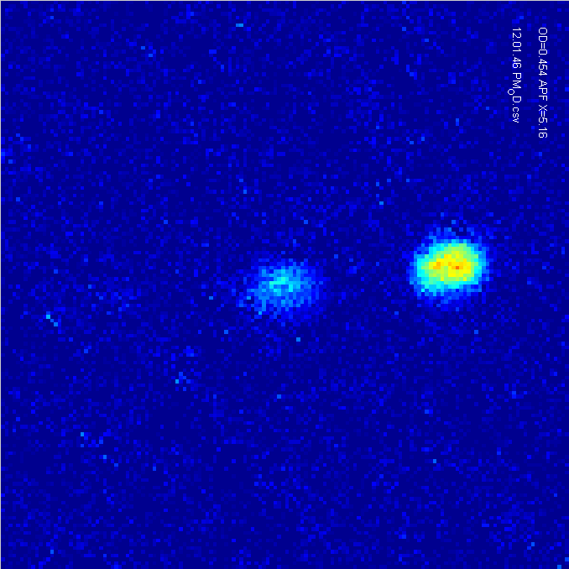
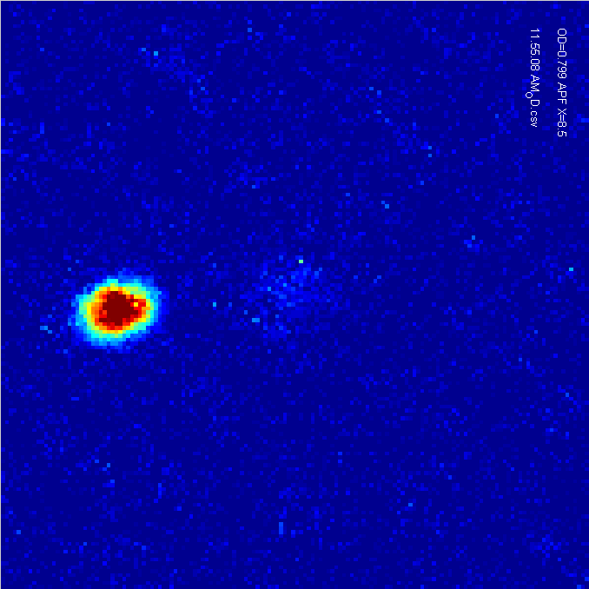
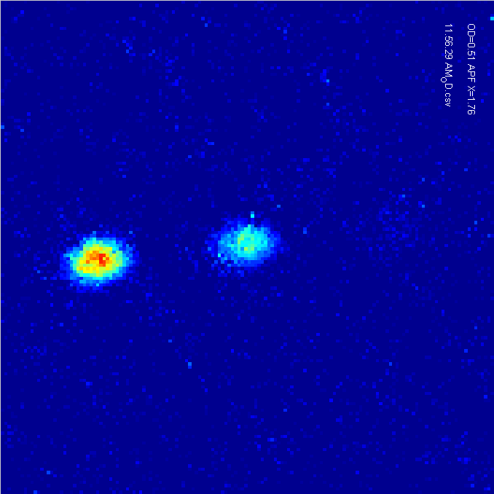
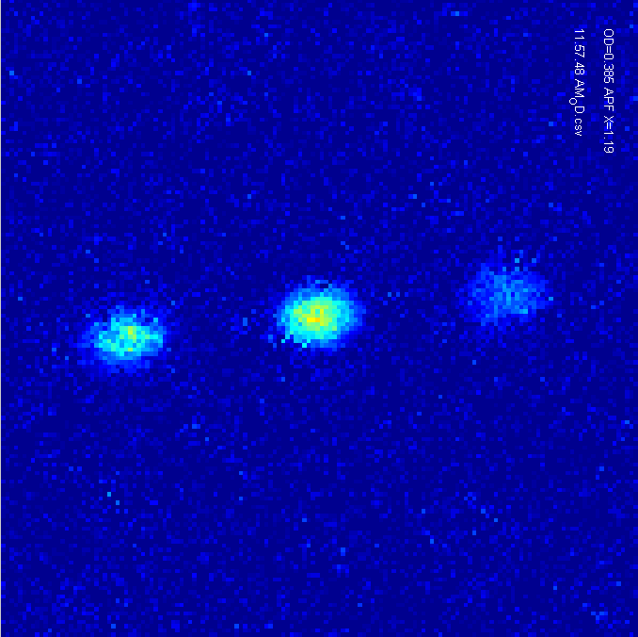
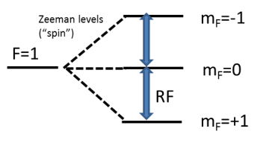
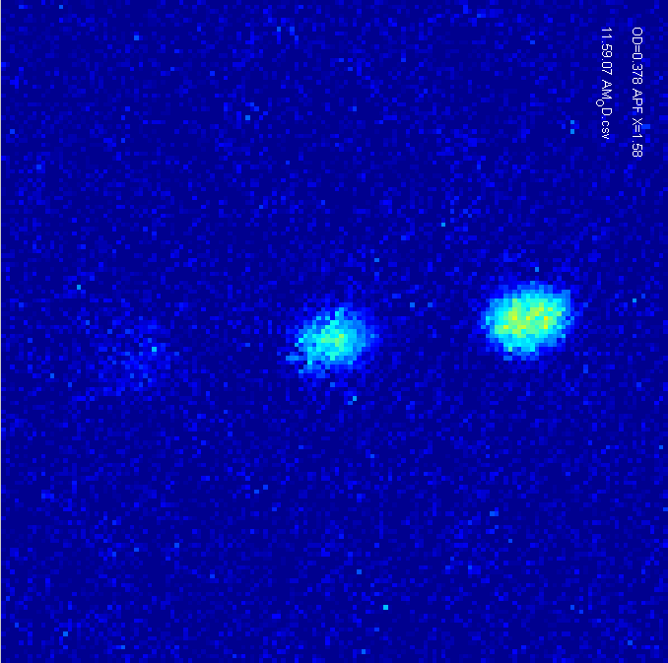
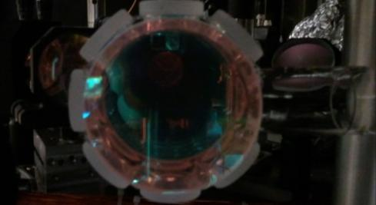
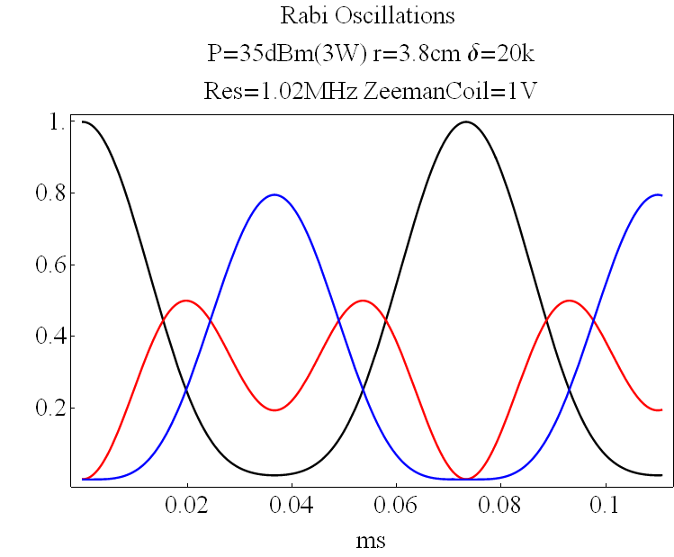
cold atoms/BEC --- “seeing” quantum mechanics & dynamics!
(“slowed down” and “blown up” so much that you can shoot photos & videos!)
Demo with our Bose-Einstein Condensation (BEC)
“spinor” BEC
Purdue QMD’s “all-optical” Rb87 BEC apparatus
with synthetic gauge fields and spin-orbit coupling
Based on several
Nobel-prize
technologies:
Chu/Phillips
/Cohen-Tannoudji’97;
Cornell/Wieman
/Ketterle’01;
Ashkin’18
“coldest place in Indiana”
(<50nK) -- laser cooled & trapped atoms
RF driven spin Rai oscillation
m_{F}=-1 0 +1
BEC
Spins (m_{f} )
-1 0 +1
1550nm cross-beam optical trap
(optical tweezer)
(Stern-Gerlach: separate
BECs with different spins)
B-field gradient
coherent oscillation of BEC
between 3 spin states
BEC (matter wave) diffraction from
laser standing wave (optical grating)
A.J. Olson et al., PRA87, 053613 (2013)
(exp. & modeling of efficient
evaporative cooling in optical trap)
”discrete spots” → ” synthetic dimension/lattice!

Slide 6
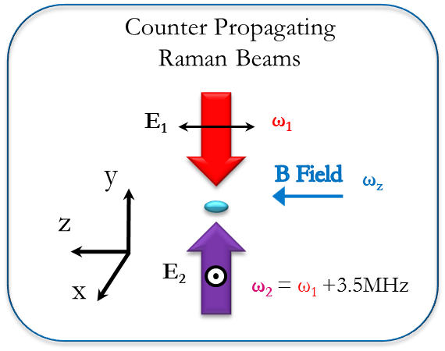
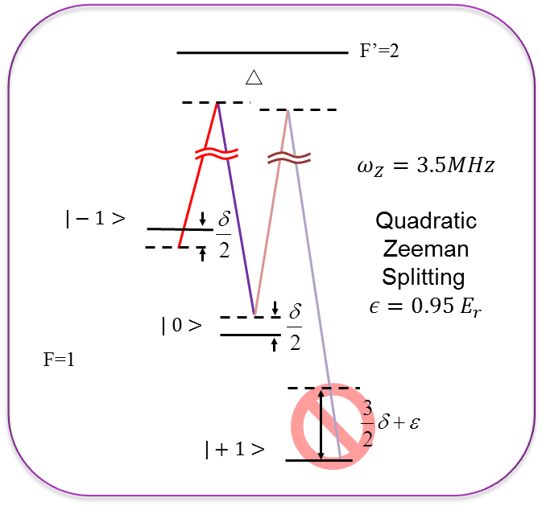
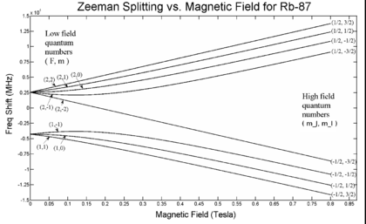

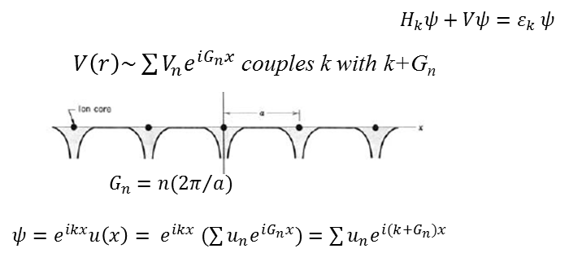
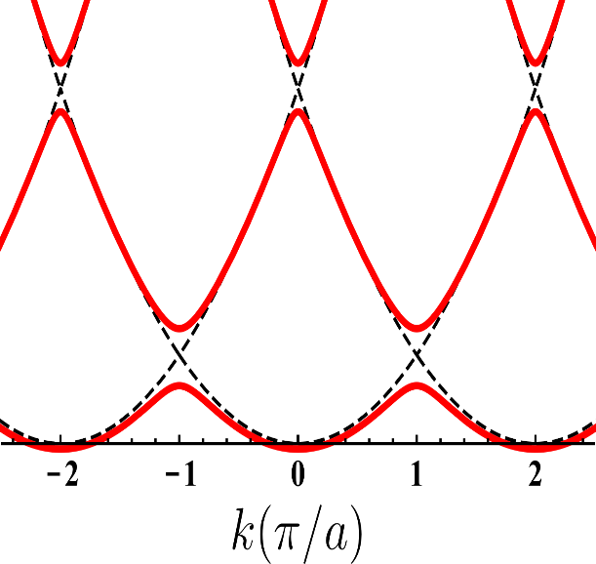

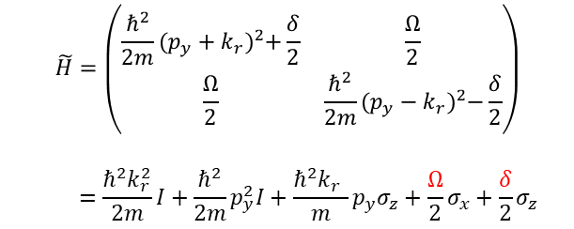
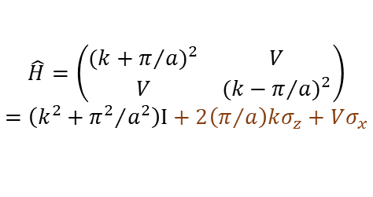


Synthetic Spin Orbit Coupling (SOC) by optical Raman coupling
(spin-momentum)
|m_{F}=-1, k+2k_{r}>
$$Ω$$
Ground state
L=0, I=3/2,S=1/2
| m_{F}=0,k>
[similar to Spielman/NIST’2011]
Synthetic (Dressed) bandstructure/SOC
Compare with bandstructure
(due to coupling by periodic V)
$$\tilde{H}=\left(\begin{matrix}\frac{ℏ^{2}}{2m}{(p_{y}+k_{r})}^{2}+\frac{δ}{2} & \frac{Ω}{2} \\ \frac{Ω}{2} & \frac{ℏ^{2}}{2m}{(p_{y}−k_{r})}^{2}−\frac{δ}{2}\end{matrix}\right)$$
$$=\frac{ℏ^{2}k_{r}^{2}}{2m}I+\frac{ℏ^{2}}{2m}p_{y}^{2}I+\frac{ℏ^{2}k_{r}^{}}{m}p_{y}σ_{z}+\frac{Ω}{2}σ_{x}+\frac{δ}{2}σ_{z}$$
control knobs
$$\hat{H}=\left(\begin{matrix}{(k+π/a)}^{2} & V \\ V & {(k−π/a)}^{2}\end{matrix}\right)$$
$$=\left(k^{2}+{π^{2}}/{a^{2}}\right)Ι+2\left(π/a\right)kσ_{z}+Vσ_{x}$$
SOC
“fictitious” B field
$$p_{y}$$

Slide 7





Synthetic Spin Orbit Coupling (SOC) by optical Raman coupling
(spin-momentum)
|m_{F}=-1, k+2k_{r}>
$$Ω$$
(↓g)
| m_{F}=0,k>
[similar to Spielman/NIST’2011]
Dressed bandstructure
(Eigen-energies vs p_{v})
$$\tilde{H}=\left(\begin{matrix}\frac{ℏ^{2}}{2m}{(p_{y}+k_{r})}^{2}+\frac{δ}{2} & \frac{Ω}{2} \\ \frac{Ω}{2} & \frac{ℏ^{2}}{2m}{(p_{y}−k_{r})}^{2}−\frac{δ}{2}\end{matrix}\right)$$
$$=\frac{ℏ^{2}k_{r}^{2}}{2m}I+\frac{ℏ^{2}}{2m}p_{y}^{2}I+\frac{ℏ^{2}k_{r}^{}}{m}p_{y}σ_{z}+\frac{Ω}{2}σ_{x}+\frac{δ}{2}σ_{z}$$
control knobs
C. Li et al. Nat.Comm.10,375’19
$$H=\frac{{(\vec{p}−q\vec{A})}^{2}}{2m}$$
$$k_{y\text{,}\text{min}}=\frac{qA_{y}}{ℏ}$$
SOC
“fictitious” B field
Synthetic
Gauge
Fields
Eigenstate (“dressed state”): α(p_{y})|↓,p_{y}+k_{r}>+β(p_{y})|↑,p_{y}-k_{r} >
$$\frac{∂A_{y}(t)}{∂t}=E_{y}$$
$$\frac{∂A_{y}(x)}{∂x}=B_{z}$$
superposition of “bare state”

Slide 8
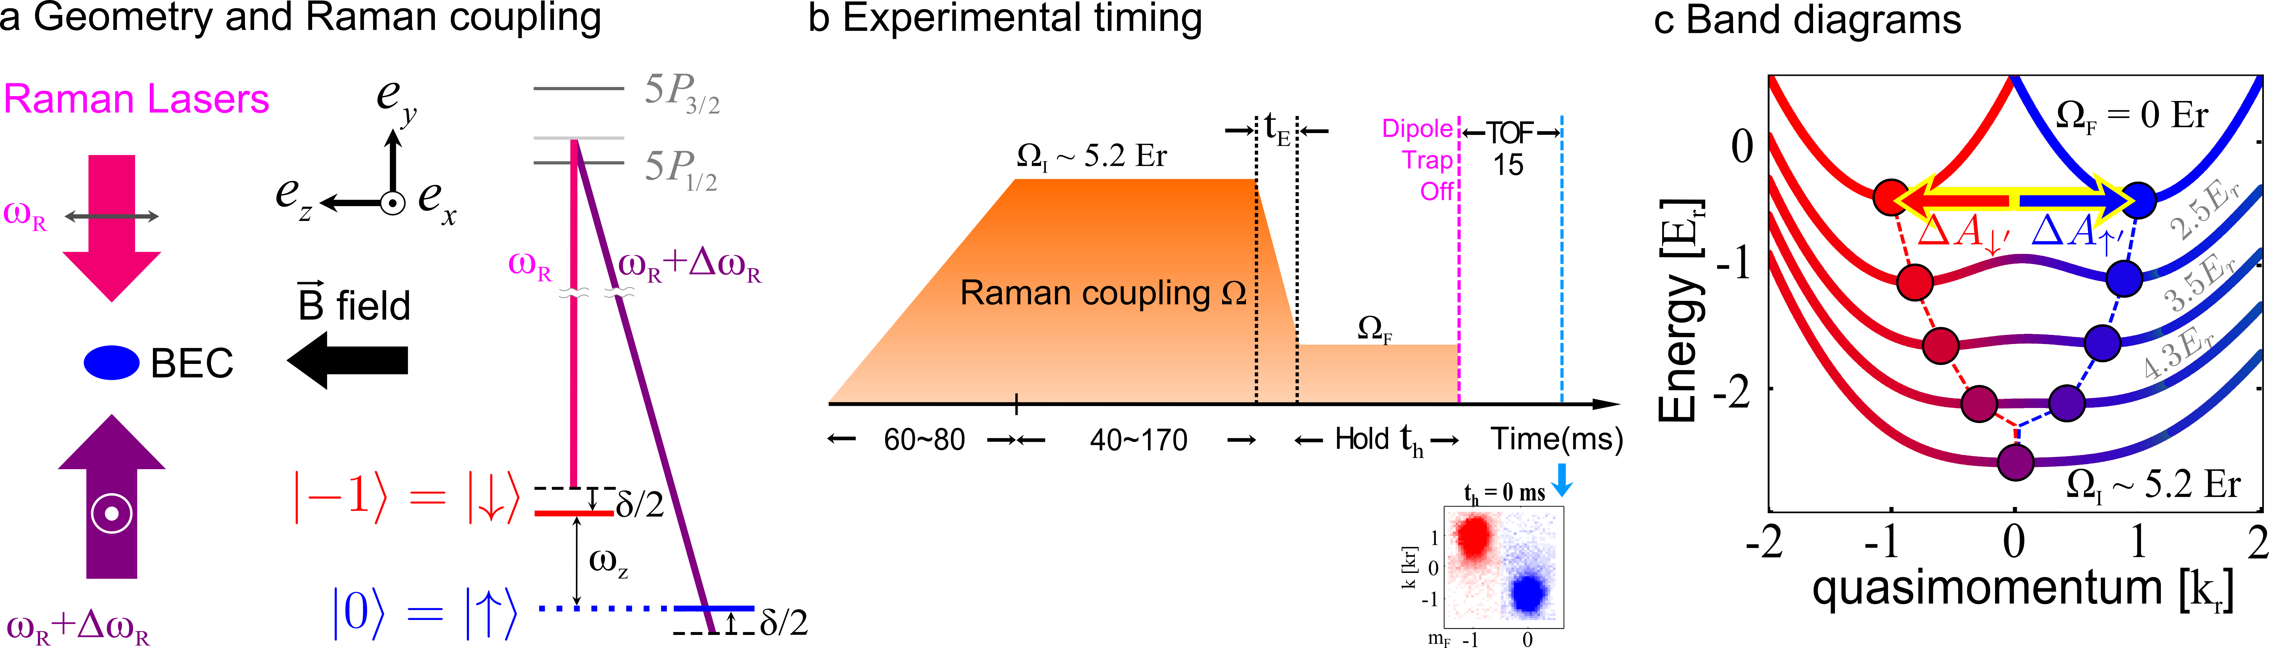
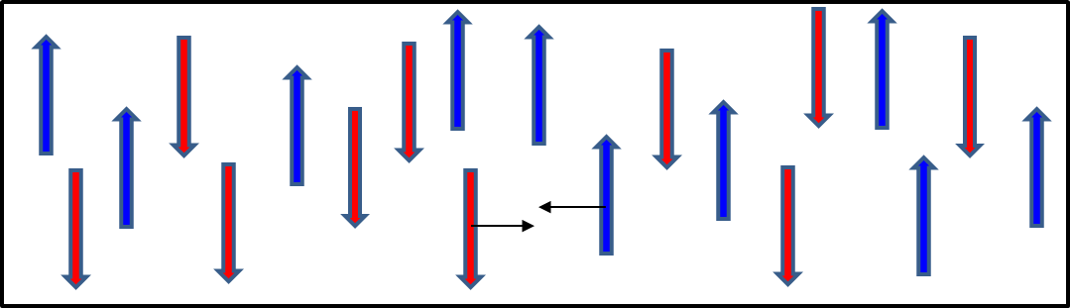

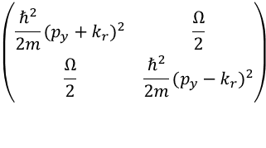
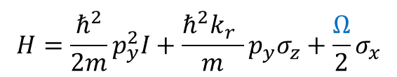
(AC) spin current [spin-dipole mode] in trap
$$\left(\begin{matrix}\frac{ℏ^{2}}{2m}{(p_{y}+k_{r})}^{2} & \frac{Ω}{2} \\ \frac{Ω}{2} & \frac{ℏ^{2}}{2m}{(p_{y}−k_{r})}^{2}\end{matrix}\right)$$
Chuan-Hsun Li,
Chunlei Qu,
RJ Niffenegger, ..YPC,
Nature
Comm.
10, 375 (2019)
“quantum
quench”
“Collide 2 spinor BECs in trap”
$$H=\frac{ℏ^{2}}{2m}p_{y}^{2}I+\frac{ℏ^{2}k_{r}^{}}{m}p_{y}σ_{z}+\frac{Ω}{2}σ_{x}$$
“spin drag”
SDM previous studied in non SOC quantum gases,
eg. fermi gas: Sommer [Zwierlein] et al’11 by magnetic gradient
bosons: Koller et al’12; Maddaloni et al’00
theory (fermi gas): Stringari’99, etc. [“spin drag”]
Spin Dipole Mode
(SDM) --- AC spin current
What is the effect of SOC?

Slide 9
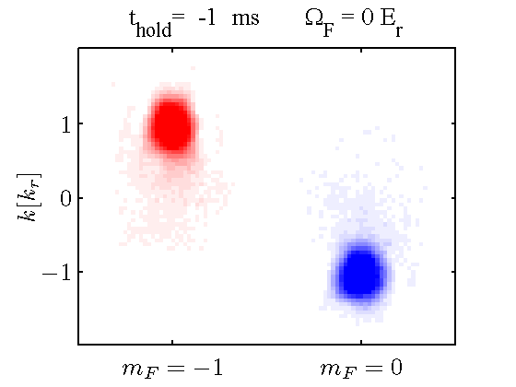
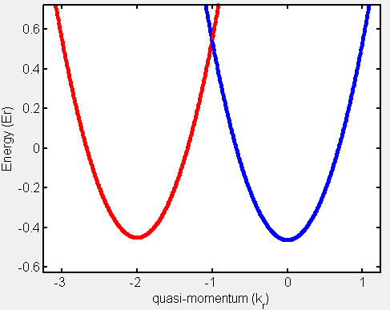
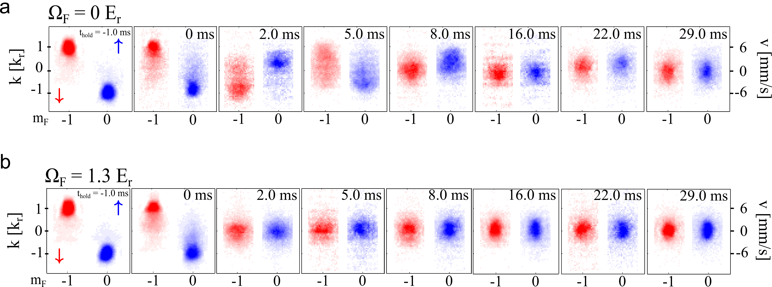
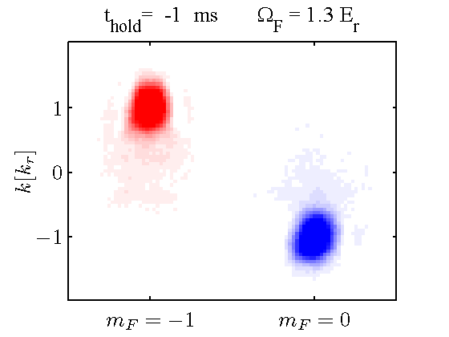
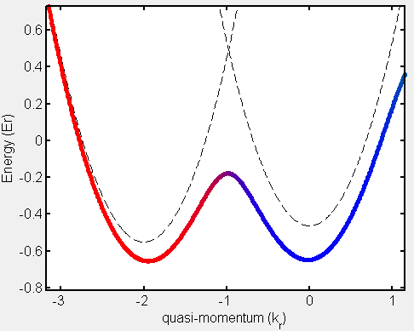
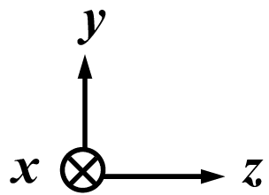


Spin Dipole Mode (AC Spin Current): no SOC vs SOC
Mechanical
momentum
Bare case
Stronger thermalization
Dressed case
Stronger momentum damping, less thermalization
Notes:
Update animations and figures

Slide 10
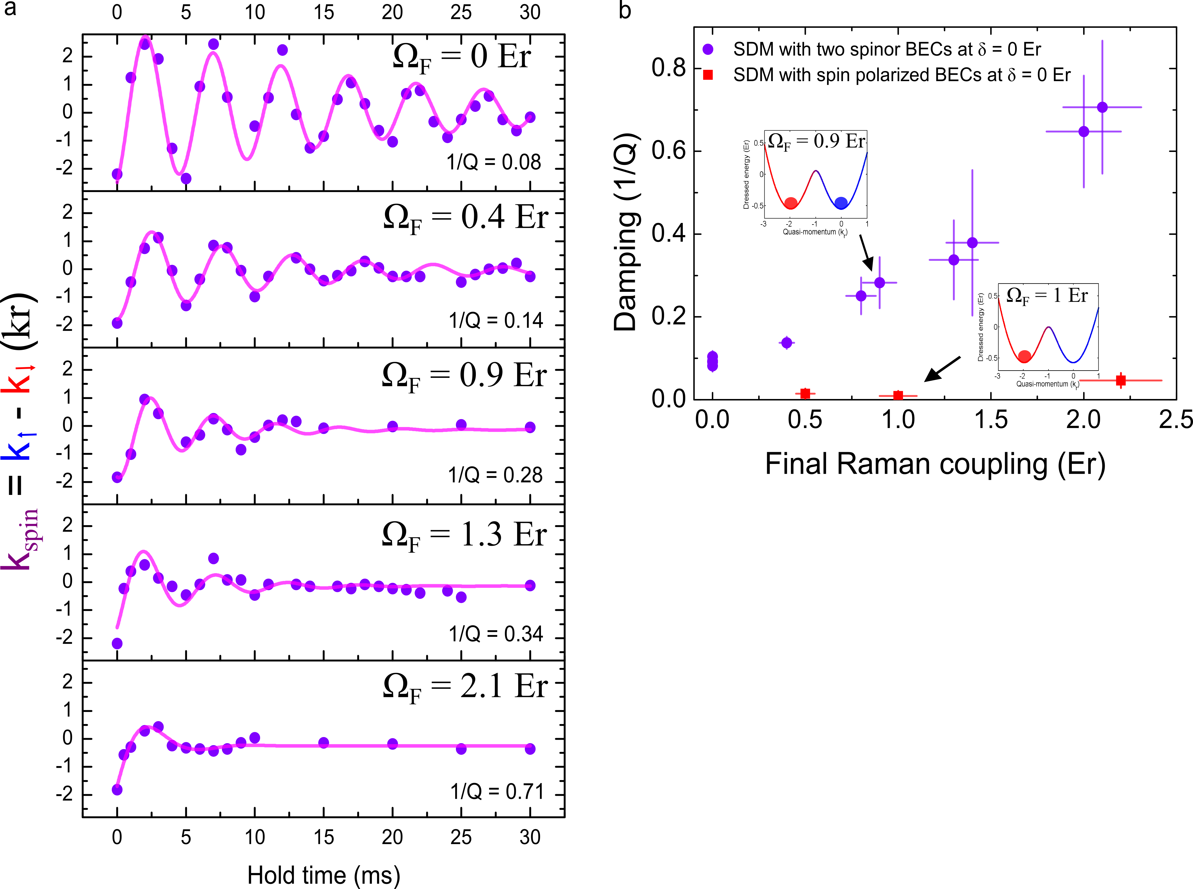
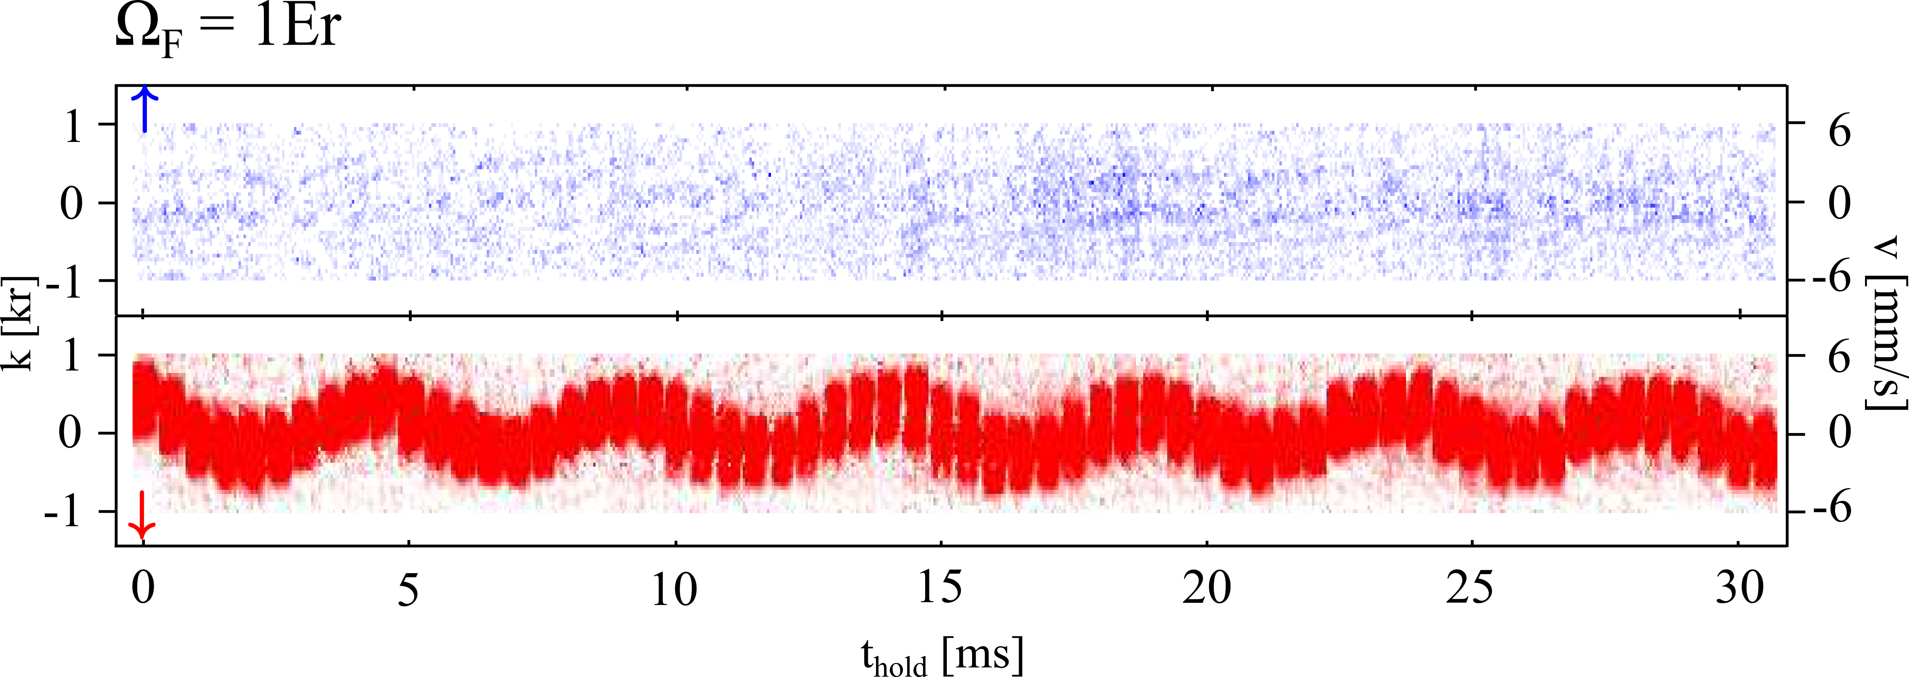



Momentum Damping (1/Q) versus Final Raman coupling Ω_{F}
Spin dipole mode/spin transport
strongly damped by SOC)
dipole mode/mass transport
NOT damped by SOC)
Damping factor (1/Q) increases
as damping increases
Notes:
Update animations and figures

Slide 11


Bare case
TOF images/movies
GPE Simulation of SDM:
In-situ images/movies
GPE done by Chunlei Qu
& Chuanwei Zhang (UT Dallas)
Dressed case

Slide 12
GPE simulation qualitatively explains damping

Slide 13


Observation of BEC Shape Oscillations (Quadrupole Modes)
We also study shape oscillations, which is an example of the kinetic energy that does not contribute to the global BEC motion.
y
z
Bare case
Dressed case
z
x
y
[1]
Oscillations do not seem to possess a
well-defined frequency.
Oscillations have a well-defined average frequency of 58 Hz,
consistent with the predicted frequency of the
m=0 quadrupole mode:
for a cigar shape BEC.
[1] W. Ketterle et al, arXiv:cond-mat/9904034
Notes:
Move earlier. Talk about exp first. Show exact freq and pred.
We also study shape osc…which is an example of the kinetic energy that does not contribute to the global BEC motion
Caution has to be paid that…because …could be challenging.

Slide 14



Understanding the SDM damping
GPE Simulation of SDM:
In-situ images
GPE done by Chunlei Qu
& Chuanwei Zhang (UT Dallas)
When two dressed spins collide: increased interaction energy, formation of density modulation,
excitation of other collective modes (eg. quadrupole mode)
(M.He & Q.Zhou)
$$H=\frac{ℏ^{2}}{2m}q_{y}^{2}I$$
$$+\frac{ℏ^{2}k_{r}^{}}{m}q_{y}σ_{z}$$
$$+\frac{Ω}{2}σ_{x}$$
Acknowledge discussion with Hui Zhai et al.
At Ω>0 (dressed), spin part no longer orthogonal, the wavefunction interference leads to enhanced interaction, which excites breathing mode (decay channel of SDM) and leads to strong damping of SDM; this strong damping gives less oscillation thus less heating
q_{y}
q_{y}
Eigenstate (“dressed state”): α(q_{y})|↓,q_{y}+k_{r}>+β(p_{y})|↑,q_{y}-k_{r} >
Other important factor: (enhanced) immiscibility of dressed BECs when moving (q→0)
Notes:
Update animations and figures

Slide 15



Thermalization and Spin Current Relaxation
Condensate fraction:
Stronger momentum damping stops the collision between different spins earlier.
Thermalization
Momentum damping
Spin current:
Effects of SOC on spin current relaxation:
Stronger momentum damping
Less thermalization
Notes:
Update animations and figures

Slide 16






AMO Research in Quantum Matter and Device (QMD) Laboratory
Bose-Einstein Condensate
(Cold/Polar) LiRb Molecules
S. Dutta
et al.
CPL
511,
7 (2011)
Spin-orbit coupled BEC (SOBEC)
laser-induced-fluorescence spectra
Joint experiment with Dan Elliott (Purdue)
Photoassociation
First LiRb cold molecules
Highest PA rate among bi-alkalis!
“synthetic” gauge fields & (dressed) bandstructures
Quantum transport & dynamics
Photoassociation
S. Dutta et al. EPL 104, 63001(2013); PRA 89,020702(2014)
D. Blasing et al. PRA 94, 062504 (2016) [short-range PA]
http://www.physics.purdue.edu/quantum/bec.php
http://www.physics.purdue.edu/quantum/mol.php

Slide 17

Effects of quantum superposition and interference in spin-dependent photoassociation of ⁸⁷Rb Bose-Einstein condensates
David Blasing
(→ Crane)
Scattering
/Reaction
path1
Scattering
/Reaction
path2
New approach for
“coherent photochemistry”
(not using pulsed/interfering lasers)
(we will also move onto 3x3 matrices..)

Slide 18

Photoassociation (PA) – loss of atoms from trap
(excited molecule)
ν_{PA}
Note: PA can measure
“Tan’s contact”
Δν_{PA}
ν_{0,mol}
PA
Photon
decay
extracting PA rate k_{PA}
Fit PA spectra and extract η = k_{PA}ρ₀t_{pa}
ρ₀ and and t_{pa} known
Calculate k_{PA}=η/ρ₀t_{pa}
Atom number: N (10³)
R(a₀)
PA detuning: Δν_{PA} = ν_{PA} - ν₀ (MHz)
⁸⁷Rb potentials from Allouche, et al., J. Chem. Phys.136, 114302 (2012).
C. McKenzie et al., Phys. Rev. Lett. 88, 120403 (2002).
Notes:
152nd vibrational level, 24.1 cm-1 binding energy beneath D2 line (P 3/2)

Slide 19

Photoassociation can be spin-dependent
Key point: choose PA line that require
colliding atoms (reactants)
must have m_{f,1} + m_{f,2} = 0
|f=1,m_{f}> pairs:
C. Hamley [M.Chapman], et al., Phys. Rev. A 79, 23401 (2009).

Slide 20
“spin-dependent” Photoassociation
Key point: for our PA line, colliding atoms must have m_{f,1} + m_{f,2} = 0
Question: atoms in spin superpositions simultaneously access multiple spin-pathways, what is PA process like?
D. Blasing et al., “Observation of Quantum Interference and Coherent Control in a Photo-Chemical Reaction”, Phys. Rev. Lett. 121, 073202 (2018)
Notes:
In caption, state the fractions lost in the previous slide. Arrows for on res/off res – which portion of the spectra is for which parts.

Slide 21



Spin(-momentum) superposition states
Rep. bandstructures at δ=0
|-1>
| 0 >
|+1>
More information on our SOC BEC: A. Olson et al. PRA’14; PRA’17
q: quasimomentum
k_{r}: recoil momenta
δ: Raman detuning
Ω_{R}: Raman coupling
ε_{q}: quadratic shift
PA
Photon
Lin/Spielman[NIST], PRL’09
Creates spin-momentum superpositions :
R(a₀)
Note: momentum part of the superposition do not affect PA (length scale << 1/k_{r})
Notes:
(q-q_min)^2 compared to (p-qA/c)^2. p-qA/c is the “mechanical momentum” from which you get velocity. p is the “canonical momentum” that is conjugate to the position operator. Therefore q is the canonical momentum in our analogy when you expand around the minmum of the band structure.
Reread some classical mechanics textbooks and also quantum mechanics for charge in a magnetic field. Meet with Chris independently about it.
Put this earlier in presenation
Take dressed momentum band-structures out. Make “diagonomal” means spin-momentum superposition

Slide 22
PA on spin(-momentum) superpositions
Evidence for superposition state (all components undergo PA together!)
PA detuning from resonance (MHz)
D. Blasing et al., “Observation of Quantum Interference and Coherent Control in a Photo-Chemical Reaction”, Phys. Rev. Lett. 121, 073202 (2018)
Notes:
10.30 from 2015, For spin-momentum superposition: Raman coup, 8.0 E_r, Raman detuning = 0Er

Slide 23

PA on spin(-momentum) superpositions with increasing Ω_{R}
(a) → (d): turning on the spin-momentum superpositions
(a) → (d): control, no spin-momentum superpositions [bare BEC of m_{F}=0]
Normalized total atom number
D. Blasing et al
Phys. Rev. Lett. 121, 073202 (2018)
PA detuning from resonance (MHz)
red and black curves diverge: PA significantly modified for dressed BEC (superposition), even ~ completely ”turned off” at large Ω_{R} !
Notes:
Notation:
N/N₀ - normalized atom number
Δν_{PA} - photoassociation detuning from resonance
Ω – strength of two-photon laser coupling
δ – two-photon laser detuning

Slide 24








PA on spin(-momentum) superpositions
( )⊗( )
$${ ψ}_{\text{scat}} ∝$$
f, m_{f}
opposite CG
coefficient!
$|1,0>⊗|1,0>$=
$${\left|2C_{−1}C_{+1}−C_{0}^{2}\right|}^{2}$$
Total F, m_{F}
$$||$$
$|1,−1>⊗|1,−1>$=
$$||$$
Prediction: PA rate for spin superpositions modified over bare rate
Notes:
Hamiltonian is in a frame rotating at Δω_{R} and after a spin-rotation

Slide 25

PA on spin(-momentum) superpositions
*
*
Various Ω_{R} at δ = 0
Rep. bandstructures
D. Blasing et al.,
Phys. Rev. Lett. 121, 073202 (2018)
at large Ω_{R}→
$C_{0}=\frac{1}{\sqrt{2}};C_{−1}{=C}_{+1}=\frac{1}{2}$ : k→0!

Slide 26
PA on spin(-momentum) superpositions
*
*
Various δ = 0 at Ω_{R} = 5.4 E_{r}
D. Blasing et al.,
Phys. Rev. Lett. 121, 073202 (2018)

Slide 27





“using chemistry to probe physics?”
(quantum condensed matter)
Summary & Outlook
Two-pathway
interference in
Chemical space
(reaction paths)
Scattering
/Reaction
path1
Scattering
/Reaction
path2
D. Blasing et al.,
Phys. Rev. Lett. 121, 073202 (2018)
Novel “light-dressed” reactants
(in superposition state)
N/N₀
Control reactants’ quantum
(superposition) states
[high-dim Hilbert space]
New approach for
“coherent photochemistry”
(not using pulsed/interfering lasers)
1.2
Observations indicate destructive interference
1.0
N/N₀
0.8
0.6
Agrees with theoretical model
k_{sup/}k_{0,0}
*
*
Ω_{R} (E_{r})

Slide 28
Spin-orbit-coupled Bose-Einstein Condensate as playground to explore quantum collision and chemistry
Outline
Intro. to experimental platform: “spin-orbit-coupled (SOC) BEC”
[“spin-helical atoms”] (by optical dressing)
(Spin) transport & Spinor BEC collider [how is it affected by SOC?]
Quantum Synthesis: Interferometry in quantum (photo)chemistry
C. Li et al.,
Nature Comm.
10, 375 (2019)
“2x2”
Chuan-Hsun Li
D.Blasing et al.
PRL 121, 073202
(2018)
“3x3”
David Blasing
(→ Crane)
Acknowledge Research Support by: Purdue Univ.; ARO; NSF;DOE

Slide 29






















(move onto 4x4 matrices..)
(proposal/prediction:
Qi Zhou:
arXiv:1810.12331)
“emergent” lattice
(no external optical lattice)
arXiv:1809.02122, under review (2018)
(experiment)
Hall ribbon
(periodic boundary condition):
Hall cylinder
Real spatial
dimension
Synthetic
magnetic flux
Raman
Raman
MW
MW
$$Ω_{2}$$
$$|4⟩$$
$$|3⟩$$
$$|2⟩$$
$$|1⟩$$
$$d=2π/K$$
Synthetic dimension
[Lewenstein et al’14; Spielman’15; Fallani’15…]
Synthetic magnetic flux
$$|4⟩$$
cyclic coupled spin
(“synthetic circle”)
Net momentum
transfer=2K=4k_{r}
$$λ≈790 nm$$
$$k_{r}=2π/λ$$
Synthetic dimension
$$|3⟩$$
$$|1⟩$$
$$K={2k}_{r}$$
$$|2⟩$$
Notes:
Helium

Slide 30

















Hall cylinder → emergent lattice & band structure
nonsymmorphic symmetry → topological protected bandcrossing
$$|1⟩$$
$$|2⟩$$
$$|3⟩$$
$$|4⟩$$
$$d=2π/K$$
$$|1⟩$$
(Hamiltonian’s period)
$$|2⟩$$
$H$ is invariant under translation $d/2$
+ a discrete unitary
transformation (“rotation”)
(|2>,|3> flip signs)
$$|3⟩$$
$$|4⟩$$
Plane waves
$$\{|ℏ\left(q_{y}+nK\right);m⟩\}=\{e^{i\left(q_{y}+nK\right)y}|m⟩\}$$
nonsymmorphic symmetry
momentum space
$$ℏ(q_{y}+nK)$$
“topological
semimetal”
BEC density develops a crystalline order with a periodicity of $d/2$,
half on the lattice period $d$ (phase’s period = $d$ or $d/2$).
C. Li et al. arXiv:1809.02122
Notes:
Helium

Slide 31





Quantum Transport in Emergent Lattice/Band → Bloch oscillations
$ℏK$
quantum transport in each band:
analogous to (momentum space) Mobius-strip!
(transport
under gravity)
Period = $2K$ (doubling the period of band structure) or $∼2.6$ ms
→consistent with the $d/2$ density modulation based on the momentum-position duality.
Band 2 offset from band 1 by K (half period of transport)
C. Li et al. arXiv:1809.02122
Notes:
Helium

Slide 32












Breaking the nonsymmorphic symmetry → open gaps @ the crossings
a topological change
In the band structure
Period = $ℏK$ or $∼1.3$ ms
arXiv:1809.02122
$$+_{rf}$$
$$|1⟩$$
$$|2⟩$$
“untwist” the Mobius strip
(in the momentum space)
$$|3⟩$$
$$|4⟩$$
$$+_{rf}$$
Notes:
Helium

Slide 33




Analysis of Bloch oscillations -> mapping band structure
Consistent with the (topologically protected) band crossings!
Similar observation under
different parameters
(crossing protected by
nonsymmorphic symmetry)
Period $∼2.6$ ms
$2ℏK$
$ℏK$
Total mechanical momentum
of the BEC
A “symmetry protected topological phase”
(for bosons)
C. Li et al. arXiv:1809.02122, under review (2018)
Notes:
Helium

Slide 34




Unzipped cylinder: Emergent lattice and Bloch oscillations disappear
arXiv:1809.02122
Notes:
Helium

Slide 35










Summary: Emergent symmetry-protected (bosonic) topological states
arXiv:1809.02122
Breaking the symmetry
Next:Can particle-particle interactions change the topology?
https://physics.aps.org/articles/v1/6

Slide 36






Outlook: Quantum science & technologies based on
“Spin-helical” particles
Novel (Topological) Quantum Matter & Quantum simulation
(spin-based) quantum control/chemistry
(& in high dim/curved space)
Scattering
/Reaction
path1
Scattering
/Reaction
path2
New playground/platforms/toolsets for:
“quantum transport/interferometry/measurement/manipulation (even chemistry)” of quantum condensed matter

Slide 37


“Spintronic” Quantum Transport, Chemistry and Interferometry in an atomic BEC
Summary
Introduction to experimental platform: “spin-orbit-coupled” (SOC) BEC
Transport & Interferometry in energy-momentum (E-k) space
  Quantum Transport in synthetic (“dressed”) bandstructure
  Landau-Zener transition: beam-splitter
  Landau-Zener-Stuckelberg interferometer (via “Fluoquet” engineering)
Spinor BEC collider: (Spin) transport & interferometry in real-space
  Spin dipole mode (AC spin current) induce by quantum quench in spin-orbit-coupled BEC
  How does such (spin) collective excitation decay?
  How does spin-orbit-coupling affect spin transport (spin current relaxation)?
  Interplay between SOC, interference, interaction
Interferometry in quantum (photo)chemistry
  What happens when reactants are in quantum superposition states?
  (spin-sensitive) photoassociation (PA): interference b/t 2 PA reaction pathways
BEC on a synthetic “Hall” cylinder (a symmetry-protected bosonic topological state)
  (circular) synthetic “dimension” → “emergent” crystalline order
  Quantum transport on a Mobius strip (E-k space)
  Topological band-crossing (protected by nonsymmorphic symmetry)
  Breaking symmetry/unzipping cylinder → topological transition
A.Olson et al.
PRA 90, 013616 (2014);
PRA 95, 043623 (2017)
C. Li et al.,
Nature Comm.
10, 375 (2019)
D.Blasing et al.
PRL 121, 073202 (2018)
C. Li et al.,
arXiv: 1809.02122

Slide 39
Bare case

Slide 40

Dressed case

Slide 41
Dressed case

Slide 42

Dressed case

Slide 43

Dressed case

Slide 44
| >
| >
| >
| >

