Slide 1




Clarendon Laboratory
Thermalisation in few-body systems: Revealing missing charges with quantum fluctuation relations
Jordi Mur-Petit
J. Mur-Petit, A. Relaño, R. A. Molina & D. Jaksch,
Nature Commun. 9, 2006 (2018)

Slide 2
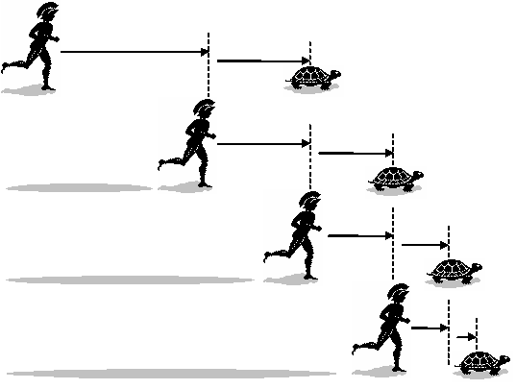
Dynamics?
Achilles vs. tortoise
Zeno (5th Cent. BCE)
ibmathresources.com

Slide 3
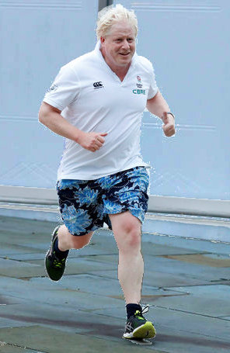
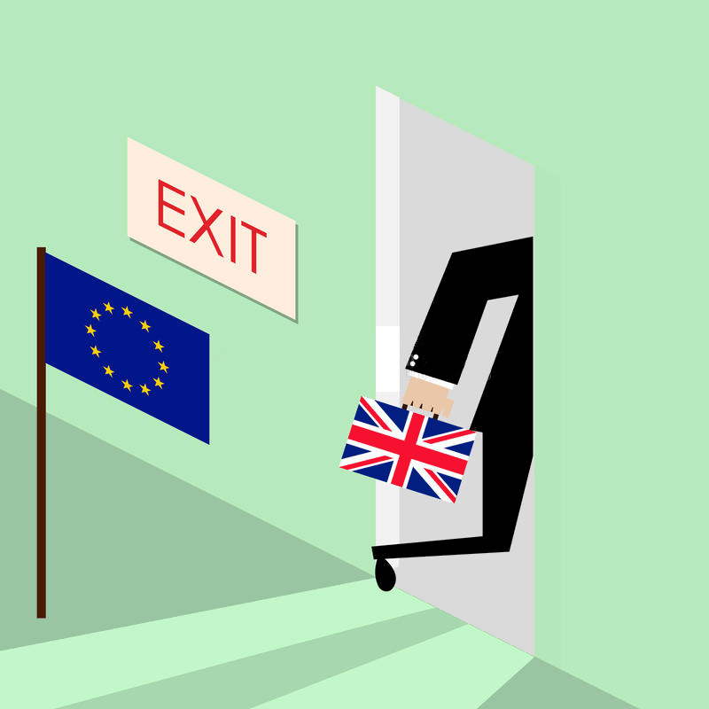
Dynamics?
Achilles vs. tortoise
Boris vs. Parliament
UK (2019)
HuffPostUK
ibmathresources.com
Dreamstime.com

Slide 4
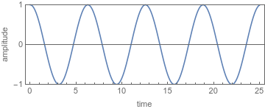

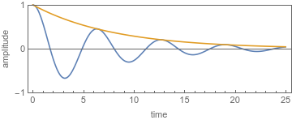
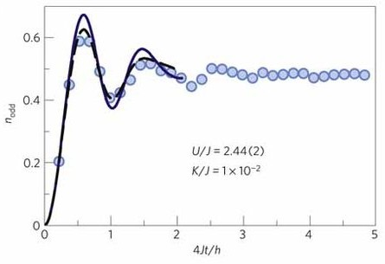
Quantum dynamics vs. Relaxation
Single isolated spin:
Bloch oscillations
Many-body (closed):
Eigenstate Thermalisation
Hypothesis (ETH)
Single spin coupled to
large bath: Dephasing
Trotzky et al., Nat. Phys. (2012)

Slide 5
Quantum dynamics vs. Relaxation
Single isolated spin:
Bloch oscillations
Many-body (closed):
Eigenstate Thermalisation
Hypothesis (ETH)
Single spin coupled to
large bath: Dephasing
Trotzky et al., Nat. Phys. (2012)
How does relaxation emerge as number of particles increases?

Slide 6
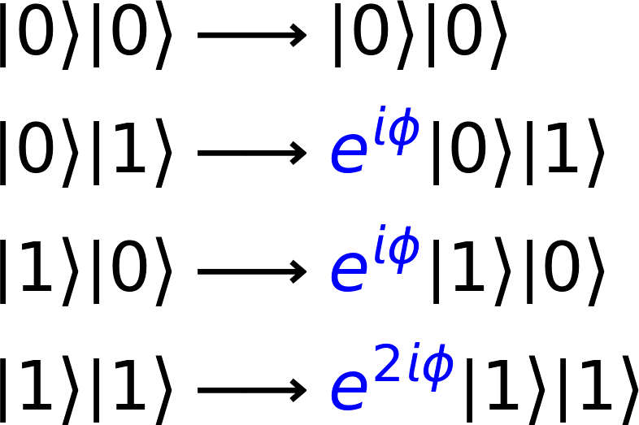
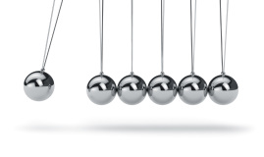
Known exceptions to relaxation
Decoherence free subspaces
Reservoir engineering
Integrable systems

Slide 7
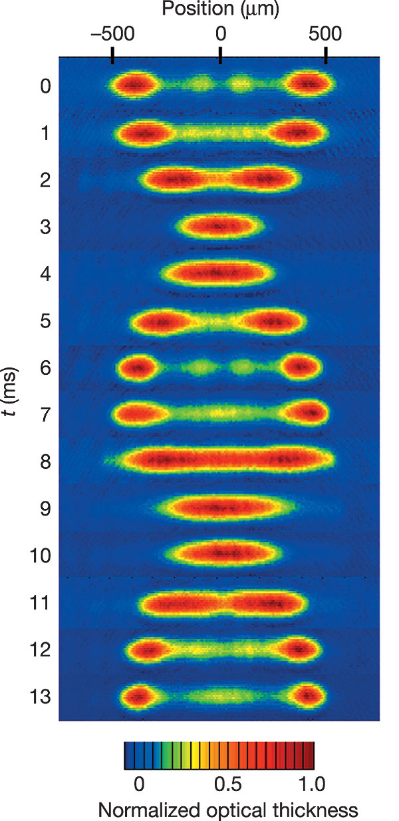
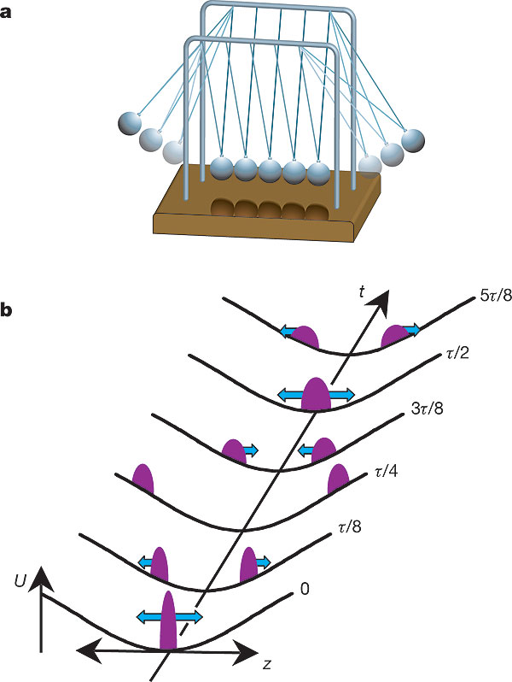
Integrable systems
Strongly interacting bosons in 1D
N~10⁶
Energy & momentum conservation in each collision preclude relaxation
Kinoshita et al., Nature (2006)

Slide 8
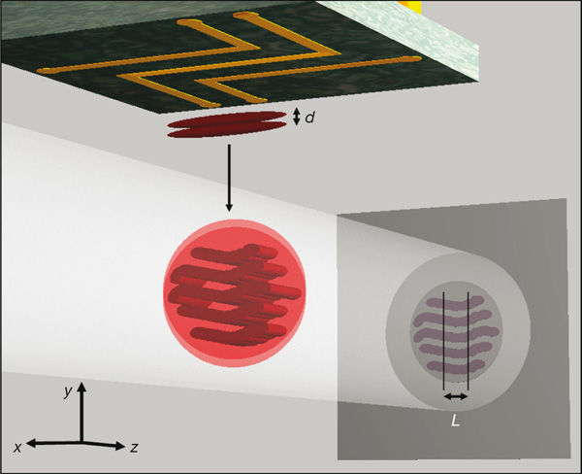

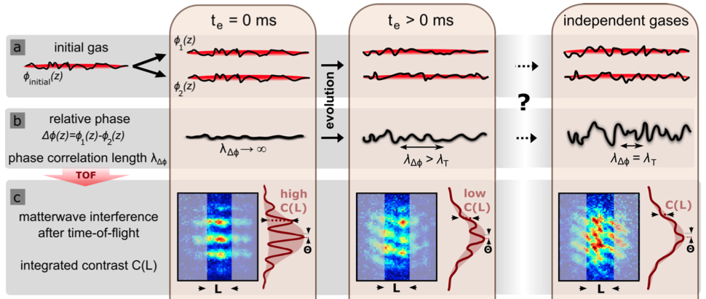
Relaxation in an integrable system
Strongly interacting bosons in 1D x 2
N~10³
Hofferberth et al., Nature (2007); Gring et al., Science (2012); Langen et al., Science (2015) (Schmiedmayer lab)

Slide 9
Relaxation in an integrable system
Strongly interacting bosons in 1D x 2
N~10³
(?)
Hofferberth et al., Nature (2007); Gring et al., Science (2012); Langen et al., Science (2015) (Schmiedmayer lab)

Slide 10
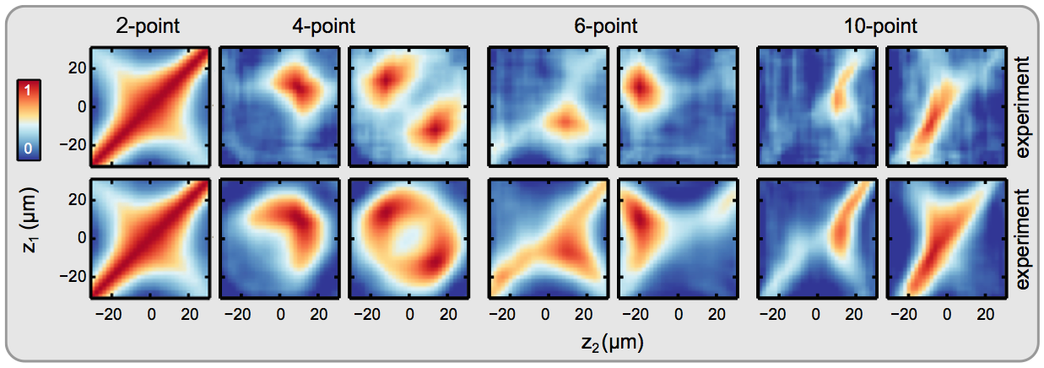
Relaxation in an integrable system
‘slow split’
‘fast split’
Slow split: Correlations match Gibbs ensemble with effective T=1/β
(BRINO)
Langen et al., Science 348, 207 (2015)
Notes:
The results are shown in Fig. 2B. In addition to the maximum of correlations on the diagonal, we observe a pronounced second maximum on the anti-diagonal. This corresponds to enhanced correlations of the points z1 = −z2, which are located symmetrically around the center of the system. These correlations are a direct consequence of an increased (decreased) population of quasi particle modes that are even (odd) under a mirror reflection with re- spect to the longitudinal trap center. Consequently, the observations can be described, to a first approximation, by the above theoretical model but with different temperatures, i.e. with
β2m = 1/[kB (Teff + ∆T )] for the even and
β2m−1 = 1/[kB (Teff − ∆T )] for the odd modes, respectively. Fitting the experimental data of the steady state with this model we find kB Teff = (0.64 ± 0.01) × μ, ∆T =(0.48±0.01)×Teff and a reduced
χ2 ≈6.

Slide 11
Relaxation in an integrable system
‘slow split’
‘fast split’
Fast split: Up to 10 different ‘temperatures’ to match!
energy
conservation
other conserved
charges
Langen et al., Science 348, 207 (2015)
Notes:
The results are shown in Fig. 2B. In addition to the maximum of correlations on the diagonal, we observe a pronounced second maximum on the anti-diagonal. This corresponds to enhanced correlations of the points z1 = −z2, which are located symmetrically around the center of the system. These correlations are a direct consequence of an increased (decreased) population of quasi particle modes that are even (odd) under a mirror reflection with re- spect to the longitudinal trap center. Consequently, the observations can be described, to a first approximation, by the above theoretical model but with different temperatures, i.e. with
β2m = 1/[kB (Teff + ∆T )] for the even and
β2m−1 = 1/[kB (Teff − ∆T )] for the odd modes, respectively. Fitting the experimental data of the steady state with this model we find kB Teff = (0.64 ± 0.01) × μ, ∆T =(0.48±0.01)×Teff and a reduced
χ2 ≈6.

Slide 12
Pre-thermalised states
Generalized Gibbs ensemble (GGE)
Conserved charges prevent relaxation to ‘true’ thermal
equilibrium: → Pre-thermalised state
How do we harness this for small-N systems?
Notes:
The results are shown in Fig. 2B. In addition to the maximum of correlations on the diagonal, we observe a pronounced second maximum on the anti-diagonal. This corresponds to enhanced correlations of the points z1 = −z2, which are located symmetrically around the center of the system. These correlations are a direct consequence of an increased (decreased) population of quasi particle modes that are even (odd) under a mirror reflection with re- spect to the longitudinal trap center. Consequently, the observations can be described, to a first approximation, by the above theoretical model but with different temperatures, i.e. with
β2m = 1/[kB (Teff + ∆T )] for the even and
β2m−1 = 1/[kB (Teff − ∆T )] for the odd modes, respectively. Fitting the experimental data of the steady state with this model we find kB Teff = (0.64 ± 0.01) × μ, ∆T =(0.48±0.01)×Teff and a reduced
χ2 ≈6.

Slide 13
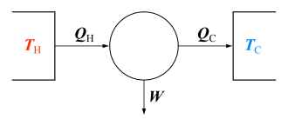
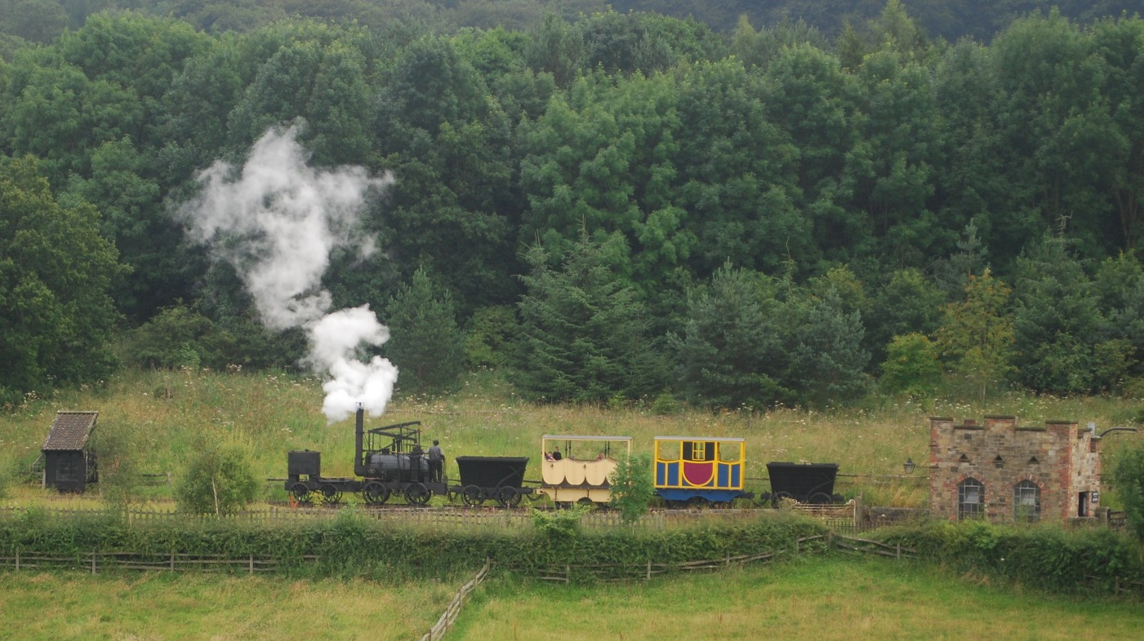
Thermodynamic Laws
Macroscopic systems: N≥10²⁴
Wikipedia
‛Puffing Billy’ (1813), Pockerley Waggonway, Beamish museum

Slide 14
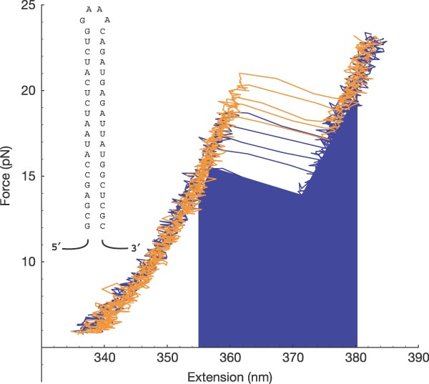
Fluctuation relations: classical
Macroscopic systems: N≥10²⁴
Wikipedia
Classical systems
Jarzynski equality
Crooks fluctuation relation
Collin et al.,
Nature 437,
231 (2005)
Constrain PDF:
Equilibrium properties from non-equil. measurements
Jarzynski (1997); Crooks (1999)

Slide 15
Fluctuation relations: quantum
Macroscopic systems: N≥10²⁴
Wikipedia
Classical systems
Quantum systems
Jarzynski equality
Quantum Jarzynski equality (QJE)
Crooks fluctuation relation
Tasaki-Crooks relation (TCR)
QJE: Tasaki (2000), Kurchan (2000), Yukawa (2000); TCR: Tasaki (2000), Monnai (2005)

Slide 16
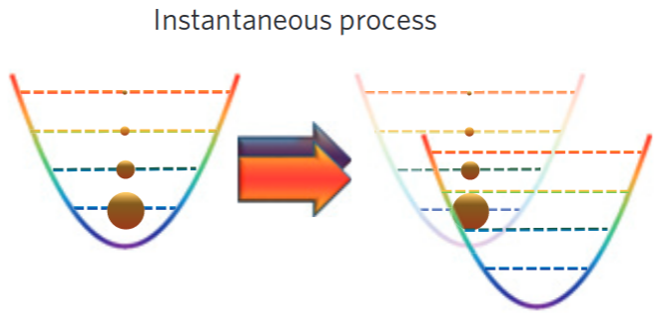
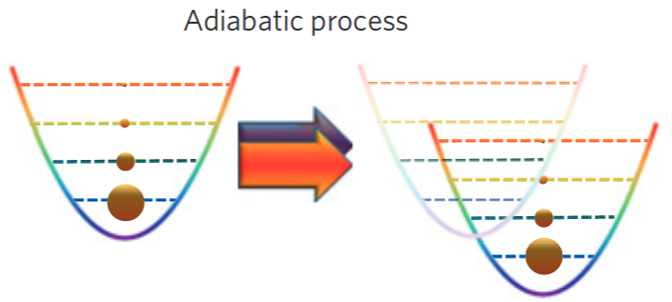
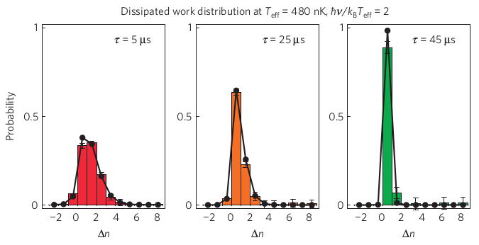


Testing the QJE with N=1 ion
Fast quench Slow quench
Bars: experiment
Lines: calculation
An et al. (Kim lab), Nature Phys. 11, 193 (2015)

Slide 17
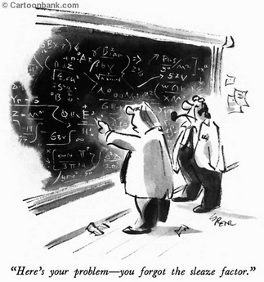
QFRs: The small print
1. Work defined via
two energy-projection measurements
U(τ)
Talkner, Hänggi et al., J. Phys. A 40, F569 (2007);
Talkner & Hänggi, PRE 93, 022131 (2016)

Slide 18

QFRs: The small print
1. Work defined via
two energy-projection measurements
2. Initial state = canonical (Gibbs) equilibrium state
U(τ)
GGEs
Talkner, Hänggi et al., J. Phys. A 40, F569 (2007);
Talkner & Hänggi, PRE 93, 022131 (2016)

Slide 19

QFRs for GGEs
Quantum systems: Gibbs
Quantum systems: GGE
Q. Jarzynski equality (QJE)
Generalised QJE
Tasaki-Crooks relation (TCR)
Generalised TCR
GGEs!
Generalised work
Hickey & Genway, PRE (2014);
Guryanova et al.; Yunger Halpern et al., Nature Commun. (2016)
JMP, Relaño, Molina & Jaksch,
Nature Commun. 9, 2006 (2018)

Slide 20
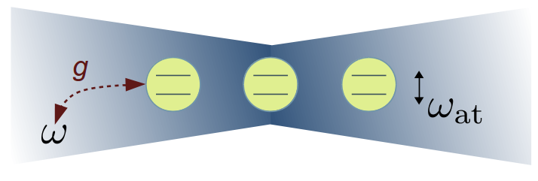
Testing ground: Dicke model
N=7
Two phases
g>g_{cr} → Superradiant
g<g_{cr} → Subradiant
Two regimes
α={0, 1} → Integrable (TCM)
Otherwise → Not integrable

Slide 21
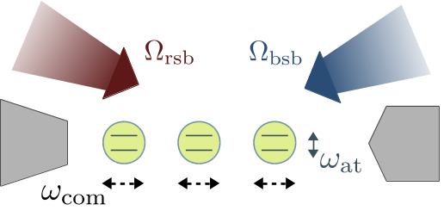
Testing ground: Dicke model
N=7
Two phases
g>g_{cr} → Superradiant
g<g_{cr} → Subradiant
Two regimes
α={0, 1} → Integrable (TCM)
Otherwise → Not integrable
Nature Commun. 9, 2006 (2018)

Slide 22
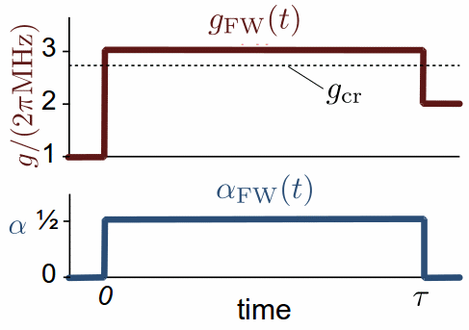
Dicke model: Protocol
{
1. Prepare system in GGE state, α=0
2. Non-equilibrium protocol: quench α
3. Repeat many times to collect
statistics of work [*]
Repeat with time-reversed protocol (BW)
FW:
BW:
[*] Filtering protocol: Huber et al., PRL 101, 070403 (2008);
An et al. (Kim lab), Nature Phys. 11, 193 (2015)
JMP, Relaño, Molina & Jaksch,
Nature Commun. 9, 2006 (2018)

Slide 23
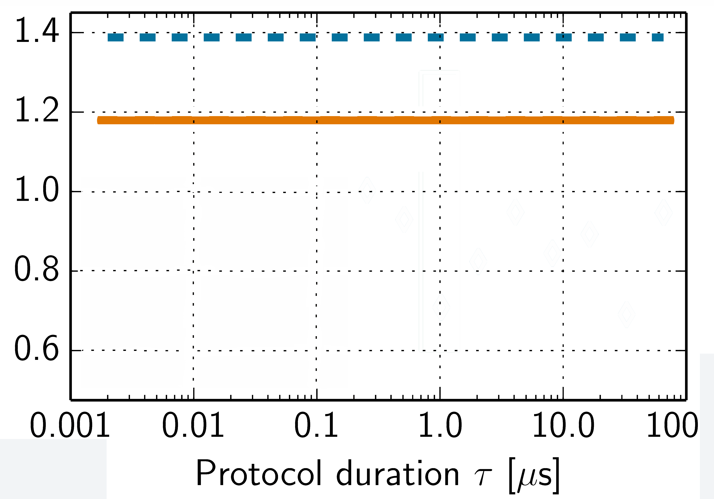
QJE: Varying protocol duration τ
– std:
– gen:
JMP, Relaño, Molina & Jaksch,
Nature Commun. 9, 2006 (2018)

Slide 24
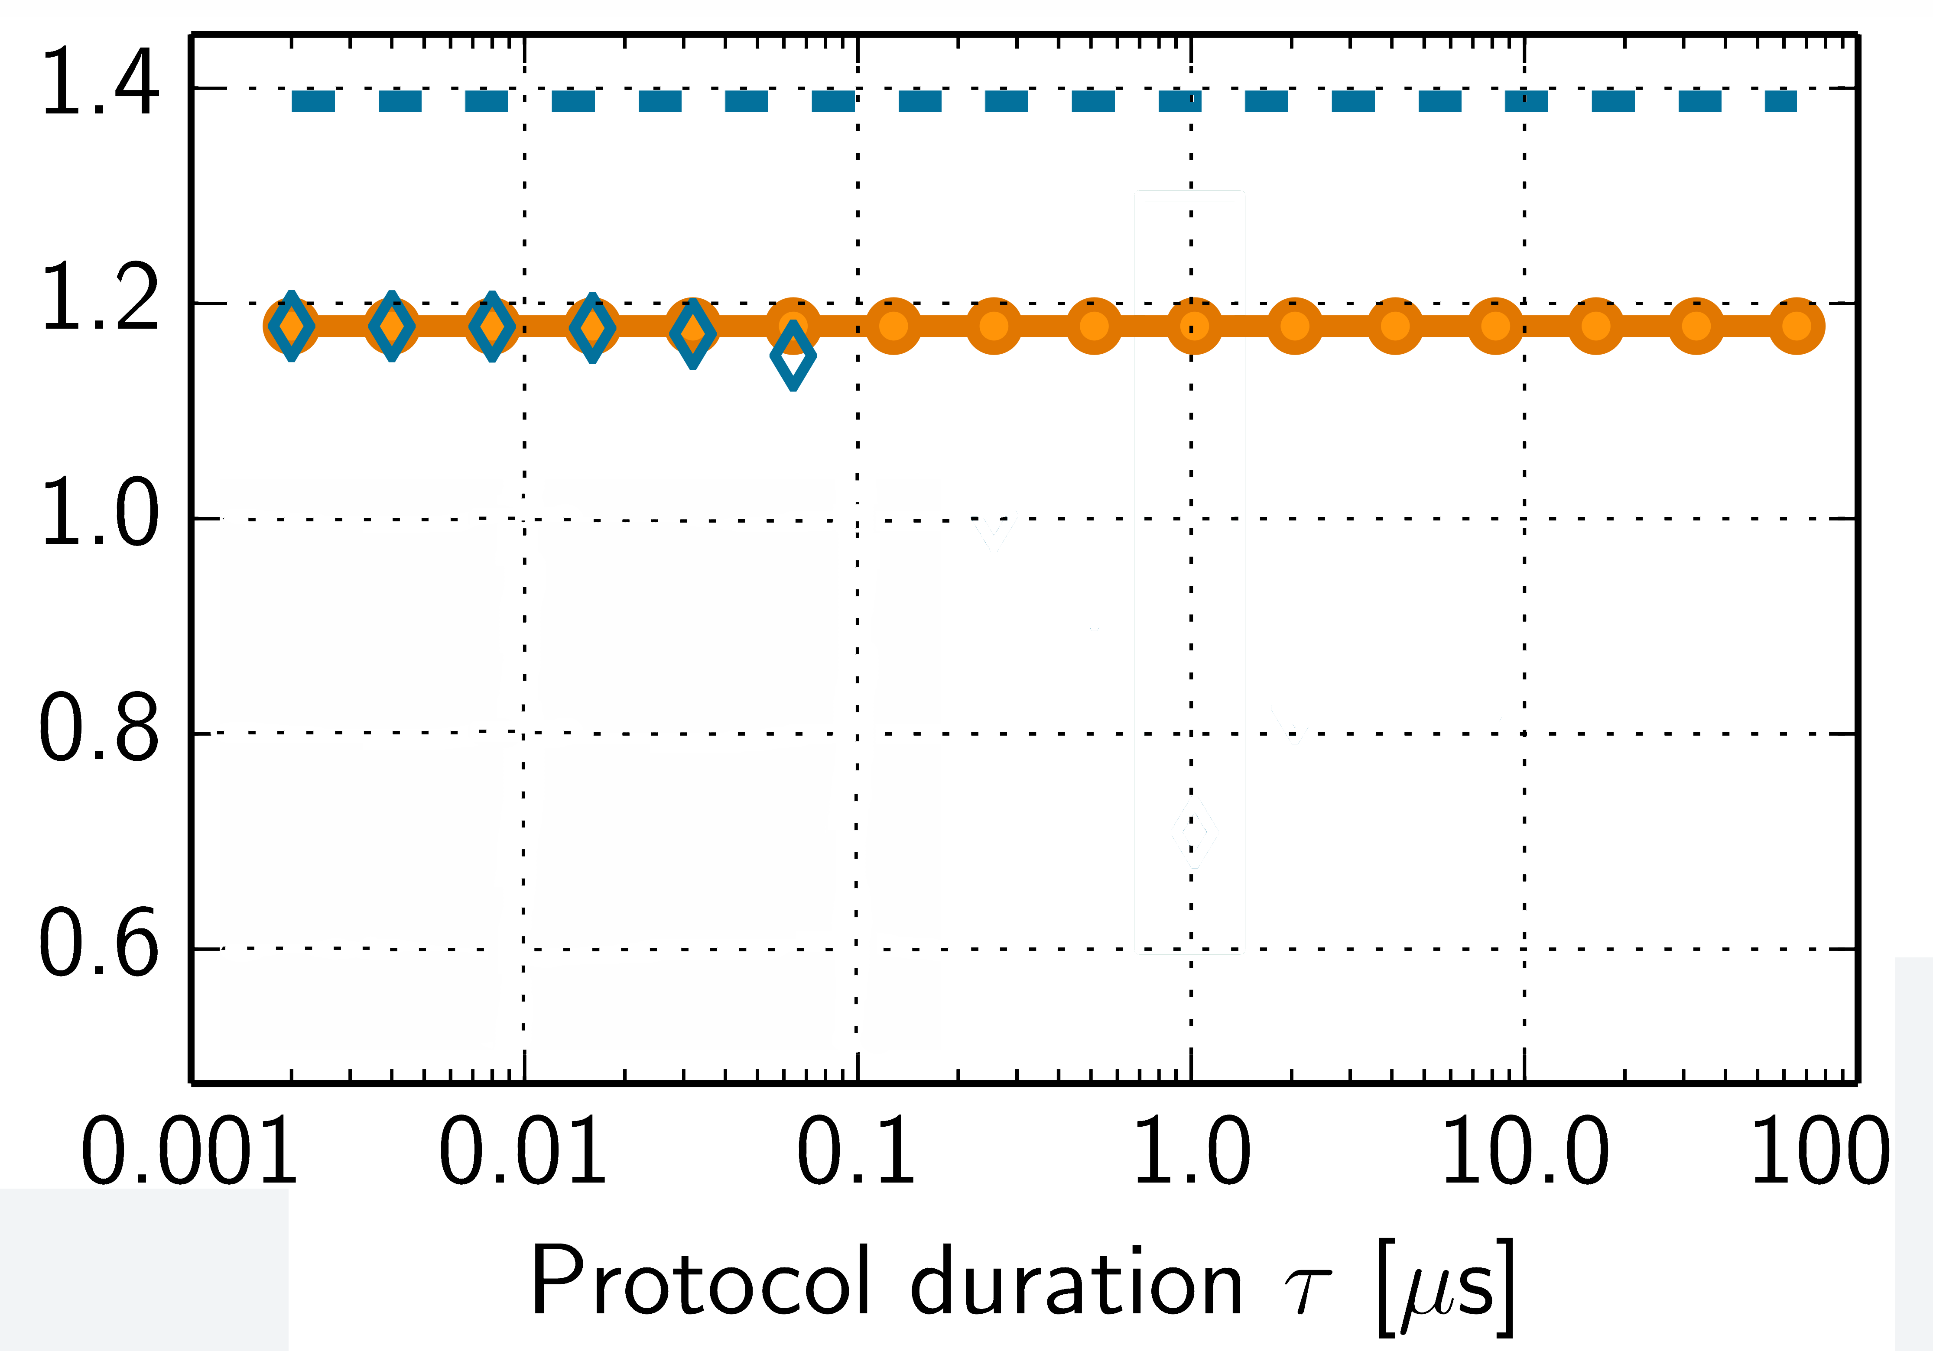
QJE: Varying protocol duration τ
– std:
– gen:
F Beware wrong
estimates of
Short evol.
JMP, Relaño, Molina & Jaksch,
Nature Commun. 9, 2006 (2018)

Slide 25
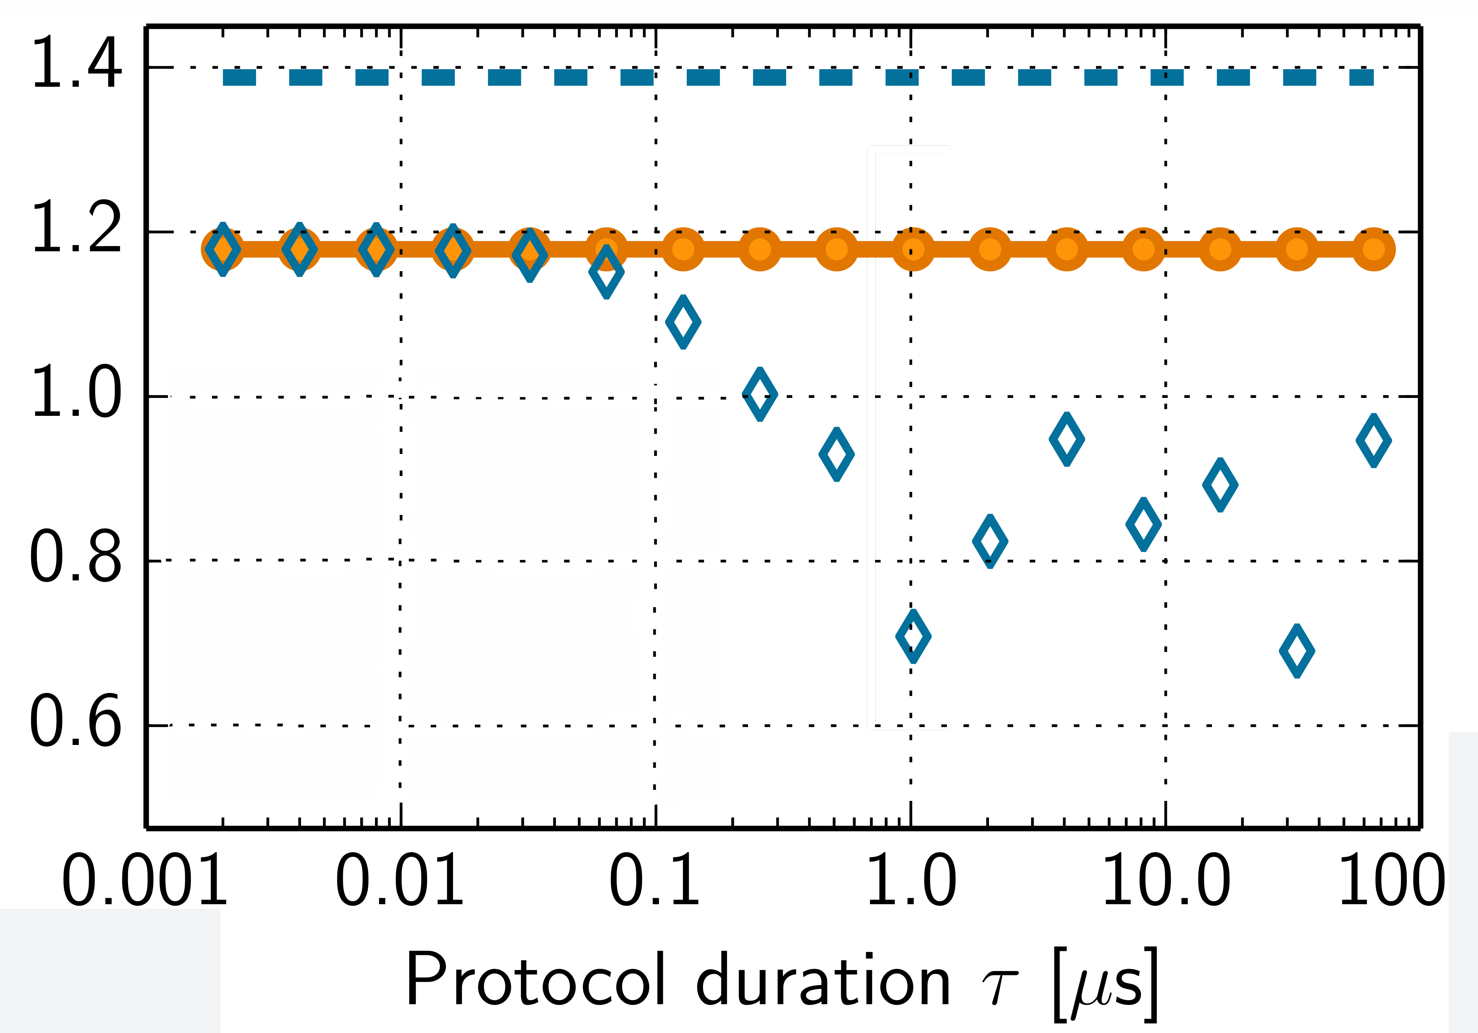
QJE: Varying protocol duration τ
– std:
– gen:
F Reveal missing
charges relevant
to dynamics
Short evol.
Long evol.
JMP, Relaño, Molina & Jaksch,
Nature Commun. 9, 2006 (2018)

Slide 26
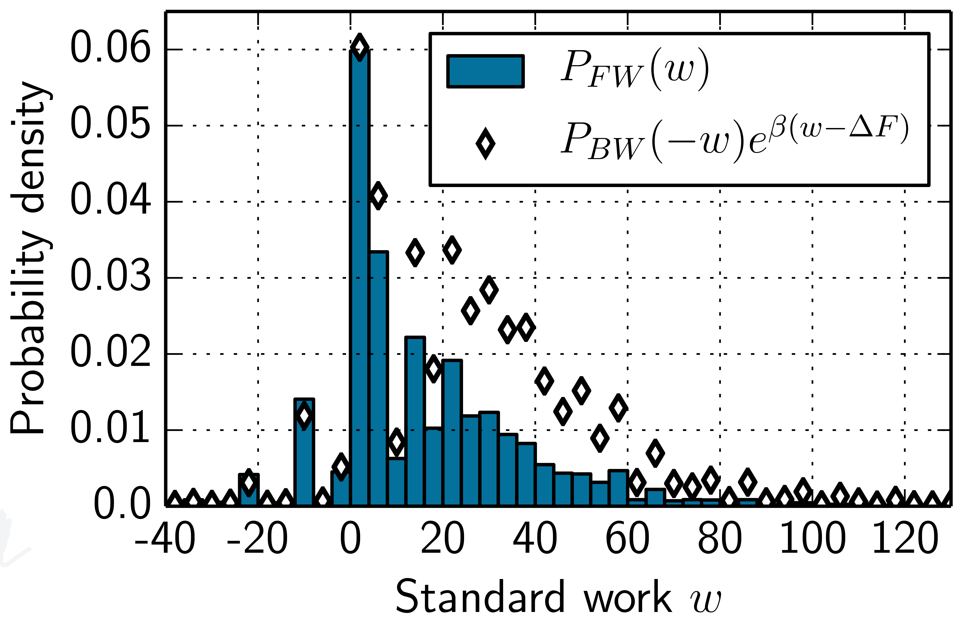

Dicke model: TCR for τ≈1 μs
{
FW:
BW:
Standard TCR
F Detect if ρ_{ini} is
missing charges
F Beware wrong
estimates of
Nature Commun. 9, 2006 (2018)

Slide 27
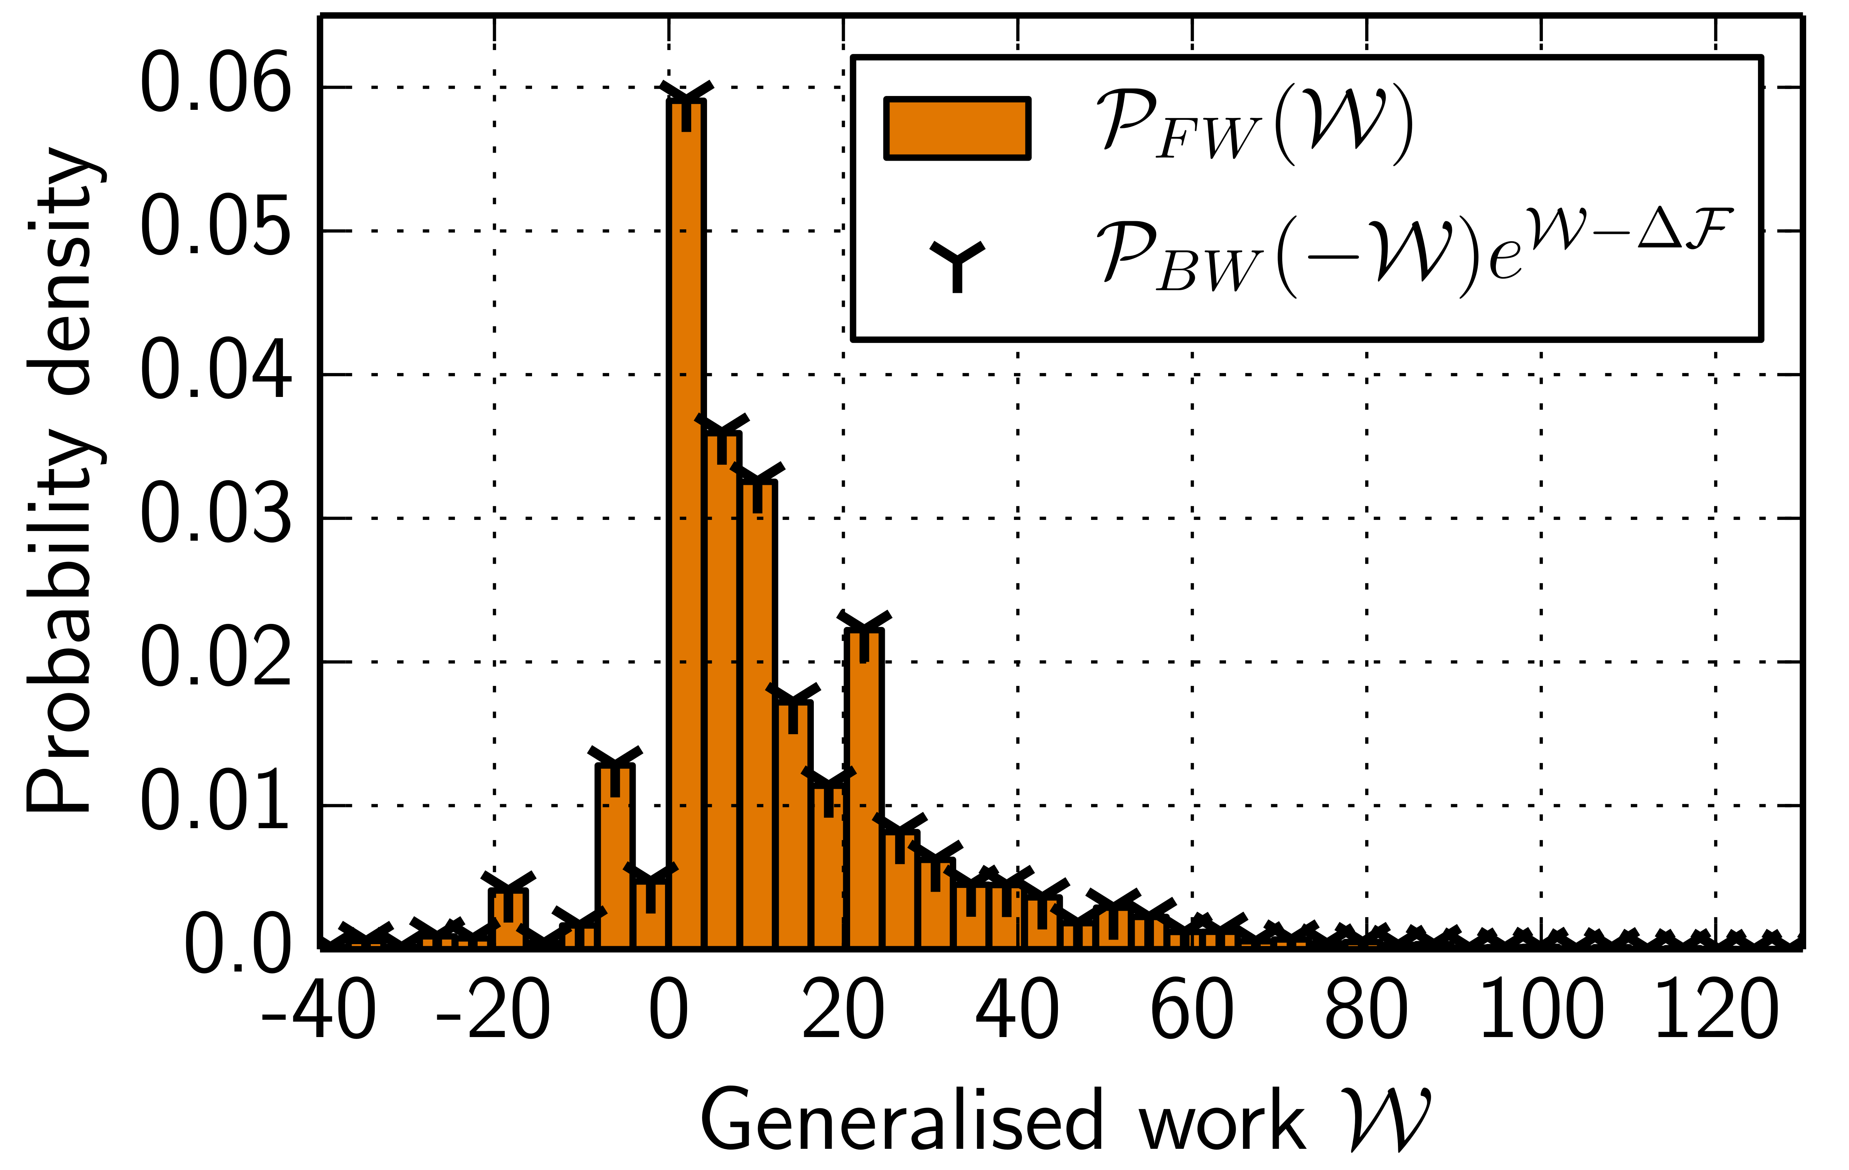

Dicke model: TCR for τ≈1 μs
{
FW:
BW:
Standard TCR
Generalised TCR
Nature Commun. 9, 2006 (2018)

Slide 28
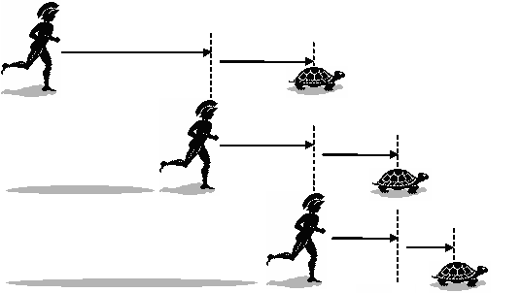


Summary & Outlook
Few-body q. systems:
Ideal testing ground for Q. Thermo.
  Relaxation vs. conservation laws
New QFRs for systems with charges:
Reveal hidden charges
Avoid biased temperature estimates
Readily testable in experiments
Outlook
Multiple charges: XXZ…
Efficiency of quantum nanodevices?
Short evol.
Long evol.
Nature Commun. 9, 2006 (2018)

Slide 29
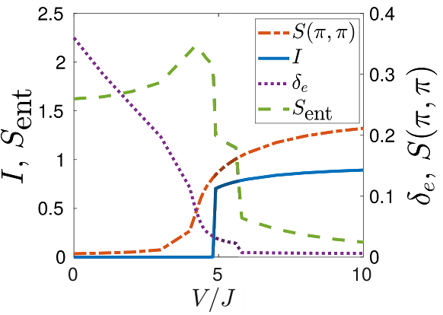
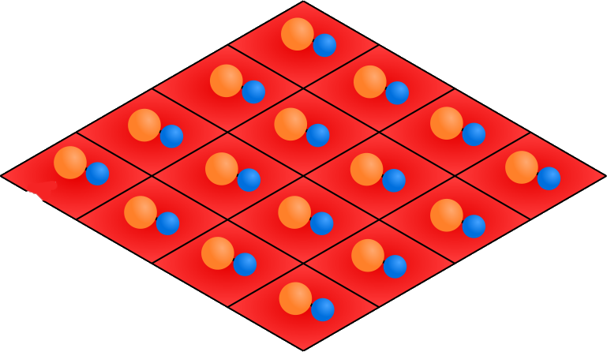
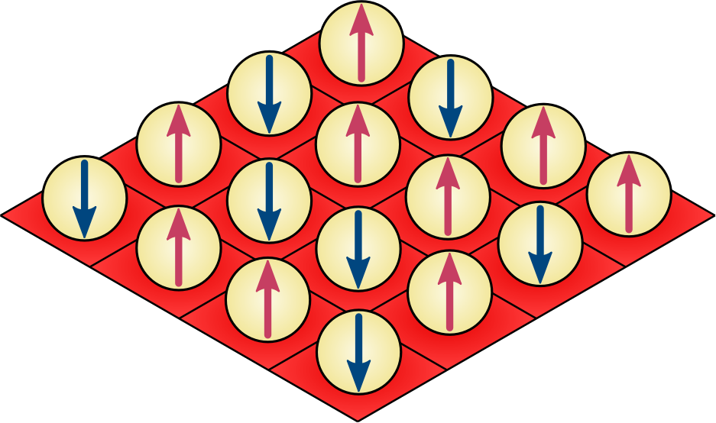


Ongoing research projects
Controlling dipolar interaction
between polar molecules in tweezers
  M. Hughes et al., to be submitted
From few- to many-body:
Quantum phases in small
cold-matter systems (10-100 part.)
  P. Rosson, M. Kiffner, JMP, D. Jaksch,
  to be submitted
Polar molecules for quantum simulation
with Uni. Durham & Imperial College
J. Blackmore et al., Quantum Sci Tech 4, 014010 (2019)
SF
SS
DW

Slide 30
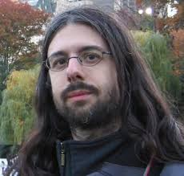
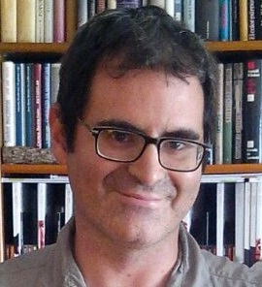









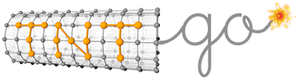
Thank you!
Prof. Dieter Jaksch
Dr Jordi Mur-Petit
Dr Martin Kiffner
Dr Frank Schlawin
Dr Michael Lubasch
Dr Berislav Buča
Dr Carlos Sánchez
Dr Jon Coulthard
Paolo Rosson
Joey Tindall
Hongmin Gao
Michael Hughes
Nikita Gourianov
Benjamin Jaderberg
Armando Relaño
Rafael Molina
www.qsum.org.uk
www.tntgo.org

